Slide 1





Multi-Grid: the New Generation Large-Area Detector for Neutron Scattering Science
Anton Khaplanov
On behalf of ESS Detector Group and Collaborators
www.europeanspallationsource.se
July 13, 2017

Slide 2

Outline
B10 detector development
Multi-Grid detector
  Where it will be used
  How it works
  Characterization tests
  Current development
Multi-Grid test at CNCS, SNS
  Setup at CNCS
  Results from CNCS
Conclusion

Slide 3

Acknowledgements and Publications
ILL:
Bruno Guerard, Jean-Claude Buffet,
Jean-Francois Clergeau, Anthony Leandri ,
Victor Buridon, Fabien Lafont
ESS:
Anton Khaplanov, Fatima Issa, Richard Hall-Wilton, Oliver Kirstein, Tomasz Brys, Michail Anastasopoulos, Isaak Lopez Higuera, Richard Bebb, Sara Arranz, Carina Höglund*, Linda Robinson*, Susan Schmidt*
Centre for Energy Research (Hungary):
Eszter Dian
Linköping University:
Jens Birch, Lars Hultman, (also *)
SNS:
Ken Herwig, Georg Ehlers, Michelle Everett, Kevin Berry
Earlier – the participants of the CRISP project on Large-Area detectors.
Horizon 2020 grant agreement 676548
WP 4.3: Large-Area Detectors
Earlier publications:
B4C layers:
*C. Höglund et al, J of Appl. Phys. 111, 104908 (2012)
Characterization:
*A. Khaplanov et al., arXiv:1209.0566 (2012)
*B Guerard et al., NIMA, 720, 116-121 (2013), http://dx.doi.org/10.1016/j.nima.2012.12.021iJ
*J. Correa et al., Trans. Nucl. Sc. (2013), DOI: 10.1109/TNS.2012.2227798
*A. Khaplanov et al., (2014) J. Phys.: Conf. Ser. 528 012040 doi:10.1088/1742-6596/528/1/012040
Gamma sensitivity:
*A. Khaplanov et al., JINST 8, P10025 (2013), arXiv:1306.6247
Alpha background:
*A. Khaplanov et al., JINST 10, P10019 (2015); doi:10.1088/1748-0221/10/10/P10019
Latest publication:
A.Khaplanov et al. “Multi-Grid Detector for Neutron Spectroscopy: Results Obtained on Time-of-Flight Spectrometer CNCS" https://arxiv.org/abs/1703.03626 2017 JINST 12 P04030

Slide 4
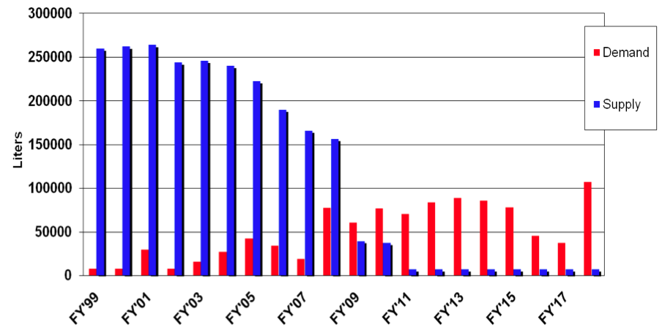

B10 Detectors as Alternative to He3
³He crisis, demand vs. supply:
Several other isotopes have capture reactions that allow thermal neutron detection. We use:
¹⁰B + n → ⁷Li + α + 2.97MeV
^{NAT}B contains ~20% ¹⁰B – a relatively inexpensive isotope.
Still working with gas detectors, but now the converter is solid
³He detector
¹⁰B detector
³He gas
gas
n
conversion
⁷Li or α
Challenge, but also a new opportunity:
In addition to lower cost,
Improve rate performance
Improve position resolution
No requirement for gas purification
No high pressure gas
n
³H or p
⁷Li or α
³H or p
conversion
B-10 film
pressure vessel
substrate

Slide 5
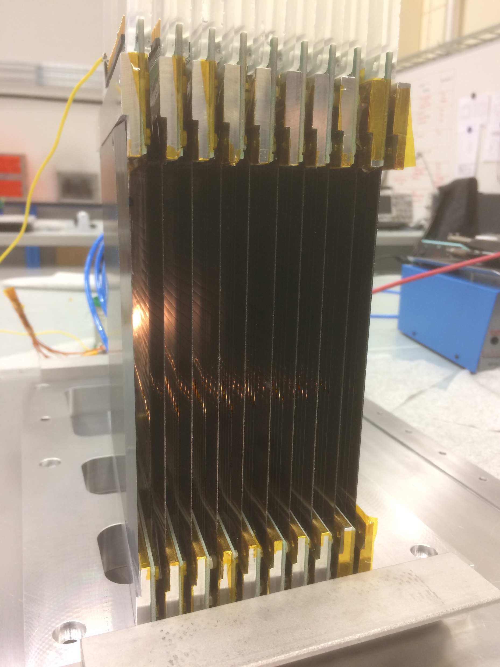
B10 Detectors as Alternative to He3
gas
n
conversion
fragment 2
n
fragment 2
fragment 1
~5% efficiency
in 1 layer
fragment 1
gas
Multi-Grid:
Multiple layers at normal incidence
B-10 film
on both sides
Anode wires
Al substrate
B-10 film
on 1 side
fragment 2
Anode wires
n
fragment 1
140mm
Multi-Blade:
Single layers at ~5° incidence
Multi-Blade
reflectometry
demonstrator
Many other geometries are possible
100mm
n
See presentations J. Lacy ThB1-2 and G. Nowak ThB1-3
*F.Piscitelli, JINST 12, P03013 (2017)

Slide 6
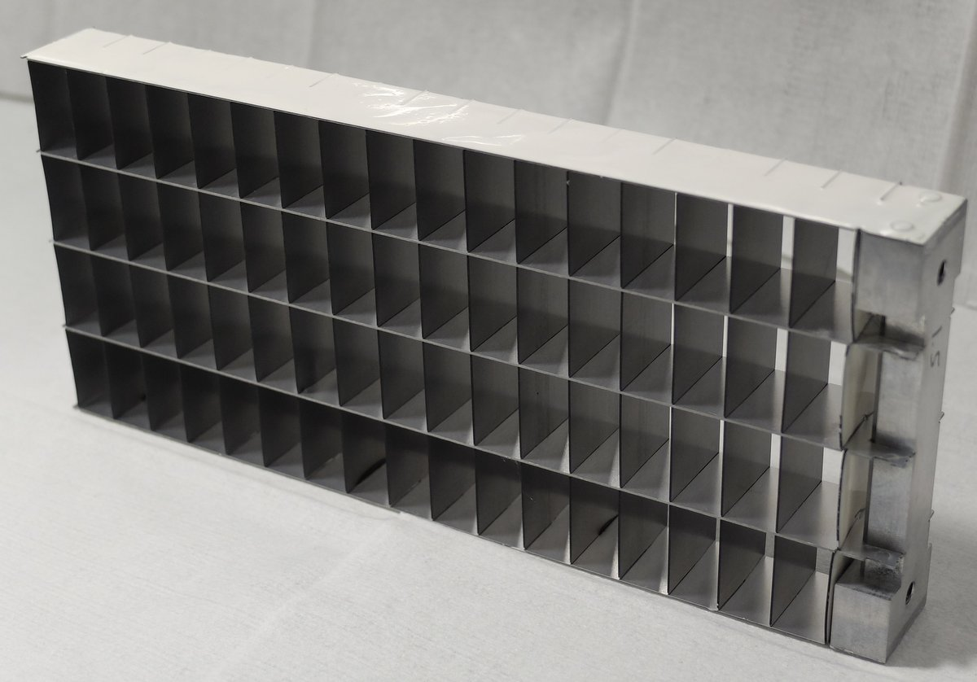
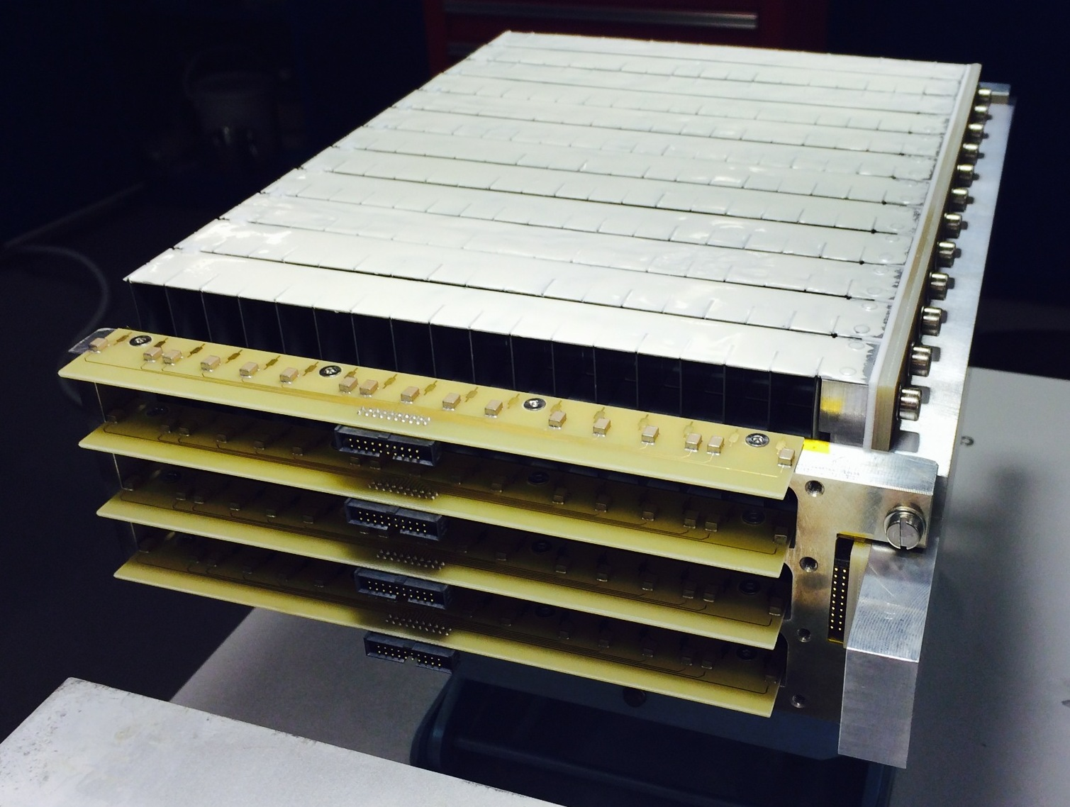
Multi-Grid: How it Works
n
n
n
Low cost for large area
Modular
High total efficiency
Many layers – lower local rate
No need for resistive readout – low gain
Introduced at ILL, jointly developed by ILL and ESS under CRISP project,
now under BrightnESS

Slide 7
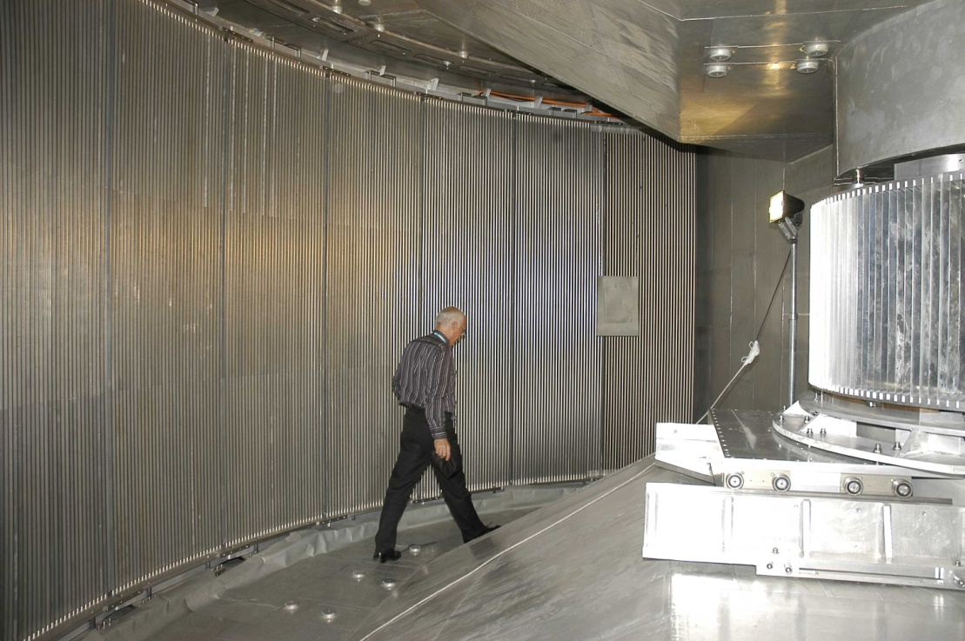
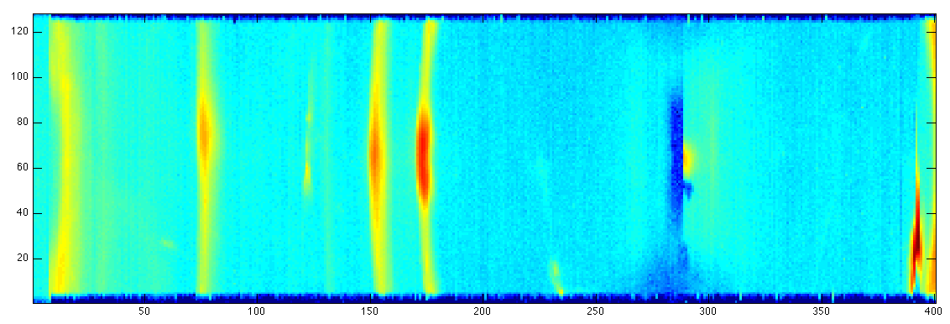
Application of Multi-Grid: Time-of-Flight Spectrometers
IN5 at ILL
Time-of-flight information
2-5 m sample to detector distance
→ Energy transfer
20-40 m² detector area
Position resolution O(1inch)
Momentum transfer
High dynamic range
Low background
Detected image
Incident beam
n E_{i}, Q_{i}
n E_{f}, Q_{f}
Detected ToF spectrum
Sample

Slide 8
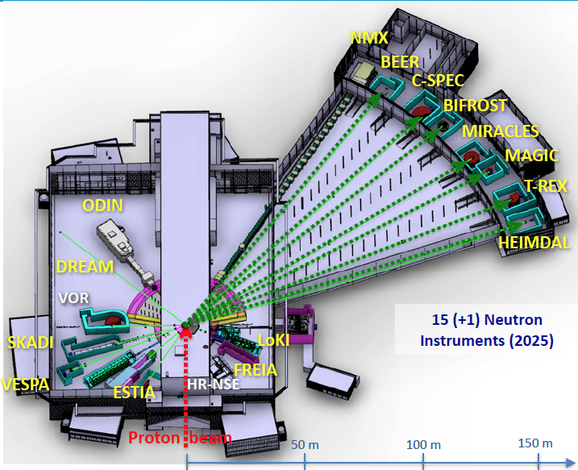
Time-of-Flight Spectrometers at ESS
First 15 instruments chosen
3 ToF spectrometers for ESS
CSPEC and T-REX – design phase
VOR – accepted proposal
Multi-Grid as baseline detector technology
Instrument | C-SPEC | T-REX | VOR
Sample – detector | 3.5 m | 3 m | 3 m *
Detector height | 3.5 m | 2.2 m | 3 m *
Detector area | 29 m² | 21 m² | 37 m² *
*as proposed

Slide 9


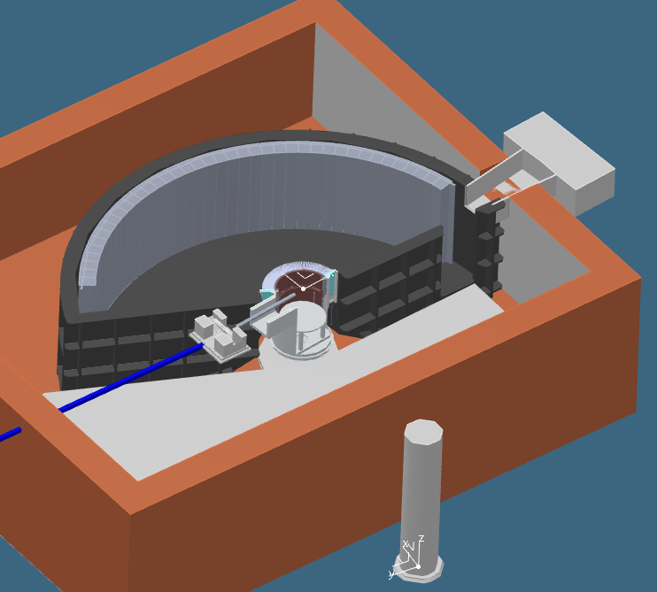
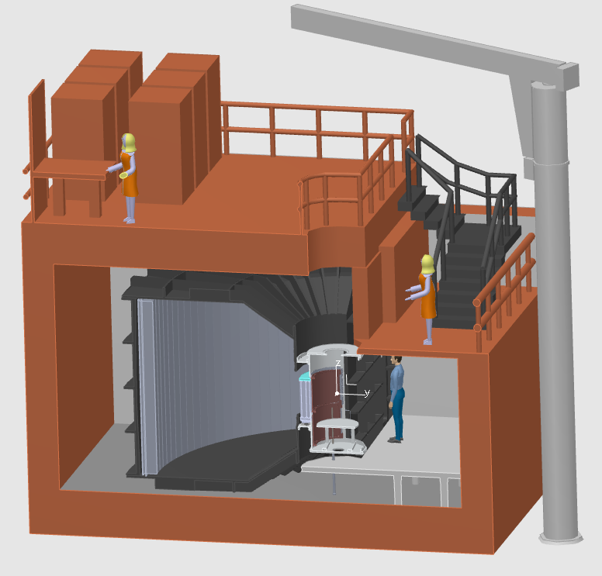
CSPEC at ESS
Cold spectrometer
0.2 meV < E_{i} < 20 meV
29m² detector
Horizontal coverage 5° to 135°
Vertical coverage -25° to 25°

Slide 10


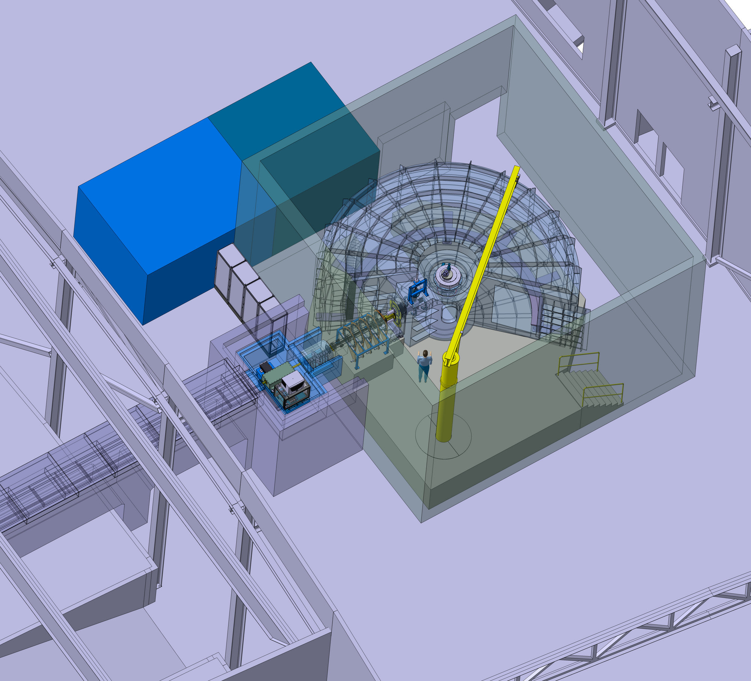
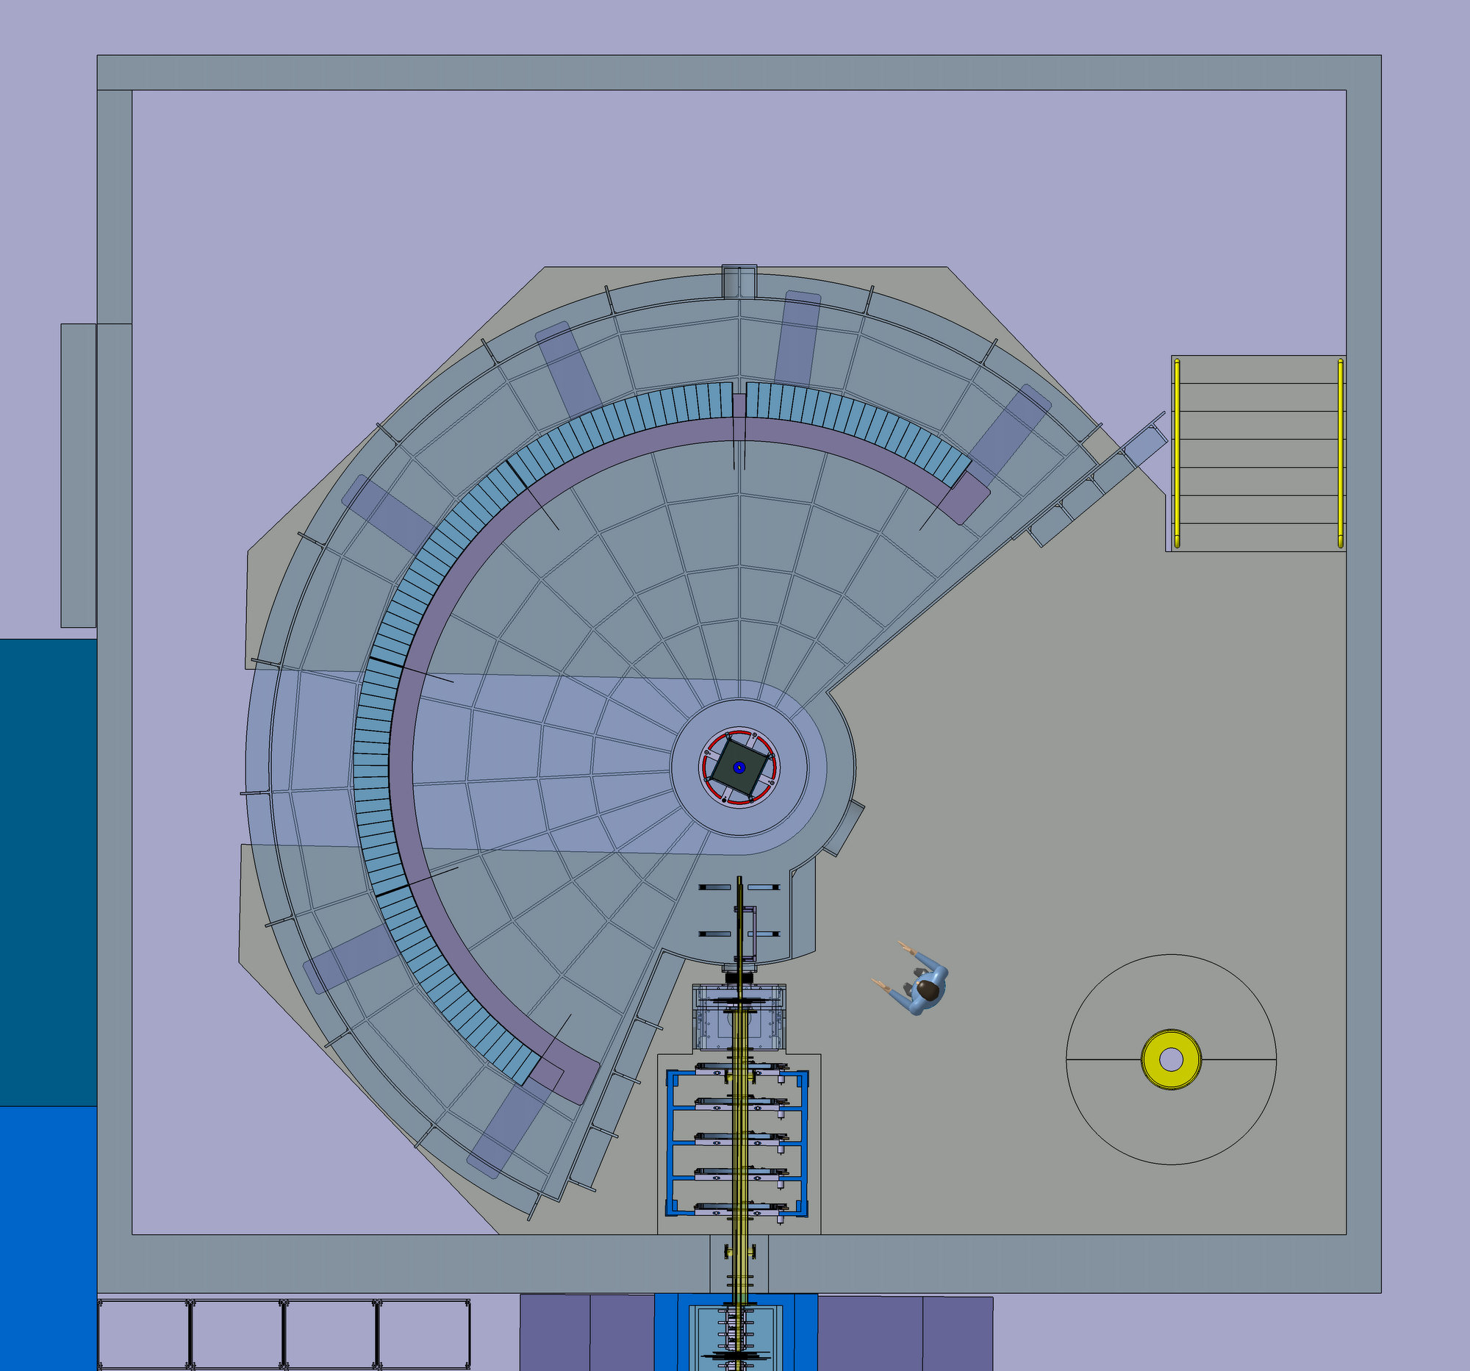
T-REX at ESS
Thermal / bispectral spectrometer
2 meV < E_{i} < 160 meV
21m² detector
Horizontal coverage -36° to -1° and 1° to 144°
Vertical coverage -25° to 15°

Slide 11
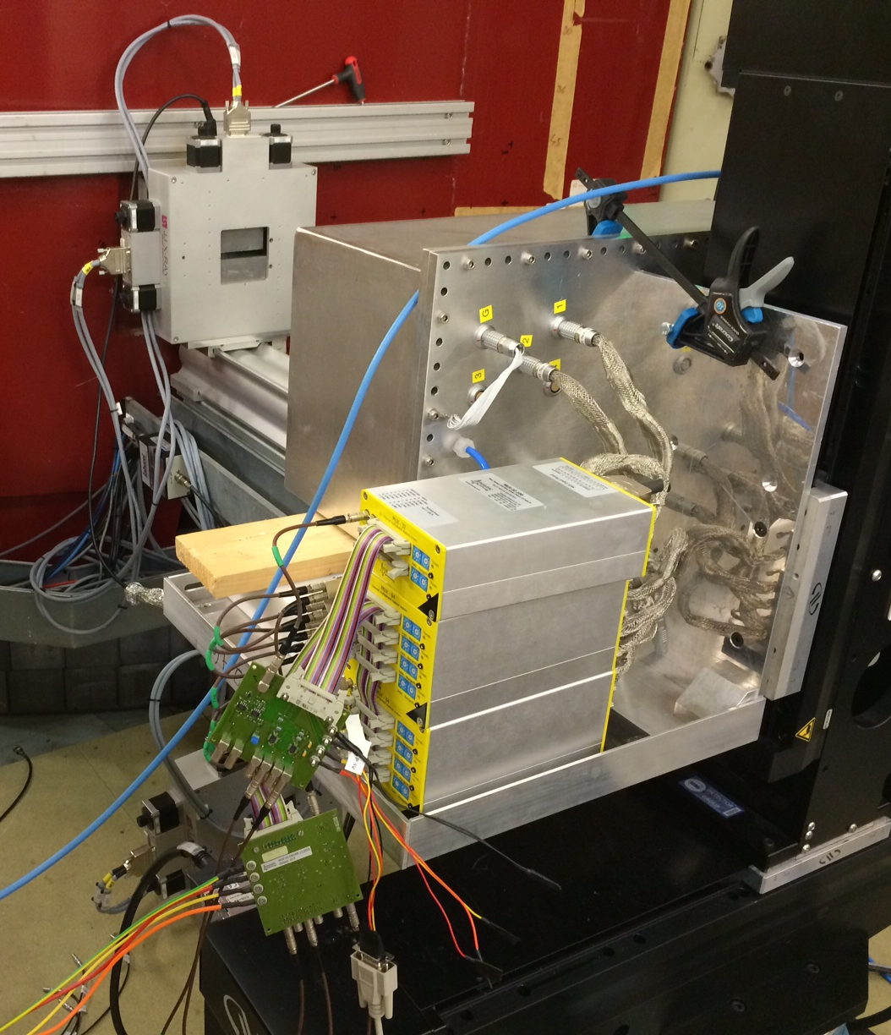
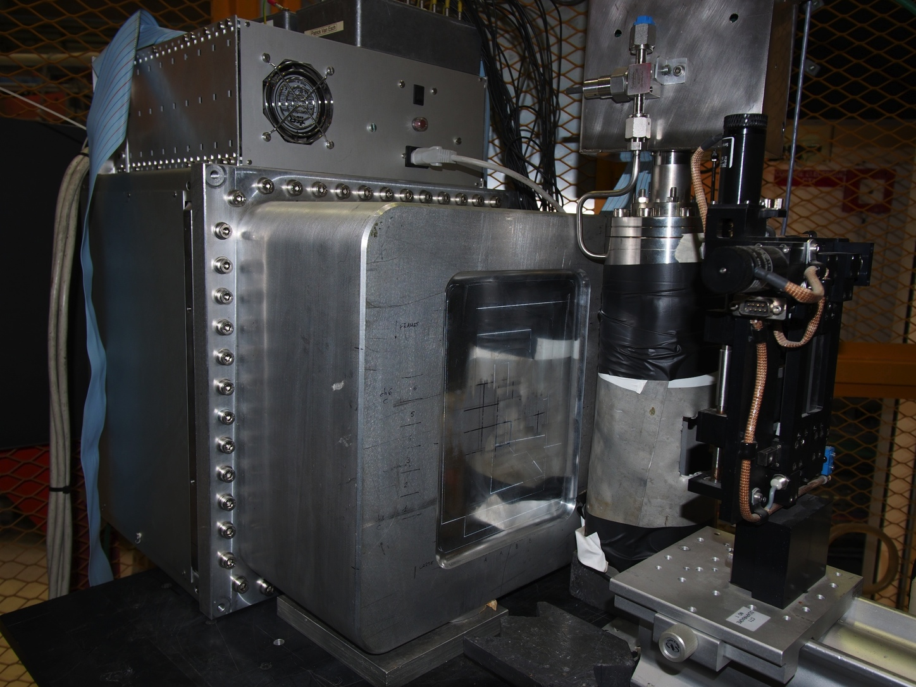
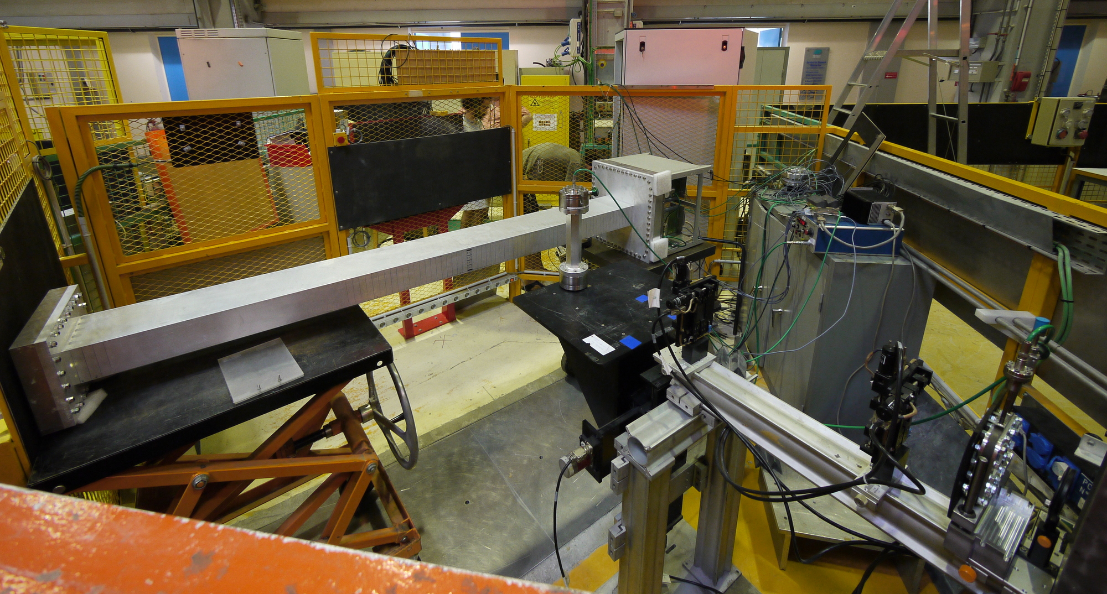
Multi-Grid Prototypes for Characterization
Measurements:
Absolute efficiency
Uniformity
Position reconstruction
γ sensitivity
Rate tests
Ageing
MG.24 @R2D2 @IFE
Proto 1 at CT1 @ILL
Proto 2 at CT2 @ILL

Slide 12
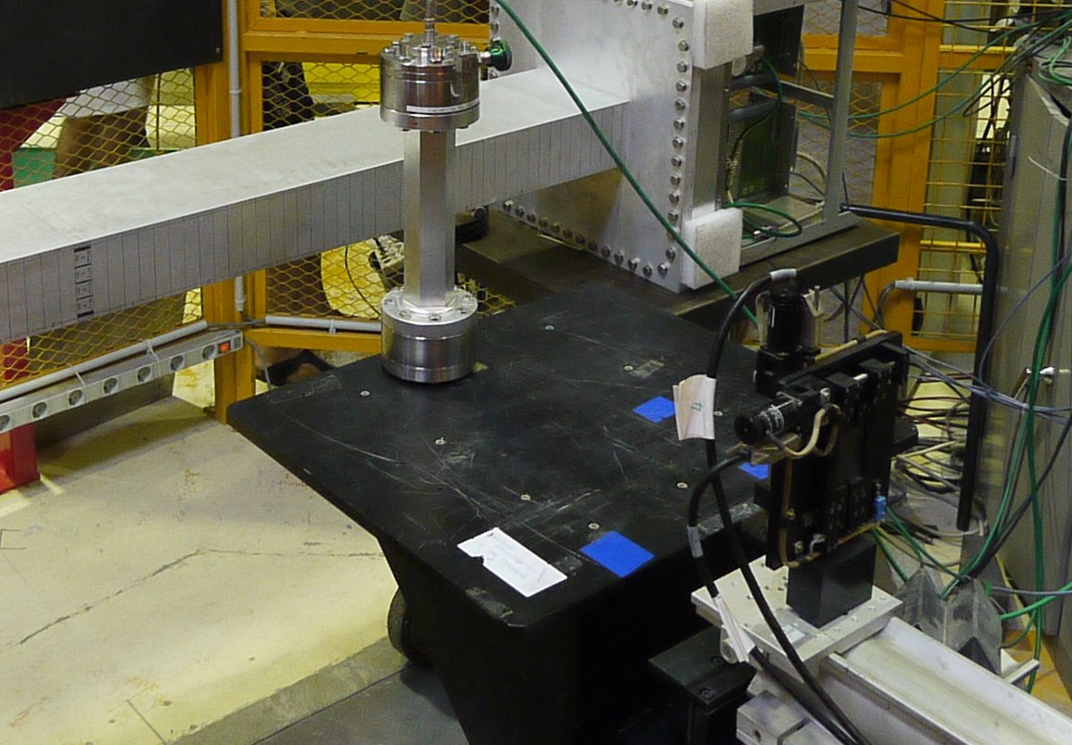
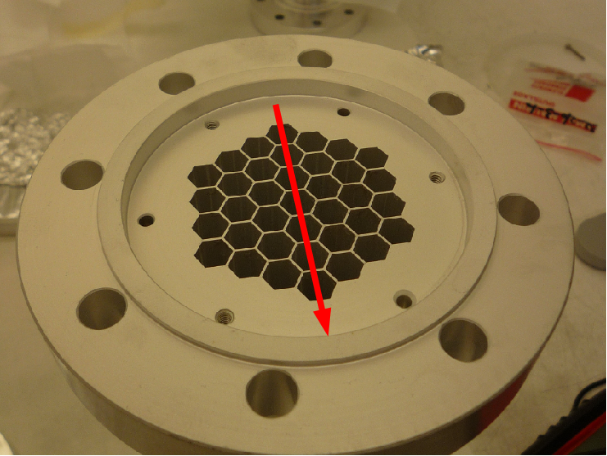
Efficiency measurement at Test Beam
Counts compared to a carefully calibrated reference detector,
in a constant beam,
background subtracted
→ error bars below 1%
ILL “Honeycomb” detector
n beam
Efficiency vs. layer thickness
Proto 2 at CT2 @ILL

Slide 13
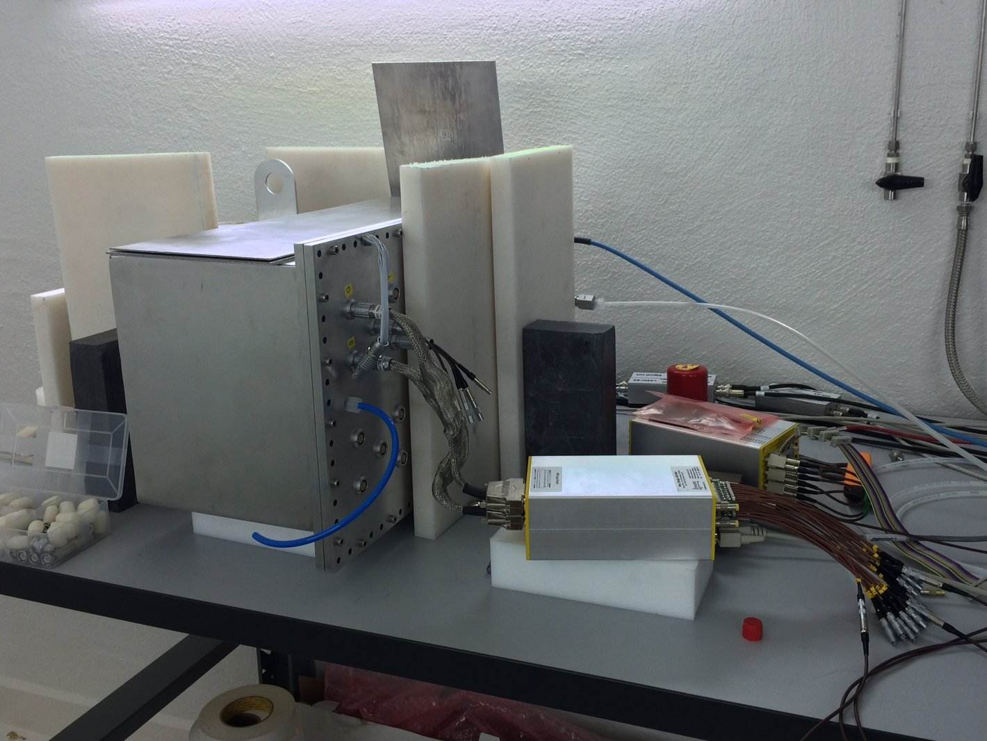
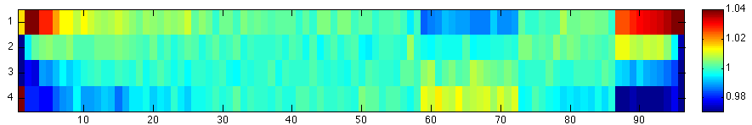
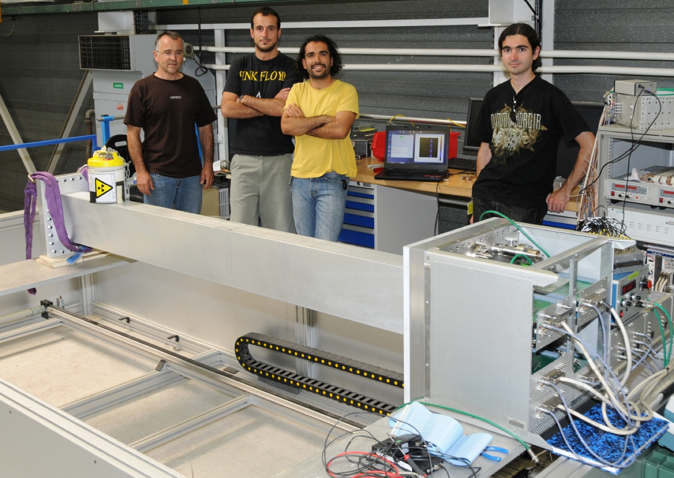
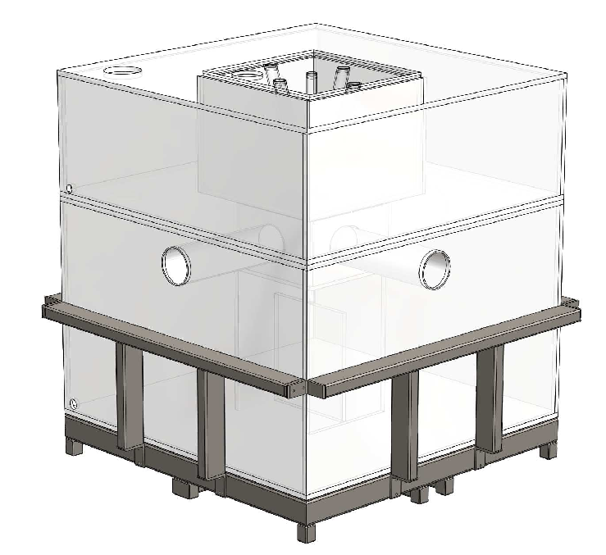
Source Measurements
Laboratory sources:
Thermal neutrons: α-Be or ²⁵²Cf +PE moderator;
γ sources: ⁵⁷Co, ⁶⁰Co, ¹³³Ba, ¹³⁷Cs, etc.
4 regions of grids assembled in different ways
(edge effects due to incomplete scanning range)
A
B
C
D
Source Testing Facility, Lund
Fast neutron sources: α-Be or ²⁵²Cf;
Water tank with beam ports
Source motion
Scanning table, ILL

Slide 14
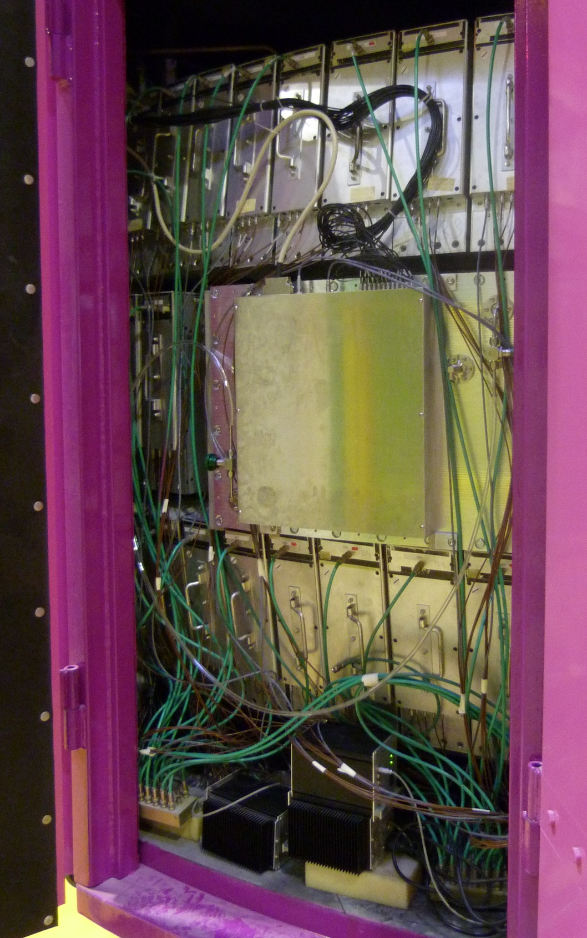
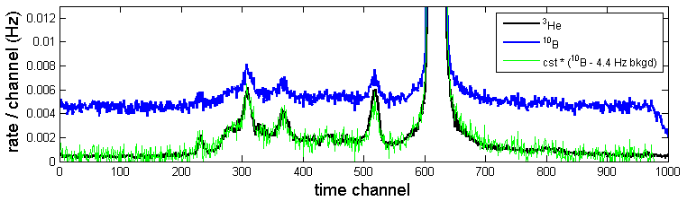
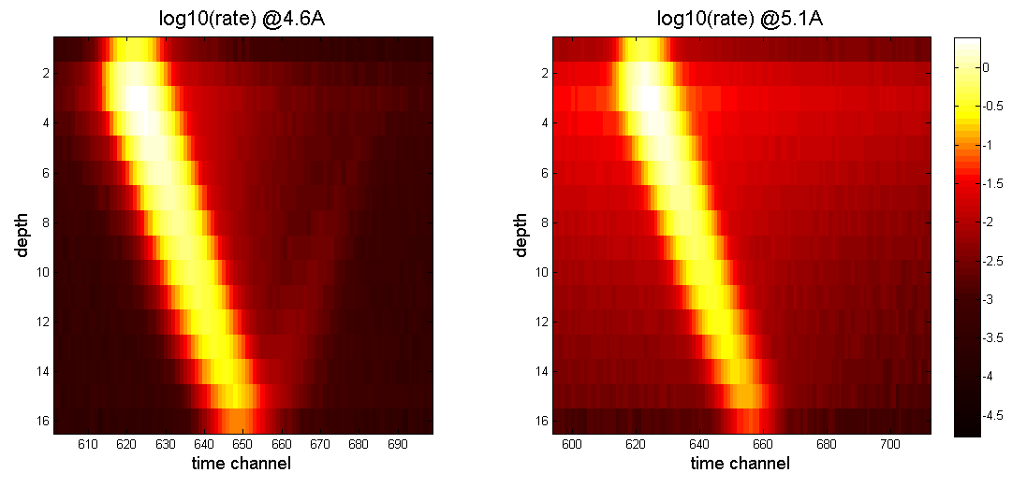
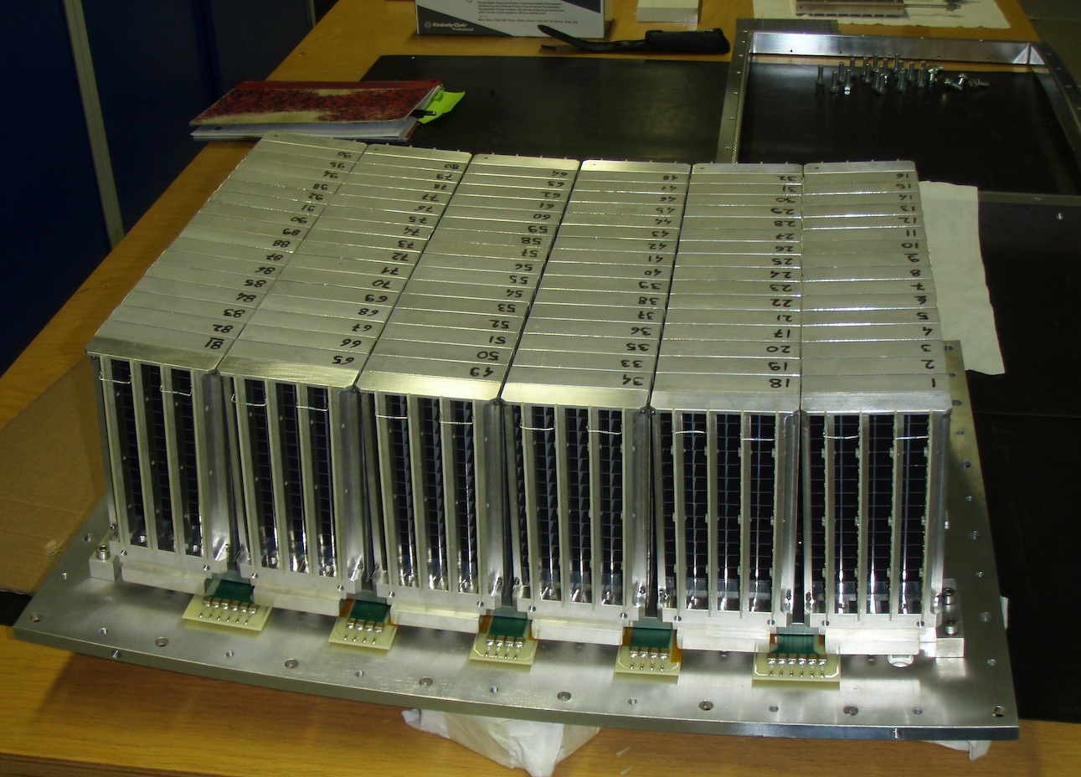
First Multi-Grid tested on an Instrument
Detector tested on cold chopper spectrometer IN6 @ILL
Active Area 30 x 45 cm2
96 grids in 6 modules of 16 grids, 360 anode wires
Operated for ~2 weeks, replacing 25 He3 tubes
@ 4.1, 4.6 and 5.1 Å incoming wavelength
Main topics of the test:
First ToF spectra
Background investigation
Elastic line shape
*A. Khaplanov et al. 2015 JINST 10 P10019
*A. Khaplanov et al. J. Phys: Conf Ser 528 (2014) 012040

Slide 15
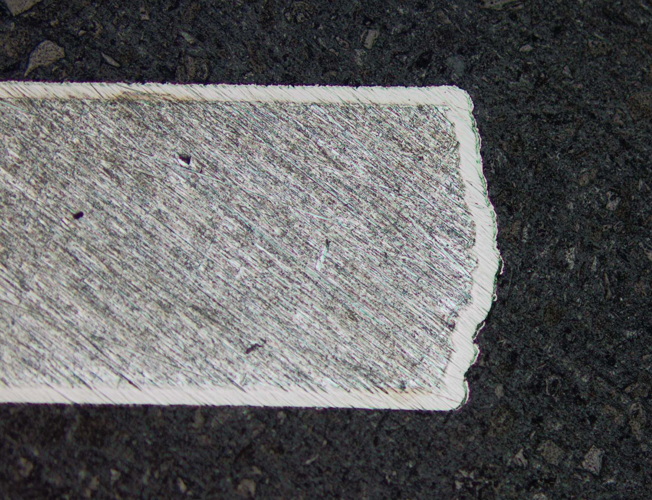
Intrinsic background
Spectrometers work with a very large dynamic range → very high signal-to-noise is required.
Intrinsic background often found in Al due to α emitter impurities (U and Th).
x50-x100 background reduction using:
high-purity Al
Ni-plating
Spectrum from standard Al
Ni-plating on a 0.5mm Al blade
⁷Li α
N + ¹⁰B→⁷Li + α
α decay U, Th
A. Khaplanov et al. 2015 JINST 10 P10019

Slide 16
γ Sensitivity Investigated
Beam + source setup for γ sensitivity measurement
High statistics ¹³⁷Cs measurement
Operation HV, can choose γ sensitivity 10⁻⁶ – 10⁻⁹
Plateau for γ and n measurement
γ rejection demonstrated in ToF @IN6
* A. Khaplanov et al., JINST 8, P10025 (2013), arXiv:1306.6247

Slide 17
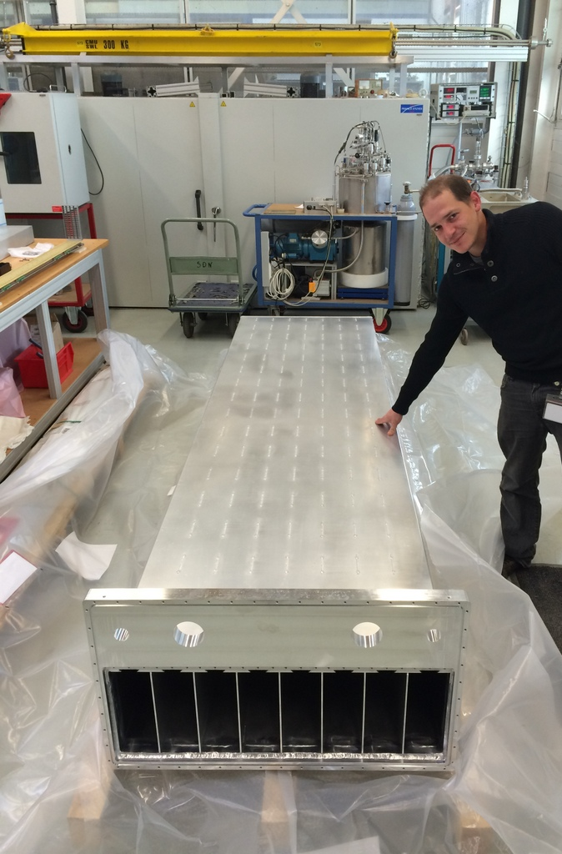
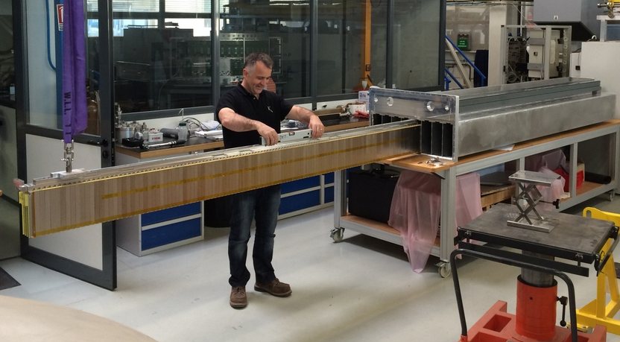
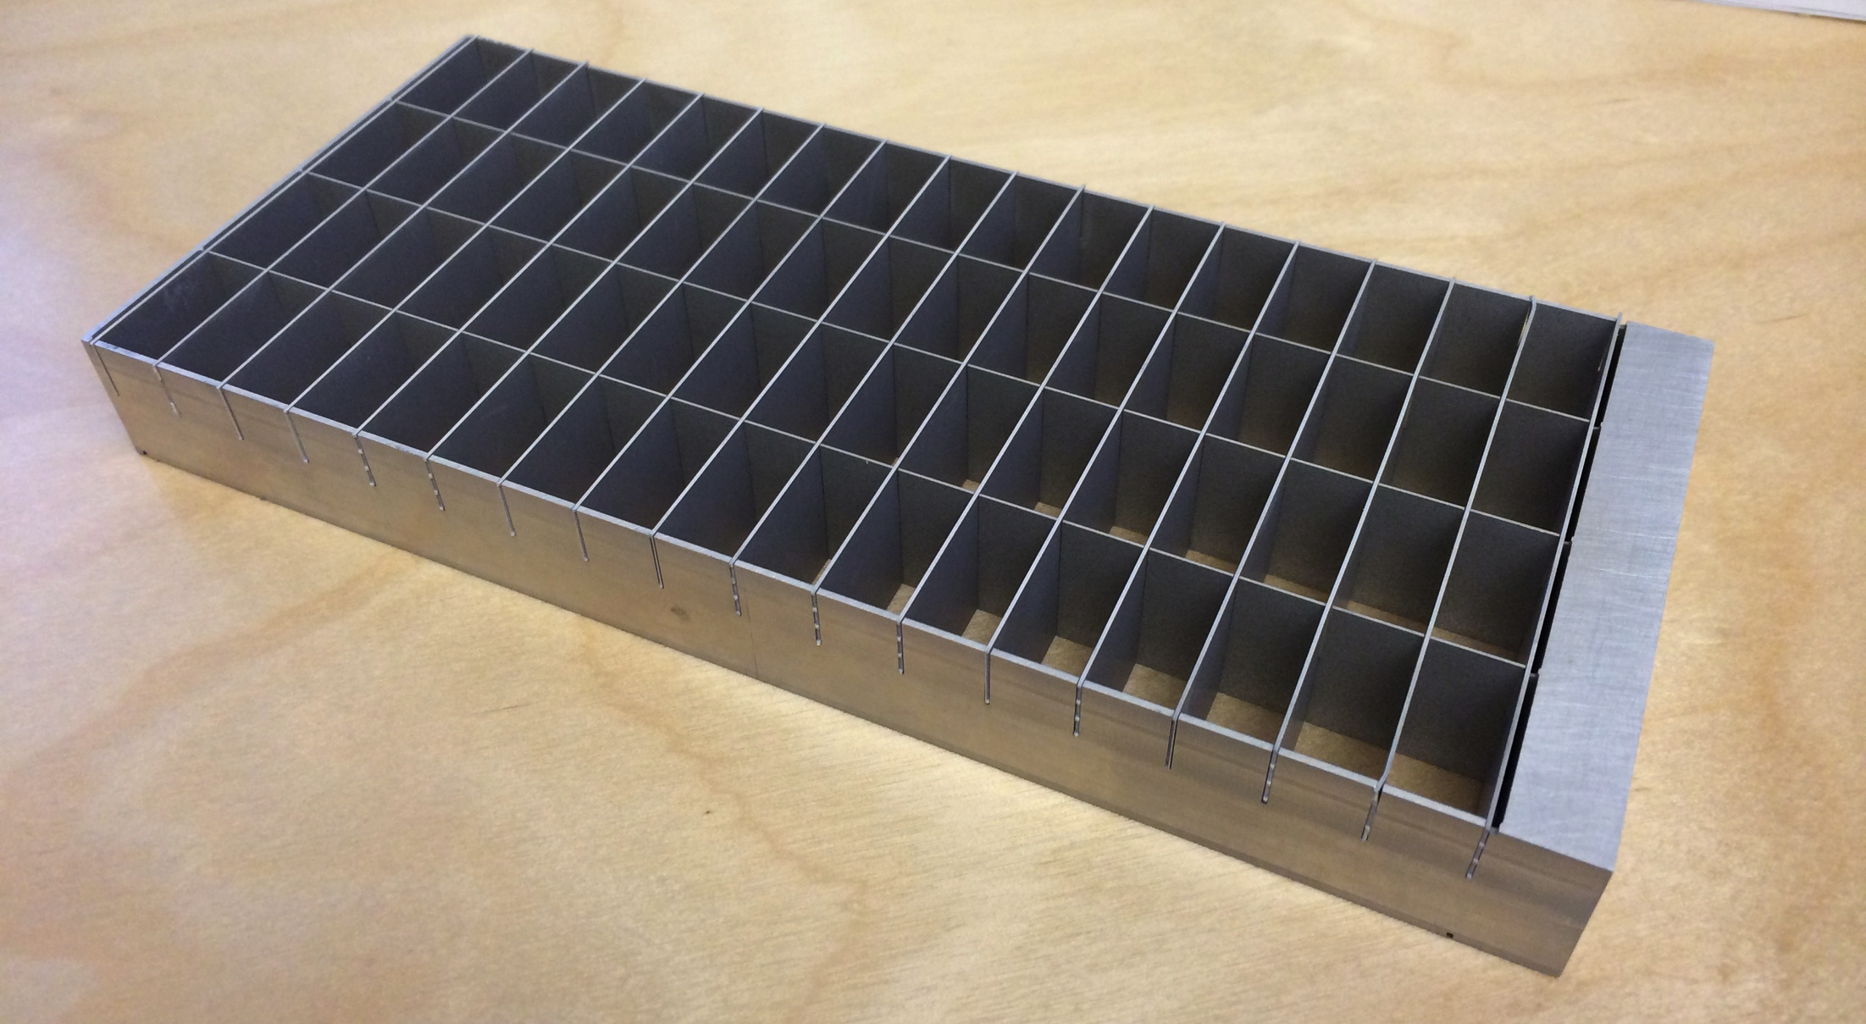
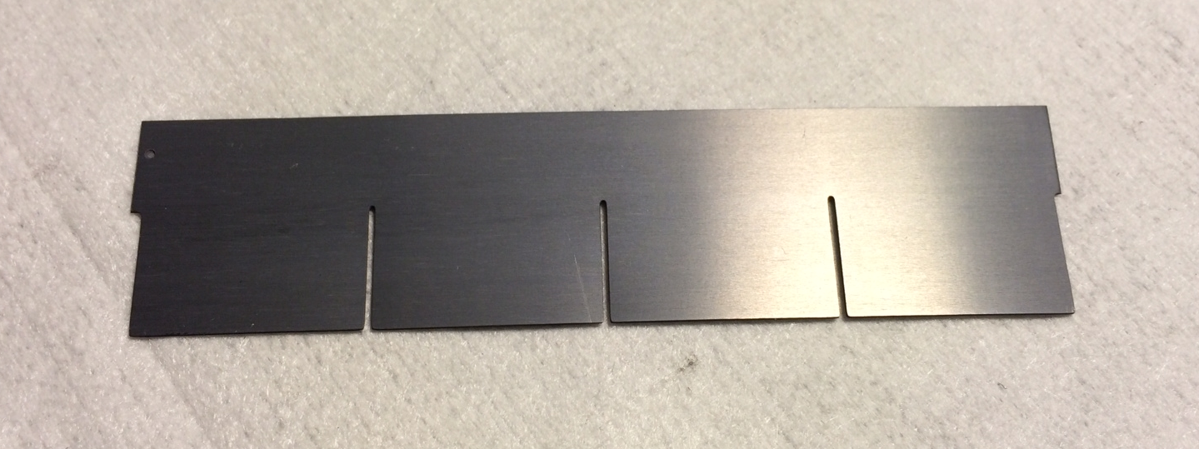
IN5 Demonstrator – Large-Scale
Module x8:
wire-frame coincident readout
3 m
Grid x1024:
low activity,
minimal dead material
Blade x18432:
enriched B4C coating
good adhesion, uniformity,
80cm
Detector:
2.4 m² active area

Slide 18
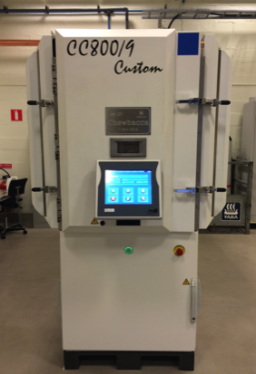
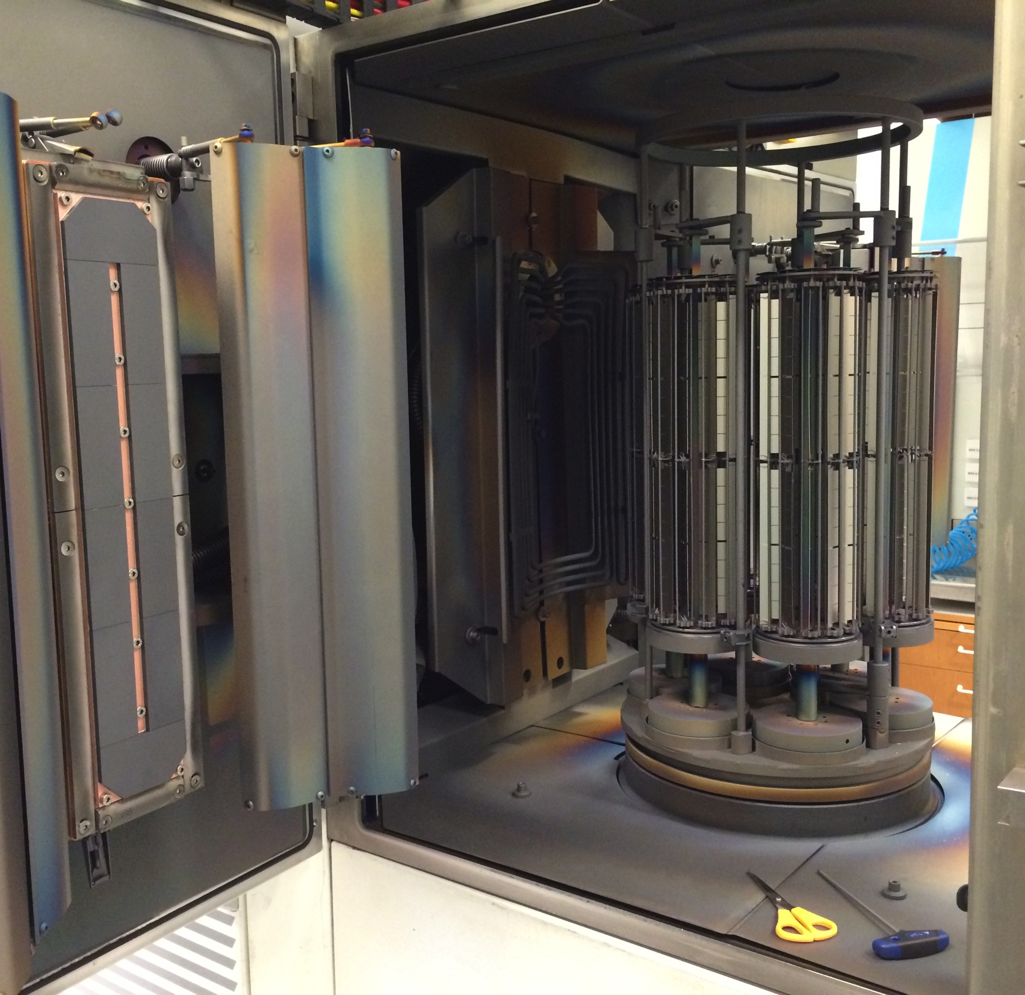
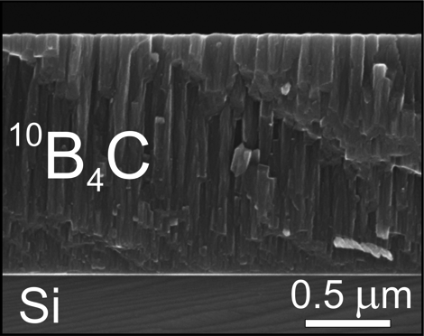
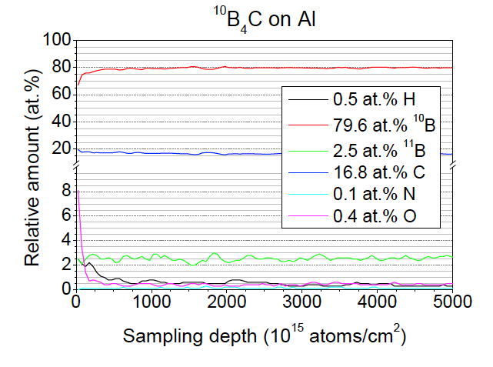
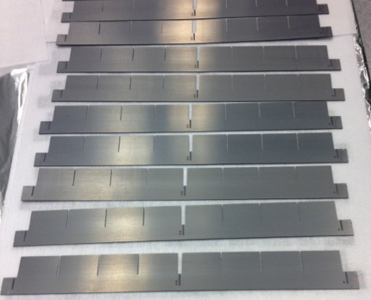
¹⁰B₄C coating facility in Linköping
ESS workshop, Linköping, Sweden
¹⁰B₄C coatings for detectors
Using DC magnetron sputtering
B4C layer analysis
at Linköping University:
Thickness, uniformity
Composition, impurities:
Produced blades for MG
Many other types of substrates can be coated

Slide 19
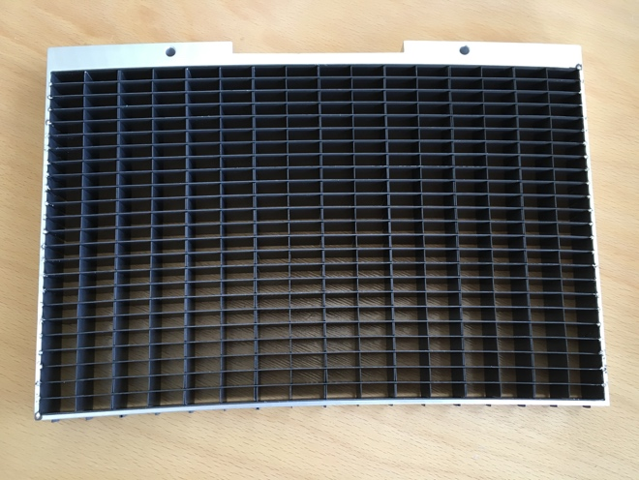
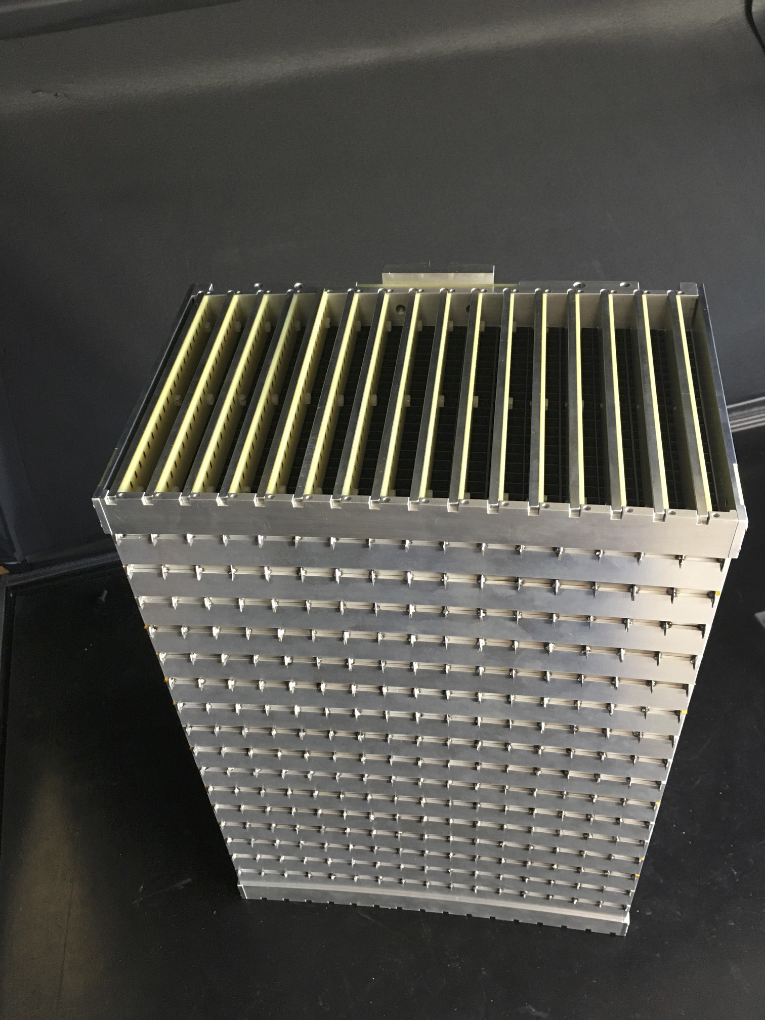
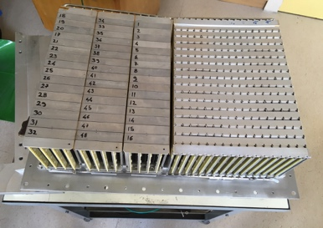
New grid design at ILL
New Grid design at ILL
3x grid width – fewer dead gaps
24 layers - higher efficiency
Coating on parallel blades – absorption of scattered neutrons
Curved grids
n

Slide 20
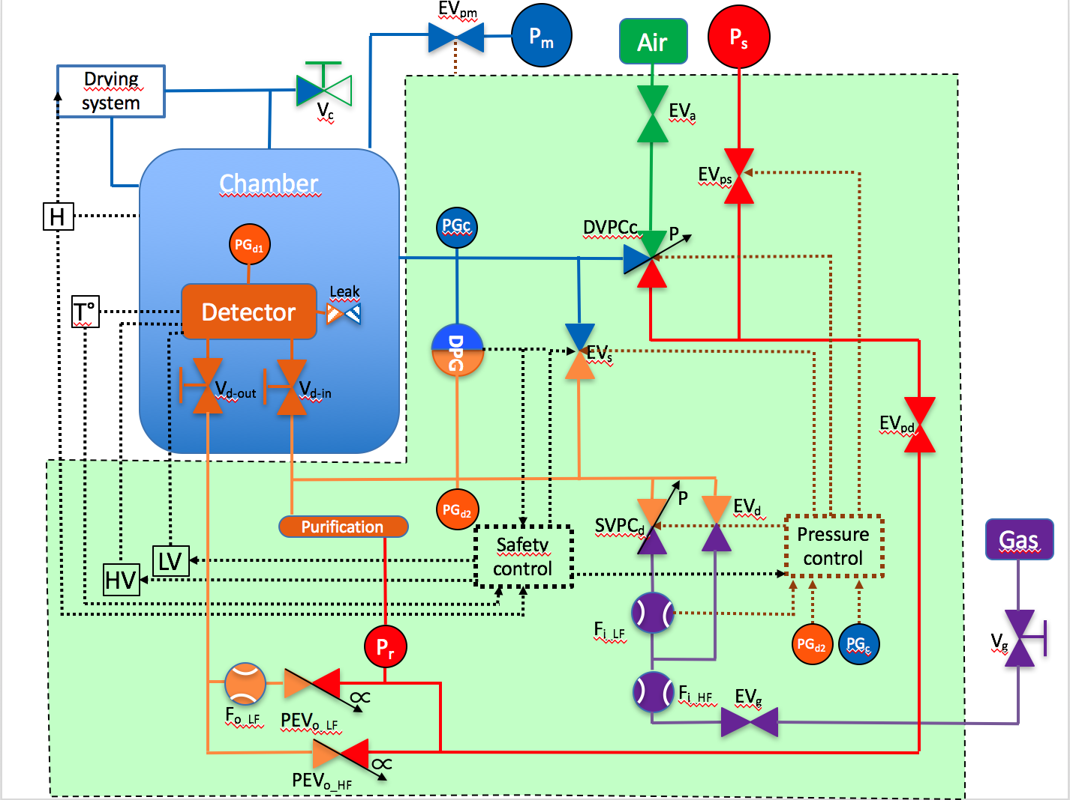
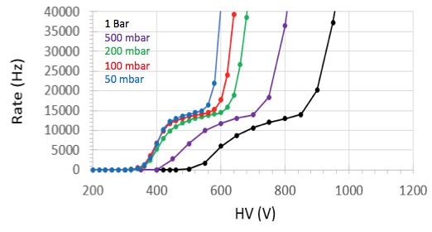
Gas pressure study at ILL
Development of gas circulation system
Detector can be operated at
50 mbar – 1 bar
Ambient vacuum
Performance as a function of pressure – the detector can be operated at 50 mbar with no loss of performance.

Slide 21
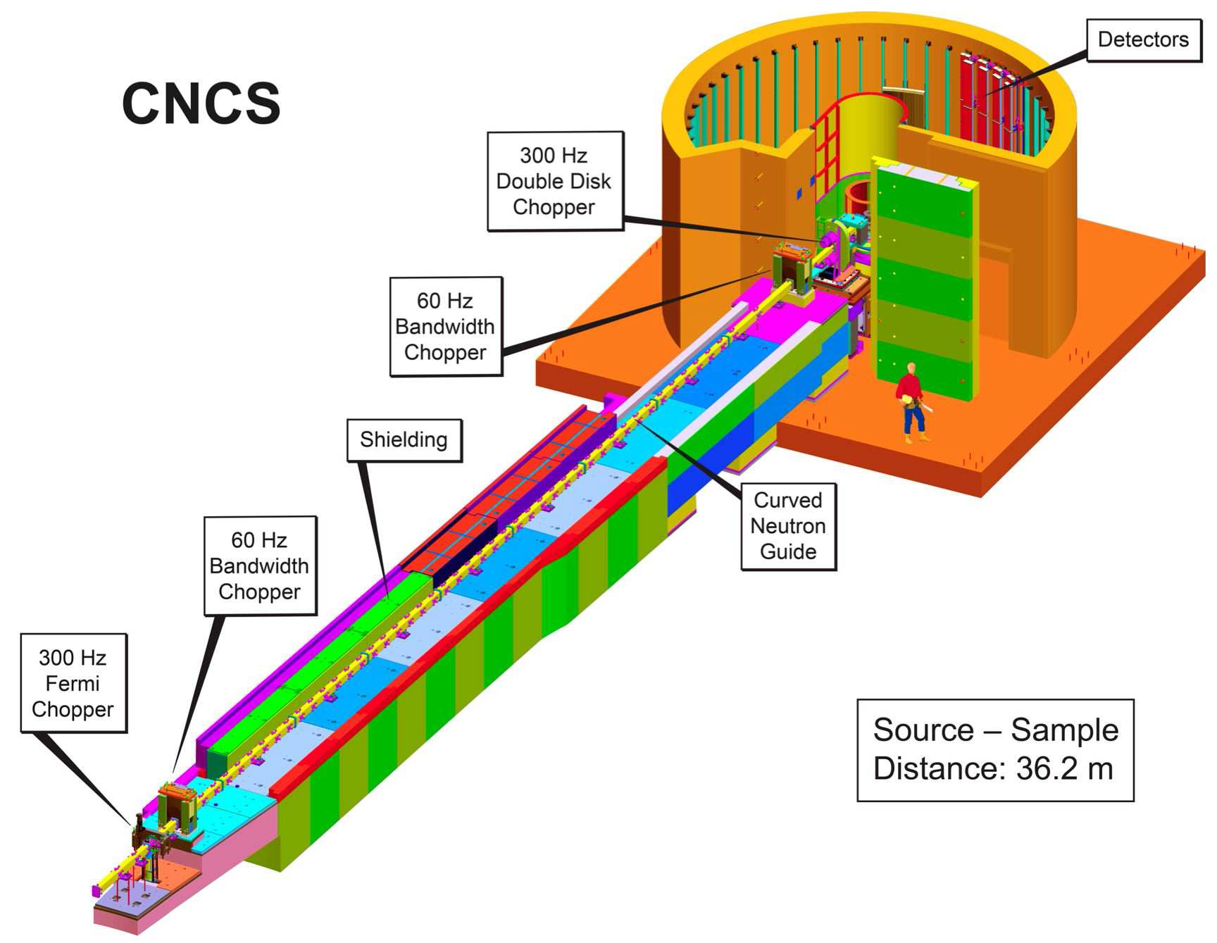
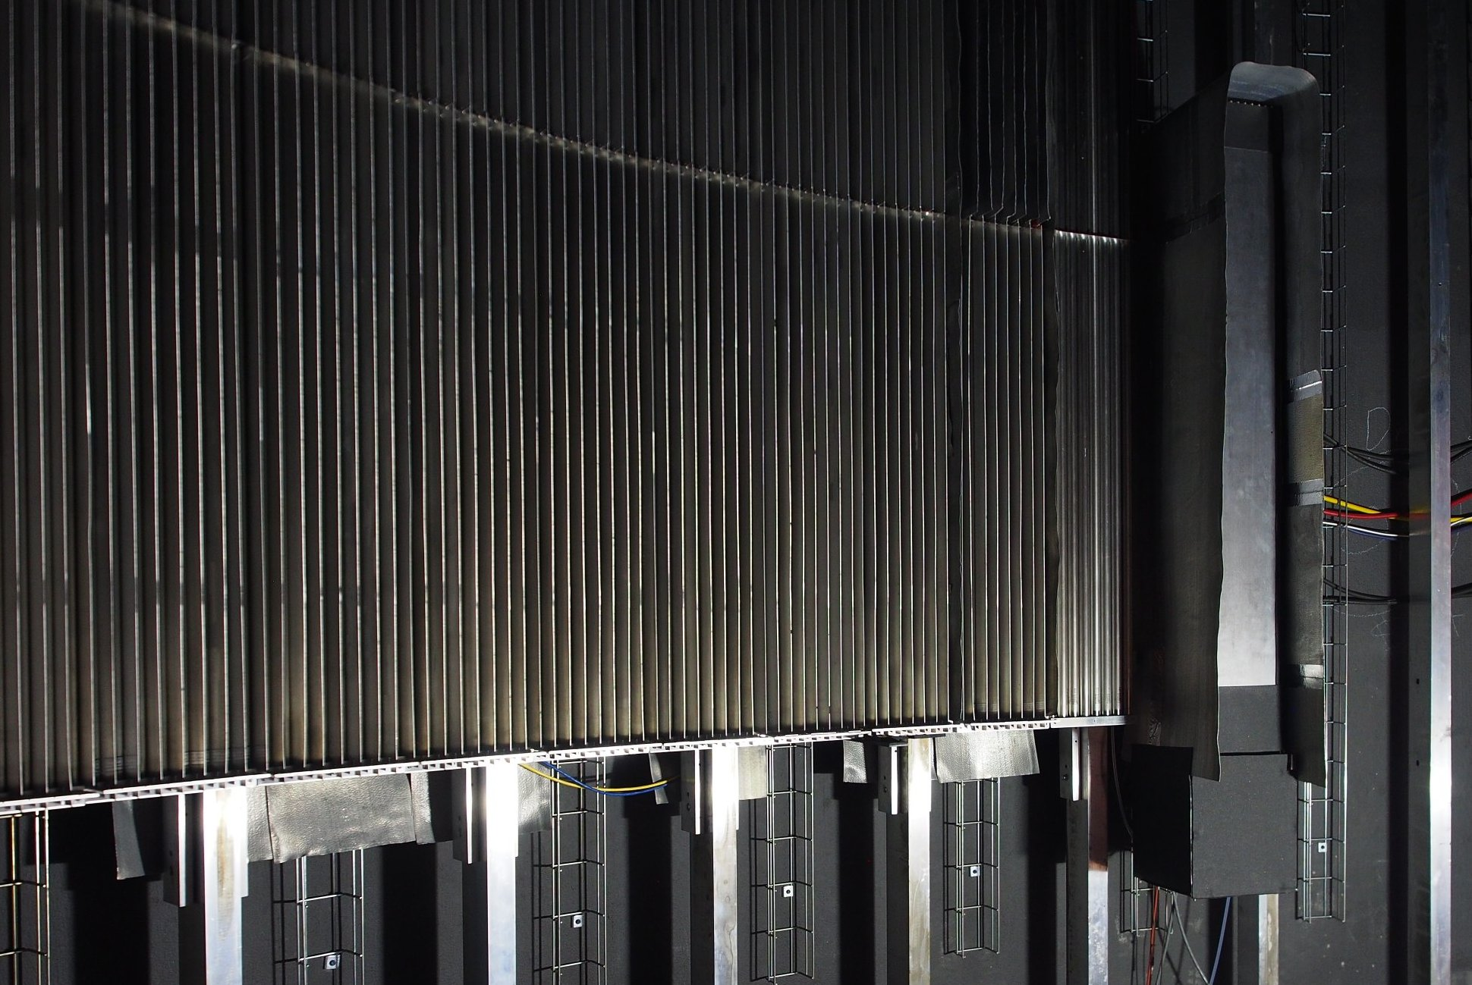
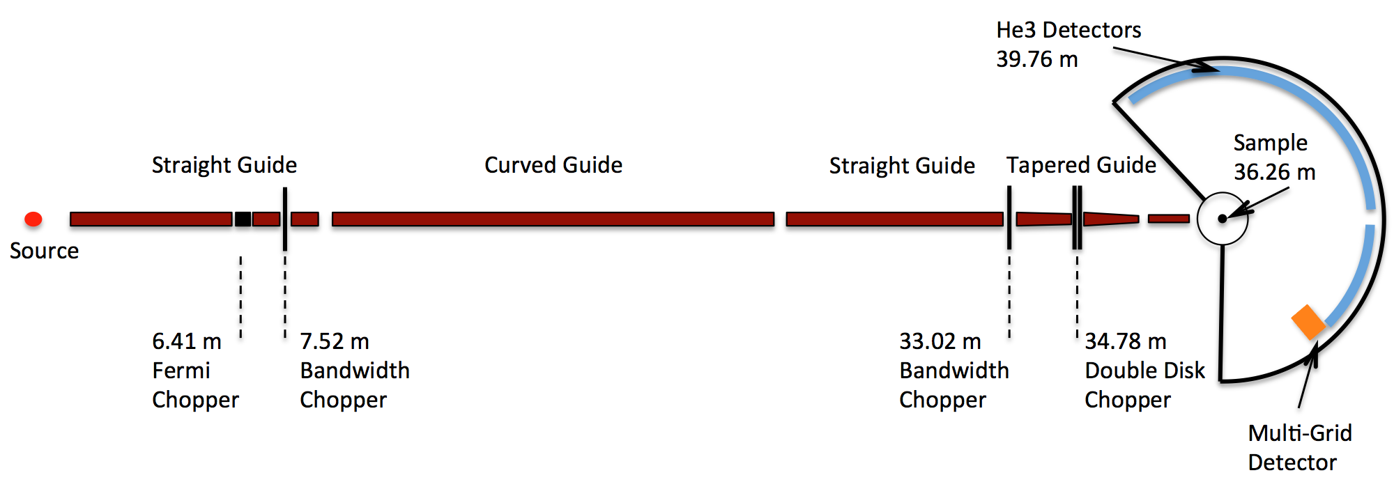
Test on CNCS, Cold Neutron Chopper Spectrometer
A kind offer by K. Herwig to test MG at SNS
Recommendation of 2015 ESS annual review
Goals:
Test at spectrometer
Side-by-side comparison to He3
In parallel with user experiments
Dedicated tests
Solution:
Size = half of “8-pack” module – 1.1m x 19cm
Installation June-July 2016
Operated July 2016 to June 2017

Slide 22
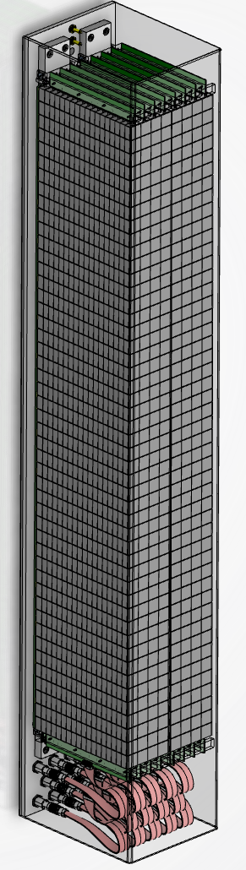
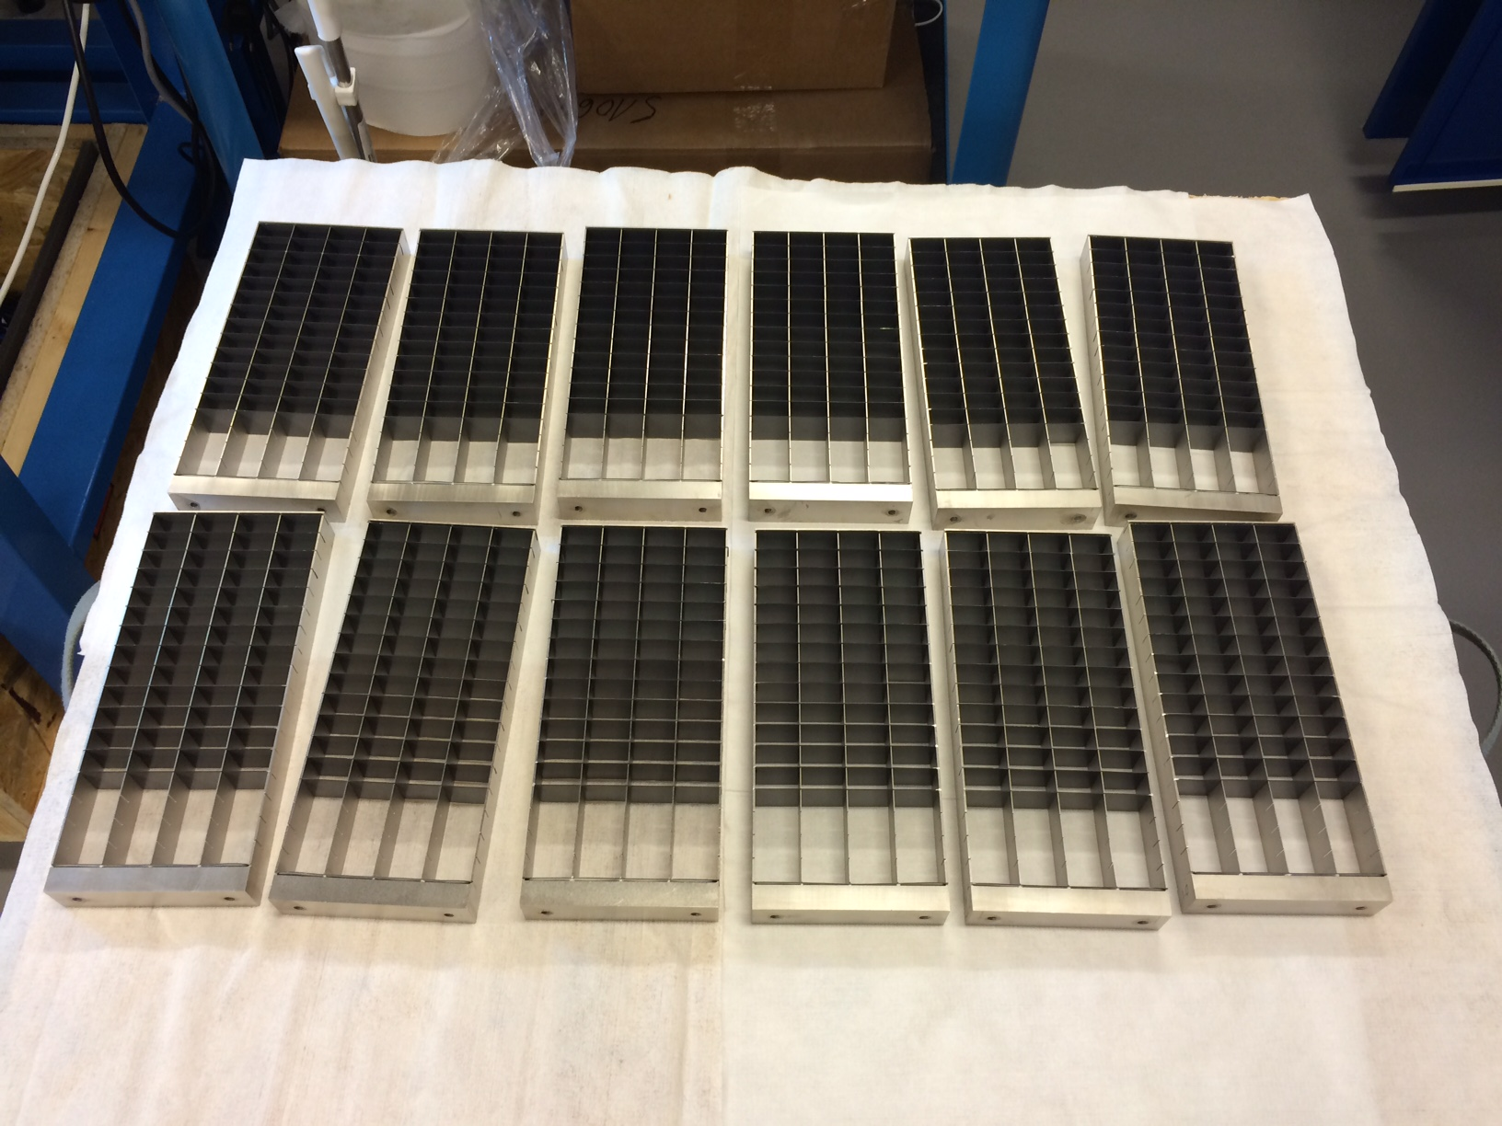
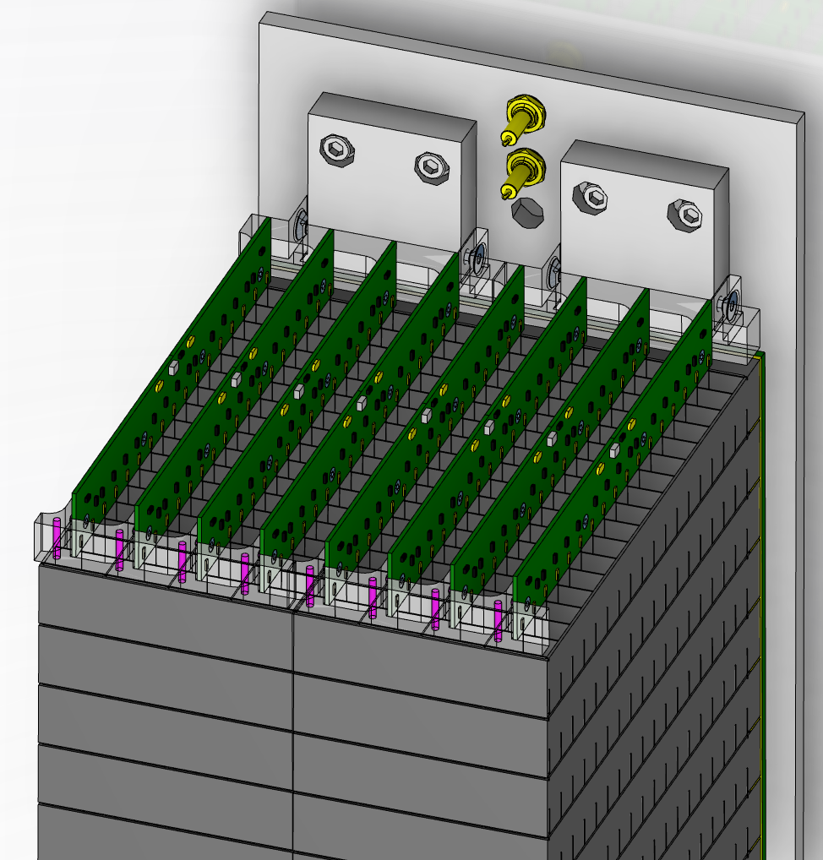
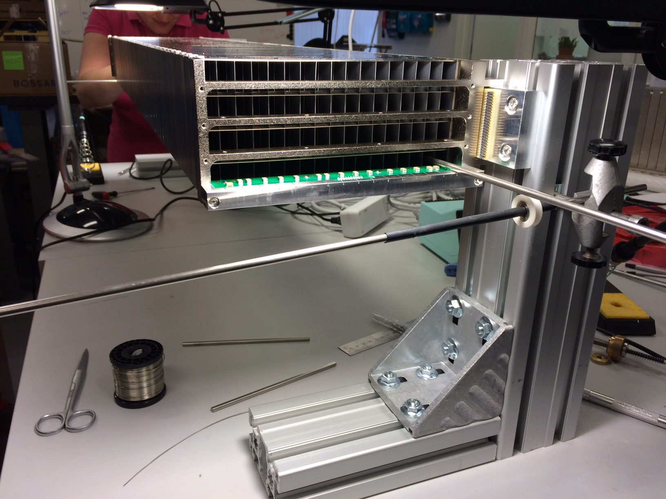
Design and Construction of MG.CNCS
1.1m

Slide 23
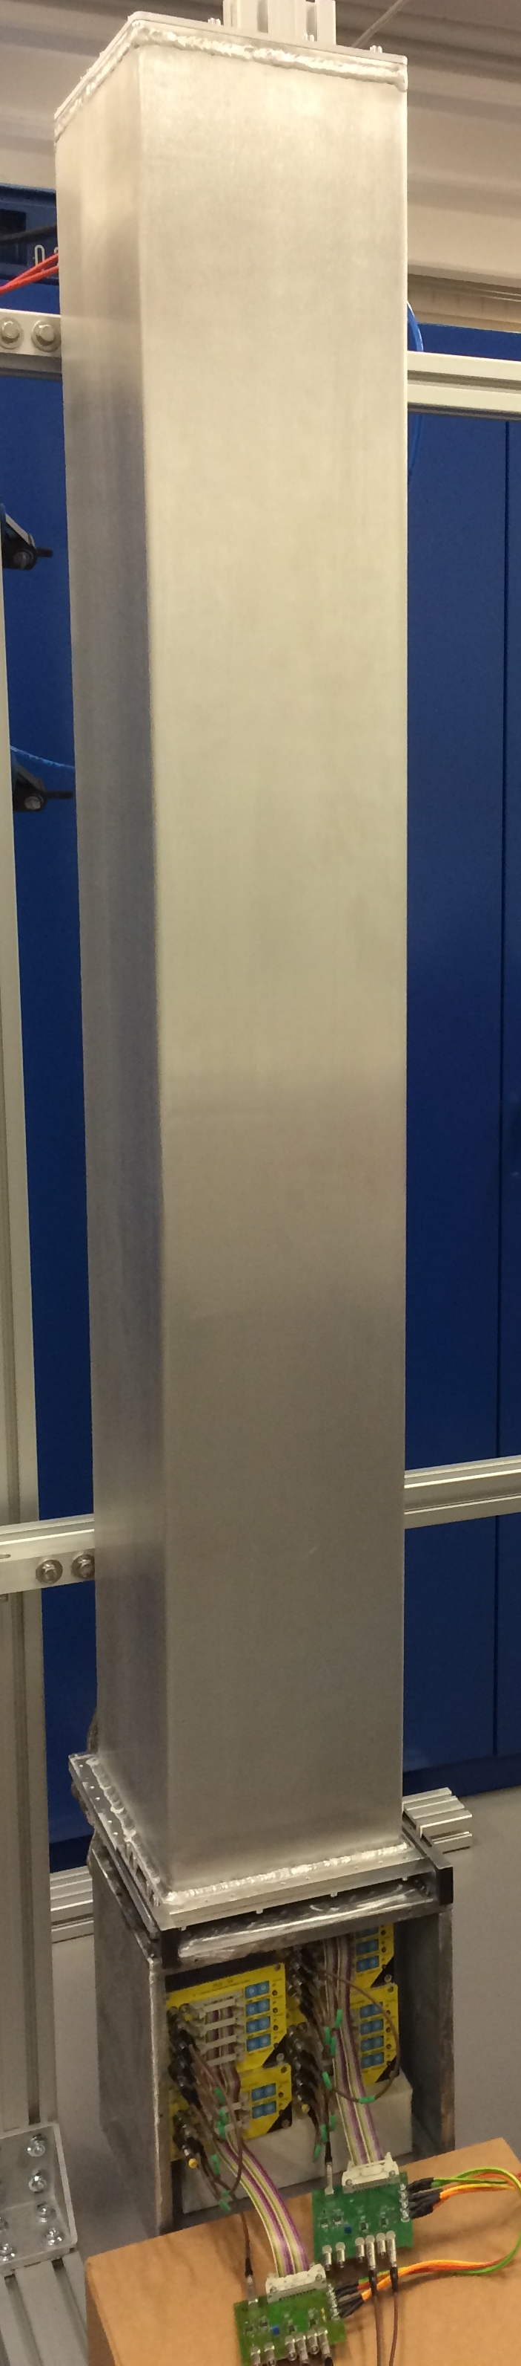
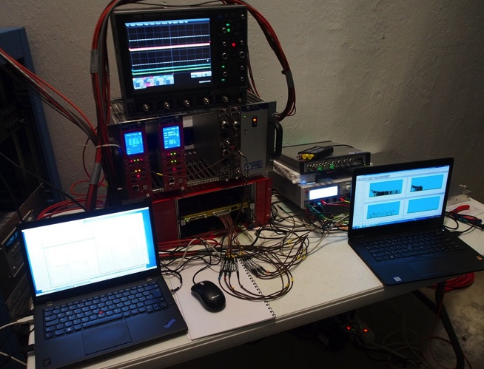
Multi-Grid installed at CNCS
Detector installed at 57° scattering angle
Inaccessible between summer and winter shutdowns
DAQ setup outside, accessible remotely
He-tubes
MG
View from sample
³He 8-packs
M-G
2m
1.1m
20cm
19cm

Slide 24
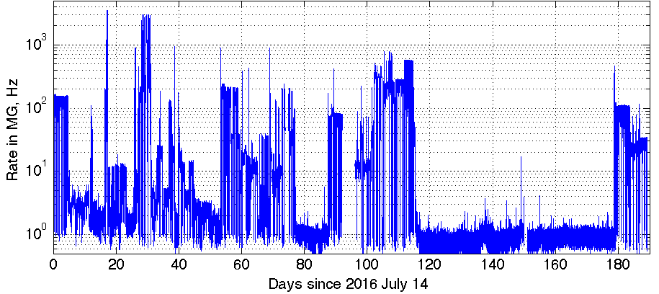
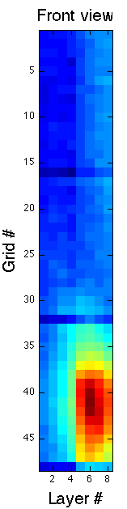
Methods Used for Tests
Vanadium
Counts over time, background
Rate and background analysis
Single crystal
High local rate
Water, Ice
Fast neutrons (fission, prompt)
Gamma background
(NaI detector)
x2 lower fast n counts in MG
Allowing to measure:
Energy resolution – efficiency, scattering – background sensitivity – saturation

Slide 25
Elastic Energy Resolution

Slide 26
Efficiency
Counts from integral of the elastic peak in dE
Efficiency measured relative to the nearest He3 tubes
Error bars: 5-8%, agrees with prediction

Slide 27



Single Crystal Reflection
He3
A single crystal reflects neutrons according to Bragg’s law:
Resulting in an intense spot seen by detector
MG
Reflected beam at E_{i} = 17.20meV
Crystal
Reflected beam at E_{i} = 13.74meV
Incident beam

Slide 28


Single Crystal Reflection
Image recorded in each detector as a function of time during elastic peak
Each frame advances 30 μs
Multi-Grid
He3
No loss of position resolution or saturation observed in Multi-Grid

Slide 29




GEANT4 Simulation of MG.CNCS
Isotropic scattering
particles simulated from sample
Detector
Sample environment
3.3 m
E_{trf} = E_{initial} - E_{final}
Elastic peak
Scattered background
from sample environment
Scattered neutron background
from detector
Simulation of MG.CNCS
Neutrons generated at sample
Reconstructed energy calculated from ToF
Sample environment included
Detector tank window included
Contribution of each component can be separated
*See presentation by K. Kanaki , MoF1-4

Slide 30

Conclusion
Multi-Grid developed and characterized.
Large-Area detectors possible again
Operated at CNCS over 11 months.
Multi-Grid baseline detector for
    CSPEC and T-REX at ESS
Instrument-focused design is underway
Proposal for a thermal instrument test in preparation
Horizon 2020 grant agreement 676548
WP 4.3: Large-Area Detectors
Thanks to the colleagues at SNS for this opportunity and cooperation!
2017 JINST 12 P04030
(https://arxiv.org/abs/1703.03626 )

Slide 31
Extra slides

Slide 32
Time-of-Flight Spectrum
Prompt peak
Elastic peak
Neutron energy gain
Neutron energy loss
Time between source pulses

Slide 33

Energy Reconstruction
Energy transfer: E_{f}-E_{i}
Raw ToF spectrum:
no information on geometry used
dE spectrum: Including information on position of each detected neutron.

Slide 34










¹⁰B₄C coatings
Coatings of ¹⁰B-enriched B₄C thin films have been produced for a variety of detectors and substrate materials
Some new challenges:
Temperature sensitive substrates
No substrate bending when 1-side coated
Pre-defined coating resistivity
Complex substrate shapes
Publications:
*C. Höglund et al, J of Appl. Phys. 111, 104908 (2012)
*S. Schmidt et al, J. of Materials Science 51, Issue 23 (2016)
*C. Höglund, Rad. Phys. and Chem. 113 , 14-19 (2015);

Slide 35


Single Crystal Reflection
He3
The 6th image frame from previous slide
(Peak rate in 1 tube / 1 line of pixels ≈ 150kHz)
Position:
Charge division in He3 PSD – saturation causes loss of position resolution
Coincidence between grids and wires in Multi-Grid
Local count rate limit:
space charge in gas (*)
  x10 lower in MG per event
  x10 lower in MG due to lower gain
Dead time of electronics
depends on electronics, similar per channel
No saturation observed in Multi-Grid
MG

Slide 36

Aluminium Bragg Edge
Scattering effects from SE and detector
Sample
Sample environment
Detector
Incident n

Slide 37
Efficiency Optimizations
Optimized grid
n
Efficiency as a function of wavelength for MG optimized for cold vs. thermal spectrum
Tested at MG.CNCS
Thermal Optimization
0.5μm
1.0μm
1.5μm
Layer thicknesses in MG.CNCS (16 blades):
7 blades 0.5μm,
7 blades 1.0μm,
3 blades 1.5μm
Proposed for a thermal detector (20 blades):
4 blades 1.0μm,
10 blades 1.25μm,
6 blades 2.0μm.
Thermal optimization
Cold – optimization centered on 4Å
Thermal – optimization centered on 1Å
*F. Piscitelli, P. van Esch, 2013 JINST 8, P04020

