Slide 1
SPK RFPS Interfaces
Mini PDR - June 2017
Paulo Torri
Carlos Martins
Rutambhara Yogi
www.europeanspallationsource.se
26th June2017

Slide 2
Introduction
SPK RFPS DIAGRAM
CP INTERFACE
PSS INTERFACE
MPS INTERFACE
ICS INTERFACE
LLRF
RFDS
WATER COOLING
SPK LPS (SPK Local Protection System)

Slide 3
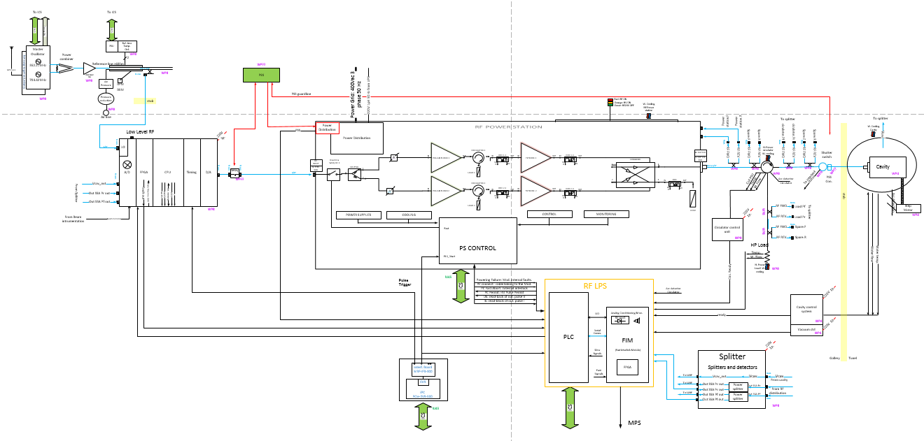
SPK RFPS DIAGRAM

Slide 4
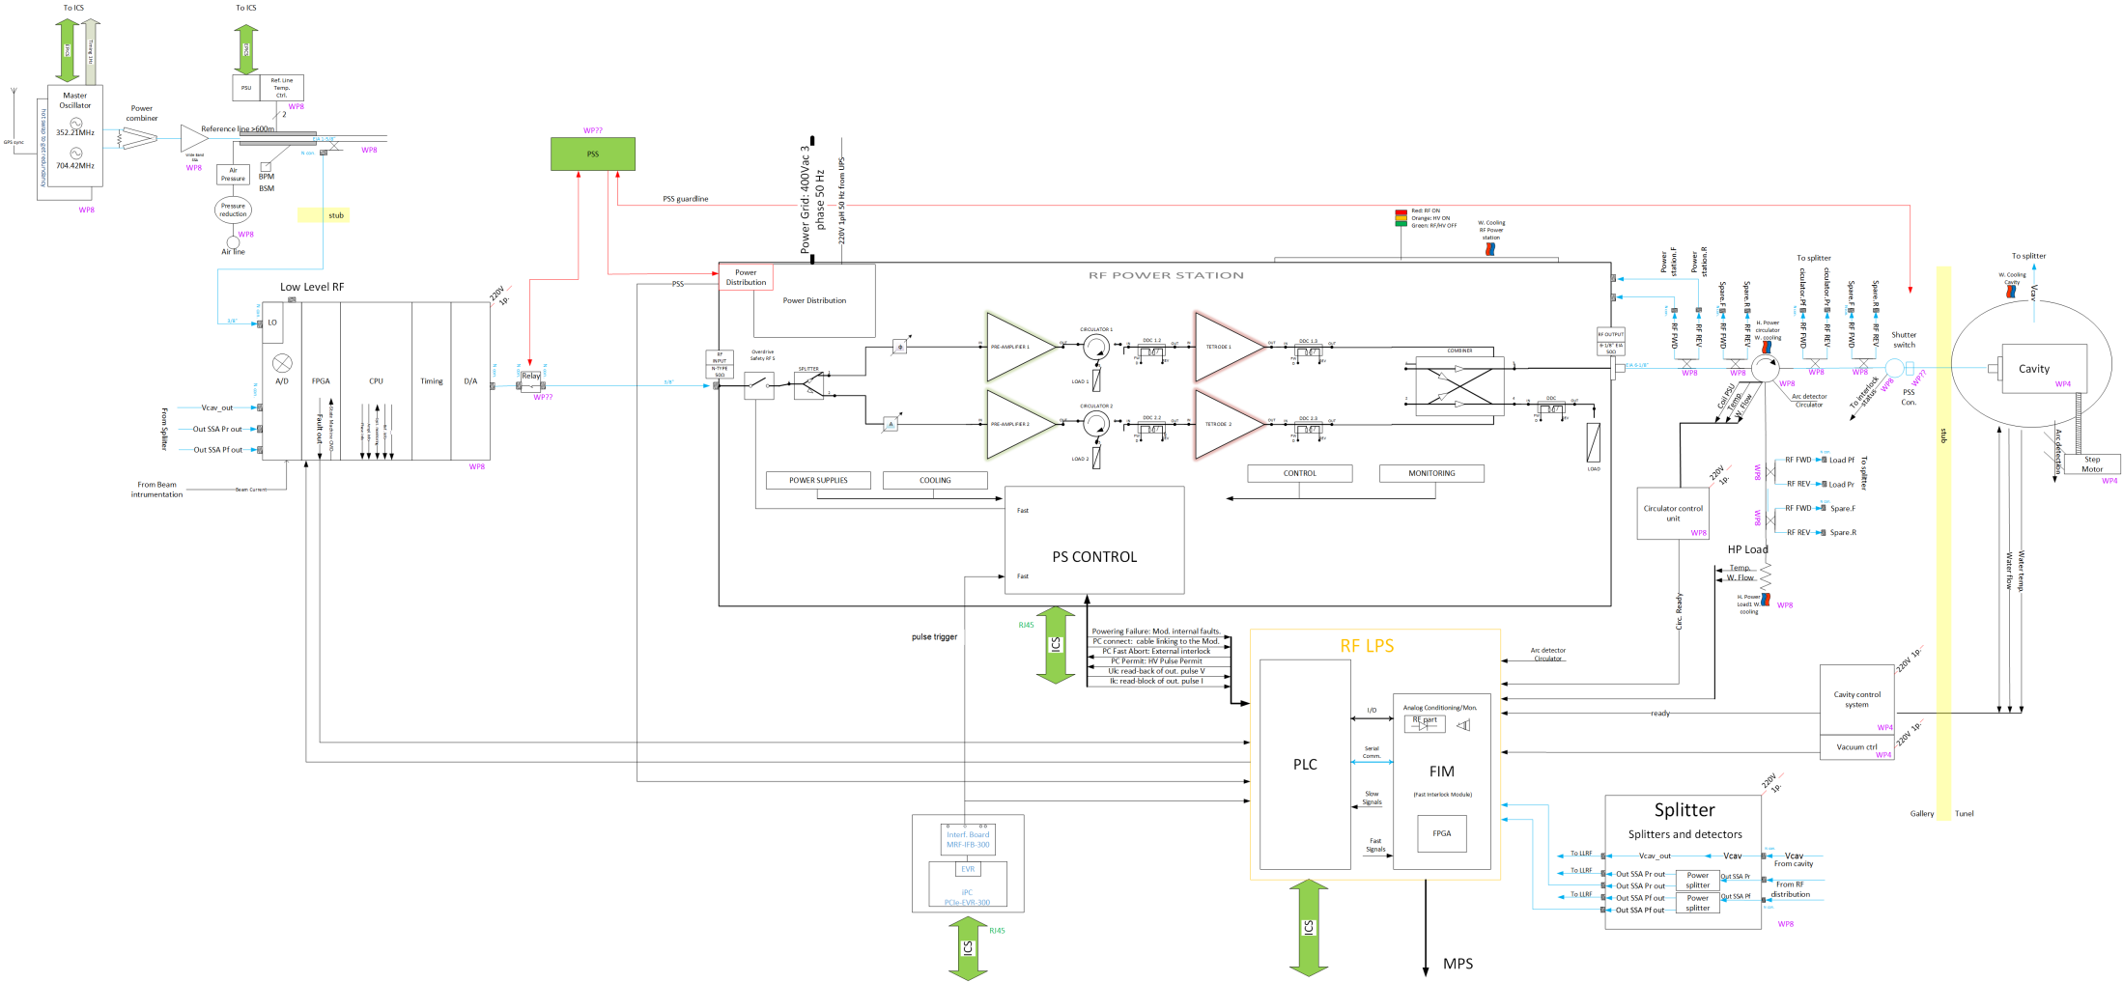
CP INTERFACE
Conventional Power Interface

Slide 5
CP Interface
Electrical loads inside RFPS:
3 Phase 400 Vac (Power Port):
- Anode Power supply: 1 x 40 kW
- RF SSA: 2 x 1 kW
- Tetrode air blower: 2 x 750 W
- Filament PS: 2 x 2 kW
- Other loads (Cooling fans, etc): 1 kW
Total Power: 50 kVA (72 A @ 400 Vac)
- Connecting point: ?
3 Phase 400 Vac (Control Port):
- Screen/control grid PS: 100 W
- RFPS Control: 200 W
- Connecting point: ?

Slide 6
CP Interface
3 Phase 400 Vac (Power Port): 50 kVA power is already available from switchgear panels, cable from switchgear to the RFPS is already defined but may be selected one without full EMC specs (EV)

Slide 7
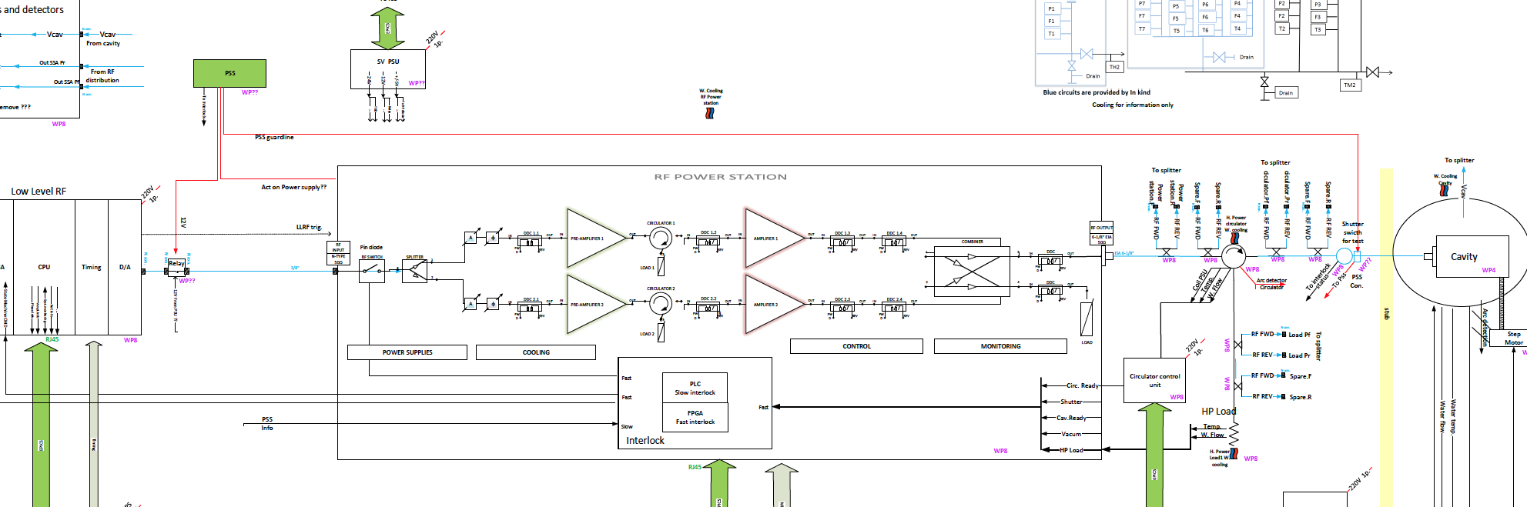
Spoke Cavity PSS Interface
From: S Birch - RF Cell System Review - 11 May 2017
Incoming Power
Interface
RF Switch
Interface
Wave Guide
Interface

Slide 8
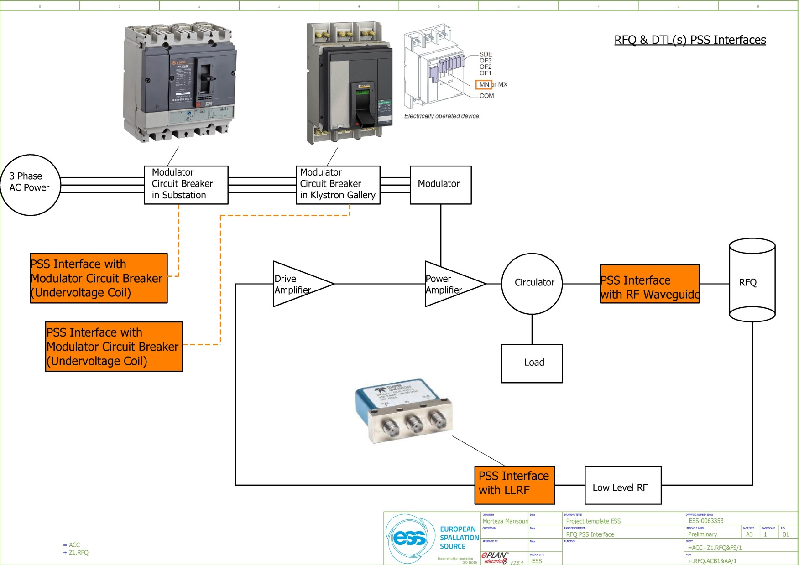
PSS Interfaces: RF Systems
In case of access to tunnel by personnel, the RF modules test can only be performed after a piece of waveguide has been removed and sealed properly in the Klystron Gallery.
PSS will use failsafe, 24 VDC RF switches with indicator mirror contacts to interface with Low level Radio Frequency systems (LLRF) in RF cells such as MEBT bunchers, RFQ, DTL(s), spoke cavities, etc.
Instantaneous under voltage release coil in Moulded case circuit breakers (MCCB). As an example, to be used in case of PSS interface with RF modulators in accelerator.
The under voltage release coil instantaneously opens the circuit breaker when its supply voltage drops to a value between 35 % and 70 % of its rated voltage. If there is no supply on the release, it is impossible to close the circuit breaker, either manually or electrically. Any attempt to close the circuit breaker has no effect on the main contacts. Circuit breaker closing is enabled again when the supply voltage of the release returns to 85 % of its rated value.
The control signal for the under voltage coil passes through the two PSS contactor relays.
Notes:
Accelerator PSS will interface four subsystems of RFQ.
RFQ Modulator air circuit breaker (ACB) in substation.
RFQ Modulator air circuit breaker (ACB) in klystron gallery.
RFQ LLRF.
RFQ Waveguide.

Slide 9
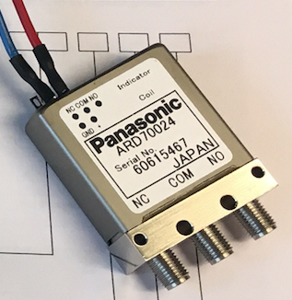
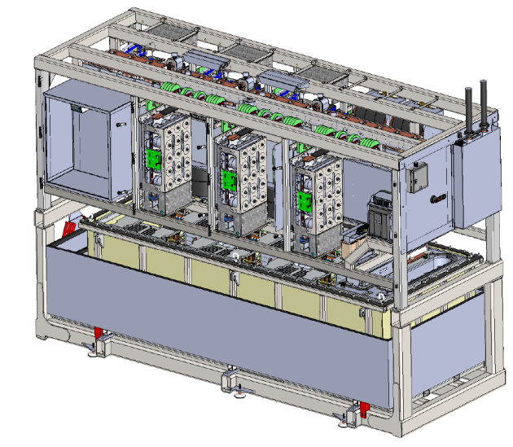
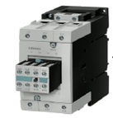
Where are We!
Coaxial Switch
Coaxial RF switch has been tested by Bruno. PSS team are currently testing the switch.
PSS contactor box
Modulator System
Modulator system PSS interface agreed and incorporated into current designs.
Solid State Power RF Cell PSS Contactors
The 400V three phase contactor box design is still in early design.

Slide 10
MPS INTERFACE
MPS (RF LPS_FAULT signal)

Slide 11
ICS INTERFACE

Slide 12
LLRF INTERFACE

Slide 13
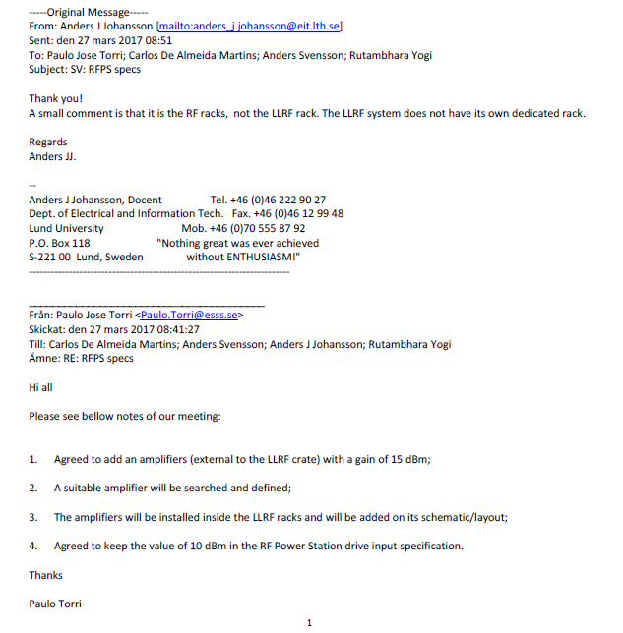
LLRF INTERFACE
RF Cable in between RF rack and RFPS: WP 8

Slide 14
RFDS INTERFACE

Slide 15
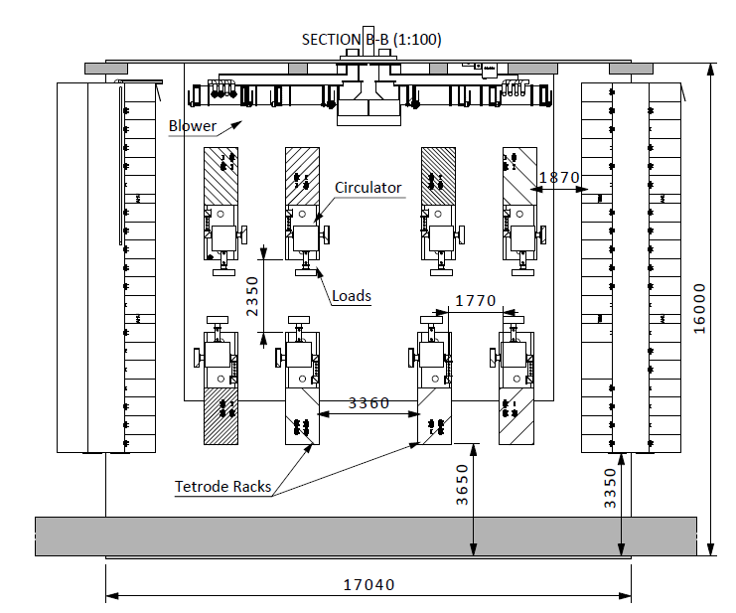

RFPS for spokes in G02 Gallery
RF_CELL_120 (8 UNITS)
RF_CELL_130 (8 UNITS)
RF_CELL_140 (8 UNITS)

Slide 16
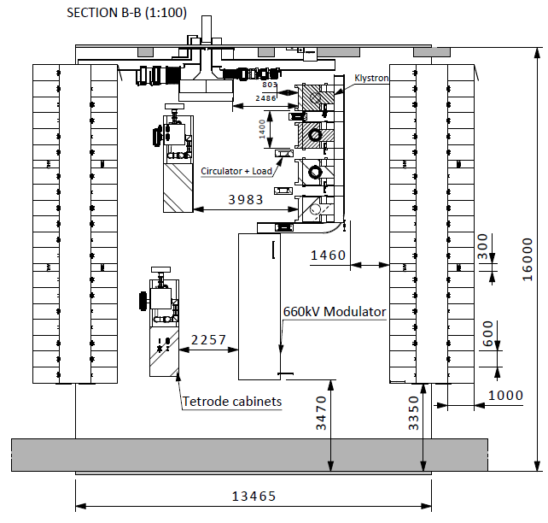
RFPS for spokes in G02 Gallery
RF_CELL_160 (2 UNITS)

Slide 17
Water Cooling Interface
Water Cooling
Interface

Slide 18
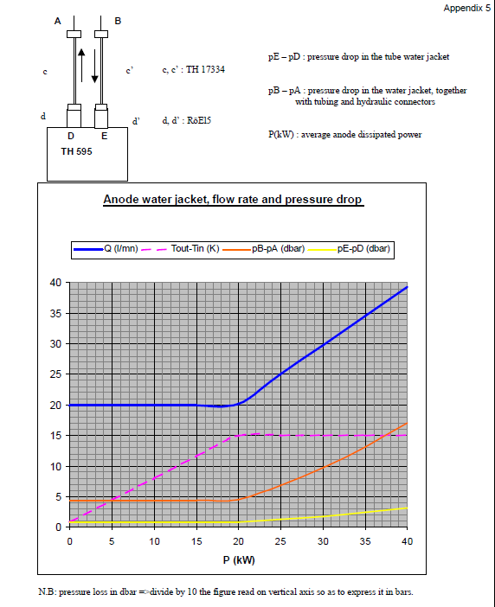
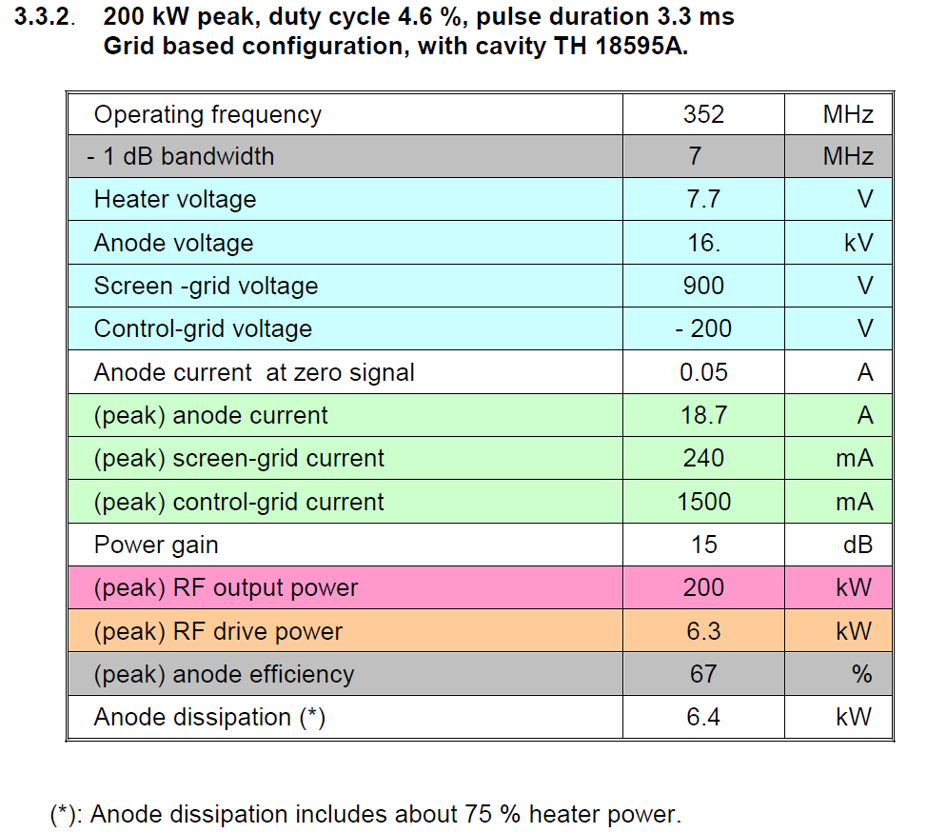
RFPS for spokes in G02 Gallery:
- Water Requirements
  Water flow requirement: HIGH: Maximum inlet temperature 50 ºC
Load: Tetrode TH595 with cavity TH 18595A
Anode dissipation: 6.4 kW
RFPS dissipation: 2 x 6.4 kW = 12.8 kW
Water flow (RFPS): 2 x 20 l/min = 40 l/min
Pressure drop: 4.3 dbar

Slide 19
RFPS for spokes in G02 Gallery:
- Water Requirements
  Water flow requirement: MEDIUM: Maximum inlet temperature: 27 ºC
RF Solid State Amplifier: rated RF Power 7 kW
Load: SSA Dissipation: 2 x 400 W = 800 W
Water flow: 2 x 5 l/min = 10 l/min
Pressure drop: ? bar

Slide 20
RFPS for spokes in G02 Gallery:
- Water Requirements
ELETTRA: 400 kW - 352 MHz Radio Frequency Power Station Technical Specification: current document
  Cooling
The RFPS shall comply with the following water cooling circuit conditions:
Type of water: Demineralized
Maximal water conductivity: 1.2 µS/cm
Two cooling water circuits are available, MEDIUM and HIGH temperature, with the following characteristics:
- High temp water: 50 C, 4 bar nom, 5 bar max
- Medium temp water: 27 C, 7 bar nom, 10 bar max

Slide 21
SPK LPS – Local Protection System

Slide 22

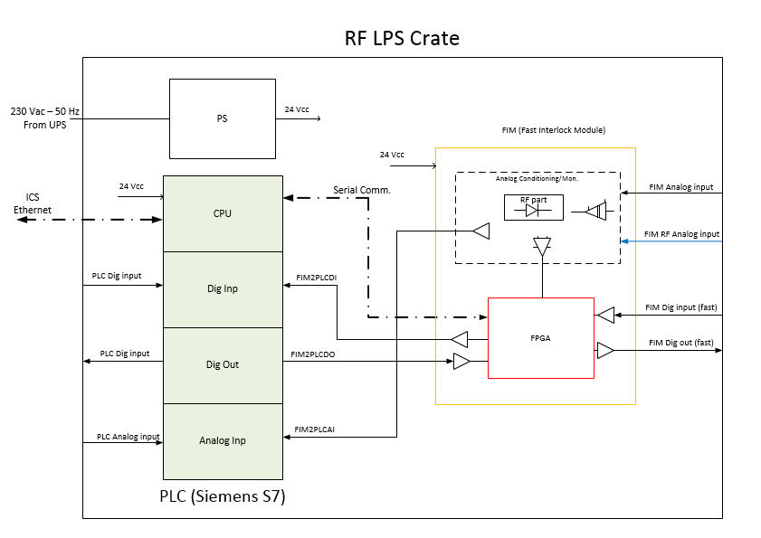
SPK LPS – Local Protection System

