Slide 1
ESS Presentation Elements
Christine Darve
Nordic Particle Accelerator School, NPAS2017
https://npap.eu/
Lund University
August 16, 2017

Slide 2
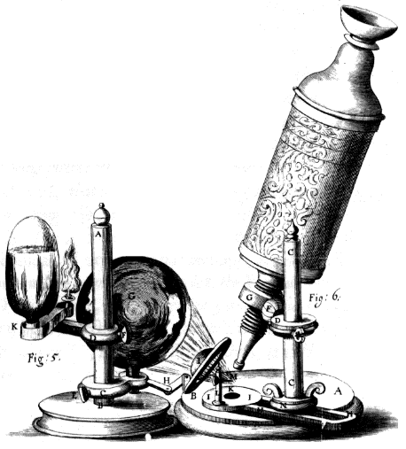
Outline
Science for society and spallation
ESS infrastructure
Instruments
Target
Accelerator

Slide 3
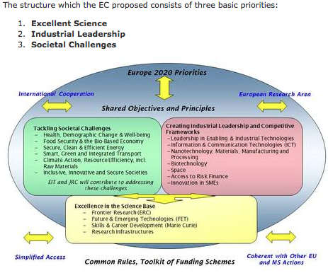
Science for Society !!
LIGHTNING
EU Horizon 2020 – strategy
NEW
MATERIALS
SOLAR
ENERGY
FUNCTIONAL
FOOD
COSMETICS
MEDICINE
PACE- MAKERS
MOBILE PHONES
TAILOR
MADE
MATERIAL
TRANSPORTS
IMPLANTS
BIO FUEL
GEO SCIENCE
Notes:
To cope with the multidisciplinary societal challenges
The development of neutron scattering over the past 40 years has been from the initial studies of basic solid state physics in model systems, to detailed studies of complex systems with applications. Similar development can be expected in the next 40 years.
Today society: Material science, bio
Connect scientific field : target a larger scientific communities
to support innovation, capacity building and industry
Neutrons are everywhere
The major players in the industry take the challenge of sustainable development seriously - taking actions that combine strong economic performance with sound environmental management and attention to social conditions.
Take the challenge we all face of constant innovation in a modern society in which knowledge is the cornerstone of long-term growth, making education is absolute priority.

Slide 4
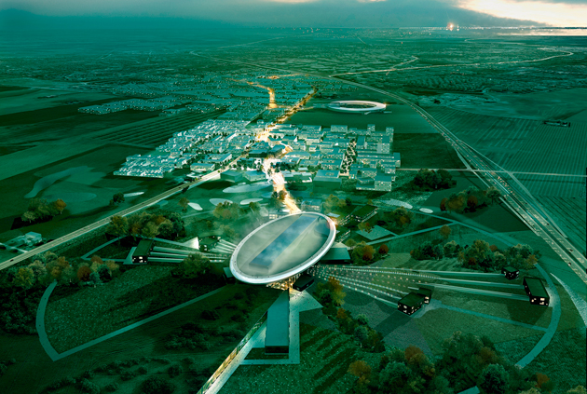
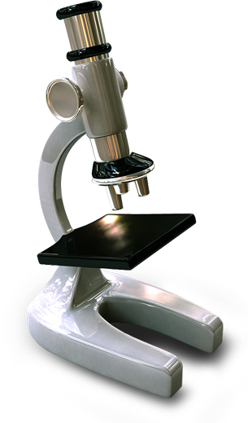
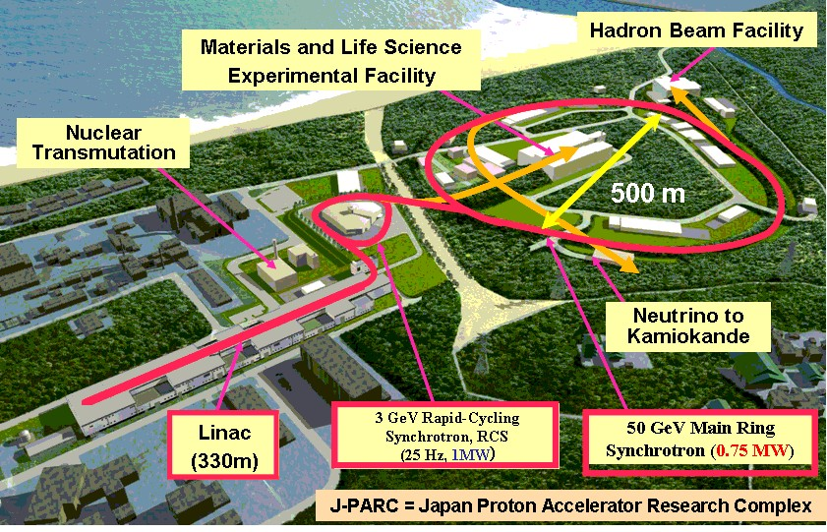
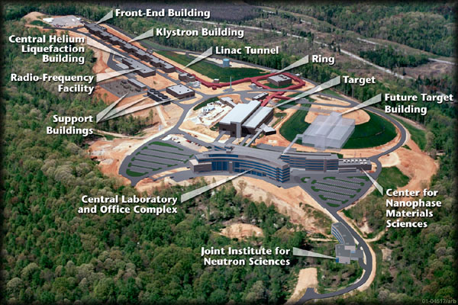
Spallation Sources
Philosophie de “Pré-vert”: Greenfield
Neutron scattering offers a complementary view of matter in comparison to other probes such as x-rays from synchrotron light sources, The scattering cross section of many elements can be much larger for neutrons than for photons.
Europe 2019: The European Spallation Source (<5 MW)
ESS will bring new insights to the grand challenges of science and innovation
Collaborative project: more than 17 countries
2014: Start of construction phase of the world's most powerful linear proton accelerator
2019: Provide the world's most advanced tools for studying materials with neutrons
(~ 450 employees; > 2500 users / year)
Lund, Sweden
Japan 2008:
JPARC (<1MW)
USA 2006:
SNS (<1.4 MW)
1 GeV, 26 mA in linac, 627 ns long pulse, 60 Hz
Notes:
Promote science, competitivity and complementarity of Life Science as operated in the USA and Japan.
USERS
Build capacity and partnership (in Europe) around science and innovation
Green-field – new investment – pre-vert
Complementarity of scientific tool: LS and NS
Each builds on the previous and prepares for the next
regional and European impact
Intensity frontiers
Beam-to-target : 2006—2019

Slide 5
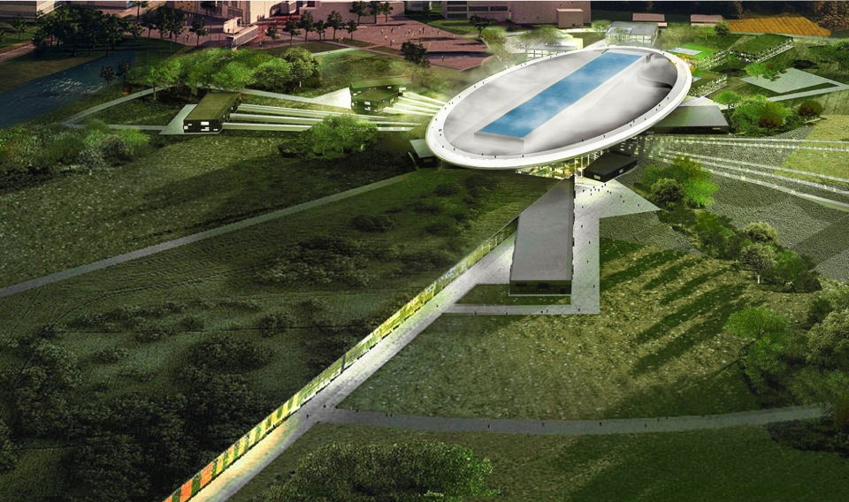
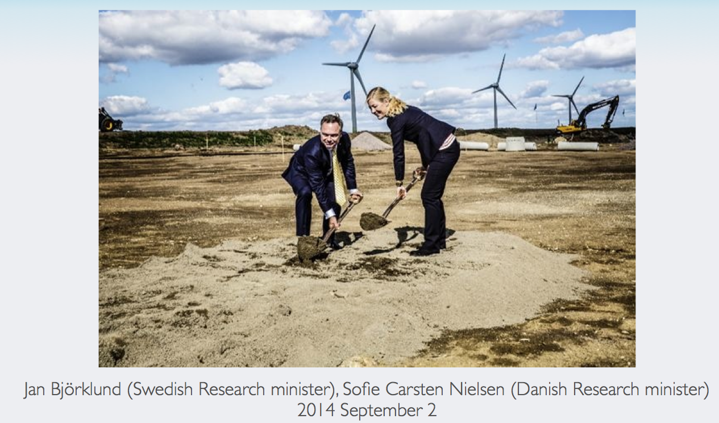
Road to realizing the world’s leading facility for research using neutrons
2025
ESS construction complete
2014
Construction work starts on the site
2023
ESS starts
user program
2009
Decision: ESS will be built in Lund
2019
First neutrons on instruments
2012
ESS Design Update phase complete
2003
First European design effort of ESS completed

Slide 6
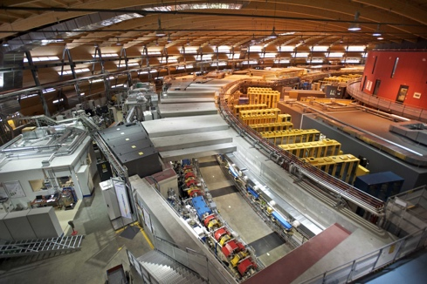
Organisation and People
401
Employees
48
Nationalities
~ 100
Collaborating Institutions

Slide 7
Partner institutions responsible for delivering the design & construction of ESS
Aarhus University
Atomki - Institute for Nuclear Research
Agder University
Bergen University
CEA Saclay, Paris
Centre for Energy Research, Budapest
Centre for Nuclear Research, Poland, (NCBJ)
CERN, Geneva
CNR, Rome
CNRS Orsay, Paris
Cockcroft Institute, Daresbury
DESY, Hamburg
Delft University of Technology
Edinburgh University
Elettra – Sincrotrone Trieste
ESS Bilbao
Forschungszentrum Jülich
Helmholtz-Zentrum Geesthacht
Huddersfield Univesrity
IFJ PAN, Krakow
INFN, Catania
INFN, Legnaro
INFN, Milan
Institute for Energy Research (IFE)
Institut Laue-Langevin (ILL)
Rutherford-Appleton Laboratory, Oxford (ISIS)
Kopenhagen University
Laboratoire Léon Brilouin (LLB)
Lodz University of Technology
Lund University
Nuclear Physics Institute of the ASCR
Oslo University
Paul Sherrer Institute
Roskilde University
Tallinn Technical Univesrsity
Technical University of Chemnitz
Technical University of Denmark
Technical University Munich
Science and Technology Facilities Council
(STFC)
University of Tartu
Uppsala University
WIGNER Research Centre for Physics
Wroclaw Univesrity of technology
Warsaw University of Technology
Zurich University of Applied Sciences
(ZHAW)

Slide 8
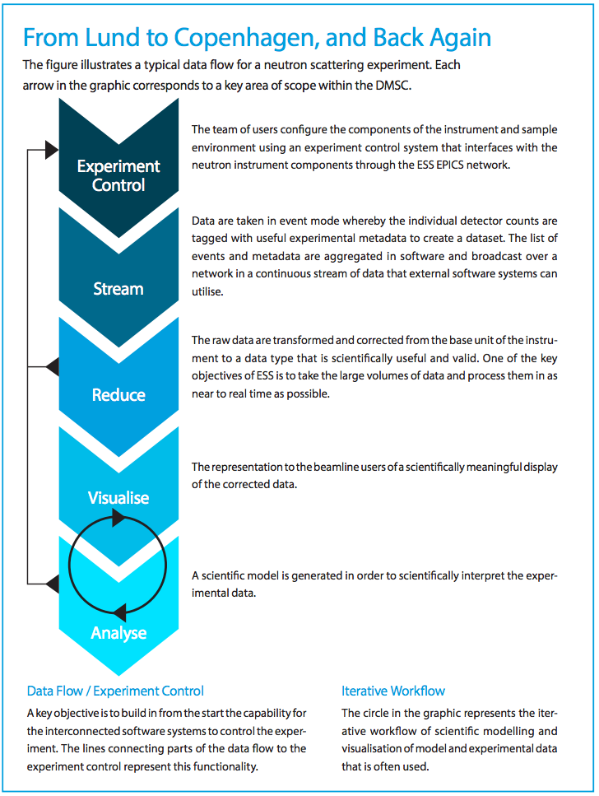
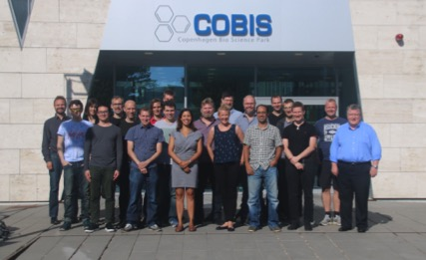
Data Management and Software Centre COBIS, Copenhagen University North Campus
Provide world leading scientific software and scientific computing support for neutron scattering at ESS
Scientific Software
ESS experiment control system, Data acquisition, Data correction software, visualization, and software to model and analyze experimental data sets.
Data center operations
Store and catalogue ESS datasets, provide ESS users remote access to their data, computing for live data correction, and analysis software during and after experiments.
User support
Support ESS users with data treatment and analysis.
22* DMSC Staff now → 60
(*20 FTEs and 2 part time)
8

Slide 9
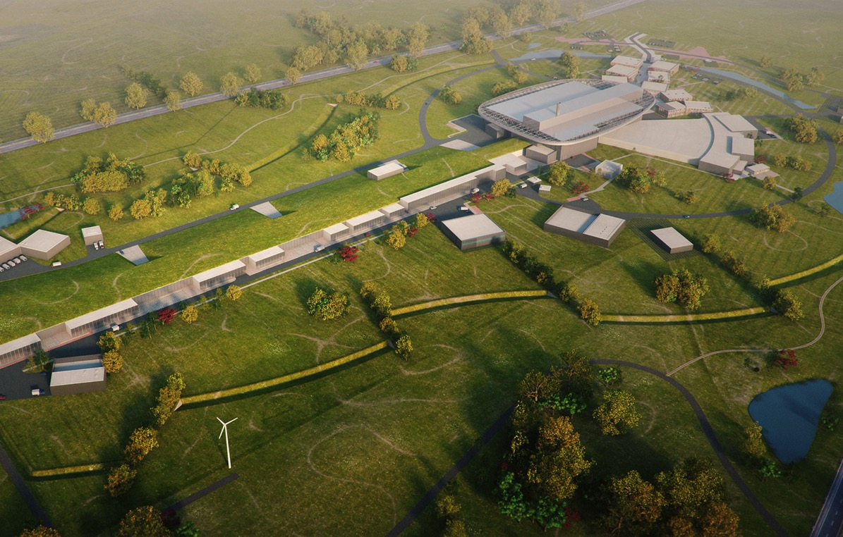
Neutron Production Target
Instruments
Superconducting Proton Accelerator

Slide 10
Helicopter view of ESS
Protons
Moderator
Target
NEUTRONS

Slide 11
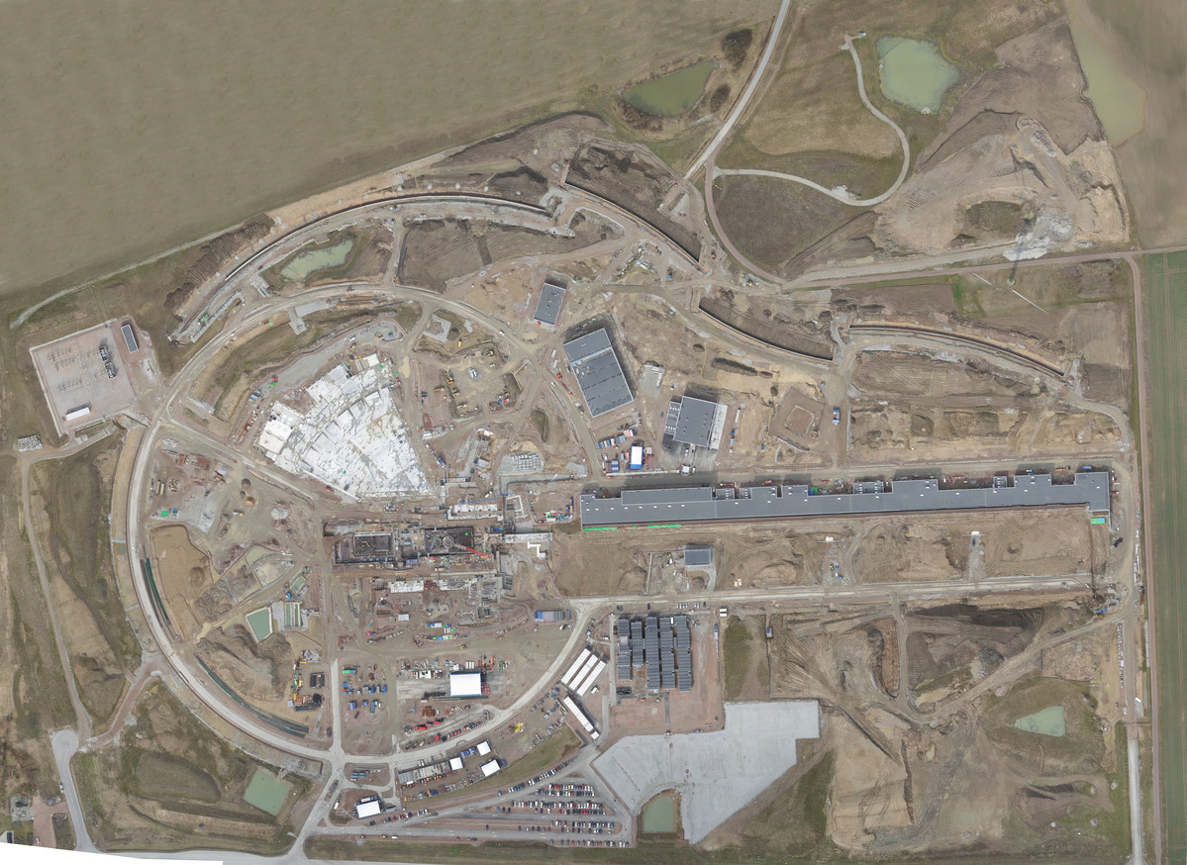
Distribution
Substation
Primary
Substation
Central Utility
Building
Exp. Hall
E01
Cryo Compressor
Building
Klystron Gallery
Front End
Building
Active
Cells
Target
Monolith
High Energy
Loading Bay
April 2017

Slide 12
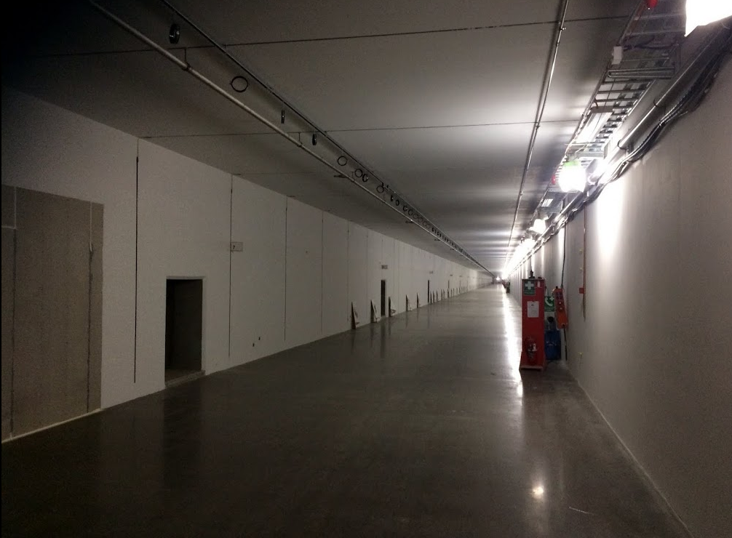
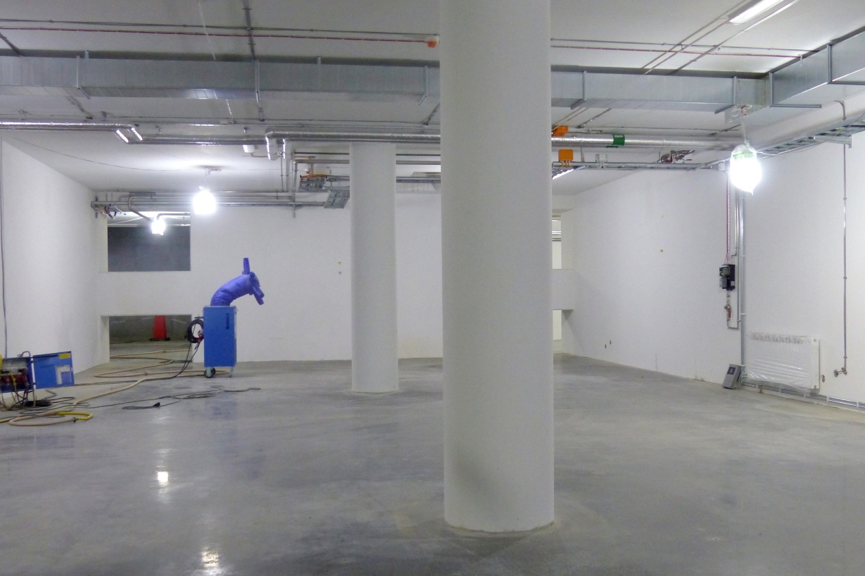
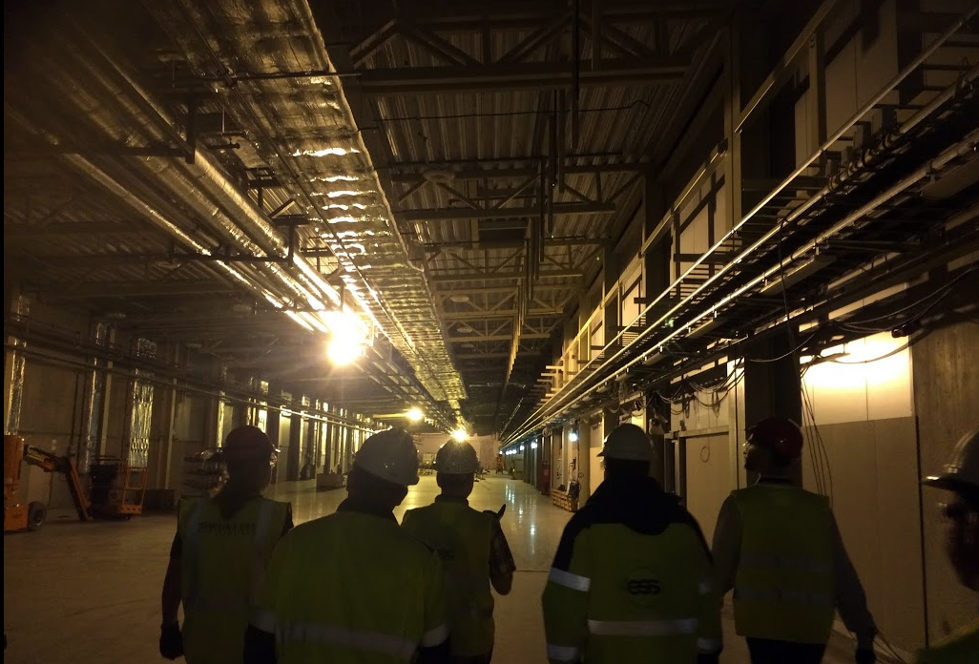
Tunnel
Tunnel, view from HEBT
Gallery Building
Front End Building

Slide 13
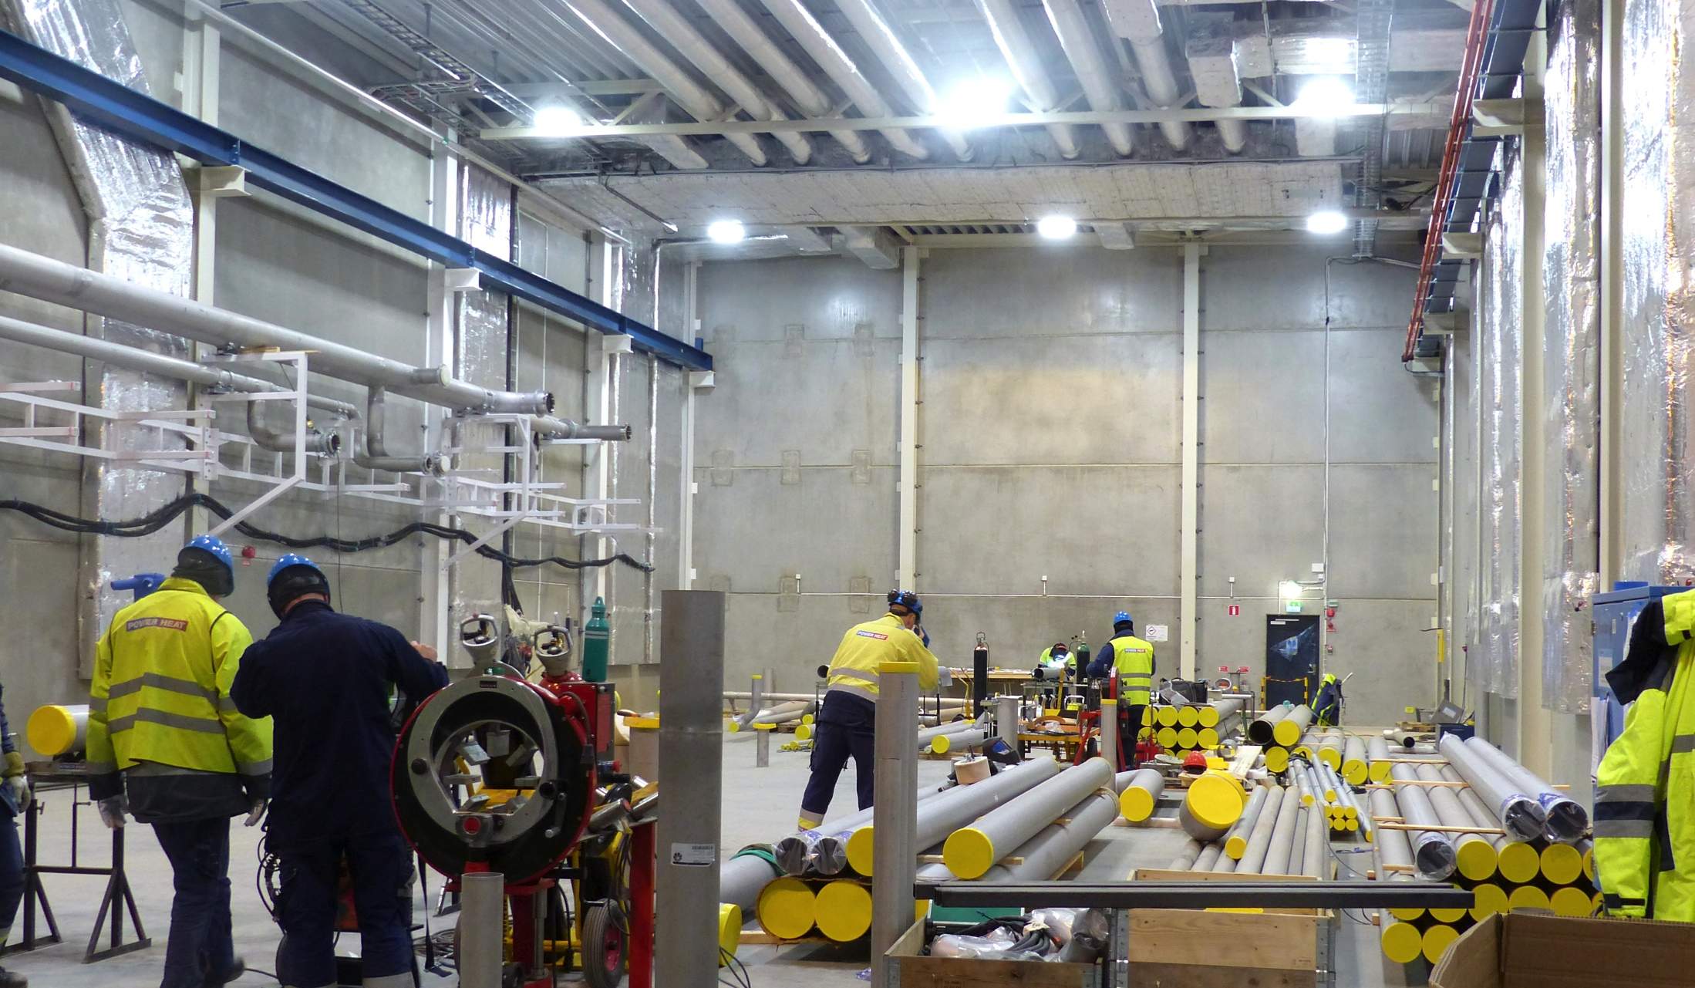
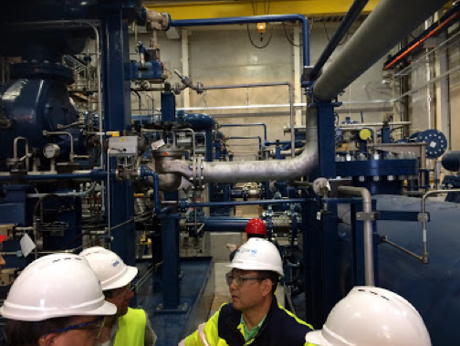
Cryo Compressor Building

Slide 14
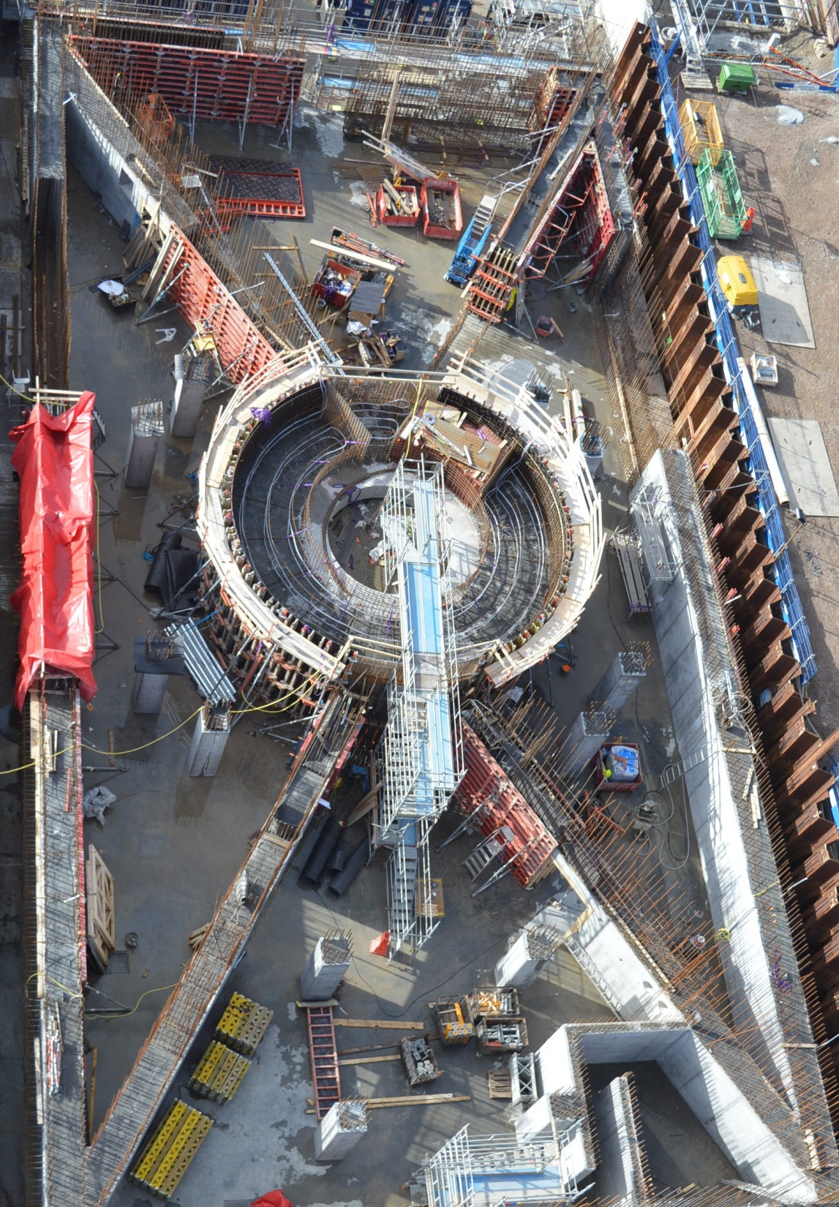
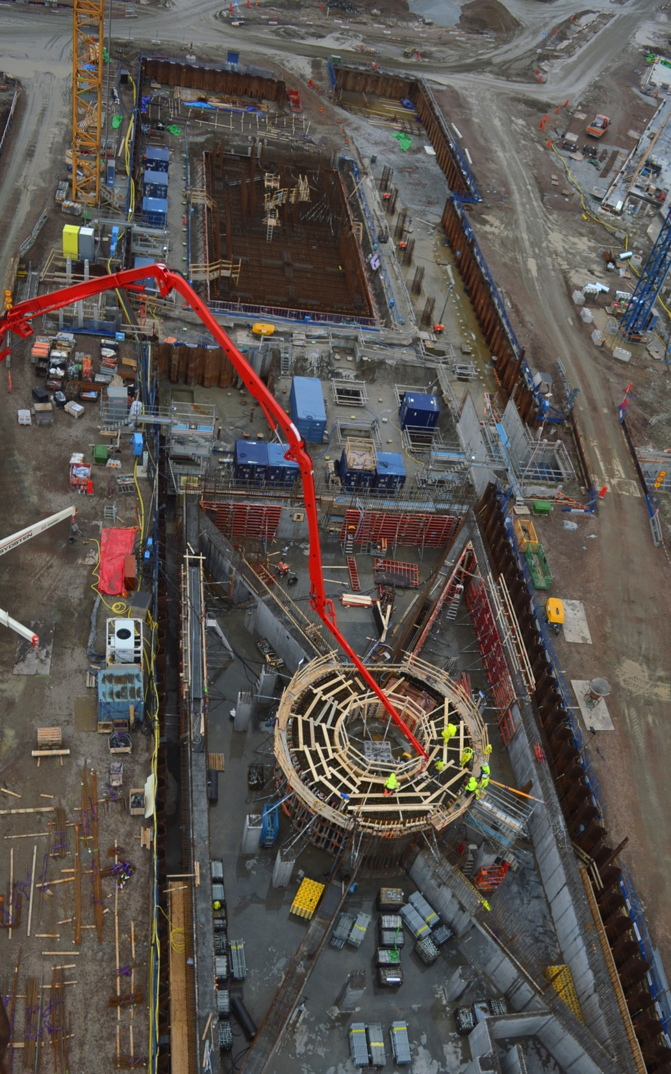
Target Monolith & Active Cells

Slide 15
Outline
Science for society and spallation
ESS infrastructure
Instruments
Target
Accelerator

Slide 16
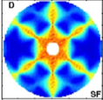
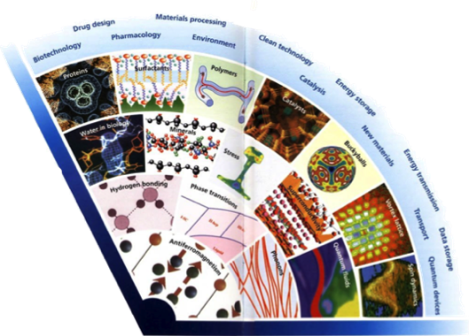
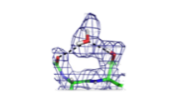
Neutron Science Needs to Push the Boundaries
Wider range of application areas
In Operandi Advanced
Energy Devices
Multi-scale structure
and dynamics
Kinetics of Complex
micro-fluids
Complex Interfaces
Charge and spin
Transport
in Novel Materials
New States of Matter
Quantum Enzymology
Protein Dynamics
Greater complexity
Need for more precision
2020+
2000’s
1990
1980
Time
1970
1960
2013-10-11
STC16 Agenda Item 9

Slide 17
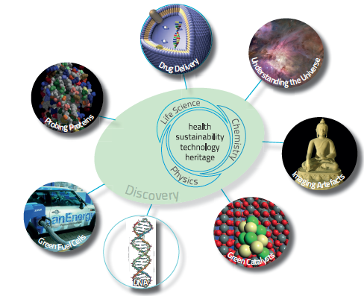
Scientific challenges
Solid State Physics
Dynamics of superlattices, wires and dots, molecular magnets, quantum phase transitions
Liquids and Glasses
Solvent structures, influence of molecular structures on protein folding
Fundamental Physics
Left and right handedness of the universe, neutron decay, ultracold neutrons
Soft Condensed Matter
Time resolution, molecular rheology, structures and dynamics
Biology and Biotechnology
Hydrogen and water , membranes, biosensors, functions
Materials Science and Engineering
Real time investigations with realistic dimensions under real conditions
Chemical Structure, Kinetics and Dynamics
Thin films, pharmaceuticals, supramolecules - structures and functionality
Earth and Environmental Science, Cultural Heritage
Extreme temperatures and pressures simulating the mantle

Slide 18
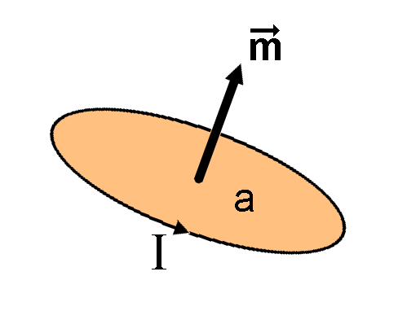
Why neutrons as a probe ?
Electrically neutral – neutrons are non-destructive and can penetrate deep into matter. This makes them an ideal probe for biological materials and samples under extreme conditions of pressure, temperature, magnetic field or within chemical reaction vessels.
Microscopically magnetic – they possess a magnetic dipole moment which makes them sensitive to magnetic fields generated by unpaired electrons in materials. Precise information on the magnetic behavior of materials at atomic level can be collected. In addition, the scattering power of a neutron off an atomic nucleus depends on the orientation of the neutron and the spin of the atomic nuclei in a sample. This makes the neutron a powerful instrument for detecting the nuclear spin order.
Ångstrom wavelengths – neutron wavelengths range from 0.1 Å to 1000 Å, making them an ideal probe of atomic and molecular structures, be they single atomic species or complex biopolymers.

Slide 19
Why neutrons as a probe ?
Energies of millielectronvolts – their energies are of the same magnitude as the diffusive motion in solids and liquids, the coherent waves in single crystals (phonons and magnons), and the vibrational modes in molecules. It is easy to detect any exchange of energy between a sample of between 1microeV (even 1 neV with spin-echo) and 1eV and an incoming neutron.
Randomly sensitive – with neutrons the variation in scattering power from one nucleus to another within a sample varies in a quasi-random manner. This means that lighter atoms are visible despite the presence of heavier atoms, and neighboring atoms may be distinguished from each other. In addition, contrast can be varied in certain samples using isotopic substitution (for example D for H, or one nickel isotope for another); specific structural features can thus be highlighted. The neutron is particularly sensitive to hydrogen atoms; it is therefore a powerful probe of hydrogen storage materials, organic molecular materials, and biomolecular samples or polymers.

Slide 20
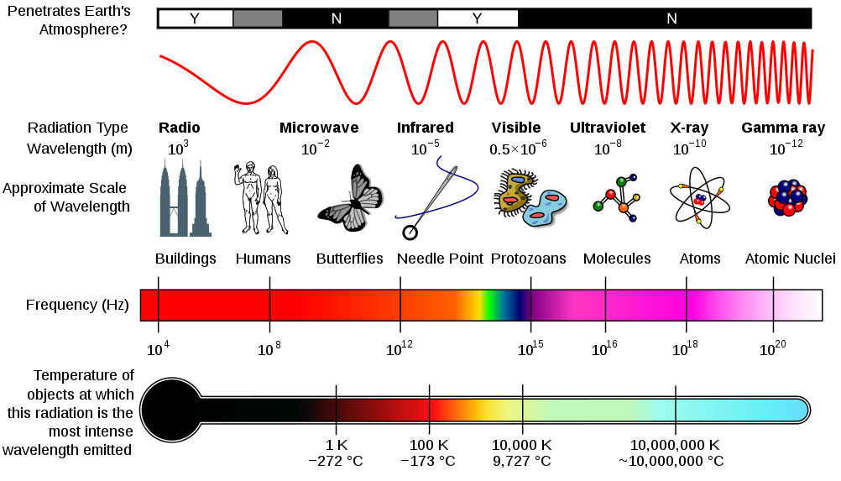
Electro-magnetic Spectrum & Neutron Microscope
Boltzmann distribution
De Broglie

Slide 21
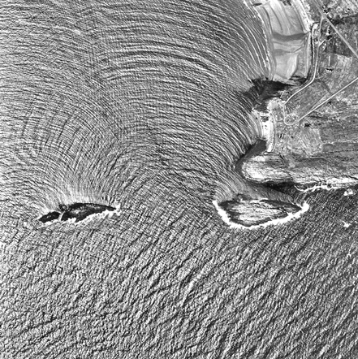
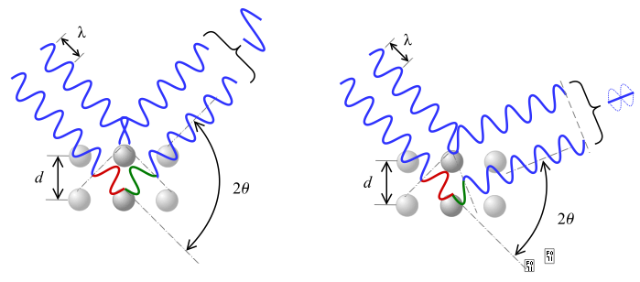
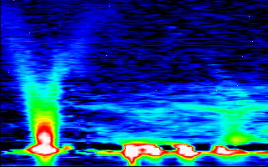
Why neutrons as a probe ?
In half a century, neutron scattering science has developed enormously with an effective gain in source performance of only a factor of 4 !
Cliff Shull
1 - 10 Ångström
Diffractometers - Measure structures
– Where atoms and molecules are
→ To analyze the structure of a material from the scattering pattern produced when a beam of radiation or interacts with it
Braggs law
Bert Brockhouse
Spectrometers - Measure dynamics
– What atoms and molecules do
1 - 80 meV
→ To measure properties of light over a specific portion of the electromagnetic spectrum
Notes:
Scattering
Inelastic scattering

Slide 22
Diffraction - Bragg
Diffraction of X-rays or neutrons by polycrystalline samples is one of the most important, powerful and widely used analytical techniques available to materials scientists. For most crystalline substances of technological importance, the bulk properties of a powder
or a polycrystalline solid, averaged throughout the sample, are required; in general a single-crystal data, even if they can be obtained, are usually of little interest except for determination of the crystal structure or for studying some other fundamental physical property. By J Ian Langford and Daniel Louer
X-rays interact with the atoms in a crystal.
According to the 2θ deviation, the phase shift causes constructive (left figure) or destructive (right figure) interferences.

Slide 23
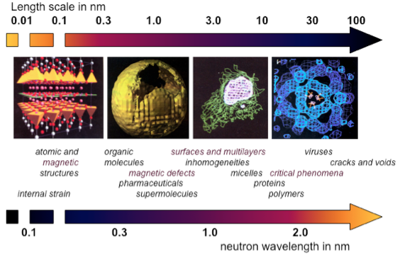
Neutron Microscope – Length scales
Notes:
Length – diffraction

Slide 24
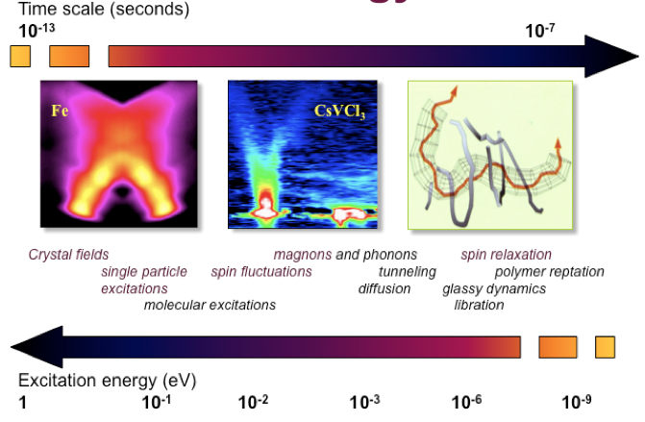
Neutron Microscope – Time & energy scales
Notes:
Energy - spectrometry

Slide 25
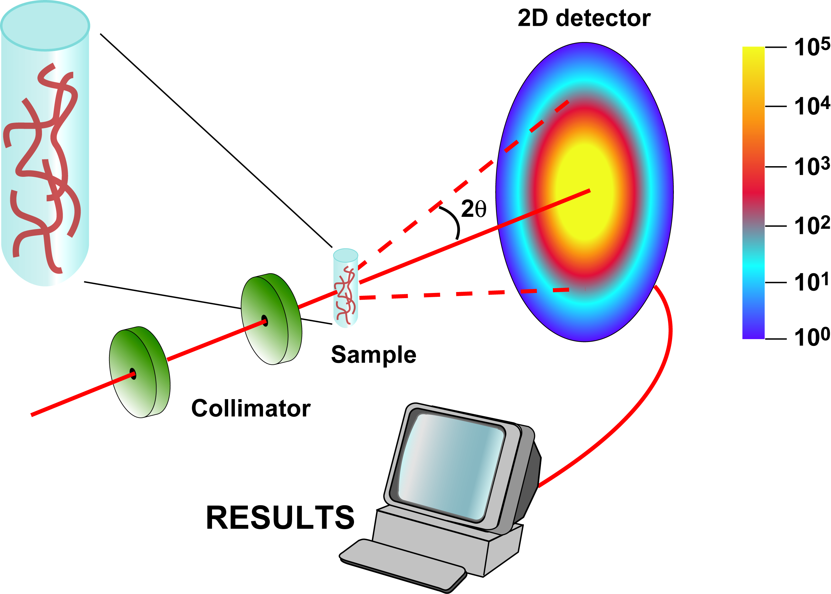
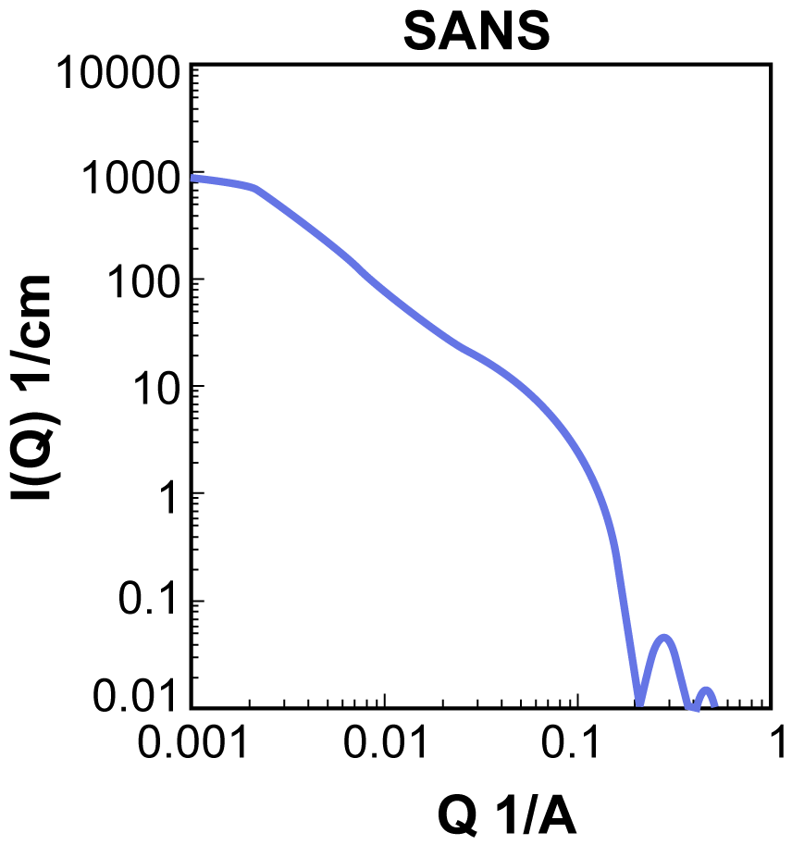
Example : Experimental Setup
Measures structures at length scales from 1 nm to 100 nm
Beam:
Neutron (SANS)
or X-ray (SAXS)
De Broglie
Bragg
Time-of-Flight:
Q_{min}≈0.03°, Q_{max}≈3°
In a standard crystallography experiment, theta_max is typically 45 degrees
Notes:
In a standard crystallography experiment, theta_max is typically 45 degrees

Slide 26
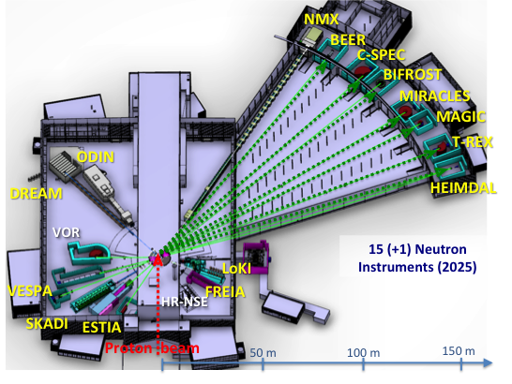
Instruments
Defined scope for 15 instruments and developed a realistic schedule ensuring early science success in line with available in-kind resources and partner capabilities
Council agreed in December 2016 to proceed with 13 more instruments (two already approved)
Also defined which instruments are expected to be operational first

Slide 27
The 15 NSS Project Instruments All are funded to be world leading in 2023
Instrument Class | Instrument | Costbook Value (M€) | Performance targets (@ 2MW)
Large Scale Structures | LOKI (Broad band SANS) | 12.19 | 5 x D22 & 20 x SANS2D
 | SKADI (General Purpose SANS) (+SONDE funds) | 11.50 | 4 x D22
 | ESTIA (Focusing Reflectometer) | 11.80 | Conventional mode: ~ 100 x D17 High intensity mode: 1cm² samples = seconds
 | FREIA (Liquids Reflectometer) | 13.2 | 30 x FIGARO, INTER
Diffraction | DREAM (Bispectral powder diffractometer) | 13.66 | > 10 x POWGEN or WISH
 | HEIMDAL (Hybrid diffractometer) | 13.55 | ~ 50 x GEM, ~ 8 x new POLARIS
 | MAGIC (magnetism single crystal diffractometer) | 13.10 | Cold: > 100 x worlds best, Thermal: 1mm³ crystals = 10 min
 | NMX (Macromolecular crystallography) | 11.67 | > 10 x LADI & Biodiff
Engineering & Industrial | BEER (Engineering diffractometer) | 14.99 | world leading in strain scanning, unique flexibility
 | ODIN (multi-purpose imaging) | 11.60 | world leading for high resolution, > 10 x best for TOF methods
Spectroscopy | BIFROST (extreme environment spectrometer) | 13.45 | > 10 x THALES & MACS
 | C-SPEC (cold chopper spectrometer) | 16.50 | 100 x IN5 (w RRM)
 | T-REX (bispectral chopper spectrometer) | 16.85 | 3 x 4-SEASONS, 3 x IN5
 | VESPA (vibrational spectroscopy) | 12.0 | 10 x VISION (ΔE = 130 meV)
 | MIRACLES (backscattering spectrometer) | 13.53 | 2 x BASIS and DNA
Total cost book value |  | 199.59

Slide 28
Outline
Science for society and spallation
ESS infrastructure
Instruments
Target
Accelerator

Slide 29
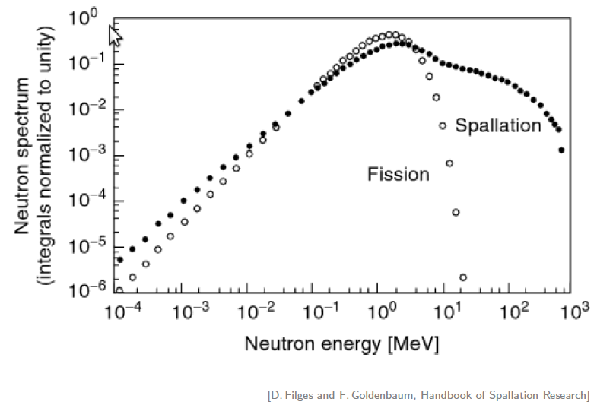
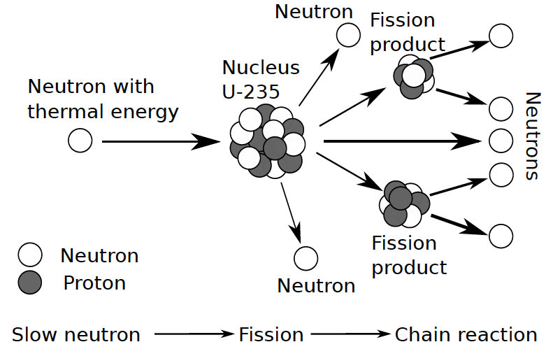
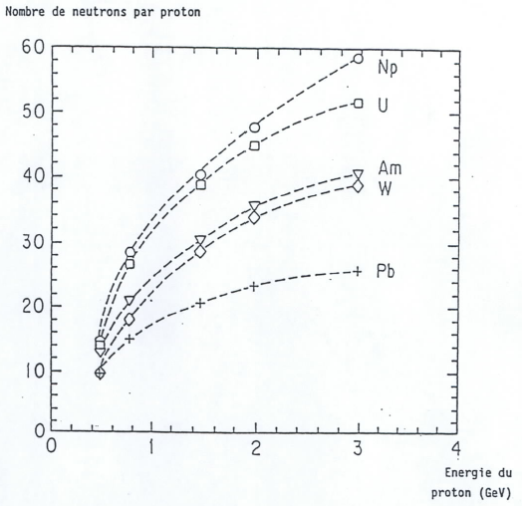
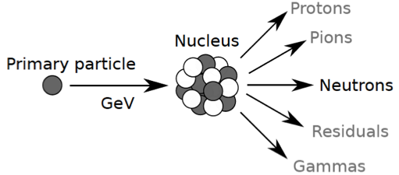
Fission and Spallation
Spallation is a non-elastic nuclear interaction induced by a high-energy particle producing numerous secondary particles
Y(E,A)=0.1 [A+20] [E (GeV) -0.12)] n/p

Slide 30
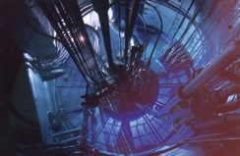
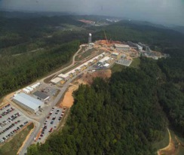
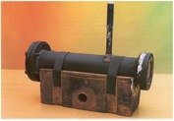
High time average and peak flux
10²⁰
Reactor Sources
Spallation Sources
J-PARC
ESS
HFIR
ILL
LANSCE
ISIS
CSNS
10¹⁵
MTR
HIFAR
MARIA
ORPHEE
IPNS
SALAM
HANARO
SNS
NRX
HFBR
NIST
ZING-P’
Dhruva
CARR
PIK
NRU
SAFARI-1
JRR-3
ETERR-2
FRM-II
OPAL
LVR
RSG
SINQ
IBR-II
HOR
JEEP II
KENS
X-10
WNR
Effective thermal neutron flux n/cm²-s
ZING-P
10¹⁰
CP-2
CP-1
10⁵
Berkeley 37-inch cyclotron
Particle driven pulsed
350 mCi Ra-Be source
Particle steady state
Pulsed reactor
Fission reactors
1
Chadwick
1930
1940
1950
1960
1970
1980
1990
2000
2010
2020
2030
(Updated from Neutron Scattering, K. Skold and D. L. Price, eds., Academic Press, 1986)

Slide 31
Neutron facilities
Reactor sources
Accelerator-driven sources
ESS
Effective thermal neutron flux n/cm²-s
J-PARC
NIST
ILL
LANSCE
ISIS
FRM-II
SNS
CSNS
Year
Notes:
CP-1 Chicago USA
CP-2 Chicago USA
X-10: Oak Ridge, USA
NRX: Chalk River, USA
MTR: Idaho, USA
LVR: Rez, Czech Republic
HIFAR: Sydney Australia
NRU: Chalk River, USA
HOR Delft Netherlands
SAFARI-1 Pretoria South Africa
HFBR: Brookhaven, USA
HFIR: ORNL, Oak Ridge, USA
NIST: National Inst. for Stds and Tech. Gaithersburg, USA
ILL: Grenoble, France
JEEP II Kjeller Norway
MARIA Swierk Poland
ORPHEE LLB Saclay France
Dhruva: Mumbai, India
RSG: serpong, Indonesia
SINQ: PSI, Switzerland
JRR-3: Tokai, Japan
ES-Salam Algiers Algeria
HANARO: Daejon KAERI, South Chorea
ETERR-2 Cairo Egypt
FRM-II: Munich, Germany
OPAL: Sydney, Australia
CARR: Beijing China
PIK: Gatchina, Russia
ZING-P Argonne USA
WNR Los Alamos USA
KENS Tsukuba Japan
IPNS Argonne USA
IBR-II Dubna Russia
LANSCE Los Alamos USA
ISIS Oxfordshire UK
SNS Oak Ridge USA
JPARC Tokai Japan
CSNS Beijing China
ESS Lund Sweden
More reactor sources exist across the world….

Slide 32
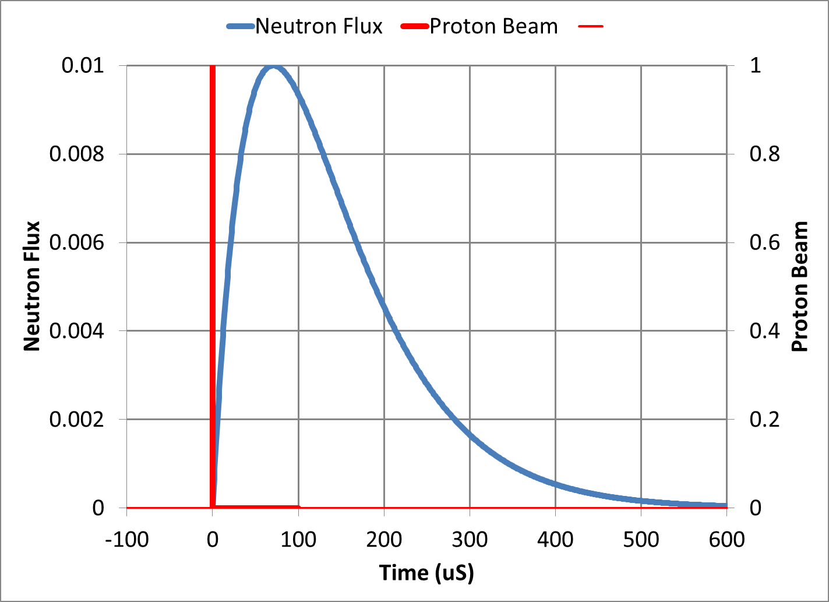
Short Pulse Neutron Spallation Sources
The neutrons are cooled by a moderator downstream of the target.
The time constant of the moderation process is about 100 μs.
Proton beam pulses shorter than 100 μs serve only to stress the metal target and limit the beam power
Typical short pulse spallation sources have storage ring circumferences ~300 meters which produce 1 μs beam pulses
To build a storage ring with a 100 μs pulse would require a ring 30 km in circumference
The target stress from the short beam pulse places a limit on proton beam power
and ultimately neutron flux and brightness

Slide 33
ESS long pulse potential
8
x10¹⁴
ESS 5 MW
2015 design
thermal moderator
λ=1.5 Å
7
Possibilities of pulse shaping
6
5
Brightness (n/cm²/s/ster/Å)
4
ESS 5 MW
2013 design (TDR)
3
2
SNS
1.4 MW
JPARC
300 kW
ISIS TS1
128 kW
ISIS TS2
32 kW
1
ILL 57 MW
0
time (ms)
1
2
3
4

Slide 34
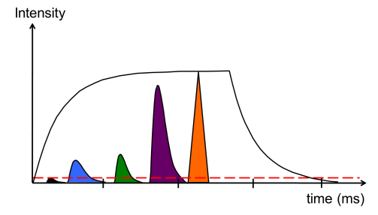
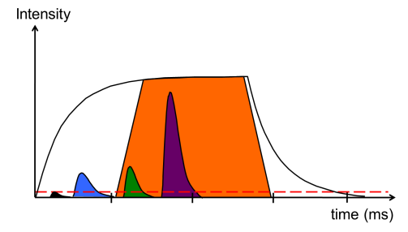
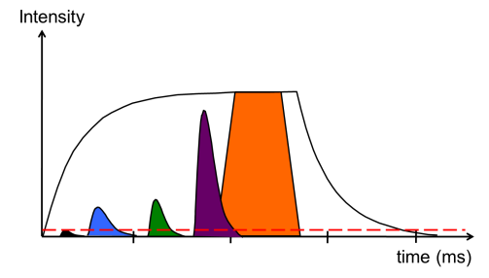
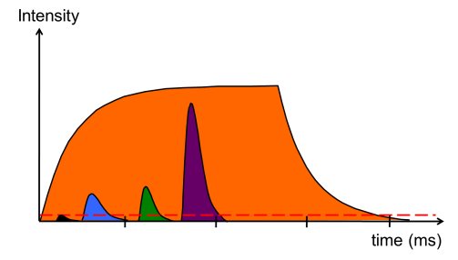
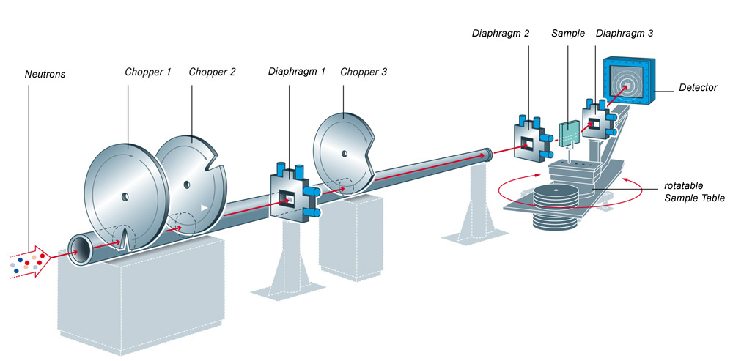
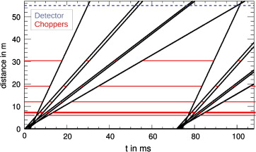
Long Pulse Concept
360 kJ packed into a short pulse of 1 μs
(360 GW peak) would destroy a target
ESS will not use a compressor ring
The linac will send the beam directly to the target over a period of 3 ms at a rate of 14 Hz.
Peak beam power on the target is less than 125 MW
The tradeoff is that ESS will
Have longer neutron guides between experiments and the target
Require a neutron choppers for precision energy measurements

Slide 35
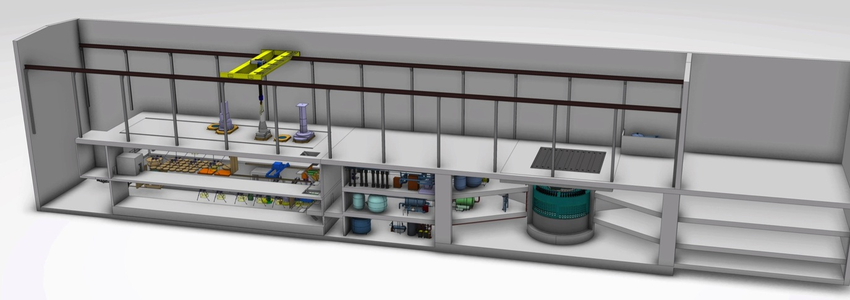
Target Station includes systems that address nuclear hazards
High bay
~ 130 m long
Remote Handling Systems
Target monolith, incl. Moderator & Reflector Systems, and Target Systems
Fluid Systems
Accelerator – Target interface
Remote Handling Systems including hot cells and associated equipment for maintenance and storage of irradiated components
Target Safety System including credited controls to protect public and environment from radioactive hazard
Fluid Systems including He, H₂ and H₂O coolant loops, ventilation, filtering, etc.

Slide 36
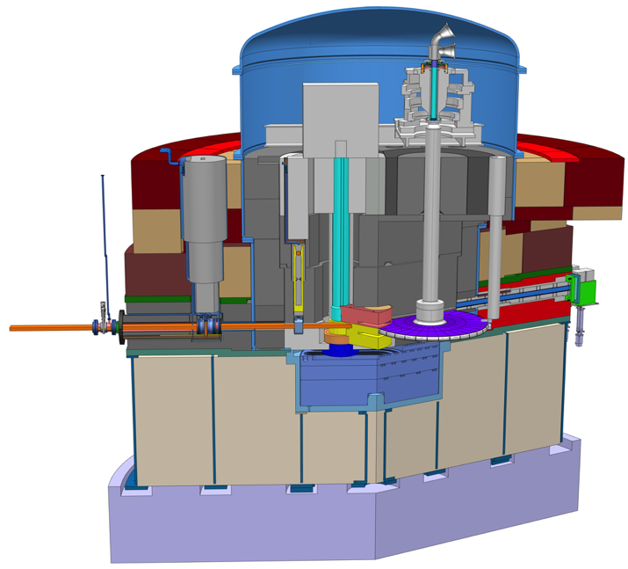
Target station converts protons to “slow” neutrons
Target Monolith
Diameter ~ 11 m; Height ~ 8 m
Mass ~ 7000 tonnes (mainly steel)
The tungsten wheel concept:
The target wheel will measure 2.5 meters in diameter, is estimated to weight 4 tonnes, and is divided into 36 radial sectors
Proton Beam Window
Monolith Vessel
Functions:
Convert protons to usable neutrons
Heat removal
Confinement and shielding
Unique features:
Rotating target
He-cooled W target
High brightness moderators
Moderator & reflector plugs
Target Wheel
Notes:
Explan spallation:
Moderation
Why choice of Solid tungsten
Low radioactive inventory

Slide 37
Outline
Science for society and spallation
ESS infrastructure
Instruments
Target
Accelerator

Slide 38
High power H/D beams around the world
2.86 ms long pulse !
5 MW
Notes:
Goal of spiral 2 ?

Slide 39
High power SRF linacs: NC to SC transition

Slide 40
What is 5 MegaWatts?

Slide 41
Linac redesign to meet ESS cost objective
352.21 MHz
704.42 MHz
2.4 m
4.6 m
3.8 m
39 m
56 m
77 m
179 m
Target
Source
LEBT
RFQ
MEBT
DTL
Spokes
Medium β
High β
HEBT & Contingency
75 keV
3.6 MeV
90 MeV
WP4
216 MeV
571 MeV
2000 MeV
WP5
Beam power (MW) | 5
Beam current (mA) | 62.5
Linac energy (GeV) | 2
Beam pulse length (ms) | 2.86
Repetition rate (Hz) | 14
 | Num. of CMs | Num. of cavities
Spoke | 13 | 26
Medium β (6-cell) | 9 | 36
High β (5-cell) | 21 | 84
[SRF2013 – “The ESS Superconducting Linear Accelerator”, C. Darve, M. Eshraqi, M. Lindroos, D. McGinnis, S. Molloy, P. Bosland and S. Bousson]
Notes:
400 m/ 600 m tunnel = SRF

Slide 42
Front End Section
Ion Source
Microwave Discharge Ion Source
Proton peak current ~75 mA
Total drain current ~100 mA
Output Energy 75 keV
Provided by INFN-LNS, Catania
Experience from TRIPS and VIS ion sources
LEBT (Low Energy Beam Transport)
Dual solenoid layout
Functions:
Transport and match input the RFQ
Clean the beam pulse from the rise/fall time of the source with a slow chopper
Provide different level of beam current with an iris
Provided by INFN-LNS, Catania
Design close to the IFMIF LEBT
Extraction system of the ESS ion source
(Courtesy L. Celona
IFMIF source and LEBT at CEA-Saclay

Slide 43
Front End Section
RFQ
352 MHz 4-vanes RFQ
5 segments of ~90 cm
Functions:
Accelerates
Bunches the pulse in a train of bunches
Focuses in the 3 planes
Provide different level of beam current with an iris
Foreseen transmission > 90 % for 70 mA input beam
Provided by CEA-Saclay
MEBT
Fully instrumented MEBT ~ 4.5 m
Functions:
Transport and match into the DTL
Characterize the beam
Fast chopping of the beam with rise/fall time ~ 10 ns
Provided by ESS-Bilbao
Design exists for ESS RFQ similar to 5 m long IPHI RFQ at Saclay. Energy 75 keV->3.6 MeV.
MEBT layout (Courtesy B. Cheymol)
Design work at ESS Bilbao for MEBT with instrumentation, chopping and collimation.

Slide 44
Front End Section
DTL (Drift Tube Linac)
352 MHz
5 tanks
Length ~ 40 m
Output energy: ~90 MeV
Provided by INFN-LNL, Legnaro
Six klystrons
352 MHz
with a maximum saturated power of 2.8 MW
and a duty factor of 4% are required for the Front End
DTL 3D view (Courtesy P. Mereu)
DTL design work at ESS and in Legnaro, 3.6 ->90 MeV.
Picture from CERN Linac4 DTL.

Slide 45
Super-Conducting Linac
2 Spoke Cavities per Cryomodule
Segmented SRF linac with RT focusing elements
Ti. Helium tank
Cold tuning System
Power coupler
4 Elliptical Cavities per Cryomodule
Notes:
2 spoke – 3 gap
4 cavity – SNS like
Segmented SRF linac with RT focusing elements

Slide 46
Cryomodule Interfaces
Most AD internal Work Packages (beam optics, RF, cryo, vacuum, test stands, electrical, cooling, installation)
External WPs cryomodule, cavity and designers and potential In-Kind collaborators
Control command (Control Box, PLC, LLRF, MPS, EPICS)
Data-logging ICS teams
ESS ES&H
Conventional Facility
ESS system engineer, QA
Survey experts
Transport
Cryogenic distridution
Cryogenic distribution
Control system
Beam Diagnostic
Beam Optics
Previous Linac version for comparison ➔
Beam Vacuum
Radio-Frequency

Slide 47
ESS Requirements and RF Parameters
Spoke cavities
Elliptical cavities
Frequency (MHz) | 352,2
Optimum beta | 0,50
Operating temperature (K) | 2
Nominal Accelerating gradient (MV/m) | 9
Lacc (βopt.x nb gaps x λ/2) (m) | 0,639
Bpk (mT) | 79 (max)
Epk (MV/m) | 39 (max)
Bpk/Eacc (mT/MV/m) | <8,75
Epk/Eacc | <4,38
Beam tube diameter (mm) | 50
RF peak power (kW) | 335
G (Ω) | 130
Max R/Q (W) | 427
Qext | 2,85 10⁵
Q0 at nominal gardient | 1,5 10⁹
 | Medium | High
Geometrical beta | 0.67 | 0.86
Frequency (MHz) | 704.42
Number of cells | 6 | 5
Operating temperature (K) | 2
Epk max (MV/m) | 45 | 45
Nominal Accelerating gradient (MV/m) | 16.7 | 19.9
Q₀ at nominal gradient | > 5e9
Q_{ext} | 7.5 10⁵ | 7.6 10⁵
Iris diameter (mm) | 94 | 120
Cell to cell coupling k (%) | 1.22 | 1.8
p,5p/6 (or 4p/5) mode sep. (MHz) | 0.54 | 1.2
Epk/Eacc | 2.36 | 2.2
Bpk/Eacc (mT/(MV/m)) | 4.79 | 4.3
Maximum. r/Q (W) | 394 | 477
Optimum β | 0.705 | 0.92
G (Ω) | 196.63 | 241
RF peak power (kW) | 1100

Slide 48
SRF Cavities Development
Spoke cavity
Elliptical cavities
→ Stiffeners on the Spoke bars
(vacuum pressure)
→ No HOM power couplers
Hydroformed Ti bellows
(+/- 3mm range)
994 mm
Stiffeners (LFD compensation)
NbTi flange
(w/bore holes for alignment & assembly tool)
+Al hex. gaskets
550 mm
418 mm
Power coupler port
Ti He vessel
Medium beta:
6 cells – beta=0.67
Length 1259,40mm
High beta:
5 cells – beta=0.86
Length 1316,91mm

Slide 49
Spoke cavity Performances (Jan-June 2015)
Spoke cavity exceeding ESS requirements in vertical test on both Eacc and Qo
Eacc_max=15.3 MV/m achieved with “Romea”
Several MP barriers but easily processed.
Qo > 1.6 10¹⁰
Strong FE at max gradient
Limitation is the cooling capacity (unstable conditions, cavity in vertical position)

Slide 50
Elliptical Cavity Preparation
High beta cavity fabrication (Zanon and RI)
Vertical Electropolishing system@ CEA
Study of the tooling in progress @ CEA
Example of the tooling for the assembling of the coupler on the cavity in clean room

Slide 52
Spoke linac (352 MHz) RF System Layout
26 Double Spoke cavities
Power range 280-330 kW
Combination of two tetrodes
Other options:
Solid State Amplifiers
Large power supply (330 kVA) to supply 8 stations (16 tetrodes)

Slide 53
Elliptical (704 MHz) RF System Layout
One cavity per klystron
4 klystrons per modulator
16 klystrons per tunnel penetration
Tunnel

Slide 54
Elliptical (704 MHz) RF System Layout
Klystrons
Racks and Controls
Modulator
WR1150 Distribution
4.5 Cells of 8 klystrons for Medium Beta
10,5 Cells of 8 klystrons (IOTs) for High Beta

Slide 55
EXTRA

Slide 56
Linac Design Choices
The energy of the linac is a tradeoff of
Linac length
Beam current:
Space charge forces
Halo losses
Copper Linac
Low construction costs but high operational costs
Small bore radius < 3 cm
Long linac > 750 meters for 2 GeV
Superconducting Linac
High construction costs but low operational costs
Large bore radius > 7 cm
Short Linac < 360 meters for 2 GeV

Slide 57
Why neutrons as a probe ?
Wave Particle Magnetic moment Neutral
Particle beam (neutral subatomic particle)
Interactions with the nuclei and the magnetic moment of unpaired electrons (in the sample)
Scattered by all elements, also the light ones like the hydrogen isotopes
Deep penetration depth (bulk studies of samples)
Less intense beam measuring larger samples
1.675×10⁻²⁷ kg
Neutron properties:

Slide 58
Inelastic Scattering of plane wave
σ_{tot}=number of neutrons scattered in all directions per sec/incident flux
Scattered spherical wave: –b exp(ikr)/b
Simple spherical object!!
b
k
dΩ
Plane incident wave: exp(ikr)
k’

Slide 59
Diffraction = Coherent Elastic Scattering of plane wave
σ_{tot}=number of neutrons scattered in all directions per sec/incident flux
Scattered spherical wave: –b exp(ikr)/b
Simple spherical object!!
b
k
dΩ
Plane incident wave: exp(ikr)
k’

