Slide 1
An amazing summer with DG
Edgars Karnickis
www.europeanspallationsource.se
1 September, 2017

Slide 2
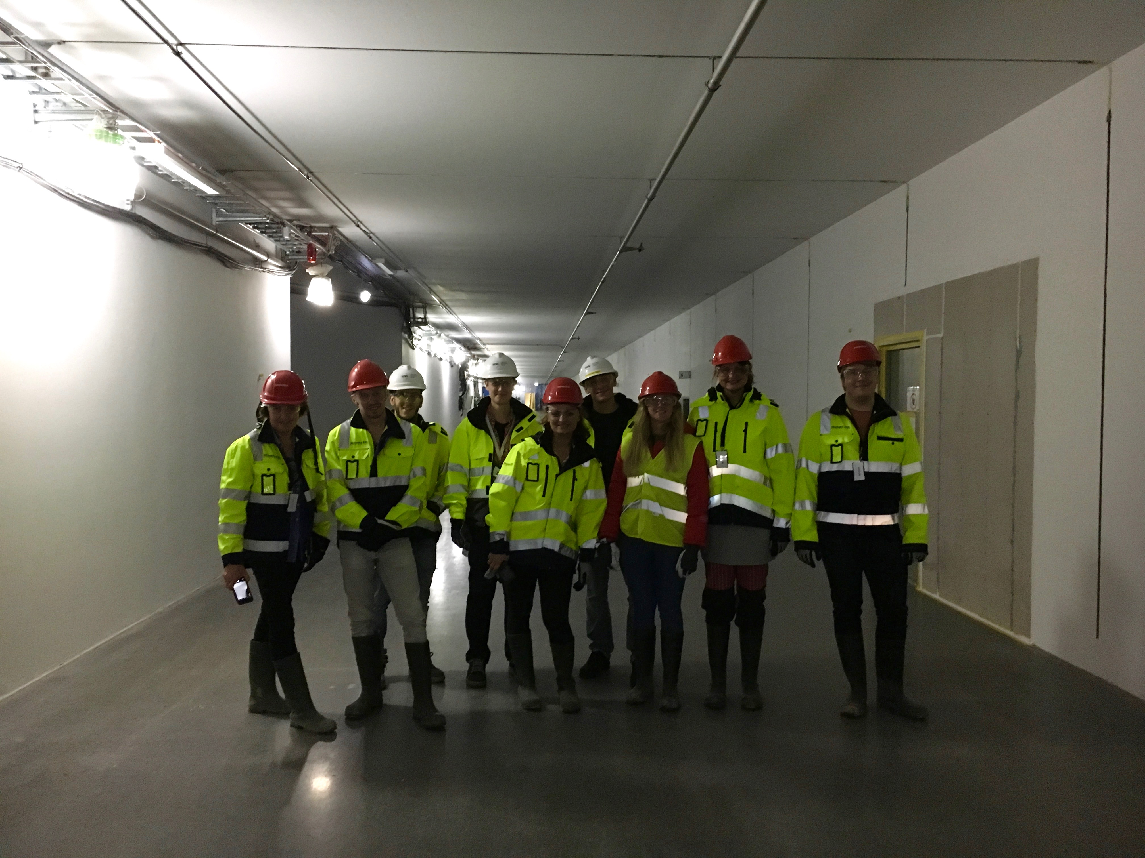
Getting started

Slide 3
Some of Utgård daily tasks
Shelve assembly, fixing shelves
Rearranging scintillator bars
Inventory
Modifying racks
Wiring workstations
Assembling tables

Slide 4
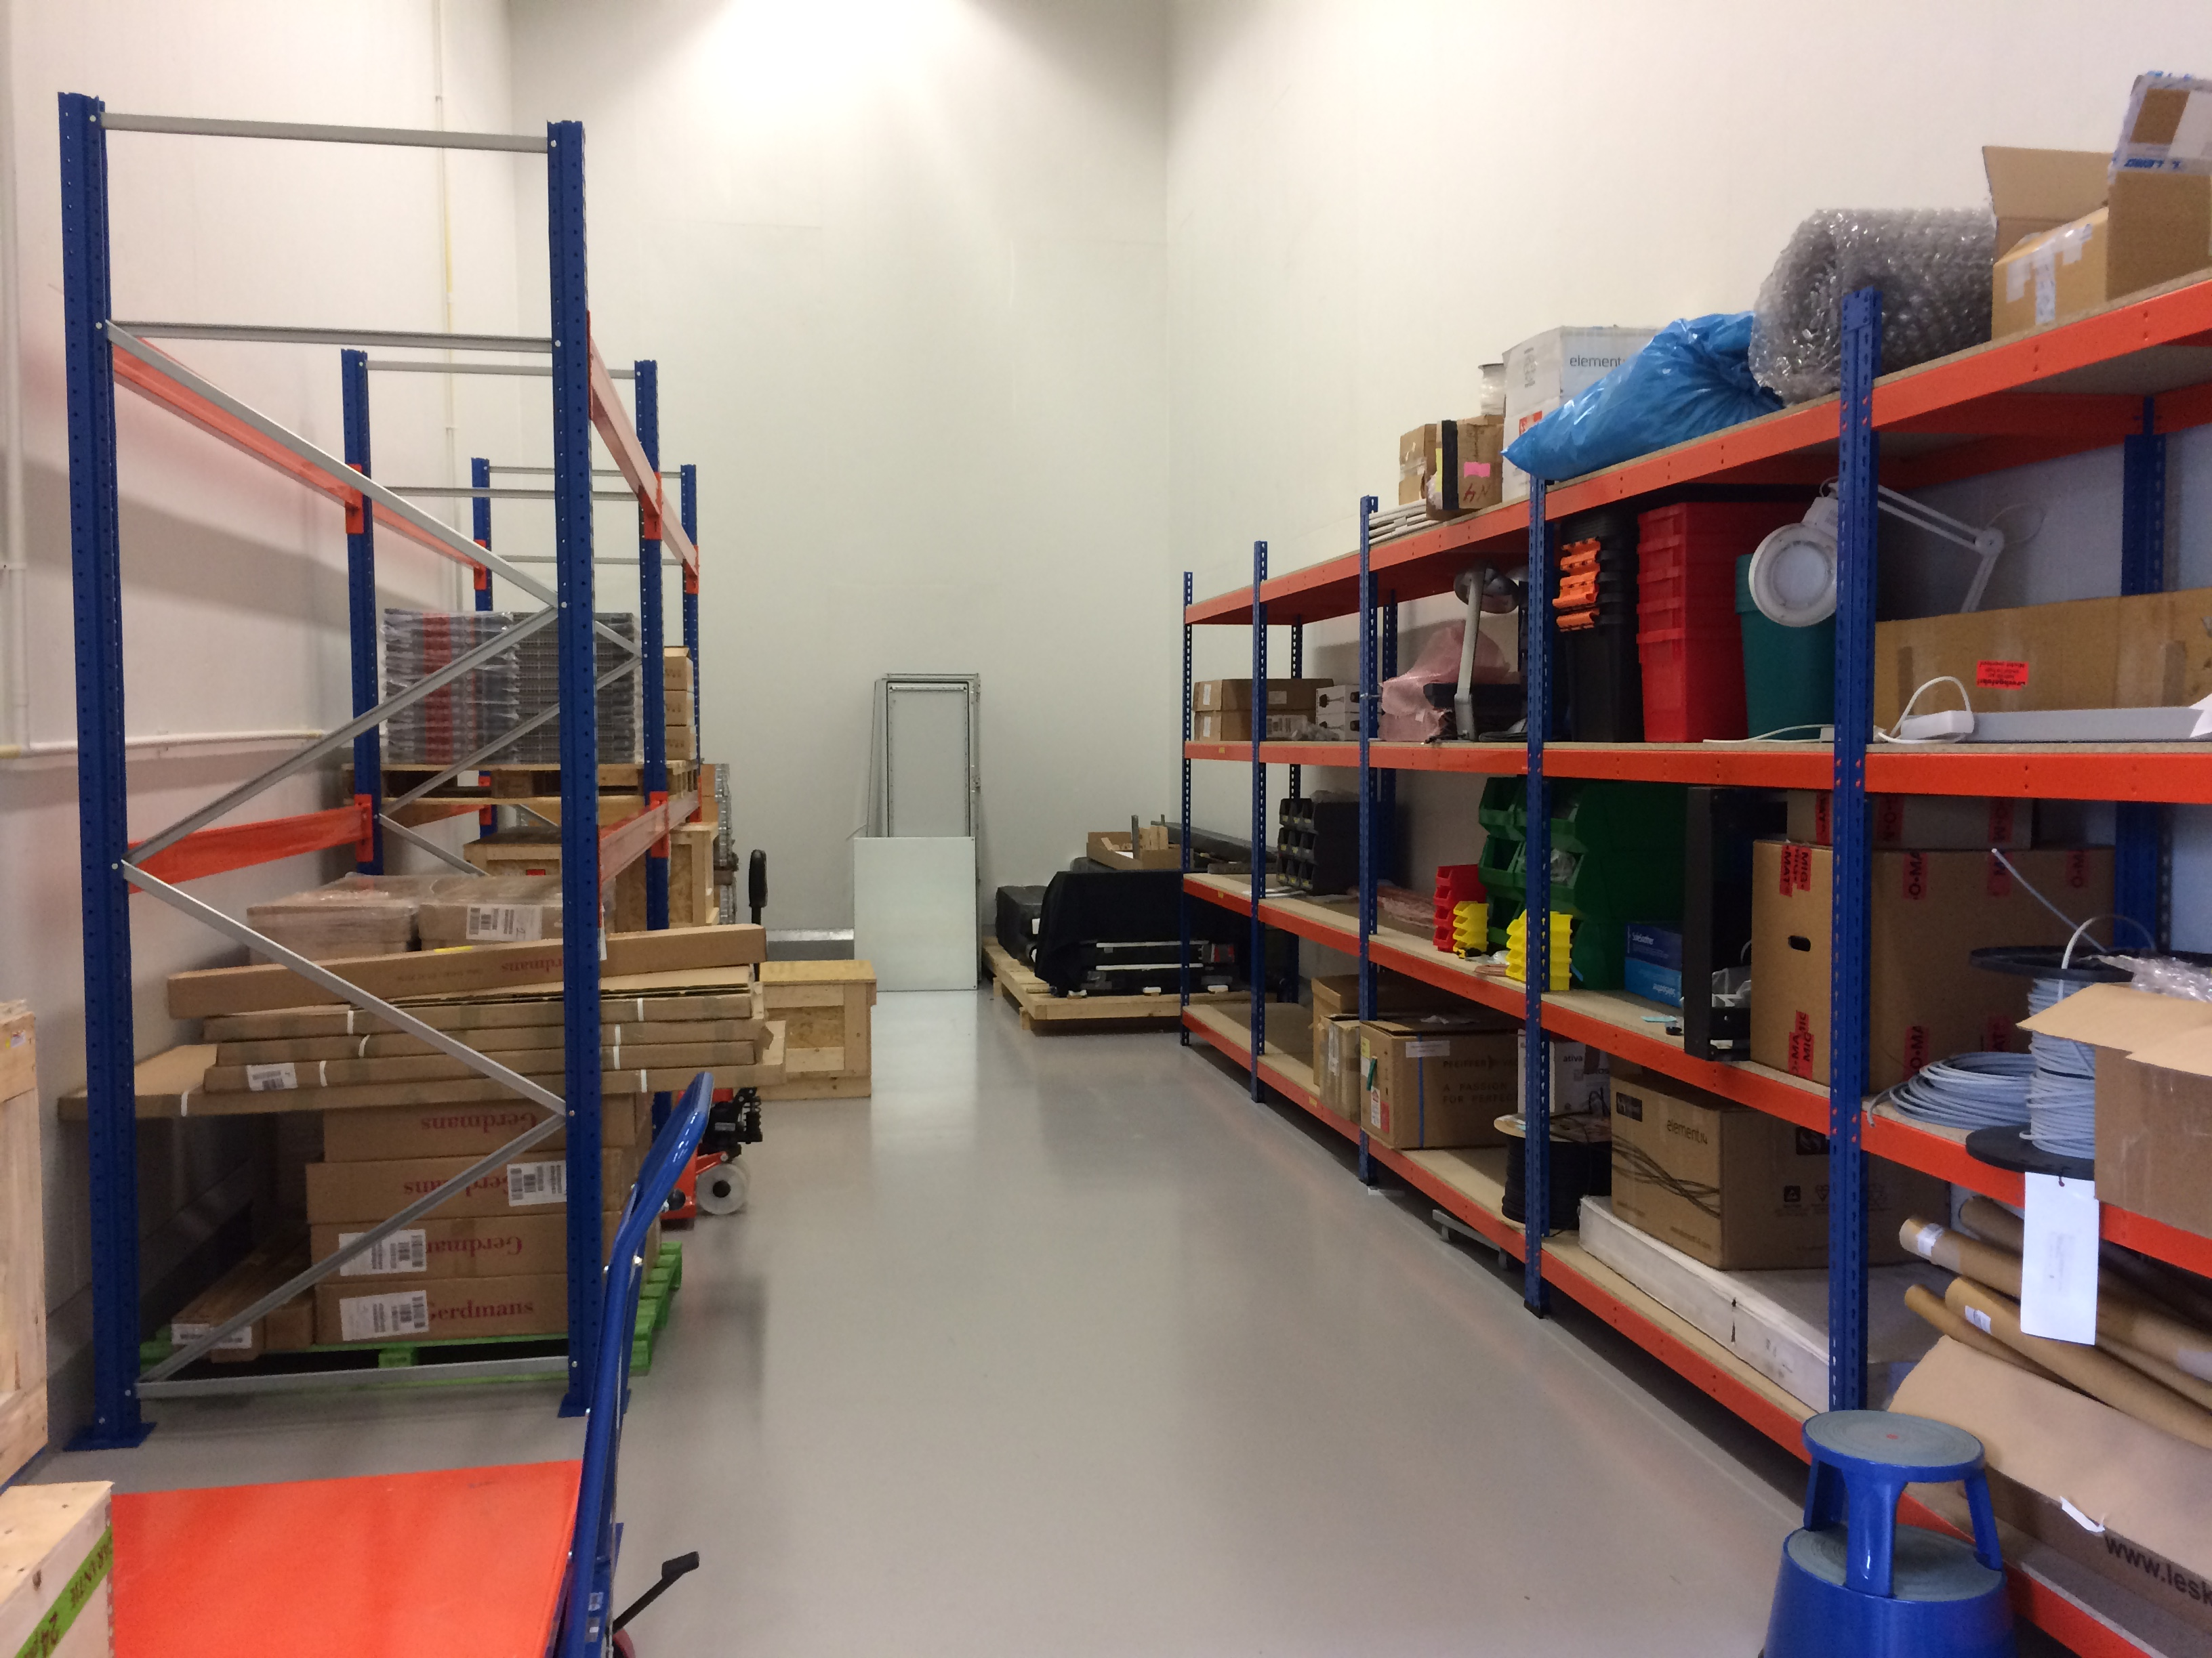
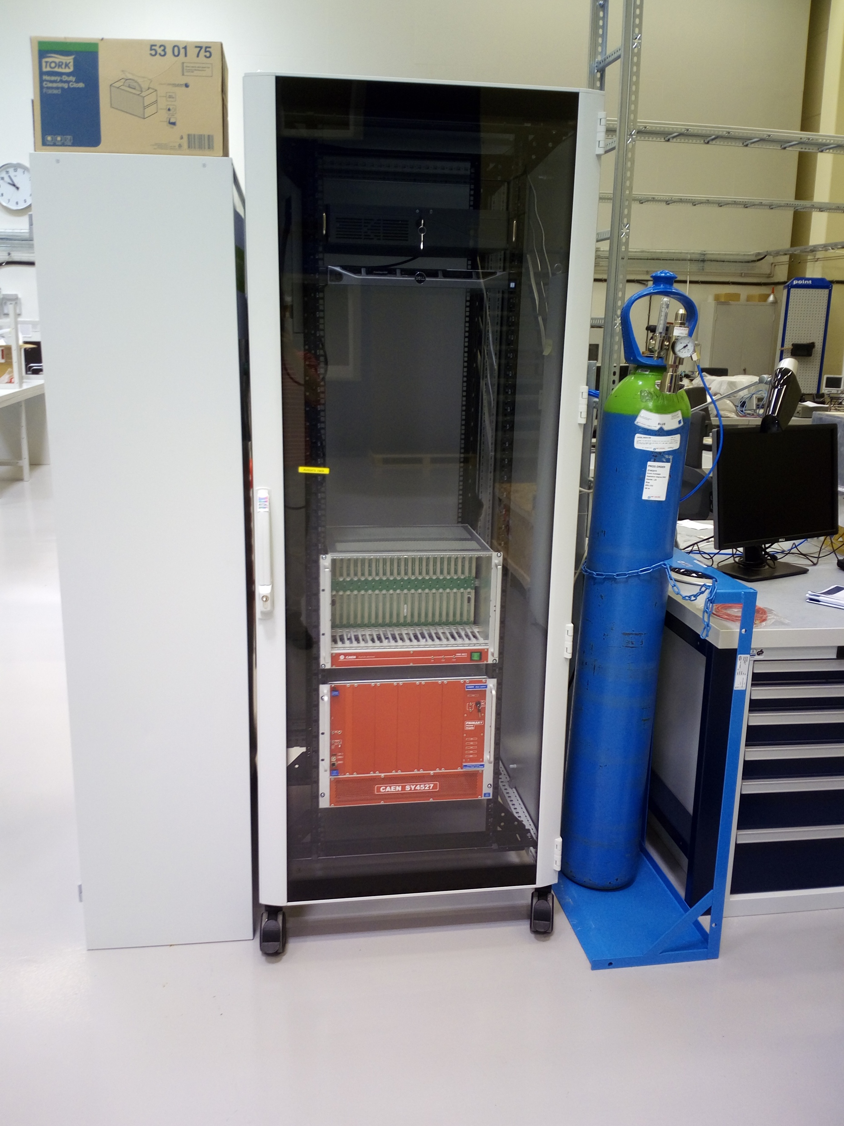
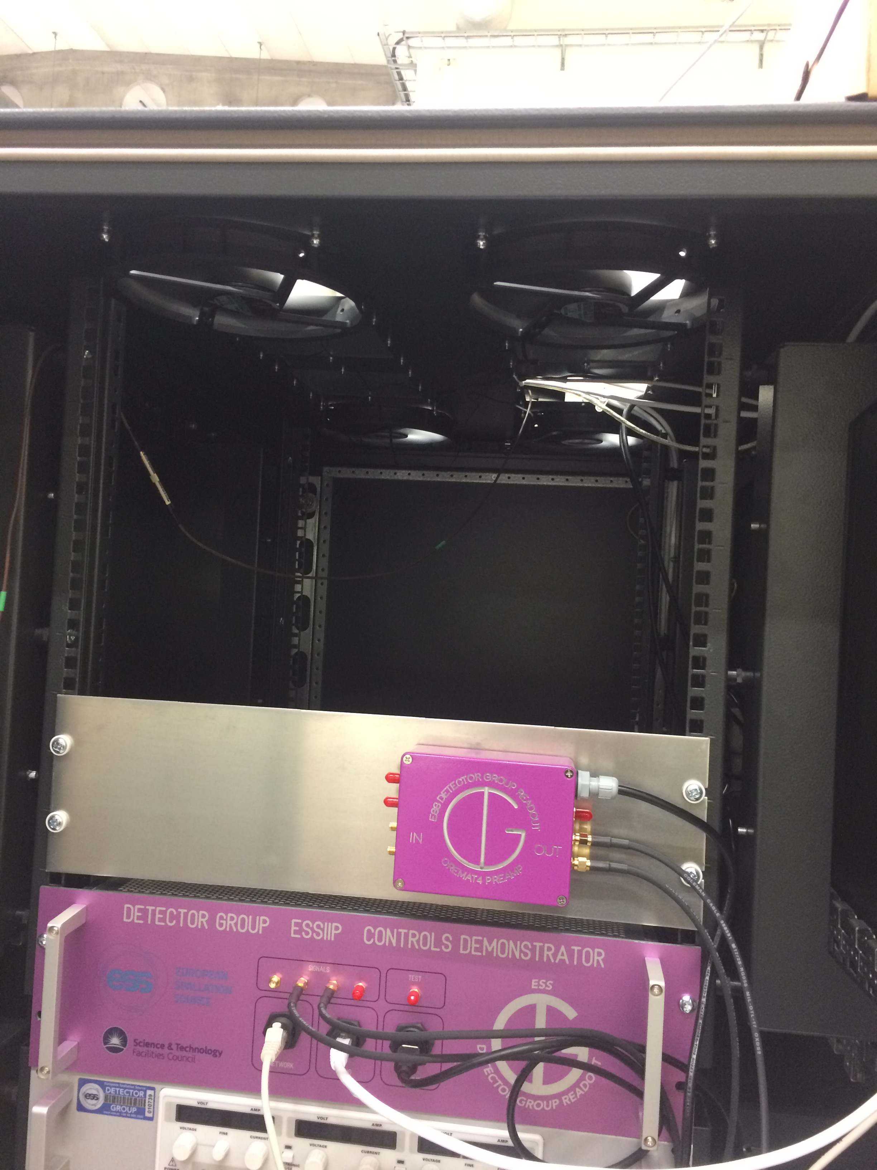
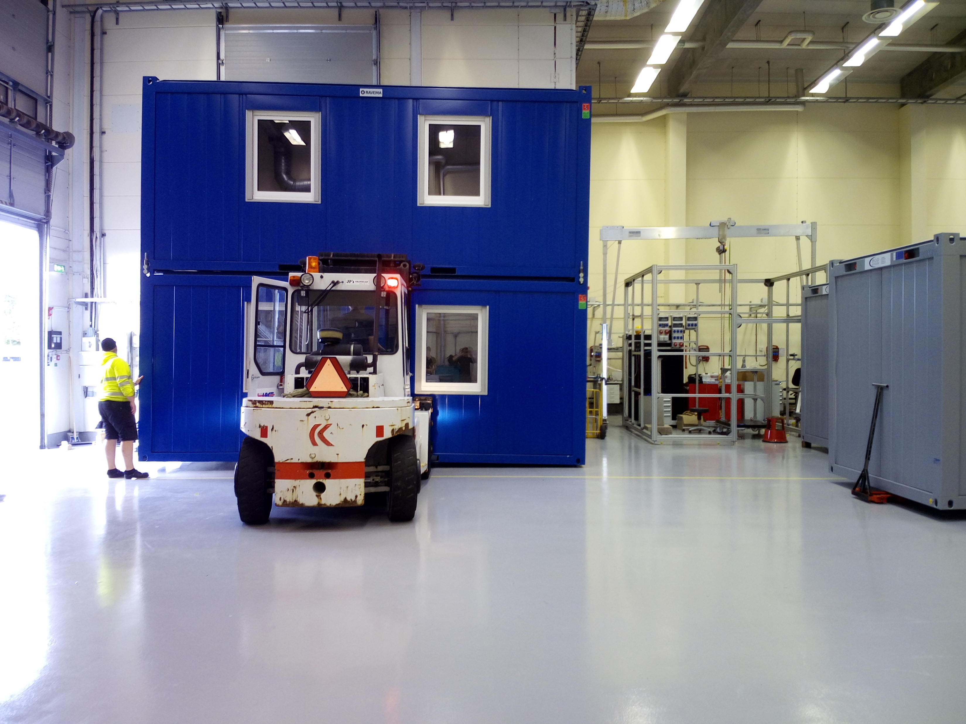

Slide 5
More science related hands on tasks
Wiring for Irina
Assembling a MG detector
Wiring a MG detector with Nicholai
Making grids with Anton and Anders

Slide 6
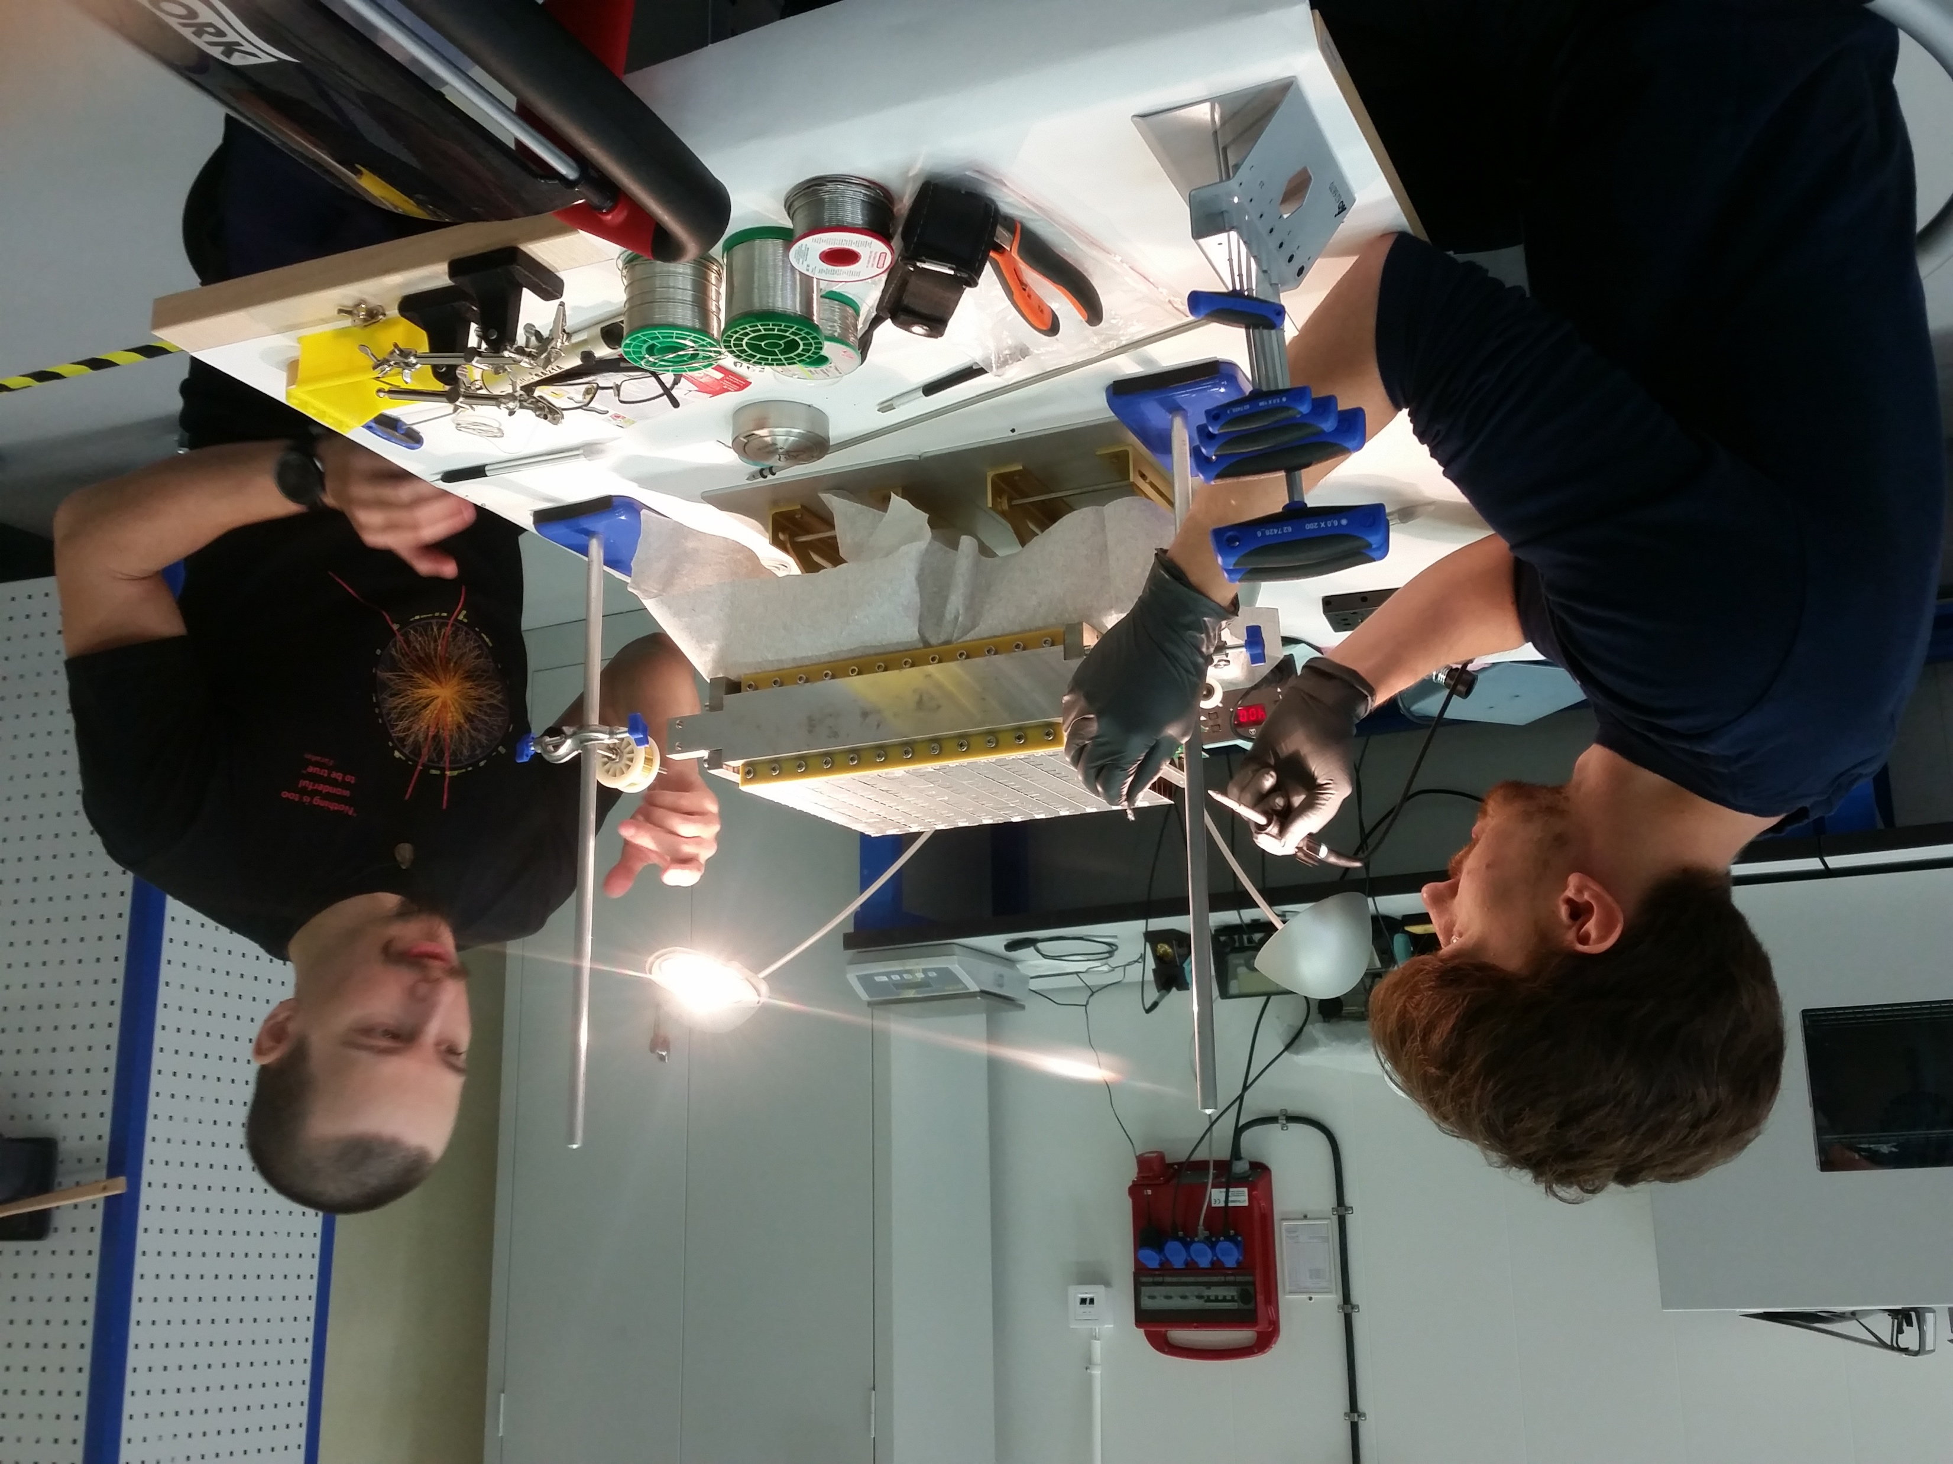
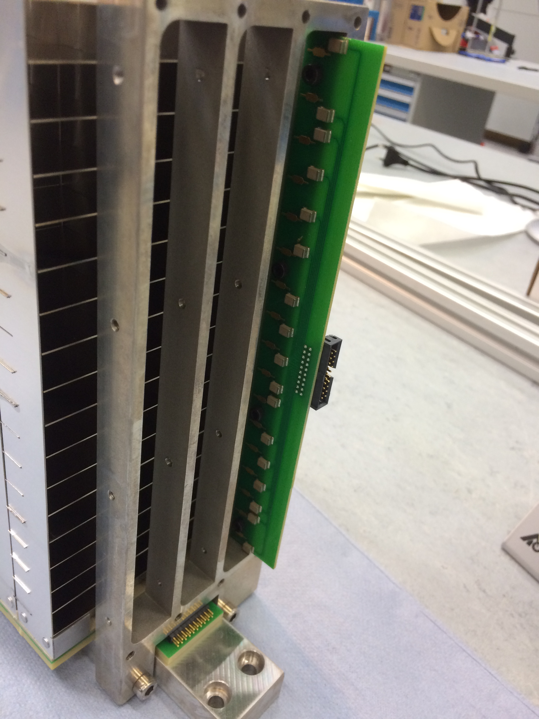
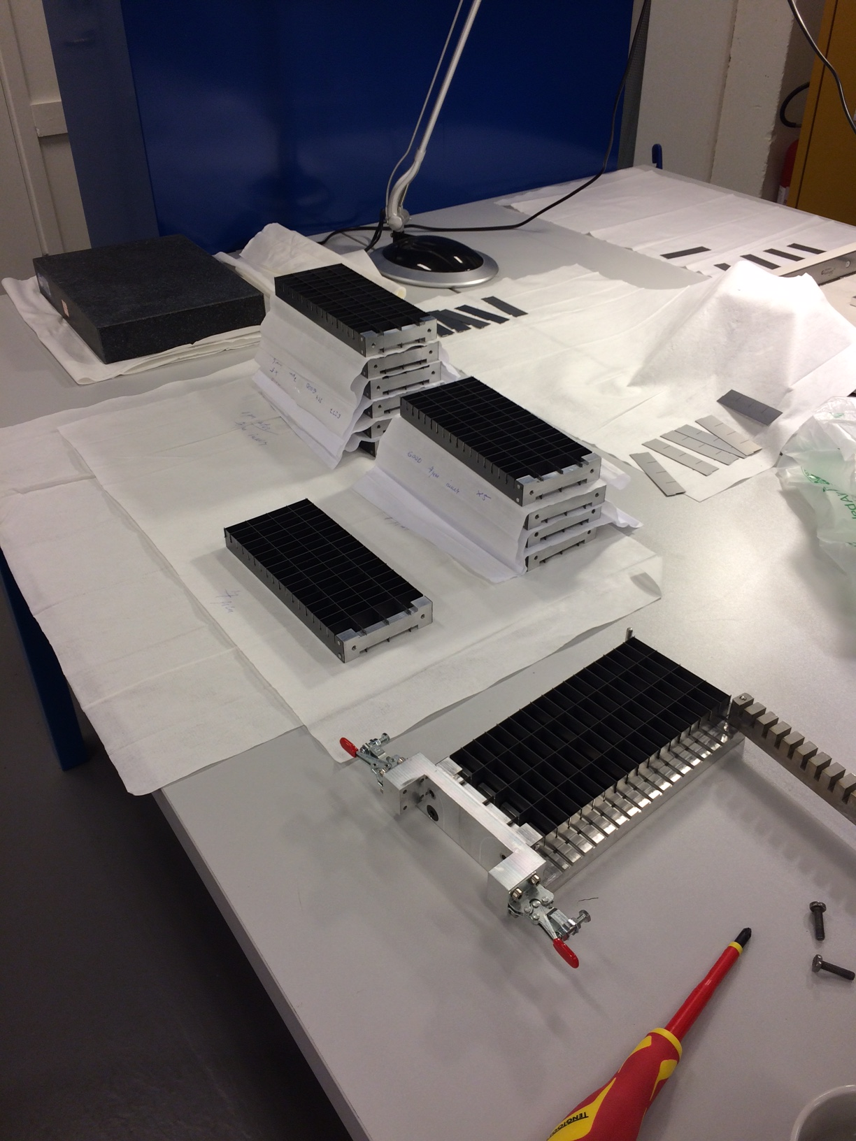
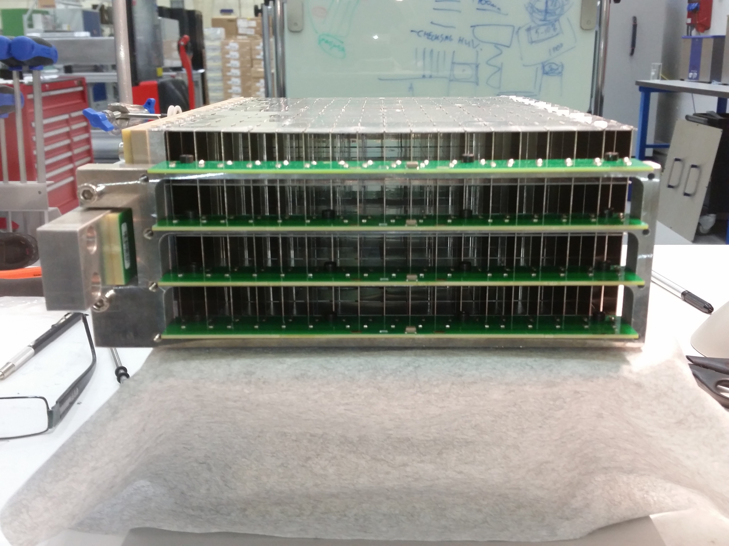

Slide 7
MG data analysis project
Trying out the DMSC code
Making a Python code
Analyzing data

Slide 8
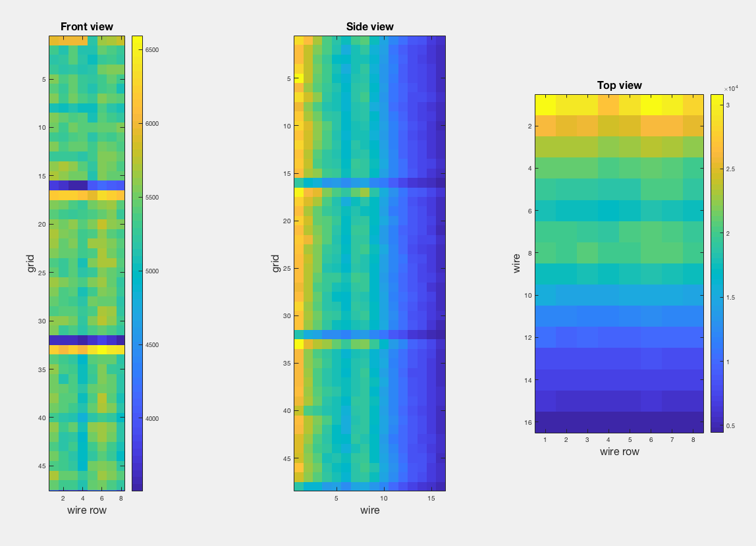
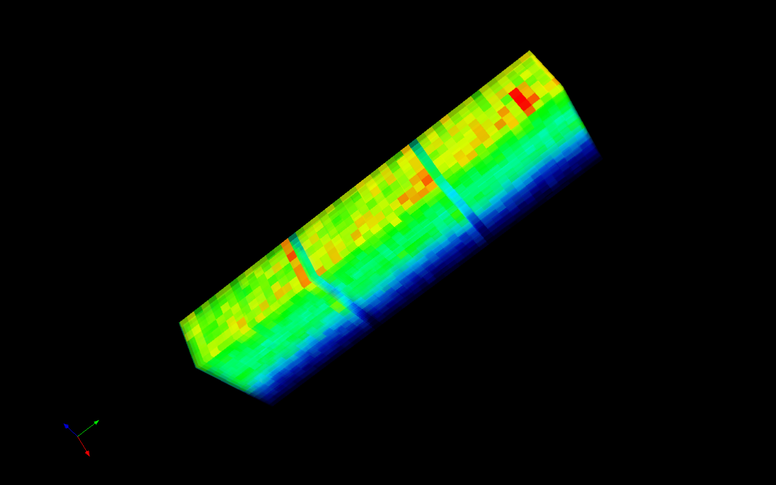

Slide 9
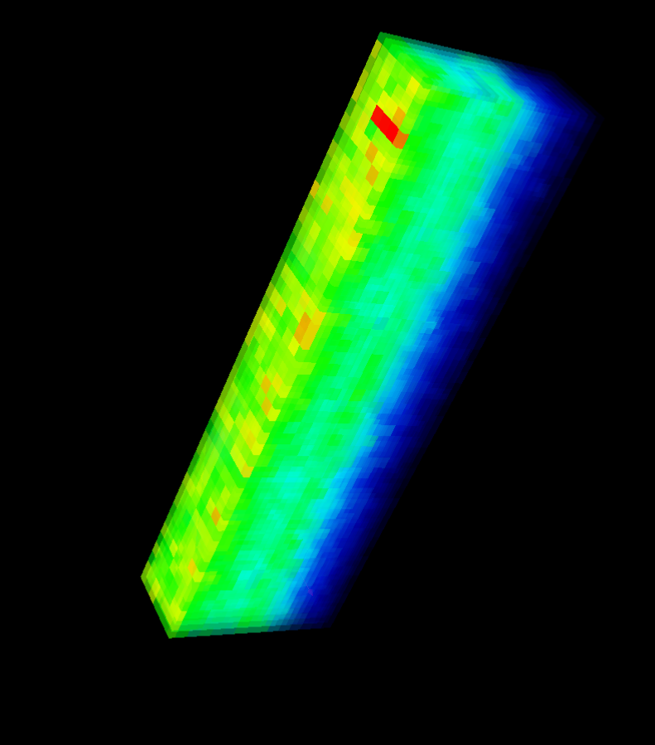

Slide 10
Thank you!
www.europeanspallationsource.se
1 September, 2017

Slide 11
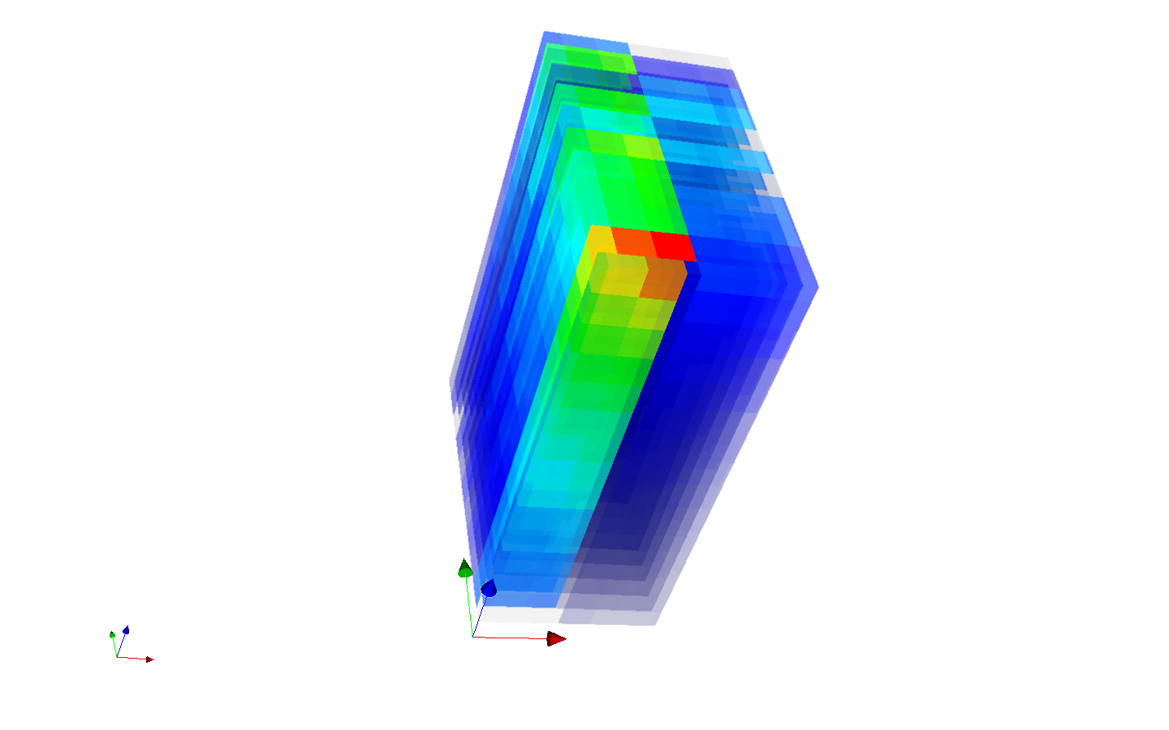

Slide 12
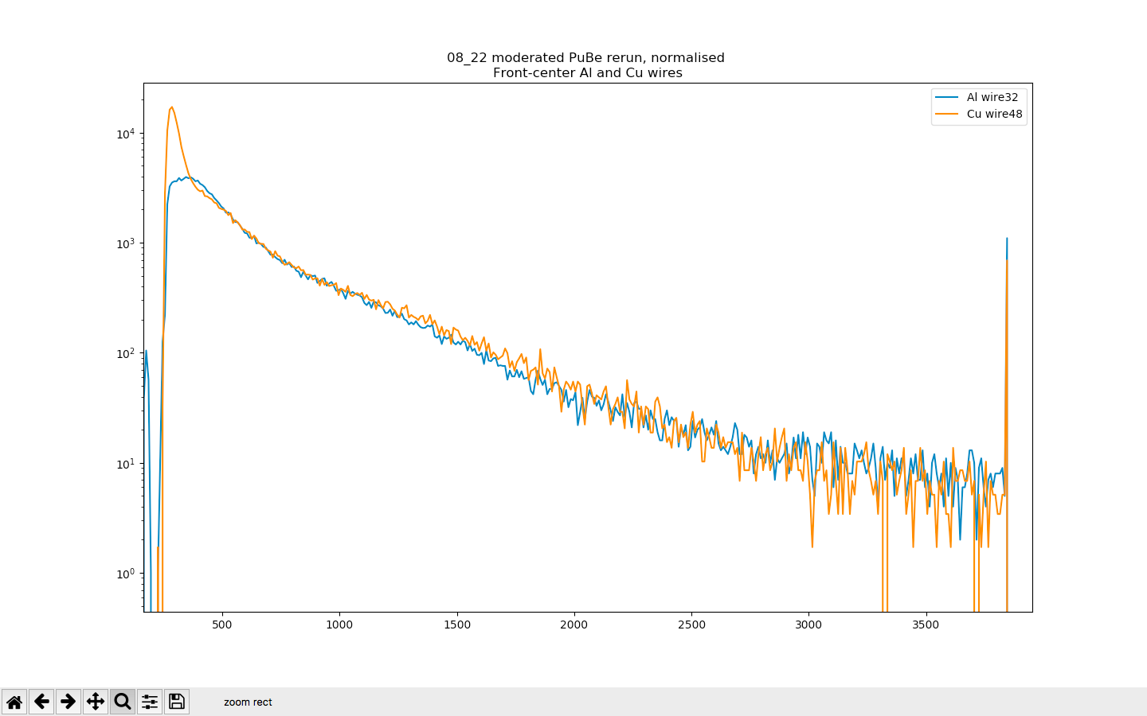

Slide 13
