Slide 1
Monthly meeting Detector Group ESS
Giacomo Mauri

Slide 2
Outlook
Scientific career
Educational backgrond
Internship work
Multi-Blade assembly and testing
What next
Developments of the Multi-Balde project

Slide 3

Educational background
2013- Bachelor degree
Vibration Energy Harvesting
using non linear nano
membranes.
2015- Master degree
Development of a solid state
thermal neutron detector
2015-now- PhD Scienze e Tecnologie per la Fisica e la Geologia
Università degli Studi di Perugia

Slide 4
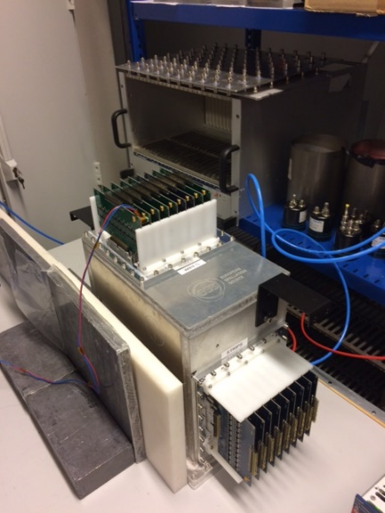
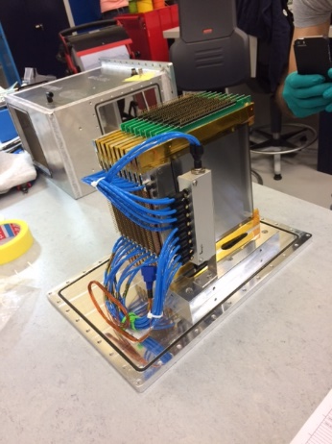
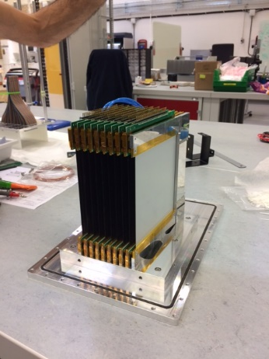
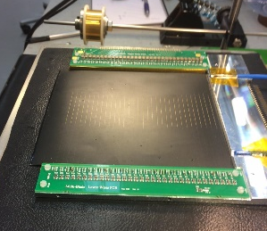
Internship work
MULTI-BLADE ASSEMBLY AND TESTING
DRAFT
Fast neutron sensitivity of neutron detector based on boron-10 converter layer

Slide 5
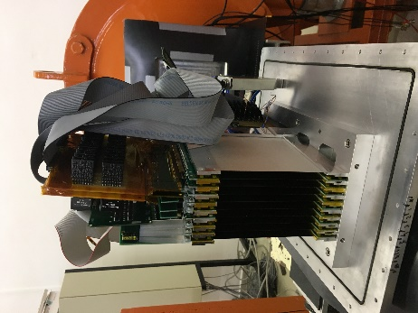
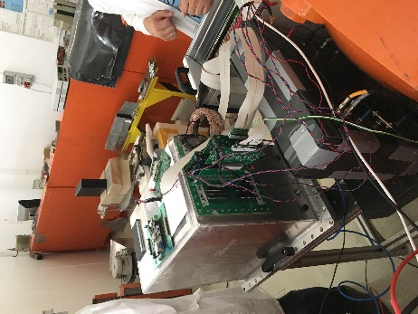
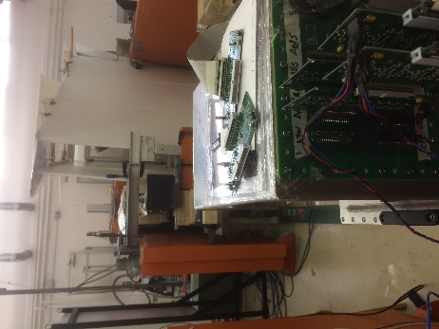
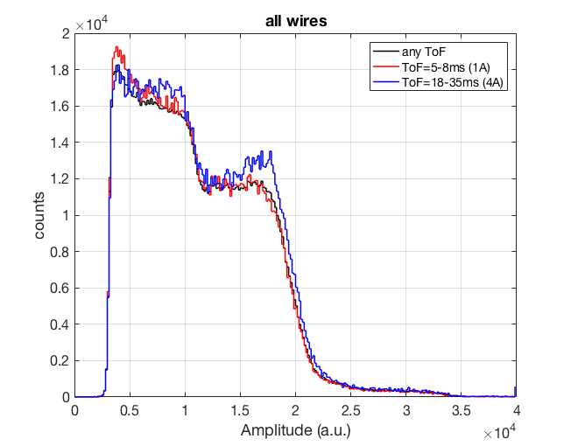
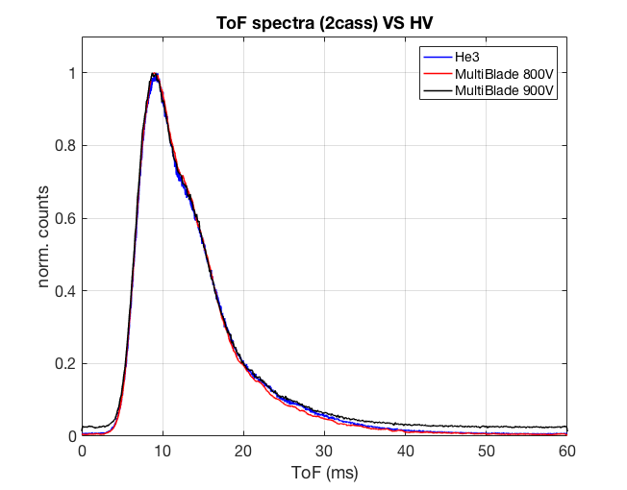
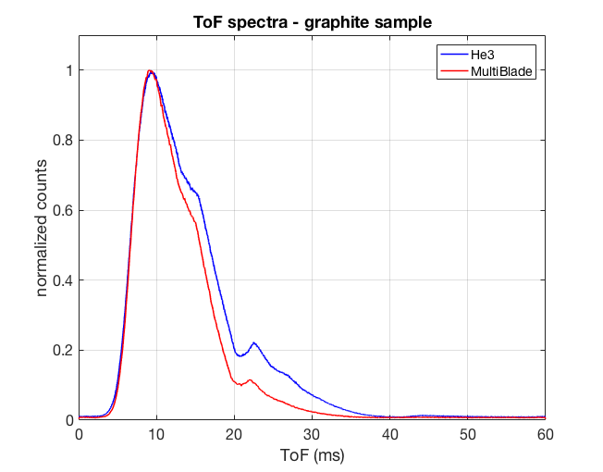
Internship work
BEAM TEST KFKI (Budapest June 2017)
Pulse height Spectrum
ToF Spectrum

Slide 6

What next…
Refining Draft
Test for neutron reflectometry at ISIS
Development of Multi-Blade
PhD thesis

Slide 7
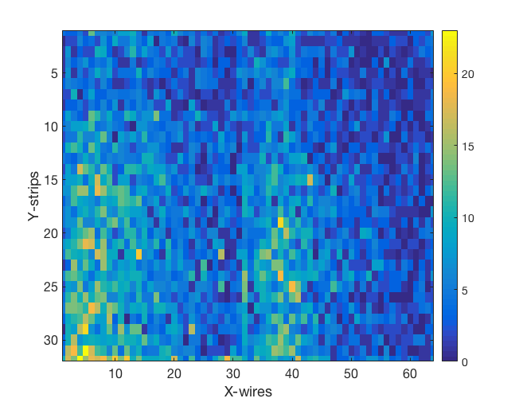
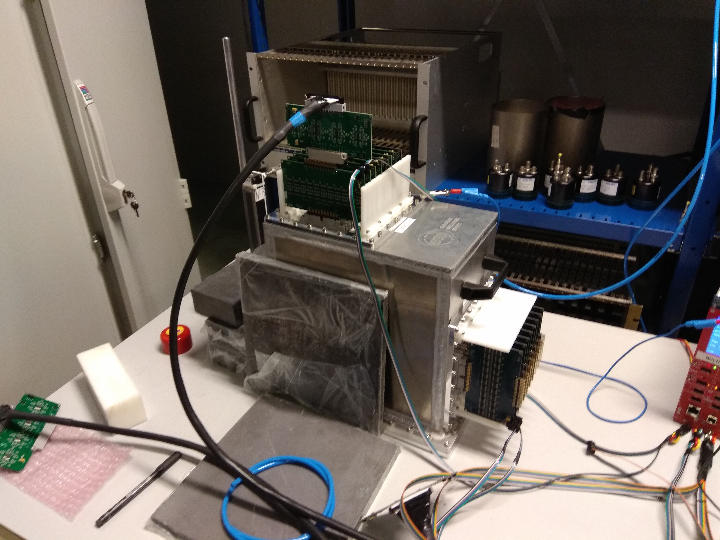
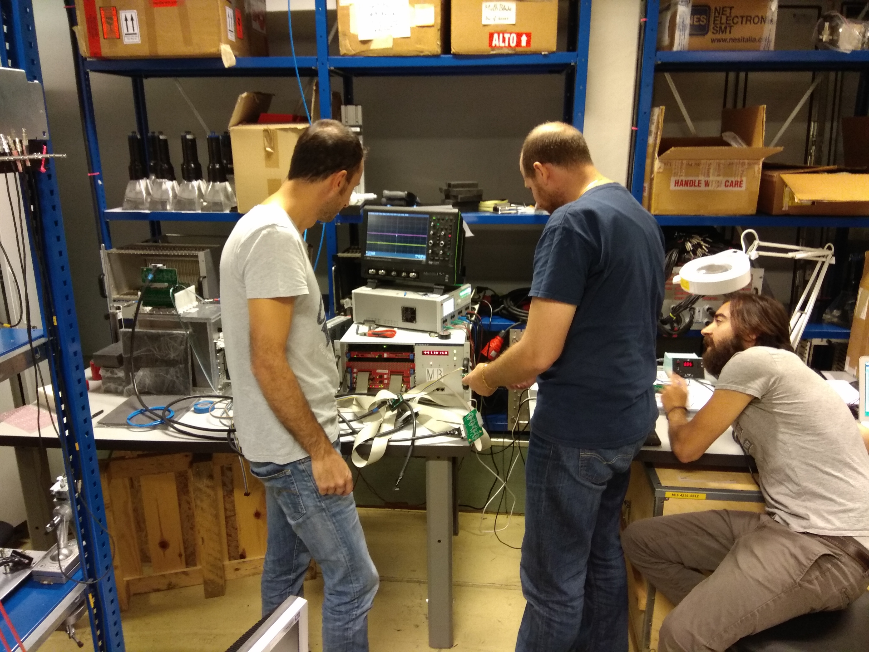
Thank you for attention

