Slide 1
Neutron Scattering Science and the
European Spallation Source
Shane Kennedy
Deputy Director for Science
Neutron Scattering Systems Project Leader
ESS Engineering Lecture: 14th September 2017

Slide 2
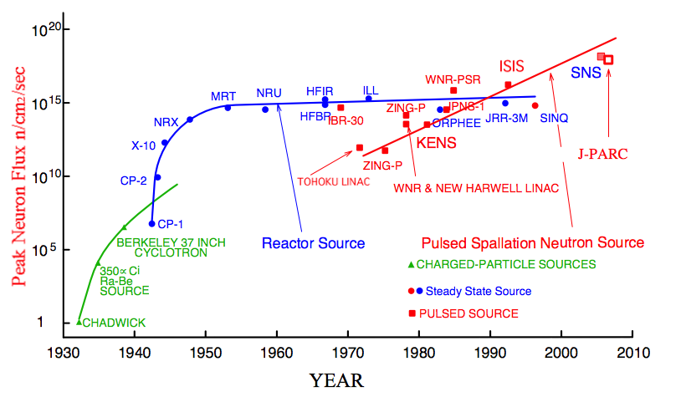
Evolution of Neutron Sources
ESS
SNS
CSNS
FRM-II
CARR
RMB
HIFAR
OPAL
MRR
RA-10
HANARO
Peak Neutron Flux (n/cm²/sec)
2020
2030
Year

Slide 3
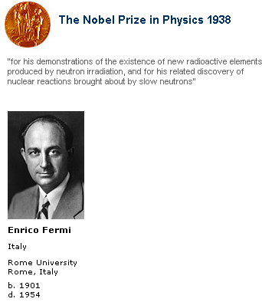
Nobel Prize for discoveries with neutron irradiation

Slide 4
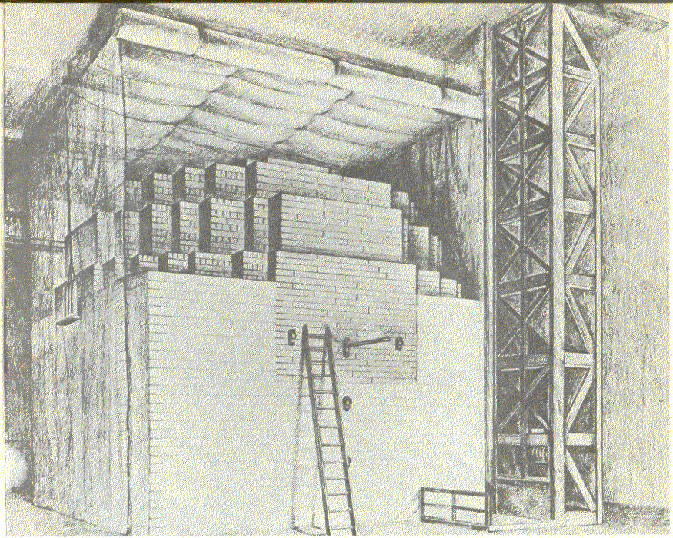
Nobel Prize for discoveries with neutron irradiation
The first nuclear pile (Argonne, 1942)

Slide 5
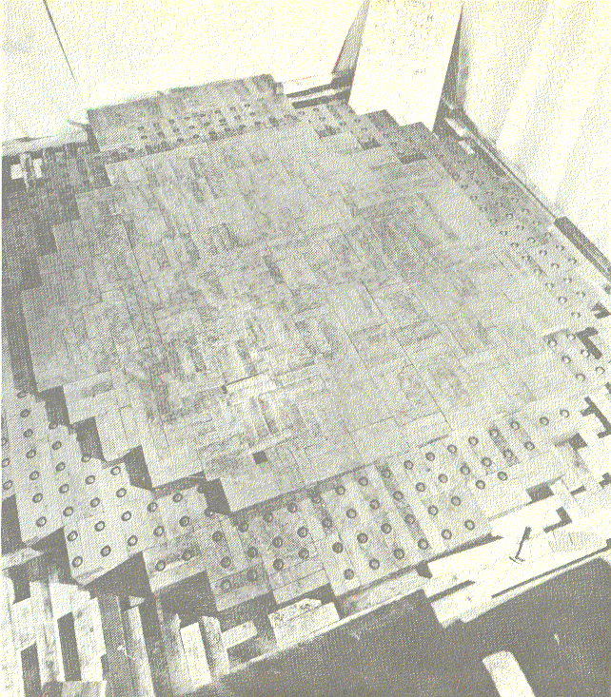
Nobel Prize for discoveries with neutron irradiation
Chicago Pile #1:
Alternating layers of Uranium/graphite (U/C) and pure graphite
Total = 57 layers of U/C
Graphite:
brick size: 4¼” x 4¼” x 16½”
Total graphite = 385 tons
Uranium:
40 tons U₂O₃
+ 6 tons U-metal
Total Uranium = 46 tons
Control Rods:
Cadmium & Boron

Slide 6
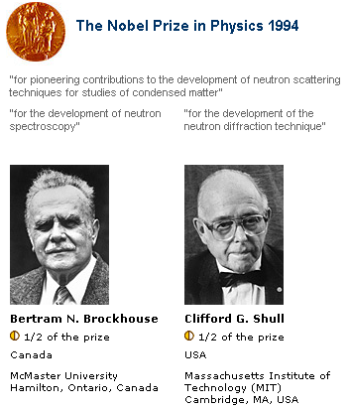
Nobel Prize for Neutron Scattering Science

Slide 7
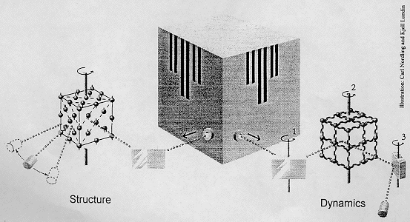
Nobel Prize for Neutron Scattering Science

Slide 8
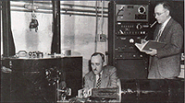
Nobel Prize for Neutron Scattering Science
Cliff Shull and Ernie Wollan doing neutron diffraction in ~1946

Slide 9
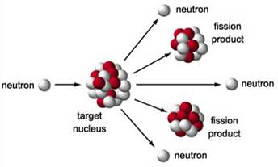
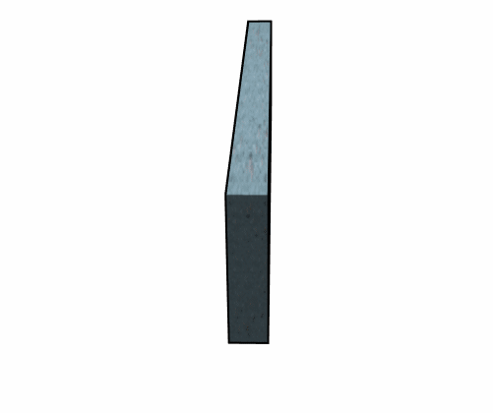
Neutron production (fission, spallation), thermalization and research reactors
The nuclear fission process
The spallation process

Slide 10
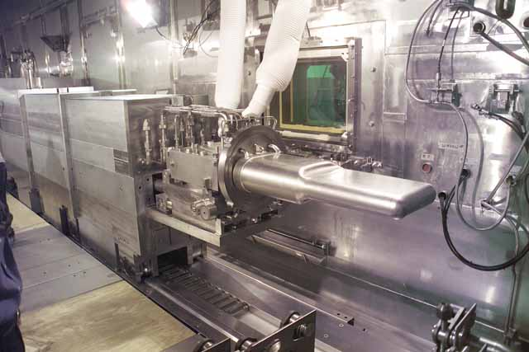
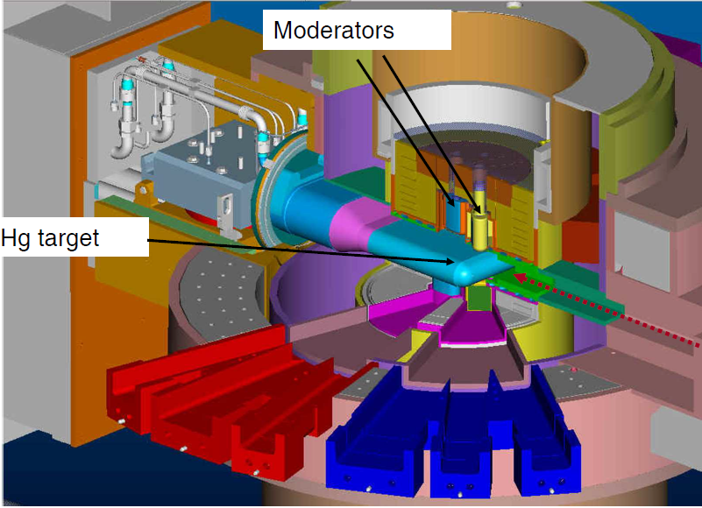
Neutron production by spallation
(The Spallation Neutron Source, USA)
The Liquid Mercury Target
Proton pulses
SNS (ORNL, USA)
5th AONSA Neutron School,
Peking Uni., China, 24 October 2012
Notes:
See web page atomicarchive.com for many schematics on fission; including explosive and implosive

Slide 11
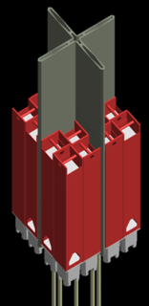
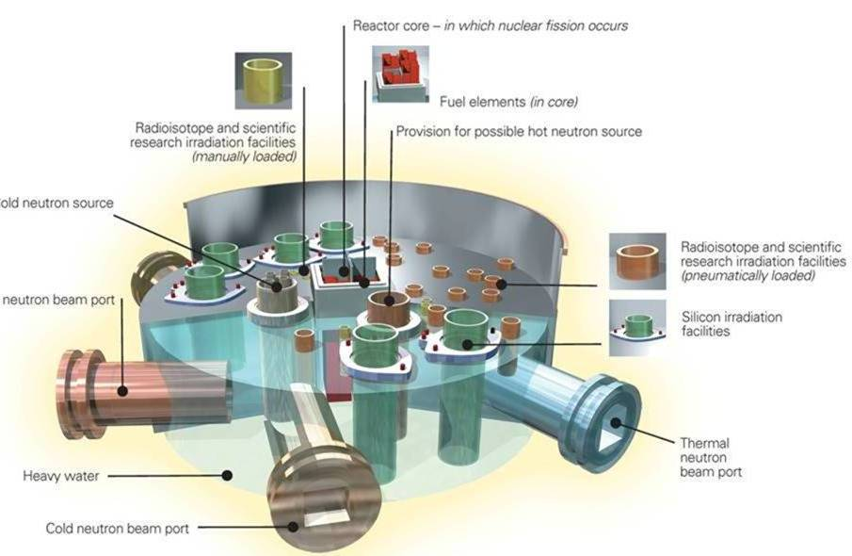
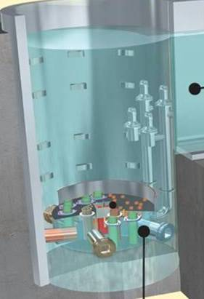
OPAL’s core and multipurpose reflector vessel
Zircaloy (D₂O) reflector tank:
operational design life: 40 yrs
OPAL’s Compact LEU Core:
4x4 grid, plate type.,
60 cm x 32 cm²;
Power = 20 MW_{th},
φ₀=4x10¹⁴ n/cm²/s
Neutron beams, radioisotopes & NTD Silicon
Provision for Hot NS or 2nd Cold NS
Light Water
D₂ Cold
Neutron Source

Slide 12
OPAL’s core and multipurpose reflector vessel
Zircaloy (D₂O) reflector tank:
operational design life: 40 yrs
OPAL’s Compact LEU Core:
4x4 grid, plate type.,
60 cm x 32 cm²;
Power = 20 MW_{th},
φ₀=4x10¹⁴ n/cm²/s
Neutron beams, radioisotopes & NTD Silicon
Provision for Hot NS or 2nd Cold NS
Light Water
D₂ Cold
Neutron Source

Slide 13
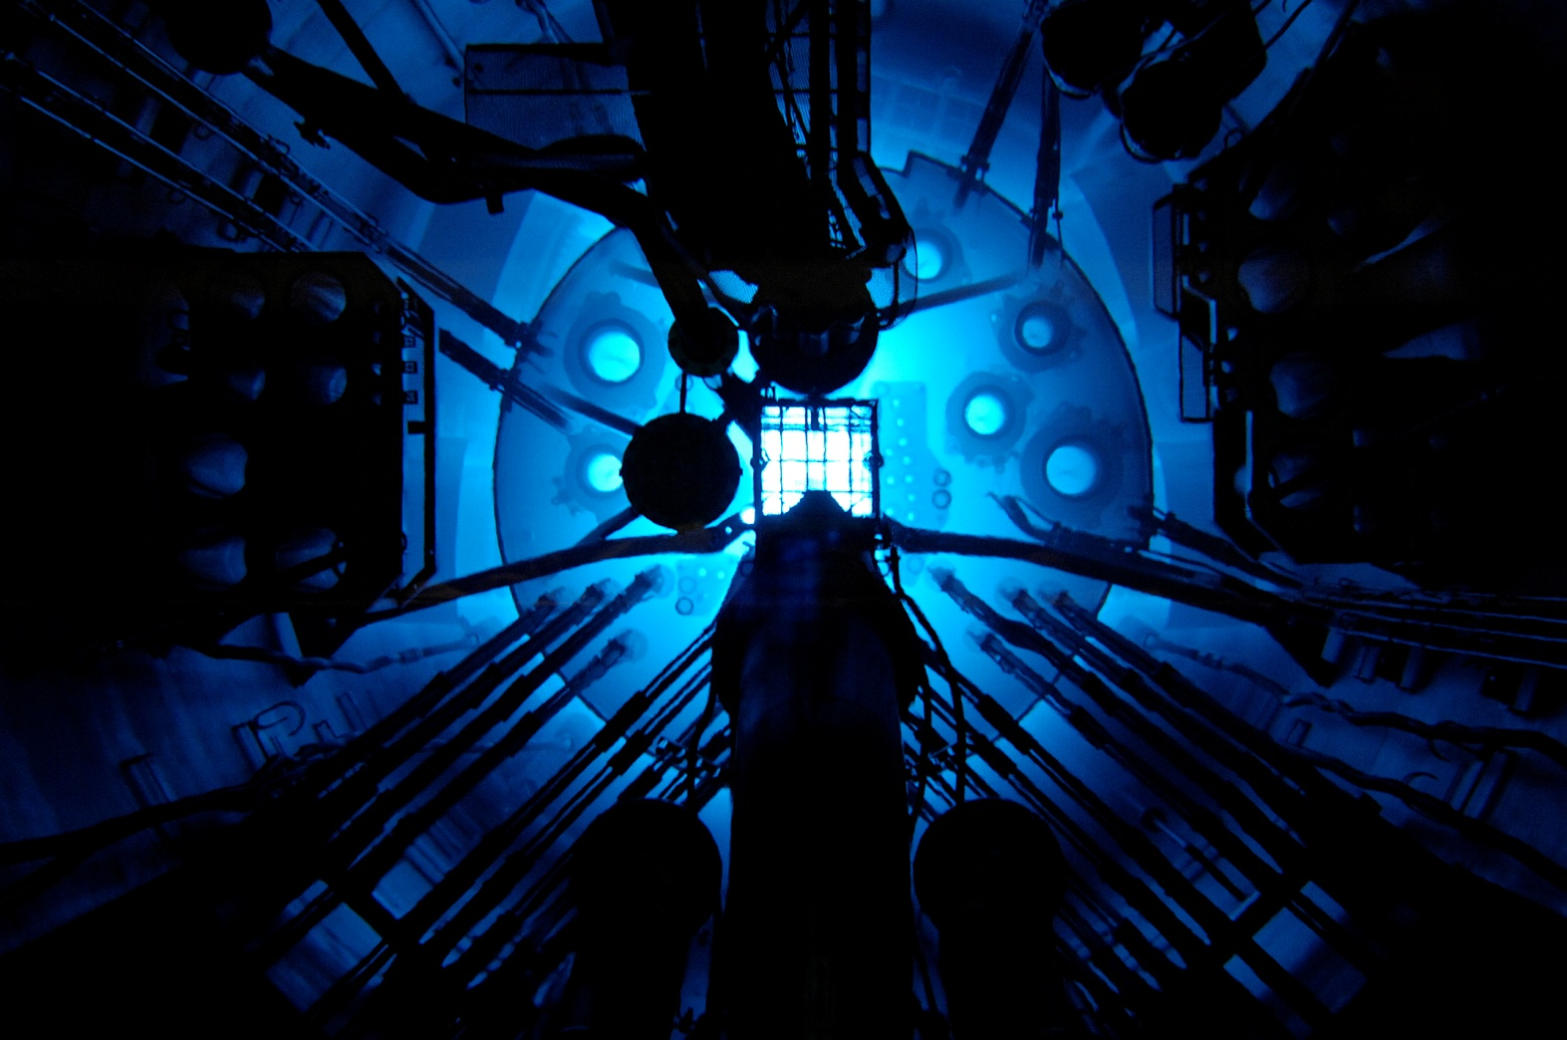
OPAL’s core and multipurpose reflector vessel
OPAL’s Compact LEU Core:
4x4 grid, plate type.,
60 cm x 32 cm²;
Power = 20 MW_{th},
φ₀=4x10¹⁴ n/cm²/s
Light Water

Slide 14
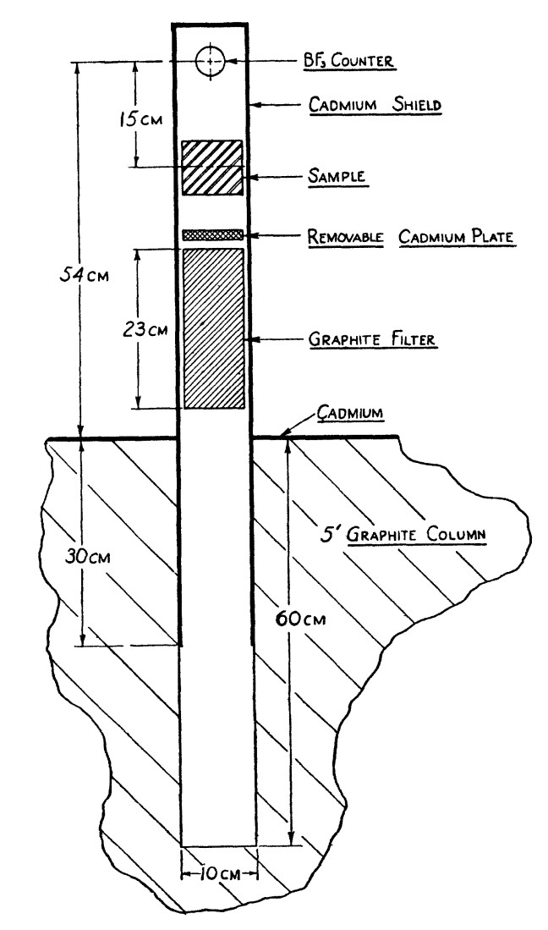
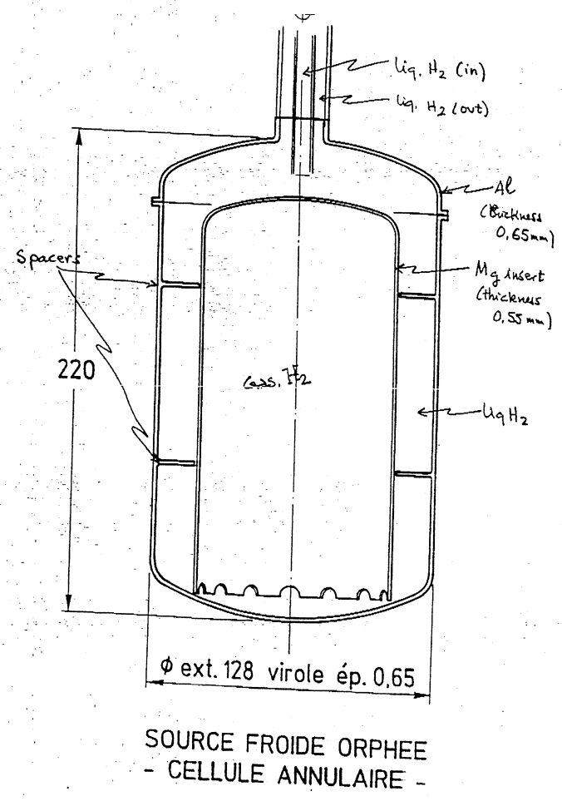
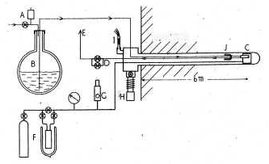
Ancient History; the first cold neutrons
Bepo (Harwell)
1957 H₂(liq) –flow through system (~ 1-2 day capacity)
First cold neutrons; Argonne Pile
Anderson, Fermi & Marshall (1946)
Orphee (LLB) H₂(liq)
CNS2 (1990) annular
5th AONSA Neutron School,
Peking Uni., China, 24 October 2012

Slide 15
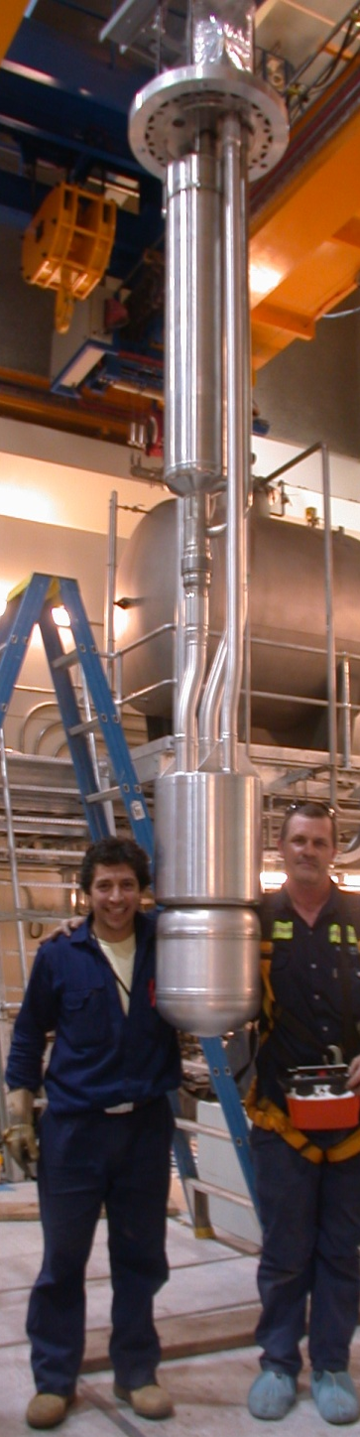
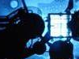
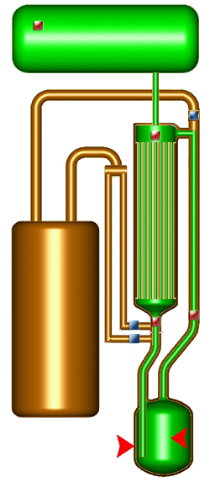
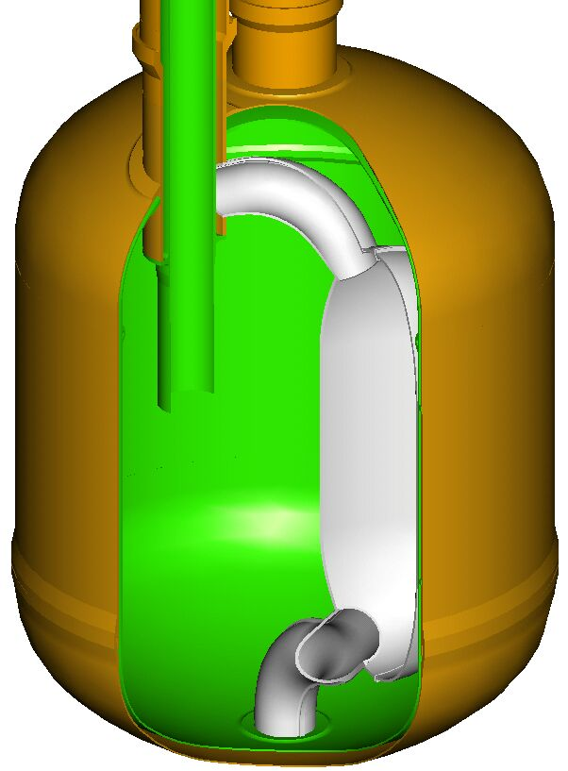
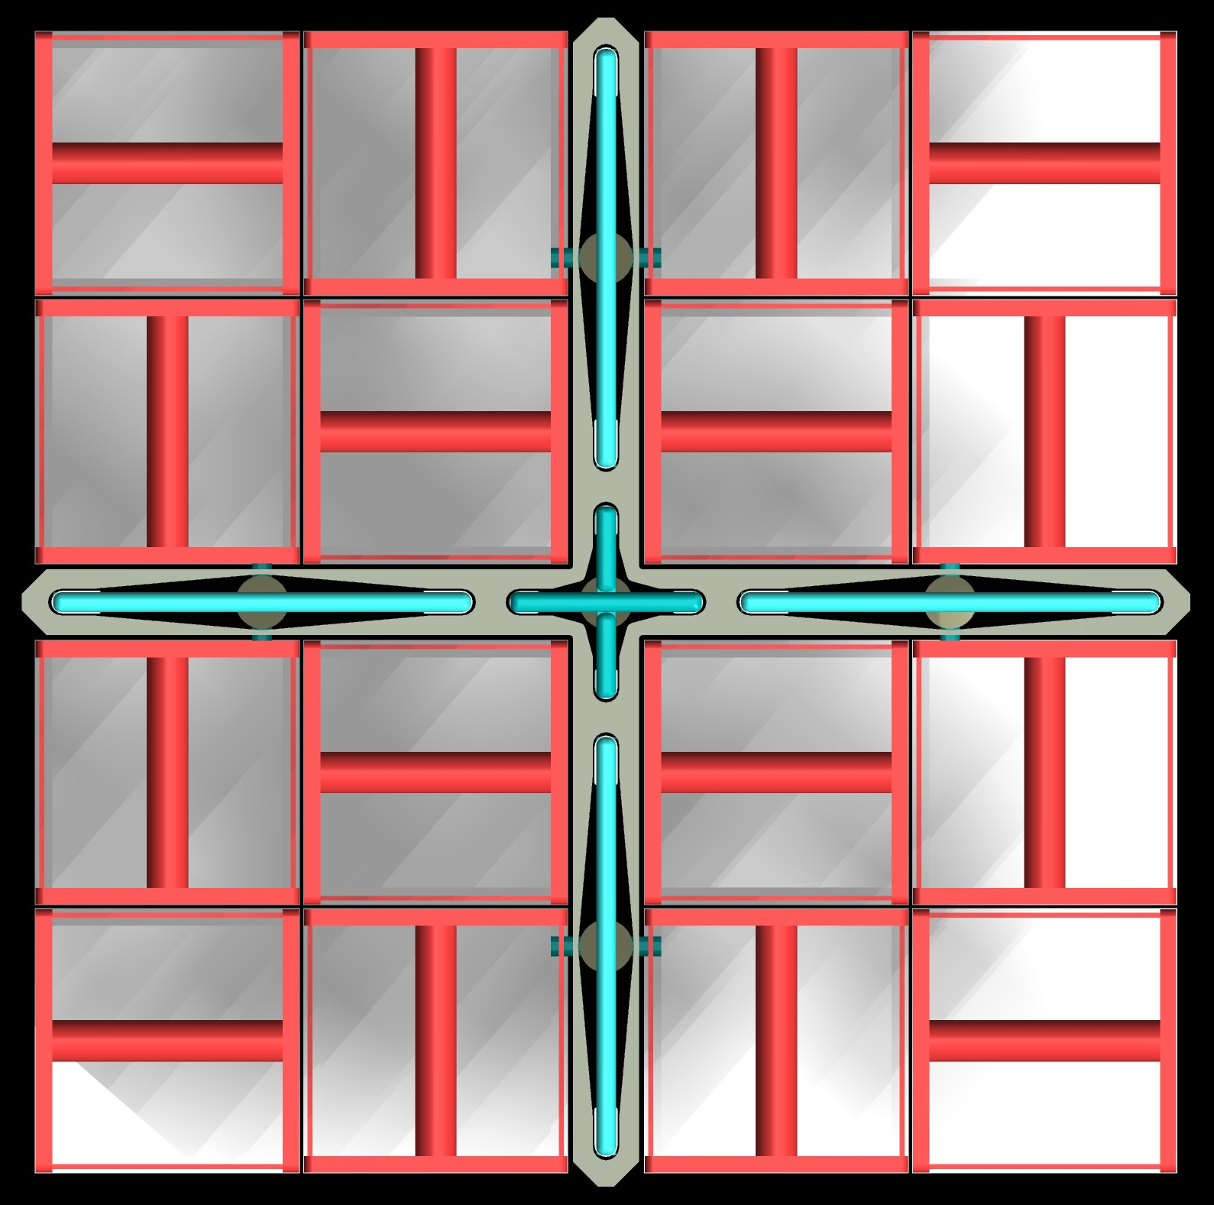
OPAL’s cold neutron source
OPALs D₂ moderator
Volume: 20 litres
Temperature: ~ 23 K
Heat load: < 4.5 kW
T_{M-B}: ~ 45 K & 210 K
CG1-3 beam tube
50 cm
Reactor Core
D₂ moderator
D₂O moderator
CG4 beam tube
Liquid Deuterium moderator chamber
5th AONSA Neutron School,
Peking Uni., China, 24 October 2012

Slide 16
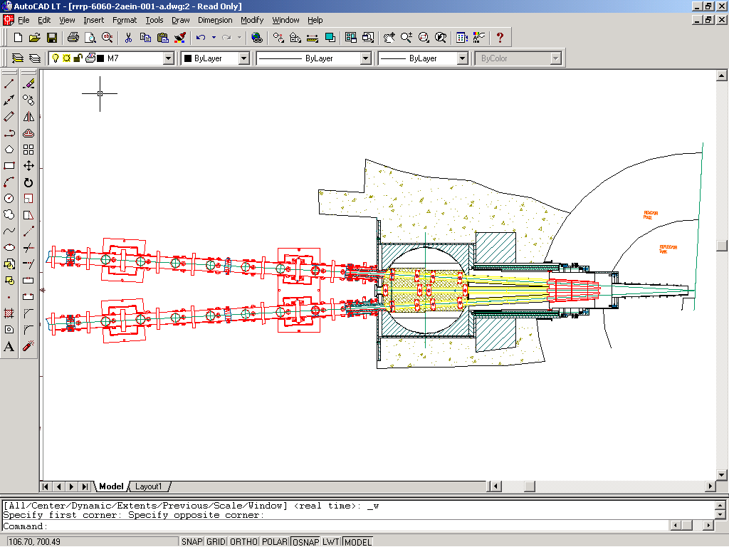
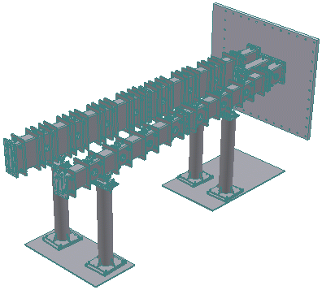
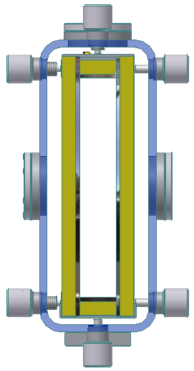
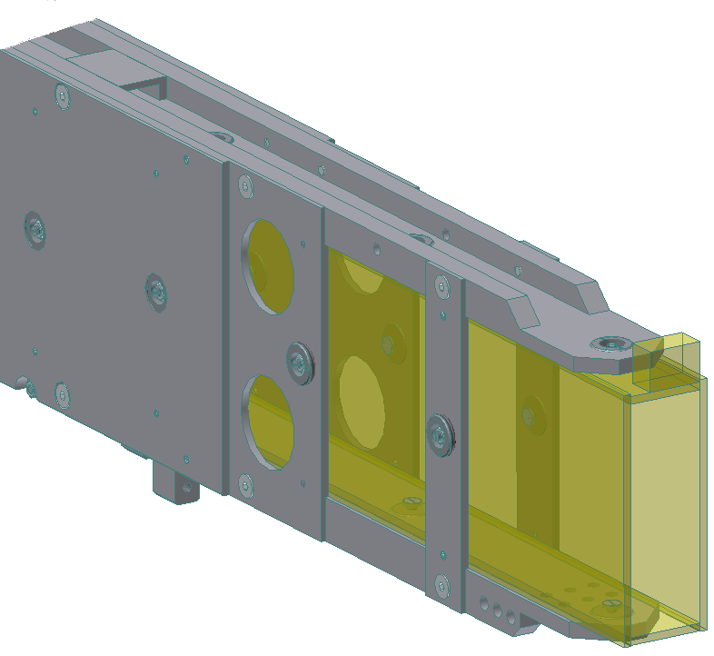
Neutron beam transport:
OPAL’s neutron reflecting guides

Slide 17
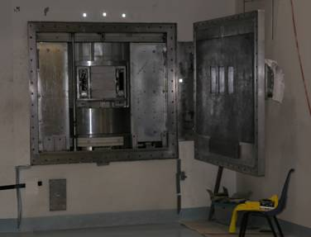
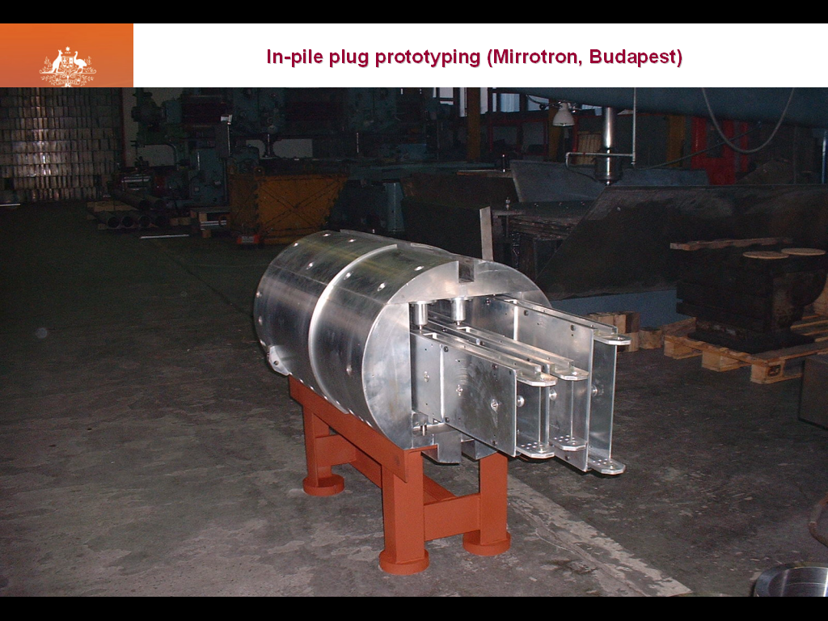
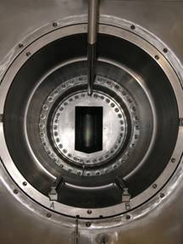
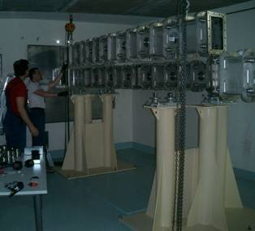
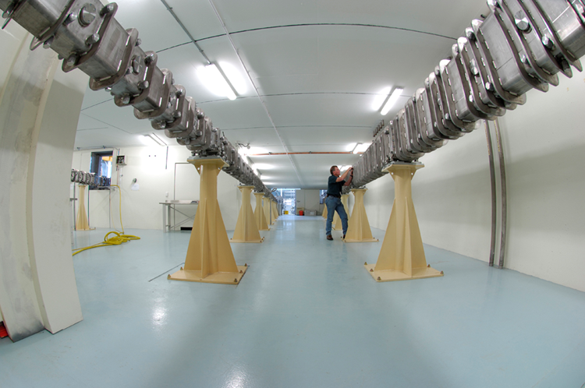
OPAL’s neutron guide system
5th AONSA Neutron School,
Peking Uni., China, 24 October 2012

Slide 18
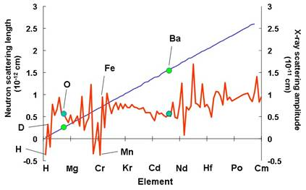
Competitive advantages of neutron beam science
Effective magnetic scattering lengths
light elements
  H, Li, C, N, O…
magnetism
  long and short range
atomic motion
  vibration, libration, diffusion
in-situ studies
  T,H,P,V, gas…
Gd
Fe
Comparison of neutron & X-ray scattering lengths

Slide 19
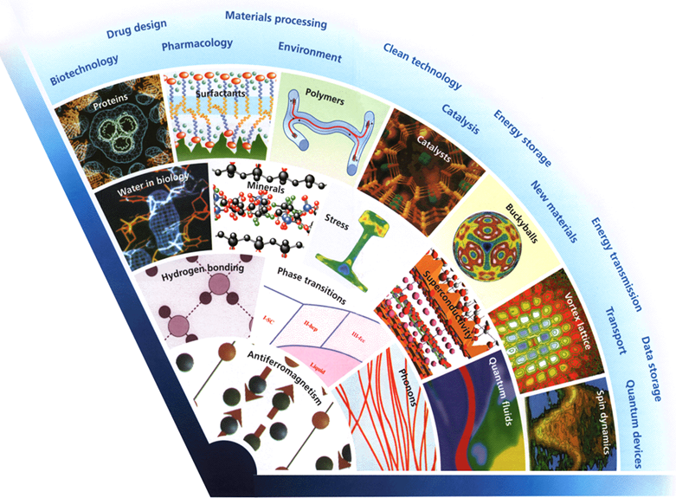
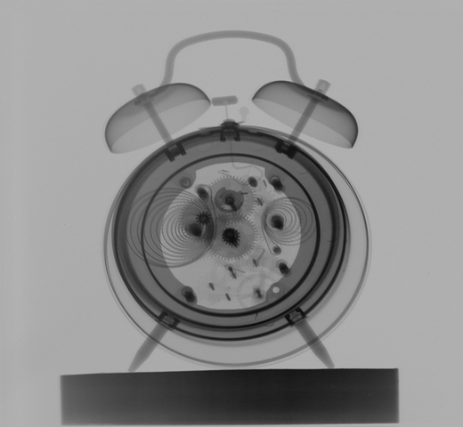
Seven decades of neutron scattering
.. and Imaging
radiography & tomography
Ref: European Spallation Source (ESS) report (ENSA, 1997)

Slide 20
Capabilities for structural characterization at OPAL
Polarised beam and polarization analysis options
KOALA (Crystal)
KOWARI (Strain)
ECHIDNA & WOMBAT (Powder)
Length scale
100 μm
10 μm
1 μm
100 nm
10 nm
1 nm
100 pm
10 pm
PLATYPUS (Reflectometer)
DINGO (Imaging)
BILBY (P-SANS)
slit mode
single setting
high-res
KOOKABURRA (U-SANS)
focusing lens
QUOKKA (P-SANS)
3 settings
10⁻⁵
10⁻⁴
10⁻³
10⁻²
10⁻¹
10⁰
10¹
Q (Å⁻¹)

Slide 21
Spectroscopy: First ESS instruments
Q-Energy range covered by ESS spectrometers.
The instruments in italics have not yet been approved for construction
21

Slide 22
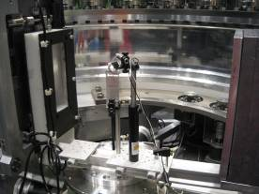
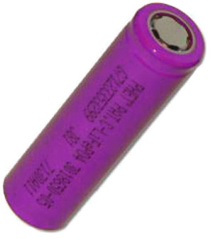
In-situ/in-operando neutron diffraction;
Lithium ion battery charge-discharge cycles
LIB setup on the WOMBAT diffractometer at the OPAL reactor for in-situ study
N Sharma et. al., J S.S. Electrochem 16, 1849 (2012)
Notes:
The figure represents a collection of in-situ neutron diffraction patterns that are a follow up to our 1st experiment with commercial Li-ion batteries. This time we have optimised sample geometry (cylindrical battery (pictured) as opposed to a prism) which has allowed us to probe aspects such as different cycling rates (pictured) and over-charging.
A reflection characteristic of the anode and cathode are identified.

Slide 23
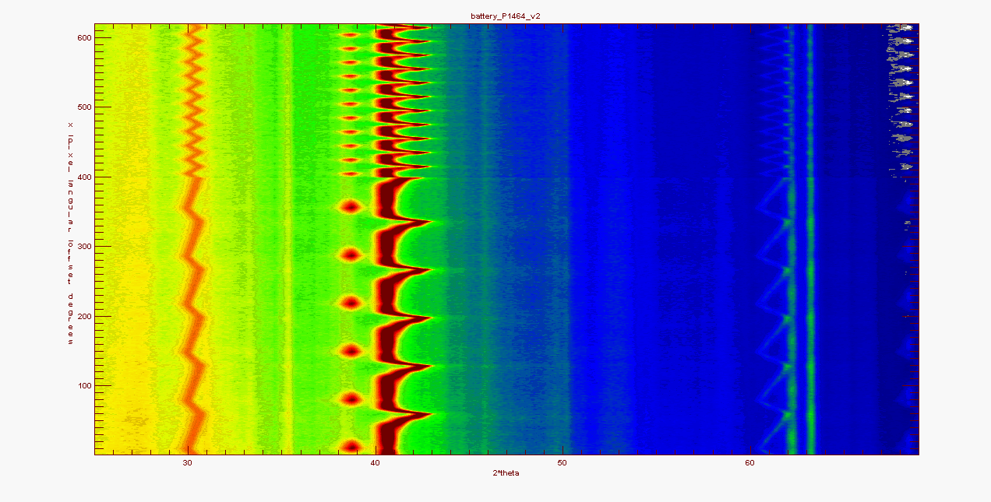
In-situ/in-operando neutron diffraction;
Lithium ion battery charge-discharge cycles
2 Amp charge & discharge
Cathode peak
Anode peak
Time
1.25 A charge 0.5 A discharge
Discharging
LIB setup on the WOMBAT diffractometer at the OPAL reactor for in-situ study
Charging
30
40
50
60
2θ (degrees)
N Sharma et. al., J S.S. Electrochem 16, 1849 (2012)
Notes:
The figure represents a collection of in-situ neutron diffraction patterns that are a follow up to our 1st experiment with commercial Li-ion batteries. This time we have optimised sample geometry (cylindrical battery (pictured) as opposed to a prism) which has allowed us to probe aspects such as different cycling rates (pictured) and over-charging.
A reflection characteristic of the anode and cathode are identified.

Slide 24
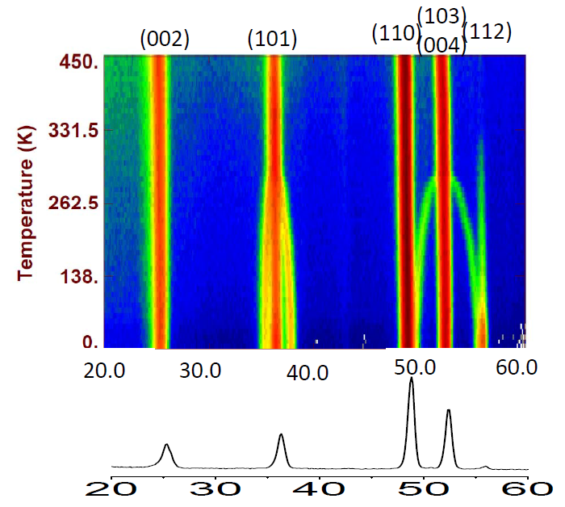
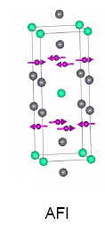
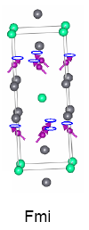
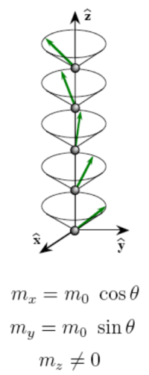
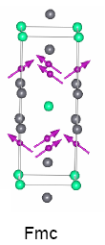
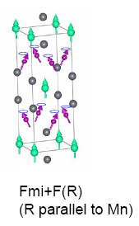
Magnetic neutron diffraction
ND measurements performed at the OPAL research reactor
PrMn₂Ge₂
JL Wang et. al., PRB 87, 1104401 (2013)
Notes:
Example of NPD and the intidactions of magnetic order in the PrMn2Ge2-xSix series

Slide 25
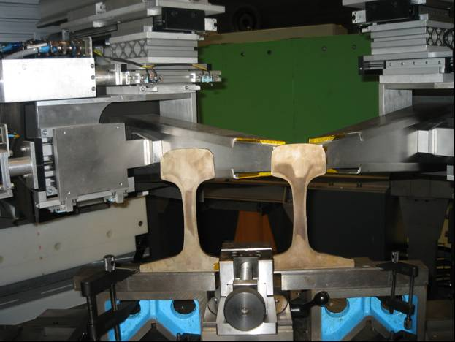
Residual Stresses in Rail Squat Formation
(University of Queensland & Railcorp Australia)
Rails mounted on Kowari
Example from OPAL

Slide 26
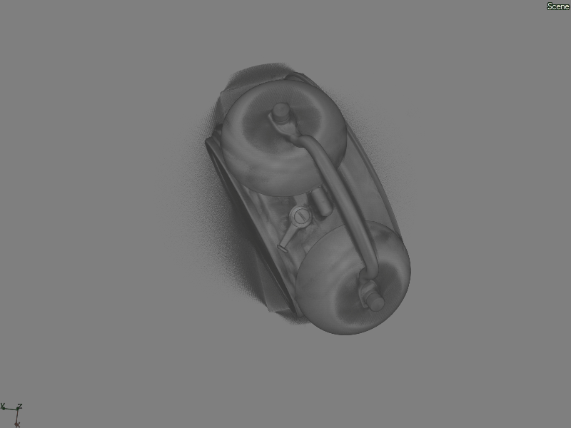
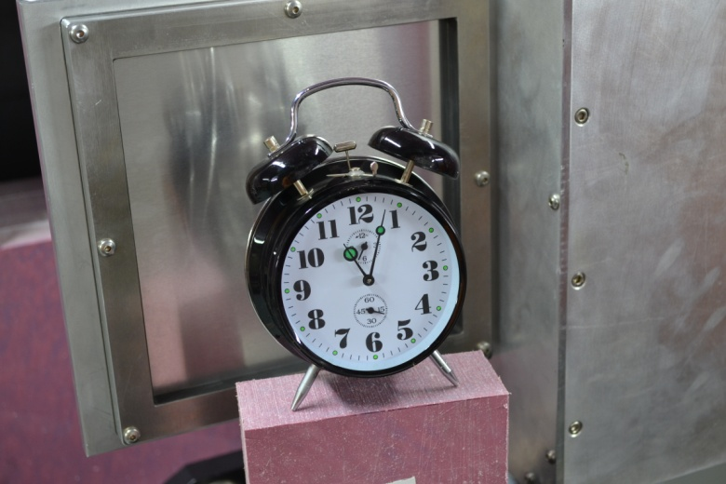

Neutron Tomography
Providing 3 dimensional images of internal structure
Radiograph
Example; a mechanical alarm clock
Dingo Neutron Imaging Station
Images courtesy of Ulf Garbe, Bragg Institute (L/D = 1000)
Example from OPAL

Slide 27
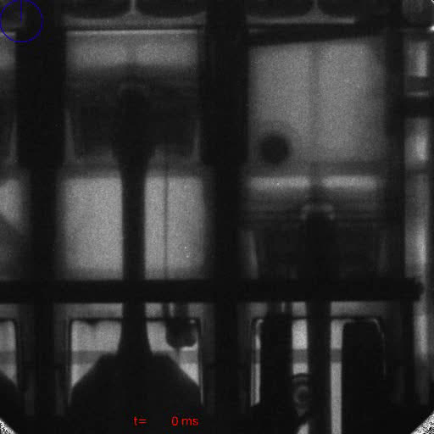
Neutron Radiography
Providing real time images of internal structure & processes
Example; oil flow in an automobile engine.
Image courtesy of
Burkhardt Schillinger,
Technical University of Munich
Example from FRM-II

Slide 28
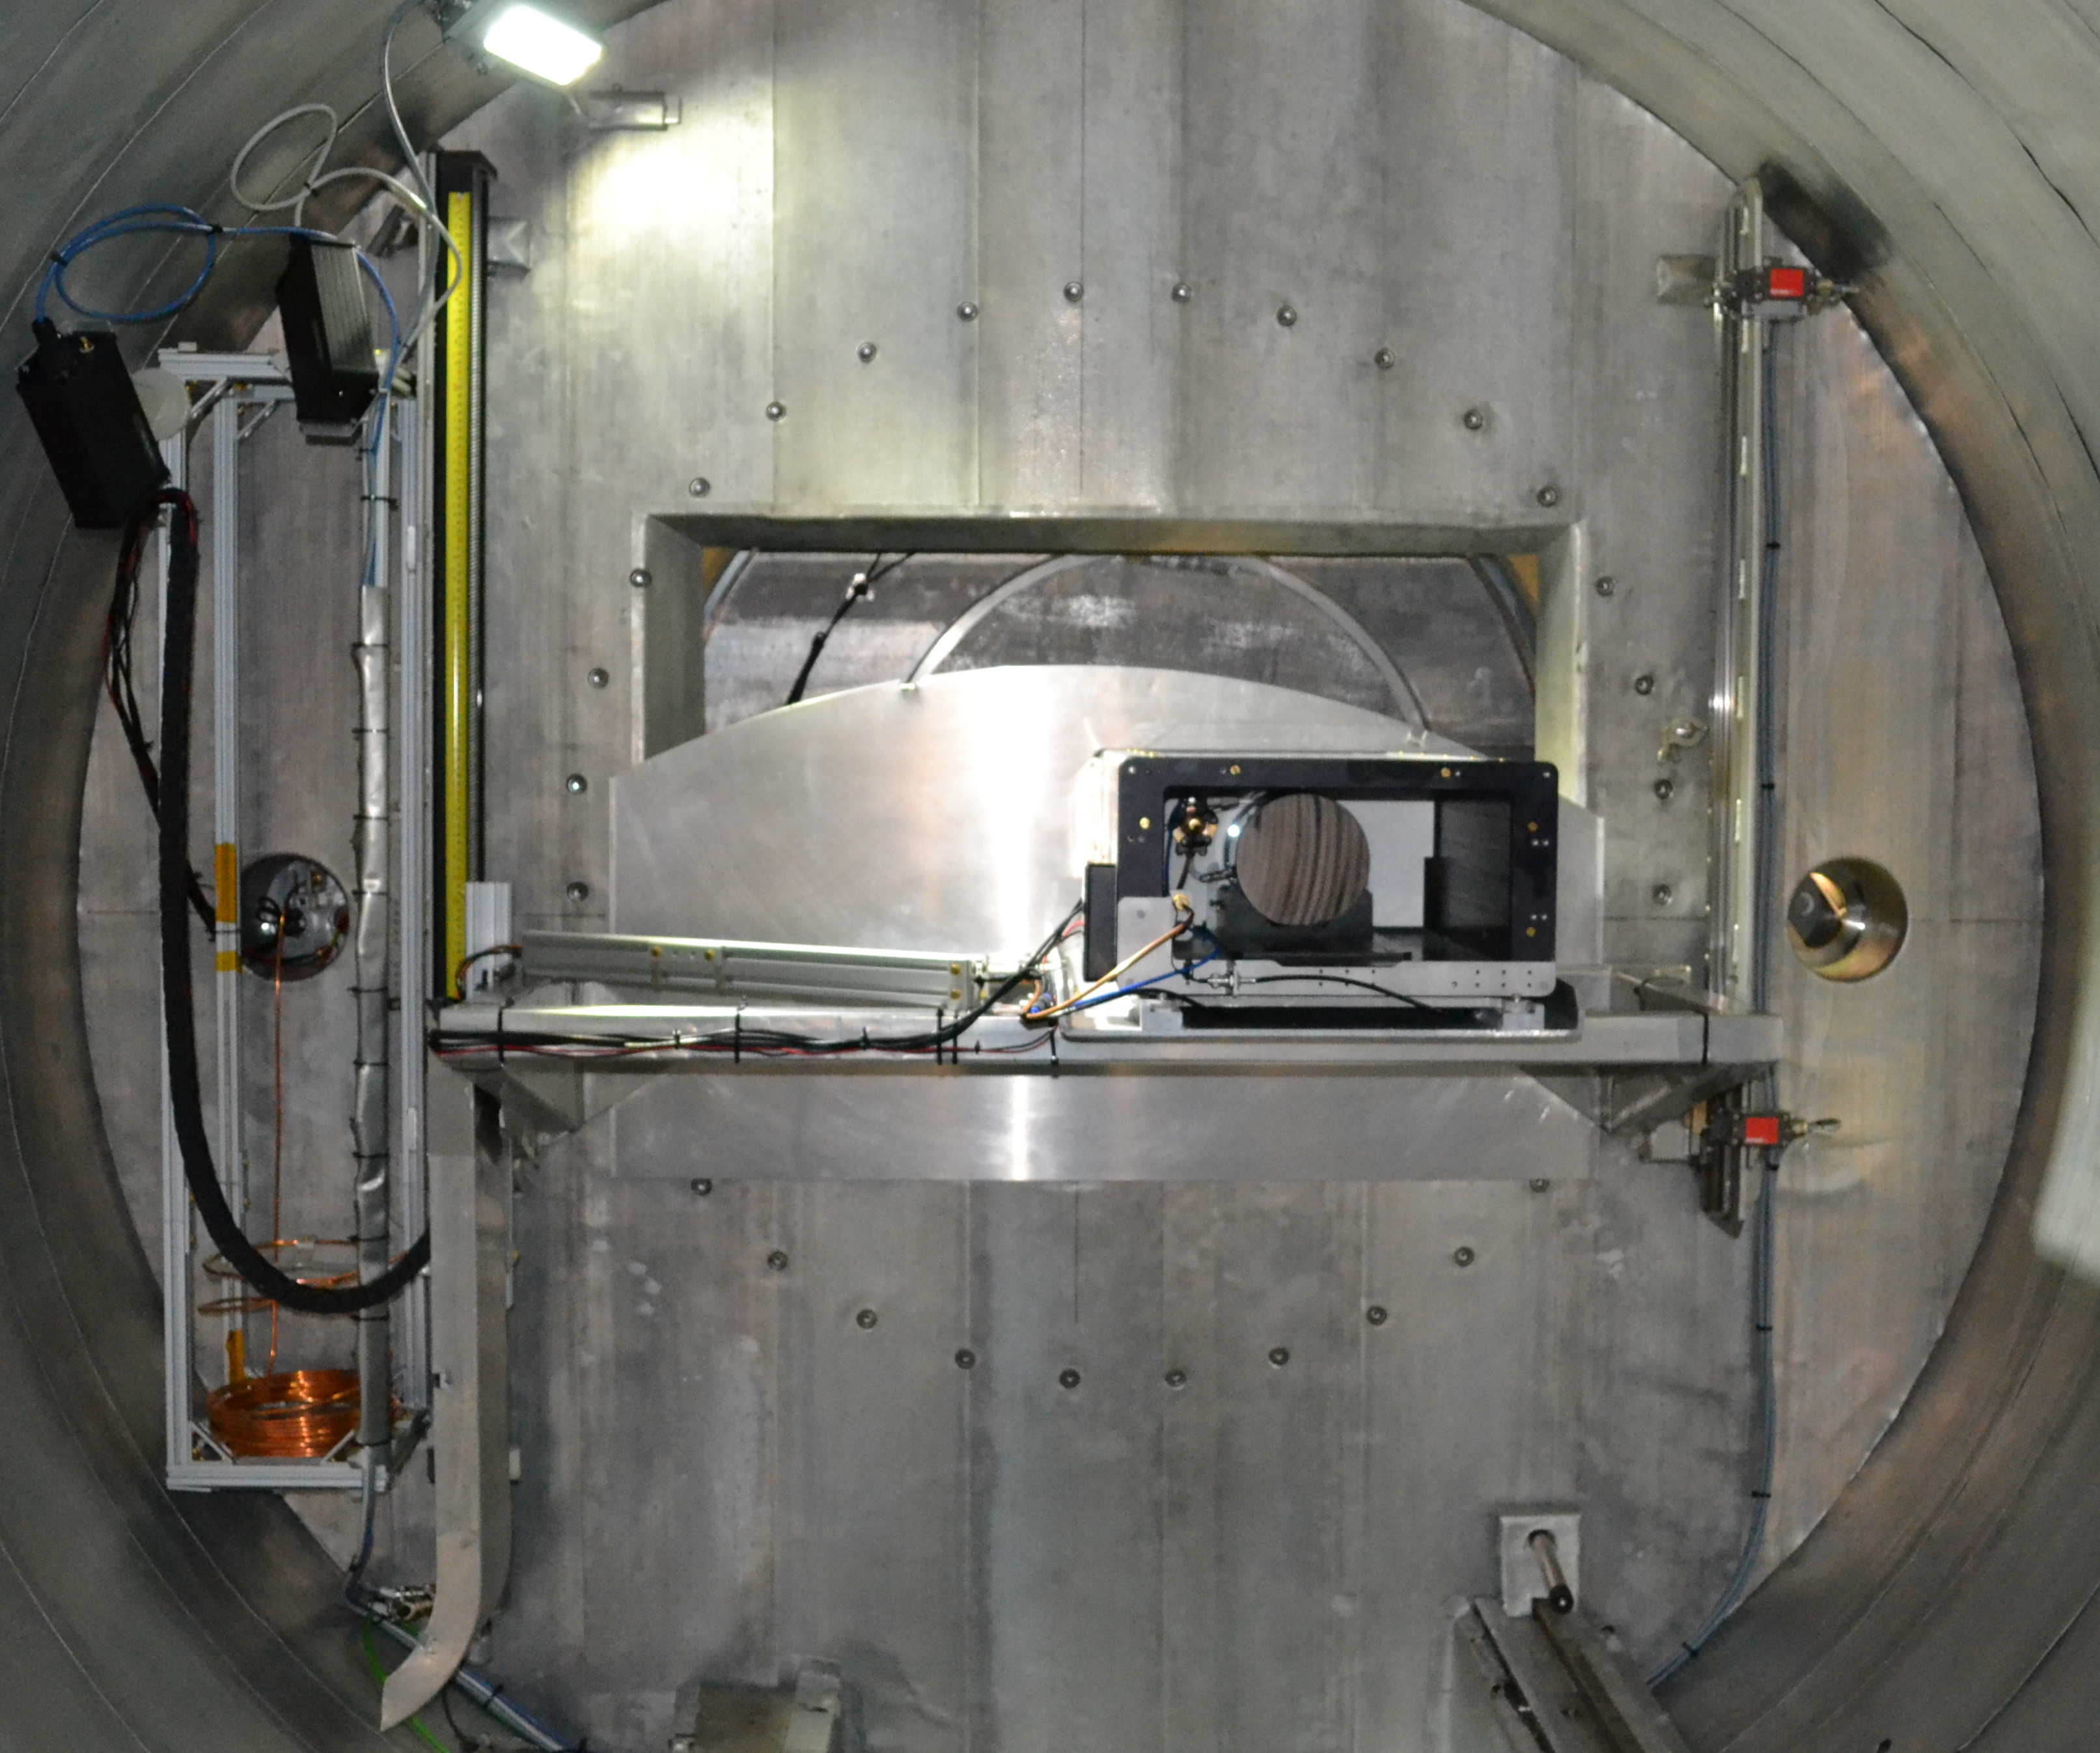
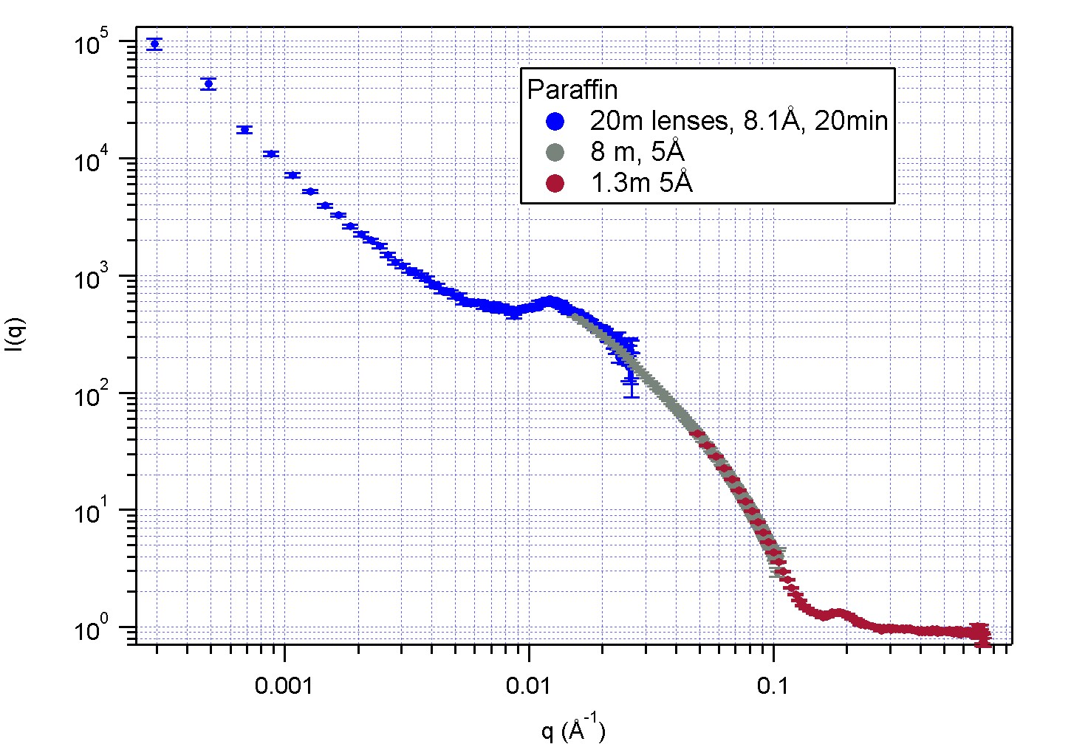

Small Angle Neutron Scattering Spectrometers
QUOKKA: High resolution (40 m) pinhole SANS with beam focussing and Polarization Analysis (PA) option
PA mode
q_{min} ≈ 4 x 10⁻⁴ A⁻¹ ; q_{max} ≈ 7 x 10⁻¹ Å⁻¹
³He analyser with in-situ refilling
focussing mode

Slide 29


Small angle neutron scattering of magnetite nanoparticles
(a) Experimental setup of polarized SANS
(b) 2-D SANS images (at 1.2 T, 200 K)
(c) Composite model:
ferrimagnetic core φ ~ 7.4 nm with 90°canted magnetic shell ~ 0.8-1.2 nm thick
Experiments at NCNR, NIST
Reference: K. L. Krycka et. al., PRL104 (2010)207203

Slide 30



Small Angle Scattering for nanoscale structures; polymers, pores, inclusions, protein conformation, hierarchical materials…
SANS and SAXS from (d-LMW-h-HMW) stretched polymer, elongation factor ~6
Hierarchical polymer blend
(LMW-HMW-Polyethylene)
Experiments at JRR3, KENS and Spring8
T Kanaya et. al., Macromol 40, 3650 (2007)

Slide 31



Proton diffusion in Alkali Metal Hydrogen Sulfates - Inelastic neutron scattering
INS of RbHSO₄ sulfate showing large amplitude proton motions at low Temp
Crystal structure of alkali metal hydrogen sulfates has chains of XO₄ tetrahedra, linked by hydrogen bonds, O-H..O.
Above RT, phase has dynamically disordered tetrahedra, and very high protonic conductivity.
Hydrogen motion most likely responsible for this excitation
Experiments at NCNR, NIST
T Yildirim et. al., SSI 145, 429 (2001)

Slide 32



Proton diffusion in Alkali Metal Hydrogen Sulfates - Quasi-elastic neutron scattering (CsH(SO₄)_{0.76}(SeO₄)_{0.24})
Experiments at NCNR, NIST
Images courtesy of Dan Neuman (NIST)

Slide 33
Major Neutron Beam Facilities Worldwide
Underlined names show facilities in planning or construction phase
ESS (EU)
HMI (GER)
FRM-II (GER)
MRR (CHN)
CARR (CHN)
CSNS (CHN)
ISIS (UK)
SINQ (SUI)
●
PIK (RUS)
IBR-2 (RUS)
●
●
NRU (CAN)
IPNS (US)
NBSR (US)
HFIR (US)
SNS (US)
LANL (US)
RMB (BRA)
●
●
●
●
●
●
●
HANARO (KOR)
●
●
●
ORPHEE (FRA)
HFR – ILL (FRA)
●
●
●
●
●
●
●
●
●
●
ETRR-2 (EGP)
●
JSNS/J-PARC (JPN)
J-RTR (JRD)
●
JRR-3 (JPN)
●
●
● Reactor
● Accelerator
●
●
SAFARI-1 (RSA)
RA-10 (ARG)
OPAL (AUS)
CIRUS (IND)
RSG-GAS (INA)

Slide 34


FUTURE SCENARIOS OUTLINED IN
THE 2016 ESFRI REPORT
Pessimistic scenario: ILL operates at reduced output until 2023, ESS with 22 instruments beyond 2028. Earlier closer and/reduced operations for a number of medium power sources
Optimistic scenario: ILL operates until 2030, ESS with 35 instruments beyond 2035.
ESFRI = European Strategy Forum on Research Infrastructure

Slide 35















Financing
Host Countries Sweden and Denmark
Construction 47.5% Cash Investment ~ 97%
Operations 15%
Non Host Member Countries
Construction 52.5% In-kind Deliverables ~ 70%
Operations 85%
(Jan 2013 pricing) | M €
Conventional Facilities | 531.9
Extra CF investment by host countries | -93.0
Accelerator Systems | 510.2
Target Systems | 155.2
Integrated Control System | 73.0
Design & Engineering | 33.7
Neutron Scattering Systems | 350.0
Project Support & Administration and Licensing | 123.8
Contingency | 158.2
Total Construction Budget | 1843.0

Slide 36

ESS design
High Power
Linear Accelerator:
Energy: 2 GeV (1.4 GeV in construction budget)
Rep. Rate: 14 Hz
Current: 62.5 mA
Target Station:
He-gas cooled rotating
W-target -5MW average
power (2 MW in
construction budget)
42 beam ports
Committed to deliver 22 instruments by 2028 (15 Instruments in Construction budget)
Peak flux ~30-100 brighter than the ILL
Ion Source
Environmental goal (“Sustainability”)
Energy responsible
Renewable energy
Recyclable heat
Total cost: 1843 M€ ₂₀₁₃

Slide 37



The European Spallation Source
Flat moderator delivering smaller and brighter neutron beams
High Power Accelerator means more neutrons
High brightness and tuneable resolution makes new measurements possible
An Innovative Target Station that can host >30 instruments

Slide 38
Long-pulse performance – 2MW
15
x10¹³
ESS 5 MW
2015 design
λ = 5 Å
Possibilities of pulse shaping
10
Brightness (n/cm²/s/sr/Å)
ESS 5 MW
2013 design (TDR)
5
JPARC
0.3-1 MW
SNS
1-2 MW
ESS 2 MW
2015 design
ISIS TS1
128 kW
ISIS TS2
32 kW
ILL 57 MW
0
time (ms)
1
2
3
4

Slide 39
Two strategies for neutron instrumentation at ESS
Intensity
Use as much as possible of the whole pulse:
Good for low wavelength resolution instruments.
SANS, Reflectometry, single crystal diffraction.
Estimated gains 10-100 times than currently available.
0
1
2
3
4
time (ms)
Cut the long pulse into smaller pulses:
Good for higher wavelength resolution instruments
Diffraction, cold/thermal spectrometers.
Long Instruments (80-100 m)
Estimated gains 10-30 times than currently available.
Thermal gains lower.
0
1
2
3
4
time (ms)

Slide 40




Organisation and People
> 400
Employees
48
Nationalities
> 45
Collaborating Institutions

Slide 41
ESS partners
Aarhus University
Atomki - Institute for Nuclear Research
Bergen University
CEA Saclay, Paris
Centre for Energy Research, Budapest
Centre for Nuclear Research, Poland, (NCBJ)
CNR, Rome
CNRS Orsay, Paris
Cockcroft Institute, Daresbury
Elettra – Sincrotrone Trieste
ESS Bilbao
Forschungszentrum Jülich
Helmholtz-Zentrum Geesthacht
Huddersfield University
IFJ PAN, Krakow
INFN, Catania
INFN, Legnaro
INFN, Milan
Institute for Energy Research (IFE)
Rutherford-Appleton Laboratory, Oxford(ISIS)
Kopenhagen University
Laboratoire Léon Brilouin (LLB)
Lund University
Nuclear Physics Institute of the ASCR
Oslo University
Paul Sherrer Institute
Polska Grupa Energetyczna - PGE
Roskilde University
Tallinn Technical University
Technical University of Denmark
Technical University Munich
Science and Technology Facilities Council
University of Tartu
Uppsala University
WIGNER Research Centre for Physics
Wroclaw University of technology
Warsaw University of Technology
Zurich University of Applied Sciences (ZHAW)
41

Slide 42













NSS Neutron Instrument positions:
Project scope -December 2016
ESS Lead Partners for instrument construction
+
Nuclear Physics Institute
NMX
BEER
+
C-SPEC
BIFROST
MIRACLES
MAGIC
ODIN
T-REX
DREAM
HEIMDAL
LoKI
VESPA
FREIA
SKADI
ESTIA
+
ESS In-Kind Partners also collaborate on sample environment, data management systems etc.
ESS Instrument Layout (December 2016)

Slide 43

Central Utilities Building (CUB)
LINAC
Site
Offices
East sector Instruments
West sector (160 m) Instruments
Target
South sector Instruments
ESS Major Milestones:
First Neutrons – Beam on Target - Oct 2020
First Instrument– Beam on Instrument #1 – Feb 2021
First 8 Instruments – Start of open user program – Aug 2021
Full User Program – first 15 instruments – Jan 2026
Full scale operations – 22 user instruments – 2028 -> 2030
August 2017

