Slide 1
Studies of electron emission & multipacting in HOM couplers
Stephen Molloy
European Spallation Source

Slide 2
Overview
Motivation for these studies
  SNS problems…
Multipactor in couplers
  Comparison of two designs
Field emission in multiple cavities

Slide 3
Installation of HOM couplers
An important question for many machines
Well known risks of not installing
    Beam breakup, emittance dilution, cryoload, …
But, installation is not risk-free
    S. Kim, “SNS Superconducting linac operation experience and upgrade path”, LINAC08
  Electron loading in the coupler
      Field emission (FE), & multipacting (MP)
Proposed couplers should be investigated

Slide 4
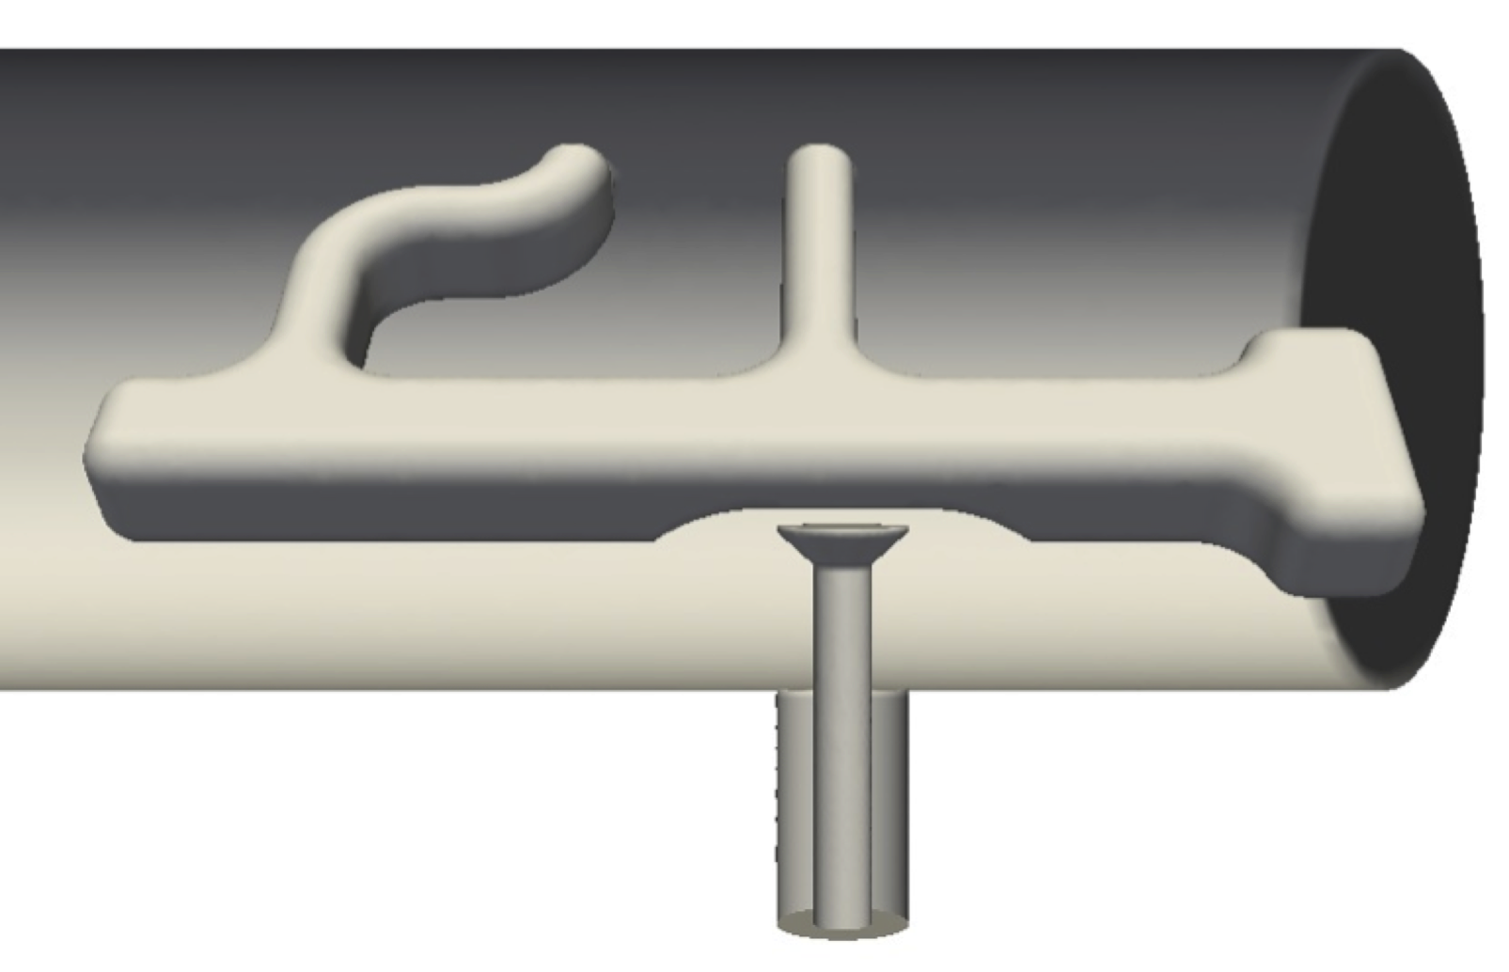
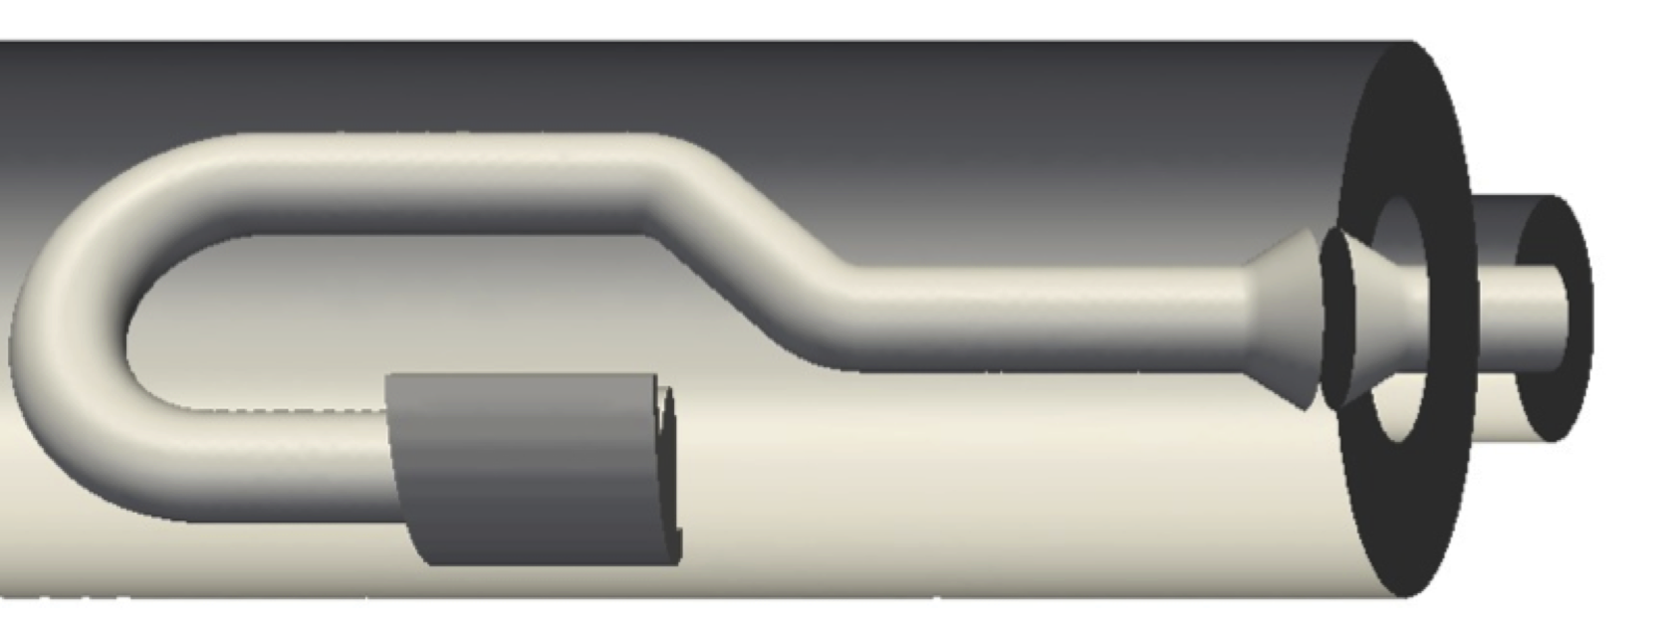
Coupler designs proposed for ESS:
LC loops to filter accelerating mode
Re-scaled from TESLA design (R. Calaga)
Design from Rostock University
Each design has already been optimised for RF properties, however investigations of FE/MP is also necessary.

Slide 5
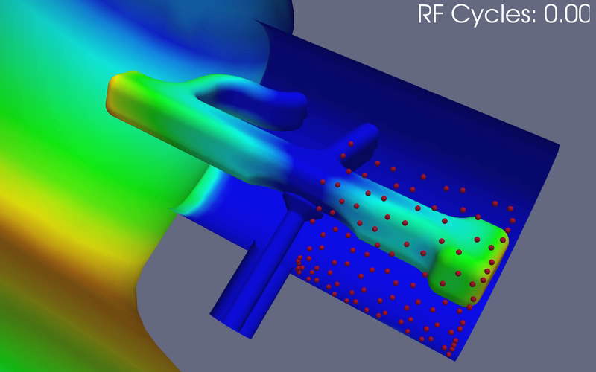
Multipactor in the re-scaled TESLA design
Build cavity & coupler volume, and mesh
Find eigenmodes (using Omega3P)
Track electrons emitted from coupler surface (using Track3P
Find resonant impacts & scale by SEY

Slide 6

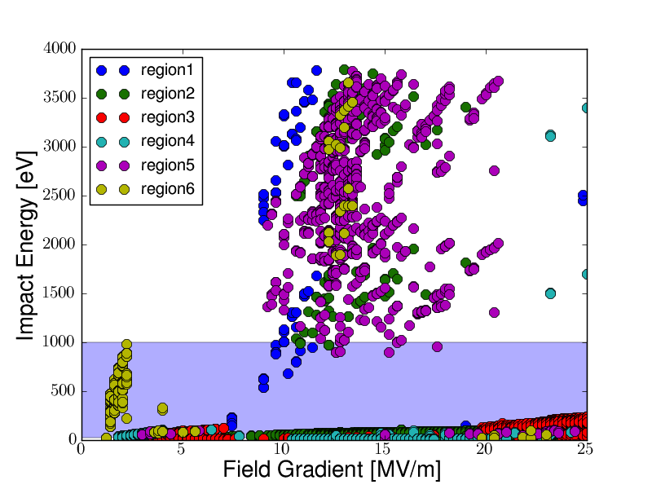
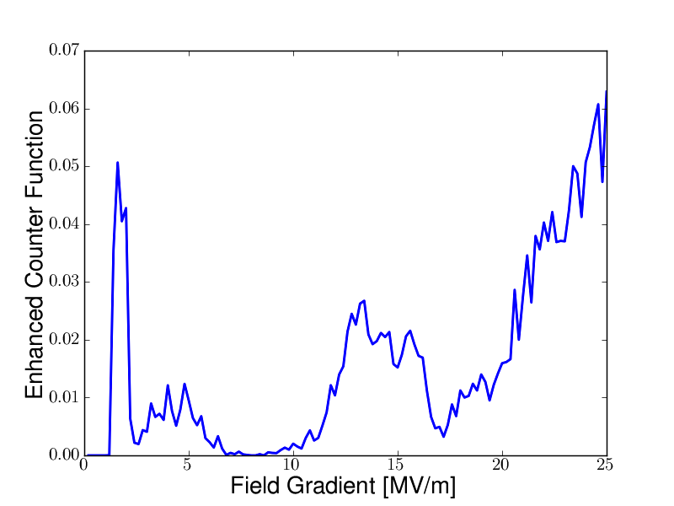
Multipactor in the re-scaled TESLA design
Build cavity & coupler volume, and mesh
Find eigenmodes (using Omega3P)
Track electrons emitted from coupler surface (using Track3P
Find resonant impacts & scale by SEY

Slide 7
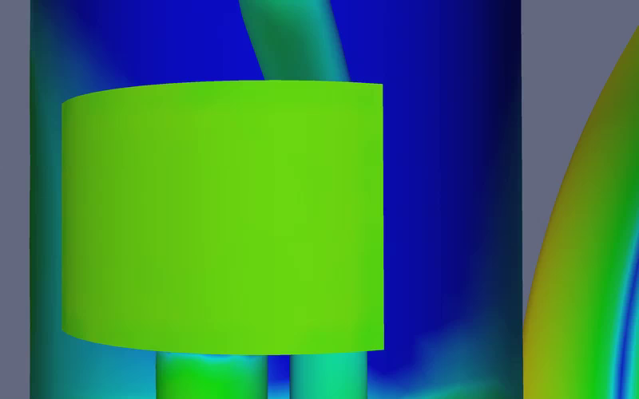
Multipactor in the Rostock design
Build cavity & coupler volume, and mesh
Find eigenmodes (using Omega3P)
Track electrons emitted from coupler surface (using Track3P
Find resonant impacts & scale by SEY

Slide 8
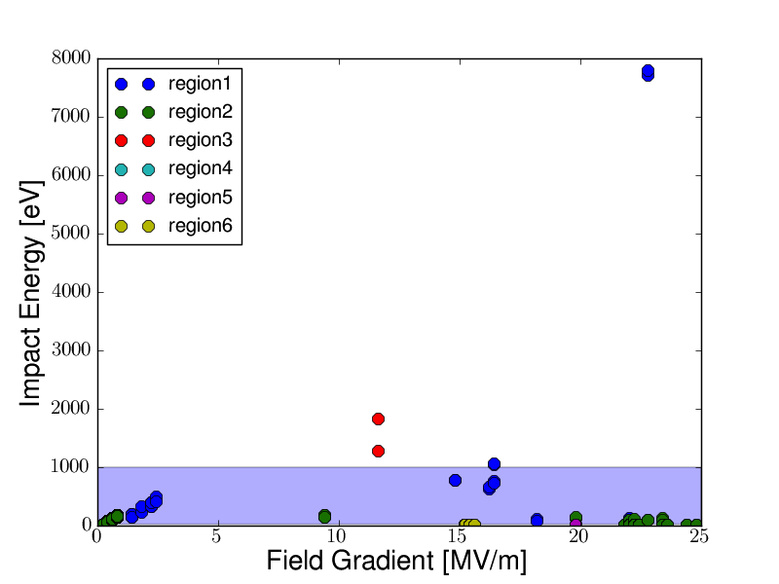
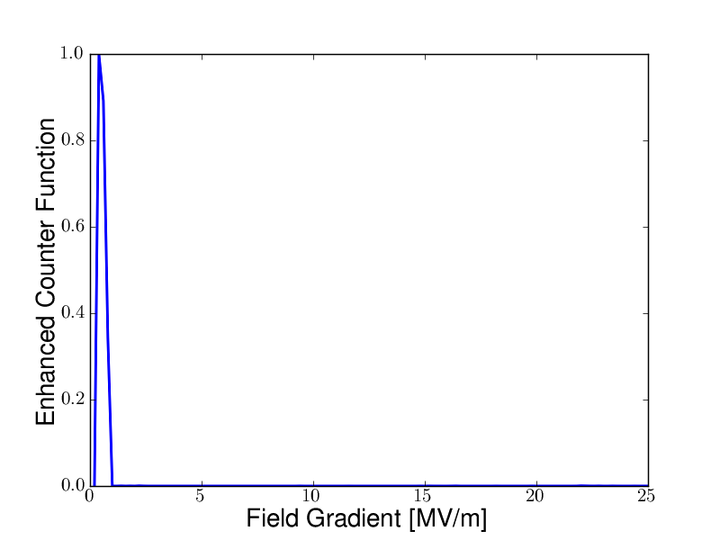
Multipactor in the Rostock design
Build cavity & coupler volume, and mesh
Find eigenmodes (using Omega3P)
Track electrons emitted from coupler surface (using Track3P
Find resonant impacts & scale by SEY

Slide 9
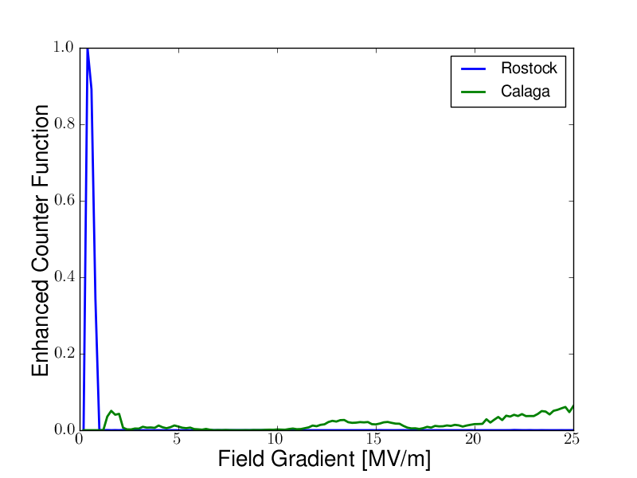
TESLA vs Rostock
Preliminary conclusions:
Large MP band in Rostock design appears risky.
“Broadband” activity in TESLA design is undesirable.
Open questions:
Ability to “process away” MP bands? (Can this be simulated?)
How much could geometrical tweaks help?
Trustworthiness of assumptions in the modelling code? (Furman-Pivi, or very basic model?)

Slide 10
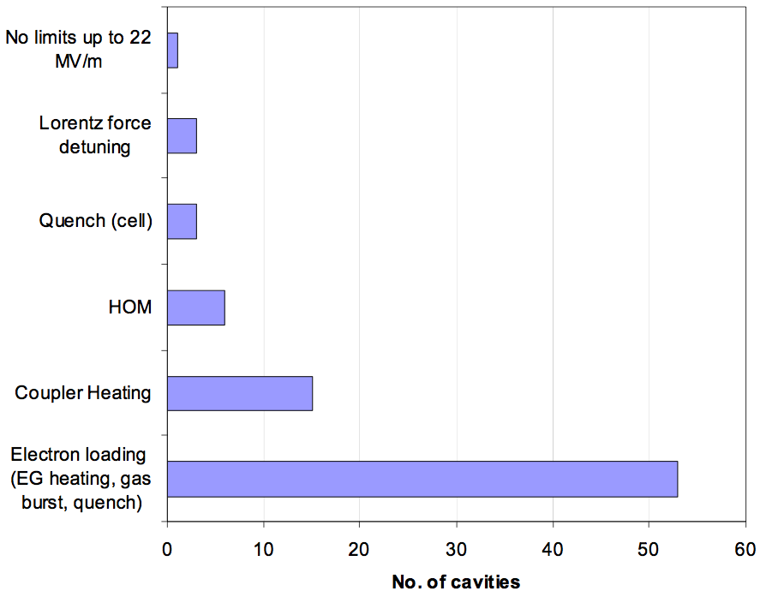
SNS limitations

Slide 11
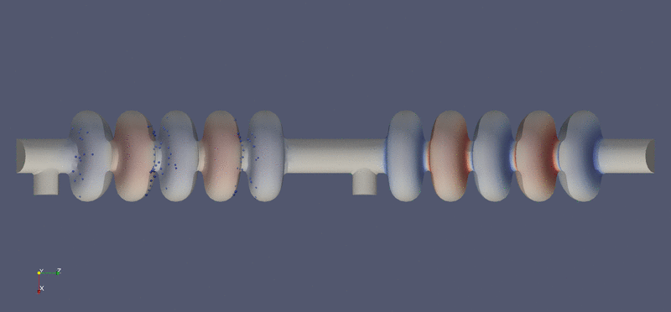

Transport of FE electrons

Slide 12
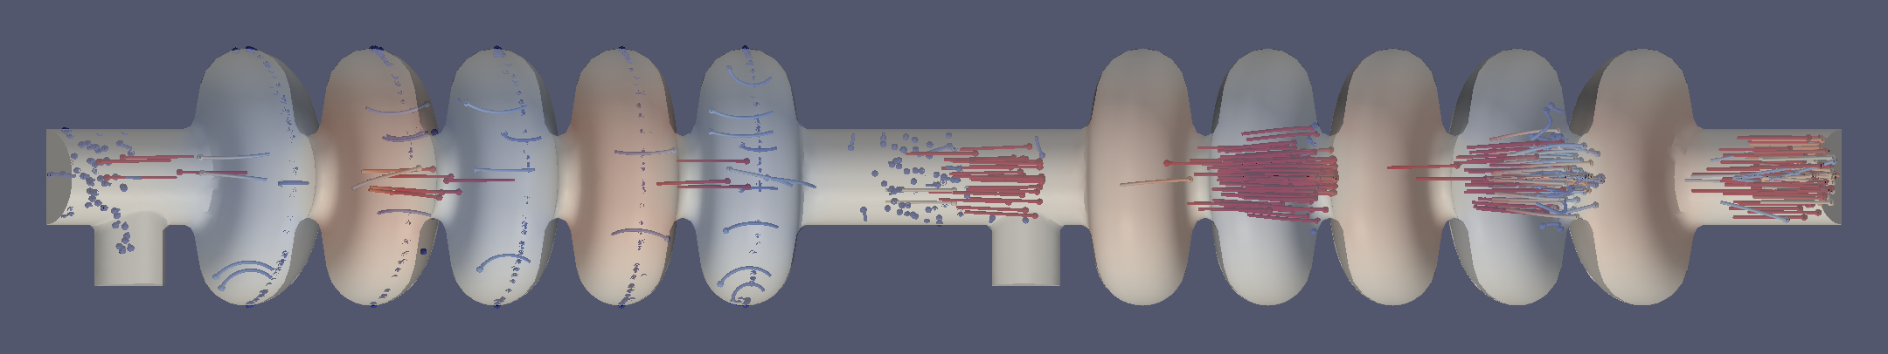
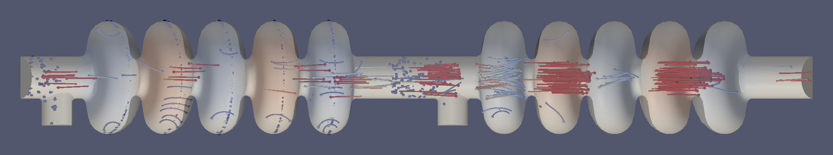
Transport of FE electrons
Instantaneous phase difference = 0
Instantaneous phase difference = 180°

Slide 13
FE current is dependent on cavity phase relationship

Slide 14
Thanks for listening!
Questions?

