Slide 1
ESS Normal Conducting Linac
Edgar Sargsyan
ESS Engineering Lecture
www.europeanspallationsource.se
14 September, 2017

Slide 2
Outline
Basics of RF Linacs
Overview of the ESS Normal Conducting Linac
  Ion Source (ISRC)
  Low Energy Beam Transport (LEBT)
  Radio Frequency Quadrupole (RFQ)
  Medium Energy Beam Transport (MEBT)
  Drift Tube Linac (DTL)

Slide 3
ESS Accelerator
Normal Conducting Linac
Superconducting Linac
Normal Conducting Linac
  ISRC – proton beam generation
  LEBT – beam transport, diagnostics, matching to the RFQ
  RFQ – beam bunching and acceleration
  MEBT – beam transport, diagnostics, matching to the DTL
  DTL – beam acceleration

Slide 4



In-kind contribution partners
RFQ
DTL
MEBT
Ion Source & LEBT

Slide 5
- BASICS OF RF LINACS -

Slide 6
RF Linac
Acceleration by time varying electromagnetic field overcomes the limitation of static acceleration
First experiment towards an RF linac: Wideroe linac 1928
First realization of a linac: 1931 by Sloan and Lawrence at Berkeley Laboratory
The realization of the first linac was made possible by the availability of high-frequency power generators developed for radar application during World War II

Slide 7
Basic principle of an RF Linac
RF power source: generator of electromagnetic wave of a specified frequency. It feeds a
Cavity: space enclosed in a metallic boundary which resonates with the frequency of the wave and tailors the field pattern to the
Beam: flux of particles that we push through the cavity when the field is maximized as to increase its
Energy.
RF power source
Wave guide
Power coupler
Cavity

Slide 8
Field limit in a cavity
Normal conducting:
  Heating
  Electric peak field on the cavity surface (sparking)
Superconducting:
  Quenching
  Magnetic peak field on the surface (in Niobium max 200mT)

Slide 9
Kilpatrick sparking criterion
In 1950 W.D. Kilpatrick analyzed the data on RF breakdown and defined conditions for breakdown-free operation of cavities as
f = 1.64 E² exp (-8.5/E)
Nowadays a peak surface field of up to 2xKilpatrick field is possible

Slide 10
Beam optics
In order to increase the energy of a beam of particles while keeping them confined in space, we need to provide a longitudinal field for ACCELERATION and a TRANSVERSE force for FOCUSING.
We need a beam structure on the scale of the RF wavelength to have a net transfer of energy to the beam
We need to bunch the beam and keep it bunched all the way through the acceleration - need to provide LONGITUDINAL FOCUSING

Slide 11
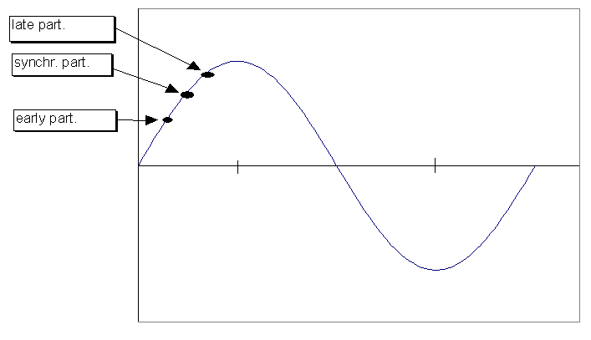
Acceleration
The particle that we use to calculate the phase along the accelerator and whose velocity is used to determine the synchronicity with the electric field, is called a synchronous particle.
RF voltage
RF phase [deg]
Energy gain of the synch. particle
-90
0
90
180
For phase stability we need to accelerate when dE_{z}/dz >0, i.e. on the rising slope of the RF wave

Slide 12
Transverse focusing
MAGNETIC FOCUSING (dependent on particle velocity)
  example: solenoid, quadrupole
ELECTRIC FOCUSING (independent of particle velocity)
  example: Einzel lens, RFQ
The transverse focusing force is characterized by transverse phase advance

Slide 13
- Overview of the ESS Normal Conducting Linac -

Slide 14
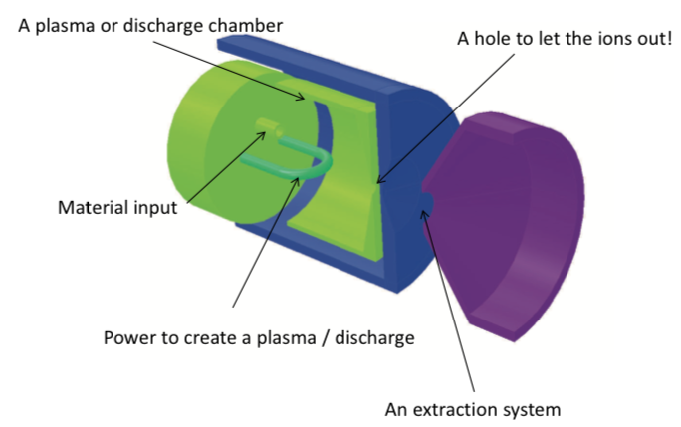
Particle sources
Main requirements for sources:
Generation of requested particles and intensity (beam current)
Beam quality (emittance) matched to the acceptance of following accelerator
Stable performance (low beam fluctuations, min. maintenance)
S. Gammino, “Ion sources for medical applications “, CAS’5

Slide 15
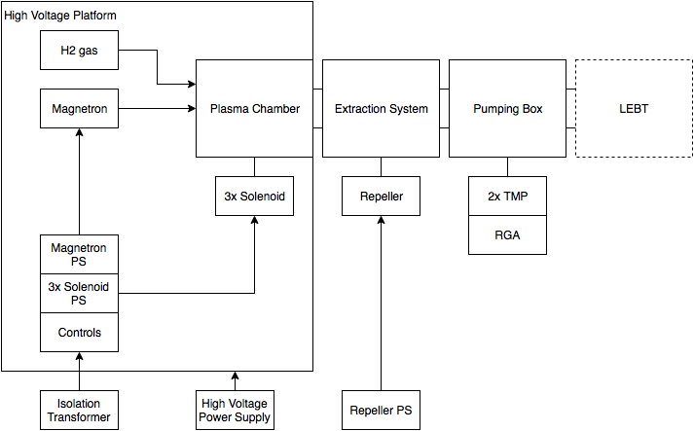
ESS Ion Source basics
The ion source has two main functions: creating the plasma and extracting the beam.
The plasma is created by a microwave discharge in a chamber filled with H₂ gas.
The RF power is generated by the magnetron and injected into the plasma chamber.
Three solenoids create an axial magnetic field that confines the plasma, and optimizes the ion production.
The isolation transformer feeds the electrical power necessary for all the equipment sitting on the HV platform, and isolates this environment form ground potential.
The equipment on the HV platform includes the magnetron power supply, the solenoid power supplies, and the controls.
The HV platform is charged to 75 keV by a high voltage power supply. This allows the beam to be extracted and accelerated to 75 keV by the extraction electrodes at ground potential.

Slide 16
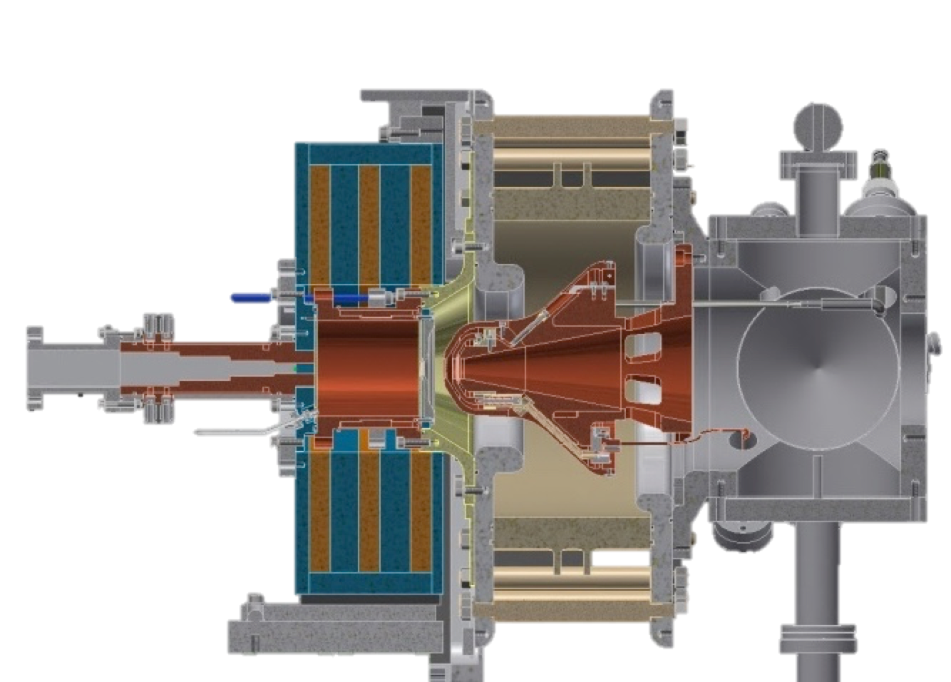
Ion Source
High voltage insulator
Extraction electrodes
Plasma chamber
Waveguide
Gas injection
Pumping ports
50 cm
Solenoid magnets

Slide 17
Ion Source Microwave System
Microwave System
Magnetron up to 2kW @ 2.45 GHz
WR340 Automatic Tuning Unit (ATU) for measurement and matching of the “load impedance” (plasma chamber)
Vacuum window + Tee/E-plane bend + Ridge coupler
Matching transformer

Slide 18
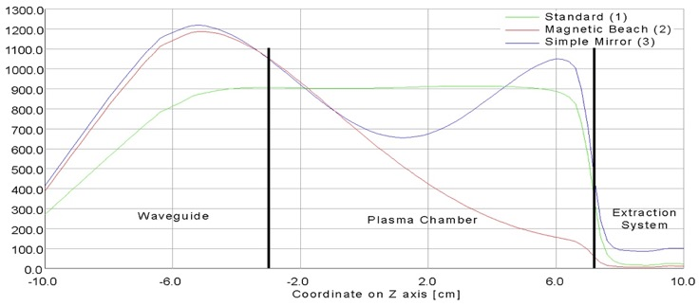
Ion Source-flexible magnetic system
Three compact copper magnets (coils) with ARMCO iron in between to ensure maximum flexibility

Slide 19
Ion Source extraction electrodes
Simulated beam distribution
2D beam extraction simulation (3 electrodes system)
Electric field in the acceleration region is less than 80 kV/cm to reduce the probability of discharge

Slide 20
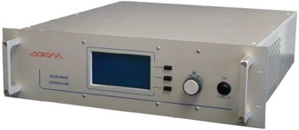
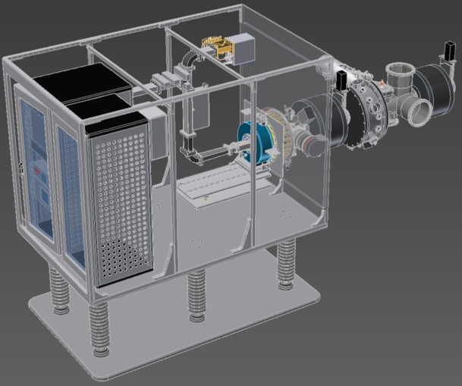
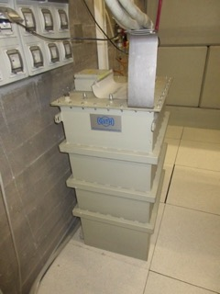
Ion Source – HV platform (75 kV)
Waveguide
Microwave generator
Extraction
75 kV
Proton source
Racks
HV insulators
Bottom plate at ground potential
HV Power Supply
Isolation Transformer

Slide 21
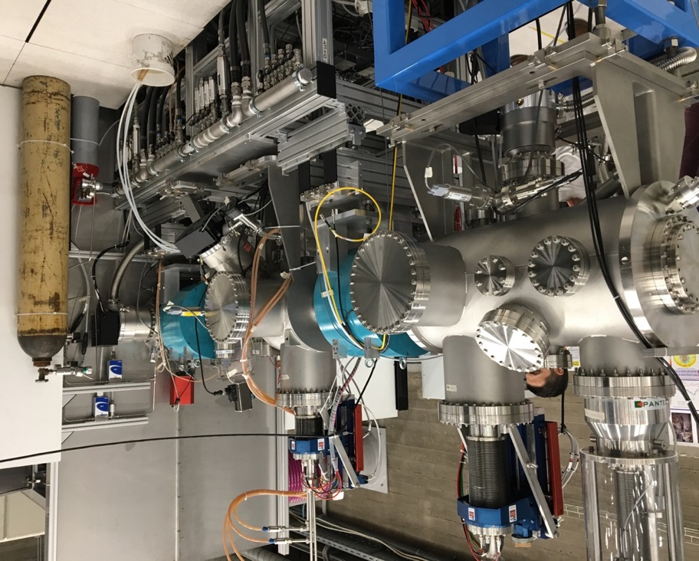
Low Energy Beam Transport (LEBT)
Main functions
Shape the transverse and longitudinal beam properties
Analyze the beam properties
Match the beam to the downstream section (RFQ)
LEBT as installed at INFN-LNS (Catania, Italy) including commissioning tank

Slide 22
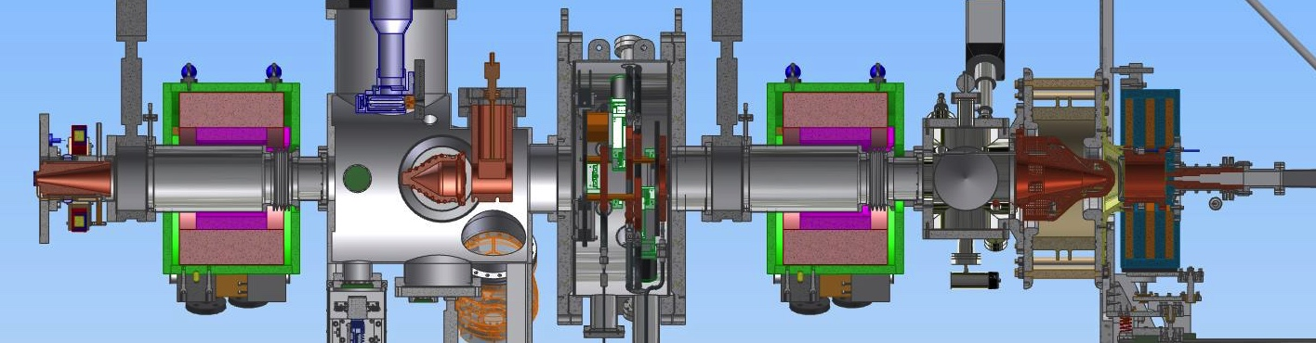
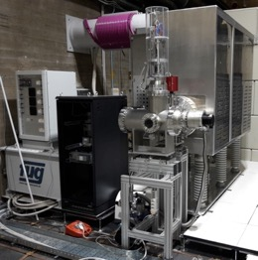
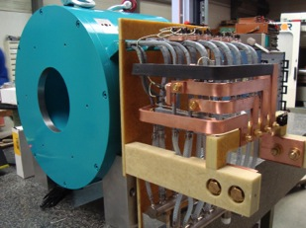
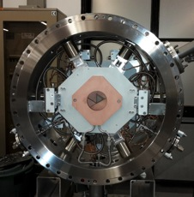
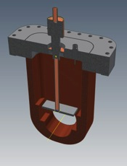
Low Energy Beam Transport
Extraction
extracts the beam
Pumping box
creates vacuum
Faraday Cup
measures beam current
Emittance-meter
measures beam emittance
Beam Current Transformer
measures beam current
Proton source
creates the beam
Solenoid
focuses the beam
Iris
controls the current
Chopper
controls the pulse length
Collimator
dumps the
chopped beam

Slide 23
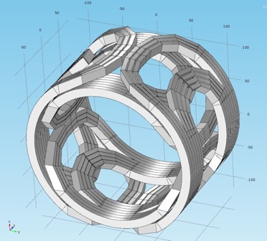
LEBT Solenoids
Solenoid magnet with integrated horizontal & vertical steerer coils
Based on design from CEA-Saclay for FAIR Project
Water-cooled
Solenoid
  B=0.486 T
  I=469 A
  P=12.5 kW
Steerers
  BL=14 mT.m
  I=120 A
Author: O. Delferriere
Steerer coils

Slide 24
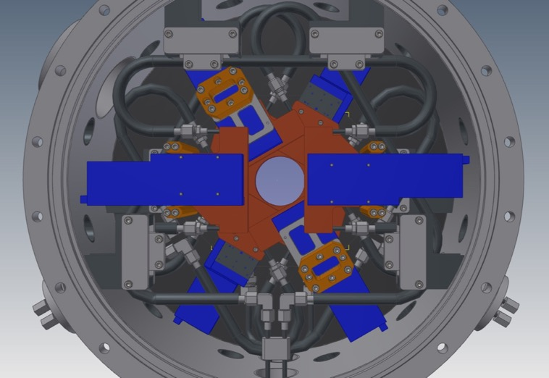
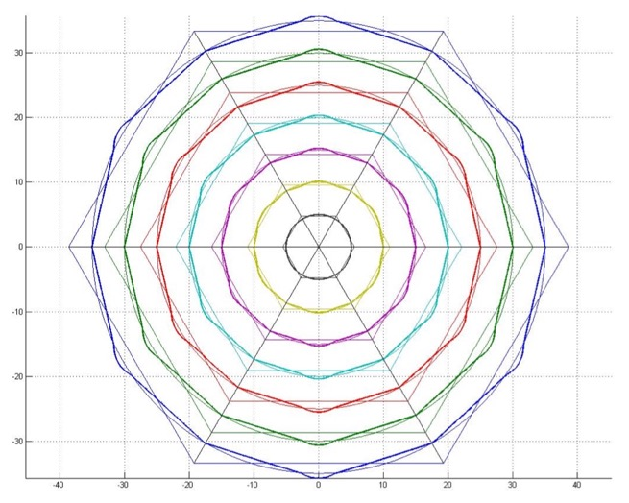
LEBT Iris
Hexagonal shape (6 water-cooled blades) to control aperture from 1 mm to 80 mm and consequently control beam current from 6 mA to 74 mA.

Slide 25
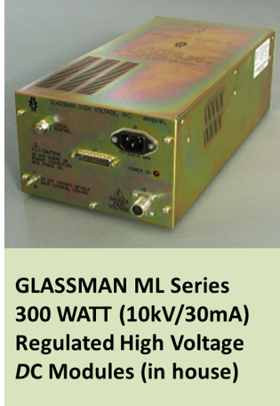

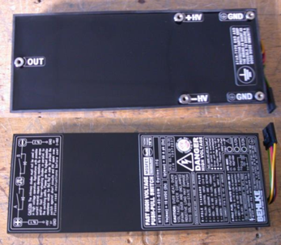
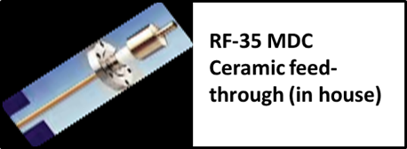

LEBT Chopper
230 VAC/50Hz
Variable
High Voltage Power Supply 0-10KV (30mA)
The chopper in short is….
+ 5 Vdc
High Voltage
Switch
High
voltage
0~10KV
Buffer Capacitor
capacitance
beam
BEHLKE HTS 151-0-3
Deflecting plates
TTL Driving signal
Frequency ≤ 20Hz
Duty cycle 0.01-10 %
Jitter < 100 ns
frequency
Courtesy: A. Caruso

Slide 26
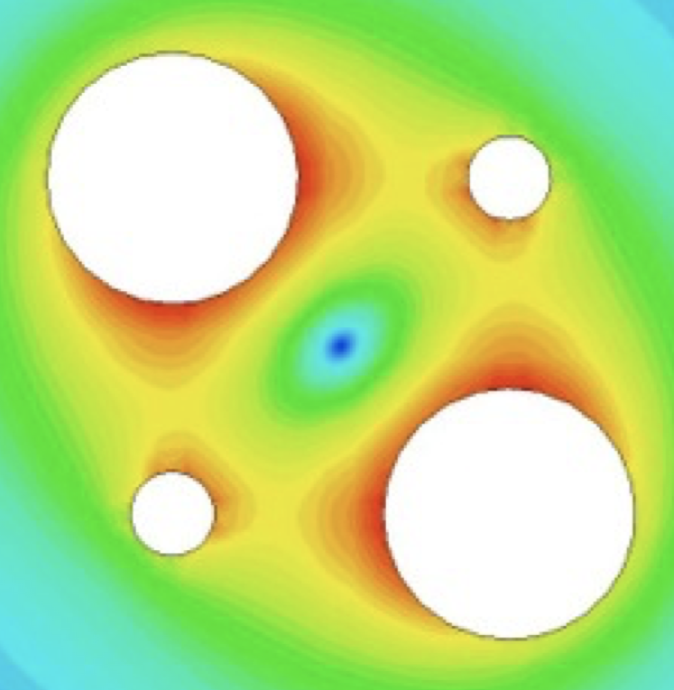
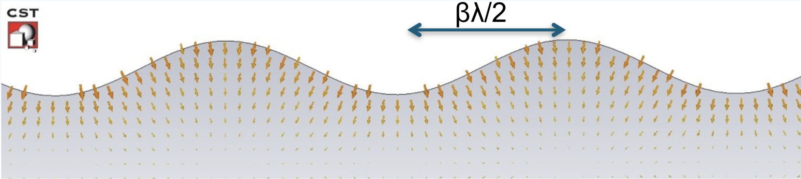
Radio Frequency Quadrupole (RFQ)
Purpose: Transition between ion source and DTL
Create particle bunches out of continuous beam from ion source
Accelerate bunches to energy, which is acceptable for the following structure
Special about the RFQ: accelerate (longitudinal forces) and focus (transverse forces) by electric field

Slide 27
Radio Frequency Quadrupole (RFQ)
In 1970 Kapchinsky and Teplyakov (K-T) proposed the idea of the radiofrequency quadrupole (I. M. Kapchinsky and V. A. Teplvakov, Prib.Tekh. Eksp. No. 2, 19 (1970))
The resonating mode of the cavity is a focusing mode
Alternating the voltage on the electrodes produces an alternating focusing channel
A longitudinal modulation of the electrodes produces a field in the direction of propagation of the beam which bunches and accelerates the beam
Both the focusing as well as the bunching and acceleration of the beam are performed by the RF field
The RFQ is the only RF linear accelerator that can accept a low energy CONTINOUS beam of particles

Slide 28
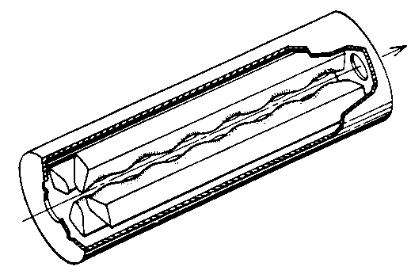
RFQ
cavity loaded with 4 electrodes (TE mode)
four-vane or four-rod
CERN RFQ1

Slide 29
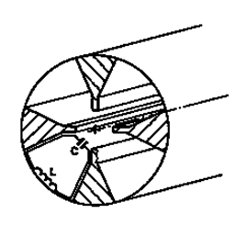
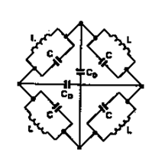
Four-vane RFQ
Capacitance between vane tips, inductance in the inter-vane space
Each vane is a resonator
Frequency depends on cylinder dimensions (good at freq. >200 MHz, at lower frequency the diameter of the tank becomes too big)
Vane tips are machined by a computer controlled milling machine
Need stabilization (problem of mixing with dipole mode TE₁₁₀)

Slide 30
Transverse focusing in RFQ
-V₀
+V₀
+V₀
-V₀
Close to the beam axis, an RF electric field is created between poles with transverse quadrupolare symmetry. The electric field contributes to beam transverse confinement (a time varying FODO channel).

Slide 31
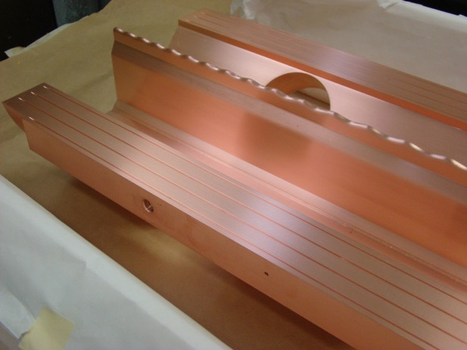
Bunching in RFQ
Pole modulation induces longitudinal electric field component,
Electric field amplitude is quasi-sinusoidal with z,
The longitudinal electric field component is increased by progressively increasing the modulation of the poles.

Slide 32
Acceleration in RFQ
modulation • aperture
aperture
The continuous beam is injected into the RFQ at -90° RF phase of the synchronous particle ➔ no acceleration, maximum acceptance.
Then the RF phase of the synchronous particle is shifted to higher values by progressively increasing the modulation period of the poles. ➔ adiabatic bunching
Up to ~ -30° for ➔ acceleration.
The process of adapting the RF synchronous phase is accompanied by bucket reduction. Beam should be bunched before acceleration process to accelerate as many particles as possible.

Slide 33
Main challenges in RFQ design
Low peak field (< 2 Kilpatrick),
Number of particles accelerated as high as possible,
Transmission as good as possible,
Control of beam losses,
Low emittance growth,
Low sensitivity to errors (misalignment …): tolerances,
Good vacuum properties,
Easy cooling,
Good RF stability,
Easy tuning.

Slide 34

ESS RFQ - overview
Length 4.5 m (between inner walls);
5 sections of ~0.9 m;
Axis to vane tip distance r₀= 3.530 to 5.332 mm;
Vane tip radius ρ= 3.0 mm;
Inter-vane gap g= 3.235 to 5.783 mm;
Peak RF power 1.6 MW
Vane voltage 80-120 kV
Vanes machining precision 20 μm, positioning and brazing precision 30 μm
Frequency tuning by cooling water temperature (skid)
Cooling water temperature 30±0.1 ºC

Slide 35
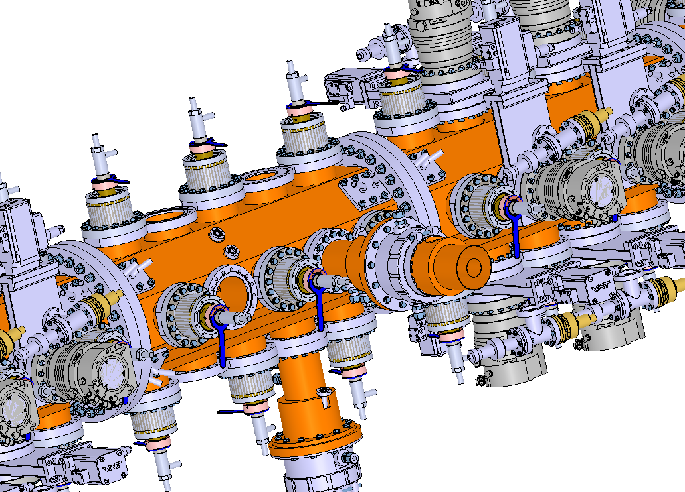
ESS RFQ - overview
Pumping system x10
Cooling connector x80
Tuner x60
Pick up x22
Fiducials x30
(not represented here)
RF Power Coupler x2

Slide 36
ESS RFQ - material
Material specs based on:
Radio-Frequency requirements
  High electrical conductivity
    Electromagnetic field from RF
Vacuum requirements
  Low outgassing rate for ultra-high vacuum
    Low pressure for RF and beam
Thermo-mechanics effect
Cooling process
  High thermal conductivity
    Stable temperature
Manufacturing procedure
  High machining precision
    Tolerance of ±20 microns (impacts RF and beam quality)

Slide 37
ESS RFQ - material
Cu-OFE is chosen for our application (NF EN 13604 =
ASTM B170 Grade 1)
  3D hot forging (800/800/400°C)
  Annealing (400°C / 1h)
  Grain size < 500 μm
  Hardness: Hv = 45 +/- 5
Has all required properties
  Low outgassing rate: 1.0e-6 Pa.m³.s⁻¹ (after 10h)
  High electrical conductivity: 101% IACS
  High thermal conductivity: 390 W.m.K⁻¹
Already used for other RFQs (IPHI, LINAC4, Spiral2)
Cu-OFE can be machined and brazed «easily»
Addition of a prevention step: HIP (High Isostatic Pressing)
  To avoid porosity/casting defects
  After copper delivery and before the start of machining

Slide 38
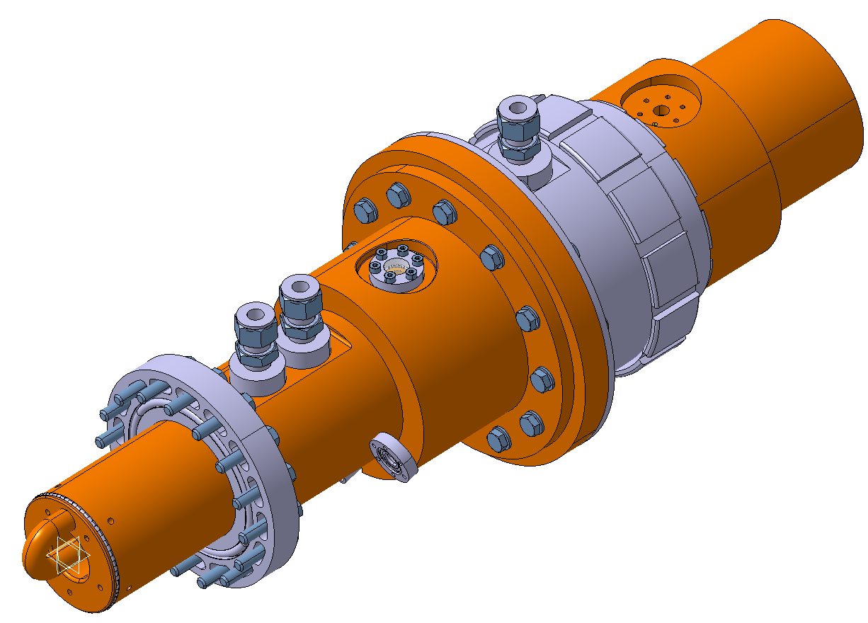
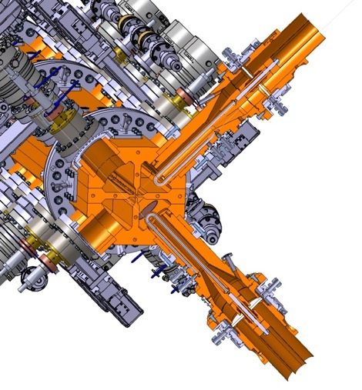
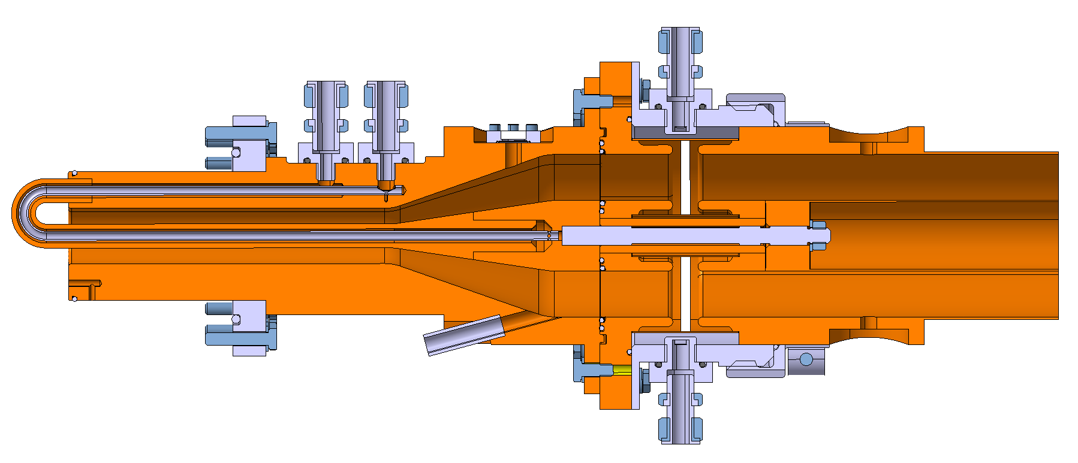
ESS RFQ RF Power Coupler
4’’1/2 Coaxial connector
SMS SPINNER
Couples 1.1 MW peak RF power
into the RFQ cavity
Water-cooling circuits
Ceramic RF window
(Alumina 97.6% pure)
Dimensional tolerance: 0.2 mm
Surface roughness: Ra 0.8
RF antenna (loop)
Dimensional tolerance: 0.2 mm
Surface roughness: Ra 0.8
Vacuum
Atmospheric pressure

Slide 39
ESS RFQ Tuner
Tuner IN
Tuner OUT
Main purpose of the tuner: ideal voltage law along the RFQ
Displacement range: 60 mm

Slide 40

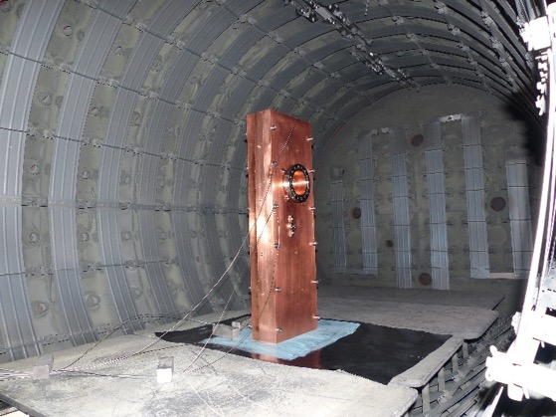
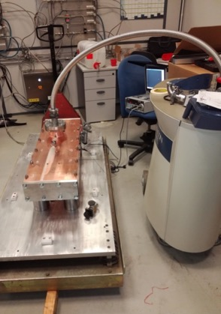
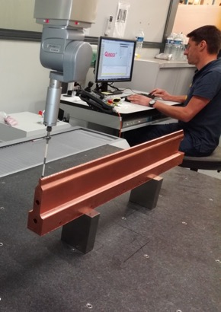
ESS RFQ section manufacturing
Test sample for validation of deep drilling process (10 mm holes with ±0.5 mm longitudinal deviation on 1m section)
Test sample for validation of machining process (±20 μm precision, Ra 0.8 μm)
Test sample for validation of
brazing process (Cu/Cu)
3D measurements of the machining mock-up vane
Brazing mock-up in oven at Bodycote
(±30 μm positioning precision)
Brazing mock-up leak test (leaks <1.10⁻¹¹ Pa.m³/s)

Slide 41
ESS RFQ section manufacturing
Major vane
Minor vane
Complete RFQ section
One step brazing
Machining
Assembly

Slide 42
RFQ validation
Vacuum leak test validation
RF test validation (bead-pull measurements)

Slide 43
ESS RFQ tuning
motor
frequency/phase meter
bead
pulleys
The electric and magnetic field can be separately measured in the same location by using both a metallic bead, which removes E and H-field volume, and then retracing the path with a dielectric bead, which alters the E-field only.
Subtracting one measurement from the other will separate the E and H fields in the path of the bead.

Slide 44
RFQ resonators (4-vanes)

Slide 45

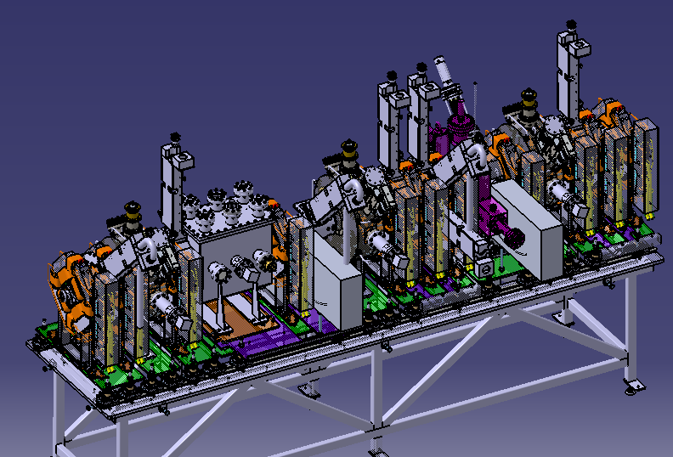
Medium Energy Beam Transport
Main functions
Shape the transverse and longitudinal beam properties
Analyze the beam properties
Match the beam to the downstream section (DTL)
Integration of large amount of components in a small space

Slide 46
MEBT components
Magnets – beam focusing and trajectory steering
Buncher cavities – keep beam bunched, match to the DTL
Chopper & dump – remove unwanted beam
Collimators – remove beam halo
Beam Diagnostics – monitor and measure beam properties

Slide 47
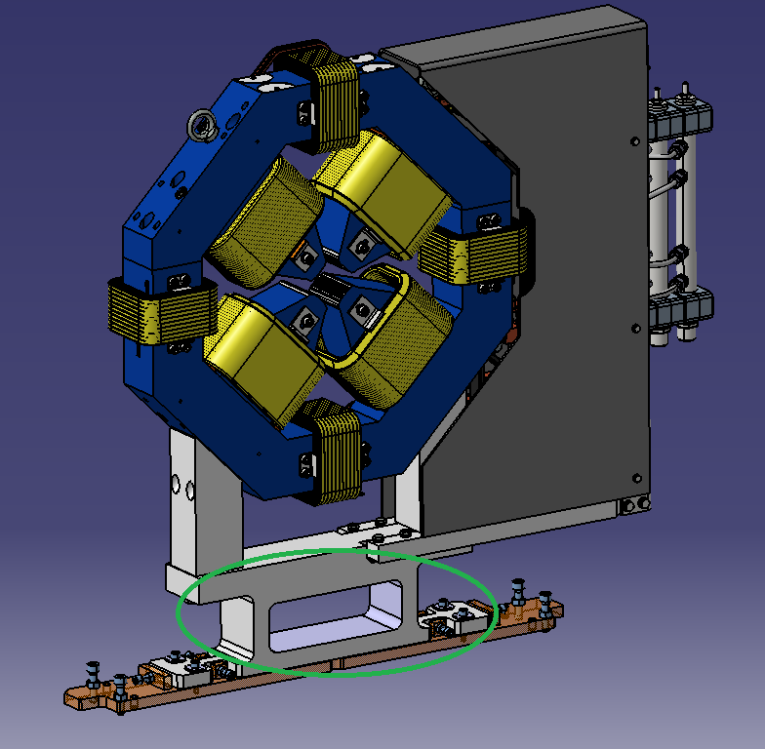
MEBT magnets
OFHC hollow copper conductor for quad coils
OFHC solid copper conductor for dipole coils
High purity iron with low carbon content for yoke
Magnet design by Danfysik
2D dipole fields
2D quadrupole fields

Slide 48
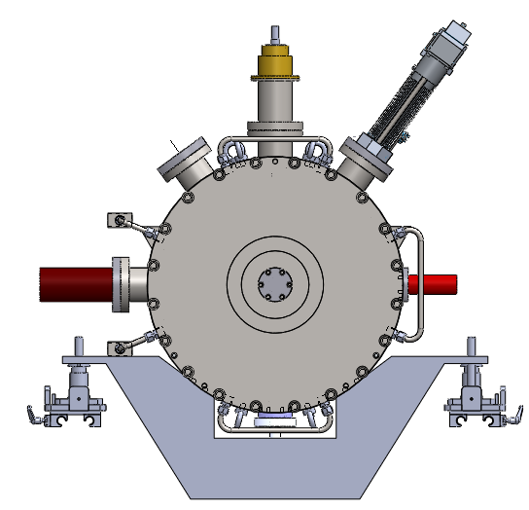
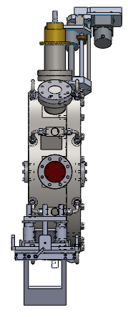
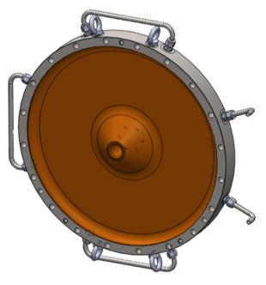
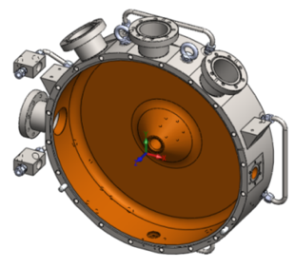
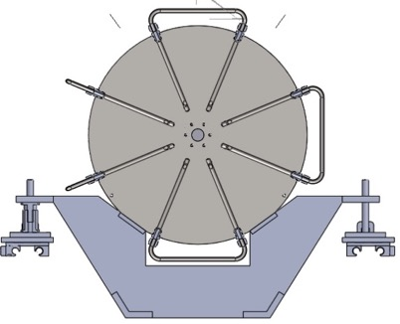
MEBT buncher cavities
A: Vacuum Port
B: Tuner Port
C: RF power Port
D: Tuner Port
E: Pick-Up Port
F: Gauge Port
G: Support
x: Blank Flange (Beam Pipe)
y: Body
z: Cover
C
B
D
y
z
A
F
x
x
E
Cover
G
Cavity machined out of AISI 304L stainless steel, inner surface copper-plated (30µm)
Diameter: 530 mm
Frequency: 352.2 MHz
Peak power: 20 kW
Effective voltage (E0TL): 150 kV
Body
Cooling channels

Slide 49
MEBT – assembly & alignment

Slide 50
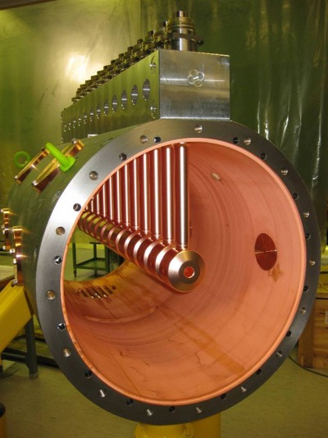
Drift Tube Linac (DTL)
CERN Linac4 DTL in the tunnel
CERN Linac4 DTL during the assembly

Slide 51

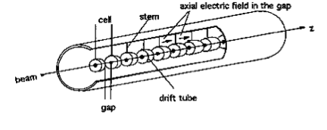
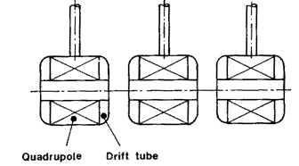
DTL essential features
Frequency range : 100 →400 MHz
(quadrupoles of a few cm in the drift tube at βλ minimum)
Diameter: 40 →150 cm
Tank length: 2 →20 m (maximum length allowed by the available RF source (MW’s))
There is space to insert quadrupoles in the drift tubes to provide the strong transverse focusing needed at low energy
The cell length (βλ) can increase to account for the increase in particle energy
DTL becomes less efficient (shunt impedance ↓)
at high energies (~50 - 100 MeV)

Slide 52
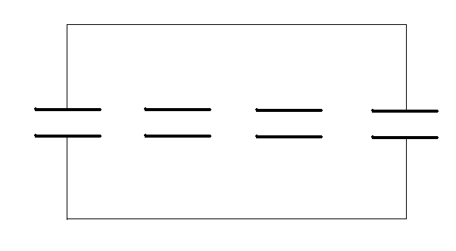
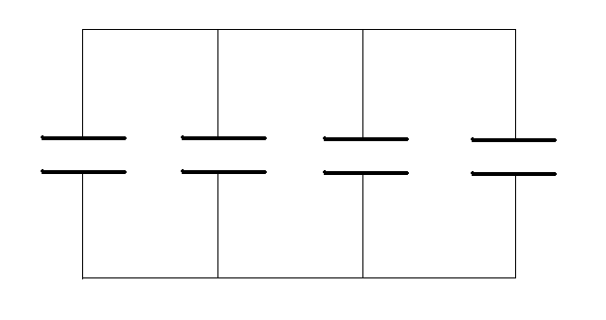
DTL operation principle
52
The DTL operates in 0 mode for protons and heavy ions in the range of β=0.04-0.5 (750 keV - 150 MeV)
E
Synchronism condition (0 mode):
z
l=βλ
The beam is inside the “drift tubes” when the
electric field is decelerating
The fields of the 0-mode are such that if we
eliminate the walls between cells the fields are
not affected, but we have less RF currents
and higher shunt impedance

Slide 53
DTL components
Drift tube
Tuning plunger
Quadrupole lens
Post coupler
Cavity shell

Slide 54
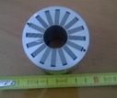
ESS Drift Tube Linac
License agreement for Linac4 DTL design and related patent signed between INFN and CERN
DTL total length is ~39 m;
5 independent tanks with 4 segments/modules each;
Segment/module length 1740-1990 mm;
Each segment of tank (equipped) weight is ~1700 kg;
Drift-tube length ~63 mm to ~225 mm;
168 drift-tubes in total, each of them is unique;
89 Permanent Magnet Quadrupoles (PMQ) inside drift-tubes;
4 Inter-tank sections to house the beam instrumentation
RF peak power per tank ~2.2 MW

Slide 55
DTL Tank Module
Tuner port
Girder housing
Post-coupler port
Water distribution
Inter-Segment Ring can be re-machined to allow alignment between segments and to compensate possible machining errors of the modules. Alignment precision 0.08 mm.
Water connector housing
M20 stud hole
Pick-up port
Hoist point
Laser Tracker reflector housing
Key aperture
Housing of the Helicoflex seal:
Vacuum tightness + RF continuity

Slide 56
DTL Tank and Girder
The design of the ESS DTL is derived from the CERN LINAC4 DTL
TANK:
MASTER structure acting as a high stiffness support
AISI 304L forged cylinder, machined with internal Cu-plating on finished surface;
Housing of the Helicoflex sealing of the drift-tubes.
GIRDER:
SLAVE structure for the precise positioning of the drift-tubes
EN AW5083 Al alloy machined bar
Housing for the water in and out connectors for the drift-tube stems
BLOCK:
Belleville washer loaded system to give the Helicoflex the sealing load between stem and tank
BLOCK
GIRDER
TANK

Slide 57
Drift Tubes
The vacuum brazing technique is a very well known and widely used technology at INFN-LNL
Good/excellent results in terms of maintaining the geometrical tolerances of the brazed components
Vacuum brazing has therefore been used instead of some EBWs of the LINAC4 design
water inlet
water outlet
Vacuum brazing
EBW
Stainless steel stem (Cu-plated)
To increase the inner space for the passage of cables for BPM and steerer with same mechanical characteristics;
To avoid the annealing of the copper during the brazing;
To have steel/steel surfaces for the Helicoflex sealing between stem and tank

Slide 58
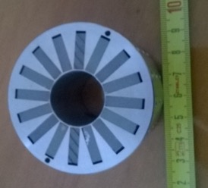
Drift-Tube with PMQ
The PMQ drift-tube is assembled in a two-step brazing procedure:
Step 1: brazing of the DT body with the internal components (sleeve, separation cylinder);
Step 2: brazing of the stem and internal pipe with the DT body;
After each brazing step a vacuum leak test is carried out
Stem references
Drift-tube references
PMQ references
The stem is machined to have the references for the assembly of the drift-tube with the positioning references on the girder
The PMQ housing is machined to have radial and longitudinal references for the PMQ
The DT body is machined to have laser tracker fiducials housing (3x)

Slide 59
ESS DTL Technological Methods
Copper-plating
Layer
Material
Thickness
Electroplating
Copper
x3÷x4 skin depth = 30 μm
Buffer Layer
Nickel / Copper
2÷4 μm
Substrate
≈ 50 mm
AISI 316L
Copper Plating
Copper Sulfate CuSO4 • 5 H₂O: 75 g/l
Sulfuric Acid (conc.): 100 ml/l
Chloride: 0.075 g/l
Voltage: 1.5 – 3.5 V
Temperature: 20-30°C
Current Density: 1.8-2 A/dm²
Time: 75 minutes (equal to 30 μm)

Slide 60
ESS DTL Technological Methods
Electron Beam Welding
single pass welding;
welding without filler material when there is no gap between the parts to be joined;
welding of very thick parts (tenths of mm) by the formation of a vapor capillary.
very narrow welds (molten zone and heat affected zone) because of the very high energy density;
welds inducing very low distortion, which makes these two processes a precision mechanical solution, since it thus becomes possible to weld machined parts or parts not requiring deformation correction after welding.
welds under vacuum (electron beam), which ensures a good protection against the oxidation of the molten zones and heat affected zones.

Slide 61
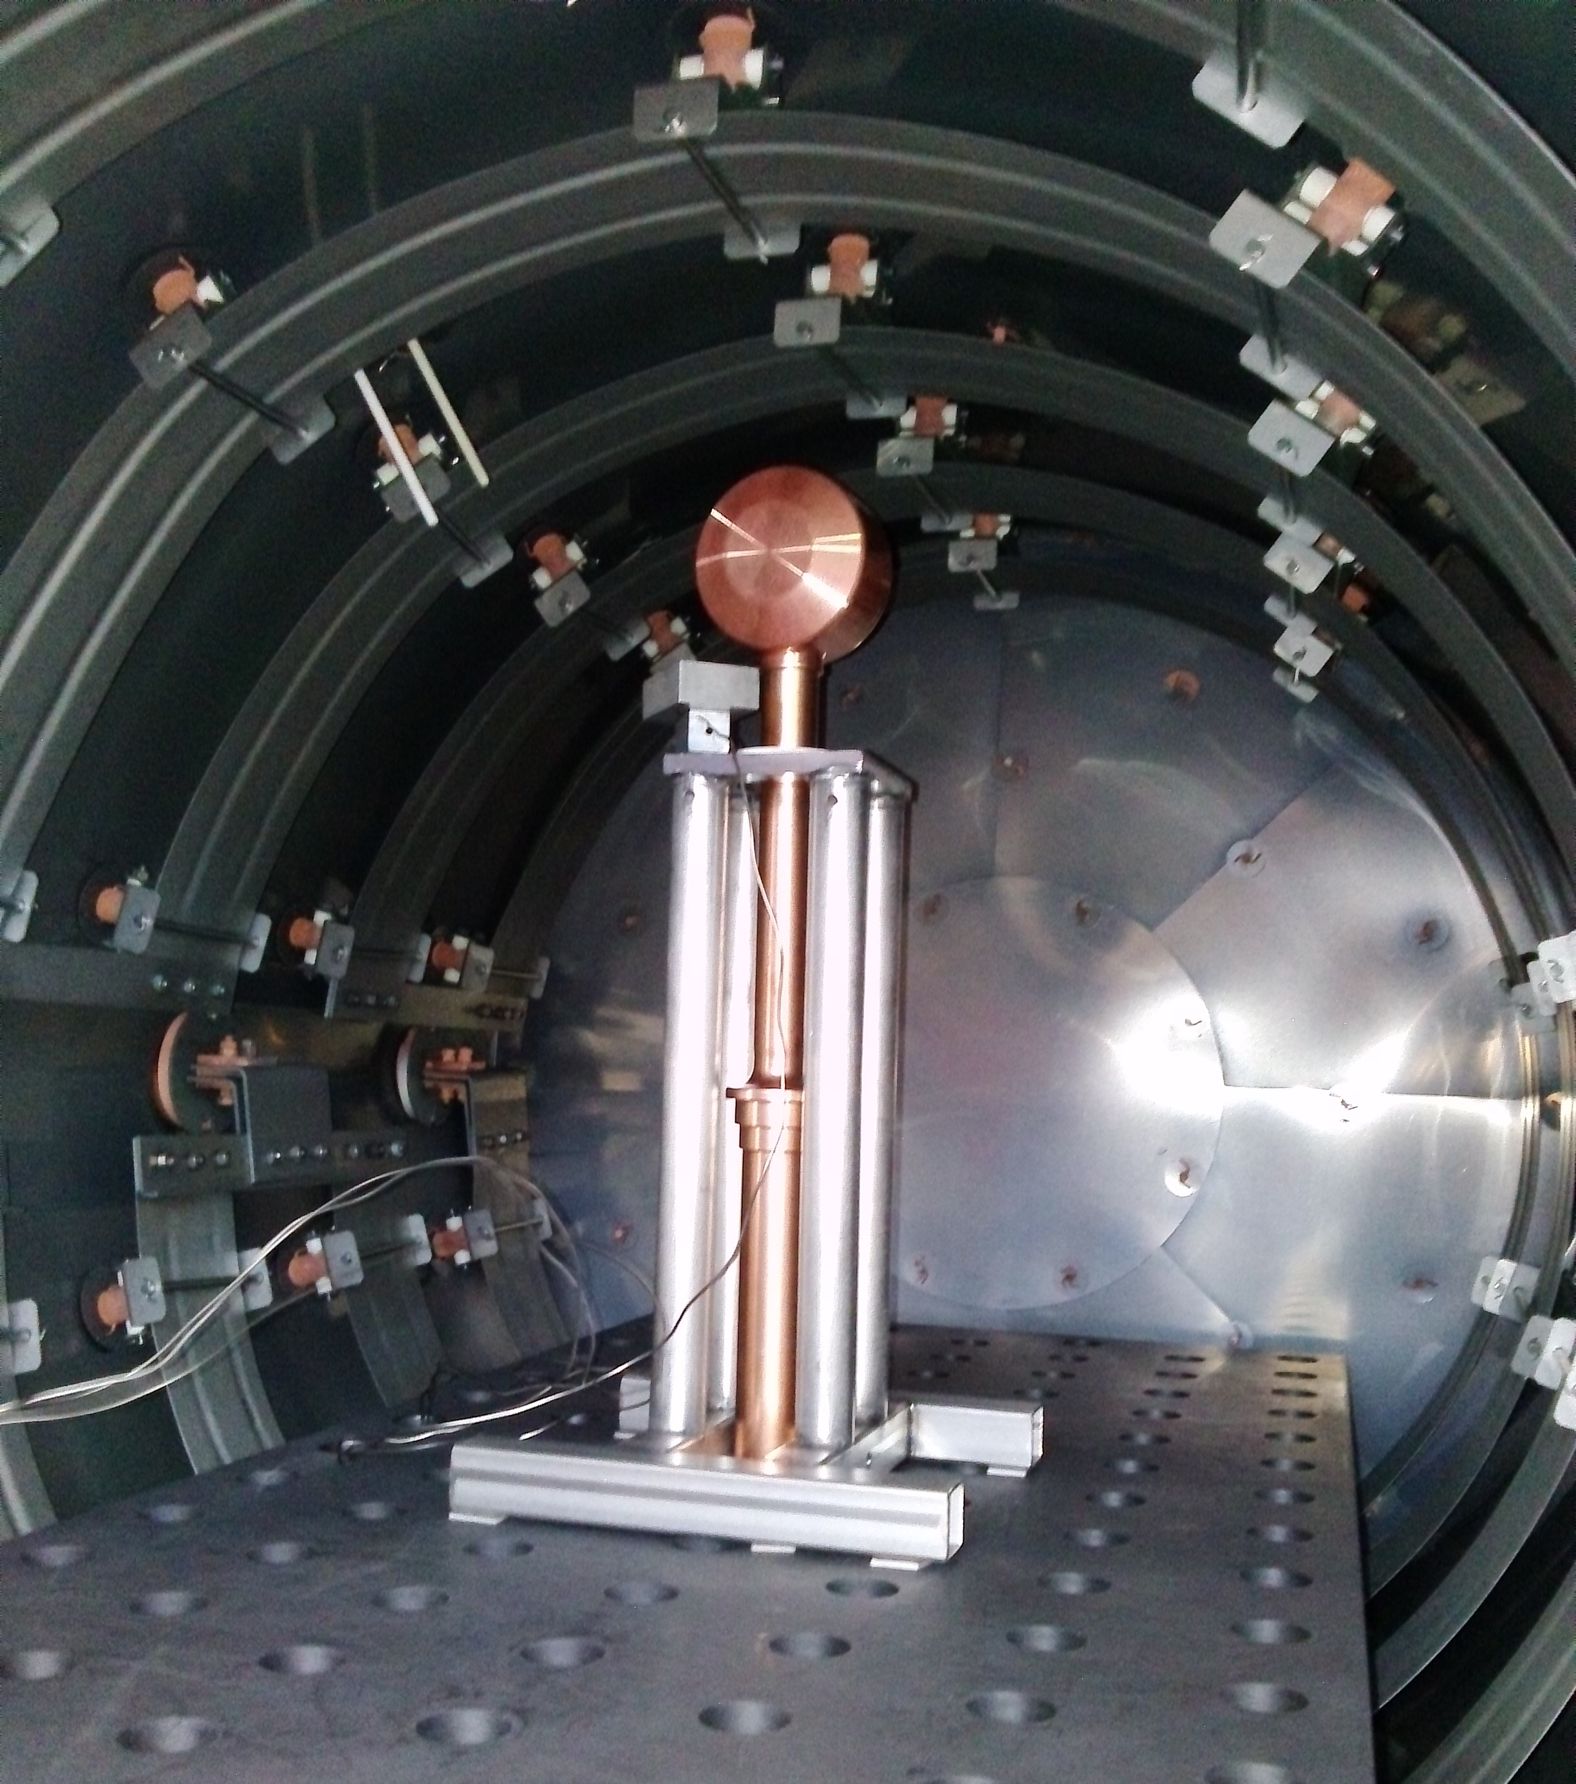
ESS DTL Technological Methods
Vacuum Brazing
Cu-Ag-Pd
Main features
Brazing does not involve any substantial melting of the base metals
Maintain closer assembly tolerances and produce a cosmetically neater joint without costly secondary operations.
Brazing makes it possible to join dissimilar metals (or metals to ceramics). Therefore, steel can be brazed to copper as easily as to another steel.
Brazing also generally produces less thermally induced distortion. An entire part can be brought up to the same brazing temperature.
Brazing readily lends itself to mass-production techniques. In fact, given the proper clearance conditions and heat, a brazed joint tends to make itself and is not dependent on operator skill, as are most fusion welding processes.
As a rule, the heat-affected zone (HAZ) produced during brazing is wider and less sharply defined than those resulting from other fusion-related processes.

Slide 62
Acknowledgements & References
Material of the lecture from
  CERN: A. Lombardi, M. Vretenar
  INFN-LNS: L. Allegra, A. Caruso, L. Celona, G. Gallo, S. Gammino, D. Mascali, L. Neri, S. Passarello, G. Torrisi
  CEA-Saclay: A. Alberi, D. Chirpaz, M. Desmons, A. France, M. Lacroix, N. Misiara, O. Piquet, B. Pottin
  ESS-Bilbao: I. Bustinduy, Fernandez-Cañoto, N. Garmendia, D. JL Muñoz, J. Martin, I. Rueda, A. Zugazaga
  INFN-LNL: F. Grespan, P. Mereu, A. Pisent, C. Roncolato
Accelerator Schools:
  CERN Accelerator School, http://cas.web.cern.ch/
  JUAS, http://www.esi-archamps.eu/Thematic-Schools/Discover-JUAS
Further reading:
  RF Linear Accelerators, T.P. Wangler, Wiley, 2008
  An introduction to particle accelerators, E.J.N. Wilson, Oxford Univ. Press, 2001

