Slide 1


ESS Cryomodules
Christine Darve
(with input from CNRS-IPNO and CEA-IRFU)
ESS Engineering Lecture
Lund University
September 14, 2017

Slide 2
Outline
  Cryomodule Functions
  Cryomodule Components
  Cryomodule Assembly
  How to operate a cryomodule

Slide 3
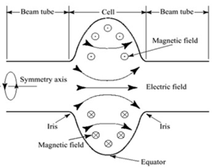
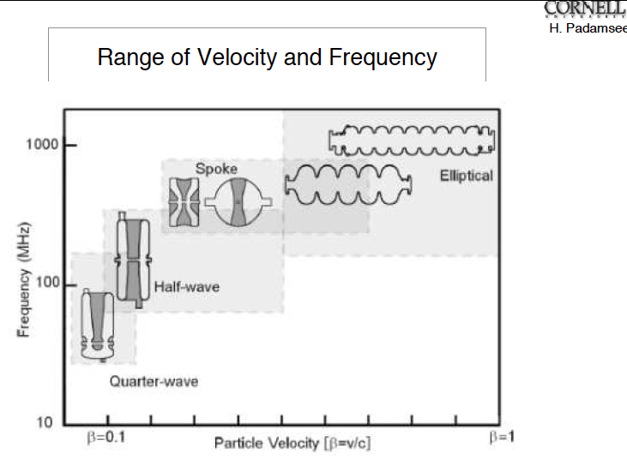
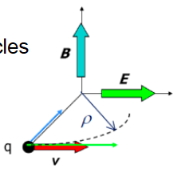
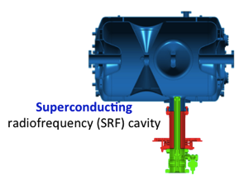
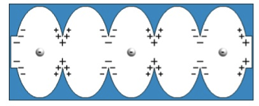
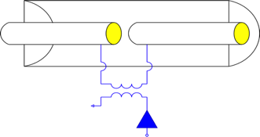

Main function: to house SRF cavities
Lorentz Force
Electrical Field
Magnetic Field
β= v/c
Low β − Spoke cavity
High β − Elliptical cavity
Gap
Beam
Power Coupler
Waveguide
RF Input
Power Amplifier (Klystrons)
Equivalent circuit for a 4 cell cavity with beam pipe

Slide 4
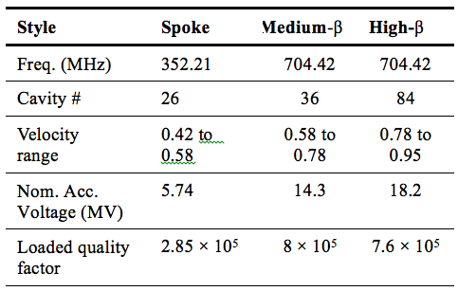
ESS Linear Accelerator Layout
352.21 MHz
704.42 MHz
2.4 m
4.6 m
3.8 m
39 m
56 m
77 m
179 m
Target
Source
LEBT
RFQ
MEBT
DTL
Spokes
Medium β
High β
HEBT & Contingency
75 keV
3.6 MeV
90 MeV
216 MeV
571 MeV
2000 MeV
➔ ESS needs high gradient SRF cavities
Notes:
400 m/ 600 m tunnel = SRF

Slide 5
ESS Requirements and RF Parameters
Spoke cavities
Elliptical cavities
Geometric beta | 0,50
Frequency (MHz) | 352,2
Nominal Accelerating gradient (MV/m) | 9
Lacc (βopt.x nb gaps x λ/2) (m) | 0,639
Bpk (mT) | 79 (max)
Epk (MV/m) | 39 (max)
Bpk/Eacc (mT/MV/m) | <8,75
Epk/Eacc | <4,38
Beam tube diameter (mm) | 50
RF peak power (kW) | 335
G (Ω) | 130
Max R/Q (W) | 427
Qext | 2,85 10⁵
Q0 at nominal gradient | 1,5 10⁹
 | Medium |  | High
Geometrical beta | 0.67 |  | 0.86
Frequency (MHz) | 704.42
Number of cells | 6 | 5
Operating temperature (K) | 2
Epk max (MV/m) | 45 | 45
Nominal Accelerating gradient (MV/m) | 16.7 | 19.9
Q₀ at nominal gradient | > 5e9
Q_{ext} | 7.5 10⁵ | 7.6 10⁵
Iris diameter (mm) | 94 | 120
Cell to cell coupling k (%) | 1.22 | 1.8
p,5p/6 (or 4p/5) mode sep. (MHz) | 0.54 | 1.2
Epk/Eacc | 2.36 | 2.2
Bpk/Eacc (mT/(MV/m)) | 4.79 | 4.3
Maximum. r/Q (W) | 394 | 477
Optimum β | 0.705 | 0.92
G (Ω) | 196.63 | 241
RF peak power (kW) | 1100

Slide 6
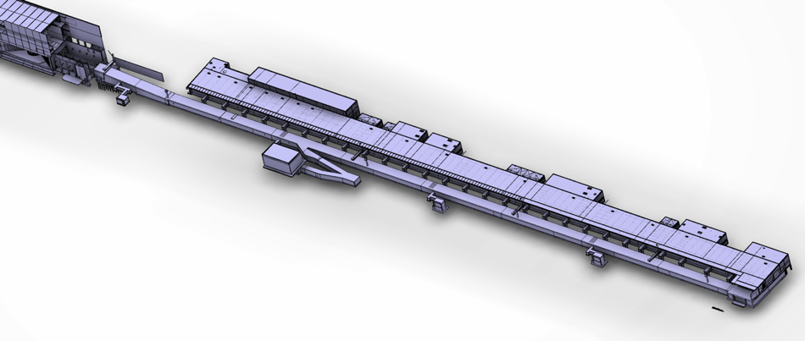
ESS Linac Layout
Beam power (MW) | 5
Beam current (mA) | 62.5
Linac energy (GeV) | 2
Beam pulse length (ms) | 2.86
Repetition rate (Hz) | 14
Target
A2T ← DgLg ← HEBT
2000 MeV
High β
Cryo
(179 m)
Medium β
571 MeV
(77 m)
 | Num. of CMs | Num. of cavities
Spoke | 13 | 26
Medium β (6-cell) | 9 | 36
High β (5-cell) | 21 | 84
Spoke
Warm
DTL
(56 m)
216 MeV
(39 m)
MEBT
(3.8 m)
RFQ
90 MeV
(4.6 m)
LEBT
3.6 MeV
(2.4 m)
Source
75 keV

Slide 7
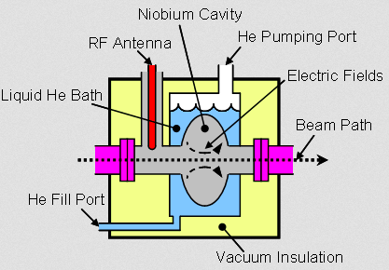
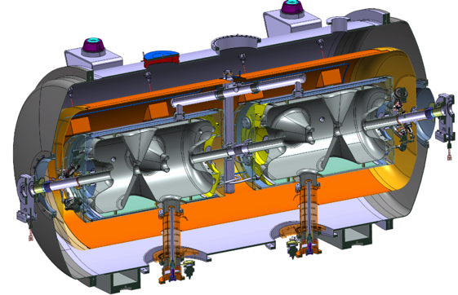
Cryomodules Function
A Cryomodule permits to operate SRF cavities in a cryogenics atmosphere.
For ESS, the Spoke and Elliptical cavities operate in a saturated superfluid helium bath

Slide 8
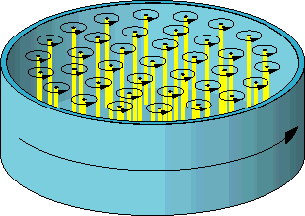

Environment - Superfluidity Helium and Supraconductivity (see Steve Molloy’s presentation)
Helium (25 %) is the most common element in Universe after Hydrogen (73 %)
Two isotopes: ³He (fermion) & ⁴He (boson)
Normal-fluid fraction:
excited states atom (phonons & rotons)
➔ like a conventional viscous fluid
finite density , r_{n}
finite viscosity, η
entropy, s
Superfluid fraction:
- atoms that have undergone BEC
➔ like an ideal inviscid liquid resulting in the absence of classical turbulence.
finite density, r_{s}
NO viscosity
carry NO entropy
irrotational behavior for an inviscid fluid
but vortices can be generated in the superfluid component
Counter-flow mechanics
Macroscopic quantum physic system simplification
The two-fluid model is only a phenomenological model !
Quantized vortices
No bulk flow
Heat flux
Counter-flow turbulence

Slide 9
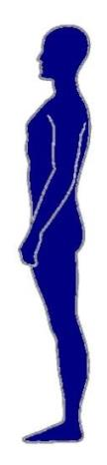

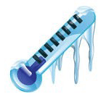

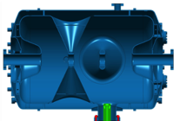
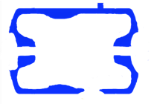
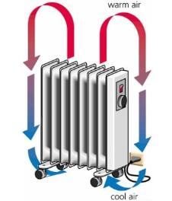

Spoke cryomodule
Acknowledgment: Patxi Duthil
A cryomodule: what is it and what for?
Room T°
Vacuum
Vessel
Thermal conduction
Thermal shield
T°≤ -200°C
Supports
Vacuum
T°≤-269°C
Thermal radiation
Superconducting radiofrequency (SRF) cavity
RF electro magnetic wave (352 MHz)
1/ To provide a cryogenic environment to the cold mass (cavity) = cryostat:
- distributing the cryofluids to cool-down and maintain at cold T° (LHe, LN₂)
- limiting the heat transfers

Slide 10
Spoke cryomodule
A cryomodule: what is it and what for?
Vacuum vessel
Supports
Supports
Cryomodule
Diag
Tunnel
2/ To support the cavities and perform accurate alignment
- with respect to the beam axis
- with respect to other linac components (cryomodules, diagnostics, tunnel)
NB: alignment must be preserved during thermal and pressure cycles

Slide 11
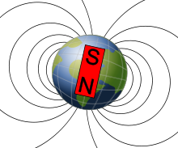

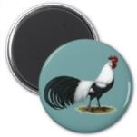
Spoke cryomodule
A cryomodule: what is it and what for?
Vacuum vessel
Magnetic shield
3/ To offer magnetic shielding
- from the local magnetic sources
- from the earth magnetic shield
NB: the magnetic shield might be cooled (for better performances)

Slide 12
Spoke cryomodule
A cryomodule: what is it and what for?
Vacuum vessel
4/ To provide all interfaces between the cavity and the tunnel:
- beam pipe
- RF
- cryogenic
- vacuum
- diagnostic (instrumentation)
- mechanical (support and alignment)

Slide 13
Outline
  Cryomodule Functions
  Cryomodule Components
  Cryomodule Assembly
  How to operate a cryomodule

Slide 14
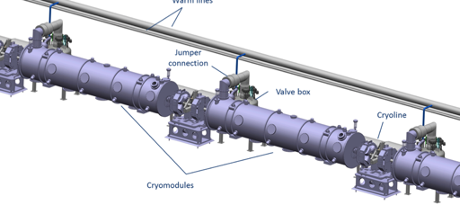
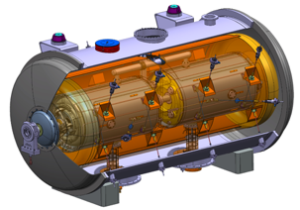
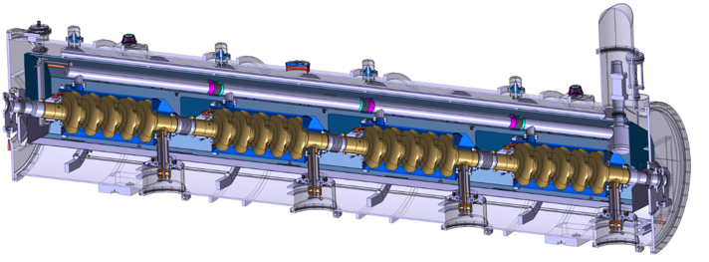
ESS SRF cavities and cryomodules
2 Spoke Cavities per Cryomodule
Segmented SRF linac with RT focusing elements
Nb cavity enclosed in Ti Helium tank
Cold tuning System
4 Elliptical Cavities per Cryomodule
Power coupler
Magnetic shield
Notes:
2 spoke – 3 gap
4 cavity – SNS like
Segmented SRF linac with RT focusing elements

Slide 15
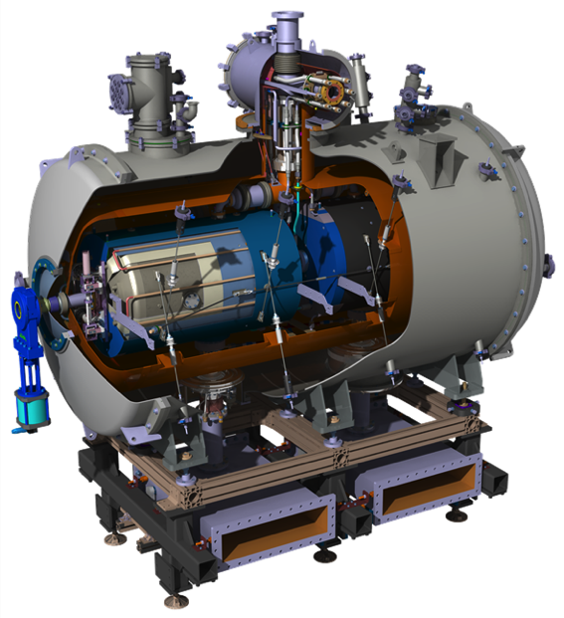
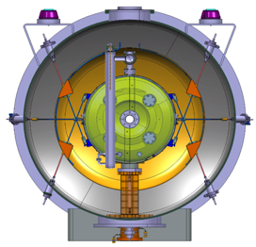

Spoke cryomodule
Diameter
1350 mm
2900 mm

Slide 16

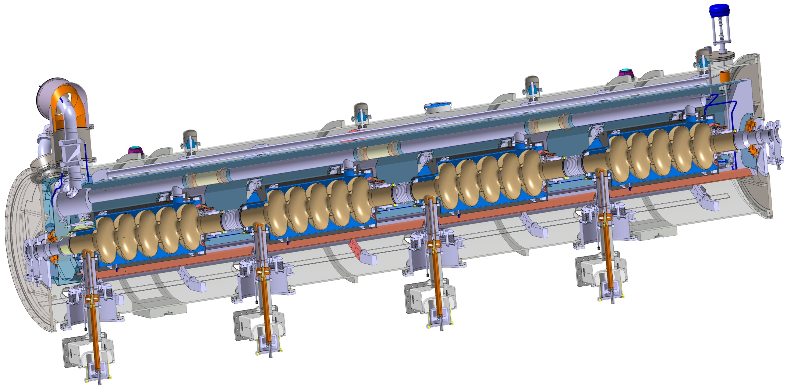
Elliptical cryomodule
Similar to CEBAF/SNS cryomodule concept with 4 cavities per cryomodule
Common design for medium (6 cells) and high beta (5 cells) cavities
Regulation He valve
Thermal shielding
Alignment fiducial
Vacuum valve
Jumper connection
Magnetic shielding
Spaceframe support
Heat exchanger
Diphasic He pipe
Proton Beam
Cavity with Helium tank
Intercavities bellows
Power coupler
Warm to cold transition

Slide 17
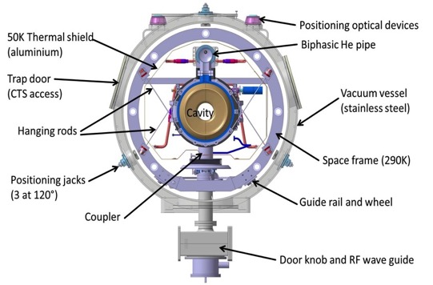
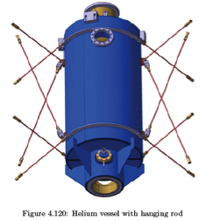
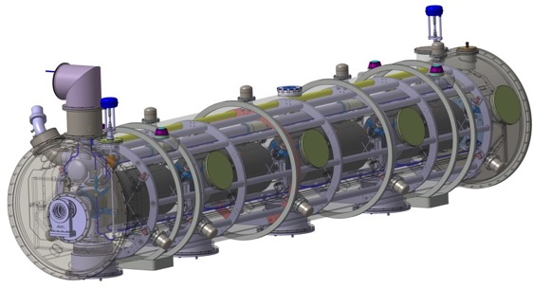
Elliptical Cryomodule Components
50K Thermal shield
Positioning optical devices
Two phase He pipe
Lateral port
(CTS, alignment)
Vacuum vessel
(stainless steel - 1200 mm diam.)
Tie rods (TA6V)
Space frame
Positioning jacks
(3 at 120°)
Power coupler
Guide rail and wheel
Wave-guide transition
Cryogenic line interface
The cryomodule design and calculation:
Thermo-mechanical studies
Magnetic studies
Safety analysis to size all components
Reliability analysis, FMEA
Access traps to the tuners

Slide 18
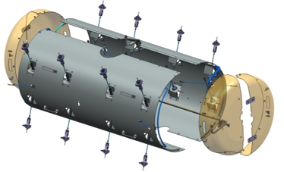
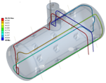
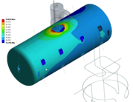
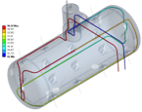
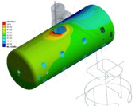
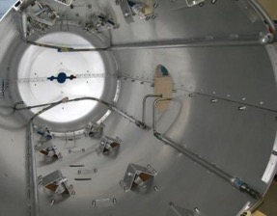
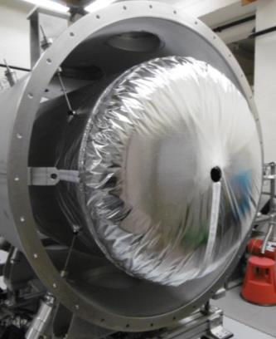
Thermal shield for Spoke cryomodule
He 20 bars
(machine)
    Material: Al6062
    Thickness: 2 mm
    Assembled and supported (rods)
Sat N₂
(Proto)

Slide 19

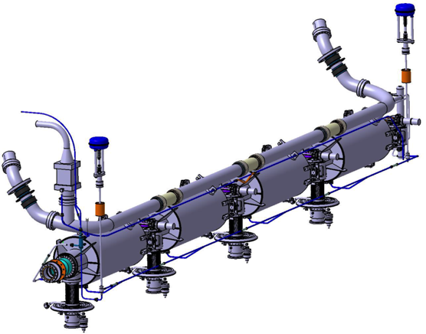
Safety relief devices
Identify: Hydraulic circuits
  volume and pressure
    fluid
  most credible incident
Assess/calculate:
Pressure drop distribution
        Mass-flow to extract
        Diameter of the relief
        Type of device
Mitigate/design ➔

Slide 20
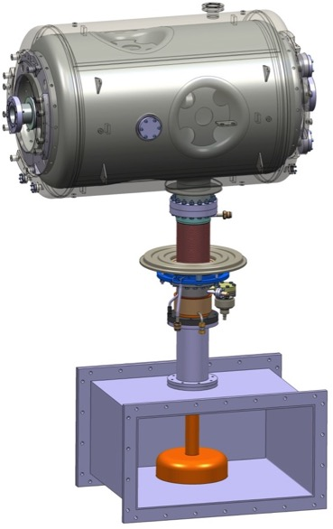
Cavity package
Double Spoke Cavity
Cold Tuning System
Heat exchanger necessary to make
the transition from 300 K to 2 K
Integrating a mechanical system
to compensate efforts
RF Power Coupler
Doorknob – Transition between
the coaxial power coupler and
the WR2300 rectangular waveguide

Slide 21
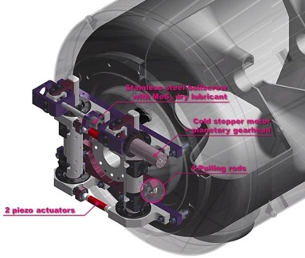
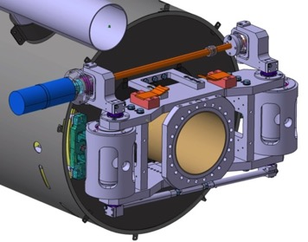

Cold Tuning System
Spoke CTS
Elliptical CTS
Type V ; 5-cell prototype
+/- 3 mm range on cavity
Stepper motor and planetary gearbox (1/100e) at cold and in vacuum
2 piezo stacks
Slow tuner
Main purpose : Compensation of large frequency shifts with a low speed
Actuator used : Stepper motor
Fast tuner
Main purpose : Compensation of small frequency shifts with a high speed
Actuator used : Piezoelectric actuators
&

Slide 22
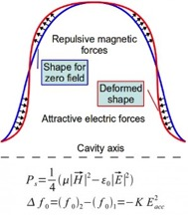
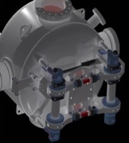

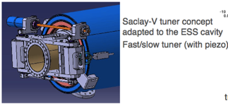
Cavities tuning: Lorentz De-tuning
ESS and long pulse: 2.86 ms
Because of the enormous gradients in superconducting cavities,
  the radiation pressure deforms the cavities
We expect over 400 Hz of detuning in the ESS cavities
  Unloaded cavity bandwidth = 0.07 Hz
  Loaded cavity bandwidth = 1 kHz
The mechanical time constant of the cavities is about 1 ms compared to the pulse length of 3 ms
  Static pre-detuning as done in SNS will not be sufficient
  Dynamic de-tuning compensation using piezo-electric tuners is a must!
  Or else pay for the extra RF power required

Slide 23
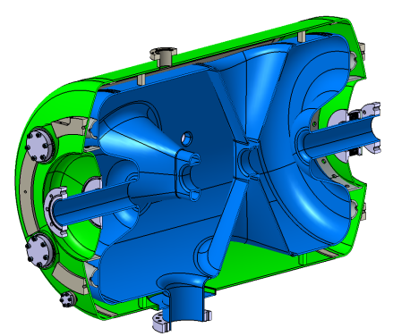
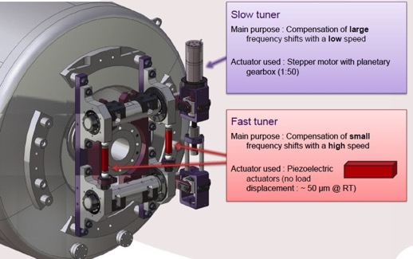
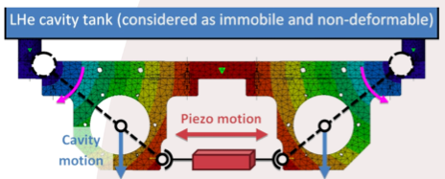
The Spokes Cryomodule
Helium tank
4 HPR Ports
Bellows
Coupler port

Slide 24
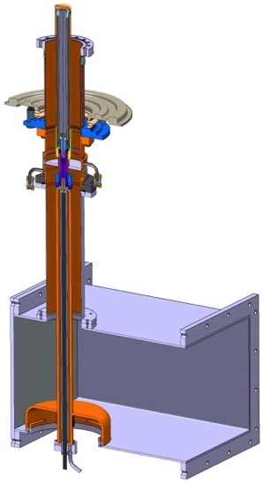
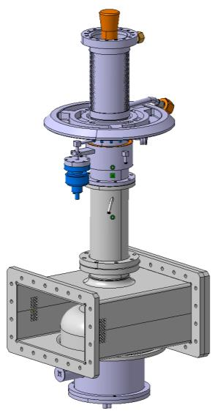
Fundamental Power Coupler
Antenna
Vacuum
Outer conductor
(LHe-cooled)
Spoke:
335 kW
Elliptical:
1.1 MW
Inner conductor
(water-cooled)
Al₂O₃
ceramic disc
WR2300
Short circuit
RF input
Doorknob

Slide 25
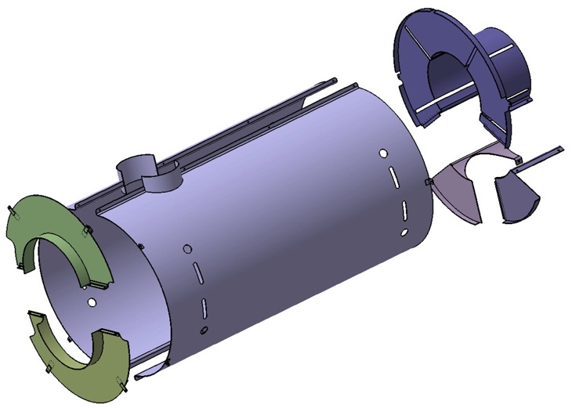
Magnetic shield for Elliptical Cavity
Courtesy of J. Plouin/ CEA
Achievable with 1.5 mm,
µ_{r} =20000 shielding material
Limit contribution of the trapped flux to the surface resistance to 4 nΩ
Limit the external static field to Bext = 14 mG.
→ Required shielding efficiency equal to 35.

Slide 26
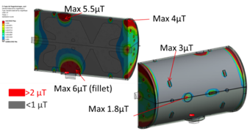
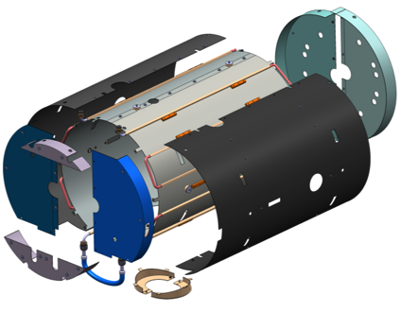
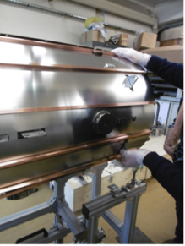

Magnetic shield for Spoke Cavity
Cooling circuit
Internal shield
Tuner side ends
External shield
Shrim
Cavity bellow side ends
Material: Cryophy®
Actively cooled (better performances)
Shield support
Coupler shield
    Magnetic shields fabricated
    Assembly test performed
    To be tested within the cryomodule

Slide 27




Validation of spoke cryomodule component performance
Step 1: Spoke cavity
@ IPNO
@ Uppsala University - HNOSS
Step 2: Spoke cavity packages
@ IPNO - Warm and 4 K
@ UU - HNOSS
Step 3: Cryomodule w/ prototype valve box
@ IPNO
@ UU - HNOSS
Double spoke cavity, 352.2 MHz, β=0.50
Goal: Eacc = 9 MV/m [Bp= 62 mT; Ep = 39 MV/m]
Lorentz detuning coeff.: ~-5.5Hz/(MV/m)²
Tuning sensitivity Δf/Δz = 130 kHz/mm
Notes:
between coaxial power coupler and WR2300 waveguide
(eg. mag. Shield cooling validated at HNOSS !)

Slide 28








Spoke cavities results @ IPNO
View of the spoke cavity bars
Romea
Giulietta
Germaine
Inter-cavity bellows
Thermal shield
Spoke cryomodule vacuum vessel:
Fabrication achieved (FAT done)
Magnetic shield
No heat treatment
No baking
Cold Tuning System
Notes:
Germaine died after final BCP (after HPR)
Eacc_max=15.3 MV/m achieved with “Romea” , Qo > 1.6 10¹⁰
Several MP barriers but easily processed.
Strong FE at max gradient
Limitation is the cooling capacity (unstable conditions, cavity in vertical position)

Slide 29












Test Stand and coupler conditioning
@ IPNO
Power coupler conditioning
Clean room ISO 4
Surface treatment
lab
Furnace
Control and security rack
(with fast interlocks)
Vertical cryostats
Notes:
Infrastructure adapted from earlier use (e.g. Spiral2)
Heat treatment furnace by the earlier cooperation agreement – chemical treatment
Conditioning of power-coupler

Slide 30
Outline
  Cryomodule Functions
  Cryomodule Components
  Cryomodule Assembly
  How to operate a cryomodule

Slide 31


Cryomodule life-cycle
High pressure rinsing
In clean room (ISO5 or ISO4)
Cavity fabrication
Chemical treatment
Validation test of the cavity in vertical cryostat
Transport
Cryomodule components fabrication
Cryomodule reception and storage
Qualified cavity storage
Cavity string assembling in clean room
Cryomodule assembling
Validation test of the cryomodule
Processed couplers storage
Tools fabrication
Cryomodule storage
Coupler RF processing
Space frame
Tuning system
Assembling in clean room
Magnetic shield
Cryomodule on beam line
TA6V rods in X pattern to keep the beam axis at the same position during cool down
Power coupler fabrication
Beam valves and extremity flange
31
Notes:
QA control

Slide 32



Elliptical Cavity Preparation
Elliptical beta cavity fabrication
Vertical Electropolishing system@ CEA

Slide 33





Elliptical Assembly Procedure
Cavity string assembly in clean room
Build on existing knowledge (SNS, XFEL)
Develop Training and “Fabrication file”
Pre-industrialization
Industrialization
Cold mass assembly (outside the clean room)
Spaceframe
Thermal shield
Vacuum
vessel
Design concept of the tooling: most of parts will be used for both types of elliptical cryomodules
Notes:
Only minor differences:
Length of the inter-cavity bellows, details in cryo piping, beam pipe bellows
Tuner piezo frames
Penetration of the antenna for Q_{ext} adjustment

Slide 34






Infrastructure in Saclay
    Clean room for the M-ECCTD (and H-ECCTD)
High Pressure Rinsing HPR
    Possible IKC for the assembly by industry at Saclay (XFEL cryomodules assembly)
    Uses the current infrastructure at Saclay
    Benefits from the experience of the XFEL cryomodule assembly (ALSYOM)
IS0 7 27,5 m²
Water cleaning
IS0 5
52,69 m²
    The clean room inauguration
    → May 13th 2014
Notes:
Only minor differences:
Length of the inter-cavity bellows, details in cryo piping, beam pipe bellows
Tuner piezo frames
Penetration of the antenna for Q_{ext} adjustment

Slide 35



Assembly process inside the clean room

Slide 36
Outline
  Cryomodule Functions
  Cryomodule Components
  Cryomodule Assembly
  How to operate a cryomodule

Slide 37


Cryomodule Interfaces
Disciplines: beam optics, RF, cryogenics, vacuum, electrical, cooling
Test stands
Control command (Control Box, PLC, LLRF, MPS, EPICS)
Quality Assurance
Data-logging
ES&H
Conventional Facility
Survey
Logistics (Transport, storage)
Cryogenic distridution
Cryogenic distribution
Control system
Beam Diagnostic
Beam Optics
Beam Vacuum
Radio-Frequency

Slide 38


RF power test stations at CEA Saclay
704 MHz
RF Plateform
Modulator HT 110 kV
Coupler Conditioning
Klystron:
704 MHz
1 MW
Manual switch
Pilot
Switch RF
Water
vacuum
Safety
RF
Circulator + load
Security box
Security box
water
C/C
C/C
waveguides
C/C
C/C
ESS Cryomodule
(ECCTD+ pre-series)
Supratech
Cryogenic system
Vacuum
Water
safety
Cryo
RF
Fast acquisition (RF signals, electron pick-up,
arc detector by photomultipliers)
+ slow acquisitions (vacuum…)
Security box
Signals for fast interlock
C/C
C/C

Slide 39







Test Stand @ Uppsala (FREIA)
RF Power Source + LLRF
Control System & Interlock
HNOSS
Cryogenics
Spoke & Elliptical cavity package
SRF cavity
Notes:
Thanks to an earlier collaboration with UU to build up capacity in UU from 2011
support for multi-disciplinary cryostat and lab

Slide 40




Validation of Elliptical Medium-β
Technology Demonstrator
Step 1: Elliptical cavities
Medium-beta
@ Saclay
@ LASA
Step 2: M-Elliptical Cavity Cryomodule Technology Demonstrator
@ Saclay
@ Lund
 | LASA | CEA
Q_{ext} | 7.7×${10}^{5}$ | 7.5×${10}^{5}$
k | 1.55% | 1.22%
sep. (MHz) | 0.70 | 0.54
G (Ohm) | 198.8 | 196.6
r/Q (Ohms) | 374 | 394
E_{peak}/E_{acc} | 2.55 | 2.36
E_{peak} (MV/m) | 42.6 | 40
B_{peak}/E_{acc}(mT/MV/m) | 4.95 | 4.79
M-ECCTD = 3 CEA cavities + 1 LASA cavity
Notes:
Design of Mb (even if Hb first proto in the framework of the cooperation agreement).
Test of 6 Mb
Added LASA in the SRF collaboration at a later stage.
Complete a new RF design plug-compatible with Mb cryomodule. test
Cell to cell coupling, k
Pi and 5pi/6 separation mode +30%

Slide 41

Process and Instrumentation Diagram
Instrumentation function
  Monitoring
  Control
  Interlock
  Alarms
Operating Modes under definition

Slide 42
Cryogenic operating modes
Acknowledgment : N Elias

Slide 43

Control integration

Slide 44

Superconducting linac
Klystron gallery
 | MEDIUM-β | HIGH-β
β | 0.67 | 0.86
# CM | 9 | 21
Cav. /CM | 4 | 4
# Cav. | 36 | 84
CM L [m] | 6.584 | 6.584
Sector L [m] | 77 | 179
Elliptical cavity Cryomodules ECCTD
Proton Beam
→ 70% of the phisical length of the linac
→ 95 % of the proton acceleration

Slide 45



Elliptical (704 MHz) RF System Layout
One cavity per klystron
4 klystrons per modulator
16 klystrons per tunnel penetration
Tunnel

Slide 46

Elliptical (704 MHz) RF System Layout
Klystrons
Racks and Controls
Modulator
WR1150 Distribution
4.5 Cells of 8 klystrons for Medium Beta
10,5 Cells of 8 klystrons (IOTs) for High Beta

Slide 47


Acknowledgements & References
ESS SRF Linac Collaborative Space: https://confluence.esss.lu.se/display/CRYOM
US-Particle Accelerator School, http://uspas.fnal.gov/materials/materials-table.shtml
CERN Accelerator School, http://cas.web.cern.ch/cas
JUAS, https://espace.cern.ch/juas/SitePages/Home.aspx
NPAS, https://npap.eu/
Few books
RF Linear Accelerators, T.P. Wangler, Wiley, 2008
RF Superconductivity for Accelerator, H. Padamsee, J. Knobloch, T. Hays, Wiley, 2011
An introduction to particle accelerators, E.J.N. Wilson, Oxford Univ. Press, 2001
An introduction to the physics of high-energy accelerators, D.A. Edwards & M.J. Syphers, Wiley, 1993

Slide 48
Extra slides

Slide 49


The Spokes Cryomodule
Ceramic disk, 100 mm diameter
400 kW peak power (335 kW nominal)
Antenna & window water cooling
Outer conductor cooled with SHe
Double spoke cavity (3-gaps), 352.2 MHz, β=0.50
Goal: Eacc = 9 MV/m [Bp= 62 mT ; Ep = 39 MV/m]
4.2 mm (nominal) Niobium thickness
Titanium Helium tank and stiffeners
Lorentz detuning coeff. : ~-5.5 Hz/(MV/m)²
Tuning sentivity Δf/Δz = 130 kHz/mm
Alignment tie rods
2-phase manifold
Cold Tuning System
C-W transition
Power coupler double wall cooling
Power coupler antenna cooling

