Slide 1
RF Power Sources
Anders Sunesson
Morten Jensen
High Power RF Section Leader
www.europeanspallationsource.se
12 October 2017

Slide 2
Background
The RF system provides energy to accelerate beam
  For acceleration
  To make up for energy losses
  Longitudinal focussing
The RF system converts the high DC voltage to RF energy.
The RF energy is directed to the cavities to accelerate the beam (charged particles).

Slide 3
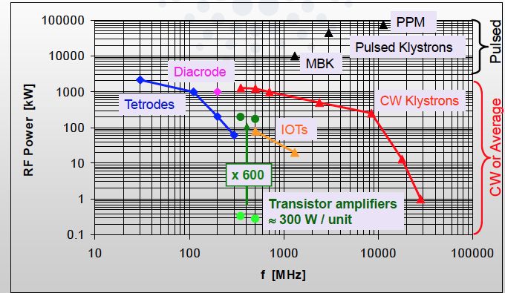
RF Sources
Common RF sources for Accelerating Cavities

Slide 4
How to pick the technology
Frequency
Power CW/pulsed
Gain
Efficiency, capital cost, operating cost
Technical risk
Reliability, availability
Stability

Slide 5

The Typical RF Chain
Auxiliary supplies, interlocks etc
Splitters and distribution
Beam
Master Oscillator
LLRF
Cavity
Pre-Driver
High Power Amplifier
RF Load
Books are written about amplifiers so consider this a taster…

Slide 6
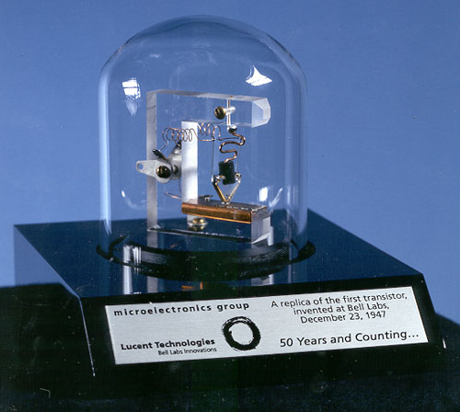
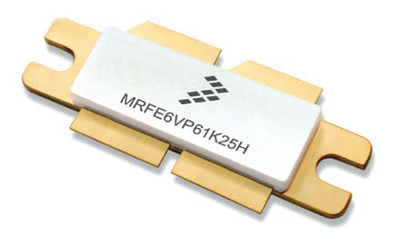
Solid State Amplifiers
1925 theory, Julius Edgar Lilienfeld
1947 Germanium US first transistor, John Bardeen, Walter Brattain, William Shockley
1948 Germanium European first transistor, Herbert Mataré and Heinrich Welker
1953 first high-frequency transistor, Philco
1954 Silicon transistor, Morris Tanenbaum
1960 MOS, Kahng and Atalla
1966 Gallium arsenide (GaAs)
1980 VDMOS
1989 Silicon-Germanium (SiGe)
1997 Silicon carbide (SiC)
2004 Carbon graphene
First transistor invented at BELL labs in 1947
XXI century LDMOS

Slide 7
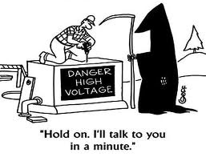
Solid State Amplifiers
Use two transistors
Power each for half RF cycle
Transistor efficiency continuously improving
but many are combined to achieve high power
No high voltage source
but many low voltage power supplies
Vdc
NPN BJT
Vin
Vout
PNP BJT
Cost per W is still high
-but dropping!
Size also dropping

Slide 8
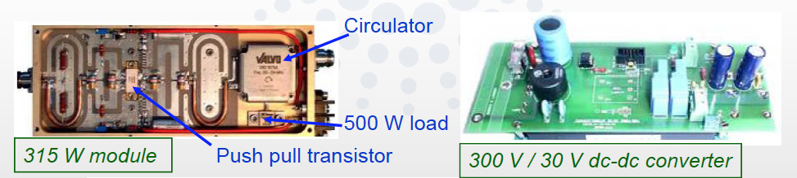
Solid State Amplifiers
Solid State has been used as drivers for many years
Soleil (3rd generation light source in France) – first light source to operate with high power RF from SSAs
Transistor technology has been pushed by huge market opportunities
Solid state amplifiers are largely replacing broadcast systems

Slide 9
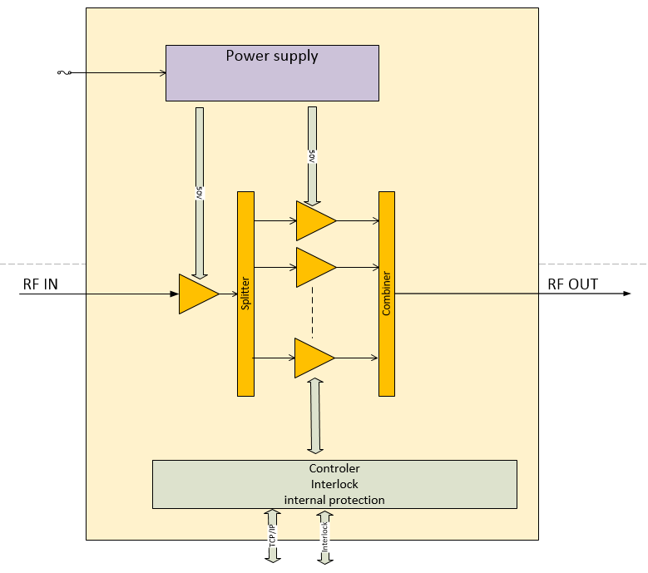
Solid State Amplifiers
RF input signal is amplified and split
Each split is amplified by many amplifiers in parallel
Each output is recombined in high power combiner
Each amplifier has status and control input and output

Slide 10
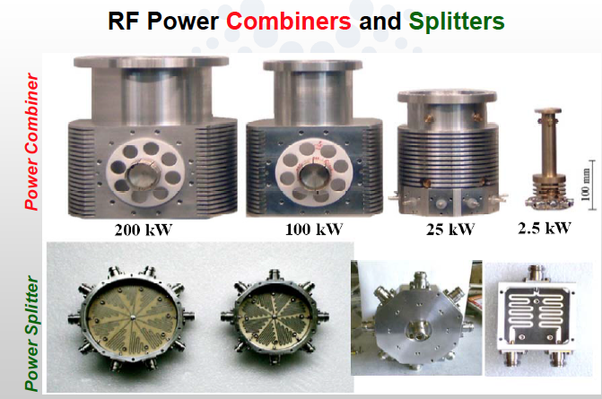
Solid State Amplifiers
Take many individual stages and keep combining
Soleil Synchrotron Light Source

Slide 11
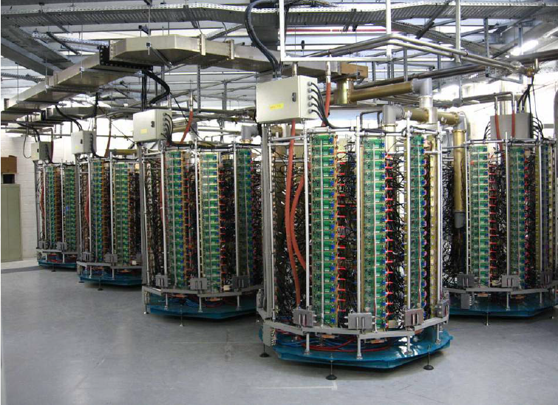
Solid State Amplifiers
Soleil’s famous 45 kW towers
First SSA for a storage ring
Exceptional uptime
Highly redundant
Has led the way of thinking about the use of SSA for more and more high power applications

Slide 12
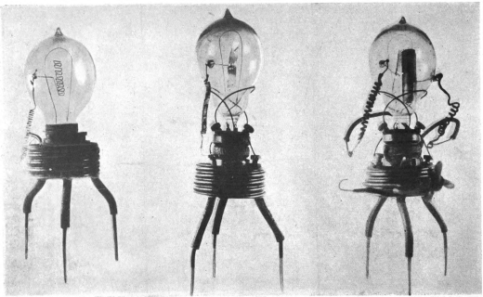
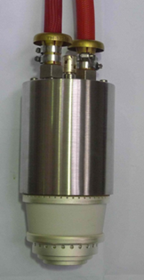
Tetrodes
Diode, John Ambrose Fleming
Audion (first triode), Lee de Forest
Triode as amplifier, Fritz Lowenstein
Triode ‘higher vacuum’, Harold Arnold
first transcontinental telephone line, Bell
1916 Tetrode, Walter Schottky
Pentode, Bernardus Tellegen
1994 Diacrode, Thales Electron Devices
The first diode prototype Fleming Diode, 1904
Thales TH 595
12

Slide 13
Tetrodes
Gridded tube with an intensity modulated beam
Good efficiency and power levels from few kW to few MW (pulsed or CW)
Transit time effects (time for electrons to travel from cathode to grid) limit the frequency to 300-400 MHz
Combined input and output circuit!
Diode
Triode
Tetrode
Second grid reduces the internal capacitance between grid and anode allowing higher frequencies and higher gain
e⁻
e⁻
e⁻
Current controlled by DC supply
Grid
Grid
Current modulated by grid voltage
Screen grid

Slide 14
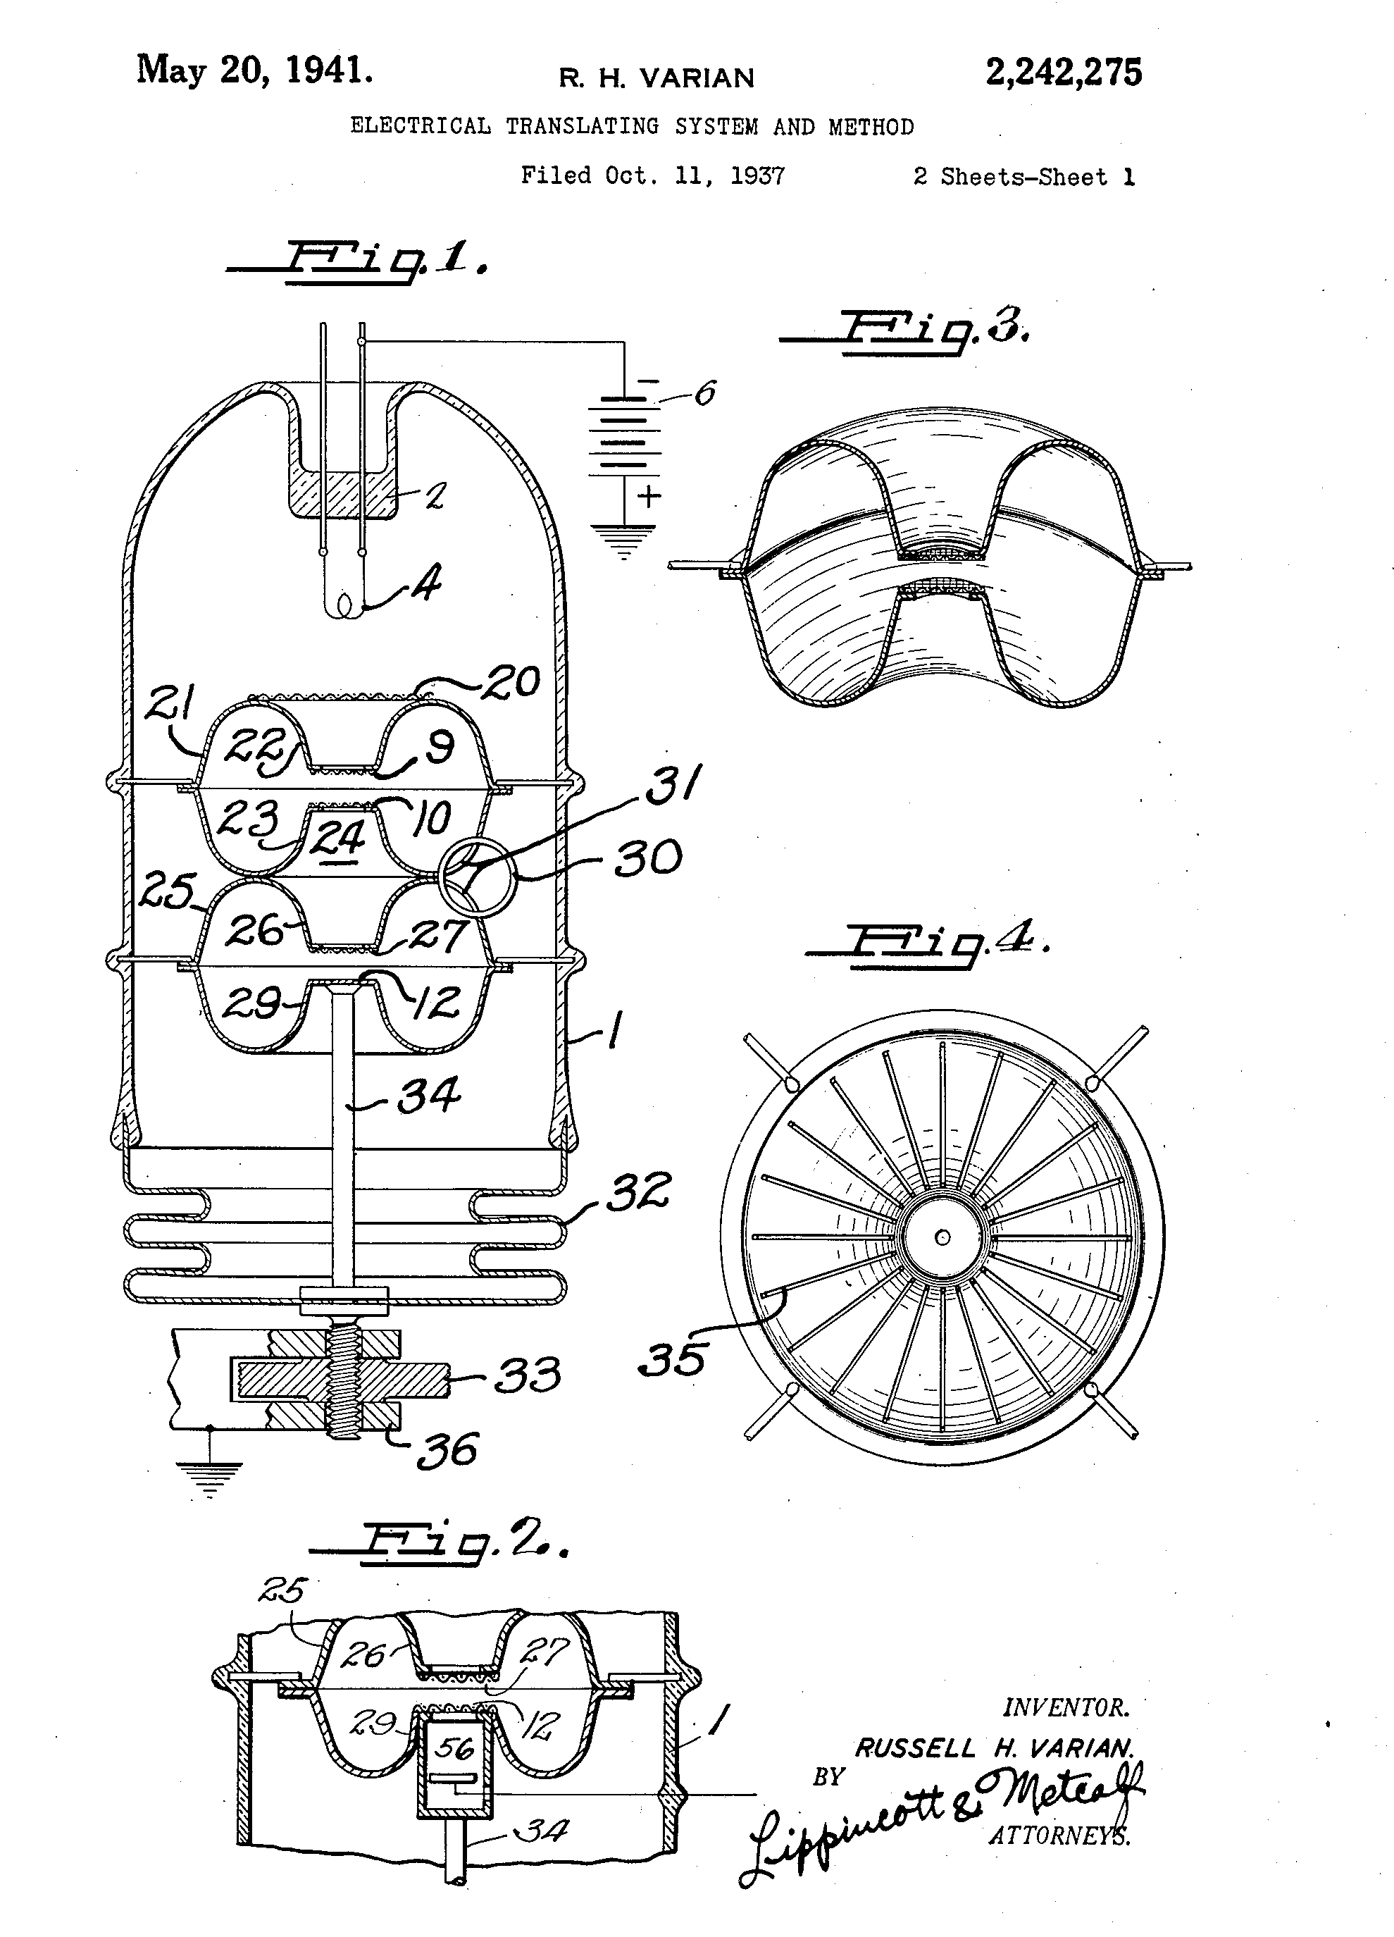
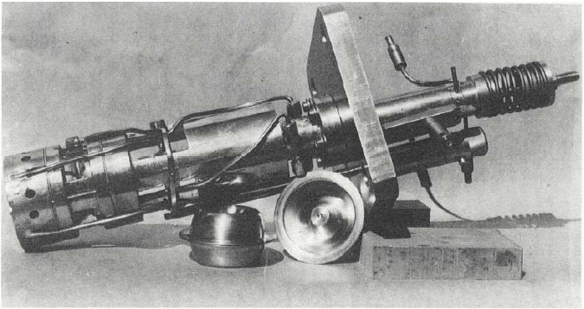
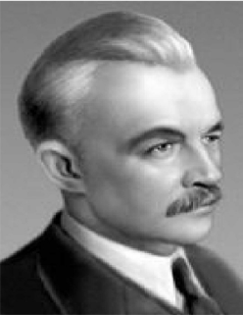
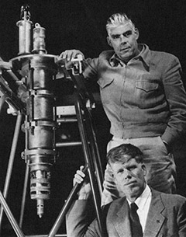
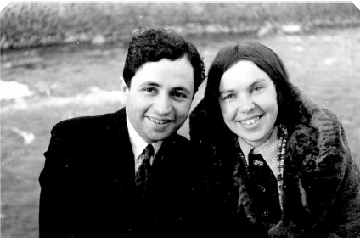
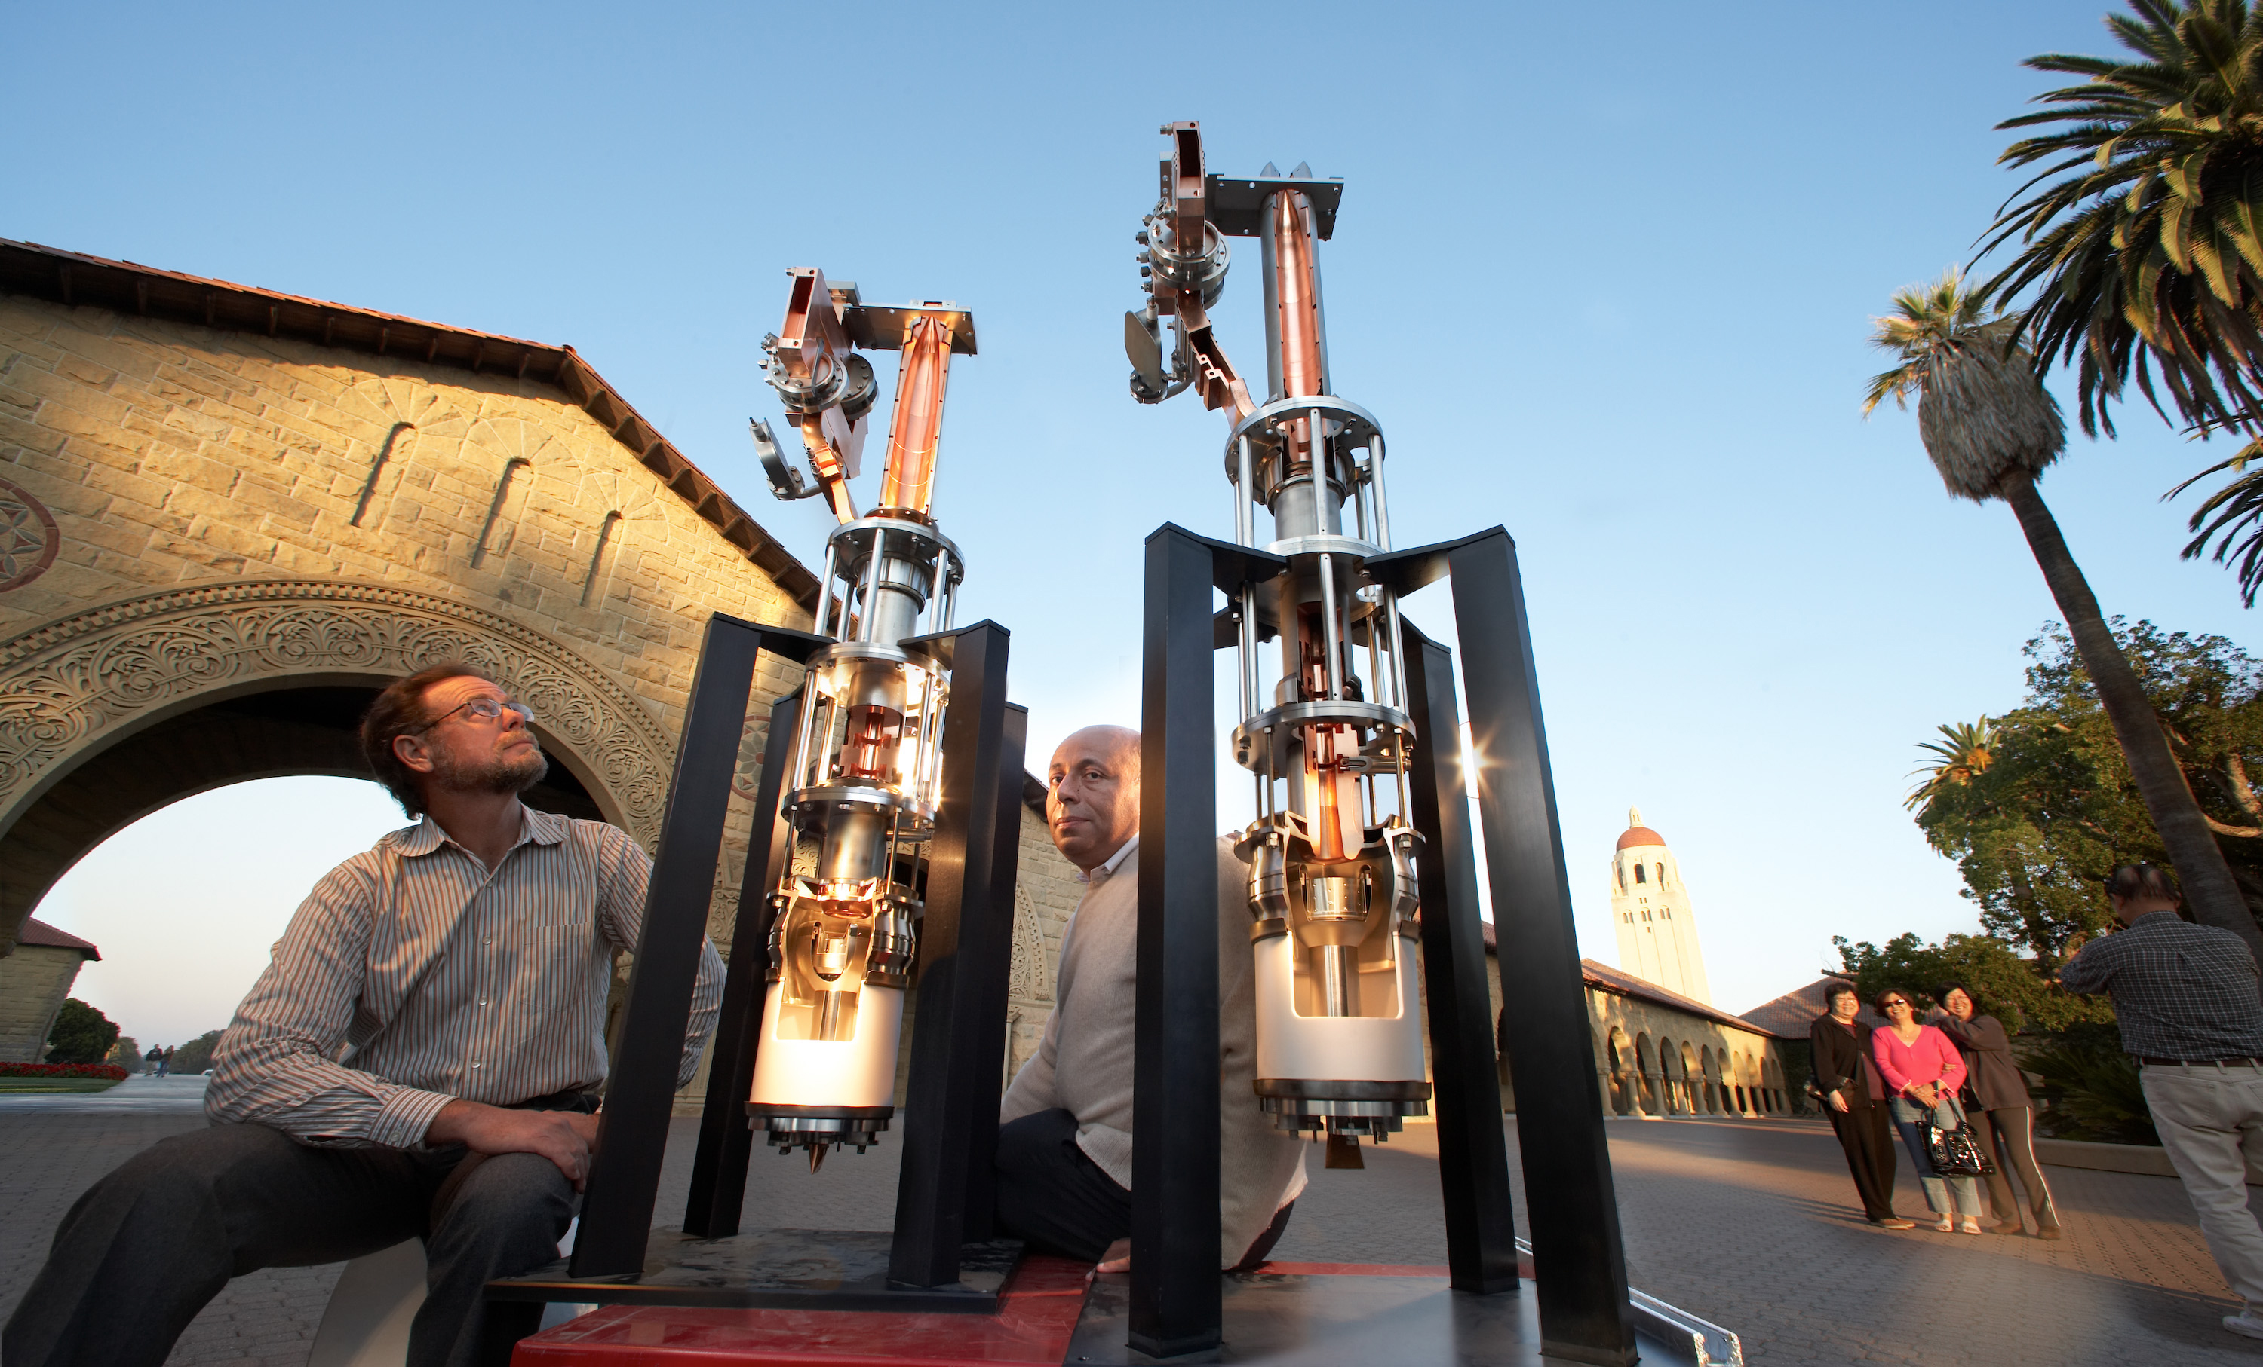
Klystrons
Officially invented by the Varian brothers and Bill Hansen in 1937 in Stanford (but papers on velocity modulation had already been published some years before by Rozhansky and the Heils in Europe and Russia).
D. A. Rozhansky
Russel and Sigurd Varian
The Stanford “model A” klystron
A picture explaining the klystron principle from the Varian patent
Oskar and Agnessa Heil
The device was named “klystron” from the Ancient Greek verb κλυζω, which refers to waves hitting the shore + the suffix –tron, for the electrons.
Klystrons cutaway models in the Stanford main quad

Slide 15
Klystrons
Key to accelerators for > 50 years
For CW machines power is limited by cooling capacity since collector size can be increased
For pulsed machines power is limited by RF and DC breakdown
Klystrons are generally cost effective at high power and high frequency

Slide 16
Klystrons
Charged particles, eg electrons, emitted from the cathode surface affect the voltage of the volume which they occupy. Describes the ‘charge of the volume’ occupied by the collection of point charges.
Electrons ‘boiling’ off the surface
The ‘voltage’ above the surface ‘pushes’ electrons back into the metal
Metal surface
Adding like charges to the same volume increases the charge of the volume.
Heater
Positive Voltage
Applying a voltage allows a current to flow
Perveance (k) is a constant describing how the space charge limited current varies as a function of voltage
It is largely determined by geometry
Metal surface
Heater
0V

Slide 17
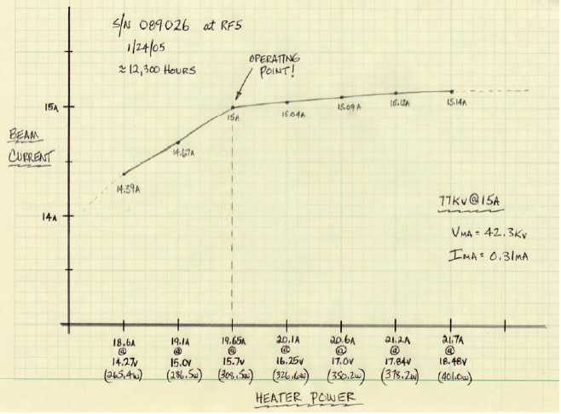
Klystrons
Typical heater curve
(APS 350 MHz)
Space charge limited cathode current
Thermally limited cathode current

Slide 18
Klystrons
A Power Point Klystron
Magnetic Focussing
Cathode (-HV)
RF input
(DC Beam)
Magnetic Focussing
I=kV^{3/2}

Slide 19
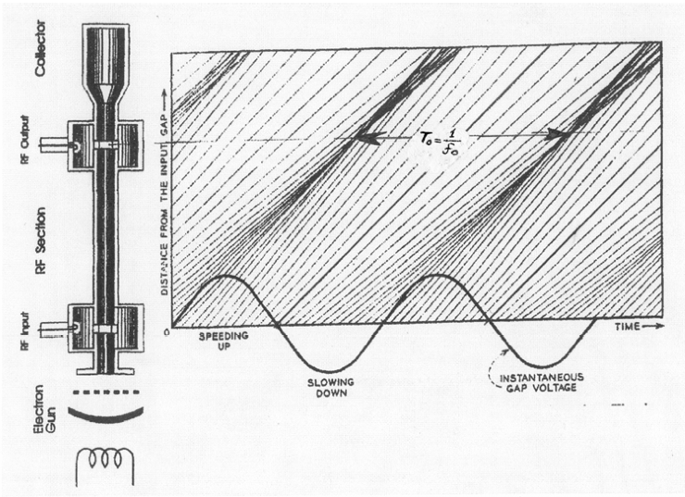
Klystrons
A two Cavity Example
Early Applegate diagram
(SLAC-pub-10620)

Slide 20
Klystrons
A Power Point Klystron
Magnetic Focussing
Cathode (-HV)
RF input
RF output
(DC Beam)
Magnetic Focussing
Klystron
(Velocity modulated)

Slide 21
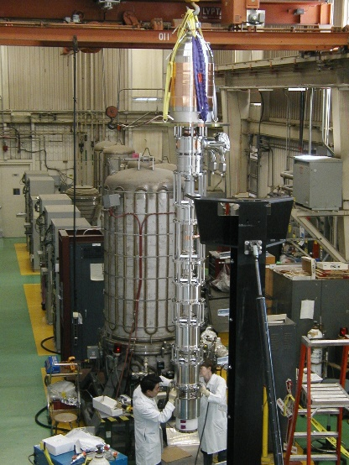
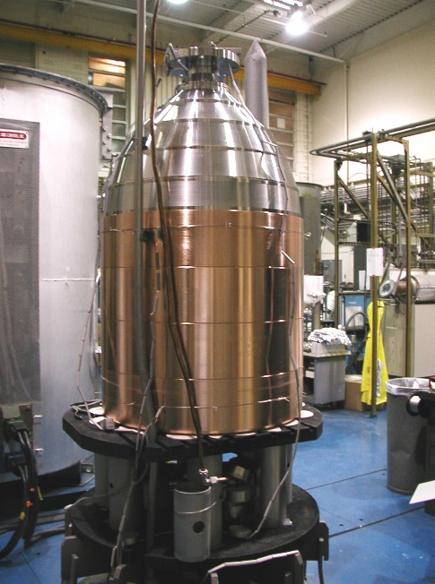
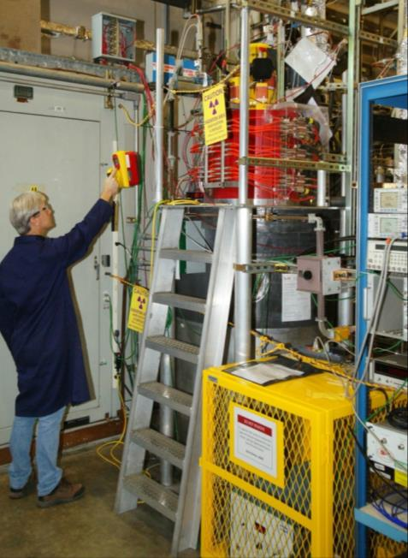
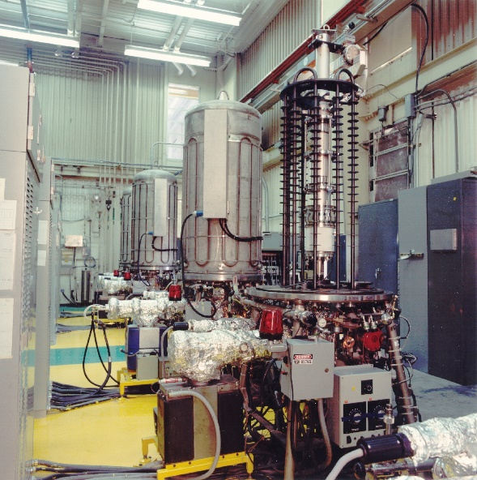
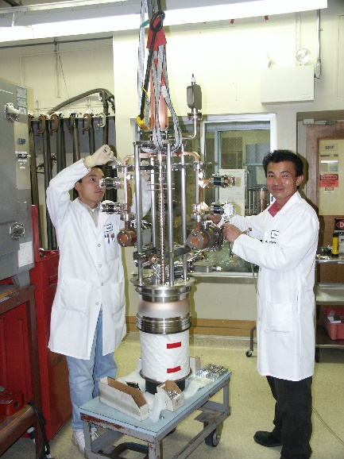
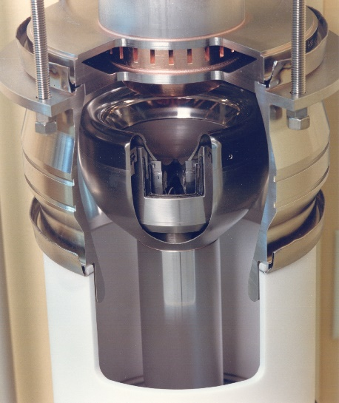
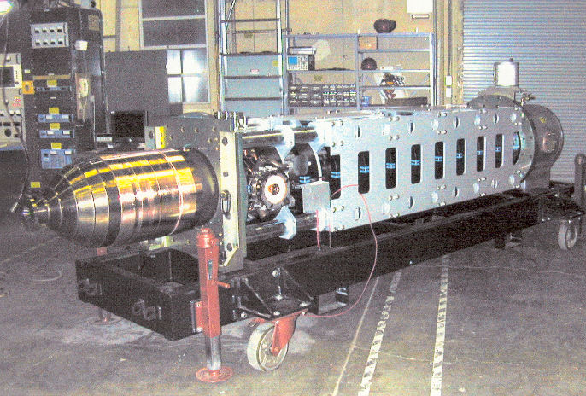
Klystrons
Final assembly of the B-factory klystron at SLAC
CPI-XL5 during commissioning at SLAC
Array of four 5045 bakeout ovens (SLAC)
B-factory klystron (1.2 MW CW, 476 MHz) collector
Final assembly of the 75-XP3 klystron (SLAC)
B-factory klystron with solenoid
Cut of a 5045 electron gun

Slide 22

Klystrons
Klystrons reach maximum efficiency at saturation (65% for our 704 MHz klystrons, and 55-57% for the 352 MHz klystrons).
Typically need to be operated below saturation to allow overhead for control
Operation at full voltage for machines with varying power requirements reduces efficiency dramatically. For ESS the efficiency would be as low as 11% for the first amplifiers of the section!
It is then important that we are able to operate the klystrons at reduced beam voltages

Slide 23
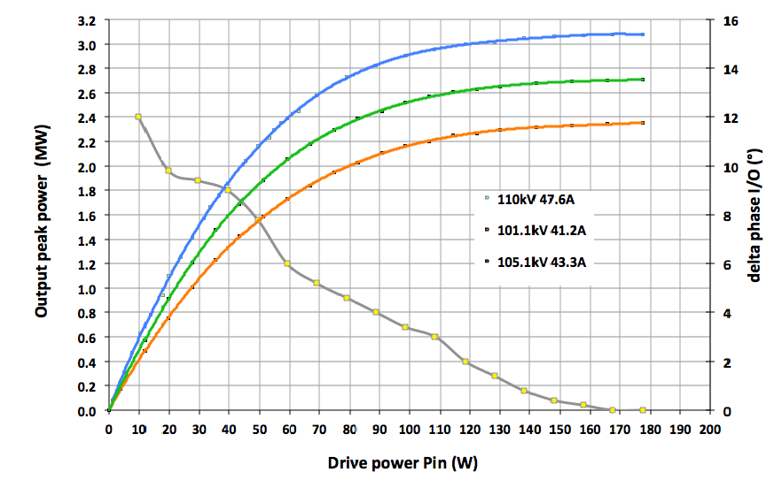
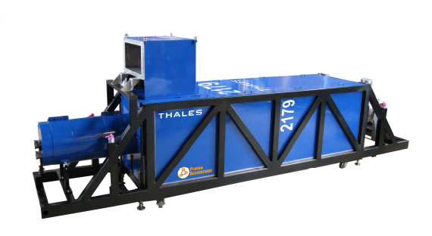
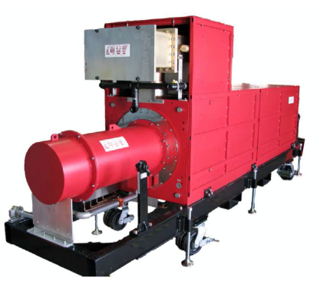
Klystrons
1 RFQ (1.6 MW input power at 352.21 MHz)
5 DTL tanks (2.2 MW input power at 352.21 MHz for each DTL, two couplers per DTL)
Klystron specs:
Nominal output power | 3 MW
Frequency | 352.21 MHz
BW | ≥ +/- 1 MHz
Pulse width | 3.5 ms
Repetition rate | 14 Hz
Perveance | 1.3*10⁻⁶
Efficiency | >52%
VSWR | Up to 1.2
Power Gain | ≥ 40 dB
Group Delay | ≤ 250 ns
Harmonic Spectral content | ≤ -30 dBc
Spurious Spectral content | ≤ -60 dBc
Saturation
25% overhead + 5% losses in RF distribution
2.1 MW saturated power from the RFQ klystron
2.9 MW saturated power from the DTL klystrons
CPI VKP-8352A
Two klystrons currently available:
Thales TH2179
Dimensions: 5.3 m x 1.5 m x 1 m

Slide 24
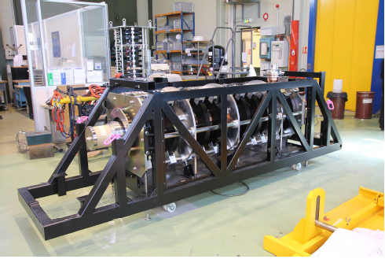
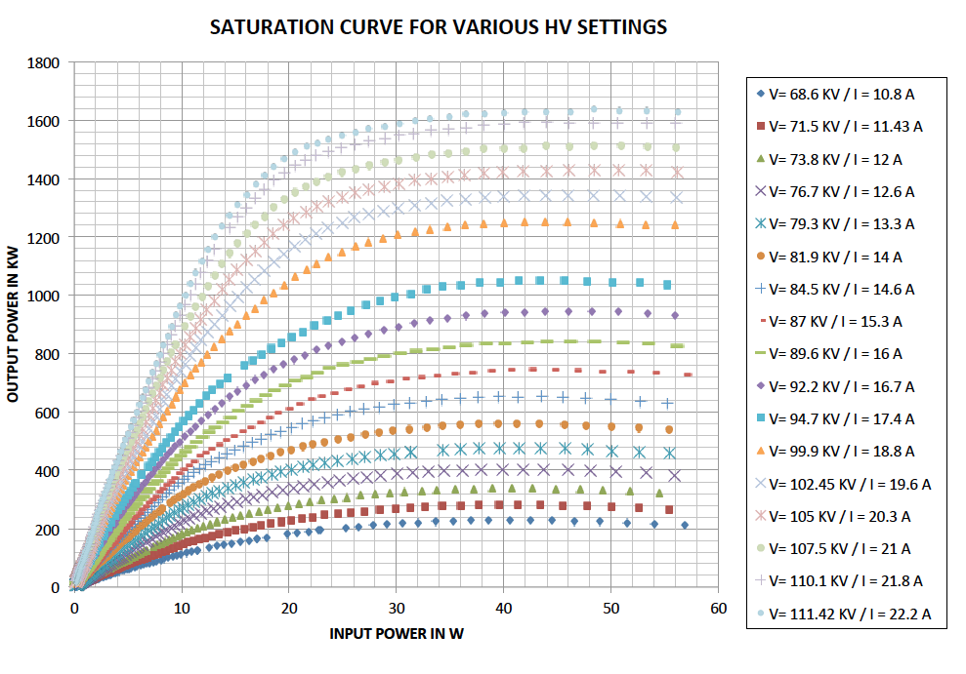
Klystron
Klystron at CERN with very similar parameters to ESS
Nominal output power | 1.5 MW (for ESS)
Frequency | 704.42 MHz
Beam Voltage | 115 kV (max)
Beam current | 25 A (max)
Repetition rate | 14 Hz
Pulse length | 3.5 ms
Efficiency | 66%
Saturated Gain | 45.15 dB
Group Delay | 130 ns

Slide 25
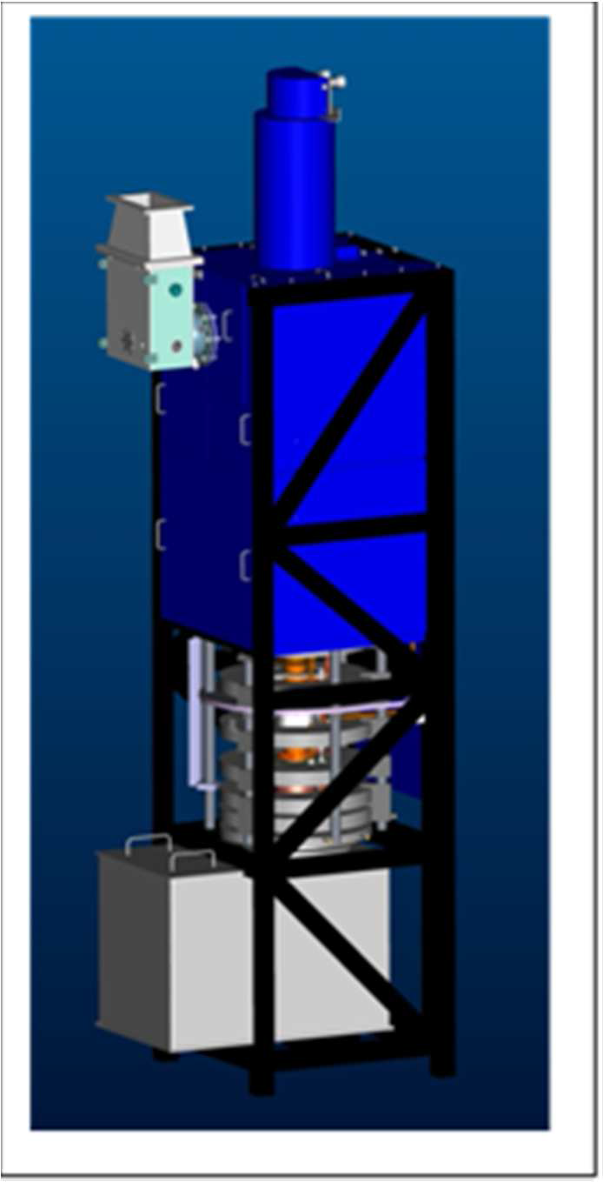
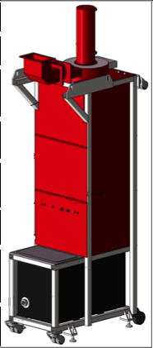
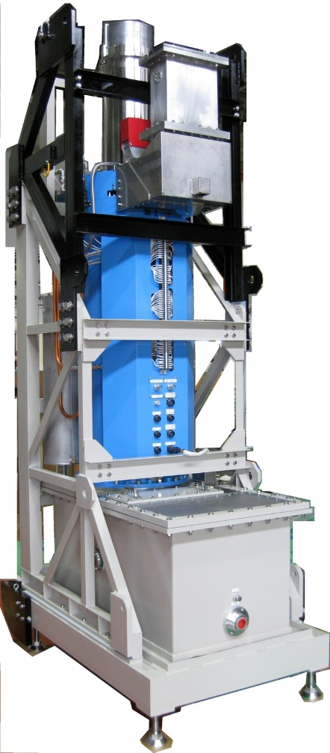
Klystrons for ESS 704 MHz linac sections
Toshiba
Thales
CPI

Slide 26
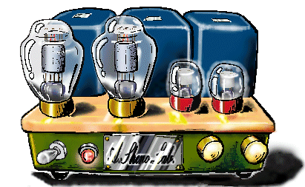
The Inductive Output Tube (IOT)
Invented in 1938 by Andrew V. Haeff as a source for radar
To overcome limitation of output power by grid interception (notice transit time limitation is back)
Pass beam trough a resonant cavity
Achieved: 100 W at 450 MHz, 35% efficiency
Used first in 1939 to transmit television images from the Empire State Building to the New York World Fair
IOTs then lay dormant
Intense competition with velocity modulated tubes (klystron had just been invented by the Varian Brothers.)
Difficult to manufacture
The IOT is often described as a cross between a klystron and a triode hence Eimac’s trade name ‘Klystrode’

Slide 27






IOT
Control
Source
Bunching
Deceleration = RF Output
Acceleration

Slide 28

IOT
IOT
(Density modulated)
Magnetic field
Reduced velocity spread compared to klystrons
Higher efficiency
No pulsed high voltage
RF input
Biased
Control Grid
RF output
k = perveance (constant)
μ = amplification factor (constant)
Vg = grid voltage
Va=anode voltage
n=1.5-2.5 (typical)

Slide 29
The Performance Comparison
IOT’s don’t saturate.
Built-in headroom for feedback.
IOT
MB-IOT
Klystron/MBK
Back-off for feedback
+6 dB
Short-pulse
excursions possible
Operating
Power Level
η_{sat} ~ 65-68%
Long-pulse
excursions possible
P_{out}
ESS ~ 45%
~ 70%
High gain
Typical Example of 80 kW IOT
Courtesy of CPI
Low Gain
P_{in}
Klystrons: Back-off for feedback cost 30%
IOTs: Operate close to max efficiency
Courtesy of e2v

Slide 30
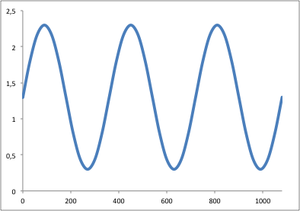
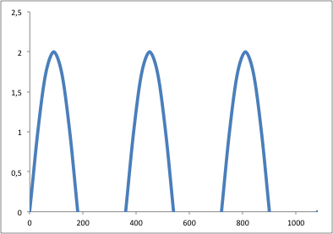
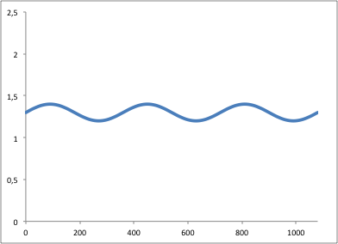
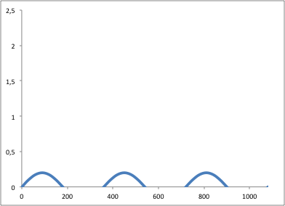
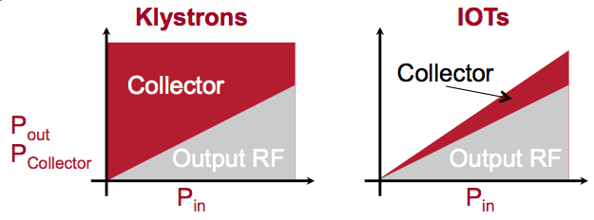
Klystrons
IOTs
Another
Cartoon!
Power delivered to beam
Power delivered to beam
High Beam Current
Electrical Power Consumed
Low
Beam Current

Slide 31
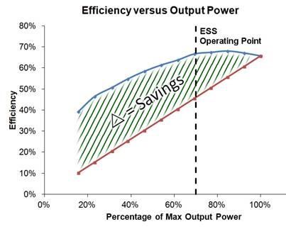
Efficiency comparison of Klystrons and IOTs
traditional
IOT measurements courtesy of M. Boyle, L3
Based on broadcast IOT L-4444
System setup limited by drive power and beam voltage
IOT setup for maximum gain (not efficiency) without breakdown
No optimisation of coupling, grid voltages etc. for different power levels
IOT
Klystron
Klystron assumed to have same saturated efficiency as the IOT
No optimisation of coupling, voltages, perveance for different power levels

Slide 32
Key advantages of IOTs
High efficiency even when operating ‘backed-off’ for reduced RF output or regulation
Good linearity
Small and compact
Power is pulsed by RF instead of HV
Lower operating voltage
Lower Gain therefore needs more drive
Particularly beneficial for machines with:
  Varying power loads
  Non uniform power profiles
  Margins for overhead for regulation
  One-to-one relationship with amplifier to accelerating structure
  High average power applications

Slide 33
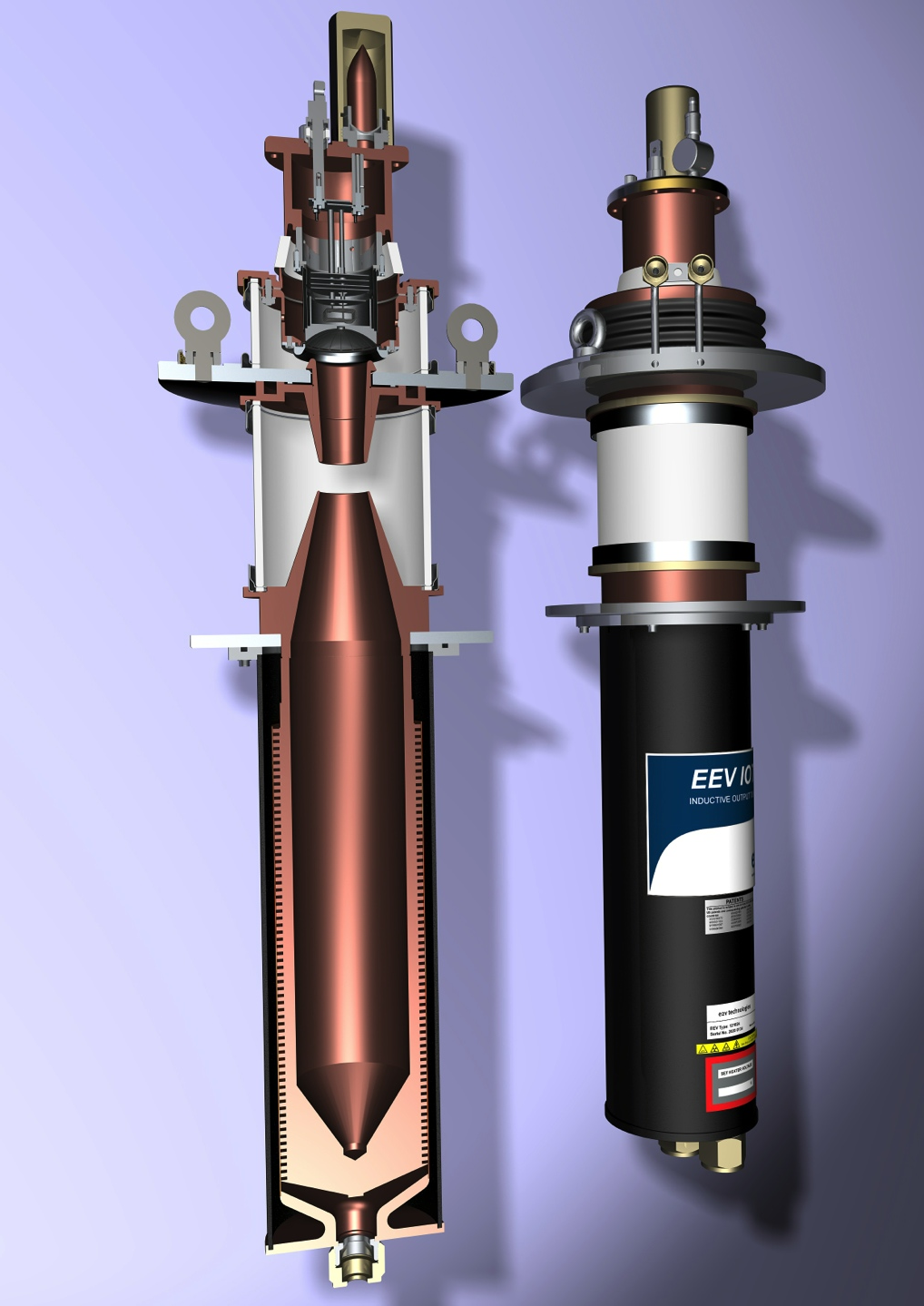
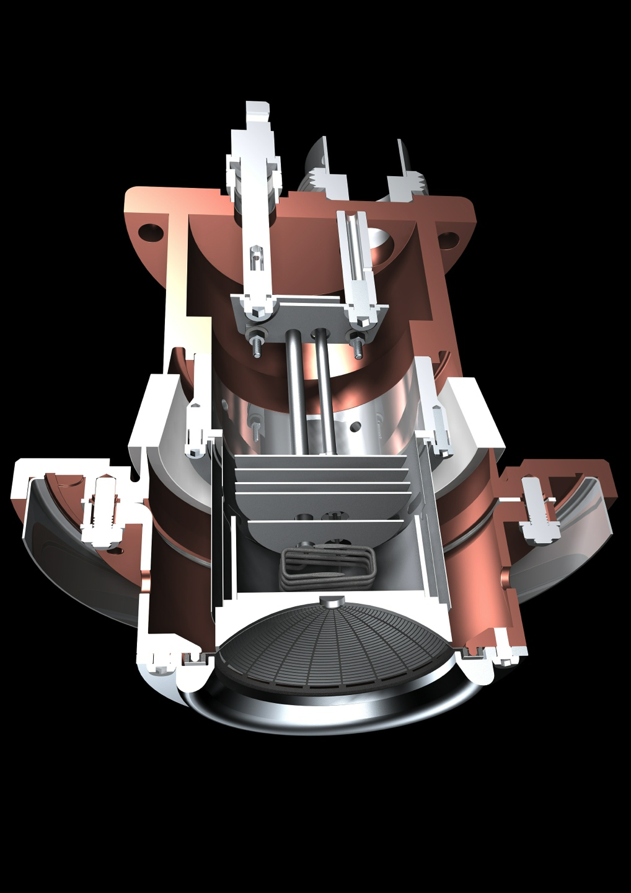
Typical Broadcast IOT
Courtesy of e2v

Slide 34

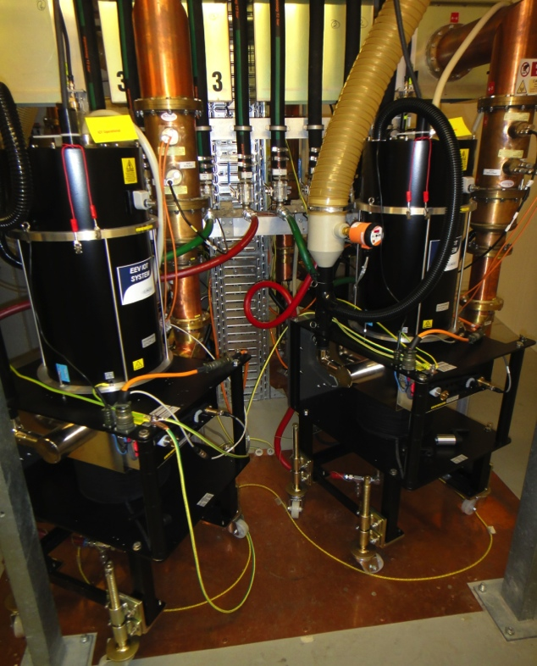
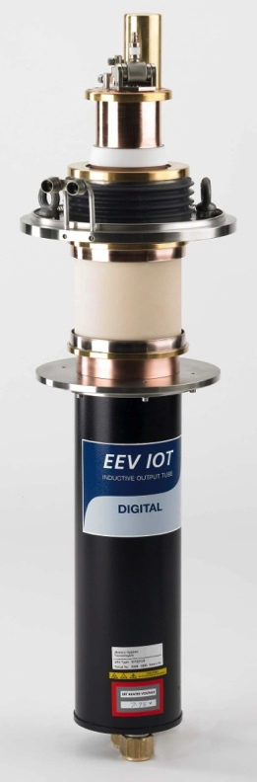
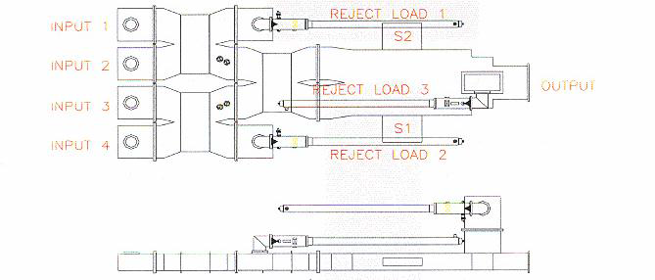
3rd Generation Light Sources
Three 500 MHz 300 kW amplifier for Storage Ring: 4 x 80 kW IOT combined
IOT 1
IOT 2
IOT 3
Output
IOT 4

Slide 35

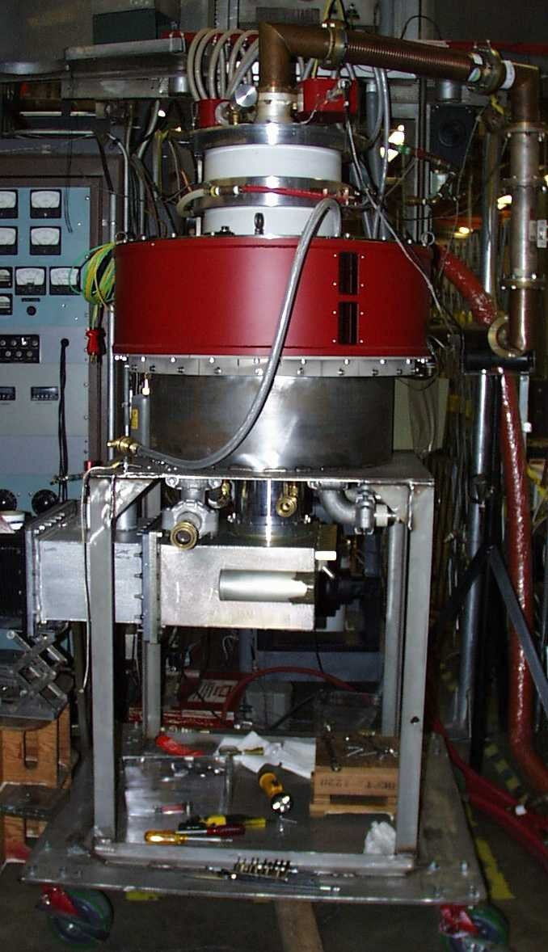
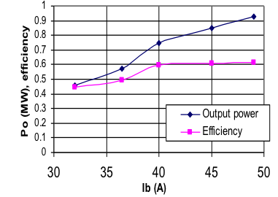
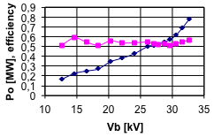
700 MHz HOM IOT Experience
Design Parameters value units
Power Output 1000 kW (min)
Beam Voltage 45 kV (max)
Beam Current 31 A (max)
Frequency 700 MHz
1dB Bandwidth ± 0.7 MHz (min)
Gain 23 dB (min)
Efficiency 71 % (min)
Diameter 30/76 in/cm
Height 51/130 in/cm
Weight 1000/450 lbs./kg
Collector Coolant Flow 220 gpm
Body Coolant Flow 10 gpm
O/P Window Cooling (Air) 35 cfm
RF Input
Gun
@ 31kV
Solenoid,
O/P Cavity
RF Output
Collector
Test Results
(pulsed)
  VHP-8330A IOT

Slide 36
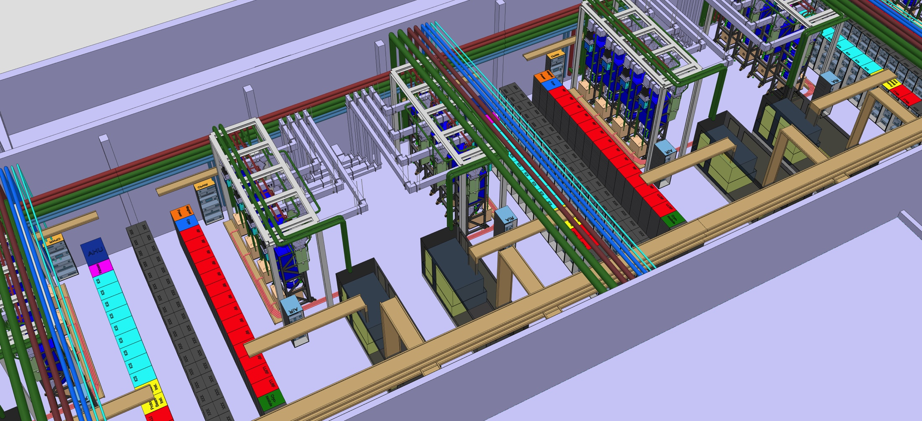
Elliptical (704 MHz) RF System Layout
Power needs space
Klystrons
Modulator
Installed RF Power 8 x 1.5 MW = 12 MW
Space available = 130 m² > 90 kW / m²
Solid State solution:
15 kW/rack = 100 racks excl. combiners etc.

Slide 37
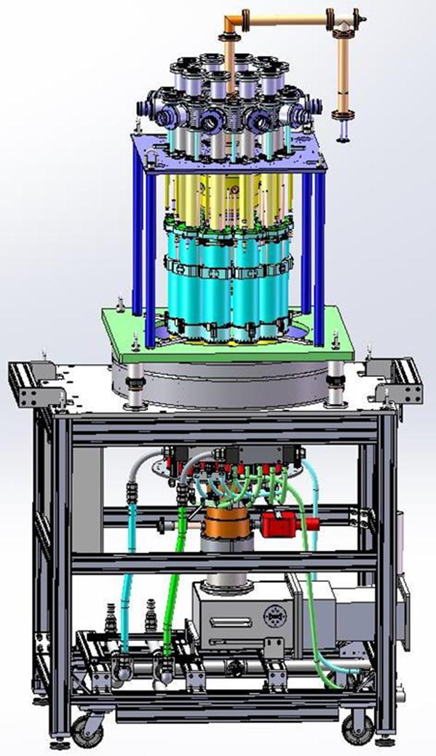



Multi-Beam IOTs for ESS
Broadcast IOTs are limited in power to 100 kW
Operate with a single cathode
So how to achieve > 1 MW?
10 Beam Multi-Beam IOT
1.2 MW
704 MHz

Slide 38
The IOT for ESS
Parameter |  | Comment
Frequency | 704.42 MHz | Bandwidth > +/- 0.5 MHz
Maximum Power | 1.2 MW | Average power during the pulse
RF Pulse length | Up to 3.5 ms | Beam pulse 2.86 ms
Duty factor | Up to 5% | Pulse rep. frequency fixed to 14 Hz
Efficiency | Target > 65%
High Voltage | Low | Expected < 50 kV
Design Lifetime | > 50,000 hrs
Saving:
3.3 MW power reduction by using IOTs for High Beta

Slide 39

Current Status of the first ESS MB IOT
Output Cavity under cold test

Slide 40

ESS accelerator power profile
Average beam power: 5 MW > 130 MW peak
Pulse repetition rate: 14 Hz
Beam pulse length: 2.86 ms
36 Medium beta cavities: 704 MHz
1.5 MW Klystrons
26 spoke cavities:
352 MHz
Tetrodes
Normal-conducting Linac:
One RFQ and 5 DTL tanks
6 off 352 MHz klystrons
3 MW
3 Solid state amplifiers for bunchers
352 MHz, 30 kW
84 High beta cavities: 704 MHz
1.2 MW MB IOTs (klystrons as backup)

Slide 41


What will power (ESS)?
The most powerful proton linac built.
  Average beam power of 5 MW (Peak > 130 MW RF)
  Over 150 individual high power RF sources
30 kW Solid State Amplifiers
3 MW Klystrons
200 kW Tetrodes
1.5 MW Klystrons
1.2 MW IOTs
Solid state Drivers (100 W – 10 kW)
352 MHz
704 MHz

Slide 42
Summary
Accelerators have different requirements
  Power, frequency, cost, space, …
Technology choice depends on what is available or what can be developed subject to time, budget, risk, …
Main RF sources for accelerating cavities include:
  Solid State Amplifiers
  Tetrodes
  Klystrons
  IOTs

Slide 43
Summary
Solid State amplifiers:
  Modern and rapidly improving performance
  Broad frequency range but high power means 1000s of units combined for MW power levels
  Efficiencies up to > 60% depending on power and frequency.
  Very competitive and compact for small supplies up to a few kW
  No HV supply required
  Still costly for large systems and needs space
Tetrodes
  Good efficiency at point of operation, particularly at lower frequency
  Power capability reduces as frequency increases (200 kW at 350 MHz)
  Max frequency around 400 MHz
  Tetrode is ‘cheap’ but full amplifier is costly
  Tetrode life expectancy up to 30k hours subject to application

Slide 44
Summary
Klystrons
  Has been workhorse for > 50 years
  Suitable from > 300 MHz to many GHz
  MW in CW, 10s MW pulsed
  Life expectancy can by > 100k hours depending on application
  Efficiency up to 65% at saturation but often lower at point of operation
IOT
  Suitable frequency range 400 MHz – 1.3 GHz
  Available in units of 100 kW which can be combined
  MW class IOT under development
  >60% efficiency at point of operation
  Life expectancy 50k – 100 k hours

