Slide 1
ESS RF SYSTEMS INTRODUCTION
Anders Sunesson RF group leader
www.europeanspallationsource.se

Slide 2
Summary
ESS Linac
Why do we need RF systems?
RF systems:
  High Voltage Power conversion
  High Power RF Amplifiers
  Local Protection system/Interlock
  Low Level RF system
  Phase reference / Master Oscillator
  RF Distribution System
Tests

Slide 3
ESS Linac
The ESS linac will be the worlds most powerful proton linac
  Beam pulse width is 2.86 ms and pulse rep rate 14 Hz
  Protons will be accelerated up to 2 GeV with a beam current of 62.5 mA, beam power 5 MW
Construction in two stages, stage 1 ready 2019 (570 MeV), stage 2 ready 2022 (2 GeV)
ESS has a target to be energy efficient – drives design decisions
  Multi-beam IOT project
  Cooling water at high temperature
  Regulation optimization

Slide 4
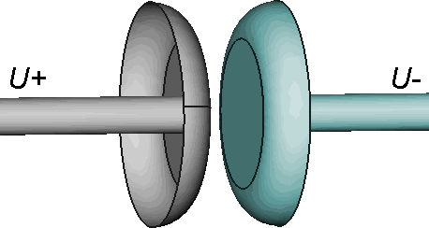
Particle accelerator – why RF??
Protons can be accelerated by applying voltage between two electrodes
The electric field will then accelerate particles if these are let in through a hole
To get the particle energies needed for ESS the voltage would have to be 2 GV (2 000 000 000 V)
0 eV
2 GeV

Slide 5
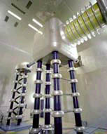
DC can be used
Up to 750 keV
Cockroft- Walton accelerator

Slide 6
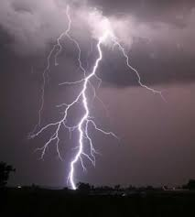
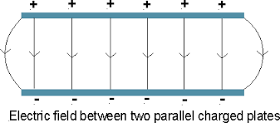
There is a problem though…
Only to generate this voltage difficult
The breakdown strength is a lot lower, up to MV/m
There would be electric breakdown
Typical lightning bolt 10-100 MV
2 GV

Slide 7
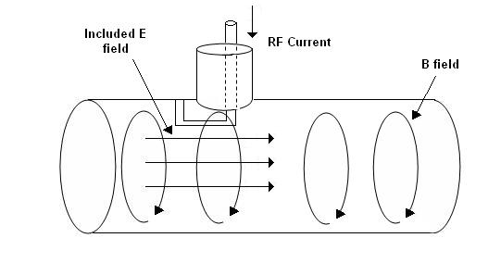
Alternative: use RF
Apply RF in a resonant cavity
This creates an electric field
A particle gets a kick dE proportional to the field
The field changes direction – no kick
Then the next particle comes in phase and gets a kick
Particles come in “bunches”
x
X+dE

Slide 8
So RF is used (after 1930’s)
Can be stacked one after the other to get more kick
Scalable, no net field outside – no breakdown outside (can occur inside though)
Very high particle energies can be reached (CERN LHC 7 TeV)
More energy possible by just adding cavities
Drawback: High power RF is bulky and expensive

Slide 9




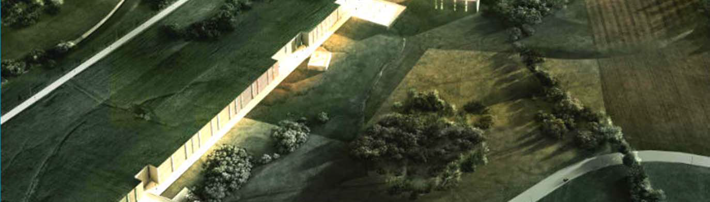
An artists impression of ESS

Slide 10
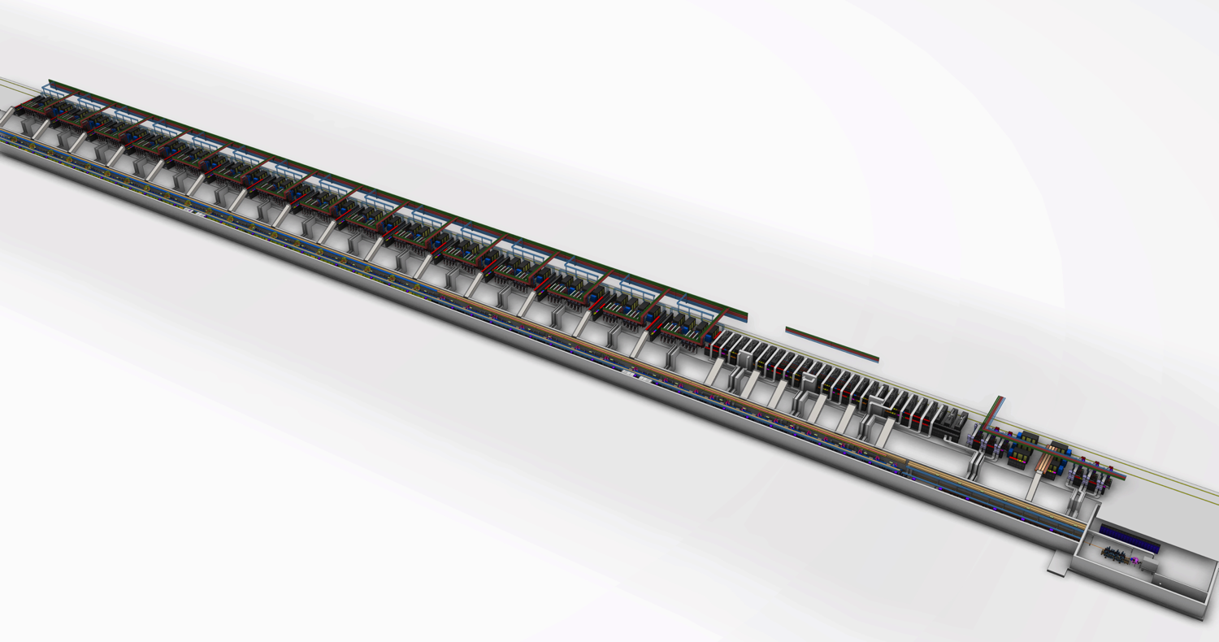
ESS Linac Layout
155 cavities in total, total length ca 350 m until HEBT
High beta RF
NC linac RF
Medium beta RF
Low Energy Front end
Spoke RF
High beta cryomodules
Medium beta cryomodules
Spoke cryo-modules
NC linac cavities

Slide 11
RF Requirements
352.21 MHz
704.42 MHz
2.4 m
4.5 m
3.6 m
40 m
54 m
75 m
174 m
Target
Source
LEBT
RFQ
MEBT
DTL
Spokes
Medium β
High β
HEBT & Contingency
75 keV
3.6 MeV
90 MeV
220 MeV
570 MeV
2000 MeV
 | Energy (MeV) | Frequency /MHz | No. of Cavities | βg | Temp / K | RF power /kW
Source | 0.075 | - | 0 | – | ~300 | –
LEBT | 0.075 | - | 0 | – | ~300 | –
RFQ | 3.6 | 352.21 | 1 | – | ~300 | 1600
MEBT | 3.6 | 352.21 | 3 | – | ~300 | 20
DTL | 90 | 352.21 | 5 | – | ~300 | 2200
Spoke | 220 | 352.21 | 26 (2/CM) | 0.5 βopt | ~2 | 330
Medium β | 570 | 704.42 | 36 (4/CM) | 0.67 | ~2 | 870
High β | 2000 | 704.42 | 84 (4/CM) | 0.86 | ~2 | 1100
HEBT | 2000 | – | 0 | – | ~300 | –

Slide 12
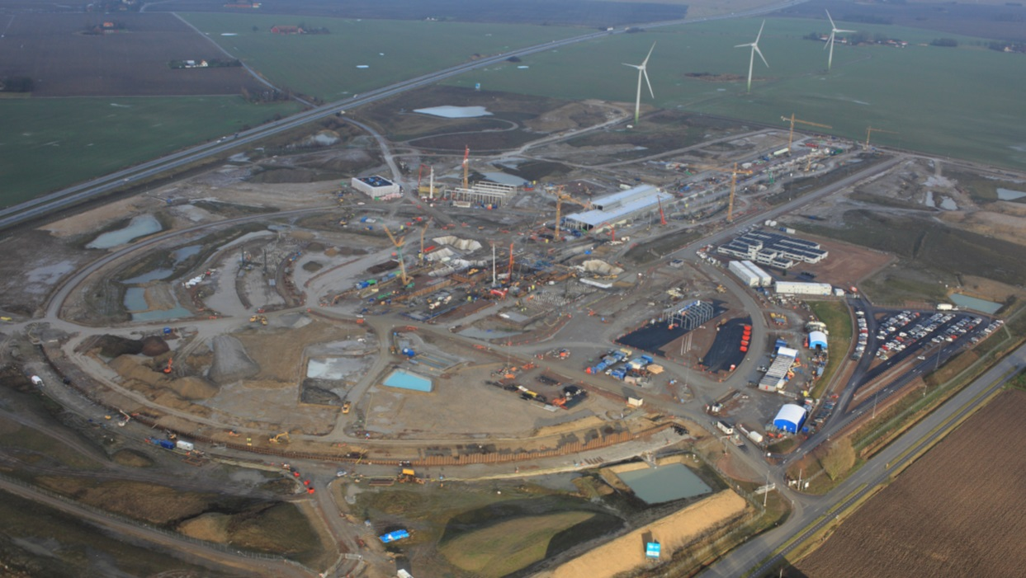
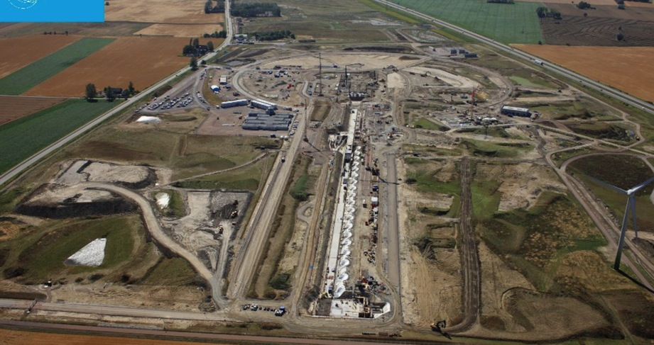
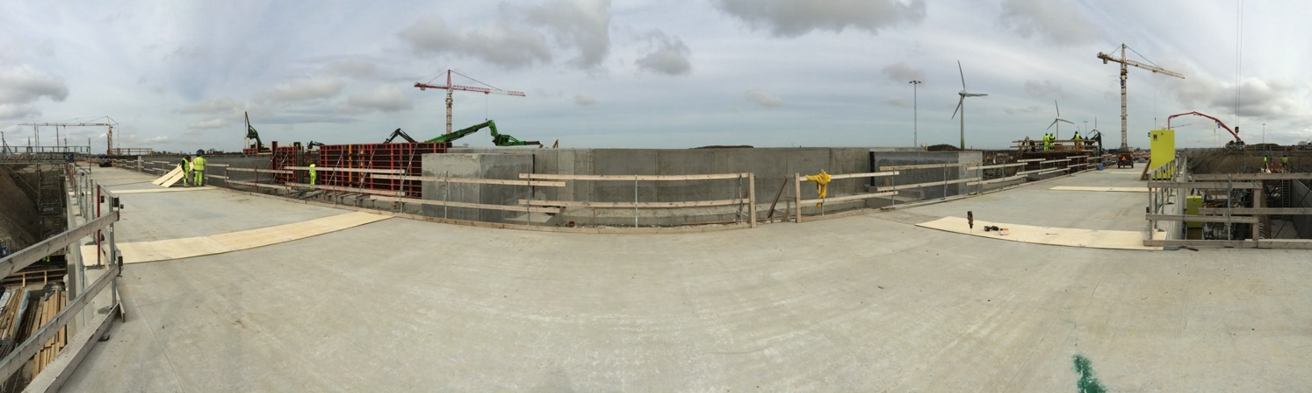
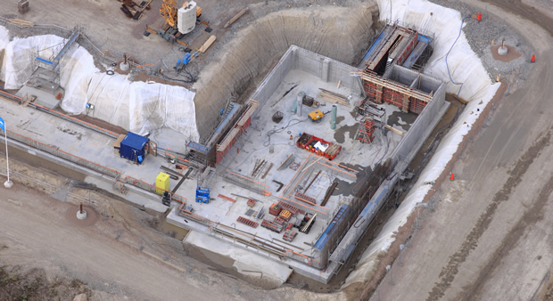
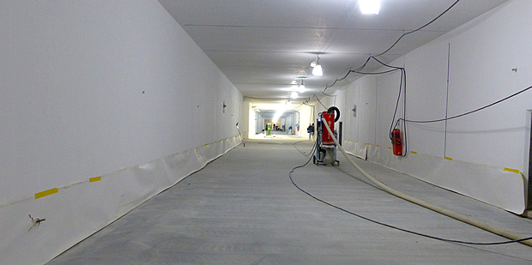
Site construction work Aug-Dec 2015

Slide 13
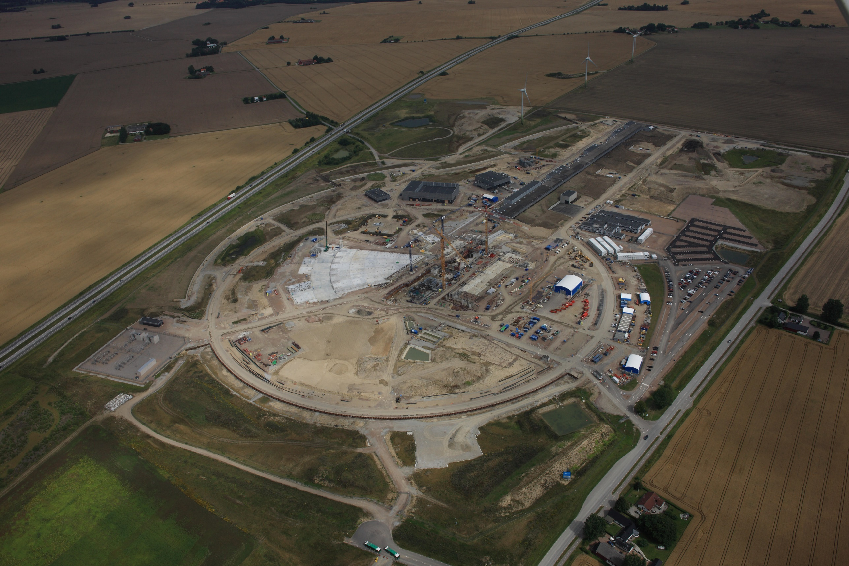
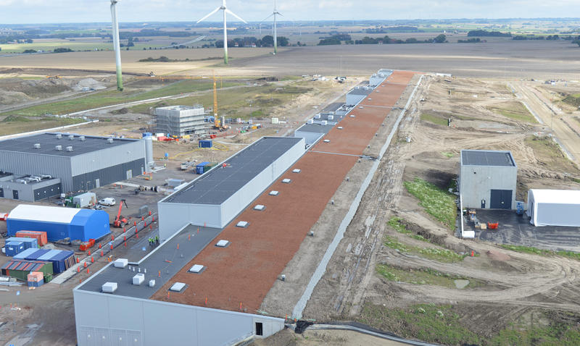
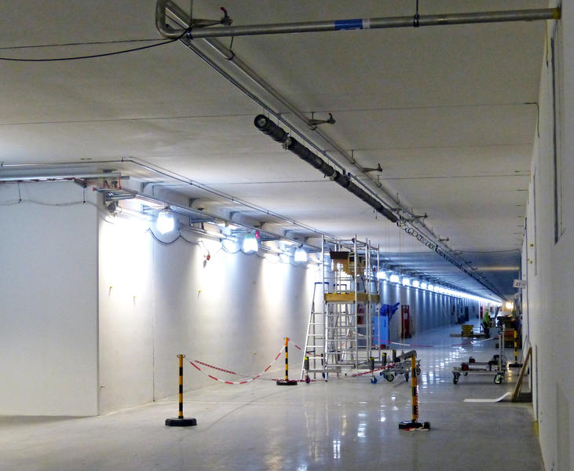
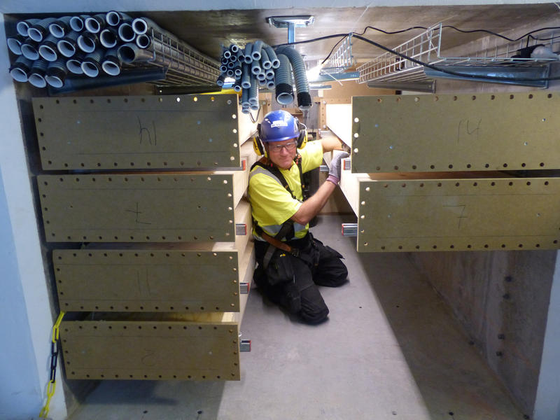
Site construction work Aug-Oct 2017

Slide 14
RF systems
Power to 155 cavities, one RF station/cavity
  High Voltage new development: SML modulator topology
  High Power RF Amplifier new development: MB-IOT amplifier (targeted for high beta)
A large part of the RF systems is provided in collaboration with partners
      RF NC linac (Spain)
      Spoke RF stations (Italy)
      LLRF (Spain and Poland)
      RF high power distribution (UK)
      Phase ref distribution (Poland)
      Installation (Poland))
Collaboration Lund Univ Uppsala Univ(FREIA facility)

Slide 15
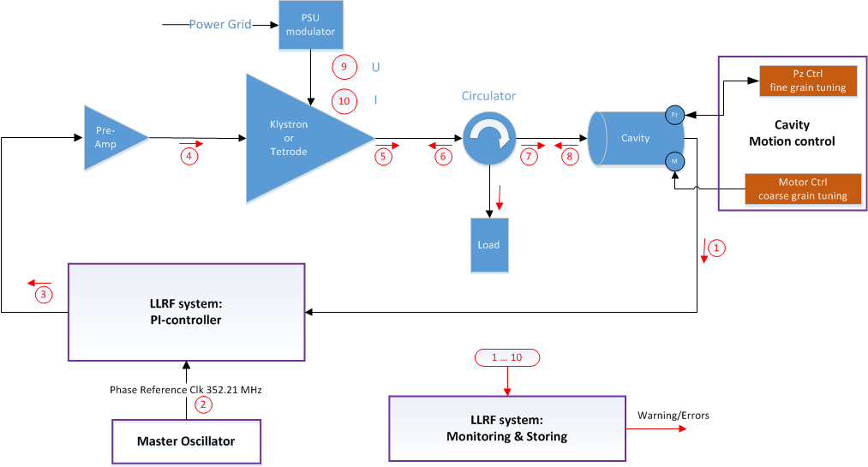
RF Cell
Interlock
Basic building block for RF systems is the RF cell:
High Voltage
Amplifiers
Regulation (LLRF)
Protection – Interlock
Waveguides

Slide 16
High voltage
Carlos Martins
Interlock
High voltage systems
Needed to power RF amplifiers
Voltages to >100 kV
Currents 20-80 A
Pulsed or cw
Large and $$$
See lecture Carlos Martins

Slide 17
High voltage
Power converter
AC grid
50Hz
400V
High Voltage
DC or long pulsed
Contents:
HF
Transf.
Filter
AC /
DC
DC /
DC
DC /
AC
AC /
DC
AC grid
50Hz
400V
DC-link
1.1 kV
AC
15 kHz
1 kV
AC
15 kHz
25 kV
AC + DC
15 kHz
25 kV
DC
(25 kV,
klystrons)
(12.5 kV,
IOT’s
Capacitor bank
1 kV

Slide 18
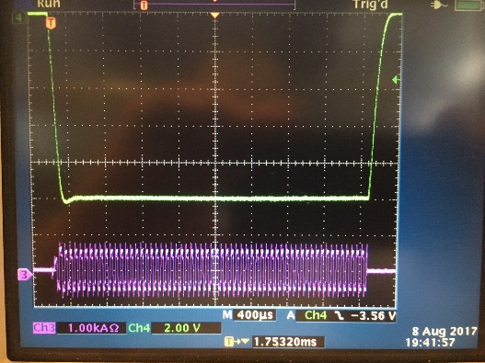
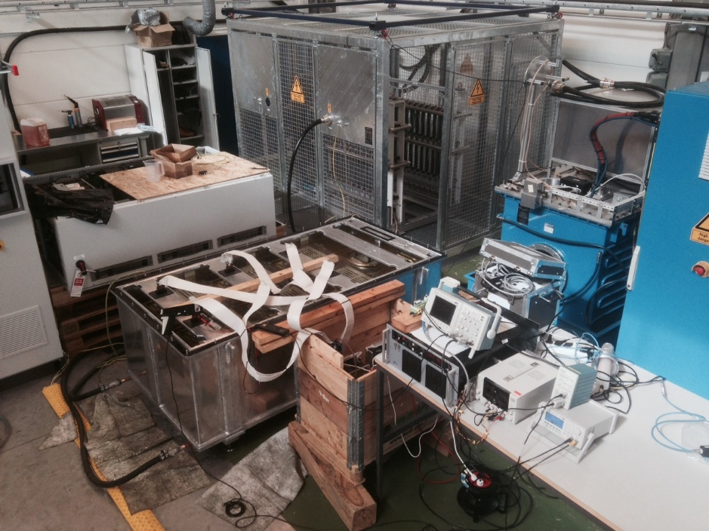
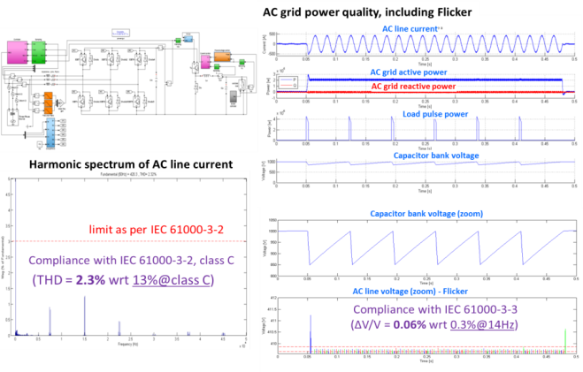
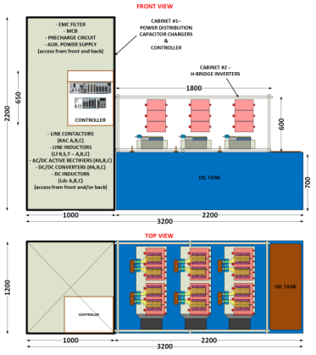
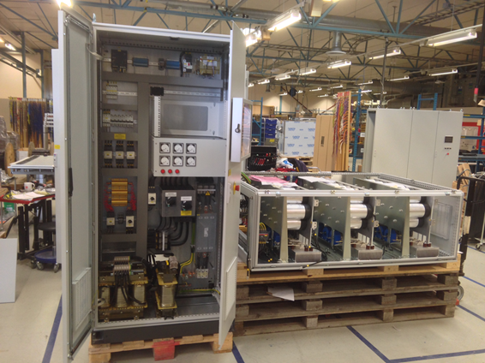
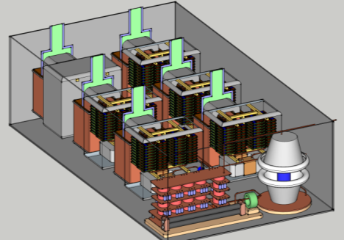
From a conceptual design to reality…
The Stacked Multi-Level (SML) modulator: development timeline
2017
Mid 2013
2013-2014
2016
2014
2014
2014
18

Slide 19
Development strategy ESS
Strategy | Rated power | Ready/Delivery | Validated | Outcome
A – SML (ESS internal development) | 660 kVA (4 klystrons 704 MHz in parallel) | Dec 2015 | Q2 2016 | Strategy A: Launch call for tender for 660 kVA modulators: 3 units for RFQ/DTL 9 units for medium beta
B:1-Ampegon (ESS contract) | 330 kVA (2 klystrons 704 MHz in parallel) | Summer 2017 | Fall 2017 | Strategy B: Launch call for tender for 330 kVA modulators: 6 units for RFQ/DTL 18 units for medium beta
Strategy A chosen. Contracts for 3x660 kVA modulators (NC linac) and 9x660 kVA (Medium beta linac) placed Aug/Sep 2017

Slide 20
High power amplifiers
Morten Jensen
Interlock
Amplifiers:
Generate High power RF
Power up to several MW
Typical example klystron
Large, $$$
See lecture Morten Jensen

Slide 21
Amplifiers
Solide state amplifiers
  Transistors
  Low voltage
  Combine many
Tube amplifiers
  Vacuum tubes
  Electron beam
  High voltage (10 kV-120 kV)
  Current 5 A-100 A

Slide 22
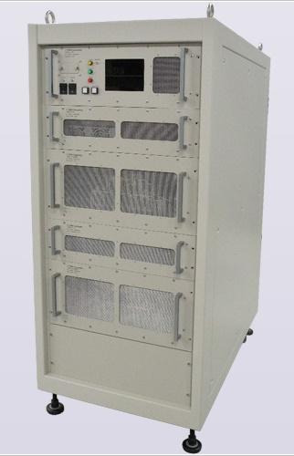
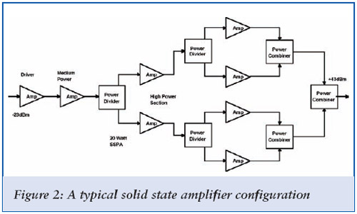
Solid state power amplifiers
Split input in several
Amplify each separately
Combine to one output
Can reach several 100 kW’s

Slide 23
Klystron (Velocity Modulated)
RF input
RF output
Cathode at -100 kV
(DC Beam)
Collector
Electron beam 10->50 A
Klystron draws continuous current
  Cathode pulsed
Klystron is velocity modulated
Invented in the 1930’s
Radar/broadcast applications
Other tube types exist
See lecture by Morten Jensen

Slide 24
High power amplifiers ESS linac
Section | Power /kW | Baseline design | Status
Normal conducting RFQ and DTL | 2800 | Klystron | In kind
Normal conducting bunchers | 30 | Solid State | In kind
Spoke linac | 400 | Tetrode | In kind, proof of concept UU
Medium beta linac | 1500 | Klystron | Prototyping
High beta linac | 1500/1200 Klystron/IOT | MB-IOT (decision 2017-2018) | Prototyping

Slide 25
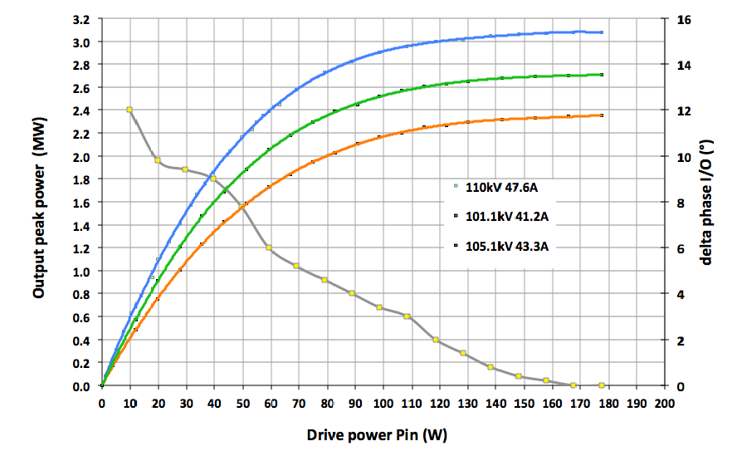
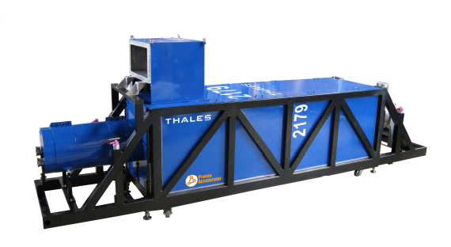
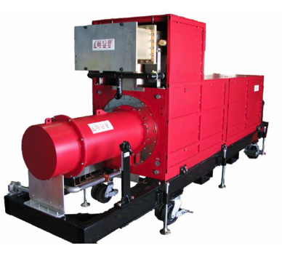
Normal conducting linac
Output vs Voltage
Frequency | 352 MHz
RF Power | 3 MW peak
High voltage | to 115 kV
Current | to 50 A
Repetition Rate | 14 Hz
Pulse width | 3.5 ms
3 MW
Phase
Courtesy of Thales ED
Two klystrons per modulator
Thales TH2179
CPI VKP-8352A

Slide 26
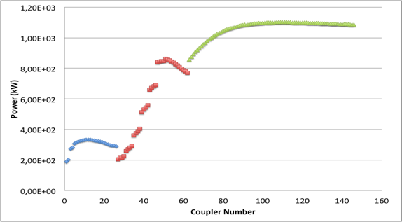
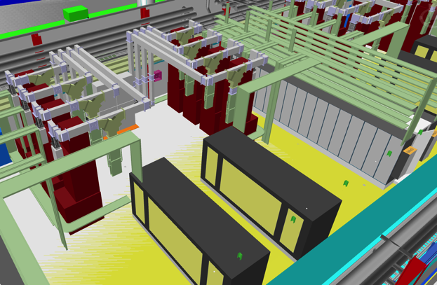
Medium beta linac
866 kW
Frequency | 704 MHz
Power | 1.5 MW peak
High voltage | to 115 kV
Current | To 25 A
Repetition Rate | 14 Hz
Pulse width | 3.5 ms
200 kW
Vertical orientation to fit in the gallery
High Power Density: 12 MW of RF in approx. 10 x 13 m
Four klystrons per modulator
Three prototypes procured: Thales, Toshiba and CPI
All delivered
Medium beta klystrons (36) contracts awarded 2017. Delivery start Q1 2018
Klystrons
Modulators
Courtesy of Chiara Marrelli

Slide 27
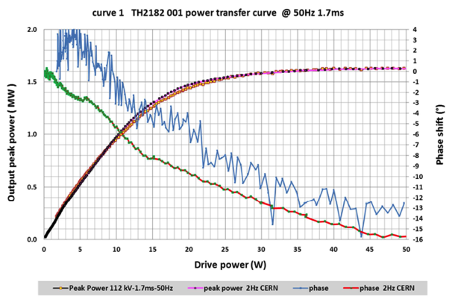
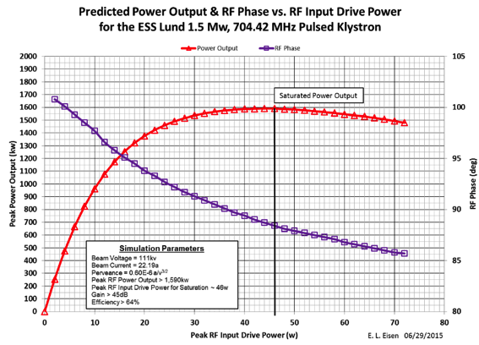
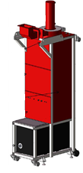
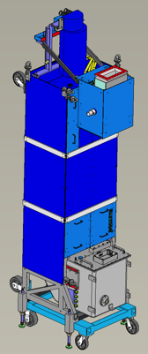
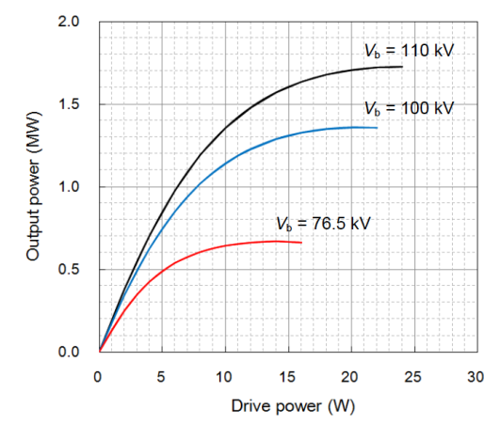
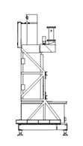
Thales TH2180
704 MHz klystron prototypes
Data from the TH2182
CPI VKP-8292A
Toshiba klystron has higher gain
Toshiba E37504
Courtesy of Chiara Marrelli

Slide 28
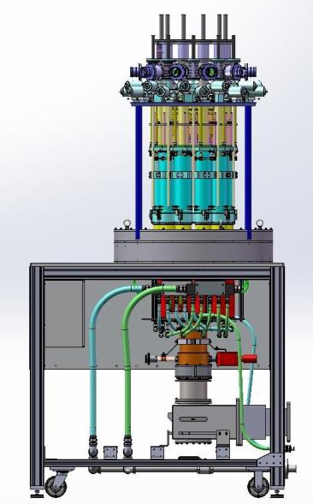
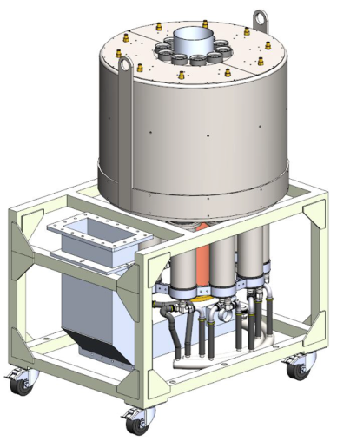


High Beta linac: Multi-Beam IOTs
New class of device
More compact than klystron
Does not saturate
Two prototypes on order for Delivery during 2016
1.2 MW, 704 MHz

Slide 29
Interlock
Rafael Montano
Interlock
Protection:
Amplifier
Waveguides
Cavity
LLRF
Fast (μs) and slow (ms)

Slide 30
Local Protection System - Interlocks
Typical RF Chain separating fast and slow interlocks
FPGA
Fast – FPGA
Slow - PLC
PLC
155 Systems Needed
Courtesy of Rafael Montano

Slide 31
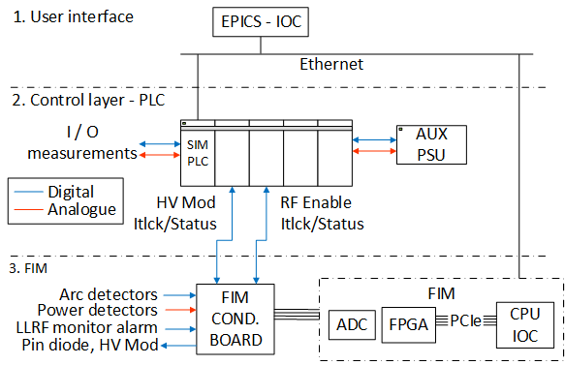
ESS RF-LPS HW Configuration
Notes:
There is a brief summarize about the total system to be installed at ESS

Slide 32
Klystron protective interlocks
Intermediate protection – The Klystron beam voltage must be interrupted within 100 ms, of following conditions:
  Solenoid voltage
  Solenoid current
  Ion-pump current
  Collector flow rate
  Body flow rate
  Window air flow rate
RF Drive Interruption – The RF Drive must be removed within 10 μs under any of the conditions listed below:
  Arc detectors
  Reflected power
Filament interruption – In order to protect the filament from poor vacuum conditions, a protective circuit shall switch off the filament.
Notes:
There are some conditions about the Klystron protective interlocks.

Slide 33
RF-LPS prototype design – signal types
The PLC shall collect and process more than 70 signals per station according to the preliminary signal list requirements
  Temperature
  Cooling flow-rates
  Cooling water pressure
  Solenoid PS interlock signals
  Vacuum
  Cryomodule system ready
Fast Interlock Module (FIM) more than 20 signals
  Power forward/reflected
  Arc detectors
  Modulator remote interlocks
  LLRF monitor alarm
  Pin diode

Slide 34
LLRF
Anders Johansson LU
Rihua Zeng
Interlock
LLRF regulates cavity amplitude and field:
PI-control
Adaptive feedforward
Inner klystron loop
Beam current variation
compensation

Slide 35
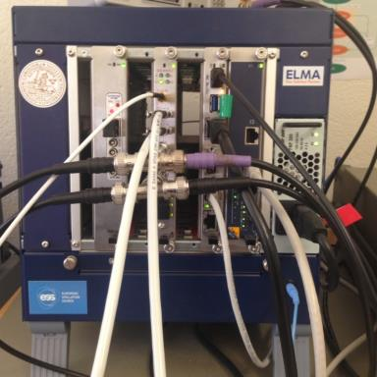
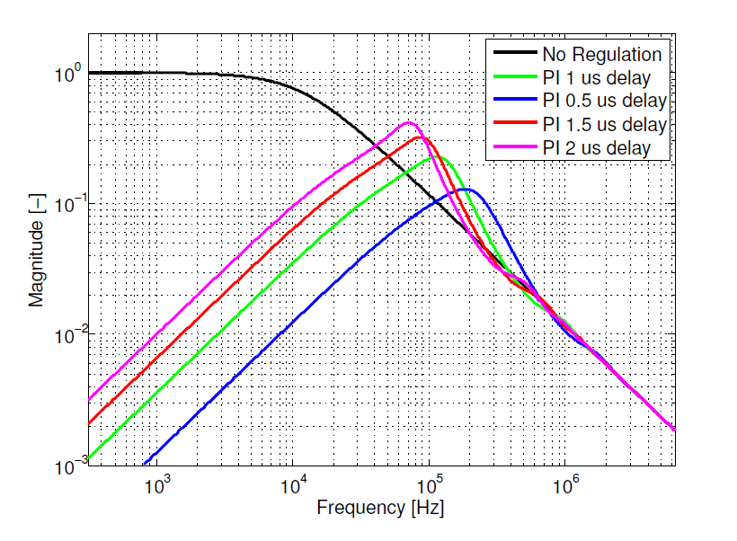
ESS LLRF prototype and efforts
  μTCA 4 standard
  352 and 704 tested and running
  Adaptive feedforward learning
  Lorentz force detuning compensation
  Tests (352 @ FREIA, 704 @ Saclay)
  Klystron linearization
  Requirements on precision
    Control/cavity system modeling
    Beam physics (loss) modeling
    Regulation system set-up
    Handling beam current variations
    Handling modulator ripple

Slide 36
Field Stability
Current requirements for regulation accuracy of the cavity field.
RFQ
  +/- 0.2 % RMS amplitude
  +/- 0.2 º RMS*
Normal Conducting
  +/- 0.2 % RMS amplitude
  +/- 0.2 º RMS
Super Conducting
  +/- 0.1 % RMS amplitude
  +/- 0.1 º RMS
Relaxed requirements
for initial 10 us.
Cavity
Field
Beam
2.86 ms
Time
*Relative the phase reference line. All other phase requirements relative the beam.

Slide 37
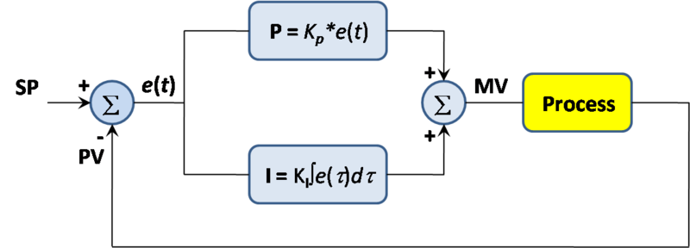
PI-control
Classic controller
  Proportional
  Integral
Two independent, but equal, PI-controllers, on I and Q.
An additional inner loop for linearization is planned.

Slide 38
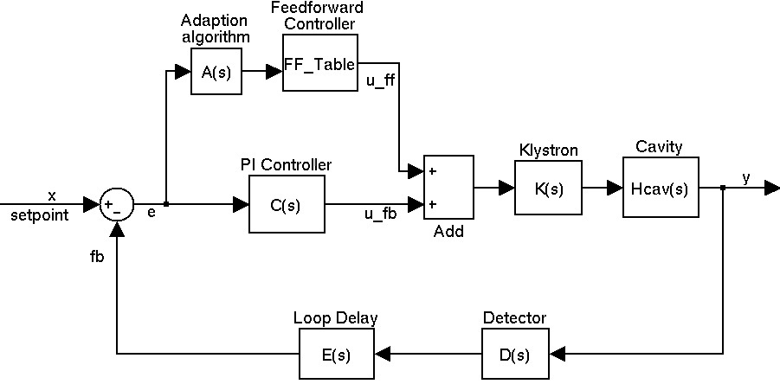
FeedForward control
Based on stationarity of system
  Every pulse looks the same
  Adaptation handles slow drift

Slide 39
Master oscillator, phase reference line
Rihua Zeng
Interlock
Phase reference:
What is the right phase?
LLRF regulates to that
Given by phase ref
All along the linac
Phase reference line

Slide 40
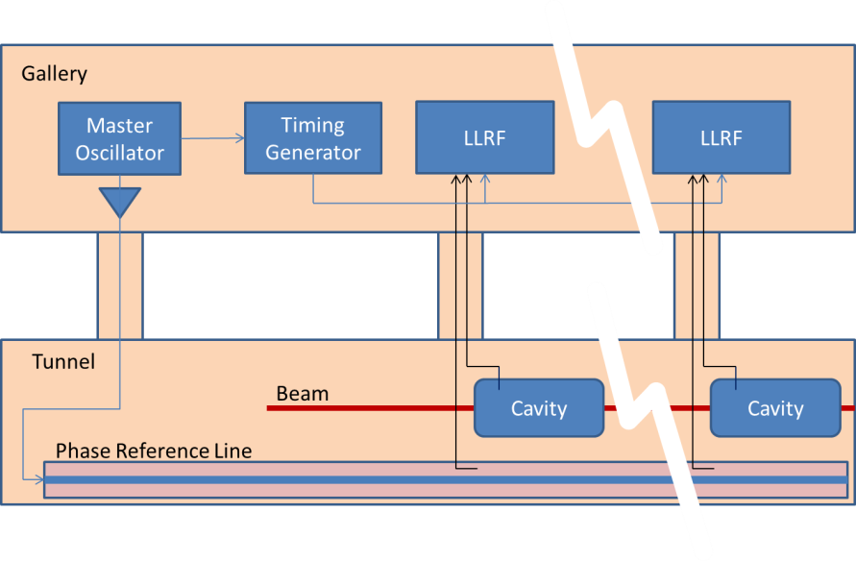
Timing and Phase Reference
Phase reference line in tunnel.

Slide 41
Phase ref line
First design prepared
Prototyping 2015-2016, scaled down version to test
    Phase reference signal delivery system
    Air pressure system
    Temperature control system
    Data acquisition, drift calibration, EPICS interface
Several design alternatives
Temperature controlled within ±0.1°C
MO
20dBm,352.21MHz
20dBm, 704.42MHz
~40dBm, 352.21MHz
~50dBm, 704.42MHz
Temperature controlled within ±0.1°C
352.21MHz, 1 5/8’’ rigid line
704.42MHz, 1 5/8’’ rigid line
…
…

Slide 42
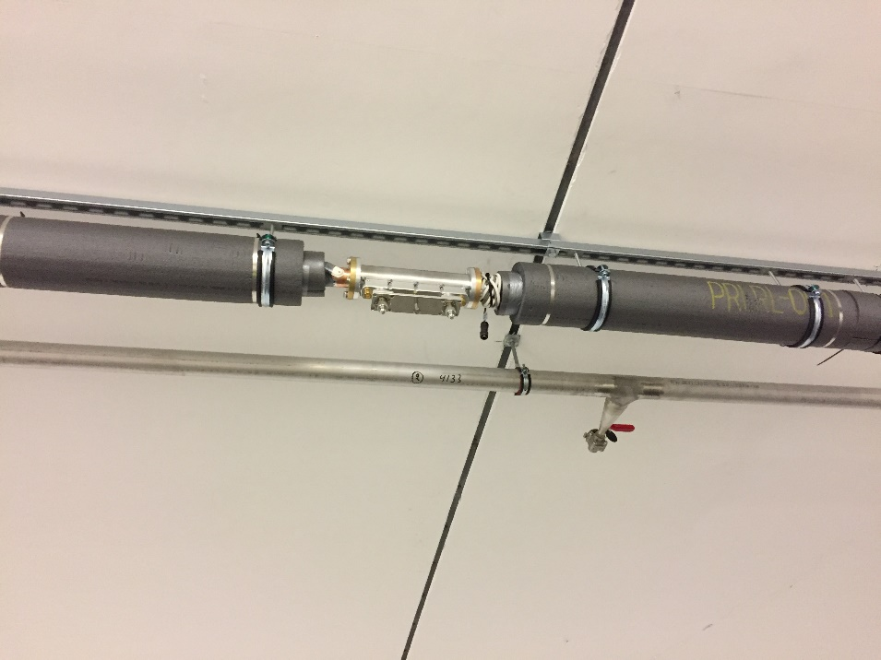
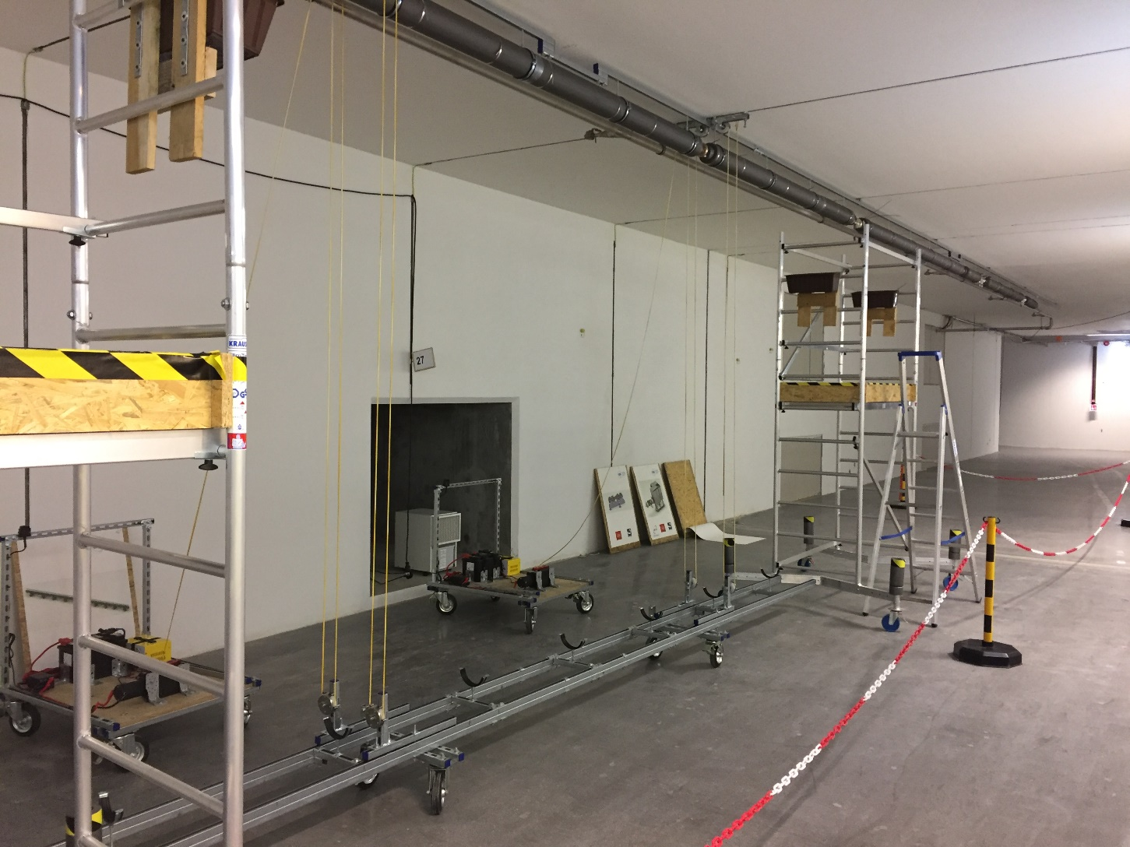
Installation started!

Slide 43
Distribution system
Stevo Calic, Bruno Lagoguez
Interlock
Transport RF power to cavity:
Waveguides
Circulator to protect amplifier
Load to take up reflected power
Couplers for measurement
Arc detectors for protection

Slide 44
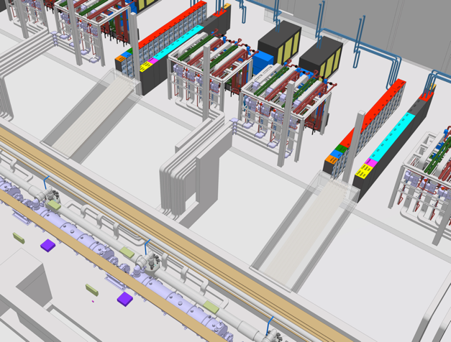
RF distribution transports RF power
Waveguides, circulators, loads, directional couplers

Slide 45
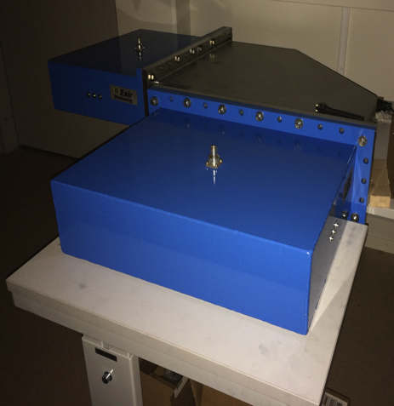
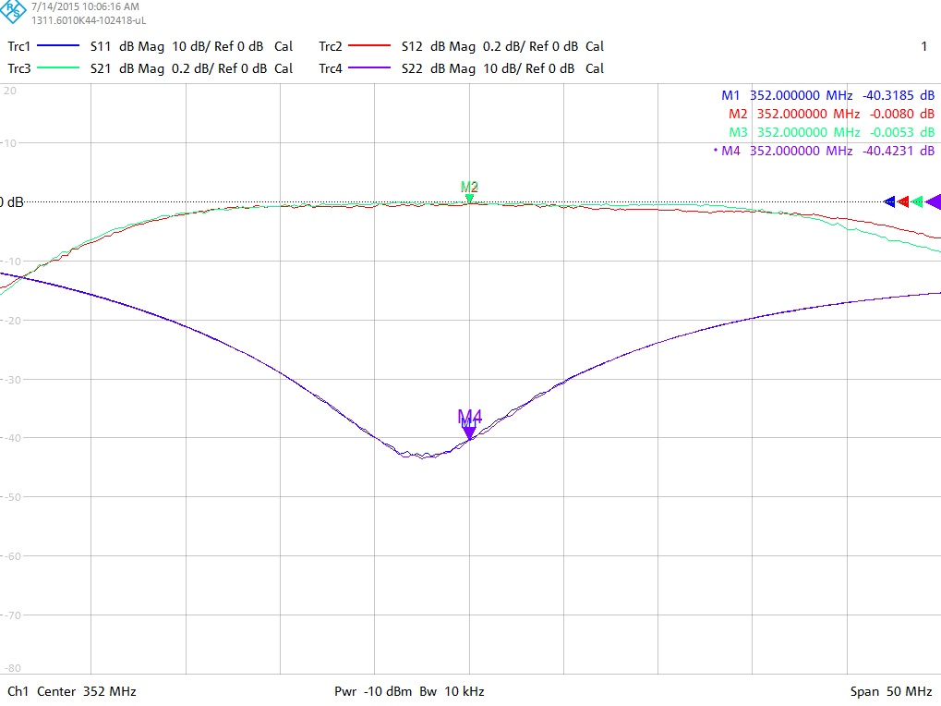
Distribution: Waveguide, coax, circulators and RF loads
ESS needs several kilometers of waveguide and thousands of elbows
Simple to design
Detailed manufacturing drawings allow manufacture by variety of companies
Potential of significant cost saving
ESS Design
Waveguide extends through flanges
Failed in visual inspection
H-Elbow
First waveguide prototypes received from two companies
Coax-waveguide
Adapters
Prototypes for 704 MHz circulators and loads
  Circulators: AFT, FMT and MEGA
  Loads: AFT, Thales and MEGA
S11 > 30 dB
S21 < 0.05 dB
Courtesy of R Yogi

Slide 46
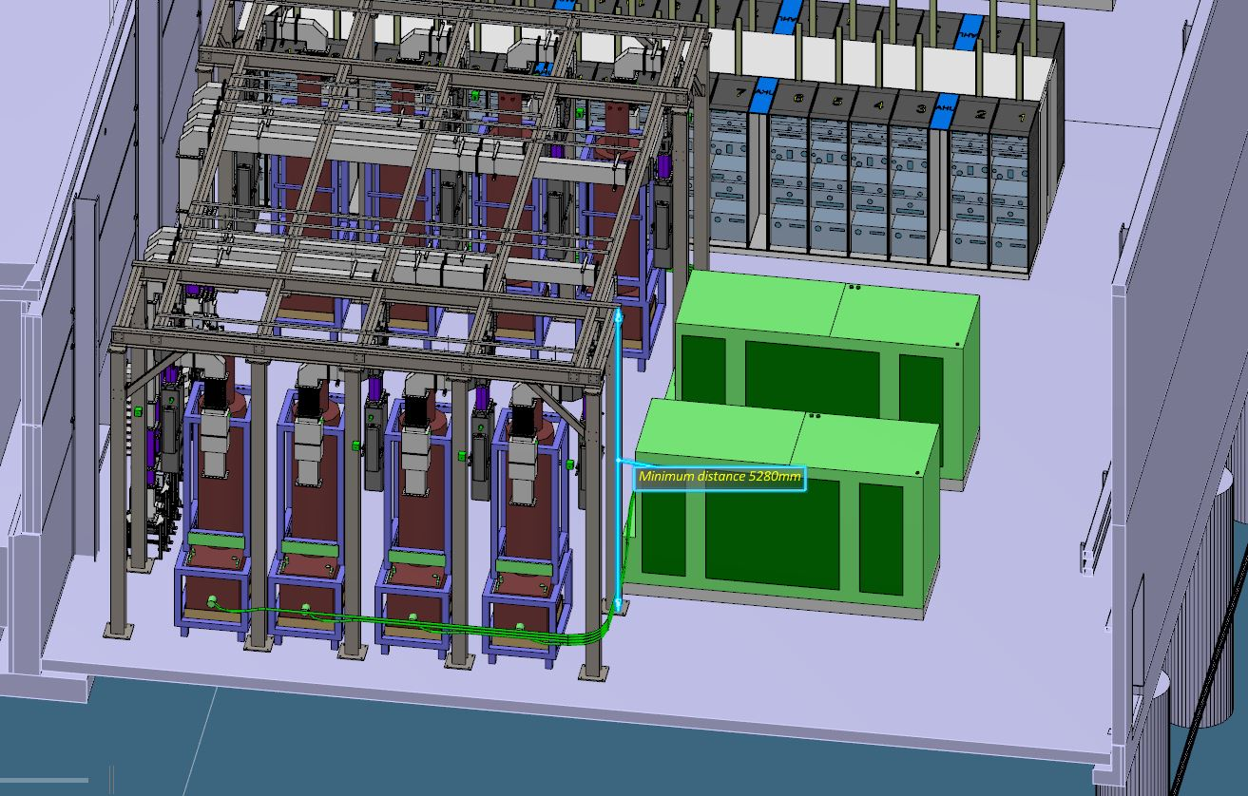

Distribution: supports, filling stubs
The stubs are hugely cramped, and getting all waveguides in is challenging
There are very large and heavy support structures in the gallery

Slide 47
Test stands
It is vitally important to prototype and test RF equipment
No large facility works without a test stand
ESS employs several test stands:
  Integration test stand in Lund University
  FREIA test stand in Uppsala (352 cryomodules, 352 power, modulator prototype, 704 cavity prototype)
  Cryomodule test stand at ESS (704 cryomodules)
  RF HP test stand at ESS (high power RF components, starting with modulators)
  CERN tests of IOT prototypes

Slide 48

Integration Test Stand
Integration test stand being prepared in M-building, Södra apparathallen
  CERN modulator + old LEP klystron
  SML prototype + Toshiba klystron

Slide 49
Next Steps
Deliveries are starting November 2017!
Integration design of RF in gallery
Planning of installation
Installation
Challenging and complex installation schedule/procedure
Cryomodule test stand set-up and operation
HV test stand set-up and operation
Commissioning
Ready for beam during 2019

Slide 51
Summary
RF is used to accelerate particles via resonant cavities
RF systems span many disciplines
  HV engineering
  Physics
  Microwave technology
  Electronics
  Automatic control
  Test and measurements
  …
RF is great fun!

Slide 52
Thank you

