Slide 1
ESS Engineering
- Magnets -
Zvonko Lazic
Mech. Engineer
www.europeanspallationsource.se
2017-10-12

Slide 2
Presenter
Zvonko Lazic
At ESS, The Bunker project manager; NSS integration– Science division.
Background – Special purpose automation; magnetics.
Magnetic FEA using Vector field.
Permanent magnet modeling for ECPMDC rotating machines.
Normal conducting magnets for ion implant lines and synchrotron labs.
High temperature superconducting magnets for industry and physics labs.
Engineering background helps designing magnetics that can be produced.

Slide 3
Overview
Magnets as part of an accelerator; types and what do they do.
Magnetic design in accelerator environment.
- fundamentals
Electrical design (of magnets).
Mechanical design (of magnets).
Manufacturability and errors/tolerances.
Verification and measurement of magnets (for accelerators).

Slide 4
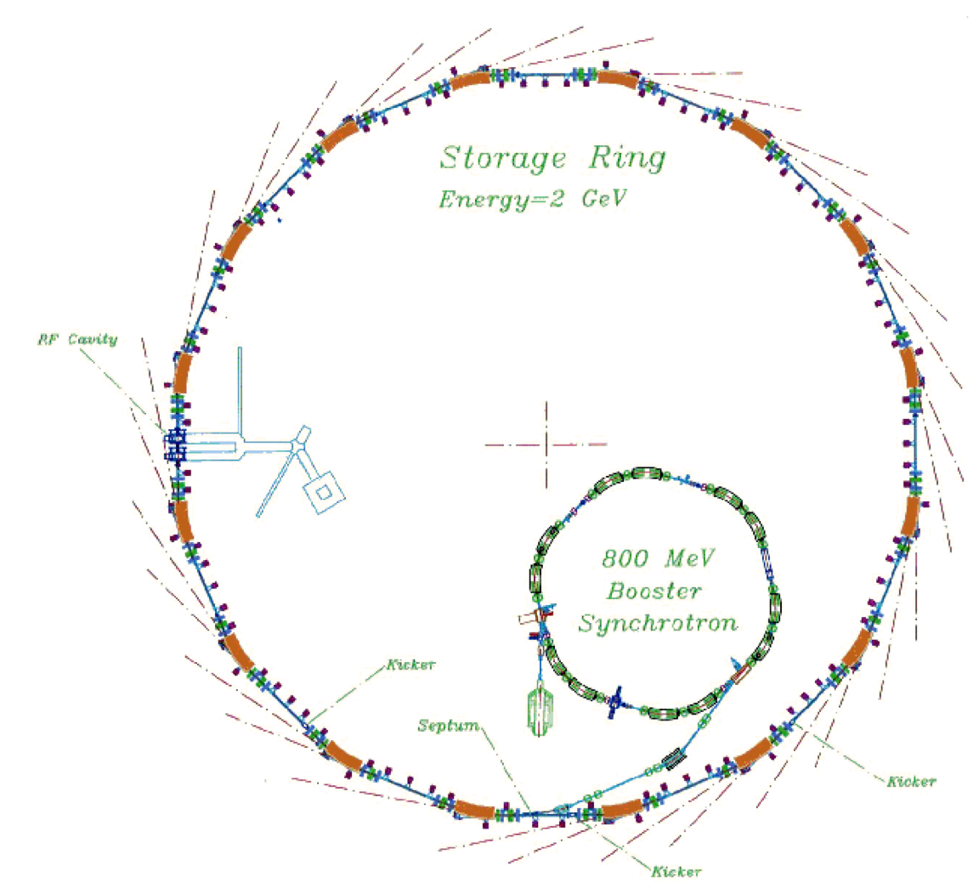
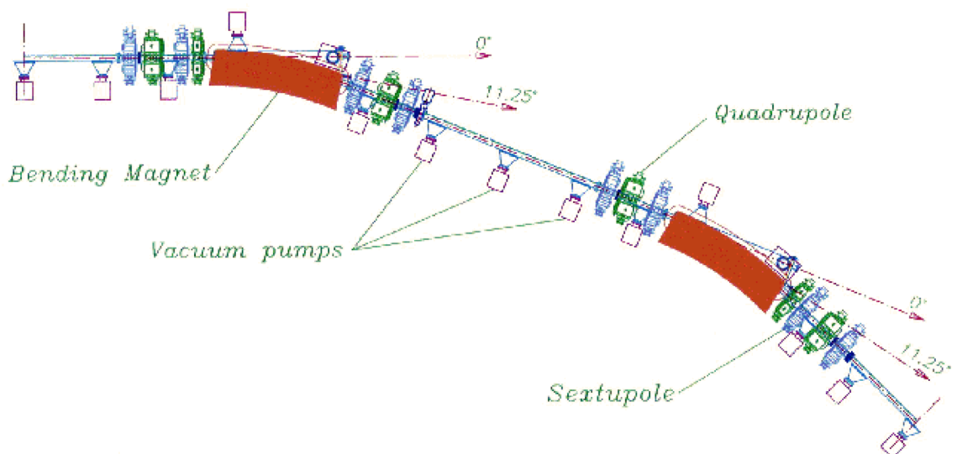
Accelerator magnets
There are a few accelerator types.
Linear, Storage, Collider;
Consider a storage ring.
Storage ring (synchrotron) accepts particles (from a linac or a booster ring), keeps them stored and recirculate in order to produce a synchrotron light.
Particles are ‘stored’ by utilising magnetic field (they are contained in a magnetic field).
For this to work, several types of (electro)magnets are required.
Something to make the beam bend into a circle, something to keep the beam contained, something to extract the beam, something to use in a sample environment, etc…

Slide 5

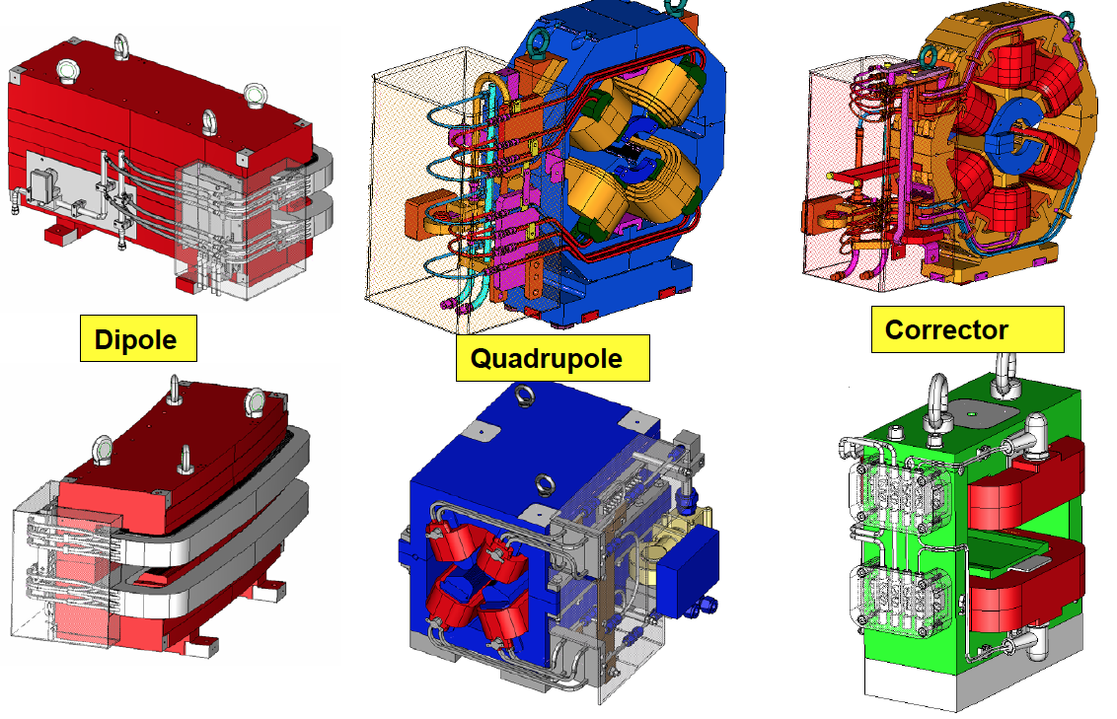
Accelerator magnets
Credit: D. Einfeld & M. Pont_CELLS/ALBA

Slide 6
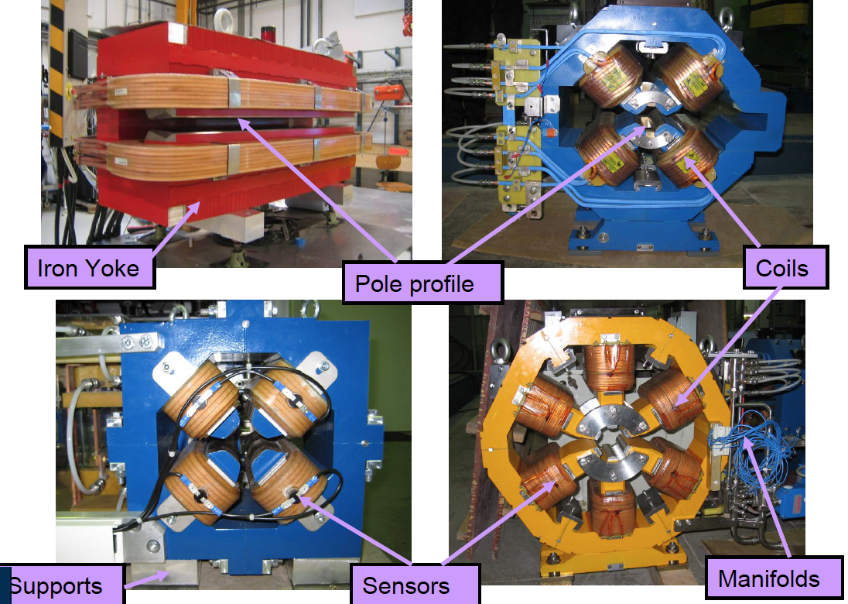
Main components of a Magnet system
Credit: D. Einfeld & M. Pont_CELLS/ALBA

Slide 7
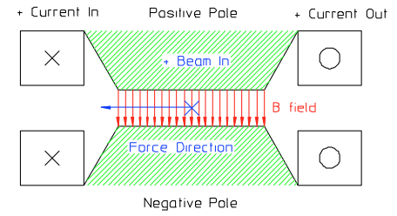
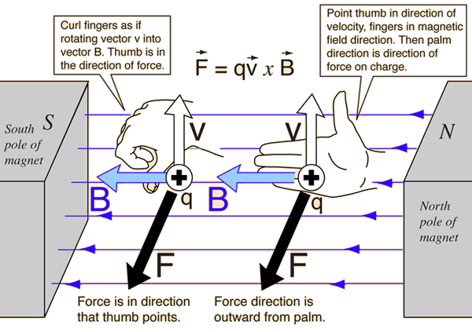
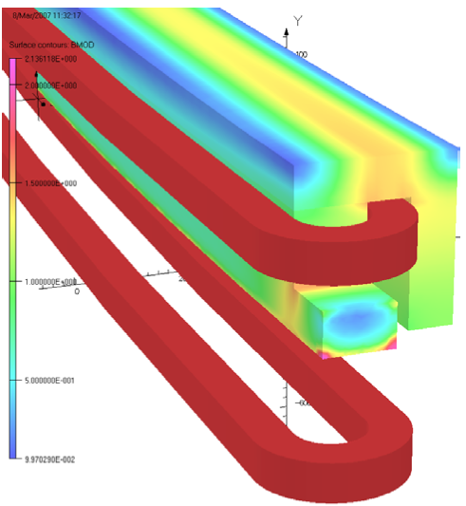
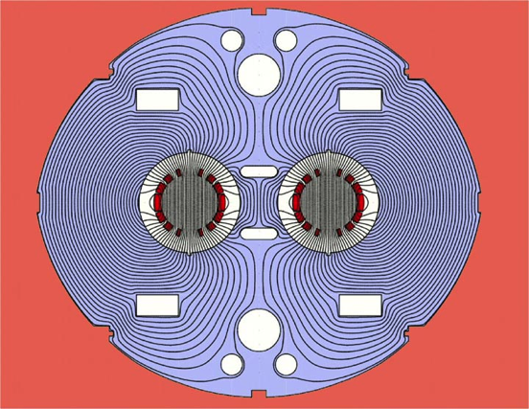
Dipoles
Dipoles serve to steer the beam, to ‘bend it’ and ensure circular trajectory of the particle bunch.
Synchrotron dipoles can have different configurations; main layouts, an H, a C, gradient dipoles, etc.

Slide 8
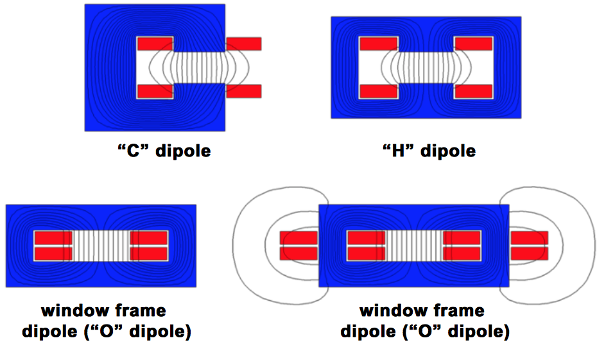
Dipoles (main types)
Credit: Attilio Milanese; CERN_ “An introduction to Magnets for Accelerators”

Slide 9
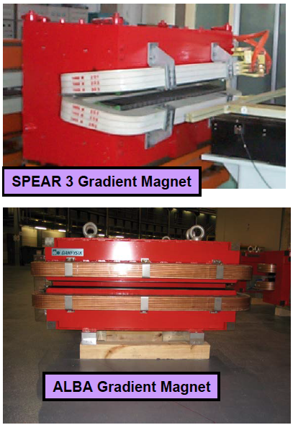
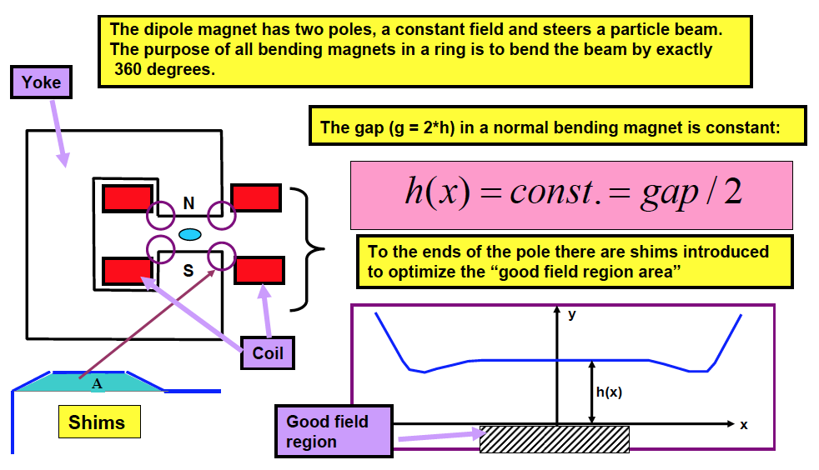
Dipoles
We use mks system of units on the vector equation;
The right hand rule is used for vector directions.
Credit: D. Einfeld & M. Pont_CELLS/ALBA
J. Tanabe _ “Magnet design”

Slide 10
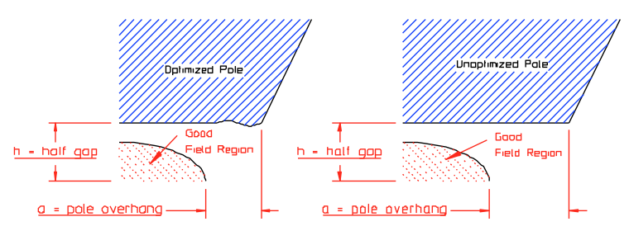
Dipoles _ Specification
The size of a dipole is given by the required good field region, the required bending radius, the beam energy and the field that can be achieved in the good field region.
To achieve required field uniformity in the good field region, several design/manufacturing practices are involved.
Dipoles are designed with ‘shims’. These are special profiles designed into the magnet poles to facilitate the field uniformity within the good field region. This shim design allows for lower magnet footprint and for optimised field profile.
Credit: D. Einfeld & M. Pont_CELLS/ALBA
J. Tanabe _ “Magnet design”

Slide 11
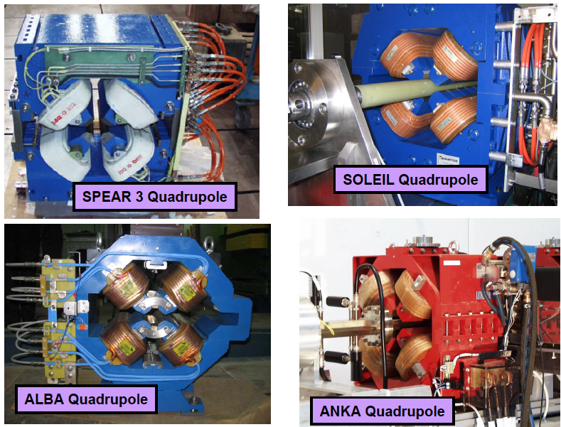
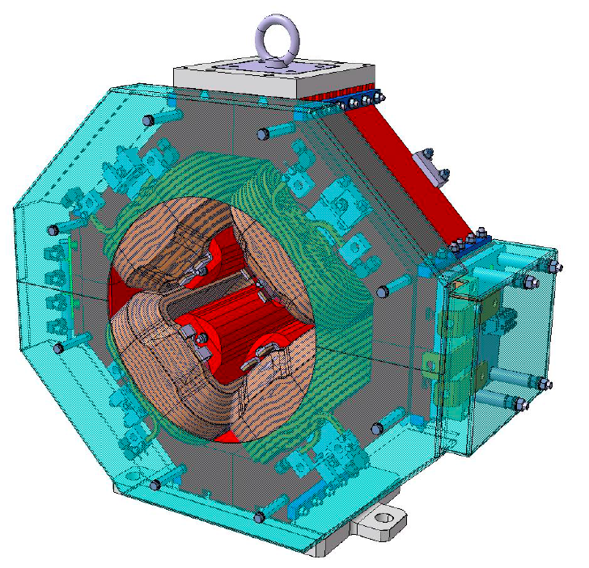
Quadripole Magnets
ESS Quadripole
Credit: D. Einfeld & M.Pont_CELLS/ALBA; J. Tanabe _ “Magnet design”

Slide 12
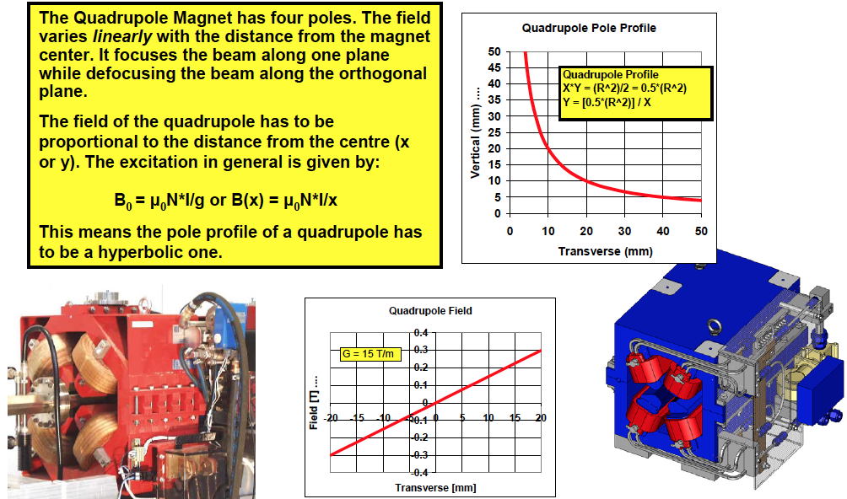
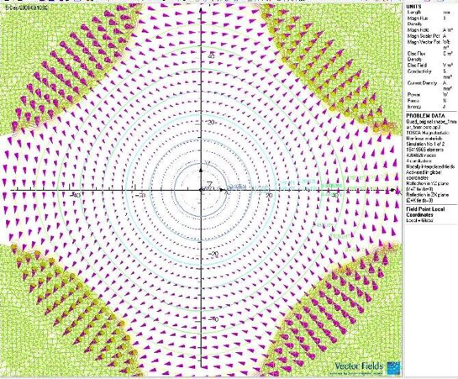
Quadripole Magnets
Credit: D. Einfeld & M.Pont_CELLS/ALBA; J. Tanabe _ “Magnet design”

Slide 13
Harmonics and Fourier transforms - intro
Some definitions include (but are not limited to..) :
In acoustics and telecommunication, a harmonic of a wave is a component frequency of the signal that is an integer multiple of the fundamental frequency. For example, if the fundamental frequency is f, the harmonics have frequencies f, 2f, 3f, 4f, etc. ...
Harmonic - In mathematics, a number of concepts employ the word harmonic. The similarity of this terminology to that of music is not accidental: the equations of motion of vibrating strings, drums and columns of air are given by formulas involving Laplacians; the solutions to which are given by eigenvalues ...
Harmonics are electric voltages and currents that appear on the electric power system as a result of certain kinds of electric loads. Harmonic frequencies in the power grid are a frequent cause of power quality problems.
harmonic - of or relating to harmony as distinct from melody and rhythm; "subtleties of harmonic change and tonality"- Ralph Hill
harmonic - of or relating to the branch of acoustics that studies the composition of musical sounds; "the sound of the resonating cavity cannot be the only determinant of the harmonic response"
harmonic - a tone that is a component of a complex sound
harmonic - relating to vibrations that occur as a result of vibrations in a nearby body; "sympathetic vibration"
Many different ways to explain it… The term (harmonics/harmonic) is used a lot across math, music, physics…
To make things simpler, let us draw..

Slide 14
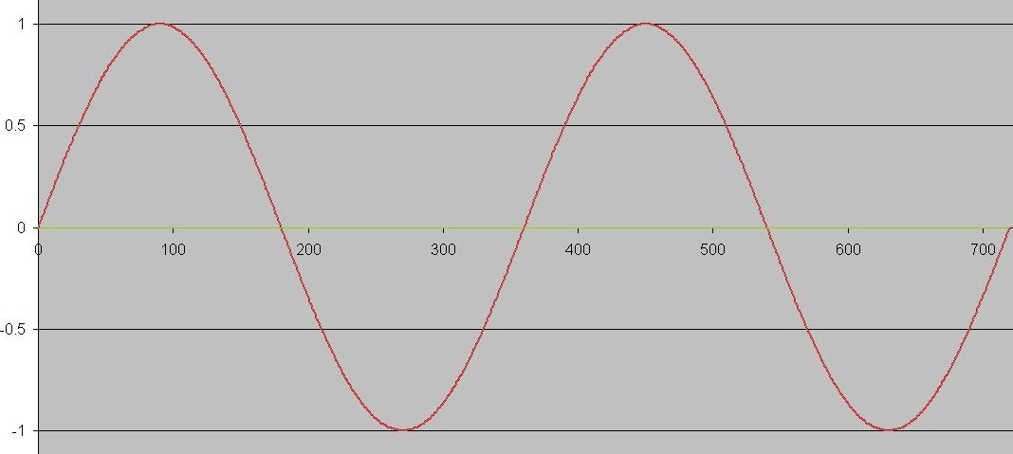
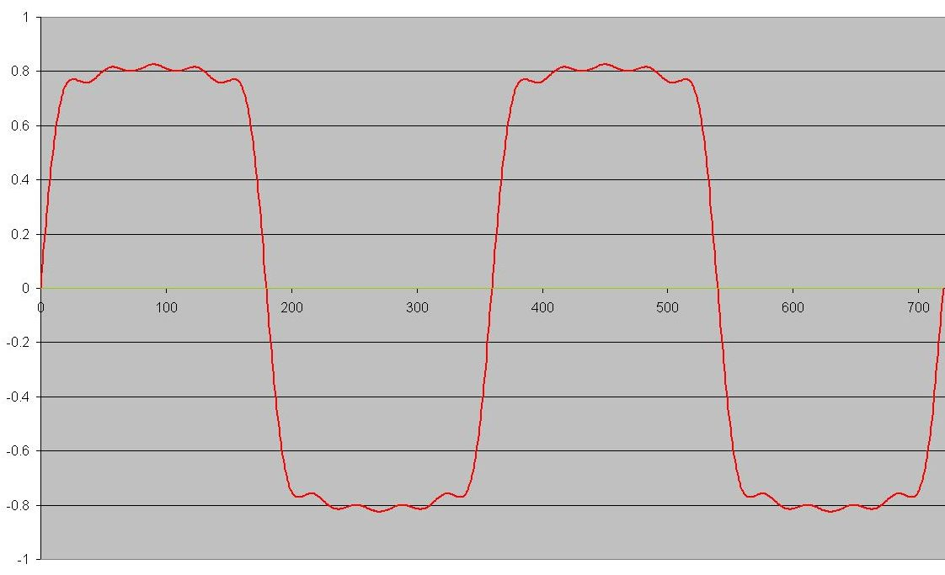
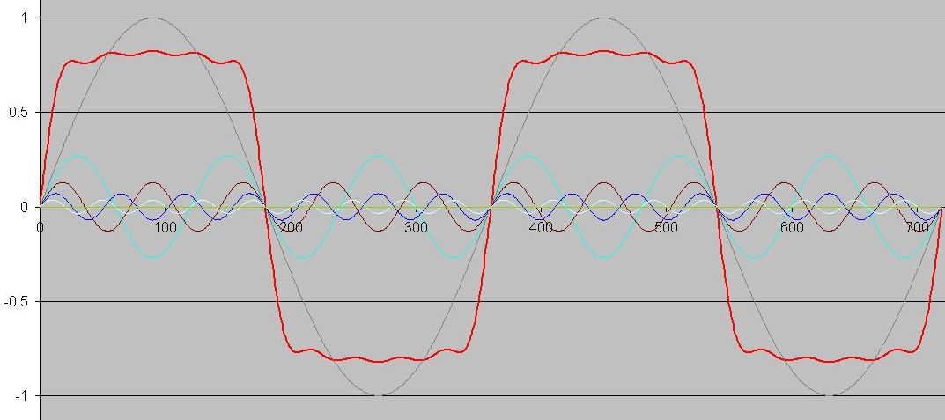
Harmonics and Fourier transforms - intro
Consider a SINE WAVE…
A Sine Wave falls under a ‘pretty’ category. It is very pretty, and reasonably hard to ‘produce’. (for example, some people spend lots of time trying to make newly developed electro-motors to produce a Sine Wave BEMF)… Things wouldn’t be interesting if everything was so simple…
Consider another wave form…
And here we are…
All sine waves making up the resulting waveform (when added up) are HARMONICS of that waveform
‘Fundamental’
Resulting waveform
Not-so-sine-wave
Several sine-waves

Slide 15
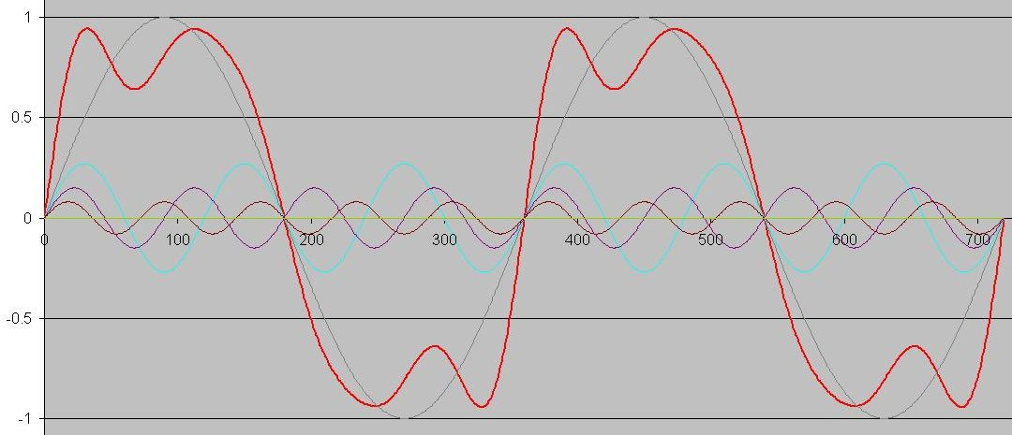
Harmonics and Fourier transforms - intro
All sine waves making up the resulting waveform (when added up) are HARMONICS of that waveform
Counting how many times does ‘harmonics sine wave’ oscillate inside one oscillation of the fundamental, will give you the ‘harmonics order’…
For example, 3rd order harmonics of a fundamental is the sine waveform that is got 3 times the frequency of the fundamental…
4th order 4 times,
5th order 5 times and so on…
What this all mean to us?
Well, magnetic field quality is often (more appropriate word here is ALWAYS) described as allowed HARMONICS to the fundamental…
Let us DRAW some more…

Slide 16
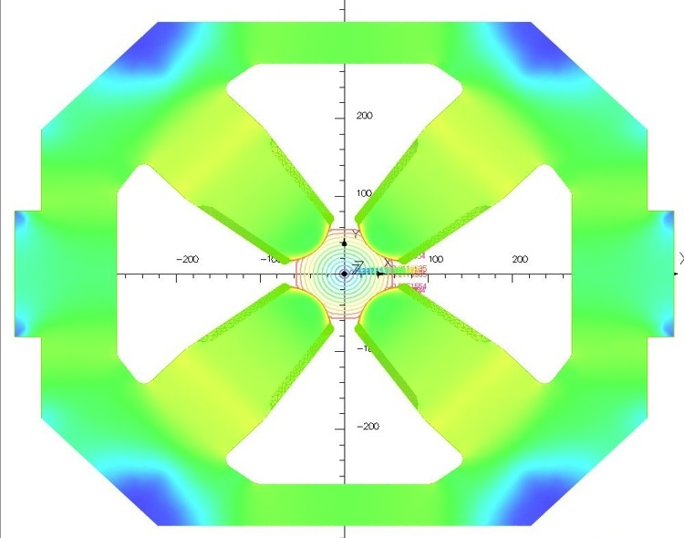
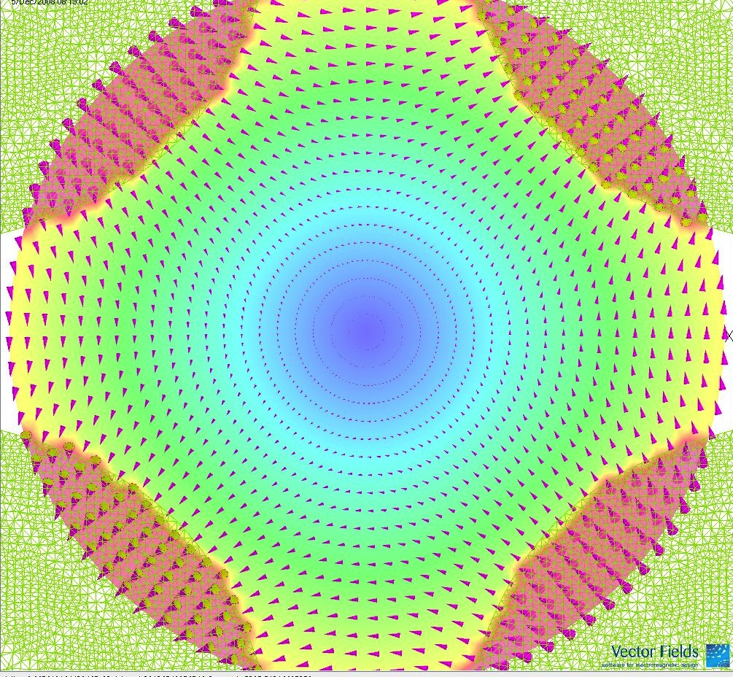
Harmonics and Fourier transforms - intro
For example, take a BNL Quadripole magnet…
When a physicists talk about their quadripole field, there is always a radius at which this field is specified.

Slide 17
Harmonics and Fourier transforms - intro
The way measurements are made goes roughly like this:
imagine a straight line positioned on the specified radius inside that quad magnet.
than magnetic field density is measured for that line
the line is stepped around the circle (lots of steps, more to better)
for every step, there is a magnetic field density value…
plotting all the values going around the circle will give something very close to the sine-wave
however, there are ALWAYS deviations from the perfect sine wave. Those deviations are what is specified as ‘allowed harmonics’ of the field
So, ‘allowed harmonics’ are the wave components that describe deviations from the ‘fundamental’.

Slide 18
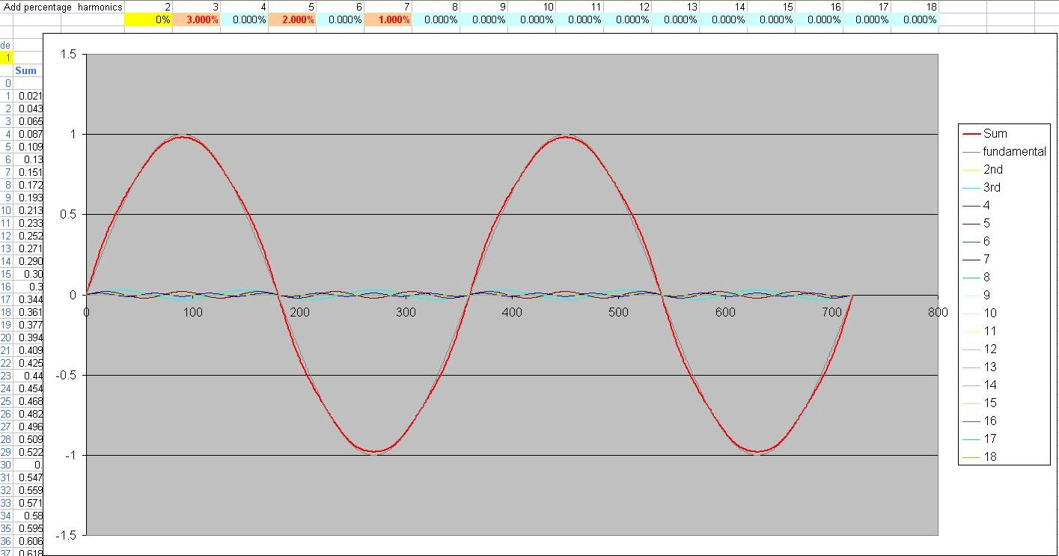
Harmonics and Fourier transforms - intro
The image bellow shows a few percents of 3rd, 5th and 7th added to the fundamental. With quad/sext magnets we produce, what we are required to ‘chase’ is a few hundredths or thousandths of a percent of harmonics ranging in order from 3 to 20 and higher.

Slide 19
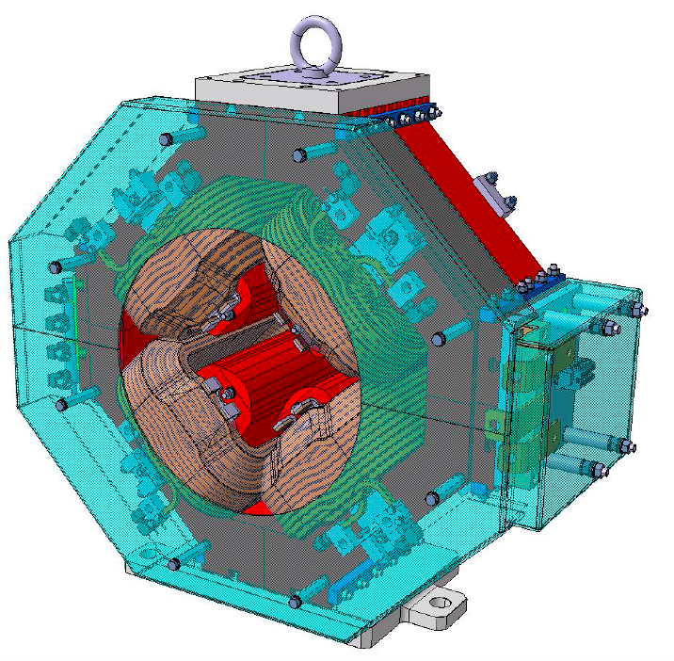
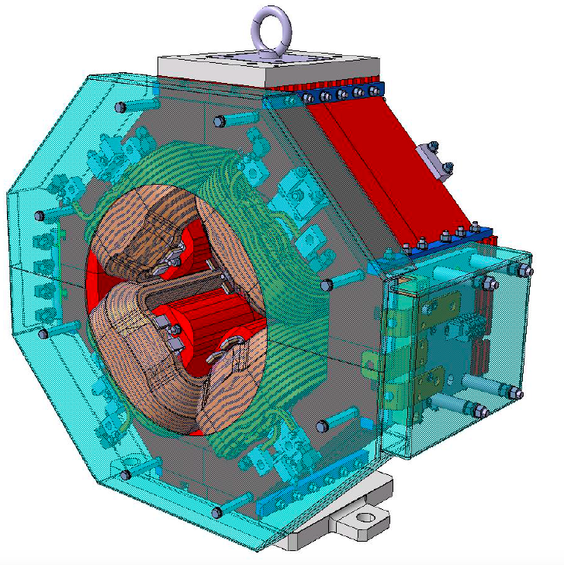
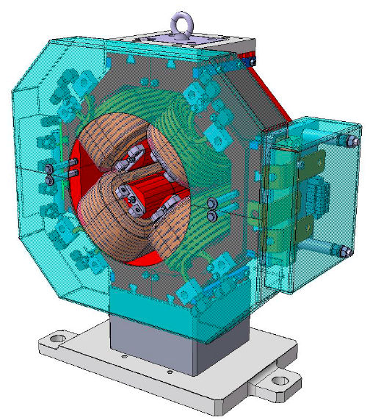
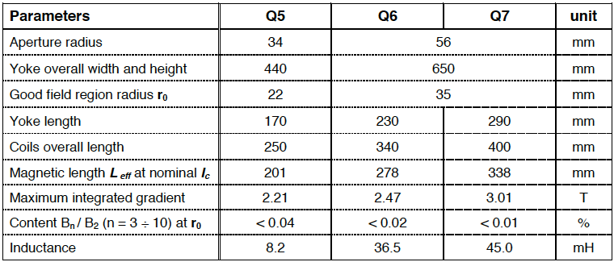
ESS Quadripole
Q5
Q6
Q7
These ESS magnets are located at different positions along the linear accelerator..
Credit: Davide Castrnovo; ELECTTRA

Slide 20
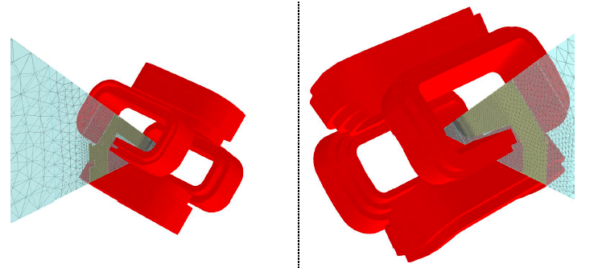
ESS Quadripole
Q5 and Q6/7, ‘2D5’ models defined in Opera 3D
Credit: Davide Castrnovo; ELECTTRA

Slide 21
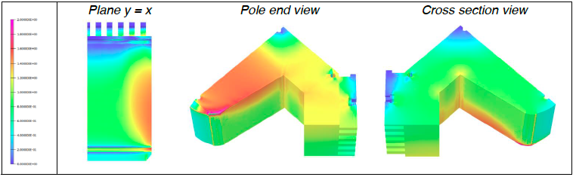
ESS Quadripole
Q6 final model; Bmod yoke distribution at 177 A (nominal maximum), colored bar from 0 to 2 Tesla
Credit: Davide Castrnovo; ELECTTRA

Slide 22
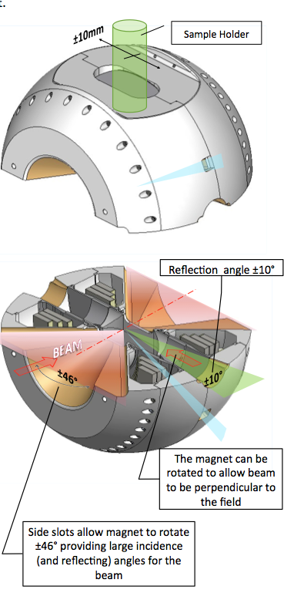
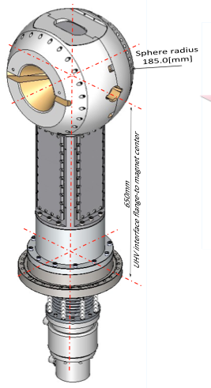
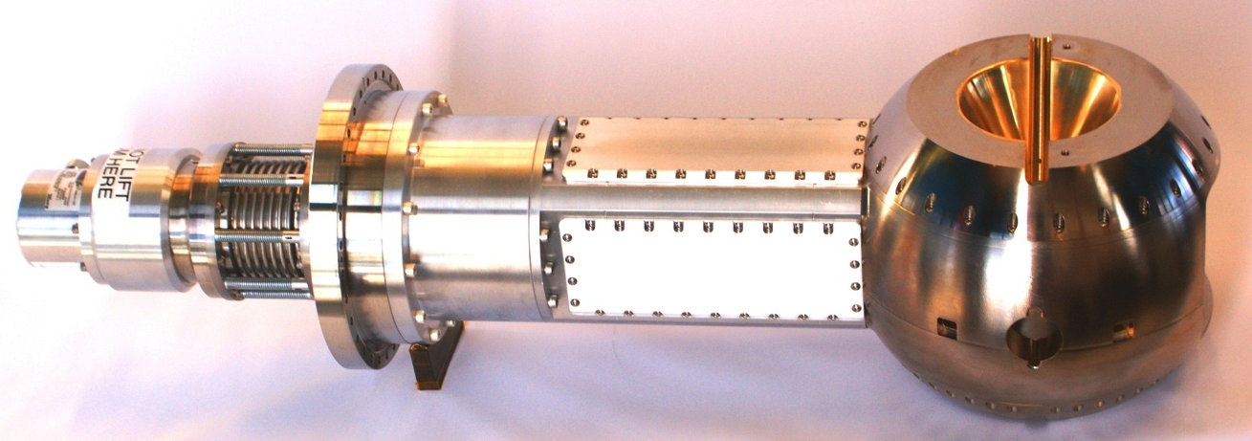
Sample environment magnets
As the name says, these magnets are used in the sample environment. Their purpose is to apply magnetic field at/around the sample area subjecting it to the required field.
The technical requirements for these magnets are very different from case to case. Depending on the experiment that needs to be performed.
Sometimes a super high field is required (over 20T) when superconducting magnets needs to be deployed. Sometimes just a steel saturation field is required (~1,5T) when conventional room-temperature conductor

Slide 23
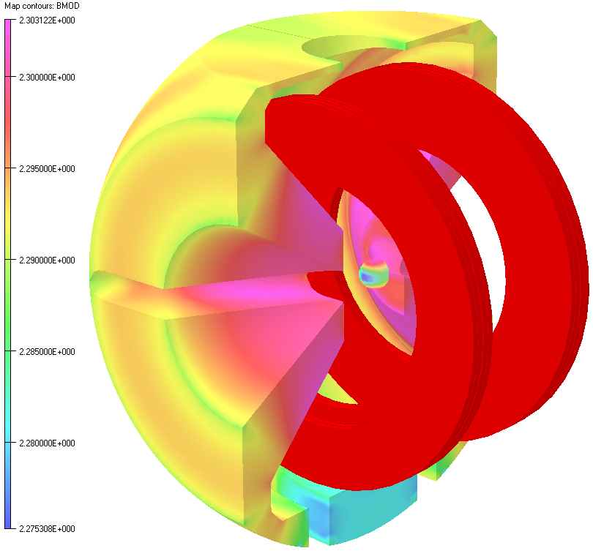
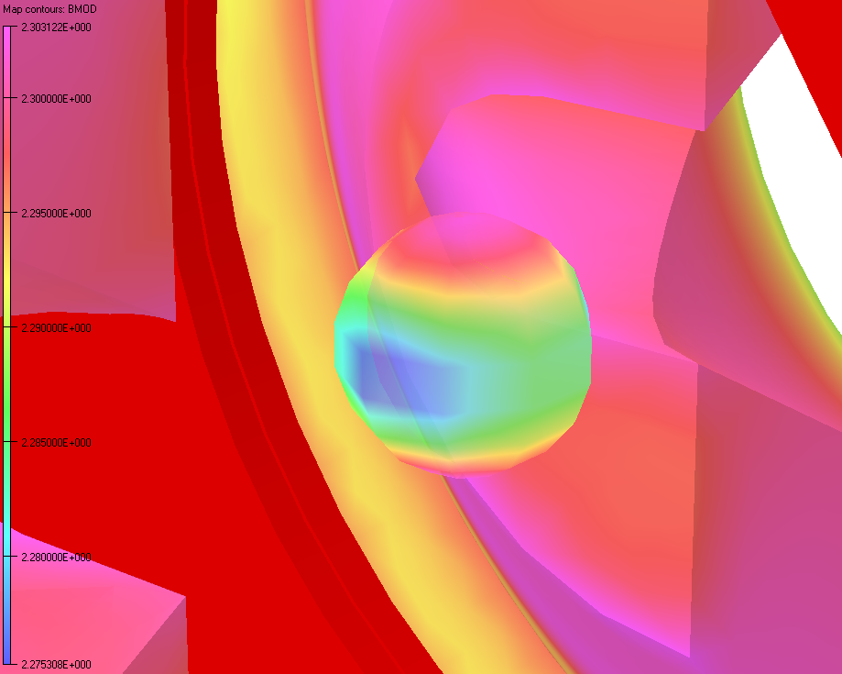
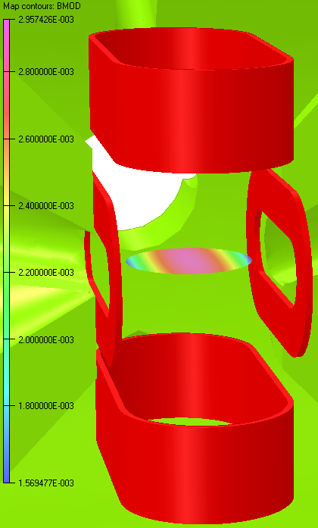
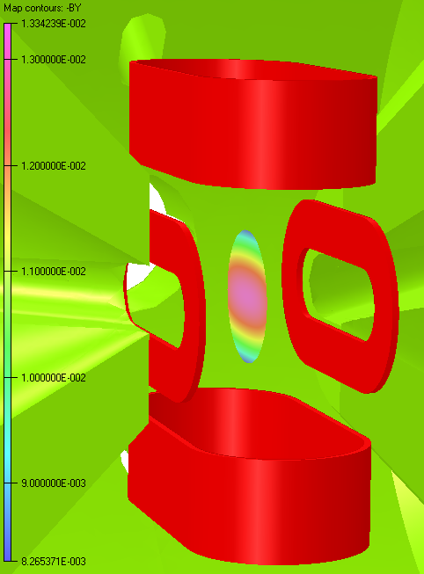
Sample environment magnets
Main coils produce required 2T with allowed 10% margin (modeled 2.2T)
Modeled performance of ambient temperature Cu (superimposing) coils.
Vertical coils produce 30 Gauss and Horizontal 133 Gauss of superimposing field.
Magnetic and thermal design of the system is performed using Opera TOSCA® software.
Magnet system performance (magnetic and thermal) is modeled applying set requirements and limits. The FEA shows that the requirements can be met. Additional (ambient temperature) coils have been designed to provide superimposing DC and AC field over the sample area.

Slide 24
Generic sequence of a magnet production
Magnet requirements (magentic specs – field, magnetic length, good field quality and specifications, etc;
Basic/initial (magnetic) design is usually presented by the magnet group, or beam Dynamics group;
The steps 1. and 2. have to be made in accordance with space requirements, vacuum, diagnostics, facility preference regarding power supplies and water cooling;
Publish tender
Manufacturer selected, contracts signed;
Detailed design done by manufacturer;
Acceptance of the detailed design;
Production of manufacturing drawings (detailing);
Production of any tooling;
Materials procurement (steel, copper,…);
Acceptance of material tests (laminations, copper);
Production of prototype (or pre-series);
Magnetic measurement of prototypes;
Determination of end chamfer;
Serial production (production of full quantity of magnets);
Mechanical testing of the yokes;
Magnetic and electrical tests of the coils;
Magnetic measurement of the magnet;
Acceptance…

Slide 25
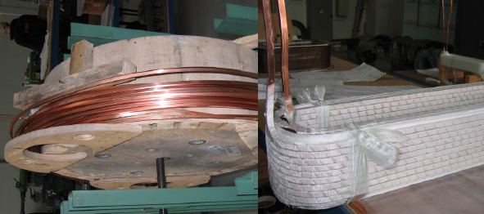
Electrical design
Magnet design starts with the magnet(ic) requirements.
To achieve certain field and field quality, the magnet is designed with the maximum available current in mind (this is usually driven by the cost and availability of power supplies).
The maximum available current, coupled with selected conductors, translates into an “Engineering Current Density”.
This is the current density [A/mm^2] of the conductor cross section as it appears in a drawing. This means that the conductor includes insulation, any cooling channels, any required spacing etc…
With setting up the current, we have to worry about the cooling.
As a rule of thumb, we say that for air-cooled coils we don’t put in more than 1A/mm^2 (but can push it to 3). For water cooled we don’t go more than 10A/mm^2 but this can be pushed further, depending on available cooling water pressure.
Out of the above, some conflicting boundaries are set for magnet design:
- magnetic design usually requires tight tolerances, as much steel as possible
- electrical design usually requires fine balancing between the current density, cooling capacities and available power supplies
- designing magnet coils require careful consideration of electrical and thermal loads on the system, all the while maintaining required field strength and quality.
In the case of the ESS, quad magnets presented here are pulsed. They operate at beam frequency of 14 Hz therefore the electrical duty cycle is reduced, therefore the demand on cooling is low. This resulted in simpler magnet design.

Slide 26
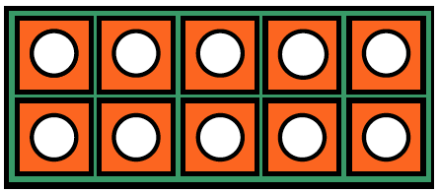
Electrical design
The electrical bussing connection creates a loop around the beam line, resulting in a small solenoidal field. This longitudinal field can rotate the beam.
The correct dipole bussing topology is shown below.
What is wrong with this picture?
The correct quadrupole and sextupole bussing scheme is shown. Again, it is recommended that the conductors be placed close to each other.
Credit: D. Einfeld & M. Pont_CELLS/ALBA
J. Tanabe _ “Magnet design”

Slide 27
Mechanical design
The mechanical design of the magnet is performed after the magnetic optimisation (usually 3D MFEA). Following the mechanical design, another round of MFEA is required to implement any magnet geometry changes that are driven by manufacturability requirements.
Some guidelines when performing the mechanical design of an accelerator magnet:
know materials restrictions (it is irradiated environment, some materials do not survive to well in this),
manufacturability is the key. Often accelerator magnets are ordered in good quantities (10s, 100s,…). During the mechanical design and implementation of magnet geometries as dictated by the MFEA, apply robust design practices. How are things produced, assembled, verified,…
have a good verification plan. This means measurement of key geometry features of the magnet (in our case, this are magnet poles geometry)…
be aware of manufacturing errors (and they always happen) influence on field quality (allowed and non-allowed harmonics).
  The shear motion of the top half of the magnet with respect to the bottom introduces skew even multipole errors.
  The vertical motion introduces real even multipole errors.
  The rotational motion introduces real odd multipole errors.
Credit: D. Einfeld & M. Pont_CELLS/ALBA
J. Tanabe _ “Magnet design”

Slide 28
Manufacturing errors
Credit: J. Tanabe _ “Magnet design”

Slide 29
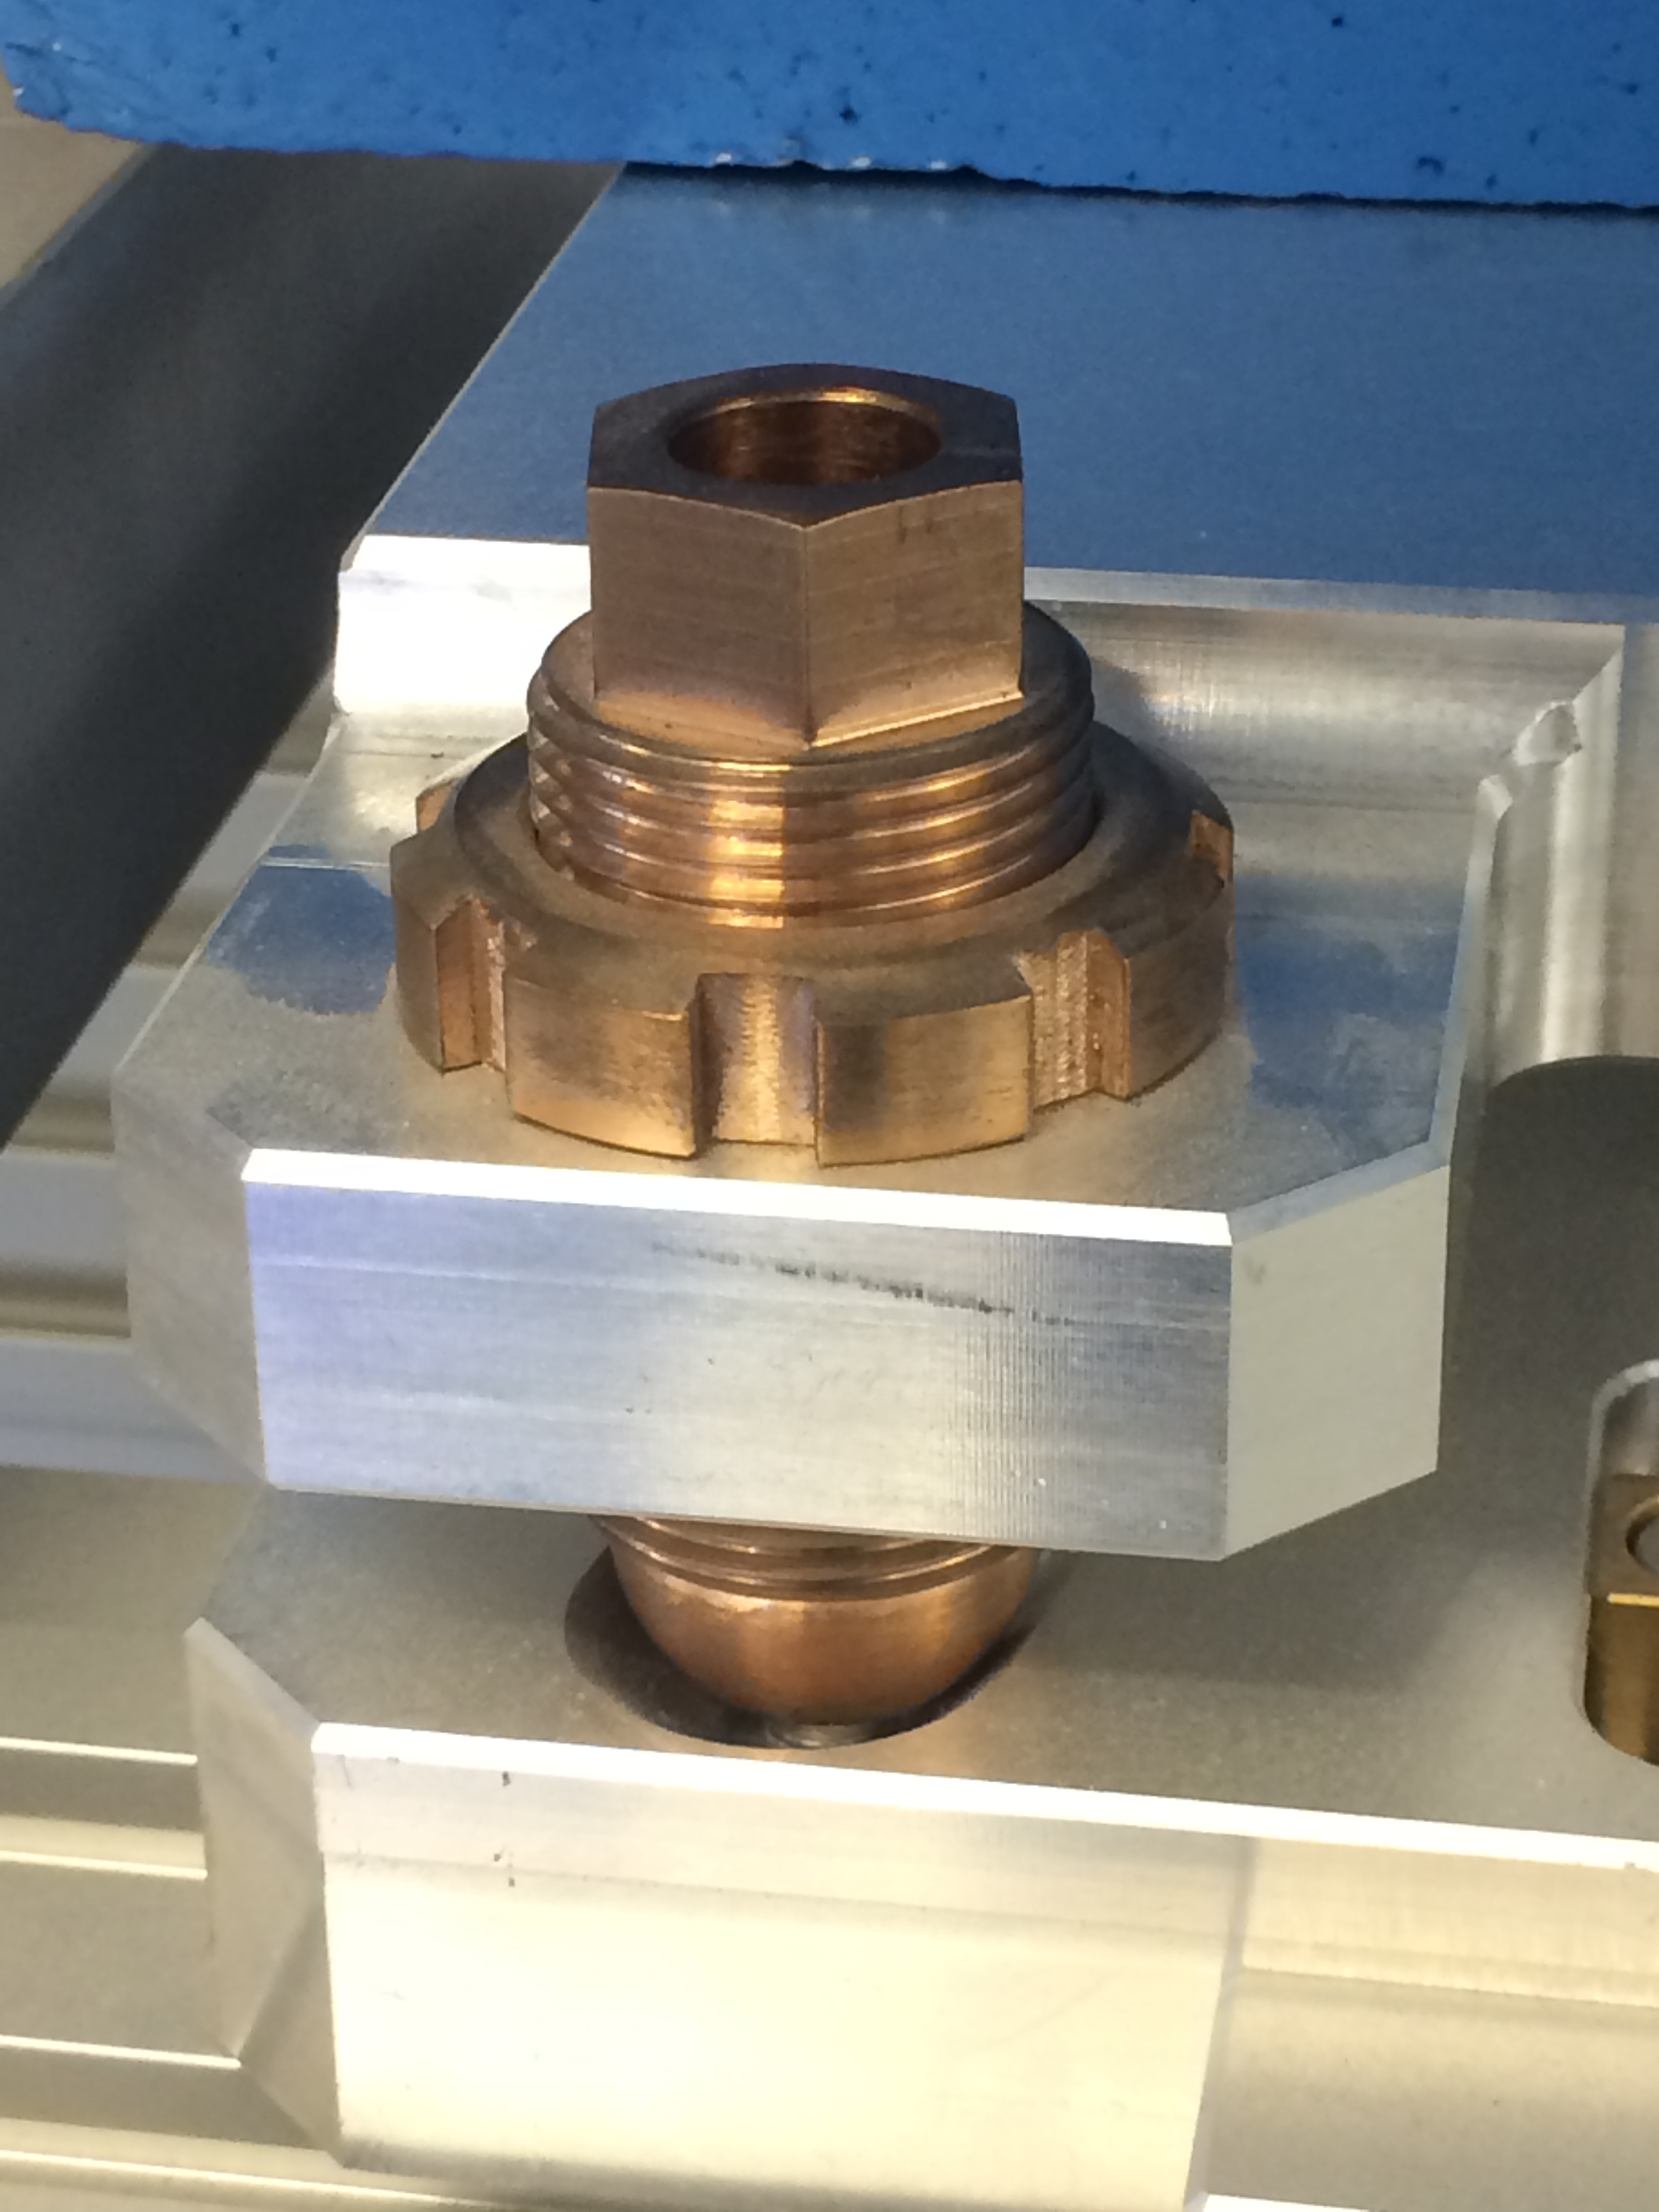
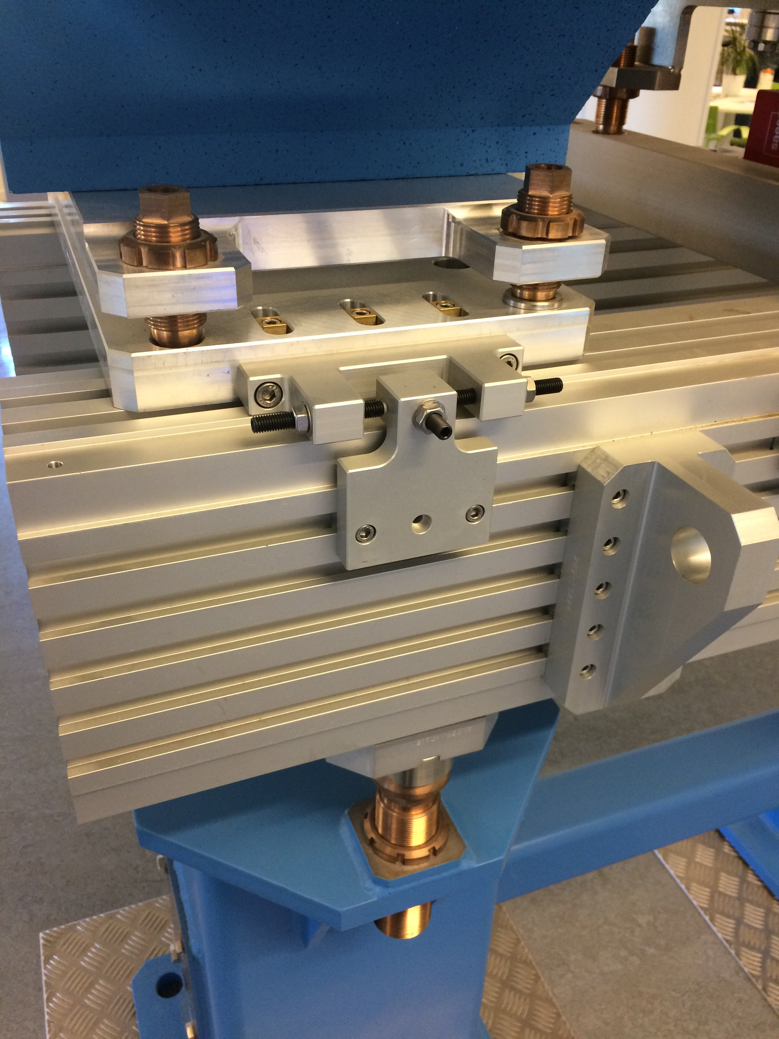
Examples of adjustment (alignment) systems

Slide 30
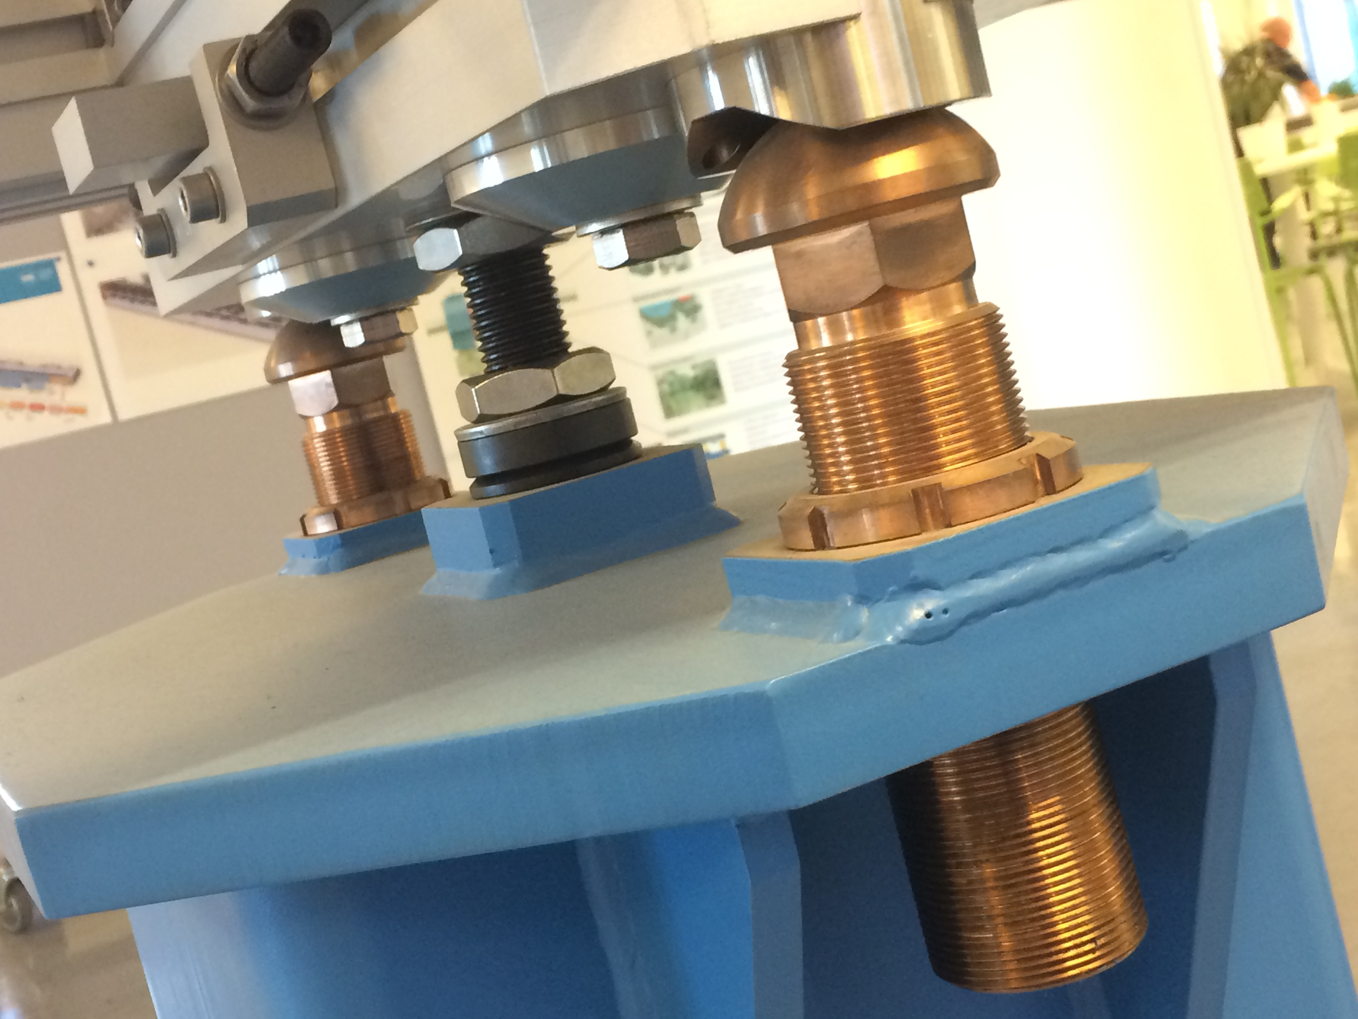
Examples of adjustment (alignment) systems

Slide 31
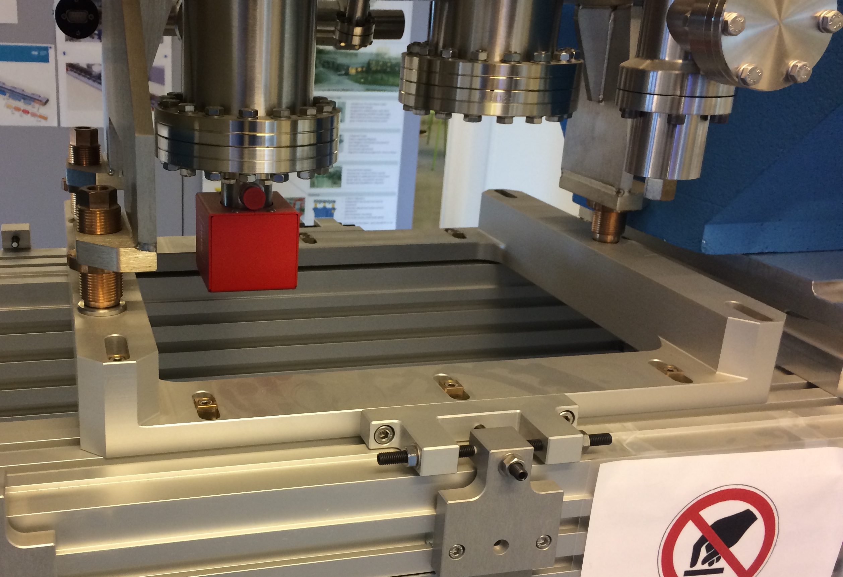
Examples of adjustment (alignment) systems

Slide 32
Testing
Testing is planned throughout the magnet manufacturing cycle.
Core is tested for magnetic properties before and after it has been assembled into a yoke. Yokes are tested for uniformity of the material spread.
Coils are tested for all electrical properties (insulation between turns, capacity to carry prescribed current.
Cooling system (designed cooling channels) are tested for thermal performance during full load.
Full CMM measurements are logged and presented (to relate any magnetic anomalies to the mechanical ones).
Magnetic testing is done
* magnetic field mapping using x/y/z hall probe mapping table,
* rotating coil for multipoles or stretched wire for dipoles tests,
* the above tests results are compiled, from these actual field quality is noted, harmonics are analysed and corrected when needed,
* pole tips add-ons are referenced to field measurements and adjusted if needed,
Acceptance report produced to accompany delivery of the magnet system.

Slide 33
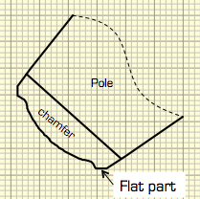
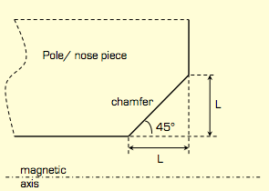
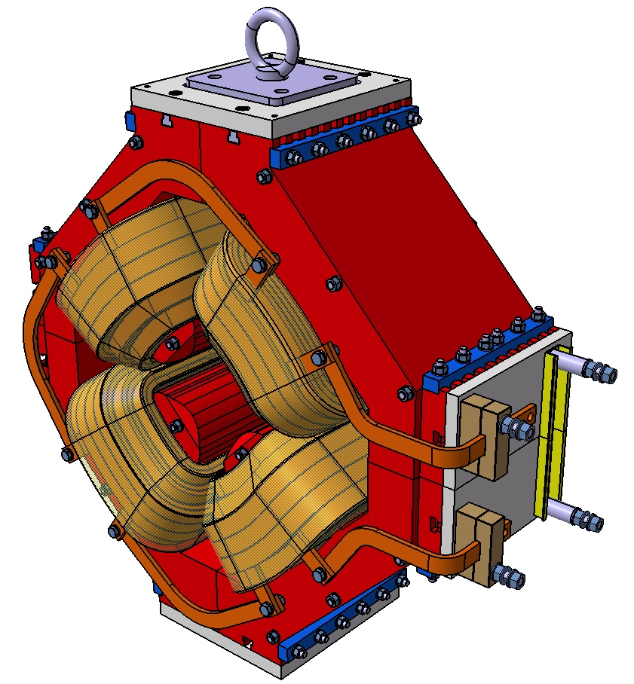
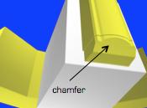
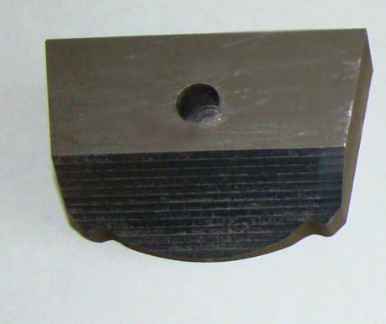
Questions…

Slide 34
What did we miss…
Yoke manufacturing – wire or laser cutting? Shuffling? Stacking and gluing?
Yoke manufacturing – final machining on assembly; stress relieveing; de-burring; chamfering.
Coil manufacturing – range of tests (Hi-pot, continuity, capacity).
Coil manufacturing – calculations background; hollow or flat conductor.
Final assembly – ability to take magnet apart and put it back together without errors; ability to connect power and cooling without difficulties.
Testing methods – rotating coil details.
MFEA – taking note of meshing restrictions and effects; modelling transients.
‘On-beamline’ performance and testing.
Touch on superconducting (LTS and HTS).
Common modes of failure.

