Slide 1

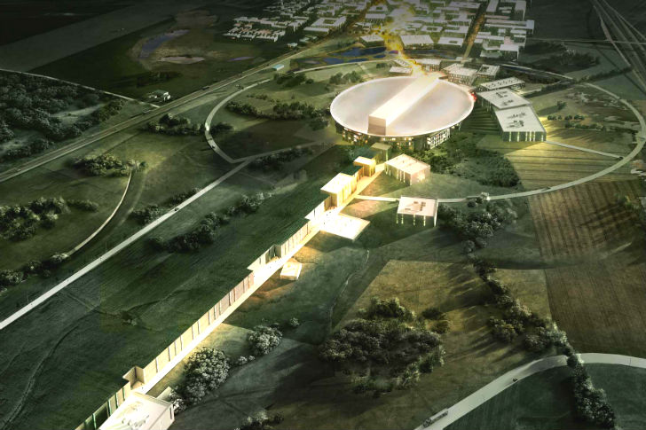

Power Converters for Particle Accelerators
– ESS Examples
Carlos A. Martins
ESS – Accelerator Division - RF Electrical Power Systems
www.europeanspallationsource.se
Oct 12nd , 2017

Slide 2
Summary
Principle of particle acceleration
  Lorentz law
  Linear acceleration and centripetal acceleration
Main powering equipment required for Linear acceleration
  The RF cavities
  The RF amplifiers
    Klystrons
    Tetrodes
  The modulators (i.e. High Voltage Power Supplies)
    CW modulators
    Pulsed modulators for klystrons and tetrodes – The example of ESS
Main powering equipment required for Centripetal acceleration (beam focusing, steering and bending)
    Various types of magnets and their role;
    Power converters for:- quadrupole magnets; steering/corrector magnets; bending dipole magnets;
Impact on the AC power distribution grid and compensation techniques
Power Electronics as the main discipline

Slide 3
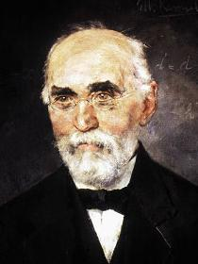
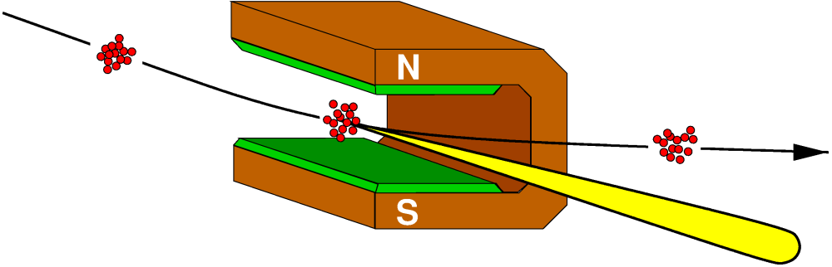


Principle of particle acceleration
Hendrik
Lorentz
(1853-1928)
1st term of Lorentz equation
2nd term of Lorentz equation
$$\vec{F}=q\vec{E}+q\left(\vec{v} x \vec{B}\right)$$
$$\vec{F}=q\vec{E}+q\left(\vec{v} x \vec{B}\right)$$
linear acceleration
Centripetal acceleration
The electrical field applied between both electrode plates by the voltage generator accelerates the charged particle in the direction of the field lines
The magnetic field created by the dipole magnet introduces a deviation on the particle trajectory by an angle Ɵ, which depends on the magnetic field B (which in turn is proportional to the current I_{g}), the length of the magnet l_{m} and the particle speed (momentum)
Current generator, I_{g}
Ɵ
Vg
l_{m}
-
+
Energy gain, for 1 electron:
ΔW = Vg [eV]
Energy gain, for 1 electron:
ΔW = 0
Voltage generator, Vg

Slide 4

Principle of particle acceleration
How to reach high acceleration energies ?
Method 1: The electrostatic accelerator
1st term of Lorentz equation
idea 1: works but the generator and insulation is a strong limiting factor
$$\vec{F}=q\vec{E}+q\left(\vec{v} x \vec{B}\right)$$
linear acceleration
Energy gain, for 1 electron:
ΔW = Vg [eV]
Problematic:
High Electric fields require high voltages, Vg;
Voltage generator construction limitations;
Limitations on electrical insulation of the system;
Example:
To reach an energy of 1MeV, a voltage generator rated for 1MV is required -> very difficult
Most of accelerators today can reach energies in the range of several GeV !
Vg
idea 2: works but insulation is still a strong limiting factor
Energy gain, for 1 electron:
ΔW = 3 x Vg [eV]
Vg
Vg
Vg
idea 3: does not work (total energy gain is still ΔW = Vg [eV], due to decelerating field)
Vg
decelera-ting field
Vg

Slide 5
Principle of particle acceleration
How to reach high acceleration energies ?
Method 2: AC / RF accelerator
1st term of Lorentz equation
$$\vec{F}=q\vec{E}+q\left(\vec{v} x \vec{B}\right)$$
linear acceleration
Principle:
The AC voltage applied between multiple electrodes by a single generator creates electrical fields with the right polarity in those gaps where particles are to be accelerated;
The generator reverses polarity when the particles are inside the drift tubes (i.e. subject to zero electric field)
Limitations:
For higher speeds, the frequency of the generator must increase;
For high acceleration power, the power of the generator must increase.
How to generate intense AC fields (tens MV/m) at high frequencies (tens/hundreds MHz)?

Slide 6
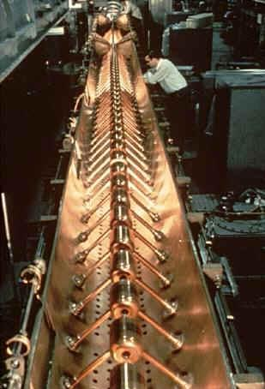
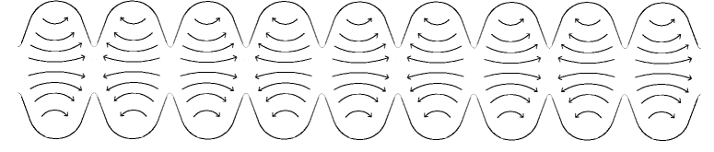
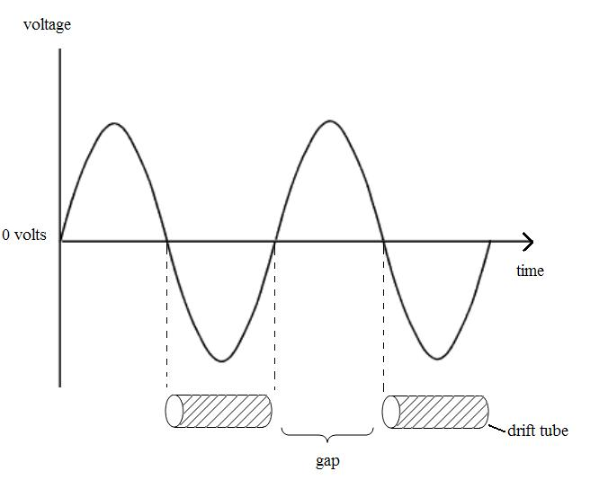
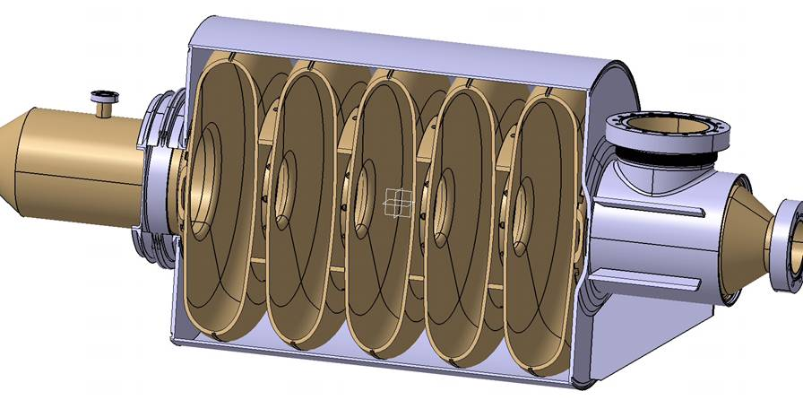
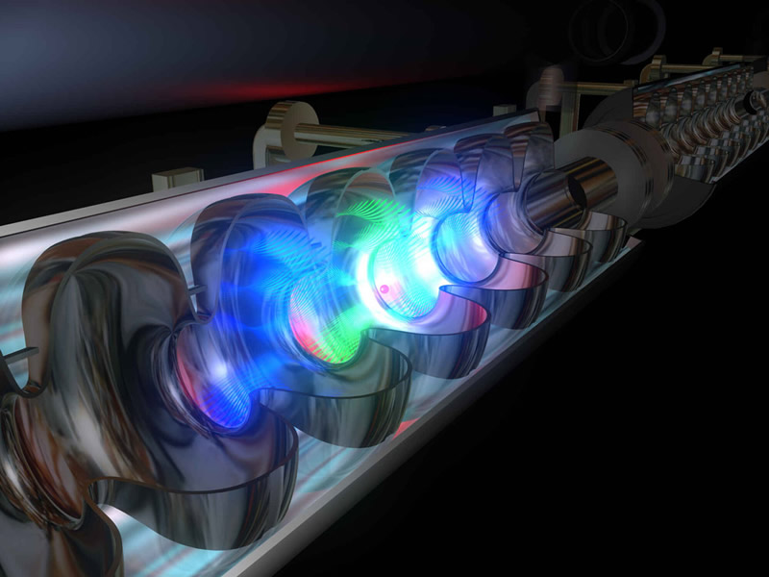
RF cavities and RF sources as key elements of modern particle accelerators
Bunch of particles
electric field lines
Elliptical RF cavities
Drift Tube Linac (DTL)
Radio Frequency (RF) cavities, once excited by RF power, produce high intensity AC electric fields that accelerate the particle beam bunches longitudinally
RF sources are systems that generate the required RF power and transmit this power down into the RF cavities where the particle beam circulates and will be accelerated

Slide 7
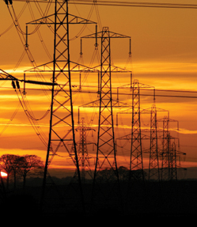
General architecture of a RF source
- Schematics and main components
5
Modulators are HV power supplies that feed the RF amplifiers.
- RF amplifiers are therefore the loads of modulators
Electrical network
Particle beam
RF power out
3
RF cavity
HV
AC
-
1
2
4
3
3
RF signal in
3
3
6
+
1- Modulator (HV power supply)
- Converts the electric power from a standard AC network into High Voltage (HV), either DC (Direct Current) or pulsed, depending on the accelerator duty-cycle (i.e. beam “on” versus beam “off” time) ;
2- RF amplifier (generator)
Converts electrical power into RF power, by amplifying a low power input RF signal (RF signal in) into a large power electromagnetic wave (RF power out);
3- Waveguides; 4- circulator; 5- RF load; 6- power coupler;

Slide 8
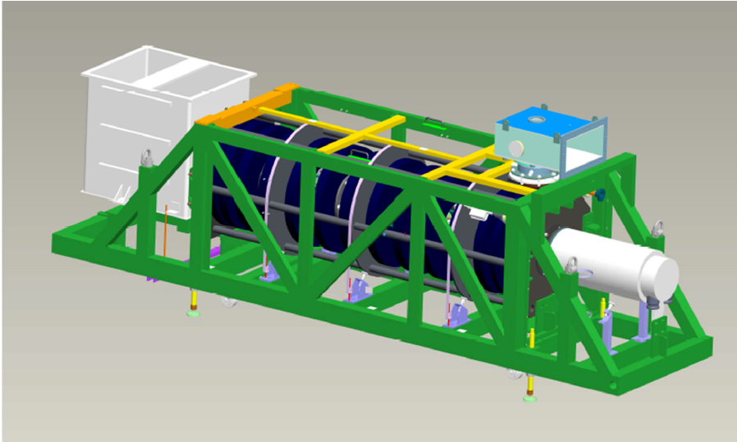
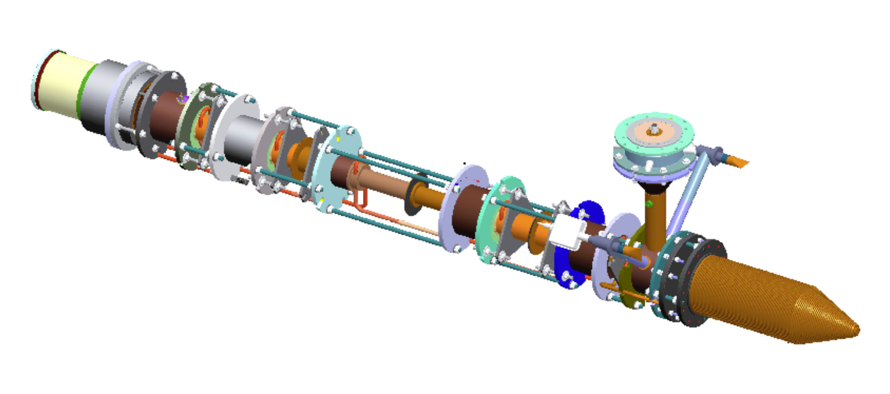
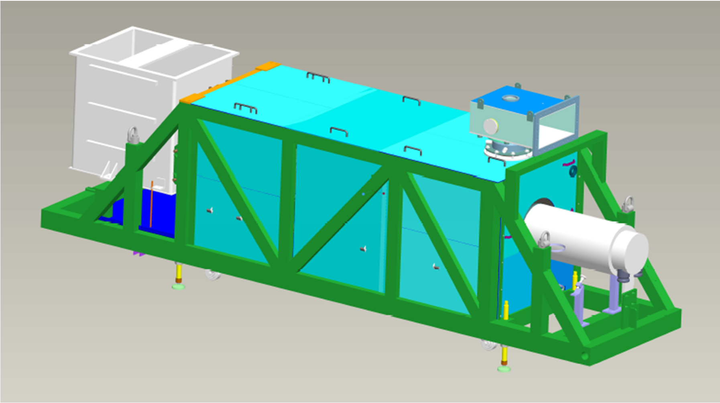
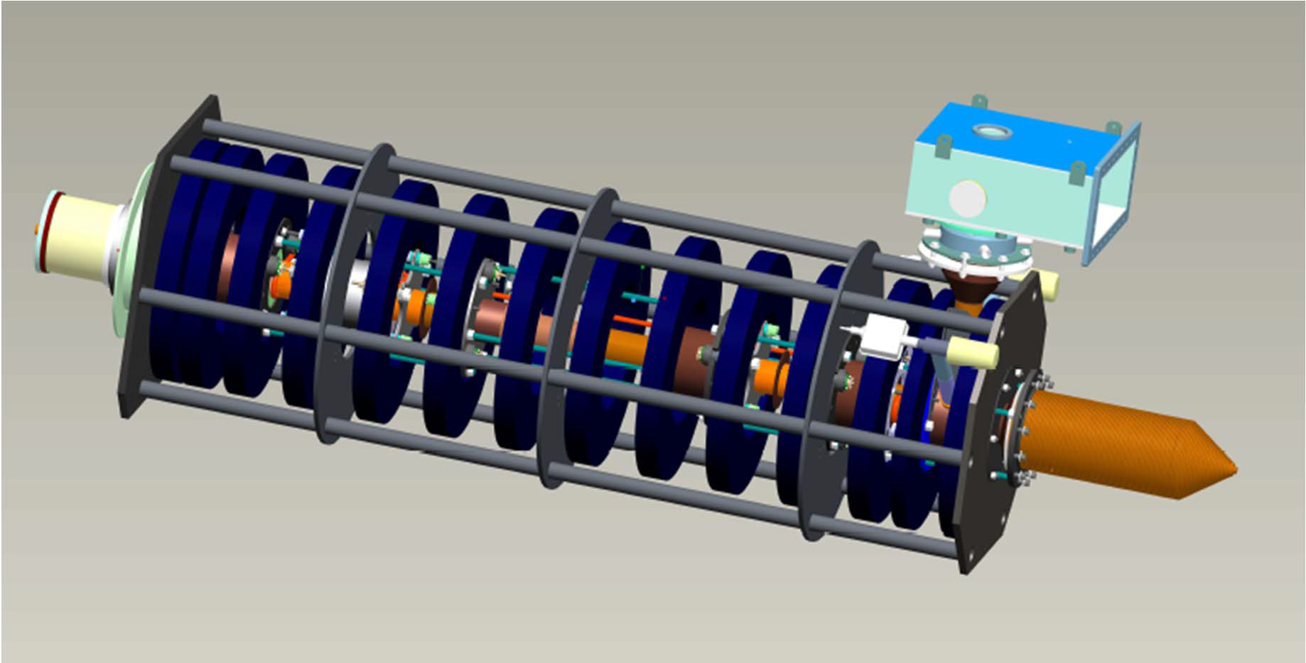
RF Amplifiers:
- The klystron
Klystron is a “non gridded” tube:- current is drawn whenever cathode voltage is applied
(diode I/V characteristics)
Cathode + filament
(= electron gun)
gun oil tank (contains filament power supply)
collector
collector jacket (water cooled)
bunching cavities
output RF cavity
support frame
RF output waveguide
Lead cage for X-rays’ shielding
Solenoid magnet focalizes the beam all along the klystron tube
Courtesy Thales Electron Devices

Slide 9
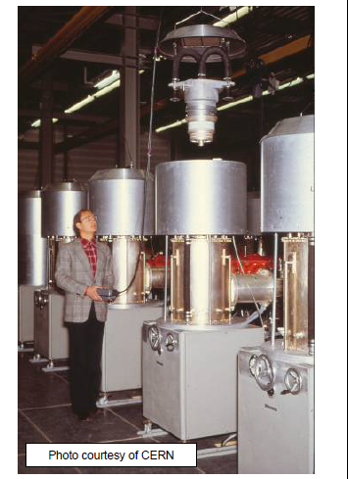

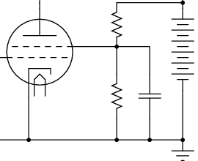
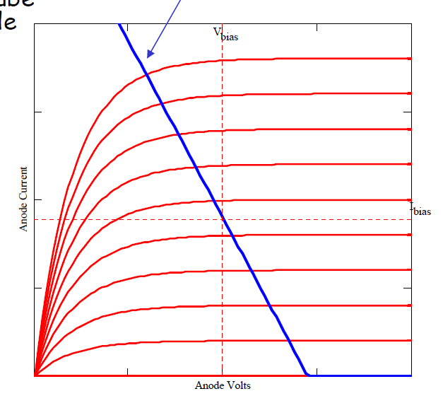
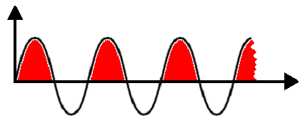
RF Amplifiers:
- The Tetrode as a RF amplifier
Tetrode is a “gridded” tube:- current can be controlled by the the grid potential independently on the anode voltage applied
RF output cavity
waveguide
RF power out
tetrode
a
g1
g2
Anode power supply
RF signal in
~
k
f f
Filament power supply
Grid bias power suply
UB
- The anode-plate serves as an antena that radiates RF power into the RF output cavity
The waveguide collects and transmits the RF power to the load (accelerator RF cavities)
The control grid g1 is polarised with a DC voltage equal to UB. The RF input signal is coupled to the control grid via the capacitor
waveguide
Electron bunches
UB1
Grid voltage
UB2
UB1
UB2
RF in
t(s)

Slide 10
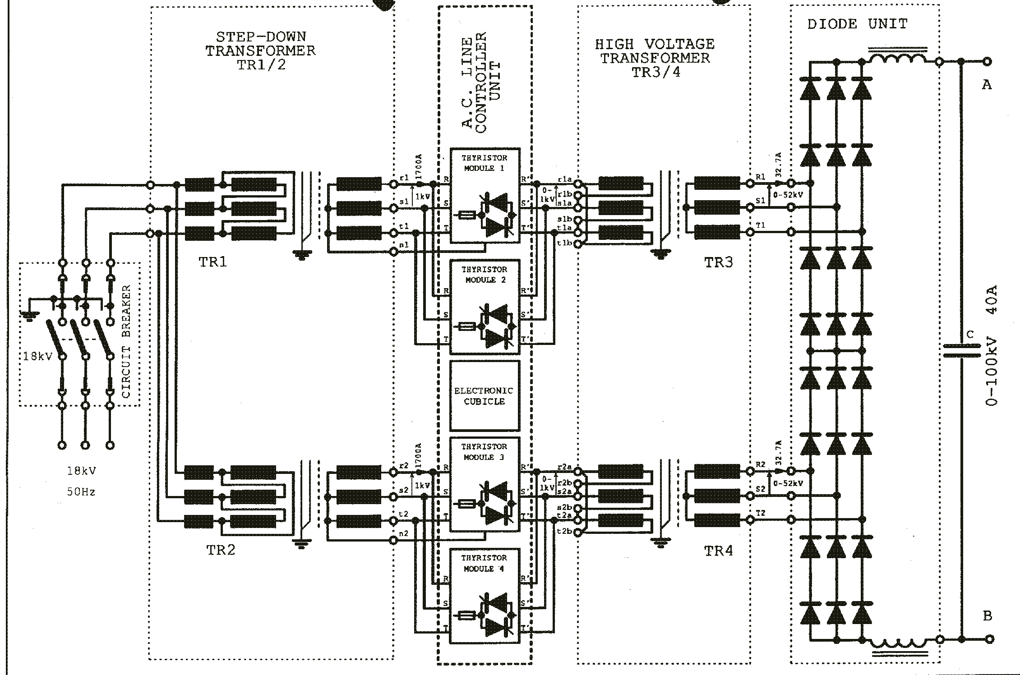
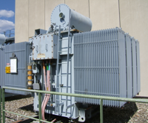
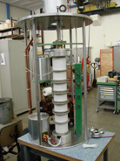
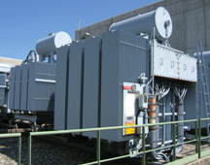
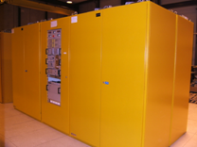
Modulators (i.e. High Voltage Power Supplies):
CW (Continuous Wave) modulators
conventional topology
AC electrical network
A CW modulator is generally just a High Voltage power supply that feeds:- the Anode of tetrodes or the Cathode of klystrons, etc;
Depending on the type of HV power supply a CROWBAR might be needed to bypass the current in case an arc occurs in the RF amplifier tube
100 kV crowbar (Thyratron)
Klystron
Thyratron CROWBAR

Slide 11
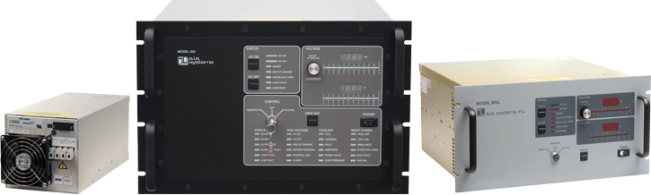
Modulators:
CW (Continuous Wave) modulators
modern switch mode based topology
The parallel CROWBAR can be avoided since the Power Converter can be switched off very quickly by acting on the H-bridge inverter and the stored energy in the output filter and HF transformer is very small
More compact, higher stability, lower voltage ripple solution

Slide 12
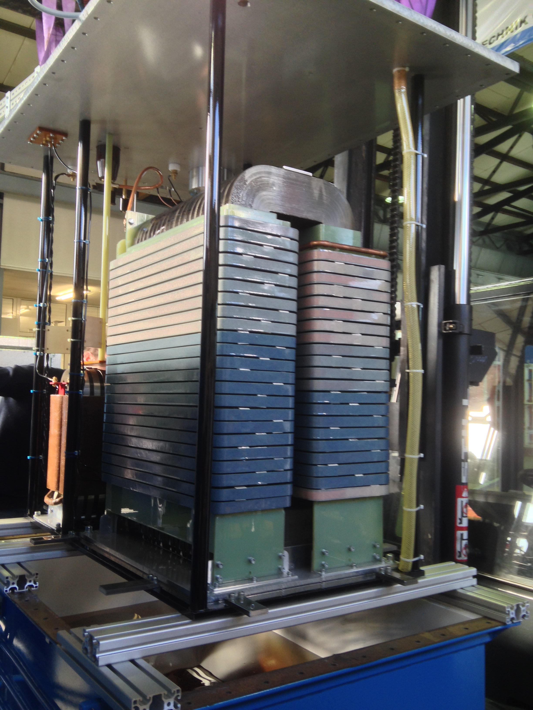
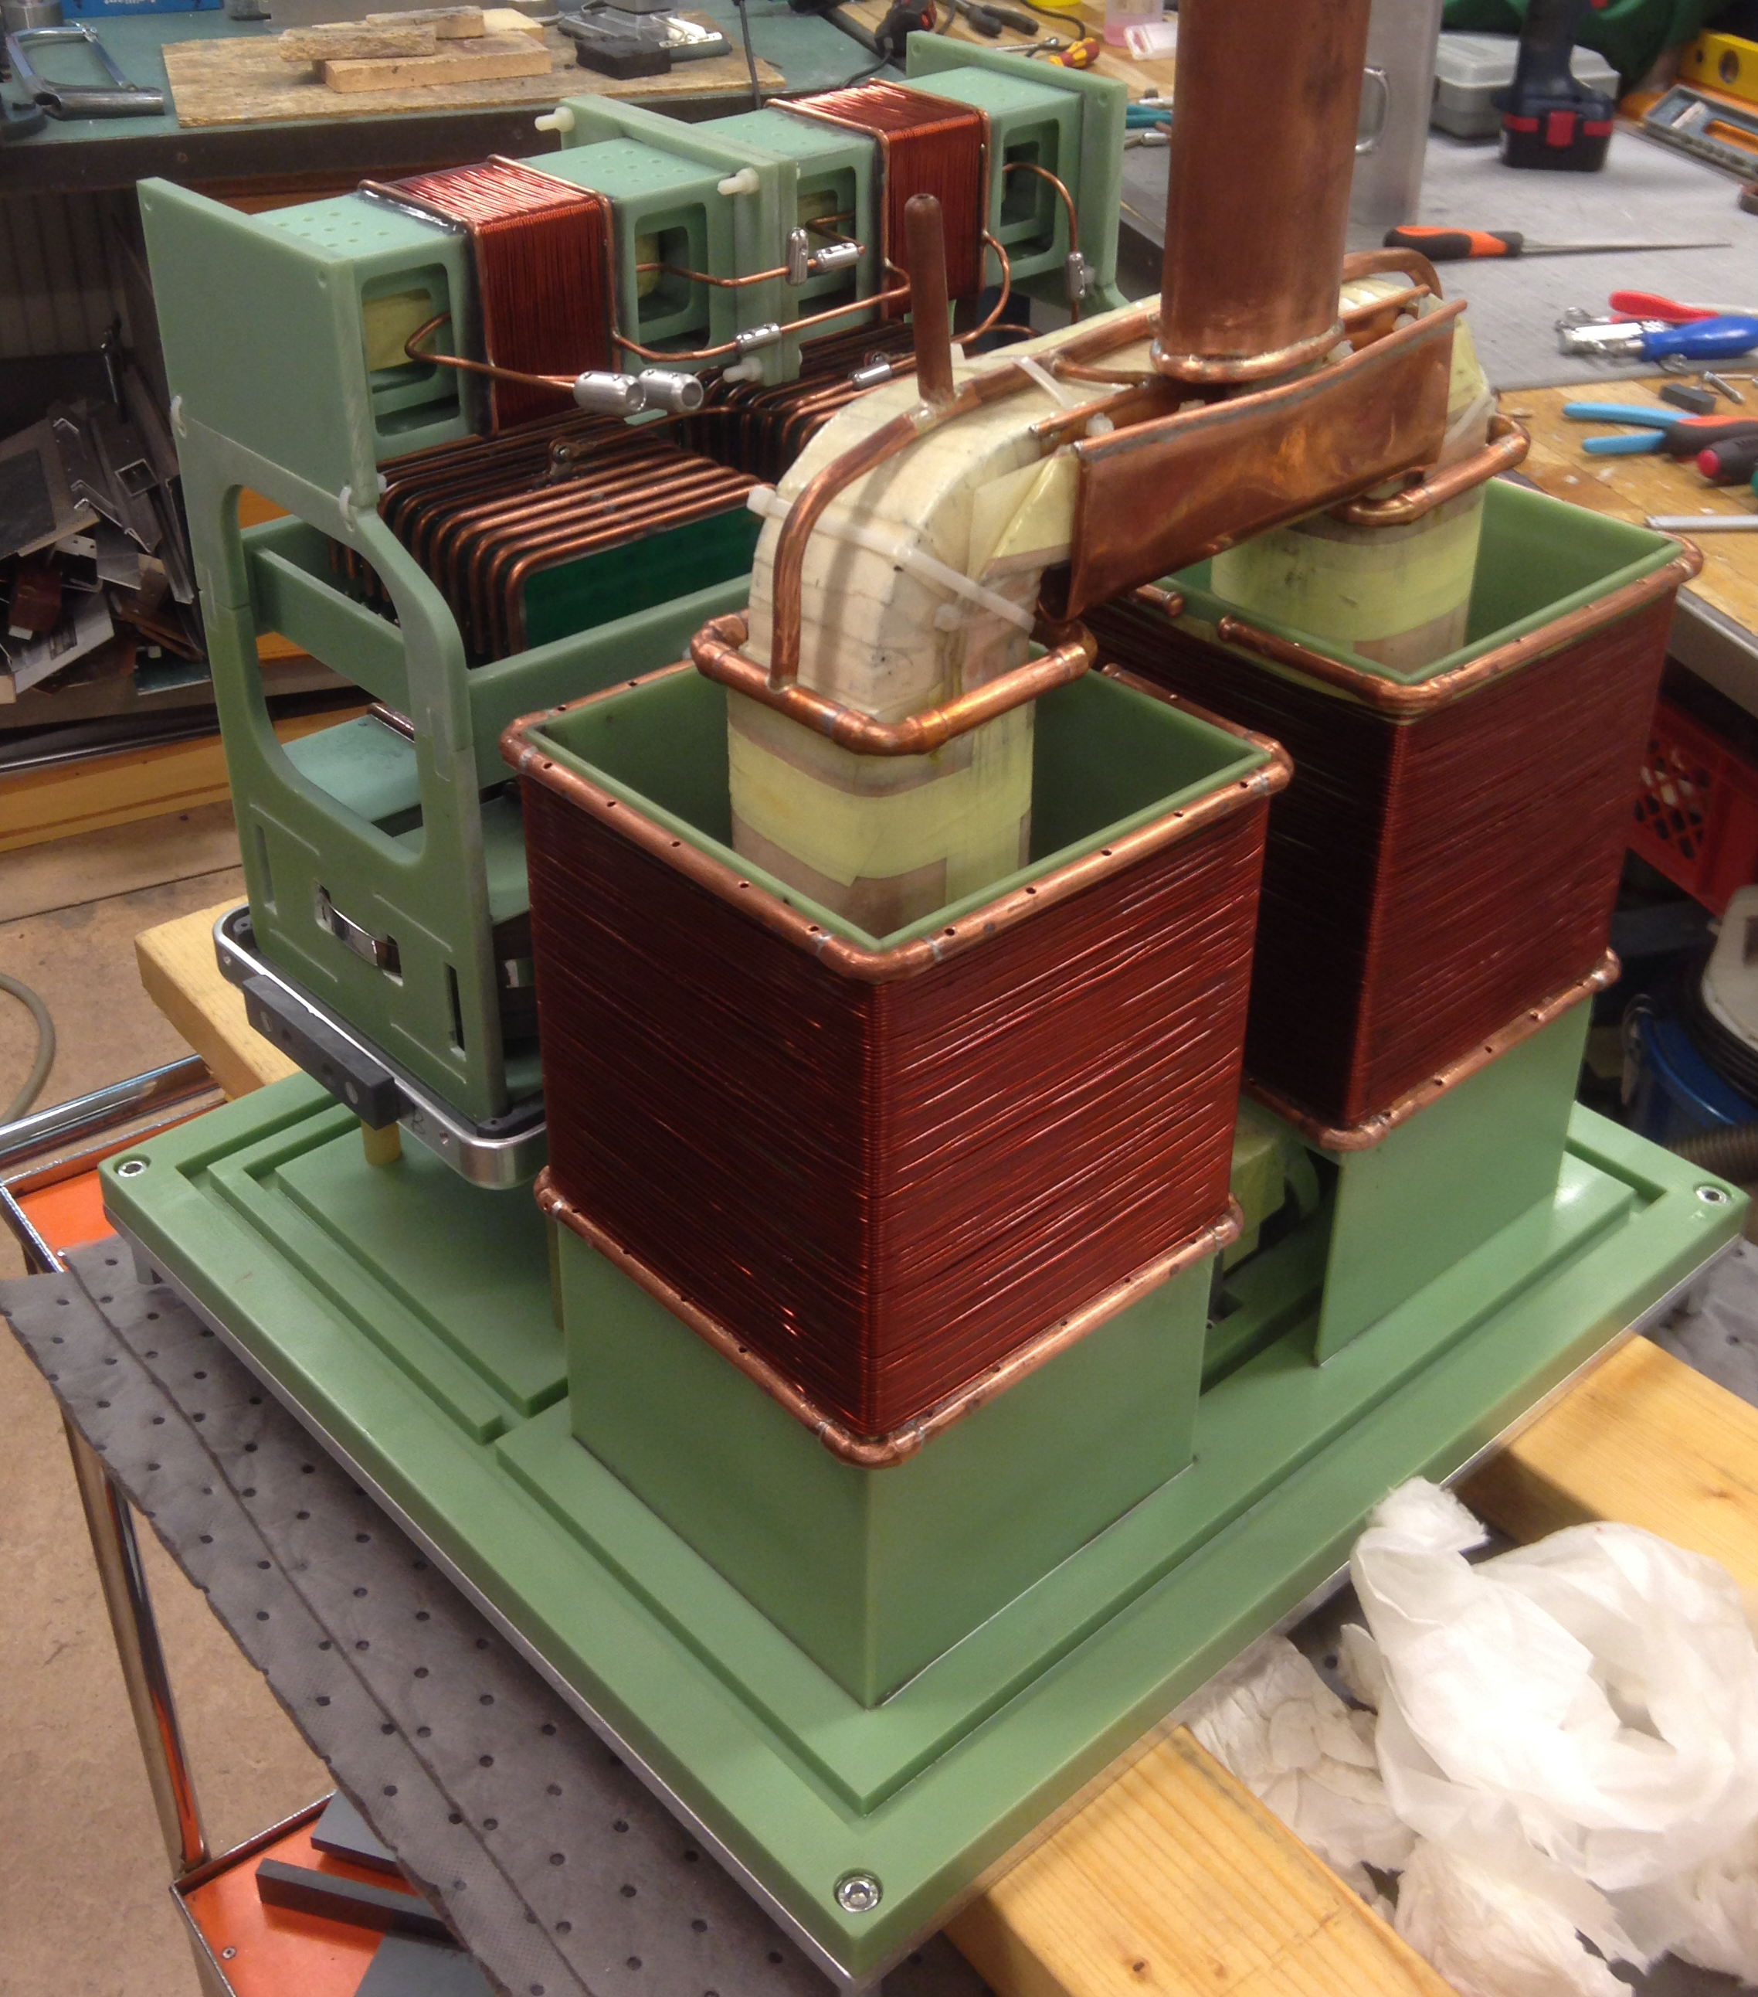
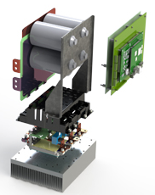
Modulators:
- Pulsed modulators for klystrons:- two main topologies
Topology 1: Pulse Transformer based
HV pulse transformer
Topology 2: HF transformer based
HV HF transformer + AC/DC + filter
HV switch
LV DC/AC Inverter

Slide 13
Pulsed modulators for klystrons:- Topology based on pulse transformers
Pulse Transformer Based Modulator
Modulator main requirements:
Vp – Pulse voltage;
Ip – Pulse current;
fp – Pulse repetition rate;
Tp – Pulse width;
Tr – Max. rise time;
os – Max overshoot;
Drp – Max pulse flat-top droop;
PPr – Pulse to pulse reproducibility;
Pripp – Max voltage ripple on flat-top;
Earc – Max energy deposed in case of klystron arc
t_{p}
Droop
Vp
Overshoot
t_{r} rise time
Tp=1/fp

Slide 14
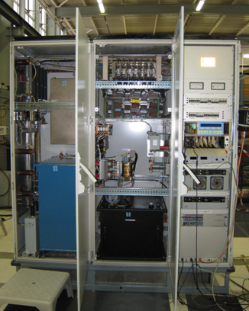
Pulsed modulators for klystrons:- Topology based on pulse transformer. Example of CERN Linac4
100 kV, 20A, 0.8ms, 2 Hz
Simplified schematics
The power absorbed by the klystron during the pulse cannot be delivered by the electrical network;
A capacitor bank is required to store the energy that will be given to the klystron during the pulse (buffer);
A capacitor charger charges the capacitor bank before the pulse is generated. It is fed from the AC network;
The pulse is formed by switching “on” and “off” the main solid state switch, therefore connecting/disconnecting the capacitor bank to the primary side of the pulse transformer;
The pulse transformer steps-up the voltage to the value required by the klystron cathode;
A droop compensation system is required to keep the voltage flat over the entire duration of the pulse despite the fact that the voltage across the capacitor bank droops down by 5 to 15% (discharge during the pulse);
No HV crowbar is needed. In case of arcing in the klystron, the main solid state switch is opened in less than 10µs

Slide 15

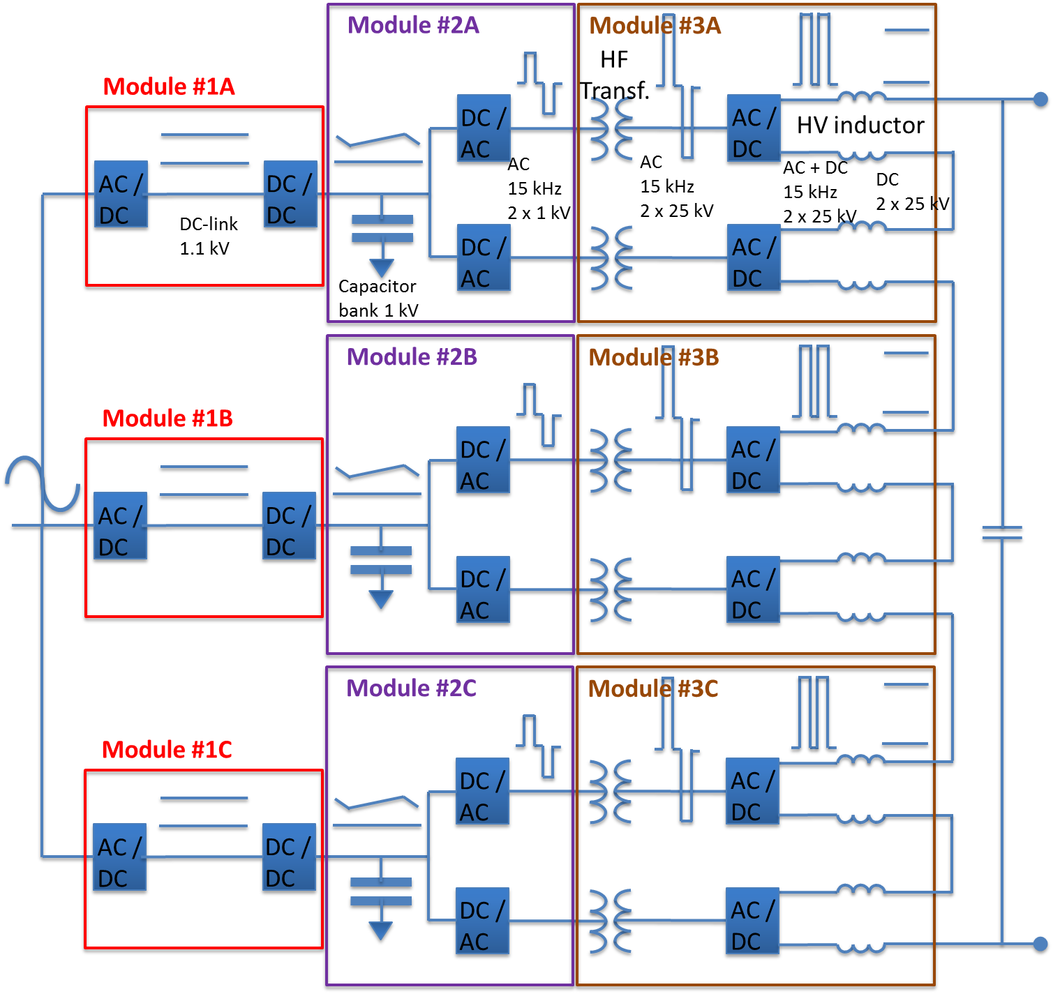
Pulsed modulators for klystrons:- Topology based on High Frequency transformers
Modular topology, scalable to higher power levels;
Compact and cost effective;
High efficiency (92%);
Good pulse quality (low ripple, low rise-time);
Excellent grid power quality due to AFE’s (low flicker, low current THD);
High reliability (MTBF ~ 70’000 hours)

Slide 16
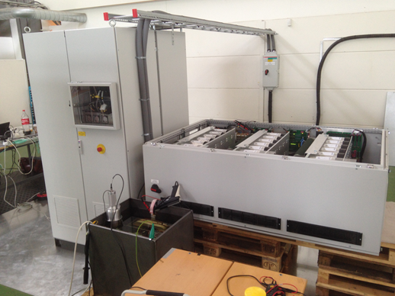
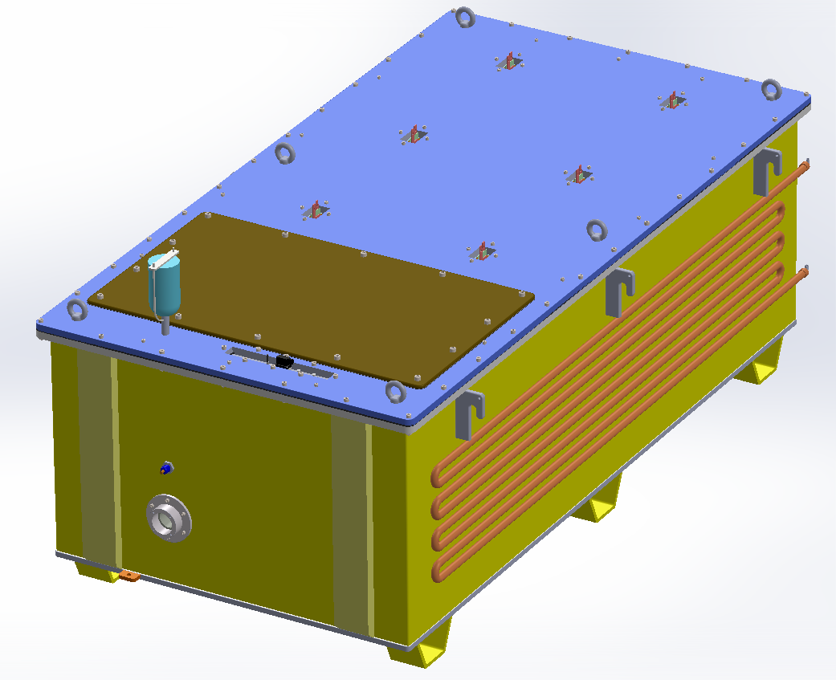
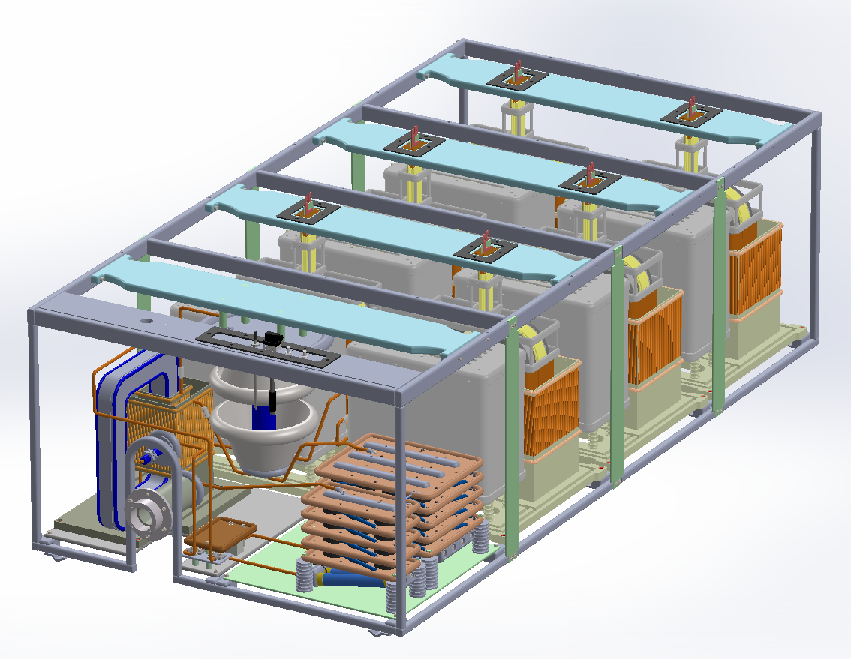
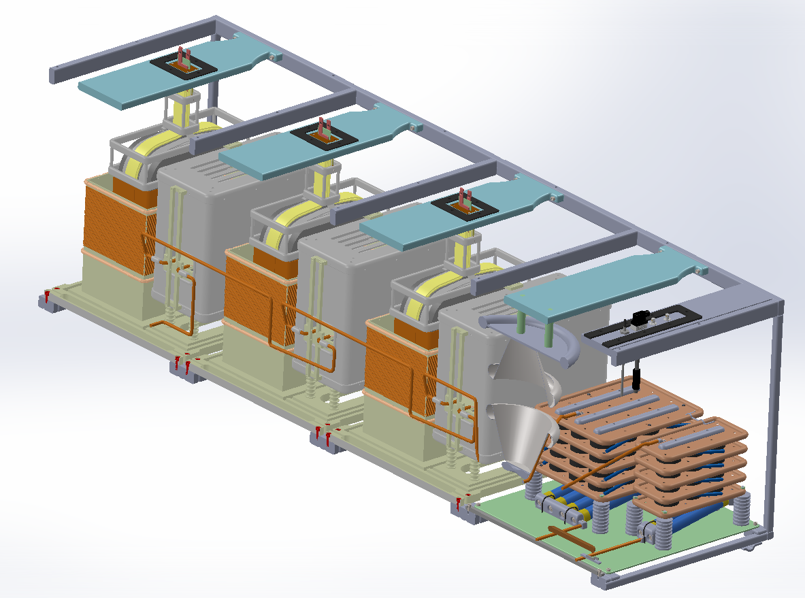
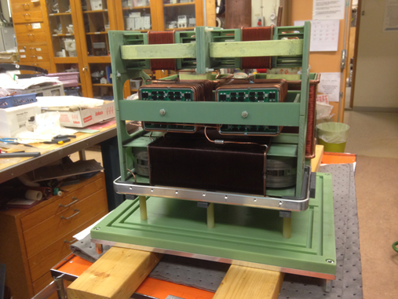
Pulsed modulators for klystrons:
- Topology based on High Frequency transformers. Example of ESS accelerator
Part I – Low voltage power converter
Silica gel breather
Tank lid
Part II – HV modules in oil tank
Inspection lid
Water cooling serpentine
HV output connector
HV module prototype in assembly workshop at LTH

Slide 17
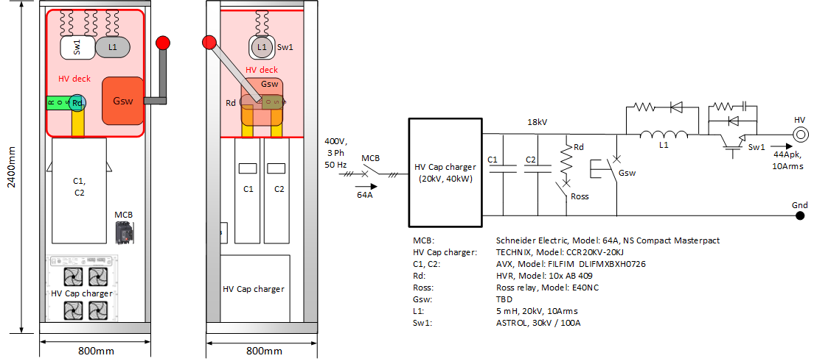
Pulsed modulators for Tetrodes
Example: ESS Tetrode modulators for spoke cavities
Modulator
Tetrode
Grid bias PS
Anode
Grid
+
-
Cathode
Tetrodes are gridded tubes, therefore the pulsed power can be generated by pulsing the grid terminal using the RF input driver ;
In that case, the Anode can be permanently connected to a HV source formed by a HV capacitor charger and a capacitor bank (C1 and C2);
The series switch, Sw1, is always at “on” state in normal operation. Only in case of an arc in the tetrode Sw1 is switched “off”, therefore lowering the voltage across the Anode down to zero clearing the arc.
When the RF input driver is switched “on”, the current starts flowing from Anode to Cathode, initiating the pulse;
During the pulse, the energy flows from the capacitor bank to the tetrode, discharging partially the capacitor bank (by ~5%);
The capacitor bank is recharged after the pulse has finished and before the next pulse starts;

Slide 18
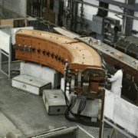

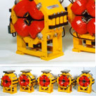
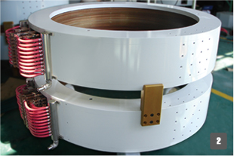
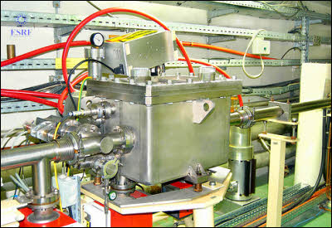
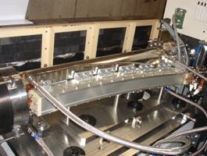
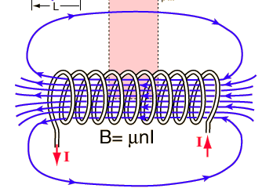

Power converters for magnets
Coming back to the 2nd term of Lorentz equation
Types of magnets and their function in accelerators:
$$\vec{F}=q\vec{E}+q\left(\vec{v} x \vec{B}\right)$$
1.- Bending dipoles:
- bend the trajectory of the beam
3.- Steering/corrector dipoles:
- Correct the trajectory of the beam in horizontal and vertical planes
These types of magnets are used in the ESS accelerator
4.- Kickers and Septa:
- “kick-in” or “kick-out” the beam from a straight beam line to a circular trajectory
2.- Quadrupoles and solenoids:
- Focalize the beam
Not used at ESS

Slide 19
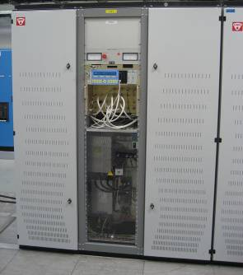
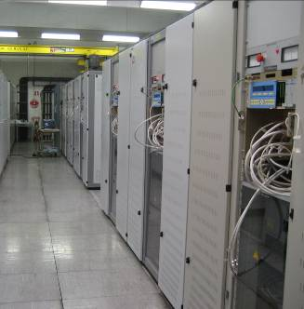
Power converters for magnets
Example: steering/correction magnets of CERN Proton Synchrotron; similar for ESS dogleg bending dipoles
4-Quadrant
( +/-1200V,
+/-250A )

Slide 20
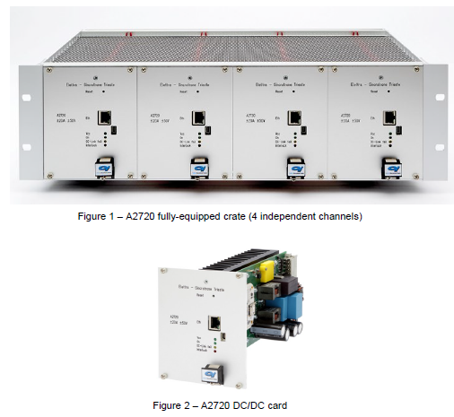
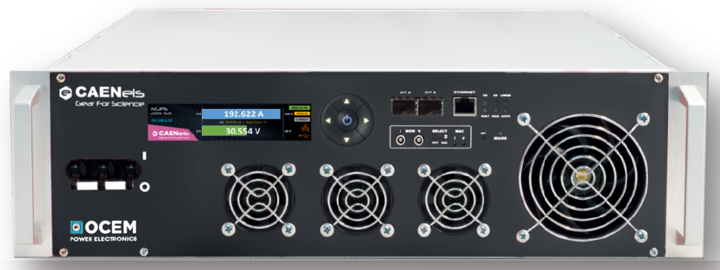
Power converters for magnets
Example: ESS Power Converters for corrector and quadrupole magnets
ESS Power Converters for corrector magnets
144 power supplies rated for 1kVA:
  +/-50V; +/-20A
(bipolar in voltage; bipolar in current)
ESS Power Converters for quadrupoles & DogLeg Dipole magnets
142 power supplies rated for 10kVA:
  +50V; +200A
(unipolar in voltage; unipolar in current)
Required expertise:
  Power Electronics;
  Digital Control Systems / Programming;
20

Slide 21
Impact on the power distribution grid:
- Power quality issues
Power converters typically generate disturbances in the power distribution grid that can affect other sensitive equipment connected to the same grid:
Current harmonic distortions (low frequency harmonics);
Electro-Magnetic Interferences (EMI, high frequency noise up-to 30MHz)
Flicker (slow fluctuation of absorbed power, below 20Hz)
POWER CONVERTERS
LOAD
HV
Power
Converter
RF Tube #1
Can be mitigated by using grid compensators
Power
Converter
RF Tube #N
MV
Power
Converter
Magnet String #1
Grid
Compensators
Power
Converter
Magnet String #N
LOAD

Slide 22
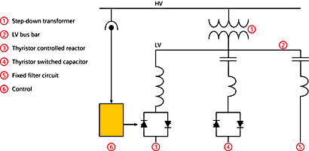
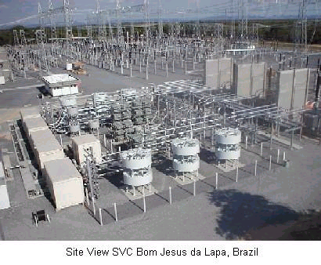
Classical grid compensator topology
Centralized compensation scheme
Power converters (distorted load)
AC
DC
AC
DC
SVC
AC
DC
TCR
TSC
Static VAR Compensators (SVC’s):
Reactive power compensation;
Voltage stabilization of the common LV or MV grid busbar (flicker mitigation);
Current harmonic filtering (compliance with Energy Quality standards)
Bulky and expensive solution

Slide 23
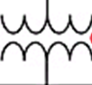
Grid Friendly Power Converter Topologies using Active Front End’s (AFE’s) AC/DC
Integrating compensation functionalities in the Power Converter structure
AC
DC
DC
DC
Power converters (“pure” load)
AC
DC
DC
DC
SVC
AC
DC
DC
DC
Example:
- ESS klystron modulators’ AC grid front end stage
Unitary power factor;
Nearly zero harmonic distortion (sinusoidal current absorption)
Energy recovery to the grid, if required
grid
AC/DC: Active Front End
DC/DC: IGBT H bridge

Slide 24
Power Electronics as the main discipline
to learn about power converters/power supplies
Electrical circuits theory;
Main electronic components;
Main power electronic conversion structures (i.e. building blocks using the electronic components to perform basic functions: AC/DC; DC/DC; DC/AC; AC/AC;
Thermal design and cooling (basics of);
Packaging (i.e. mechanical assembling);
Digital and analogue control systems (i.e. microprocessors, FPGA’s, filters, signal conditioning);
Control theory;

