Slide 1
Control System of the European Spallation Source
Timo Korhonen
Chief Engineer
Integrated Control System Division
www.europeanspallationsource.se
26 October 2017

Slide 2
Outline
Short recap of the ESS
Functions of a control system
Technologies
  Hardware (Electronics)
  Software
System structures
Summary

Slide 3
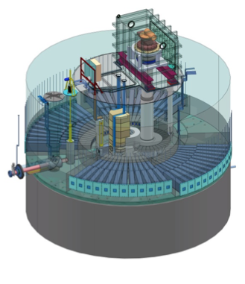
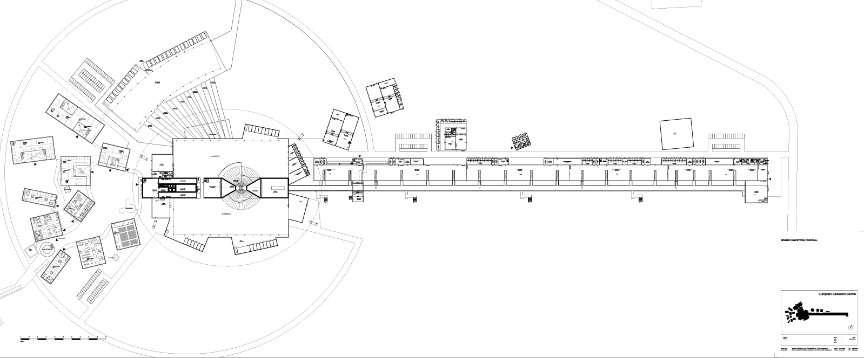
The European Spallation Source
The European Spallation Source (ESS) consists of :
  a pulsed accelerator that shoots protons into
  a rotating metal (tungsten) target to produce neutrons
  (up to ) 22 neutron instruments for various experiments

Slide 4
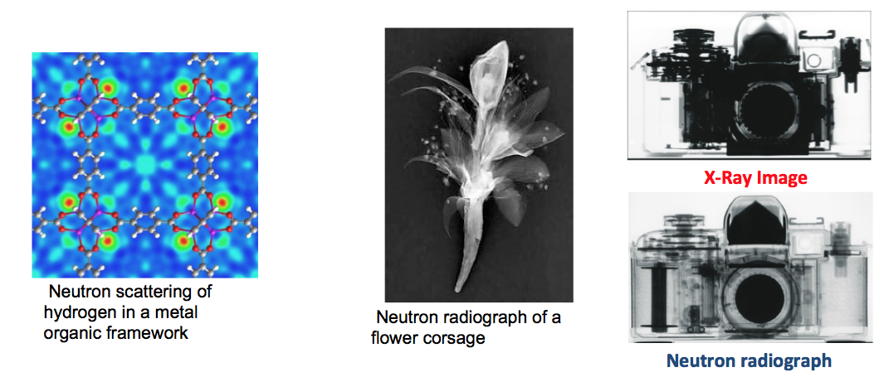
The European Spallation Source
ESS is a neutron spallation source for neutron scattering measurements.
Neutron scattering can reveal the molecular and magnetic structure and behavior of materials:
  Structural biology and biotechnology, magnetism and superconductivity, chemical and engineering materials, nanotechnology, complex fluids, etc.

Slide 5
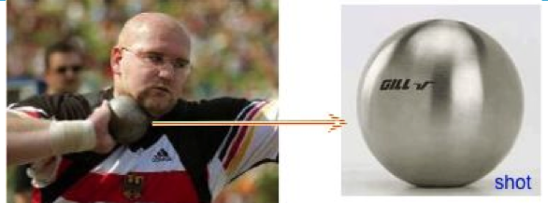
The European Spallation Source
The European Spallation Source (ESS) will house the most powerful proton linac ever built.
  The average beam power will be 5 MW.
  The peak beam power will be 125 MW
At 5 MegaWatts, one beam pulse
  has the same energy as a 7.2kg shot traveling at 1100 km/hour (Mach 0.93)
  Has the same energy as a 1000 kg car traveling at 96 km/hour
  Happens 14 x per second

Slide 6
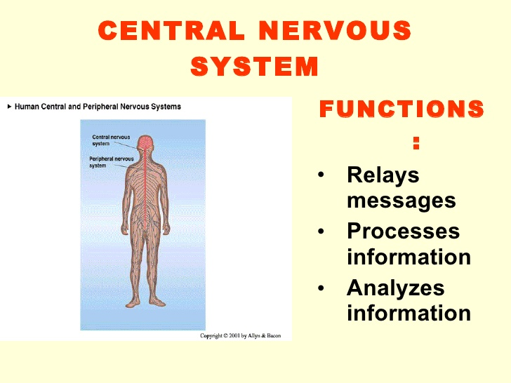
The Integrated Control System (ICS)

Slide 7

Functions of the control system
A good analogy: central nervous system of a human being
  Connects components together
  Collects and stores information
  Sends commands to “actuators”
  Some autonomous functions like in the brain: react to dangers
Enables the operation of the facility
  Thousands of devices, millions of control points

Slide 8
Requirements for the control system
Enable operation of ESS from a single control room
High reliability: 95% for the whole ESS, 99.99 for ICS (exact numbers for ICS to be defined, high in any case)
24 hours, 7 days a week operation
Long lifetime (planned lifetime 40 years)
  Upgrades will happen in between, though
  High maintainability
Support (up to) 14 Hz operation of ESS
Provide controls for the Accelerator, Target, Site infrastructure, Neutron Instruments (excl. data handling)

Slide 9
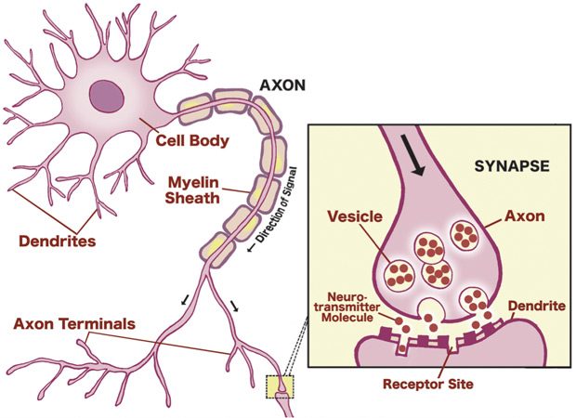
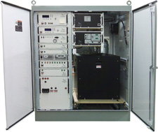
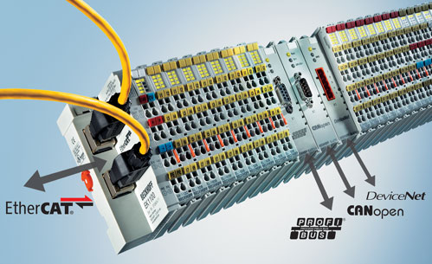
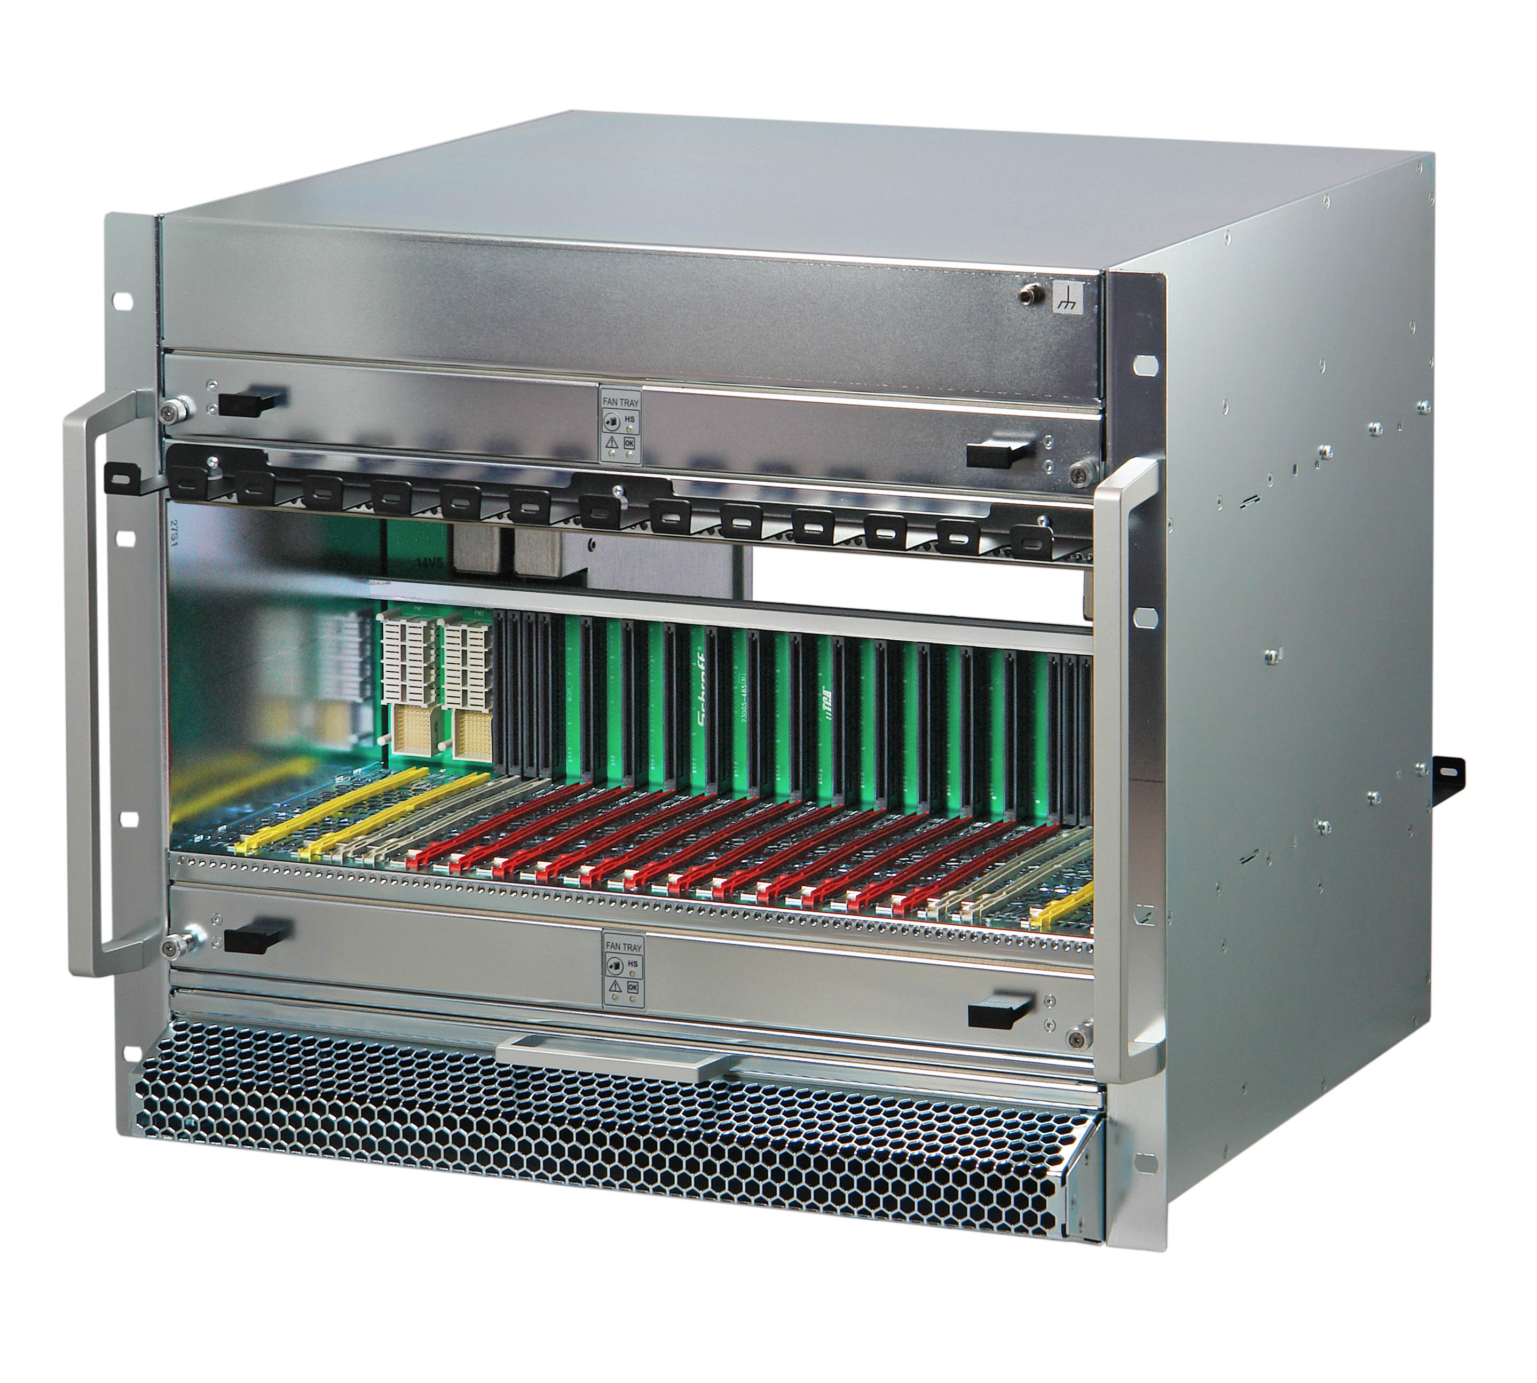
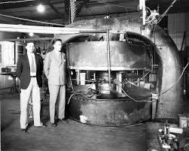
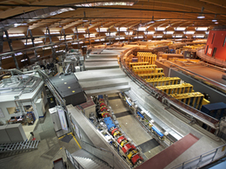
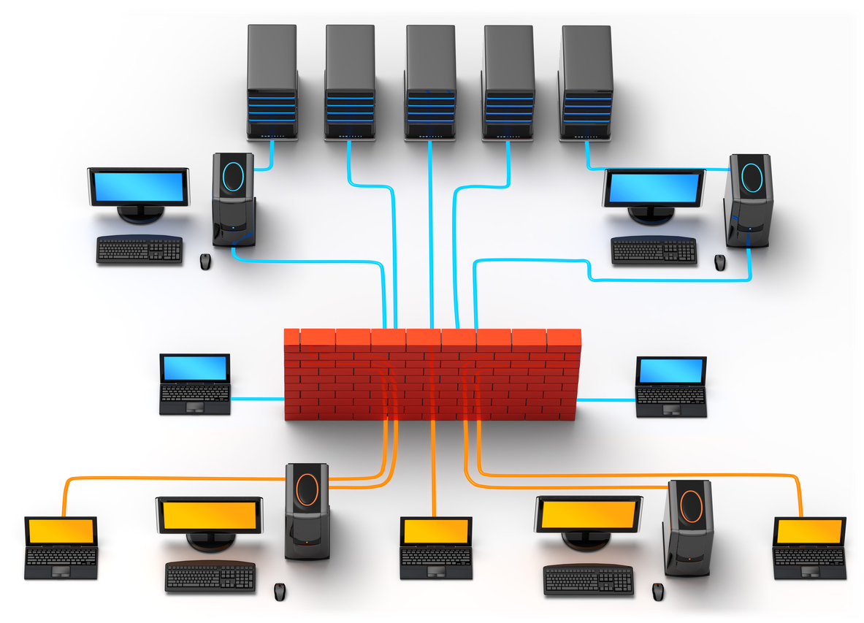
Control system Functions #1
  Connect components together
    Distributed control system, connected over a computer network
      (Ethernet)
    Computers on the field are the neurons, with I/O cards as synapses

Slide 10
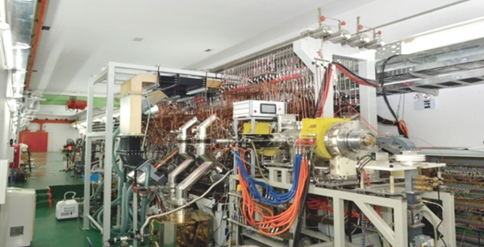
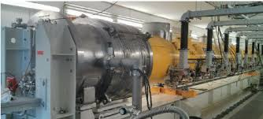
Control system Functions #1
  Connect components together
    A lot of things to connect!
      Management of complexity
      Ideally, one button in the control room: Switch beam on or off
      Reality is not quite that simple -
    Each subsystem may (usually does) have its local control system
      Subsystems may interact with each other directly (via control system)

Slide 11
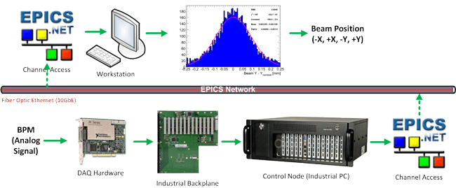
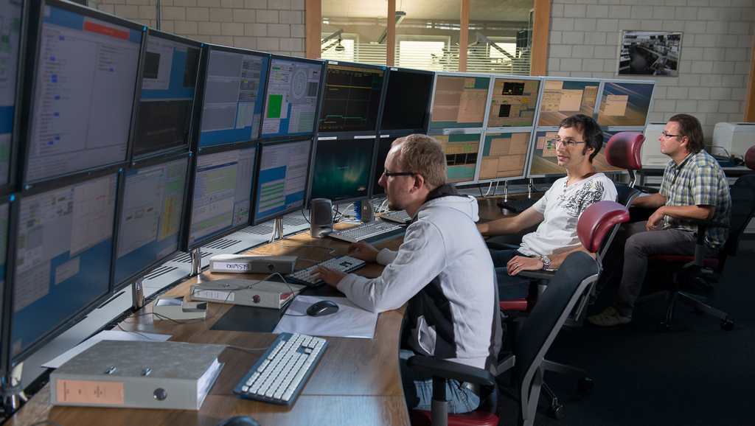
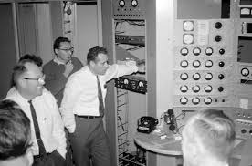
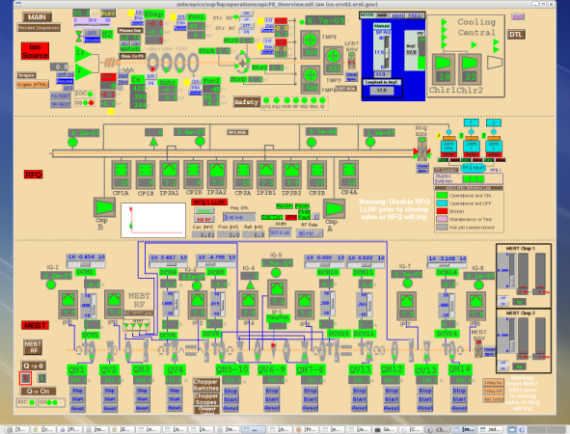
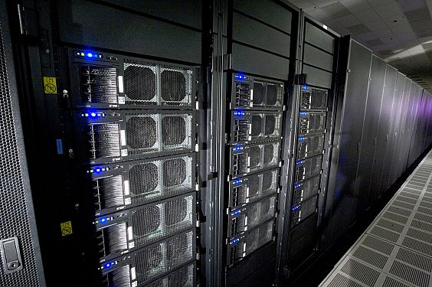
Control system Functions #2
  Collect, display and store information
    Device status & control displays in the control room
    Store status data into archive to be analyzed later
      How did the system perform last night? What happened on beam pulse # 102364?

Slide 12

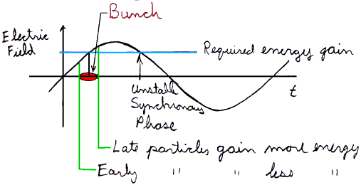
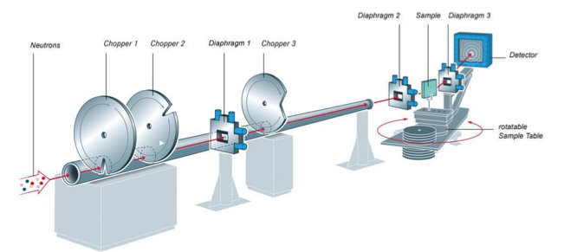
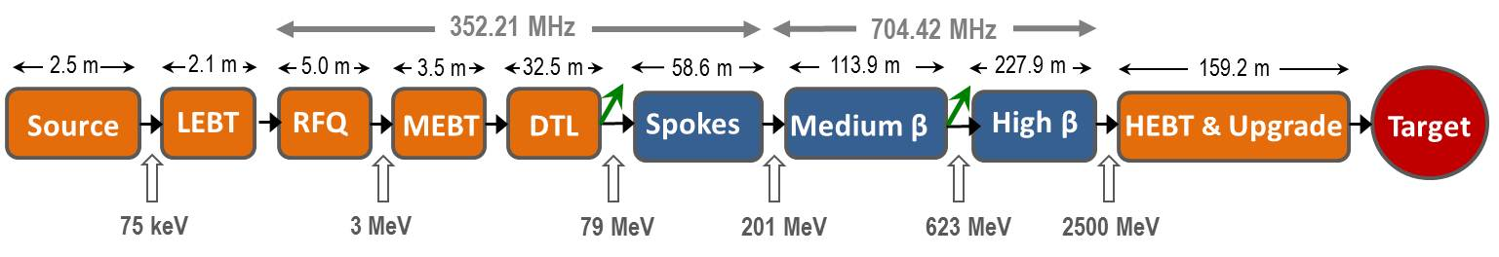
Control system Functions #3
  Send commands to actuators
    Switch on/off, set current, chop beam, etc.
  Synchronized – 14 Hz operation
    Send the protons going
    RF pulses have to be there when the beam comes
    Monitors have to be triggered when the beam is there
    Accelerated beam has to hit the target at the right place
  Timing system
    Synchronizes actions
    Distributes time for the whole facility

Slide 13
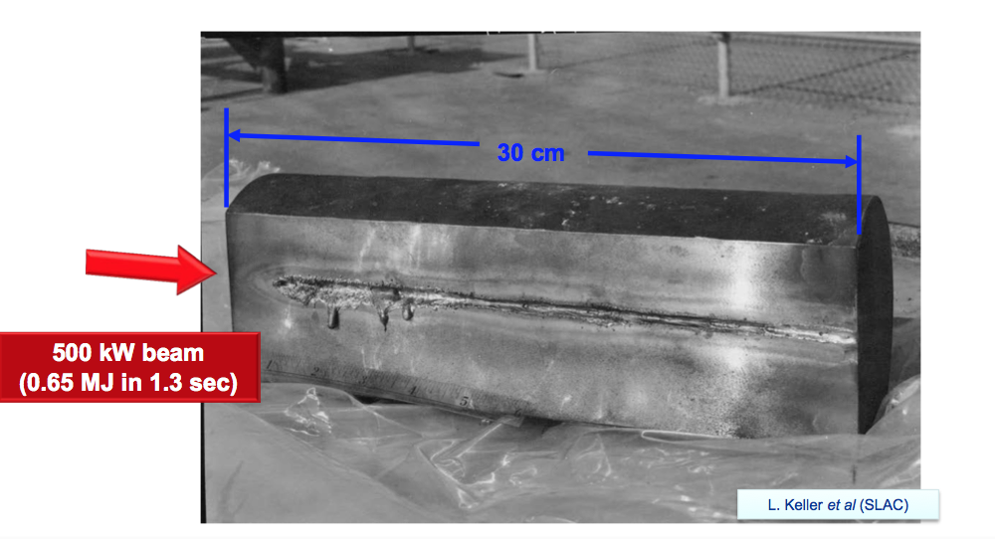
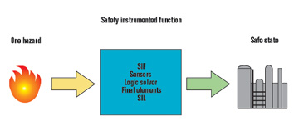
Control system Functions #4
  React to dangers: Machine Protection
    Remember: 5 MegaWatts of average beam power!
  Beam can damage accelerator components
    Much faster than a human can react – in microseconds!
  The accelerator has to be protected against itself
  Task of a Machine Protection System
  Consisting of
    sensors to detect dangerous situations (beam loss)
  Beam Interlock System
  Actuators to stop the beam
Fast logic in hardware (FPGA)
  Autonomous, but close relation to equipment control
  Configuration and operation via software
  Rigorous development and testing

Slide 14
Control System Technologies
Hardware (Electronics)
Level 1: Industrial control electronics
  PLCs: robust, reliable, well proven
Level 2: Highly synchronized
  React within one pulse (14 Hz, 71 milliseconds)
Level 3: (as) fast (as possible)
  Fast measurements and reactions (microseconds, nanoseconds)

Slide 15
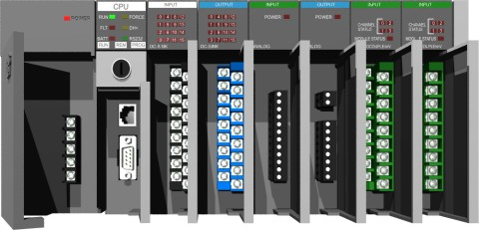
Control System HW Technologies #1
PLCs for distributed control
(Programmable Logic Controller)
Vacuum systems
  pumps, gauges
Cryogenics control
  Cooling down helium to 2 Kelvin
  Takes two weeks from room temperature to cool down a cryomodule for operation
    Reliability is essential – speed (as far as sufficient) secondary
Building (aka Site Infrastructure, or Conventional Facilities)
  Is an important part for operation of the facility
    Cooling, electric power, etc.
Target systems
  Cooling, gas and liquid flows, etc.

Slide 16
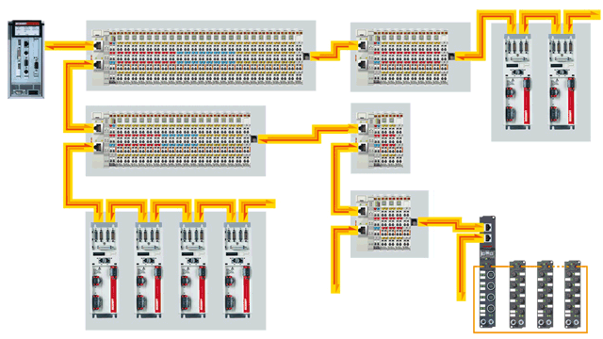
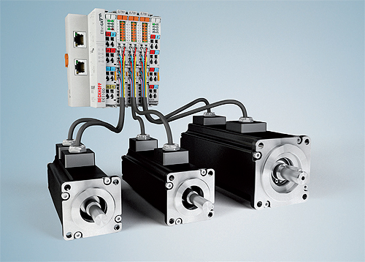

Control System HW Technologies #2
Event-synchronized real-time systems
  Need to react within one pulse (14 Hz, 71 milliseconds)
  Use the EtherCAT standard (https://www.ethercat.org)
    Real-time capable Ethernet protocol
    Widely used in industry
  Use with an open-source driver on a regular computer (or with PLCs)

Slide 17
Control System HW Technologies #3
Ultrafast systems (by today’s standards)
  Need to measure/react in nanoseconds
  Implemented in direct logic (FPGA, Field Programmable Gate Array)
Large amounts of data to handle
  Analog-to-digital converters in 100 MSPS range
  Sometimes needs to be stored for analysis
Fastest industrial systems of today
  Telecommunication : MTCA (Micro TeleCommunications Architecture)
  Adapted for physics applications: MTCA.4

Slide 18
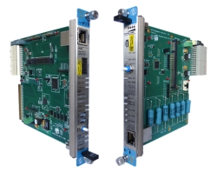
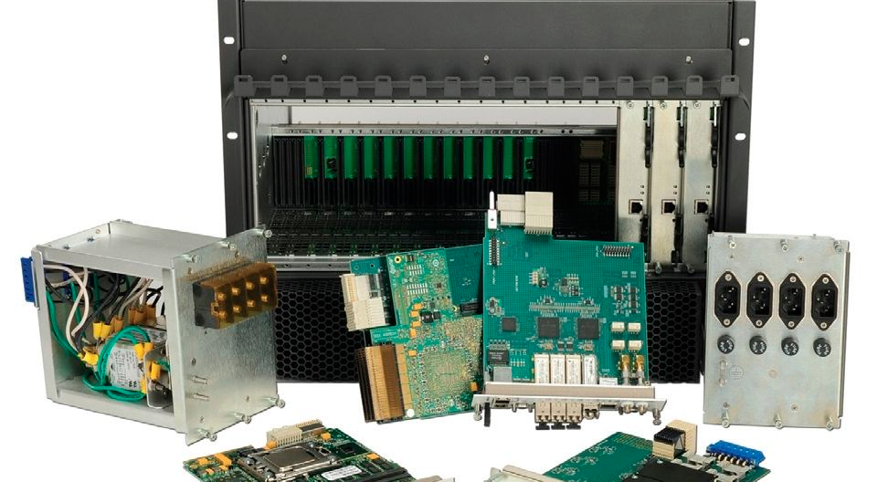
MicroTCA.4 systems
Modular (multi)computer system
  Plug-in modules (I/O, CPU)
  Based on PCI Express (MTCA.4)
  High data bandwidth
  Multi-CPU systems
  High-performance electronics, FPGA (Field Programmable Gate Array), fast I/O
  Extensive platform management
Rather expensive
  Used where justified by performance needs

Slide 19
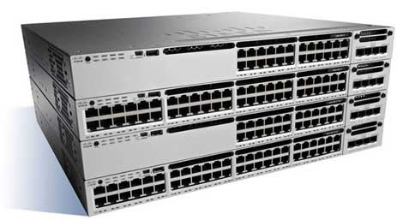
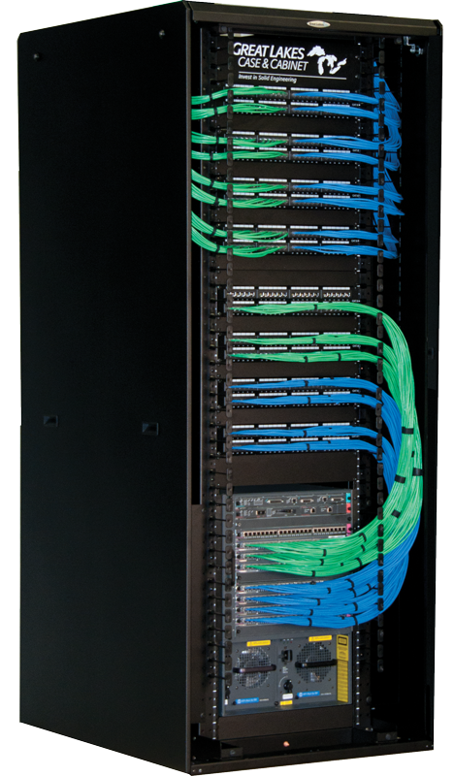
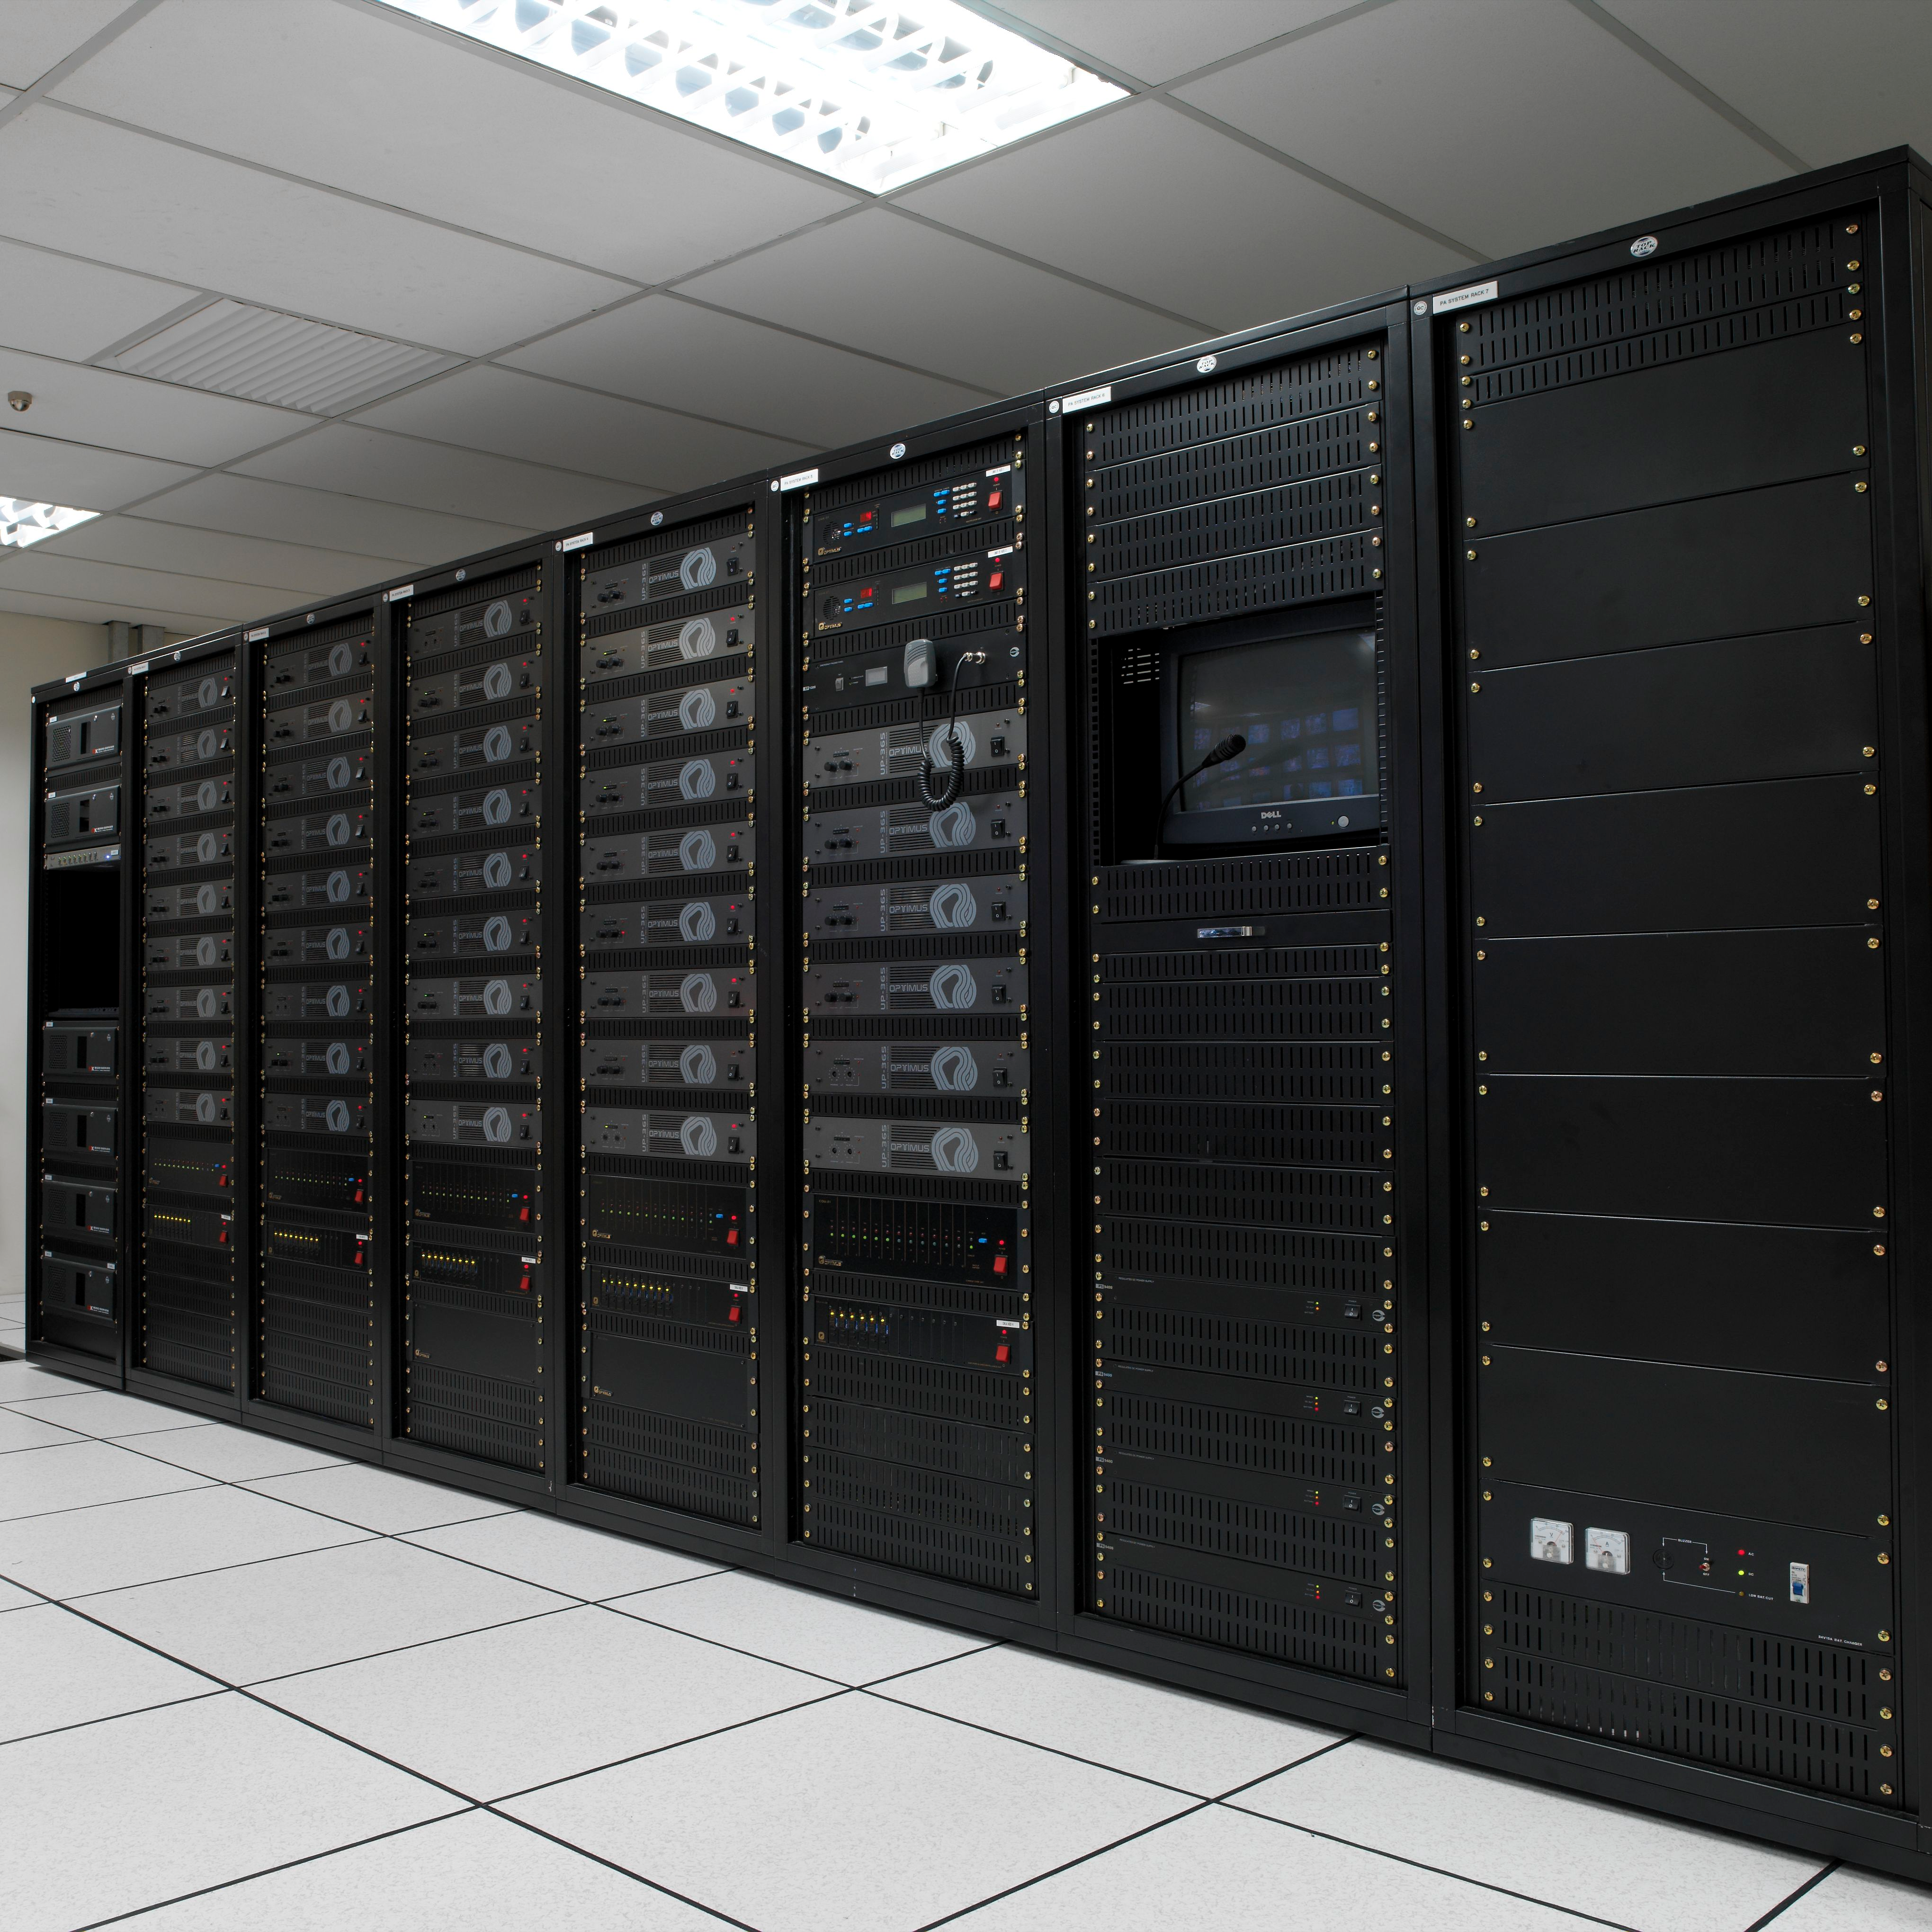
Control System (HW) Technologies #4
Networking
  Thousands of computing nodes in one network
    Reliability, flexibility, management
  High traffic volumes
    Archiving millions of process variables, detector data, images, etc.
    Several petabytes/week traffic (recent similar facilities)
  Flexibility required
    Computers and controllers may come and go
    Traffic may need segmentation (not all data interests everybody)
    But some data may be needed by anybody/everybody
Servers and storage
  Virtualization (reduce number of PC boxes)
    High availability
  High-speed storage
    Big volumes, data retention requirements

Slide 20
Software technologies
Control System Toolbox: EPICS
  Experimental Physics and Industrial Control System
  One of a few software packages specialized for accelerator and experimental systems
    Others: TANGO (ESRF, MaxIV, etc), DOOCS (DESY), FESA (CERN), etc.
  Open source, collaborative effort
    Not precisely known, but over 100 labs and installations use EPICS
      From huge scientific installations to beer brewing (really!)
EPICS allows us to connect to the signals in the field
  Read, write, monitor over network
  Scales from a few signals up to millions of signals
Server-client model
  Like a small-scale Internet of Things (or Intranet of Things)

Slide 21
Very quick overview of EPICS (recap)
    LINAC:BPM4:xPosition -0.323 mm
  NAME: SPK-020LWU:PWRC-PS-010.Curr
  VALUE: 18 A
  Signal:
  Process Variable (PV)
PV Access Clients
(PVA Client)
  EPICS is a network-based “client/server” model (hence the EPICS logo)
PV Access Servers
(CA Server)
Network protocol:
PV Access
IOC (Input Output Controller)
A list of Process Variables

Slide 22
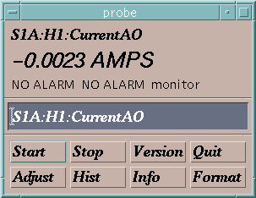
Connect to I/O via EPICS PV Access
“connection request” or “search request”
“get” or
“caGet”
“put” or
“caPut”
“set a monitor”
  Who has a PV named
  “SPK-020LWU:PWRC-PS-010:Curr”?
Change its value to 30.5
Notify me when the value changes
What is its value?
Channel Access Client
CA Client
CA Server
Channel Access Server
I do.
18.5 AMPS
OK, it is now 30.5
It is now 20.5 AMPS
It is now 10.5 AMPS
It is now -0.0023 AMPS
Process Variables:
  SPK-020LWU:PWRC-PS-010:Curr
SPK-020LWU:PWRC-PS-010:x
SPK-020LWU:PWRC-PS-010:y
“put complete”
30.5 is too high. It is now set to the maximum value of 27.5.
“post an event”
or
“post a monitor”
or
You are not authorized to change this value
or

Slide 23
EPICS Technologies
Programming languages
  C, C++ (most of the low-level layer, also client code)
  Java (Client software, associated services)
  Python is a popular scripting language, many others are supported
Operating systems
  EPICS runs on many operating systems
    Linux, Windows, MacOS
    Real-time operating systems (usually I/O layer only)
      Embedded Linux RT, vxWorks, RTEMS, etc
Platforms
  From big to small
    From Raspberry PI to large server machines
    On a toaster – almost.
  A lot of I/O devices supported
    And (relatively) easy to write your own support.

Slide 24
Application and GUI/HMI development
Several tools available from the community
  GUI (graphical User Interface) builders
  Tools for data archiving, alarm management, etc.
Control Systems Studio as a standard tool
  Java-based plug-in architecture
    Can be configured to user’s needs and extended
  Several tools available as plug-ins:
    Display Builder (GUI tool), (Archive) Data Browser, Alarm Handler
  System integrator does not need to write code

Slide 25
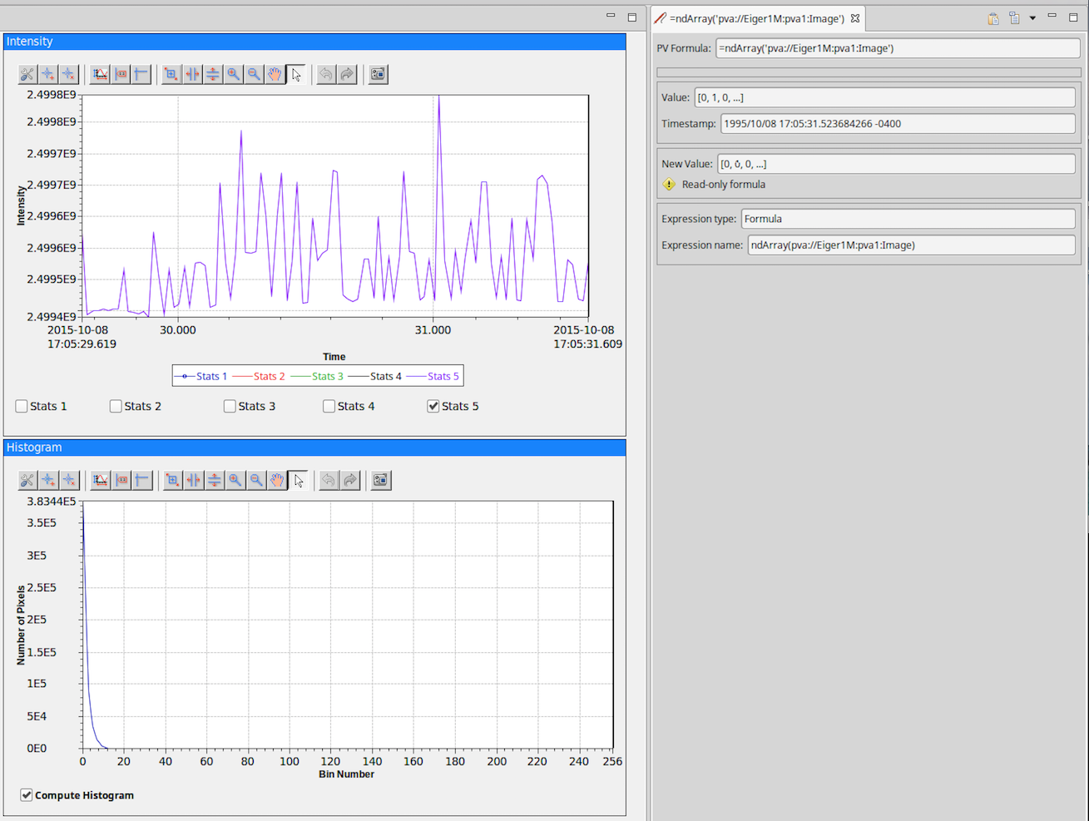
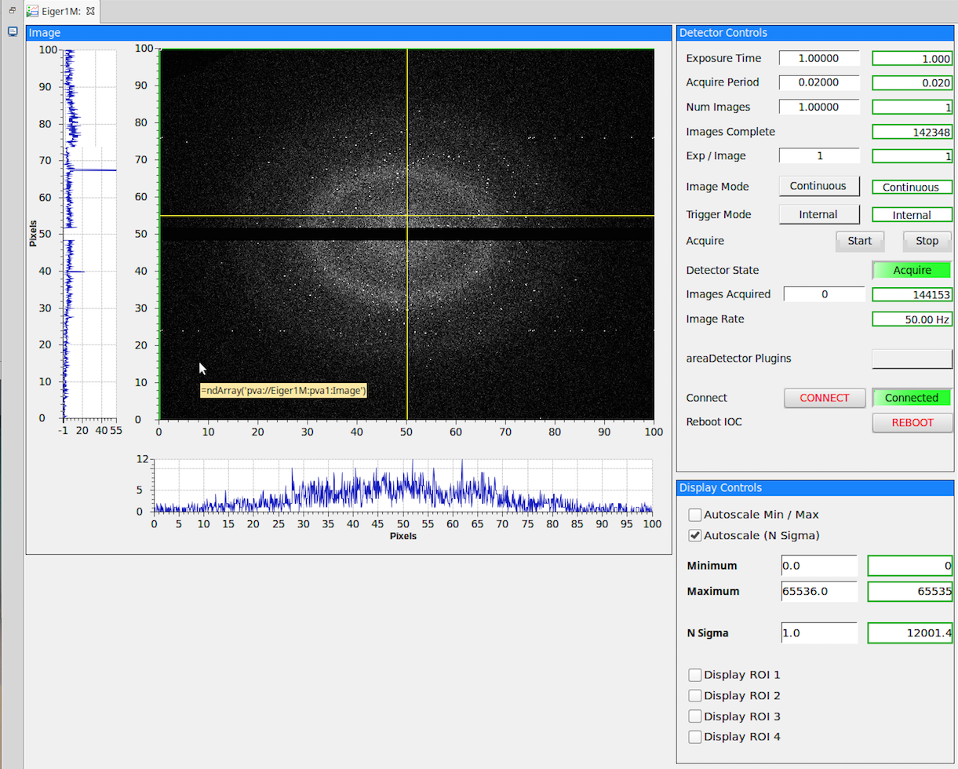
Control System Studio examples
The “Process Variable”
“Eiger1M:pva1:Image”
Figures: CS-Studio screenshots showing an EPICS PV of the type for areaDetector images

Slide 26
Composition of the Control System
Physics application
Feedback application
Scripting Client
Control System Studio
Client/Application software
PVAccess
PVAccess
PVAccess
PVAccess
Ethernet
PVAccess
PVAccess/REST
PVAccess/REST
PVAccess
PVAccess
PVAccess
Middle Layer Servers
Model Server
Lattice Server
Channel Finder Svr
Archive Data Server
Save/Compare Restore Svr
Magnet Conv, Response Matrix, Dispersion, etc….
OpenXAL
SQL
SQL
data handler
SQL
RDB
RDB
Data backend
RDB
RDB
PVAccess
PVAccess
PVAccess
PVAccess
PVAccess
Utilities etc..,
Distributed Front-Ends
Diagnostics
Power Supplies
RF
Vacuum
Physical Device
Physical Device
Physical Device
Physical Device
Physical Device

Slide 27
Control System Applications
General-purpose services
  Process variable archiving for analyzing what happened
    Continuous or “post mortem”
  Handling alarms
    Notify operators or engineers if something is going wrong
Sub-system controls
  Starting up and tuning the RF (or magnet, vacuum, etc) systems for operation
Accelerator Physics applications
  Use control system facilities to steer and shape the beam
  Optimize beam quality and behavior
Operation Sequencer
  Steer the accelerator (and target) from low power beam to full power in a controlled way
Support applications
  Properties of the equipment, status displays, operation logbook, error and event logging, etc.

Slide 28
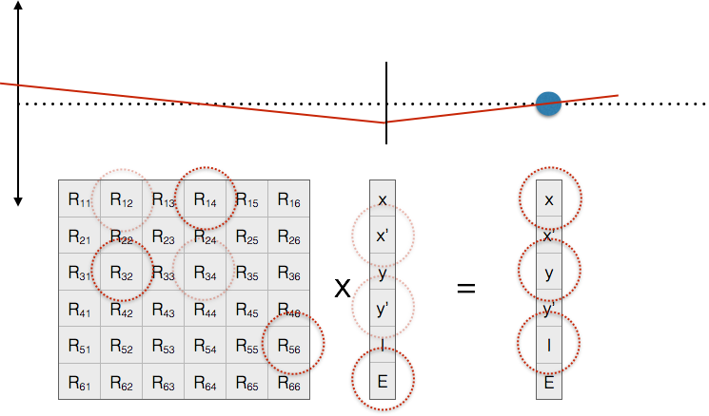
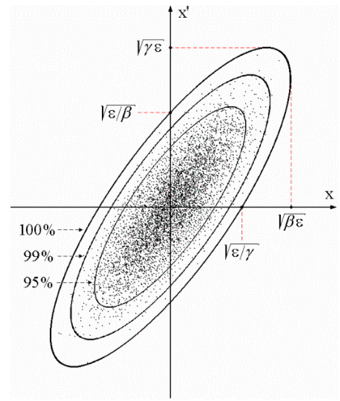
EPICS for beam dynamics modeling
Transverse
beam offset
“A”
“B”
Z
$ eget -s XCOR:IN20:491:RMAT -a b BPMS:IN20:525
0.669591 0.694604 0 0 -3.08532e-19 2.41325e-19
-0.570851 0.901275 0 0 -1.23627e-19 1.45491e-19
0 0 1.33379 0.966896 0 0
0 0 0.358415 1.00957 0 0
-2.29302e-24 8.92892e-20 0 0 1 1.20724e-05
1.00974e-28 0 0 0 0 1
From N. Delerue, Oxford Univ.
$ eget XCOR:LI24:900:TWISS
energy 5.00512
psix 37.7625
alphax 13.6562
betax -2.78671
etax -0.00698294
etaxp 0.00107115
psiy 31.9488
alphay 116.762
betay 5.2592
etay 0
etayp 0
z 2438.72
Figure: EPICS modelling service giving orbit response matrices
and Twiss parameters for given devices. These are the basis of 95%
of emittance minimization applications – feedback, steering, bumps, etc.

Slide 29
Summary
Control system touches almost every aspect of the ESS facility – thus: Integrated Control System
Enables the operation of the (very complex) facility as a single entity
Technology spectrum is very wide
  9 orders of magnitude in controlling timespan (nanoseconds to weeks, cryogenics processes to beam manipulation)
  Networking, servers, datacenter
  from Gigabytes/sec data handling to high reliability (and safety) systems
  Software ranging from databases to accelerator physics, from GUIs to low-level kernel drivers
  Electronics hard- and firmware development

Slide 30
Summary (cont)
Very high reliability and availability requirements
  Datacenter level, 24/7 operation, 99.99xx availability
Handling of millions of Process Variables
  Offer different abstractions to different users
    Subsystem engineer, accelerator physicist, neutron scientist, manager,…
    Ease of use
  Storage and manipulation of data
    How to find and access the required data

