Slide 1
Vacuum Seminar: introduction to vacuum technology and engineering
Dr. Marcelo Juni Ferreira
Vacuum System Section Leader
European Spallation Source ERIC

Slide 2
Outline
- Introduction,
- Class “0” of vacuum: surface/material science perspective,
- Vacuum for accelerators, gas regimes and simulations,
- ESS Vacuum System: standardize solution, control system,
- ESS examples: RFQ (simulation) and ion source (control system),
- Target vacuum,
- LOKI – instruments,
- Vacuum Laboratory,
- References,
- Conclusions,
2
Nov 2, 2017

Slide 3
Introduction
Goal: short introduction on the vacuum field (surface science, gas dynamics, simulations, vacuum instrumentation...) and the science and engineering for a larger “user facility.”
Justification: why do we need vacuum?
“the surrounding gas can interfere on the desirable process, it means, it is a requisite part of the process or/and an integral part of a product”
Ex: heat transfer, vaporization, chemical/physical reactions or effects, protection...
3
Nov 2, 2017

Slide 4
Introduction:
Vacuum Terms (ISO 3529/1)
ISO definition:
“A commonly used term to describe the state of a rarefied gas or the environment corresponding to such a state, associated with a pressure or a mass density below the prevailing atmospheric level”
Vacuum range Pa [N/m²] | Naming
100 kPa - 100 Pa (1000 mbar - 1 mbar) | low (rought) vacuum
100 Pa - 0,1 Pa (1 mbar - 10⁻³ mbar) | medium vacuum
0,1 Pa 10 µPa (10⁻³ mbar - 10⁻⁷ mbar) | high vacuum (HV)
< 10 µPa (abaixo de 10⁻⁷ mbar) | ultra-high vacuum (UHV)
< 10⁻¹⁰ Pa (abaixo de 10⁻¹² mbar) | extreme high vacuum (XHV)*
Standard references conditions for gases :
Temperature : 0 °C
Pressure : 101,325 Pa (= 1,013.25 mbar)
4
Nov 2, 2017

Slide 5

Introduction:
Pressure range of earth’s atmosphere
Moon’s surface atmospheric pressure:
3 x 10⁻¹⁰ Pa
13 km commercial flight limit
Nov 2, 2017

Slide 6
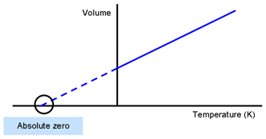
Introduction: Ideal Gas Law
P . V = N. R. T
P = pressure [Pa]
V = vomule [m³]
N = amount of substance [mol]
R = universal gas constant (k . N_{A}) [8.314 J. K⁻¹mol⁻¹]
T = temperature [K]
6
Nov 2, 2017

Slide 7
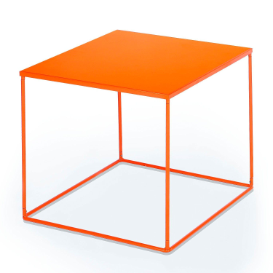
Class “0” of vacuum : monolayer
How many molecules we have at the surface of a cube of 1 liter?
CAS CERN-94
A.G. Mathewson
Place one molecule of nitrogem by side another over the cube surface (definition of monolayers).
6 side = 0.010 x 0.010 x 6 = 0.06 m²
1 = 7.3 . 10¹⁸ molecule/m²
3.7 . 10⁻¹⁰ x 3.7 . 10⁻¹⁰
0.06 x 7.3 . 10¹⁸ = 4.4 . 10¹⁷ molecules
The molecular diameters are measured in Ångström (1 Å=10⁻¹⁰ m).
Diameter of nitrogen molecule : 3.7 Å
7
Nov 2, 2017

Slide 8
Class “0” of vacuum : pressure equivalent
What is one monolayer of gas as pressure equivalent?
Using the ideal gas law at standard conditions for temperature and pressure (STP):
10⁵ Pa (1 atm) at 273.15 K (0º C)
2.69 . 10²² molecules in 1 liter.
4.38 . 10¹⁷ x 101325 = 1.65 Pa (1.65 mbar) medium vacuum!!!
2.69 . 10²²
8
Nov 2, 2017

Slide 9
Class “0” of vacuum : gas in solid solution
How much gas we have in solid solution (1 liter) on stainless steel (SS) 304?
Typical value (ASTM handbook) for nitrogen on austenitic phase is 150 ppm in weight. SS304 density: 8 . 10³ g/liter
150 ppm = 150 x 8 . 10³ = 1.20 g/liter
10⁶
Using the ideal gas law at STP :
2.69 . 10²² molecules in 1 liter => 4.77 . 10⁻²³ * 2.69 . 10²² = 1.28 g
≈ 150 ppm of nitrogen in SS304 is equivalent of 1 bar atmosphere!!
1 molecule of nitrogem weight = 4.77 . 10⁻²³ g
9
Nov 2, 2017

Slide 10
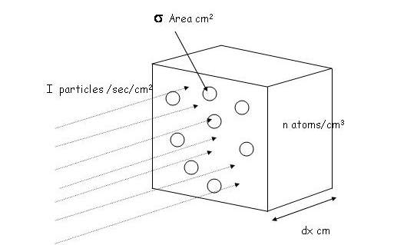
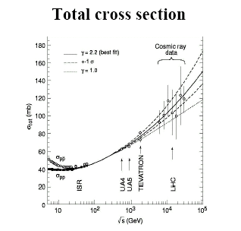
Vacuum for accelerators:
Gas-beam interaction
CAS CERN-2007
P. Grafström

Slide 11
Regimes and simulations
Knudsen number (Kn): is a dimensionless number defined as the ratio of the molecular mean free path length to a representative physical length scale
Kn = λ
L
λ = mean free path (average distance in between gas-gas
L= representative physical length (Ex: diameter of a pipe)
Kn >> 1 hydrodynamics regime (Navies-Stokes, ANSYS commercial software)
Kn << 1 free molecular regime (Monte Carlo MOLFLOW, angular coefficient COMSOL)
Kn ≈ 1 transitional regime (no commercial or academic software), every application requires a new model.
11
Nov 2, 2017

Slide 12
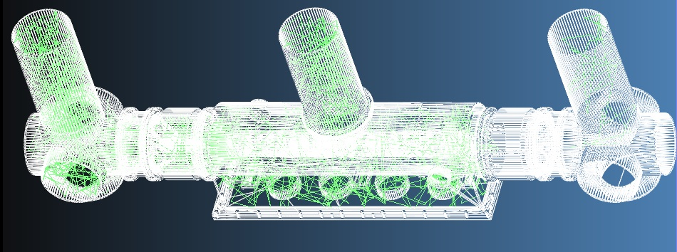
MOLFLOW +
By Roberto Kersevan (CERN), more than 20 years of development for synchrotron accelerators.
- steady state and transient,
- only molecular regime,
- temperature,
- accept external files STL,
- possible to couple synchrotron radiation,
12
Nov 2, 2017

Slide 13
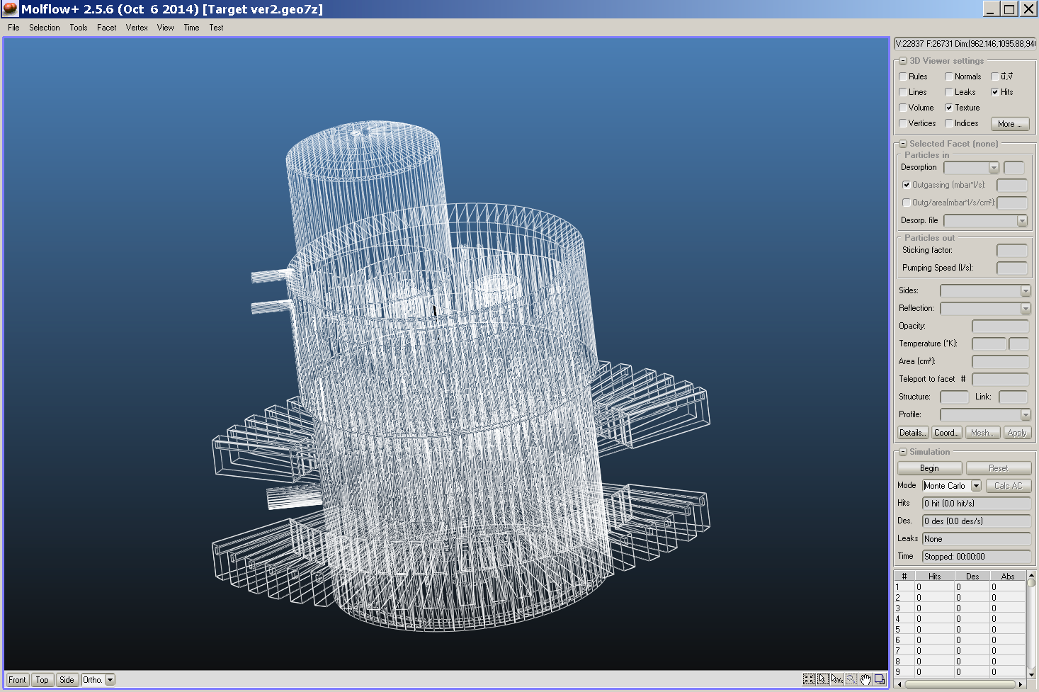
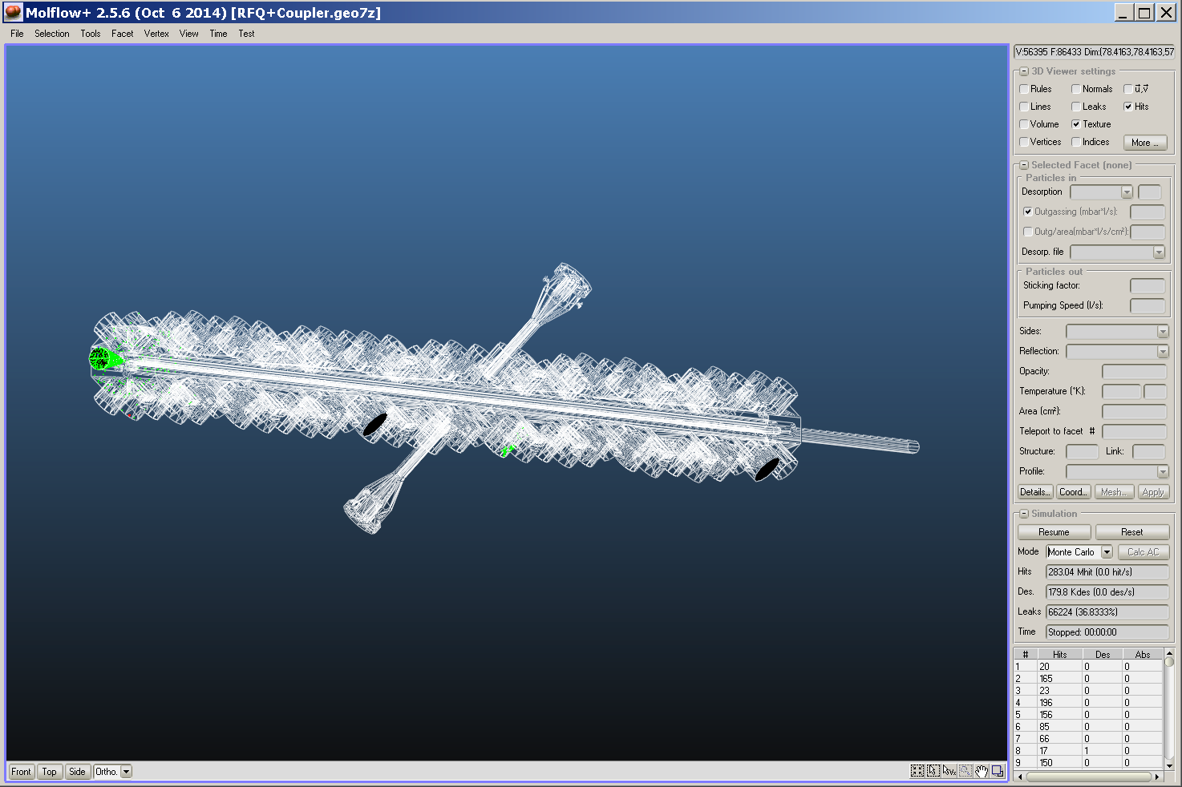
MOLFLOW +
Ex: Target monolith vessel and RFQ
Target monolith vessel
RF Quadrupole

Slide 14
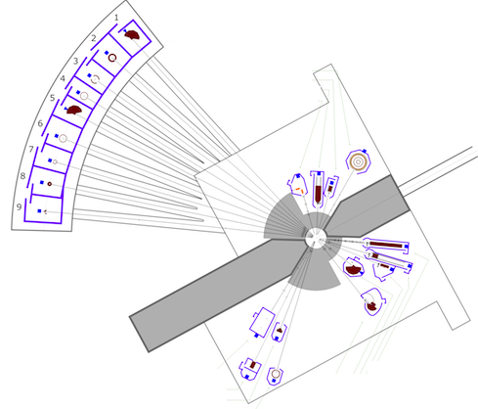
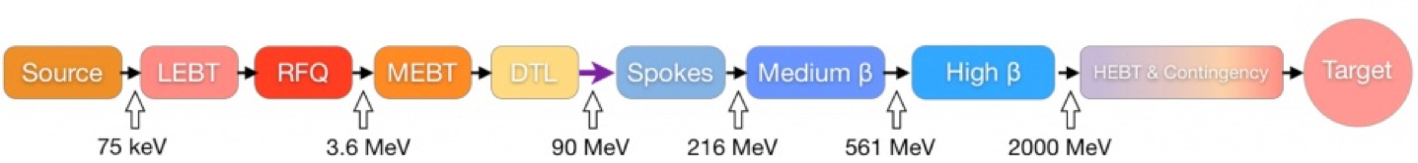
ESS Vacuum system
Target
Warm LINAC
Cold LINAC
The ESS organization charges the ESS Vacuum Group (VG) with the responsibility for all ESS vacuum systems including not only the Accelerator, but also Instruments and Neutron Beam Lines and the Target.
The main task of the ESS VG is to support the in kind contributions on the vacuum system and the integrated vacuum design of the ESS complex.
Neutron instruments
Nov 2, 2017

Slide 15

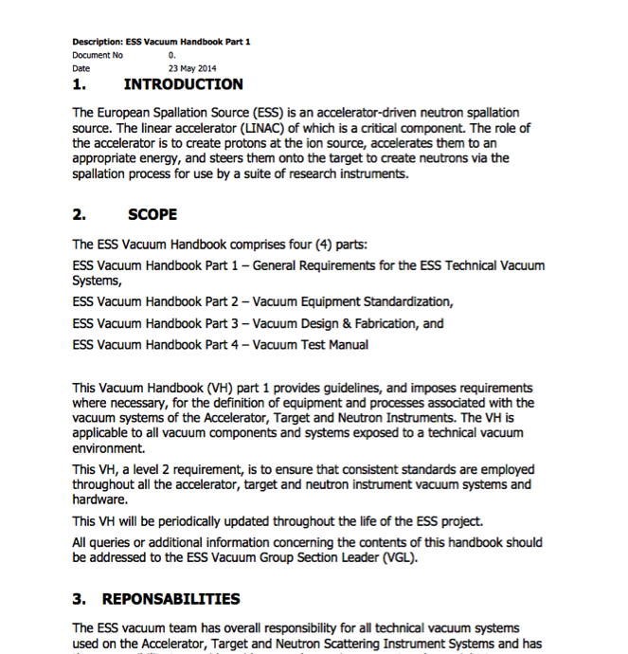
Vacuum Standardization, an Integrated Approach
Working closely with our partners across the project one of our primary goals was to promote the use of common vacuum equipment and standards. As a result a Vacuum Standardization meeting was held in February 2014 where equipment suitable for Standardization was agreed and reflected in the ESS Vacuum Handbook.
An important element of this Standardization is the Procurement Policy applied for the procurement of all “major” vacuum equipment. The primary objective of the program is to develop a list of standard vacuum equipment for use project wide to minimize project costs, reduce spares holdings, training and achieve other benefits of standardization.
http://europeanspallationsource.se/accelerator-documents
Nov 2, 2017

Slide 16
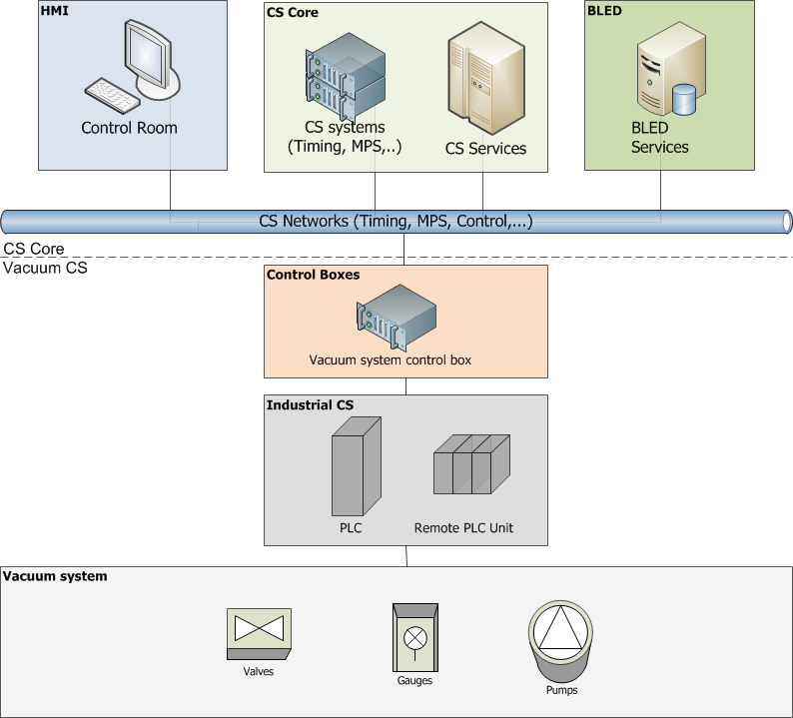
Vacuum Control System
Epics Domain
ICS team responsibility
Vacuum team responsibility
Nov 2, 2017

Slide 17
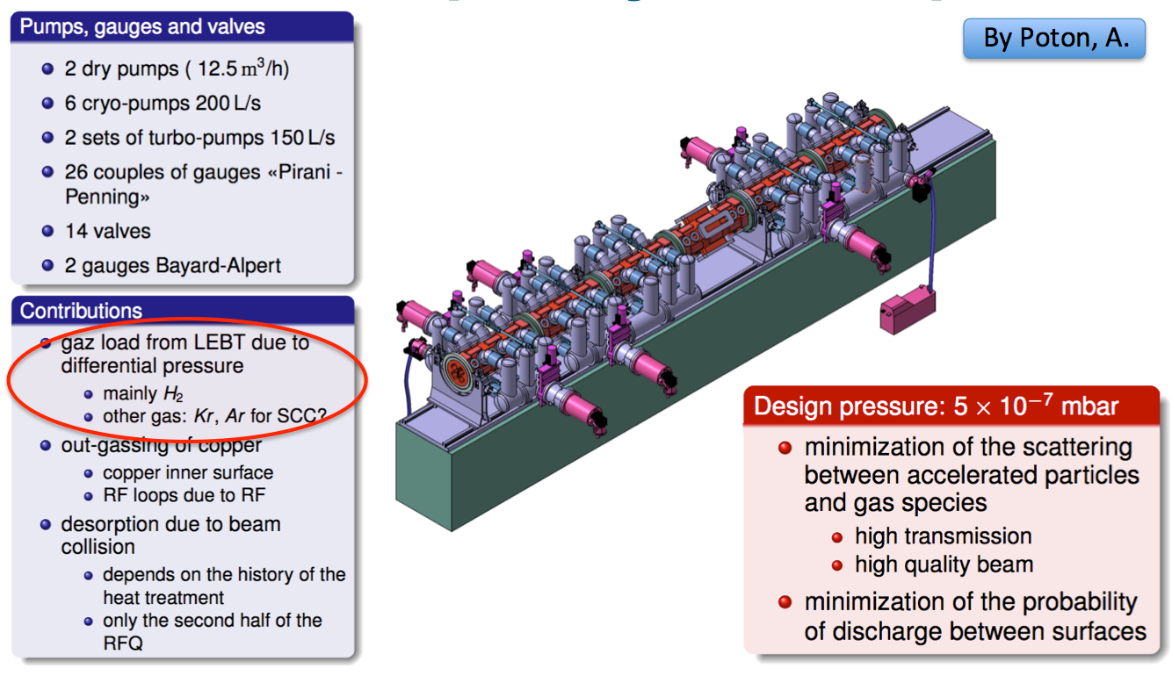
Vacuum Requirements: warm LINAC
Radio Frequency Quadrupole (RFQ)
Nov 2, 2017

Slide 18
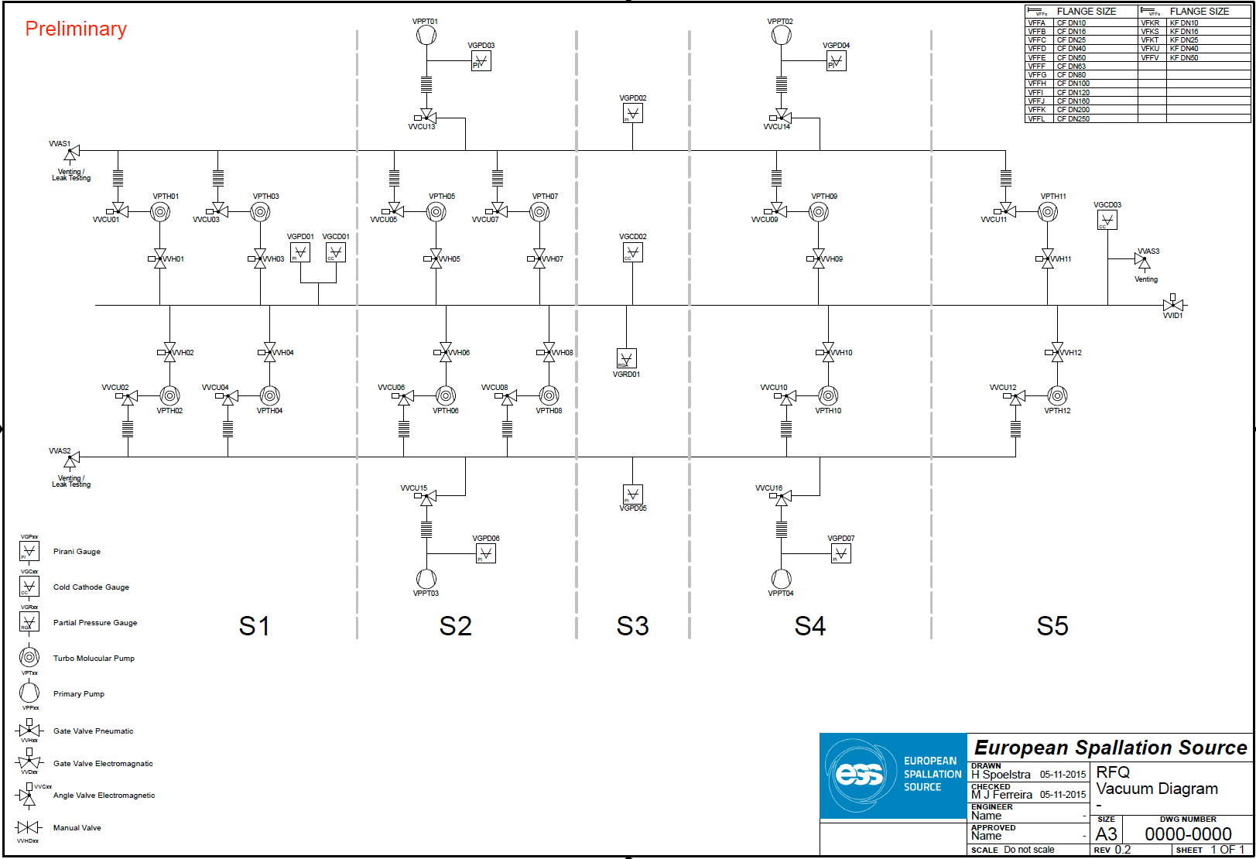
ESS RFQ case:
Requirement and simulations
Vacuum diagram
ESS – Vacuum
H. Spoelstra

Slide 19
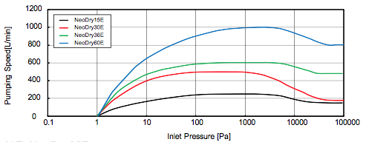
ESS RFQ case:
Requirement and simulations
Operating pressure requirement RFQ.SyR-32 (DOORS Level 3): The maximum operating pressure over 75% of the length of the RFQ shall not exceed 5E-7 mbar for the defined gas throughput from the LEBT to the RFQ.
Interlock requirement (CEA, level 4): P < 2E-6 mbar.
ESS – Vacuum
S. Scollari
Pump-down simulation (1-2 pumps)
High vacuum simulation (MOLFLOW +)
Used Software: VacTran
Starting pressure: 1000 mbar
Target pressure: 10⁻² mbar
Gas composition: Air
Pump: NeoDry 36E
(30 m³/h @50Hz)
Operation (8 and 10 TMPs)
Acceptance cases (TMP)
Inlet pressure: 6 . 10⁻⁵ mbar
Outlet pressure: 5 . 10⁻⁸ mbar
OGV* : 5 . 10⁻¹⁰ mbar•l/s/cm²
Gas**: 50% N₂ and 50% H₂
TMP used: Leybold 361
S***: 231 l/s (N₂) 229 l/s (H₂)
Inlet: Flanged
Outlet: Flanged
4 different OGV** considered
Gas: 100% N₂
TMP used: Leybold 361
S***: 231 l/s
*OGV = Outgassing Gas in High Vacuum
**Gas composition coming from LEBT
*** Effective pumping speed including the gate valve. Leybold 361 pumping speed are: 345 l/s for N₂ and 340 l/s for H₂

Slide 20
Pump down time (1 and 2 pumps)
ESS – Vacuum
S. Scollari
Simulations with one and two primary pump has been carried out.
The conductance between each pump and the RFQ has been assumed composed of: the TMP, a DN40 elbow and 4 meters of DN40 bellow.
The pump down time, in both the cases is
< 20 min.
20
Nov 2, 2017

Slide 21

Nominal (10 pumps) vs Failure (8 pumps) case
A nominal (10 pumps) and a failure (8 pumps) cases have been considered.
As worst case, the two failed pump have been considered in the first section.
The operational and interlock requirements are fulfilled in both cases.
The system is failure tolerant in case of two TMP stops.
ESS – Vacuum
S. Scollari
LEBT
Section 1
Section 2
Section 3
Section 4
Section 5
MEBT
Failed pumps

Slide 22
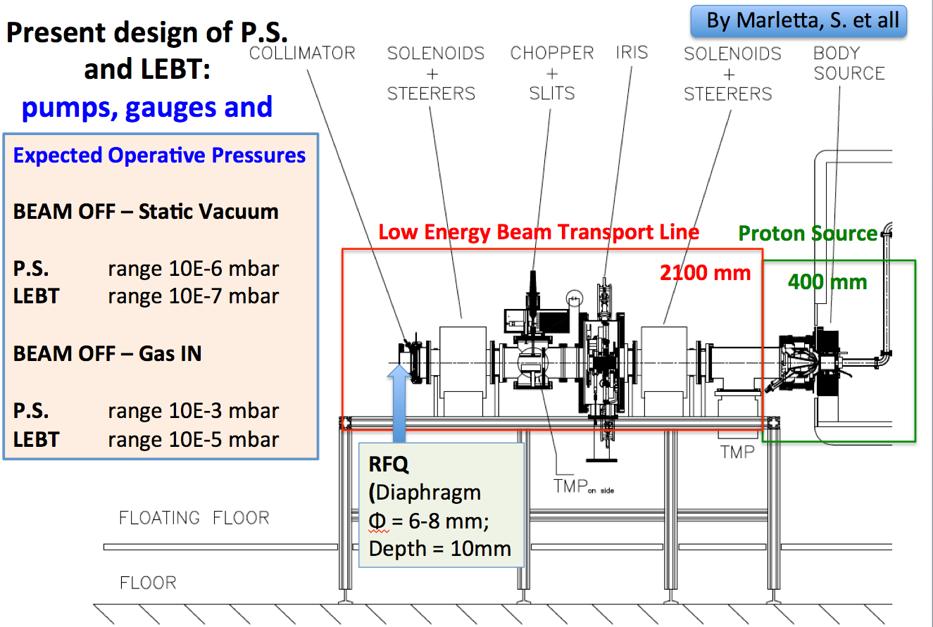
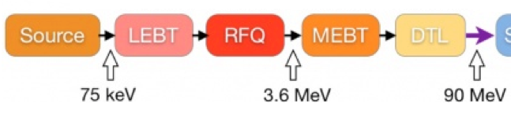

Vacuum Requirements: warm LINAC
Proton Source (PS) and Low Energy Beam Transport (LEBT)
Nov 2, 2017

Slide 23
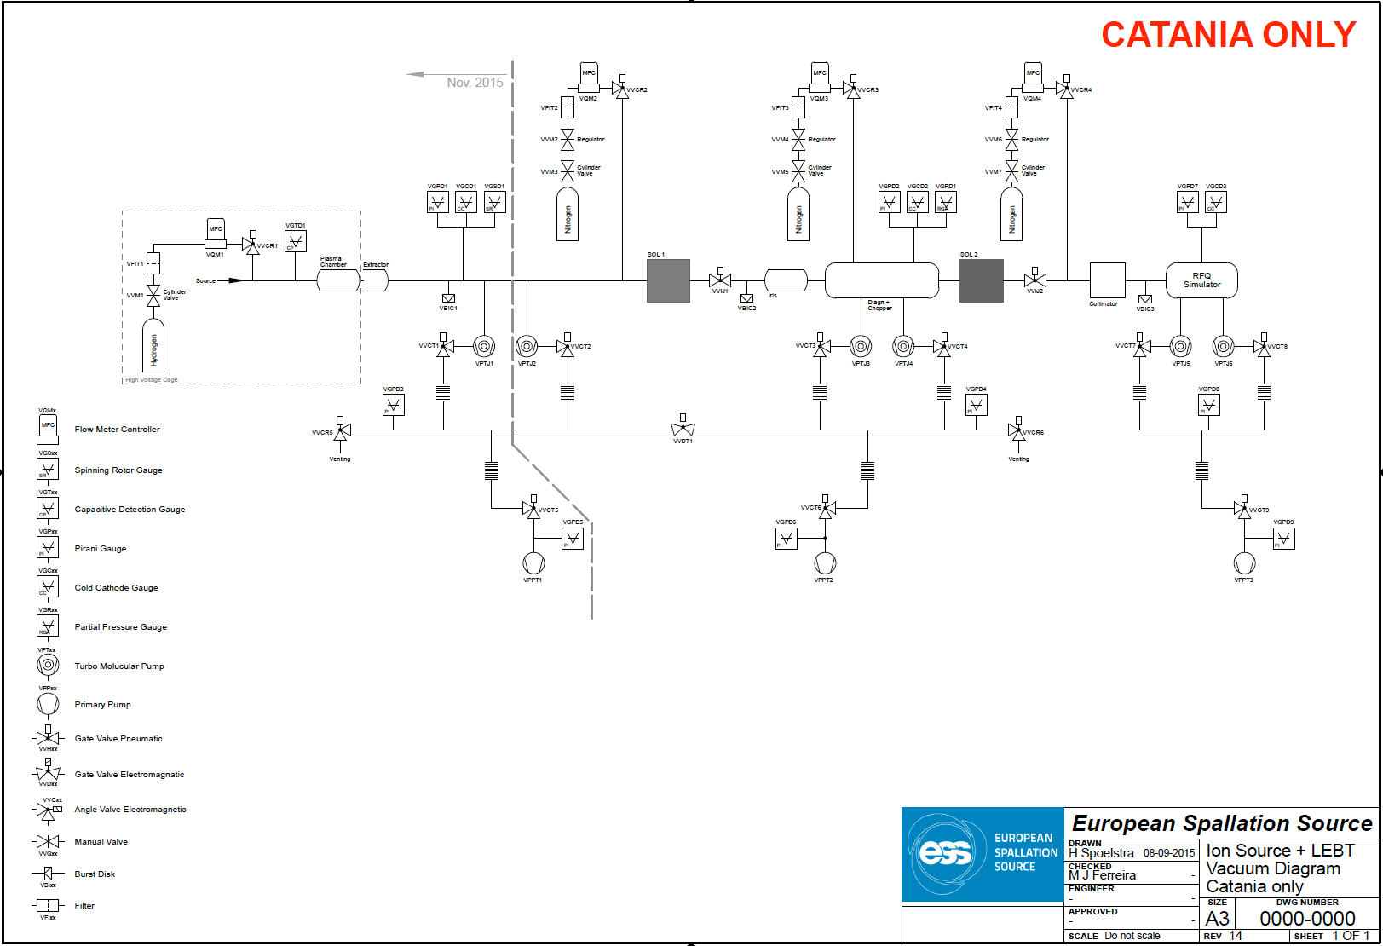
Vacuum Requirements: warm LINAC
Proton Source (PS) and Low Energy
Vacuum diagram
ESS – Vacuum
H. Spoelstra

Slide 24
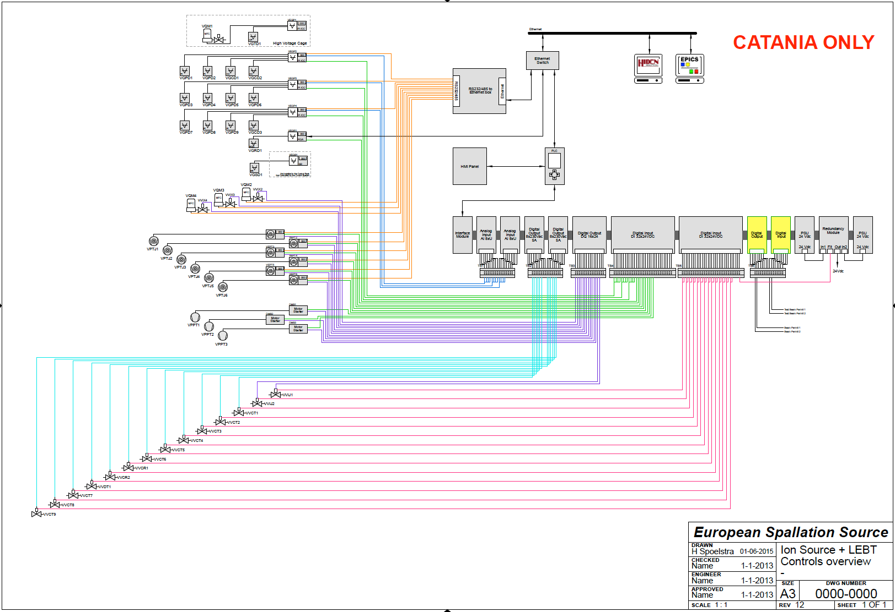
Vacuum Requirements: warm LINAC
Proton Source (PS) and Low Energy
ESS – Vacuum
H. Spoelstra
Vacuum wiring diagram and logic (interlock system)

Slide 25
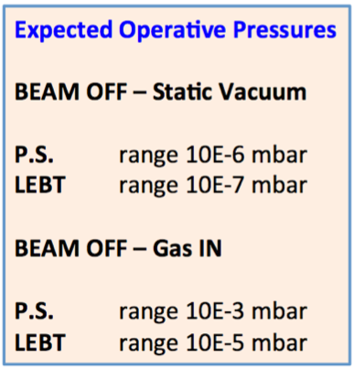
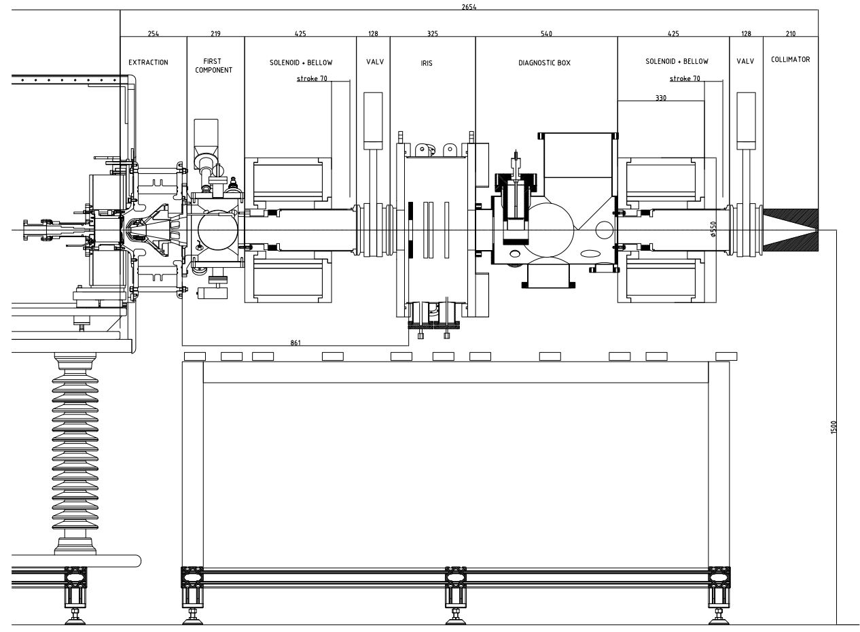
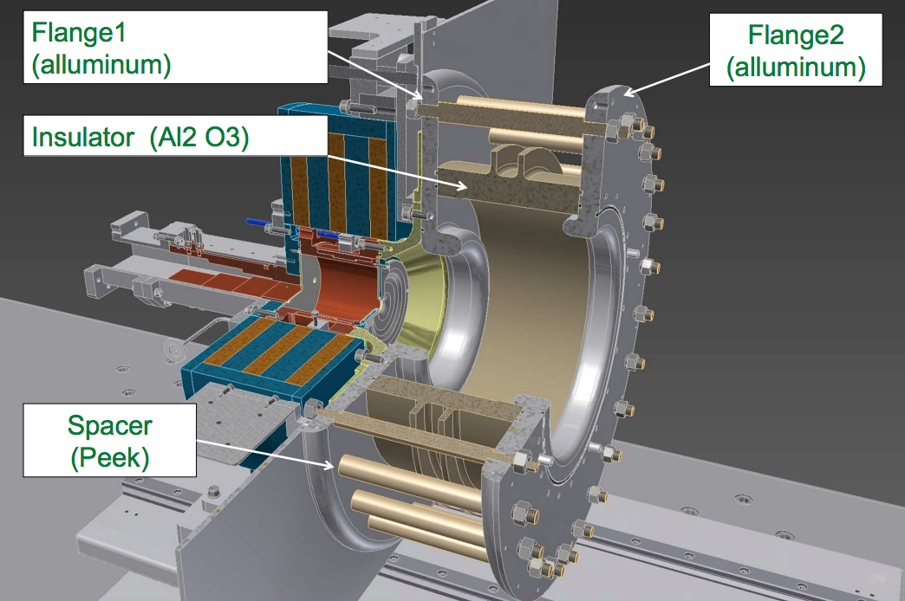
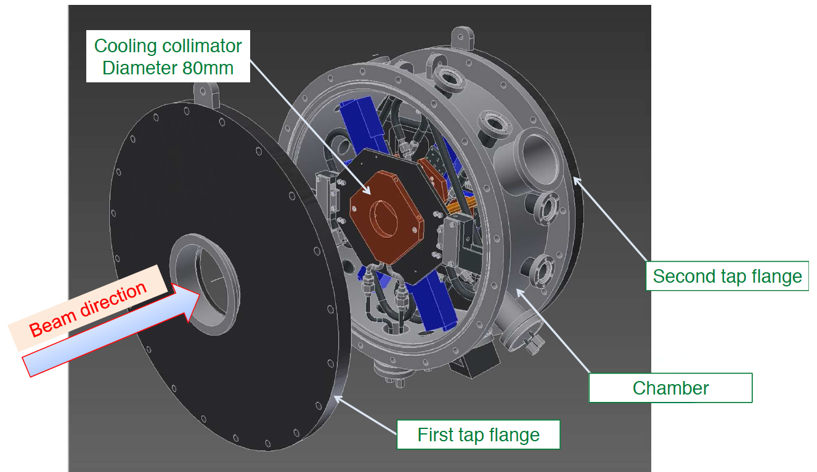
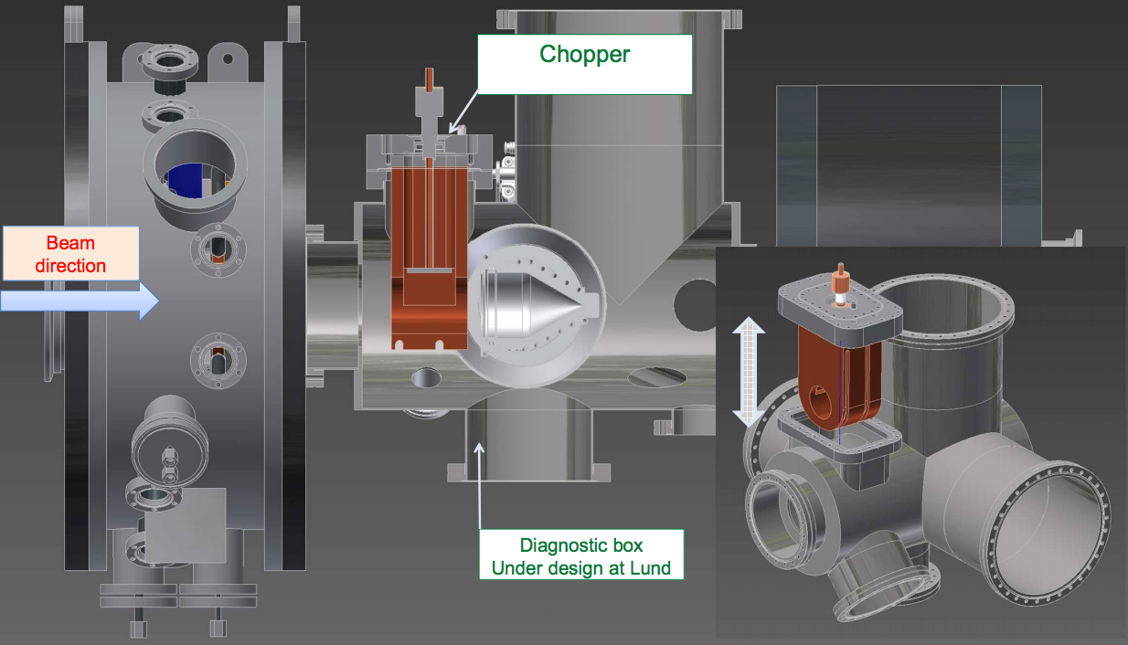
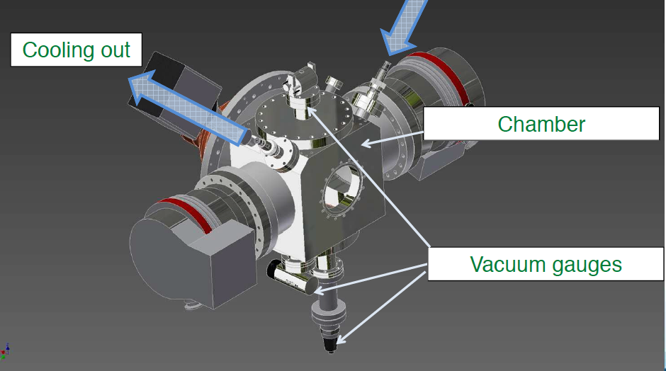
Proton Source (PS) and Low Energy Beam Transport (LEBT)

Slide 26
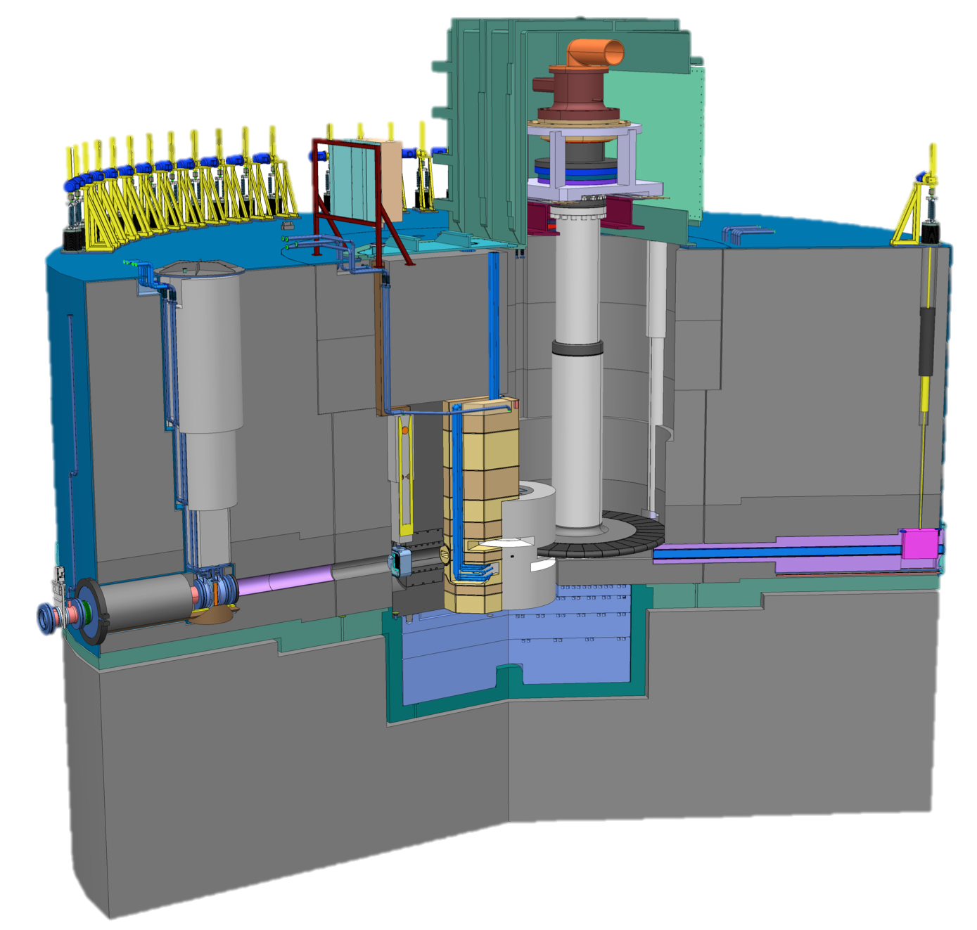
Vacuum Requirements: Target
The monolith vessel will operate in vacuum. In between the accelerator and the monolith vessel will have a Proton Beam Window (PBW) to separate both environments. The monolith will be designed and built to high vacuum standards to ensure that the operation of the Target for the life of the facility, corrosion inside the vessel is the major question. Operating pressure will be < 10⁻¹ Pa.
The moderator and reflector will have vacuum insulation for the cryogenic temperatures of the hydrogen used on the cooling.
Target drive housing
Neutron beam extraction
Proton beam from accelerator
Proton beam window
Target wheel
Moderator and reflector plug
Neutron beam window
Nov 2, 2017

Slide 27
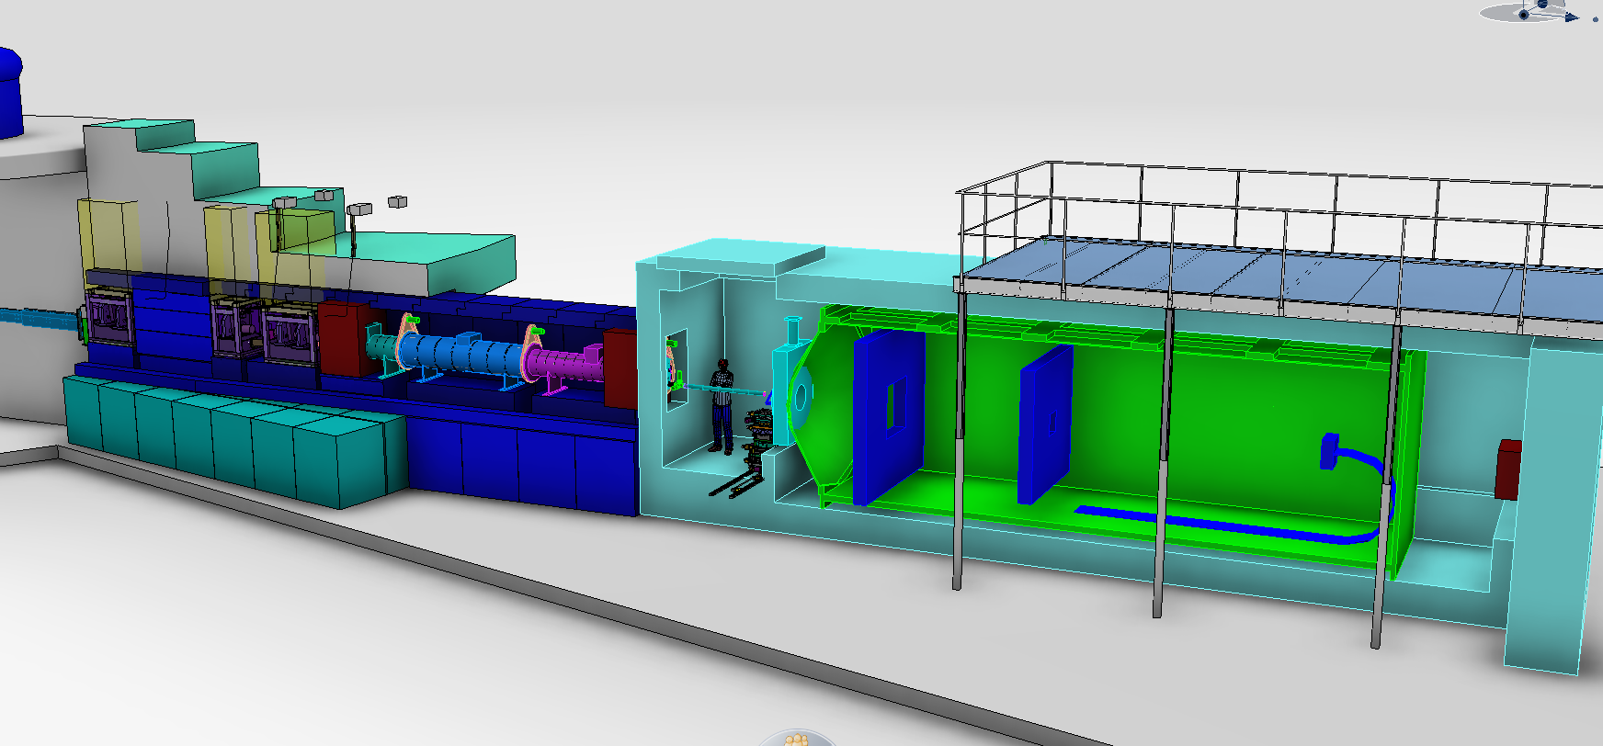
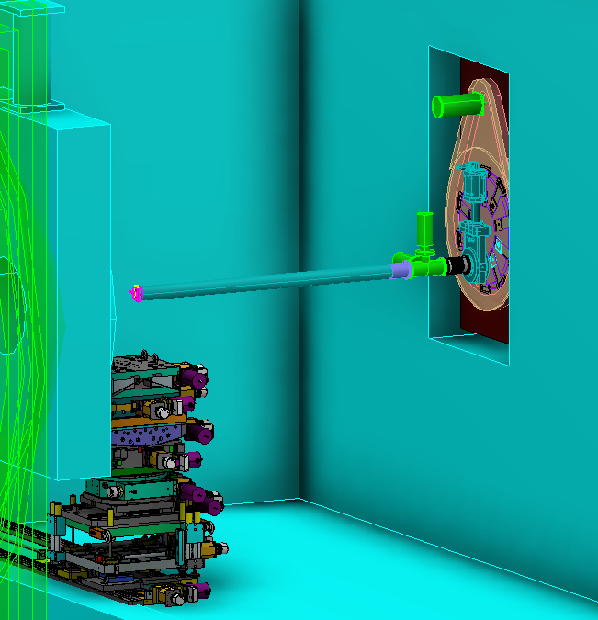
LoKI – SANS Instrument
Interface document for Instruments already in discussion,
Standardization model in place.
Chopper Pit 1
Second shutter
Window Target
Gate valve at sample
Gate valve Chopper
Chopper Pit 2
Window Target
Sample positioning
Chopper
Collimators
Sapphire window Sample
Detectors tank
Monolith
Gate valve
Nov 2, 2017
0
2
6
7.5
9.7
10.3
12.5
20.5
22.5
38

Slide 28
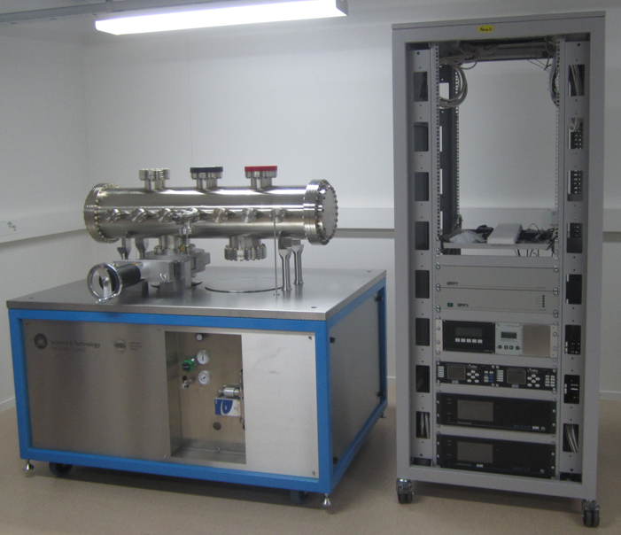
Vacuum Laboratory
Vacuum Integration Test Facility (VITF)
This facility will provide the capability for seamless integration of all vacuum systems used on the accelerator, target and neutron instruments with the ICS (ESS Integrated Control System). This allows control logic to be developed together ICS and interlocks checked before implementation on the actual systems for which they are designed. EPICS control screens will also be developed together with data acquisition functions using this facility.
Nov 2, 2017

Slide 29
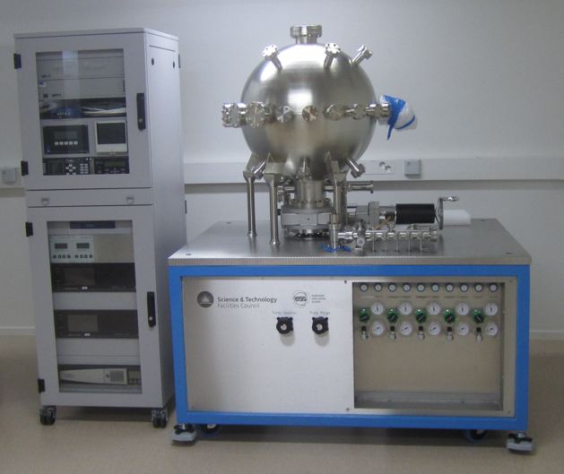
Vacuum Laboratory
Gauge Calibration Facility (GCF)
The GCF will be used to confirm the operation and calibration of all vacuum gauges prior to installation with calibration performed against a secondary standard. All vacuum gauges installed on the accelerator, target and neutron instruments will use this facility. Gauge accuracy is important since gauge readings will be used for set point control and the interlocking and sequencing of the various vacuum system operations.
Nov 2, 2017

Slide 30
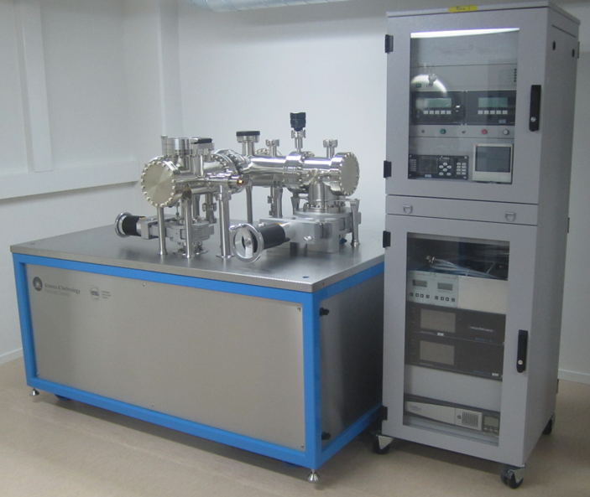
Vacuum Laboratory
Outgassing Test Facility (MTF)
This facility is designed to support the selection and approval of materials for use in a vacuum environment in accordance with the requirements of the ESS Vacuum Design Handbook (VDH) where materials having vacuum compatible characteristics are listed. The selection of vacuum compatible cabling, to minimize the contamination of vacuum spaces from the outgassing of hydrocarbons from plasticizers inherent in cable insulation, will be made using this facility.
Nov 2, 2017

Slide 31
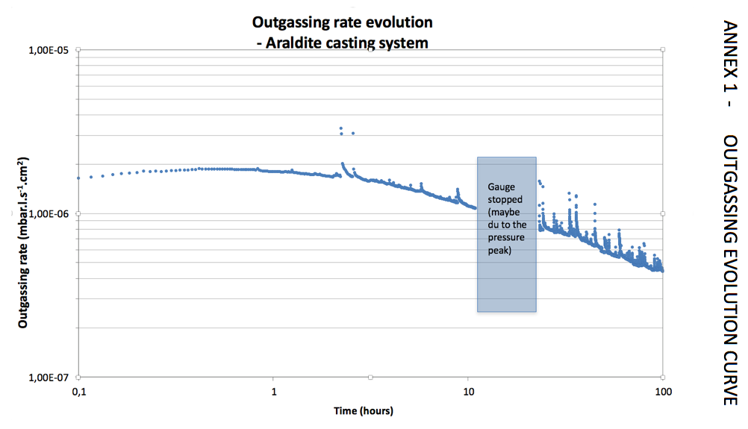
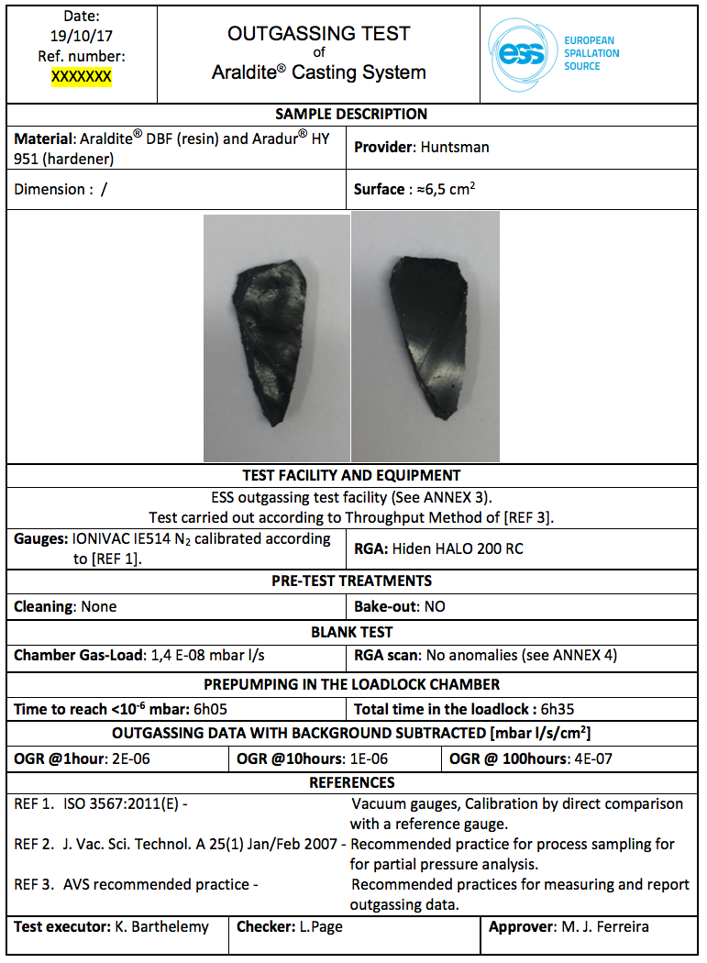
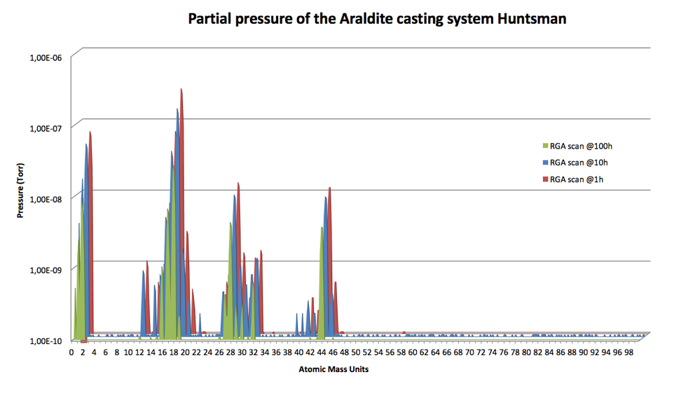
Report for Outgassing Test
ESS – Vacuum
K. Barthelemy

Slide 32
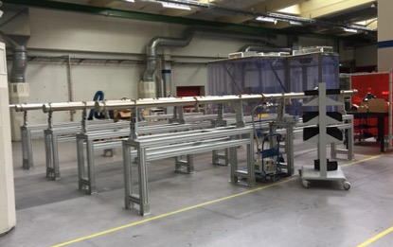
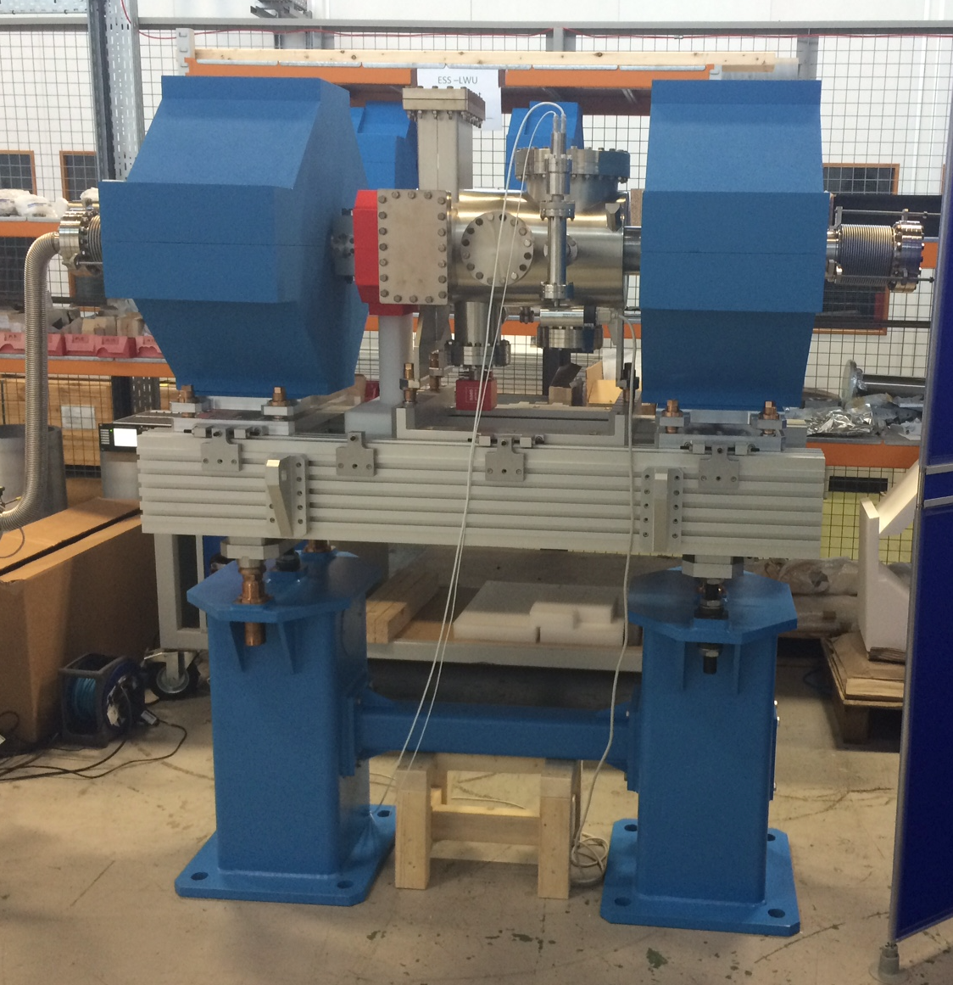
RATS Facility

Slide 33
References
MatheWson, A.G. Vacuum System Design. In: TURNER, S. (ed.). Proceedings, CERN Accelerator School: 5th General Accelerator Physics Course. CERN - 94. v. 2. p.717-729.
Proceedings, CAS – CERN Accelerator School: Vacuum in Accelerators, CERN-2007-003, Geneva, 2007.
INTERNATIONAL ORGANIZATION FOR STANDARDIZATION. ISO 3529-1:1981 - Vacuum technology – Vocabulary – Part 1: General terms. Genebra, Suíça, 1981.
WUTZ, M.; ADAM, H.; WALCHER, W. Theory and Practice of Vacuum Technology. Braunschweig, Germany: Friedrich Vieweg & Sohn, 1989, 686p. ISBN 3-528-08908-3
Jousten, K (ed.). Handbook of Vacuum Technology. Weinheim, Germany: Wiley-VCH, 2008. 1002p. ISBN 3-527-40723-5.

Slide 34
Conclusion
Vacuum group is responsible for the vacuum requirements of the machine,
Vacuum Group responsible to over see all related aspect of the vacuum for ESS (including the in kind contributions),
ESS Vacuum Handbook main point of interface,
Interface all other subsystem to provide the vacuum signals and logic to the machine control system.

Slide 35


Thank you!
Tack!

