Slide 1
BEAM INSTRUMENTATION
Tom Shea
and the ESS Beam Instrumentation Team

Slide 2
Outline
Accelerator and its Beam
Beam Instrumentation by Function
  Measurements
  Protection
Summary

Slide 3
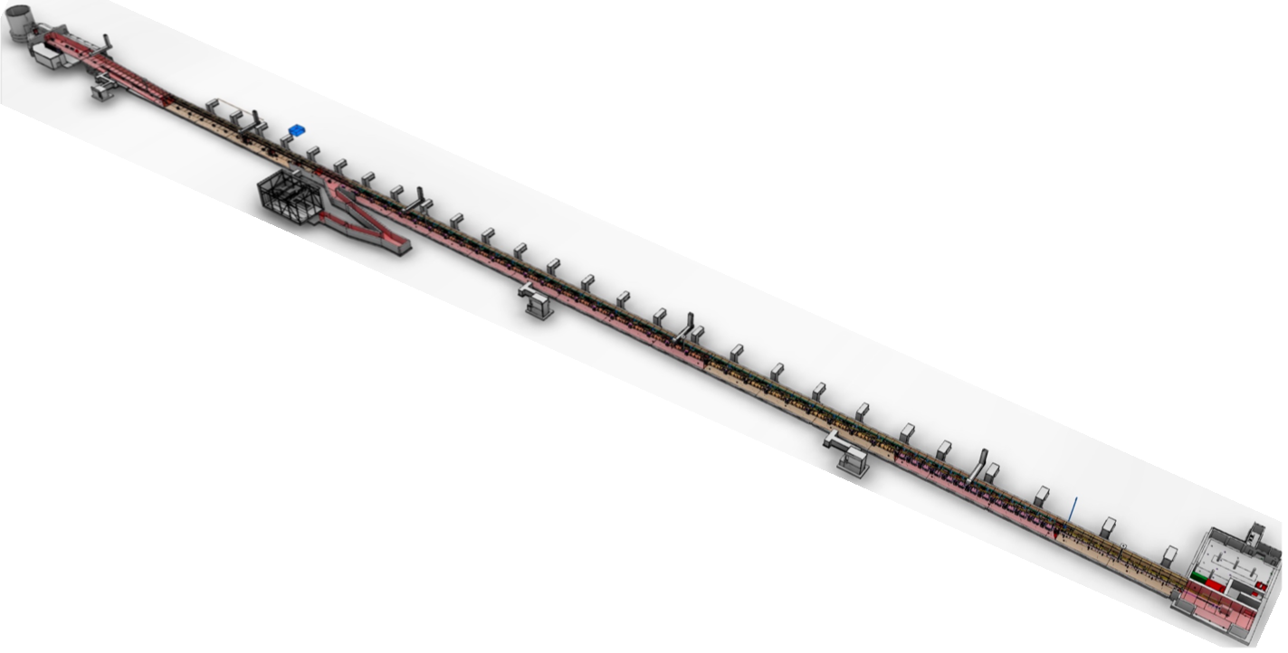
Accelerator Layout
The Beam
Long pulse proton beam 2,86 ms
Pulse frequency 14 Hz
Proton energy 2 GeV
Beam power, time averaged 5 MW, within pulse 125 MW
Beam current 62,5 mA
Target
2 GeV
beam
571 MeV
High Beta
0.7 µs
216 MeV
Beam Instrumentation
Sensory system
Distributed throughout the accelerator
Measures beam beam properties
Delivers measurements to the control system
90 MeV
Medium Beta
0.4 µs
3.6 MeV
Spokes
0.4 µs
75 keV
Ion Source
DTL
0.5 µs
MEBT

Slide 4
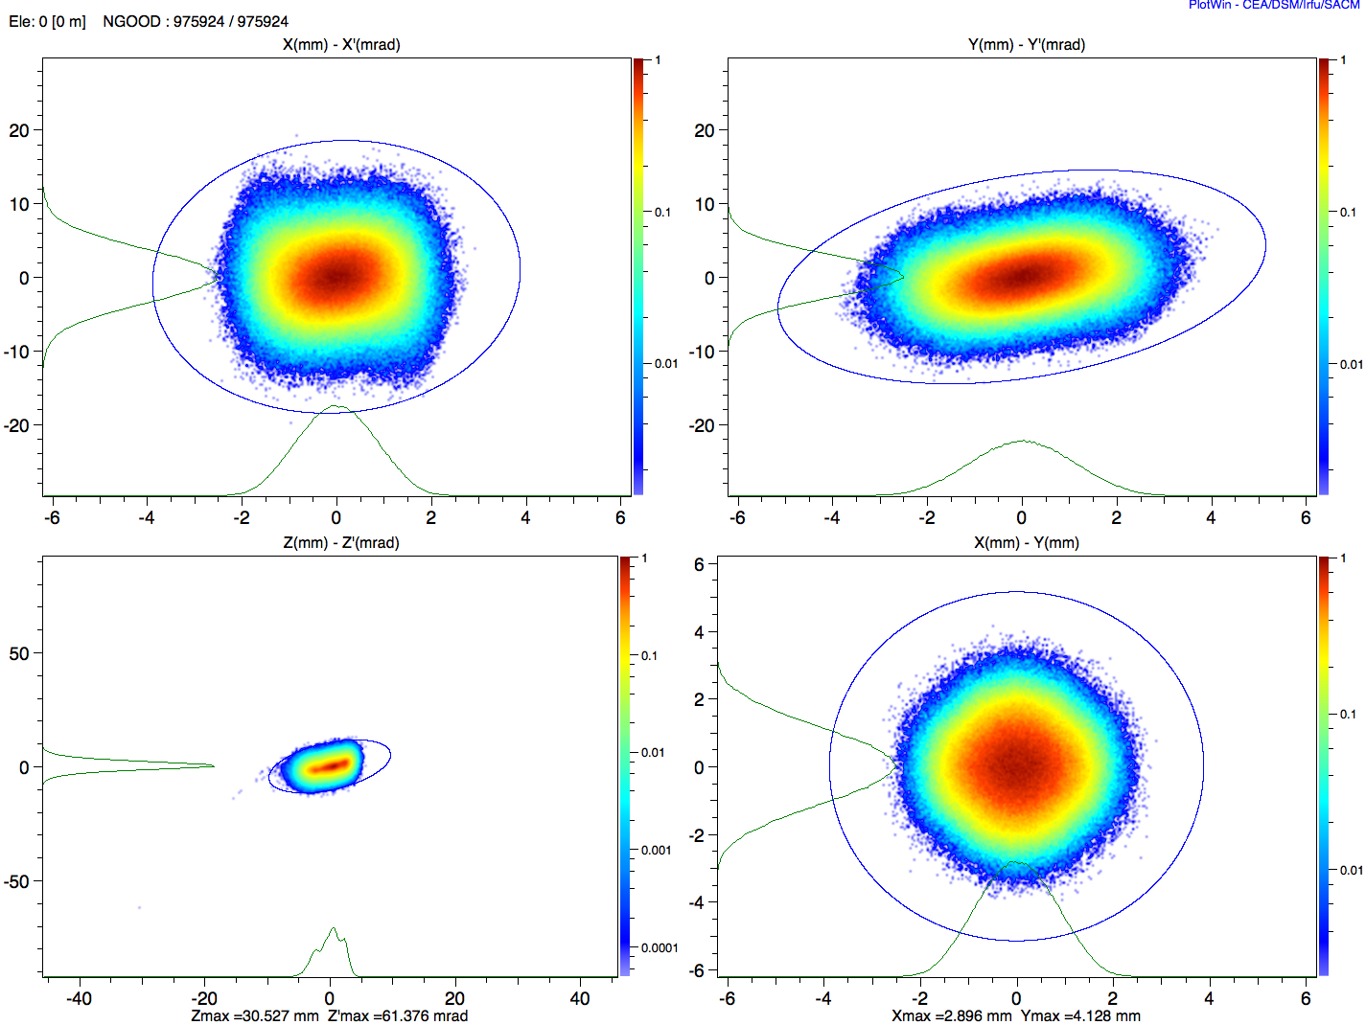
Beam: Phase Space, Emittance
Transverse: x (mm), x’ (mrad)
Transverse: y (mm), y’ (mrad)
Transverse: x (mm), y (mm)
Longitudinal: z, z’
(also: eV, seconds)
Eshraqi

Slide 5
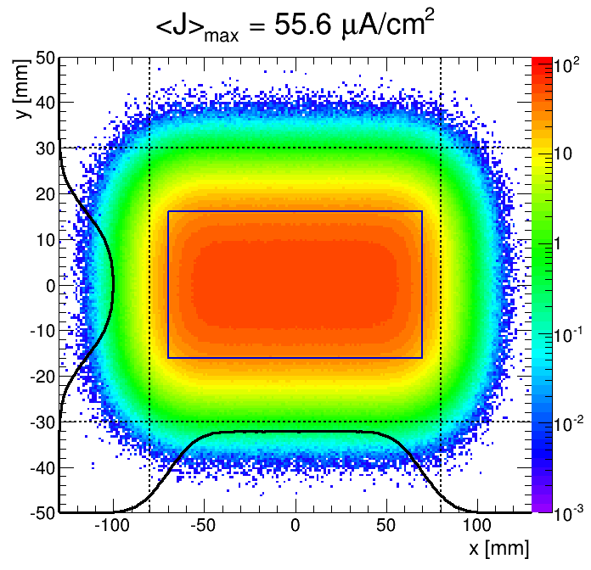
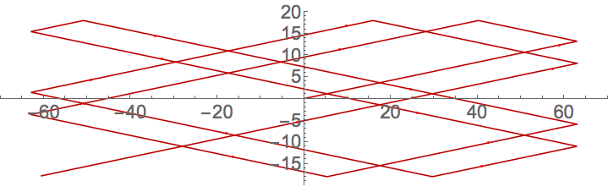

ESS Beam Parameters at Target
Beam footprint enclosing 97.5% beam fraction | 180 mm (horizontal) 60 mm (vertical)
Nominal time-averaged peak current density | 56 µA/cm^2
Max displacement of footprint from nominal position | ±5 mm (horizontal), ±3 mm (vertical)
Nominal RMS size of Gaussian beamlet | 16 mm (horizontal) 5.3 mm (vertical)
Raster frequencies | 40 kHz (horizontal) 29 kHz (vertical)
Sector of Target Wheel
Gaussian
beamlet

Slide 6
Beam Instrumentation Devices
Accelerator Interfaces:
Machine Protection System Interfaces:
Possible Functions:
Measurements
  Beam Accounting
  Measurement of Beam Centroid
  Measurement of Beam Distribution
Protection
Controls network
Buffering
post mortem
Timing/event
Signal Processing
device health
RF reference
configuration
Low-latency data
beam interlock
device state
Shielding
cabling
Beamline device
Notes:
Only those most relevant for MPS
Also include optional out of band config for thresholds and direct MPS link to beamline device state (like SNS)
also, environmental considerations: electromagnetic interference, radiation, cryogenic environment, ultra-high vacuum, etc.
Reference: Forck lecture notes

Slide 7
Beam Accounting
Measuring beam current and where it is lost
  Constituents of beam extracted from ion source (what fraction is protons?)
  Lost protons that damage or activate accelerator
  Beam leaving aperture and overheating target/dump components
Systems
  Doppler
  Faraday Cups
  Beam Current Monitors
  Beam Loss Monitors
    Neutron detectors
    Ion chambers
  Aperture Monitors
Beam pulse parameters for diagnostics measurements extend from a few mA for a few µs at low repetition rate up to full duty factor.

Slide 8
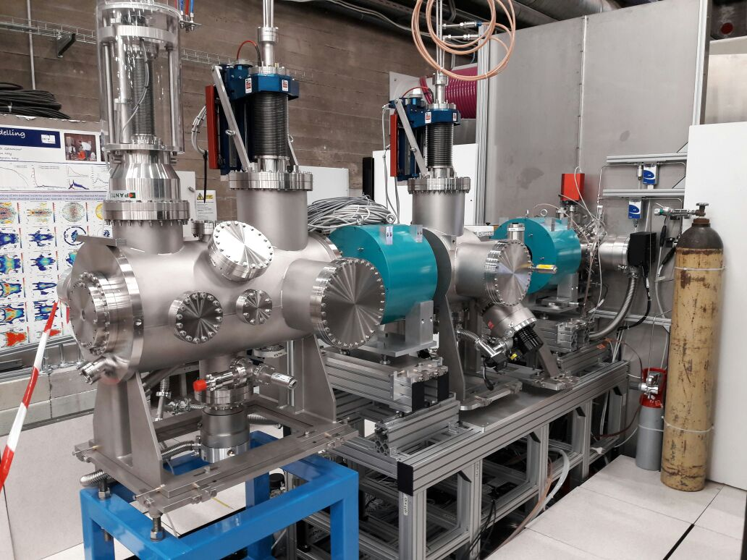
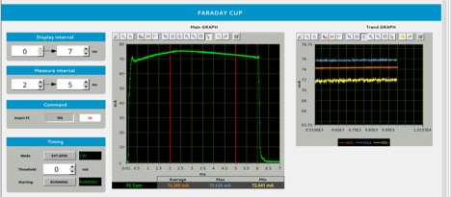
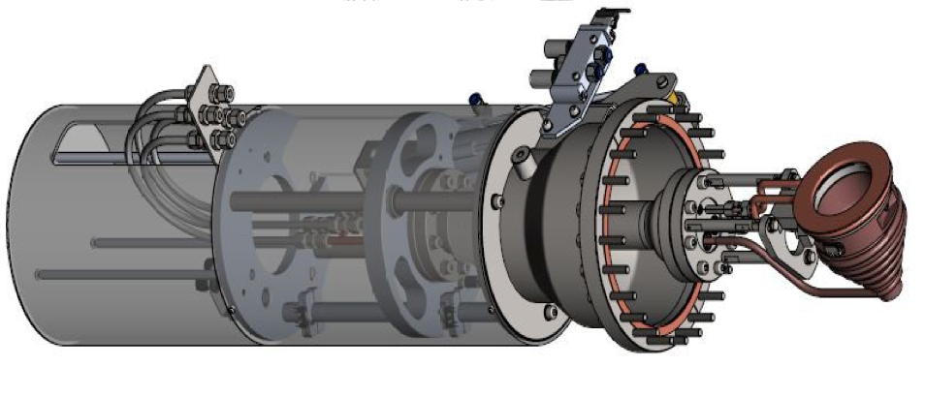
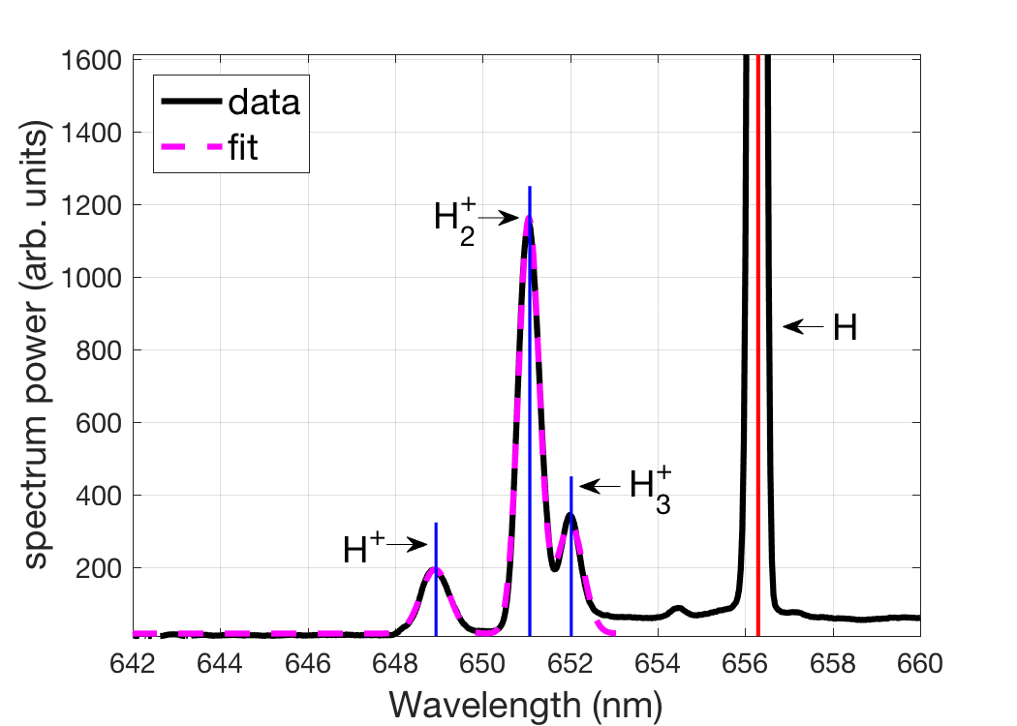
Beam Accounting:
Doppler and Faraday Cup
as installed @Catania
Faraday cup measuring 75 keV beam
Doppler system: optical spectrometer measures doppler shifted visible light emission and reports ion species
Current vs. time
Several milliseconds
Beam into conducting cup

Slide 9
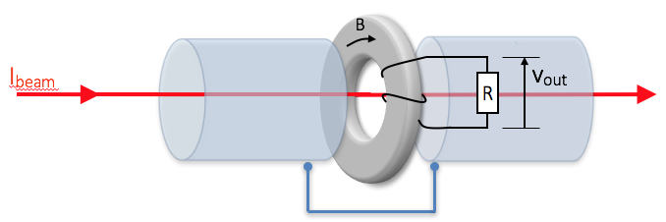
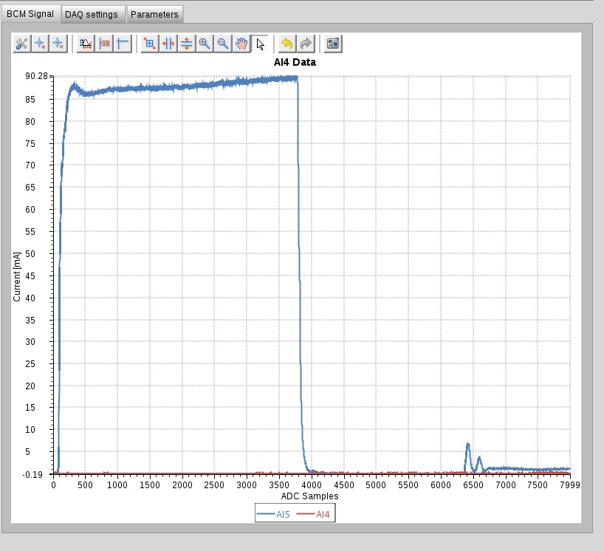
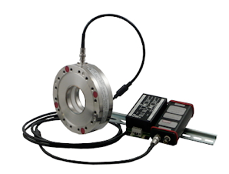
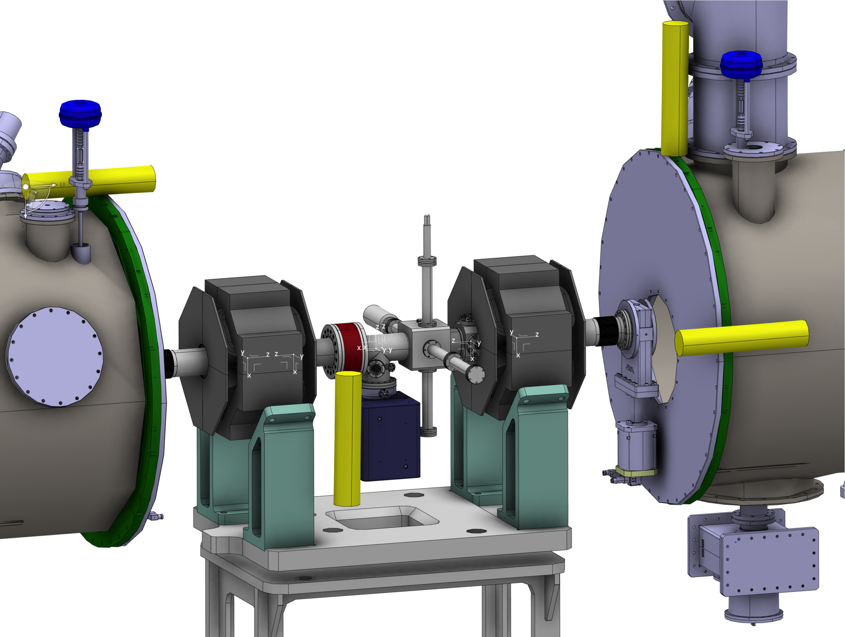
Beam Accounting: Beam Current Monitor
Single channel measurements:
1% accuracy
<1 µs response to measure current and remove beam permit on
  Wrong pulse parameters
  Difference from previous pulse
Difference measurements between two devices:
Digital optical link and processing
Minimum threshold: ~2% current loss.
< few µs typical to calculate current difference and remove beam permit on fast loss
Current vs. time
Forck, Grishin, Hassanzadegan

Slide 10
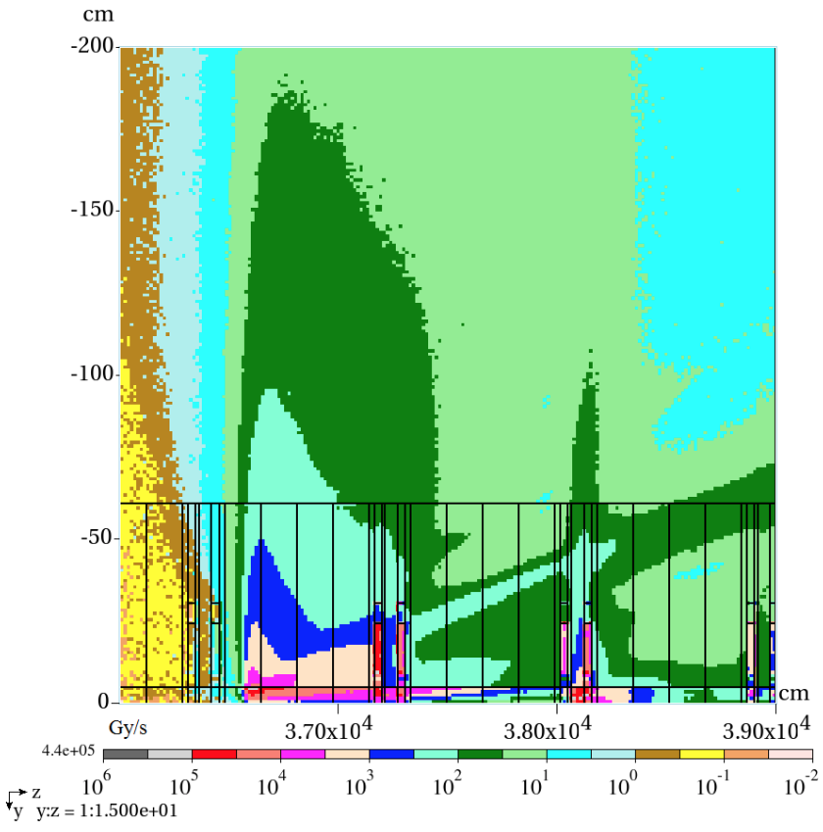
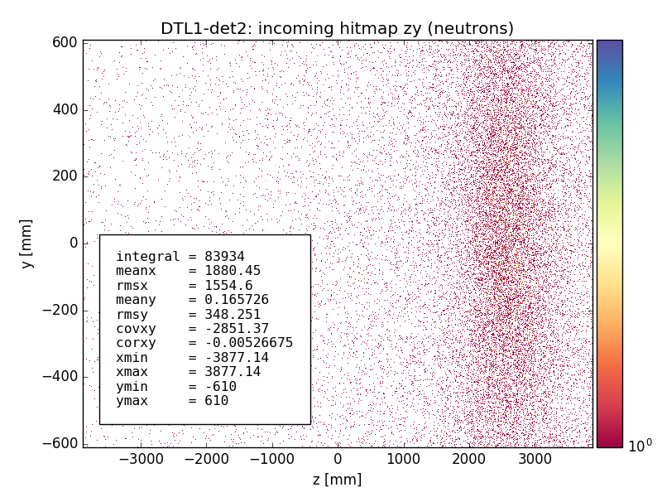
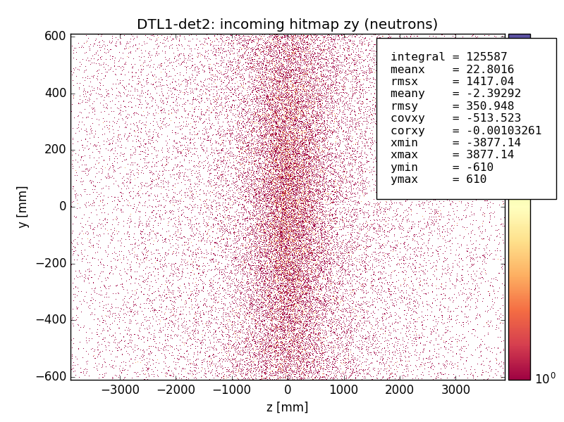
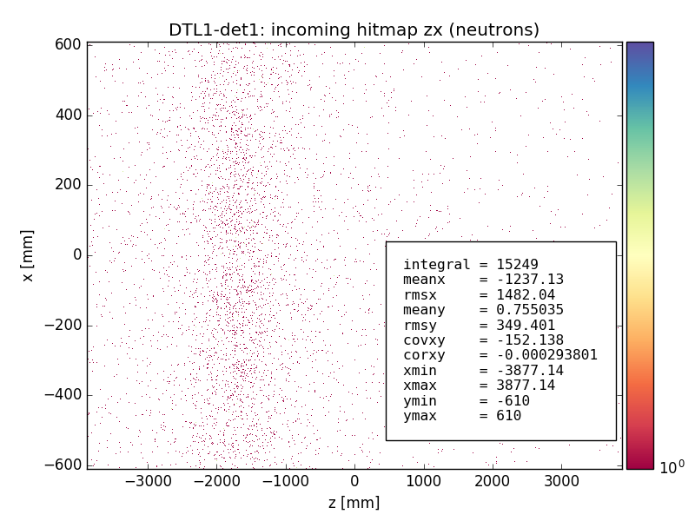
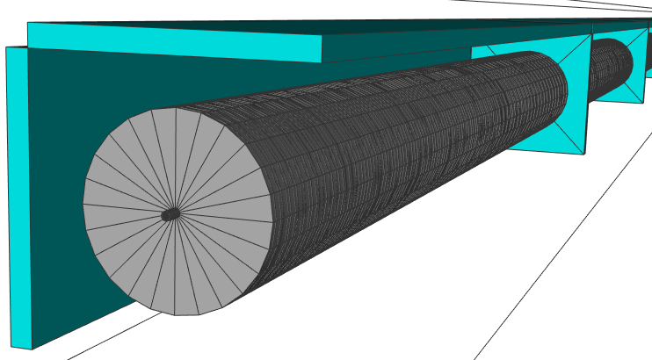
Beam Accounting:
Beam Loss
Neutron hit maps for 3 different localized loss locations along the DTL tank1: possible correlation of the distribution peak position with the loss location
Absorbed dose map, all particles,
from point loss @ 2 GeV
det0
y
det2 “detector” volume
x
z
det1
I. Kittelmann
M. Jarosz

Slide 11
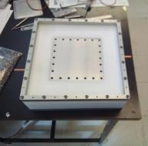
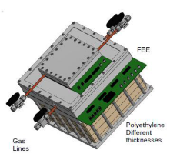
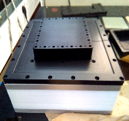


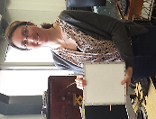
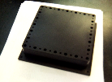
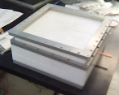

Beam Accounting: neutron Beam Loss Monitors
SLOW
FAST
(n, α) ¹⁰B reaction
Detection of fast neutrons after moderation in polyethylene (~4cm)
More efficient, 4π, but slower response
Recoil protons produced by neutrons in polypropylene
High flux high energy n's (>0.1 MeV)
Faster response
Gas chamber
Different thickness of polyethylene can be added
Detector size
~30x30x30cm3
~3kg
Easy to transport
CEA Saclay

Slide 12
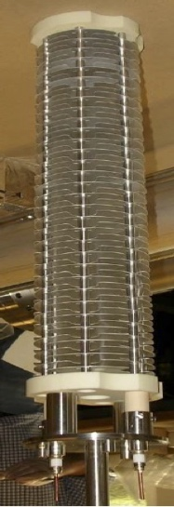
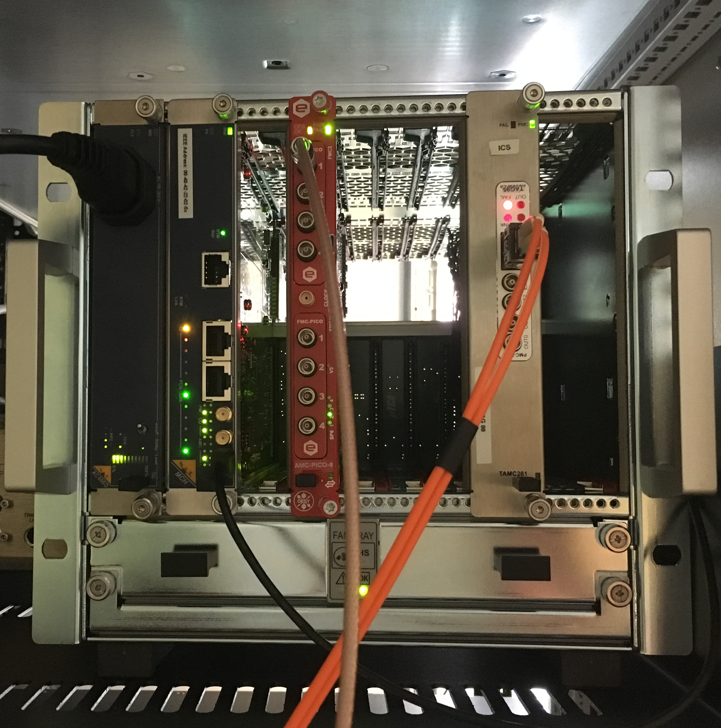
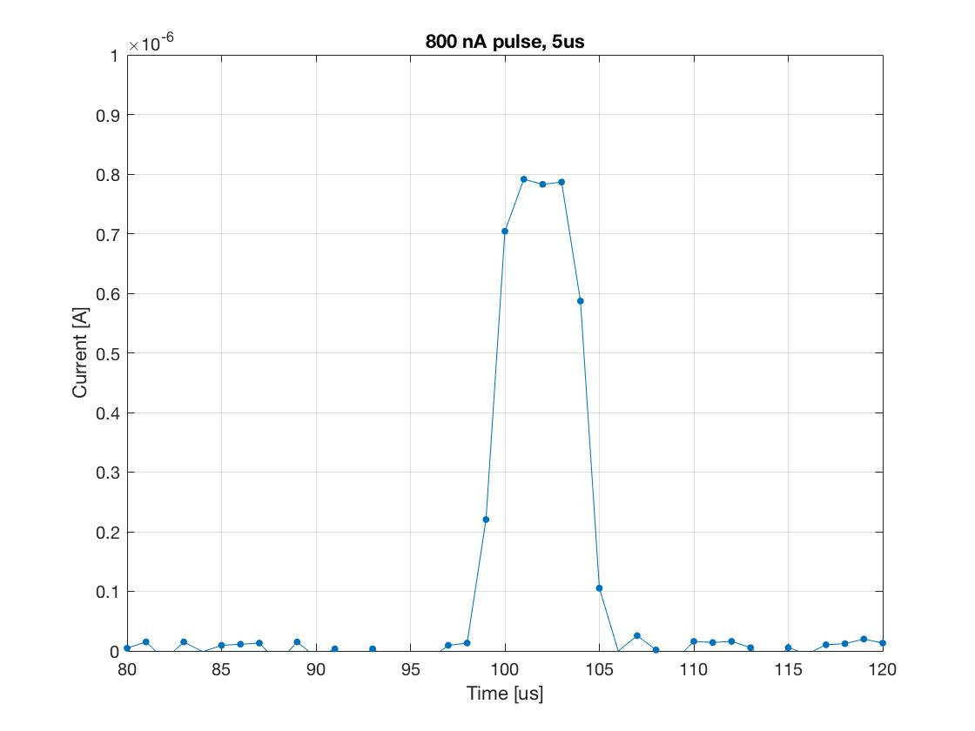
Beam Accounting:
Ion Chamber Beam Loss Monitors
Particle shower from lost beam ionizes gas in the Ion Chamber
Electric field sweeps charge to electrodes
Resulting current is measured
Shortest pulse (5 us):
→ 1% of 1 W/m beam loss
Current sensitive digitizer
Pico Amps

Slide 13
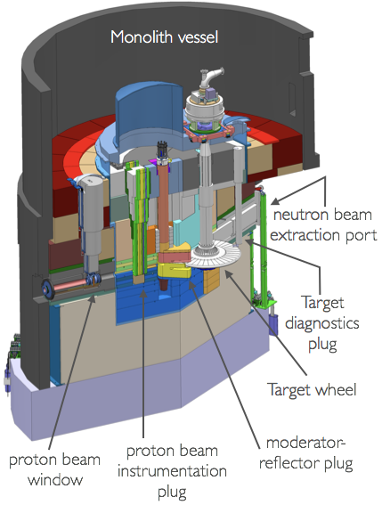
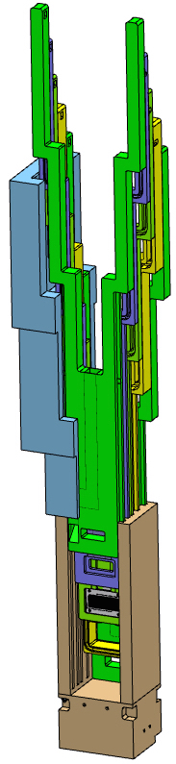
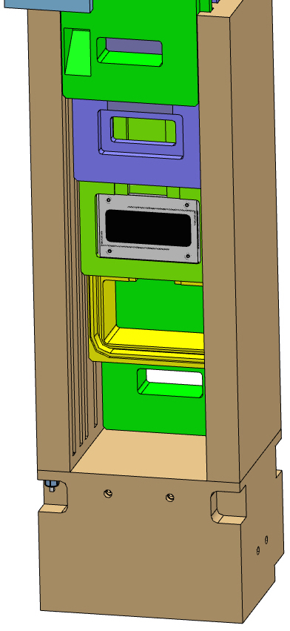
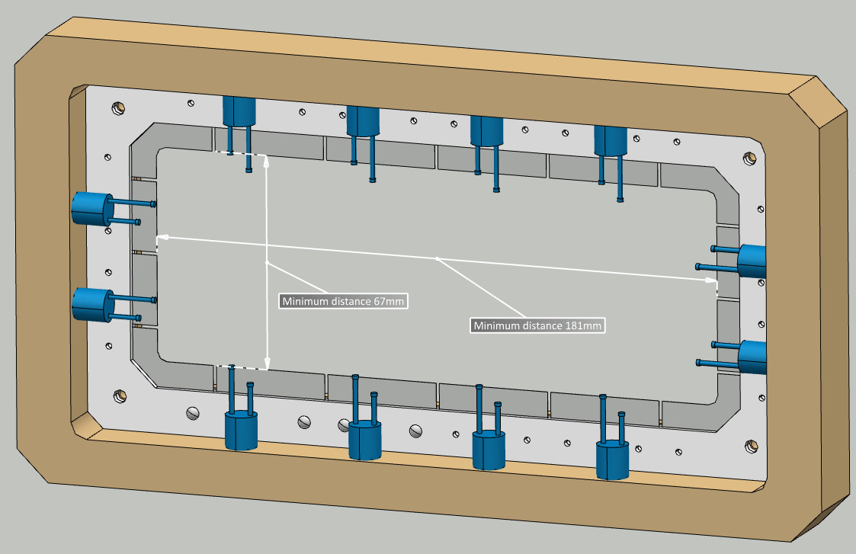
Beam Accounting:
Aperture Monitors
Instrumentation
Plug
Aperture
Aperture Monitor concept:
Nickel blades and K-type thermocouples
Grid

Slide 14
Centroid Measurements:
Beam Position and Phase
Centroid is primarily measured by the Beam Position Monitor (BPM) system
  In most accelerators, transverse position is the most important measurement
  In a linac like at ESS, longitudinal position (phase) is also very important
Additional systems at ESS
  Profile monitor measures position after ion source (no appropriate signal for BPMs)
  Imaging and grid systems measure centroid on target, dump
  Bunch Shape Monitor also reports phase centroid vs. RF reference

Slide 15
Centroid Measurement: Measure Position of Beam with Electromagnetic Beam Position Monitors
Simplified model: image charge in an electrode is proportional to the beam current and to the angle included between the beam and the electrode extremes:
In addition to this geometric effect, the field lines tend to cluster closely in the region of the nearest electrode (the E field must be perpendicular to the walls). For this geometry, this gives an additional factor two.
Pro Tip: Analytical approximations for concept development, FEM for detailed design
J. Byrd

Slide 16
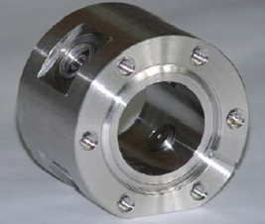
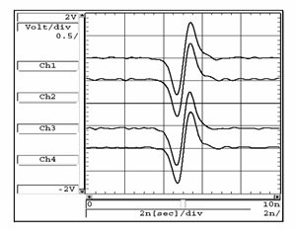
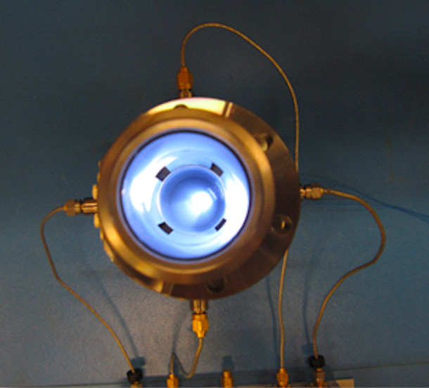
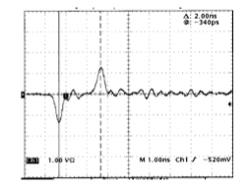
Centroid Measurement: Position monitor styles
They also measure time of beam arrival
Buttons
SOR-Ring
Striplines
Byrd, Musson

Slide 17
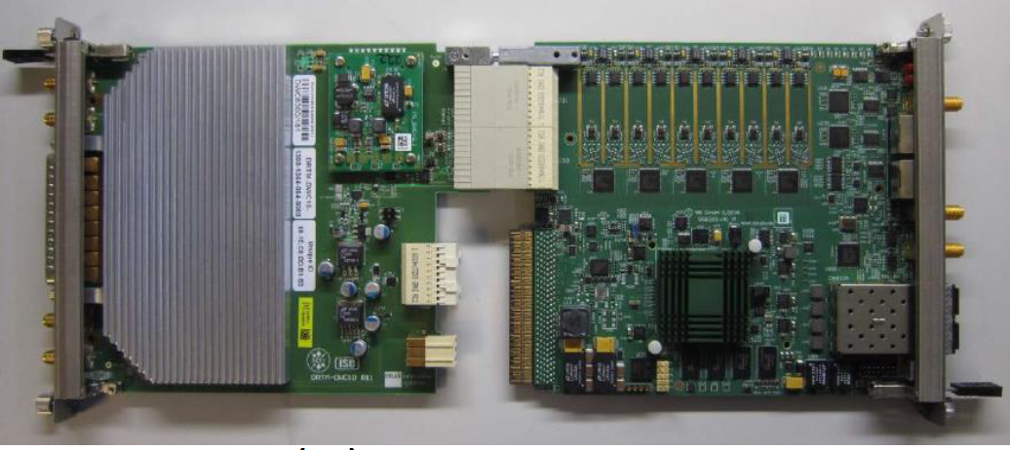
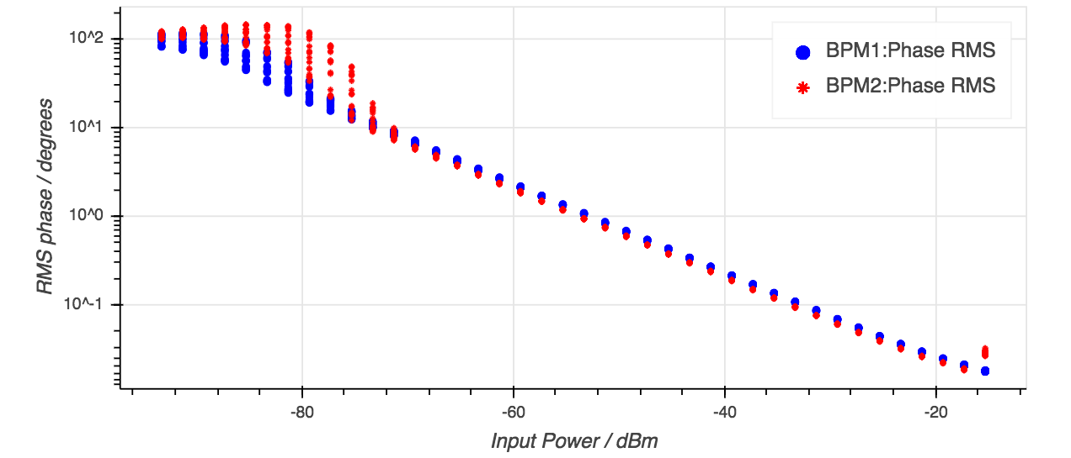
Centroid Measurements:
Beam Position and Phase
Electronics
  Vector receiver
  352 MHz and 704 MHz
  non-IQ receiver design coordinated with Radio Frequency (RF) team
Analog transition module, Digitizer with FPGA
Also, custom RF front end
Approximately 1 mA of beam
Approximately 0.1 mA of beam
S. Molloy, R. Baron, ESS Lund

Slide 18
Distribution Measurements
Peer into the the beam and measure with more detail
  Transverse Phase Space
  Transverse Profile
  2-dimensional map of transverse distribution
  Longitudinal Profile (of the short microbunches)
Systems
  Emittance Measurement Units
  Wire Scanners
  Bunch Shape Monitors
  Non-invasive Profile Monitors
  Grids
  Imaging Systems

Slide 19
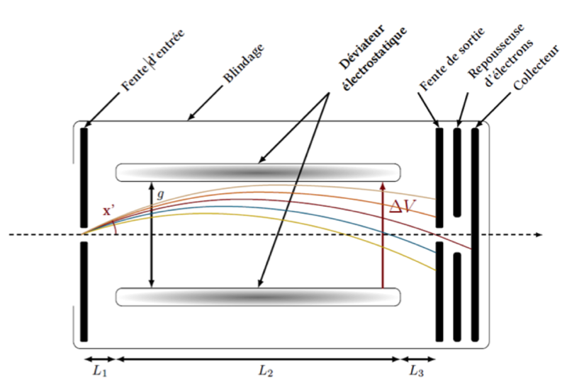
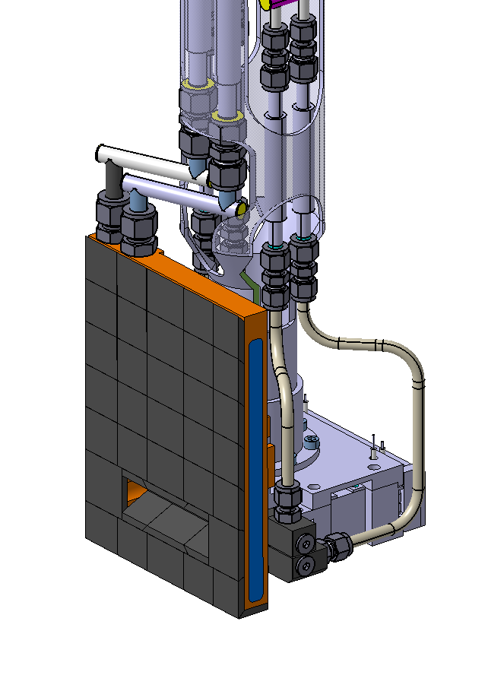
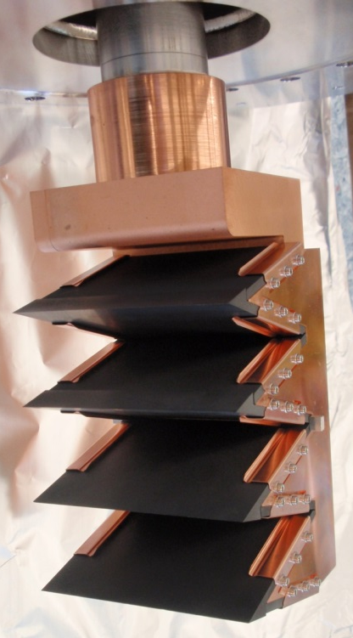
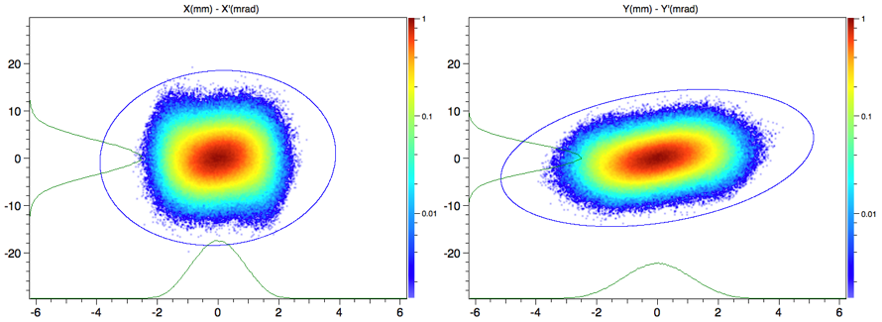
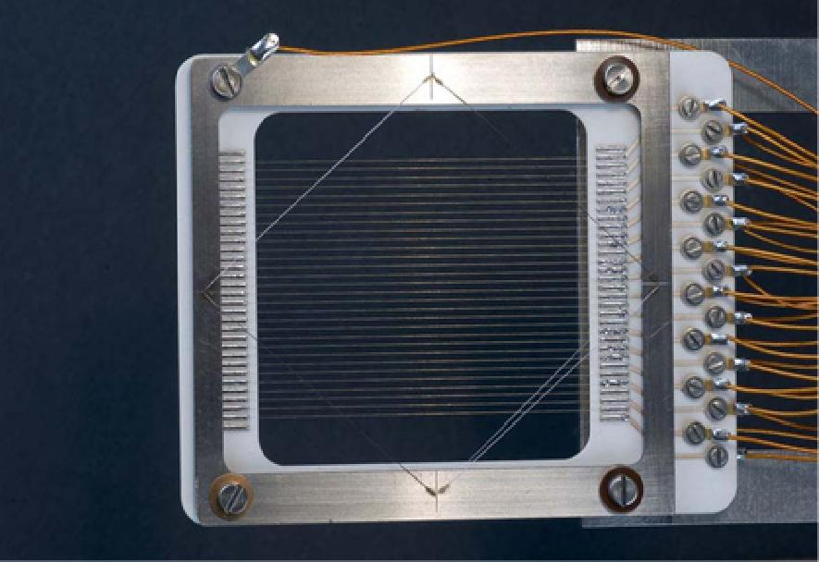
Distribution Measurement:
Emittance measurement of beam at low energy
At 75 keV
At 3.6 MeV
Allison scanner developed at CEA for the ESS LEBT. Full power capable.
LINAC4 emittance meter slit and grid (CERN)
Schematic view of Allison scanner (CEA/IRFU)

Slide 20
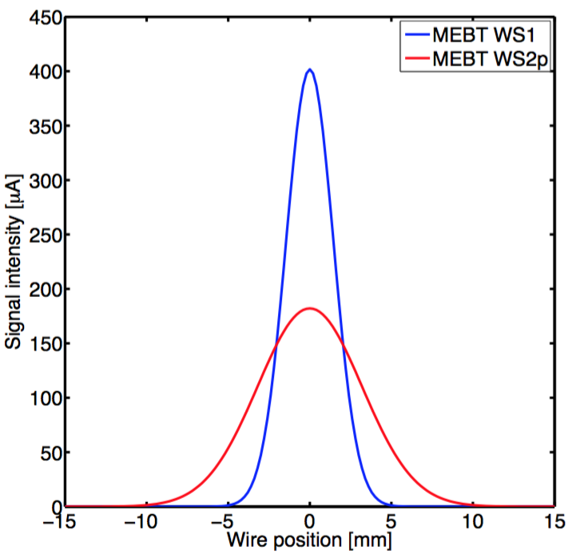
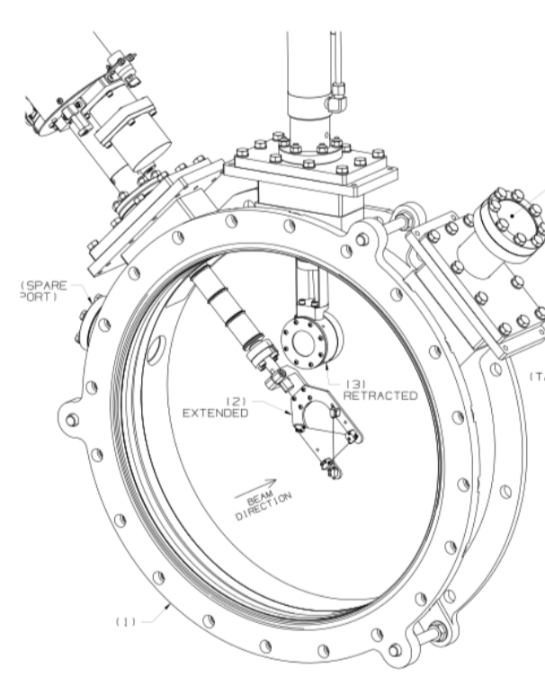
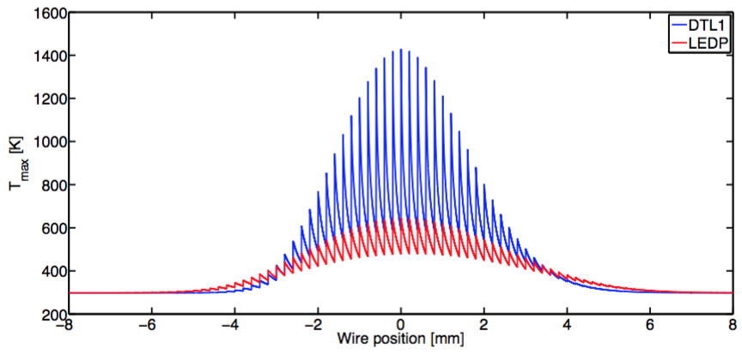
Distribution Measurement: Measure Transverse Profile of
Short Beam Pulses with Wire Scanners
Current induced in wire vs. wire position
DTL example shown
Wires located all along the accelerator
Temperature of wire vs. wire position
B. Cheymol

Slide 21
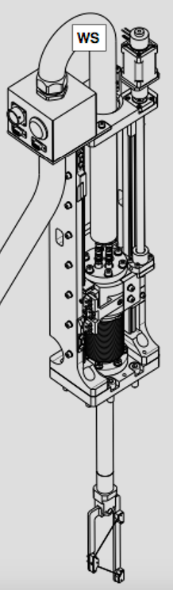
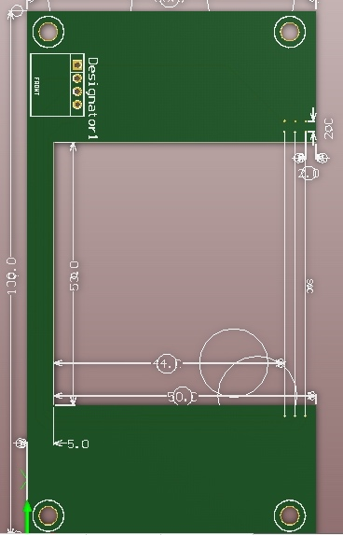
Distribution Measurements:
Invasive Profile and Shape
Increasing beam handling capability
Linear wire scanners (as previous slide) and Bunch Shape Monitors
Multi-wire grid in target station
Fast CERN wire scanners in High energy transport line
Like a wire scanner, but a grid of stationary wires
analysis: B. Cheymol

Slide 22
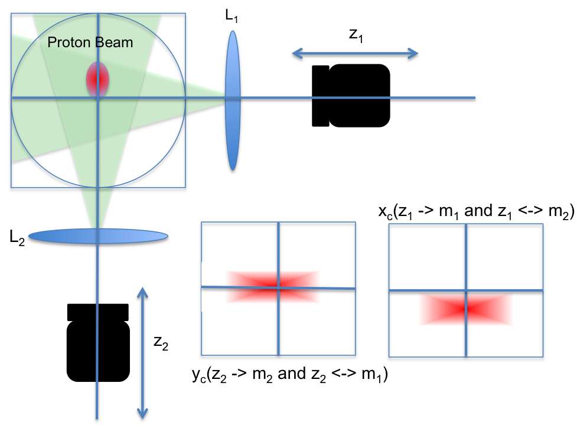
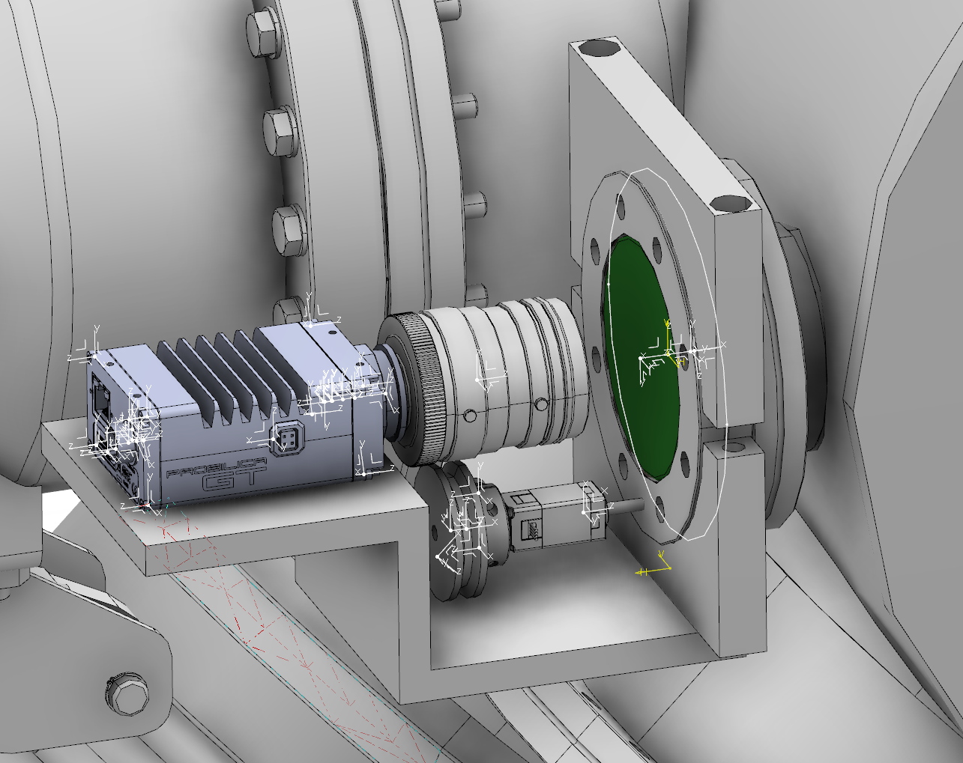
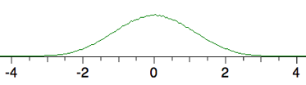
Distribution Measurement: Measure Long Beam Pulses with Non-invasive Profile Monitors
Gas Luminescence monitor
Very little gas in cold part of accelerator, so there, we use more efficient, but complicated method of collecting ions inside the vacuum chamber
C. Thomas

Slide 23
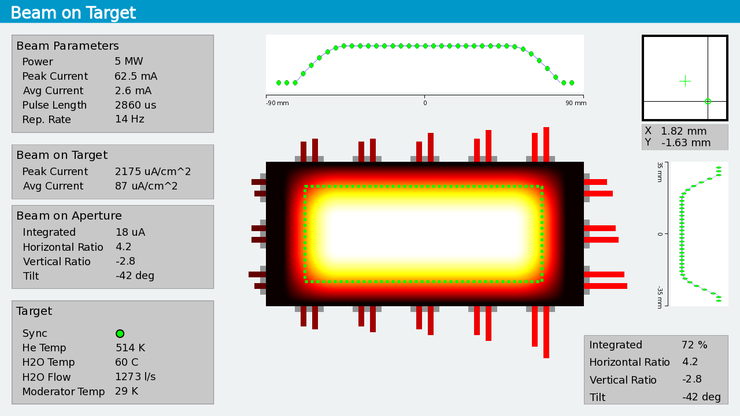
Distribution Measurement: Measure 2-D Map of Beam Current with Imaging Systems
Mockup of Desired Beam-on-Target Display
Luminescent coating on target provides image; transported through complex optics to camera

Slide 24






Distribution Measurement:
ESS Imaging Systems Technologies
Retroreflector for the fiducials
Optics
Development
Target Design (simpler for dump)
Prototype @Oslo
Ray Tracing results
Baseline
Several alternatives
Irradiation tests:
Luminescent Material Development
Spectrum
Yield
Decay time
Temperature and Radiation Tolerance
Additional Development
Beam tests: @ORNL, LANL, Oslo, CERN
XRD, XANES / XAS,TEM
Coating technology:
HV, Stony Brook
Y2WO6:Sm
Temperature
Al2O3:Cr
Wavelength
Spectrum, Yield
Capsule @BNL
Also @DTU

Slide 25

Protection: from Beam Loss
  Total beam loss, microsecond measurement latency required for protection
  BCM, icBLM (saturation, nBLM (current mode) -> Interlock; Threshold/derivative term for fast protection
> 1.6 milliamp lost for up to 200 µs
  BCM, icBLM, nBLM -> Interlock; Damage model for protection
~ microCoulomb lost over 200 µs to many seconds (diffusion time)
  icBLM, nBLM -> Interlock; Damage model for protection
~ “1 Watt/meter” radiation dose management
  icBLM, nBLM -> alarm based on dose/activation plan
Sparse coverage by Current Monitors
coverage by Ion Chambers
Neutron Detectors

Slide 26


Protection: from Damaging Beam Conditions @Target/Dump
Quads 1-4
Raster
magnets
Quads 5,6
Beam on Target
Candidate interlock inputs
BPM (target)
Aperture
Grid
Imaging
B_{y} B_{y} B_{x} B_{x} | B_{x} B_{x} B_{y} B_{y}
4 cm
2 m
Magenta line: beam centroid
Blue line: 10 rms
Neutron
Shield Wall

Slide 27


ESS Diagnostics Partners and Collaborators
Aarhus University
CEA Saclay, Paris
CERN, Geneva
Cockcroft Institute, Daresbury
DESY, Hamburg
Elettra – Sincrotrone Trieste
ESS Bilbao
INFN, Catania
INFN, Legnaro
Lund University
University of Oslo
Technical University of Denmark
Science and Technology Facilities Council, Daresbury
Warsaw University of Technology
Chinese ADS
J-PARC, Japan
Oak Ridge National Laboratory
Los Alamos National Laboratory
INR, Moscow
Högskola Väst, Trollhättan

Slide 28






Slide 29

Example from SNS in the US: First Beam on Target
ESS in Sweden: First beam next year, beam on target in a few short years

Slide 30
Thank you

