Slide 1
Cryogenic Systems
J. G. Weisend II
Deputy Head of Accelerator Projects
www.europeanspallationsource.se
November 2017

Slide 2
Goal
The goal of this tutorial is to provide a background in cryogenics along with pointers for further study. It will also provide an overview of the ESS Cryogenics system
  At the end of these talks, you should understand the basics of cryogenics as it applies to accelerators and Spallation Sources
The tutorial is divided into 2 logical parts: one on making things cold i.e. refrigeration systems & He II (Catching Cold) and 1 on maintaining things cold i.e. Cryostats and cryomodules (Keeping Cold) plus the ESS cryogenics system.

Slide 3
What is Cryogenics ?
Cryogenics is the science & engineering of phenomena that occur at temperatures below 120 K
Cryogenic applications include:
  Air Separation
  MRI Systems
  Cooling of superconducting magnets for research: HEP, Fusion, High Field Labs
  Liquefaction of gases allows transport at high densities and low pressure: LNG, oxygen, nitrogen, argon, hydrogen, helium
  Space Applications: LOX, LH₂, sensor cooling typically below 3 K
  Biomedical: cryosurgery, cell preservation)
  Other physics applications: Dark matter searches, calorimeters, EXO
  Aerospace and military – IR sensing
  SRF Systems
While this tutorial will only cover a few of these applications, the basic principles taught apply to all of them

Slide 4
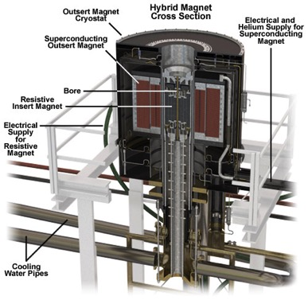
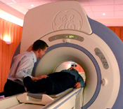
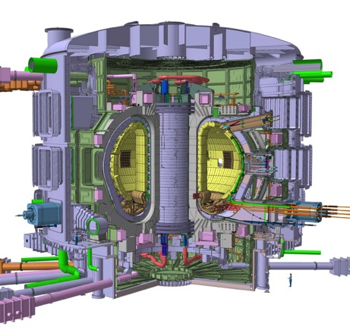
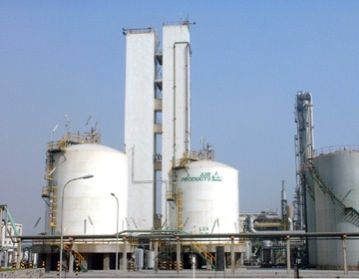
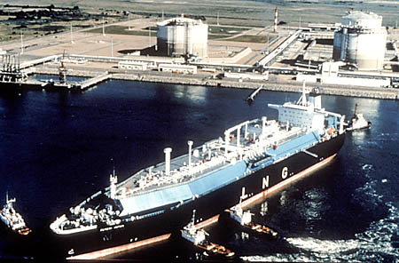
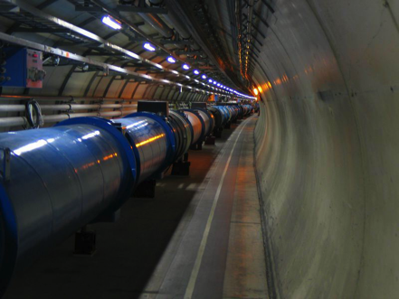
Some Examples

Slide 5
Why Does ESS use cryogenics?
Superconducting RF cavities ( see S. Molloy’s Talk) provide the bulk of acceleration.
  Superconductivity means better fraction of electrical power delivered to the beam – you still have to power the cryogenics system though
  2 K minimizes wall losses
Supercritical hydrogen at ~ 17 K provides a high density moderator that results in “Cold Neutrons”
LHe used in sample environments or to cool s/c magnets in experiments

Slide 6
Catching Cold
Before we get involved in thermodynamic cycles, let’s go over the basics
There are really only a few ways in which to make a pure fluid such as helium colder
  Cause the fluid to do work by making it expand against a piston or turbine while keeping it thermally isolated from the outside environment Isentropic Expansion
  Transfer heat from the fluid to a colder surface
  Cause the fluid to do “internal work” by expanding it through a valve while keeping it thermally isolated Isenthalpic Expansion
    Joule-Thomson expansion (more later)
  Once the fluid is a liquid, reduce the pressure above the fluid below atmospheric pressure thus reducing the saturation temperature
All modern cryogenic plants do the first 3. Ones that provide cooling below 4.2 K also do the last item

Slide 7
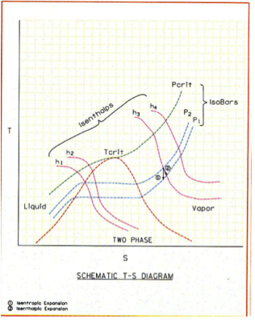
Generic T-S diagram Showing Isenthalps, Isobars and 2 Phase Region
Enthalpy
h = u + pv

Slide 8
Carnot Cycle
This is an ideal cycle: all processes are reversible
  Entropy is only changed by absorbing or removing heat at constant temperature
  2nd law of Thermodynamics, in a reversible process dQ = -TdS
The Carnot Consists of 4 steps
  Compress the working fluid isothermally at T_{H} (1-2)
  Expand the working fluid isentropically from T_{H} to T_{C} (2-3)
  Absorb heat into the working fluid isothermally and reversibly at T_{C} (3-4)
  Compress the working fluid isentropically from T_{C} to T_{H} (4-1)
  Note isentropically = reversibly and adiabatically

Slide 9
Carnot Cycle
T
T_{H}
2
1
T_{C}
3
4
Q
S
s₁
s₂
How do we describe the performance of such a cycle?

Slide 10
Coefficient of Performance
& the Carnot Cycle
Coefficient of Performance: the heat absorbed from the cold sink divided by the net work required to remove this heat
  Minus sign takes into account that the heat absorbed by the cycle is positive while the work done is negative
  For the ideal (and in practice unachievable) Carnot cycle it can be shown that:

Slide 11
Coefficient of Performance
& the Carnot Cycle
For a plant operating between room 300 K and 4.2 K, the Carnot COP is
4.2/( 300 – 4.2) or 0.0142
The Carnot cycle is the ideal case. It is the best you can do without violating the laws of thermodynamics
Note that the form of the Carnot COP shows that you have a better COP (thus a more efficient process or refrigerator) if T_{C} is large
  It is always thermodynamically more efficient to intercept heat (provide cooling) at higher temperatures
  This fact drives a lot of cryogenic design
In practice, we generally discuss the inverse of the COP because this allows us to describe the number of watts of work required to provide 1 Watt of cooling at a given temperature. For a Carnot cycle providing cooling at 4.2 K. This is 70 W/W
  People will frequently and incorrectly refer to this as a COP as well

Slide 12
Carnot Cycles & the Real World
Can we build a real machine using a Carnot cycle? In a word NO
Why?
  Compressing a fluid isothermally is very hard to achieve, Normally the fluid is compressed and then cooled back down to 300 K
  Expanding or compressing fluid isentropically is basically impossible
  We can absorb heat into a boiling fluid isothermally but not with out irreversible losses
How close can we get to Carnot? We define the Figure of Merit (FOM) as:
  We also speak in terms of “percent Carnot” i.e. FOM of 0.2 is 20% Carnot

Slide 13
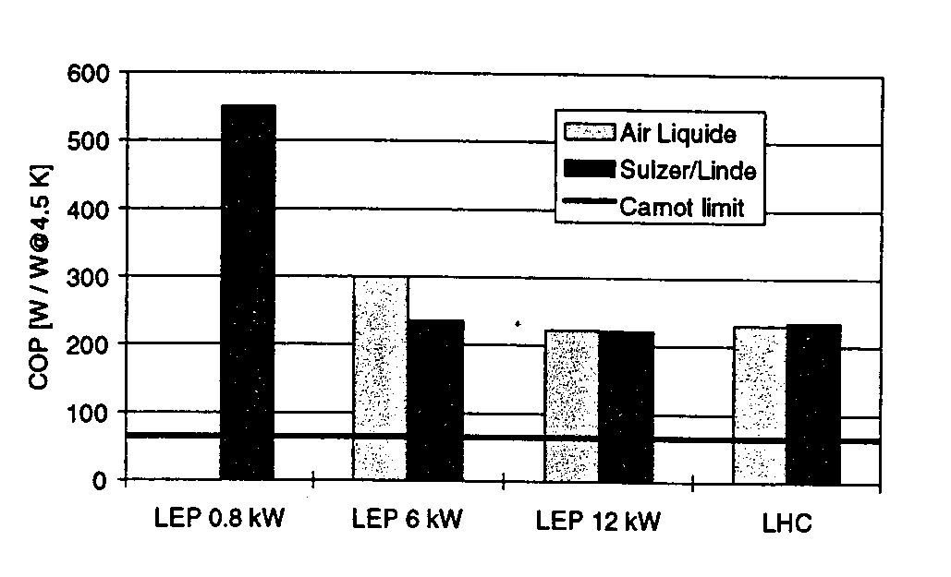
The real world is sometimes not kind to cryogenic engineers
These are state of the art helium refrigerators. Note that the best of them (for LHC) runs at about 220 W/W or a FOM of 0.318 or at 32% Carnot

Slide 14
Practical Impact of Plant Performance
How much power does it take to operate a large cryogenic refrigeration plant?
AT ESS we expect to have a refrigeration plant capable of removing as much as 9.5 kW at 4.5 K. The FOM of the plant is expected to be 0.26
If the plant operates as expected this means we will need:
(66/0.26) x 9500 = 2.4 MW of mechanical power
We are adding some additional margin to the electrical power requirements and have asked for at least 2.6 MW available for powering the compressors

Slide 15
Joule-Thomson Expansion
Isenthalpic (h=constant) expansion
Fluid cools as is it is expanded at constant enthalpy through a valve
However, depending on both the fluid and the temperature, such an expansion can also cause heating.
Define the Joule-Thomson expansion coefficient
μ_{j} must be positive for cooling to occur
Cooling by JT expansion has some advantages
  No moving parts
  Can easily handle two-phase mixtures

Slide 16
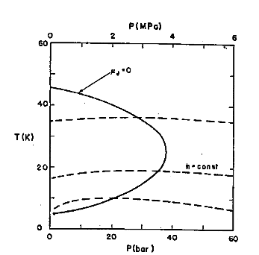
JT Inversion Curve & Maximum
Inversion Temperatures
Fluid | Max Inversion Temperature (K)
Nitrogen | 623
Argon | 723
Hydrogen | 202
He | 43
Maximum inversion temperature for helium is 43 K
Note that below ~ 2 K He again warms on JT expansion
Many fluids, such as N₂ can be liquefied using JT expansion – JT cycle
Inversion curve for Helium

Slide 17
Practical Large Scale Helium Refrigerators
Modern large scale Helium refrigerators/liquefiers use a variation of the Claude cycle known as the Collins cycle
The key difference between these cycles and the JT cycle is the addition of expansion engines (pistons or turbines) that the fluid does work against and thus cools
The process through these expansion engines may be idealized as Isentropic (s = constant) expansion
  Cooling occurs at any temperature
  ΔT for a given ΔP is much larger than for isenthalpic expansion
Claude cycle = 1 expansion engine, Collins cycle = multiple expansion engines
  The post WW II development of the Collins liquefier revolutionized laboratory research in cryogenics

Slide 18
Claude Cycle
From Cryogenic Systems
R. Barron

Slide 19
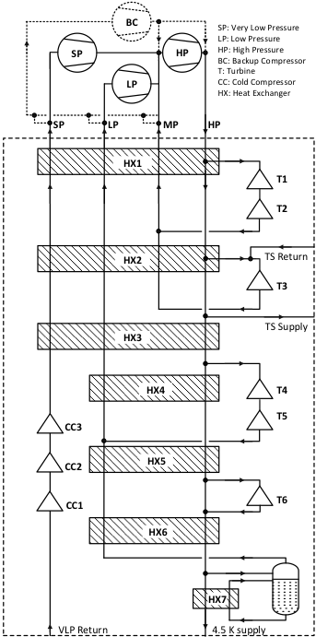
Accelerator Cryoplant for ESS
(Linde)
Note:
1) No LN₂ Precooling
2) Last stage of subatmospheric
pumping is warm
3) Provides up to 3 kW @ 2K

Slide 20
He II (Superfluid Helium)
2nd liquid phase of helium (hence He II)
Phase transition is 2nd order (no latent heat) but there is a discontinuity in the specific heat (λ transition)
T_{λmax} = 2.2 K
Has unique thermal and fluid properties
  High effective thermal conductivity
  Zero viscosity under certain conditions

Slide 21
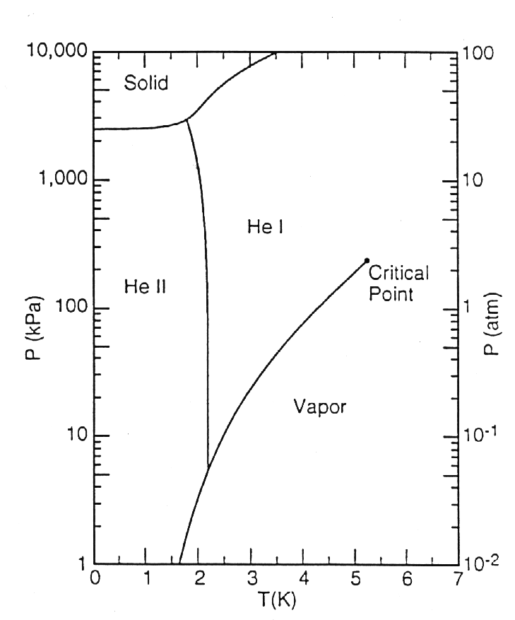
Helium Phase Diagram

Slide 22
Why Use He II in SRF Systems?
The biggest single advantage is the lower temperature (<4.2 K)
  Lower temperature means lower BCS losses in cavities, size of effect is RF frequency dependent
  He II refrigeration is more costly (due to Carnot & machine inefficiencies)
  Generally speaking, removing 1 W at 2 K is the equivalent of removing 3 W at 4.2 K
  There is a point at which the gain from lower BCS losses is better than the additional cost of refrigeration
An additional advantage is the very efficient heat transfer mechanism in He II
  This results in no bulk boiling which reduces microphonics
The majority of new SRF systems operate in the He II regime

Slide 23
What is He II ?
A “Bose – Einstein like” Condensate
  A fraction of atoms in He II have condensed to the quantum ground state
  He II was the first of these condensates discovered
  The only one that has significant industrial applications
The properties of He II can be understood via the two fluid model

Slide 24
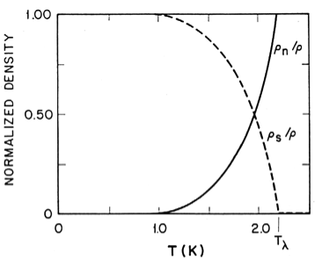
Two Fluid Model
He II can be thought of a fluid with two interpenetrating components:
  Normal fluid component
    Finite viscosity
    Finite entropy
  Superfluid component
    Zero viscosity
    Zero entropy
The interaction of these components can explain He II behavior
Relative Densities of Superfluid and Normal fluid components
(From Helium Cryogenics – Van Sciver)

Slide 25
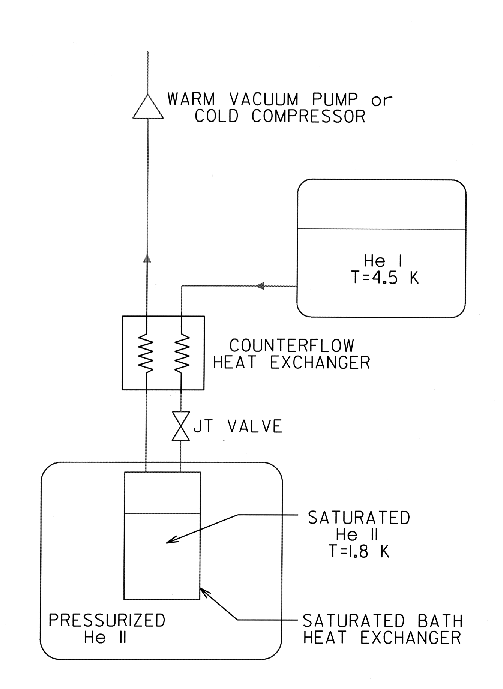
Typical He II Refrigeration System
He II (Superfluid Helium) S. W. Van Sciver,
in Handbook of Cryogenic Engineering,
There 2 approaches to providing He II To SRF systems:
Create the He II for a given string of components and distribute it (LHC, XFEL, CEBAF)
  Less expensive, fewer warm/cold transitions
Create the He II at each cryomodule (12 GeV, SNS, ESS, FRIB)
  Less Heat load to 2 K
  Better flexibility

Slide 26
He II Summary
He II is a unique fluid that displays quantum behavior on a macroscopic scale
He II has significant applications in large scale cryogenics for scientific research
Despite its unique properties, the use of He II in industrial scale engineering applications is well understood and significant experience exists: Tore Supra, LHC, Jlab, NASA

Slide 27
Part II : Keeping Cold

Slide 28
Cryostats and Cryomodules
What is a cryostat?
  A device or system for maintaining objects at cryogenic temperatures.
Cryostats that contain SRF systems are frequently known as a cryomodules. Design approaches are the same
Cryostat design involves many subtopics:
  Development of requirements
  Materials selection
  Thermal insulation
  Support systems
  Safety
  Instrumentation
One of the best ways to learn about cryostat design is through examples
There are many different types of cryostats with differing requirements
  The basic principles of cryostat design remain the same
  Before we can do anything else we have to define our requirements

Slide 29
Cryostat Requirements
Maximum allowable heat leak at various temperature levels
  This may be driven by the number of cryostats to be built as well as by the impact of large dynamic heat loads (SCRF or target cryostats)
Alignment and vibration requirements
  Impact of thermal cycles
  Need to adjust alignment when cold or under vacuum?
  Alignment tolerances can be quite tight (TESLA: +/- 0.5 mm for cavities and +/- 0.3 mm for SC magnets)
Number of feed throughs for power, instrumentation, cryogenic fluid flows, external manipulators
Safety requirements (relief valves/burst discs)
Size and weight
  Particularly important in space systems
Instrumentation required
  Difference between prototype and mass production

Slide 30
Cryostat Requirements
Ease of access to cryostat components
Existing code requirements (e.g. TUV or ASME)
Need, if any, for optical windows
Presence of ionizing radiation or magnetic fields
  Magnetic shielding is a important part of SRF cryomodules
Expected cryostat life time
Will this be a one of a kind device or something to be mass produced?
Schedule and Cost
  This should be considered from the beginning
  All Design is Compromise

Slide 31
Cryostat Materials
Materials for cryostats must function properly at cryogenic temperatures
Material properties change greatly as a function of temperature between 300 K and cryogenic temperatures – such variations must be taken into account in the cryostat design
Typical materials for cryostats include:
  Austenitic stainless steels
  Aluminum
  Copper
  G-10 (Fiber reinforced plastic)
  Glass
  Quartz (for viewing ports)
As will be seen, the location of materials used in a cryostat is optimized to reduce heat leak.

Slide 32
Thermal Insulation of Cryostats
Three Ways to Transfer Heat
Conduction
  Heat transfer through solid material
Convection
  Heat transfer via a moving fluid
    Natural or free convection – motion caused by gravity (i.e. density changes)
    Forced – motion caused by external force such as a pump
Radiation
  Heat transferred by electromagnetic radiation/photons
There is no such thing as a perfect insulator – though we can design systems with very small heat leaks
All matter above 0 K radiate heat
  Remember we can’t get to 0 K – 3rd Law of Thermodynamics though we can get vanishingly close
Heat flows from high temperature to low
  Heat leaks in, cold doesn’t leak out

Slide 33
Conduction Heat Transfer
Fundamental Equation – The Fourier Law in one dimension
If we assume constant cross section we get:
Reduce conduction heat leak by:
  Low conductivity material: make K(T) small
  Reduce cross sectional area: make A small
  Increase length: make L large
  For a given T_{C} make T_{H} smaller: i.e. use intermediate temperature heat intercepts
    You still have heat leak from 300 K to this intermediate temperature but remember Carnot, It’s more thermodynamically efficient to remove heat at higher temperatures

Slide 34
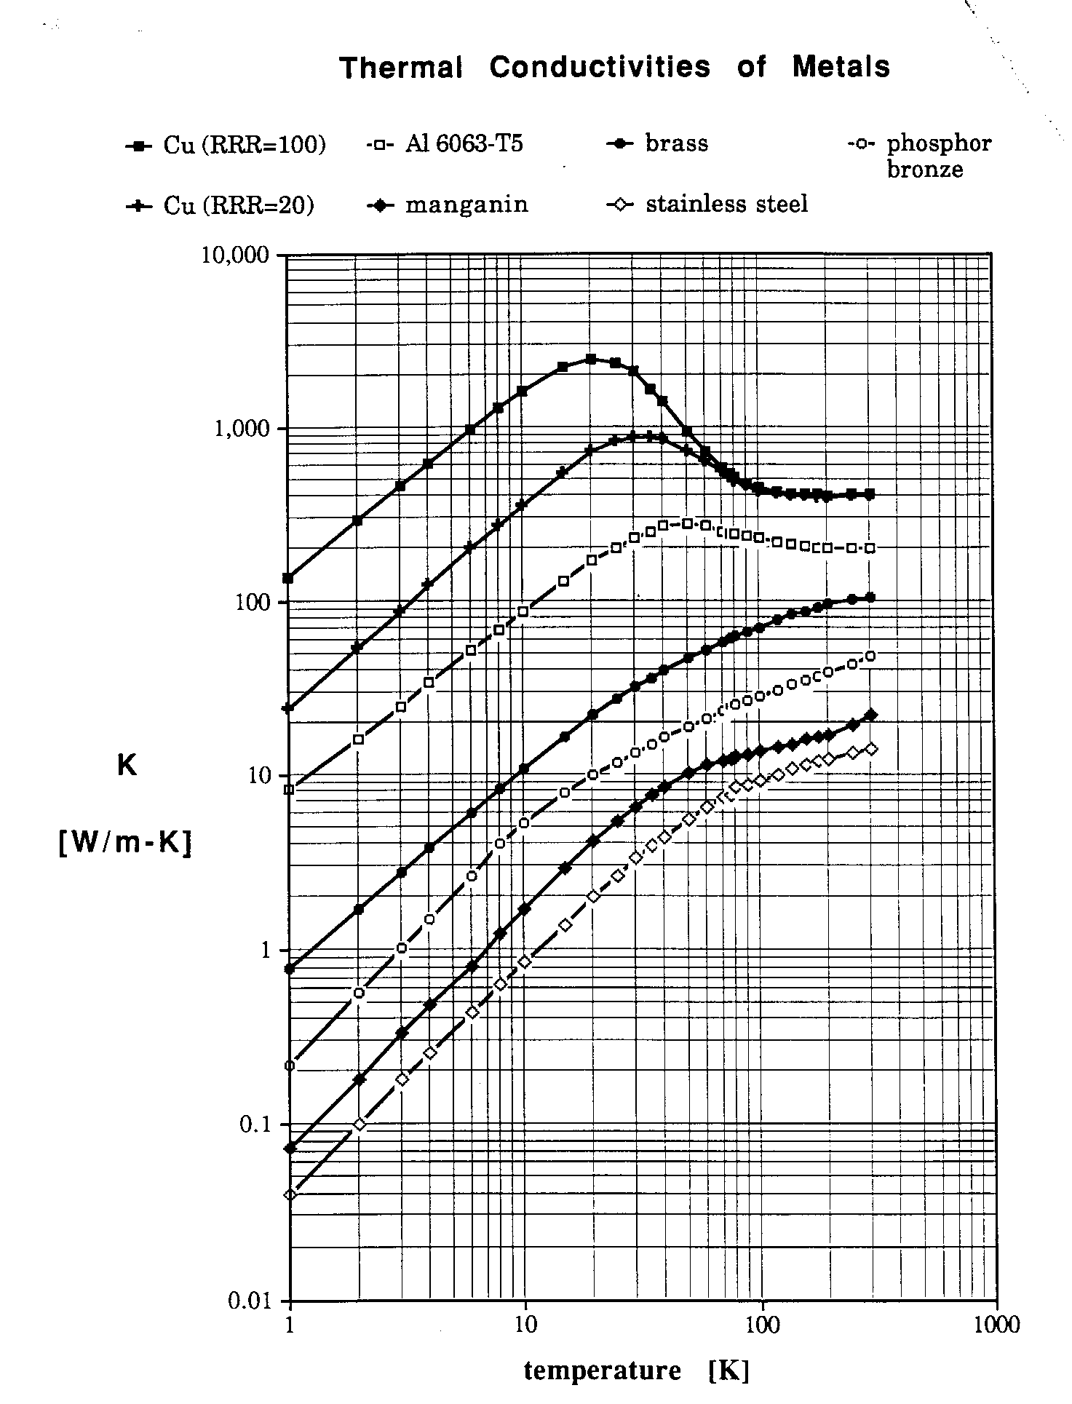
Thermal Conductivities of Metals
Variation of Thermal conductivity with
temperature can be addressed with Thermal Conductivity integrals
See backup slides
From Lakeshore Cryotronics

Slide 35
Convection Heat Transfer
Fundamental Equation: Newton’s law of cooling
Q = hA(T_{surface} – T_{fluid})
where h is the heat transfer coefficient and is a function of Re, Pr, geometry etc depending on the situation
In cryogenics we eliminate convection heat leak in cryogenic systems by “simply” eliminating the fluid – vacuum insulation
Using vacuum insulation to create vessels capable of storing cryogenic liquids was first done by James Dewar – who liquefied hydrogen
  Such vessels are frequently called dewars – though not always, more later
  Thermos bottles are a simple example of this approach

Slide 36
Vacuum Insulation
How much vacuum is enough?
  This of course depends on the heat leak requirements but generally we want to be below 10⁻⁵ torr If we maintain this level or better we can generally neglect the convection heat leak for most applications.
    Cryogenic Engineering, Flynn (1997) has a good discussion of calculating heat leak due to residual gas pressure
Cryopumping
  At cryogenic temperatures almost all common gases condense and freeze onto the cold surface. Typically, we’ll see that once surface are cooled to ~ 77 K the isolation vacuum will drop to the 10⁻⁸ torr or better range if the system is leak tight and doesn’t have significant outgassing
  But don’t just start cooling with everything at room pressure
    Heat leak will likely be too high
    Safety hazards due to enrichment of LOX on cold surfaces
    Large amounts of condensed gases in vacuum space can lead to other problems including rapid pressure rise upon warming and possible solid conduction
    Best practice is to be at least 10⁻³ torr before cooling, lower pressures are better but there may be operational tradeoffs

Slide 37
Radiation Heat Transfer
Frequently the largest source of heat leak to cryogenic systems
Fundamental Equation: Stefan-Boltzmann Law – energy emitted from an ideal black body: E_{b} = σT⁴ where σ = 5.67x10⁻⁸ W/m²K⁴
  Real world Assumptions:
    Emissivity (ε) << 1 and independent of wavelength (grey body)
    Two parallel infinite plates: Radiative heat flux (W/m²)
    Eq. A
    Frequently in cryogenic systems ε₁ ~ ε₂ << 1 then Eq. A becomes:
    Eq. B

Slide 38
Radiation Heat Transfer
    Two long concentric cylinders or concentric spheres (1 represents the inner cylinder): the radiative heat flux (W/m²) on the inner cylinder is
    Eq. C
    Note as is frequently the case in cryogenics, if the spacing between the cylinders is small compared to the inner radius (i.e. A₁ ~ A₂ ) Eq. C becomes Eq. A

Slide 39
Radiation Heat Transfer
Looking at Eq. A, How do we reduce the radiation heat transfer?
We could reduce the emissivity (ε)
  This is done in some cases; using either reflective tape or silver plating
  Better below 77 K
  It’s also part of MLI systems (see below)
  We have to consider tarnishing
  May be labor intensive

Slide 40
Radiation Heat Transfer
Another way to reduce radiation heat transfer is to install intermediate actively cooled radiation shields that operate at a temperature between 300 K and the lowest cryogenic temperature. This has several advantages.
  It greatly reduces the heat load to the lowest temperature level
    Assume parallel plates with ε = 0.2
    then from Eq. B q ( 300 K – 4.2 K ) = 46 W/m² while q (77 – 4.2) = 0.2 W/m²
  It allows heat interception at higher temperatures & thus better Carnot efficiency
  Such an actively cooled shield provides a convenient heat intercept for supports, wires etc to reduce conduction heat leak.
Shields may be cooled by
  Liquid baths ( LN₂)
  Vapor boil off from stored liquid – common in LHe storage dewars
  Cooling flows from refrigeration plants
  Conductive cooling via small cryocoolers

Slide 41
Thermal Radiation Shields
Uncooled thermal radiation shields placed in a vacuum space between the warm & cold surfaces also help reduce the thermal radiation heat leak
It can be shown (with the grey approximation and equal emissivities) that with N shields thermal radiation heat transfer is given by:
This is the motivation behind Multilayer Insulation

Slide 42
MultiLayer Insulation
Also referred to as superinsulation
Used in the vacuum space of many cryostats (10⁻⁵ torr or better for best performance) – can be used instead of or with actively cooled thermal shields or baths
Consists of highly reflective thin sheets with poor thermal contact between sheets.
  Made of aluminized Mylar ( or less frequently Kapton)
  May include separate non conducting mesh
  May use Mylar aluminized on only one side and crinkled to allow only point contacts between sheets
  Frequently perforated to allow for better pumping
Can be made up into blankets for ease of installation
Don’t pack MLI too tightly. Doing so will cause increased conduction heat leak negating the value of the MLI

Slide 43
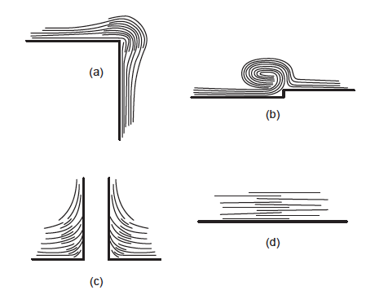
MultiLayer Insulation
Great care must be taken with seams, penetrations and ends.
  Problems with these can dominate the heat leak

Slide 44
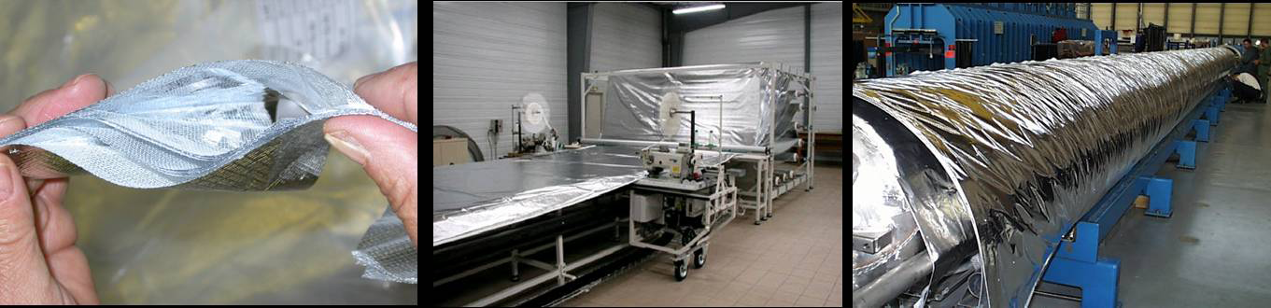
MLI Example from LHC cryostats
“SERIES-PRODUCED HELIUM II CRYOSTATS
FOR THE LHC MAGNETS: TECHNICAL CHOICES,
INDUSTRIALISATION, COSTS”
A. Poncet and V. Parma
Adv. Cryo. Engr. Vol 53

Slide 45
How Are These Cryostat Design Features Seen at ESS?

Slide 46



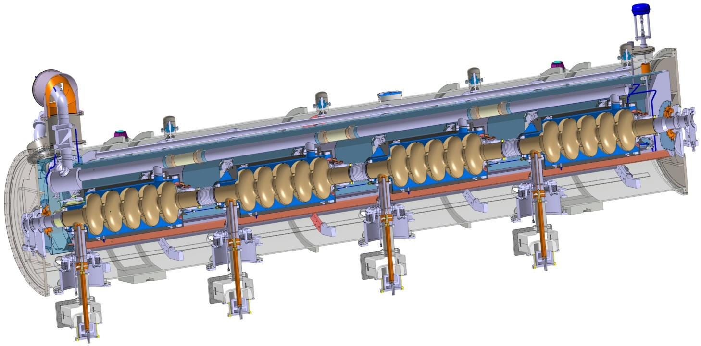
Elliptical Cavities & Cryomodule
(See C. Darve’s Talk)
Similar to CEBAF/SNS cryomodule concept with 4 cavities per cryomodule
Common design for medium (6 cells) and high beta (5 cells) cavities
Regulation He valve
Thermal shielding
Alignement fiducial
Vacuum valve
Jumper connection
Magnetic shielding
Spaceframe support
Heat exchanger
2 Phase He pipe
Proton Beam
Cavity with Helium tank
Intercavities belows
Power coupler
Cold to warm transition

Slide 47

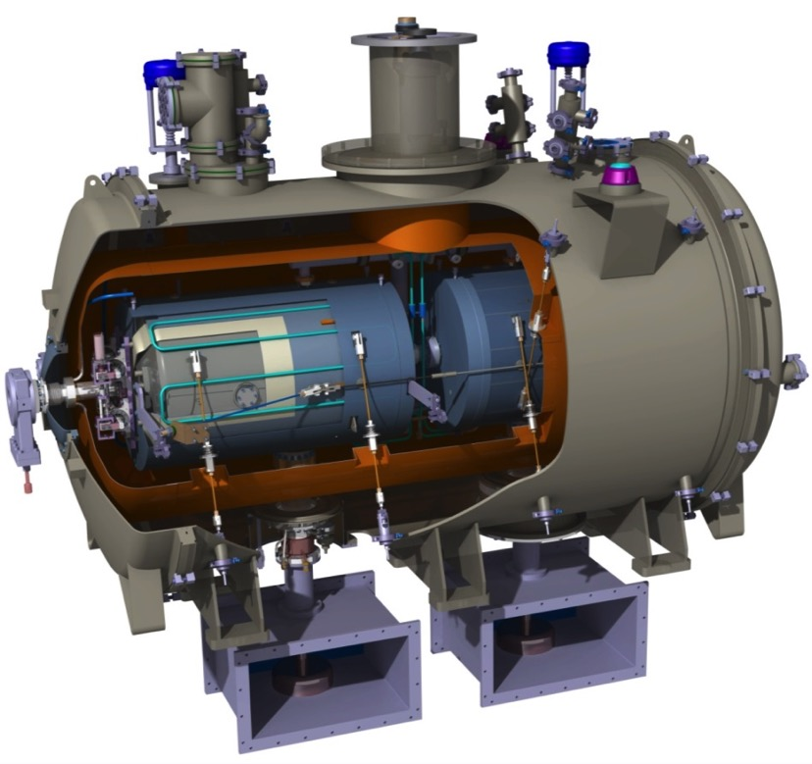
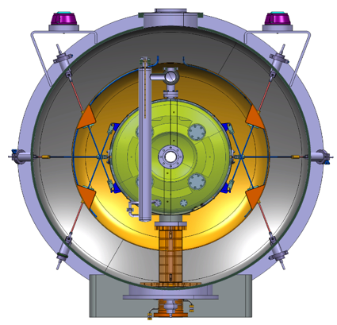
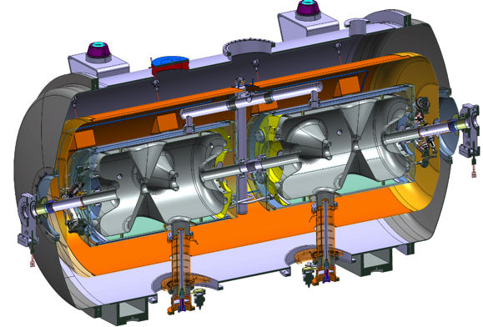
Spoke cavity string and cryomodule package (See C. Darve’s Talk)
Diameter
1350 mm
2900 mm

Slide 48
Applications of Cryogenics at ESS
Cooling for the cryomodules (2 K, 4.5 – 300 K and 40 K)
Cooling for the Target supercritical H₂ Moderator (16.5 K)
Liquid Helium and Liquid Nitrogen for the Neutron Instruments
Cooling for the cryomodule test stand (2 K, 4.5 – 300 K and 40 K)
This is accomplished via 3 separate cryoplants

Slide 49
Cryogenic System Overview
Pure Helium
Gas Storage 1
Standalone Helium Purifier
Helium Recovery System
Pure Helium
Gas Storage 2
Target Moderator
Cryoplant
Accelerator
Cryoplant
20 m³ LHe Tank
5 m³
LHe Tank
Test & Instrument Cryoplant
Target Cryodistribution System
LHe Mobile Dewars
Test Stand Cryodistribution System
Cryodistribution System for Elliptical Linac
Cryodistribution System for
Spoke Linac
LN2 Storage Tanks
Hydrogen Circulation Box
Elliptical
Cryomodules
Spoke
Cryomodules
LN2 Mobile Dewars
Instruments & Experiments
Test Stand Lund 2
Hydrogen Moderator
Notes:
ACCP: 3kW @ 2K, 11kW @ 40K, 270 l/h Liquefaction → special plant, power consumption in MW range, big industrial compressors, sophisticated CC system
TICP: 76W @ 2K, 420W @ 40K, 6 l/h Liquefaction → plant well in the standard range
TMCP: 32kW @ 15-20K → very large again, some challenges but not terribly sophisticated process, compared to ACCP
Large and sophisticated cryo-distribution system for all plants and their consumers

Slide 50
Accelerator Cryogenics
Bulk of acceleration is carried out via 3 classes of SRF cavities: Spoke, Medium (β = 0.67 ) Beta Elliptical and High (β = 0.86) Beta Elliptical
No superconducting magnets in the accelerator. There are some in the instruments
Cavities operate at 2 K with a 40 – 50 K thermal shield
Inner power coupler cooling from 4.2 K to 300 K
Accelerator lattice permits an 14 additional cryomodules to compensate for lower than expected cryomodule gradients (Stage 2)

Slide 51
ESS Accelerator Cryoplant (ACCP)
  Provides cryogenic cooling to Cryomodules
    13 Spoke and 30 Elliptical (Stage 1)
    Sized to allow an additional 14 Elliptical Cryomodules for design contingency (Stage 2)
  Allows for number of operating modes
  Connected to the cryomodules via a cryogenic distribution system
  High availability and turn down capability are important features
  Compressor heat is absorbed by Lund District Heating System (unique ESS feature)

Slide 52
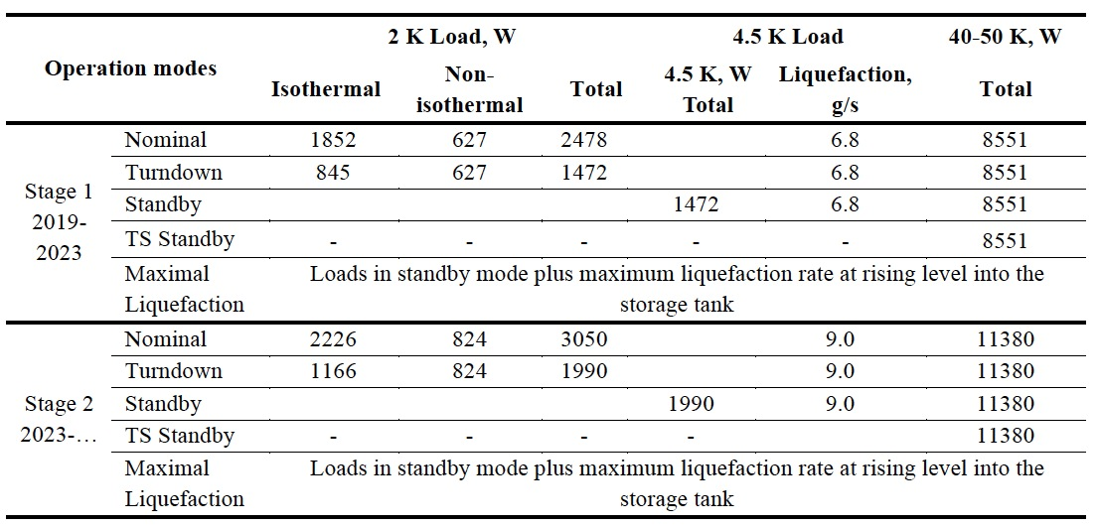
Accelerator Cryoplant (ACCP) Capacities

Slide 53
Simplified Flow Schematic from Linde for ACCP
Note:
1) No LN₂ Precooling
2) Last stage of subatmospheric
pumping is warm
Notes:
Contract signature pending (expected March 2015), contract value < 20 million EUR (excluding installation, LHe Dewar, warm gas storage etc.)

Slide 54
Cryogenic Distribution System
Allows warm up and cool down of one or more cryomodules w/o affecting remaining cryomodules
Connection between distribution line & cryomodule is done via fixed connections
Separate isolation vacuums in the distribution lines and cryomodules
Operating modes defined
Under Construction
Provided as an In Kind Contribution by IPN Orsay (France) and WrUT (Poland)

Slide 55
Linac CDS – function and layouts
Cryogenic System of the Optimus Linac
Linac
Cryoplant
Cryogenic
Transfer
Line (75 m)
Cryogenic Distribution Line (310 m)
comprising 43 valve boxes
Auxiliary process lines
Endbox
Splitting
box
21 High Beta
Cryomodules
(174 m)
9 Medium Beta
Cryomodules
(75 m)
13 Spoke
Cryomodules
(54 m)
Superconducting section of the Optimus Linac (303 m)

Slide 56
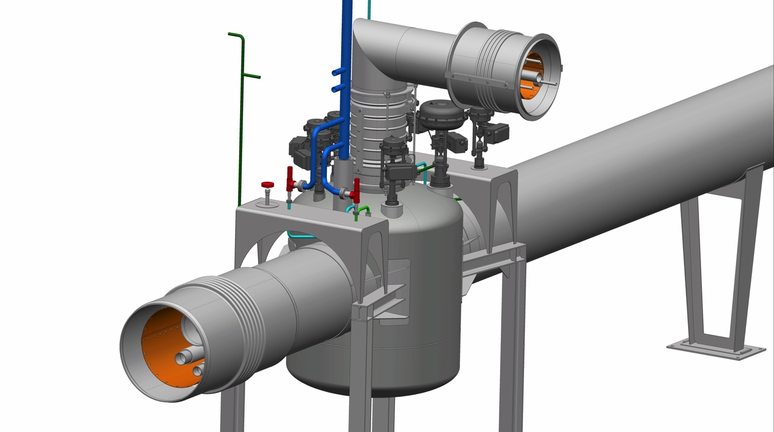
Valve box – vacuum jacket
Jumper connection vacuum jacket
with a lateral compensators
(vertical: DN350 horizontal: DN450 )
Interconnection
sleeve at the interface to the cryomodule
Cryoline interconnection
sleeve with axial compensator (DN600)
Cryoline vacuum jacket (DN550)
Valve box
vacuum jacket
Cryoline
support
Valve box
supports
Bottom plate
(demountable)

Slide 57
Target Moderator Cryoplant – Substantial Load Increase
Heat Load at 15 K increased from 20 kW to 30.3 kW due to moderator re-design (higher brightness, more neutrons)
Impact on space requirements, utilities, interference with other cryoplants and budget (minimal impact on schedule) – technical solutions are currently worked out
Tight collaboration with FZ Jülich, TU-Dresden and Hans Quack
Plant Under Construction (Linde)

Slide 58
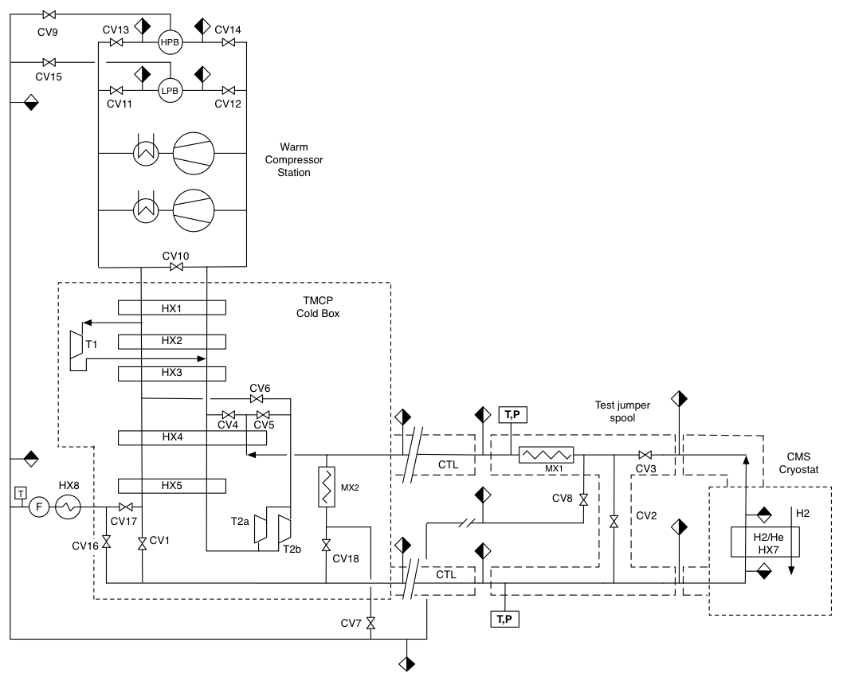
Target Moderator Cryoplant

Slide 59
Test & Instruments Cryoplant (TICP)
Provides cooling for Cryomodule Test Stand
During Science Operations, also provides LHe for sample environments and Science Instruments
TICP provides for CM testing: 76 W at 2 K, 383 W at 33 K and 0.2 g/s of liquid helium
Sub-atmospheric operation via warm vacuum pumps
During Science Operations, the TICP shall provide more than 7500 liters of LHe per month
A recovery system is being built to recover all He gas from instrument halls and return it for purification and liquefaction.
Under installation (provided by Air Liquide)

Slide 60
Helium Recovery and Storage
The ESS goal is to recovery, purify and reuse as much He as possible
ACCP and TICP cryoplants will share a common gas system while TMCP has separate storage that can be cross connected
The system will include a separate cryogenic purifier
Systems will be provided by IKC or separate contracts
Expected He Storage Capacities:
  LHe
    20 m³ (Includes storage for second fill of linac)
    5 m³ (Backup for Instruments He)
  GHe (20 Bar)
    1330 m³ - sufficient to hold all the linac inventory
  GHe (200 Bar)
    12 m³ - Instrument He storage
Total He Inventory – 3 Tonnes
ESS will also recover and recycle MAX IV He

Slide 61
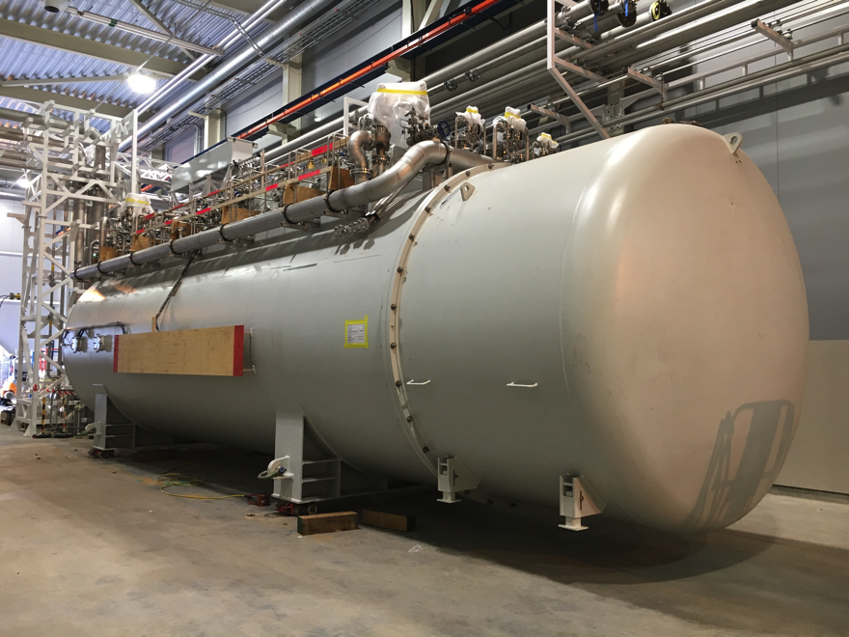
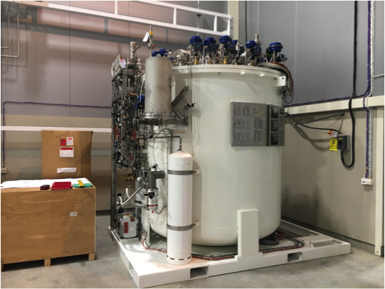
Cold Boxes
ACCP (Linde)
TICP (Air Liquide)

Slide 62
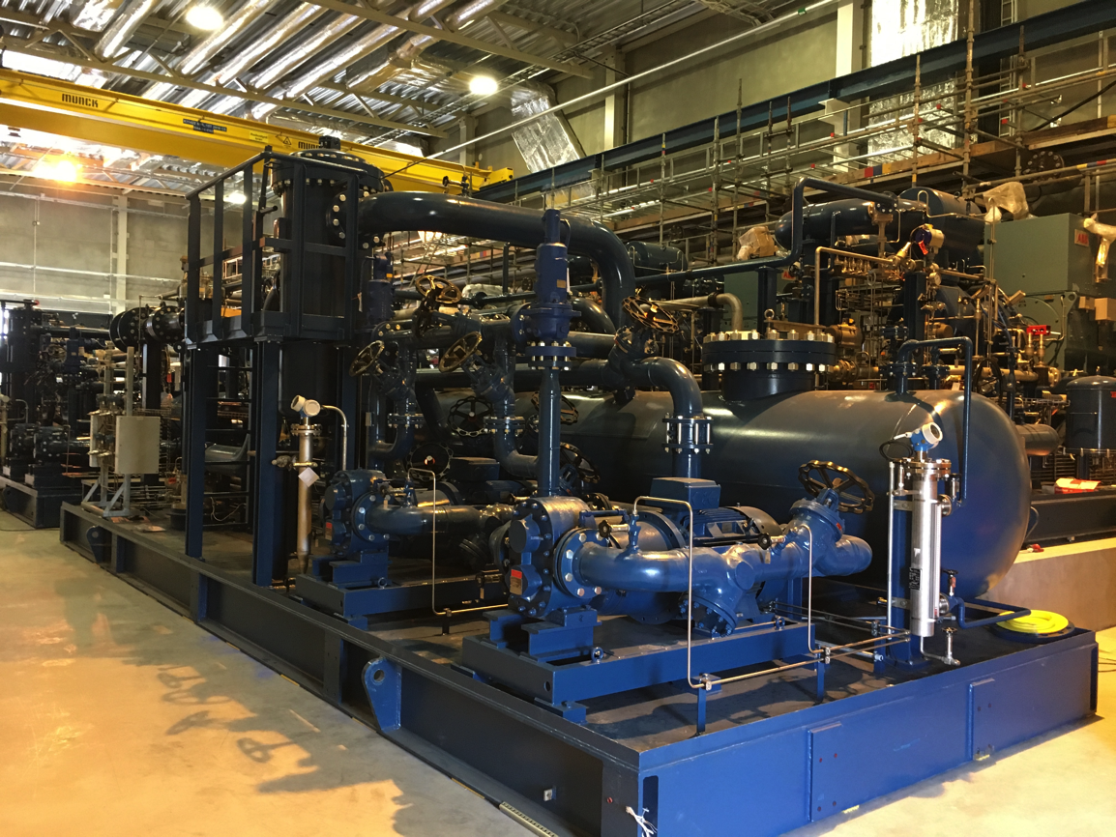
ACCP Compressors

Slide 63
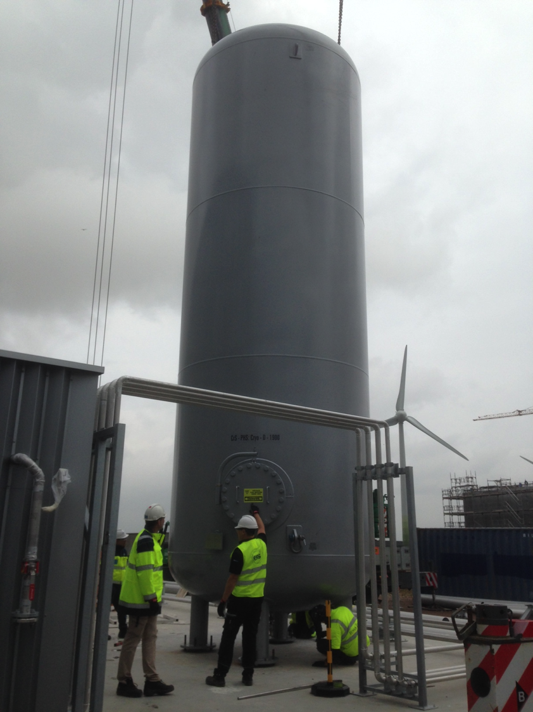
First Medium Pressure
(20 Bar) Helium Gas Storage Tank Installed

Slide 64
Summary
Cryogenics will play a major role in ESS and affects the accelerator, target and instruments projects
Work is well underway
  A very skilled team has been assembled
  Equipment is under construction and significant installation has started
  Required buildings have been delivered
  All three cryoplants will be commissioned by the end of 2018 with the linac cryogenic distribution system commissioned by Q3 2019

Slide 65
Backup Slides

Slide 66
Refrigerators vs. Liquefiers
Refrigerators are closed cycle systems
  They provide cooling and can create liquids but all the mass flow is returned to the start of the cycle
  Such systems are said to have “balanced flow”
Liquefiers are open cycle systems
  They provide a liquid which is then drawn off and used elsewhere
  These have “unbalanced flows” the amount of mass returned to the start of the cycle is less than the amount that started by the mass that was converted to liquid.
  In order to keep the cycle running this mass would have to be added as room temperature gas.

Slide 67
Refrigerators vs. Liquefiers
In practice, this distinction is less clear cut
  Modern cryogenic plants can operate either as refrigerators or liquefiers and in fact, generally operate as a mixture of the two.
  We talk about refrigeration loads & liquefaction loads
  A key issue is at what temperature is the boil off gas from a cryogenic liquid returned to the cycle?
    If brought back at a cryogenic temperature and used to cool incoming warmer gas then this is a refrigeration load
    If brought back warm and not used to cool incoming warmer gas this is a liquefaction load
The thermodynamic rules are the same for refrigerators and liquefiers

Slide 68
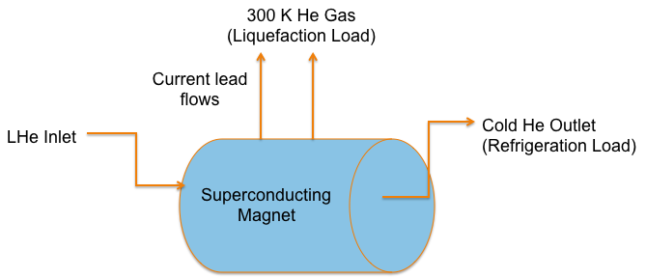
Consider the cooling of a superconducting magnet and its current leads

Slide 69
Collins Cycle
Cycle consists of :
  1) Compression to ~ 16 Bar with cooling back to 300 K + oil removal
  2) Cooling of high pressure gas with LN₂
  3) Isentropic expansion via 2 or more expansion engines
  4) Cooling of high pressure gas by the cold returning low pressure stream
  5) Isenthalpic expansion through JT valve
  6) Return of gas to compressors at just above 1 Bar

Slide 70
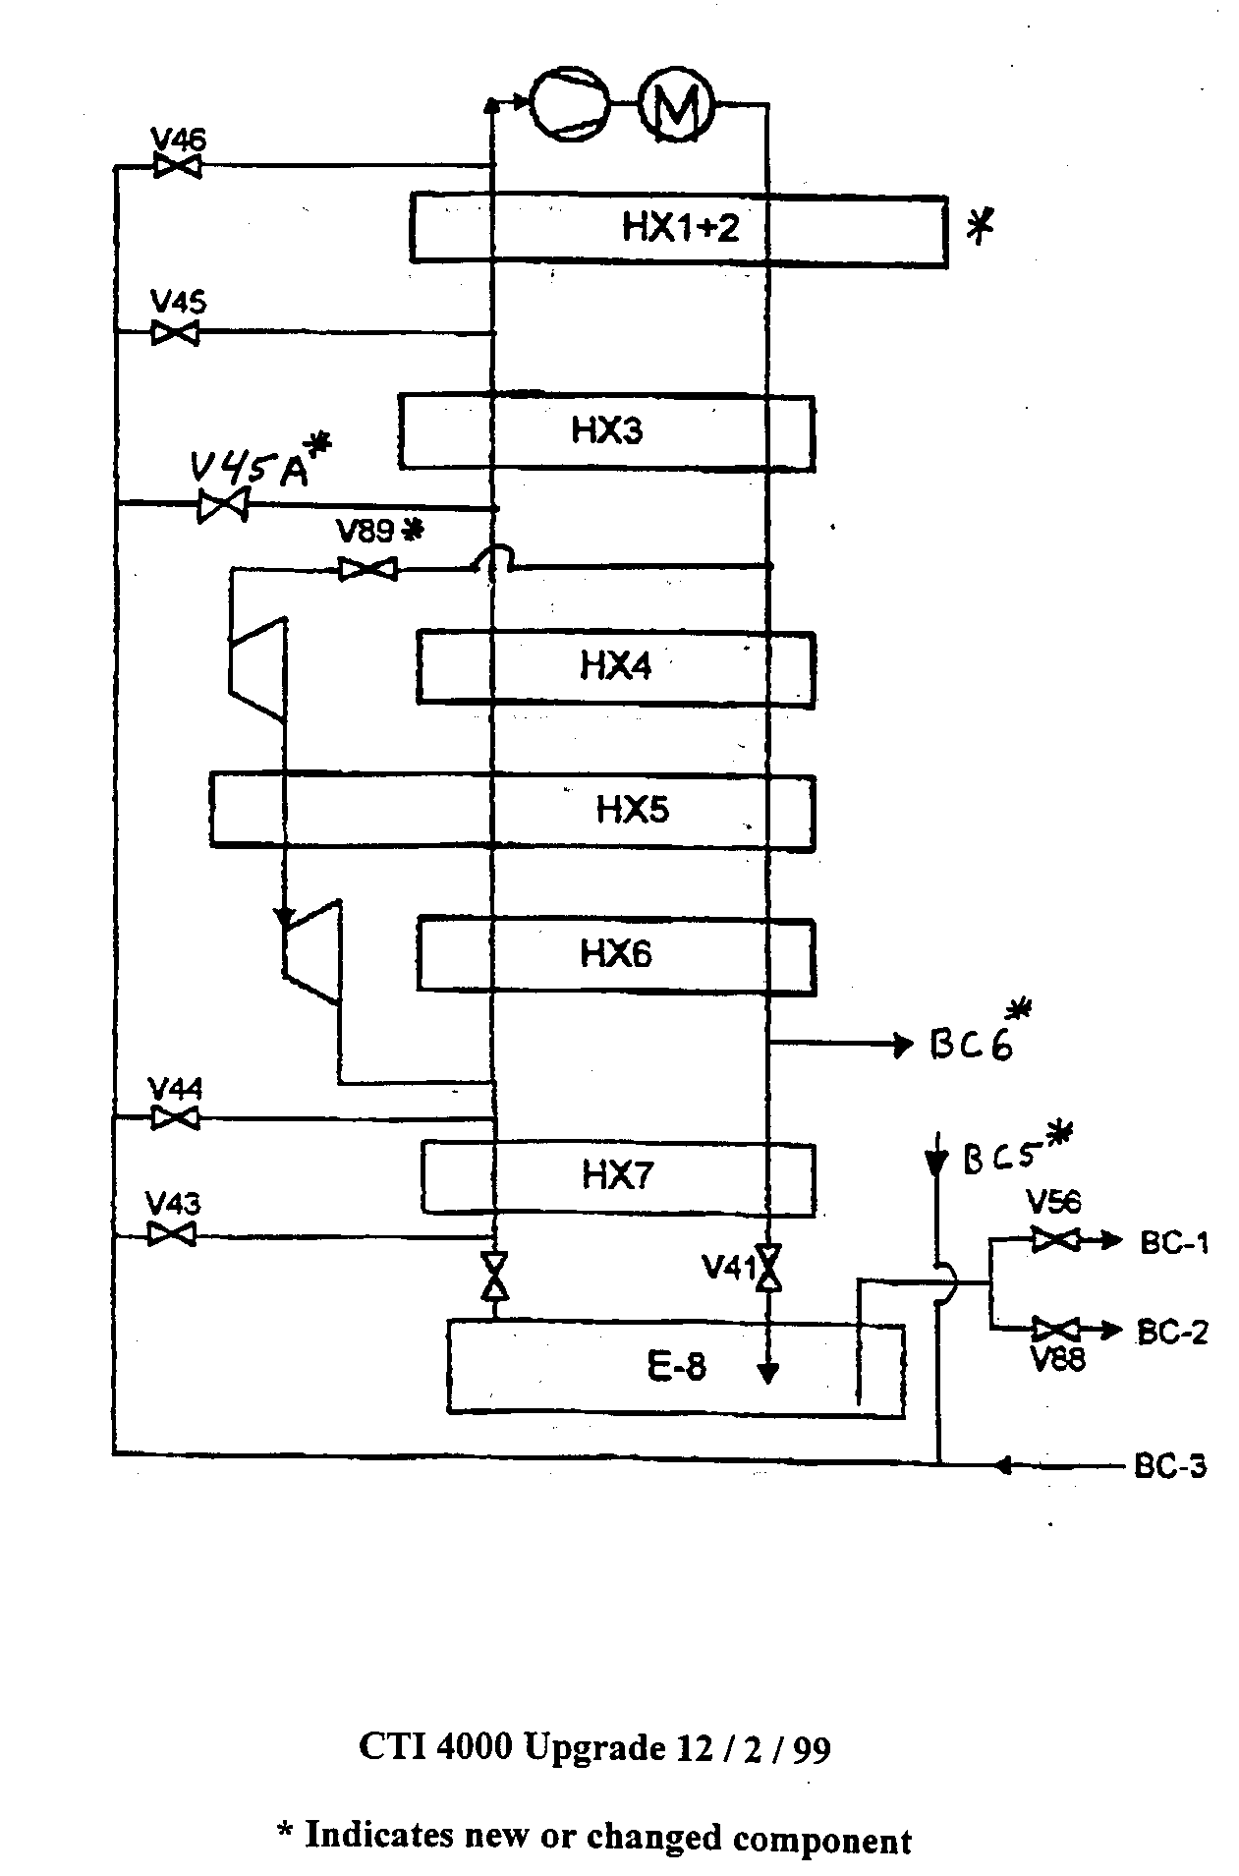
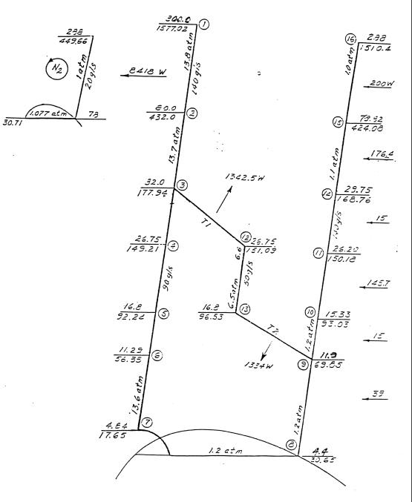
CTI 4000 Refrigerator
(early 80’s vintage ~ 1.2 kW @ 4.5 K)

Slide 71
Quantized Vortices
(or does He II at 1 K rotate in a bucket)
At 1 K He II is almost entirely the superfluid component and thus has almost 0 viscosity. This would imply that He at 1 K in a spinning bucket wouldn’t rotate but it does. What’s the answer?
  The vortices are quantized:
Solves rotating bucket problem
  In the body of the fluid:
  At the wall:
This has been experimentally observed
The quantized vortices in the superfluid component are an important part of heat transfer mechanism in He II

Slide 72
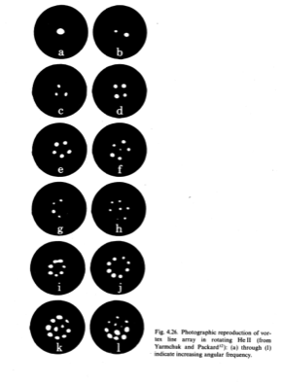
Direct Observation of Quantized Vortices via Electron Trapping

Slide 73
Heat Transfer in He II
The basic mechanism is internal convection:
No net mass flow
Note that this is not conduction or classical convection but an entirely different heat transfer mechanism
This can be extremely efficient (more than 1000x better than conduction through copper)
V _{n}
Q
V_{s}
T_{H}
T_{L}

Slide 74
Heat Transfer in He II
There are 2 heat transfer regimes:
  V_{s} < V _{sc}
  V_{s} > V _{sc}
    Mutual Friction Regime (quantized vortices interact with the viscosity of the normal component
As V _{sc} ~ d^{-1/4} (cgs units) the mutual friction regime is most applicable in engineering applications of He II

Slide 75
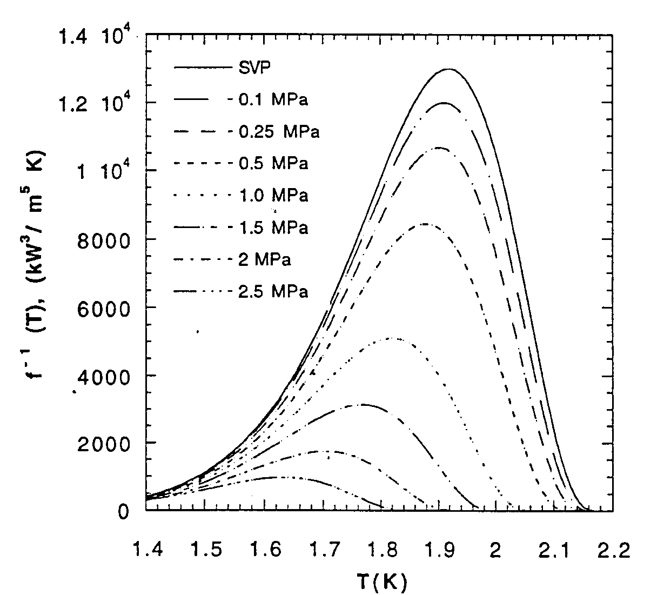
Heat Conductivity Function

Slide 76
He II Heat Transfer Limits
In pressurized He II: T _{h} must be less than T _{λ}
Thus the peak heat flux q* is:
At 1.9 K and 1 bar :
q*L^{1/3} ~ 15 kW/m^{5/3}

Slide 77
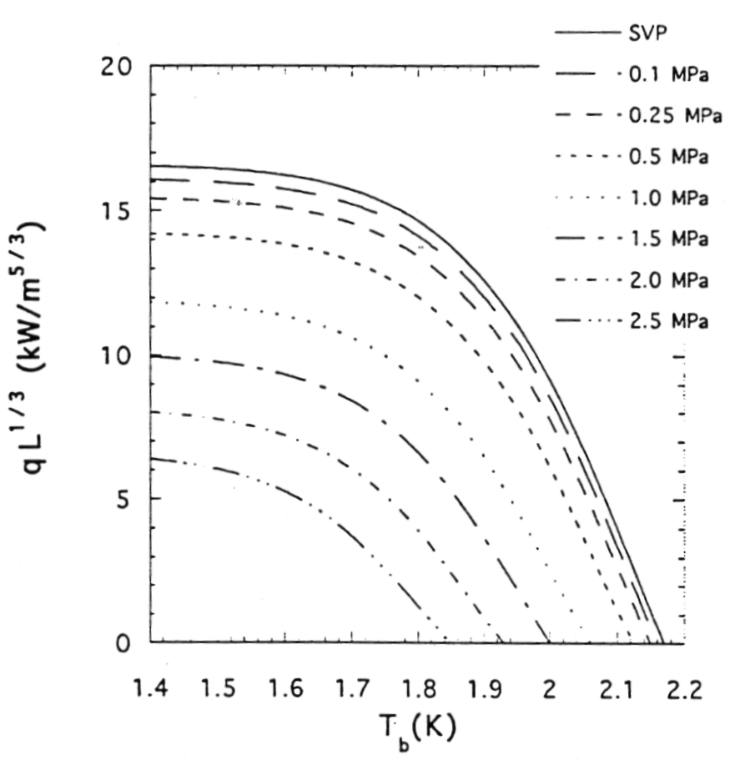
Peak Heat Flux (q*) in Pressurized He II

Slide 78
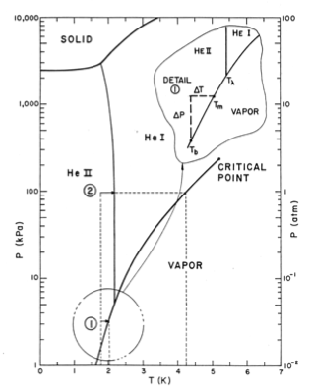
Limits on He II
Heat Transfer
In saturated He II, the limit is given by the local saturation temperature & the degree of local subcooling
In the ILC cavity He vessel this works out to about 1 W/cm² or ~ 30 W total through the connection tube
  More heat than that would require a redesign
Exceeding the heat transfer limits in either the saturated or pressurized case results in conversion to He I and boiling at the heated surface

Slide 79
Surface Heat Transfer
Heat transfer from a surface into He II is completely dominated by a fundamental inefficiency in moving energy from the surface to the fluid
This effect exists but is not important in standard convection problems
  Normally we assume T_{w} = T_{fw} but this is not true in the case of He II
This surface heat transfer effect is described by Kapitza Conductance
  For q < 1 kW/m²
  For q > 1 kW/m²
h _{k,} a and m are empirical and dependent on material, temperature and surface condition

Slide 80
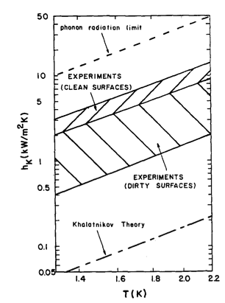
Surface Heat Transfer
m ~ 3
Kapitza conductance is not dependent on helium flow rate

Slide 81
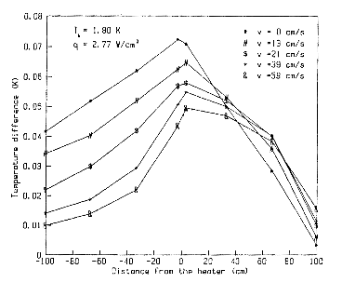
Forced Convection and He II
If Kapitza Conductance is independent of flow rate does forced convection in He II make any sense?
  Yes! Forced convection has the effect of reducing the maximum temperature in the He II and thus allowing more heat to be transferred before reaching the peak heat flux

Slide 82
He II Fluid Dynamics
Despite the presence of the superfluid component, in almost all engineering applications He II behaves as a classical fluid. This includes :
  Pump performance
    Except cavitation in saturated He II
  Pressure drop in tubes, valves, bellows and fittings
  Flow metering techniques
This is likely a result of the quantized vortices in the superfluid component being coupled via mutual friction to the normal fluid viscosity
However, keep in mind that the unique heat transfer properties still exist as described.

Slide 83
He II Fluid Dynamics
He II does behave differently in cases of:
  Film flow
  Porous plugs
  Two – phase flow (liquid/vapor) due to the large density difference between liquid and vapor in the case of He II

Slide 84
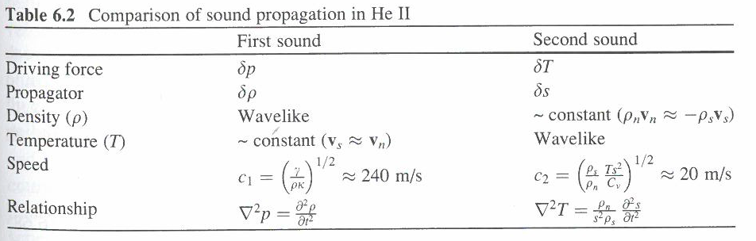
Second Sound
The two-fluid model predicts and experiments show that temperature waves may be established in the He II due to oscillations in the local entropy. These temperature waves are known as second sound as they are analogous to density waves caused by pressure oscillations.
Recall that the superfluid component has zero entropy
From Helium Cryogenics S.W. Van Sciver (2013)

Slide 85
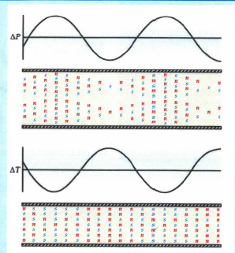
Second Sound
Second sound can be detected via
  thermometry (either time or flight or resonance techniques)
  Oscillating Superleak Transducers
Second sound is attenuated by mutual friction and has been used extensively quantum turbulence
More recently second sound has been used to locate quenches in SRF cavities
From Donnelly Physics Today October 2009

Slide 86
Outgassing and Getters
All materials outgas into a vacuum. This can raise the pressure in a sealed vacuum space
Reduce outgassing by:
  Minimize amount of polymers, wire insulation, FRP etc – difficult
  Keep vacuum surfaces as clean as possible. Remove any oil or cutting fluid, wear gloves etc.
Getters: materials (such as activated charcoal or silica gel) inserted into vacuum spaces to remove residual gas at low pressures
In cryogenic systems, getters may be useful in removing residual gas and passively managing small leaks

Slide 87
Thermal Conductivity
Integrals
The strong temperature dependence of K makes heat transfer calculations difficult
The solution is frequently to use thermal conductivity integrals
The heat conduction equation
Is written as:

Slide 88
Thermal Conductivity
Integrals
G is the geometry factor
θ is the thermal conductivity integral

Slide 89
Thermal Conductivity
Integrals
Advantages:
  Simple
  Only end point temperatures are important. (assuming there are no intermediate heat sinks) The actual temperature distribution is not.
  Thermal conductivity integrals have been calculated for many engineering materials
  This is quite useful for heat leak calculations

Slide 90
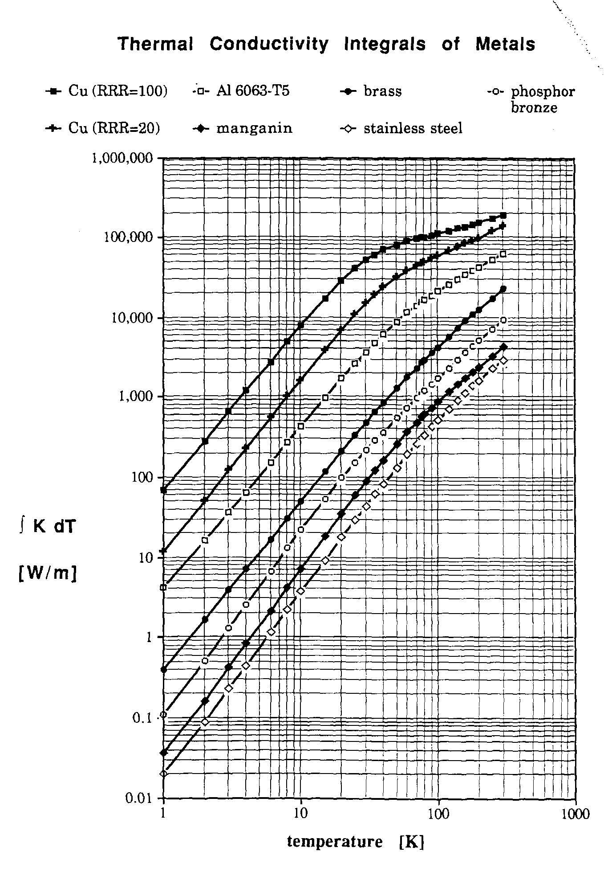
Thermal Conductivity Integrals of Metals
From Handbook of Cryogenic Engineering, J. Weisend II (Ed)

Slide 91
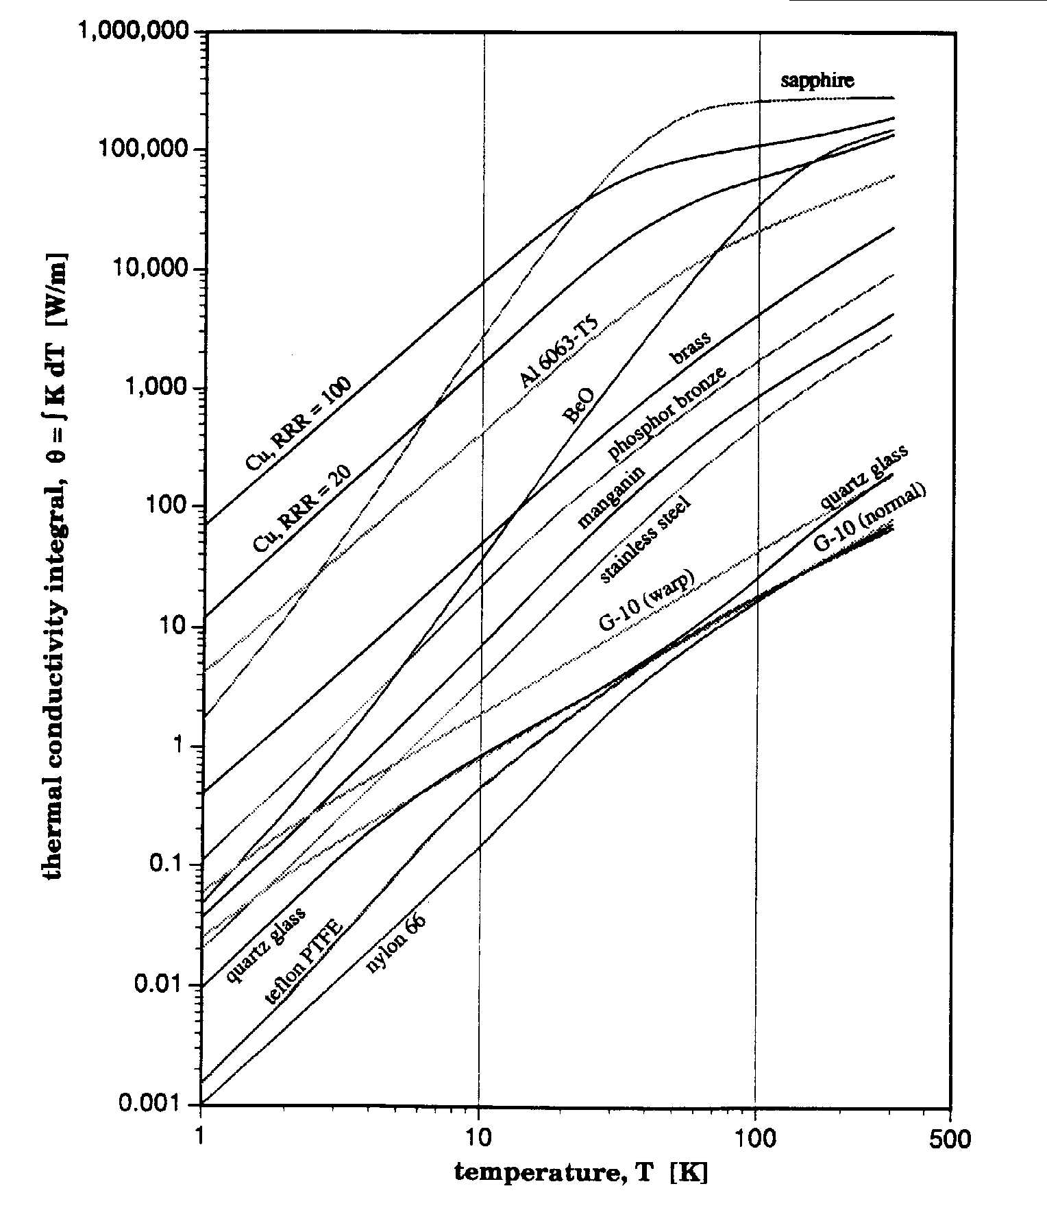
Thermal Conductivity Integrals of
Metals & Nonmetals
From Lakeshore Cryotronics

Slide 92
Cryomodule Examples: Elliptical Cavities
Due to the cavity shapes and the general efficiency of using cylinders as pressure/vacuum vessels, these systems are almost always cylindrical in geometry
  Cold Masses are loaded in from the ends
  Cryogenic piping connections go out the ends
  Common design features with accelerator magnet systems
  Can be further divided into “Space Frame” designs” & “Internal Transfer Line” designs

Slide 93
Space Frame Based Designs
Cold Mass Components are installed into a Space Frame that is inserted into a cylindrical vacuum vessel.
Space Frame may also contain thermal shield and MLI systems
Generally alignment is done warm and system is designed to not require realignment once cold
Very suitable for systems in which the cryo segmentation is done per module with a parallel transfer line
Higher cost and heat loads tend to limit this approach to small & medium sized machines ( ~ 50 CMs)
Examples include: ESS, SNS and Jlab 12 GeV Upgrade

Slide 94
JLab 12 GeV Upgrade Cryomodule
Based on successful SNS design - a total of 10 CMs were needed
Cavities at 2.1 K, thermal shield at 50 K – no s/c magnets present
Cold Mass tied to space frame via nitronic rods
Space frame rolls into vacuum vessel
Despite extensive SNS experience, design changes (mainly in cold mass) were required after 1st prototype – value of prototyping

Slide 95
Internal Transfer Line Based Designs
Cryogenic distribution piping is contained with cryomodules - limited external transfer lines
Approach commonly used where infrequent cryo-segmentation is desired
Lower static heat leak & lower cost
More difficult maintainability (larger number of CMs to thermal cycle)
Suitable for systems containing large numbers of cryomodules (ILC, XFEL, LCLS II)
Designs frequently use large diameter distribution lines as the structural backbone for the cold mass

Slide 96
ILC Cryomodule Design
Based on extensive TESLA development program
Cavities at 2 K, thermal shields at 5 K and 40/80 K, s/c magnets at 4.5 or 2 K
Design uses large GRP (whose size is dictated by allowable pressure drop) as the structural backbone for the cold mass
FRP posts connect GRP to vacuum vessel
Alignment is done warm. System is designed to keep alignment when cooled
Design drivers
  ~ 2000 cryomodules required
  Low heat leak and low cost
  Infrequent cryo-segmentation
  Ease of mass production
Significant amounts of prototyping (FLASH)
3 generations of design with continuous improvement
Design being used on XFEL and LCLS II (with mods)

Slide 97
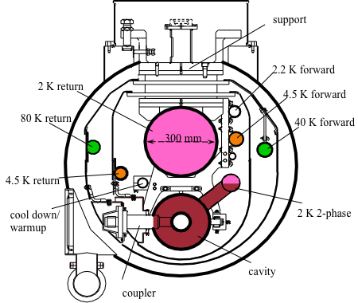
3rd Generation ILC Cryomodule

Slide 98
Cryomodules with QWR and HWR Cavities
Low to medium beta cavities typically used in heavy ion machines IISAC-II, (TRIUMF) ATLAS Upgrade (ANL), RAON & FRIB (MSU)
Due to cavity geometry, particularly the QWRs, these cryomodules have a rectilinear geometry
The designs can be further divided into “Top Supported” or “Bottom Supported” Designs
Cryogenic lines go out either the top or bottom of assembly
So far only used in systems where cryo-segmentation is at the individual CM level – external transfer line

Slide 99
Top Down Designs
All components are suspended from a top plate via metallic rods
  Length between top plate and connection to cavity mounting beam can be maximized to reduce heat leak
System is lowered into a simple bath tub style vacuum vessel
Possibility of better vibration response ( longer path between floor and cavity
Cryogenic and other feedthroughs go through the top plate though coupler and tuner feedthroughs may be through the side or bottom
Most common type of HWR/QWR cryomodule

Slide 100
ALTAS Upgrade Cryomodule
Top down design similar to IISAC-II but separate cavity & isolation vacuum – thus clean room assembly needed but higher performance cavities possible
7 QWR plus 1 solenoid all at 4.5 K
“Commissioning of the ATLAS Upgrade Cryomodule”, P.N. Ostroumov et al. Proceedings of HIAT09 (2009)

Slide 101
Bottom Supported Design
Here the components, instead of being hung from the top plate, are supported by FRG posts from a bottom plate.
Vacuum vessel lid is lowered down on top (FRIB) or slid into a cylindrical vacuum chamber (Fermilab SSR)

Slide 102
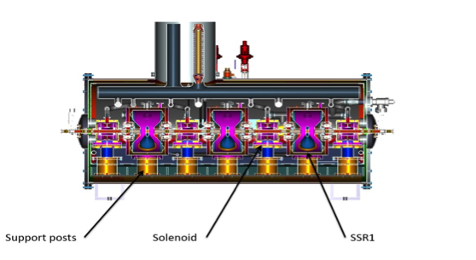
Example of Bottom Support in a Cylindrical Geometry
Proposed Fermilab Single Spoke Resonator
Each component has its own support post – very “stiff design”

