Slide 1
Materials Scope and Lifetime Criteria for ESS Target Station
Yongjoong Lee
Group Leader – Materials
Target Division
www.europeanspallationsource.se
4 December, 2017

Slide 2
Outline
Introduction to Beam Intercepting and Functional Systems at ESS Target Station
Systems with Dose Limited Lifetime and Materials Selection
Prospect for Materials R&D at ESS
Summary

Slide 3
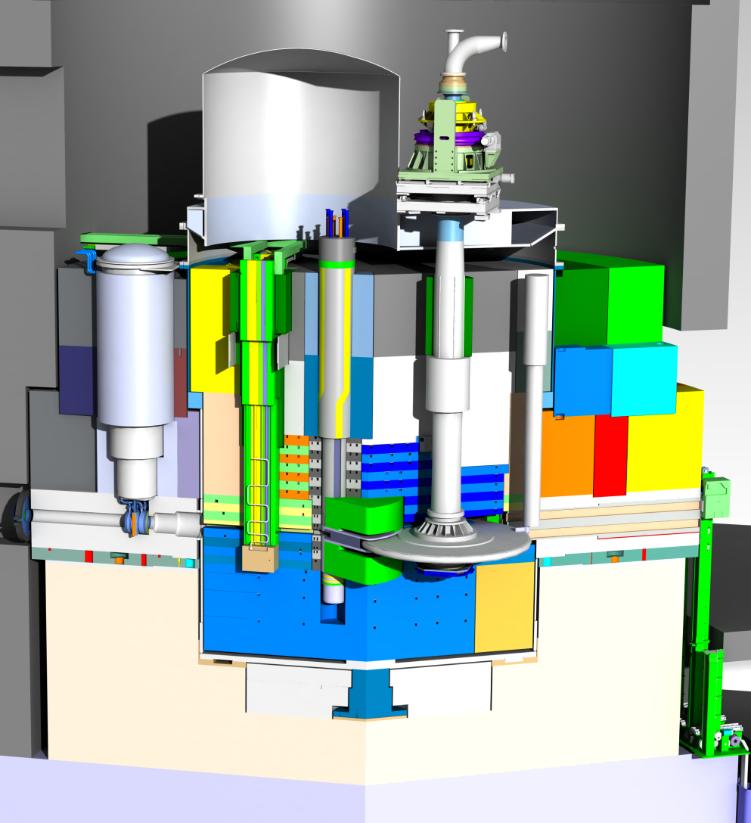
Target Monolith - Systems with Dose Limited Lifetime
Proton Beam
Instrumentation Plug (PBIP)
Moderator-Reflector
Plug (MR Plug)
Target Wheel
Proton Beam
Window (PBW)
Beam intercepting systems:
  Target
  PBW
  BPMs
  Tuning dump
Functional systems:
  MR system
  Drive unit
  Monolith vessel and shielding
  Seals
  Sensors
Proton beam:
2 GeV/5 MW

Slide 4
Radiation Effects in Structural Materials
Phase instability
  Precipitation and Dissolution
Radiation induced segregation
Void swelling
Dislocation loops
Hardening & embrittlement
Etc.

Slide 5
Dose Limited Lifetime and Operational Cost
Hardware Cost Estimates of Major Devices with Dose Limited Lifetime:
  Target Wheel Unit: 4.5 M€
  Moderator-Reflector Plug: 3.5 M€
  Proton Beam Window: 0.5 M€
Consequence of Failure of Major Devices: Facility Shutdown
  Acceptable risk level should be decided in view of facility reliability and operational cost in balance
Determination of Lifetime is the basis for the operational cost estimates of the Target Station.

Slide 6
Material Selection and Lifetime Decision
Material Selection and Lifetime Decision
Operational Experiences of leading accelerator facility
Literature survey of PIE data
Irradiation campaign and PIE
Operational Risk Assessment
Nuclear Code: RCC-MRx

Slide 7
ESS Target Materials Handbook (ESS-0028465)
    Sets the baseline for
      Material selection
      Component lifetime
      Operational constraints
    Compiles reference material properties for
      FEM/FV Simulations
      Shielding and activation calculations
    Compiles the worked out material information for the day-to-day material related questions from different Target WPs

Slide 8
Systems with Dose Limited Lifetime and Materials Selection

Slide 9
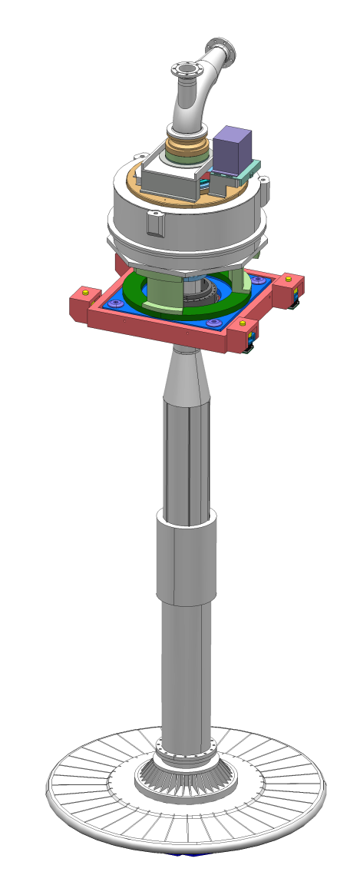
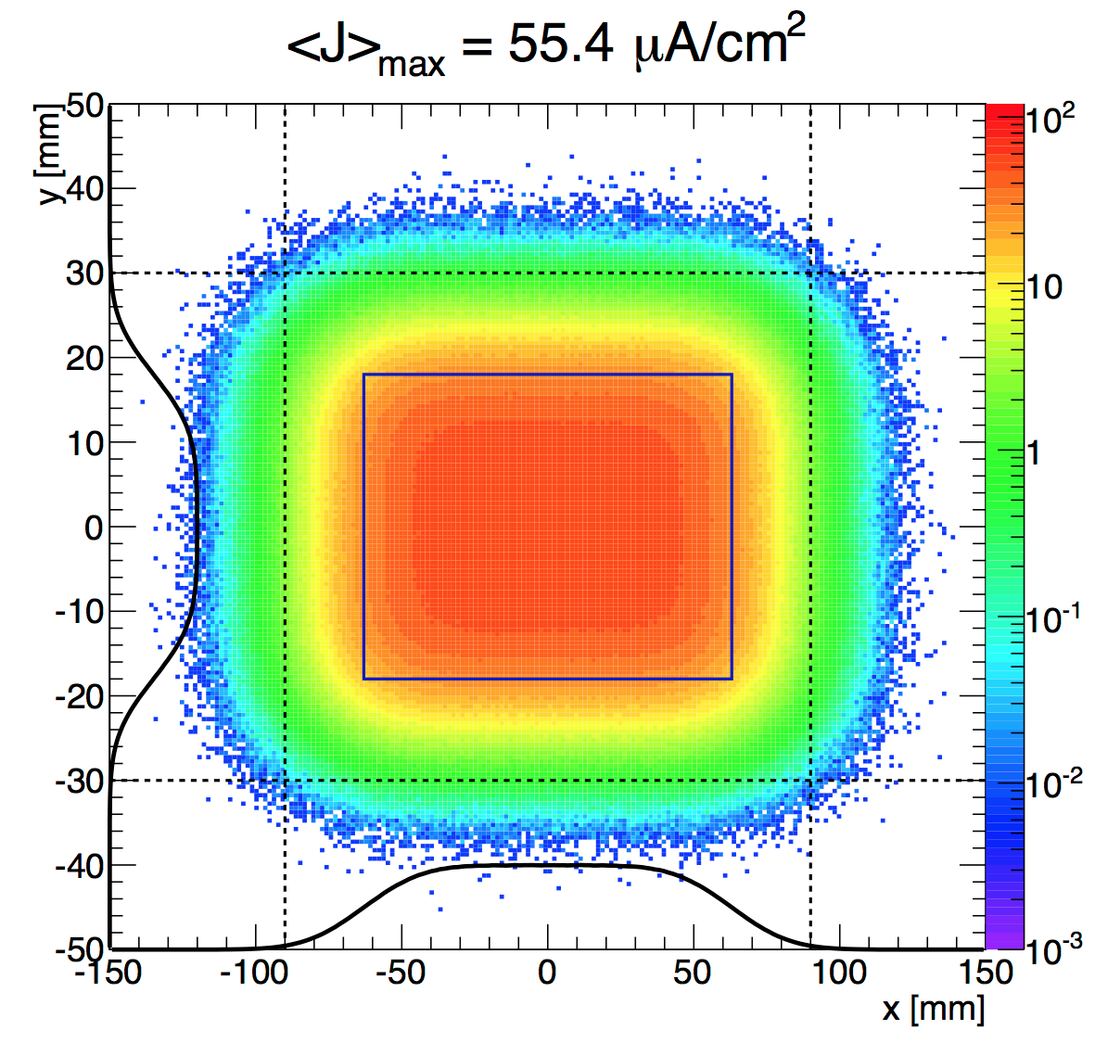
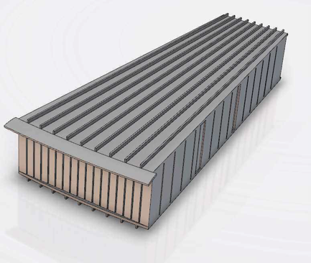
Target Wheel: System
Rotating tungsten target:
  Diameter: 2.6 m
  Rotating speed: 23.3 rpm
  Helium coolant
Beam load on the target wheel:
  Proton energy: 2 GeV
  Beam current: 62.5 mA
  Pulse length: 2.86 ms
  Repetition rate: 14 Hz
  Maximum time-averaged beam current density: 56 μA/cm²
1 ESS-Year:
  5 MW x 5400 h = 27000 MWh

Slide 10
Target Wheel: Material Selection
Proton dose limit:
  Austenitic Steel:
    SS316 LN: Fracture mode is still ductile up to 17 dpa (STIP) [Y. Dai, et al., JNM 377 (2008) 109]
    SS316L: Fracture mode is still ductile at 10 dpa (SNS target) [D. McClintock]
    SA vs CW SS316L: SA retains larger ductility up to a high proton dose compared to CW [J. Chen et al, JNM 343(2005) 236]
  Ferritic/martensitic steel:
    The DBTT of BCC-steel increases with dpa [S. A. Maloy et al, JNM 296 (2001) 119]

Slide 11
Target Wheel: Material Selection
The target wheel vessel carries the structural function
The lifetime of the target wheel is determined by the proton beam induced degradation of vessel material
Material Selection: Austenitic steel SS316L
  Large availability and pressure vessel code in RCC-MRx
  Good operational track record at SNS
  Availability of PIE data of STIP austenitic steel specimens

Slide 12

Target Wheel: Lifetime
Lifetime criteria: DPA
  Decided maximum DPA dose limit: 8 DPA
    Damage Rate: 1.6 DPA/ESS-year
    Lifetime: 5 ESS-year
  Conservatism is due to:
    Different irradiation temperatures of STIP specimens and water cooled SNS beam entrance window
    STIP specimen is SS 316 LN
    Uncertainty in DPA estimates

Slide 13
Spallation Material: Material Selection
Pure tungsten
  High neutron production density
  Lower DBTT than W-10%Re for DPA > 0.3 [H. Ullmaier, F. Carsughi, NIM-B 101, 1995]
  Higher thermal conductivity than other W-alloys [M. Rieth et al, Tech- Rep.-KIT]

Slide 14
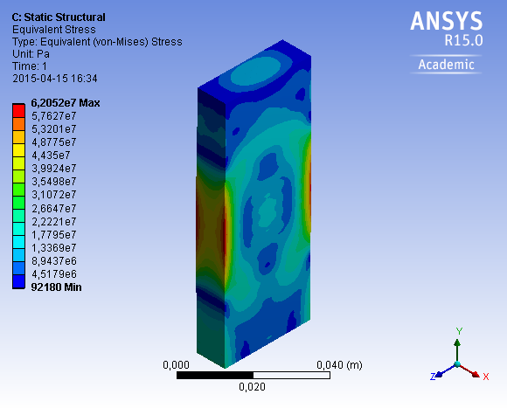
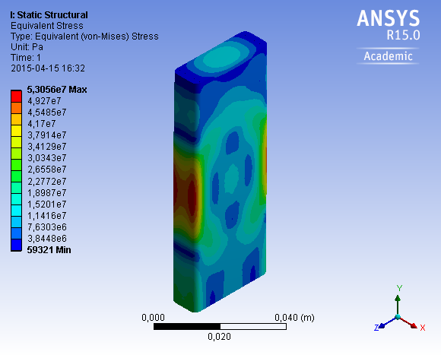
Spallation Material: Lifetime
Tungsten is not subject to dose limited lifetime
  It doesn’t carry structural load of target wheel
  But, loss of mechanical integrity of tungsten bricks caused by thermal cycling could result in premature target failure
Main concerns:
  The radiation damage pushes the DBTT of tungsten bricks above the operation temperature of the ESS target
  Uncertainty in setting fatigue limit for brittle materials

Slide 15
Tungsten: Tensile Strength
Above 0.1 dpa, all W specimens failed in a brittle manner with reduced yield strength.
Maximum damage dose in Tungsten at ESS: 2 DPA/ESS-year
I. V. Gorynin, et al., Journal of Nuclear Materials , 191-194:421-425, 1992;
H. Ullmaier, F. Carsughi, NIM-B 101, 1995

Slide 16
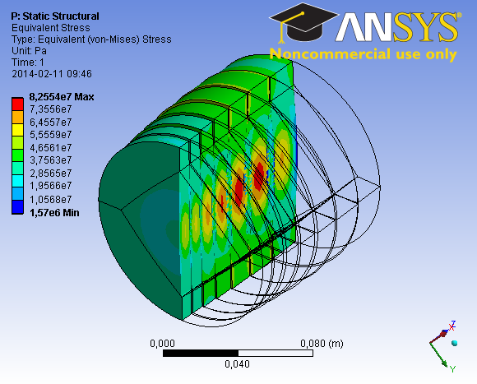
Tungsten: Benchmarking
ISIS TS-2 Target
  800 MeV proton beam with 32 kW beam power.
  10 Hz pulse repetition rate with the pulse length 500 ns.
  154 MPa maximum steady stress.
  203 MPa peak dynamic stress with the 49 MPa stress amplitude.
LANSCE Mark-III
  800 MeV proton beam with 80 kW beam power.
  20 Hz pulse repetition rate with the pulse length 250 ns.
  Equivalent stress range as TS-2 Target
P. Loveridge and D. Wilcox. HPTW4, 2013

Slide 17
Tungsten: Fatigue test and materials selection
Vendors | Raw material | Fatigue Limit [MPa] | Fracture
Vendor A | Hot rolled | 125 | Transgranular
Vendor B | Hot rolled | 312 | Transgranular
 | Hot forged | 185 | Intergranular
Vendor C | Hot rolled | 371 | Transgranular
 | HIPed | 185 | Intergranular
Rolled tungsten is chosen for its low porosity and high fatigue strength

Slide 18
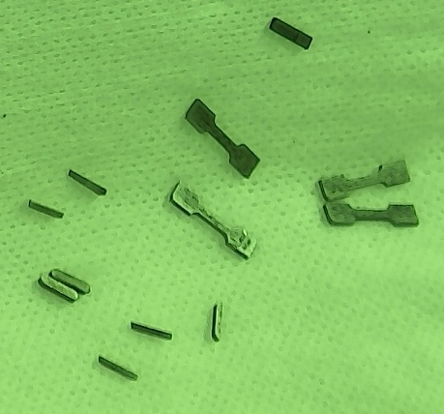
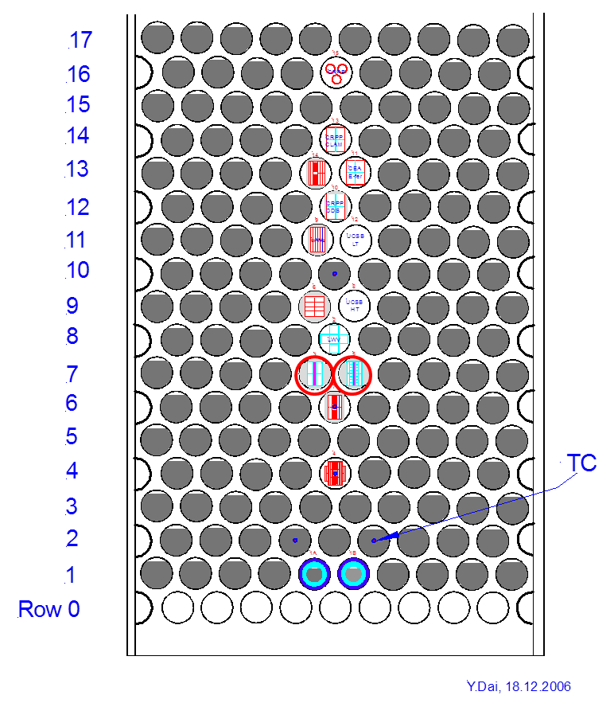
Tungsten: STIP-V W PIE
STIP-V Irradiated between 2007 – 2008
2 hot-rolled tungsten bars, size: 60x8x1mm
Displacement damage: 5 - 28 dpa
Irradiation Temperature: 100 °C-800 °C

Slide 19
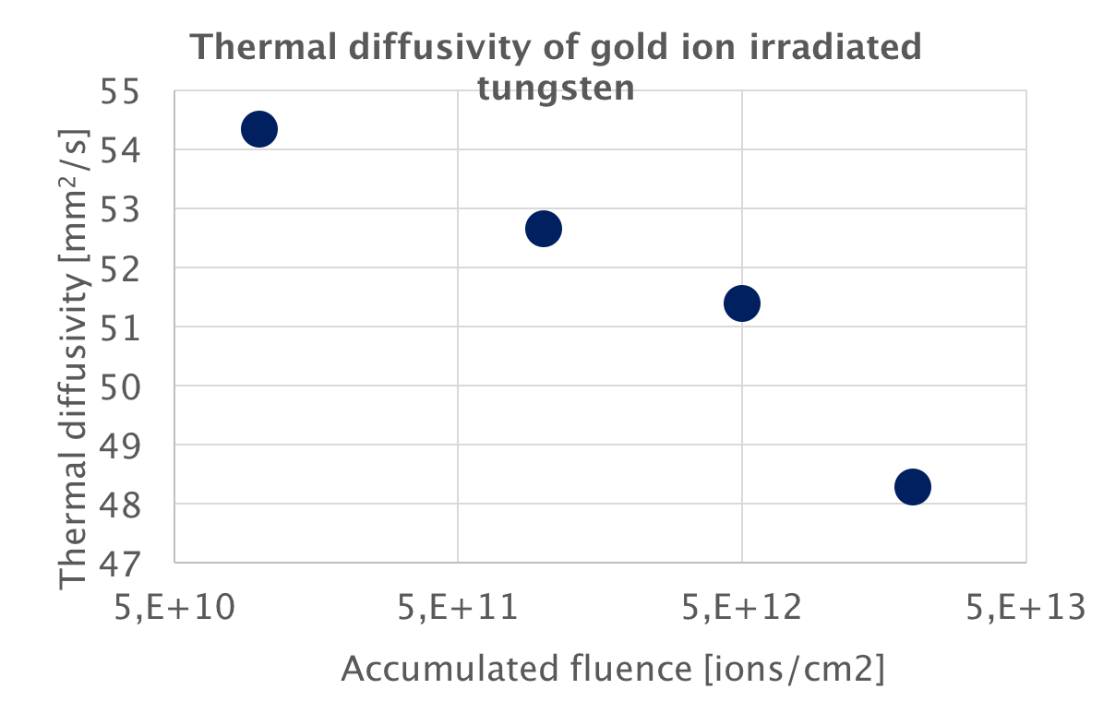
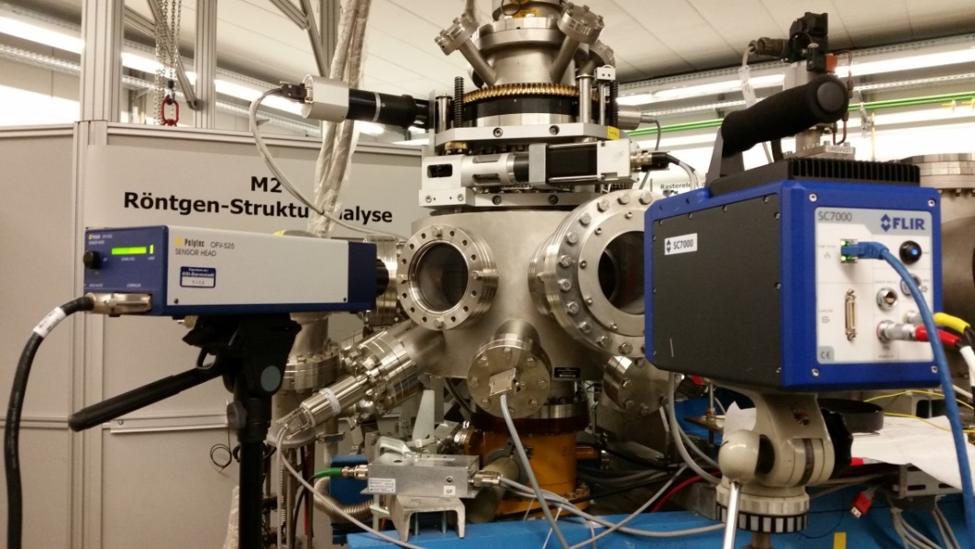
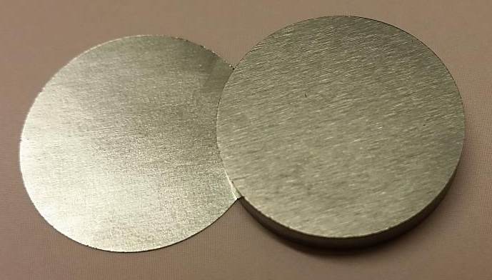
Tungsten: M3-beamline of GSI UNILAC
Uranium beam on tungsten coins
  Charge state +28
  Beam energy: 4.8 MeV/u
  Ion flux: Max. 1e10 ions/cm²/pulse
  Pulse length: 100 us
  Repetition rate: 1 Hz
ESS beam
Energy - 2.5 GeV
Rep. rate - 14 Hz
Pulse length - 2.86 ms

Slide 20
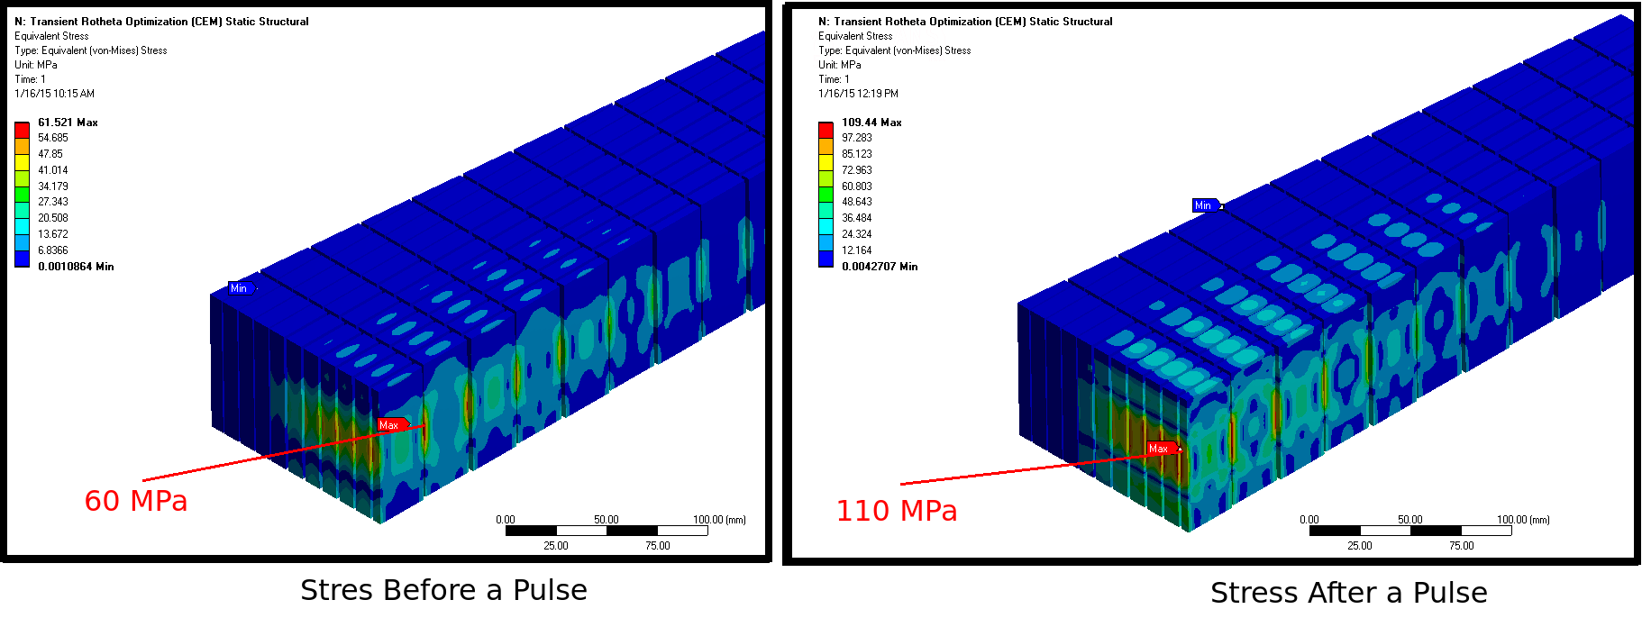
Tungsten: Operational Requirement
The W volume shall be designed to have a lowest possible stress and stress amplitudes:
  Mean stress < 100 MPa; Max Stress Amplitude < 50 MPa
Operational temperature is limited by oxidation behavior:
  Normal operation < 500°C; Loss of coolant incidents < 700°C

Slide 21
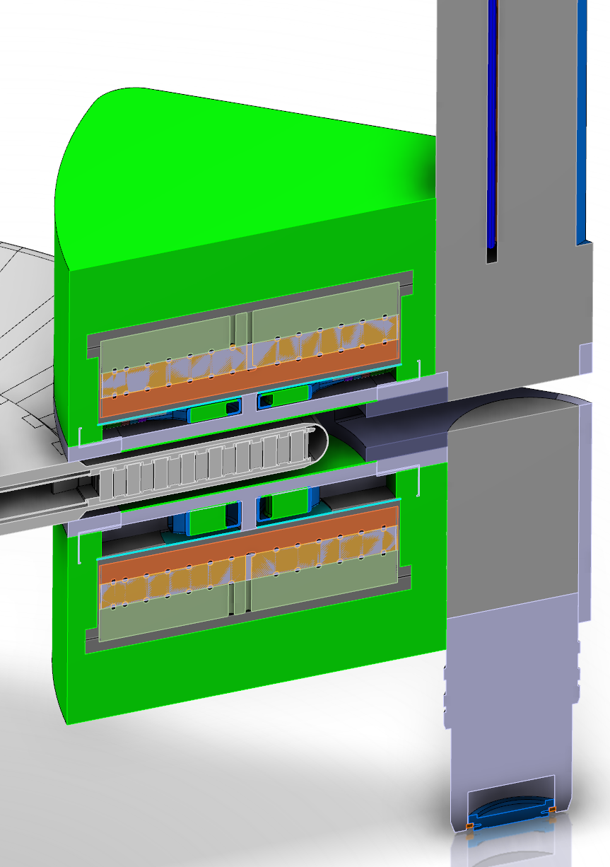
Moderator Reflector: System
Moderator-Reflector System receives a high flux of fast and thermal neutrons
Aluminum alloy is preferred for structural components
  Low neutron cross-section
  Al5754-O and Al6061-T6 are specified in RCC-MRx
Lifetime of the vessel is assessed in view of
  Silicon embrittlement
  Helium embrittlement
  Displacement damage

Slide 22
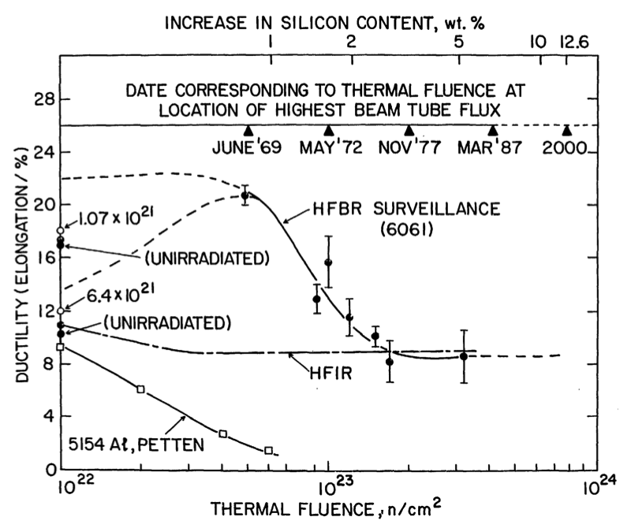
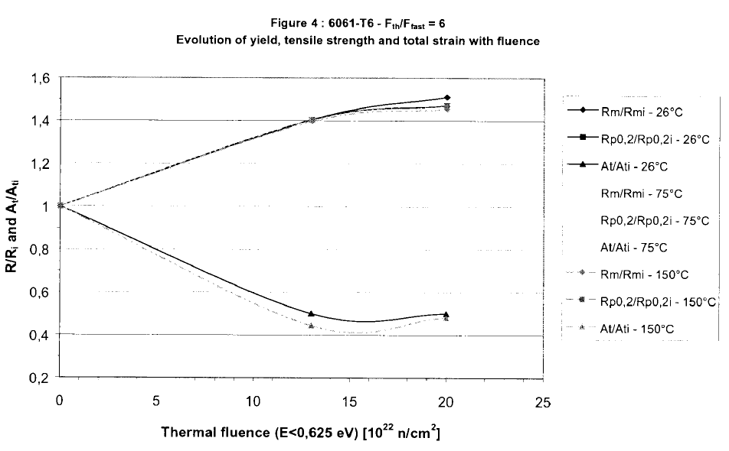
Aluminum Alloy: Dose Limit due to Silicon Embrittlement
Dose limit due to thermal neutron capture
  ²⁷Al + n_{th} → ²⁸Al + 𝜸;
  ²⁸Al → ²⁸Si + β⁻
Al6061-T6: The total elongation saturates at high thermal neutron dose: ORNL, Joule Horowitz Reactor
RCC-MRx:
  Negligible thermal neutron fluence at RT
    Al6061-T6: 1.8e22 n_{th}/cm²
    Al5754-O: 1.14e22 n_{th}/cm²
  Maximum allowable thermal neutron fluence at RT
    Al6061-T6: 6.7e23 n_{th}/cm²
    Al5754-O: 7.3e22 n_{th}/cm²
J. R. Weeks et al, 1990
B. Kapusta et al, 2003

Slide 23
Aluminum Alloy: Dose Limit due to Displacement Damage
Dose limit due to displacement damage
  SNS moderator vessel:
    Al6061-T6
    Damage rate: maximum 1 dpa/1000 MWh [W. Lu et al, JNM 377 (2008), 268]
    Design Lifetime: 30,000 MWh (30 dpa)
    Accumulated beam energy as of 18-Jul-2017: 37500 MWh (37.5 dpa)
https://ics-web.sns.ornl.gov/chico/beam.jsp

Slide 24
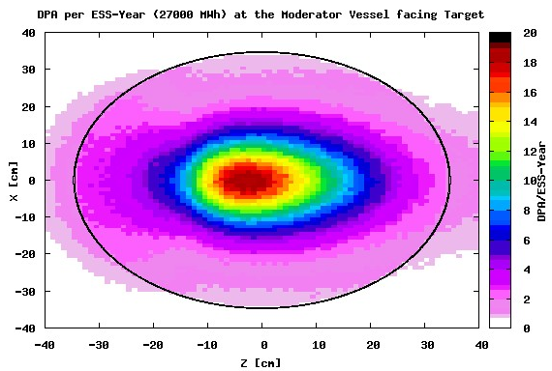
Moderator Reflector: Vessel
Maximum thermal neutron flux:
  Core:
    1.36e22 n_{th}/cm²/ESS-year
  Rim:
    4.22e21 n_{th}/cm²/ESS-year
Maximum helium production:
  Core: 300 appm/ESS-year
Maximum displacement damage:
  Core: 20 dpa/ESS-year

Slide 25
Moderator Reflector: Vessel Material
Material Selection:
  Core: Al6061-T6
  Rim: Al5754-O
Vessel Lifetime Reference:
  Thermal neutron flux perspective: 1.3 ESS-year
  Helium embrittlement perspective: 6.0 ESS-year
  Displacement damage perspective: 1.5 ESS-year
Vessel Lifetime Decision: 1.0 ESS-Year (13500 MWh)
  Uncertainty in damage mechanism in cryogenic temperature and RT annealing effects
  Uncertainty in MC simulation models

Slide 26
Reflector
Material selection: Beryllium
  It is not a structural material
  But, the radiation induced swelling could cause a premature failure of the reflector vessel
Beryllium Requirements
  High purity
  Isotropic texture
  Small grain size
G. Muhrer et al.
NIMA, 2007

Slide 27
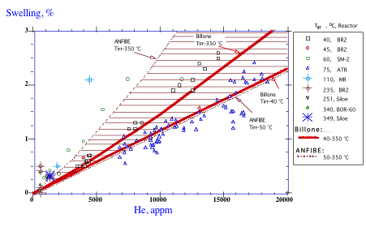
Beryllium
Swelling rate is correlated to helium production rate [ITER-EDA, ITER materials properties handbook (1998)]

Slide 28
Reflector: Lifetime Constraints
Higher temperature accelerates swelling:
  Thermal conductivity degrades with neutron fluence
  The temperature should be kept below boiling point of water
Peak He production rate: 600 appm/ESS-year
  It takes more than 10 years to reach the maximum 1% volumetric swelling.
  A space to absorb the volume expansion Be is taken into account in reflector vessel design
V. Chakin et al., Progress in Nucl. Energy 57 (2012) 2

Slide 29
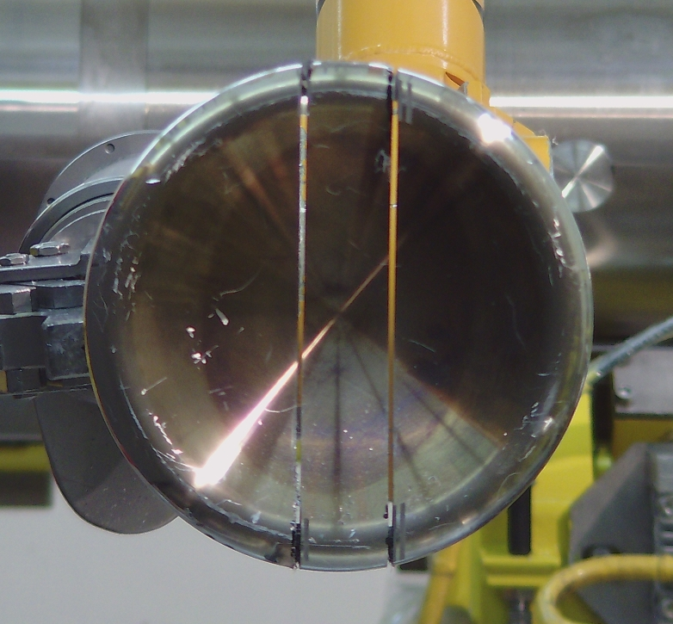
Proton Beam Window: Dose Limited Lifetime due to Helium Embrittlement
Aluminum Alloy:
  Low proton scattering cross-section
  Two alloys are defined in RCC-MRx pressure vessel code
Dose limit due to helium embrittlement
  Al-5754-O
    Operation Record of PSI safety hull: Max. 2200 He-appm (8.8 DPA)
  Al-6061-T6
    No data on helium embrittlement under proton dose
    The dose limit adopts Max. 2200 He-appm
Y. Dai et. al. IWSMT 2016

Slide 30
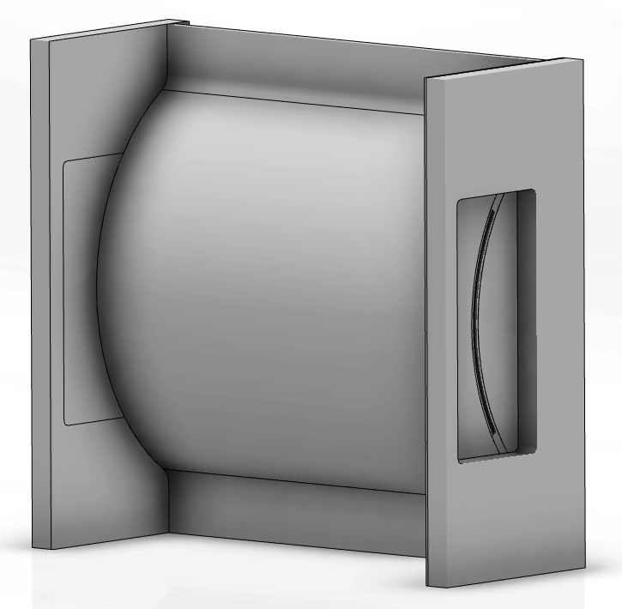
Proton Beam Window (PBW): Material Selection and Lifetime
Material Selection: Al-6061-T6
  Superior radiation resistance in research reactors to Al5XXX: HFIR, JHR, etc
  Helium embrittlement determines the lifetime
  Helium production rate: Max. 4200 appm/ESS-year
  Displacement damage rate: 7 DPA/ESS-year
The lifetime is set to be maximum 2200 He-appm in the window
  Lifetime: 0.5 ESS-year (13500 MWh)
Courtesy Mattias Wilborgsson

Slide 31
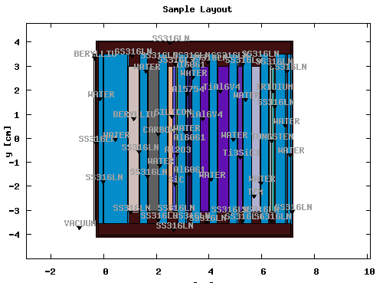
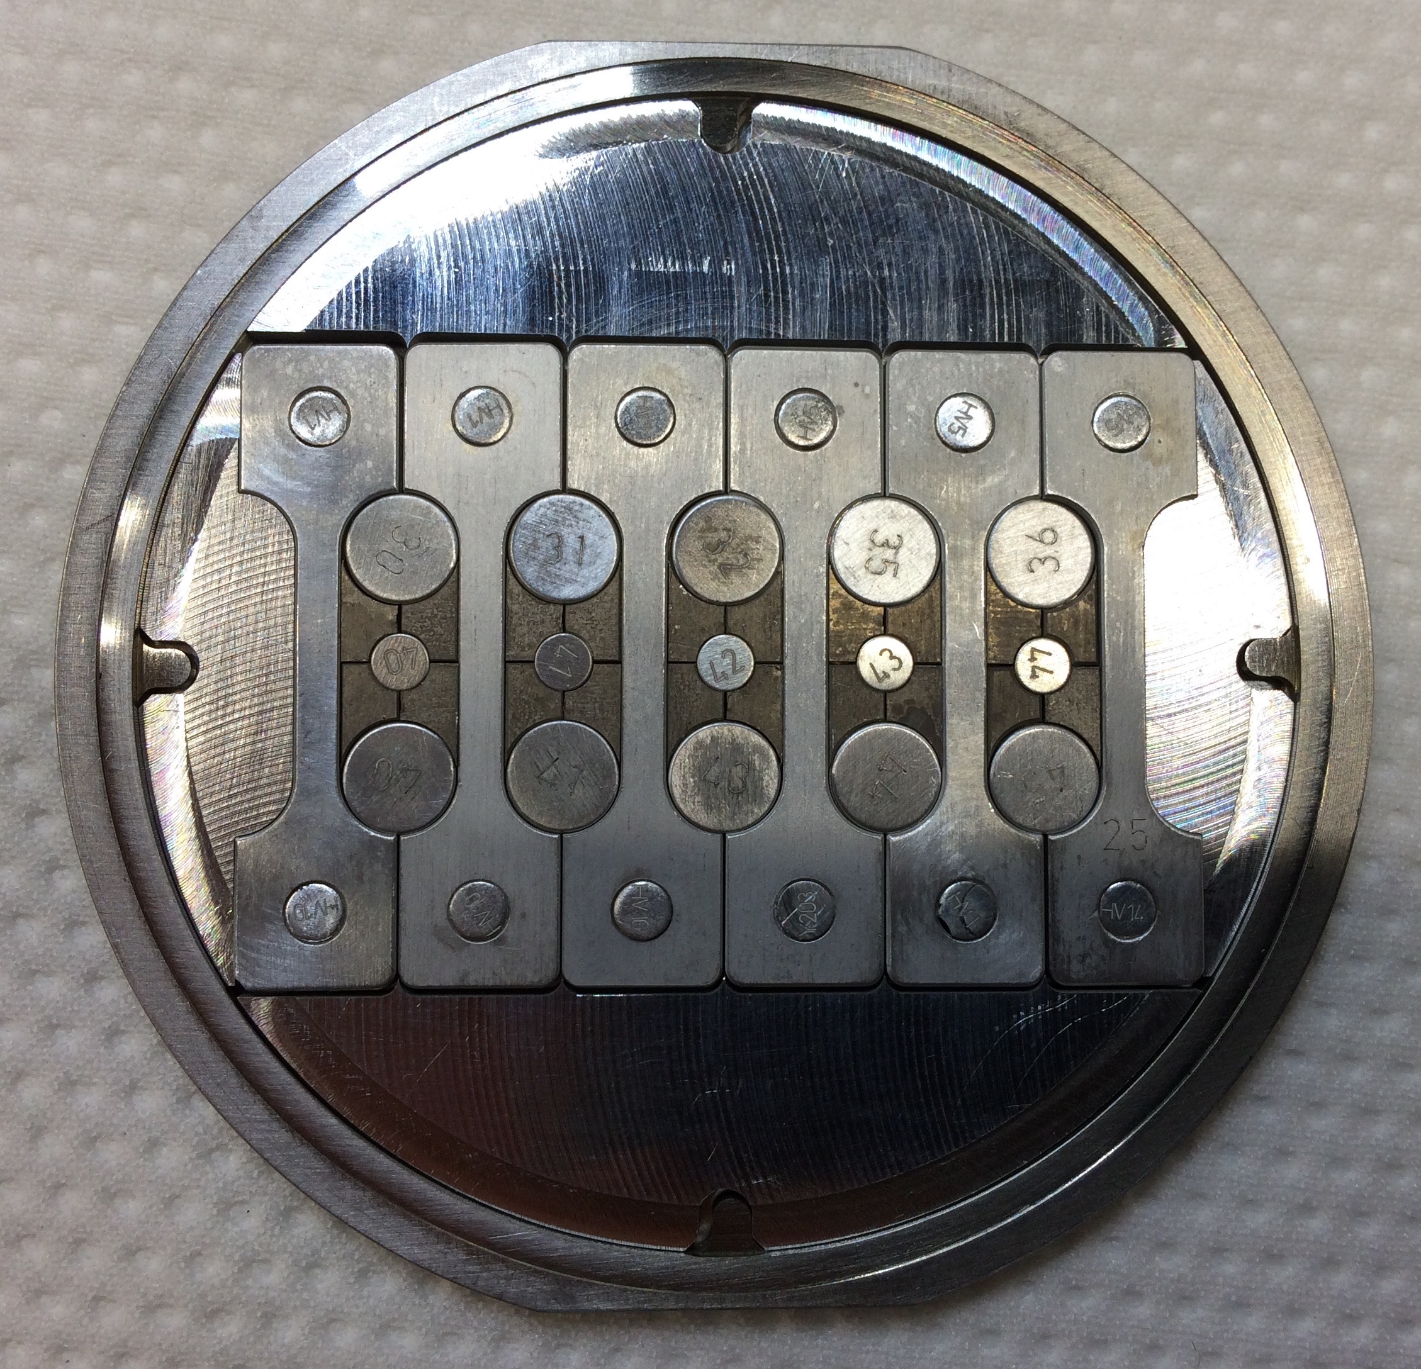
Proton Beam Window: BLIP Irradiation Program at BNL
Purposes:
  Characterization of helium bubble size and distribution in Al6061-T6 and Al5754-O
  Extension of PBW lifetime
Beam Parameters
  Energy: 181 MeV
  Current: 165 uA
  Rastered Beam Profile
  Assessment of the material properties of PBW under proton irradiation

Slide 32
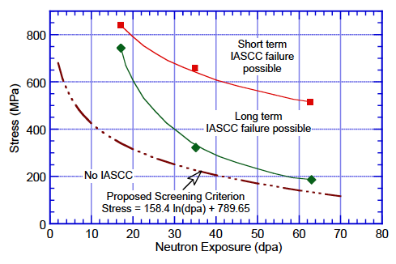
Monolith Vessel and Inner Shielding: Lifetime Criteria
Neutron dose limit:
  RCC-MRx: Negligible dose:
    SA SS316L: 2.75 dpa @ 20 - 350 ºC
    SA SS304L: 0.6 dpa @ 20 - 400 ºC
  Irradiation Assisted Stress Corrosion Cracking (IASCC):
    The DPA limit is stress correlated
Pitting corrosion in SS in contact with concrete: Pitting Resistance Equivalent (PRE) > 25 is recommended
  SS304: PRE = 19
  SS316: PRE = 25
    O. K. Chopra and A. S. Rao, JNM 409 (2011) 235

Slide 33
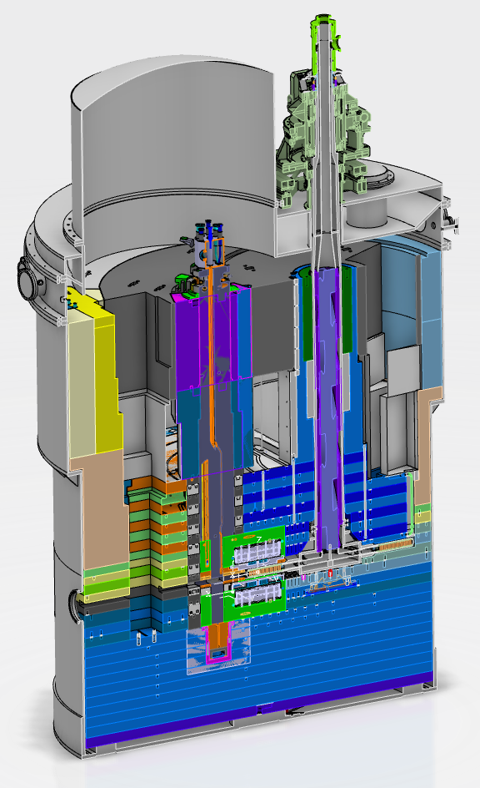
Monolith Vessel and Inner Shielding
Material Selection:
  Monolith Vessel: SS316L
  Inner Shielding: SS304L
Both systems should serve the facility lifetime of ESS
Maximum displacement damage requirements:
  Monolith Vessel: < 2.75 DPA/40 ESS-years
  Inner Shielding: < 53 DPA/40 ESS-years

Slide 34
Target Drive Unit: Permanent Magnet
Material Selection:
  Permanent Magnet: NdFeB
Lifetime is set by fast neutron fluence: Max. 1.8e12 n/cm²
Lifetime:
  Neutron flux in drive unit: 6e11 n/cm²/ESS-Year
  Lifetime: 3 ESS-Year
  Need additional shielding for longer lifetime
J. Alderman et al. NIMA 481 (2002) 9

Slide 35
Target Drive Unit: Polymers and Lubricants
The radiation resistance of polymers, adhesives and cables are compiled in CERN yellow book
  BUT, the compiled data is based on gamma radiation
  In the target monolith, most of the radiation dose is due to neutrons
  There has been progress in materials since 1980s when the CERN yellow book was published
This requires new R&D program to plan the service lifetime of polymers and lubricants at ESS

Slide 36
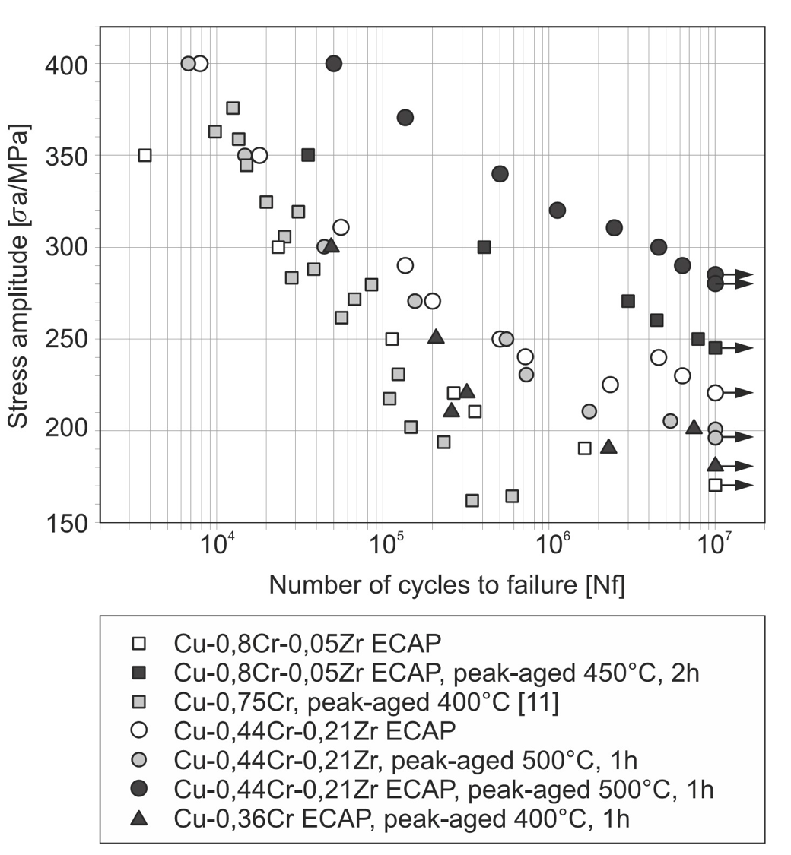
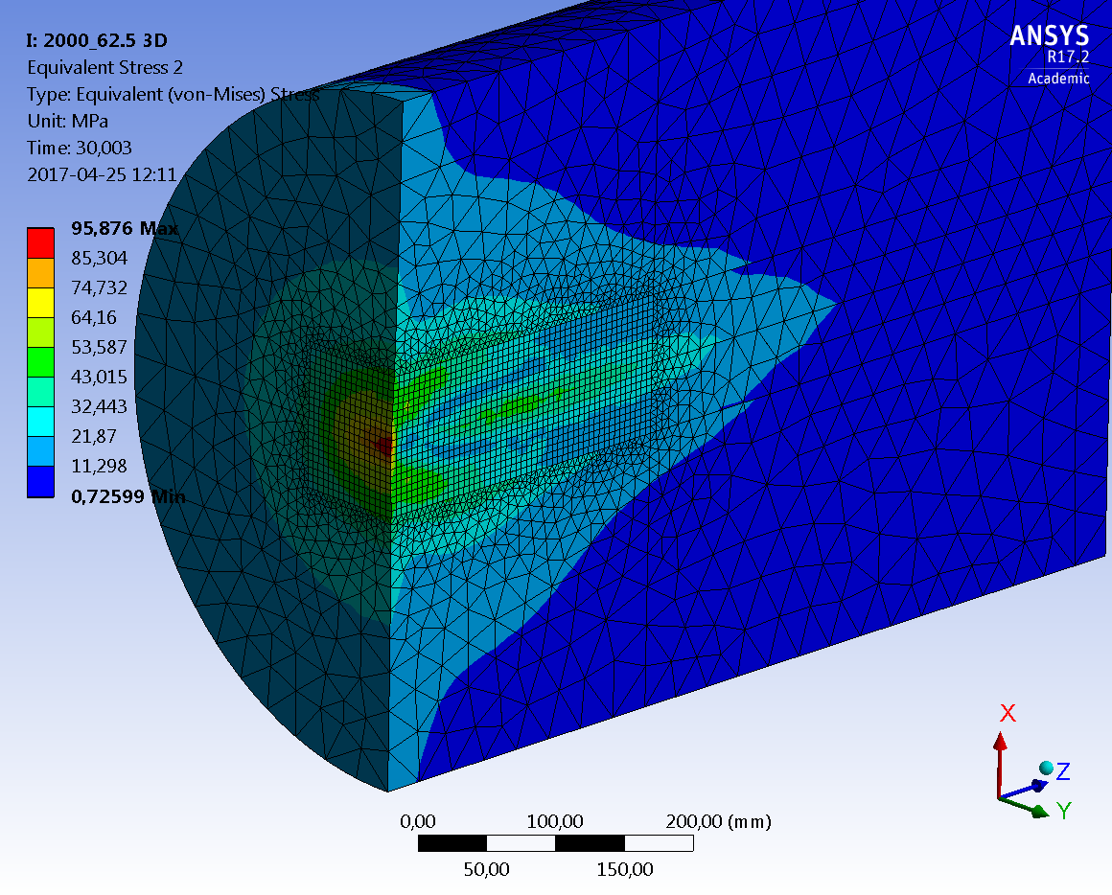
Tuning Dump (12.5 kW)
Material Selection: CuCr1Zr
  High mechanical strength and thermal conductivity
  Proven track record at CERN
Lifetime: 40 Years
  552 hours/year beam study: O(10⁷) cycles/40Y
  Thermal fatigue limit: 200 MPa
  Max. 2 dpa: <10% loss in thermal conductivity
European Copper Institute

Slide 37
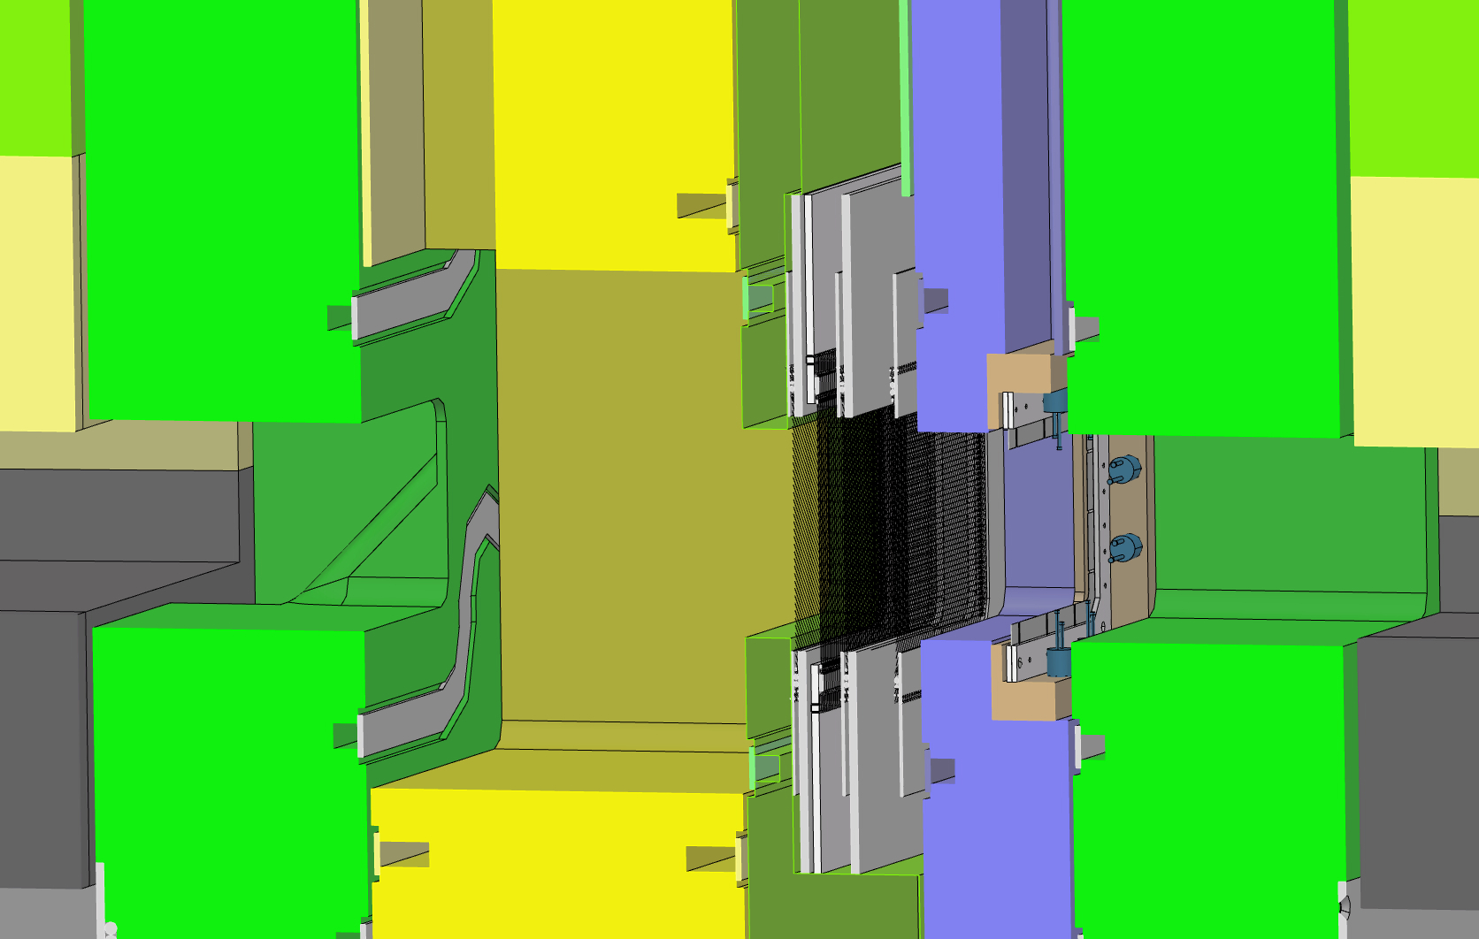
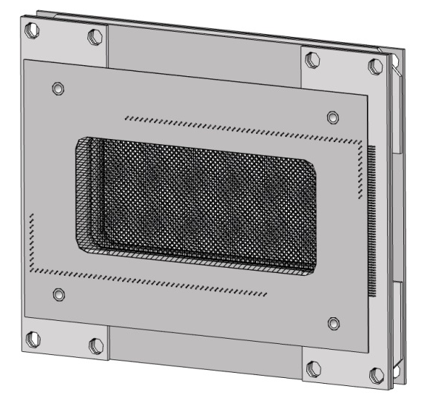
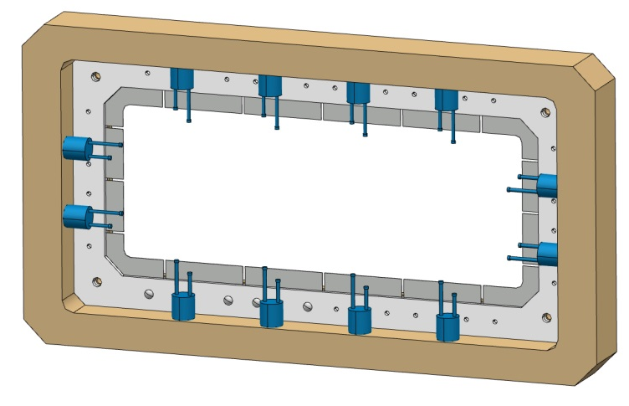
Beam Profile Monitoring Systems
All the BPM systems in Target Station planned is based on beam intercepting:
  Multi-wire profile monitor:
    Set of conducting wires intersecting proton beam
  Aperture monitor:
    Set of thin metal blades intersecting the proton beam edge
  Luminescent coating:
    Proton beam window (PBW)
    Beam entrance window (BEW) of the target wheel

Slide 38
MWPM: Radiation Damage
Harp Material | Max. DPA Rate [dpa/hour] | Annual Beam on Target Time | Max. DPA per Year
W | 0.012 | 5400 | 64.8
SiC | 0.001 | 5400 | 5.4
The tungsten harp at SNS, JSNS and the SiC harp at TS2 of ISIS have been operating without failure since commissioning of the facilities.
The accumulated damage dose on the harp in both facilities is roughly equivalent to one year dose at ESS.
Benchmarking Institution | Harp Material | Total Beam Energy/Charge | Accumulated Max. DPA
ORNL-SNS | W | 32000 MWh | 70
ISIS-TS2 | SiC | 1.5 Ah | 3

Slide 39
MWPM: Material Selection
Properties | Tungsten | SiC
Beam optics disturbance | - | o
Δ-ray production | -- | -
Radiation damage limit | 1 ESS-Year | 1 ESS-Year
Signal strength | + | -
Surface corrosion | - | +
Operation temperature | High | Medium
Mechanical load during operation | High | Low
Silicon Carbide is selected for the ESS application

Slide 40
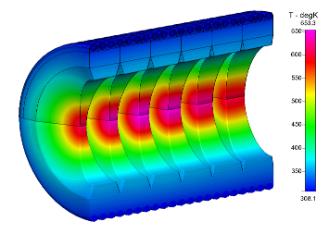
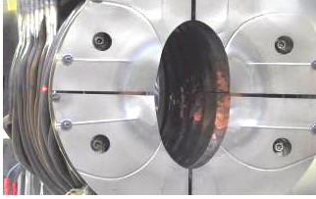
Aperture Monitor
Material Selection: Nickel
  The halo monitor mounted at the direct beam upstream of KHE-2 is made of 100 um thick nickel membrane.
A. Strinning, et. al. HB2010

Slide 41
Aperture Monitor: Radiation Damage and Lifetime
Benchmarking: PSI
  Integrated beam charge up to 2010: 120 Ah
  Maximum integrated Displacement Damage: 100 DPA
Aperture monitor at ESS
  Maximum damage rate: < 10 dpa/year for 27000 MWh/y
  The lifetime of the aperture monitor is conservatively estimated to be 10 years

Slide 42
Summary: Lifetime
System | Material | Lifetime Criteria | ESS Dose Limit | Lifetime in ESS-year
Target vessel | SS316L | Displacement damage | 8 DPA | 5.0
Spallation Mat. | Tungsten | - | - | 5.0
Target Drive Unit | NdFeB | Fast neutron fluence | 1.8e12 n_{>0.1 MeV}/cm2 | 3.0
MR vessel | Al6061-T6/Al5754-O | Therm. neut. fluence | 1.8e22 n_{th}/cm² | 1.0
Reflector | Beryllium | Helium transmutation | - | -
PBW | Al6061-T6 | Helium embrittlement | 2200 He-appm | 1.0
Monolith vessel | SS316L | Displacement damage | 2.75 DPA | 40.0
Inner shielding | SS304L | IASCC/RCC-MRx | 53 DPA | 40.0
Tuning dump | CuCr1Zr | Fatigue | - | 40.0
MWPM | SiC | Displacement damage | 12 | 2.0
Aperture monitor | Nickel | Displacement damage | 20 | 2.0
Vacuum sealing | EPDM | Neutron and 𝜸 dose | 1 MGy | 10.0

Slide 43
Prospect for Materials R&D at ESS

Slide 44
Post Irradiation Examinations in Operation
PIE of the Components with Dose Limited Lifetime:
  After Service Lifetime
  After Premature Failure
Irradiation Campaign and PIE in Collaboration:
  Materials after service lifetime or premature failure at other institutions
  Dedicated irradiation campaign and PIE of materials of common interests

Slide 45

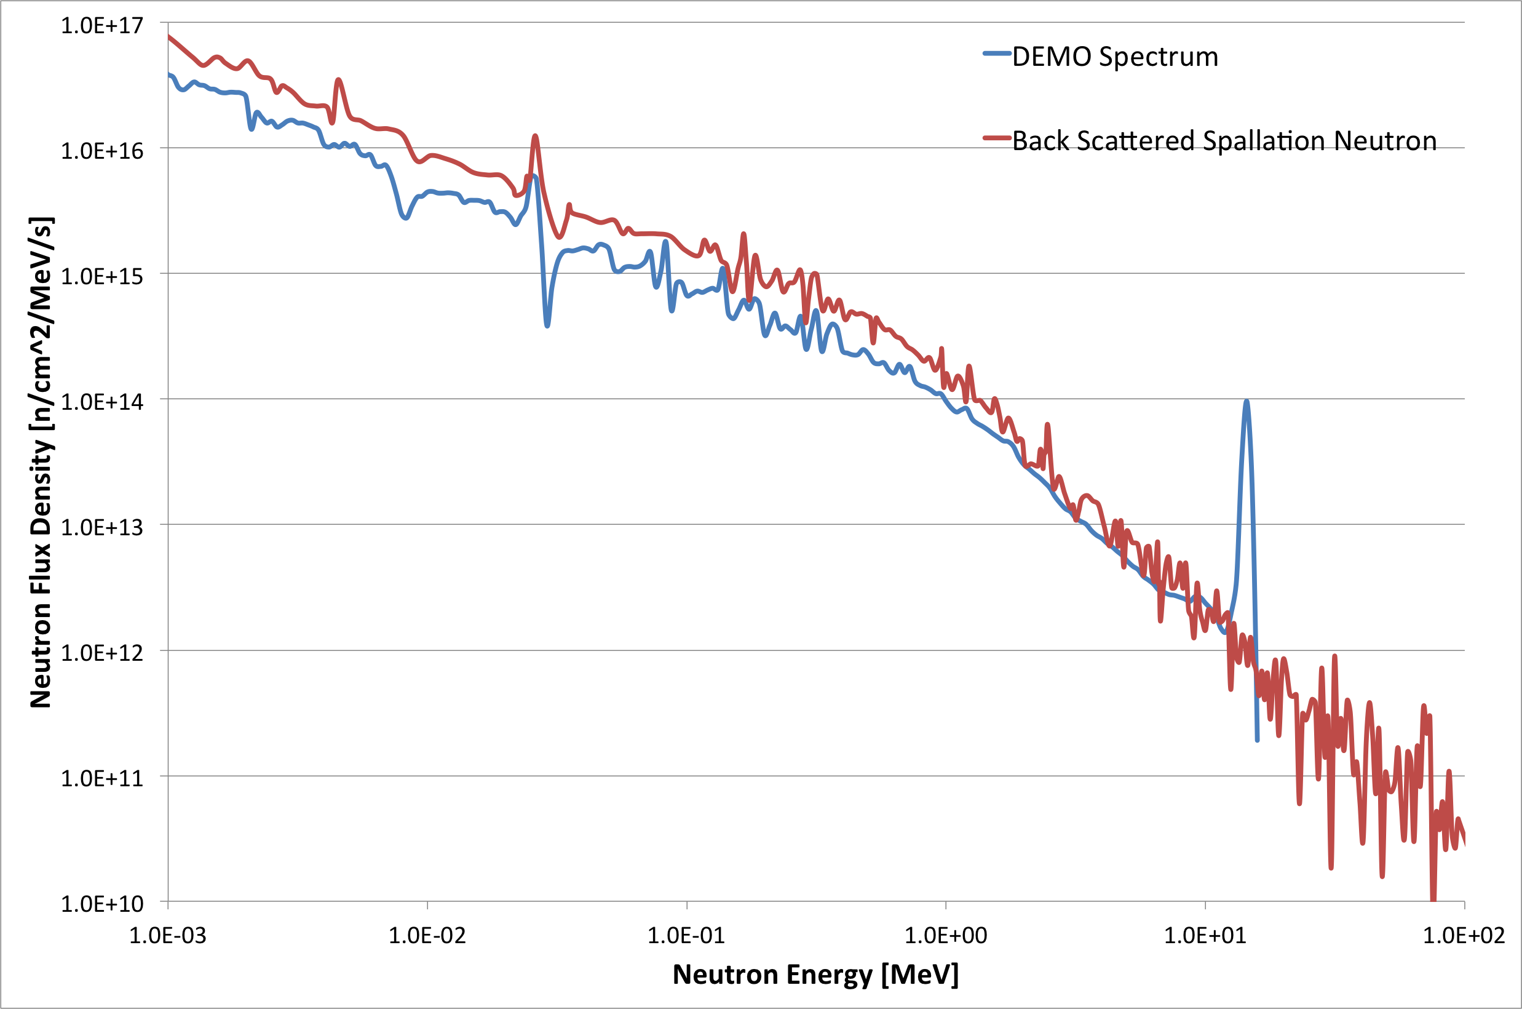
ESS Spallation Neutron Irradiation Program (ESNIP)
ESNIP-I (2019-2024)
  Proof of Concept Module
  Passively cooled by pre-moderator water flow
ESNIP-II (2024 and on): Vision
  Located at the hot spot position for optimal damage dose
  Active temperature control
  Larger Irradiation Volume
Potential application for fusion materials research

Slide 46
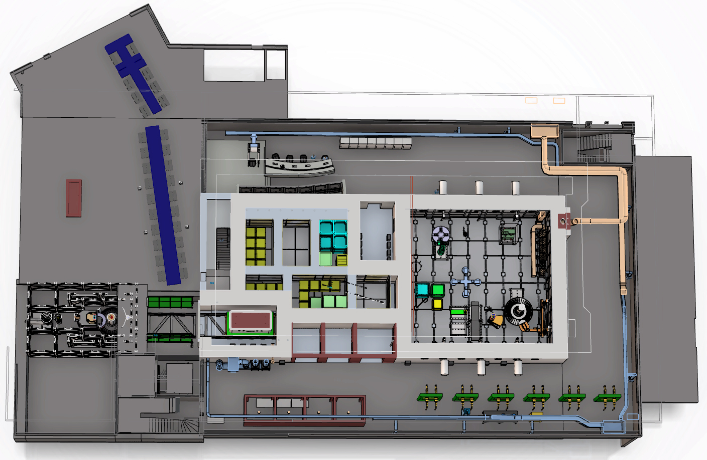
PIE Cells at ESS (PIECE)
Vision: Dedicated spallation materials research capability at ESS
Storage Pit
Process Cell
Research
Hot Cells
Transfer zone
Semi Hot Cells

Slide 47
ESS Medical Isotope Production Factory (EMIPF): Module in Target Upstream
Feasibility study proposal for external funding will be made
  Conceptual Design Study
  Operational Model Study
  Identification and Teaming-Up of Potential Stakeholders

Slide 48
Update of Dose Limited Lifetime
Update of dose limited lifetime
Operational Experiences of leading accelerator facility
PIE of used components
PIE of ESNIP samples
Irradiation campaign and PIE in collaboration
Update of acceptable risk

Slide 49
Summary
Many of the radiation exposed components at ESS Target Station suffers from radiation damage limited lifetime.
Many of the materials lack enough statistics to determine the lifetime under specific ESS radiation environments.
Study and Research activities are in progress to determine the dose limited lifetime with acceptable risks
The prospects of Materials R&D includes the materials in accelerator and target environments, and the materials for medical, particle physics and future energy technology applications as well.

Slide 50

Thank you!

