Slide 1
Introduction to High Power Spallation Target and ESS Target Station
Yongjoong Lee
Group Leader – Materials
Target Division
www.europeanspallationsource.se
4 December, 2017

Slide 2
Outline
Introduction to High Power Spallation Target
Overview of ESS Target Station
Summary

Slide 3

What does ESS Target Station Do?
Target Station is a Neutron Factory

Slide 4
Raw Neutrons using Nuclear Spallation
Spallation vs Billiard
Evaporation
Intra-nuclear cascade

Slide 5
Two Main Ingredients for Neutron Production
Energetic Proton (Cue Ball)
  2 GeV kinetic energy at ESS
  94.8% of the light speed
Target Material (Pool Ball)
  Materials of high neutron density
  Tungsten is chosen
Material | Nucleon density (per cm³)
Water | 0.6 x 10²⁴
Aluminum | 1.6 x 10²⁴
Tungsten | 11.5 x 10²⁴
Mercury | 8.1 x 10²⁴

Slide 6
High Power Spallation Target
The ESS target stops 5 MW beam
  It’s like stopping a Mercedes-Benz S-Class (2000 kg in weight) driving at 255 km/h every second.

Slide 7
What are the issues of concern for high-power targets?
How to remove the heat deposited by the beam?
Can reasonable target lifetimes be maintained?
What are the safety concerns, and how are they best addressed?
Do target operations become more complex at higher power?
How to address the added complexity of short pulses?

Slide 8
MW Class Spallation Targets
A spallation target with a power rating of 1 MW stops the beam with an energy equivalent to single Mercedes-Benz S-Class at 114 km/h, every second.
SNS Target at ORNL:
  Power Rating 1.4 MW: 1.0 GeV/1.4 mA
JSNS Target at J-PARC:
  Power Rating 1.0 MW: 3.0 GeV/0.33 mA
SINQ Target at PSI:
  Power Rating 1.0 MW: 0.6 GeV/2.0 mA

Slide 9
Example: target degradation due to thermal stress and chemical corrosion
Target from the Manuel Lujan Neutron Scattering Center, LANL [M.J. Baumgartner, et al., AccApp’03 (2003) 399]
Edge cooled tungsten target stopping 0.8 GeV/ 80 kW proton beam
Radial cracks from thermal stress
Portions corroded by highly oxidizing species produced when the proton beam passes through the cooling water

Slide 10
Example: Target Failure in Beam Over-Focus Condition
SINQ Target at PSI
Pb target in zircaloy tubing
1 MW (575 MeV, 1.8 mA) proton power is cooled by heavy water flow
Beam over-focus condition on the SINQ target due to an operator setting magnets for the wrong beam tune
Cladding breached and cooling water contaminated
Impacts to operations, safety, and technical accomplishment

Slide 11
Example: Cavitation Erosion to Beam Entrance Window
D.A. McClintock, et al., JNM 431 (2012) 147.
SNS Mercury Target Beam Entrance Window, made of SS 316L
Thermal expansion causes pressure waves that are reflected at the container walls, causing cavitation erosion at certain locations

Slide 12
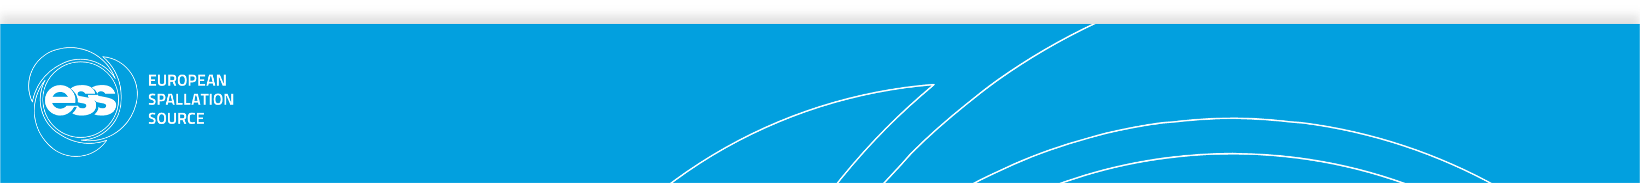
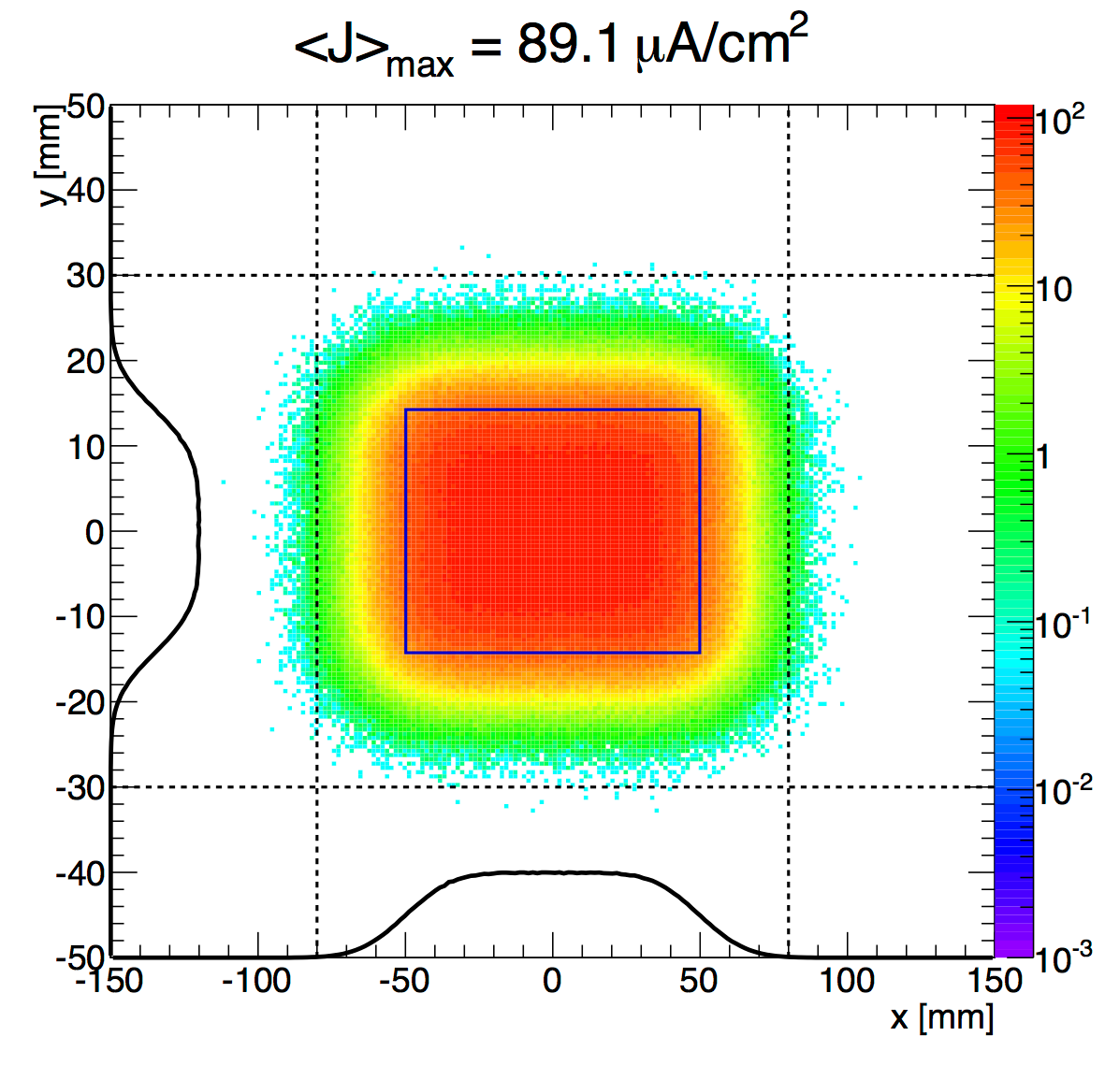
How to accommodate high beam power?
Employ “volume” coolant
  Normally incurs a performance penalty
Increase beam spot on target
  Performance penalty
Use a liquid metal (or powder) as the target
  Potentially a performance penalty
Employ a rotating target
  Operationally more complex

Slide 13
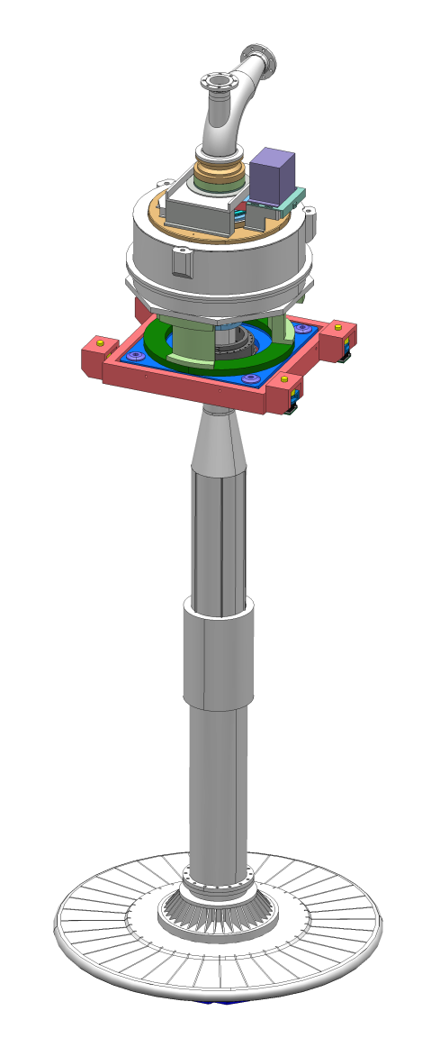
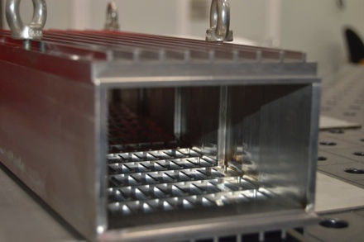
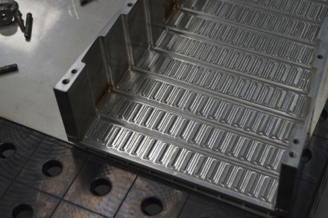
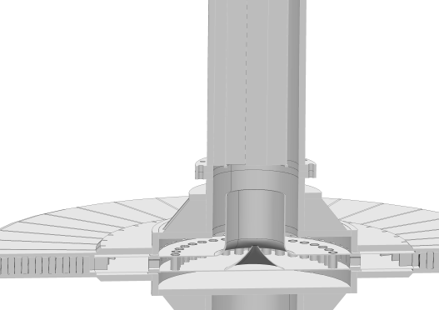
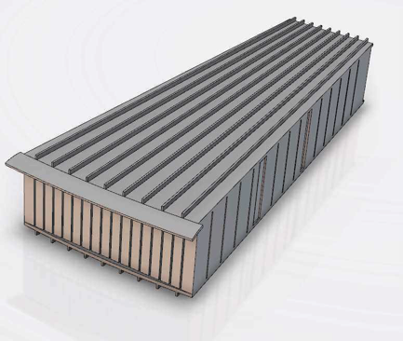
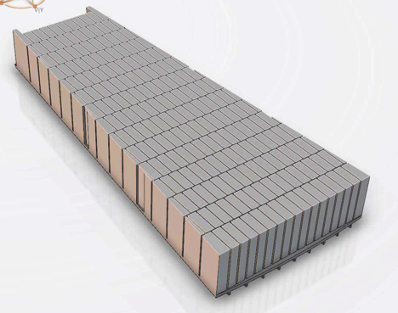
ESS Target: helium Cooled Rotating Tungsten Target
Tungsten blocks in 36 segments
  Max 0.1 GW/m³ in tungsten
  Beam stopping in a meter of tungsten
Helium coolant
  Mass flow 3.0 kg/s
  Pressure 1.0 MPa
Rotational speed 23.3 rpm
Wheel diameter 2.6 m
Shaft length > 5 m

Slide 14
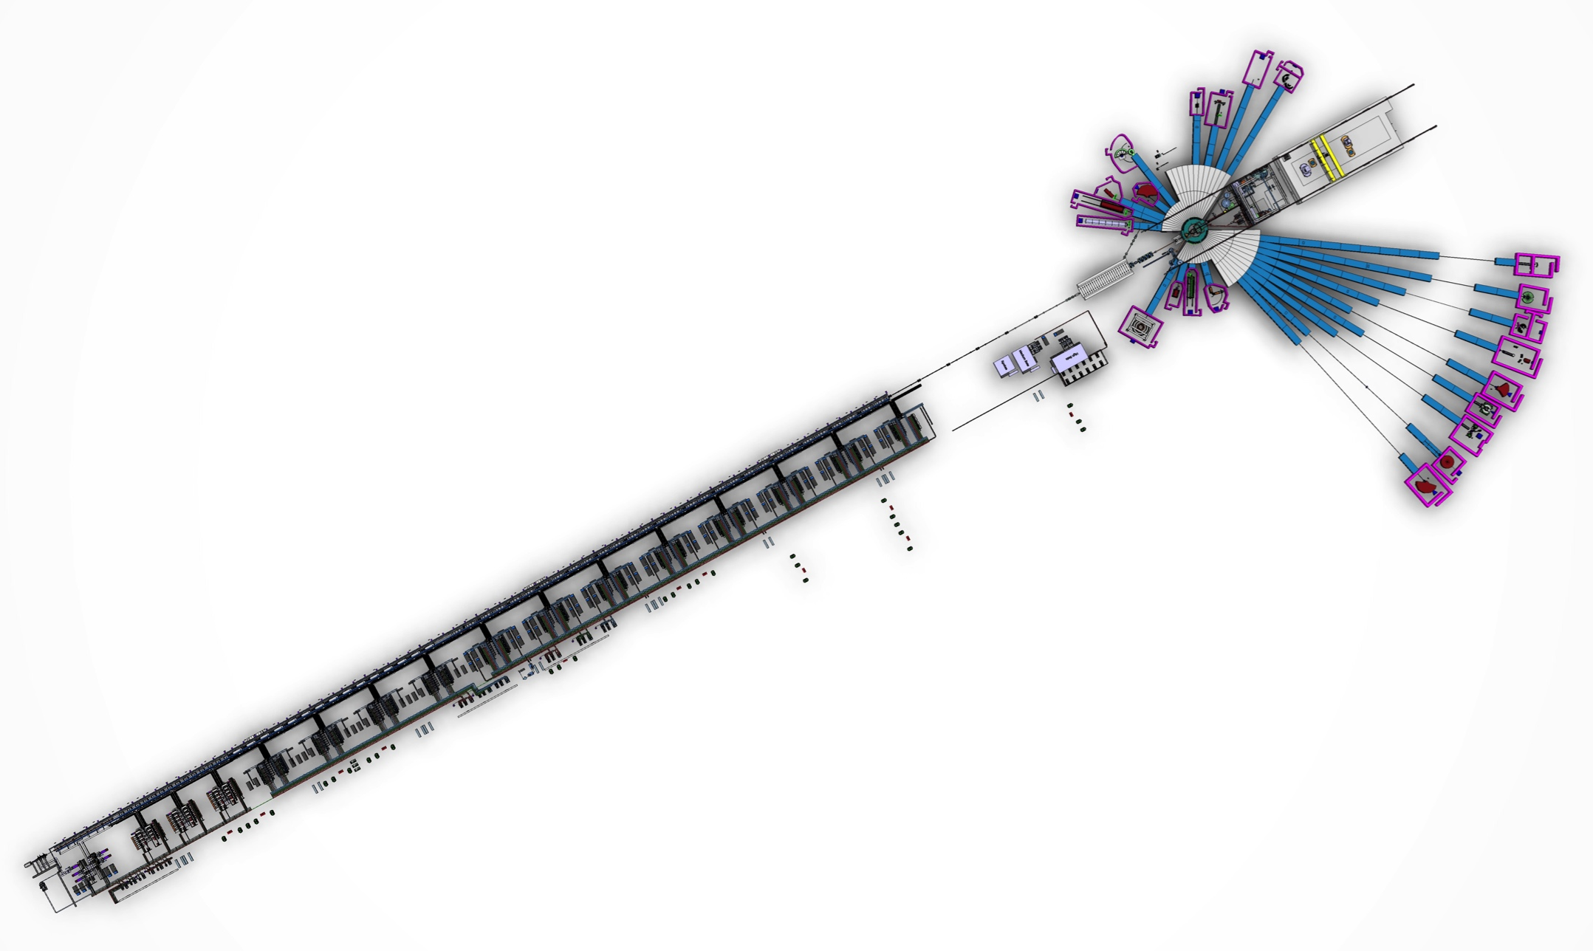
The ESS facility layout
H⁺ Accelerator:
2 GeV/ 2.5 mA avg. (5 MW)
Long pulse: 2.86 ms/14 Hz
Target
Spallation Target:
Rotating tungsten target
Helium cooled
Neutron science systems
Linear proton accelerator

Slide 15
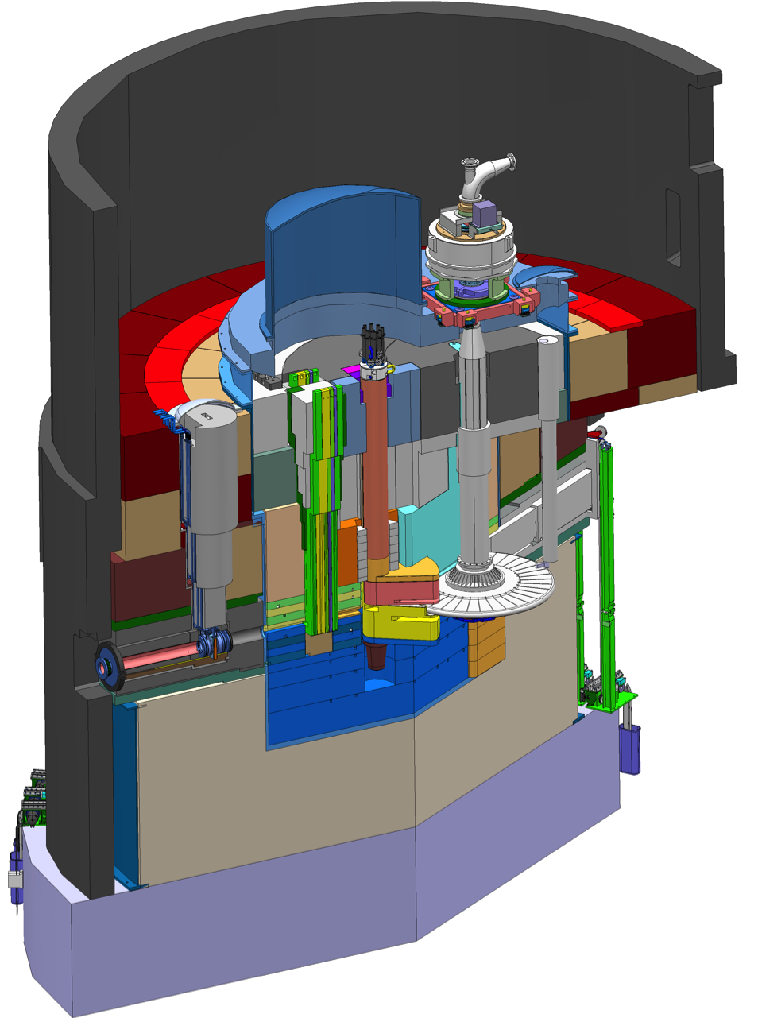
Target Monolith: Heart of ESS
Proton Beam Window: Interface between Accelerator and Target
Target: Generate Spallation Neutrons
Moderator: Slow the neutrons to speeds useful for science
Neutron Beam Ports: Guide neutrons for Science
Shielding: Shield high-energy neutrons from escaping
monolith vessel
neutron beam extraction port
target diagnostics plug
proton
beam
target wheel
moderator-reflector
plug
proton
beam window
proton beam instrumentation plug

Slide 16
ESS Target Station: High Level Functions
Generate spallation neutrons
Beryllium reflects neutrons that might otherwise escape, boosting performance by a factor of 5
Slow the neutrons to speeds useful for science
neutron guide
(start of the neutron
scattering instrument)
conversion
efficiency ~ 10^{–5}
Liquid hydrogen
moderator at 20 K
cold neutrons
tungsten target
produces about 60 neutrons per proton
≈ 10¹⁸ neutrons per second
2-GeV proton
Guide neutrons to neutron scattering instruments

Slide 17
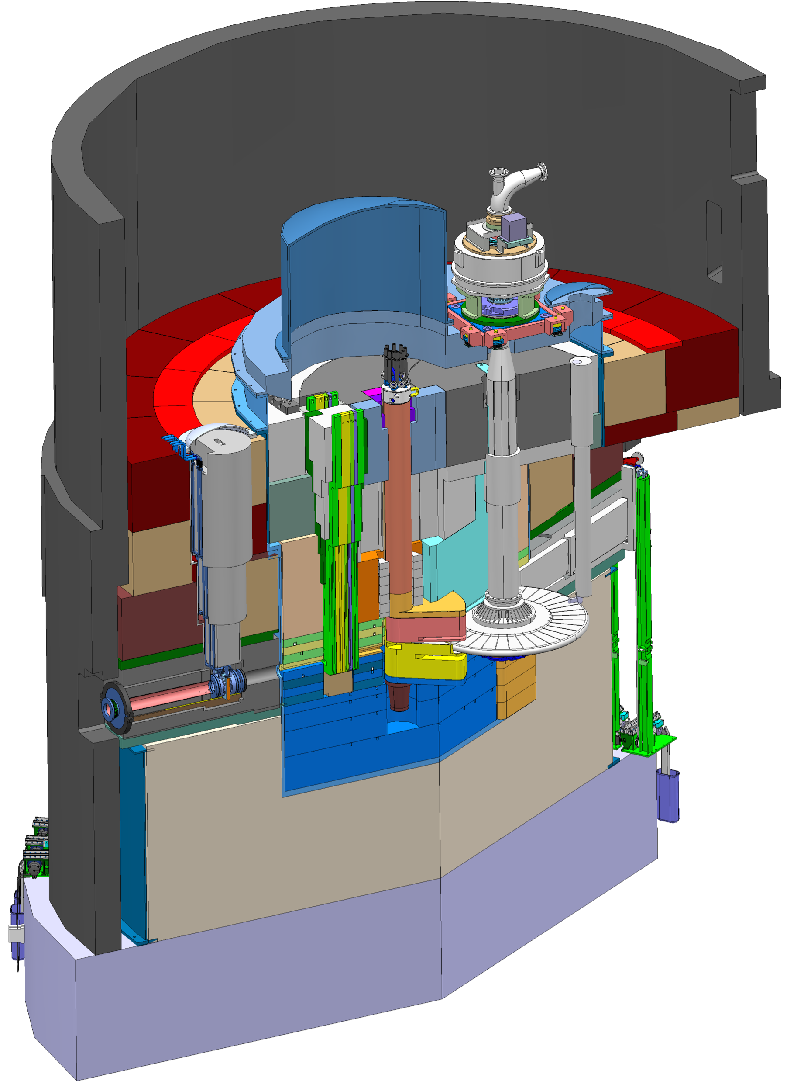
Key features of the ESS Target Station
Moderator and reflector
Target Safety System
Monitors target coolant flow, pressure and temperature, monolith pressure,
& target wheel rotation
Prohibit beam on target if parameters are outside specified limits
proton beam instrumentation plug
Helium cooling of target material
Mass flow 3 kg/s
Pressure 11 bar
Temperature inlet/outlet 40 °C/240 °C
monolith vessel
neutron beam extraction port
Rotating solid tungsten target
36 sectors
Mass, total 11 tonnes, whereof 3 tonnes of W
Rotates 23.3 rpm, synchronized with pulsed proton beam 14 Hz
proton
beam
target wheel
target monitoring plug
proton
beam window
Diagnostics and instrumentation
Controlled and integrated commissioning and operation of the accelerator and target
Fluorescent coating of PBW and target front face
Optical paths, grid profile monitor, aperture monitor
Wheel monitoring including position, temperature, vibration, as well as internal structure
Moderators
Provisional locations of moderators above and beneath the target wheel, i.e. monolith centre
1st MR plug exploits the upper space, offering:
  Cold, 30 mm high, liquid H₂ moderators, 17 K
  Thermal, 30 mm high, H₂O moderator, 300 K

Slide 18
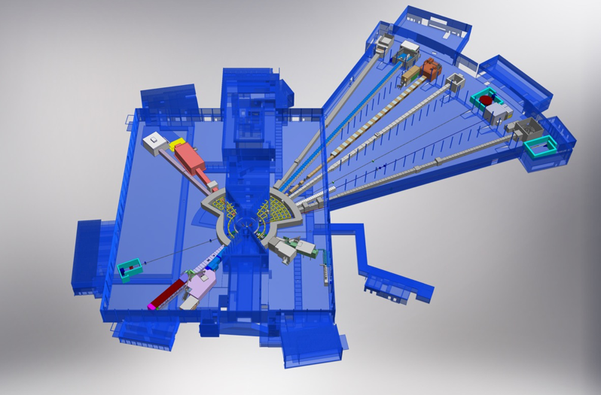

Key features of the ESS Target Station
Monolith
BEER
NMX
C-SPEC
BIFROST
MIRACLES
MAGIC
ODIN
T-REX
DREAM
HEIMDAL
LoKI
Neutron beam extraction
Offers 42 neutron beam ports
Allows neutron science instruments to view either upper or lower moderator position
VESPA
FREIA
SKADI
ESTIA
18
ESS Instrument Layout (December 2016)

Slide 19
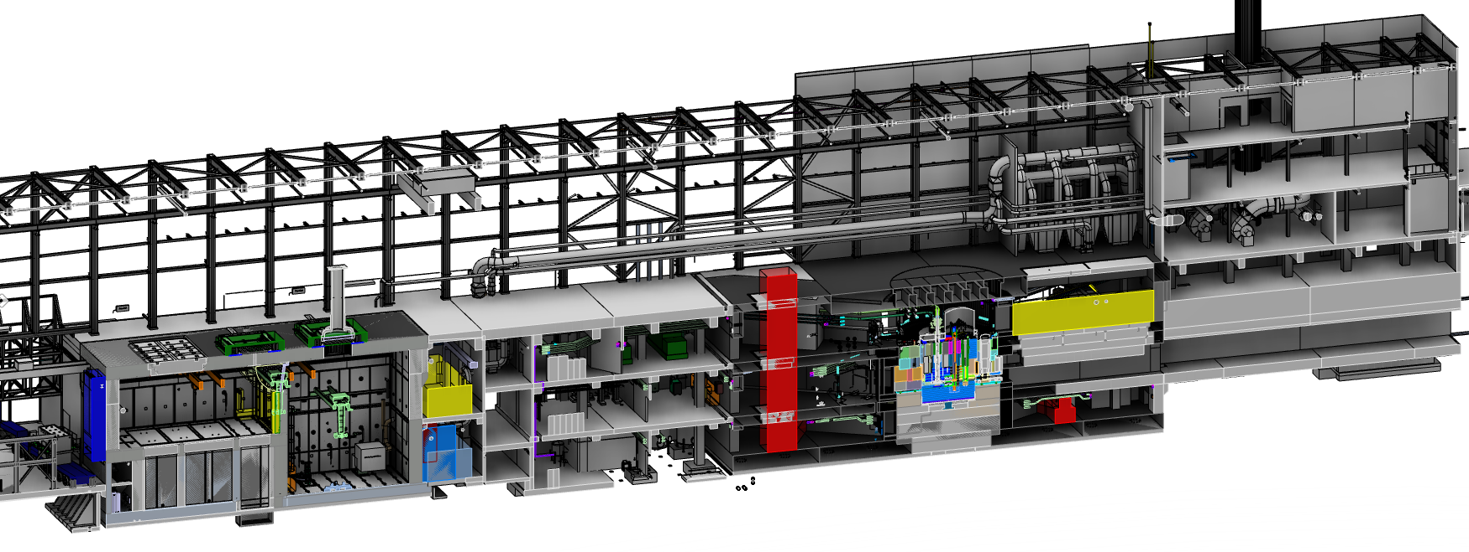
Key features of the ESS Target Station
Utilities and cooling plant
Helium cooling of target wheel
Water cooling of moderators, plugs and shielding
Intermediate water loops between primary circuits and conventional facility utilities
Helium cryoplant for refrigeration of cold moderator system
Nuclear grade HVAC system
Remote handling systems
Large active cells for safe storage and processing of spent radioactive target components
Shielded casks for transfer of spent components from monolith to active cells
High bay
22 m
130 m
Transport hall
37 m
Target
monolith
Active cells
Utilities block
Beam expander hall

Slide 20



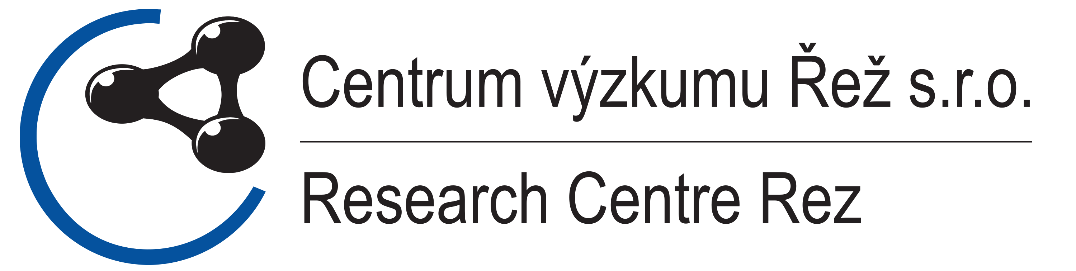






ESS Target Station Collaborators

Slide 21
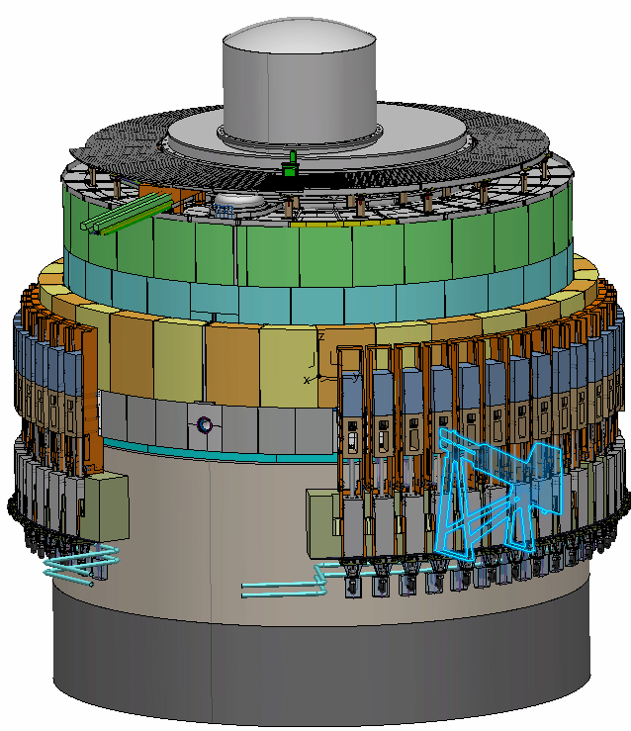
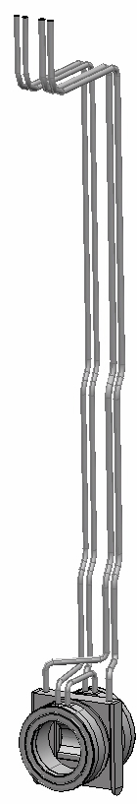
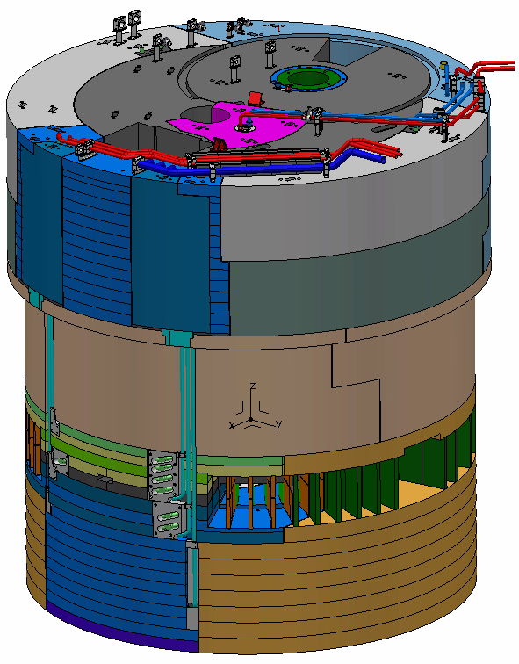
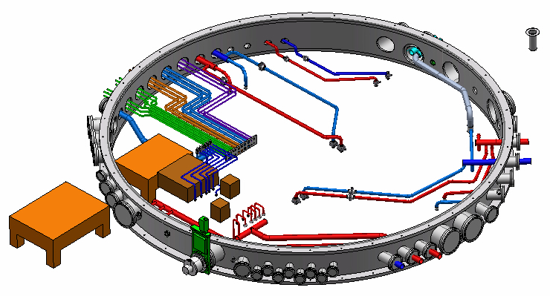
Monolith systems
Monolith vessel
  Design finalized for lower parts and procurement in preparation
  Final design on-going for connection ring and covers
Proton beam window
  Final design on-going
Proton beam instrumentation
  Specifications of instrumentation equipment in progress by ACCSYS and their Norwegian in-kind partner
Monolith shielding, internal and external
  Preliminary design finalized beginning of April 2017
proton beam instrumentation plug
monolith vessel
proton
beam window
Monolith vessel connection ring
Proton Beam Window
Monolith inner shielding (~1000 tonnes of steel)

Slide 22
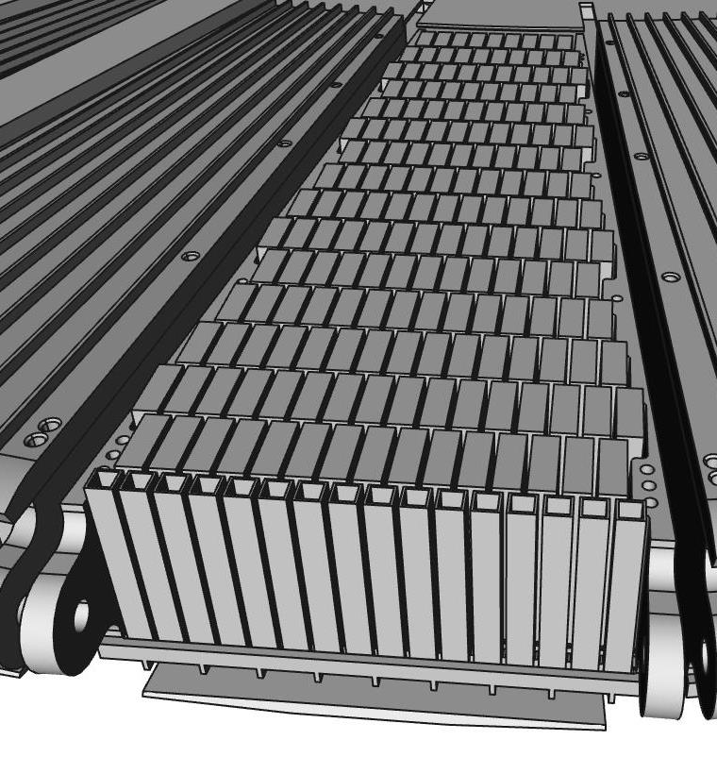
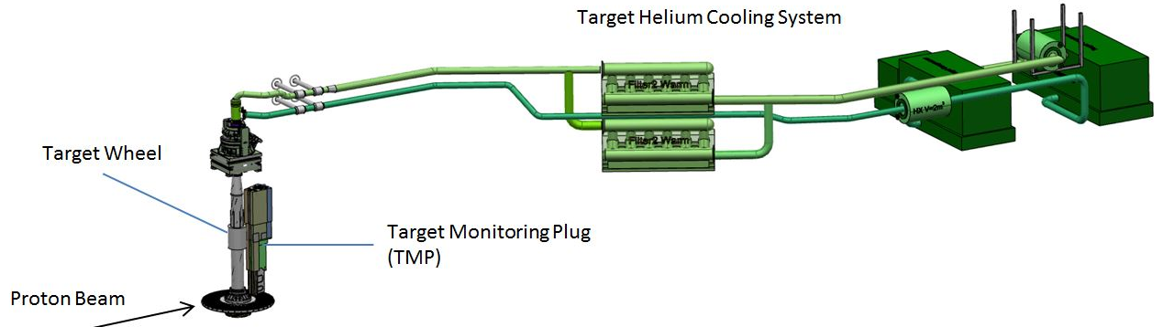
Target Systems
Target wheel and drive unit
  Design of cassettes and spallation material is finalized and procurement is imminent
  Manufacturing of prototype is on-going
  CDR for Target Wheel and Shaft planned in May 2017
Progress on Target Helium Cooling System
  Orders placed for helium circulators
  Detailed design is on-going for the rest of the cooling loop
Target monitoring
  Conceptual solutions defined and preliminary design about to start
Tungsten Bricks in Cassette

Slide 23
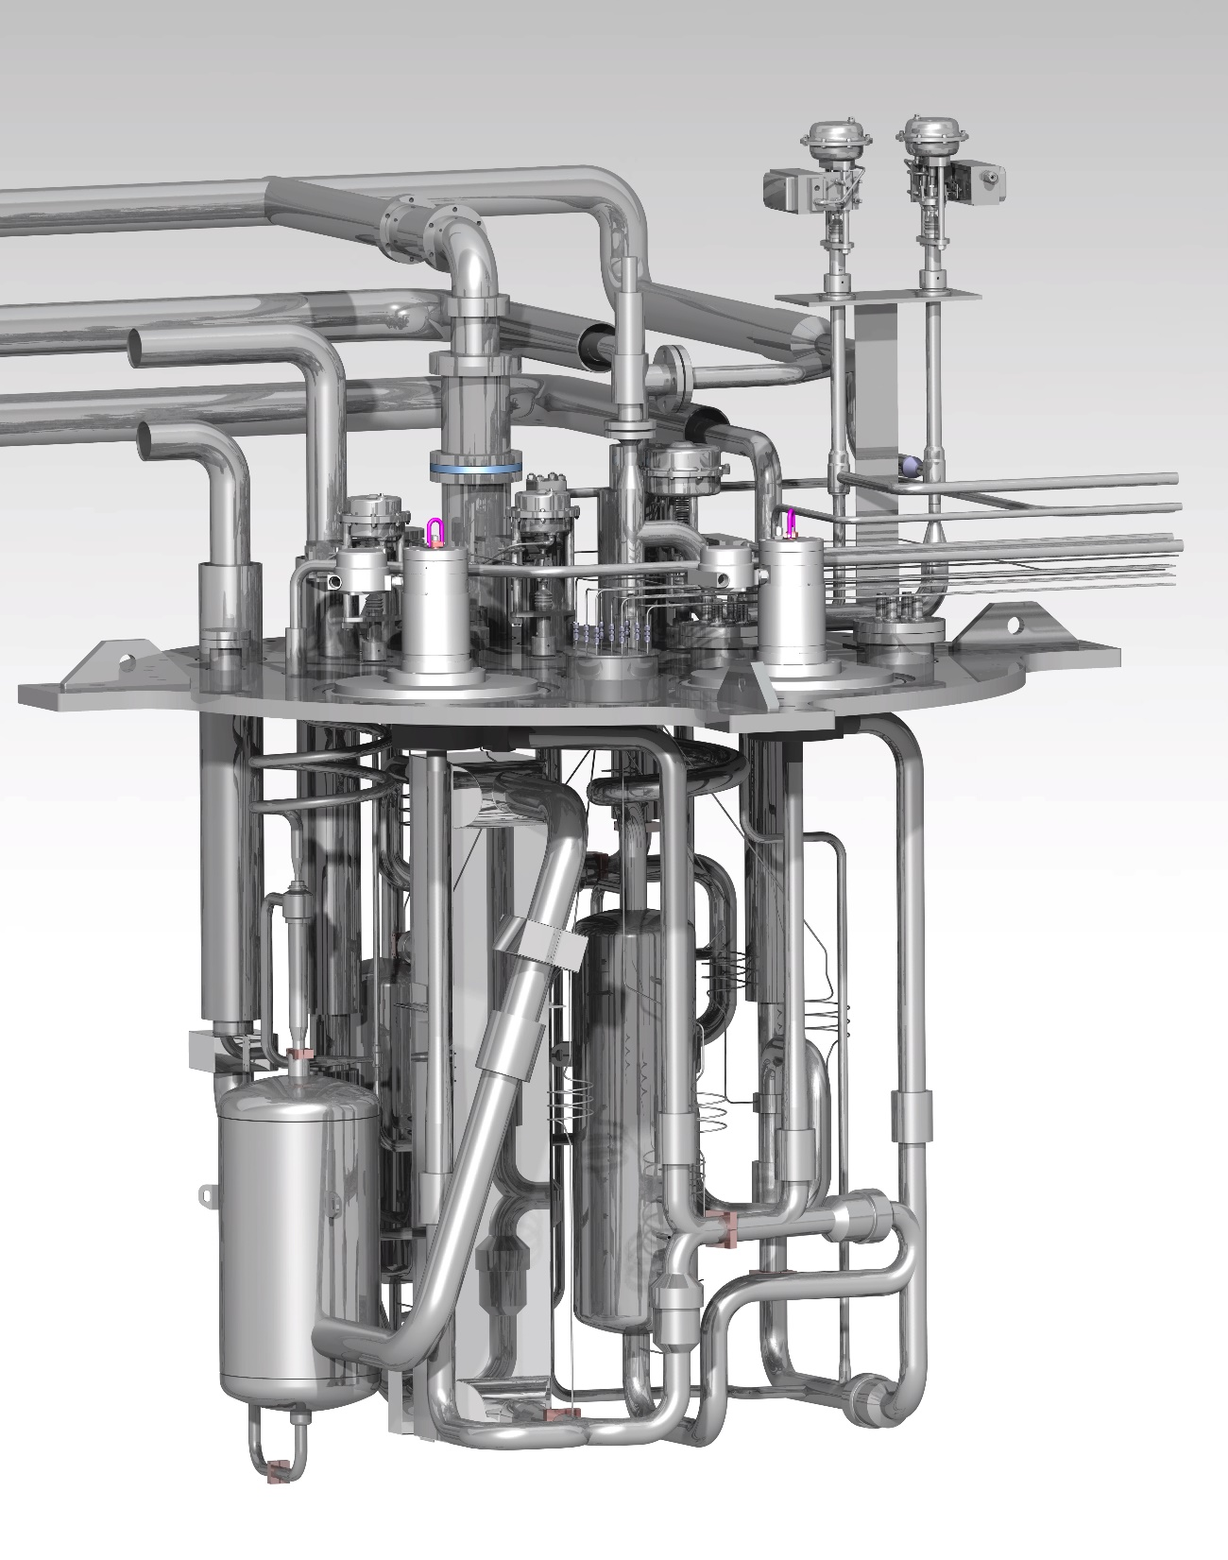
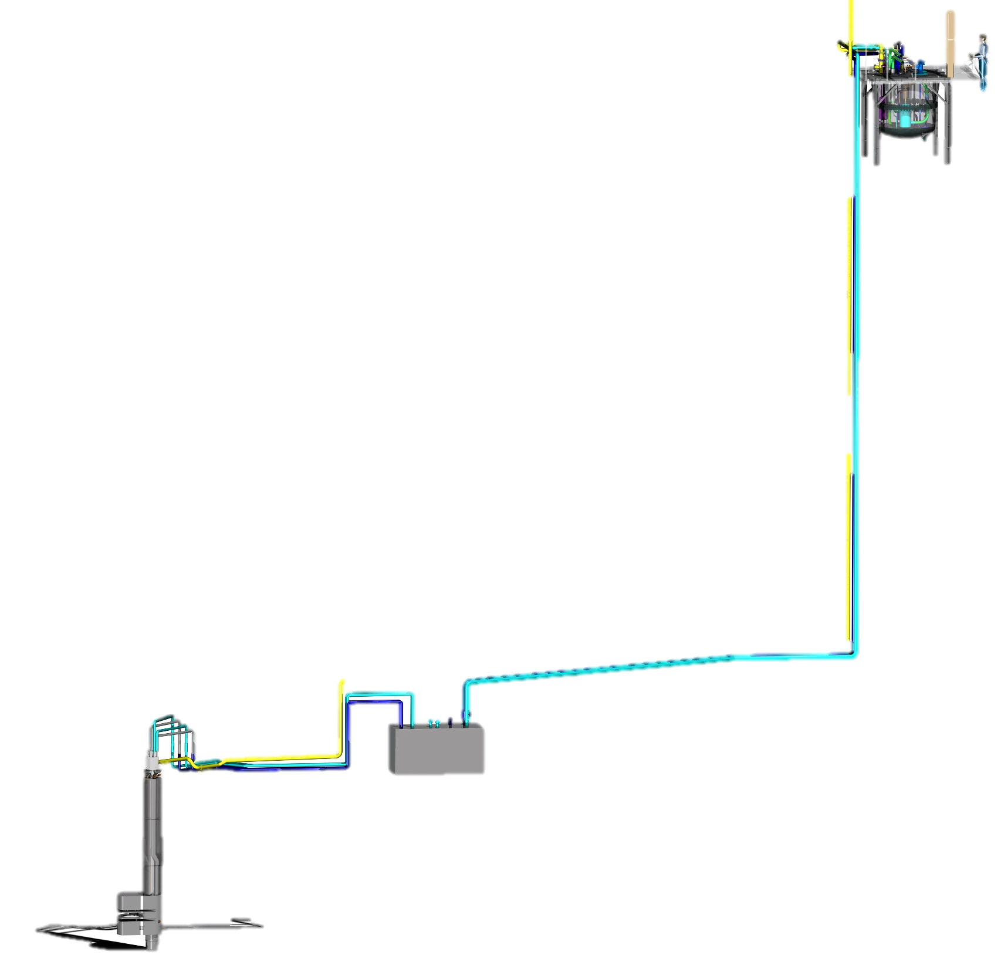
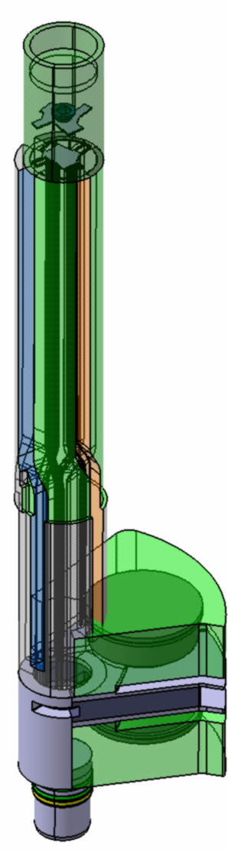
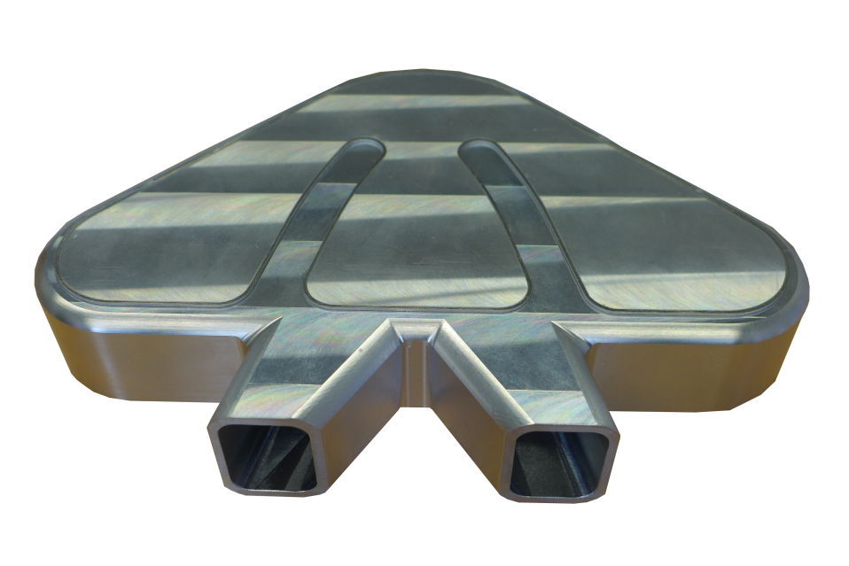
Moderator and Reflector Systems, including Irradiation Module
Helium Cryoplant
  Preliminary design completed by contractor
  Detailed design of system is on-going and will be completed 2017
Cryogenic Hydrogen System
  Detailed design finalized March 2017
  Manufacturing starting 2017 Q2
  LH2 pumps ordered
Irradiation module
  Design of sample capsule
  integrated with MR design
Cryostat internals
MR Plug
Hydrogen System
Cryogenic
Cryogenic moderator prototype
Moderator and reflector plug
  Detailed design completed for all parts of MR plug, fabrication imminent
  Order for beryllium placed
  Extensive prototyping and testing on-going

Slide 24
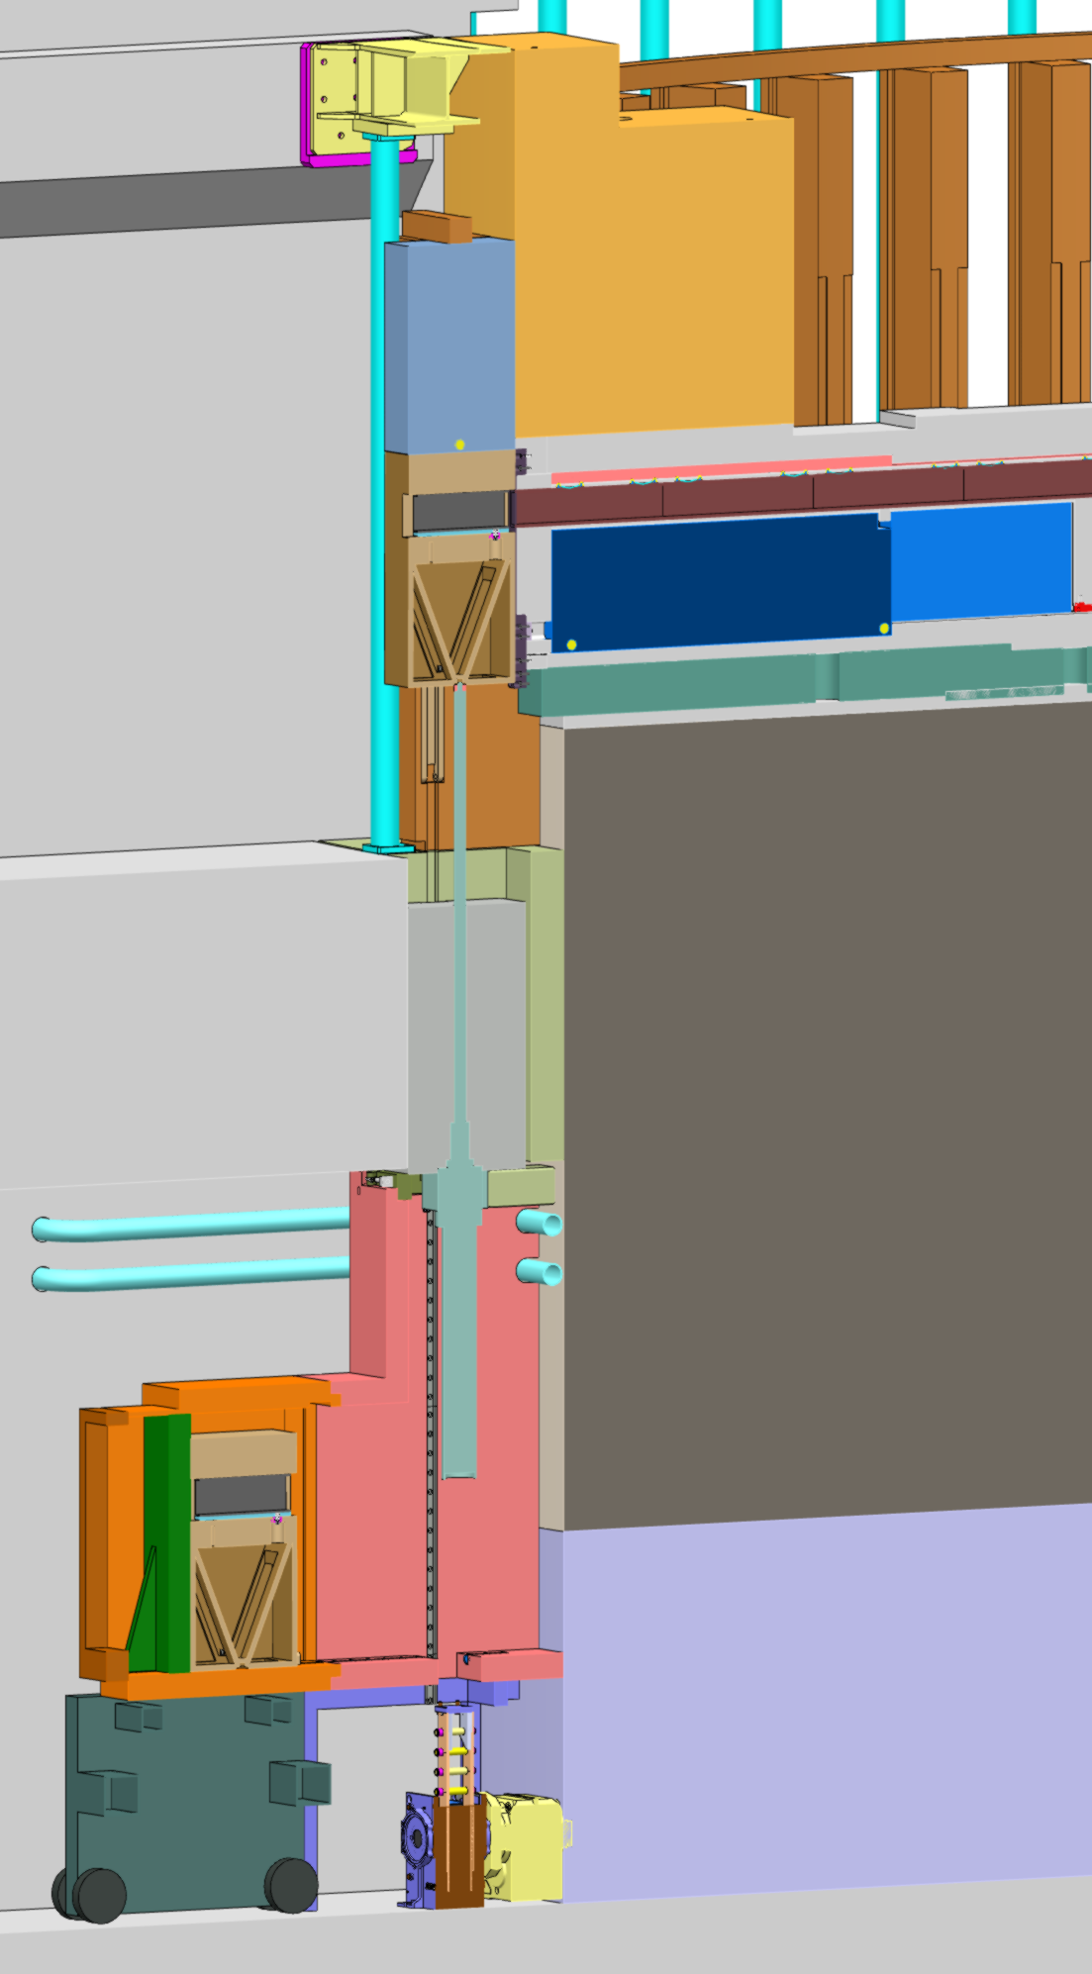
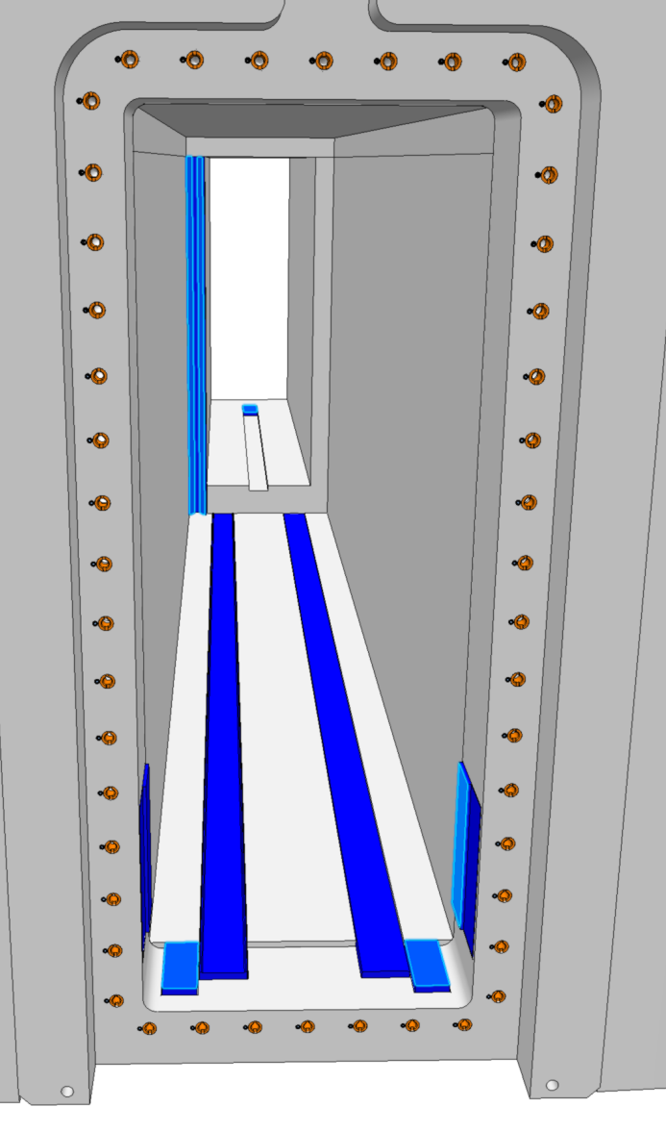
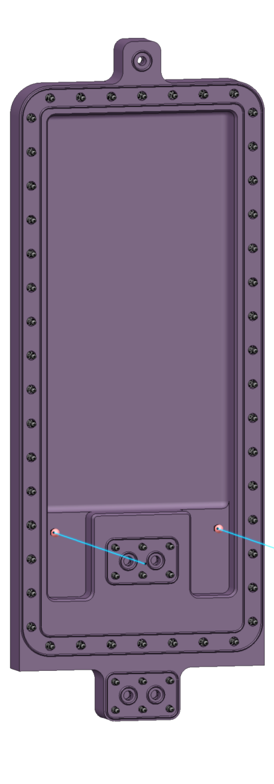
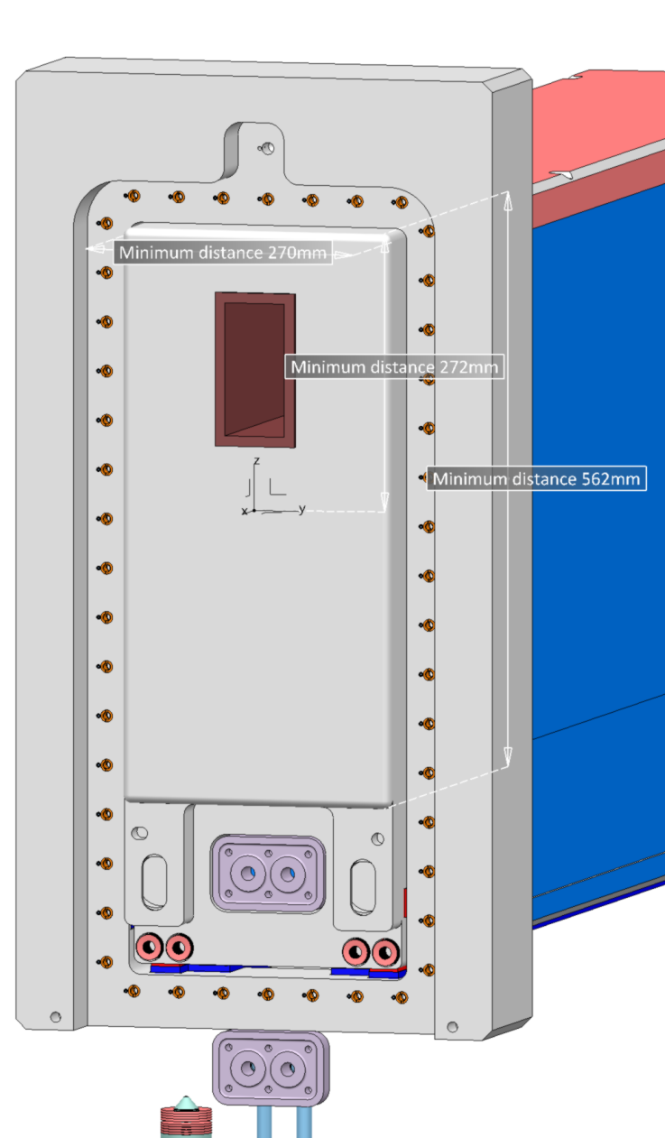
Neutron beam extraction system
Neutron beam extraction system
  Detailed design on-going
  Critical Design Review planned mid 2017
Neutron Beam Windows
  Prototypes for vacuum seal testing manufactured
  Responsibility for manufacturing and delivery will be handed over to in-kind partner as soon as detailed design
  is finalized
GBS
NBW
BBG
NBPI
Instrument position
Target level floor
Handling tooling
24

Slide 25
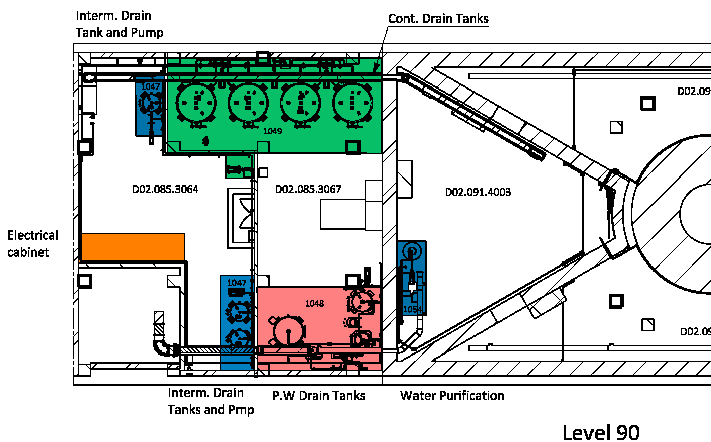
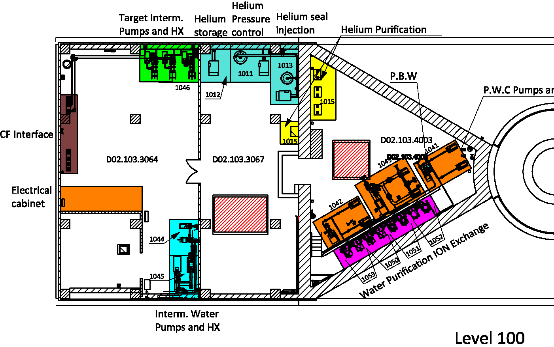
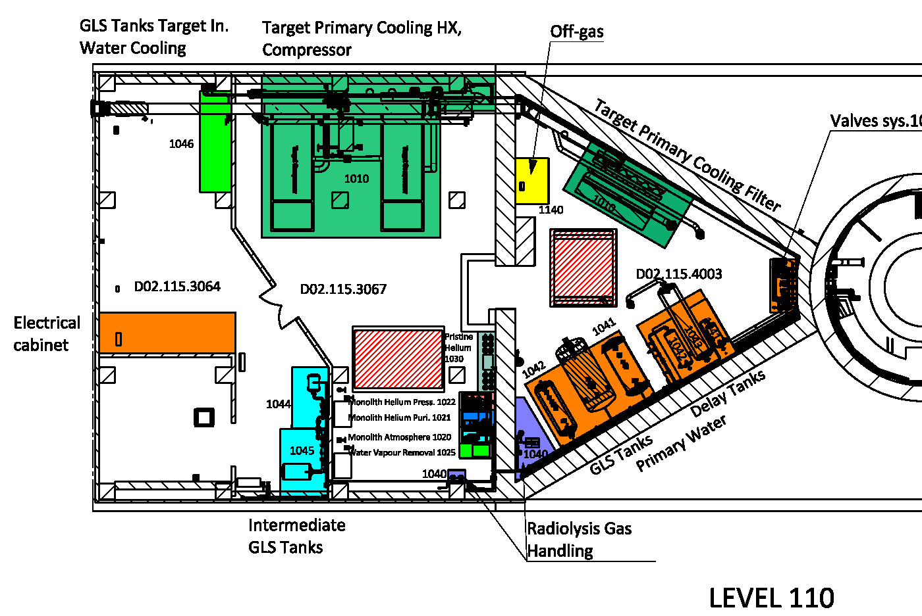
Fluid Systems
Primary and intermediate water cooling systems
  Detailed design is well underway
Target Station HVAC system
  Detailed design is on-going
All other utility and process systems
  Completion of preliminary designs are imminent
  Drain tanks procured and in fabrication

Slide 26
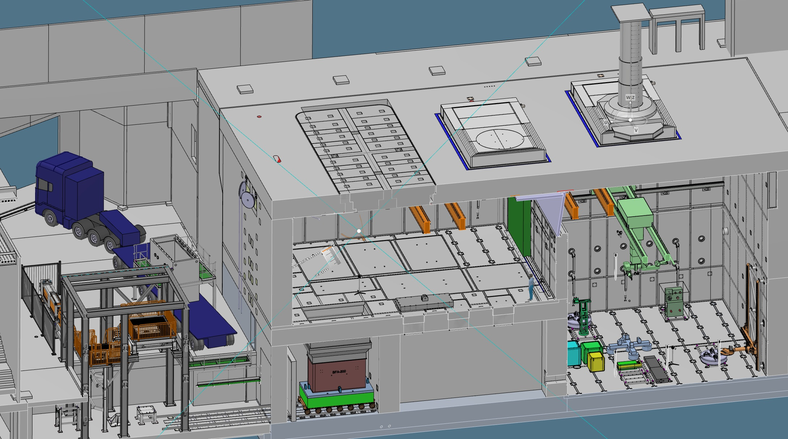
Remote Handling Systems
Casks
Active Cells Facility:
Length: 30 m
Depth: 12 m
Height: 15 m
MUTS
Active Cells Facility

Slide 27
Remote Handling Systems
Active Cells Facility – Liner package, cast-in items
  Final design completed and design packages delivered to Conventional Facilities as needed
  Components are manufactured and delivered to site as needed for installation
  Electrical conduits and anchor plates installed imminently in the ACF floor slab
  Concrete casting for ACF started end of March 2017
Active Cells Facility
  Long lead-time confinement structures and equipment - Final design completed and procurement in preparation
  Final design well advanced for all remote handling equipment, electrical distribution and safety & control system
Mock-Up and Test Stands
  Preliminary design completed
  Preparations for release for partner participation during 2017
Shielded Transfer Cask
  Preliminary design completed
  Preparations for release for partner participation during 2017

Slide 28
Target Safety System and Target Controls
Coordinated accident analyses
  Finalizing all 22 accident analyses for operations and submitted to the Swedish Radiation Safety Authority
  Implemented new dose-to-worker method and analysis of uncertainties and conservatisms
  Finalized definition of safety functions for the Target Safety System
TSS test stand operational
  Functional HMI
  Logic for single safety instrumented function (SIF) implemented
  Sensor input simulated for system logic and mode testing
Draft of I&C classification document
  To be released in April 2017

Slide 29
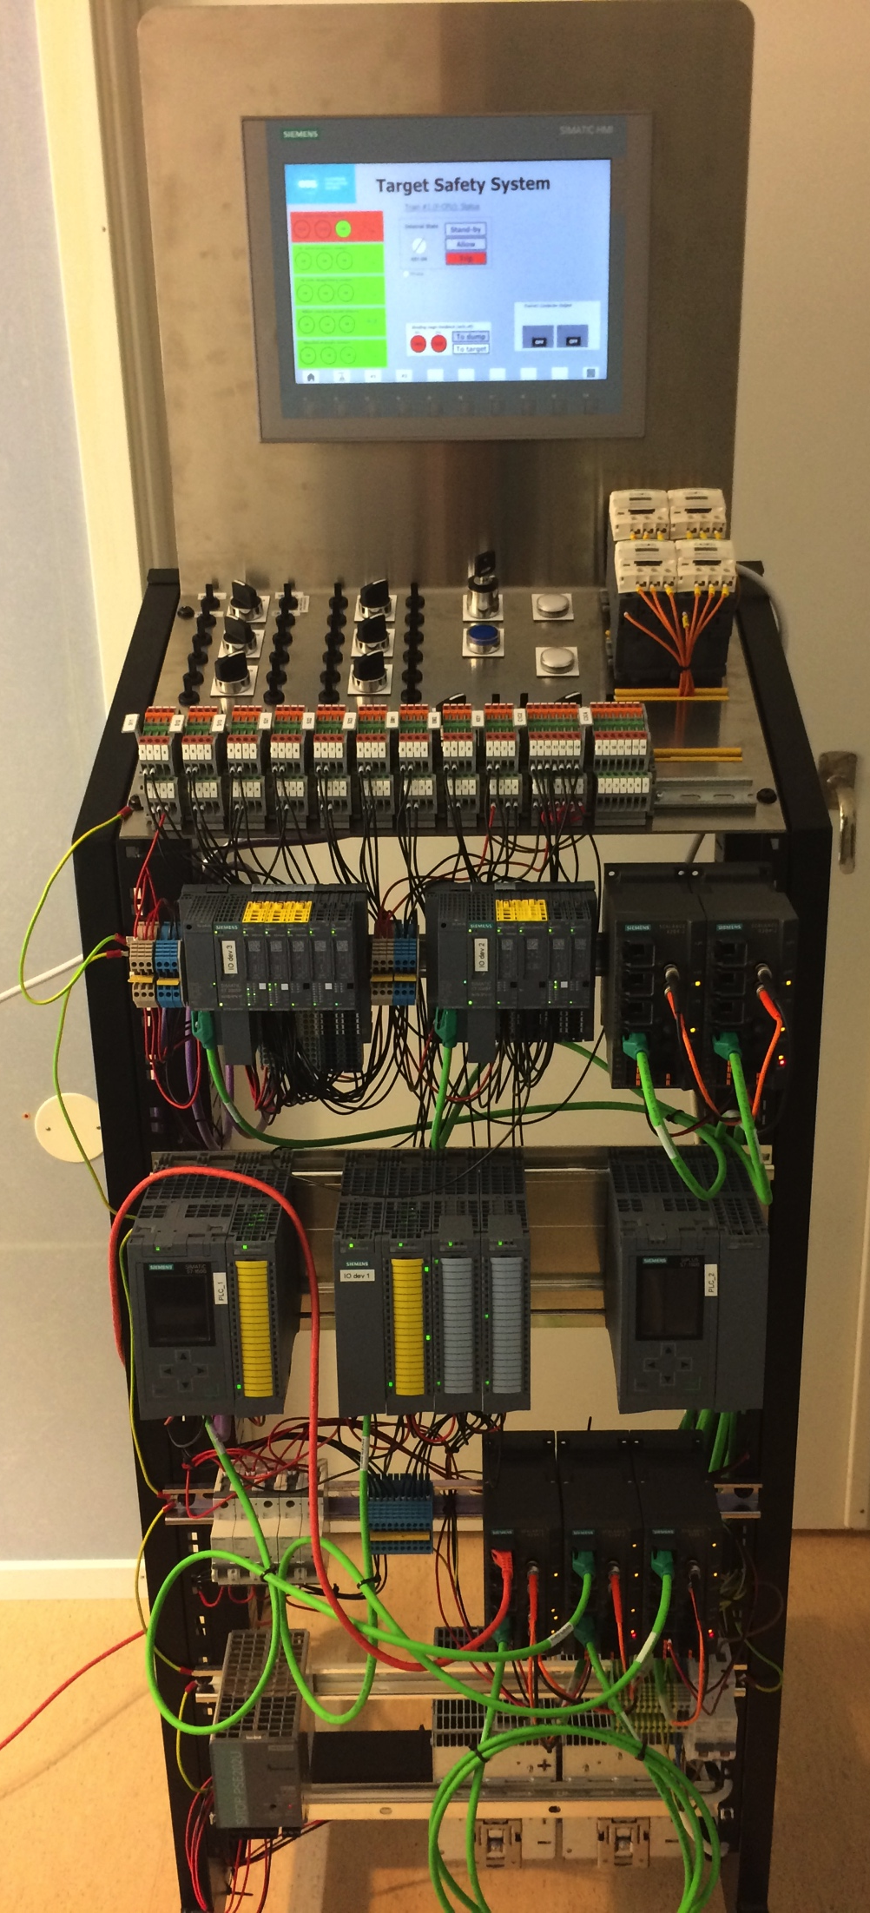
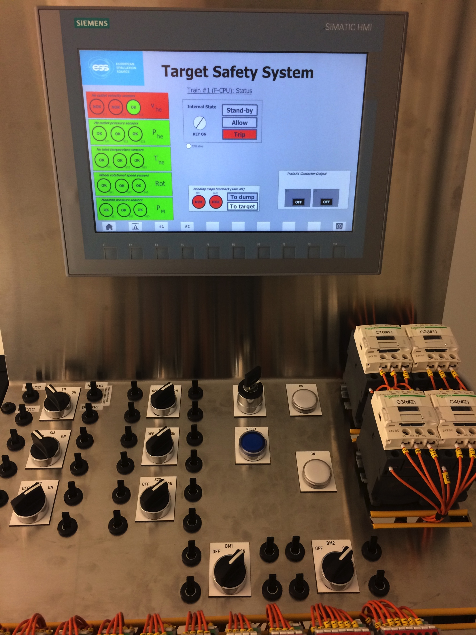
TSS Test Stand

Slide 30
Radiation Hazards Analysis and Safety Functions
Hazards analyses identified 350 events from which 22 were deemed “bounding”
  Accident Analysis reports completed and submitted to SSM early March 2017
  Accompanying dose calculations for public and workers completed for submission
Bounding events for operations:
  8 events with abnormal heating of tungsten due to beam excursions or loss of cooling
  6 events associated with the Active Cells
  6 events associated with water leaks, hydrogen explosion or fire, chopper malfunction, errant beam on tuning beam dump, and getter failures
  2 events associated with earthquake
Identified safety classified systems/functions, i.e. safety and safety related SSCs:
  TSS, monitoring target coolant flow, pressure and temperature, monolith pressure, & target wheel rotation
  Structural integrity of monolith vessel and neutron beam windows
  Structural integrity of primary cooling systems
  Several structures, functions and administrative controls of the Active Cells Facility (ACF)

Slide 31
Target Physics Support
Dedicated analyses as needed in support of engineering works, e.g.:
  Determination of volumetric heat loads
  Calculation of radionuclide inventories
  Shielding and radiation streaming
Material handbook is released and continuously updated
  Based on knowledge acquired through collaborations with partner labs
Measurement of tungsten release factors
  Tungsten blocks irradiated in ISOLDE end of October
  Release factors experimentally determined beginning of 2017, results reported by end of April

Slide 32
Summary
The ESS target station employs many innovative features:
  helium-cooled rotating tungsten target
  flat moderators
  proton beam expansion using raster magnets
  neutron beam ports that allow viewing of either the upper or lower moderator
  small angular separation between beamlines, doubling the number of neutron beam ports
The design fully achieves the specified performance while preserving the safety of employees, the public, and the environment as the paramount design criterion

Slide 33
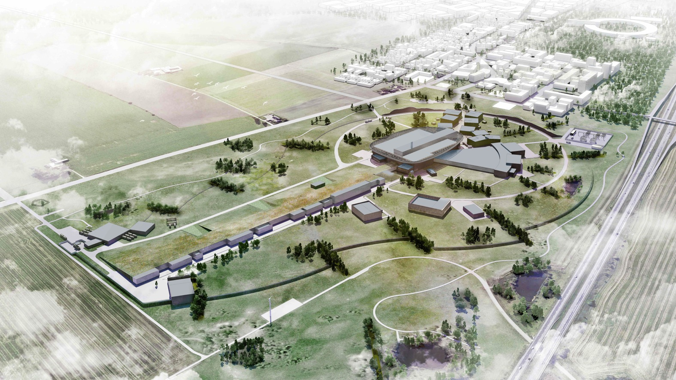
Thank you!

