Slide 1
Neutron Instruments
LTH Engineering course
7th December 2017
Ken Andersen

Slide 2
Summary
Neutron instrument concepts
  time of flight
  Bragg’s law
Neutron Instrumentation
  guides
  detectors
  choppers
  pulse-shaping
Neutron diffractometers
Neutron spectrometers

Slide 3
De Broglie Relations
Particle | Wave

Slide 4
The time-of-flight (TOF) method
distance
Δt
time

Slide 5
Diffraction: Bragg’s Law

Slide 6

Diffraction: Bragg’s Law

Slide 7
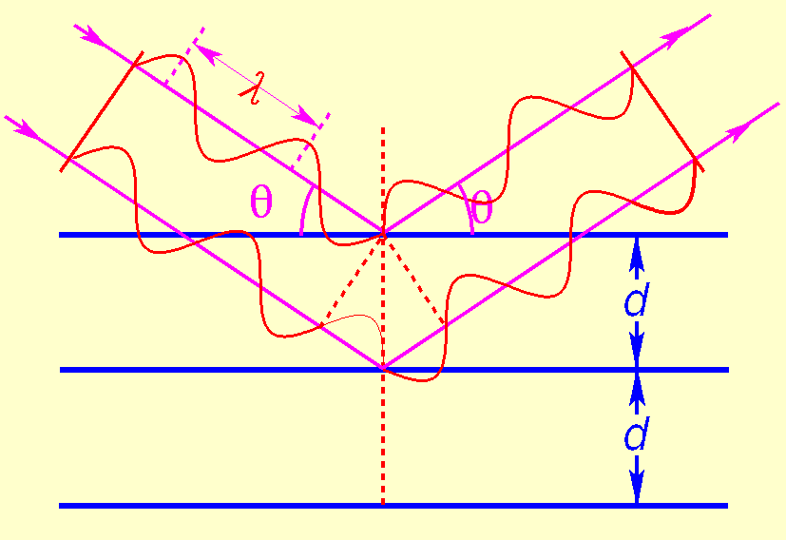
Diffraction: Bragg’s Law

Slide 8
Diffraction: Bragg’s Law

Slide 9
Diffraction: Bragg’s Law
dsinθ

Slide 10
Diffraction: Bragg’s Law
dsinθ

Slide 11
Diffraction: Bragg’s Law
2θ
dsinθ

Slide 12
Diffraction: Bragg’s Law
Wavevector:

Slide 13
Diffraction: Bragg’s Law
Wavevector:
θ
θ

Slide 14
Diffraction: Bragg’s Law
θ
θ
θ
θ

Slide 15
Diffraction: Bragg’s Law
θ
Bragg’s Law:
θ

Slide 16
Diffraction: Bragg’s Law
θ
θ

Slide 17
Diffraction: Bragg’s Law
θ
Bragg’s Law:
θ

Slide 18
Diffraction: Bragg’s Law
θ
Bragg’s Law:
θ
Conversion:

Slide 19
Reflection: Snell’s Law
incident
reflected
n=1
θ
θ’
refracted
n’<1

Slide 20
Reflection: Snell’s Law
incident
reflected
n=1
θ
θ’
refracted
θ’=0: critical angle of total reflection θ_{c}
n’<1

Slide 21
Reflection: Snell’s Law
incident
reflected
n=1
θ
θ’
refracted
θ’=0: critical angle of total reflection θ_{c}
n’<1

Slide 22
Reflection: Snell’s Law
incident
reflected
n=1
θ
θ’
refracted
θ’=0: critical angle of total reflection θ_{c}
n’<1
for natural Ni,
θ_{c} = λ[Å]×0.1°
Q_{c} = 0.0218 Å⁻¹

Slide 23
Reflection: Snell’s Law
incident
reflected
n=1
θ
θ’
refracted
θ’=0: critical angle of total reflection θ_{c}
n’<1
for natural Ni,
θ_{c} = λ[Å]×0.1°
Q_{c} = 0.0218 Å⁻¹
Definition:

Slide 24
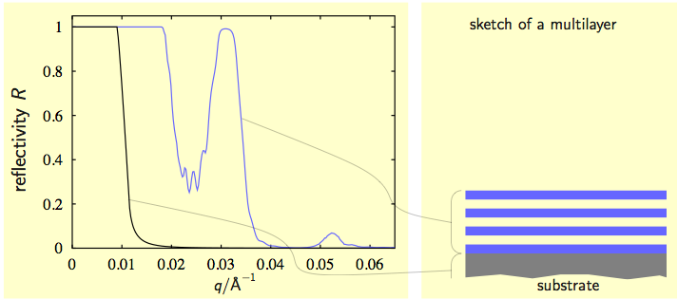
Neutron Supermirrors
Courtesy of J. Stahn, PSI

Slide 25
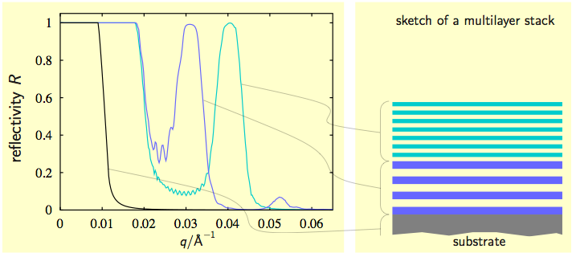
Neutron Supermirrors
Courtesy of J. Stahn, PSI

Slide 26
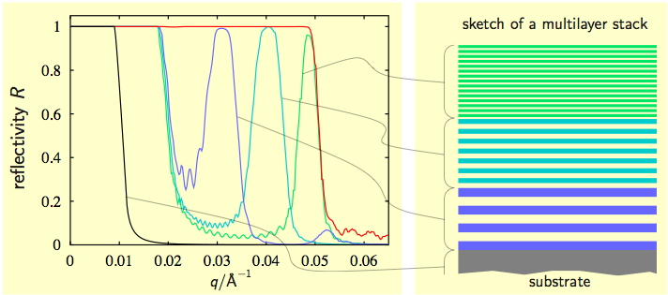
Neutron Supermirrors
Courtesy of J. Stahn, PSI

Slide 27
Neutron Supermirrors
Reflection: θ_{c}(Ni) = λ[Å] × 0.10°
Multilayer: θ_{c}(SM) = m × λ[Å] × 0.10°
λ _{c}
λ ₁
λ ₂
λ ₃
λ ₄
}
d₁
}
d₂
}
d₃
}
d₄

Slide 28
Neutron Supermirrors
Reflection: θ_{c}(Ni) = λ[Å] × 0.10°
Multilayer: θ_{c}(SM) = m × λ[Å] × 0.10°
λ _{c}
λ ₁
λ ₂
λ ₃
“m-number”
Supermirror critical angle
λ ₄
}
d₁
}
d₂
}
d₃
}
d₄

Slide 29
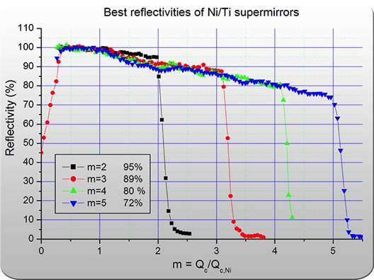
State-of-the-art Supermirrors
Mirrotron

Slide 30
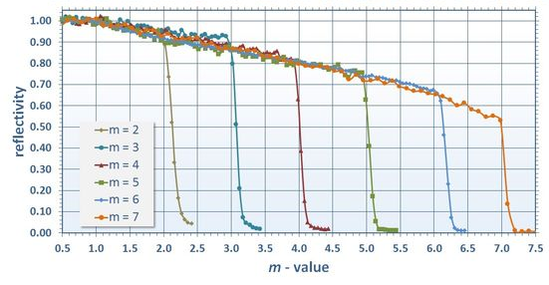
State-of-the-art Supermirrors
Mirrotron
Swiss Neutronics

Slide 31
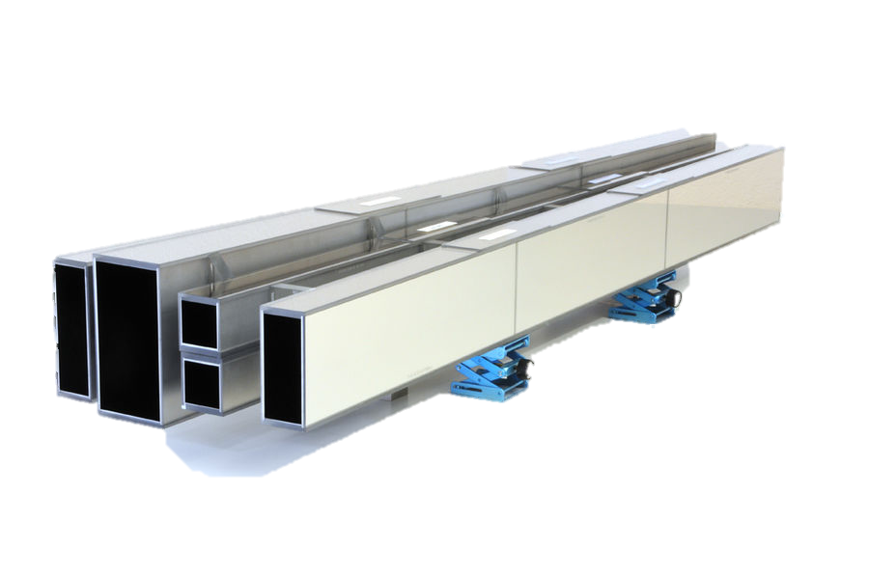
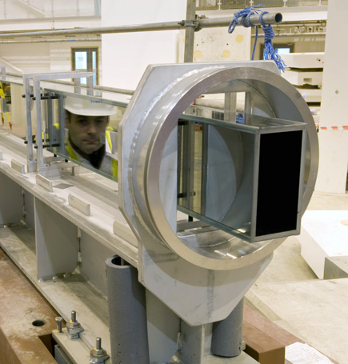
Neutron guides
WISH @ ISIS
Swiss Neutronics guides for NIST

Slide 32
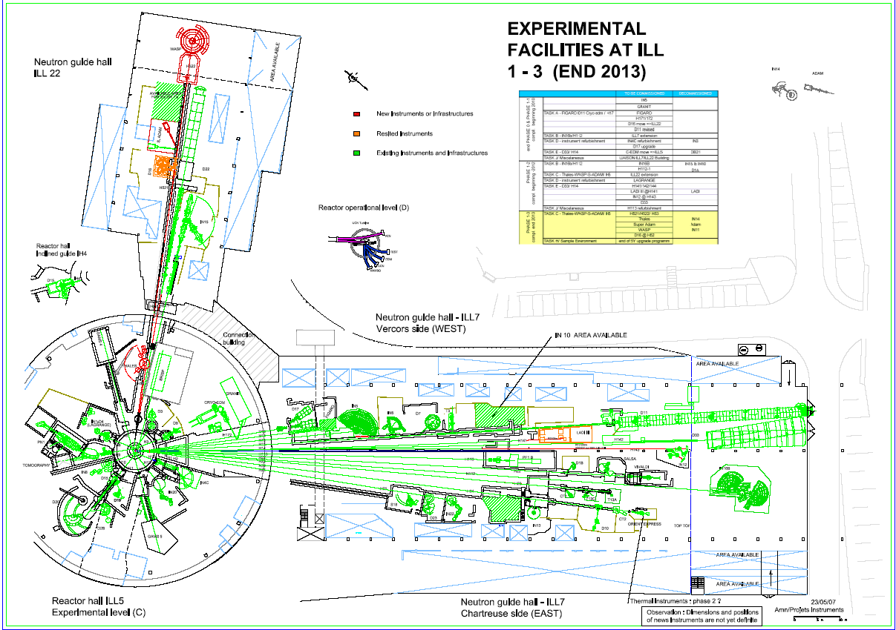
Distribution by Guides
Neutron Guides:
Creating space for instruments

Slide 33
Background Reduction
Guides can be used to reduce background
Distance:
  move away from fast-neutron source ~ 1/R²

Slide 34
Background Reduction
Guides can be used to reduce background
Distance:
  move away from fast-neutron source ~ 1/R²
Curved Guides:
  avoid direct line-of-sight
  avoid gammas
  avoid fast neutrons

Slide 35
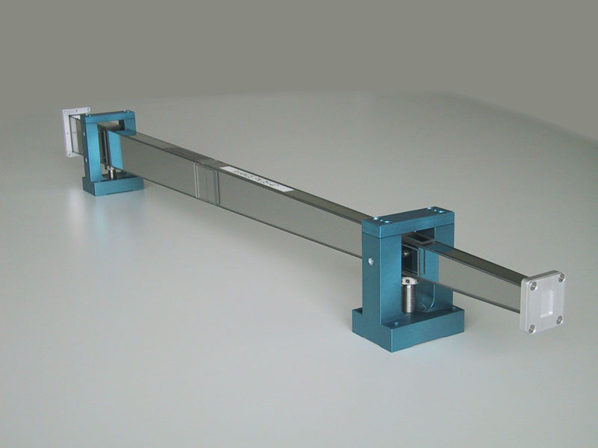
Focusing
Guides can also be used to increase flux
Converging guide increases flux, but increases divergence
(Liouville’s theorem)

Slide 36
Diffractometers
Measure structures (d-spacings)
Very general method:
  crystals
  powders
  polycrystalline materials
  liquids
  large molecules or structures
  surfaces

Slide 37
Diffractometers
Measure structures (d-spacings)
Very general method:
  crystals
  powders
  polycrystalline materials
  liquids
  large molecules or structures
  surfaces
Ideal diffractometer:
  measure k_{i} of each incident neutron
  measure k_{f} of the same neutrons
$$\vec{k_{f}}$$
$$\vec{k_{i}}$$

Slide 38
Diffractometers
Measure structures (d-spacings)
Very general method:
  crystals
  powders
  polycrystalline materials
  liquids
  large molecules or structures
  surfaces
Ideal diffractometer:
  measure k_{i} of each incident neutron
  measure k_{f} of the same neutrons
No magic monitors or detectors!
$$\vec{k_{f}}$$
$$\vec{k_{i}}$$

Slide 39
Diffractometers
Measure structures (d-spacings)
Very general method:
  crystals
  powders
  polycrystalline materials
  liquids
  large molecules or structures
  surfaces
Ideal diffractometer:
  measure k_{i} of each incident neutron
  measure k_{f} of the same neutrons
No magic monitors or detectors!
No energy-sensitive detectors!
$$\vec{k_{f}}$$
$$\vec{k_{i}}$$

Slide 40
Diffractometers
Measure structures (d-spacings)
Very general method:
  crystals
  powders
  polycrystalline materials
  liquids
  large molecules or structures
  surfaces
Real diffractometer:
  measure k_{i} or k_{f} of the beam
    time-of-flight
    Bragg diffraction
  assume k_{i} = k_{f}
No magic monitors or detectors!
No energy-sensitive detectors!
$$\vec{k_{f}}$$
$$\vec{k_{i}}$$

Slide 41
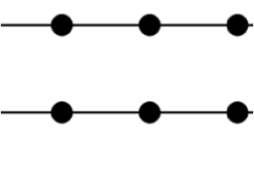
Powder diffractometers
Measure crystal structure using Bragg’s law
  Rietveld refinement
Large single crystals are rarely available
Polycrystal

Slide 42
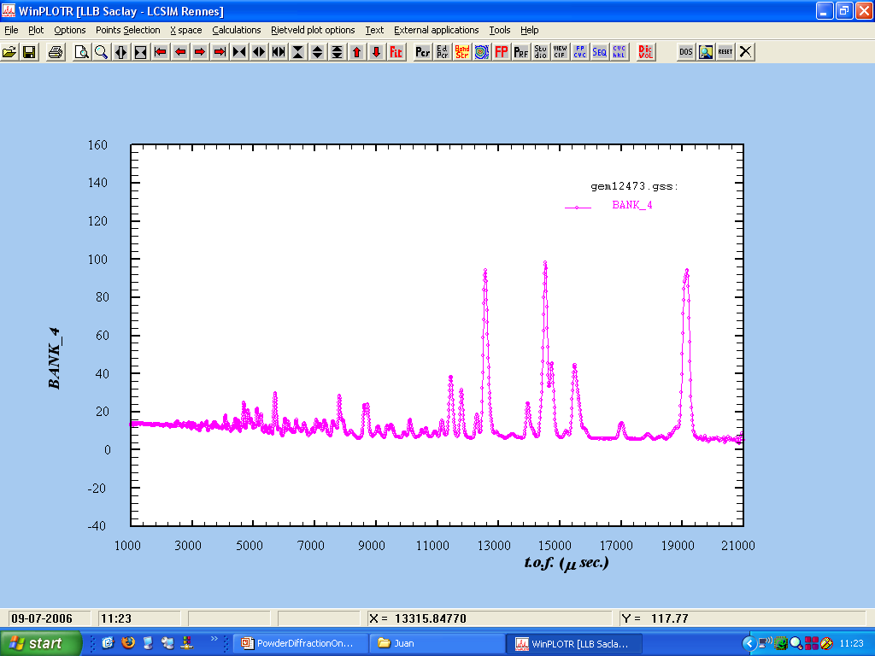
Time-of-flight (TOF) Method
distance
detector
sample
Δt
time

Slide 43
Time-of-flight (TOF) Method
distance
detector
sample
Δt
time

Slide 44
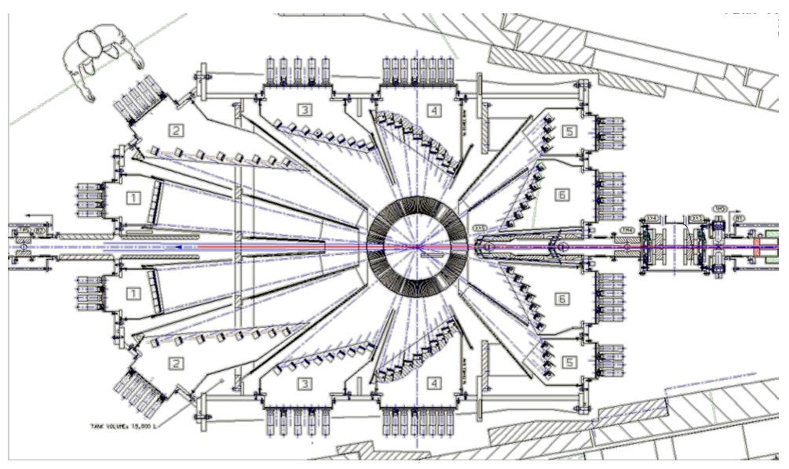
Time-of-flight (TOF) Method
POLARIS @ ISIS TS1

Slide 45
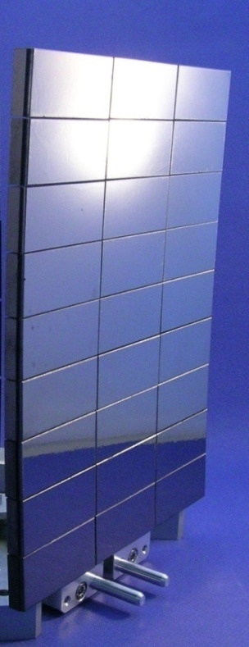
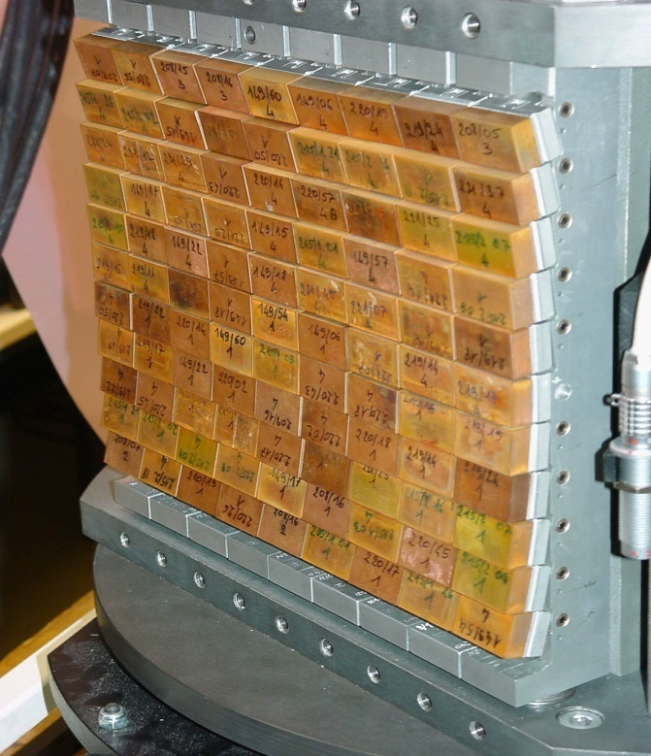
Crystal Monochromators
Graphite 002
Copper 200
 | d-spacing
Germanium 333 | 1.089 Å
Copper 200 | 1.807 Å
Silicon 111 | 3.135 Å
Graphite 002 | 3.355 Å

Slide 46
Pulsed source time structures (λ=5Å)
short pulse
log(Intensity@λ=5Å)
ILL 57MW
1
0
100μs
ISIS-TS1 128kW
ISIS-TS2 32kW
0.1
0.01
time (ms)
0 20 40 80 100 120

Slide 47
Pulsed source time structures (λ=5Å)
short pulse
log(Intensity@λ=5Å)
ILL 57MW
1
0
100μs
ISIS-TS1 128kW
ISIS-TS2 32kW
0.1
0.01
time (ms)
0 20 40 80 100 120

Slide 48
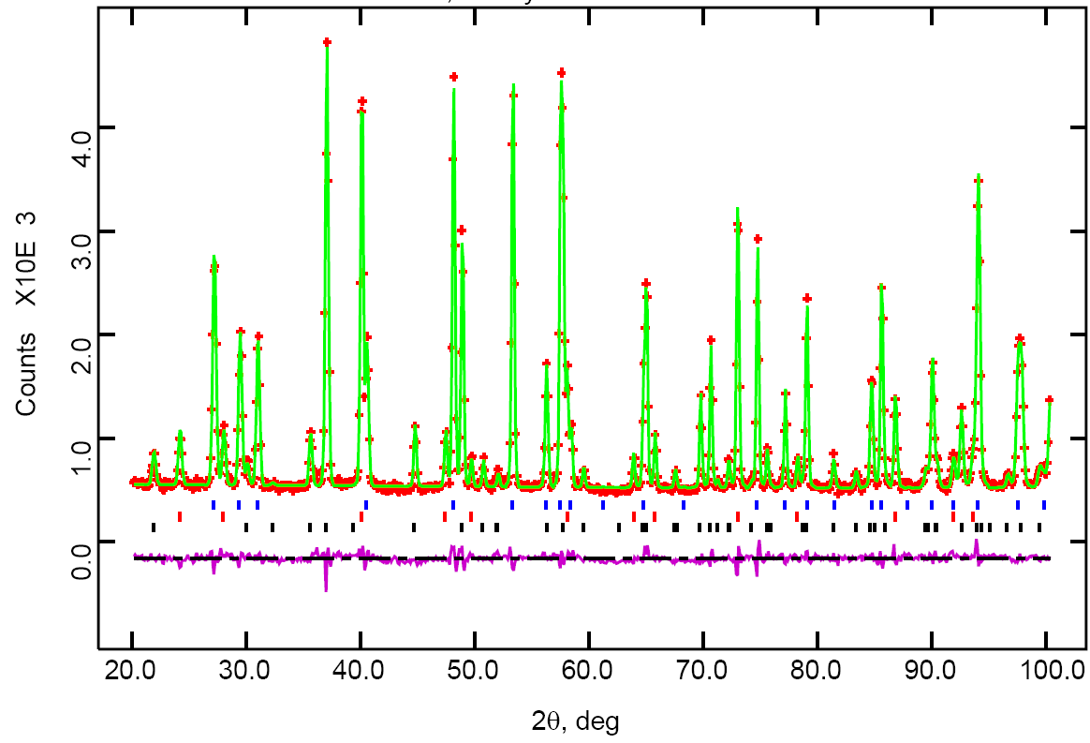
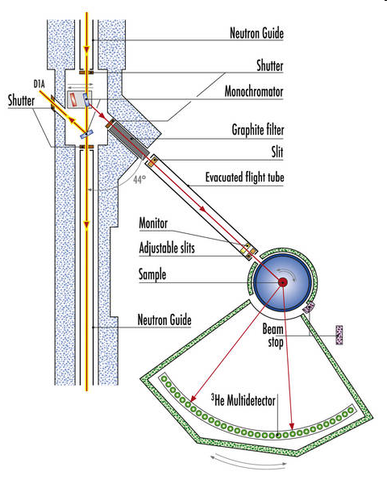
Constant-Wavelength Diffraction
D1B @ ILL
Rietveld refinement
Debye-Scherrer cone
2θ

Slide 49
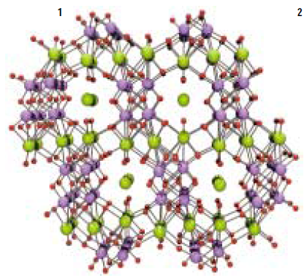
Diffuse Scattering: Local Structure

Slide 50
Single Crystal Diffraction
Complex structures
  powder averaging removes information
Magnetic structures
Large unit cells
  Protein crystallography
Two approaches:
  Monochromatic/TOF instrument
  Laue diffractometer (white beam)

Slide 51
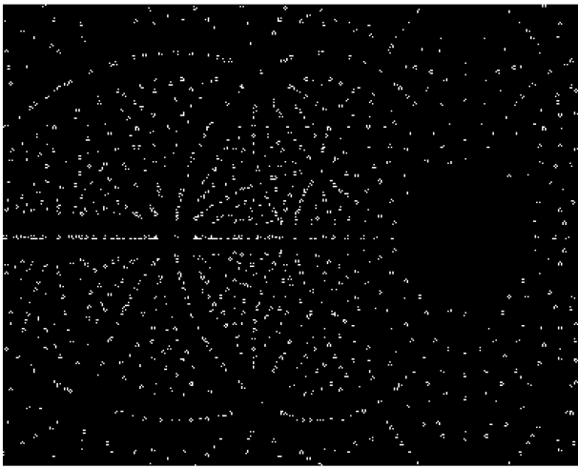
Single Crystal Diffraction
Complex structures
  powder averaging removes information
Magnetic structures
Large unit cells
  Protein crystallography
Two approaches:
  Monochromatic/TOF instrument
  Laue diffractometer (white beam)
(310)
λ(310)
(110)
(120)
λ(110)
λ(120)

Slide 52
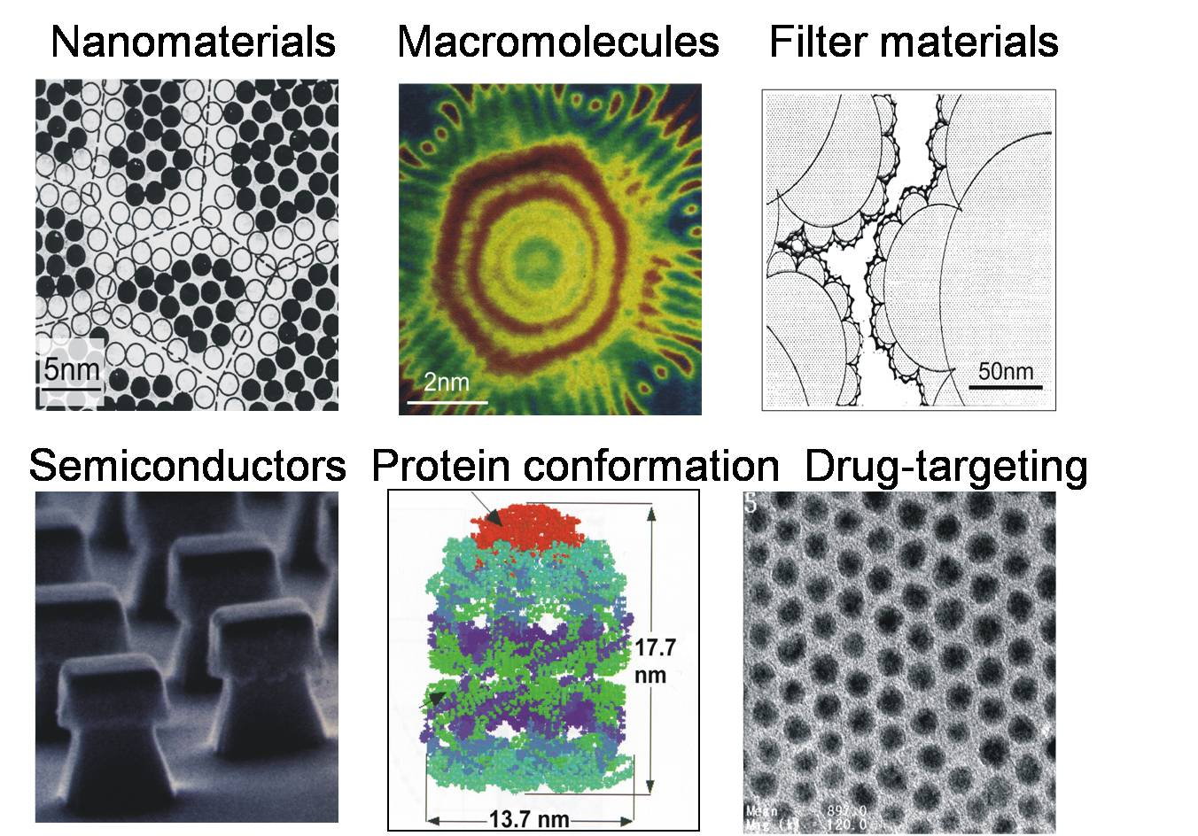
Small Angle Neutron Scattering (SANS)

Slide 53
Small-Angle Neutron Scattering
Probing the longest length scales available to neutrons
Detector
Monochromator
Δλ/λ
Sample
Collimator
2θ
Q
d
λ d 2θ
4-20 Å 5-3000 Å 0.1-20°

Slide 54
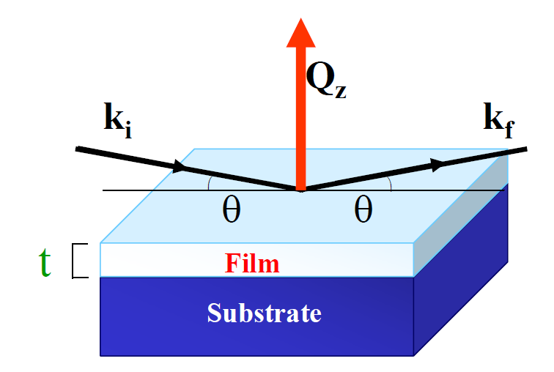
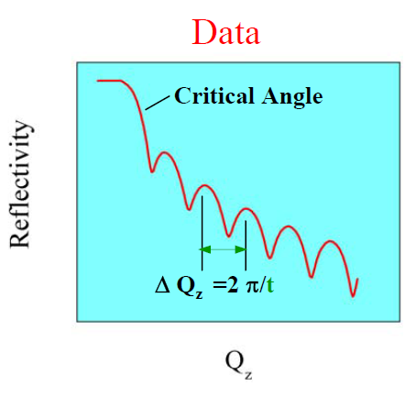
Reflectometry
Reflection from surfaces and interfaces
in
out
Log
Specular: θ_{in}=θ_{out}
Off-specular: θ_{in}≠θ_{out}
Depth profile of the scattering-length density

Slide 55
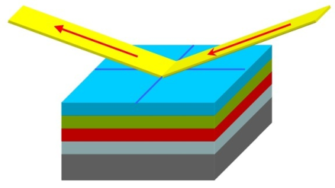
Reflectometry
Horizontal sample geometry
all samples (including free liquids, and liquid-liquid interfaces)
Vertical sample geometry
solid samples, e.g. magnetic
solid-liquid interfaces
straightforward to vary θ

Slide 56
Neutron Spectroscopy
Excitations: vibrations and other motions
  lattice vibrations
  magnetic excitations
  quasi-elastic scattering: diffusion & relaxation

Slide 57
Neutron Spectroscopy
Excitations: vibrations and other motions
  lattice vibrations
  magnetic excitations
  quasi-elastic scattering: diffusion & relaxation
Ideal spectrometer:
  measure k_{i} of each incident neutron
  measure k_{f} of the same neutrons
$$\vec{k_{f}}$$
$$\vec{k_{i}}$$

Slide 58
Neutron Spectroscopy
Excitations: vibrations and other motions
  lattice vibrations
  magnetic excitations
  quasi-elastic scattering: diffusion & relaxation
Real spectrometer:
  measure k_{i} and k_{f} of the beam
    time-of-flight
    Bragg diffraction
  Fix k_{i} and scan through k_{f} – “direct geometry”
  Fix k_{f} and scan through k_{i} – “indirect geometry”
$$\vec{k_{f}}$$
$$\vec{k_{i}}$$

Slide 59
Chopper Spectrometers
Direct geometry:
fix k_{i} by chopper phasing
scan through k_{f} by time-of-flight
distance
detector
sample
chopper
0
time

Slide 60
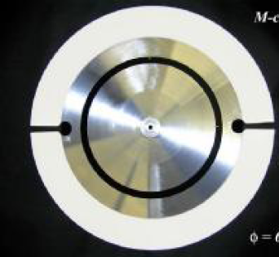
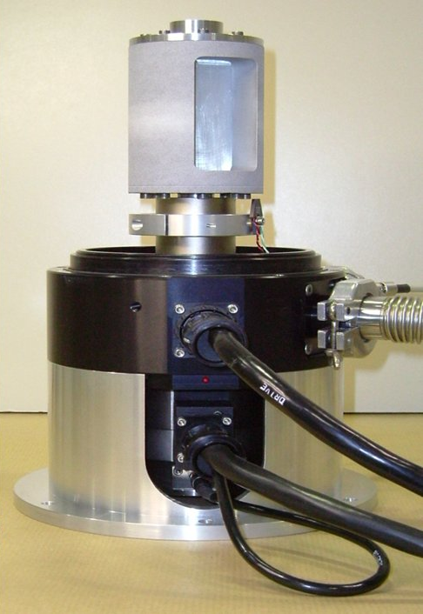
Neutron Choppers
Fermi choppers
Disk choppers
f < 600 Hz
Δt > 1μs
f < 300 Hz
Δt > 10μs

Slide 61
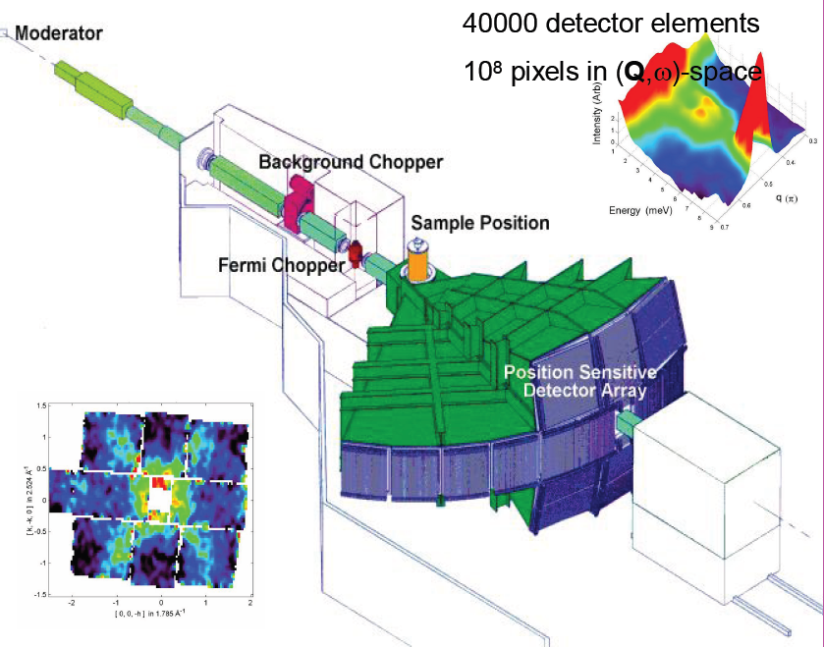
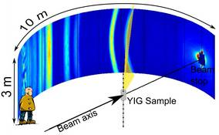
Chopper Spectrometers
General-Purpose Spectrometers
    Incident energy ranges from 1meV to 1eV
Huge position-sensitive detector arrays
    Single-crystal samples

Slide 62
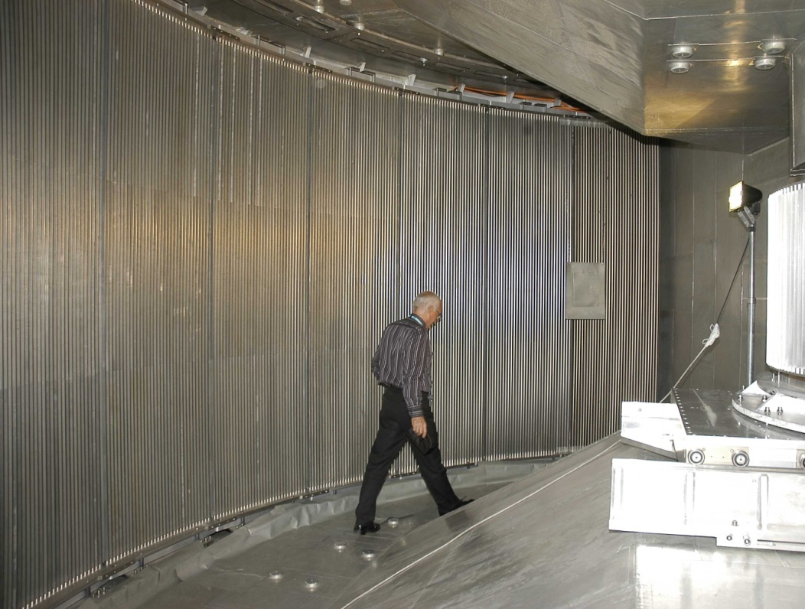
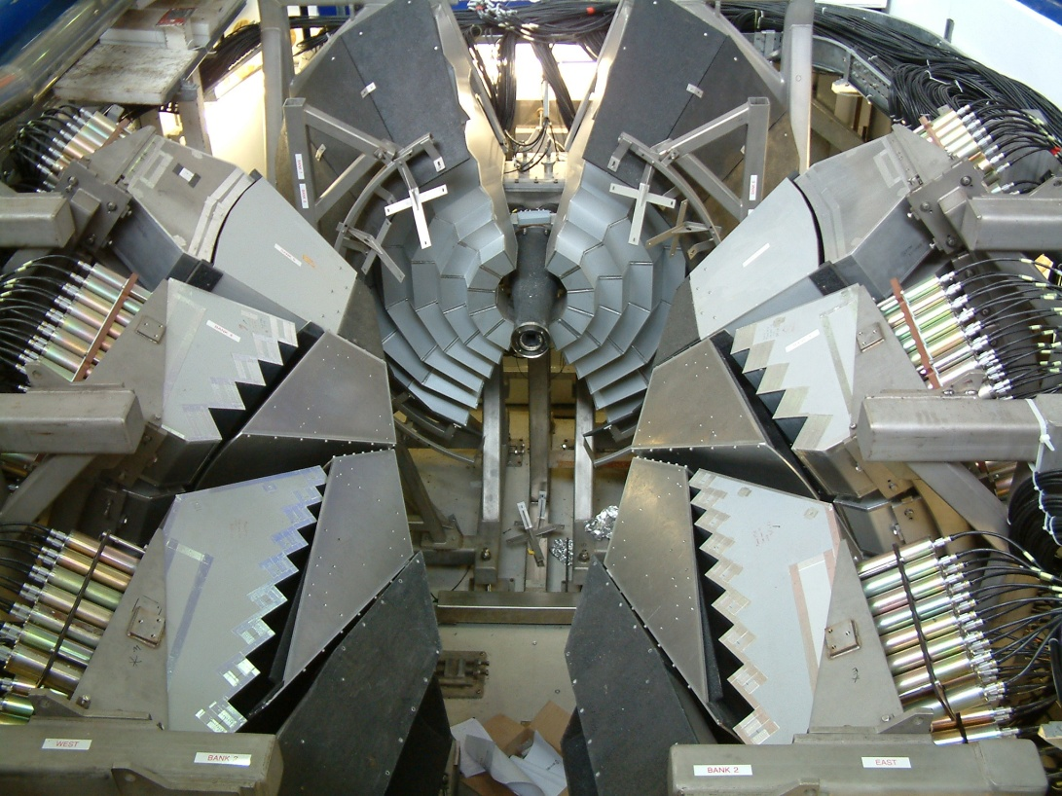
Detectors
³He gas tubes
n + ³He → ³H + ¹H + 0.764 MeV
>1mm resolution
High efficiency
Low gamma-sensitivity
³He supply problem
Scintillators
n + ⁶Li → ⁴He + ³H + 4.79 MeV
<1mm resolution
Medium efficiency
Some gamma-sensitivity
Magnetic-field sensitivity

Slide 63
Detectors
¹⁰B detectors
n + ¹⁰B → ⁷Li + ⁴He + 0.48 MeV
massive development programme
none yet in operation
many different types
inclined blades
boron layer thickness limited to ~ 1 μm
=> ~ 5% efficiency
perpendicular blades

Slide 64
Alternative to Direct Geometry
Indirect geometry:
fix k_{f} – usually by analyser crystals
scan through k_{i} by time-of-flight
distance
detector
analyser
sample
0
time

Slide 65
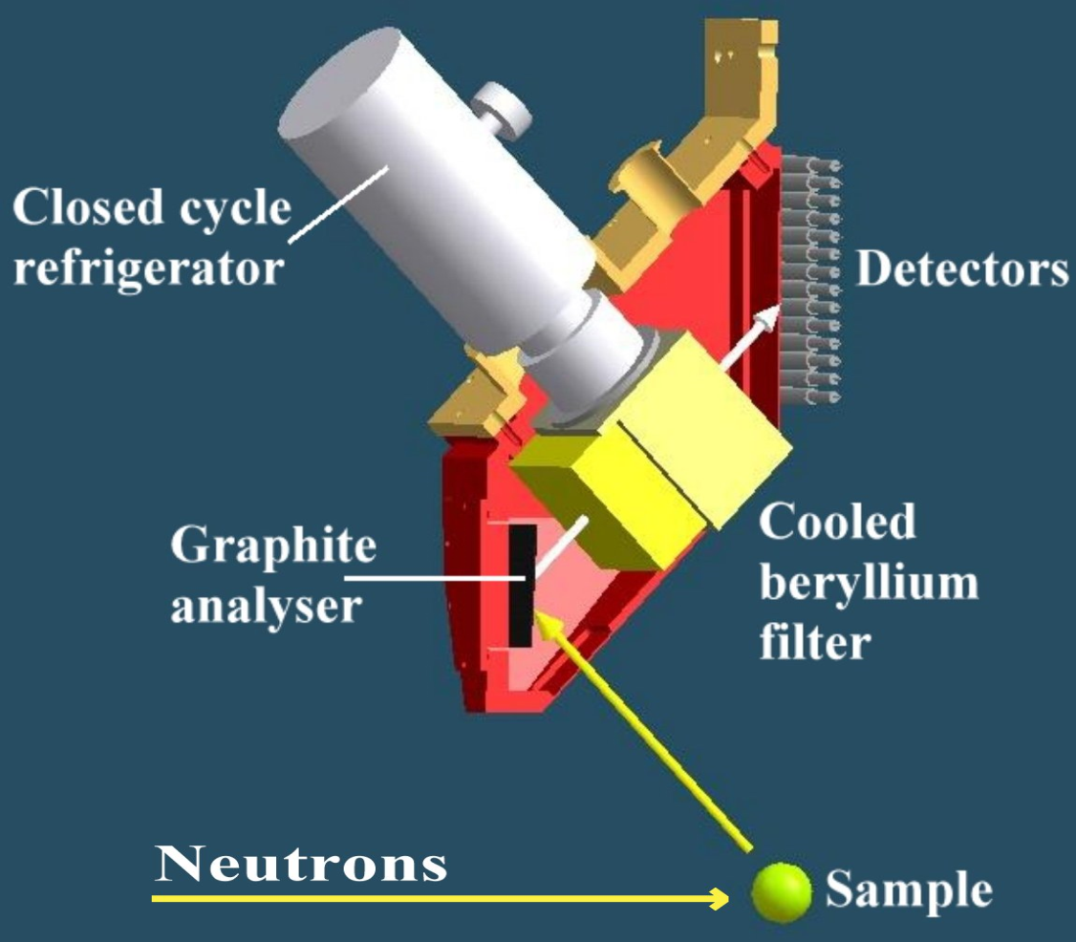
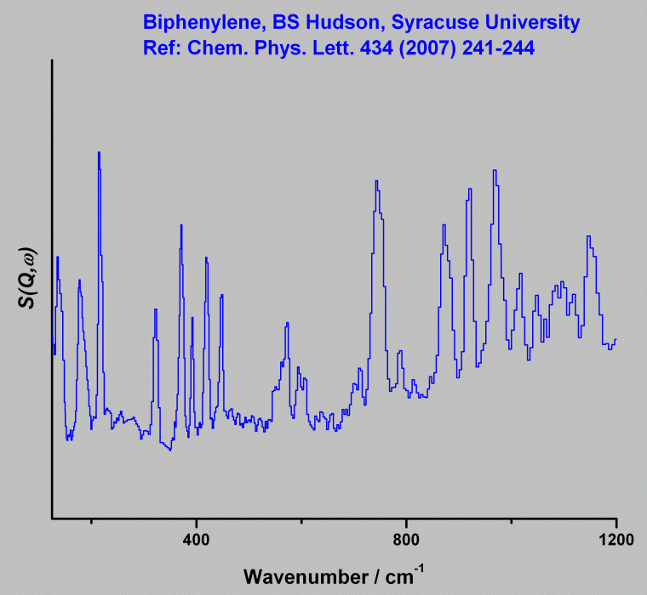
Vibrational Spectroscopy
TOSCA@ISIS
Density-of-states measurements

Slide 66
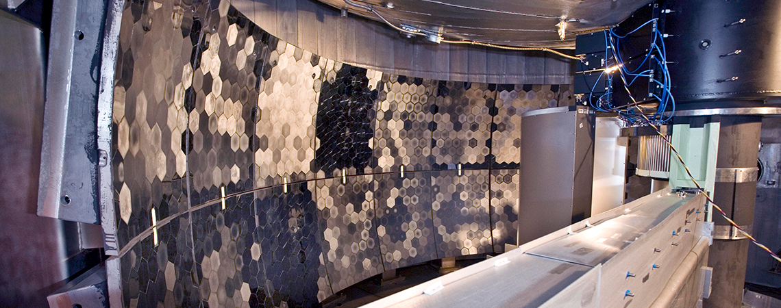
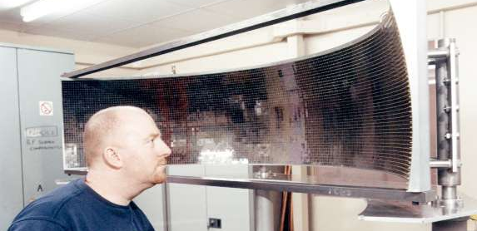
Backscattering
BASIS@SNS Si111 3μeV
OSIRIS@ISIS PG002 25μeV

Slide 67
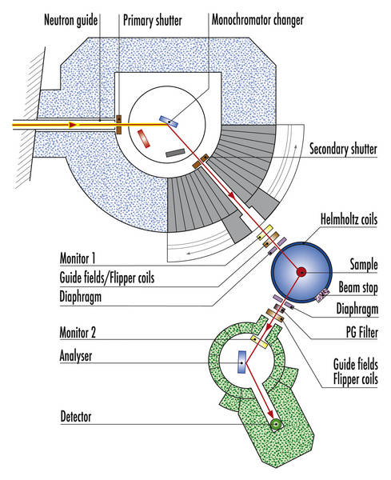
Triple-Axis Spectrometers
Single-crystal excitations
Very flexible
Measures a single point in -E space at a time
Scans:
    Constant : Scan E at constant k_{i} or k_{f}
    Constant E: Scan in any direction

Slide 68
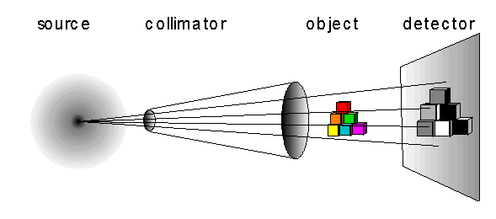
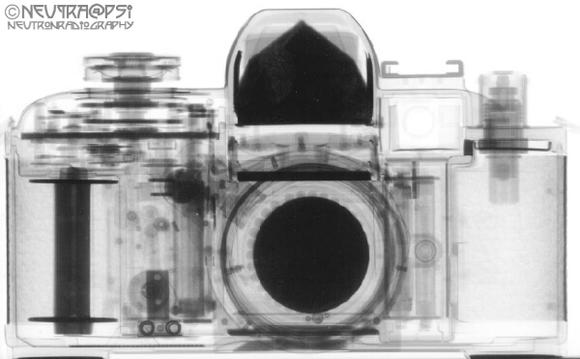
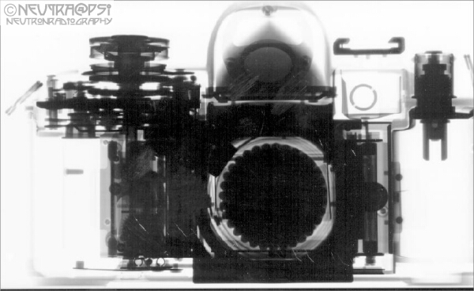
Neutron Imaging
Neutrons
X-rays

Slide 69
Summary
Neutron Instrumentation
  guides
  detectors
  choppers
Neutron diffractometers
  powder diffraction
  single-crystal diffraction
  SANS
  reflectometry
Neutron spectrometers
  direct-geometry time-of-flight
  backscattering
  triple-axis
Imaging

Slide 70
industrial components
bacteria
magnetic domains
atomic structures
viruses
polymers, proteins
texture
magnetic structures
Wavevector Q [Å⁻¹]
cell membranes
charge density
10⁻³
10⁻²
10⁻¹
1
10¹
10²
10³
elementary particles
UV & X-ray FEL: Pump & Probe studies
10⁻¹⁵
hydrogen modes
10³
Inelastic X-ray Scattering
lattice vibrations
X-ray Spec.
Infrared
Light
FTIR
Raman
Brillouin
Dynamic Light Scattering
Laser PCS
spin dynamics
TOF & Crystal
Spectroscopy
10⁻¹²
rotational tunneling
1
Infra-red
Time [s]
molecular diffusion
Energy [meV]
dynamics of macromolecules
Visible Light
10⁻⁹
10⁻³
Backscattering
Spin-echo
Dielectric Spec.
domain wall dynamics
NMR
μSR
10⁻⁶
Length [m]
10⁻⁶
X-ray PCS
10⁻¹
10⁻²
10⁻³
10⁻⁵
10⁻⁶
10⁻⁷
10⁻⁸
10⁻⁹
10⁻¹⁰
10⁻¹¹
10⁻¹²
10⁻¹⁴
10⁻¹⁵
SANS
Imaging
Diffraction
Particle Physics
Reflectometry
X-ray Imaging
SAXS, X-ray Refl.
X-ray Diffraction
EXAFS & XANES
X-rays
NMR Imaging
Triangulation
NMR
NMR
Optical Microscopy
Optical Nanoscopy
Electron Microscopy
Microscopy
SNOM
AFM
STM
Scanning Techniques

Slide 71
Thank you!
5th June 2015

