Slide 1
ANNIKA NORDT

Slide 2
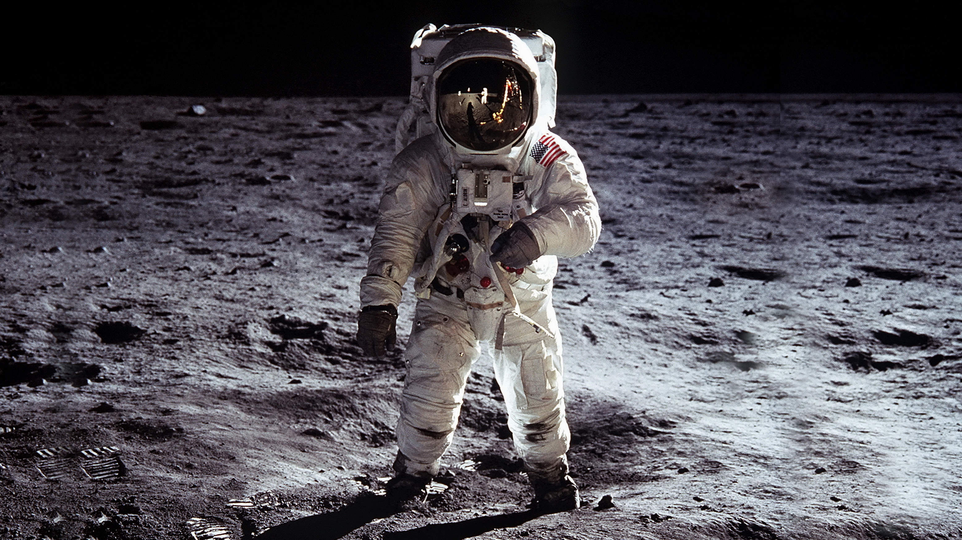

Slide 3
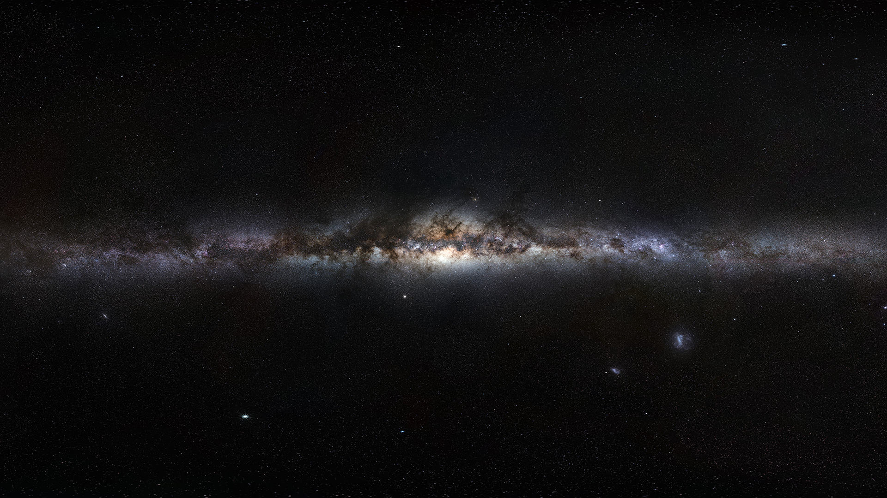

Slide 4



Slide 6



Slide 7
NEW LOGO
NEW IDENTITY

Slide 8


Slide 9
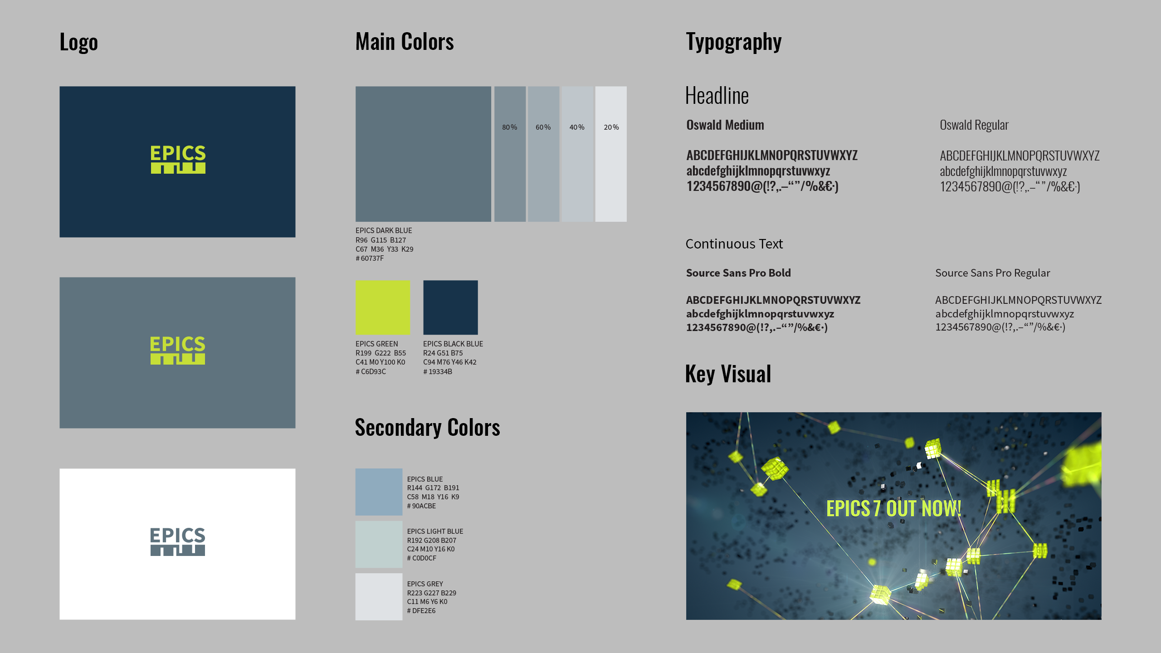

Slide 10
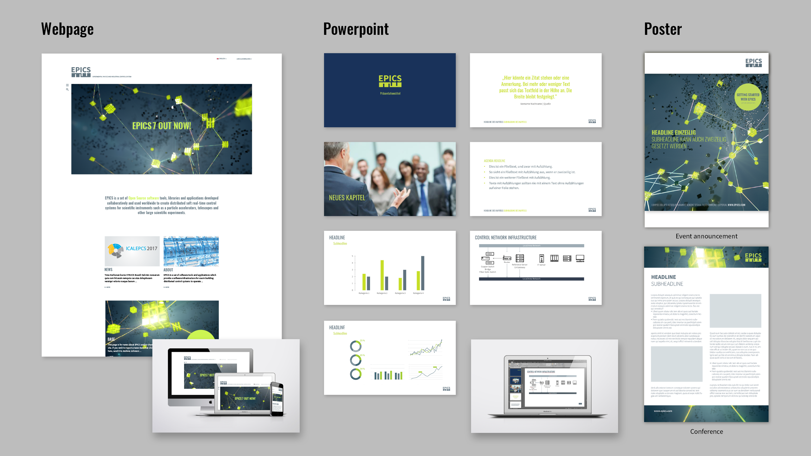

Slide 11
NEW WEBSITE
SITEMAP

Slide 12
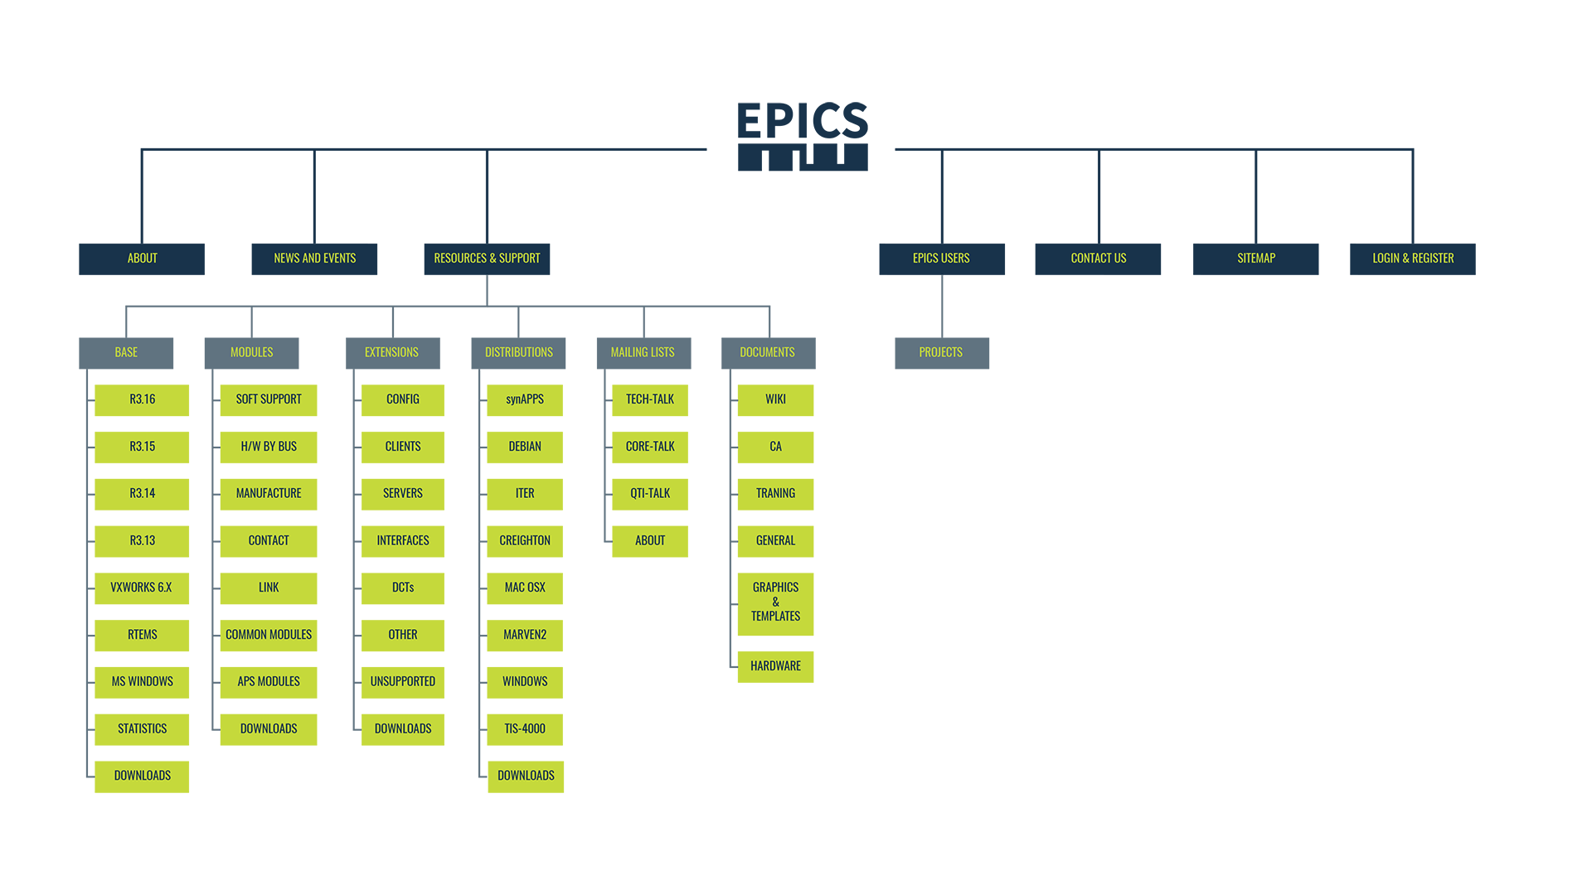

Slide 13
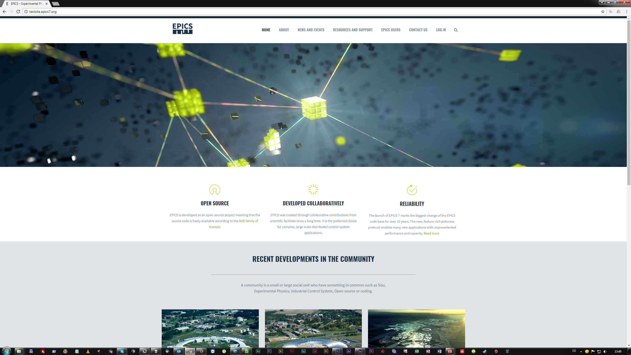

Slide 14
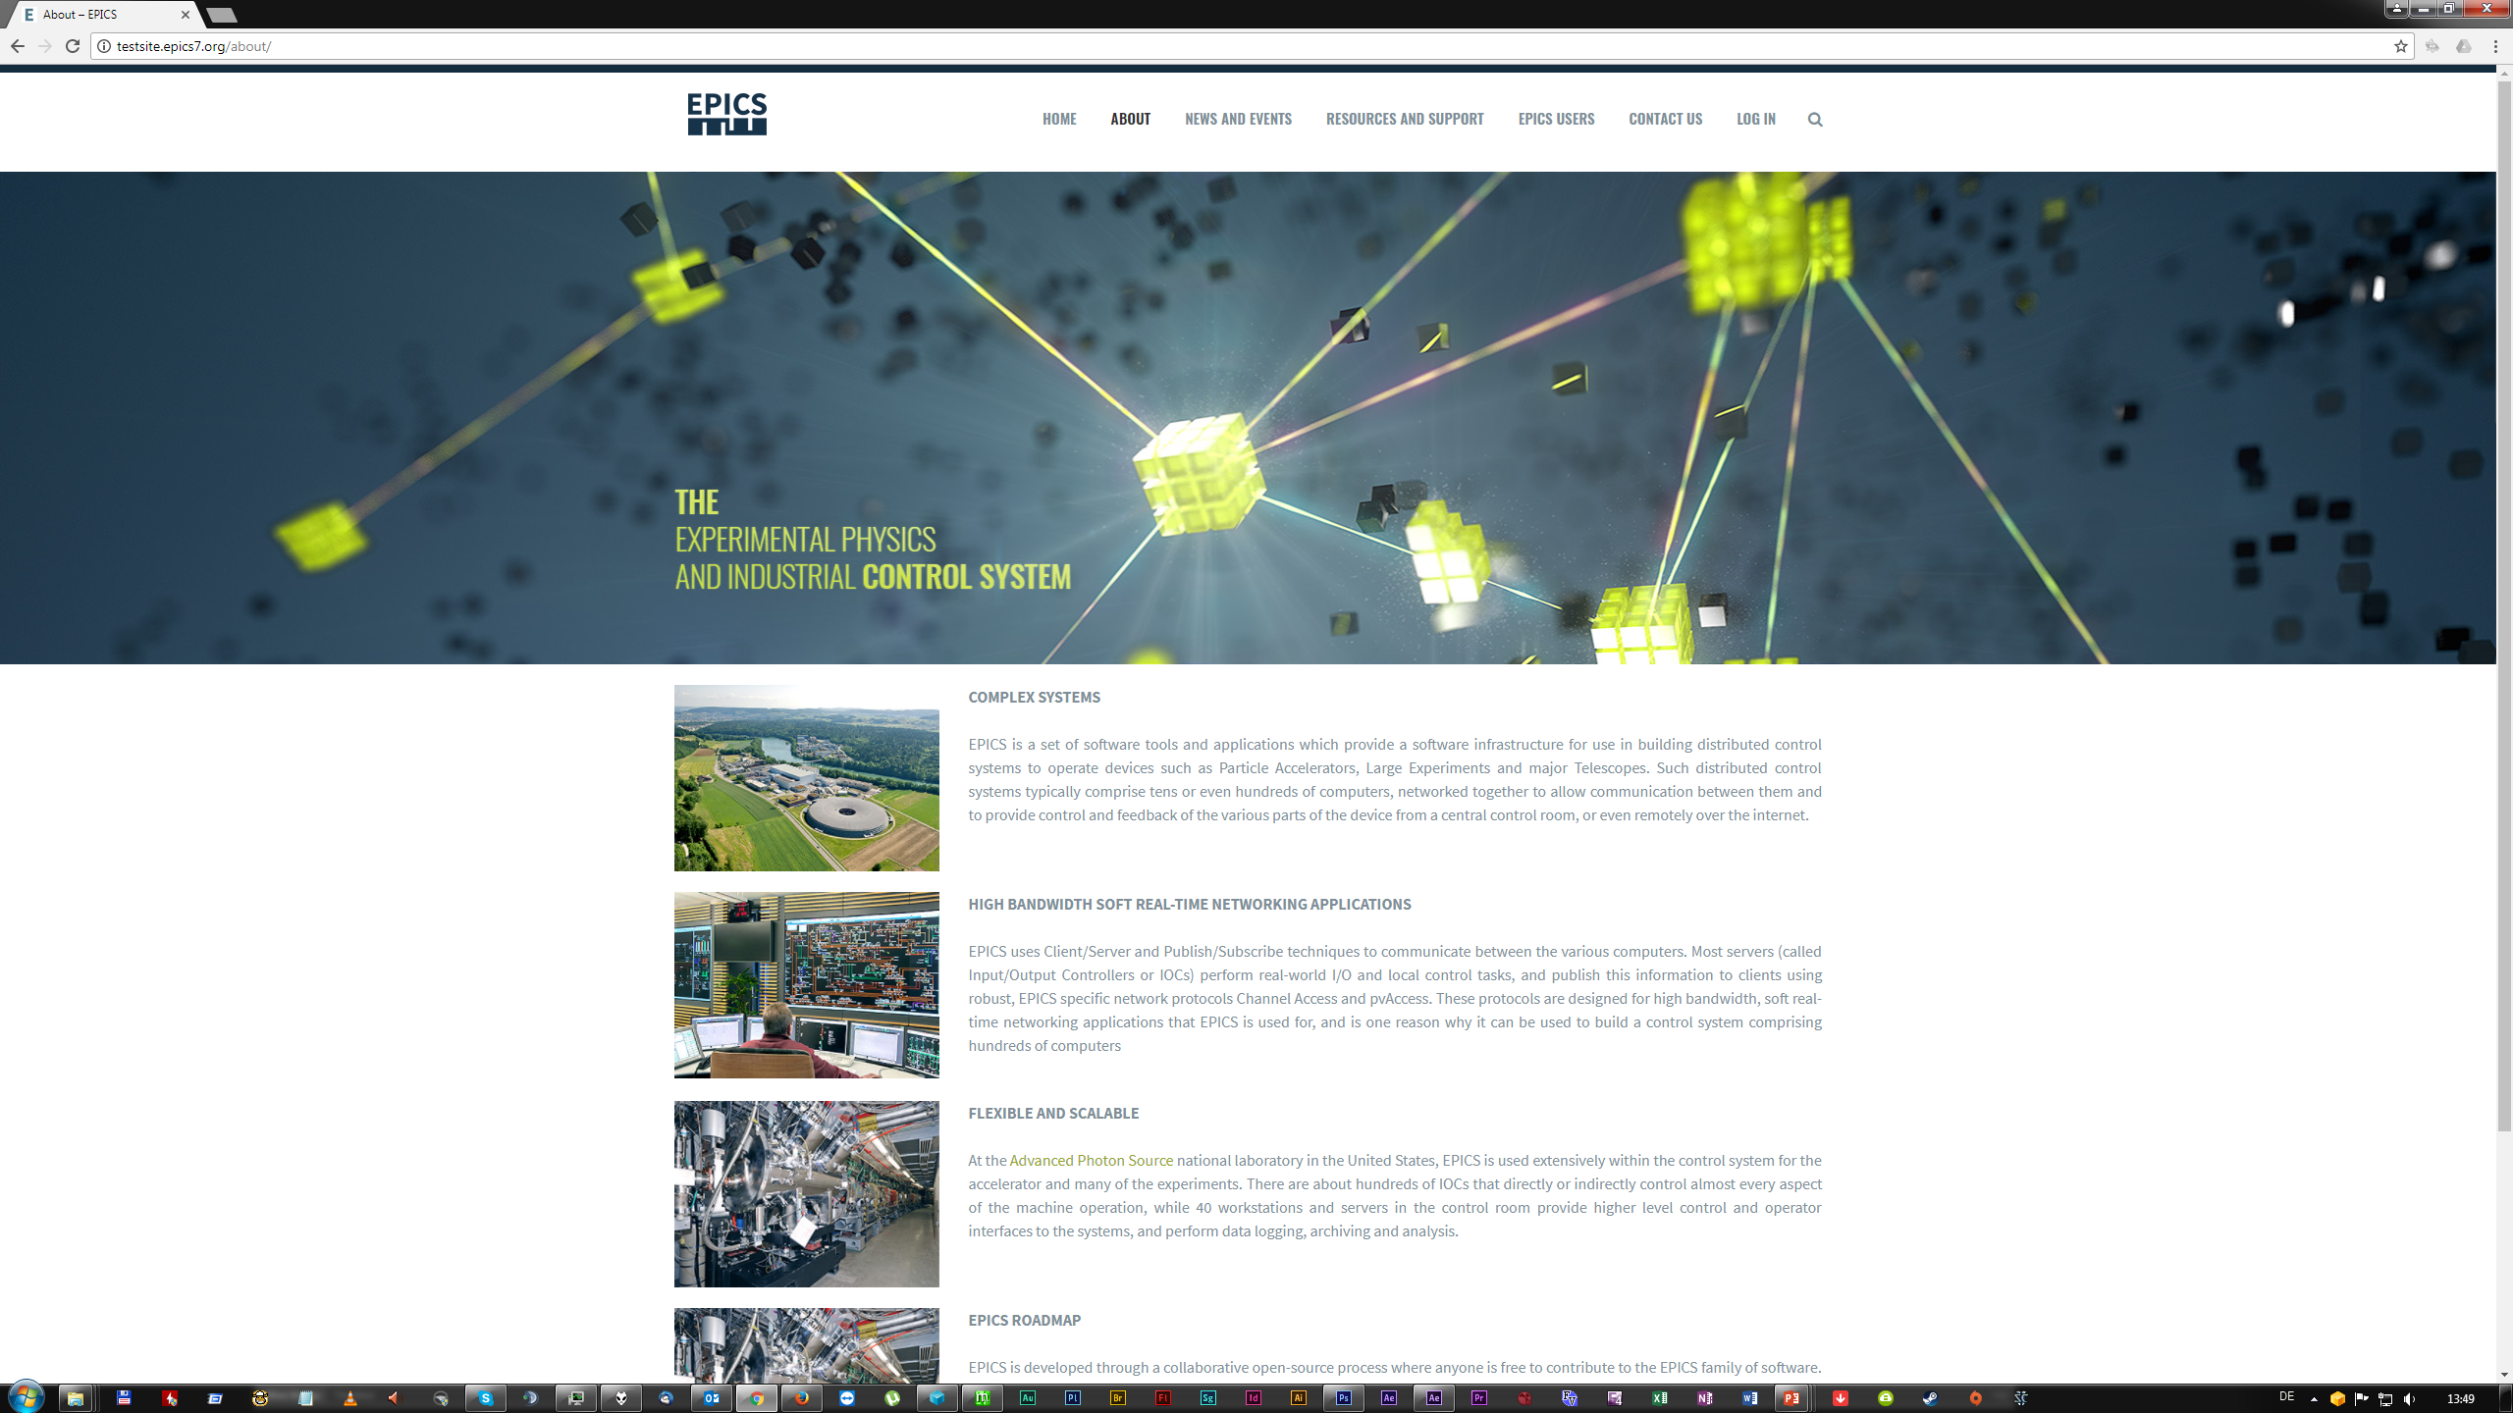

Slide 15
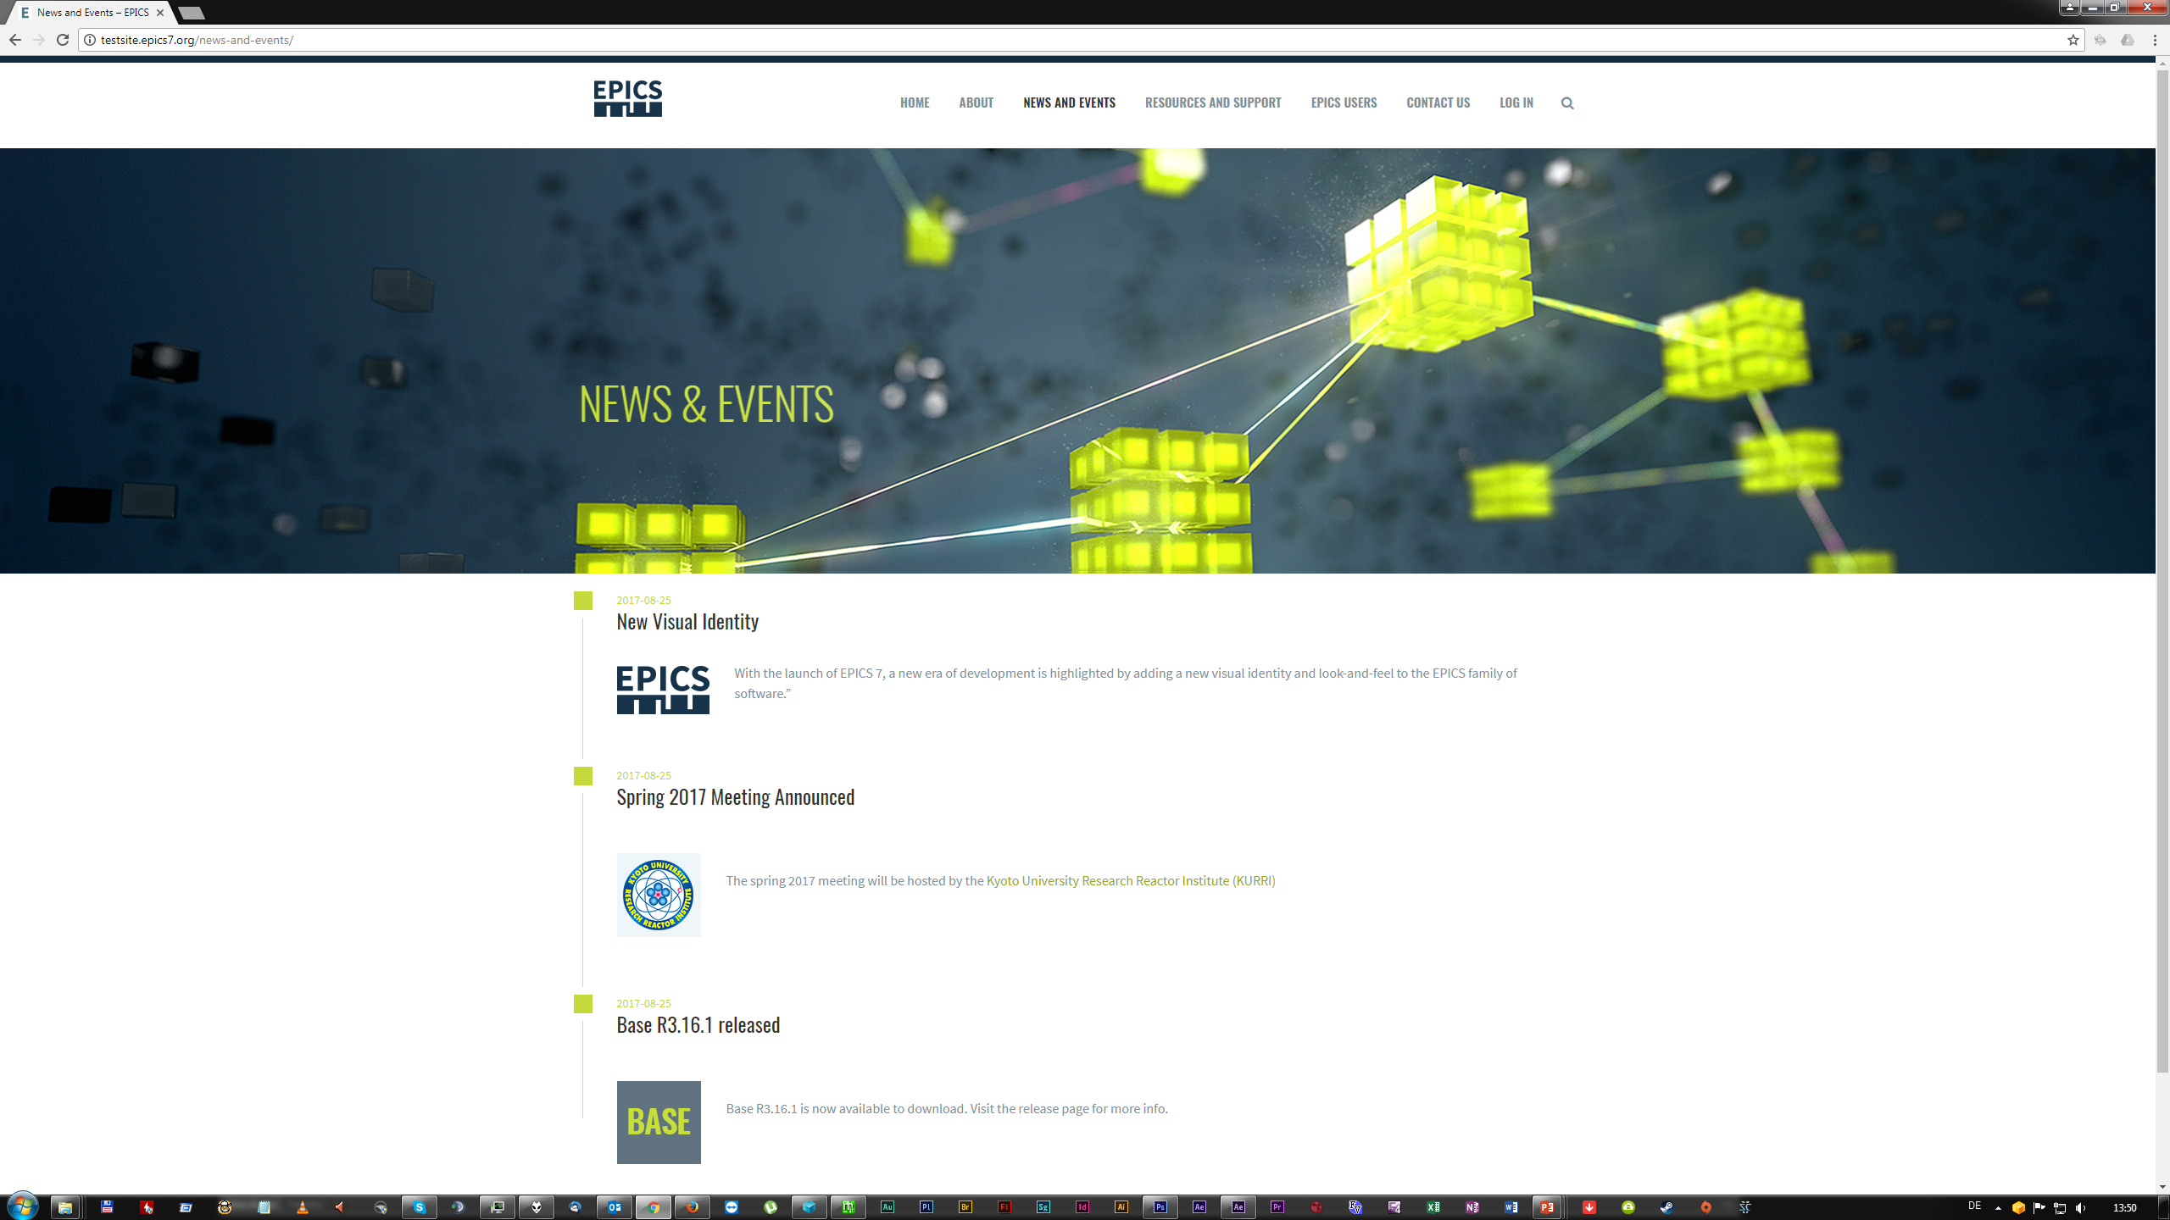

Slide 16
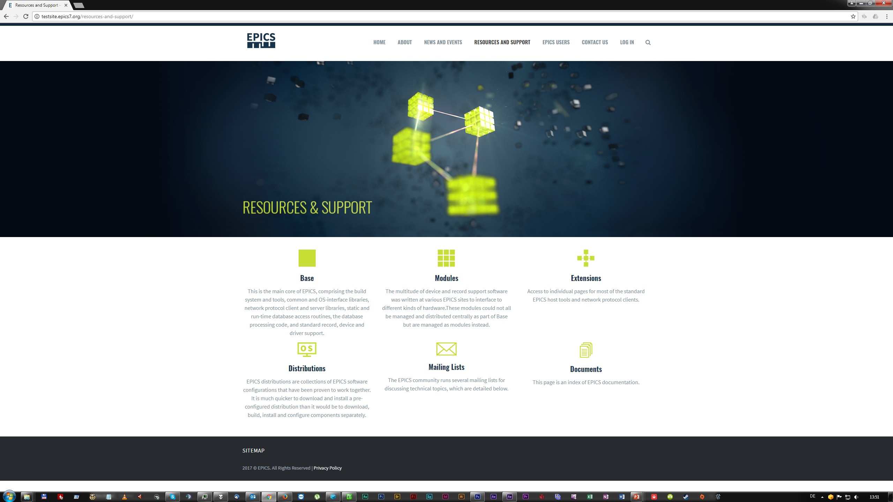

Slide 17
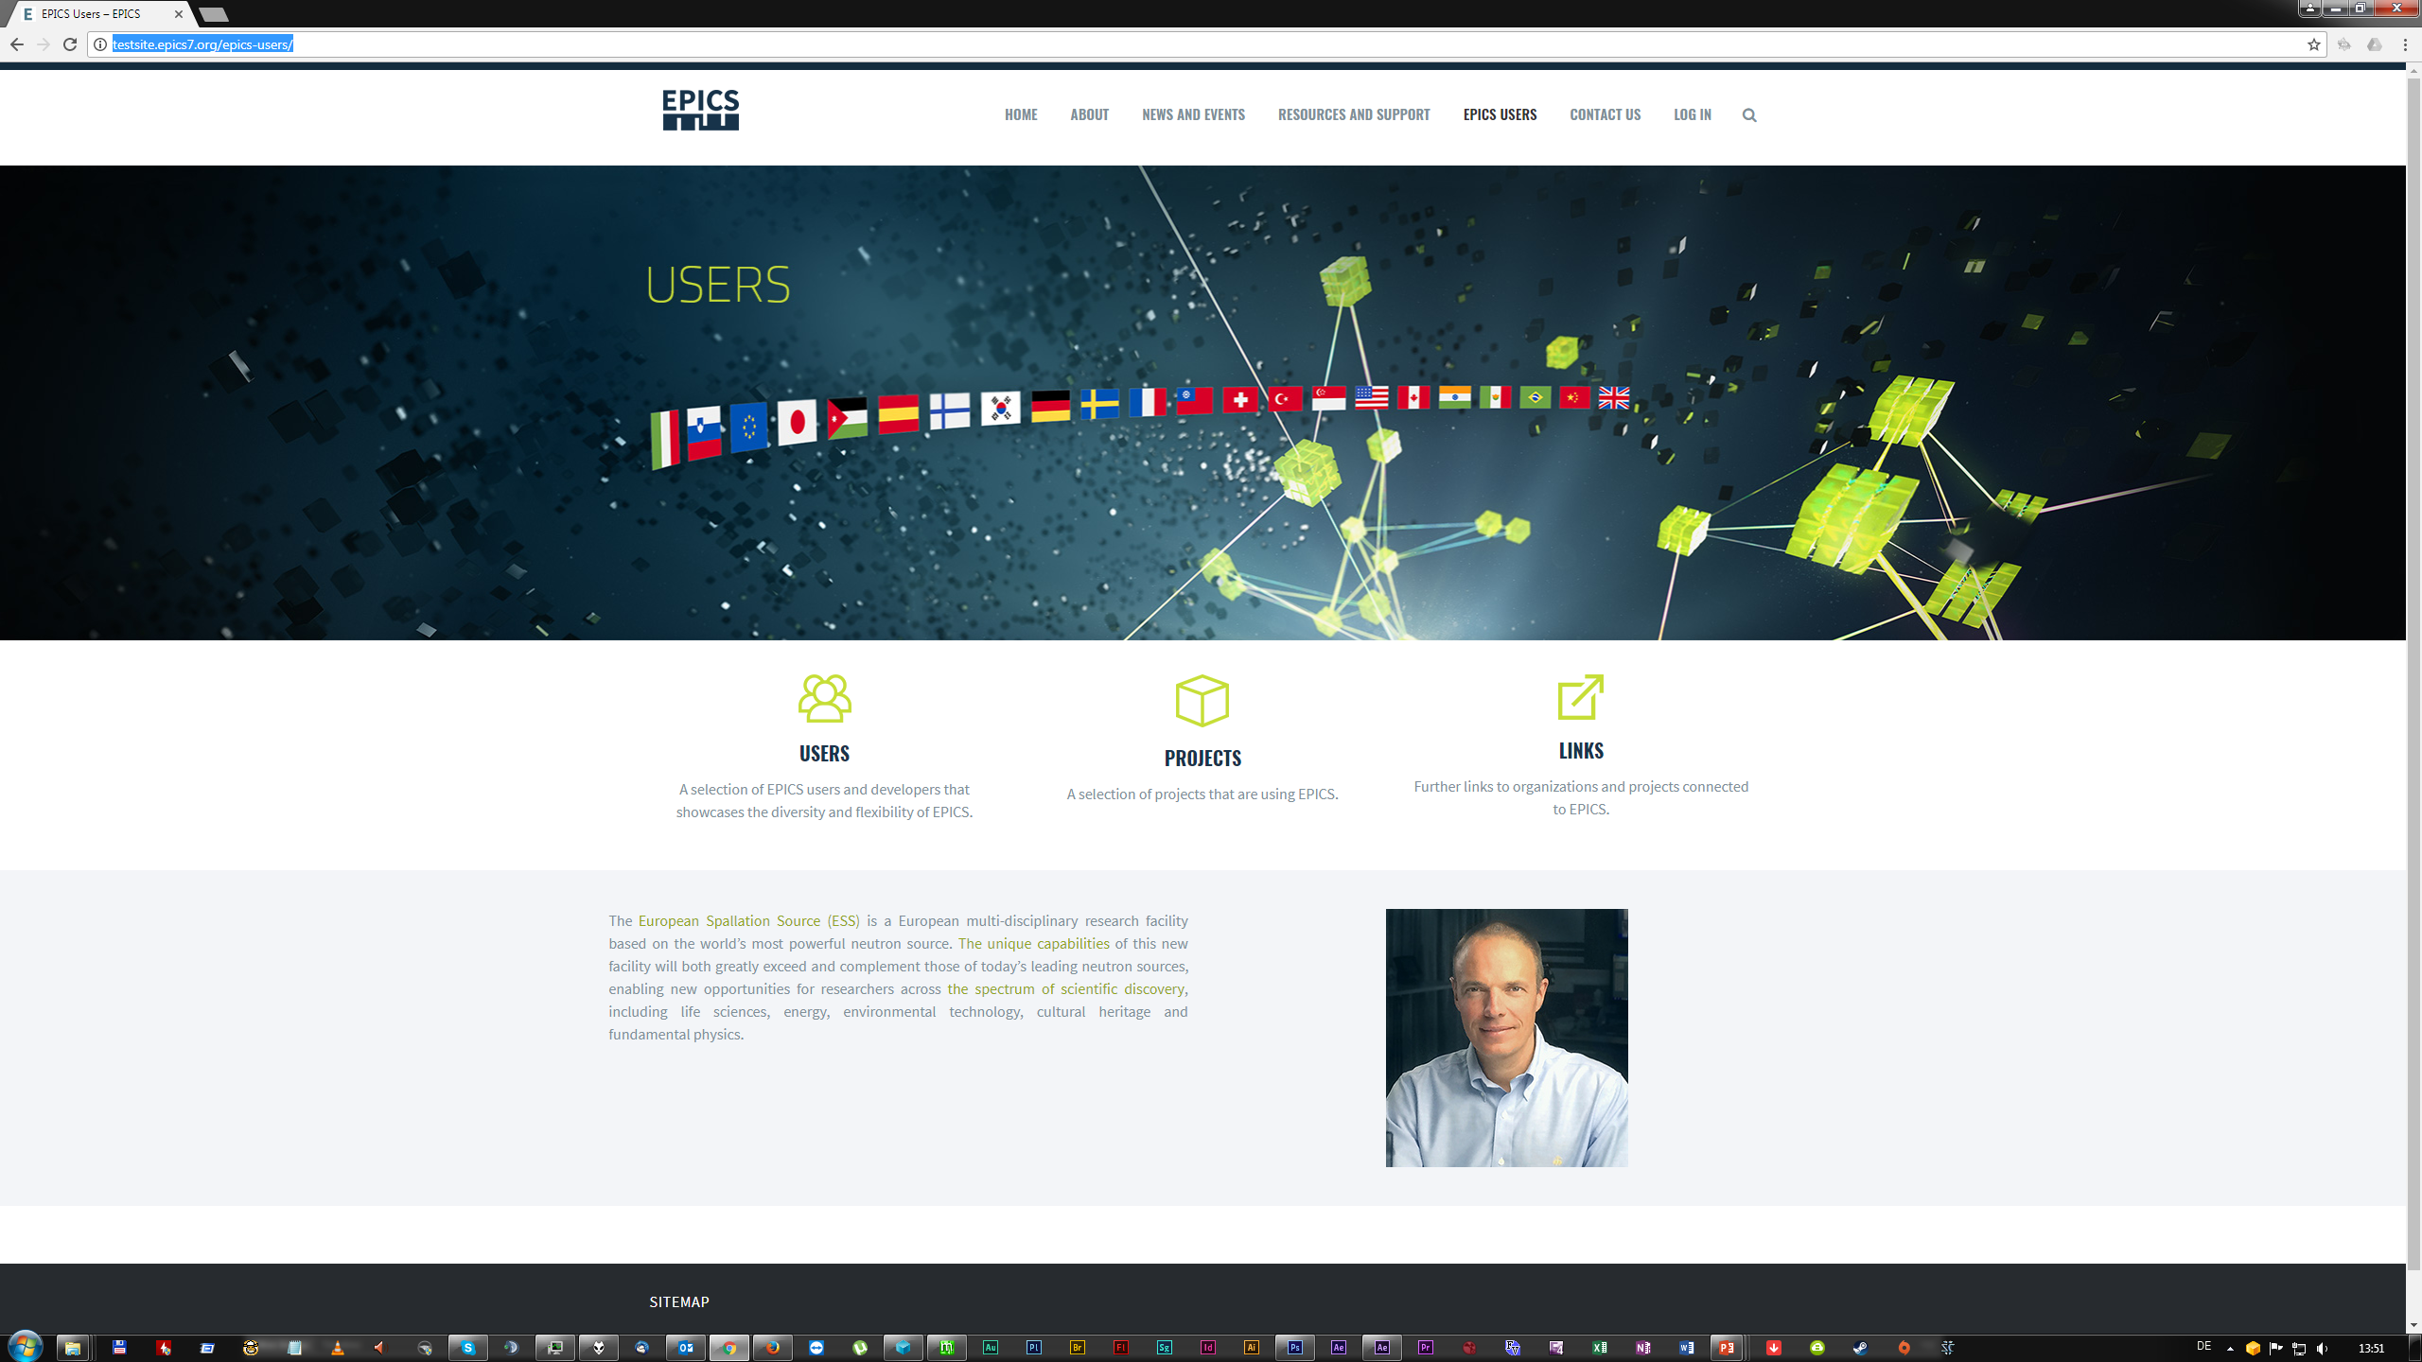

Slide 18
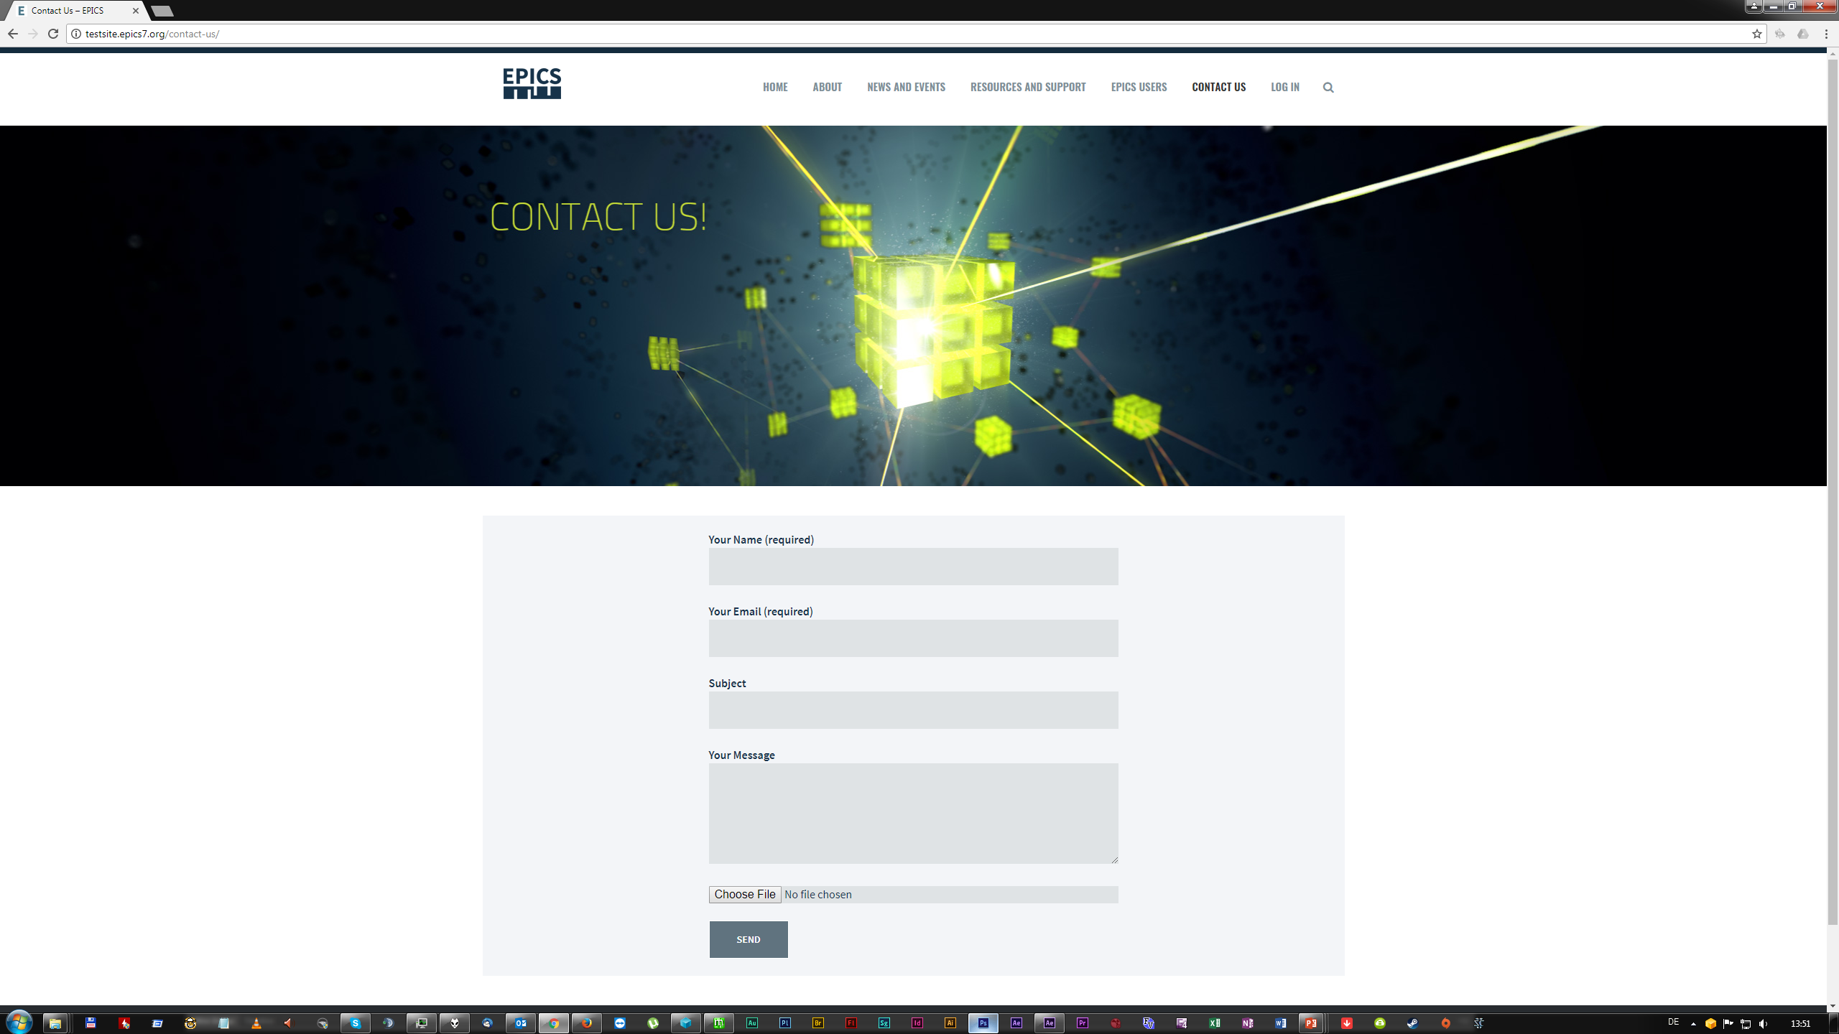

Slide 19
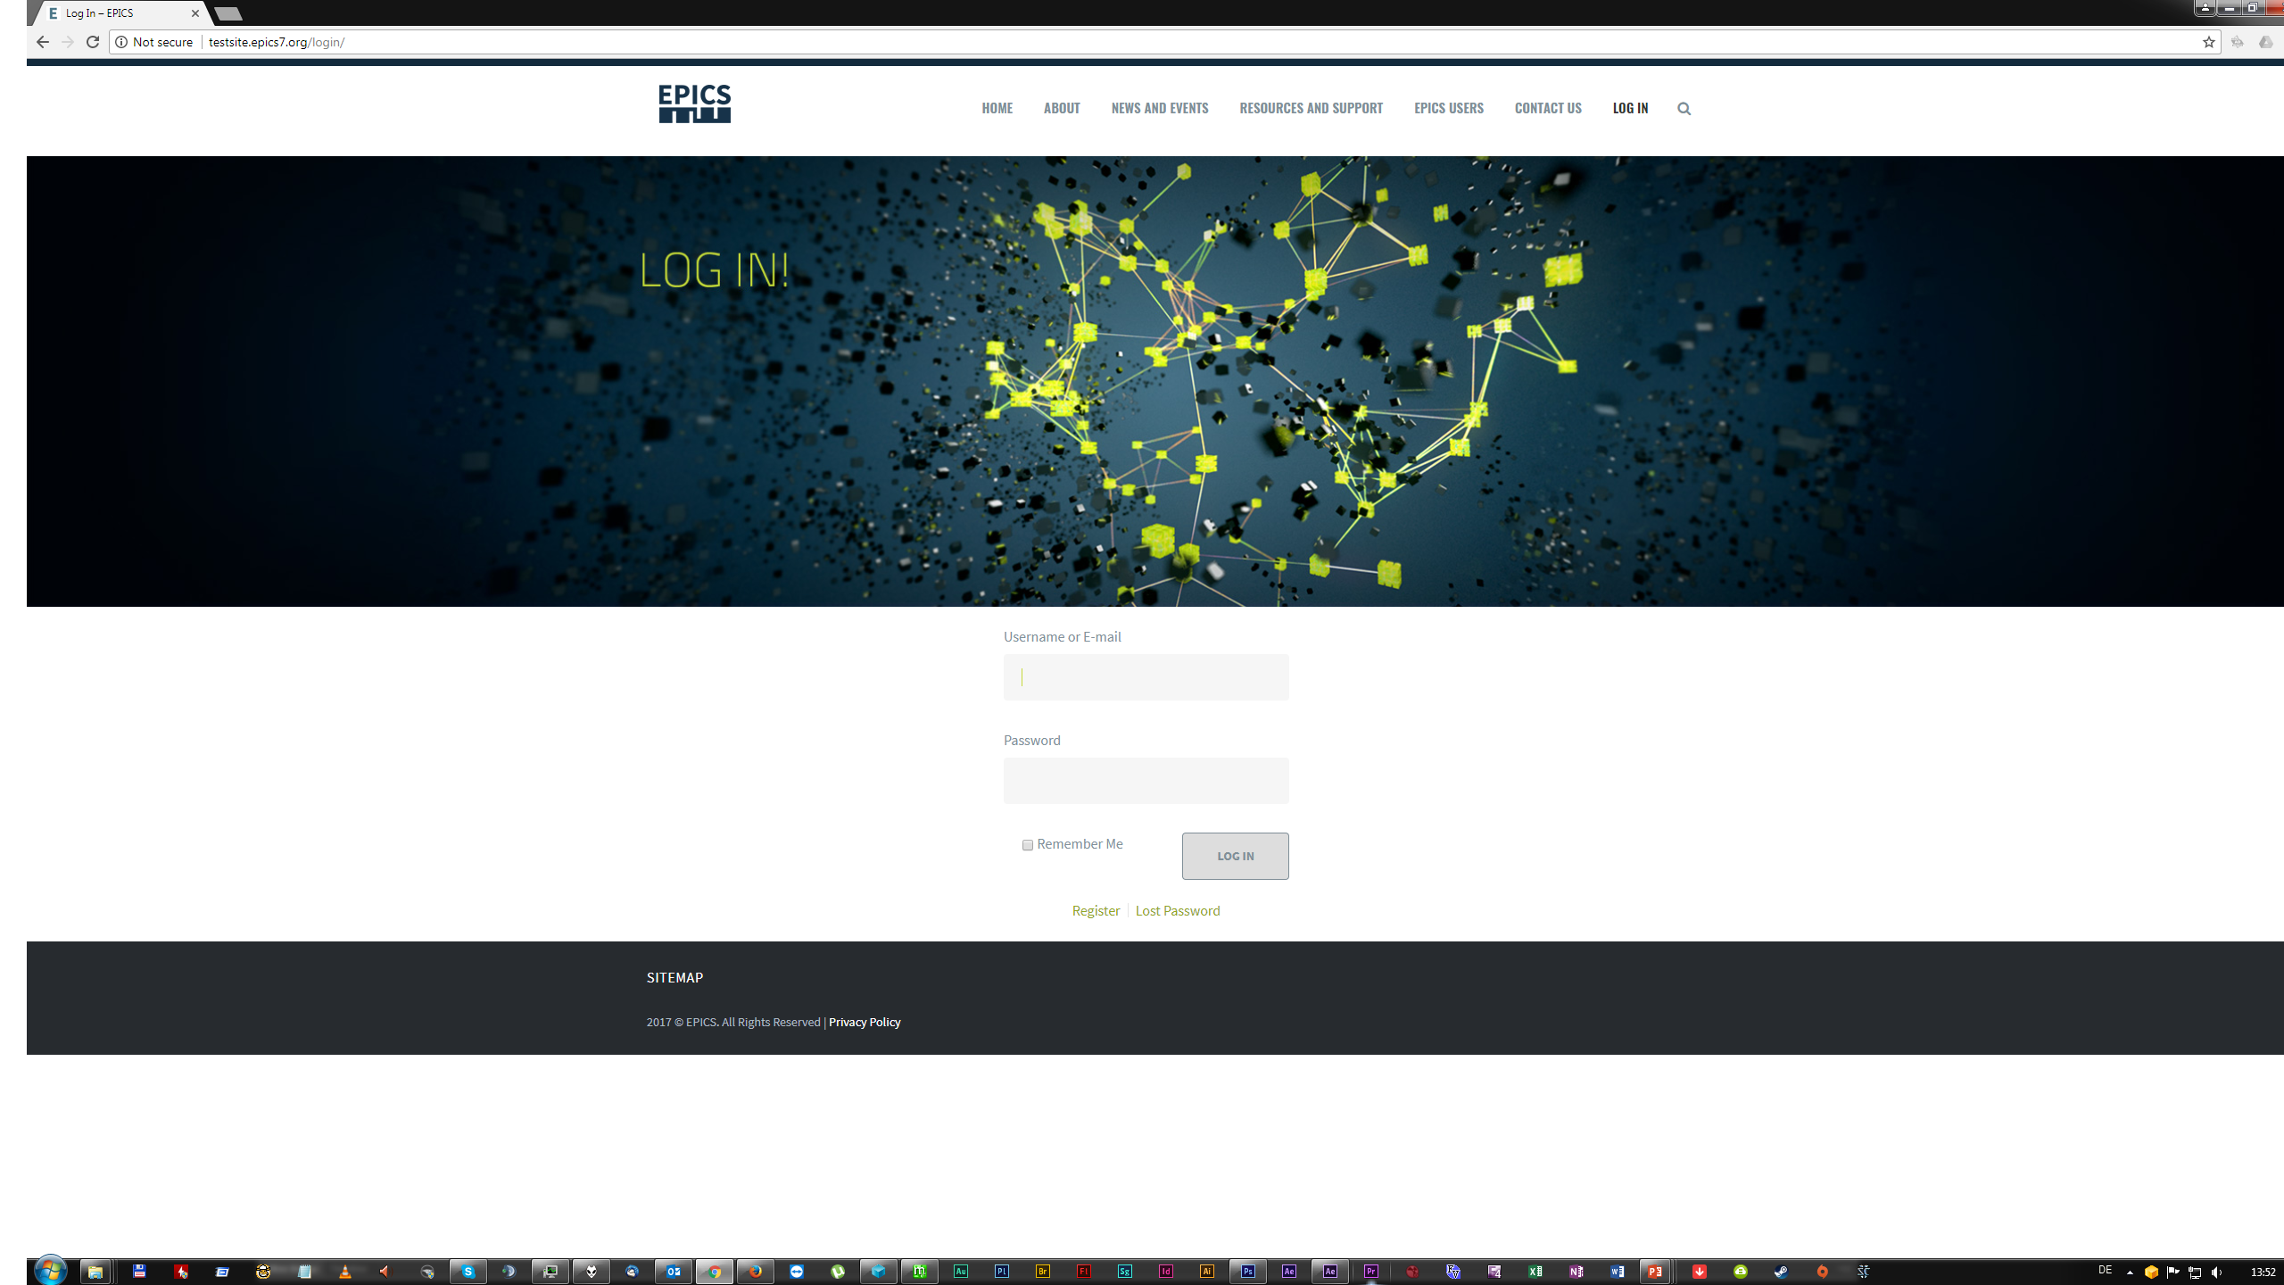

Slide 20
FORM FOLLOWS FUNCTION
1111 1111 1111

