Slide 1
Web Extensible Display Manager (WEDM)
For Installations with EPICS 3 and EDM
Ryan Slominski & Theo Larrieu

Slide 2
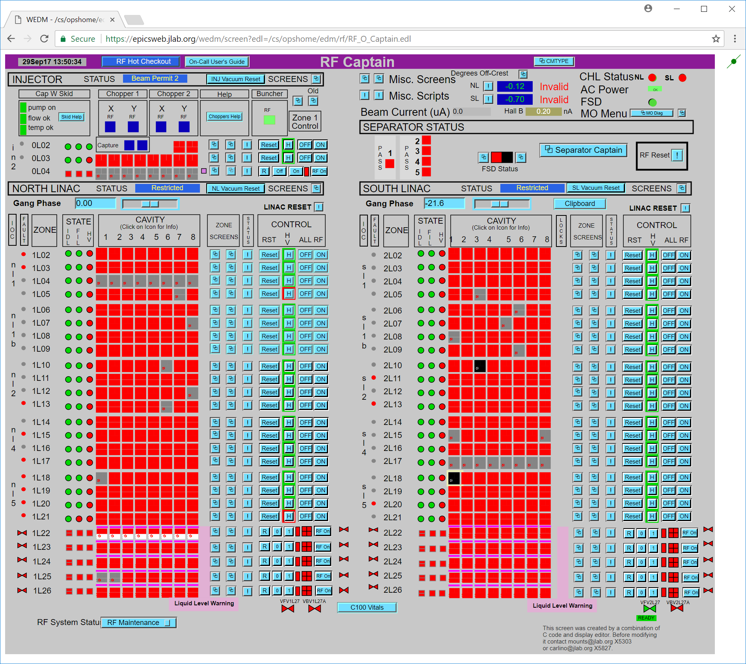
Introduction
EDM screens in a web browser
Server reads “edl” files directly
Handles 1,000s of PV updates per second
Standard EDM drag and drop screen creation tool can make mobile-sized screens

Slide 3
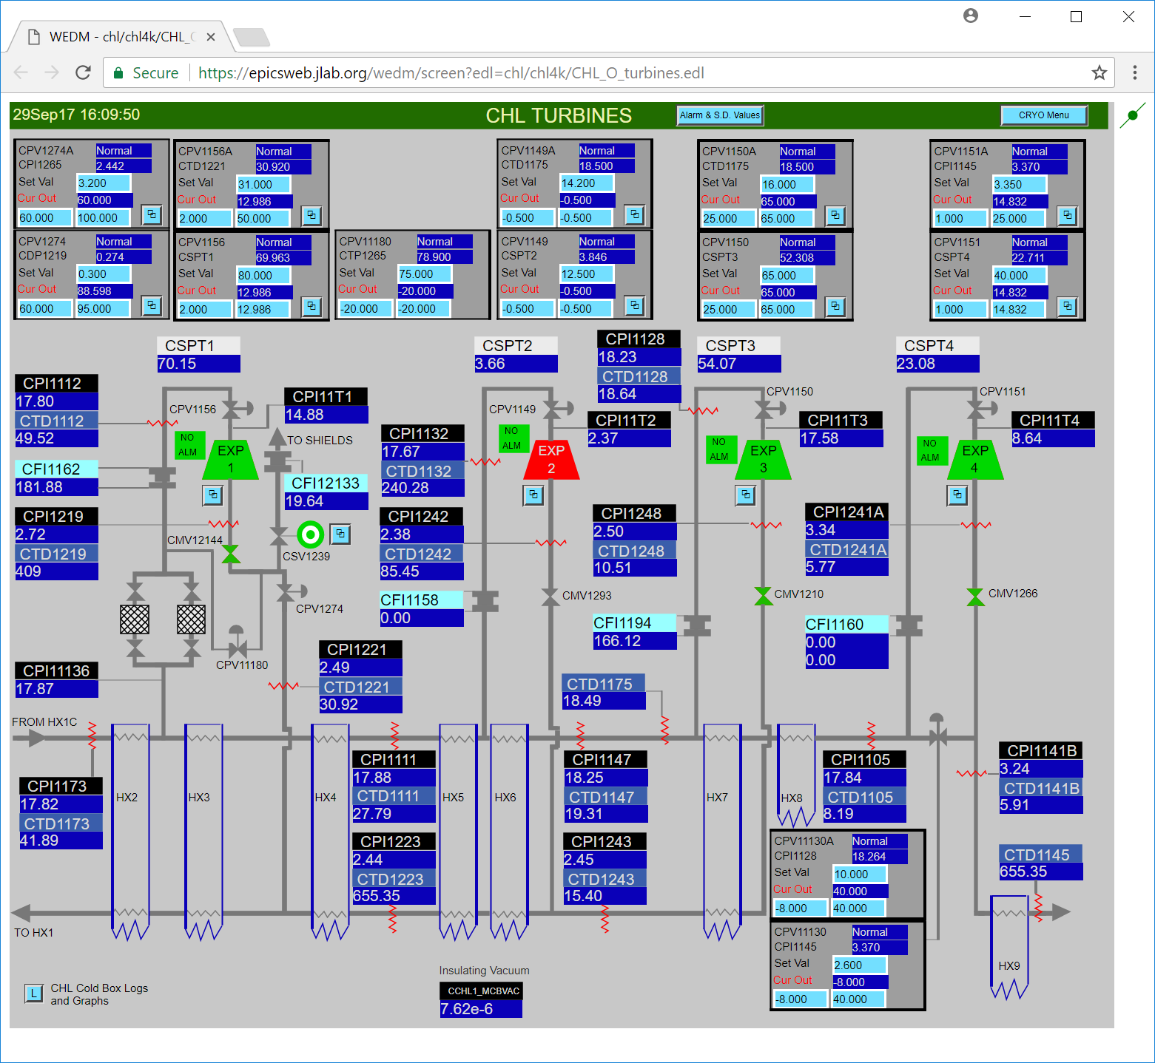
Problem
Accessing screens requires either:
Directly sitting in front of an accelerator workstation
Special network “exception” for remote computer
Accelerator account with 2-factor authentication and tunnel / VPN

Slide 4
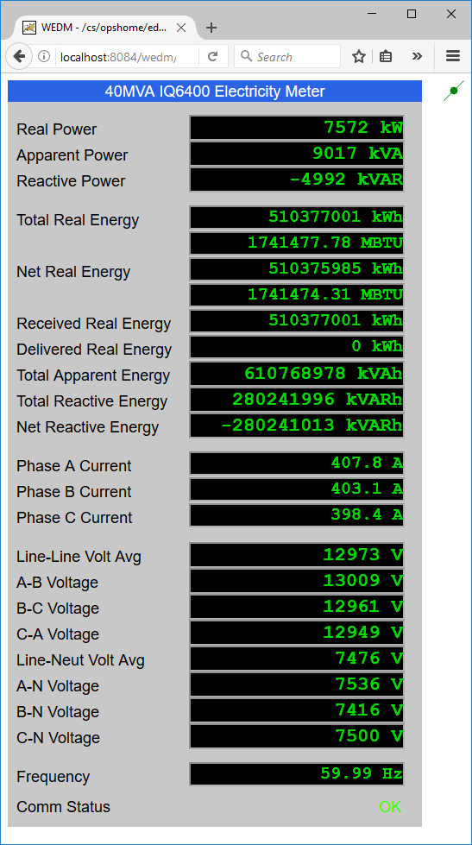
Use Cases
Facilities department remote office electric, gas, and water meter monitoring
On-call staff mobile device monitoring and troubleshooting
Guard kiosk cryogenic alarm monitoring

Slide 5
How Does It Work?
Web Browser
HTTP
WEDM Web Server
Web Socket
epics2web Web Server
EPICS CA
CA Gateway

Slide 6
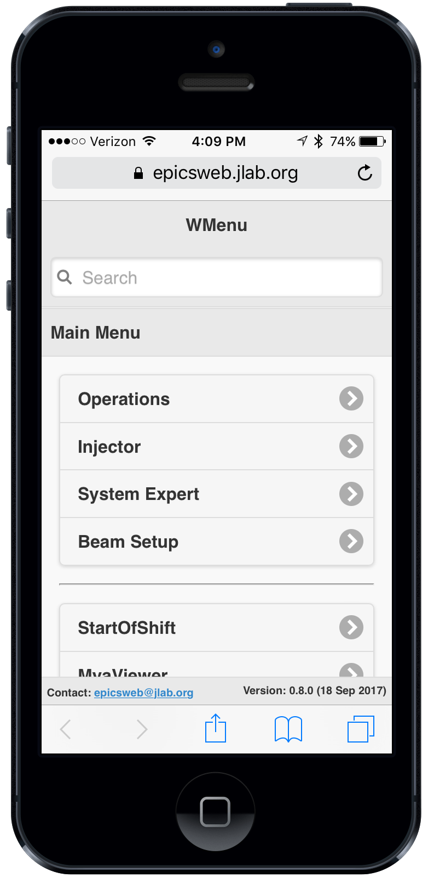
Jlab Deployment / DEMO
Mobile “directory service” app for locating screens
https://epicsweb.jlab.org

Slide 7
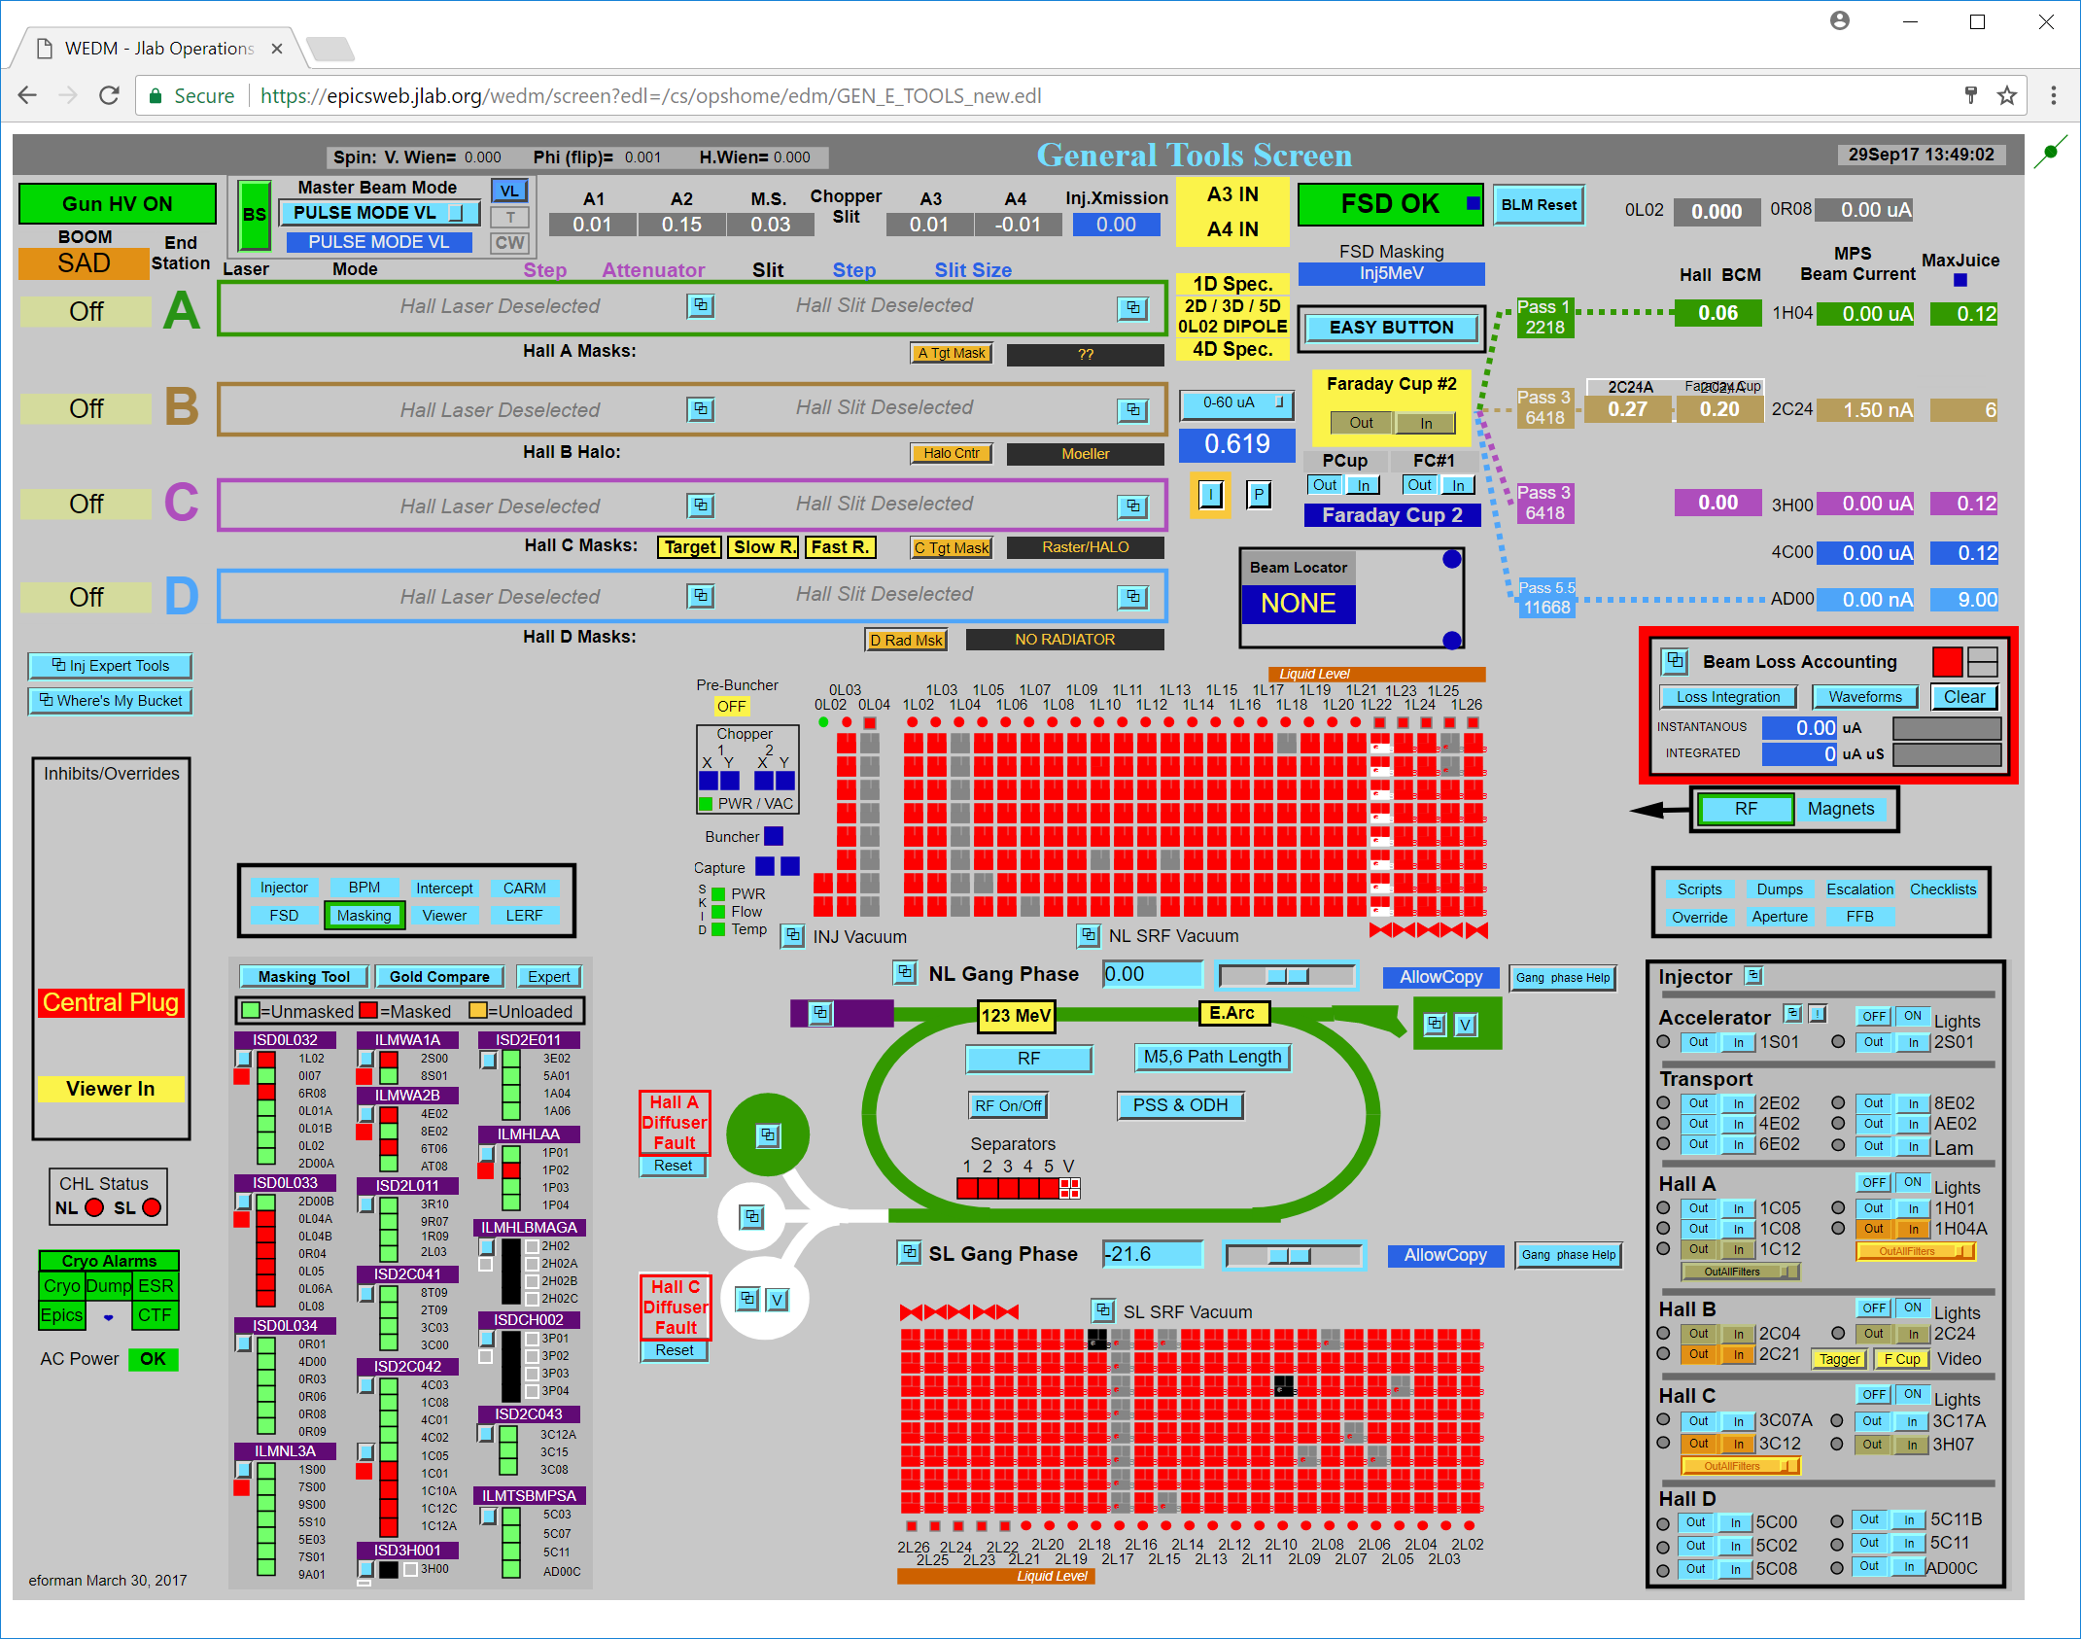
Questions?
Summary:
View existing EDM screens on the web/mobile
Faster/Easier on-call troubleshooting and remote monitoring
More Information:
ICALEPCS Poster TUPHA181
github.com/JeffersonLab/wedm
Ryan Slominski, Theo Larrieu
WEDM
EPICS Workshop 2017

