Slide 1
ORBIT CONTORL AT COSY
EPICS Implementation example
jan.malec@cosylab.com

Slide 2
Intro
About COSY
Orbit correction based on ORM
Implementation at COSY
Results and conclusions

Slide 3
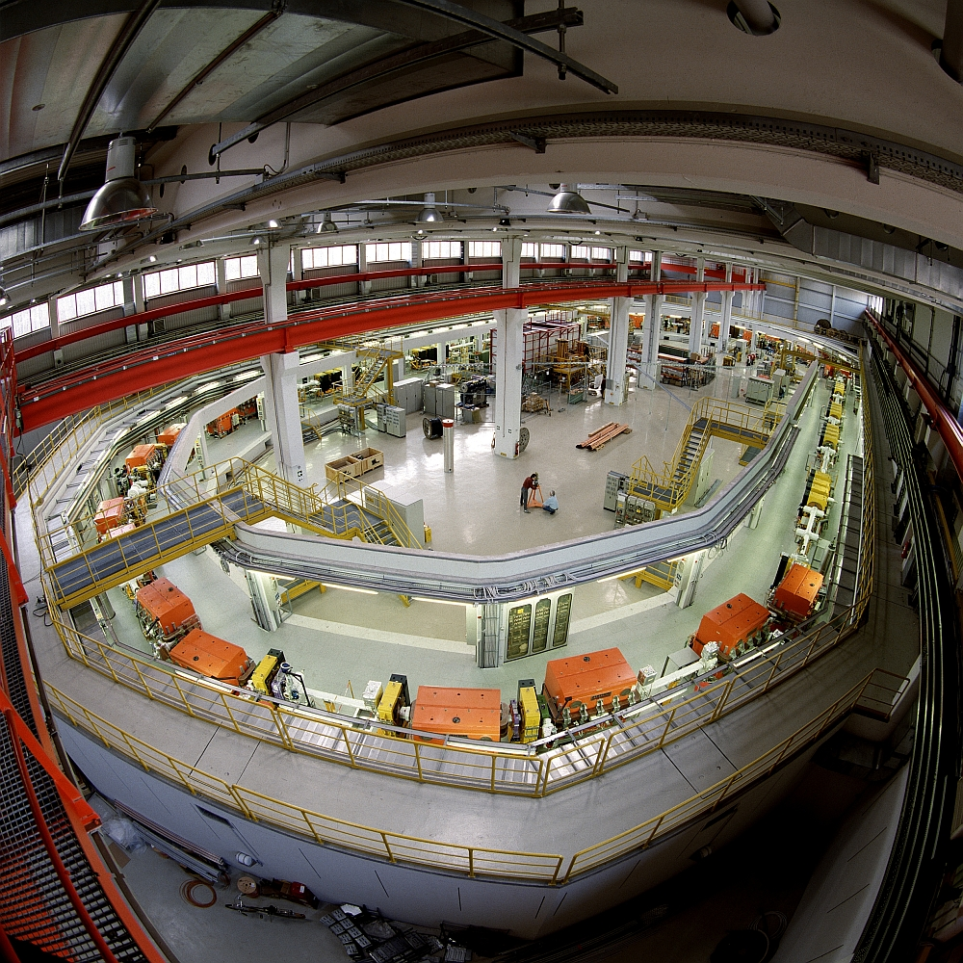
COSY (FZJ)
Cooler Synchrotron
Forschungszentrum
Jülich
Polarized and
non polarized beams
Beam cooling
Internal or
external target
Preparations for
EDM measurements

Slide 4
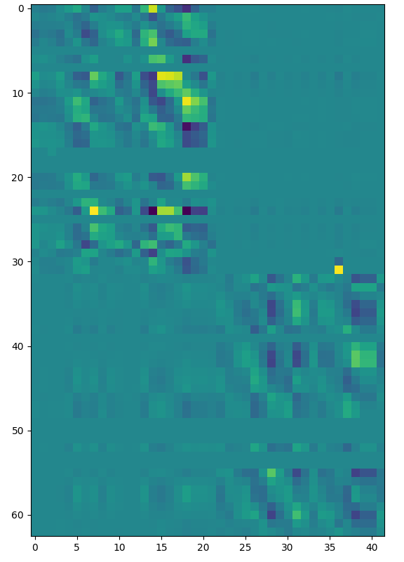
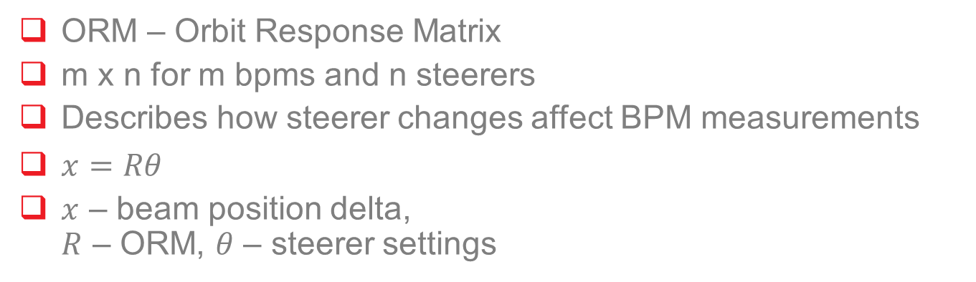
Orbit control based on ORM
ORM – Orbit Response Matrix
m x n for m bpms and n steerers
Describes how steerer changes affect BPM measurements
$x=Rθ$
$x$ – beam position delta,
$R$ – ORM, $θ$ – steerer settings

Slide 5

Orbit control based on ORM
We would like $θ$ for desired $x$
$x=Rθ$
R usually not invertible
SVD decomposition -> pseudo inverse
Find optimal $θ$

Slide 6
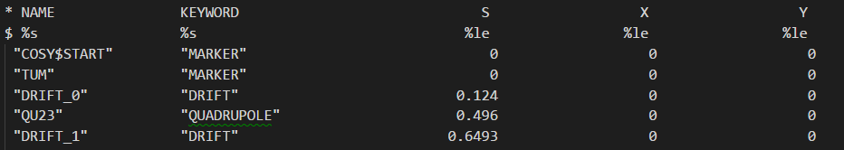
ORM and Bump Creation
Measured ORM empirically
Model -> ORM with a python script
Data from MAD-> bump creation
Bump creation confirms that model is realistic

Slide 7
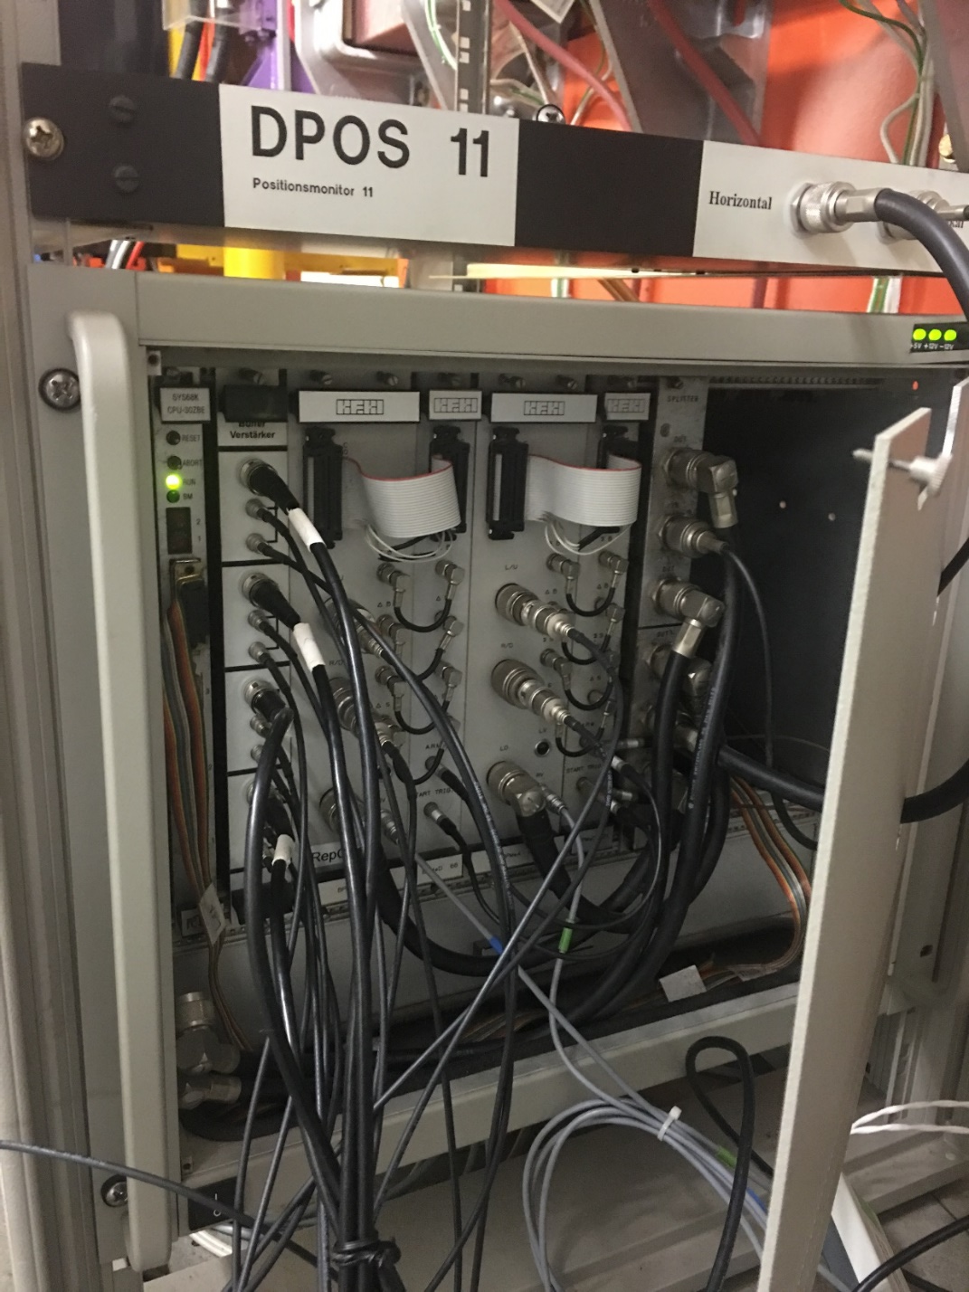
COSY Control System
Custom CPU with Motorola processors
Ethernet based timing on 10 Megabit non switched network
Non distributed
Tcl/Tk GUIs, TCP

Slide 8
Control system design

Slide 9
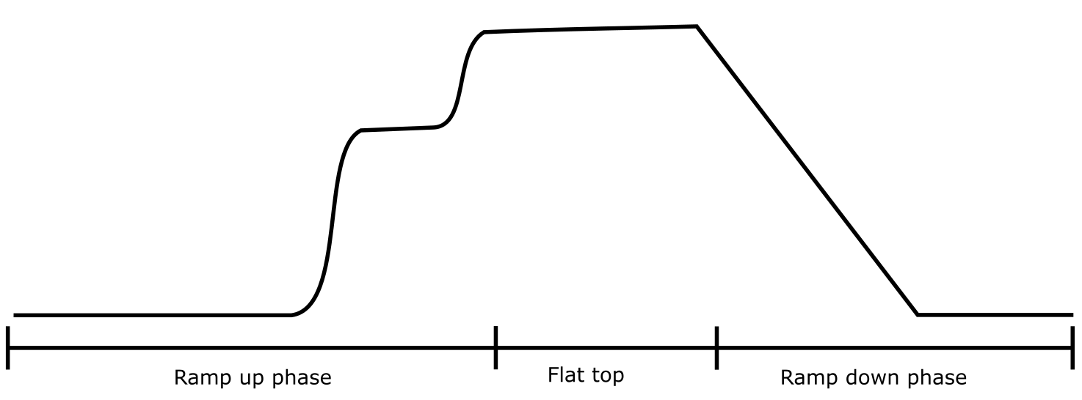
COSY cycle operation

Slide 10
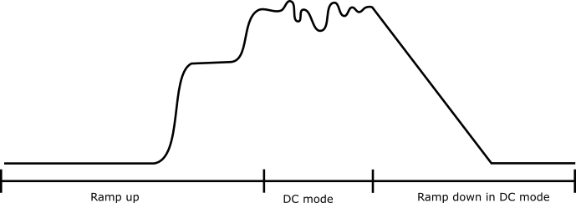
COSY cycle operation + OC

Slide 11
Full orbit correction state machine

Slide 12
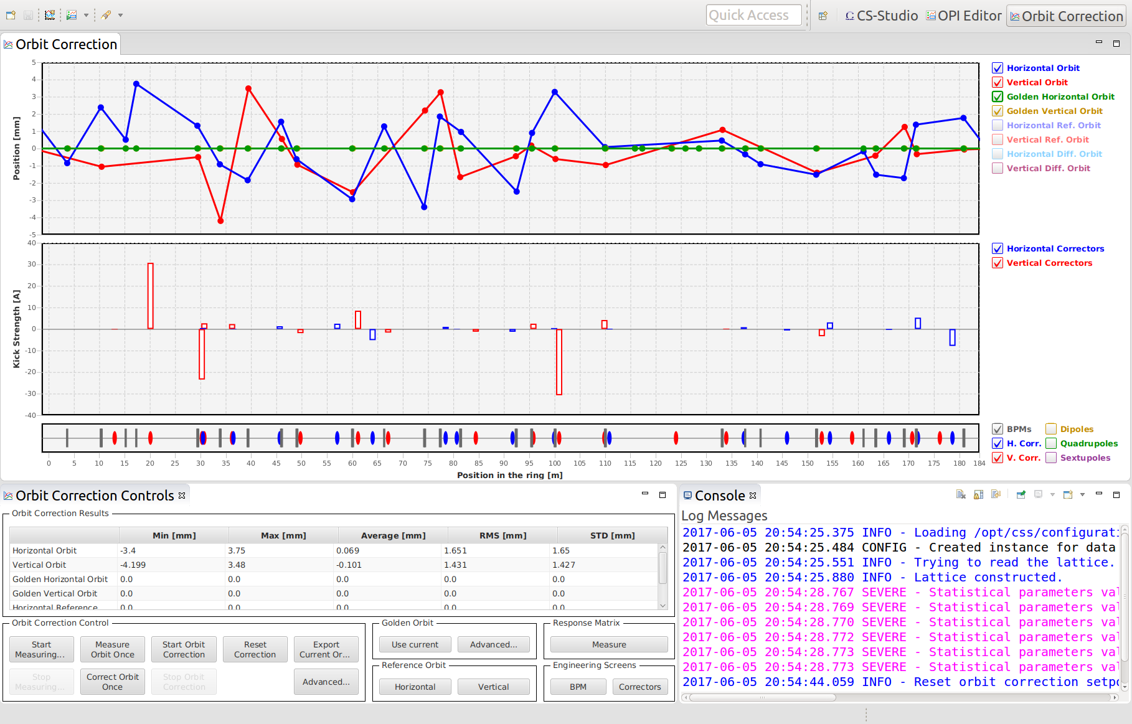
Orbit correction GUI

Slide 13
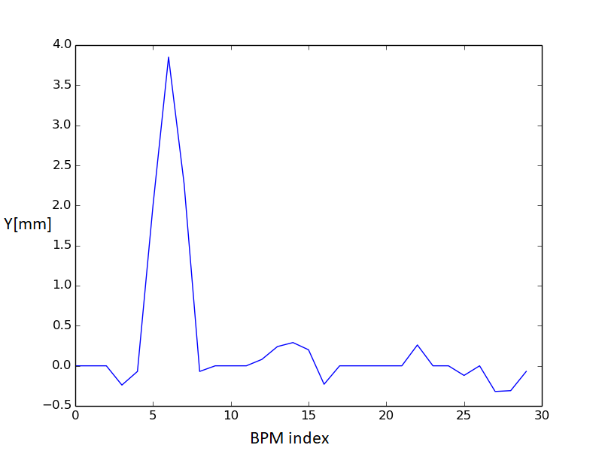
Creation of a vertical bump

Slide 14
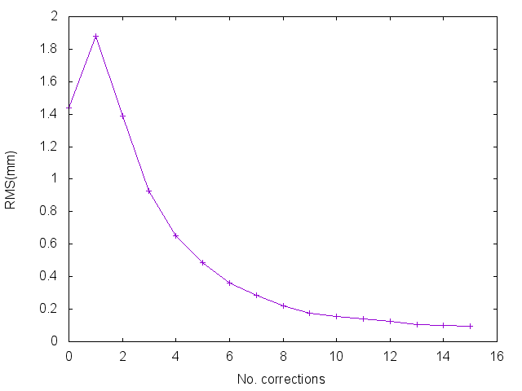
Correcting a vertical bump

Slide 15
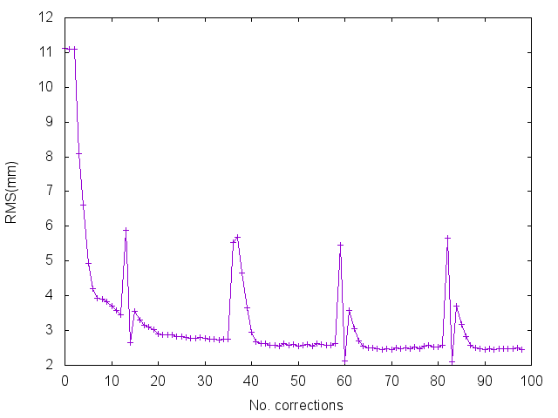
Correction to zero over multiple cycles

Slide 16
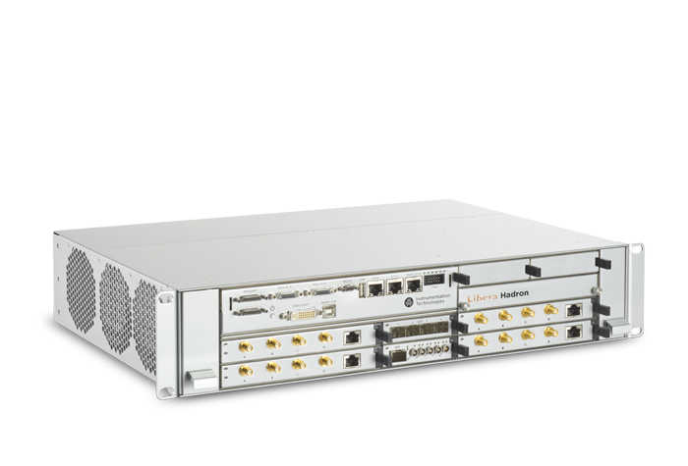
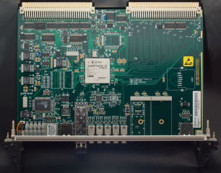
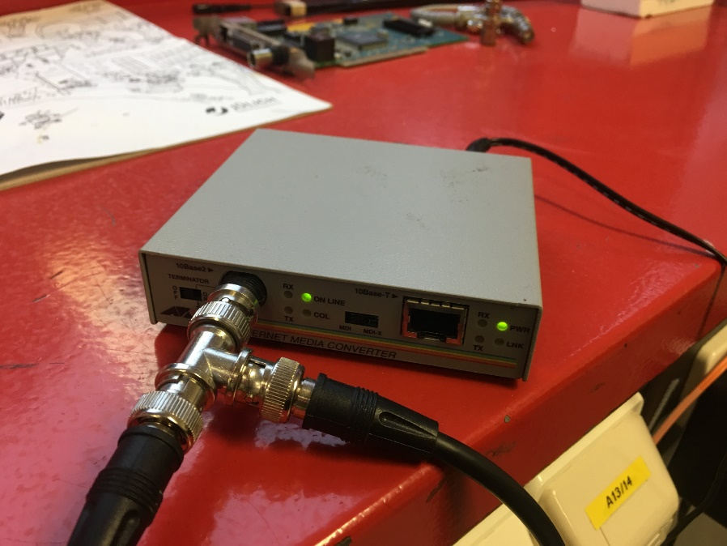
Solving possible bottlenecks

Slide 17
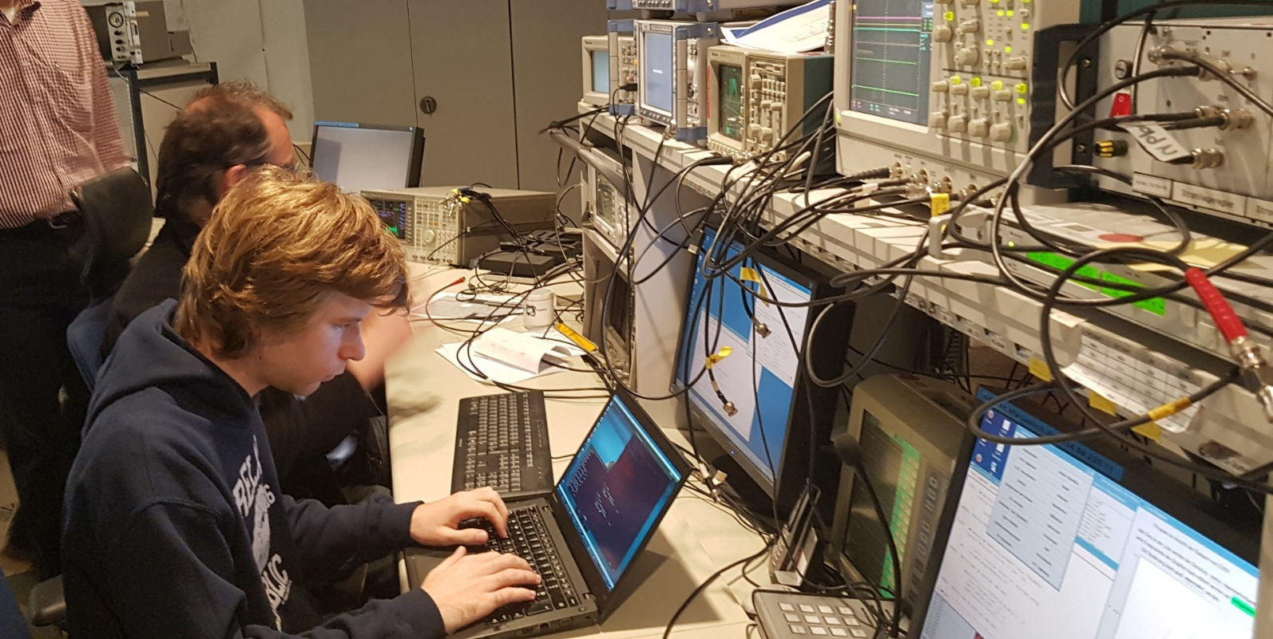
Conclusions
COSY is an interesting machine with a great team
Implemented orbit correction in EPICS with virtually no hardware changes and minimal downtime
Introduced distributed ACS
Really interesting project

Slide 18
Thank you!
Jan Malec
COSYLAB
Tel.: +386 40 671 246
Web: www.cosylab.com

