Slide 1
WebEPICS status update
Klemen Vodopivec
September 7th, 2017

Slide 2
webopi => WebEPICS
webopi was a prototype
  Use existing .opi files and display them in browser
  Mainly JavaScript code
Revised WebEPICS
  Server code in Python
    Broader community interest
  Using pvaPy for EPICS connectivity
    Scales nicely – tested about 1000s PVs
    Fast PV connects – recent change
  Split architecture

Slide 3
PVs Transport Layer
EPICS protocols available in web browser
Supports Channel Access and PV Access
  EPICS7 compatible
  Using Normative Types
Easy on web developers
  WebSocket & JSON protocol
  With JavaScript abstraction interfaces

Slide 4
Screens Converter
Re-using existing screen files
Or easily create web-pages with display editor of choice
Limited number of BOY & DisplayBuilder widgets supported
  Label, Text Update, LEDs, Button, MenuButton, GroupContainer, …
  Alarms work
  No scripts, no rules (yet)
Easily extended for other formats’ support (EDM?)

Slide 5
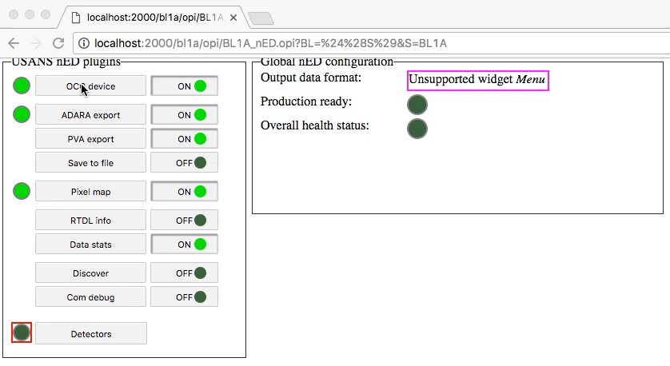
Short demo

Slide 6
Summary
EPICS7 PVs become available for web development
Display existing screens in web browser
Questions?
Feedback: vodopiveck@ornl.gov

