Slide 1
DREAM Shielding

Slide 2
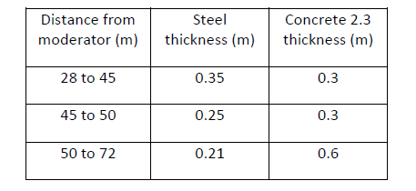
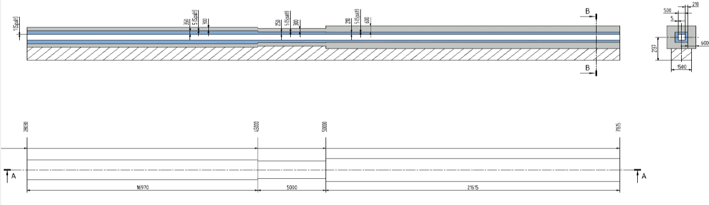
Bi-spectral
Just guides ☺
44 m
Use support
Rely on 50 cm slab

Slide 3
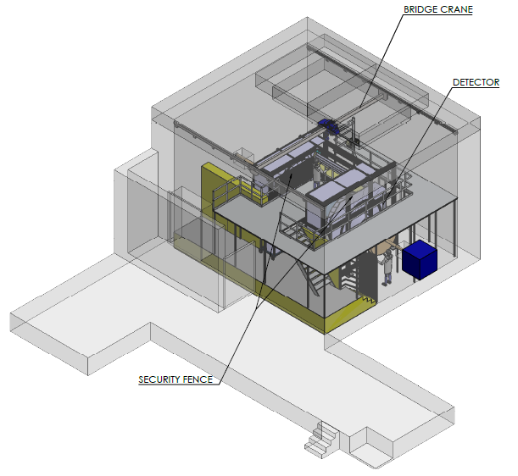
General view
9
10
23 T/m²
Floor @ 80 cm

Slide 4
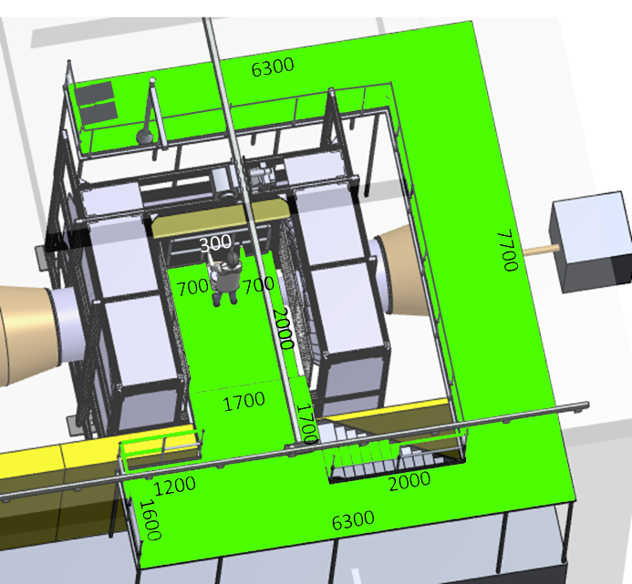
Dimensions / 2nd floor
Ancillary Equipment
2 m from SES
ESS-0038078, p17
Can be protected
from radiation
1200

Slide 5
Floor load
Concrete : 21 T/m²
S= 22 m² (36X0.6) - wall footprint
V= 187 m³ (22X6.6 + 80*0.6 - 2.5)
(walls) (roof) (door)
M= 467 T (250 k€ @ 500€/T)
B4C or equivalent (d=2.5 T/m³): 1.7 T/m²
S= 300 m², thickness 5 mm, V=1,5 m³
M= 3,7 T (100 k€ @ 30 k€/T)
Crane + Load M= 3T (30 k€)
Nothing heavy around the walls at +/- 1 m
23 T/m²
< 28 T/m² requirement

Slide 6
Strategy for neutron absorption
Alternatives to B4C:
  Ceramic borated tiles (Italian project – Ikon 13)
  Gd paint (Werner’s idea)
  Carsten Concrete
Get shielding closer
  Around the detector structure

Slide 7
To be answered
Neutron absorber:
- material
- strategy
Thickness of roof shielding:
- further away from sample
- skyshine
Floor load

Slide 8
SKADI Shielding

Slide 9
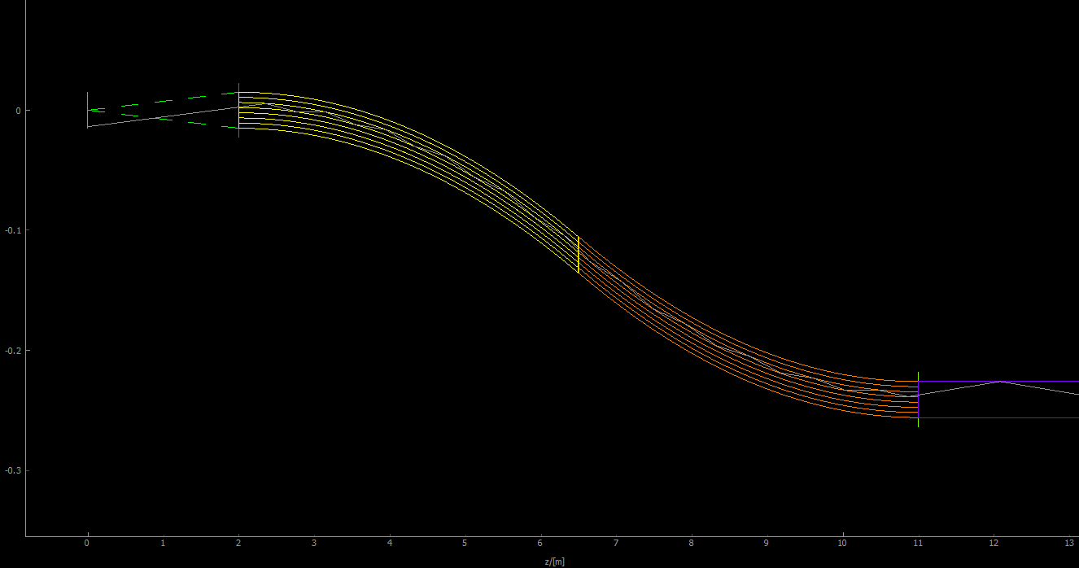
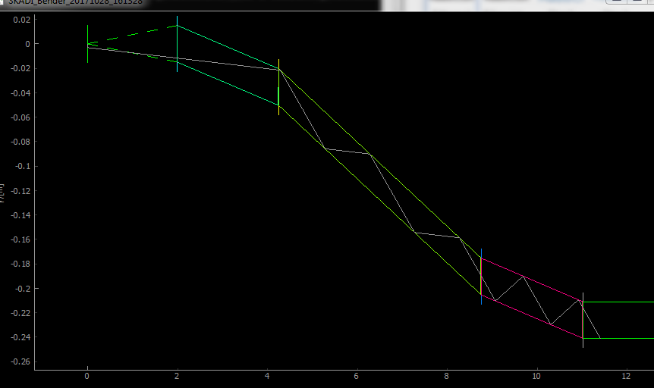
S-Bender
7 channels
DogLeg

Slide 10
Back of the enveloppe calculation
10^10 neutrons/cm2/s
Min distance from sample and inside wall = 1.5 m
All neutrons convert to 2 MeV Gamma
Calculation at the outside wall located 1.5 + X from sample
➔ 60 cm standard Concrete

