Slide 1
Update from IFE HEIMDAL and BIFROST beamlines
SHIELDING meeting, Lund, 31.10.2017
Rodion Kolevatov (IFE, Norway)
rodion.kolevatov@ife.no

Slide 2
BIFROST@W4 and HEIMDAL@W8
BIFROST: Guide curved to prevent streaming of fast neutrons
Line-Of-Sight to the moderator avoided before bunker wall (24.5 m)
HEIMDAL: Straight instrument (thermal guide), T0 chopper foreseen.
Both: Variable m-value of the coating on focusing and defocusing sections
Low value in long straight sections (low divergence)
High value in focusing and defocusing sections
This talk:
Mainly BIFROST, with optics version of mid-September 2017.

Slide 3
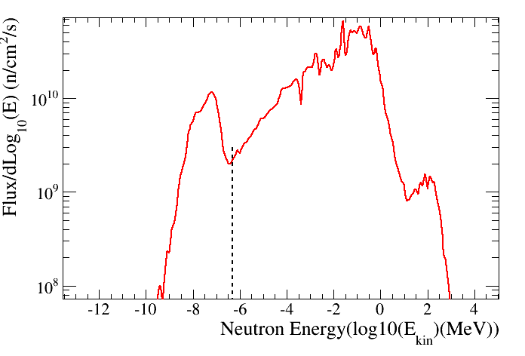
Shielding for safety
10¹⁶ neutr/s with E > 1 MeV within monolith
Monolith beamports provide significant channels of fast and relativistic neutrons
Varying dose composition along the beamline.
Hard gamma radiation released in neutron capture
Requirements:
Normal operation H1: < 3 mkSv/hr outside shielding
Calculate for 1 mkSv/hr
Likely accident (H2): <0.5 mSv per event
fast neutrons
Gamma + neutrons(?)
gamma
source and spallation
neutrons_+ streaming
Energetic photons from thermal neutron radiative capture in guide coating and substrate
30 m

Slide 4
Methods and strategy
Criterion | Analytic | Monte-Carlo
Simple to use | Yes | Variance reduction is tricky
Comp. power | Minimal | Substantial
Time | Seconds | Minutes to hours
Precision | OK | Higher precision with proper settings
Complex geom. | -- | Yes
To save time:
Start with gamma shielding – can’t have less.
Analytic evaluation is easy
Dominant contribution out of LOS/far from bunker (~80m)
Implement analytic formulas in McStas:
Spectrum of radiation can be calculated
Table values for attenuation and dose buildup from literature.
Use gamma shielding layout as a starting point for the neutron tansport simulations use heavy biasing for the source, transport and geometrical importance

Slide 5
GAMMA SHIELDING
Hard gammas from neutron capture in the coating (and, eventually, substrate).
Easy to evaluate when spectrum and intensity is known

Slide 6
Reflection from the supermirror
Capture (1/v law)
Diffuse scattering (isotropic)
Penetrates substrate at large angle, negligible capture in metal substrates
Transmission
Penetrates substrate at low angle, hence high probability of capture in the substrates, including metal or sodium float.
Scattering on the roughness
Consider worst case – add this up with transmission

Slide 7
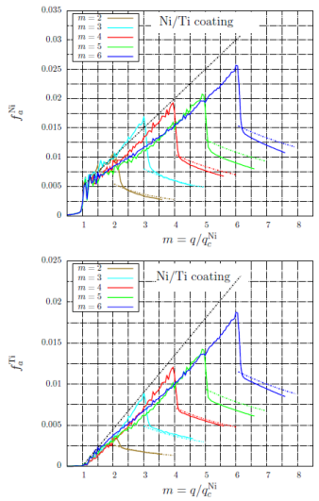
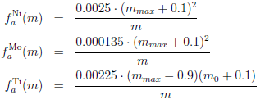
Coating capture probability: m₀ >1, m=q/q_{c}>1
Capture probability per incident neutron (“per hit”) can be calculated:
$1<m<m_{0}$: wavelength independent
$m>m_{0}$: wavelength independent
Easy to interpret: scales as path in the coating
$R_{0}$ – low angle reflectivity;
$m_{0}$ – supermirror coating cutoff.
R Kolevatov, C Schanzer, P Boeni –
arXiv preprint arXiv:1708.04486, 2017

Slide 8
Capture for m₀ =1 or q/q_{c}<1
Assume always that reflection loss is due to interaction in the coating
Assuming transmission to the substrate gives similar dose rates outside shielding
With
$$0.35∙{10}^{8}$$
n/s/m:
Interaction is either diffuse scattering or absorption.
Diffuse scattering : contribution from coherent and incoherent scattering
Wavelength dependent factor :
Present implementation:
$λ<2AA→ α=1$, both coherent and incoherent
$λ>3AA→ α=0$, incoherent only
$2AA< λ<3AA →$ linear interpolation
Concrete, cm | 100%Ni coating | 100% sodium float | 50%Ni 50% glass
0 | 38,3 μSv/h | 47,3 μSv/h | 42,8 μSv/h
50 | 1,83 μSv/h | 1,35 μSv/h | 1,59 μSv/h
60 | 1,06 μSv/h | 0,693 μSv/h | 0,876 μSv/h

Slide 9
Gamma shielding evaluation
Capture in the coating
Linear parametrization for capture “per hit” rate when 1 < q/q_{c} < m₀
1/q parameterization for capture “per hit” when q/q_{c} > m₀
For m₀= 1 and q/q_{c} >1 take parameterization with m₀=1.6 (account Ti layers)
Capture per non-reflected when q/q_{c}<1, with wavelength dependent diffuse scattering
Conservative estimate for the spectrum(e.g. 8÷9MeV γ’s treated as 9MeV)
What was not absorbed in the coating:
Assume capture in borated materials (460keV gamma emission)
Not true for metal substrates if significant fraction of neutrons transmitted to the substrate with low glancing angle.
Things to check:
Have a closer look at m=1 coating. Origin of losses (interaction in the coating vs misalignment) may have strong impact on shielding requirements.
Implement capture in the metal substrates (should be not too different from was already considered when q<q_{c} )

Slide 10
Gamma shielding evaluation
Source ESS_butterfly, power = 5MW
Wavelength 0.1 to 8 AA,
Choppers fully open
“Pessimistic” 99% reflectivity at q<q_{c}, non reflected interact in coating
m=1, q>q_{c}
On m=1 section for transmission of neutrons above q_{c} used capture probability parameterization setting m=1.6 (in reality m=1 is also a multilayer). This slight increase of m in parameterization has negligible effect for the dose.

Slide 11
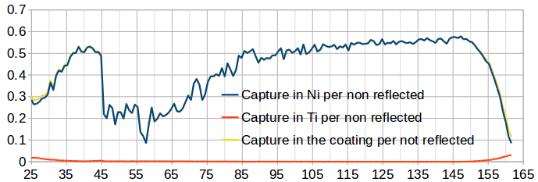
Capture per incident vs per non-reflected
Capture per non-reflected depends on the spectrum, divergence and m-value. Hardly possible to parameterize.

Slide 12
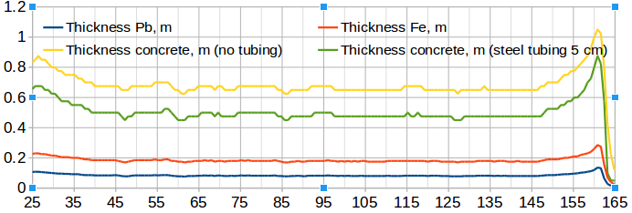
Present estimates for gamma shielding
Possible shielding layout for 5MW, R₀=0.99 and 1.5 uSv/hr outside:
1m concrete in D03 (50m) and beyond 145m
65 cm concrete elsewhere in E02 (~60 cm for 1uSv/h@2MW or 1uSv/hr@R₀=0.995&5MW)
Remember extreme scenario used for reflection loss and conservative estimates for the gamma spectrum.

Slide 13
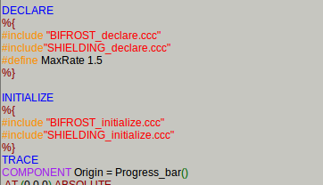
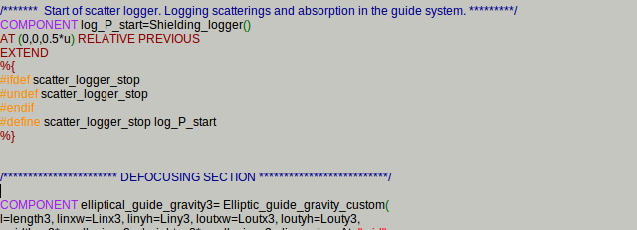
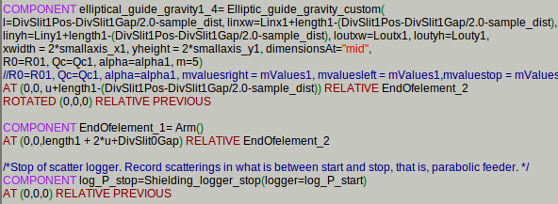
McStas implementation-1
Include files with definitions and tables into the instrument file
Wrap your region of interest with “Shielding_logger”/”Shielding_logger_stop” copmonents
Derived from “Scatter_logger_bundle” by Esben Klinkby
Replace components with the customized ones, recording m-value at reflection

Slide 14
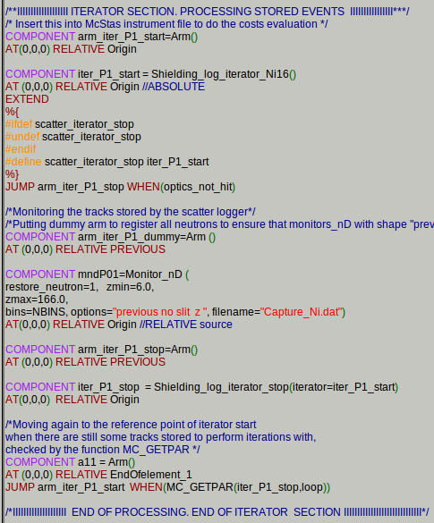
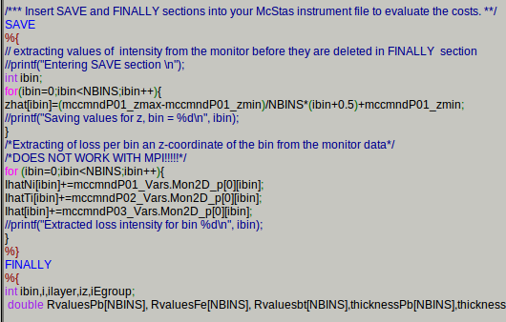
McStas implementation-2
Include the iterator components which process buffer of stored reflections to get capture in Ni, Ti and overall loss (change zmin and zmax only)
… and also some ugly hard-coded stuff for the SAVE and FINALLY sections (no doubt, usability could be improved)

Slide 15
Fast neutron shielding, bunker wall
Simulations of the BIFROST curved guide:
Do we have to worry about that at all for a curved guide?
Emphasis on rather what we have than what we should do. (For now)
Focus on the bunker wall feedthrough

Slide 16
FLUKA simulation setup
Parameterized NMX source at 2m (V.Santoro, Feb2017), heavily biased
Simple setup with no choppers/collimators:
“Steel+PE+BPE” design for the bunker wall
Monolith insert filled with “stainless steel” of ½ normal density
Copper for in-monolith NBOA (actual dimensions)
7mm Al substrates elsewhere
5mm Al tubing around bender section in the bunker
Exact geometry

Slide 17
Biasing
Source: angle (probably should be changed for duct-type) and energy
Biased interactions:
LAM-BIAS option: interacting primaries kept with reduced weight
MDSTK subroutine manipulates the buffer of secondaries produced in a hadronic interaction. For certain Z values: Perform RR for neutrons going backwards and to the sides. Leave forward unchanged.
USIMBS subroutime is applied at each step in particle transport. For certain Z: Perform RR for backward movers and splitting for very forward movers.
Weight window before the bunker wall to clean up low-weight secondaries.
$$\sim \frac{1}{(d^{2}+θ^{2})}$$

Slide 18
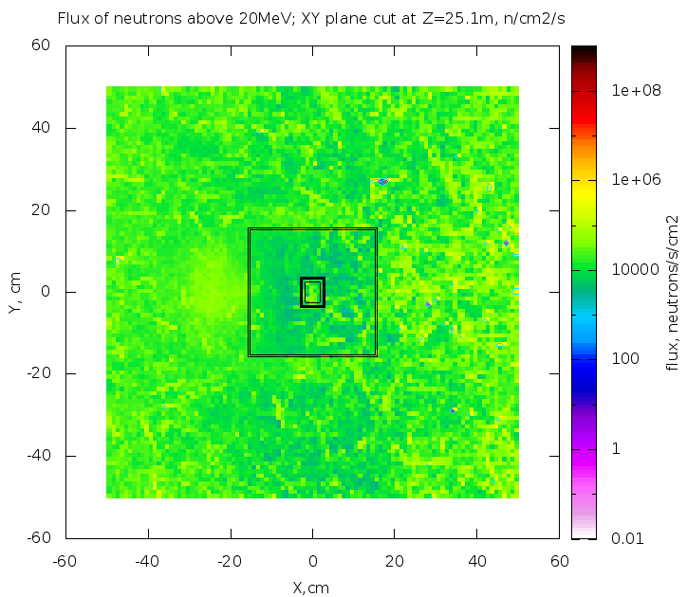
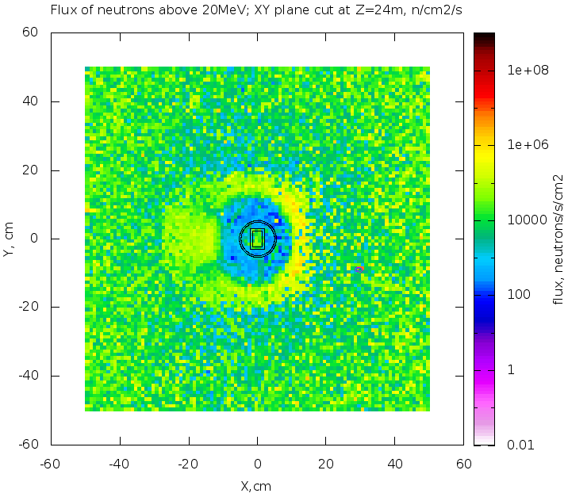
Flux before and in the bunker wall
USRBIN FLUKA tally recording High-energy hadron equivalent fluence (hadrons E<20MeV are weighted)

Slide 19
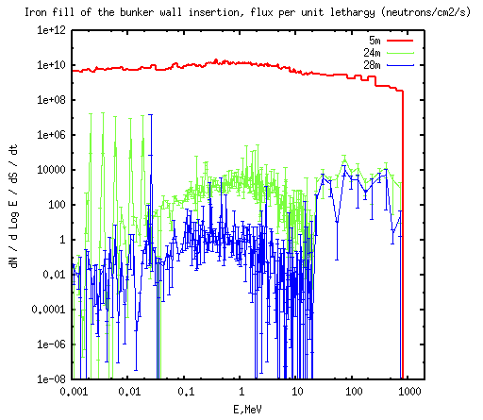
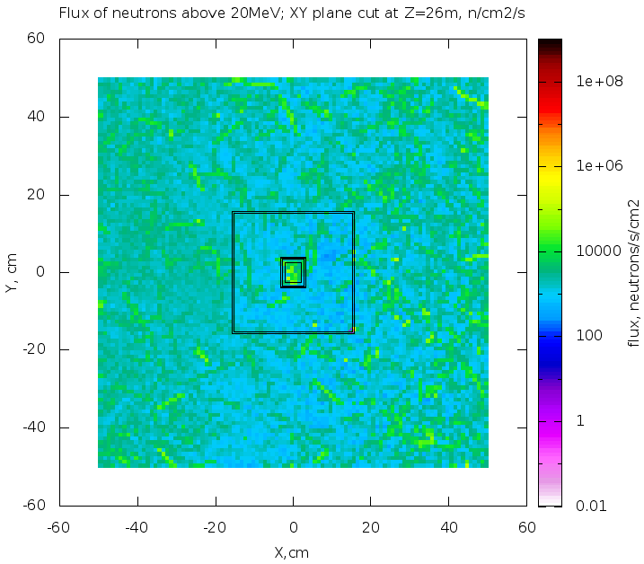
Flux before and after the bunker wall
A nice shadow provided by vacuum tubing, direct beam clearly seen
Everything is quite mixed in the wall already at 25 m
Almost no reduction of high-energy component in the guide from 24 to 28 m
Fast neutrons abundant: consider use of PE

Slide 20
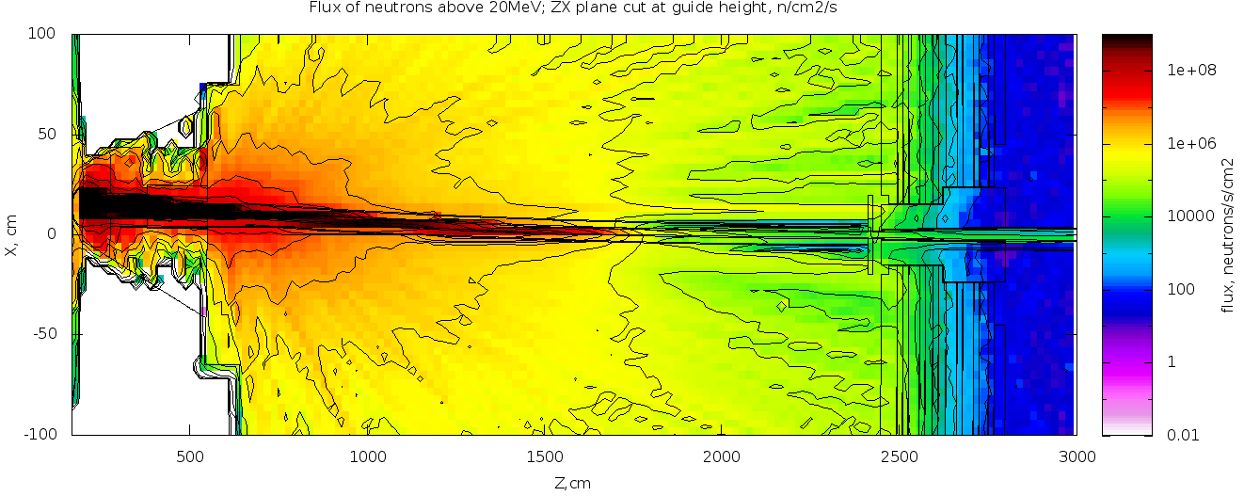
XZ plane cut, high-energy neutrons
12-17m: guide substrate illuminated by the direct beam.
A collimator at 18 m (copper?) would stop the fast secondaries streaming in the vacuum tubing
Alternatives for the substrate: let neutrons go (thin Al) or stop (thick Cu)?

Slide 21
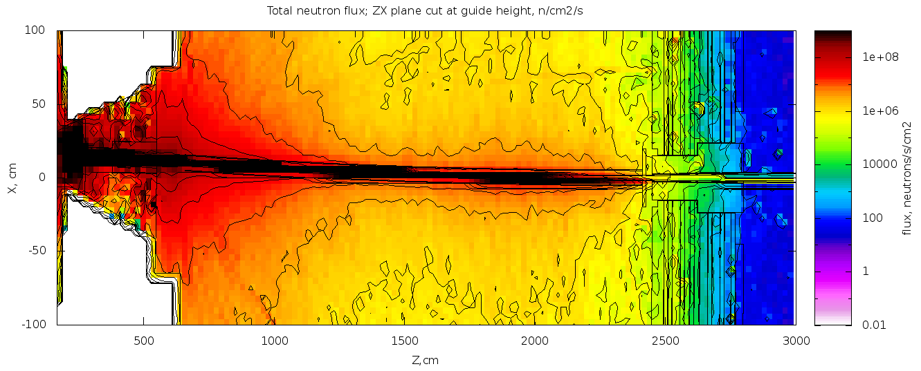
XZ plane, neutrons overall
Iron fill of the insertion provides a significant streaming path for intermediate energy neutrons

Slide 22
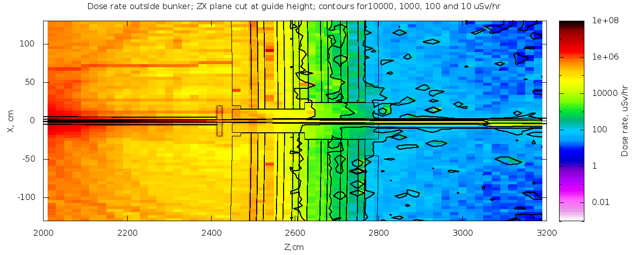
The dose rate for the iron plug
Streaming of intermediate neutrons through the plug affects the dose.
Consider using PE in the feedtrough

Slide 23
Alternative fill of the insertion
PE fill with iron “cone”: a lower weight and cheaper option
Core idea: care only about forward moving fast neutrons which would penetrate the cone at low angle which will appear effectively thick.

Slide 24
To do list
Improve variance reduction to reduce statistical uncertainties in the spectra to a reasonable level
Add components (choppers, collimators)
Play with substrates between 12 and 18 meters
Try a collimator at 19 meters
Materials for the bunker wall feedthrough.

Slide 25
BACKUP

Slide 26
Cave shielding
Normal operation (H1), 1mkSv/hr outside shielding:
Scenarios suggested by NOSG:
Full beam, with instrument components like a shutter, chopper, or slits being closed.
Full beam hitting the beamstop/downstream end of the instrument cave.
Full beam scattering of worst case sample environment equipment.
Full beam scattering of a worst-case sample.
Considered:
Capture of the full beam by boron + gamma radiation from capture at last 2m guide
Likely accidents (H2), 0.5 mSv per event:
Scenarios suggested by NOSG:
Misaligned sample environment equipment.
Sheet of cadmium in the sample
Considered:
Capture of the full beam in cadmium + gamma from last 2m of the guide.

Slide 27
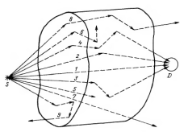
Analytic gamma dose rate evaluation
Dose rate in a given point R with shielding thickness D
Flux of primaries with no shielding: $Φ(E,R)$
Flux to dose conversion: $K\left(E\right)$, ESS-0019931
Linear attenuation in # of primaries: $e^{−μ\left(E\right)d\left(z\right)}$
Scattered primaries and secondaries: $B_{dose}^{}\left(E,μd\left(z\right)\right)$
$$\dot{H}\left(R,d\right)=\sum_{E}{B_{dose}^{}\left(E,μd\left(z\right)\right)e^{−μ\left(E\right)d\left(z\right)}K\left(E\right)Φ(E,R)}$$
Reference book by Mashkovich & Kudryavtseva (1991):
Linear attenuation $μ\left(E\right)$,
Dose buildup factors $B_{dose}^{}\left(E,x\right)$ (pre-computed via MC simulation)
Flux of primaries $Φ\left(E,R\right):$
Neutron optics simulations,
ENDF capture spectra (IAEA, https://www-nds.iaea.org/pgaa/databases.htm)

Slide 28
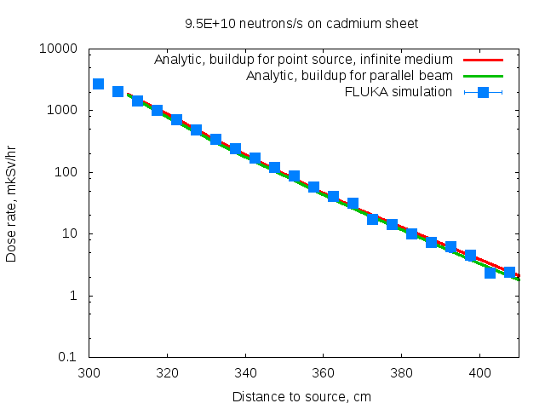
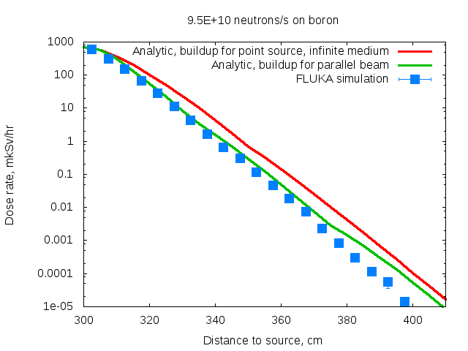
Benchmarking analytic calculations
A hollow cylinder, 3m internal radius, 1 m thick concrete walls (2.35g/cm³)
A small target (Cd or B) in the center.
A neutron E = 0.1 eV emitted in the middle.
Higher uncertainties in buildup factors for low energies (hence a slight deviation from FLUKA result), still sufficient accuracy of analytical approach.

Slide 29
Dose rate outside cave (${6∙10}^{10}$ n/s inside)
H1: Both beams captured in B + γ’s from last 2 m of the guides (Ni+Ti)
H2: Both beams captured in Cd + γ’s from last 2m of the guides (Ni+Ti)
Important: Full spectra of Cd, Ni,Ti should be used, not only the strongest lines (in the report you’ve read).Guide coating capture really matters for H1
Pb shielding: 6 cm (H1) or 16 cm (H2) bring the dose rate down to 1mkSv/h
Thickness, cm | H1 dose rate, mkSv/hr | H2 dose rate, mkSv/hr
20 | 41 | 500
30 | 8,8 | 228
40 | 3,0 | 109
50 | 1,4 | 59
60 | 0,73 | 29
70 | 0,42 | 15
80 | 0,24 | 8,1
90 | - | 4,4
100 | - | 2,4

Slide 30
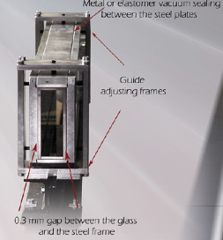
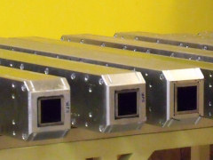
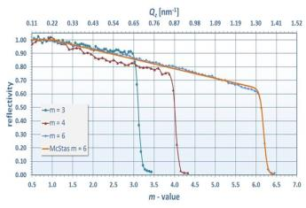
Beamline shielding. Guide materials
Coating
Alternating layers of Ni(Ni+Mo) and Ti
Few mkm total thickness
Substrate
Cu in monolith and bunker wall inserts
Al or borosilicate glass beyond 30 m
0.5-2.5 cm thick
Neutron absorbing layer (optional)
Vacuum tubing (steel or Al, optional)
Coating features:
>99% low angle reflectivity for cold neutrons
Significant fraction of not reflected neutrons is captured by the coating.
Ni+Ti: 0.87 photons/capture with E>5MeV
Capture in borosilicate glass: 477keV photons, easy to shield.
Al: low capture cross sections, γ’s below 2MeV.

Slide 31
Dose rate calculation using McStas
ESS_butterfly component, spectrum parameterized from MCNP simulation
Optics model of the HEIMDAL beamline (March 2017 by Jonas Birk)
Customized Guide_Gravity and Elliptic_guide_gravity components to set the global variable “m_local_refl” to the m-value at reflection point
Reworked Scatter_logger to record m-value at loss point along with weights and position of not reflected neutrons
Array of loss points and m-values is processed consecutively by Scatter_log_iterator_Ni, Scatter_log_iterator_Ti which calculate weights for capture in corresponding materials from the parametrization and Scatter_log_iterator recording total number of non reflected neutrons.
Supplementary code in “FINALLY” section of instrument file to automate dose rate calculation
Implements analytic formulas
Photons/capture by energy group tables (from activation X-section database)
Tables for $μ(E)$ and $B_{dose}^{}\left(E,x\right)$for common shielding materials (concrete, Fe, Pb)

Slide 32
Gamma shielding summary:
Cave:
Walls: minimum 60 cm of regular concrete depending on what is H1 event.
Lead door on the roof: minimum 6 cm of lead.
Neutron absorber inside (boralcan on walls, borated PE in front of lead?)
Cold/Thermal chopper pits: 65 cm of regular concrete
Guides: 60 cm of concrete everywhere. In addition:
Thermal guide:
5cm of steel shielding before 50 m and 5-10 cm steel shielding after 130 m
Additional steel (possibly in combination with BPE) for fast neutron shielding
Cold guide:
Supplementary 3 cm of steel shielding everywhere.
Shielding requirements for the guides can be relaxed by optimizing transported divergence in the cold guide:
Collimator close to the bunker?
Part(s) of the cold guide with m<1?

Slide 33
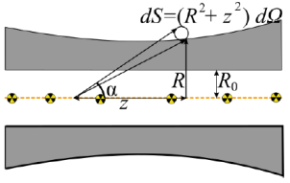
Dose rate from gamma
Neutrons captured in the guide walls give extended source of radiation: $I\left(E,z\right)$
Contribution of direct photons decreases exponentially with shielding thickness $e^{−μ(E)d(z)}$
Contribution of scattered photons and secondaries – “dose buildup” : $B_{dose}^{}\left(E, μd\right)$
Biological effect varies with γ energy. Flux to dose rate conversion:$K(E)$
$$\dot{H}(R,z)=\frac{1}{4 π} \int{dz dE K(E) I\left(E,z\right)B_{dose}^{}\left(E,μd\left(z\right)\right)\frac{1}{(R^{2}+z^{2})}e^{−μ(E)d(z)}}$$
$$d\left(z\right)= \frac{\left(R−R_{0}\right)\sqrt{R^{2}+z^{2}}}{R}$$
Agreement between analytical calculations using table values and simulation (GEANT 4) is better than 10%, checked explicitly.

