Slide 1
Reception, unloading and storage of the
ION Source and the LEBT
www.europeanspallationsource.se
14 September, 2017

Slide 2
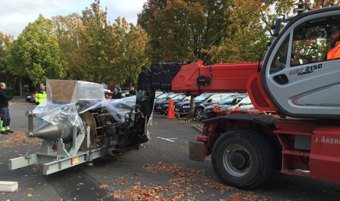
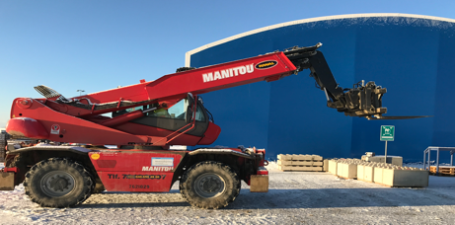
Reception and unloading
Goods reception will be booked through 4PL Central Station covering;
  SLOT time for truck access to site
  Booking of unloading resources
Unloading will be conducted by an external supplier than SKANSKA since the delivery consists of;
  Equipment of high complexity
  High value

Slide 3
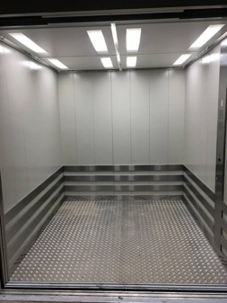
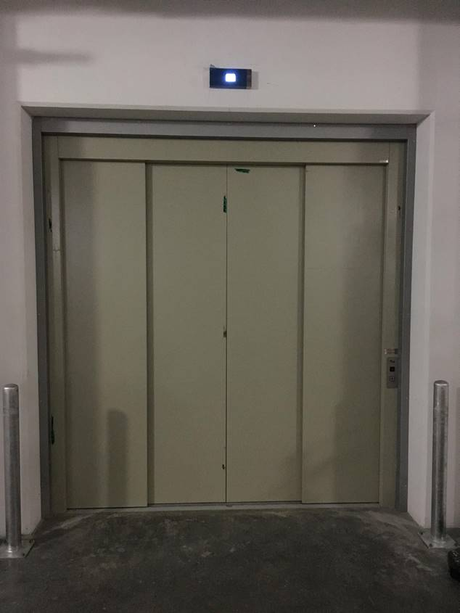
Transfer and storage
Transfer from lorry to elevator at Front End building and to the installation area
  Weather protected packaging TBD
  Stripping equipment of packaging mtrl TBD
Max capacity: 3050 kgs
Dims (mm): 2300*2300*2300

