Slide 1
IRR for the Ion Source & LEBT
Review of logistics planning: packaging, transportation, reception, unloading, storage

Slide 2
Outline
Status in Catania
Dismantling / Packaging
Transportation
Questions

Slide 3
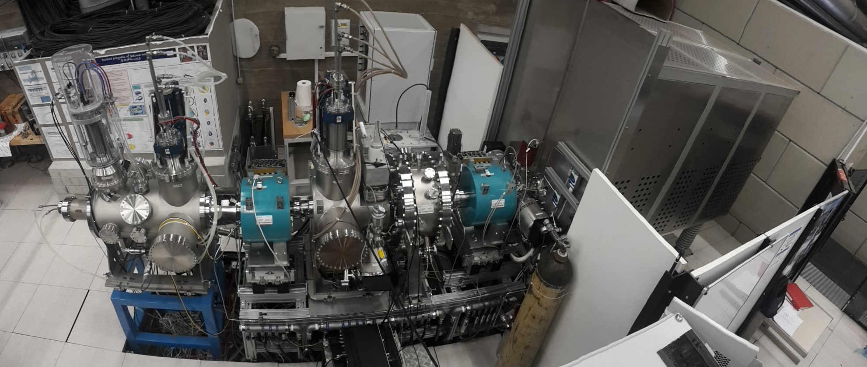
Status in Catania

Slide 4
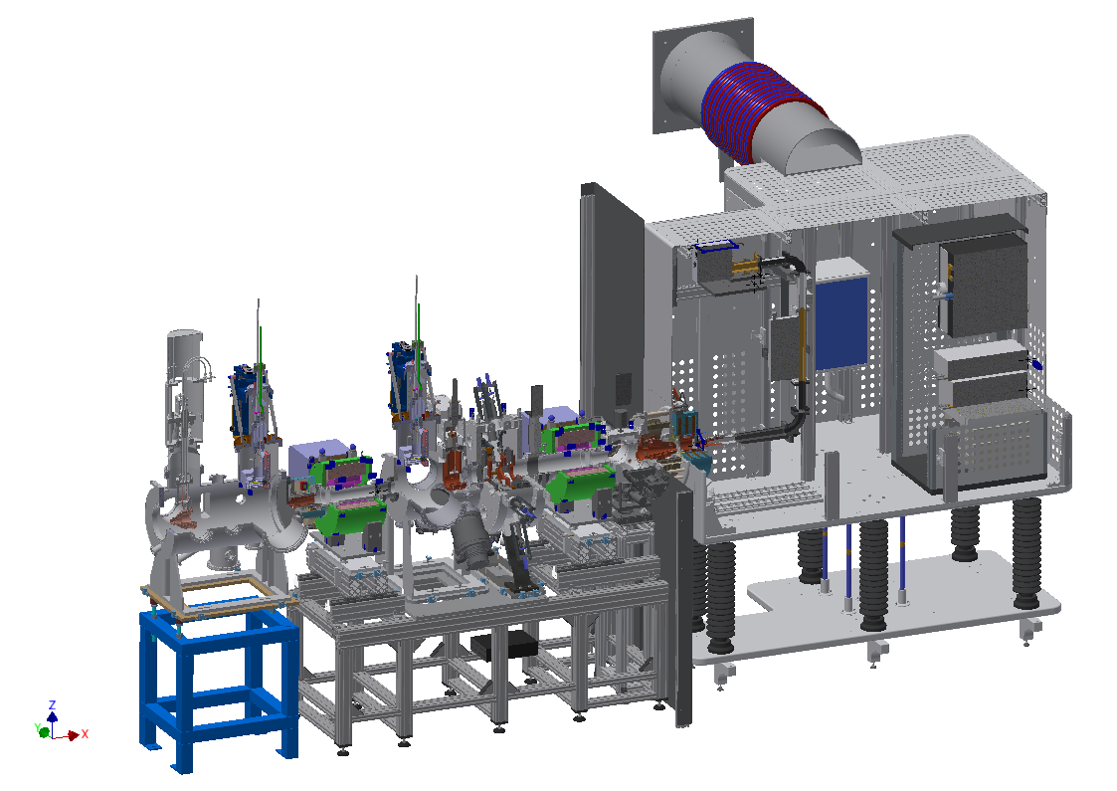
Dismantling / Packaging
Where: INFN-LNS (Catania)
Start: 18/09/2017
Duration estimate: 15 work days

Slide 5
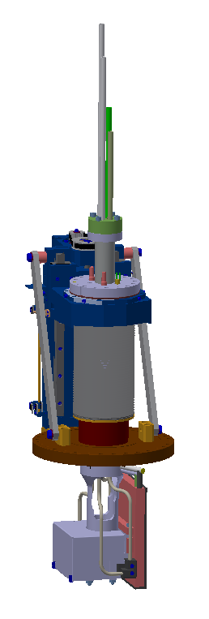
Dismantling / Packaging
Step 1 – Demage EMU on Commissioning Tank to send it to CEA
in original Box

Slide 6
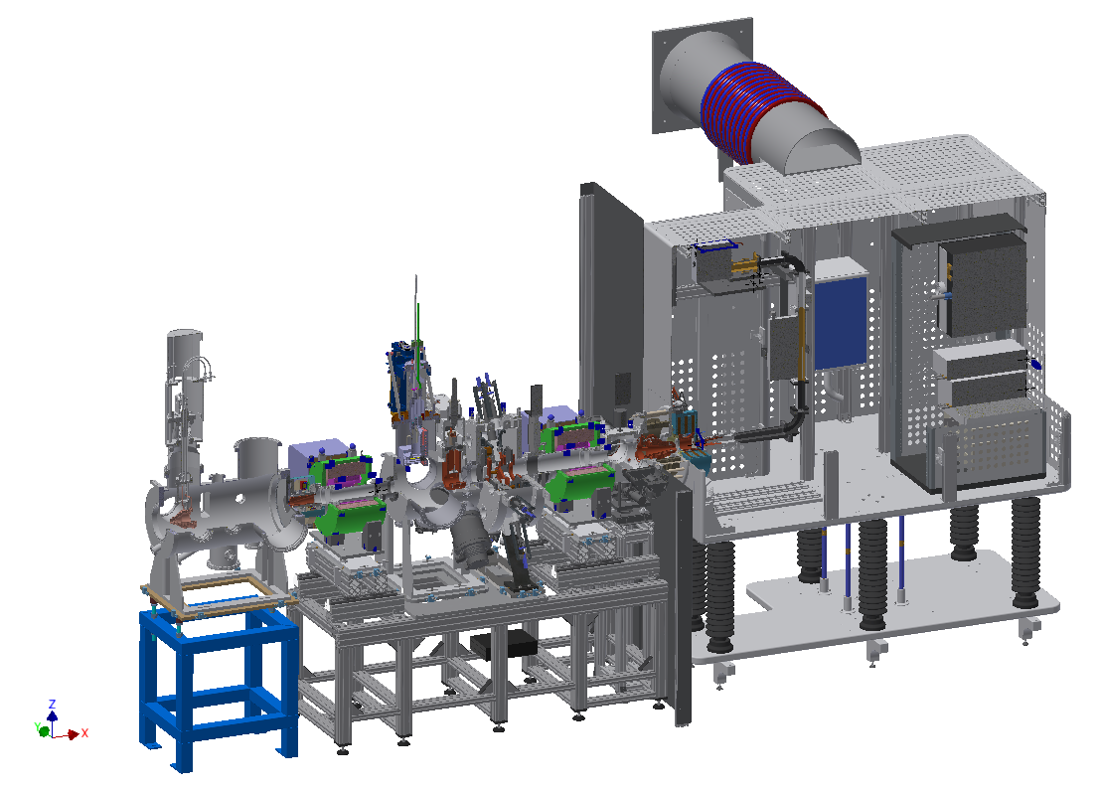
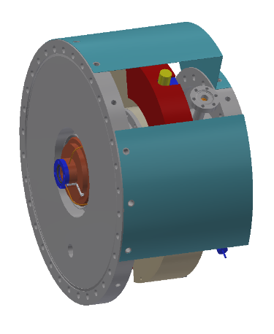
Dismantling / Packaging
Step 2 – Collimator
in Box 1

Slide 7
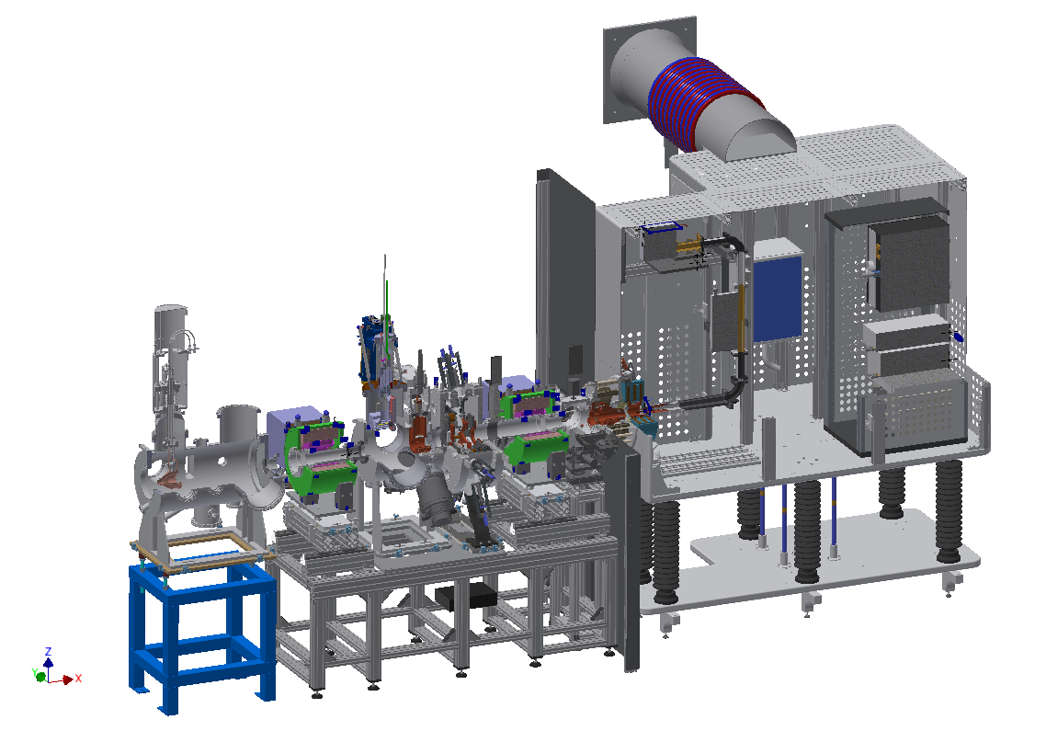
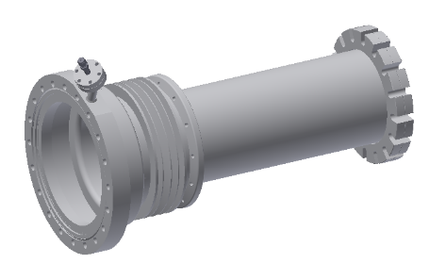
Dismantling / Packaging
Step 3 – Tube II
in Box 1

Slide 8

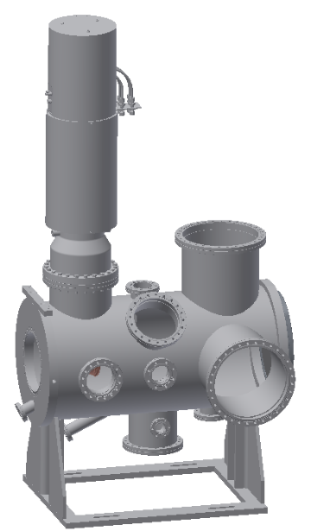
Dismantling / Packaging
Step 4 – Commissioning Tank with FC & ancillaries
in Box 2

Slide 9
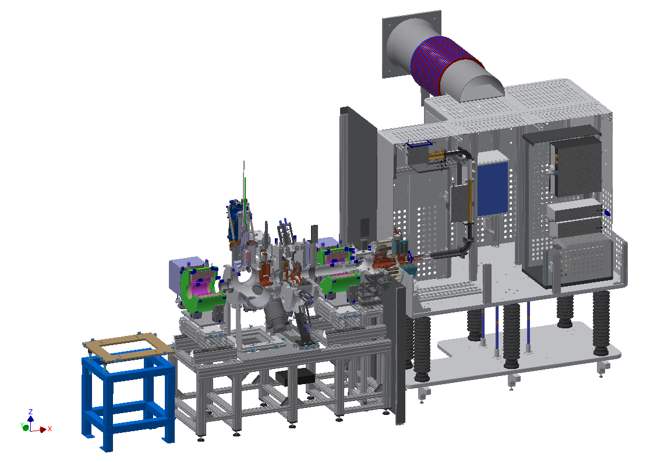
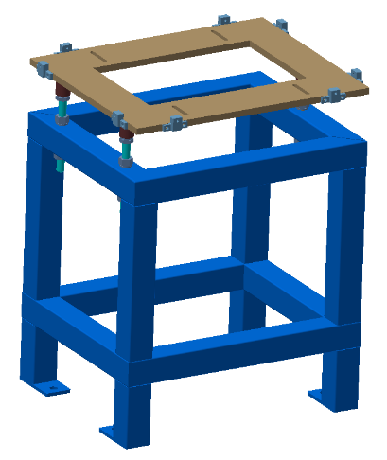
Dismantling / Packaging
Step 5 – Support of Commissioning Tank
in Box 3

Slide 10
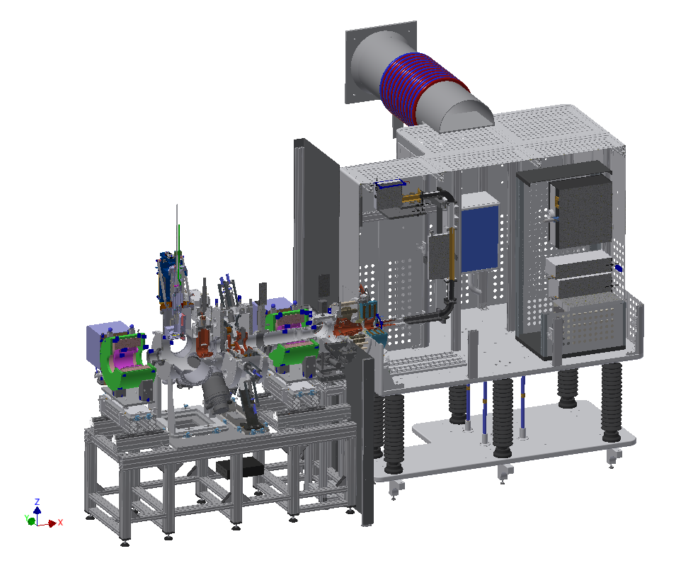
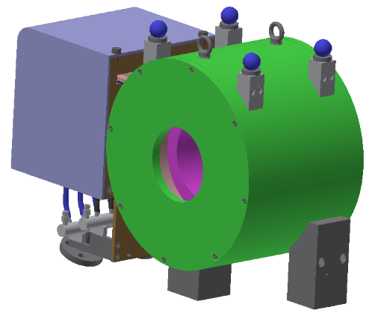
Dismantling / Packaging
Step 6 – Solenoid II
in Box 4

Slide 11
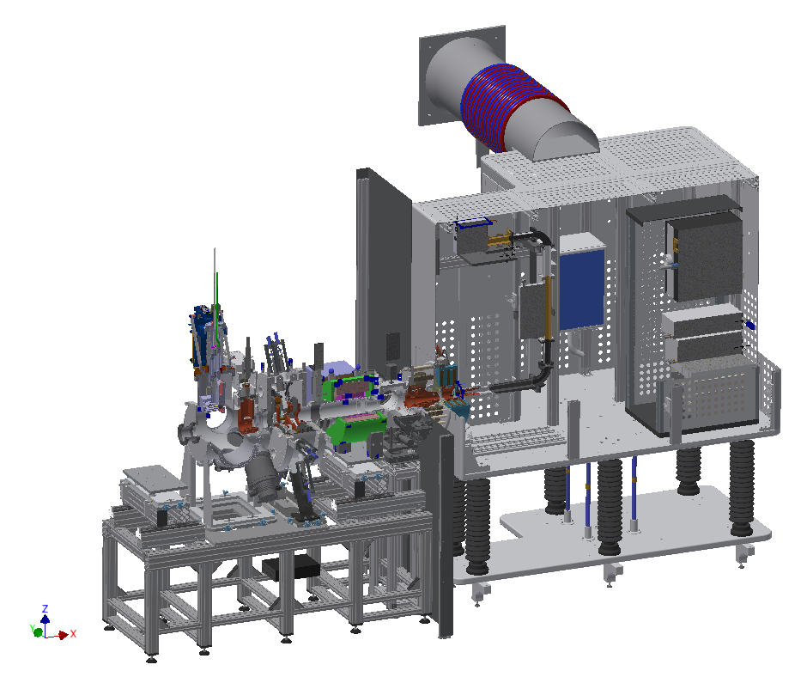
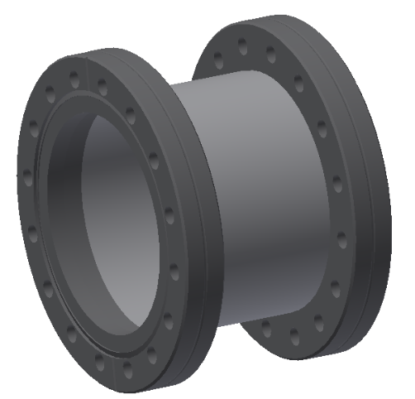
Dismantling / Packaging
Step 7 – Adapter for Gate Valve
in Box 1

Slide 12

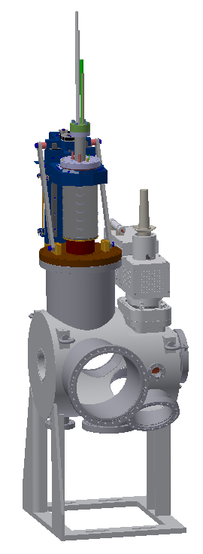
Dismantling / Packaging
Step 8 – Permanent Tank with EMU, Chopper & ancillaries
in Box 5

Slide 13
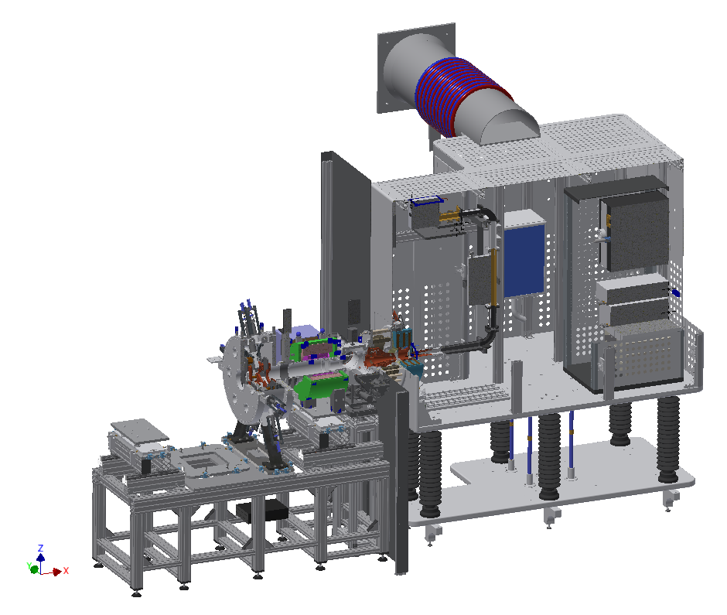
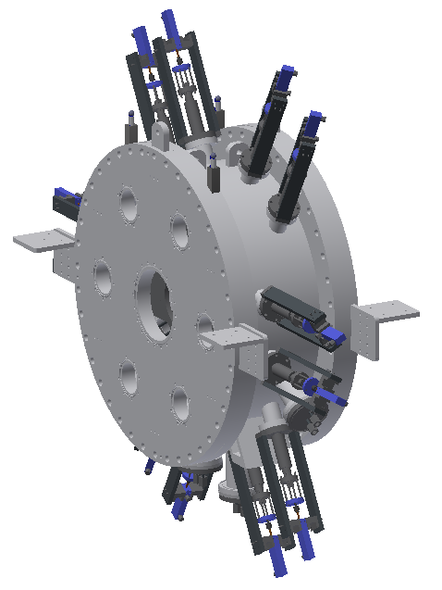
Dismantling / Packaging
Step 9 – IRIS
in Box 6

Slide 14
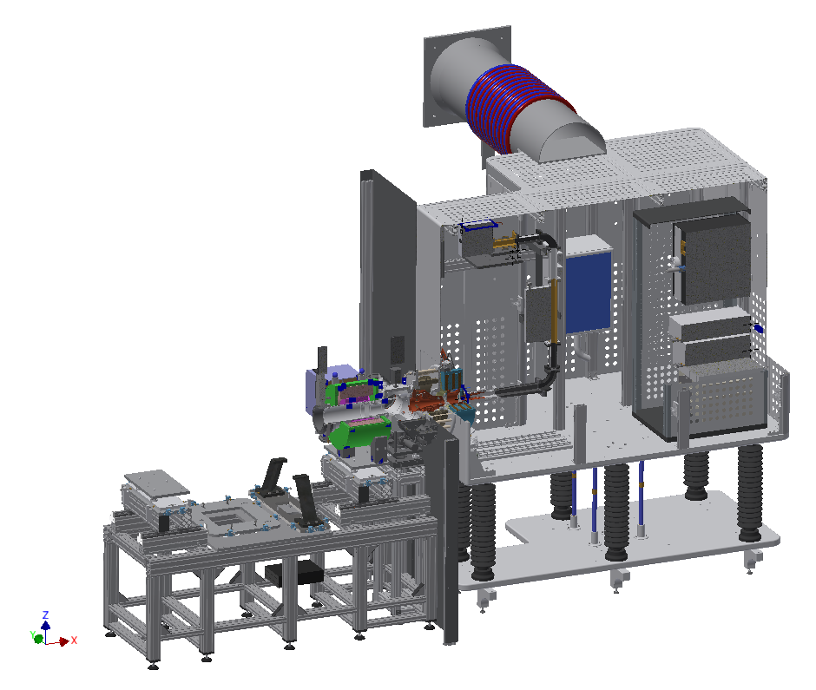
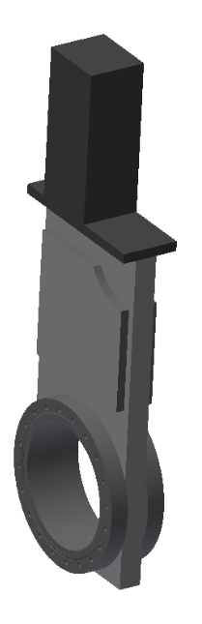
Dismantling / Packaging
Step 10 – Gate Valve
in Box 1

Slide 15

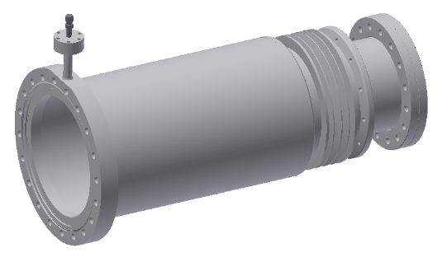
Dismantling / Packaging
Step 11 – Tube I
in Box 1

Slide 16

Dismantling / Packaging
Step 12 – Solenoid I
in Box 7

Slide 17
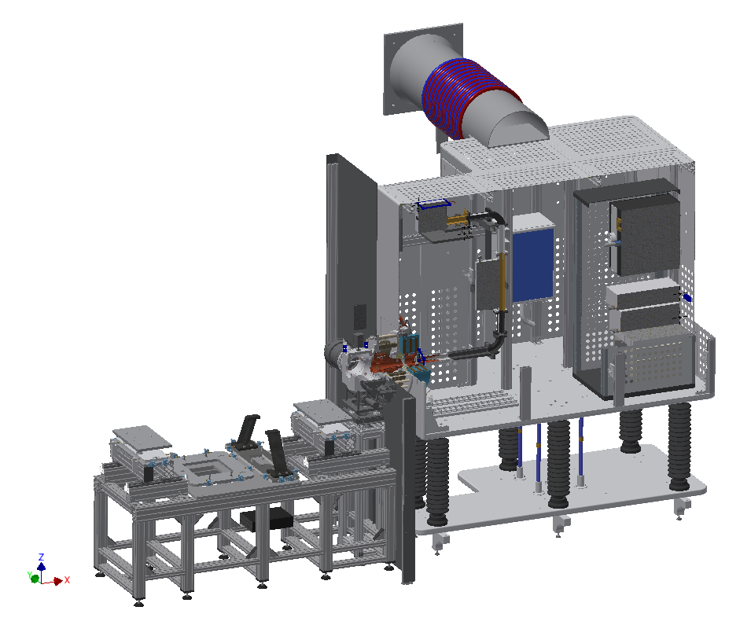
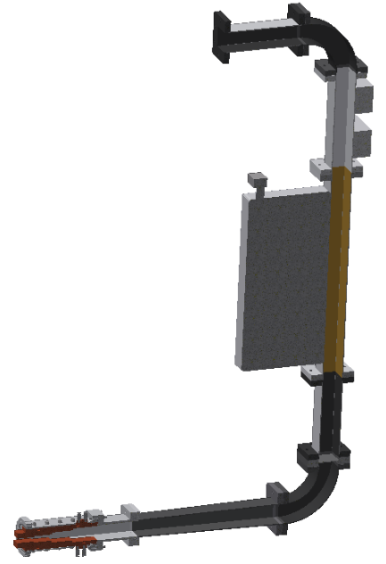
Dismantling / Packaging
Step 13 – RF System with ancillaries
in Box 8

Slide 18

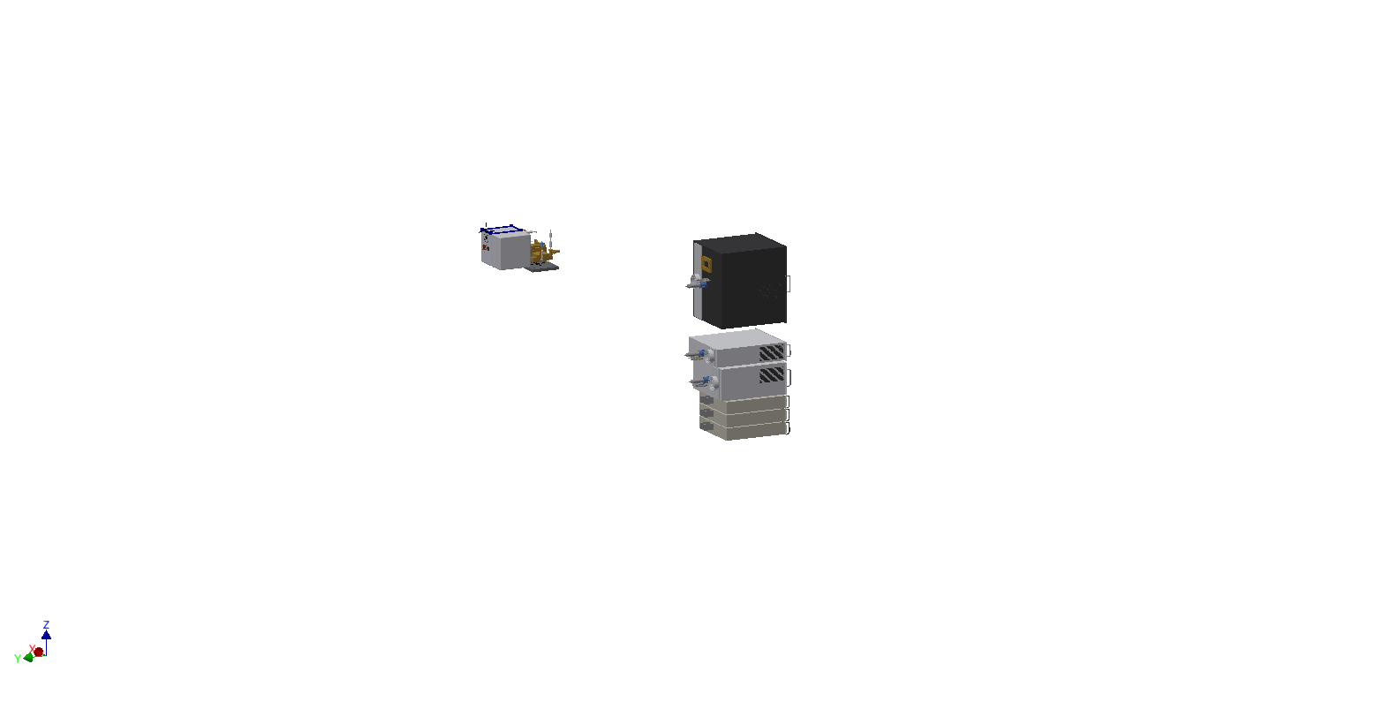
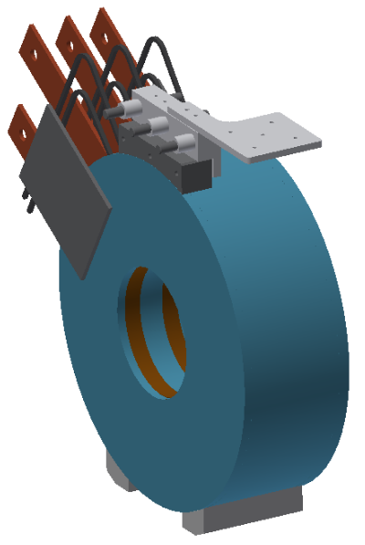
Dismantling / Packaging
Step 14 – Magnet, HV rack components
To UMAS

Slide 19
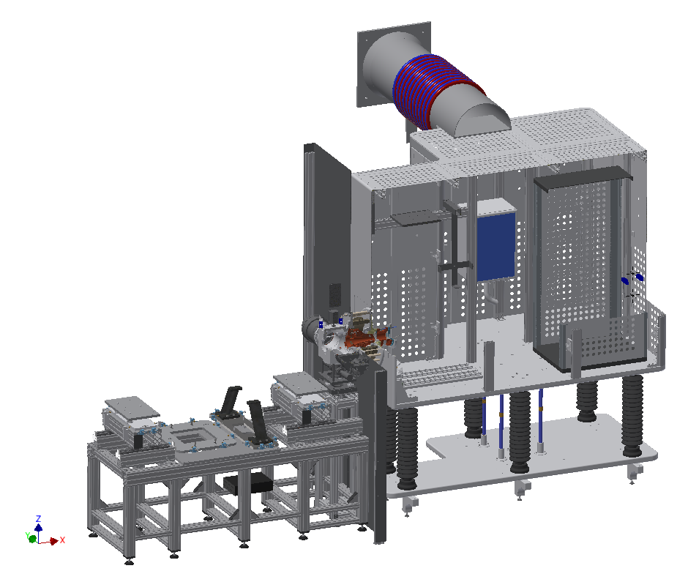
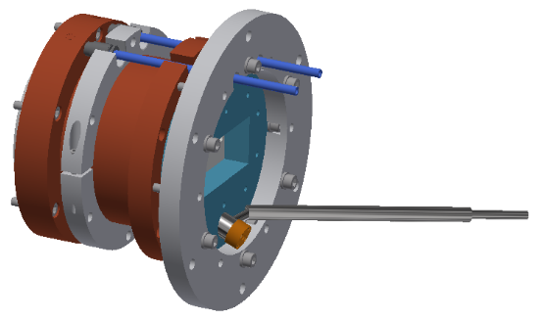
Dismantling / Packaging
Step 15 – Plasma Chamber
in Box 9

Slide 20
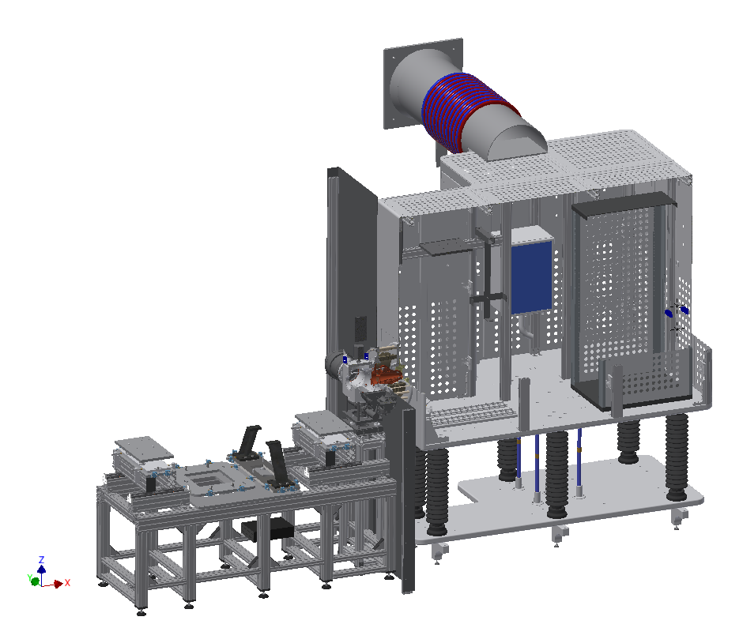

Dismantling / Packaging
Step 16 – Ground Shield
Stay at INFN-LNS

Slide 21
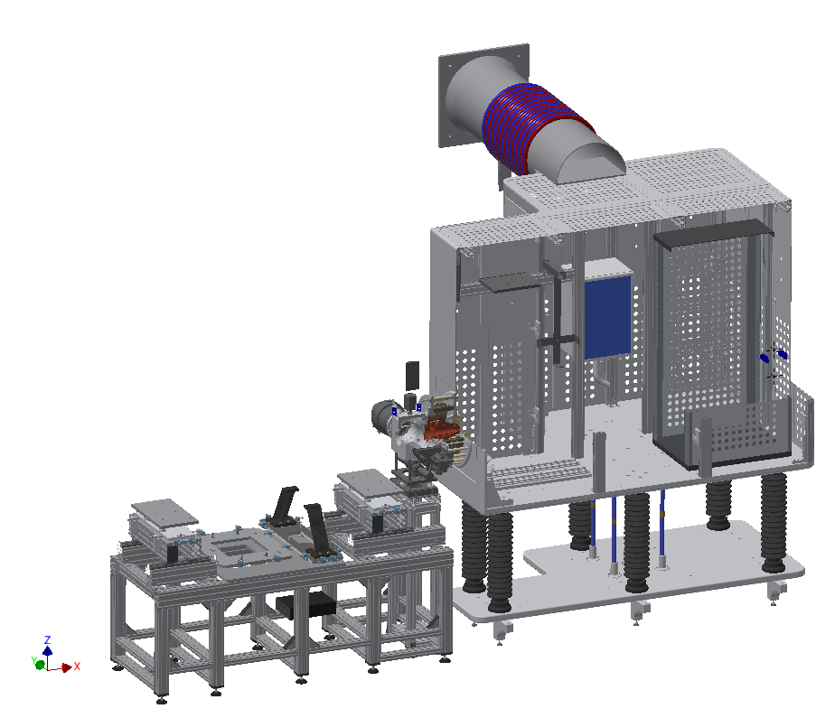
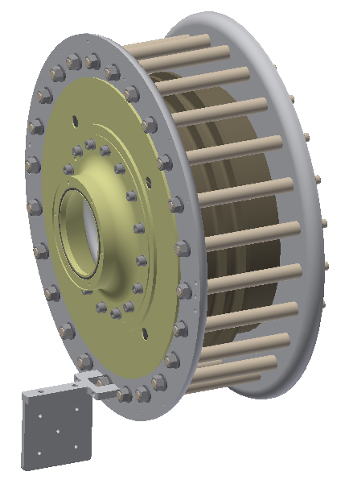
Dismantling / Packaging
Step 17 – Insulation Column
in Box 10

Slide 22
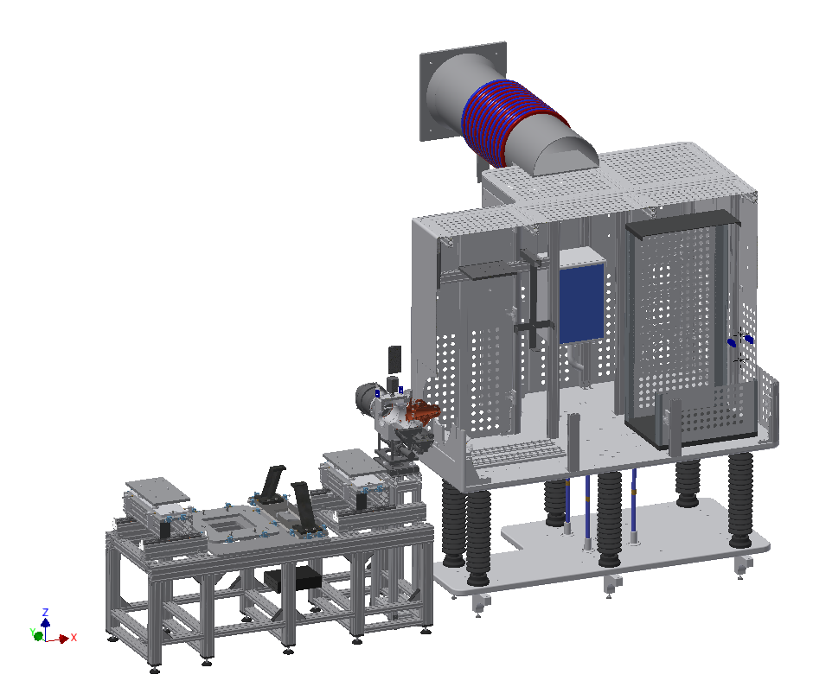
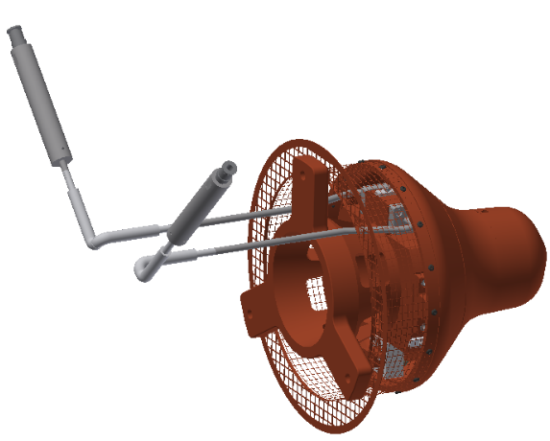
Dismantling / Packaging
Step 18 – Extraction System
in Box 11

Slide 23
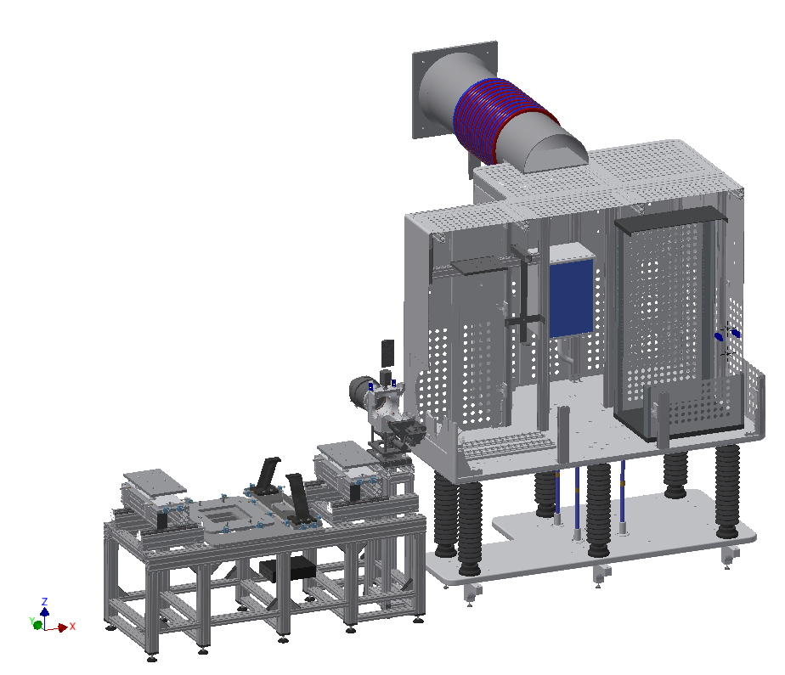
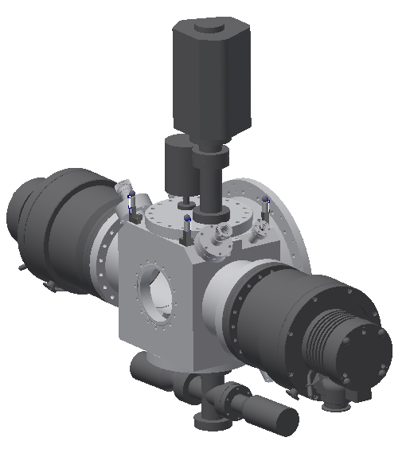
Dismantling / Packaging
Step 19 – I-COMP whit ancillaries
in Box 1

Slide 24
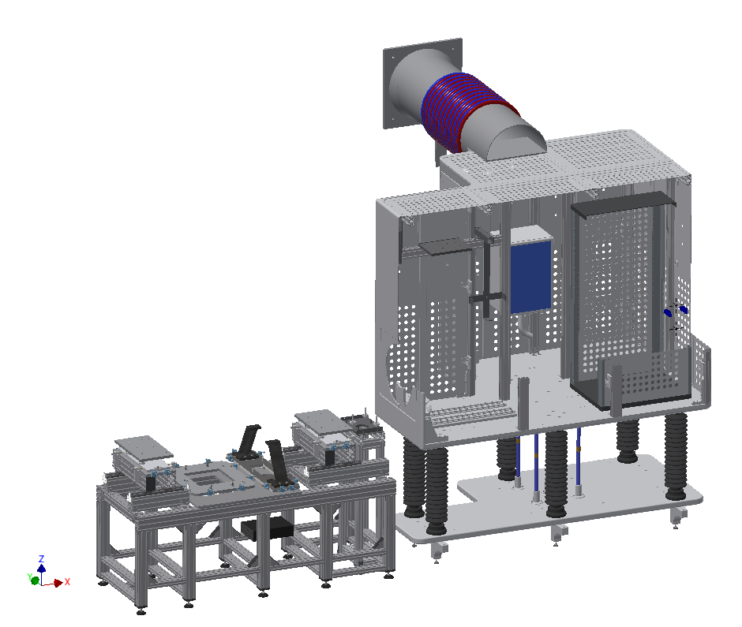
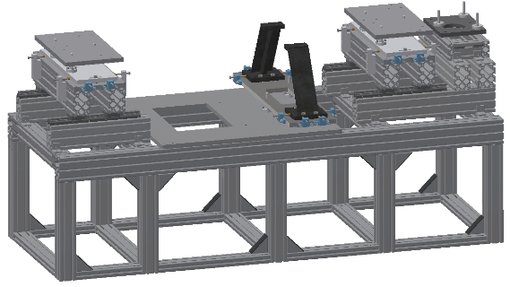
Dismantling / Packaging
Step 20 – Adjust LEBT Support
To UMAS

Slide 25

Dismantling / Packaging
Step 21 – Complete other Boxes:
  Box 12 → FUG
  Box 13 → Rack Vacuum
  Box 14 → Rack EMU
  Box 15 → GND1
  Box 16 → GND2
  Box 17 → Vacuum components
  Box 18 → PC console
  Box 24 → Spare parts
  Box 25 → PPE

Slide 26

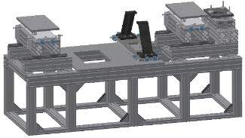
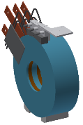

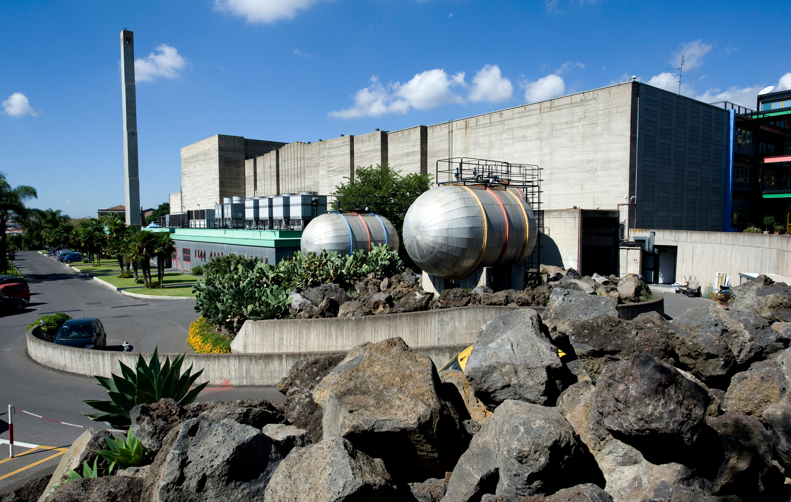

Transportation 1
Dedicated truck
Planned: 06/10/2017
To: UMAS (Enna)
From: INFN-LNS (Catania)

Slide 27
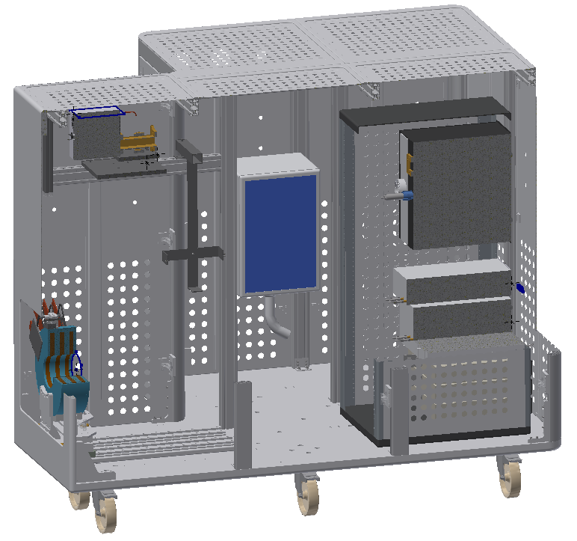
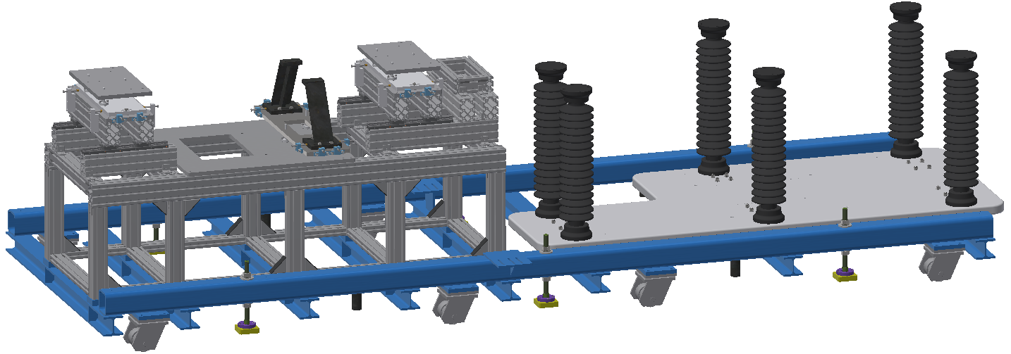
Assembling / Packaging
Where: UMAS (Enna)
Start: 09/10/2017
Duration estimate: 5 work days
Box 21
Other Boxes:
  Box 22 → Ground Shiled
  Box 23 → Foot Support
Box 20

Slide 28

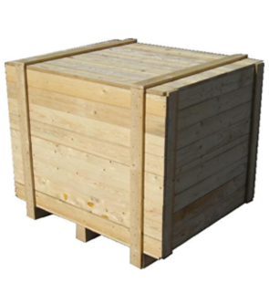
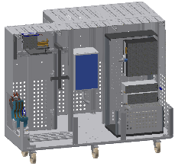

Transportation 2
Dedicated trucks with:
air suspension
shock absorbers
tilt and shock indicators
Planned: 23/10/2017
From: INFN-LNS (Catania)
From: UMAS (Enna)
To: ESS (Lund)
Planned: 31/10/2017
Reference document:
ESS-ISRC&LEBT_Transport&DeliveryPlan

Slide 29
Questions
??

Slide 30
Thanks for attention!

