Slide 1
Installation- and storage area’s, available tools and services on site
Dennis de Wit
Area Supervisor – Accelerator Tunnel
www.europeanspallationsource.se
15 September, 2017

Slide 2
Area’s
  Transportation/ Installation
  Storage
Equipment
Services

Slide 3
Area’s
FEB drop hatch will not be ready for ISRC installation.
→ Alternative is HEBT loading bay and FEB elevator.

Slide 4
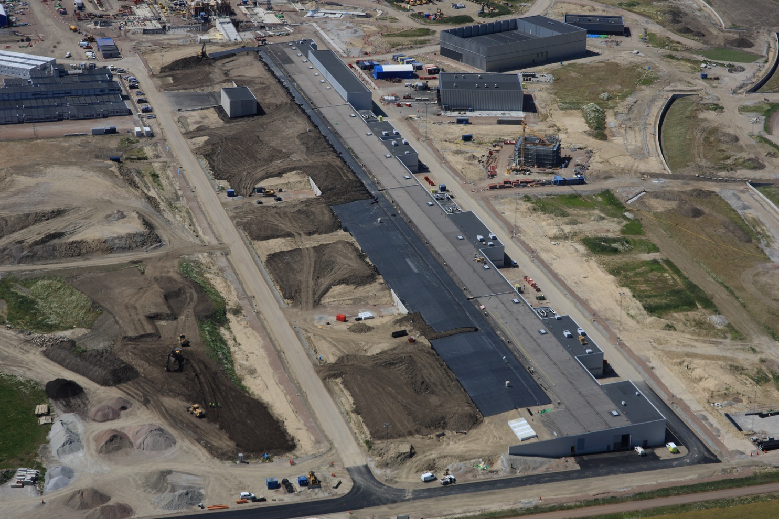
Area’s

Slide 5
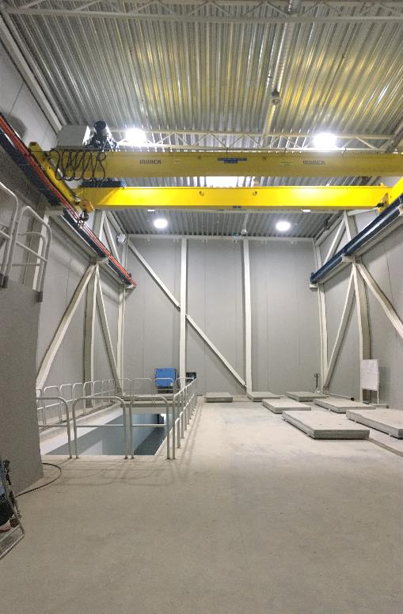
Area’s
HEBT level 100
  20T Crane
  Access for truck to enter

Slide 6
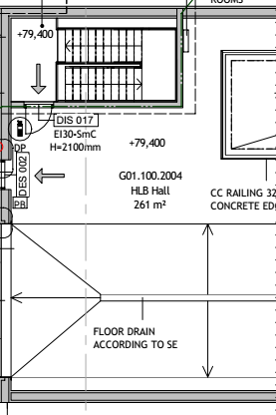
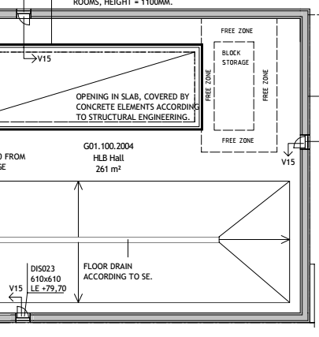
Area’s
Transportation area – HEBT level 100

Slide 7
Area’s

Slide 8
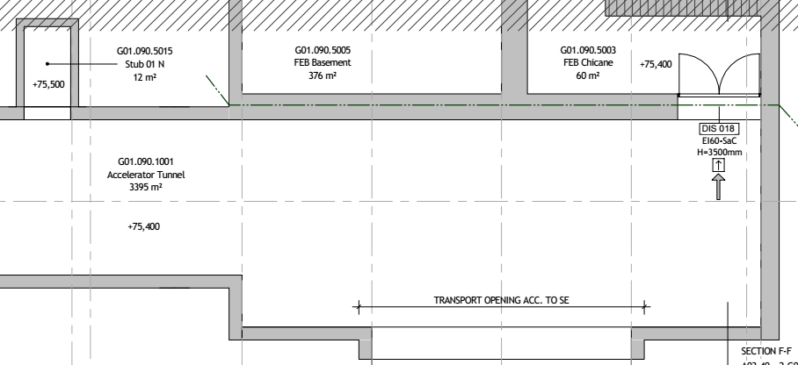
Area’s
Installation area – G01 level 090
Installation Area
2 meter wide transport area has to remain

Slide 9
Area’s
Installation area – G01 level 090
  The installation area will be constructed from wooden frames and plastic sheets.
  Installation area will have to be cleaned before installation.
  Air renewal and overpressure inside the installation area is not planned.

Slide 10
Area’s

Slide 11

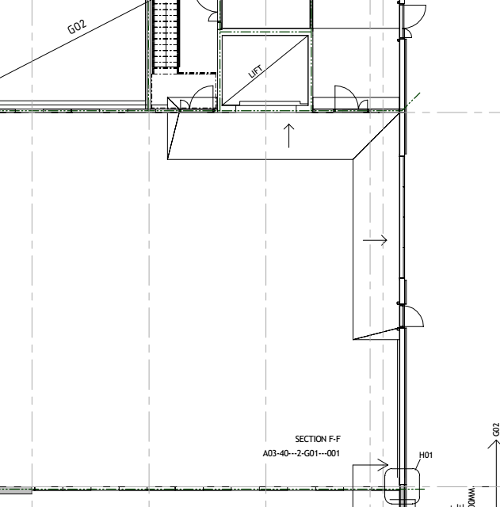
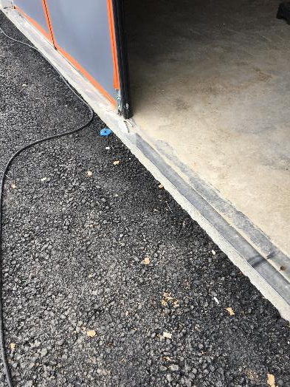
Area’s
Access to area’s – FEB 100
Gap at entrance to FEB 100 will be resolved on 2 October
10cm

Slide 12
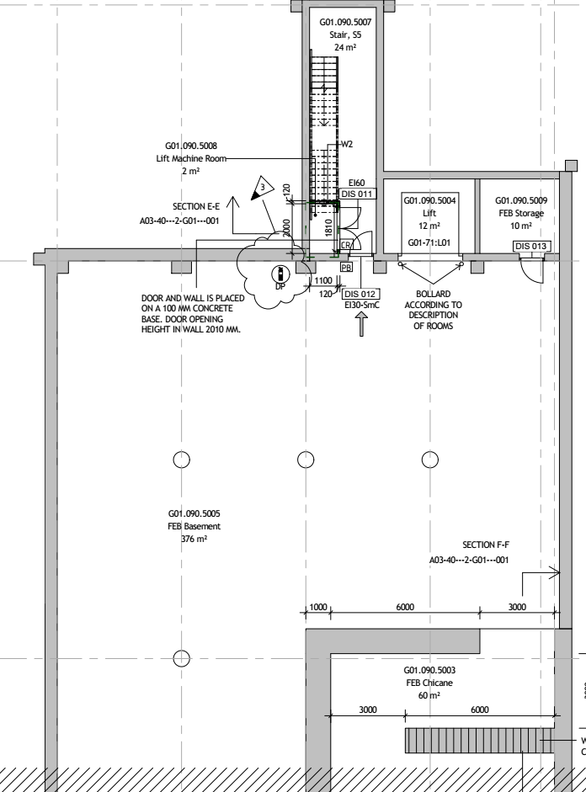
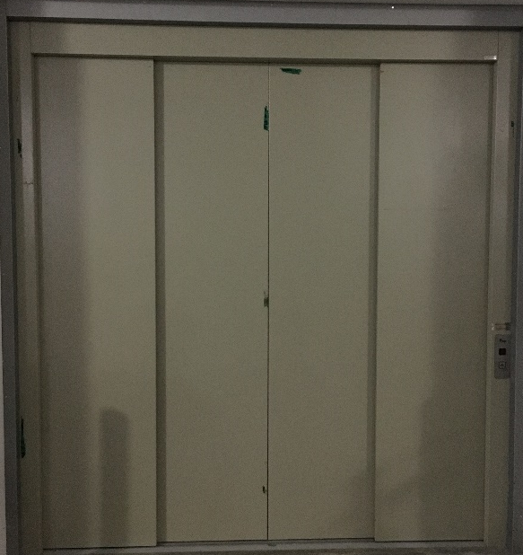
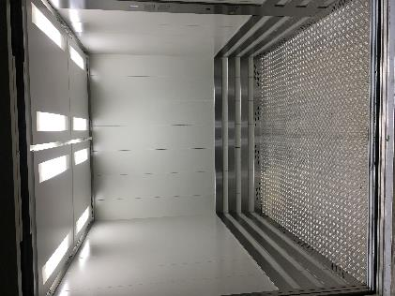
Area’s
Access to installation area:
Elevator FEB100 FEB090
  3050 kg
  ~2.3 x 2.3 x 2.3 meter
  No personnel transportation allowed

Slide 13
Area’s
Access to installation area

Slide 14
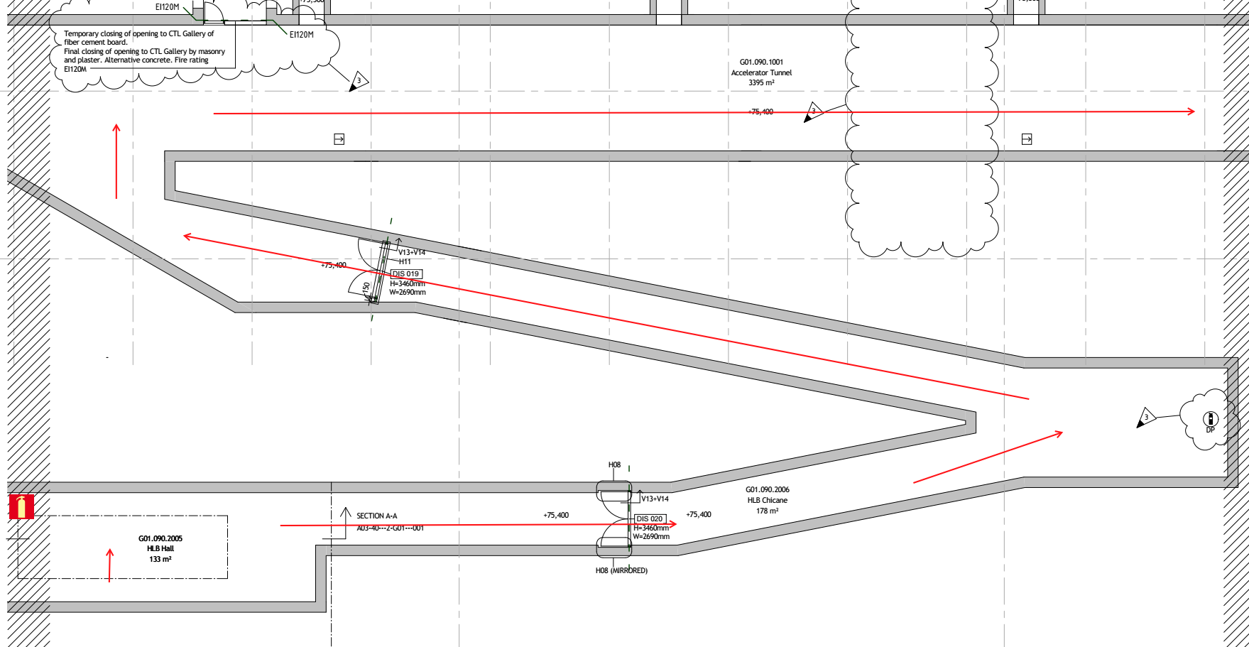
Area’s
Access to area’s

Slide 15
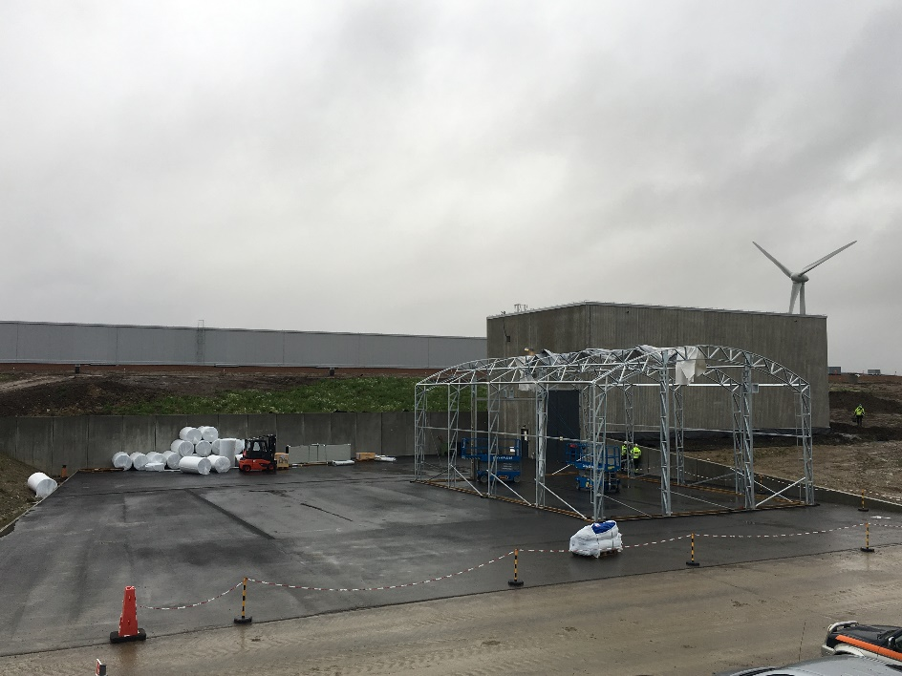
Area’s
Storage area’s
190 m2 tent outside of HEBT.
Insulated
Heated
Lighting
FEB100 (has to be confirmed)
Depending on fire regulations
Depending on activities at FEB100

Slide 16
Equipment

Slide 17
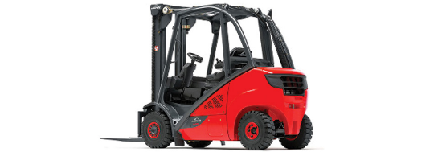
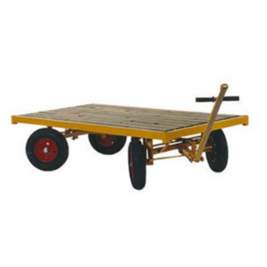
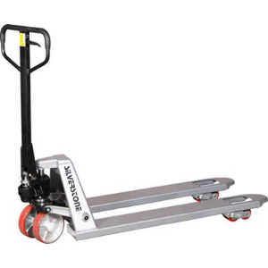
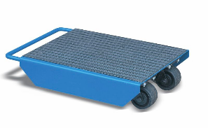
Equipment
Transport
  Pallet trucks
  Transport trolleys Procured
  Machine skates
  Forklift Will be rented

Slide 18
Equipment
Workbenches
Tools Being procured
Etc.

Slide 19
Equipment
Hoisting
  Overhead crane
    HEBT
    Adjustable spreader bar (being procured)
  Custom made crane structure
    Designed by TungaLyft
    Purchased or rented (TBD)

Slide 20
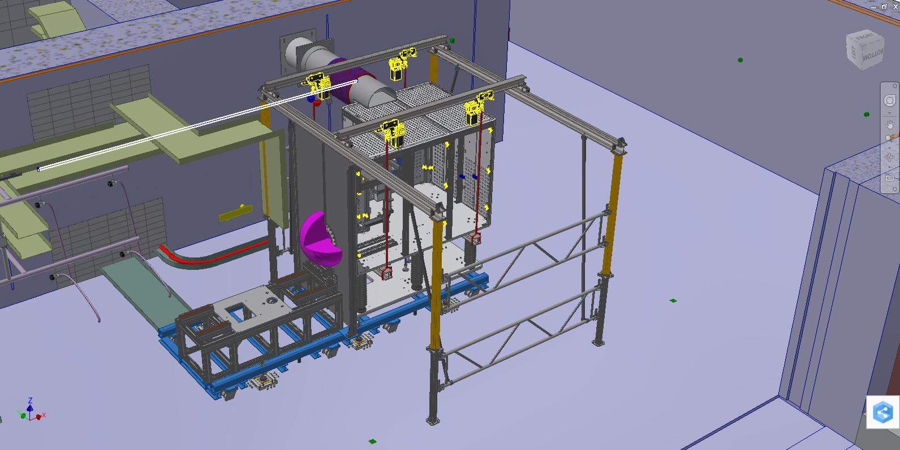

Equipment

Slide 21
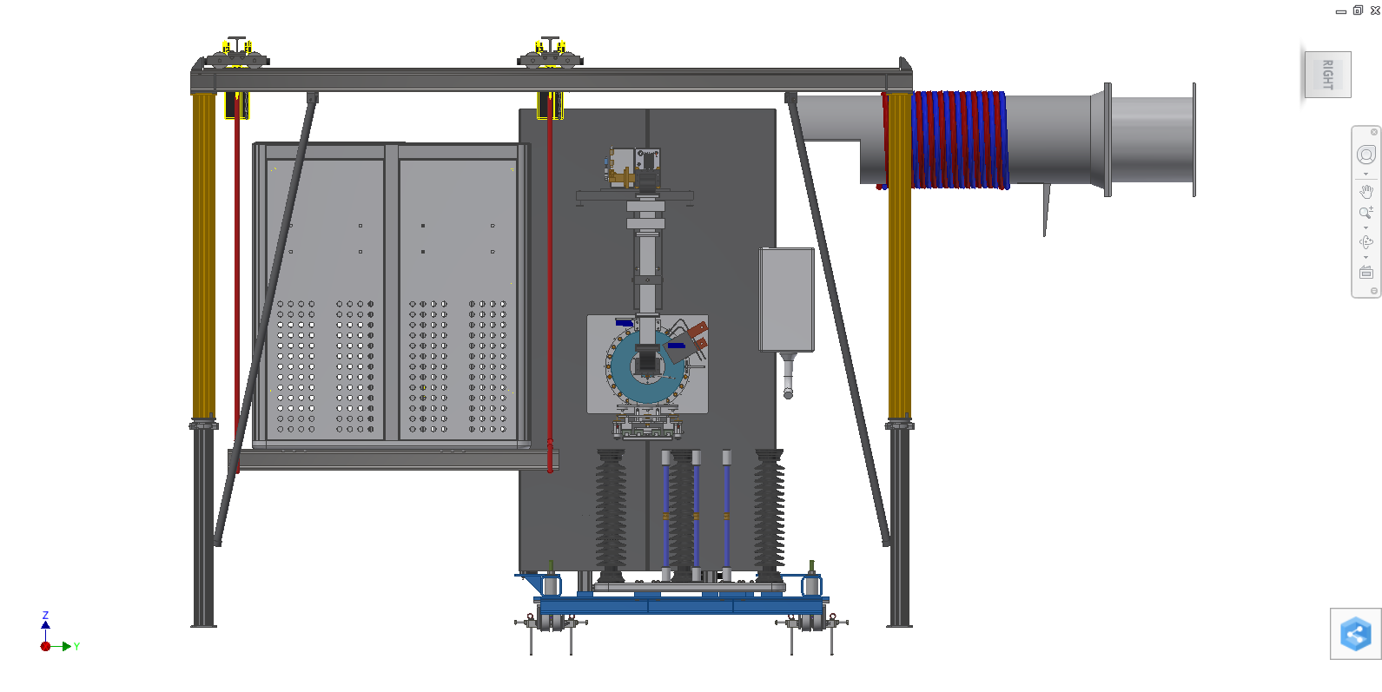
Equipment

Slide 22
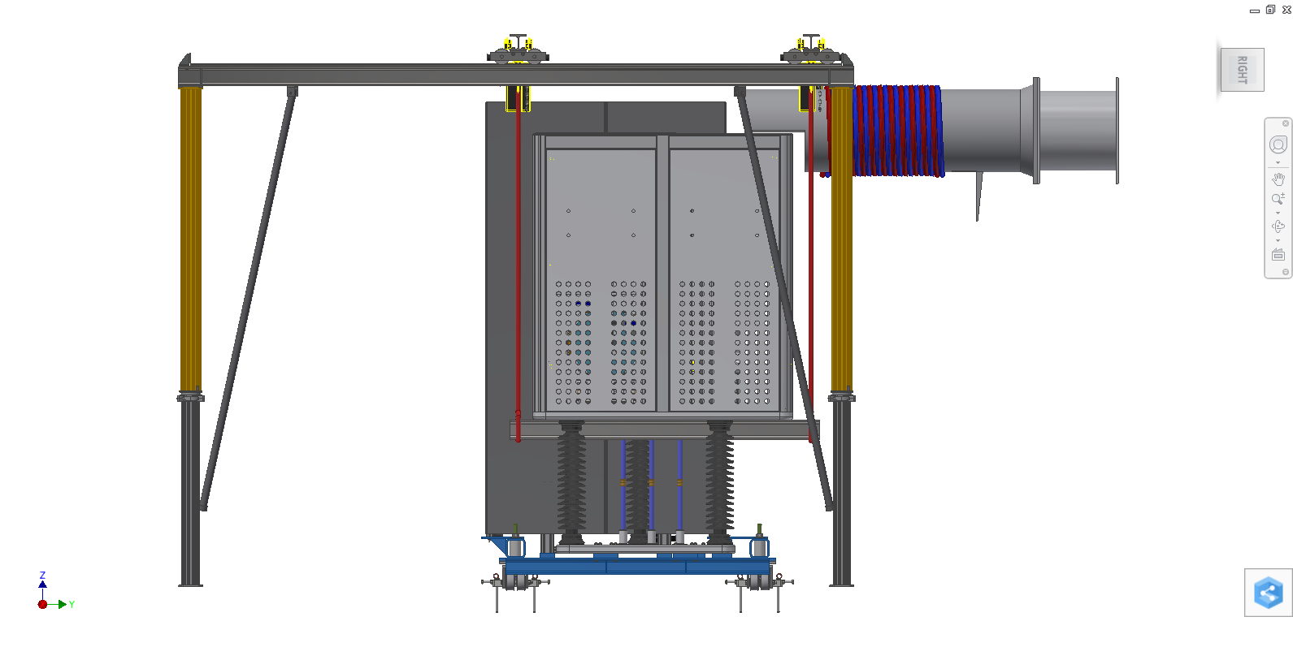
Equipment

Slide 23
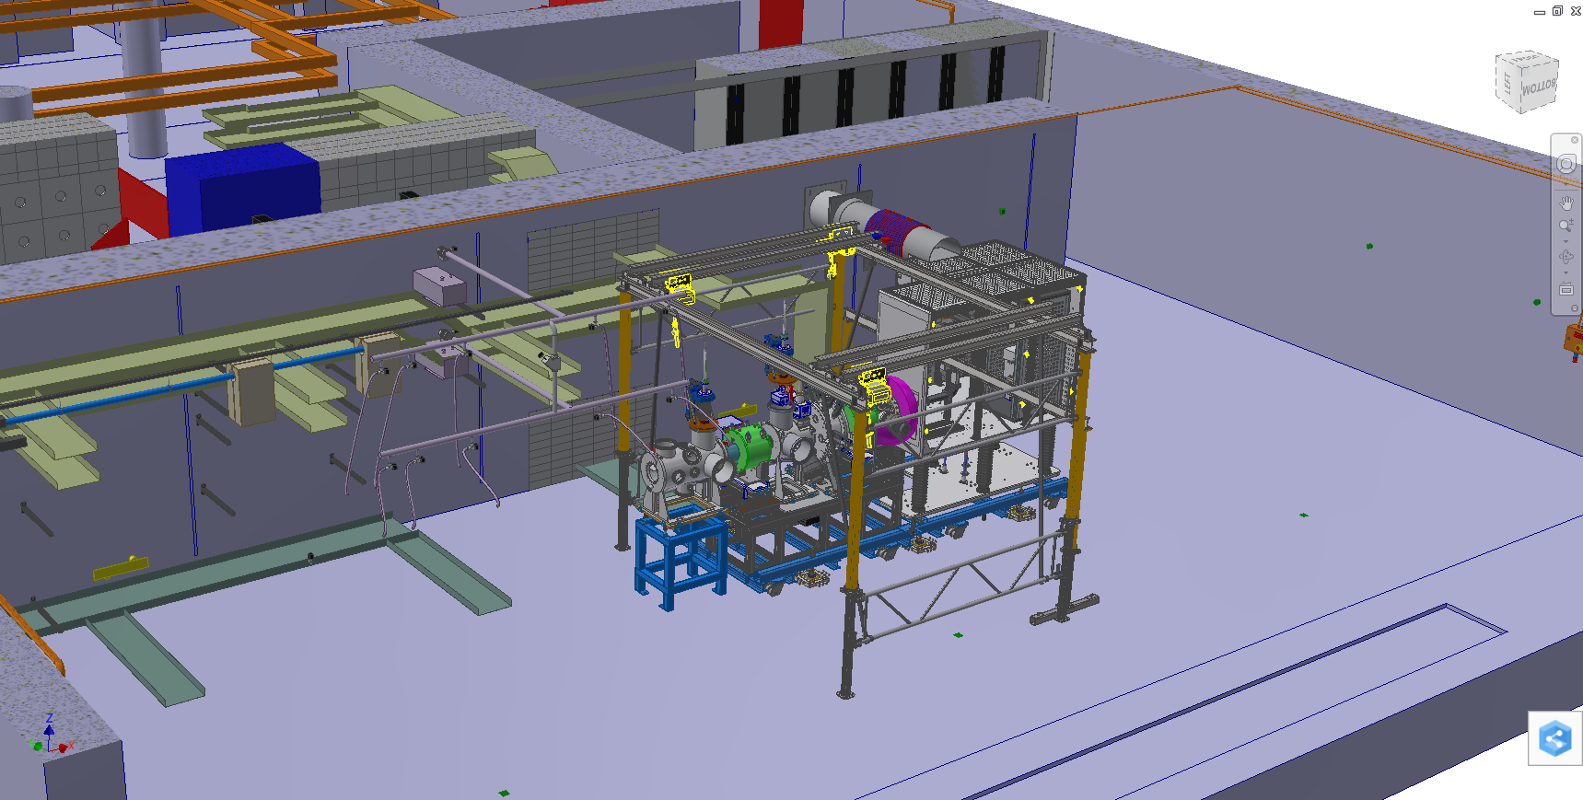
Equipment

Slide 24
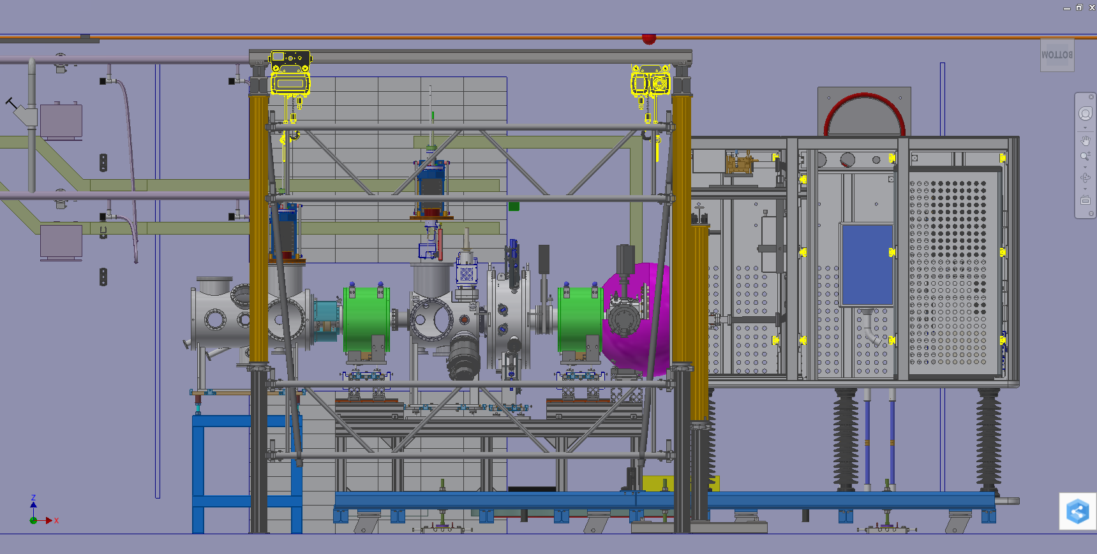
Equipment

Slide 25
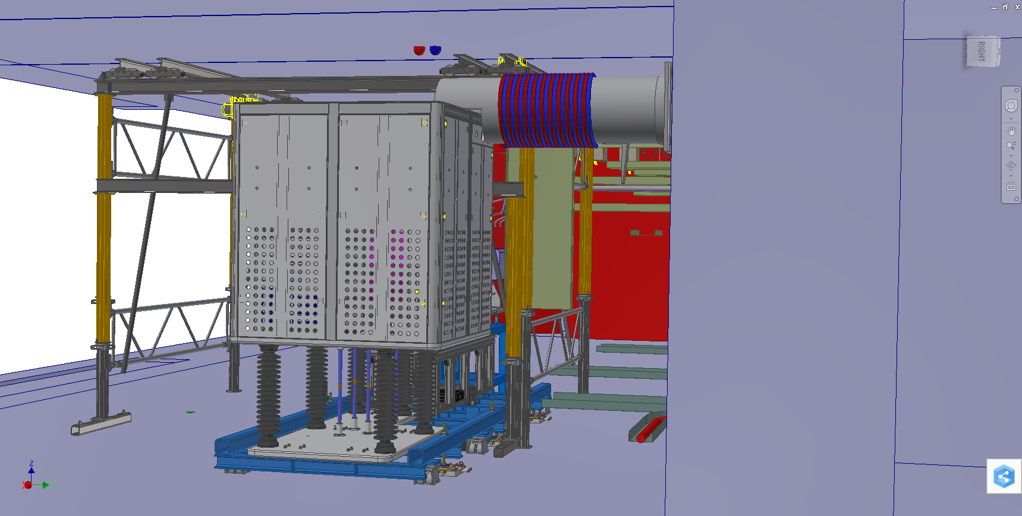
Equipment

Slide 26
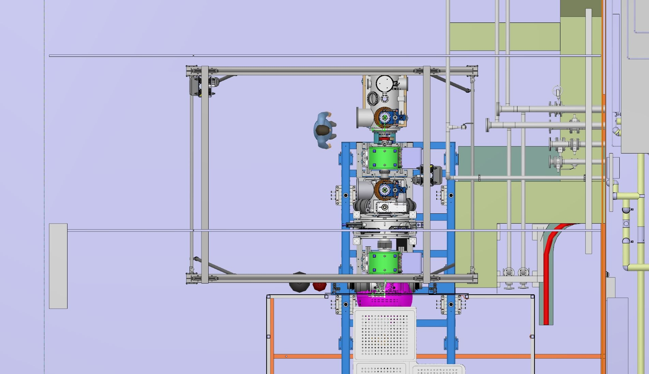
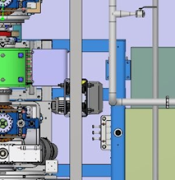
Equipment
Clash with Compressed air pipe

Slide 27
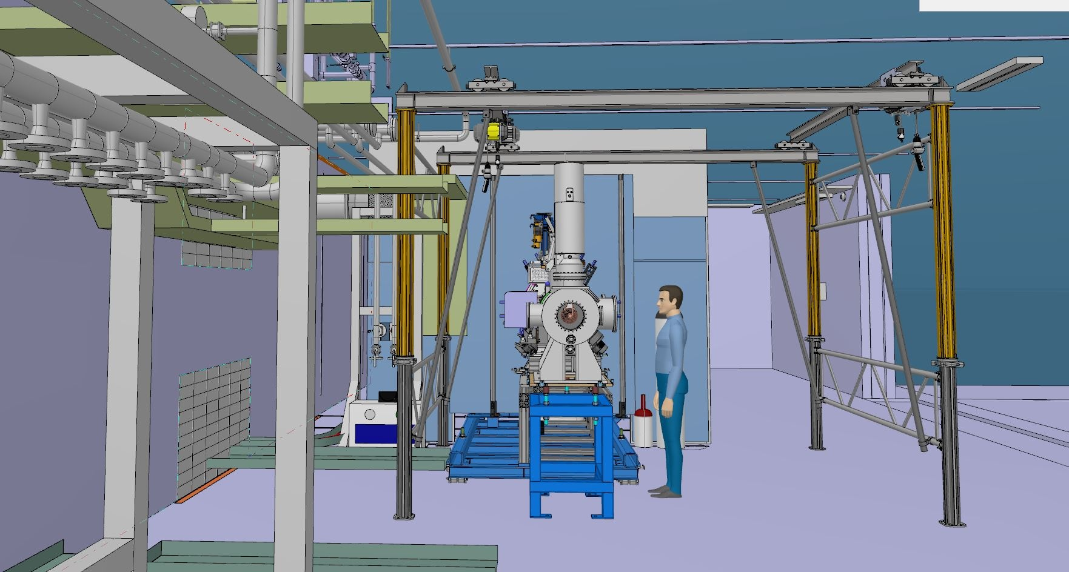
Equipment

Slide 28
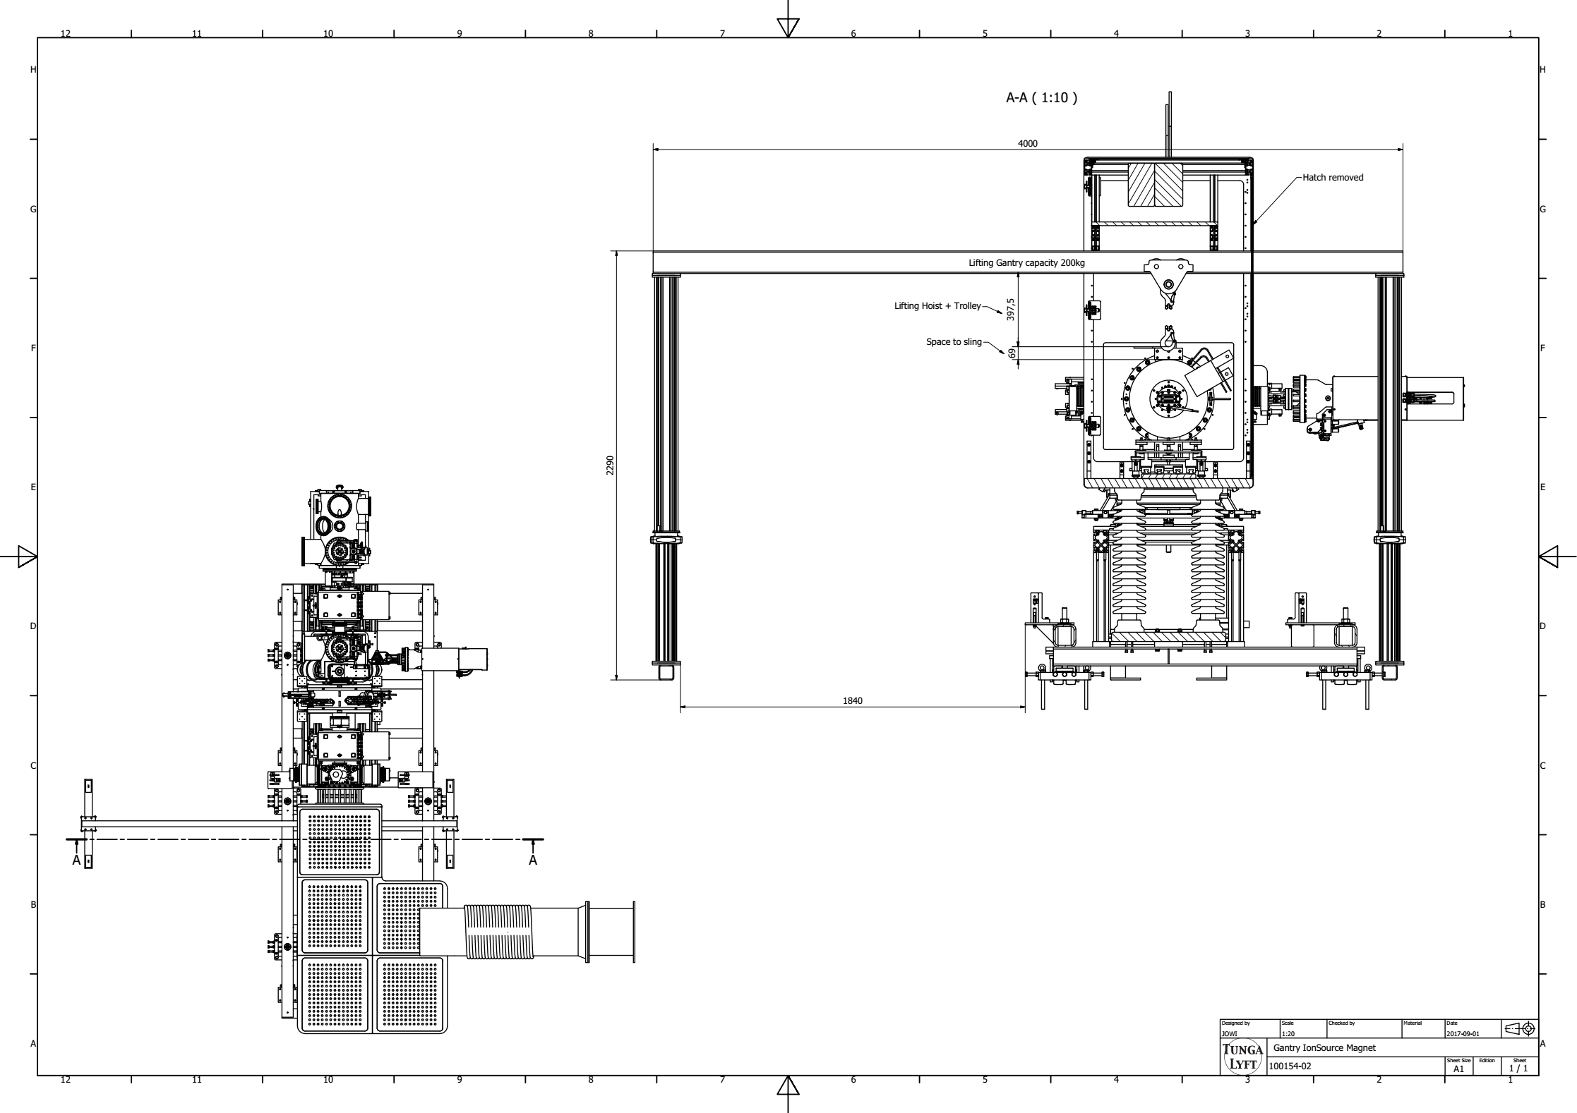
Equipment

Slide 29
Services
Power supply Available
  32A three-phase
  16A single-phase
Lighting Available
  Currently temporarily lights installed
  Additional lights on request
Compressed (instrument) air Week 42
HVAC (fully operational) Week 48

Slide 30
Questions?

