Slide 1
IRR meeting
CF Design Lead
Lennart Stenman
15 09 2017
www.europeanspallationsource.se

Slide 2
CF in ESS Matrix
DG
EMT (T)
CF
MD
SD
Central Functions/Task Forces
CF
Constr.
CF
Techn.
Acc.
Project
Target
Project
ICS
Project
NSS
Project
ETB
Tech Co-ord.
Prog. Plann.
Syst. Eng.
PLM
QA
Rad Saf.
Conv. Saf
Licensing
Nuclide Inv.
Shield. Calc.
CR
CF
Planning
Contact with C 101,
CF
Baseline team
Req. for DD
AD
Design
Constr.
Req.
TD
Design
Constr.
Req.
ISCD
Design
Constr.
Req.
Instr.
Design
Constr.
Req.
Stakeholder requirement
C 101
ESS/Skanska
Notes:
CF provide structures and support systems
Public procurement of 450 mEuro contract with Skanska 2014
Target cost collaboration contract = cost plus with incentive/ integrated organisation
Managing +200 design consultants at any time last 3 years

Slide 3
C101 sectional handover to CF and full access for AD
SEP | OCT | NOV | DEC | JAN | FEB | MAR | APR | MAY | JUN | JUL | AUG | SEP
Sectional Handover
C101 G01, G02 H05, H06
Manuals
NCR lists
DD completion
As-built dwg
CF “Pre-Ops” Management
Partial Access to stakeholdes
Full access for AD
JIRA Management
Stakeholder integration (PIM etc)
CCB changes, NCR coordination
Facility management of buildings

Slide 4
2 May Handover
New challenges when CF starts facility management
Builder not facility manager
Pre-ops team understaffed for task
Procedures for FM to be established
Service to AD slow
CF “As-built” design not “Machine standard”

Slide 5
FEB Installation set up to support AD better
An installation “Test” to improve ESS way of working
Lessons learn log for follow up of issues
Based on an stakeholder integrated design
Includes “all activities” in FEB test area:
  CF FEB coordination management of deliveries
  Sequencing and planning of installation work,
  logistics and placing equipment
  shielding blocks

Slide 6
Prel CF scope infrastructure & services
Water-cooling piping
Cables and cable trays
ISRC&LEBT water-cooling skid installed, connected
Logistics for lifting, placing and securing IK units
Compressed air available
Temp HVAC
Shielding for LEBT test
Etc …

Slide 7
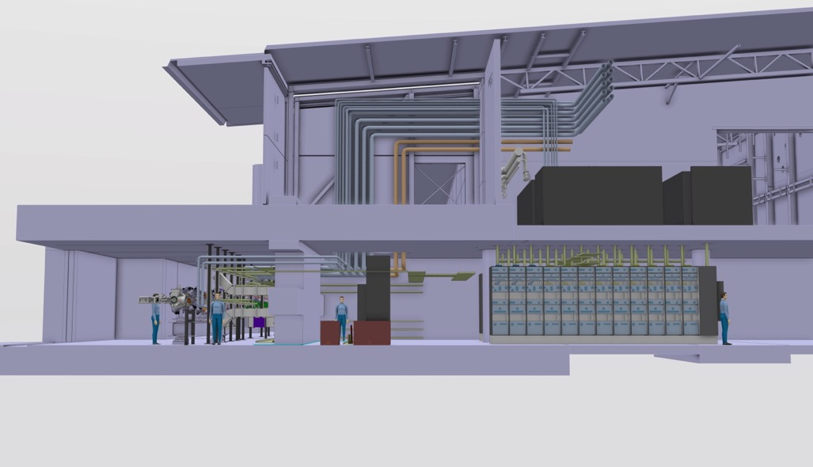
FEB Level 90 & 100 infrastructure
Shielding walls
Racks
Water-cooling pipes
Cable trays & cables
Cable trays & cables
Racks
Water-cooling skids

Slide 8
Principal programme FEB installation
SEP | OCT | NOV | DEC | JAN | FEB | MAR | APR | MAY | JUN | JUL | AUG | SEP
ETB 9/11
CF SG meet 11/10
Readiness confirmation 20/10
ION source delivery
Lessons learned 15/1
Phase 1
Ion source area
FEB installation
Installation Completion
Shielding blocks

Slide 9
FEB Phase 1, until 11 October
Complete drawings including:
  Design integration of stakeholders and laser scanning
Scope of work definition
Sequence and planning of FEB programme
Cost budget – (time & material)
Alignment negotiation of TESI agreement
Identify long lead purchase items/material

Slide 10
Critical area: Normal Conducting Front End (NCFE)
Ion Source
LEBT
RFQ
DTL tanks
MEBT
Tunnel FEB Interface

Slide 11
FEB Test team structure
Evaluation & lessons learned
Mats Lindroos/John Weisend/Peter Råhdal
Magnus Eneroth/Dan-Magnus Sköld
FEB Installation Management Team
NG/LS/HD
AD Design
Technical lead- John W/Håkan D
Installation coordintion
Area Managers
Dennis
programme dates/sequencing-
Baseline Infrastructure
Prel design basis
Anton,Evangelia,Frithiof,
Remy …
System Owners
(Edgar)
ION source
LEBT
RFQ
PSS
C/M
TSS/NPS
Responsible Function/Commissioning
C101
Skanska
& Supply chain
Delivery
Budget cost
planning
BIM model/PD
Budget
(Jörgen P)
Detailed Design
Installation coordination/integration
Requirements
Baseline
Approve
DD
Installation dwgs
TESI design
TESI
Installation &mtrl
FEB installation team
FEB design team

