Slide 1
High voltage and radiation safety
Øystein Midttun
Ion source and LEBT system leader
www.europeanspallationsource.se
15 September 2017

Slide 2
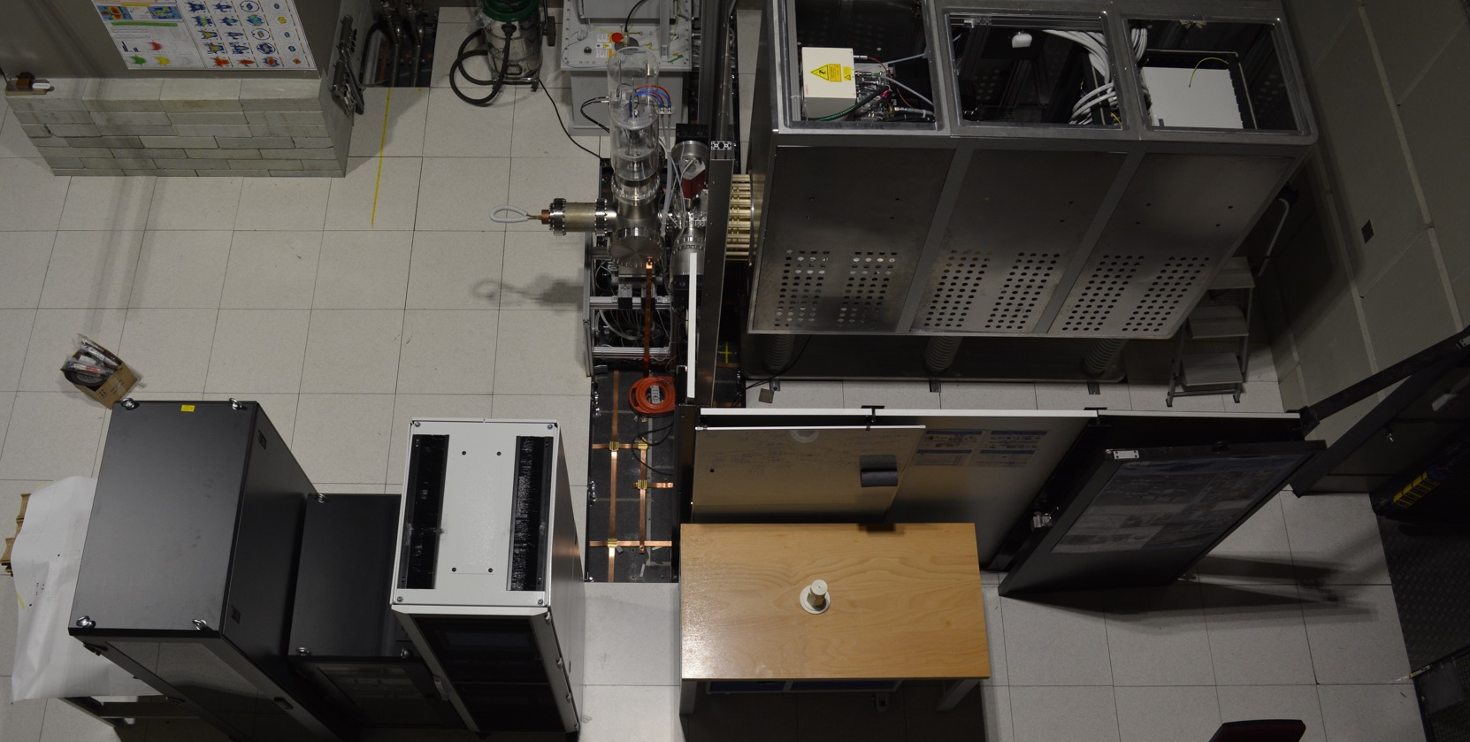
We have designed a high voltage protection cage with two main functions
1: protect against the 75 kV of the high voltage platform
75 kV

Slide 3
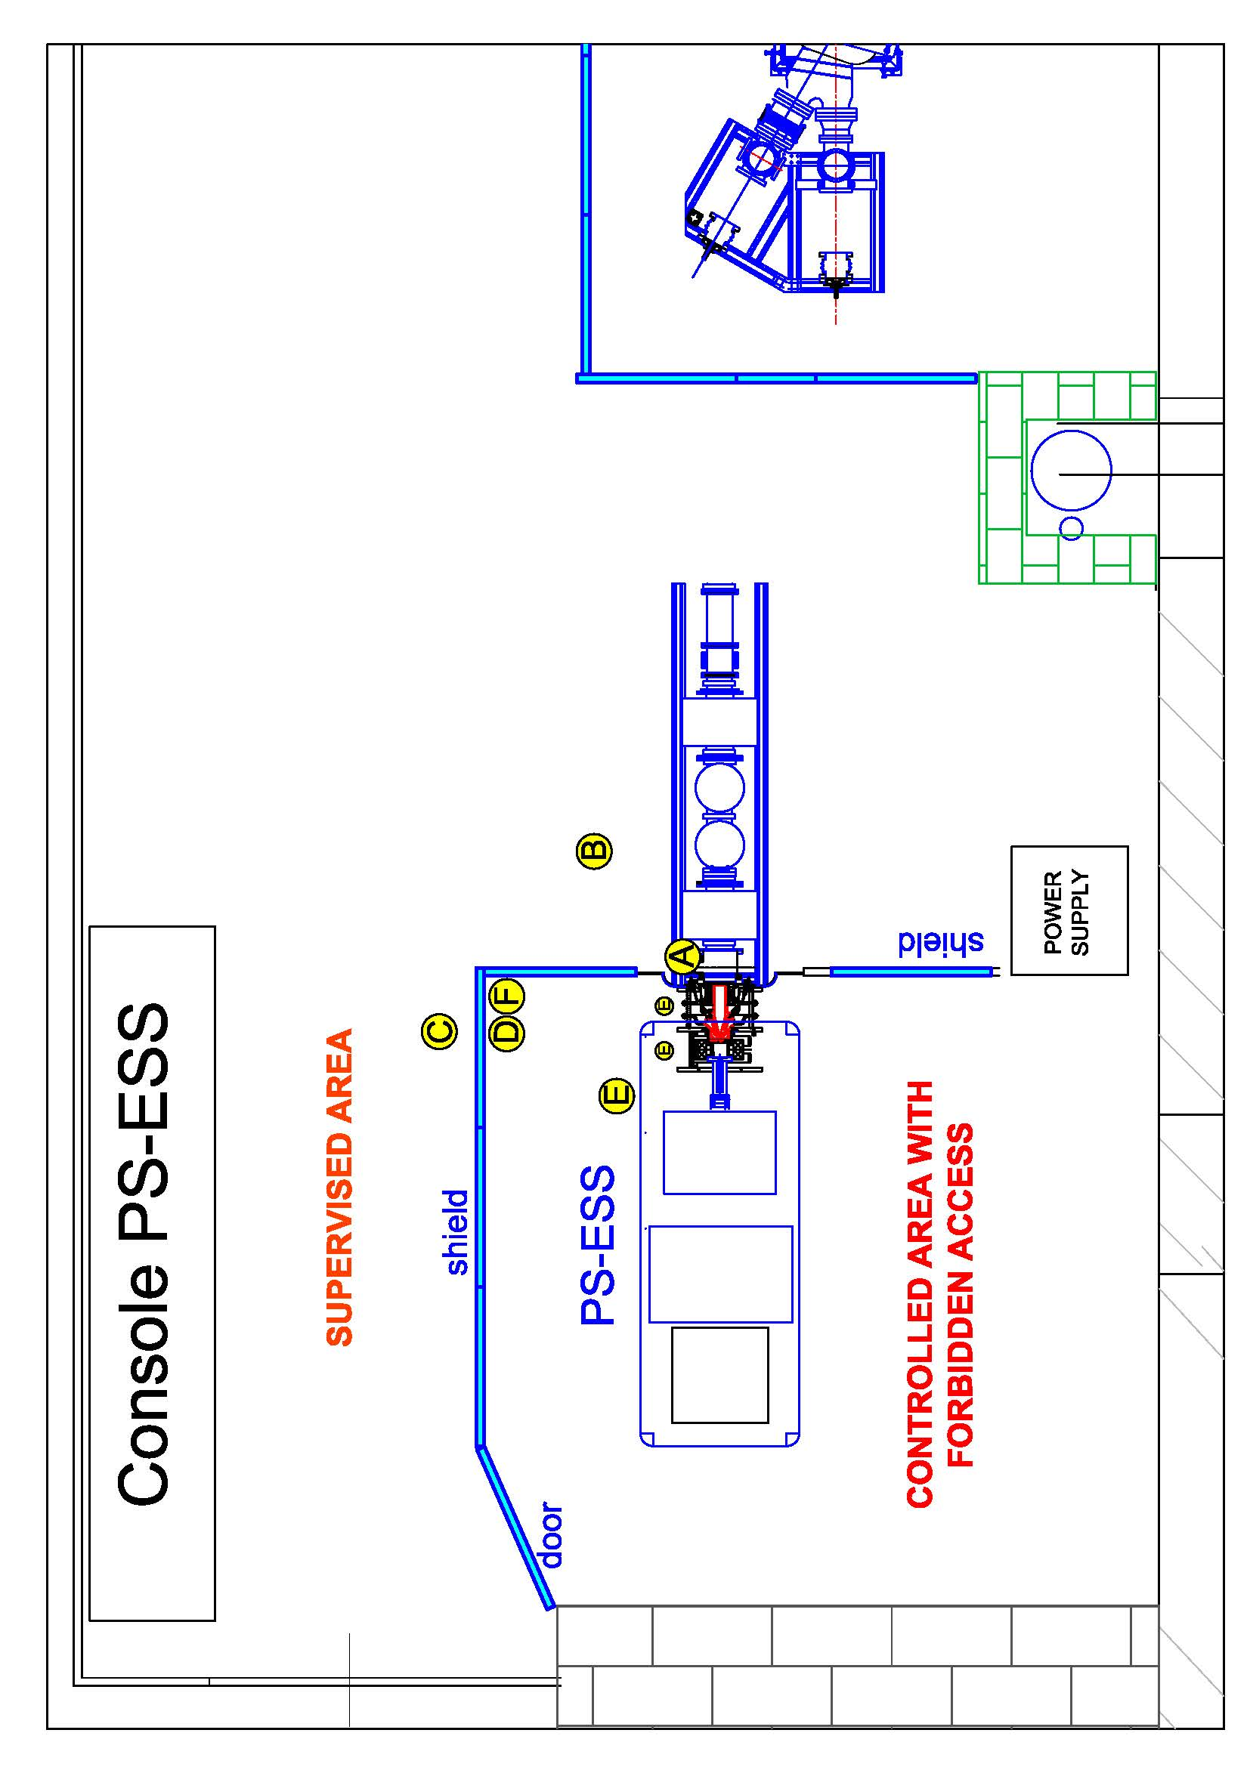
We have designed a high voltage protection cage with two main functions
2: protect against x-ray coming from the ion source during beam extraction
Radiation level below
natural background
Normal operation:
< 15 µSv/h
Maximum observed:
380 µSv/h
Measured dose rate levels
above natural background
Report: PS-ESS radioprotection report 30.03.17, ESS-0114736
fig 5

Slide 4
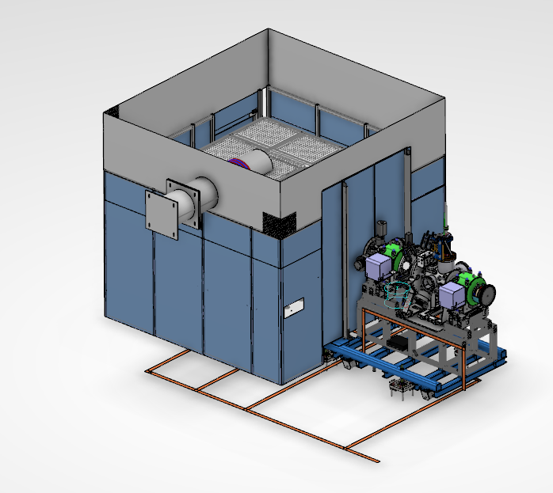
3D model of high voltage protection cage
1 m high aluminium
plates with 2.5 mm
holes (IP3x)
Additional lead shielding
at the LEBT interface
Floor-to-ceiling walls
2.5 m high, 2 mm thick
lead shielding
Cooling water inlet
for the ion source

Slide 5
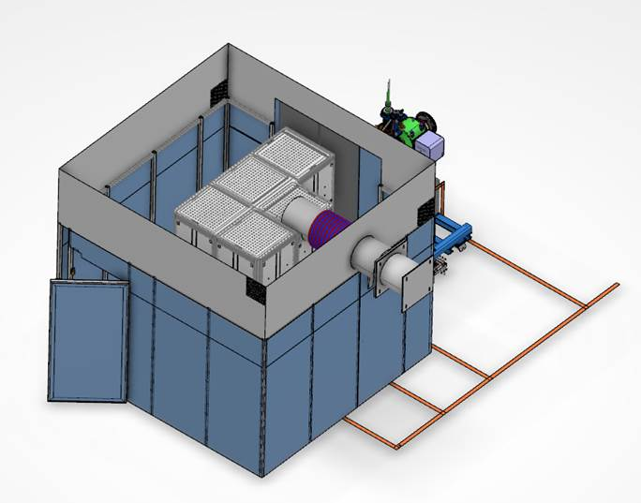
3D model of high voltage protection cage
Isolated 400 VAC
Fibre optic control cables
Safety door
PSS0
High voltage cable

Slide 6
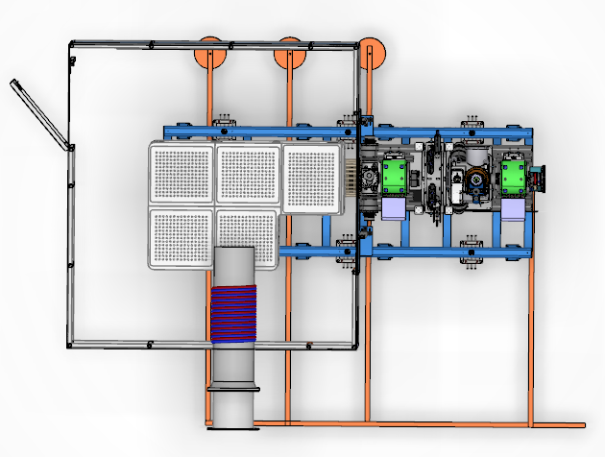
Top view of high voltage protection cage
Entry
Connection to grounding
mesh in the floor
Connection to
wall grounding
Ion source
water cooling

Slide 7
We have an integrated 3D model of the HV protection cage
– The model includes safety devices provided by PSS (i.e. lock, grounding relay, etc.)
– We’re in contact with a company for production and installation
– We’re waiting for a quotation, delivery time, and installation time
Description of the HV protection cage: ESS-0122281

