Slide 1
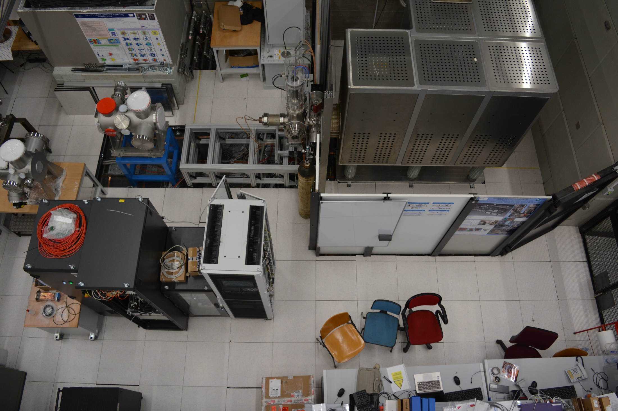

Beam commissioning of the high intensity proton source developed at INFN-LNS for ESS
Lorenzo Neri
Notes:
I want to thanks the scientific committee to had given me this opportunity.
I'm proud to be here on behalf of the INFN-LNS Accelerator R&D team to present the:...

Slide 2
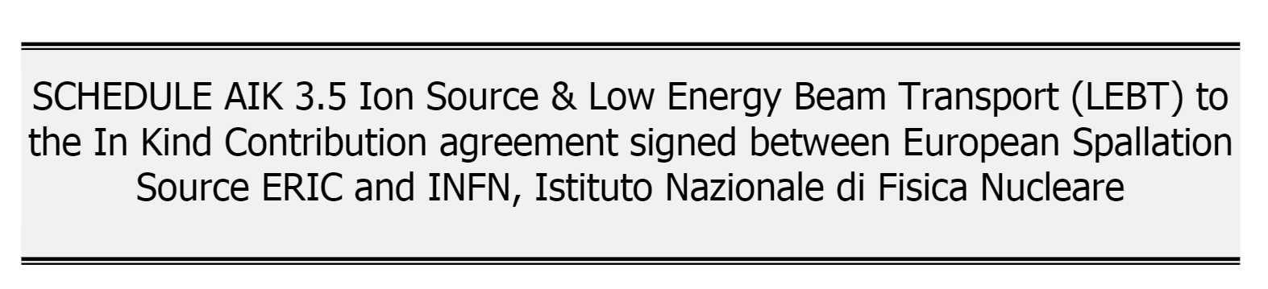


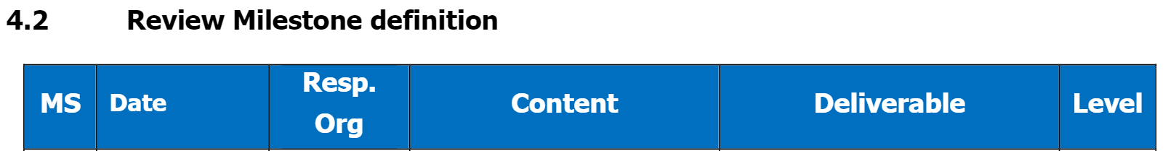
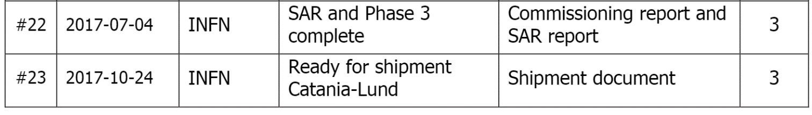
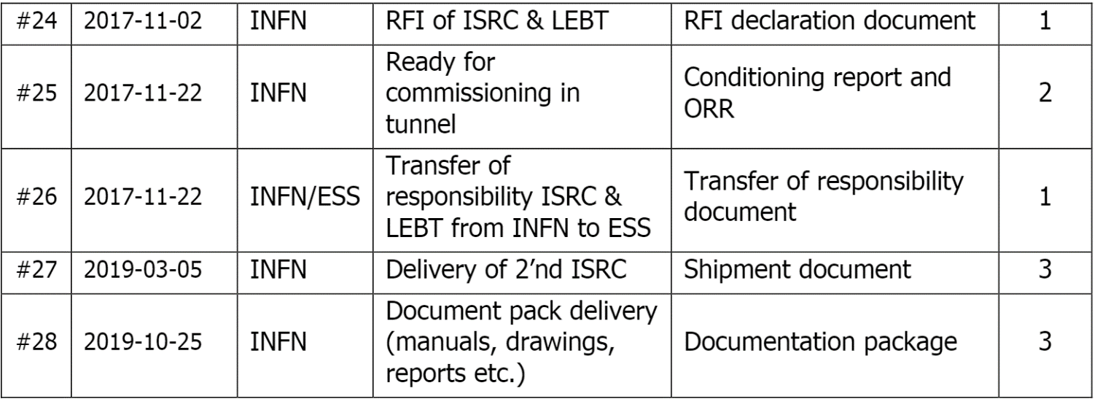

Slide 3

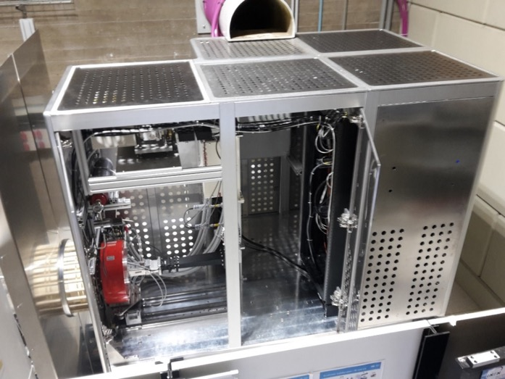
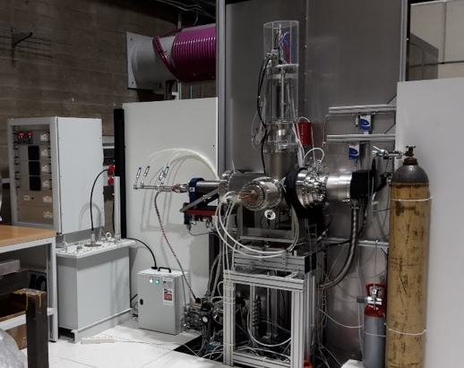
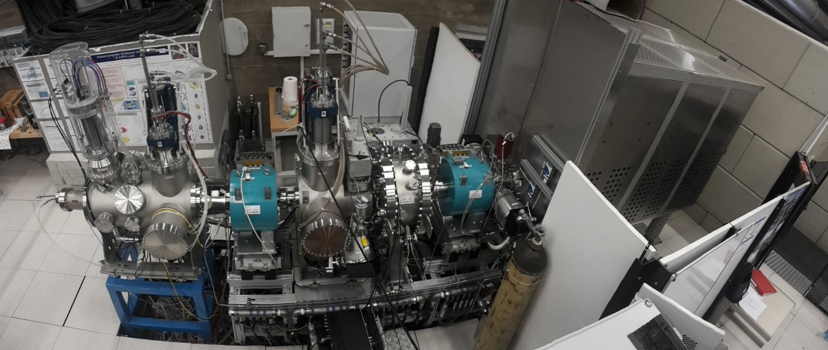
Phases
Source
Phases 1 and 2
Phases 3 and 4 = Lund commissioning

Slide 4
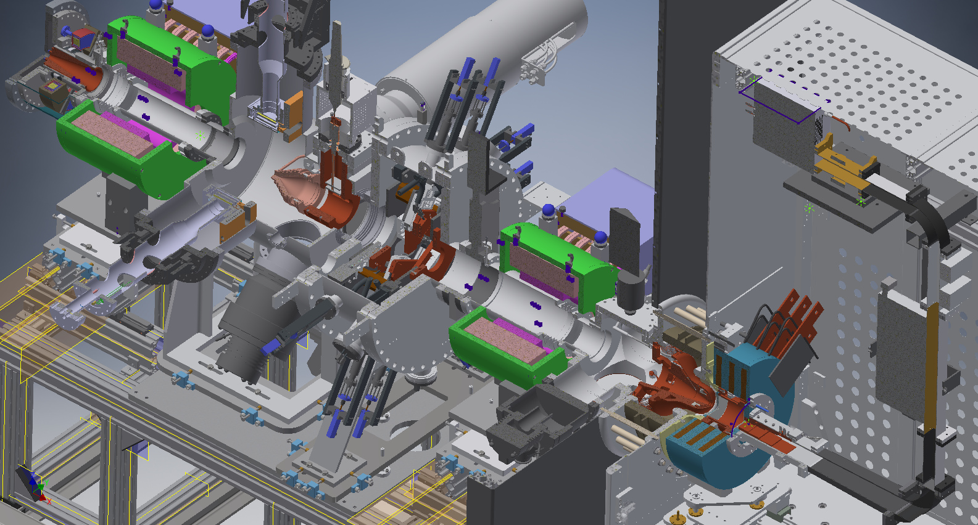
Proton Source and LEBT at INFN-LNS
Chopper
Magnetron
2x TMP
RGA
Gauges
Gas injection
(ESS)
ATU
Solenoid
Magnetic system
Collimator
H₂ injection
Six blade
iris
Solenoid
2x EMU
FC
Doppler
(CEA, ESS)
2x TMP
Gauges
Gas injection
(ESS)
Extraction
Plasma chamber

Slide 5
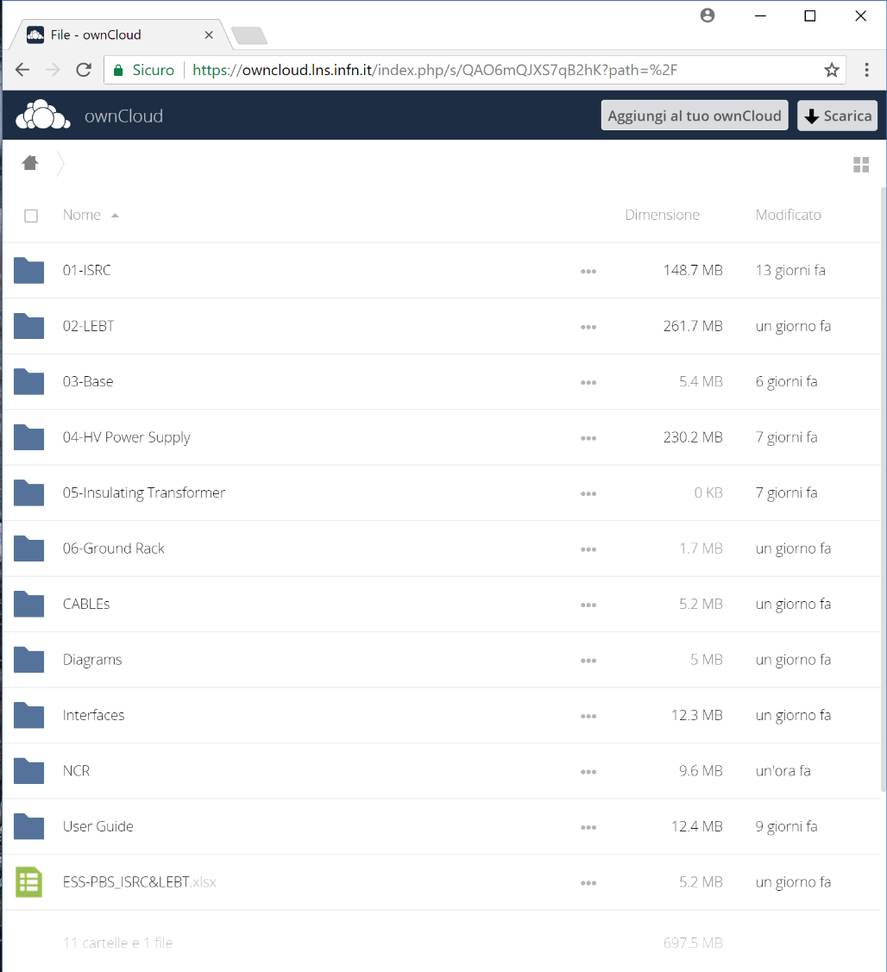
ISRC&LEBT Documentations
INFN is providing a shared INFN
collecting:
Drawings
Diagrams
Cable specifications
Manuals
Factory acceptance test
Guides
Certification of conformities
Interface drawings
Non conformity reports
The documentation is collected in folders organized following the Product Breackdown Structure.
Notes:
product breackdown structure e visione sito cloud: isrc-estrazione-drawings+ps+certificato rame, insulating column-drawings+certificato vuoto, magneti sorgente con documento completo, magnetron con manuale, lebt solenoidi drawings+ps+fat, chopper+disegni+diagramma blocchi+schematics+signal list, irisdisegni+manuale,supporti-disegni, base-disegni, fug, cavi,
Interfacce documento edgar, cartella interfacce
Standard dentro i disegni, guide, slide andrea+ornella^2

Slide 6
Physics design of Ion Source and LEBT equipment
Pulse rise and fall time using LEBT chopper (Prototype tested on BETSI)
Flexible magnetic system design
(OPERA, Comsol)
Reduction of electric field (Comsol)
Microwave to plasma coupling (3D Full wave simulation code)
Beam extraction
(Axcel)
Thermomecanical (Comsol)
Plasma dynamics and species fraction composition (Particle in cell simulation code)
Defocusing chopper (Comsol, TraceWin)
Differential pressure gap between plasma chamber and LEBT
(Comsol)
Improvements starting from IFMIF design (in collaboration with CEA)
Stationary and time dependent beam transport in space charge compensation regime (Particle in cell simulation code)

Slide 7
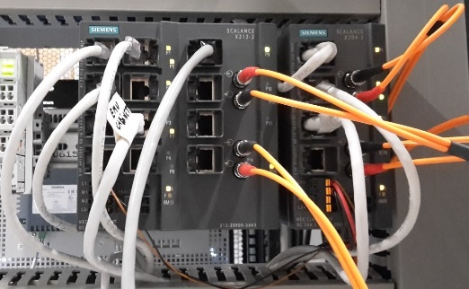
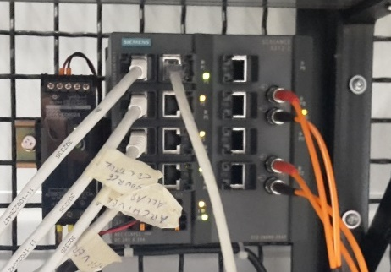
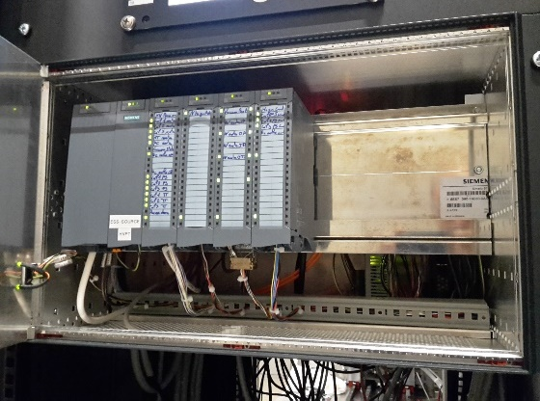
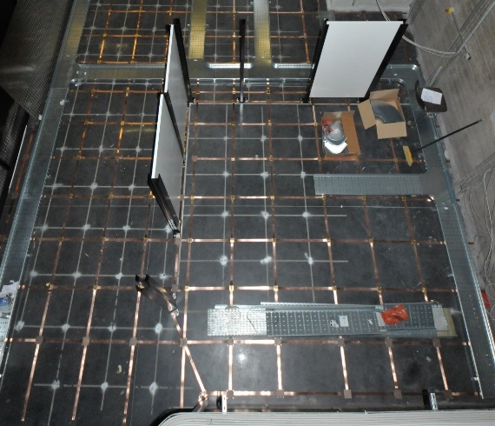
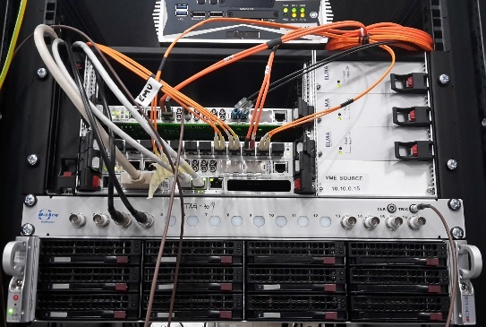
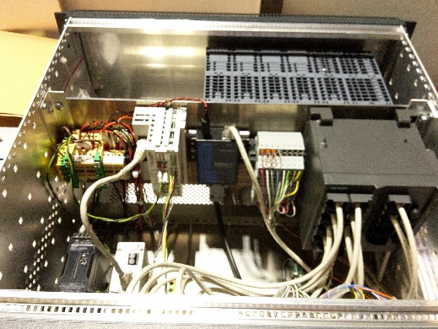
Increase electronics strength against discharge
Wide use of optical fibers
Shielded sub-rack on the HV platform
Grounding grid
FC voltage protection
Shielded sub-rack at ground

Slide 8
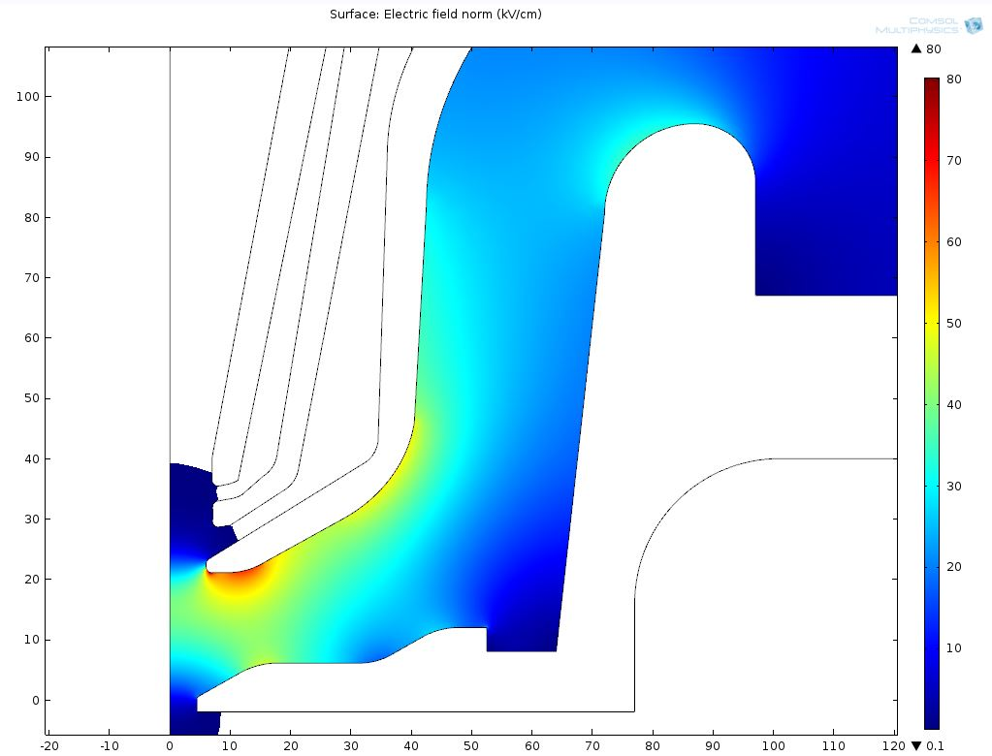
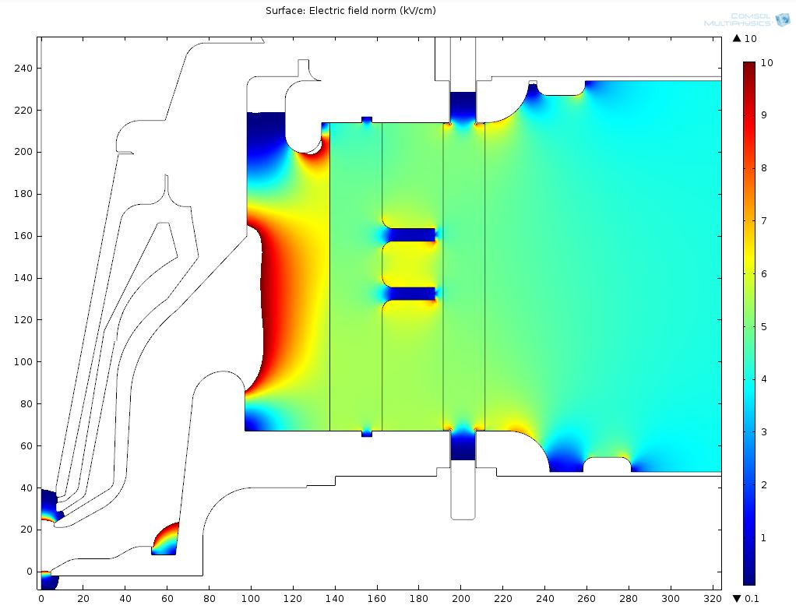
Improvements in the extraction system
Lower the useless electric field close to the extraction
X Ray protection
Beam dynamics through electrodes
Single alumina to minimize the electric field on the external surface (< 6.6 kV/cm)
New triple point design (< 6.4 kV/cm)
LEBT
Beam axis
air
Plasma chamber
Plasma chamber
We had not serious problems of discharge during beam extraction at 75 kV.
Extraction column was tested up to 90 kV.

Slide 9
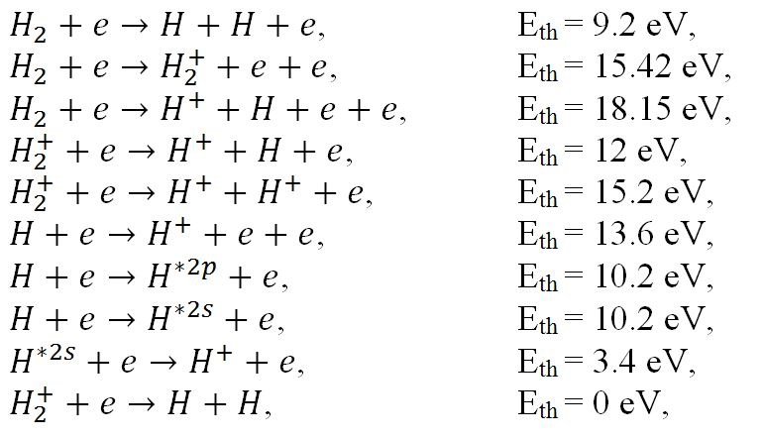
Plasma modeling
Electron Energy Distribution Function
RF energy adsorption
Magnetic system flexibility helps to tailor the EEDF
Ion formation
Generation maps
e⁻
p⁺
L. Neri et al. "Recent progress in plasma modelling at INFN-LNS", Rev. Sci. Instrum. 2016 Feb, 87(2):02(A)505

Slide 10
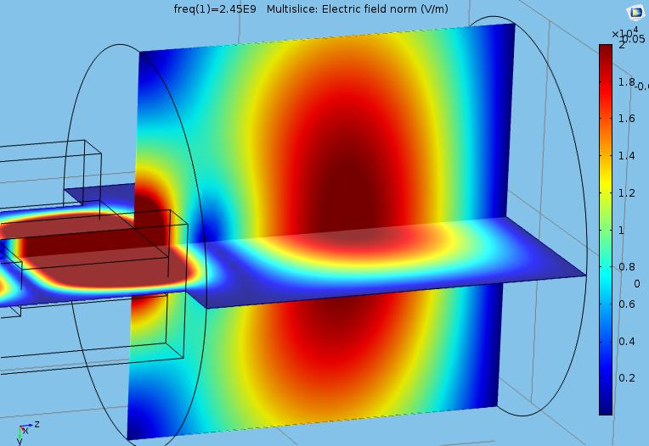
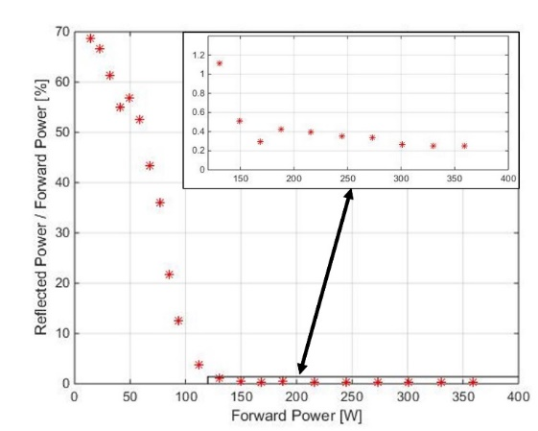
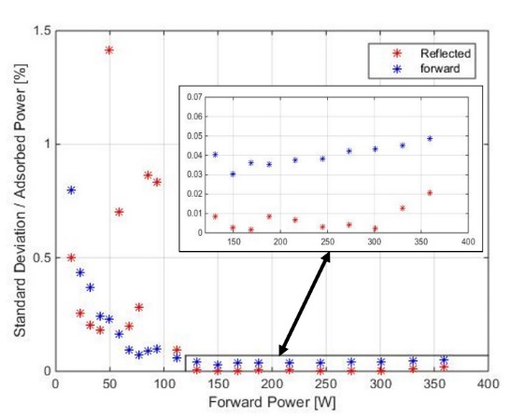
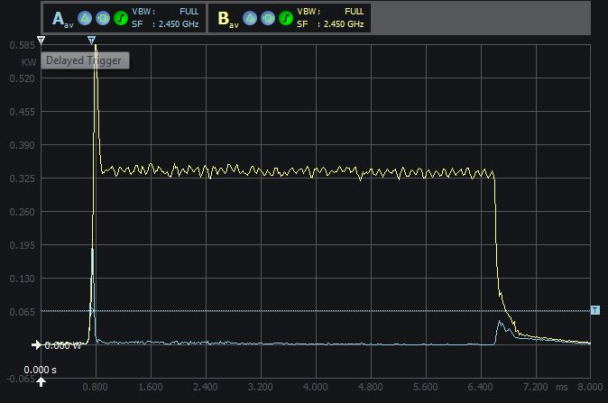
Microwave to plasma coupling
Cold tensor plasma approximation
Empty cavity
3D full wave e-m simulation in presence of the electron plasma density and strong magnetic field has driven the design of the matching transformer
G. Torrisi et al. "Full-wave FEM simulations of electromagnetic waves in strongly magnetized non-homogeneous plasma", JEWA 2014 vol. 20, no. 9, 1085-1099
Low measured reflected power
High measured stability of forward and reflected power
Measured forward and reflected pulsed power
Forward
Reflected
< 1%
< 1‰
G. Torrisi et al. "Microwave injection and coupling optimization in ECR and MDIS ion sources”, this conference

Slide 11
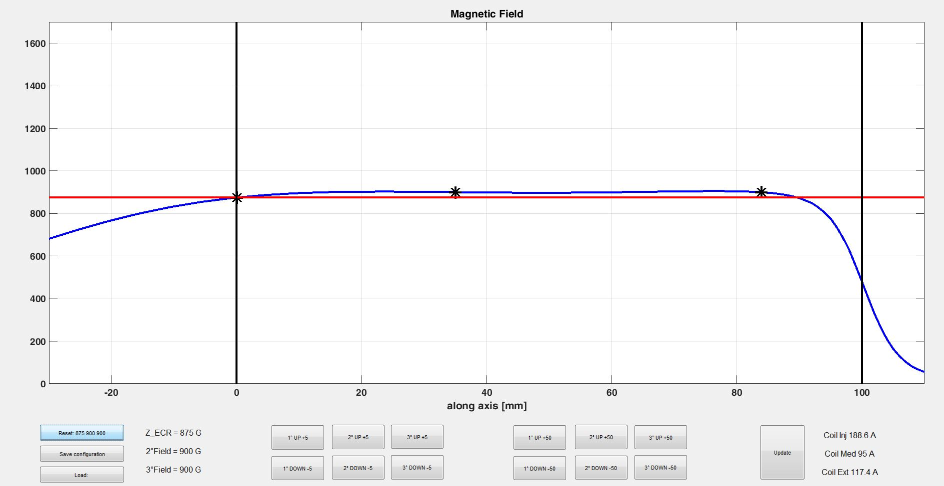
Magnetic system control interface
Very high magnetic flexibility required a dedicated interface developed at INFN that enable direct control and high reproducibility
Matching transformer
Plasma chamber
Extraction
0 mm
35 mm
84 mm
ECR
Fine tuning ± 5 Gauss
Coarse tuning ± 50 Gauss

Slide 12
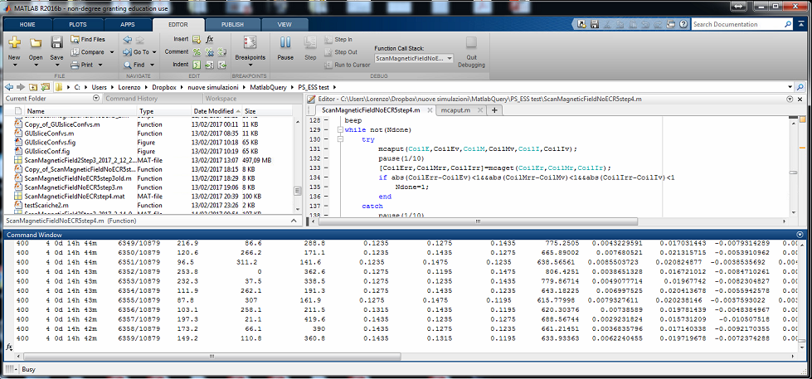

Semi-automatic characterization tool
Time left
Configurations
left
Coil 1
Coil 2
Coil 3
Watt
SCCM
Plasma modelling ➔
parameters range to be tested:
Field @ 0 mm ==> 835:20:975 Gauss
Field @ 35 mm ==> 795:40:1395 Gauss
Field @ 84 mm ==> 675:40:1995 Gauss
H2 flow ==> 2:1:5 SCCM
RF power ==> 600:200:1200 Watt
40ֺ192 configurations
From the 23/01/2017 the source is extracting beam seamless, more than 300˙000 tested configurations, no stops due to sparks.

Slide 13
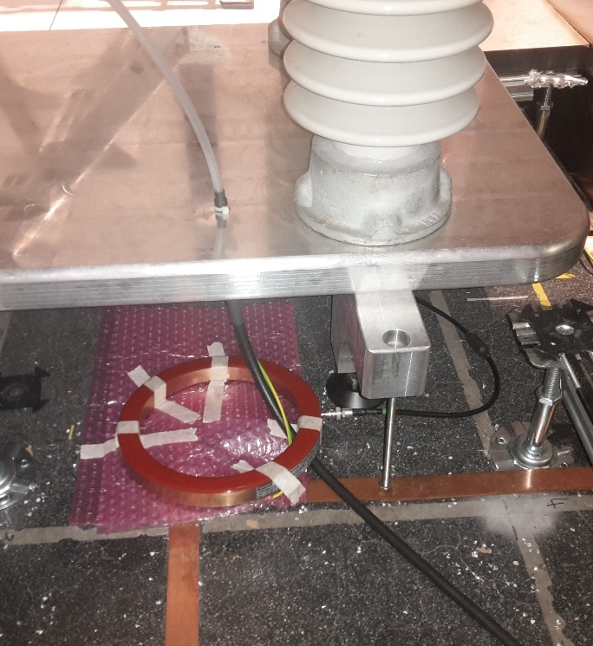
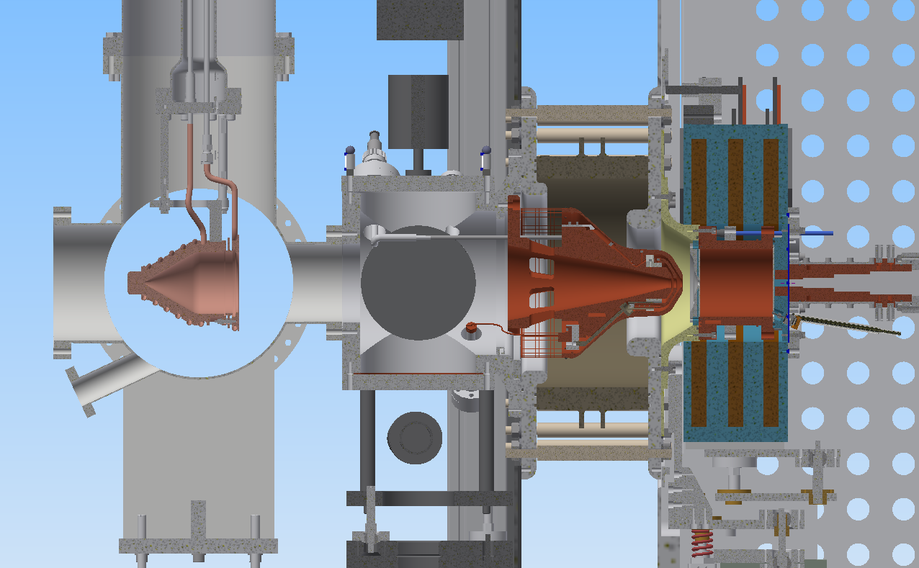
Experimental setup for source commissioning
2 xTMP
Gauges
RGA
Source
HV Platform
HV cable
ACCT
GND grid
Extraction
Faraday Cup
Emittance Measurement Unit
Doppler Shift Measurement Unit

Slide 14
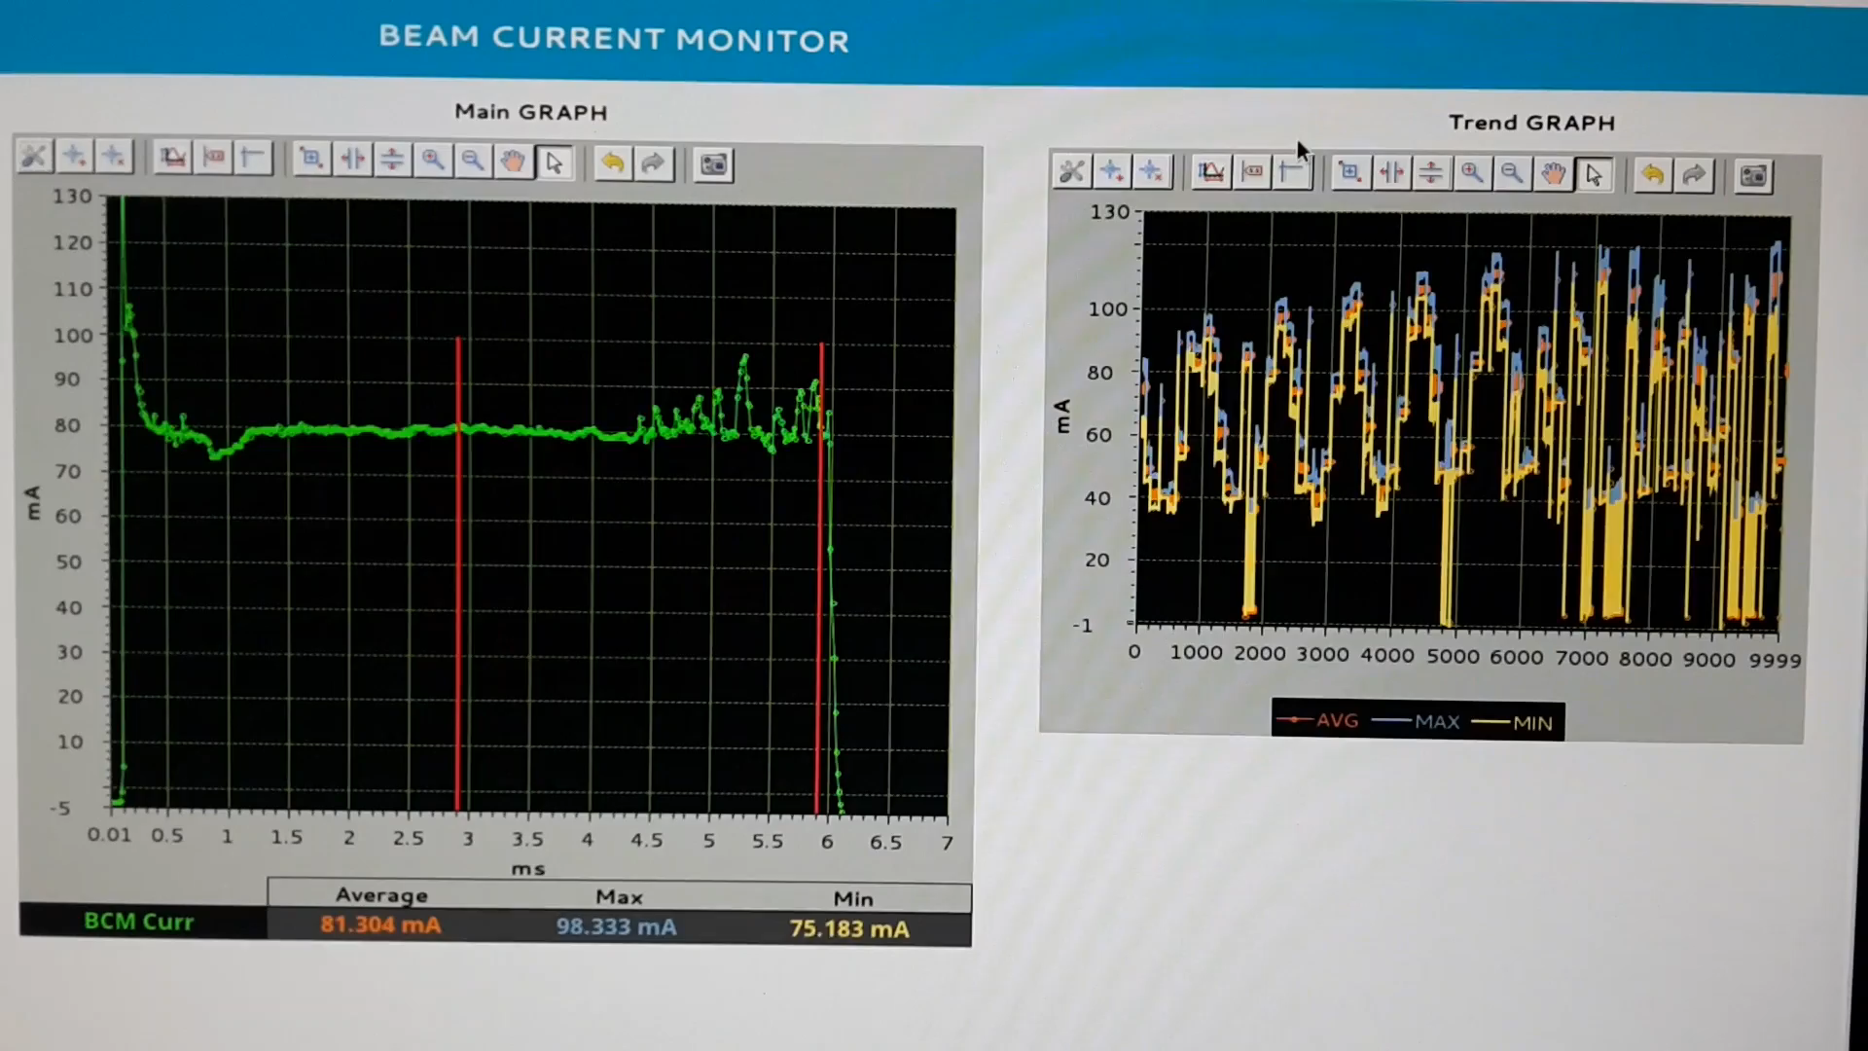
Semi-automatic characterization
40ֺ192 configurations
10 seconds each
=
4.7 days
In the graphical interface: average, maximum and minimum are evaluated and the trend showed for the beam pulse between 2.9 ms and 5.9 ms .
In the semi-automatic characterization code 26 parameters and two wave forms (@1Ms/s) are saved for each pulse produced at nominal repletion rate of 14Hz.

Slide 15
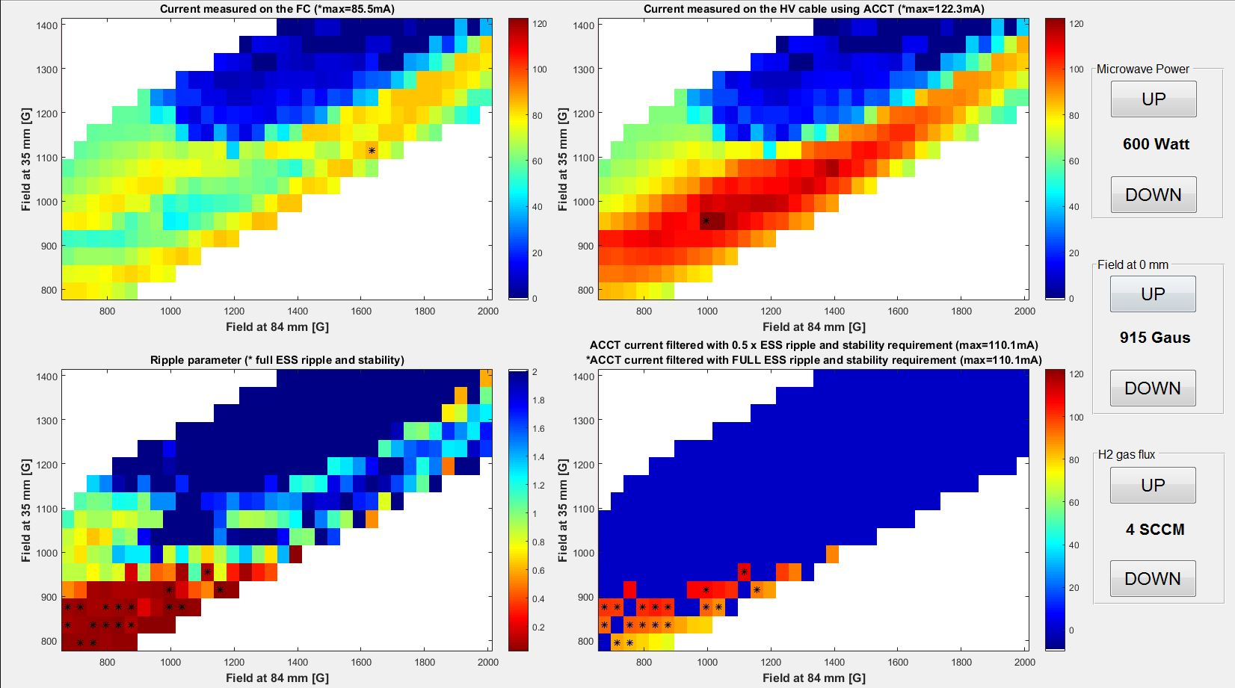
Data analysis of thousands of different configurations
FC [mA]
ACCT [mA]
Ripple [au]
ACCT(ESS) [mA]

Slide 16
Data analysis of thousands of different configurations
FC [mA]
ACCT [mA]
ACCT(.5xESS) [mA]
* ACCT(ESS) [mA]
Ripple [au]

Slide 17
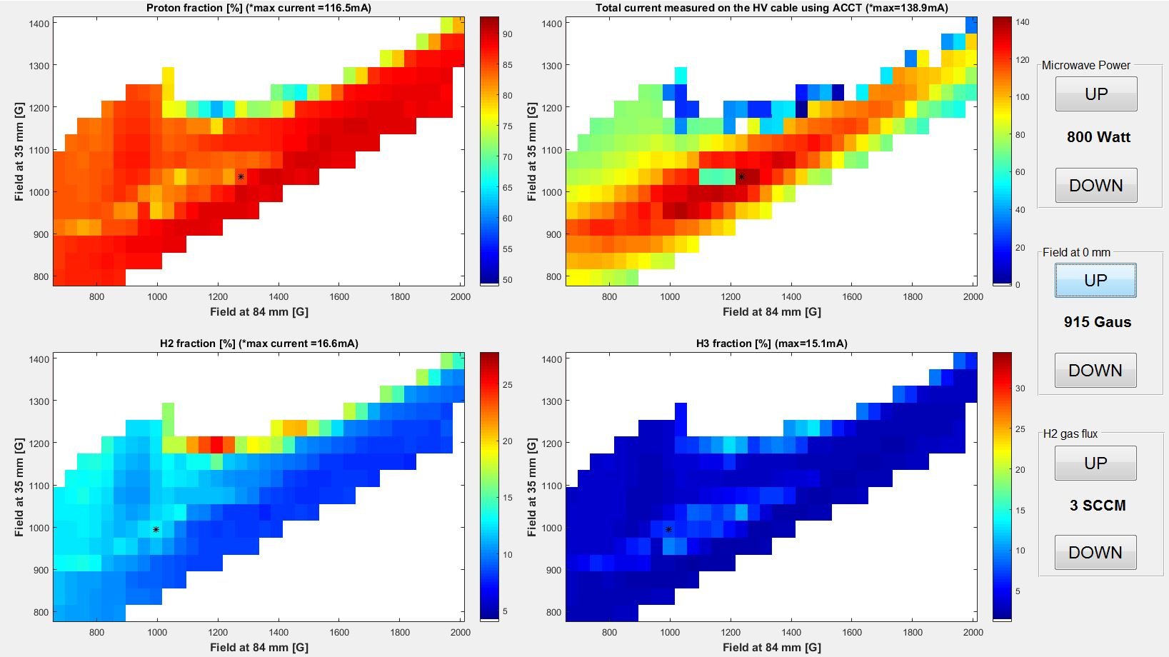
Doppler shift measurement beam characterization
Proton fraction > 75% SATISFIED
p⁺ [%]
ACCT [mA]
H₂⁺ [%]
H₃⁺ [%]

Slide 18
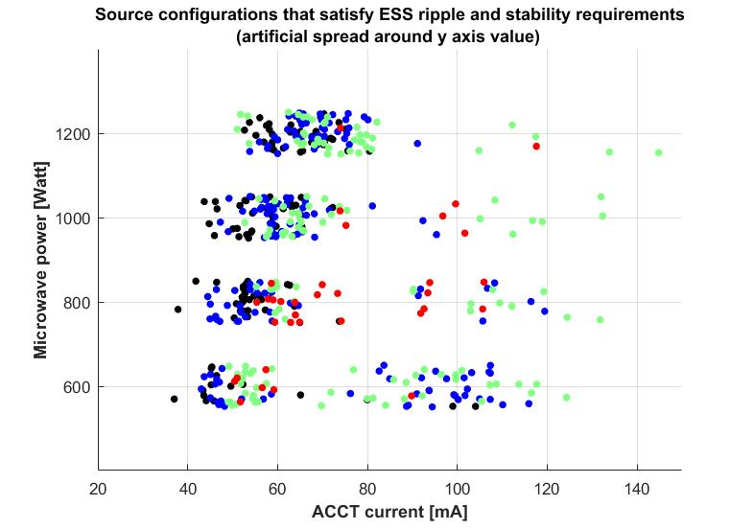
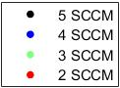
ESS stable configurations versus injected H₂ gas flux and microwave power
Total current = 100 mA SATISFIED
Increasing the injected microwave power increase the energy transfer and consequently the plasma density
Each point is a large operative range (20 Gauss x 40 Gauss x 40 Gauss x 1 SCCM x 200 Watt)
Lower current (2-5 sccm)
High current (2-4 sccm)

Slide 19
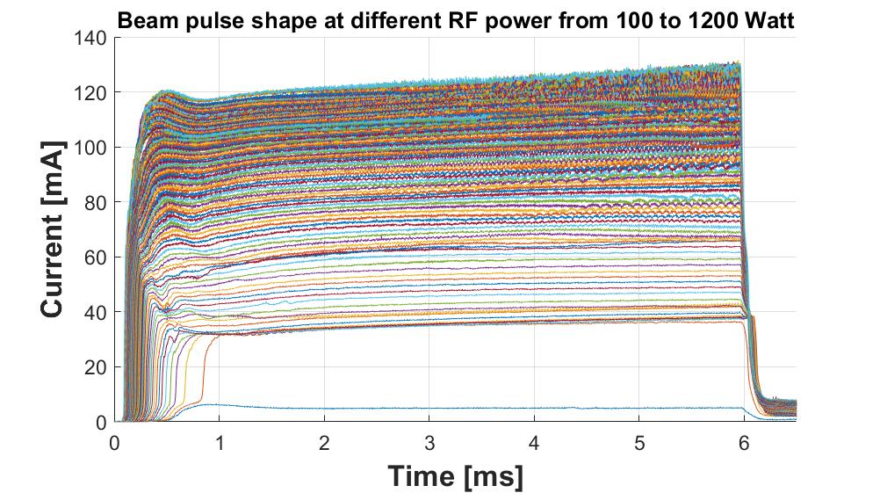
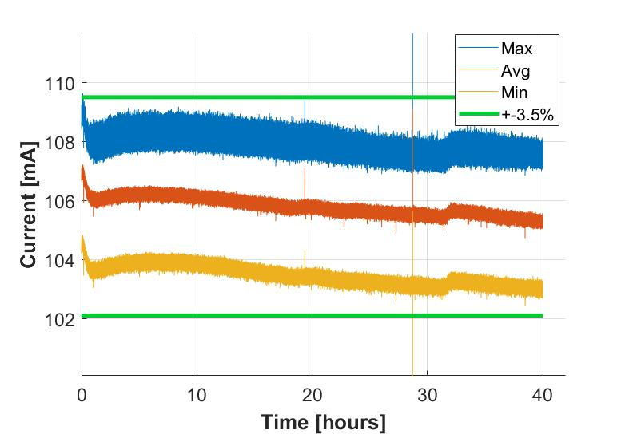
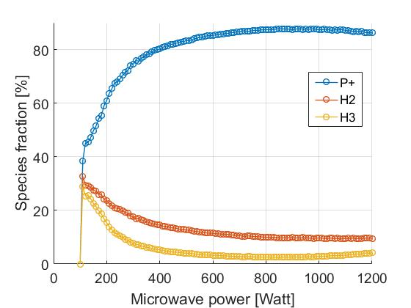
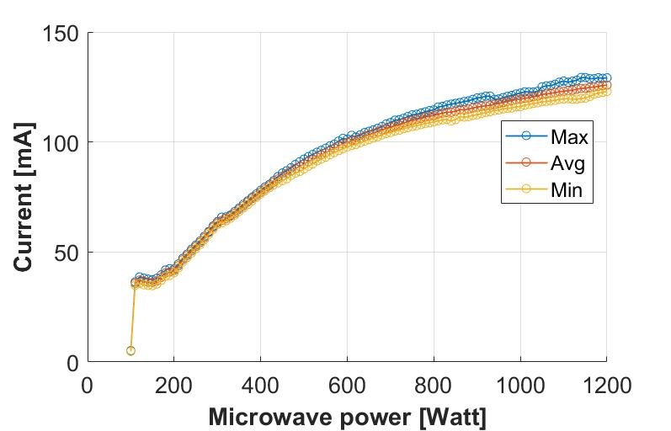
Candidate nominal configuration
109 A coil1; 67 A coil2; 228 A coil3; 3 SCCM H₂
Intra-pulse stability < ±2% SATISFIED
Pulse to pulse stability < ± 3.5% SATISFIED
Minimum proton current range 67-74 mA SATISFIED
Doppler shift measurement

Slide 20
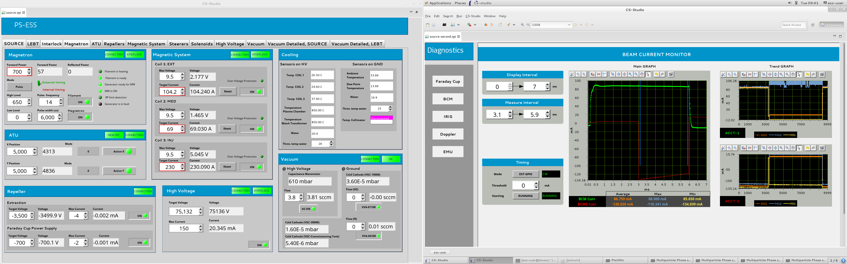
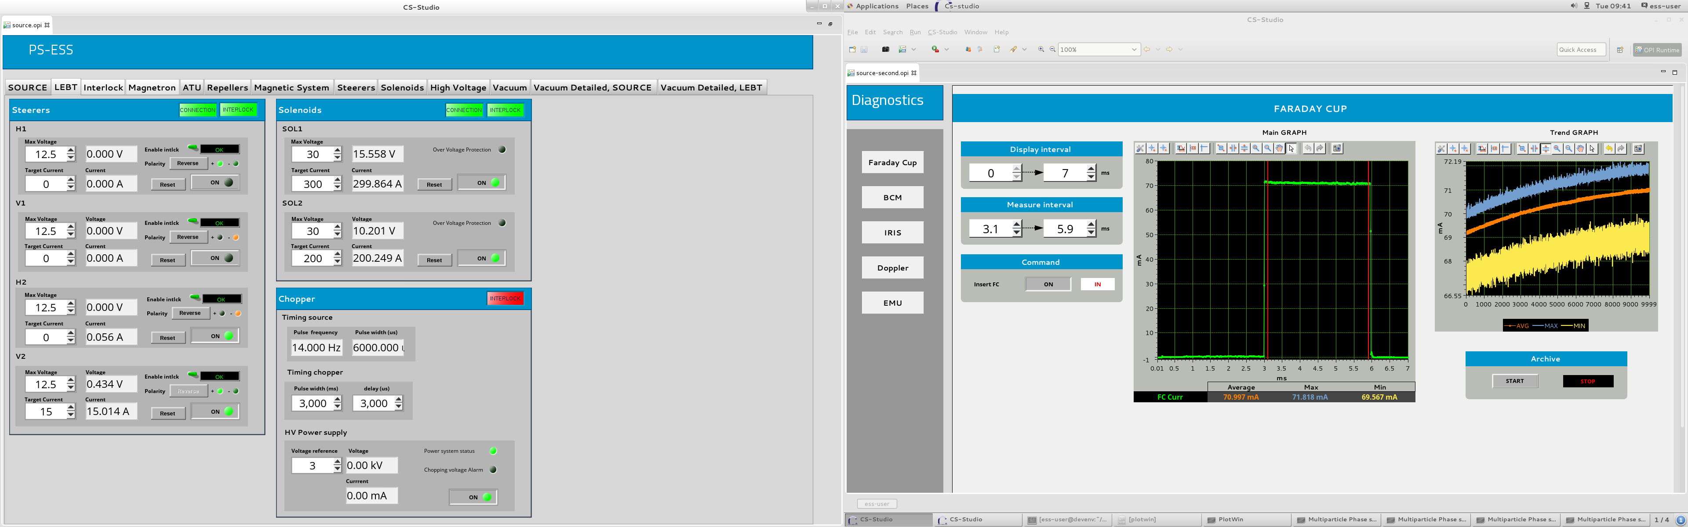
Chopping performaces
Total current
LEBT ACCT
FC current

Slide 21
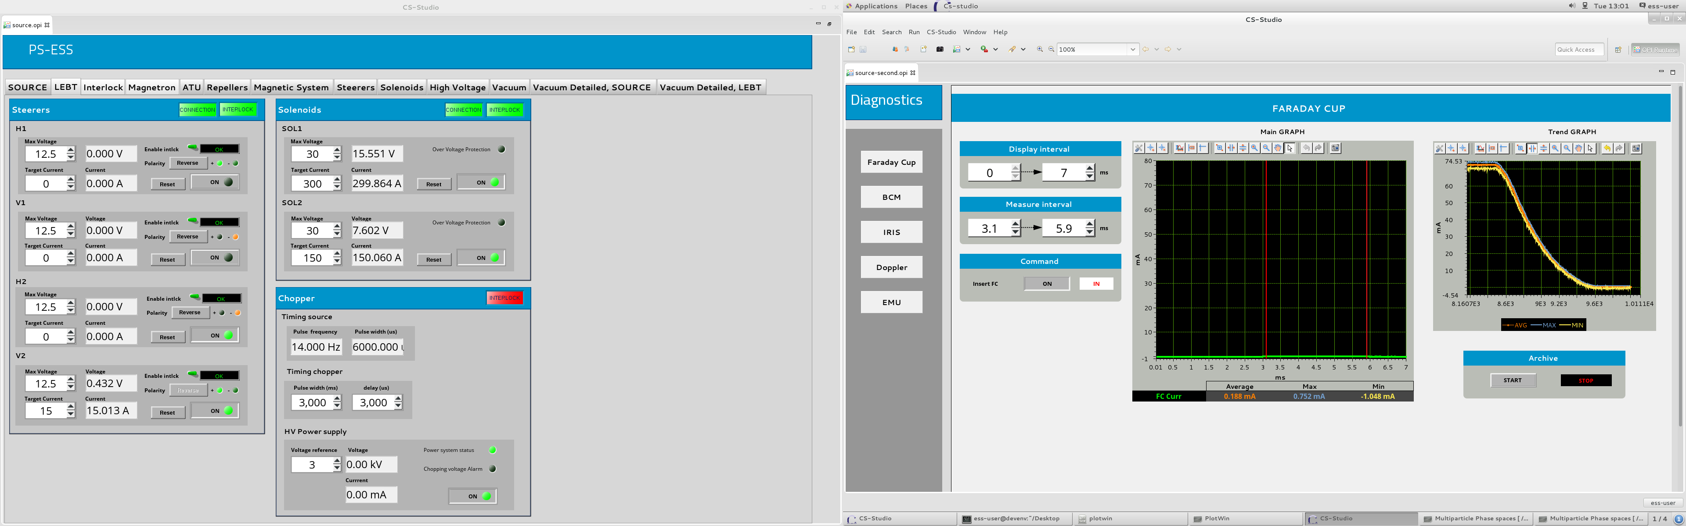
Iris performaces

Slide 22
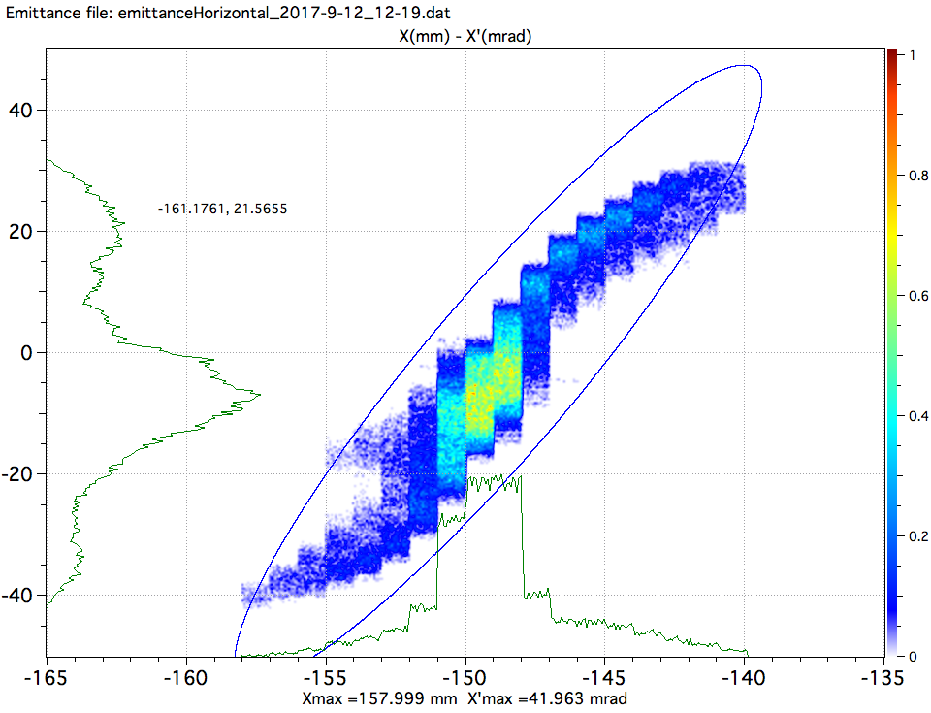
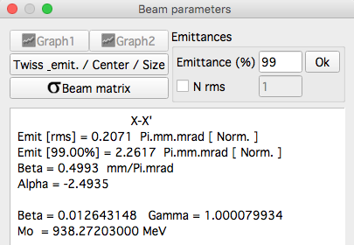
Candidate nominal configuration
109 A coil1; 67 A coil2; 228 A coil3; 3 SCCM H₂
Emittance measured after 100 mm of the RFQ beam lattice interface.
Transverse emittance SATISFIED
Emit [rms] < 0.25 Pi.mm.mrad
Emit [rms] < 2.25 Pi.mm.mrad

Slide 23
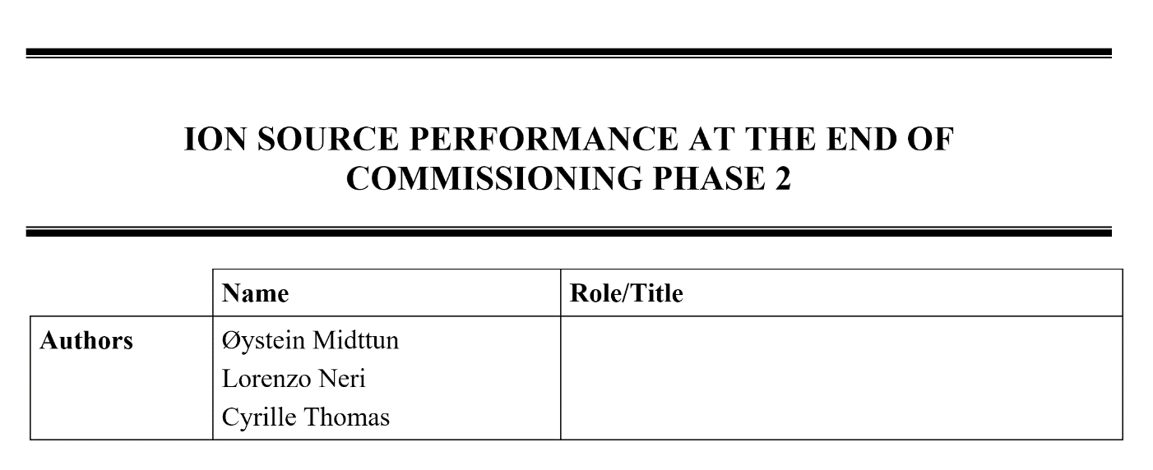
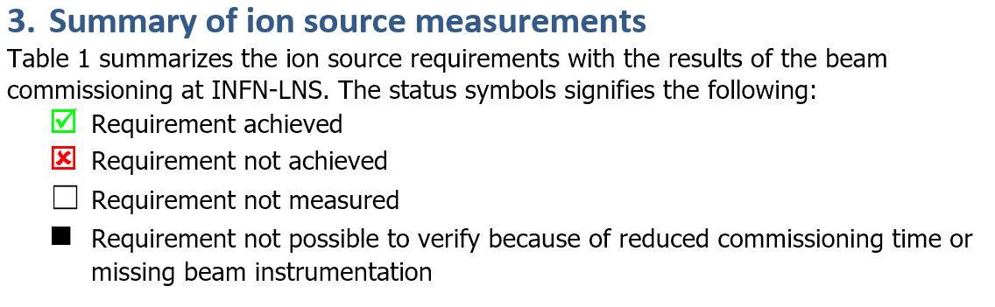
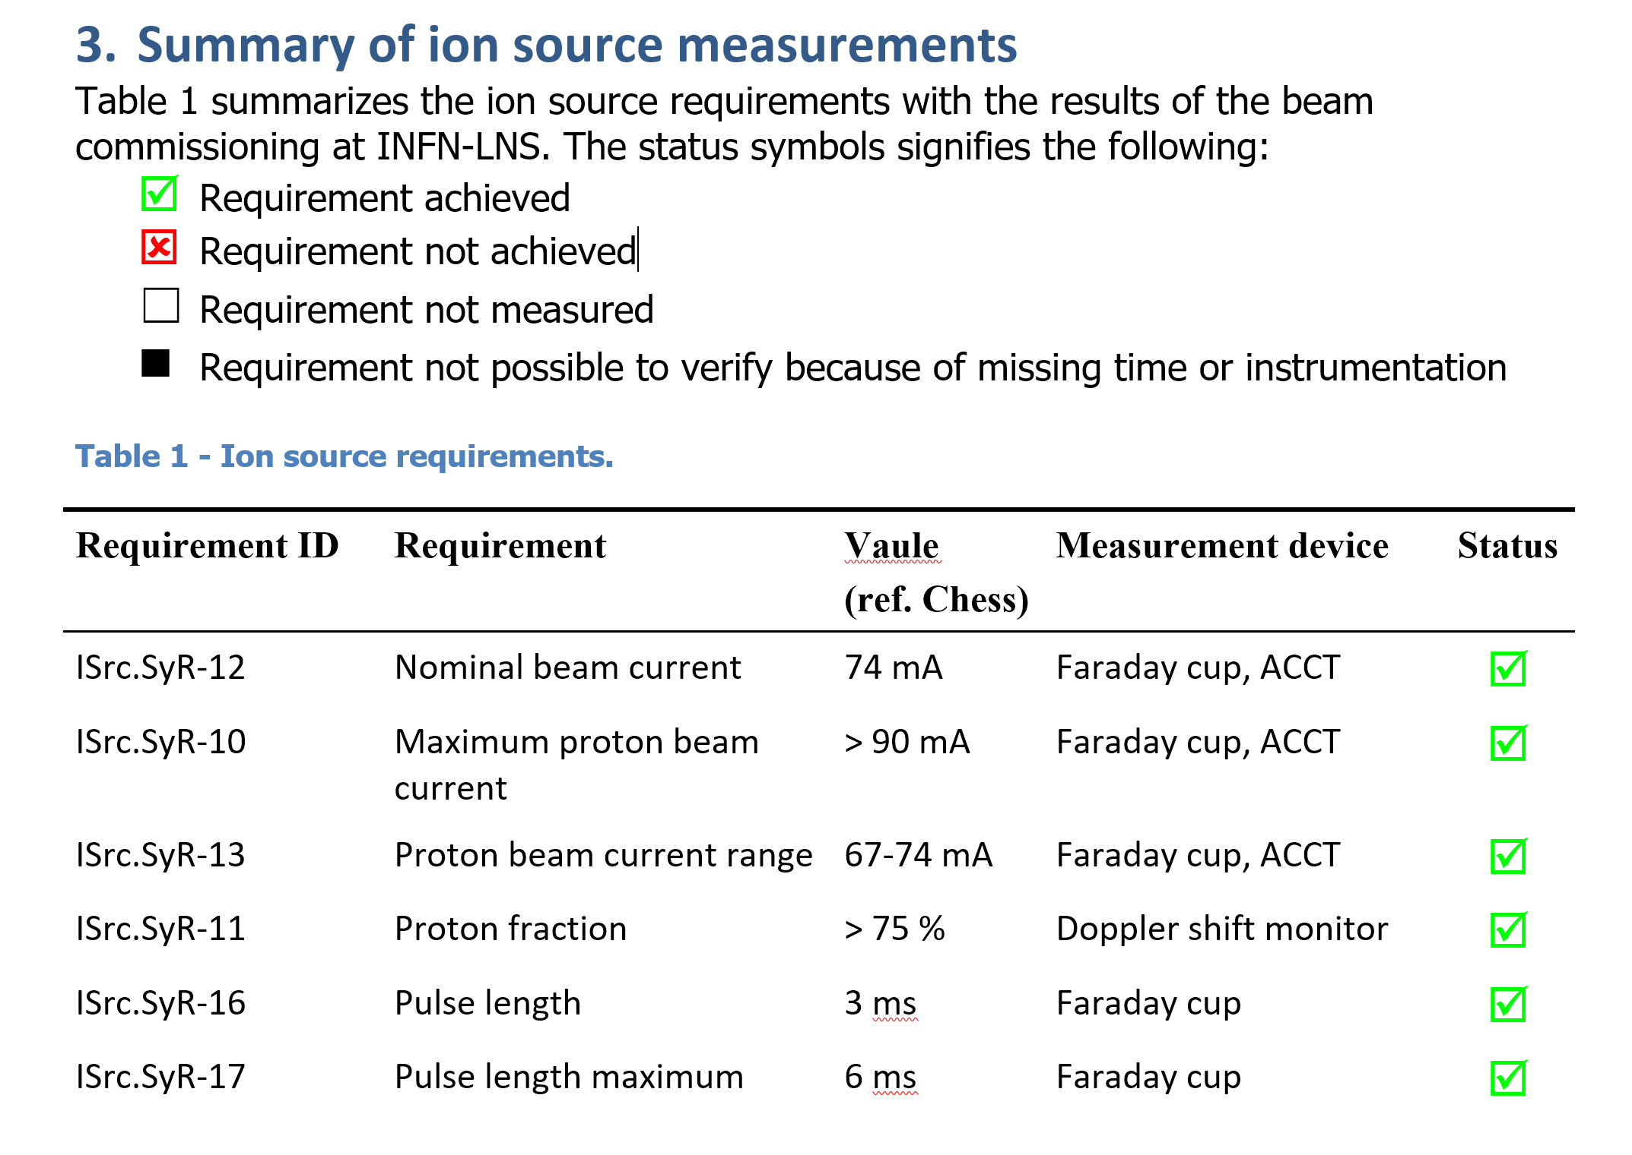

Slide 24
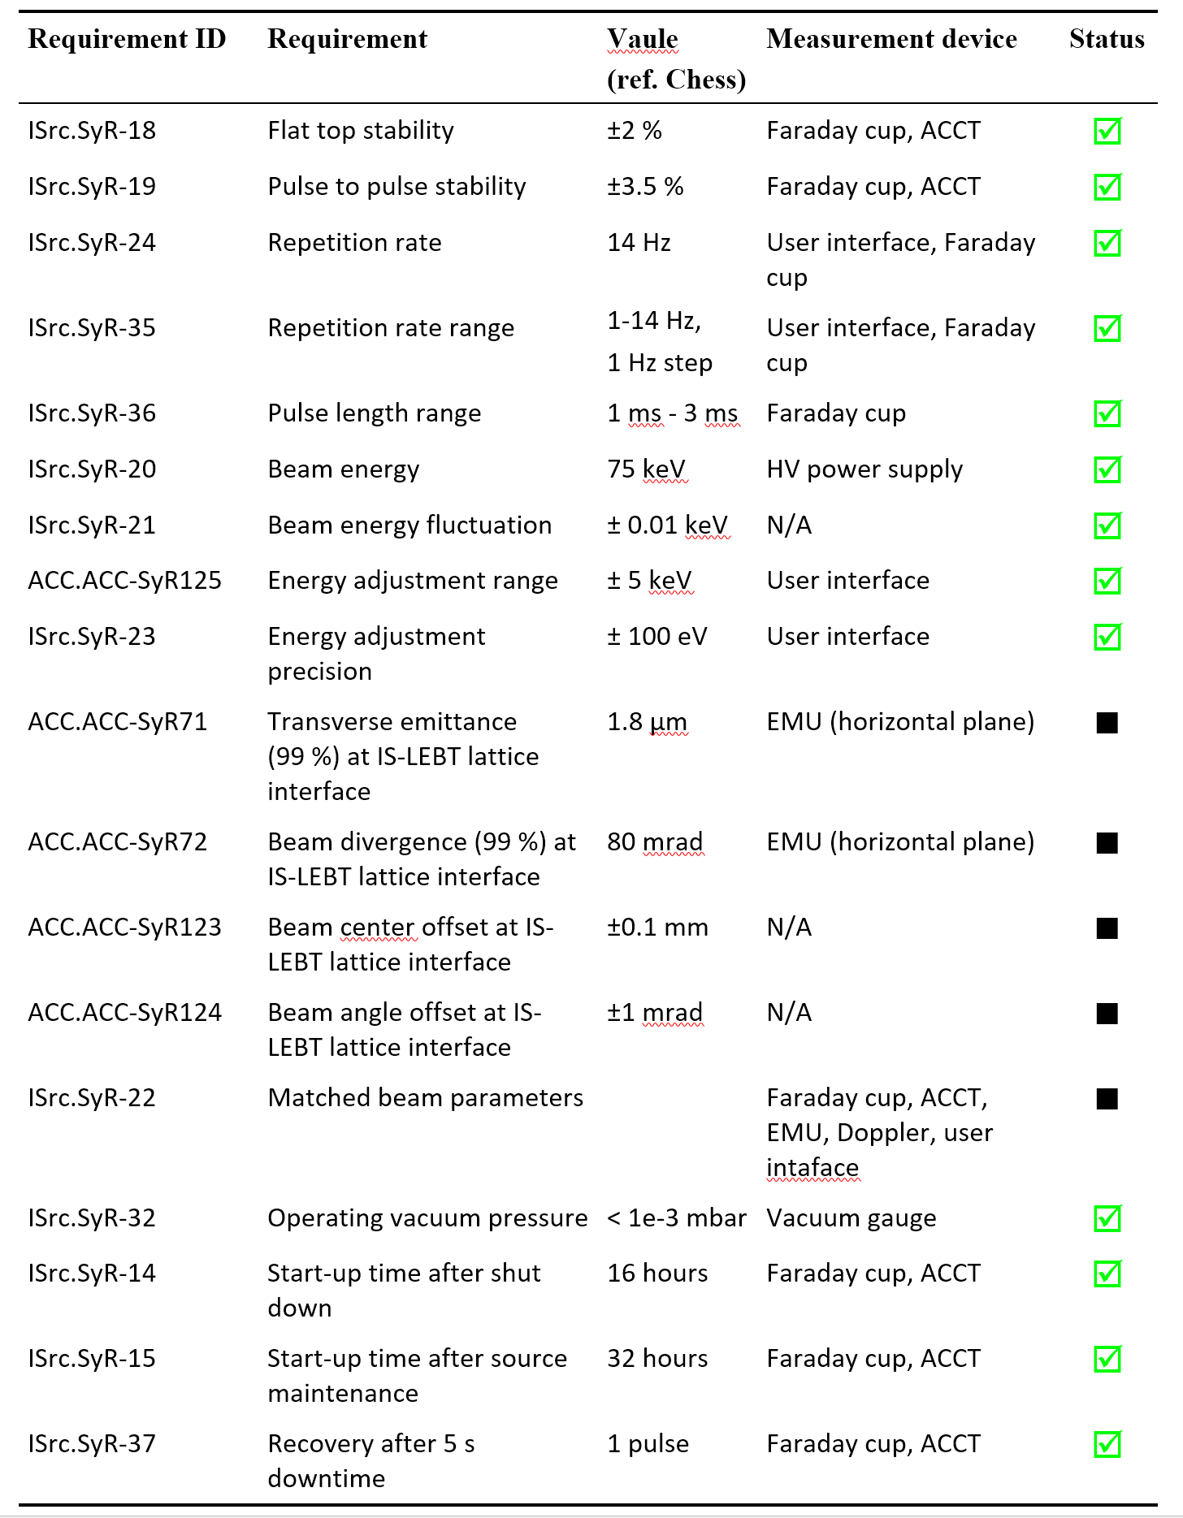
EMU (CEA) had long period of stop during phase 2
Commissioning tank (ESS) was not suitable for Phase 1 and 2

Slide 25
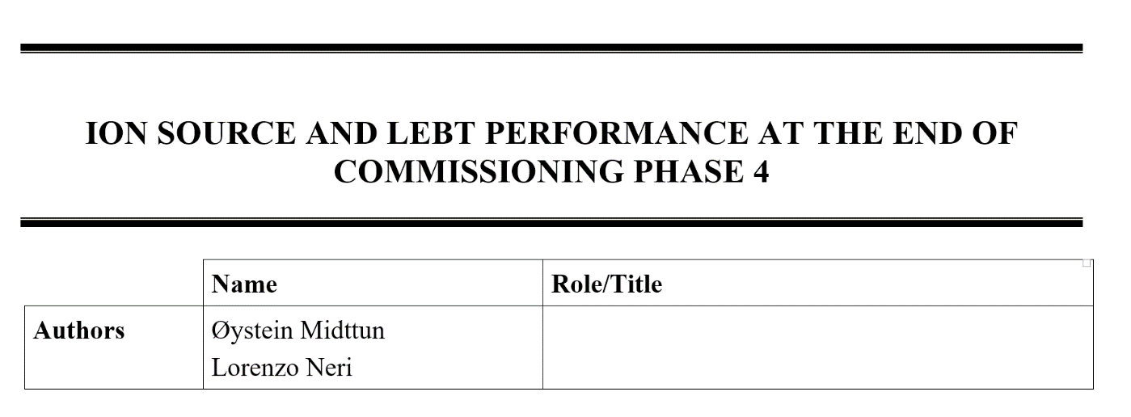
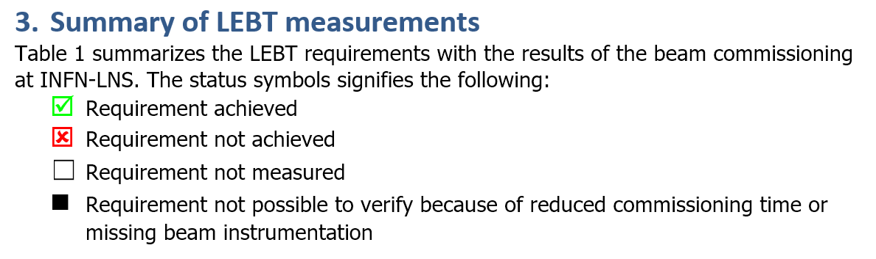
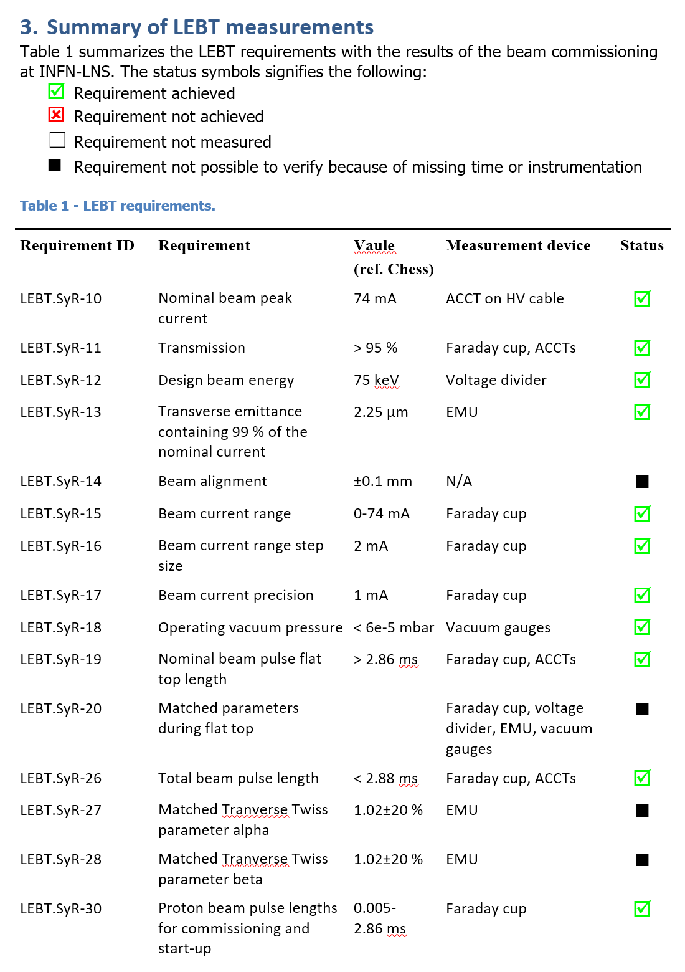
NPM (ESS) worked ones during preliminary test but never working after installation in the beam line

Slide 26
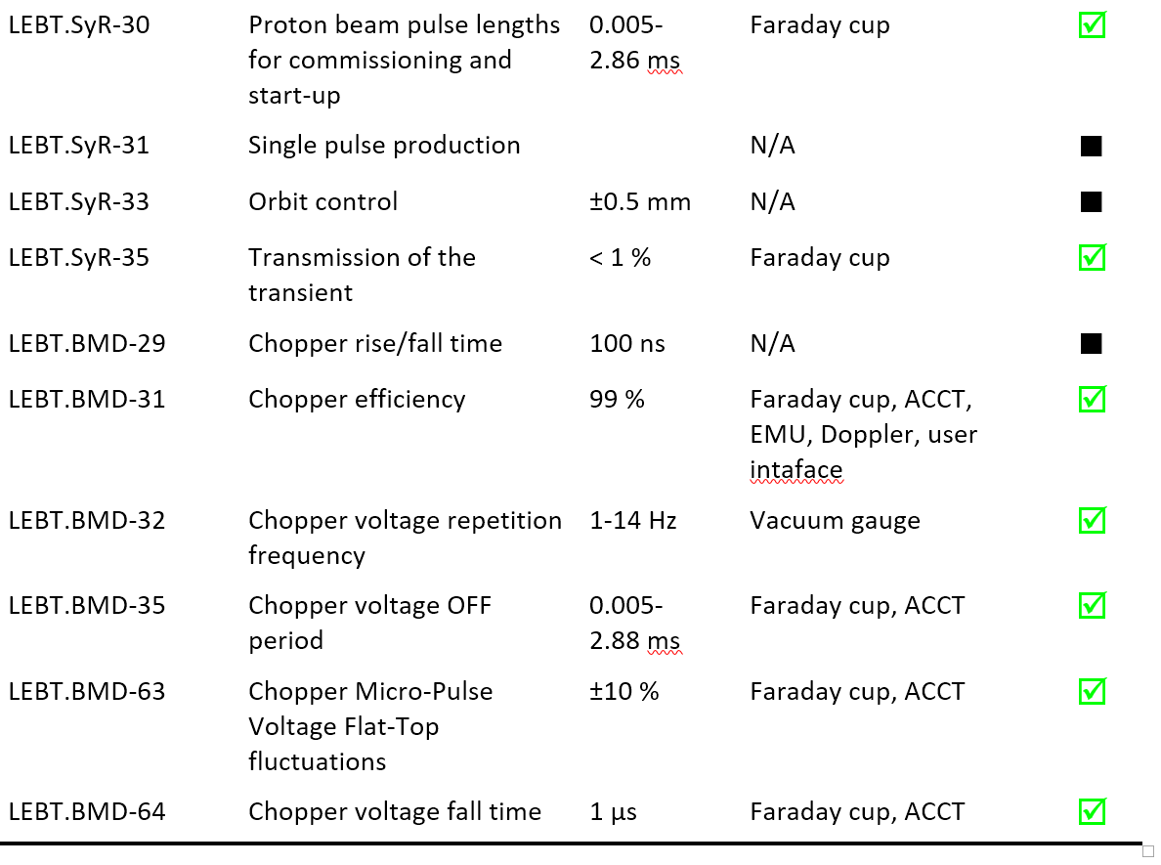
EMU (CEA) is not stable and was provided late to have enough time to allow a better match
NPM (ESS) worked ones during a test but never working after installation in the beam line
Chopper (INFN) electronics need to be calibrated for a faster transition
Chopper (INFN) non conformity didn’t affect beam performances

Slide 27
Conclusion
The flexibility inserted in the design enabled the satisfaction of ESS requirements
NO sparks relevant problems remain unsolved
No delay for the RFI date: Monday 18 September is planned to dismount the Source and LEBT

Slide 28
Thanks for your attention
Comments are welcome
Thanks to all INFN-LNS staff to valuable support provided during all the phases of the project.
The collaboration with ESS and CEA was intense, profitable, always solution oriented.

