Slide 1
ion source-lebt irr
  Electrical Infrastructure
  WP15
  Evangelia Vaena, with input from:
  Jörgen Jönsson, Frithiof Jensen, Eddie Carse, Pontus Jönsson, Carl-Johan Hårdh

Slide 2
overview
Scope definition- interfaces of electrical systems in the FEB
Power distribution description
Layouts- Single line diagrams
cable plant for Ion Source/ LEBT
grounding
status/ what will be installed in the weeks to come/ issues

Slide 3
scope definition-interfaces
WP15 (Electrical Support) provides:
1. Power (cable sizing and installation) to Ion Source equipment, Racks and water cooling skids- UPS power in the future
2. Supply and installation of Rack Cabinets
3. Cable Trays, definition cable routing and cable installation
4. Grounding of the equipment
WP15 interfaces:
1. Requirements defining the design parameters of the power distribution and cable trays (e.g. power consumption, rack space needed, cable definition)
2. power/ circuit breaker interface on CF switchgear side
3. cold water for rack cooling from WP16

Slide 4
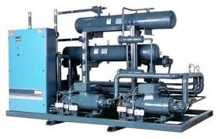

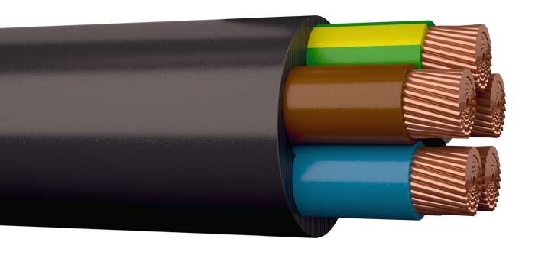
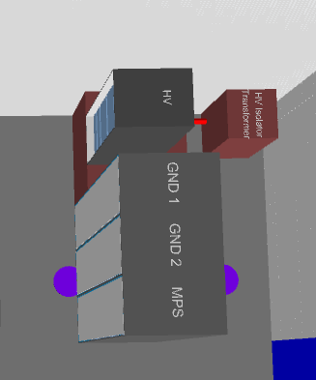
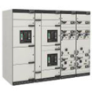

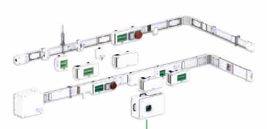
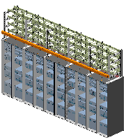


Power distribution scheme
Water Cooling Skids level 100
Power Distribution Panel level 100 FEB-N1U3:CNPW-U-001
CF 400V Switchgear
Stand Alone Racks
Power Distribution Panel level 090 FEB-N1U1:CNPW-U-001
Rack Rows

Slide 5
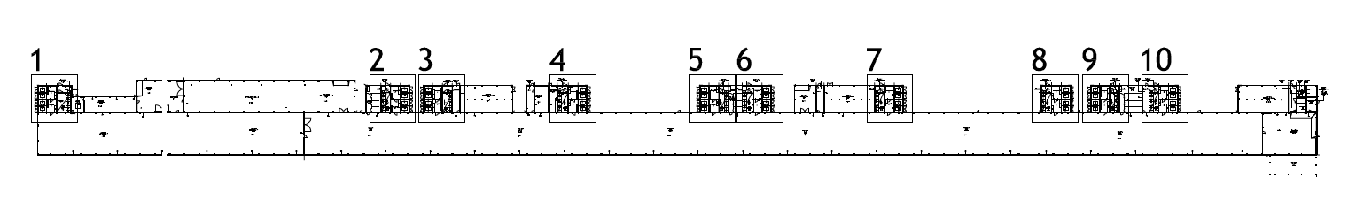
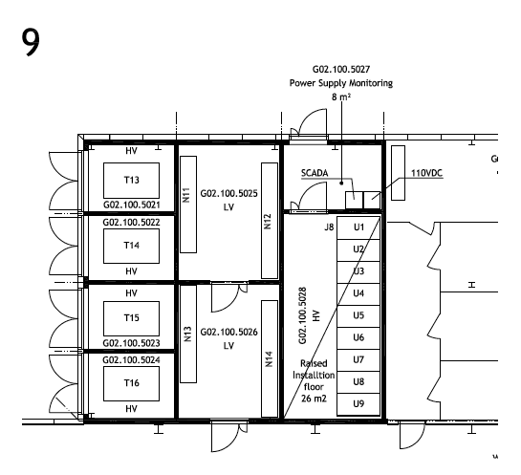
normal power distribution
From Conventional Facilities (CF) Substation to two power distribution panels:
From N13: 2 cables FXQJ 4x240/120 EMC going to 800A rated panel (FEB-N1U1:CNPW-U-001)- level 090
From N12: 2 cables FXQJ 4x150/70 EMC going to 400A rated panel (FEB-N1U3:CNPW-U-001)- level 100, for the water cooling skids

Slide 6
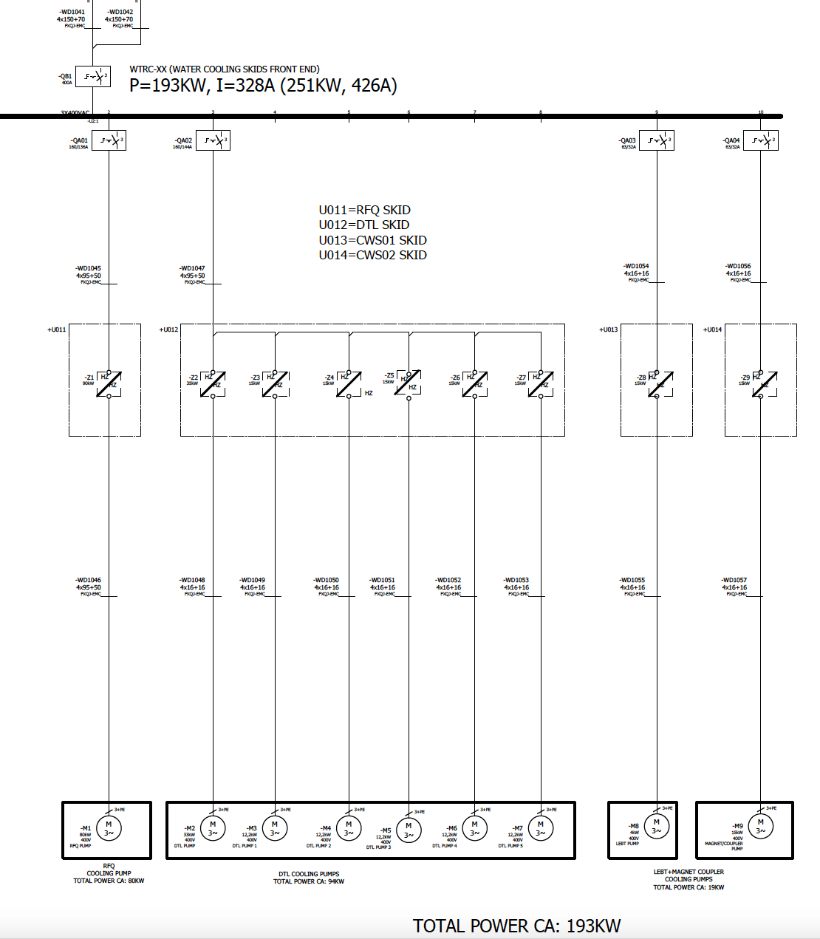
single line diagram for water cooling skids
ESS-0099571
FEB-N1U3:CNPW-U-001

Slide 7
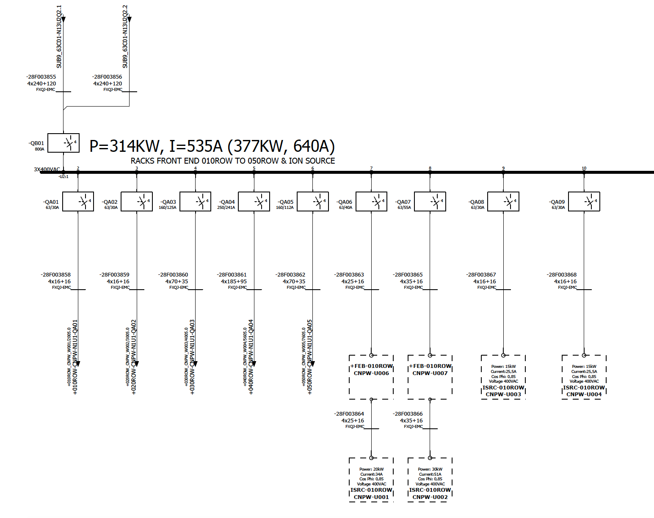
single line diagram for FEB 090 EQUIPMENT
Spec. Number:ESS-0099571
FEB-N1U1:CNPW-U-001

Slide 8
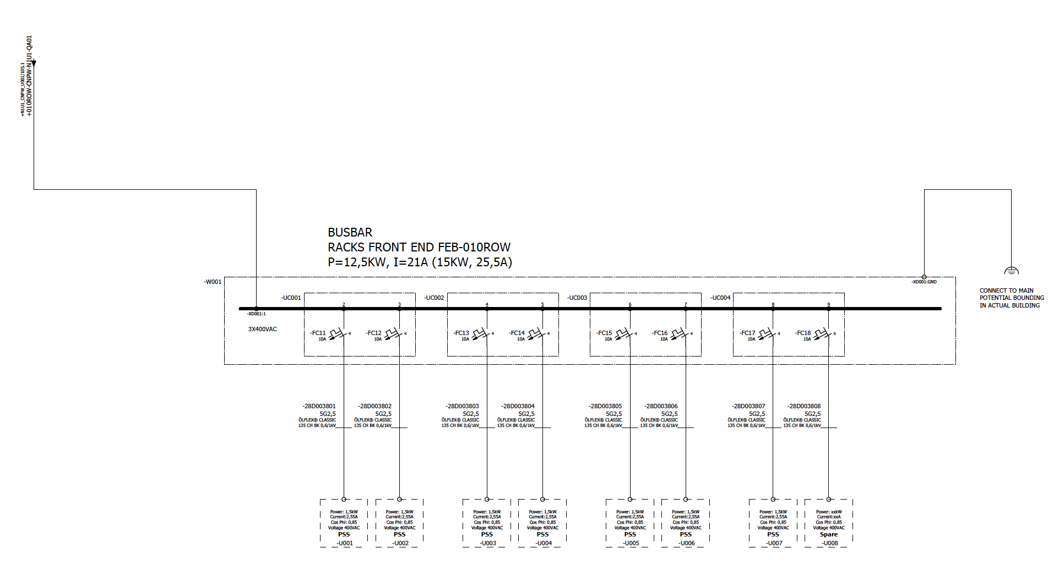
FEB-010ROW:CNPW-W-001

Slide 9
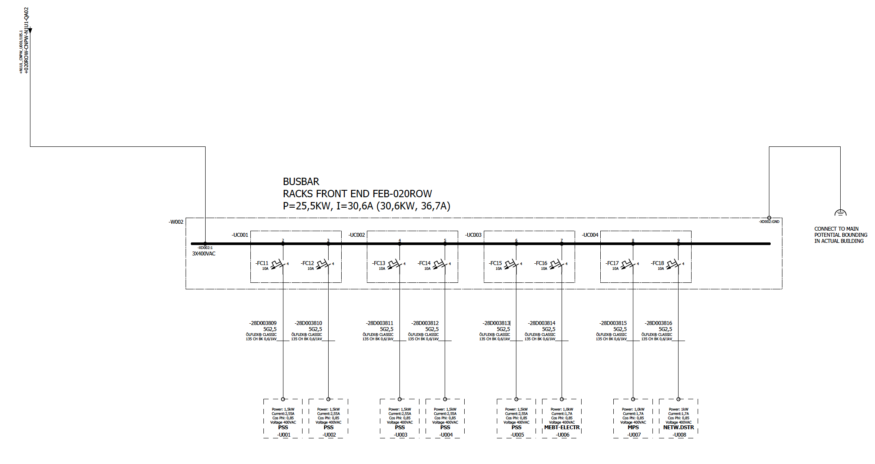
FEB-020ROW:CNPW-W-002

Slide 10
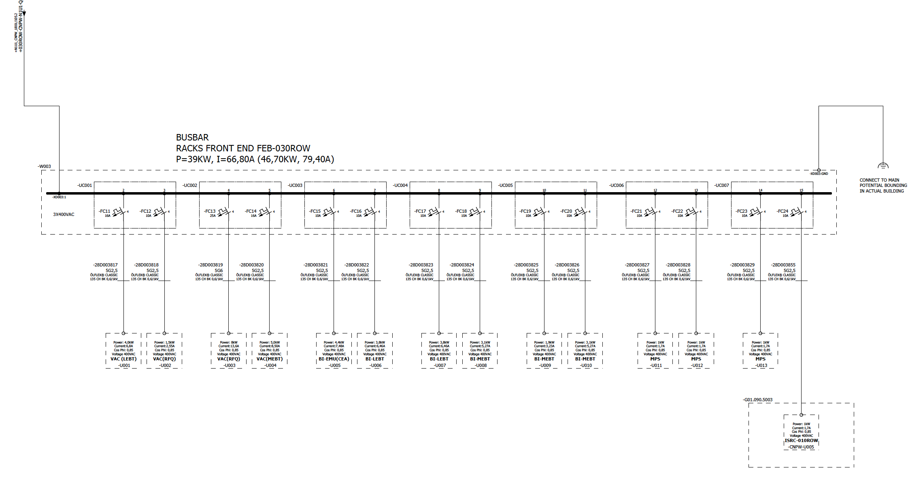
FEB-030ROW:CNPW-W-003

Slide 11
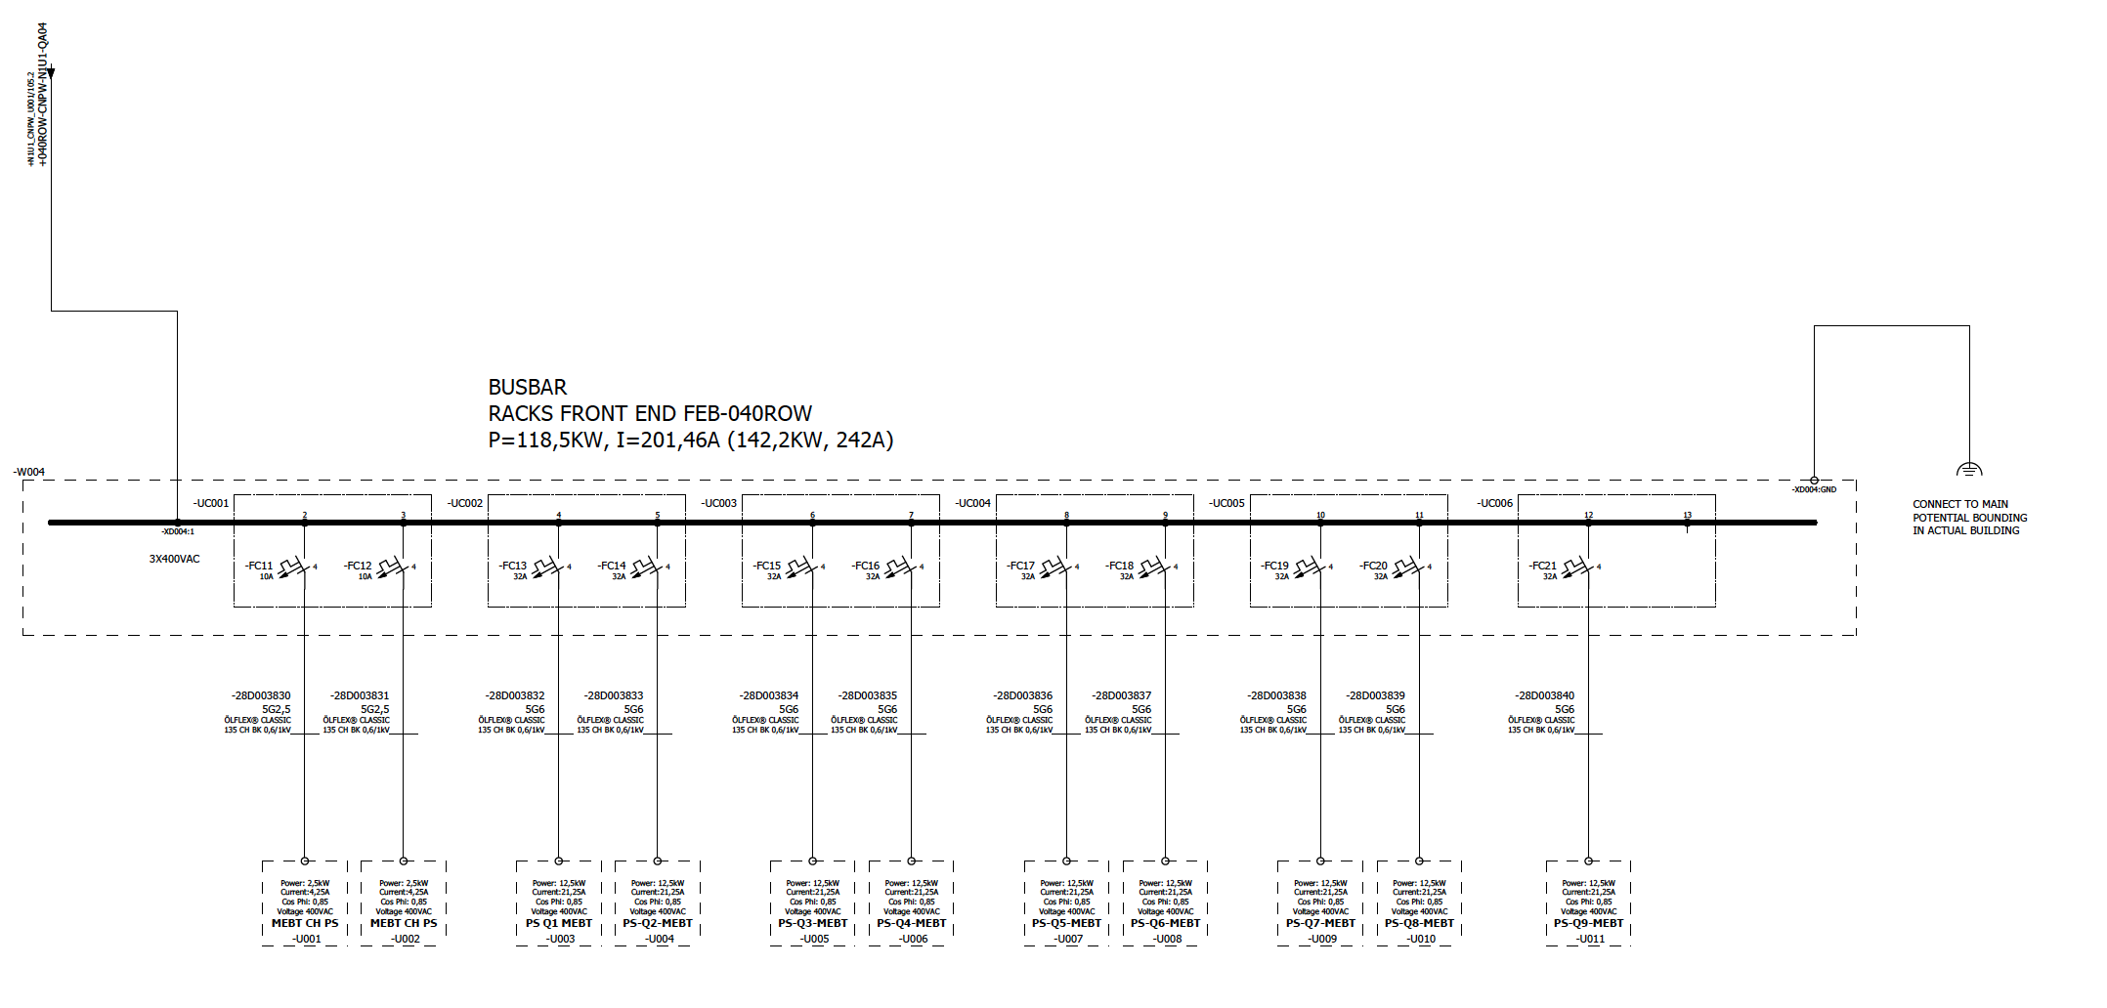
FEB-040ROW:CNPW-W-004

Slide 12
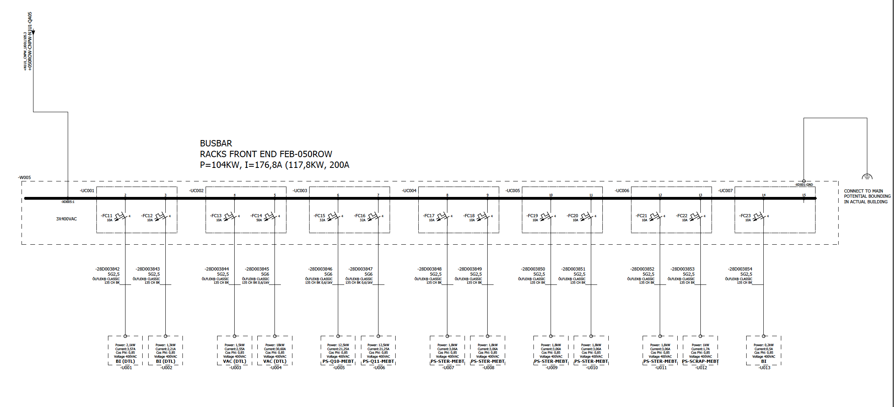
FEB-050ROW:CNPW-W-005

Slide 13
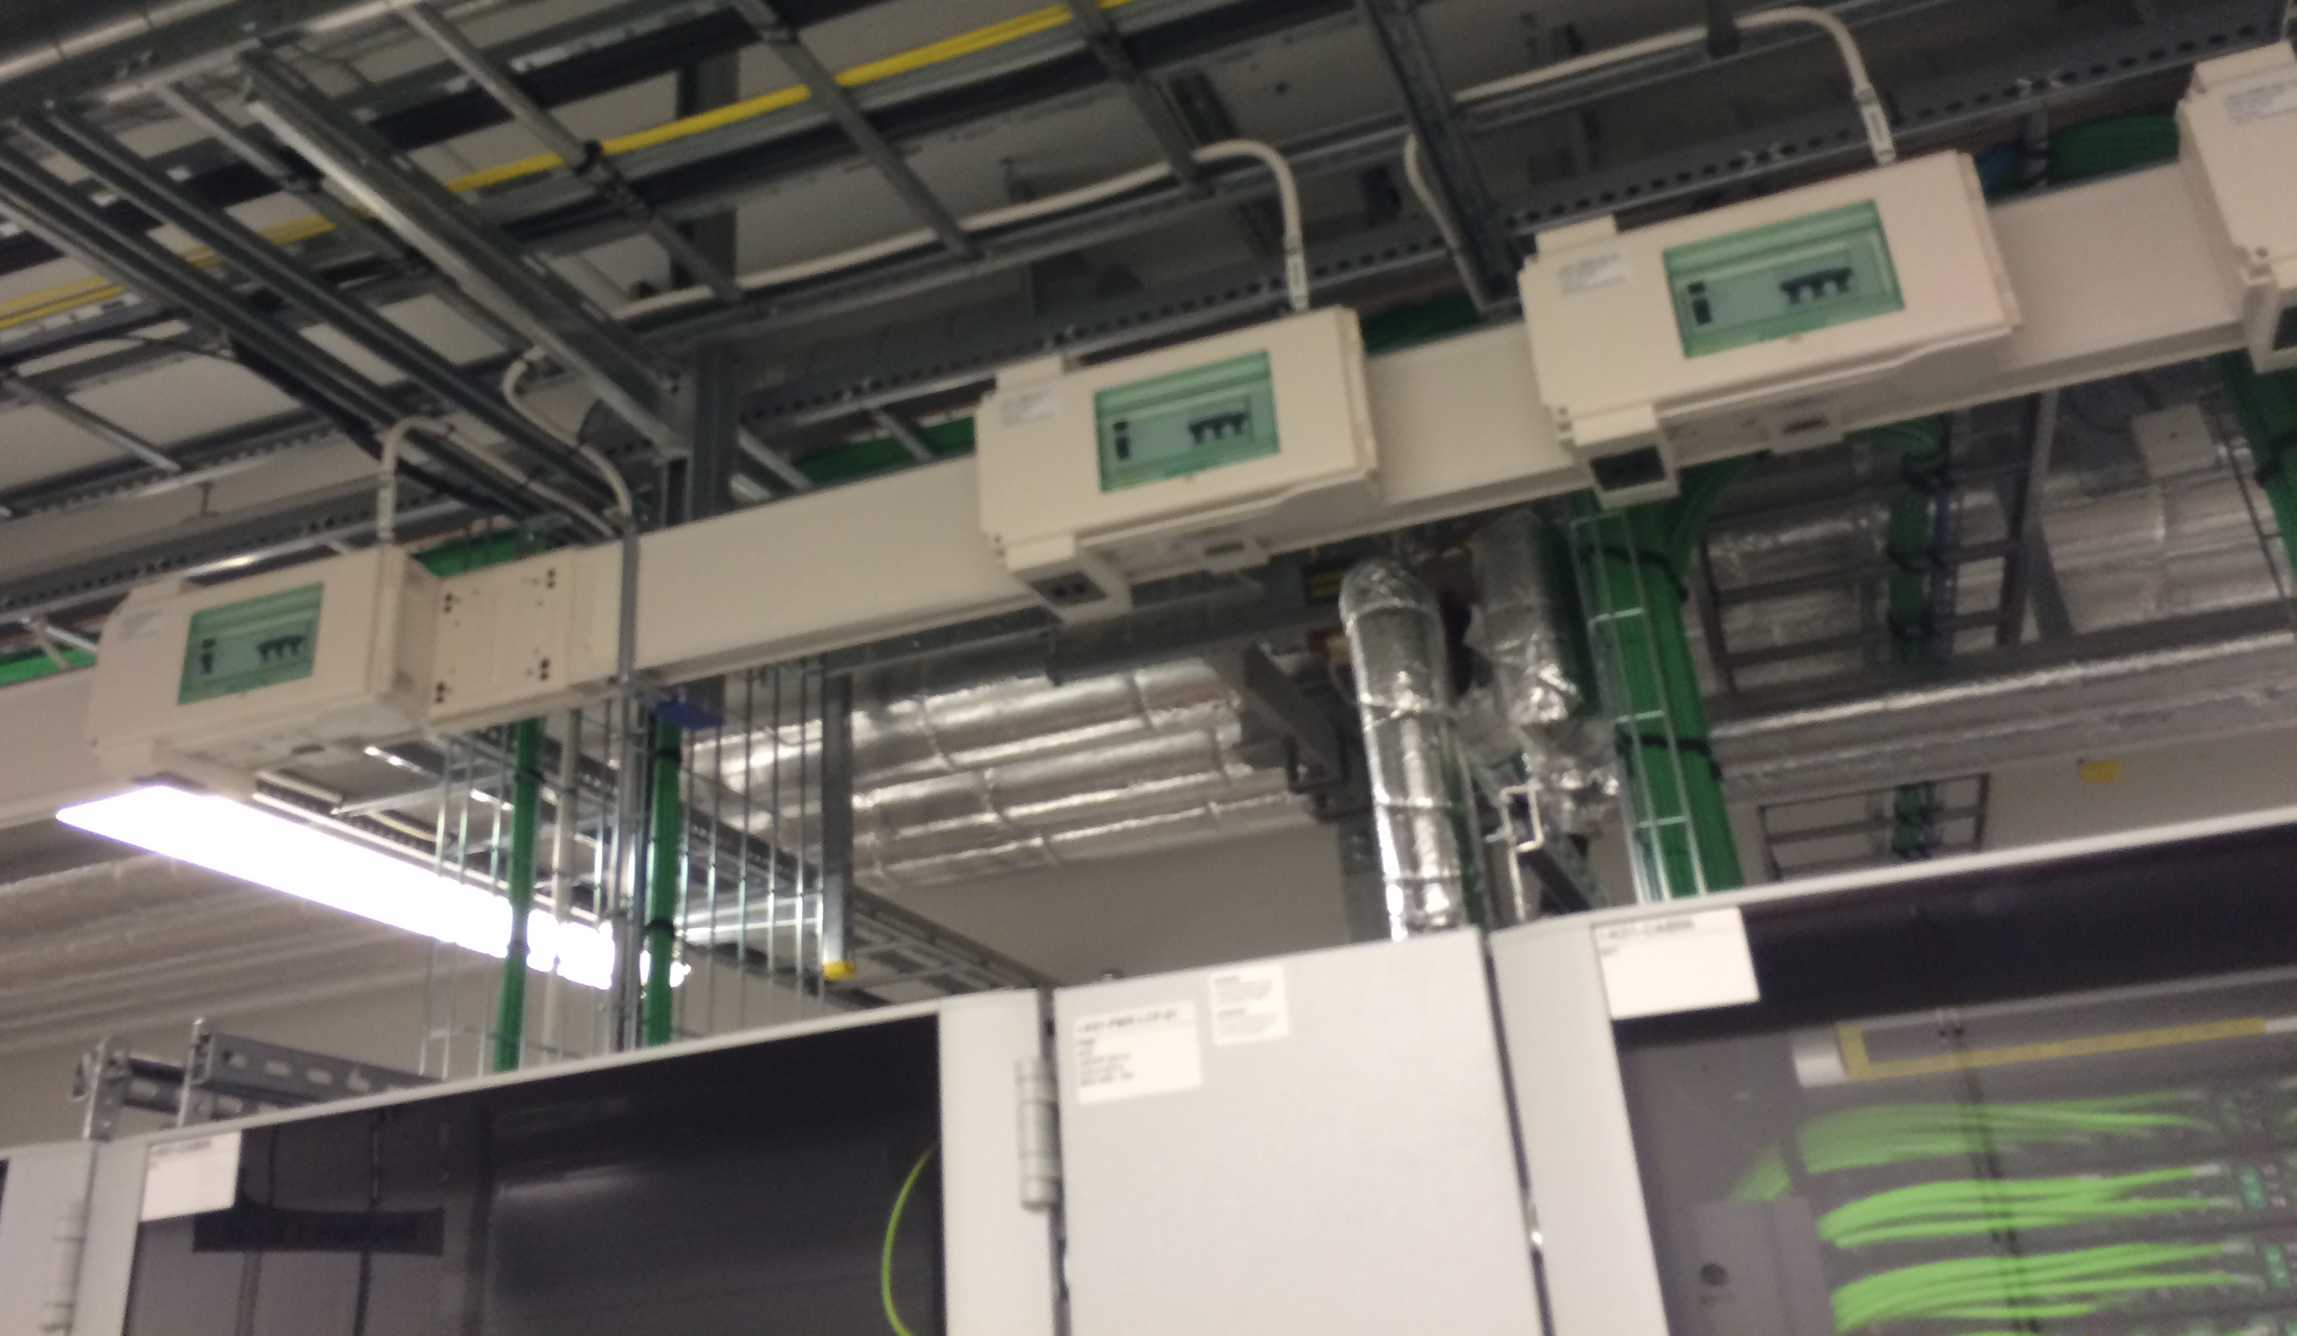
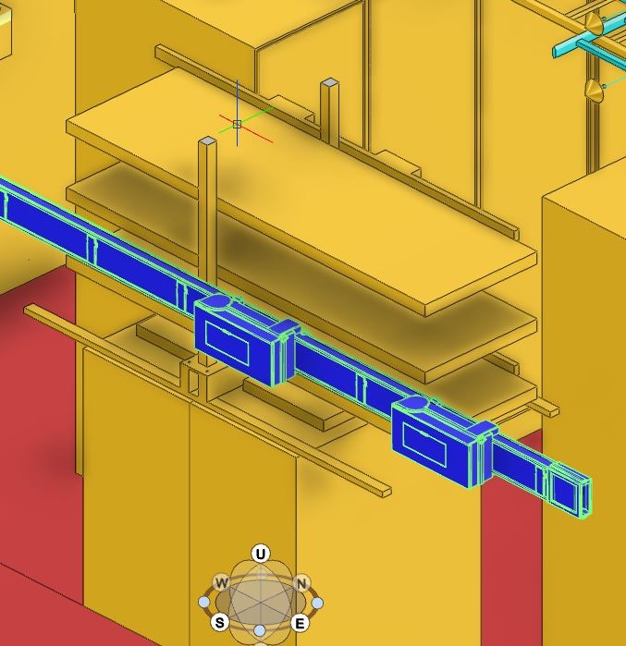

Slide 14
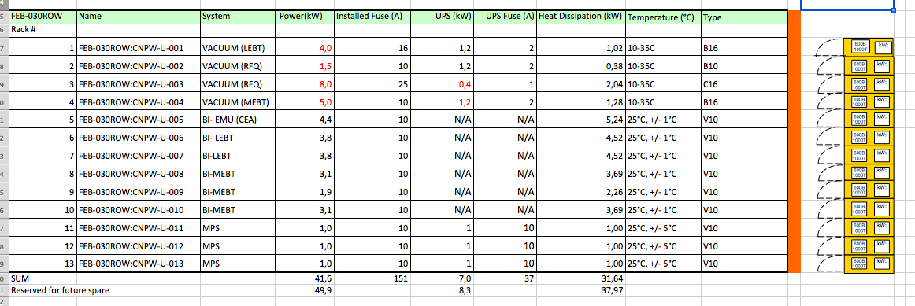
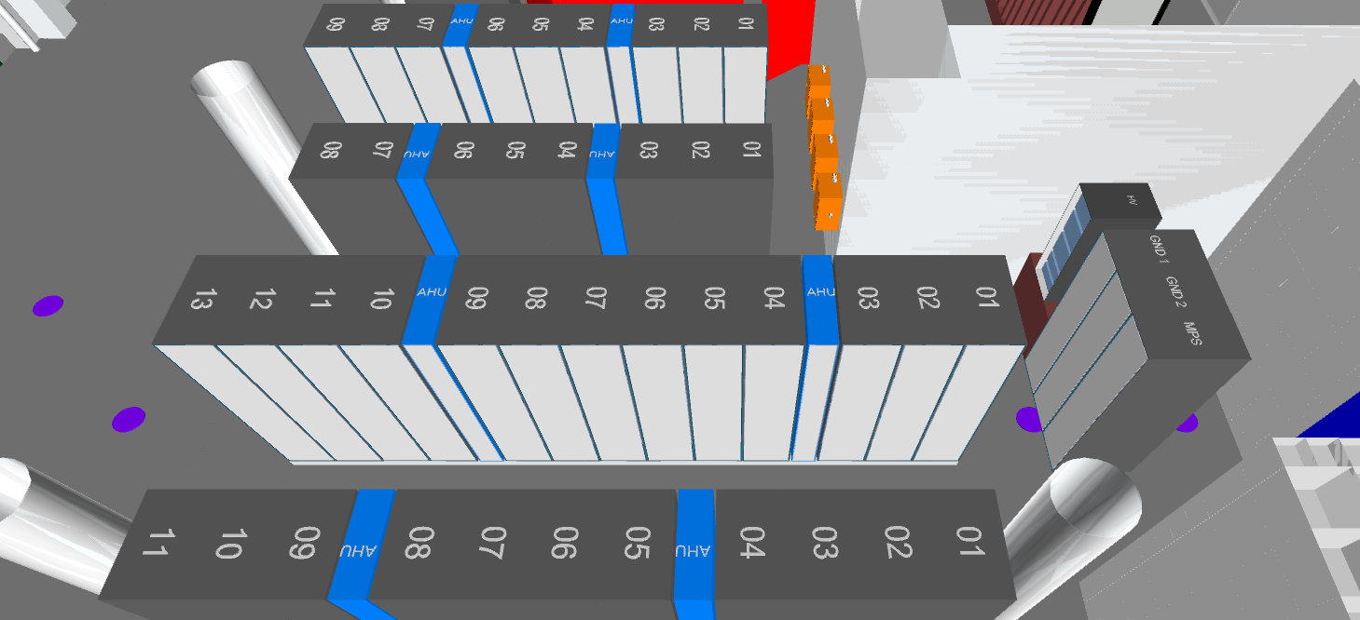
racks
7
6
5
1

Slide 15
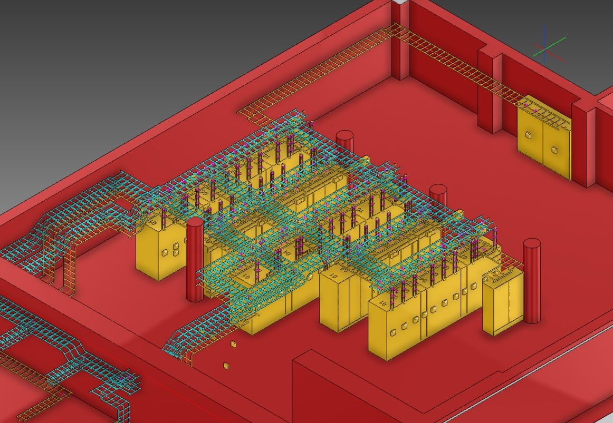
layout-Cable trays

Slide 16
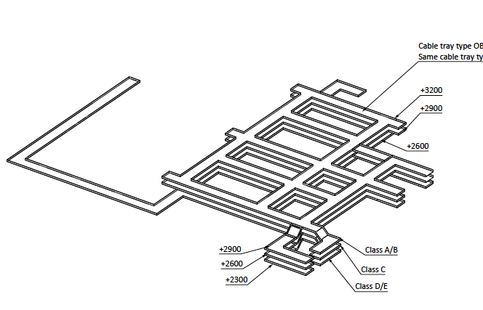
cable trays-rack area
3 layers of 600mm cable ladders
Fixed from the roof every 1,5m
Dwg No. ESS-0093481
Installation of the PSS trunking system also included

Slide 17
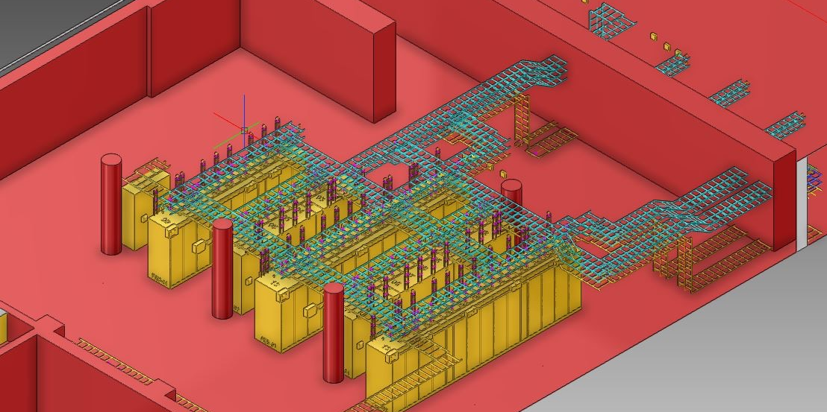
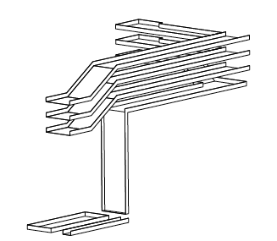
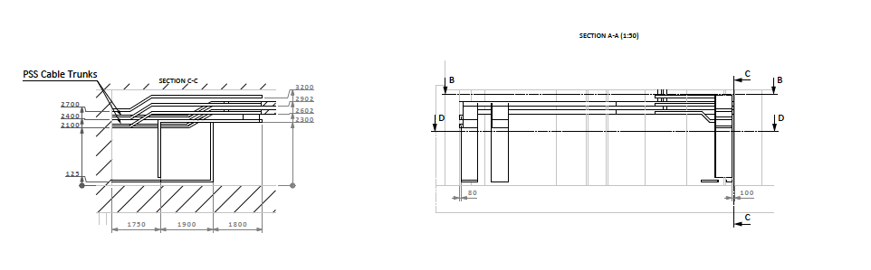
cable trays- green wall area and tunnel

Slide 18
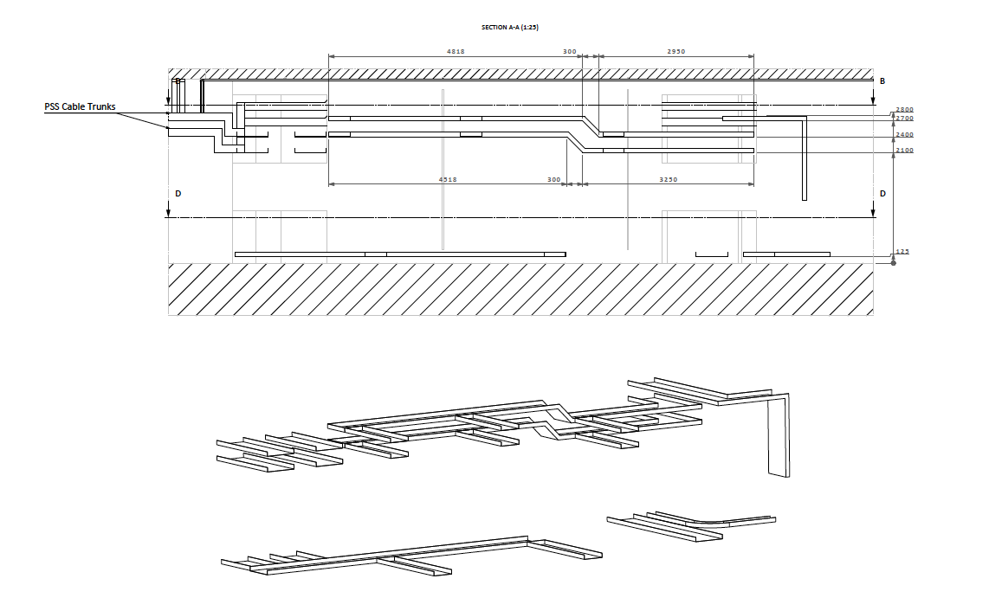
cable trays- green wall area and tunnel

Slide 19
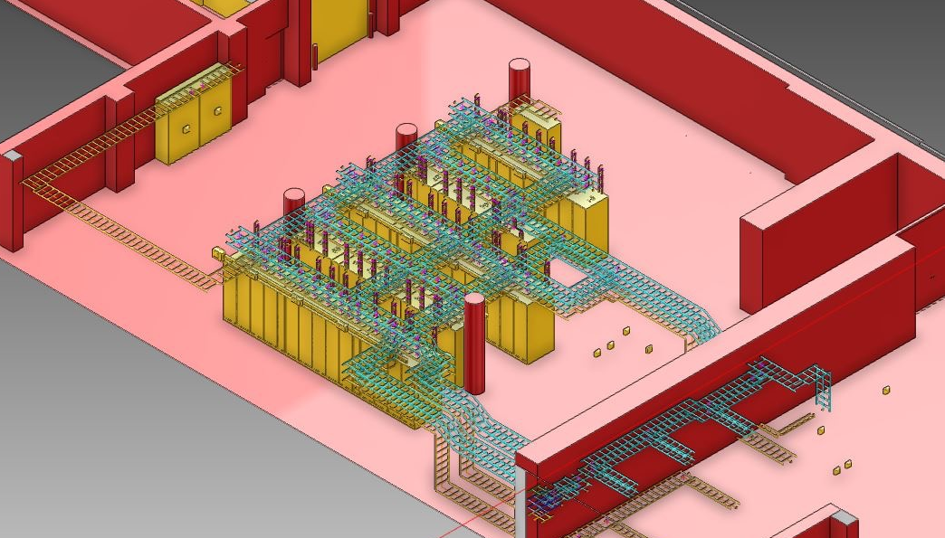
Cable tray Layout

Slide 20
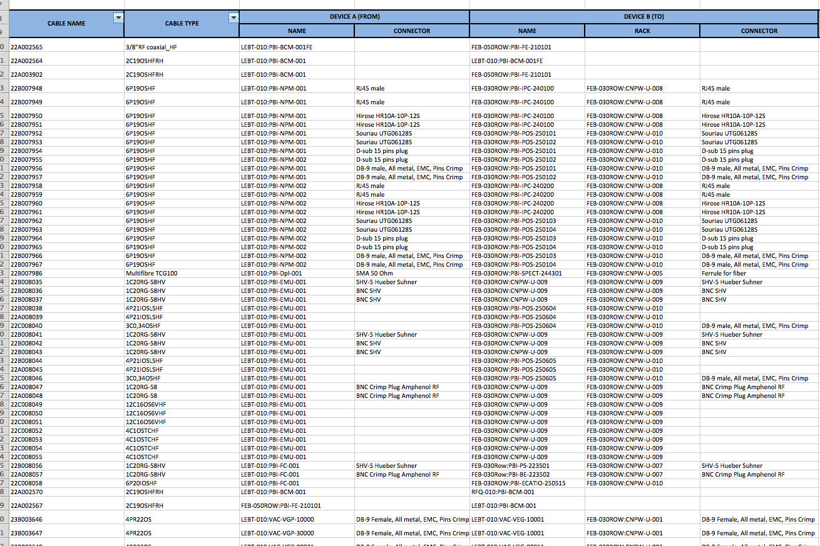
Cable List
ALL cables (Power and signal) for Ion Source and LEBT have been registered in the cable database. Systems: electrical support, Vacuum, Beam Instrumentation, INFN (203 cables). Exception: MPS cables- they will be gradually installed during the testing of the source
2 cables (HV power supply and Doppler Spectrometer) are provided by the WPs, all the rest from the contractor
Connectors identified
MPS cables will be installed
Final cable routing (with E3D) ongoing.

Slide 21
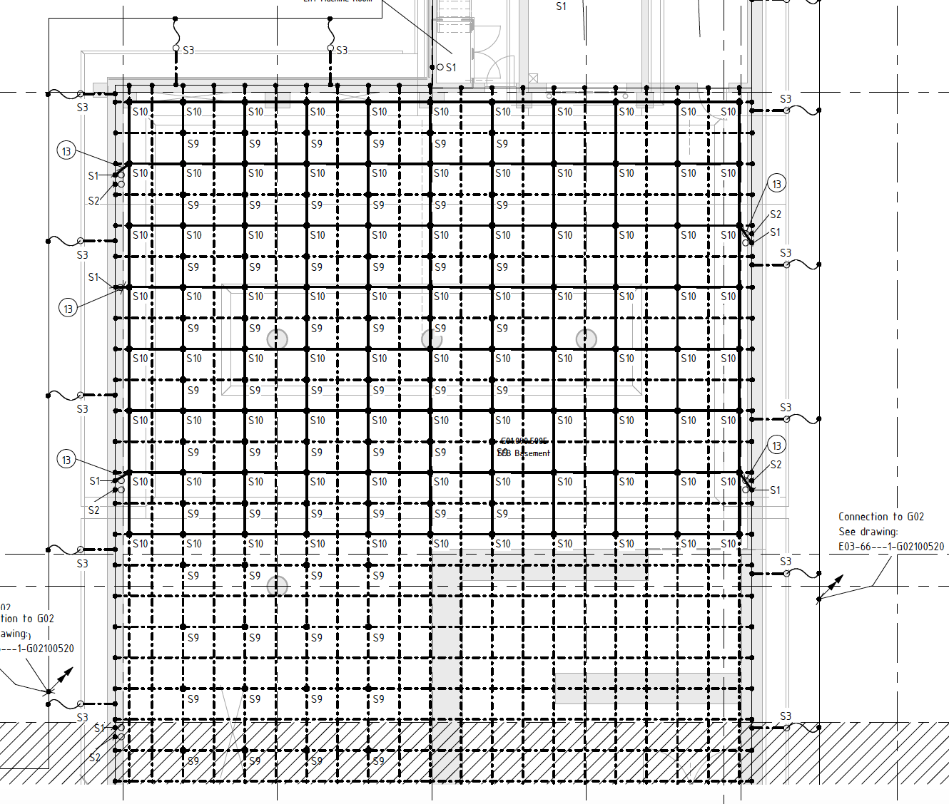
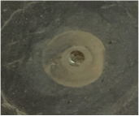
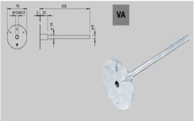
Grounding -rack area

Slide 22
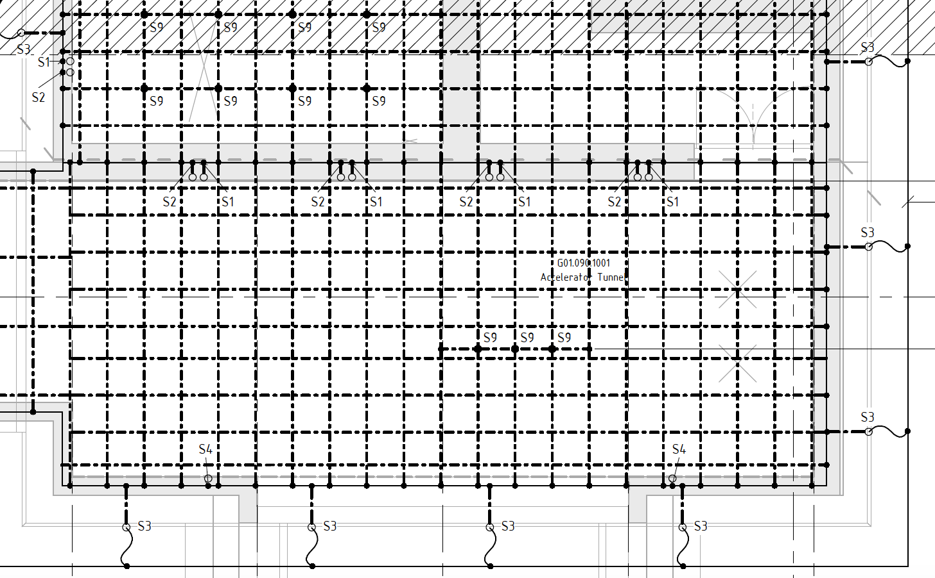
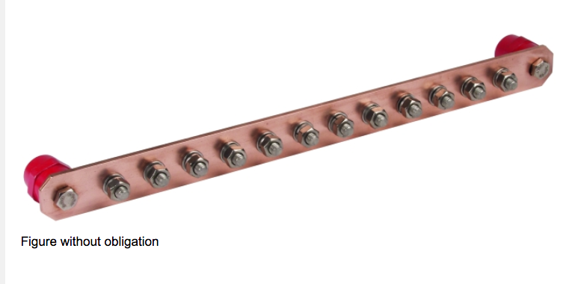
Grounding - tunnel

Slide 23
status of electrical installations
ALL the Racks for the FEB will be delivered beginning of November, installation of 5 rows takes 7 days (cooling units commissioning included);
The 2 Power Distribution panels delivered by end of October;
Cable trays- Cables- Grounding -Bus Bars for Racks: Supplied and installed by Skanska : Design complete, documentation package available, including cable list, panel and termination diagrams, job description, installation drawings and inspection test plan ready;
Cable tray supports are missing in the model in some areas- clashes with other installations should be checked;
Possible delays with permanent power provision by CF -we need to smoothen the issues with work permits inside switchgear rooms.

Slide 24


status
 | Design | Procurement | Installation
Power Distribution Panels
Racks
Cable Trays, Cables, Bus Bars, Grounding

