Slide 1

Review of Non-Conformities
Luigi Celona
Istituto Nazionale di Fisica Nucleare
Laboratori Nazionali del Sud
IRR Meeting, Lund, 15 September 2017

Slide 2
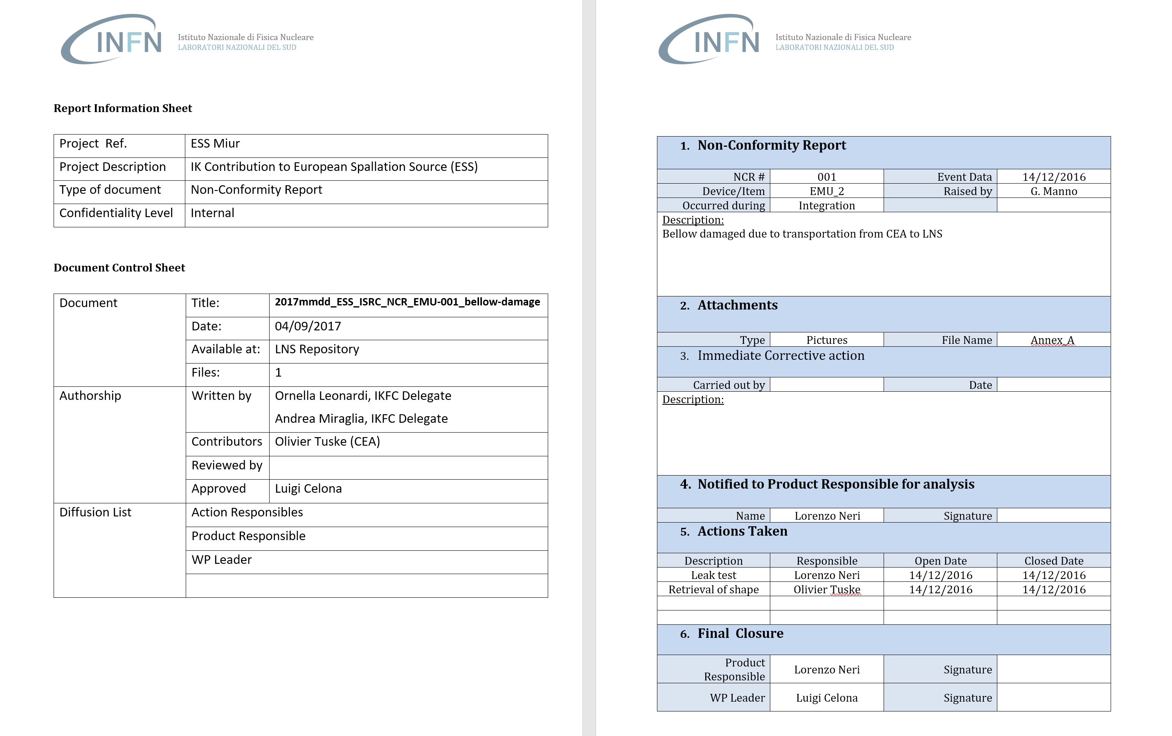
Template for non conformities

Slide 3
List of non conformities
ESS_ISRC_NCR_EMU-001_bellow-damage
ESS_ISRC_NCR_Chopper_Electrode_damage
ESS_ISRC_NCR_Collimator_braze
ESS_ISRC_NCR_IRIS_aperture-Slit
ESS_ISRC_NCR_NPM
ESS_ISRC_NCR_EMU_Software
ESS_ISRC_NCR_Doppler_SNratio
ESS_ISRC_NCR_HV_power_cut
ESS_ISRC_NCR_HV_injection_gas
ESS_ISRC_NCR_HV_collimator_noNPM
https://owncloud.lns.infn.it/index.php/s/QAO6mQJXS7qB2hK

