Slide 1
ISrc & LEBT – ICS
Installation Readiness Review
William Ledda, Control System Integrator
Nour Akel, Installation Coordinator
Integrated Control System Division
www.europeanspallationsource.se
15 September, 2017

Slide 2
Part 1 – ISrc & LEBT Controls
William Ledda

Slide 3
Outline
Introduction
ISrc & LEBT Control System Review
Summary

Slide 4
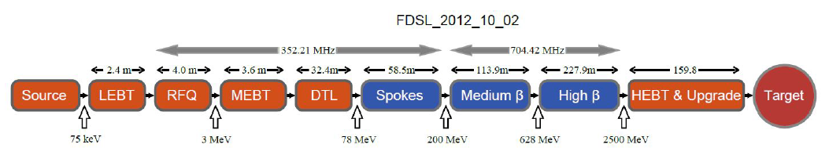
Introduction
The ISrc & LEBT are the first two elements of the ESS linear accelerator (Linac).
The ISrc produces the beam, the LEBT (solenoids, steerers, chopper) transports the beam till the RFQ.
Since there’s no acceleration at this stage we can refer to the ISrc & LEBT together as “injection” system
Injection system

Slide 5
Introduction
The ISrc & LEBT is the result of the collaboration of ESS with two In-Kind partners:
  INFN-LNS (“Istituto Nazionale di Fisica Nucleare – Laboratorio Nazionale del Sud) at Catania (Italy) for the injection system
  CEA (“Commissariat à l'énergie atomique et aux énergies alternatives”) at Saclay (France) for the Control System
This presentation is focused on the readiness of the Integrated Control System for the installation in Lund.

Slide 6
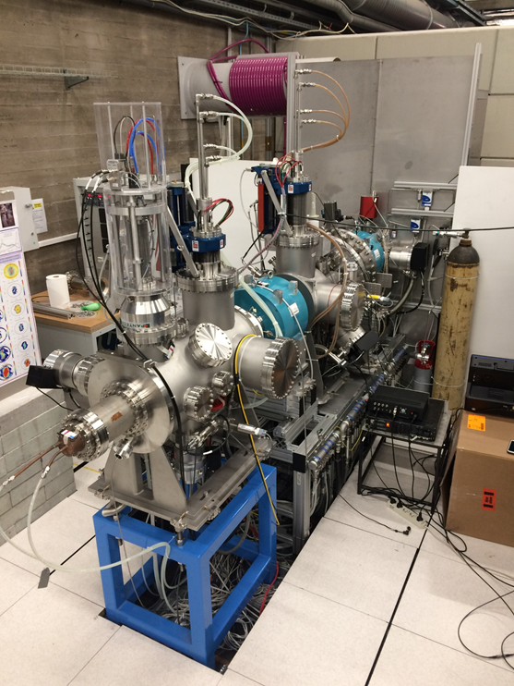
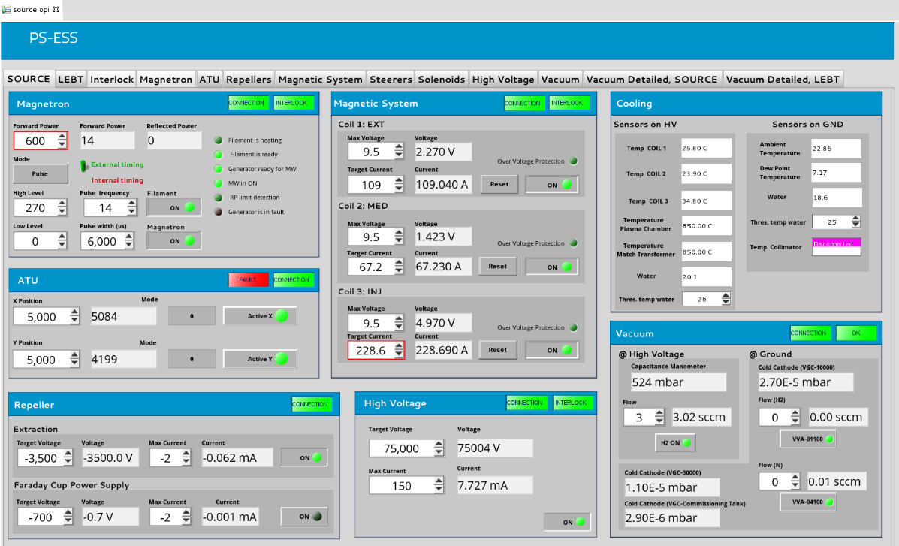
In-kind collaboration
Introduction
INFN-LNS, Catania (Italy)
The injection system
CEA, Saclay (France)
The control system

Slide 7
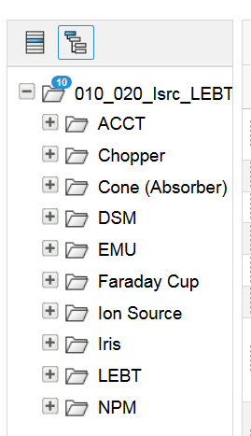
ICS technical documentation
Introduction
All documentation (datasheets, user manuals, V&V Report, technical drawing etc…) related to the Control System are available CHESS at https://chess.esss.lu.se/enovia/link/21308.51166.13056.55029
Notes:
Update the figure.

Slide 8

Ion Source Controls Architecture
CAT5 Ethernet (10.10.0.xxx,
Channel Acces, boot, nfs,…)
Archiving PC
Server
Serial, etc.
Source IPC
CAT5 Ethernet (10.10.1.xxx)
Vacuum System
Scalance
X204-2 (0)
Fibre
11
Electrical, etc.
(physical I/O, power, etc.)
Source
PLC
Scalance X204-2 (2)
Scalance X212-2 (1)
4
Source EtherCAT I/O
CU1561
5
8
3
1
HV Platform
Source EtherCAT I/O
CU1561
Source I/O
Controller
ACQ
9
Scalance X212-2 (6)
Modbus TCP
Magnetron
Scalance X204-2 (3)
SCPI
Repeller Electrodes PS (x2)
Modbus TCP
ATU
Serial Server
ASCII
Mass Flow & Gauge Controller
Scalance X212-2 (4)
2
SCPI
Source Coils PS (x3)
10
Scalance X204-2 (5)
Profinet
Source PLC
Remote I/O
SCPI
HV PS
Controls Equipment (PLC, IPC, I/O, etc.)
LINAC Equipment (PS, etc.)
Notes:
Without to go in details on it, we can just say that there are control equipment in the HV platform that are connected to the equipment on GND through FO.
There are then some equpement on GND (HV PV and repeller electrods)

Slide 9
Ion Source Controls
Ion Source and LEBT control system status
Status
  Relevant documentation available (wiring list, I/O Signal, datasheets, user manuals, etc.).
  All equipment are fully integrated in the control system.
  All EPICS modules are available, tested and documented.
  Ion source control system was accepted on July 2017.
Non-conformities / Known issues
  [non-blocking] Naming service and CCDB need to be updated for the commissioning in Lund.
  [non-blocking] The EPICS modules should be integrated in IOC Factory. Will be solved later in Lund.
  [non-blocking] The Archiving System needs to be properly configured for the commissioning in Lund.

Slide 10
LEBT Controls Architecture
Serial, etc.
CAT5 Ethernet
Fibre
NPM
IPC
ASCII
Electrical, etc.
(physical I/O, power, etc.)
1
5
NPM MC
9
8
To Source
PLC
FC Bias PS
DSM
IPC
To Source
PLC
To Source
CB EVR
DSM Spectrometer
Camera
FC
NPM
IRIS
Chopper
DSM
BCM
EMU
BCT RTM Interface Unit
IRIS MC
ASCII
EMU MC
To Isrc
VME
Control Box
4
EMU Plate PS (x2)
ASCII
EMU
EtherCAT I/O
ACQ
BCM I/O
Controller
SCPI
EMU Bias PS
To Isrc
VME
Control Box
Solenoid PS (x2)
3
2
EMU I/O
Controller
SCPI
ACQ
EMU
IPC
10
Steerer PS (x4)
Future
EMU
PLC
s7plc
Controls Equipment (PLC, IPC, I/O, etc.)
LINAC Equipment (PS, etc.)
Notes:
As for the ISrc, just a brief introduction.

Slide 11
LEBT
Ion Source and LEBT control system status
Status
  Relevant documentation available (wiring list, I/O Signal, datasheets, user manuals, etc.)
  The elements of the LEBT (Solenoids, Steerers, Chopper) are fully integrated.
  Auxiliary (diagnostic) systems (i.e. Iris, Faraday Cup, EMUs) are fully integrated.
  LEBT control system was accepted in September 2017.
Non-conformities/Known Issues
  [non-blocking] Naming service and CCDB need to be updated for the commissioning in Lund.
  [non-blocking] The EPICS modules should be integrated in IOC Factory. Will be solved later in Lund.
  [non-blocking] The Archiving System needs to be properly configured for the commissioning in Lund.
  [non-blocking] DSM and NPM diagnostic systems are integrated but not fully tested in operational conditions. They will have to be validated in Lund.
  [non-blocking] The software for the EMU is not fully stable yet, not allowing to complete the measurements sometimes. Possible error identified. It will require investigation before the commissioning phase.

Slide 12
Summary
Control System of the Injection system is tested and accepted.
Relevant documentation is available in CHESS for all equipment (datasheets, user manual, I/O signals …).
EPICS modules are available, documented and under configuration management.
Vacuum controls to be validated in Lund.
Non-conformities or known issues have been identified and registered. All can be considered non-blocking for the installation.
Beam and machine modes not implemented yet.

Slide 13
Part 2 – Isrc & LEBT support systems
Nour Akel

Slide 14
Outline
Control System Infrastructure
  Technical network
  Data centre
  Control room
Timing system
Software
  Core applications
  Beam physics applications
Personnel Safety System
  HV fenced area and platform
  Control Racks and cable support system

Slide 15
Technical Network
Control System Infrastructure
Scope relevant to this IRR
  Network connectivity from the racks in FEB L090 to G02 main communications room.
  Network connectivity from G02 communications room to G02 Local Control Room.
Activities
  [done] Data and communications cables framework contract signed.
  [ongoing] Requisition for FEB connection signing (due 2017-10-15).
  [planned] complete installation and tests (due 2017-11-24).
Risks
  Communications racks not available in time.
  Communications pipes not fit for purpose (dirty/muddy): SEC to clean them.
Overall status
  Installation feasible on the proposed dates.

Slide 16
Data centre
Control System Infrastructure
Scope relevant to this IRR
  Data centre for ICS software systems.
Activities
  [done] Data centre is already available in a temporary location until H01 Central Utility Building is completed.
Risks
  N/A.
Overall status
  Installation feasible on the proposed dates.

Slide 17
Control room
Control System Infrastructure
Scope relevant to this IRR
  Local control room to do system testing and commissioning tasks.
Activities
  [done] Main equipment installed according to plan (2017-05-31).
  [planned] Complete ICS tests when LCR is made available from CF (due 2017-10-15).
Risks
  SEC failing to deliver in time: Use the site offices.
Overall status
  Installation feasible on the proposed dates.

Slide 18
Timing system
Scope relevant to this IRR
  Timing system available (event generator, receivers).
  Operation modes feasible.
Activities
  [done] Timing system embedded in the ISrc & LEBT, enabling beam pulse (2017-07-05).
Risks
  N/A.
Overall status
  Installation feasible on the proposed dates.

Slide 19
Core applications
Control System Software
Scope relevant to this IRR
  Controls ConfigurationDB; SCORE/MASAR; CableDB; Naming Service; IOC Factory.
  Archiving Service.
  eLogbook.
Activities
  [done] CCDB, CableDB, Naming, IOC Factory.
  [planned] (new) ESS logbook to be rolled out (due 2017-10-31).
  [planned] Archiving service, and SCORE configured and validated for ISrc & LEBT (due 2017-12-15).
Risks
  Users not able to adopt ICS’ software tools: Plan for end-user trainings.
Overall status
  Installation feasible on the proposed dates.

Slide 20
Beam physics applications
Control System Software
Scope relevant to this IRR
  iPython available to Beam Physics and Beam Instrumentation group.
Activities
  [done] iPython available.
Risks
  Users not able to adopt ICS’ software tools: Plan for more end-user trainings.
Overall status
  Installation feasible on the proposed dates.

Slide 21
Personnel Safety System
PSS0 Scope:
  Personnel Safety System 0 shall mitigate against the electrical hazards arising from operation of the ISrc & LEBT test stand.
  The Ion Source will be fenced off. Access to the area inside the HV fenced area is controlled by PSS0 and ISrc HV power supply will be turned off and it’s output will be properly grounded, whilst access to the HV fenced area is permitted.
PSS0 Equipment & Infrastructure Installation Plan:
PSS0 Commissioning:
  Two weeks (weeks 1804 and 1805)
  ICS/PSS will need to have one week of dedicated access to ISrc HV fenced area for final PSS0 validation.
Note:
  The potential modification of the HV PS (i.e. separation of the mains input for power and control of the HV PS) must be planned during the Isrc & LEBT installation.
Equipment | Location | Planned Date for Installation
Field devices: HV grounding relay, grounding rod, safety switches and lock for the fence door, search buttons, key exchange, etc. | G01 - ISrc HV fenced area | Dec. 2017
6U enclosure: for PSS0 remote I/Os | G01 - ISrc HV platform | Dec. 2017
5 racks: for PLC modules and HV Power supply interface contactors | G01 - FEB | Racks delivery date by Pentair; week 1744 Afterwards, it takes 4 weeks for ICS/PSS to have the racks populated by offsite contractor and ready for installation .
Cable support system | G01- FEB & ISrc area in tunnel | Nov. 2017

Slide 22
Personnel Safety System
HV fenced area and platform
Scope relevant to this IRR
  Mitigate against the electrical hazards arising from operation of the ISRC+LEBT test stand
  Activities
  [planned] Installation of field devices: HV grounding relay, grounding rod, safety switches and lock for the fence door, search buttons, key exchange, etc. (due 2017-12-31)
  [planned] Installation of enclosure for PSS0 remote I/Os (due 2017-12-31)
Risks
  HV fence for ISrc not available in time
Overall status
  Installation feasible on the proposed dates

Slide 23
Personnel Safety System
Control Racks and cable support system
Scope relevant to this IRR
  Mitigate against the electrical hazards arising from operation of the ISRC+LEBT test stand
  Activities
  [planned] Installation of 5 control racks for PLC modules and HV Power supply interface contactors (due 2017-11-30)
  [planned] Installation of Cable support system (due 2017-11-30)
  [planned] Commissioning of PSS0 (due 2018-01-19)
Risks
  Racks not available in time
Overall status
  Installation feasible on the proposed dates

Slide 24
Summary
Main 3rd parties’ dependencies/constraints:
  Transport damaging electronic components.
  High Voltage fence delaying PSS-0 installation.
  FEB trays, containment, cables not ready in time.
  Racks not available in time.
ICS support systems overview:
  Technical network, data centre, local control room.
  Timing system.
  Software.
  PSS-0.

Slide 25
<System>
Scope relevant to this IRR
Activities
  [Done/Ongoing/Blocked]: Description
Risks
  Description: Mitigations
Overall status
  [green]: Installation feasible on the proposed dates
  [yellow]: Risk of installation delay
  [red]: Installation not feasible on the proposed dates

Slide 26
Questions?

