Slide 1
Ion Source IRR – WP16
Anton Lundmark
Cooling System Engineer
www.europeanspallationsource.se
4 September 2017

Slide 2
Outline
CF design parameters
Cooling skid
System P&ID
Pipe routing
Upcoming work

Slide 3
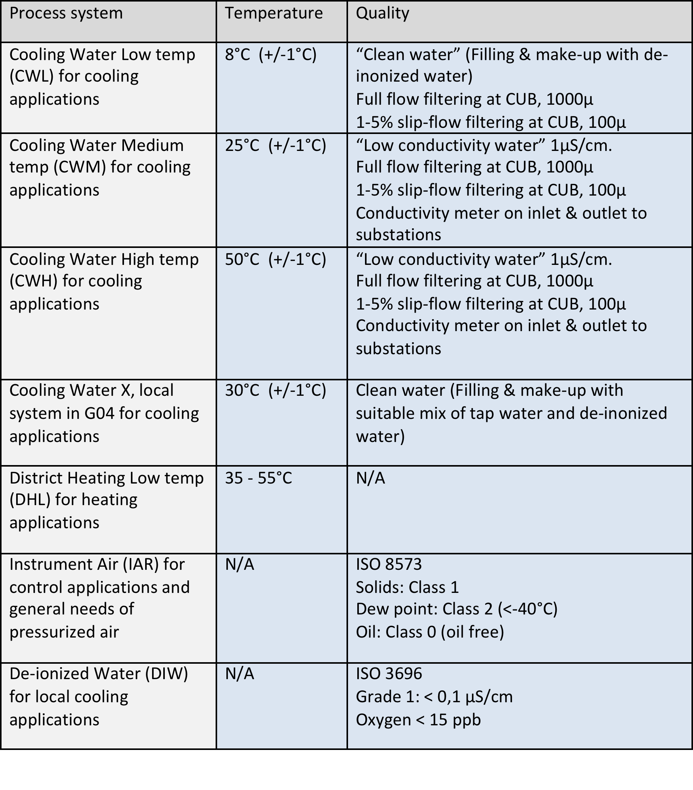
Prerequisites – CF process design parameters

Slide 4
Cooling skid for IS
CWL-CWS01 provided by WP16
  IS/LEBT/MEBT/DTL FC
  Nominal flow rate: 16 – 20 m3/h
  Nominal heat load: 75 – 85 kW
  Nominal pressure drop: 5.5 – 6.5 bar
  Design temperature: 50 °C
  Design pressure: 10 bar(g)
  Nominal operating temperature: 20 +/-5 °C
  Water Conductivity: 1 μS/cm

Slide 5
P&ID

Slide 6
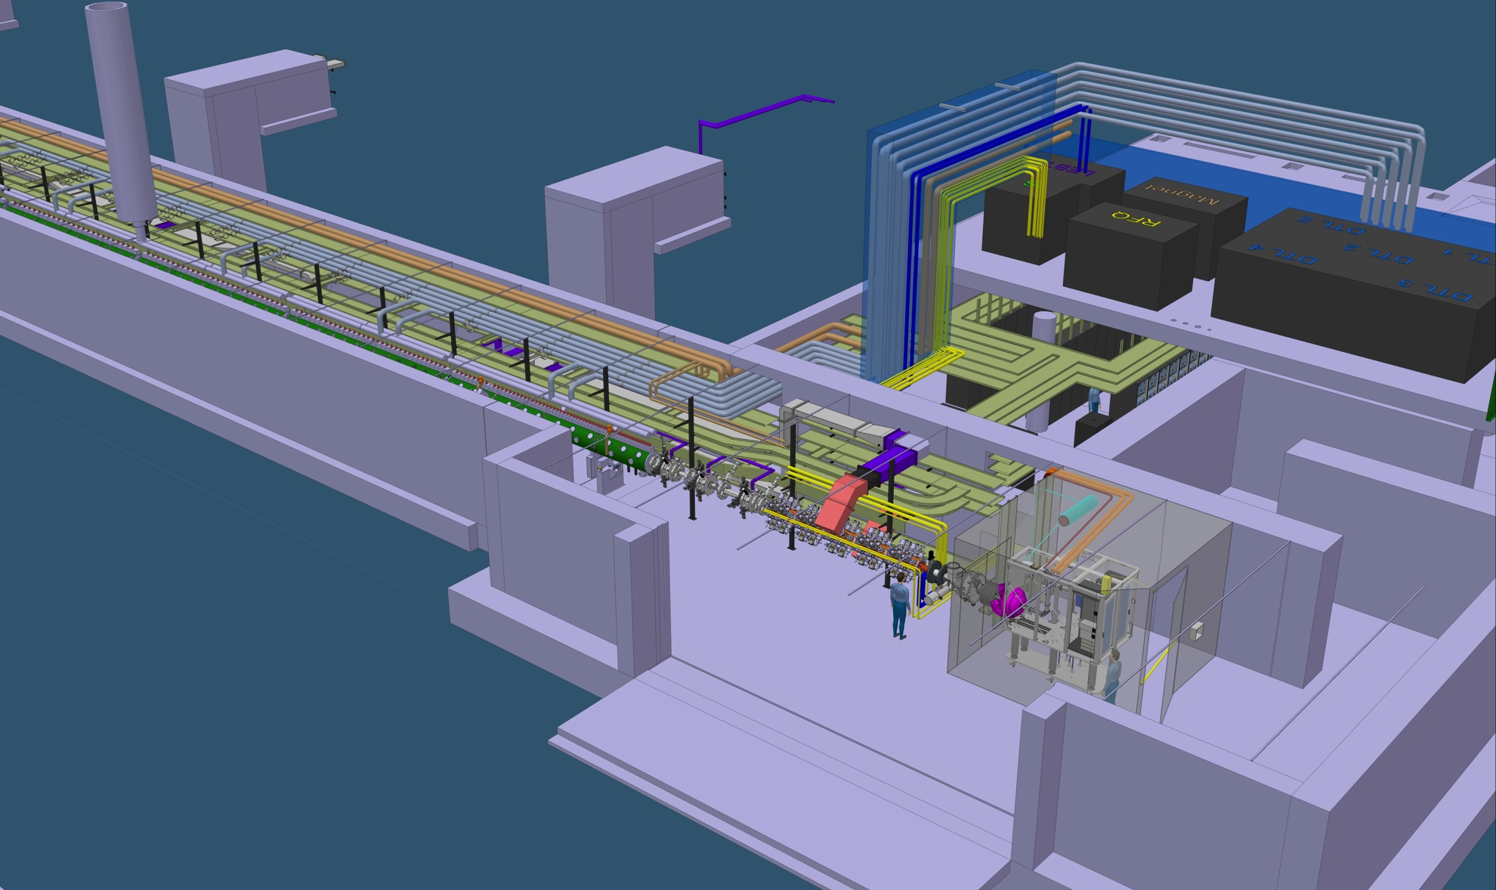
G01 accelerator tunnel

Slide 7
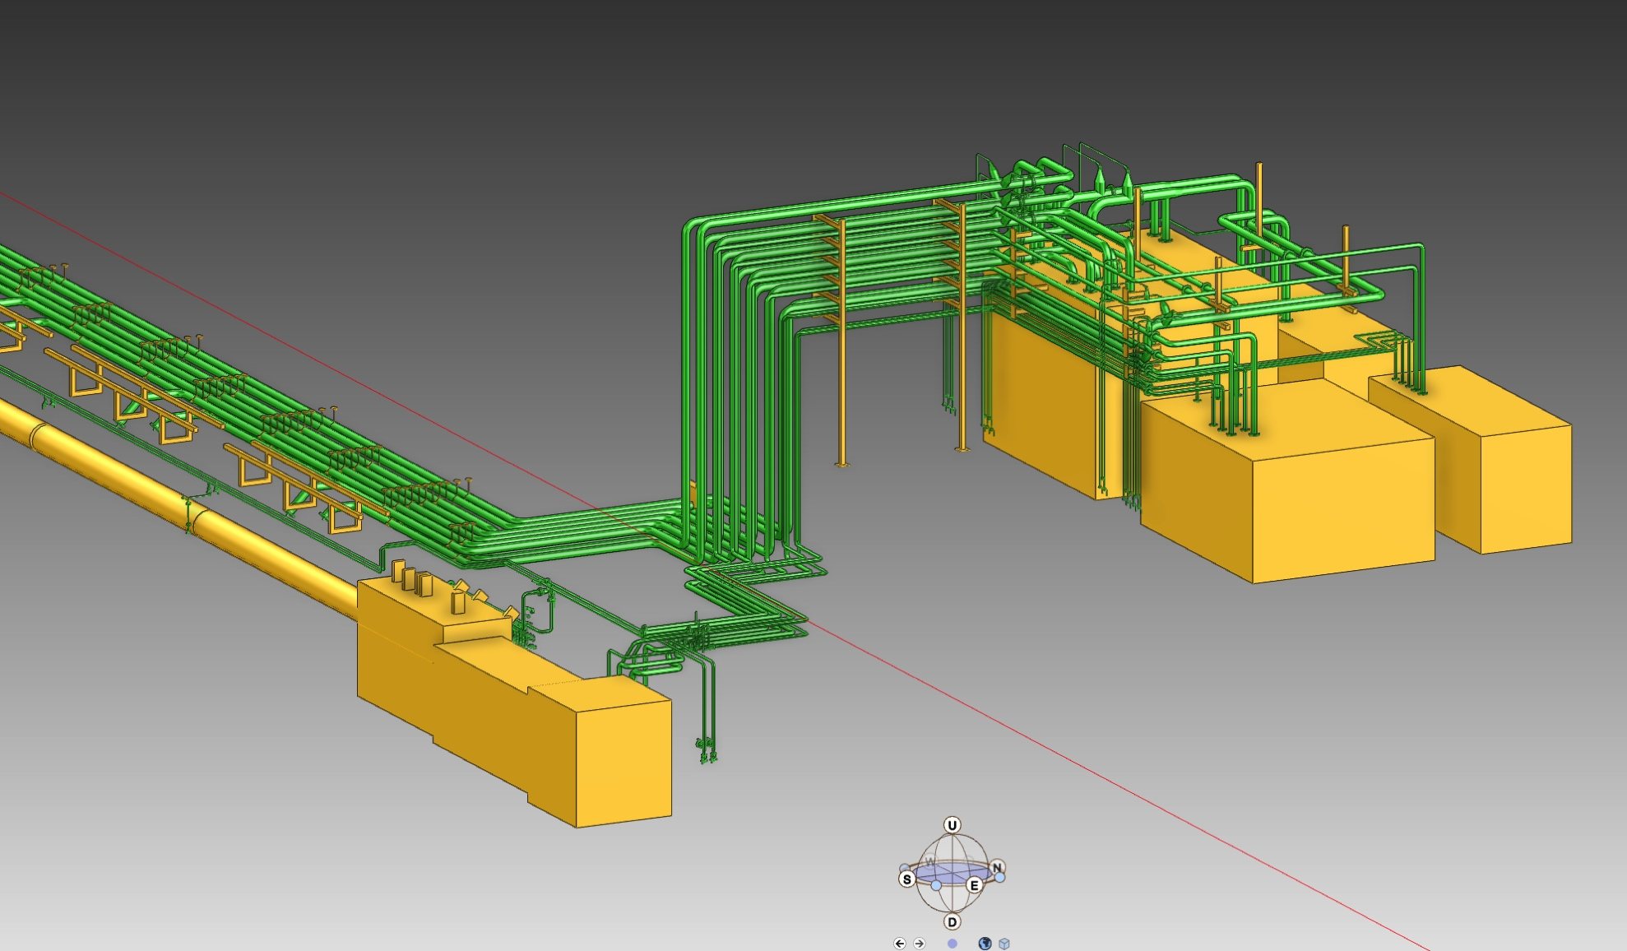
Pipe routing

Slide 8
Instrument air for IS/LEBT
No requirements transmitted to previous integration team, however we guess we need something
CF has installed header in tunnel roof with “fixed” capacity
WP16 will locate air manifold by IS/LEBT
  Number of outlets?
  Size? 3 mm hoses?

Slide 9
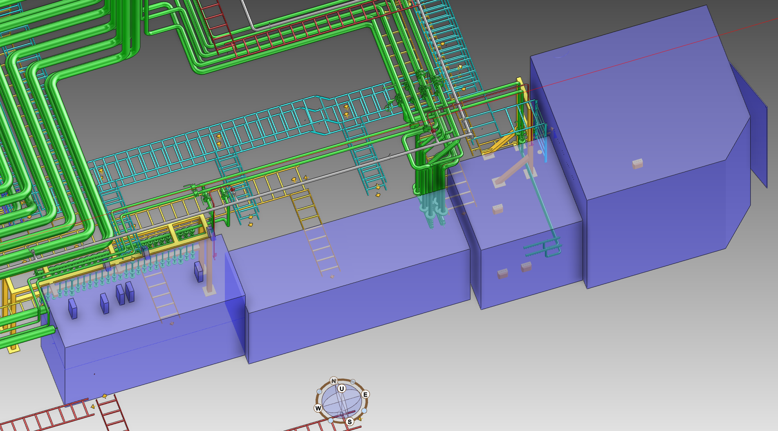
Instrument air for NCL
Location of manifolds?
Number and size of outlets?

Slide 10
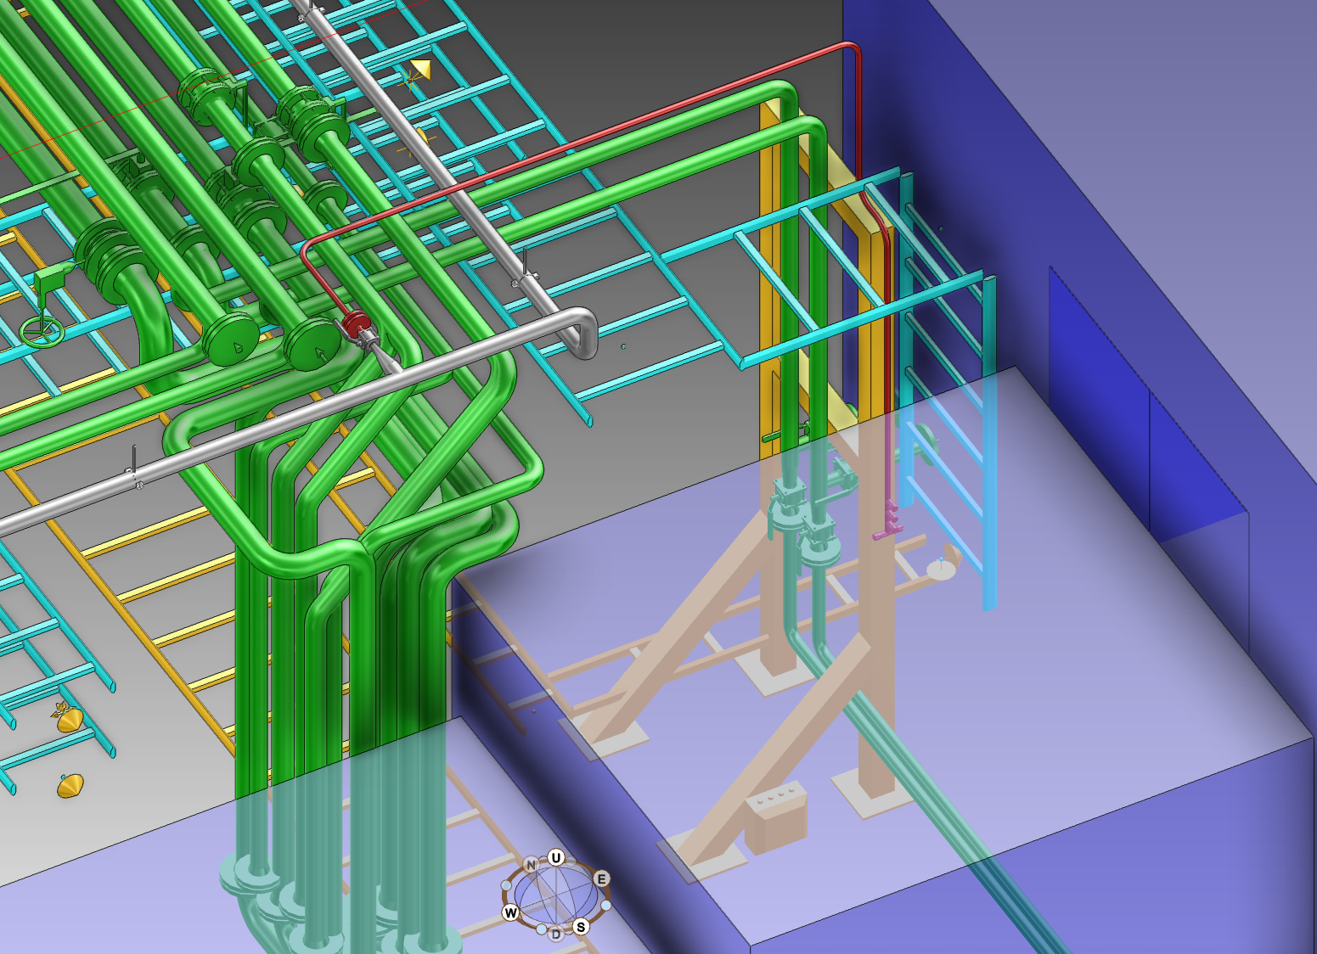
IA for IS/LEBT

Slide 11
Ongoing and upcoming tasks to support IS installation and commissioning
Install tunnel piping and cable trays
Install and commission water skid – G.R.E (UK)
Design and install instrument air manifold
Design and install water pipes for FEB racks
Open issues;
  Pressure reducer for Iris
  Connection of Catania manifolds
  Required documentation before connection – design documents, etc.

