Slide 1
IRR for the Ion Source & LEBT
Review of installation plan, alignment strategy, WSCP (including JHA), responsible personnel, trainings

Slide 2
Outline
Installation Plan
  Alignment strategy
  Responsible personnel
  JHA
Trainings
Questions

Slide 3
Installation Plan
Where: ESS (Lund)
Start: 01/11/2017
Duration estimate: 15 work days
Reference document: ESS_ISRCLEBT_Installation Plan in Lund

Slide 4



Installation Plan
Step 1 – Trasportation to Lund
RFI date: 01/01/2017

Slide 5

Installation Plan
Step 2 – Induction for LNS Team
Date: 01/01/2017
Responsible: ESS

Slide 6
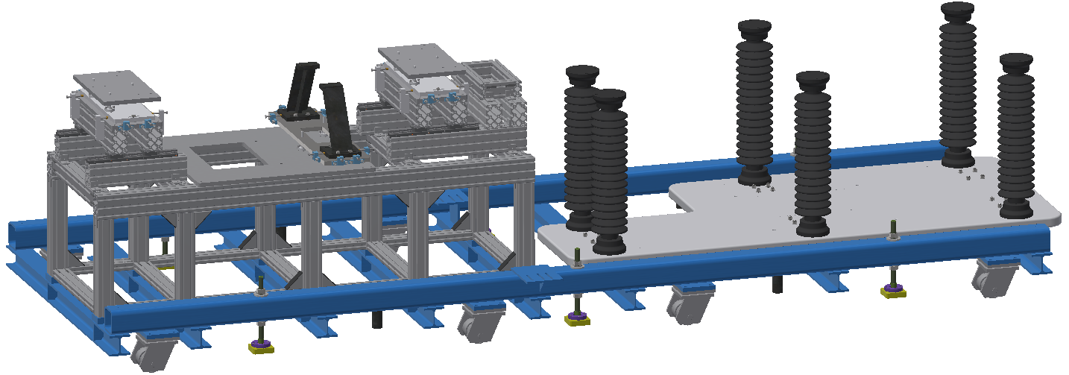
Installation Plan
Step 3 – Put down the Base from HBL on its wheels
Date: 01/01/2017
Responsible: ESS

Slide 7
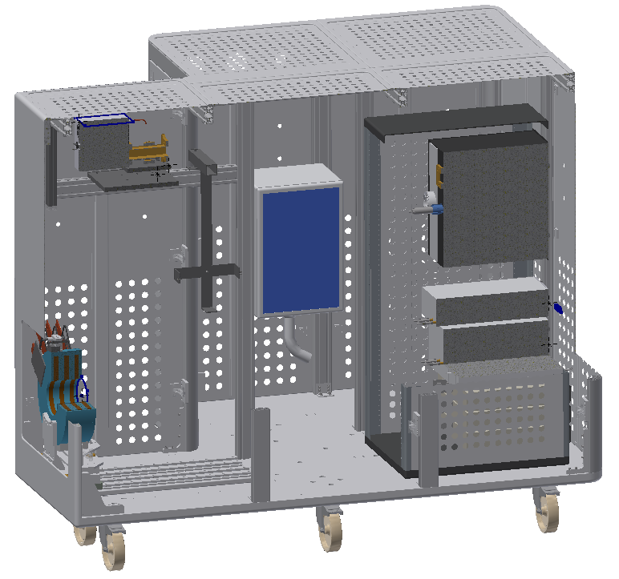
Installation Plan
Step 4 – Put down the HV Platform from HBL on its wheels
Date: 01/01/2017
Responsible: ESS

Slide 8
Installation Plan
Step 5 – Move Base and HV Platform from HBL to FEB Drop Hatch
Date: 01/01/2017
Responsible: ESS

Slide 9
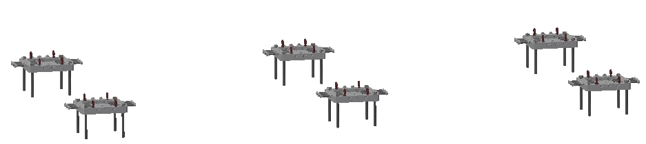
Installation Plan
Step 6 – Mark position of the feet (Base & Commissioning Tank Support)
Date: done before installation
Responsible: SAM Team

Slide 10
Installation Plan
Step 7 – Drill for feet (Base & Commissioning Tank Support)
Date: done before installation
Responsible: SAM Team

Slide 11
Installation Plan
Step 8 – Install the feet
Date: 01/11/2017
Responsible: LNS Team

Slide 12
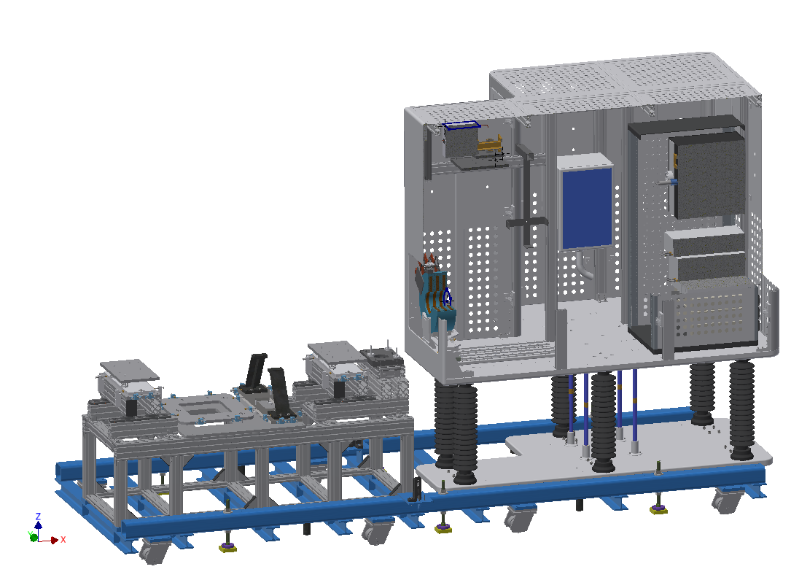
Installation Plan
Step 9 – Lift the HV Platform & put down on Ceramic Insulator
Date: 01/11/2017
Responsible: ESS

Slide 13


Installation Plan
Step 10 – Storage boxes and open to check
Date: 01/11/2017 – 03/11/2017
Responsible: LNS Team

Slide 14
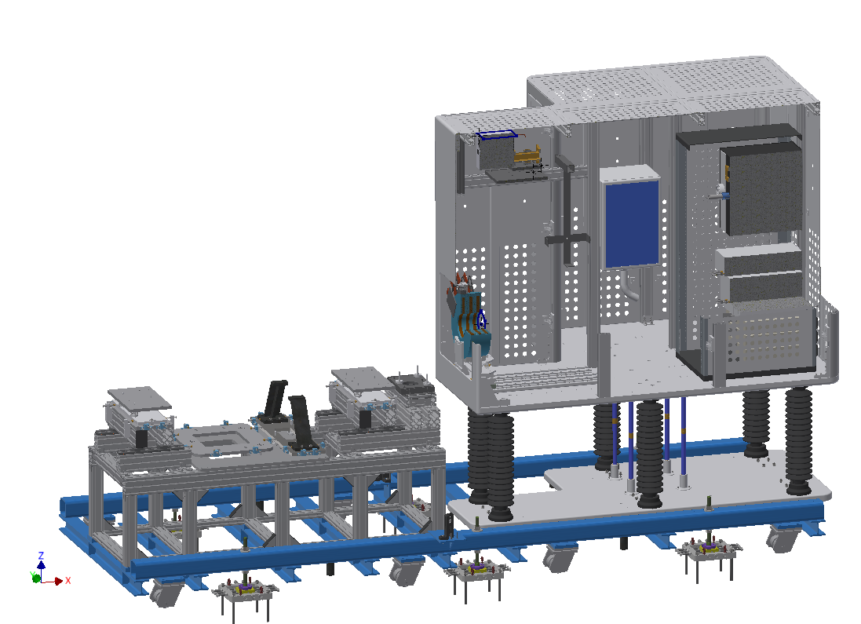
Installation Plan
Step 11 – Bring the base on the feet using the wheels
Date: 01/11/2017 – 03/11/2017
Responsible: LNS Team

Slide 15

Installation Plan
Step 12 – Allign the assembly/fix and clamp
Date: 02/11/2017
Responsible: SAM Team

Slide 16
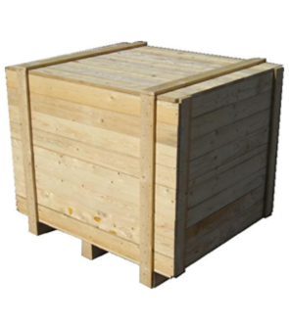
Installation Plan
Step 13 – Put down boxes for daily work from FEB lift
Date: 02/11/2017
Responsible: ESS

Slide 17
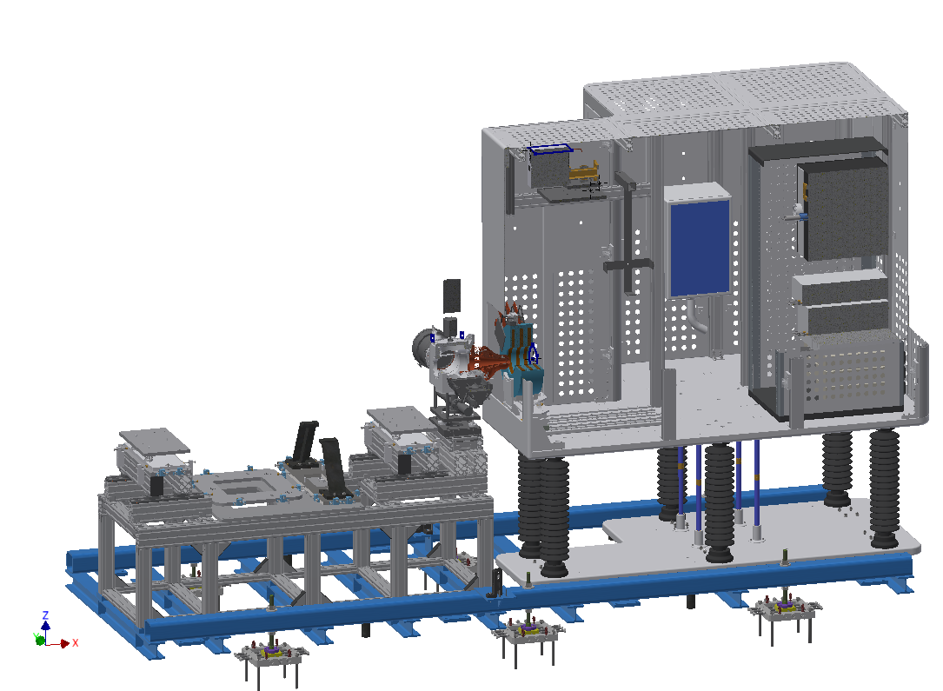
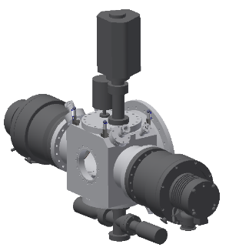
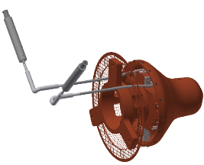
Installation Plan
Step 14 – Install I-COMP with the Extraction System & ancillaries
Date: 06/11/2017
Responsible: LNS Team

Slide 18
Installation Plan
Step 15 – Align the I-COPM with the Extraction System
Date: 08/11/2017
Responsible: SAM Team

Slide 19

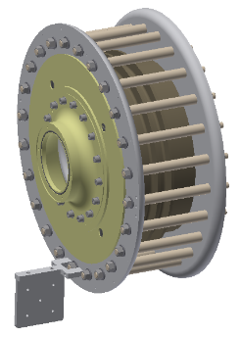
Installation Plan
Step 16 – Install the Insulation Column
Date: 09/11/2017
Responsible: LNS Team

Slide 20

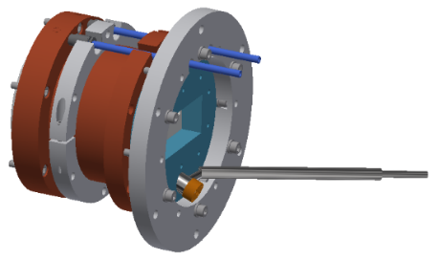
Installation Plan
Step 17 – Install the plasma chamber
Date: 09/11/2017
Responsible: LNS Team

Slide 21
Installation Plan
Step 18 – Check alignment
Date: 09/11/2017
Responsible: SAM Team

Slide 22

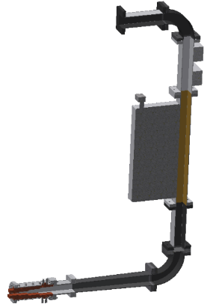
Installation Plan
Step 19 – Install the Matching Transformer and the Wave Guides
Date: 10/11/2017
Responsible: LNS Team

Slide 23
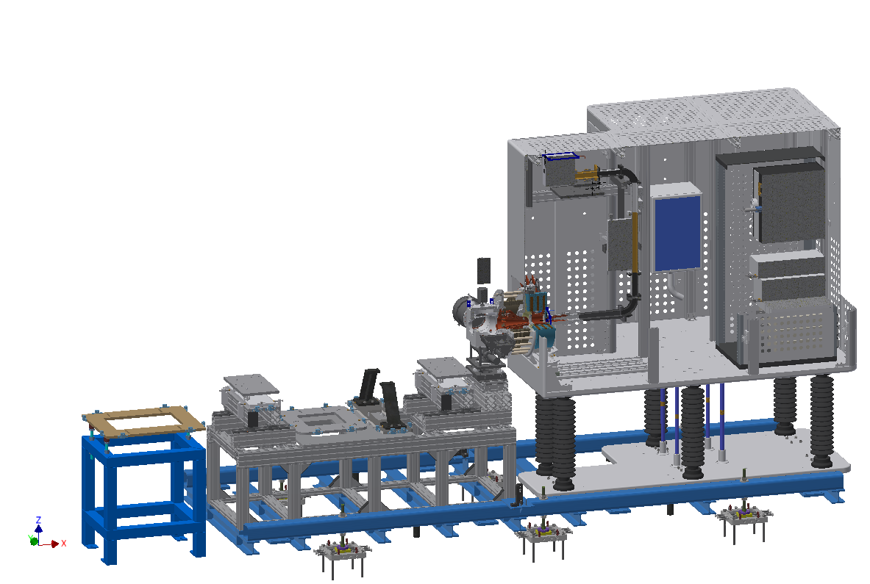
Installation Plan
Step 20 – Install Commissioning Tank Support
Date: 10/11/2017
Responsible: LNS Team

Slide 24
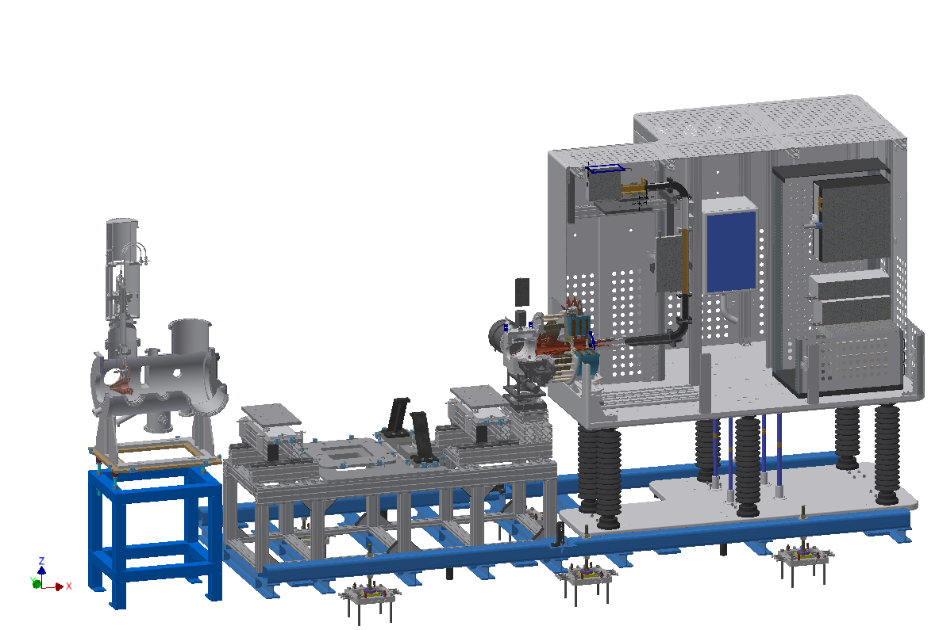
Installation Plan
Step 21 – Install Commissioning Tank with FC & ancillaries
Date: 10/11/2017
Responsible: LNS Team

Slide 25
Installation Plan
Step 22 – Align Commissioning Tank
Date: 10/11/2017
Responsible: SAM Team

Slide 26
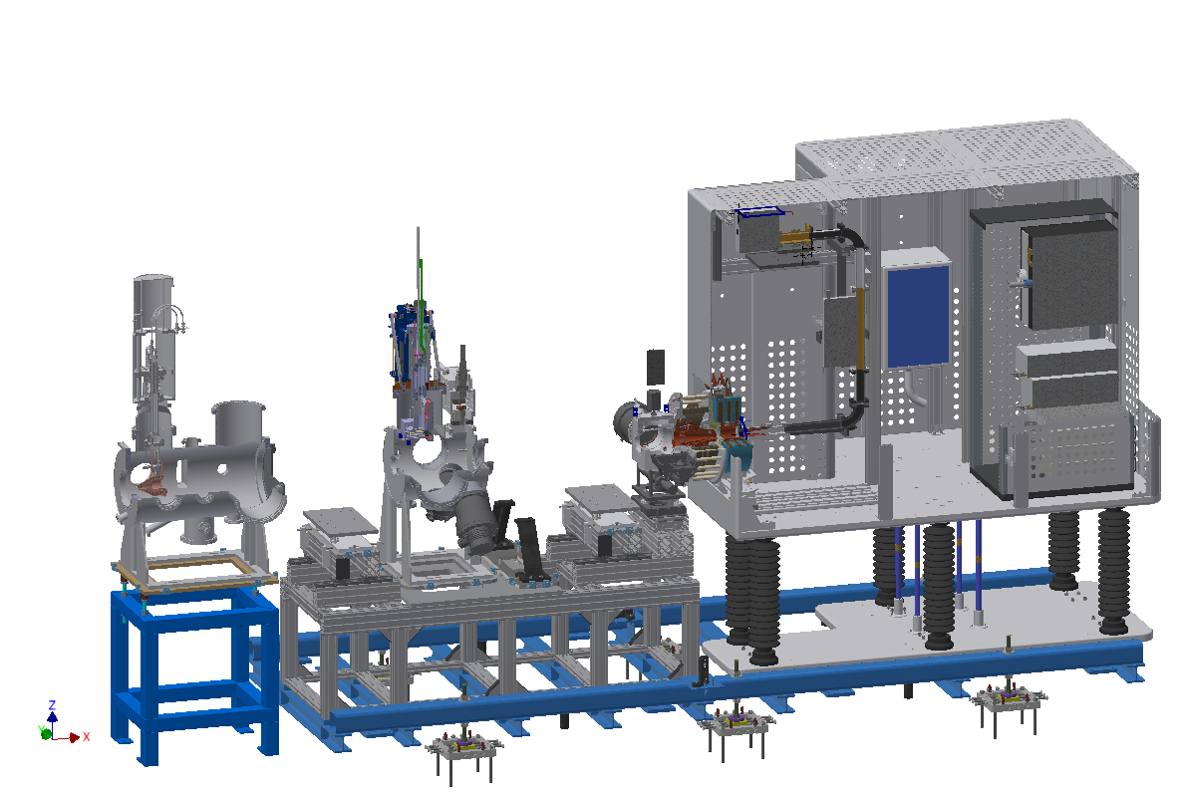
Installation Plan
Step 23 – Install Permanent Tank with EMU, Chopper & ancillaries
Date: 13/11/2017
Responsible: LNS Team

Slide 27
Installation Plan
Step 24 – Align Permanent Tank
Date: 13/11/2017
Responsible: SAM Team

Slide 28
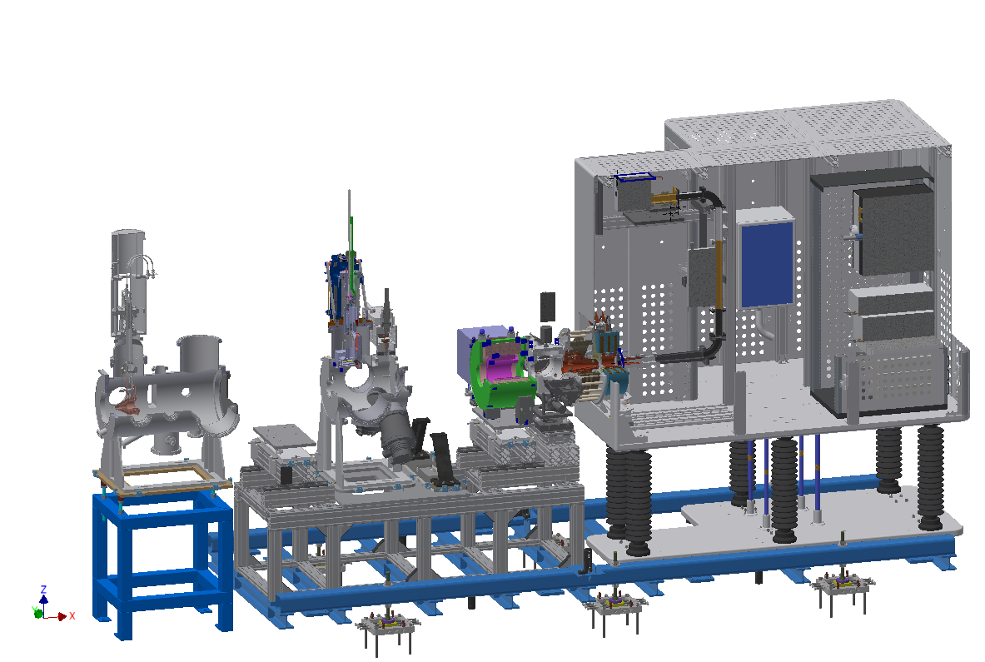
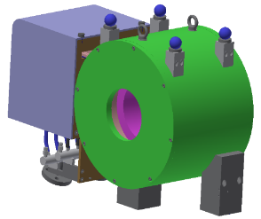
Installation Plan
Step 25 – Install Solenoid I
Date: 13/11/2017
Responsible: LNS Team

Slide 29
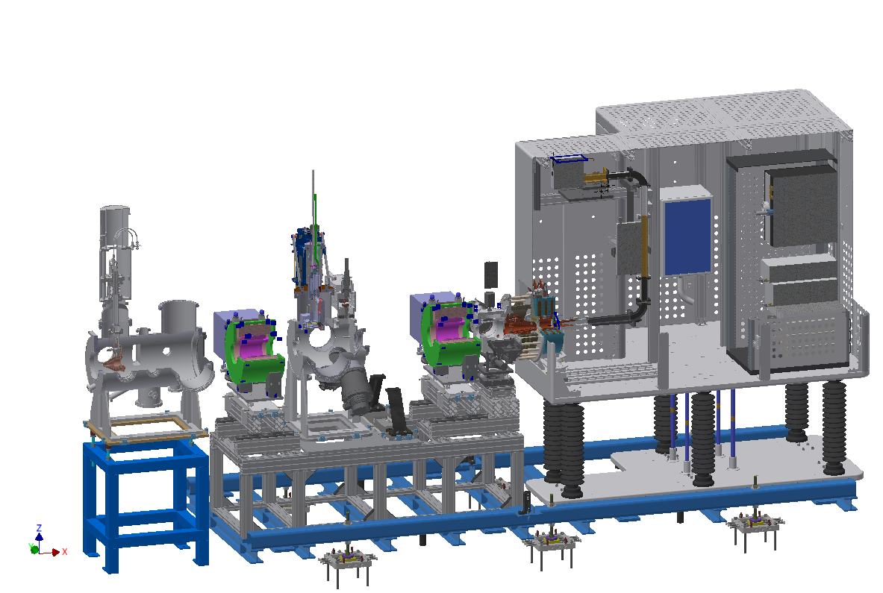

Installation Plan
Step 26 – Install Solenoid II
Date: 13/11/2017
Responsible: LNS Team

Slide 30
Installation Plan
Step 27 – Align the Solenoids
Date: 13/11/2017
Responsible: SAM Team

Slide 31

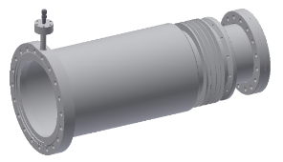
Installation Plan
Step 28 – Install Tube I and connect it to the I-COMP
Date: 14/11/2017
Responsible: LNS Team

Slide 32
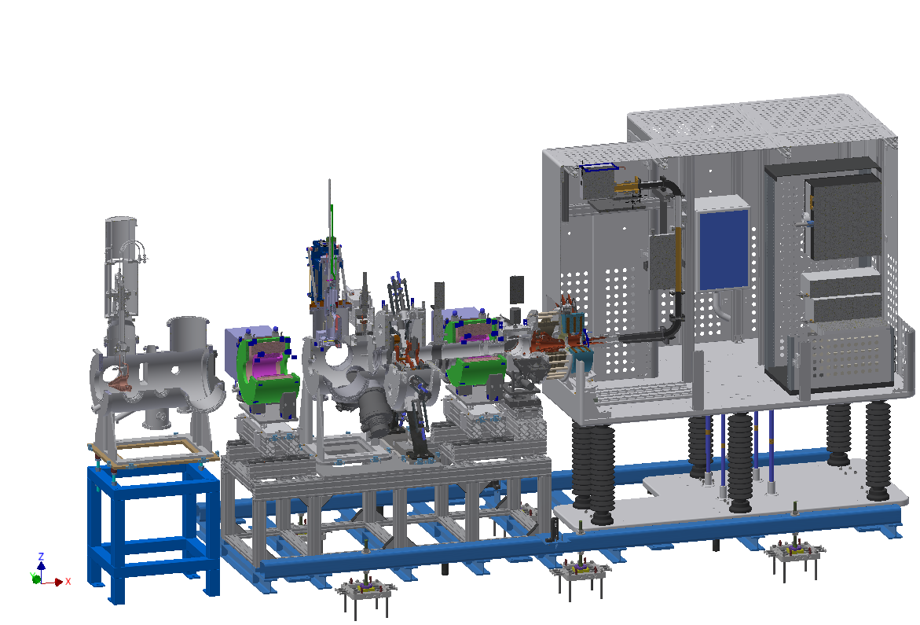
Installation Plan
Step 29 – Install IRIS with Gate Valve
Date: 14/11/2017
Responsible: LNS Team

Slide 33
Installation Plan
Step 30 – Align IRIS
Date: 14/11/2017
Responsible: SAM Team

Slide 34
Installation Plan
Step 31 – Connect the flanges of IRIS and Gate Valve
Date: 14/11/2017
Responsible: LNS Team

Slide 35

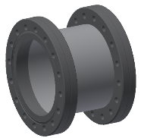
Installation Plan
Step 32 – Install Adapter for Gate Valve
Date: 15/11/2017
Responsible: LNS Team

Slide 36
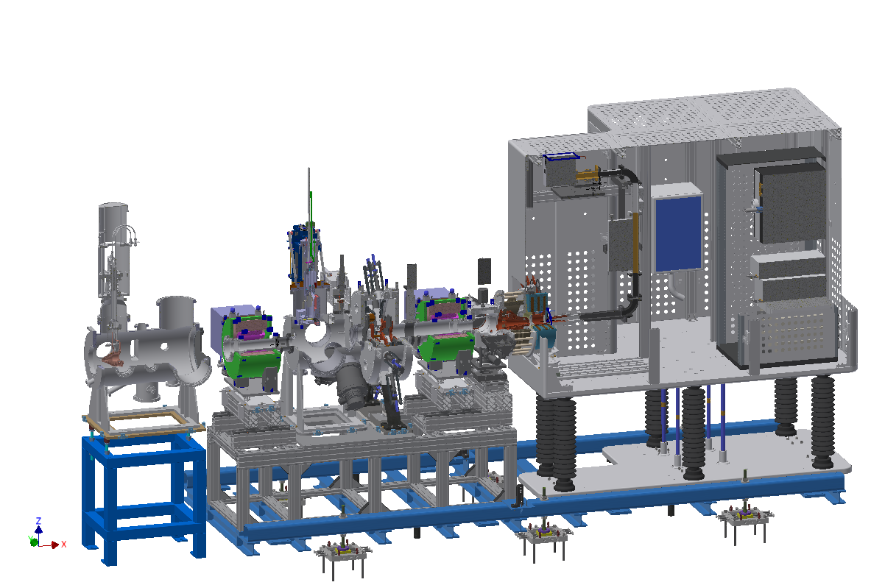
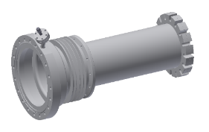
Installation Plan
Step 33 – Install Tube II and connect it to the Adapter for Gate Valve
Date: 15/11/2017
Responsible: LNS Team

Slide 37

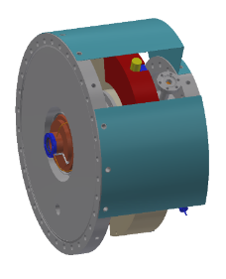
Installation Plan
Step 34 – Install Collimator on Commissioning Tank compressing the bellow of Tube II
Date: 15/11/2017
Responsible: LNS Team

Slide 38
Installation Plan
Step 35 – Connect the flange of Collimator with Tube II
Date: 15/11/2017
Responsible: LNS Team

Slide 39
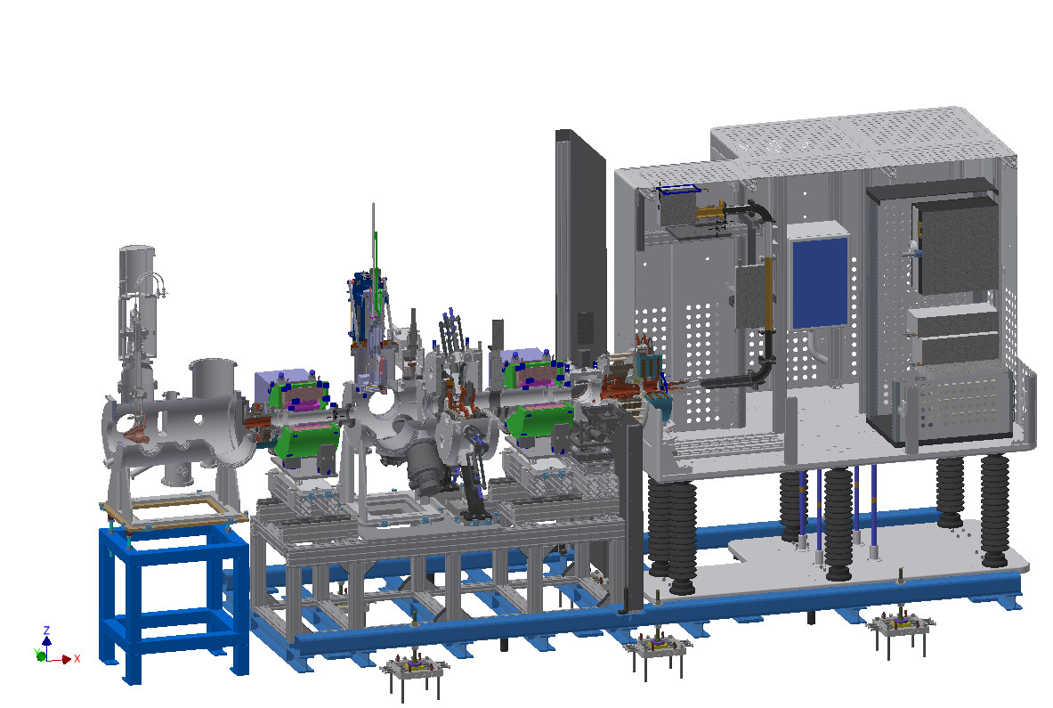
Installation Plan
Step 36 – Install Ground Shield (include lead shielding)
Date: 15/11/2017
Responsible: LNS Team

Slide 40
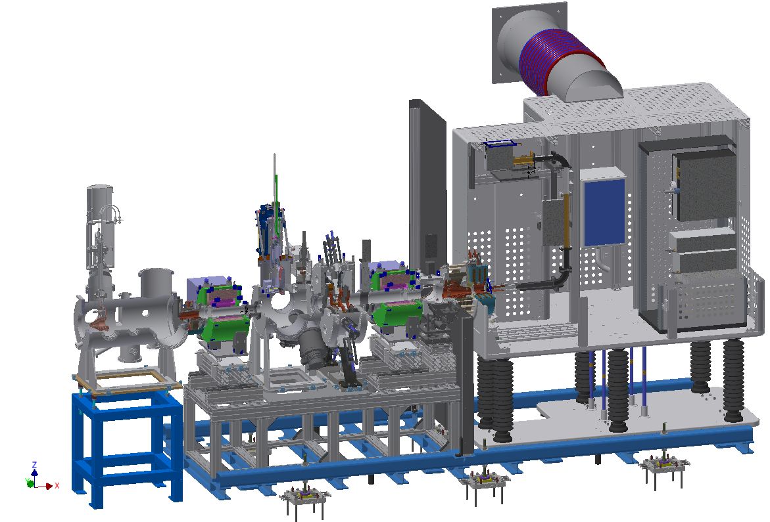
Installation Plan
Step 37 – Install Pink Tube and support
Date: 16/11/2017
Responsible: ESS Team
This operation should be finalized before the ISRC&LEBT installation?

Slide 41
Installation Plan
Step 38 – Install Gas Injection system for the ISRC (H2) and for the LEBT (N2,H2)
Date: 16/11/2017
Responsible: LNS Team
Step 39 – Install Vacuum components
Date: 16/11/2017
Responsible: LNS Team

Slide 42
Installation Plan
Step 40 – Connection to services (Controls, Power, Vacuum, Compressed air, Water)
Date: 16/11/2017 – 17/11/2017
Responsible: ESS Team

Slide 43
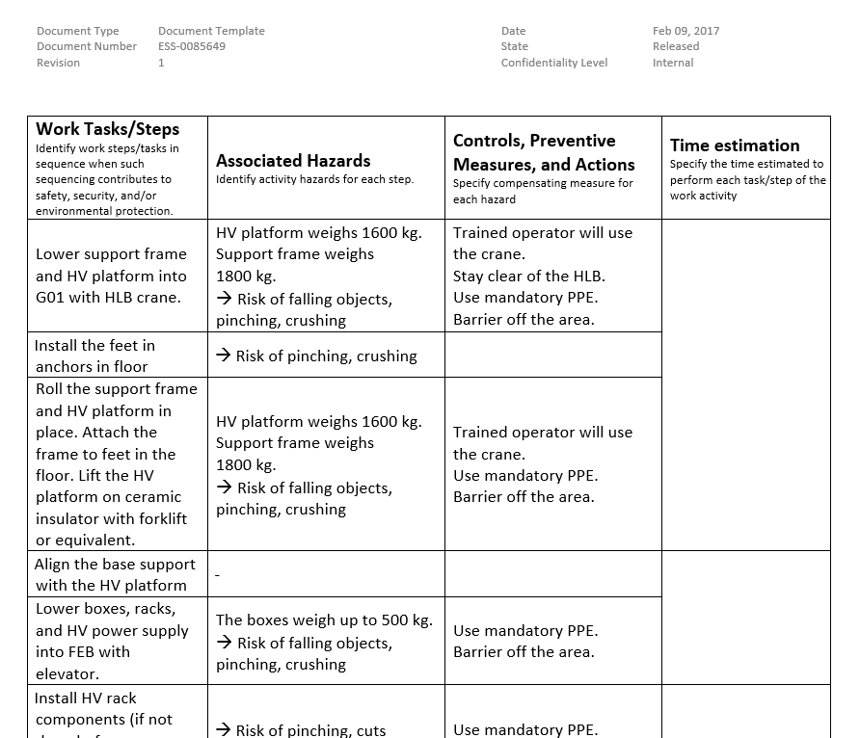
Job Hazard Analysis (JHA)
Hazards are to be identified and evaluated prior to the start-up of the work

Slide 44

Trainings
INFN-LNS personnel follow a First Aid course (BLSD certificate) next week
ESS personnel follow Dismantling phase in Catania

Slide 45
Questions
??

Slide 46
Thanks for attention!

