Slide 1
Mid Term Review meeting
Work Package 1: Project Management
Roy Pennings, Project Coordinator
Raquel Costa / Anne-Charlotte Joubert, Project Managers

Slide 2

BrightnESS inside ESS
BrightnESS is funded by the European Union Framework Programme for Research and Innovation Horizon 2020, under grant agreement 676548

Slide 3
When does ESS feel that BrightnESS is a success...
Success in delivery of BrightnESS:
- Technical: contribution to ESS construction & future operations
- Political: ESS as an ERIC = success as international collaboration model
between members
- Political: ESS as an applied research centre = competition, jobs, leadership
- Political: ESS as possible In-Kind Collaboration blueprint for future new large RIs.
Failure in delivery of BrightnESS:
- Financial damage to ESS
- Reputation / political damage to ESS (EC + partners
& wider science community)
- Possible damage to future ESS funding proposals
BrightnESS is funded by the European Union Framework Programme for Research and Innovation Horizon 2020, under grant agreement 676548

Slide 4


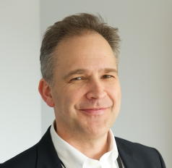
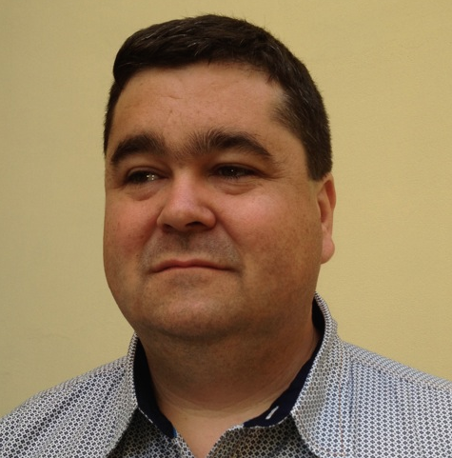
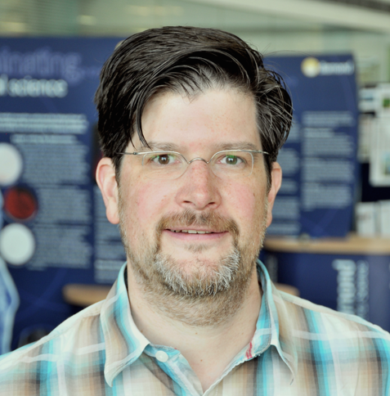
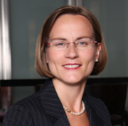
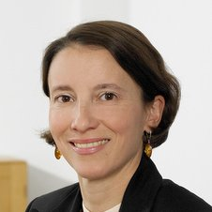
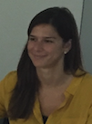

Project organisation
Steering Board (STB) members:
WP 1
WP 2
WP 3
WP 4
WP 5
WP 6
Roy Pennings
Carlo Bocchetta
Allen Weeks
Richard Hall-Wilton
Tobias Richter
Ute Gunsenh- -eimer
Juliette Forneris (DTI)
Daily project
Management
team:
Roy Pennings
Raquel Costa
(maternity leave)
Anne-Charlotte Joubert
BrightnESS is funded by the European Union Framework Programme for Research and Innovation Horizon 2020, under grant agreement 676548

Slide 5
Tasks and deliverables of WP1
TASKS | Start (planning) | Start realisation | End (planning) | End (realisation)
Task 1.1: Scientific project management | M1 | M1 | M36 | M36 (ongoing)
Task 1.2 Financial and administrative project management | M1 | M1 (internal reporting: M6, M9, M12, M15, M18, M22,…) M18: 1st Periodic Report | M36 | M36 (ongoing)
Task 1.3 Coordination of legal issues and project risk management | M1 | M1 | M36 | M36 (ongoing)
Task 1.4 Organisation of meetings and Internal Communication | M1 | M1 | M36 | M36 (ongoing)
Task 1.5: : Socio-economic impact methodology and criteria for ESS | M24 | M24 | M35 | M35
BrightnESS is funded by the European Union Framework Programme for Research and Innovation Horizon 2020, under grant agreement 676548

Slide 6
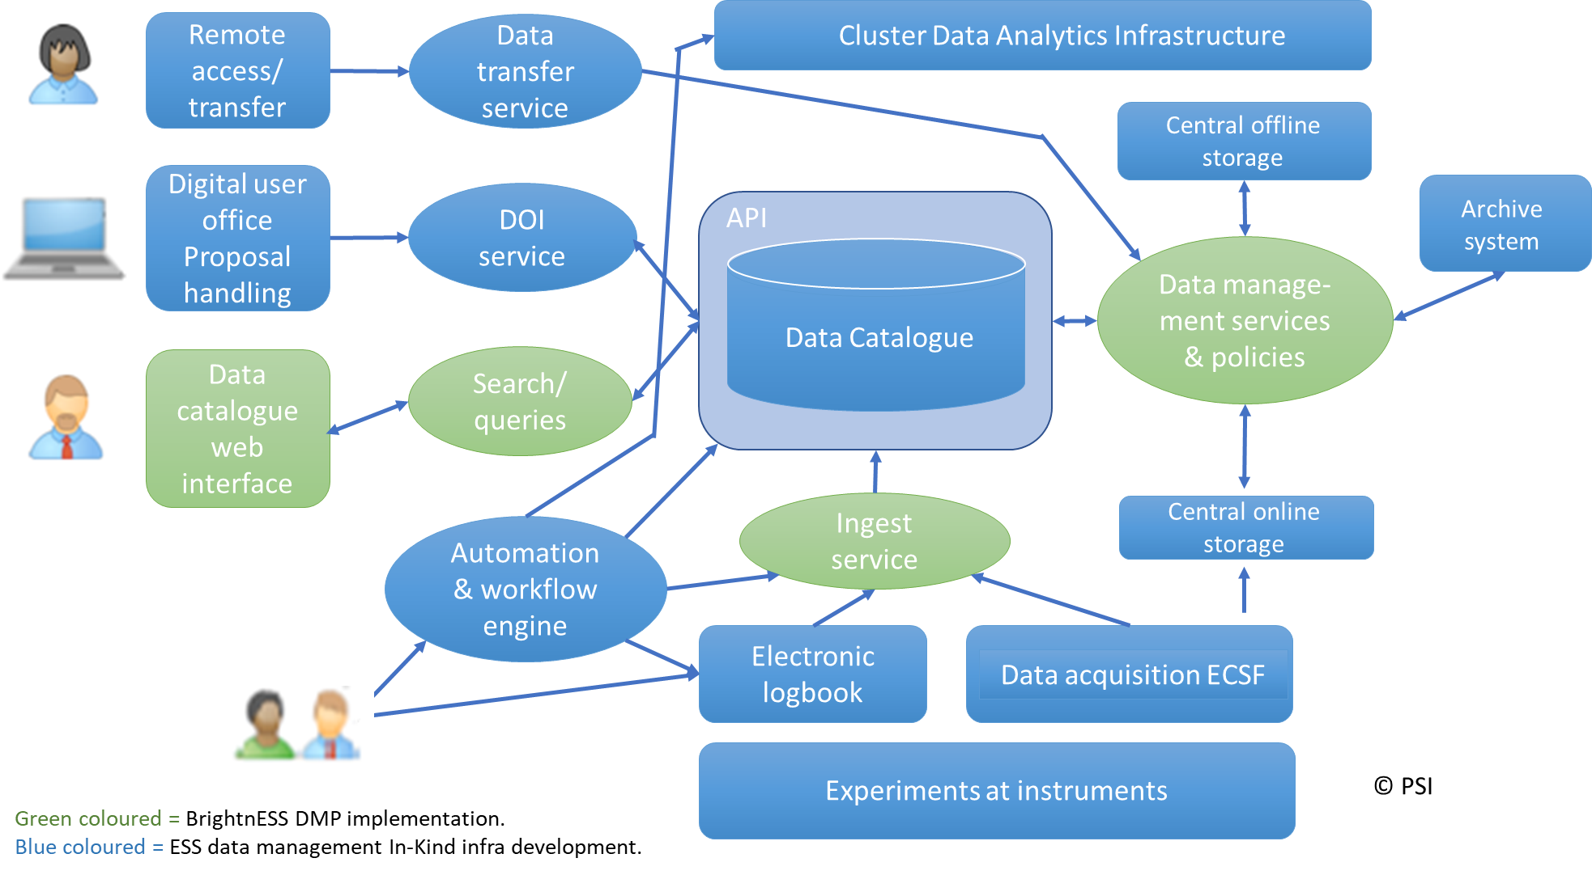
Tasks and deliverables of WP1
DELIVERABLE | Activity & evidence
D1.1: Agenda and minutes of the Kick-off and General Assembly meetings | organized by ESS on 25 September 2015, Lund • specified rules and requirements of the Grant Agreement • discussed and refined overall project planning activities, the way of communication • introduced consortium members and their individual roles • discussed each work package in details agenda, minutes and pictures.
D1.2: Data Management Plan | discussed EC requirements for DMP and ESS needs and resources produced DMP with ESS DMSC DMP now being implemented as part of WP1 DMP available and being implemented.
D1.3: 1st Agenda and minutes of yearly General Assembly | meeting held on 07 October 2016 unanimous approval of progress and management agenda, minutes and pictures also: approval for amendment and 1st Technical Report
BrightnESS is funded by the European Union Framework Programme for Research and Innovation Horizon 2020, under grant agreement 676548

Slide 7
Tasks and deliverables of WP1
DELIVERABLE | Activity & evidence
D1.4: 2nd Agenda and minutes of yearly General Assembly | meeting held on 05 September 2017 agenda and pictures. Minutes by October 2017
D1.5: Agenda and minutes of all Steering Board meetings | meetings held monthly: most physical, others as teleconferences. Quorum was always present minutes of meetings were prepared as action plans and result summary agenda and minutes.
D1.6: 3rd Agenda and minutes of yearly General Assembly | pending
D1.7: Report on methodology and criteria for socio-economic impact assessment of ESS during construction and operations | New deliverable (added as part of amendment). pending
BrightnESS is funded by the European Union Framework Programme for Research and Innovation Horizon 2020, under grant agreement 676548

Slide 8
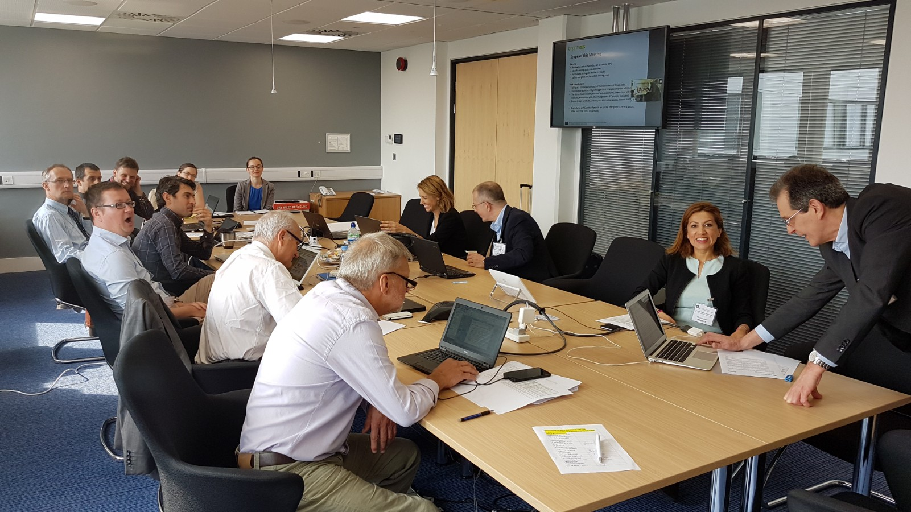
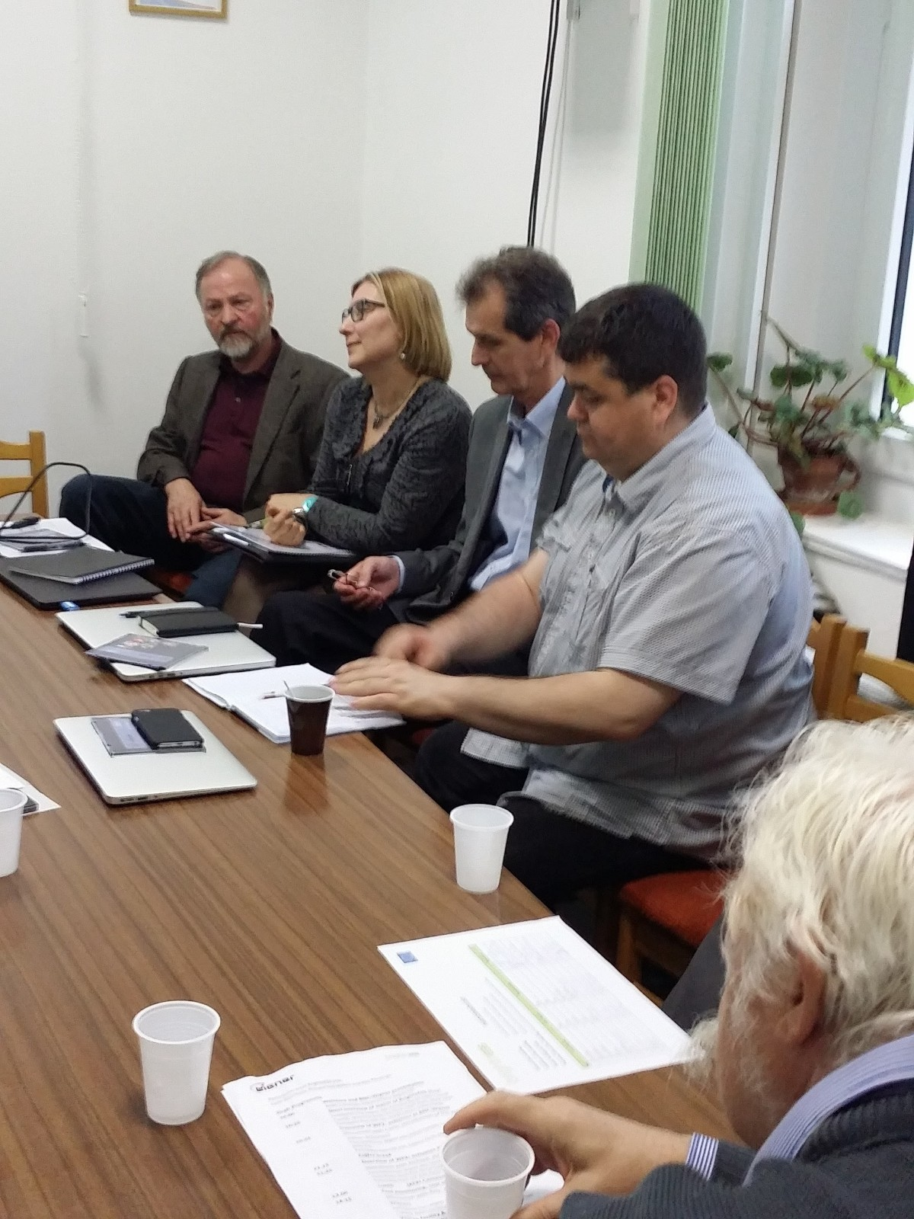
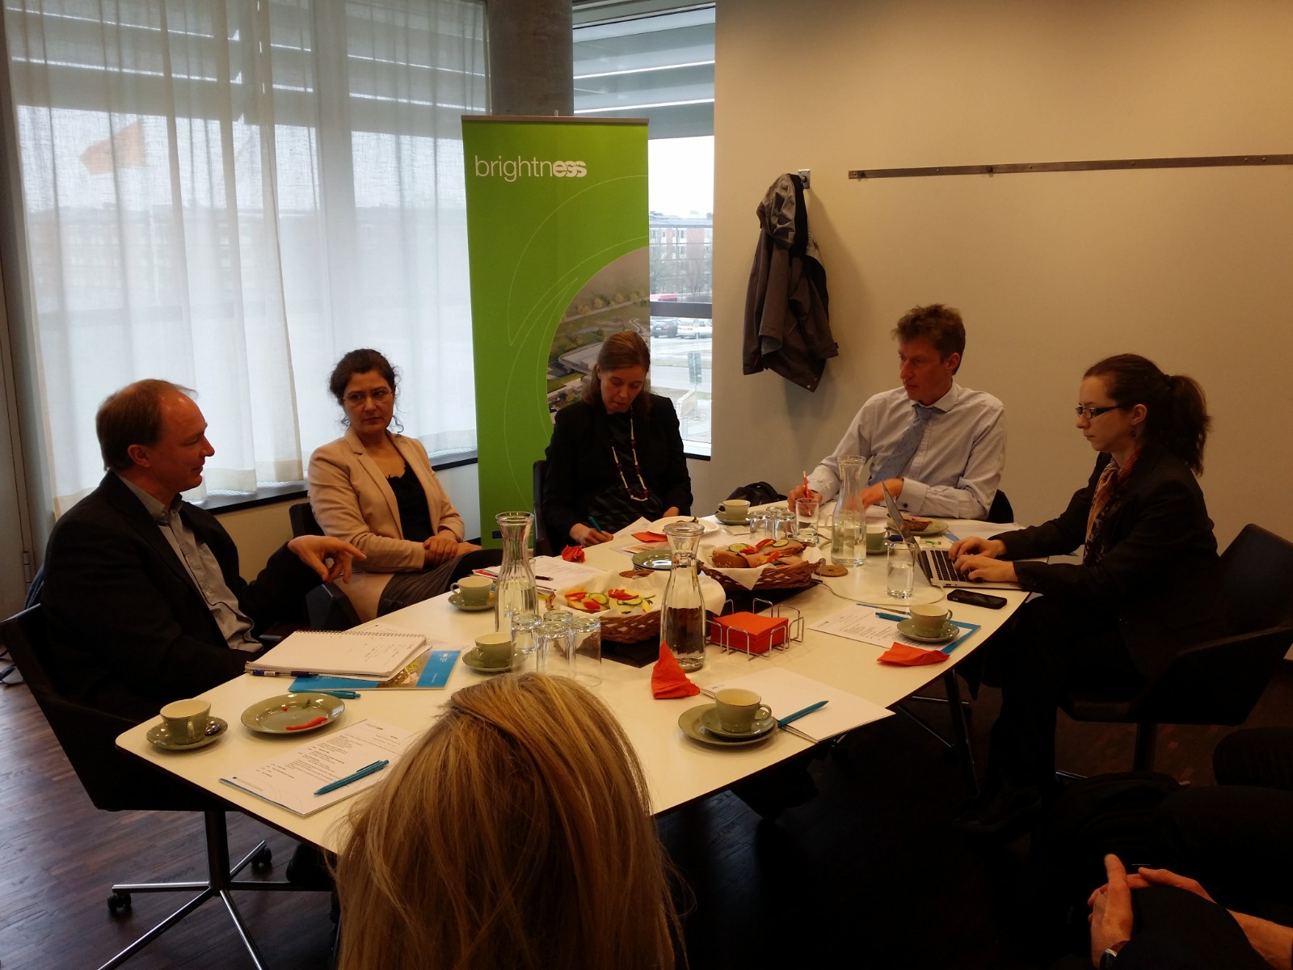
Meetings
Steering Board, EMT , EC meetings
WP meetings | Location | Date
Steering Board meetings | ESS headquarters | 16 meetings since 13.01.2016 (approx. 1/month)
ESS Management Team meeting | ESS headquarters | 29 February 2016
EC meetings (with project officer) H2020 coordinator days | EC, Brussels | 28 April 2016, 09 December 2016 24 February 2016, 14 February 2017
WP-participation
WP meetings | Location | Date
Project kick-off | ESS headquarters | 25 September 2015
WP2 kick-off meeting; WP2 progress meeting | ESS headquarters Harwell, UK | 15 October 2015 02 June 2017
WP3 VAT workshop WP3 procurement session | Malmo, SE ESS headquarters | 14 & 15 June 2016 7 September 2016
WP5 kick-off meeting; WP5 progress meeting | Villigen, CH | 31 March & 1st April 2016, 2 February 2017
WP6 industry focus group WP6 Communicators’ meeting | ESS headquarters ESS headquarters | 1 – 2 March 2016 7 March 2016
BrightnESS is funded by the European Union Framework Programme for Research and Innovation Horizon 2020, under grant agreement 676548

Slide 9
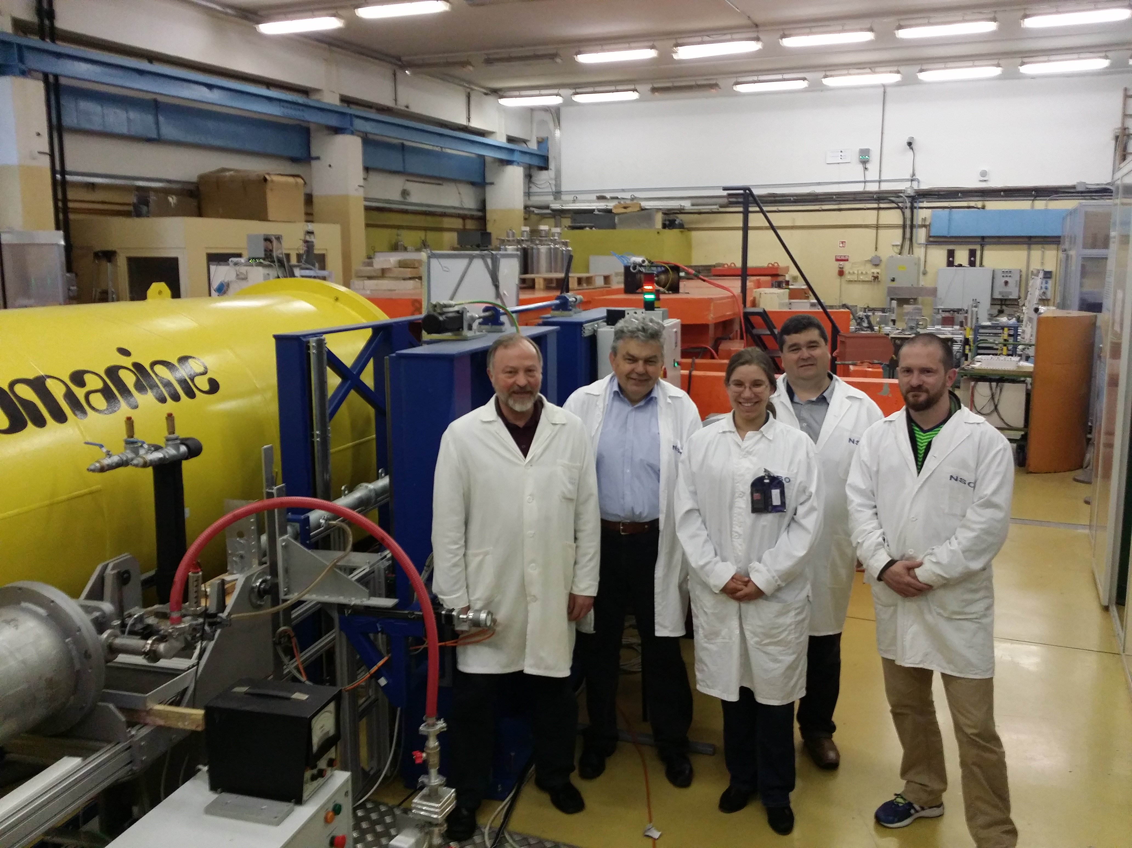
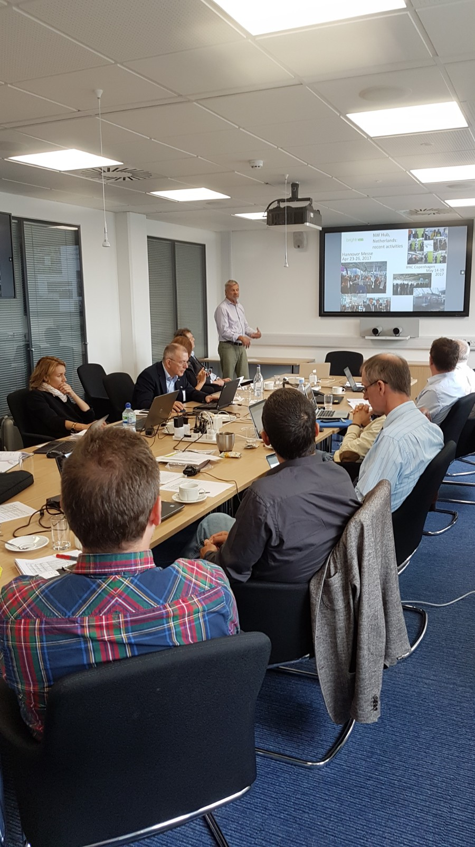
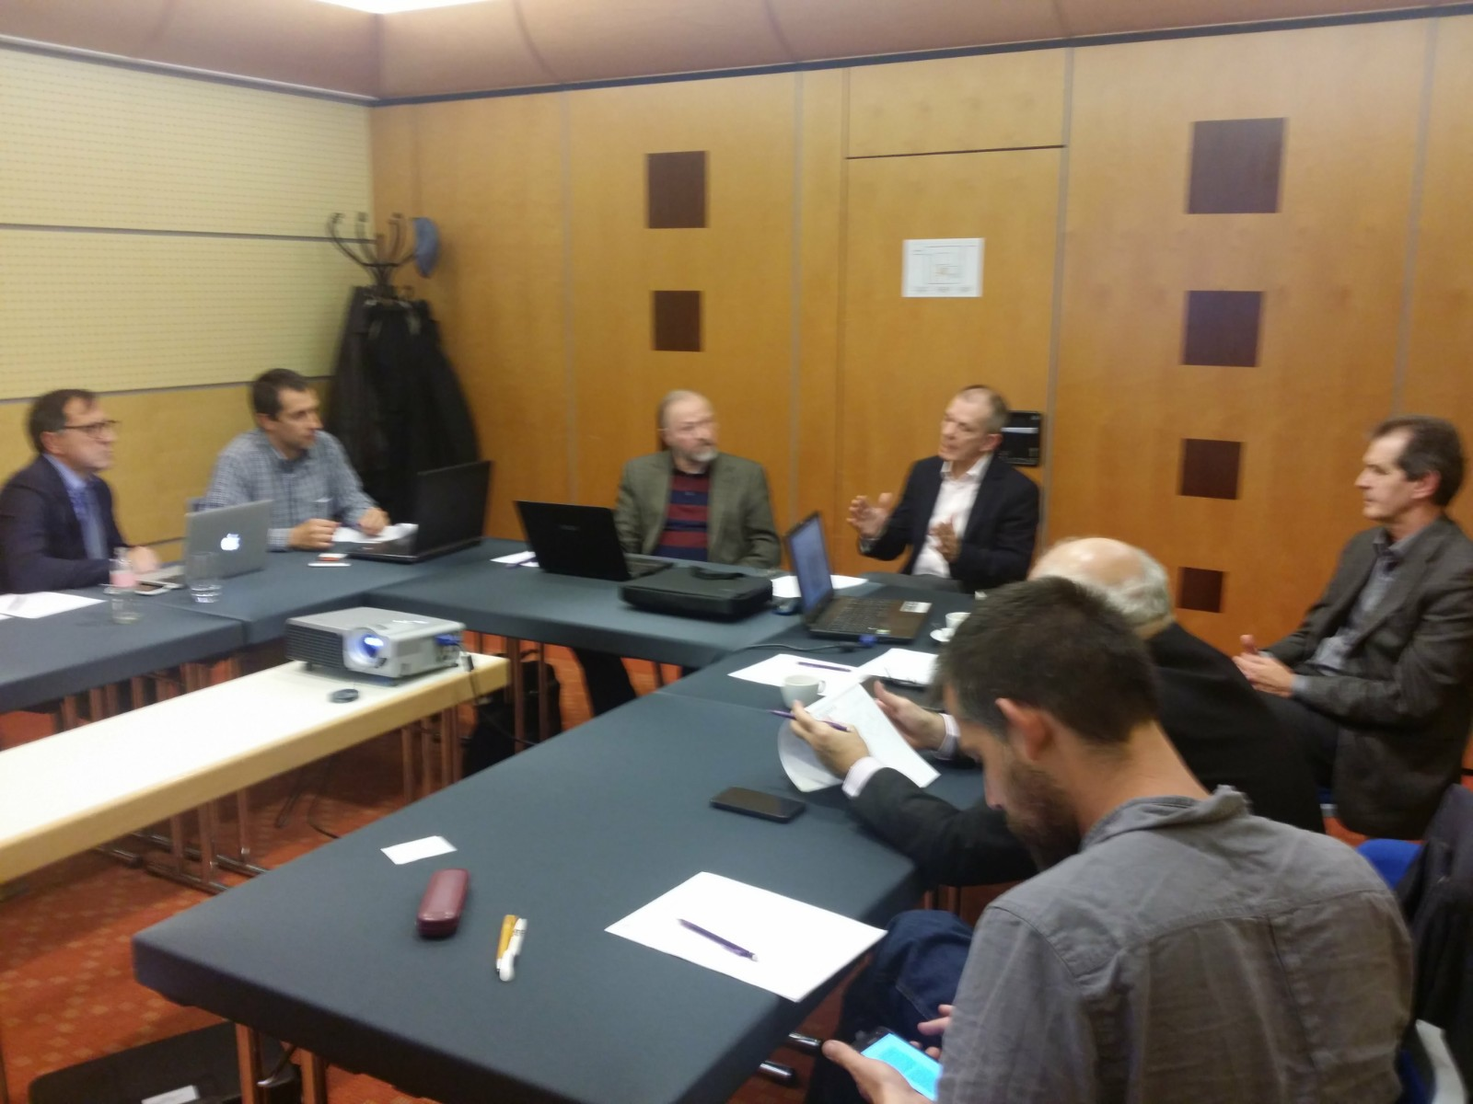
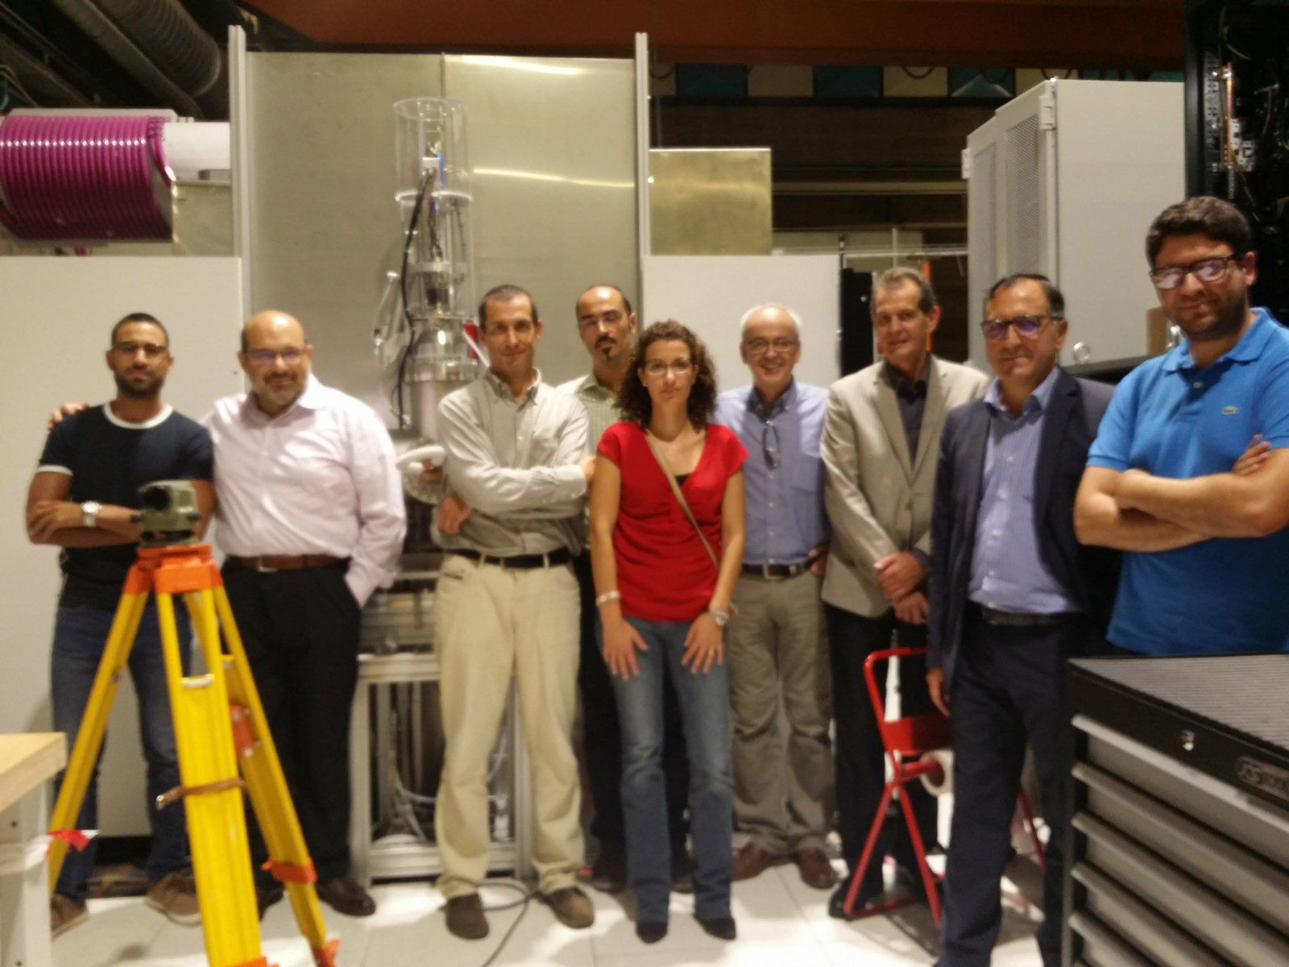
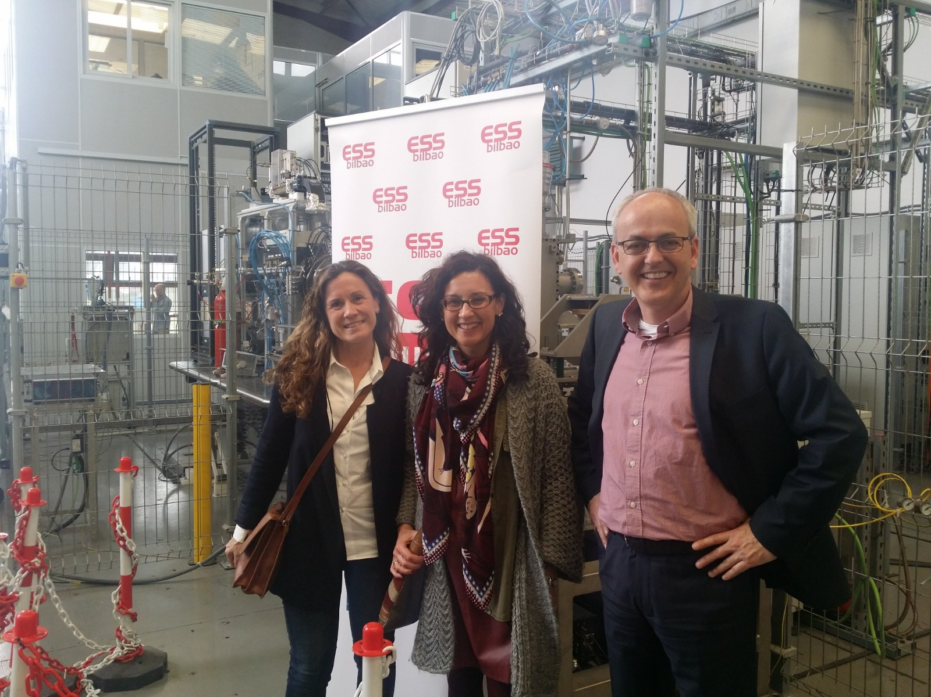
Partner meetings
@ consortium partner | Location | Date
(PSI) – part of WP5 meeting | Villigen, CH | 31 March 2016
ESS Bilbao | Bilbao, SP | 19 April 2016
BNC Wigner | Budapest, HU | 12 May 2016
ESS Bilbao | Bilbao, SP | 19 May 2016
(ILL) – included in non-BrightnESS meeting | Grenoble, FR | 02 June 2016
IEAP CTU | Prague, CZ | 19 July 2016
TUD | Delft, NL | 18 August 2016
FZJ | Jülich, D | 08 September 2016
KU | Copenhagen, DK | 09 February 2017
DTI + DTU | Taastrup, DK | 21 February 2017
LU | Lund, SE | 07 March 2017
KU | Copenhagen, DK | 03 May 2017
STFC | Harwell, UK | 02 June 2017
ESS Bilbao | Bilbao, SP | 06 & 07 June 2017
MiUN | Sundsvall, SE | 16 June 2017
LU | Lund, SE | 22 August 2017
Additional meetings to ensure
coherence and alignment
Typical points for discussion:
project aims (for admin/finance)
financial/admin record keeping
time sheets (incl. ‘difficult cases’)
general cost eligibility issues
cost transfer issues
technical progress
additional activities
status of cost expenditure
collaboration & support
2017 ‘to-do’: CEA, Elettra, CERN
BrightnESS is funded by the European Union Framework Programme for Research and Innovation Horizon 2020, under grant agreement 676548

Slide 10
Status of
Deliverables
BrightnESS is funded by the European Union Framework Programme for Research and Innovation Horizon 2020, under grant agreement 676548

Slide 11
Status of
Milestones
BrightnESS is funded by the European Union Framework Programme for Research and Innovation Horizon 2020, under grant agreement 676548

Slide 12
Timeline*
MS 1
MS 36
MS 37
MS 12
MS 14
MS 38
M 13
M 15
MS 6
MS 7
MS 2
MS 39
MS 16
month
1
month
2
month
3
month
4
month
5
month
6
month
7
month
8
month
9
month
10
month
11
month
12
21 deliverables
17 approved
2 submitted
D 1.1
D 6.1
D 2.1
D 7.1
D 7.2
D 7.3
D 2.2
D 1.2
D 5.1
1 delayed
BrightnESS is funded by the European Union Framework Programme for Research and Innovation Horizon 2020, under grant agreement 676548
MS 10
24 milestones
MS 3
MS 18
MS 19
MS 20
MS 4
MS 24
MS 40
MS 17
MS 32
MS 22
MS 23
MS 21
24 achieved
month
13
month
14
month
15
month
16
month
17
month
18
month
19
month
20
month
21
month
22
month
23
month
24
D 4.2
D 2.3
D 4.4
D 4.5
D 4.3
D 1.3
D 4.1
D 2.4
D 4.6
D 5.2
D 4.9
D 4.7
D 4.10
D 5.3
* timeline shows actual submission dates between M1 – M22
D 4.8
Approved
Delayed
Submitted

Slide 13
planned:
2000 contacts
20 best practices
9 small meetings
30 staff trained
98 IKC contracts
6 IKC phase 2 reports
BrightnESS KPIs (1)
Organisational innovation
- 12 ERIC members
- 4 innovation inputs
- PPIs identified
Innovation in neutronic technologies
- 15 scientific publications
- 3 open software packages
- 9 successful simulations (Gd GEM, MultiBlade, MultiGrid)
- 32 neutrons conference participations
Strengthening IKC
- over 20.000 contact addresses
- 25 best practice presentations
- 23 trainings & workshops
- 226 collaboration meetings
- 27 Agreements; 127 TAs
- 60 IKC phase 2 reports
planned:
12 members
4 innovation inputs
6 PCPs identified
planned:
7 publications
6 open source packages
6 simulations
23 conferences
BrightnESS is funded by the European Union Framework Programme for Research and Innovation Horizon 2020, under grant agreement 676548

Slide 14
BrightnESS KPIs (2)
Collaboration building & dissemination
- 40 outreach activities (per hub)
- 1 new Member Country
- 6 events in New Member States
- 251 Business profiles registered
- 7 new supplier contracts (above €200K)
- 1169 participants in ILO industry events
- 87 press releases (web)
- 7 non-scientific publications
- 50K+ page views per month (8K – 10K unique visits p/m)
Managing ESS data
- 39 software repositories
planned:
30 software releases
planned:
5 outreach per cluster
3 new Member Countries
10 events in new Member Countries
500 new business profiles
40 new supplier contracts
500 participants in ILO industry events
6 press releases
8 publications
25.000 average website visitors p/m
Project management
9 key risks reduced by more than 5 points
  coordination of parallel installation activities
  timely communication of mid-level requirements
  changes in technical designs
  late/changed requirements
  IKC VAT costs
planned:
6 key risks reduced by 5 impact points (according to ESS risk register)
BrightnESS is funded by the European Union Framework Programme for Research and Innovation Horizon 2020, under grant agreement 676548

Slide 15
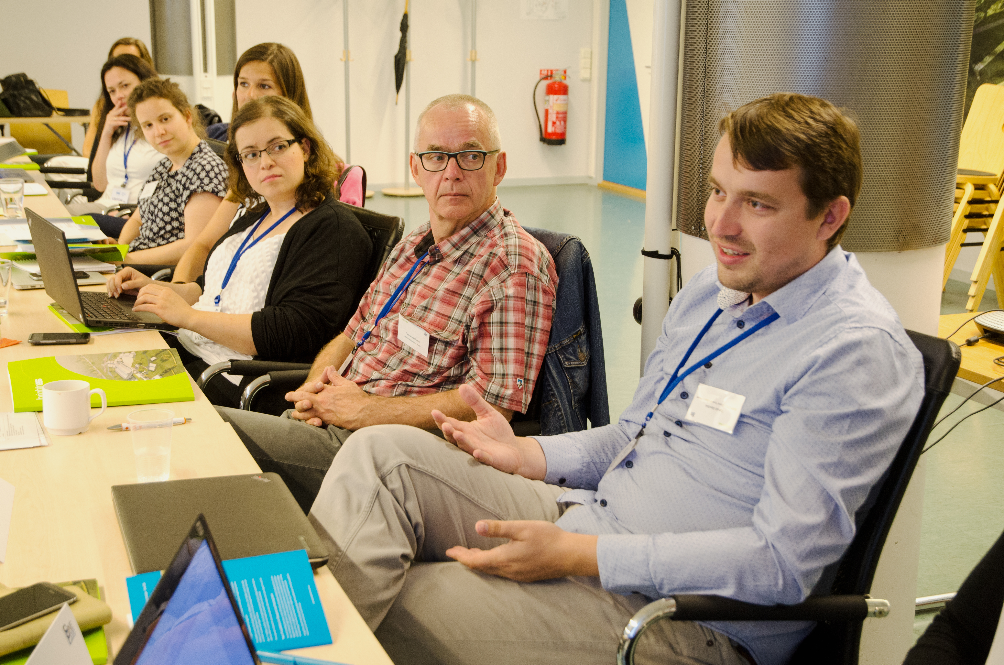
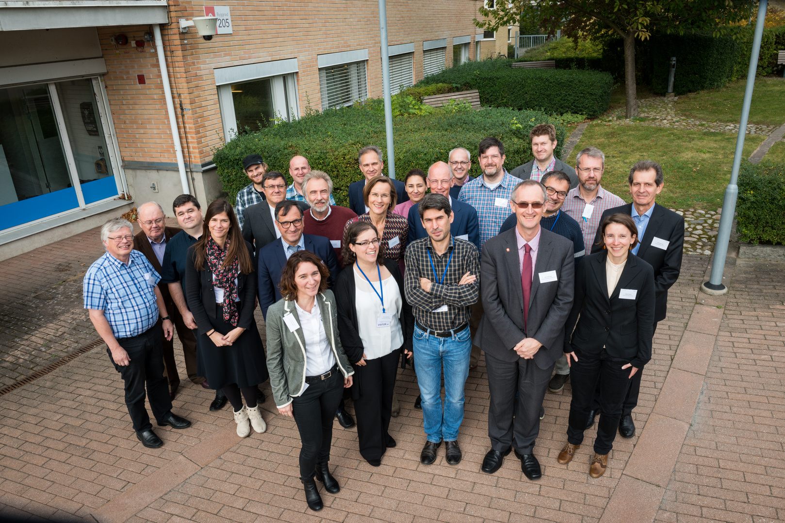
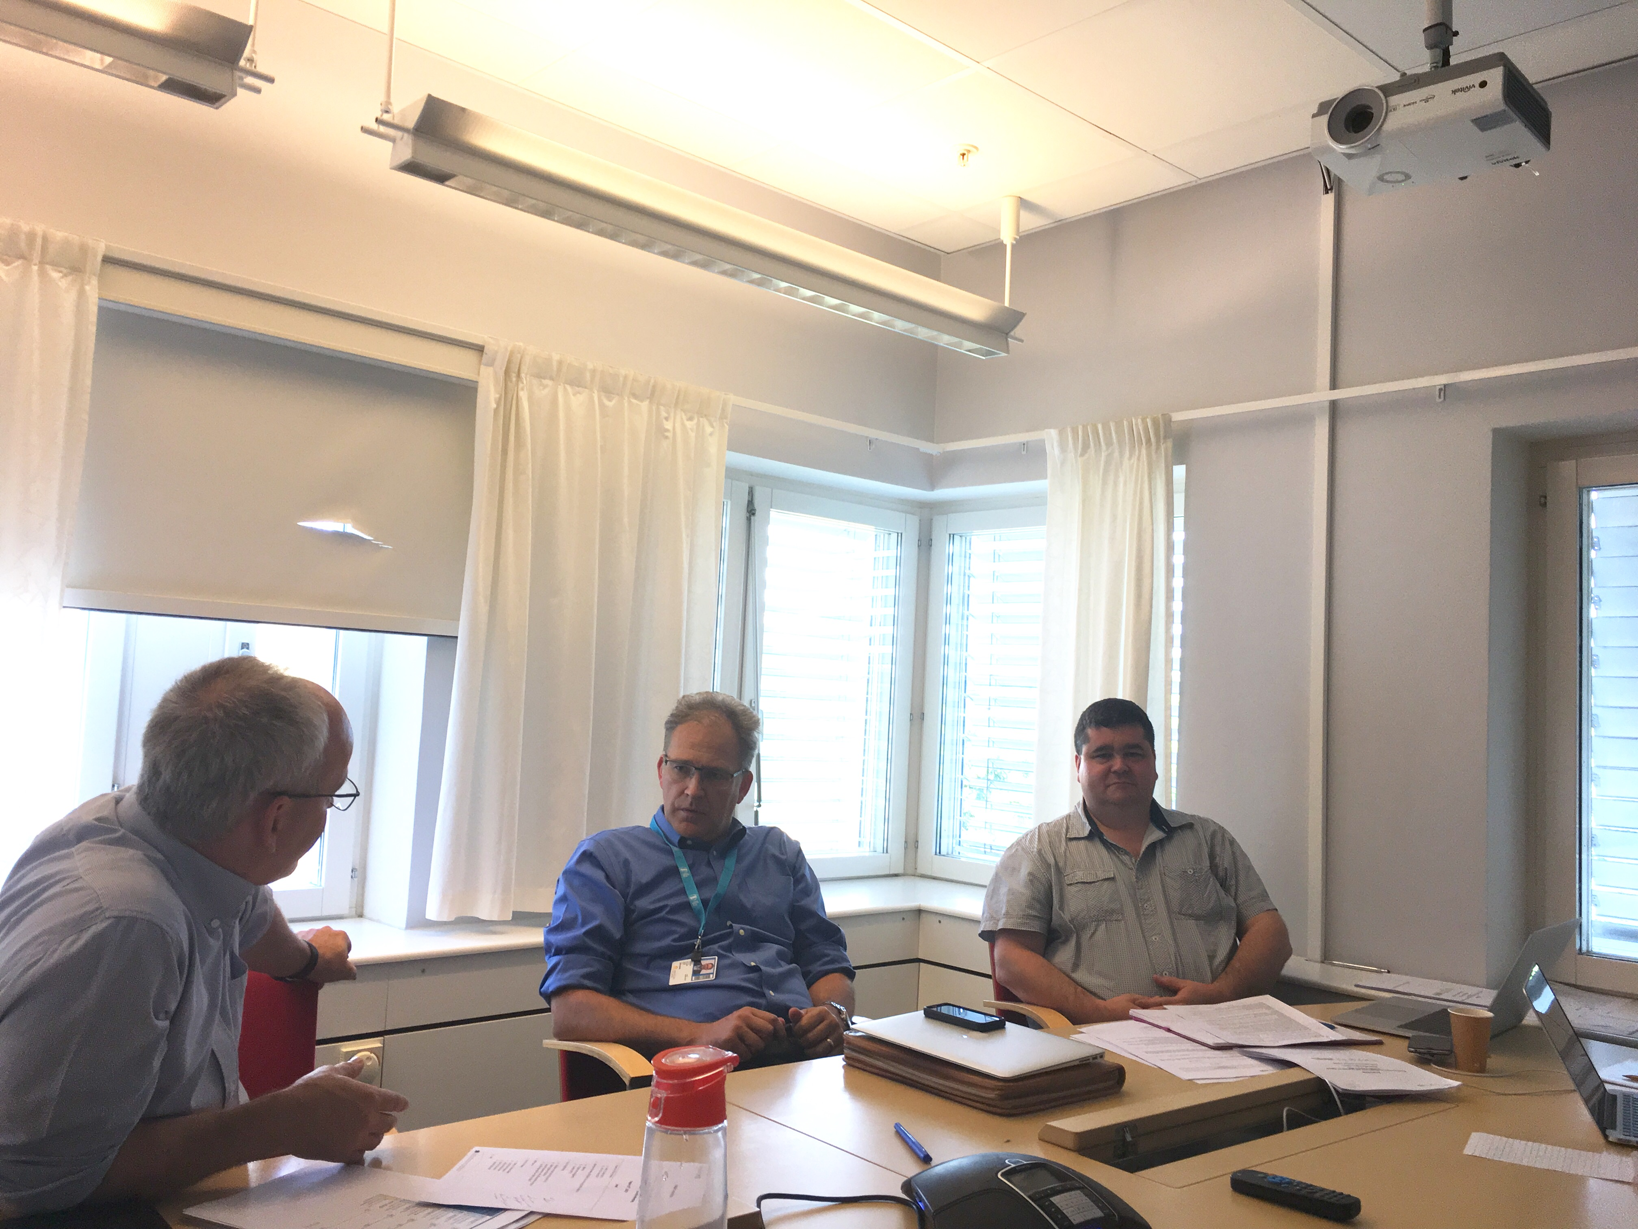
WP1 - work carried out
Established efficient communication channels and ensured interaction between the partners, and clear, timely communication with the Project Officer
Ensured overall project monitoring, proper implementation of the work plan and achievements of results
Facilitated project and dissemination activities together with the consortium bodies
Monitored the adherence to the consortium agreement, in collaboration with the partners
Carried out the day-to-day project management tasks, applying risk and delay management, as well as supporting partners with planning and regulations
Reviewed all documents and materials prepared by the partners
Organised the 1st and 2nd General Assembly meetings
Organised a 2-day training with the admin & financial staff of all partners
Submitted the 1st Periodic Report
Prepared and submitted an amendment to the Grant Agreement
Organised project meetings and teleconferences
Organised project meetings and teleconferences
BrightnESS is funded by the European Union Framework Programme for Research and Innovation Horizon 2020, under grant agreement 676548

Slide 16
(Approved) Amendment to the Grant Agreement
Change of ESS legal status of ESS to ERIC inside EC Participant Portal
Change in subcontracting
(ESS subcontracting to Elettra direct costs for XRM+)
Changed delivery dates of some deliverables
Change from PCP identification to PPI identification
New deliverable (impact assessment) with subcontracting
Addition of partners to WPs (BNC to WP2, ESS-B to WP4) and attribution of PM
Addition of activities (summer courses, visits to/from ESS from outside Europe)
Addition of cost eligibility (ESS visitor centre maintenance, specific risk assessment meetings)
Transfer of activity and potential budget transfer from ESS to LU in WP4
Reduction in new Member countries and ILO nodes (from 5 to 3)
BrightnESS is funded by the European Union Framework Programme for Research and Innovation Horizon 2020, under grant agreement 676548

Slide 17
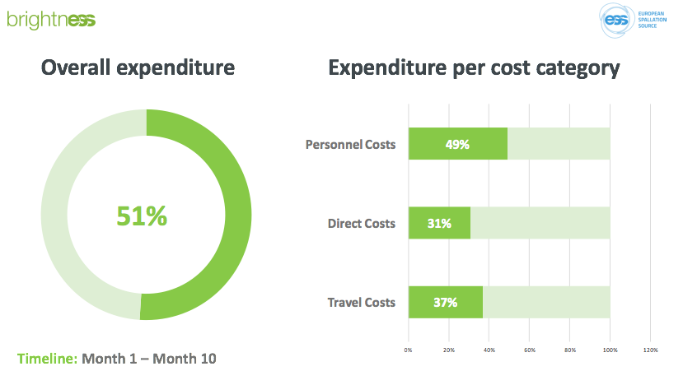
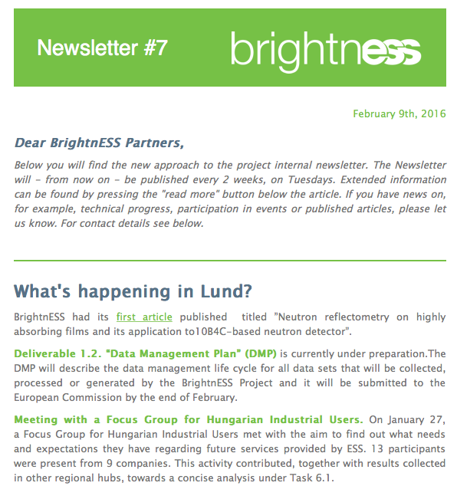
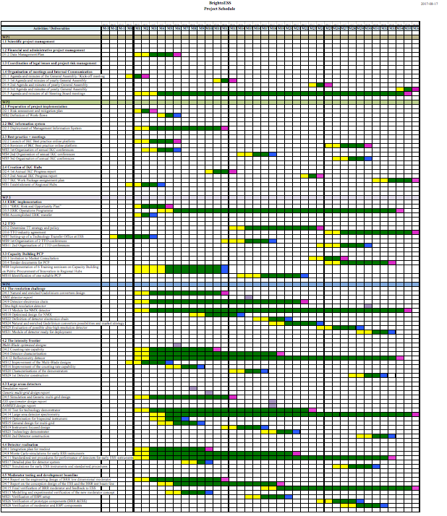
Monitoring tools: approaches and methods
Continuous, clear, honest and targeted communication
Monitoring technical progress and resources
Resource and expenditure monitoring
- Meetings,
- TelCons,
- Newsletter,
- Emails to GA
- STB minutes,
- Monitoring tools,
- Quality check,
- Partner visits
- Quarterly, with analysis per WP and partner
Expect the unexpected
Handle issues at individual level (partner visits)
Consistent collaboration management
Flexibility
- Re-design planning,
- Costs and timeframe; check consequences
- Patience,
- Acceptance of individual unforeseen problems
- Availability,
- Response-time within 24 hrs,
- Knowledge sharing
- Adjusting activities to needs
BrightnESS is funded by the European Union Framework Programme for Research and Innovation Horizon 2020, under grant agreement 676548

Slide 18
Monitoring cost performance
Quarterly monitoring
Budget control
  Project budget and updates
  Record of quarterly reports
  Project performance measurement (global/partner/WP/cost category)
  Partner report via online google form
COST MONITORING TOOL
Preventive function
Work performance indication
Project cost risk management
Performance measurement analysis
  Taking corrective action
  Project cost management plan
  Status assessment
  Comparing actual performance with budget
  Investigating the variance
  Forecasting
  Recommend corrective action
  Risk monitoring
Optimise project full value
BrightnESS is funded by the European Union Framework Programme for Research and Innovation Horizon 2020, under grant agreement 676548

Slide 19
Financials M1 – M22

Slide 20
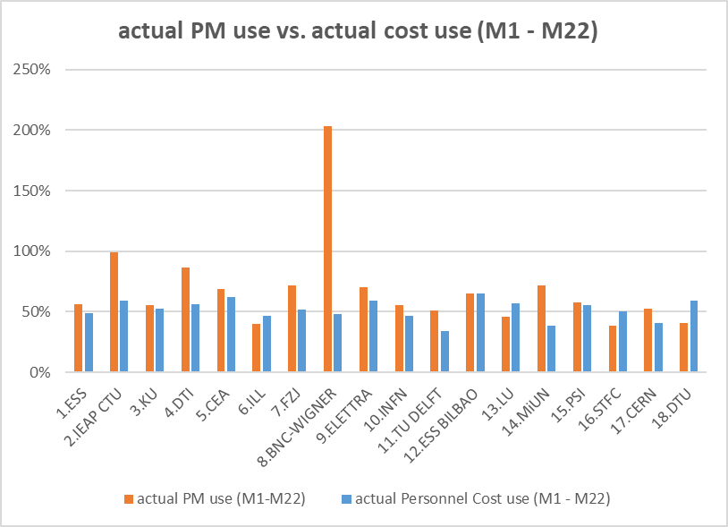
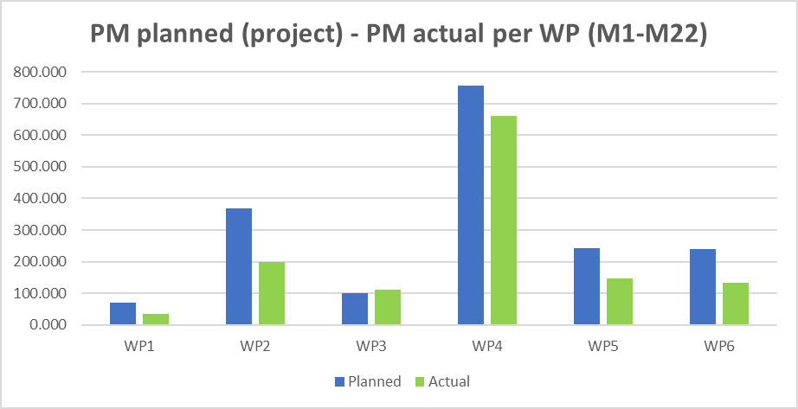
Use of effort & available efforts (PM) - 1
BrightnESS is funded by the European Union Framework Programme for Research and Innovation Horizon 2020, under grant agreement 676548

Slide 21
Personnel effort - 2
BrightnESS is funded by the European Union Framework Programme for Research and Innovation Horizon 2020, under grant agreement 676548

Slide 22
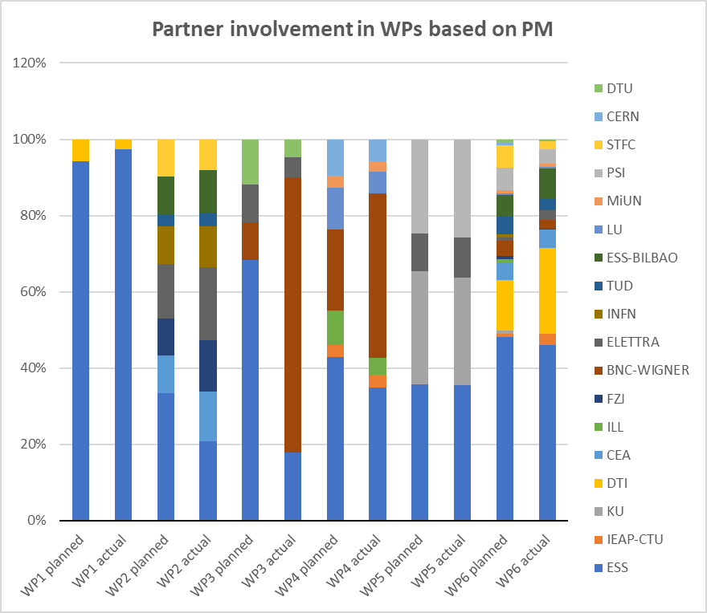
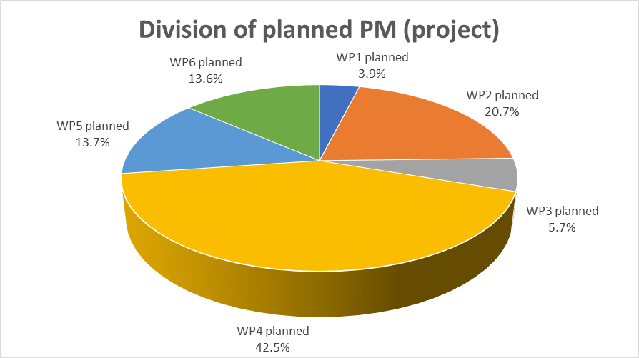
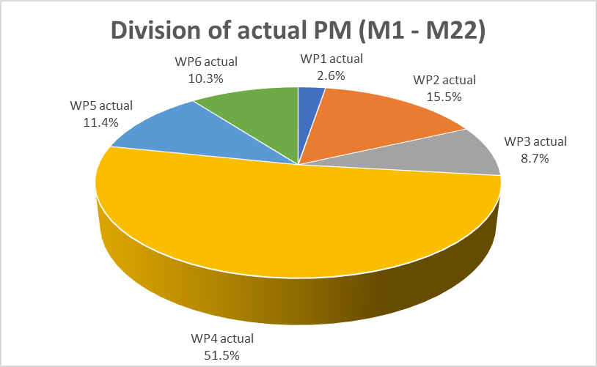
Role of WPs & partners’ role in WPs (based on PMs)
BrightnESS is funded by the European Union Framework Programme for Research and Innovation Horizon 2020, under grant agreement 676548

Slide 23
Use of effort & available efforts (PM) - 2
BrightnESS is funded by the European Union Framework Programme for Research and Innovation Horizon 2020, under grant agreement 676548

Slide 24
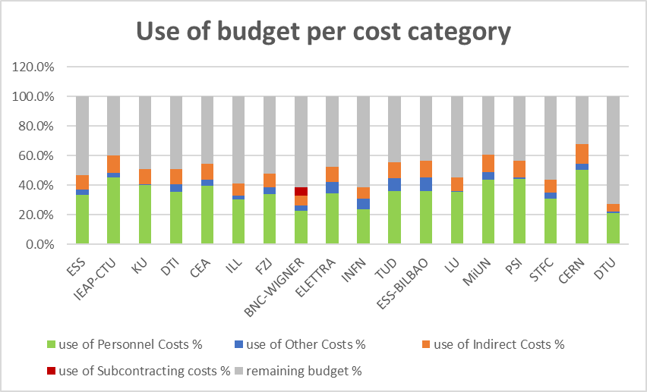
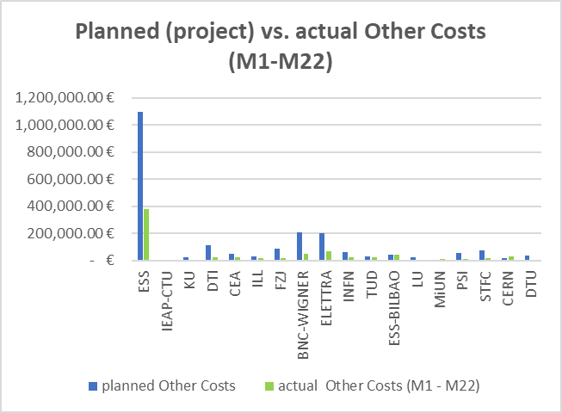
Use of budget - 1
BrightnESS is funded by the European Union Framework Programme for Research and Innovation Horizon 2020, under grant agreement 676548

Slide 25
Use of budget - 2
BrightnESS is funded by the European Union Framework Programme for Research and Innovation Horizon 2020, under grant agreement 676548

Slide 26
Use of budget – 3
(scenario based on extrapolation of M19-M22 expenditure)
BrightnESS is funded by the European Union Framework Programme for Research and Innovation Horizon 2020, under grant agreement 676548

Slide 27
Cost flexibility and planning
Current situation:
cost variance of 12% compared to linear cost progression (not realistic!), but all targets for the period have been met
forward extrapolation scenario indicates overall spent of 94%
WP1 and WP-leaders are checking forward planning for M23-M36 with all partners. Ambitious targets (expansion of existing tasks) per partner will likely result in full cost expenditure
Contingency:
WP1 to prepare a re-designed plan for individual WPs or across the project by March 2018
Examples of spending M22-M36:
WP1/WP5: implementation DMP
WP2: addition of workshop on rules/regulations on ESS-IKC installation in Sweden
WP3: innovation trainings and TTO conferences
WP4: ESS-B added to develop viability study on low background thermal neutron beam monitor
WP6: DTI to produce several BrightnESS partner videos
BrightnESS is funded by the European Union Framework Programme for Research and Innovation Horizon 2020, under grant agreement 676548

Slide 28
Summary status
Technical
Financial
Risks
  17 out of 21 deliverables successfully submitted
  (M1 – M22)
  almost all milestones for the period achieved
  planning is on target and monitoring is running
  amendment approved
  Periodic Report ‘approved’
  collaboration running
  smoothly
  ACTIONS:
  start work on Impact
  Assessment
  update KPI list
  Cost Monitoring Tool in place and checked with partners
  Financial Statements checked
  spend monitoring
  ACTIONS:
  solve ‘Portal linking’
  transfer Interim Payment
  improve monitoring tool
  track partner costs
  verify partner entries in
  periodic reporting
  staffing (WP contingency)
  under-reporting by partners
  ACTIONS:
  WP-leaders to revise
  activities/budgets;
  WP1 to monitor availability
  and follow-through of
  forward planning by partners
BrightnESS is funded by the European Union Framework Programme for Research and Innovation Horizon 2020, under grant agreement 676548

Slide 29
Thank you!
Questions or comments, please

