Slide 1
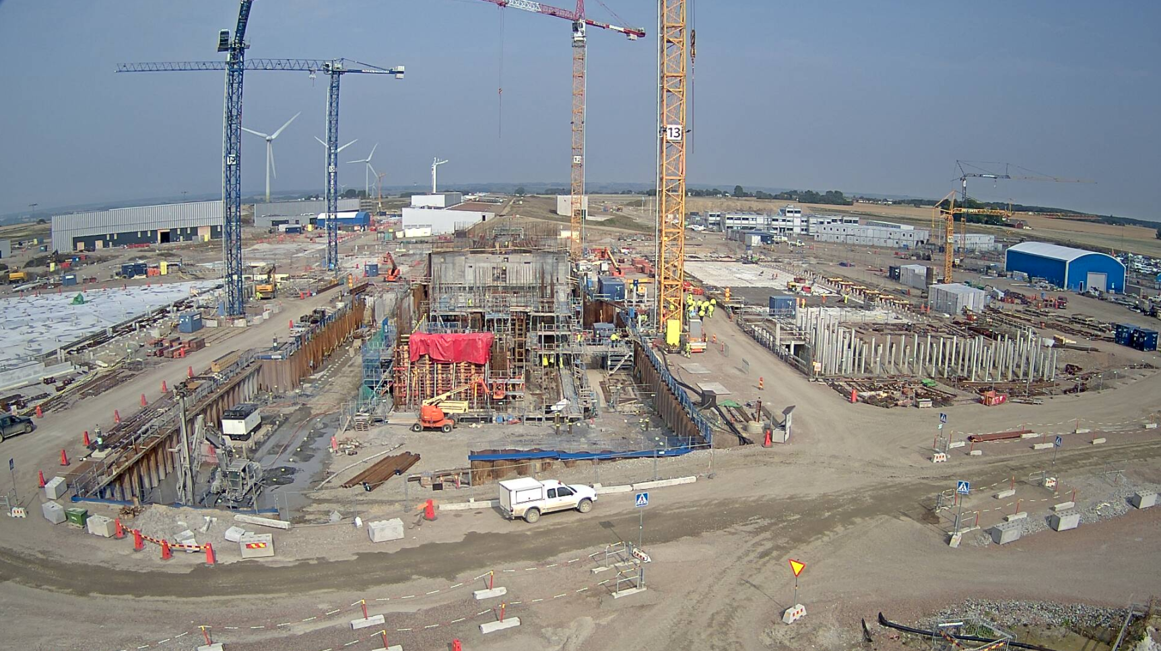

  The European Spallation Source
  John Womersley, Director General
  September 2017

Slide 2
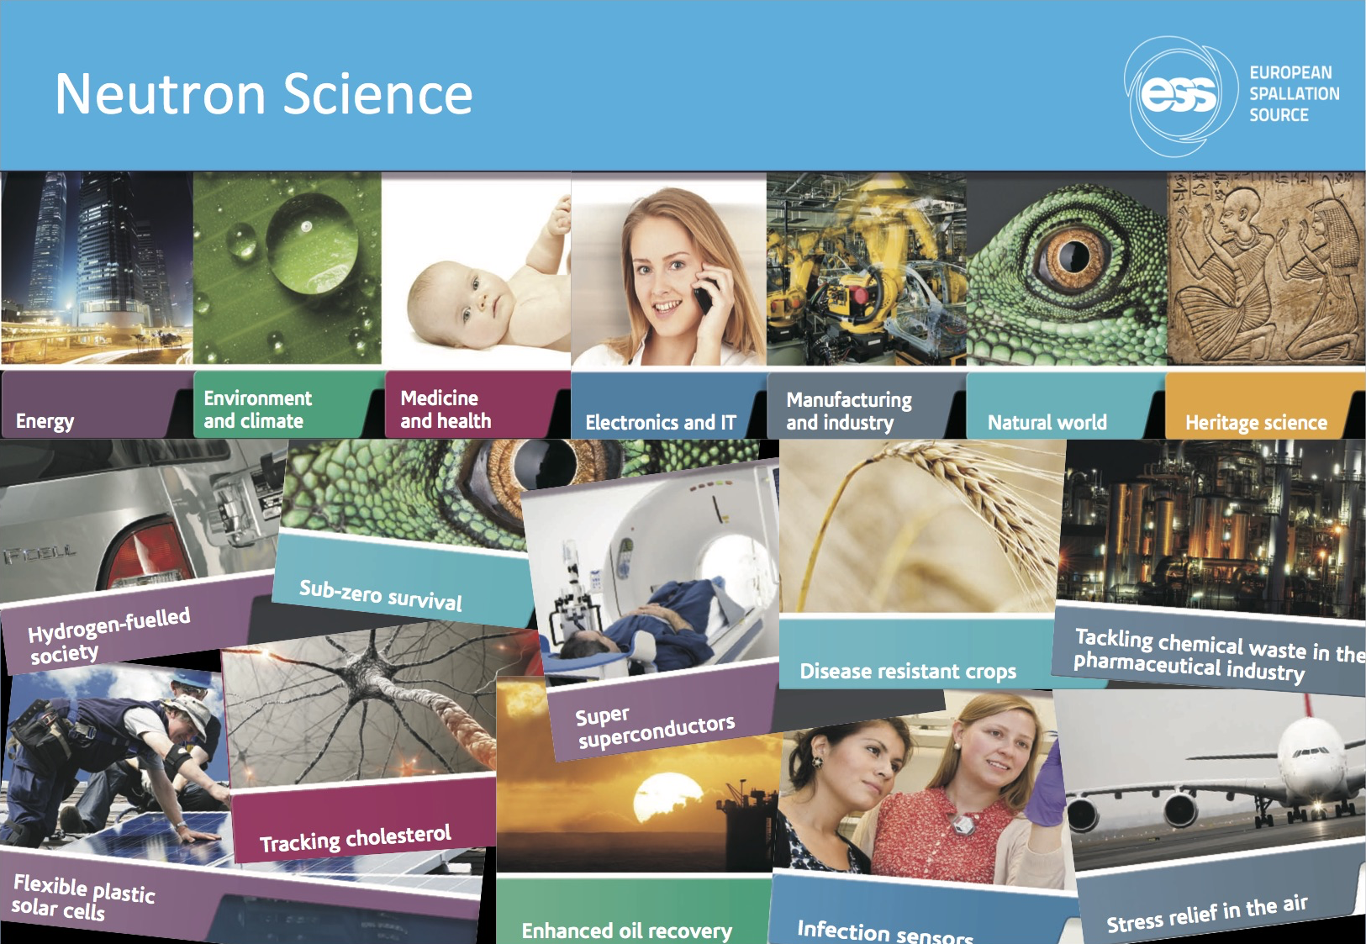
Neutron science

Slide 3



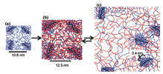




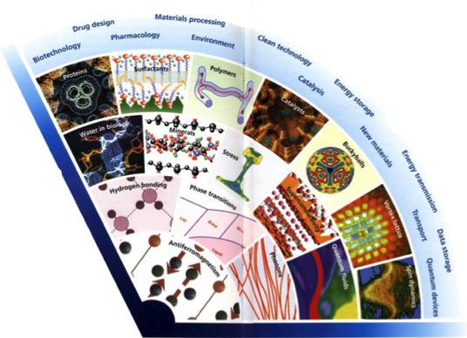
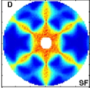

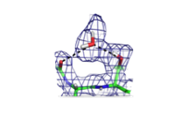

Neutron science needs to push the boundaries
Wider range of application areas
In Operandi Advanced
Energy Devices
Multi-scale structure
and dynamics
Kinetics of Complex
micro-fluids
Complex Interfaces
Charge and spin
Transport
in Novel Materials
New States of Matter
Quantum Enzymology
Protein Dynamics
2020+
2000’s
1990
Greater Materials Complexity /
Need for Precision
1980
Time
1970
1960

Slide 4
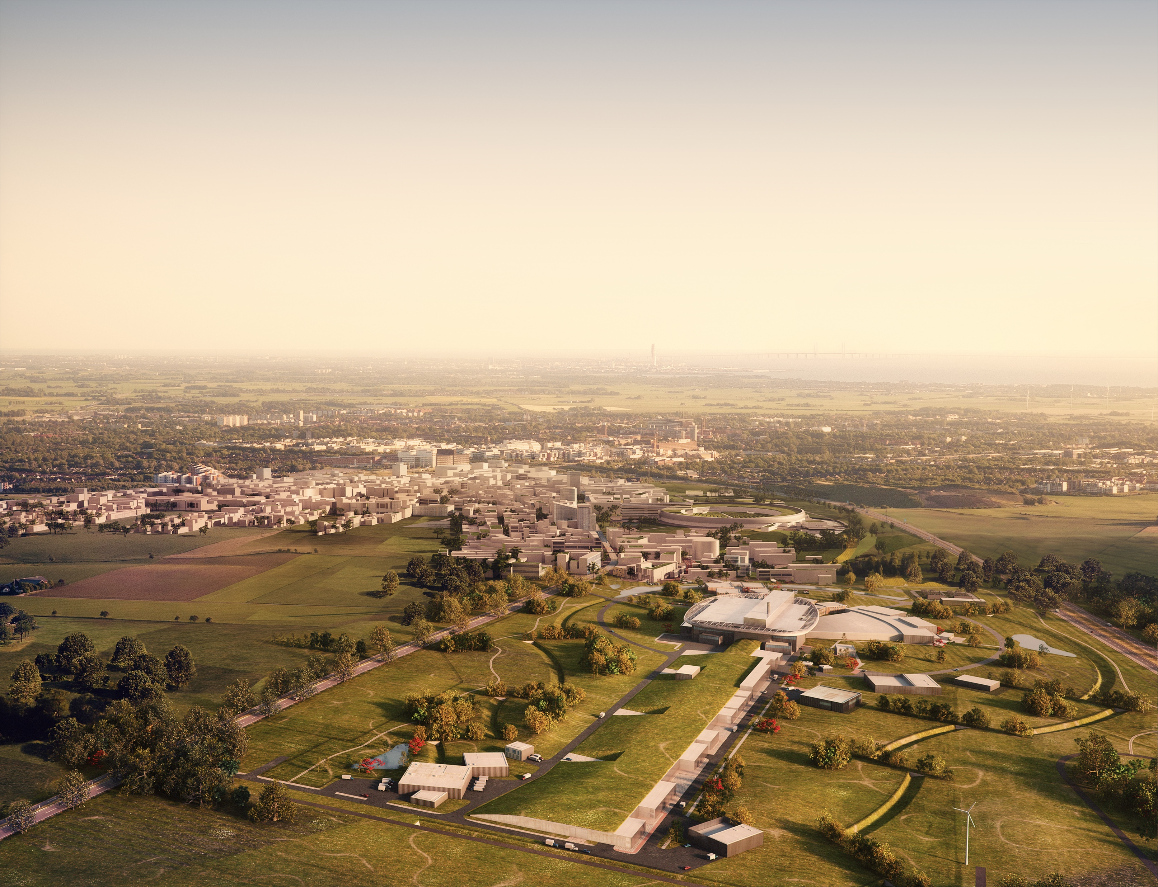
Vision, Mission and Values
ESS Vision
Our vision is to build and operate the world’s most powerful neutron source, enabling scientific breakthroughs in research related to materials, energy, health and the environment, and addressing some of the most important societal challenges of our time.
Mission
To do this, we commit to deliver ESS as a facility that:
Is built safely, on time and on budget
Produces research outputs that are best-in-class both in terms of scientific quality and in terms of socioeconomic impact
Supports and develops its user community, fosters a scientific culture of excellence and acts as an international scientific hub
Operates safely, efficiently and economically, and responds to the needs of its stakeholders, its host states and member states
Develops innovative ways of working, new technologies, and upgrades to capabilities needed to remain at the cutting edge
Core Values
Excellence • Collaboration • Openness • Sustainability

Slide 5
Neutron facilities
Reactor sources
Accelerator-driven sources
ESS
Effective thermal neutron flux n/cm²-s
J-PARC
NIST
ILL
LANSCE
ISIS
FRM-II
SNS
CSNS
Year

Slide 6
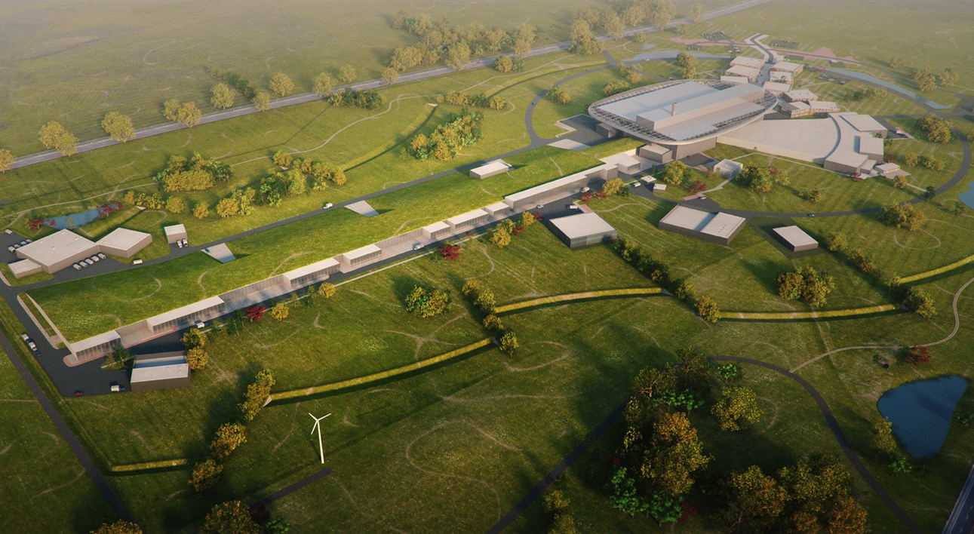
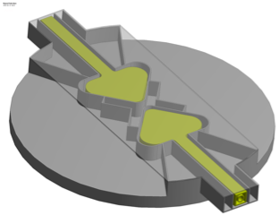
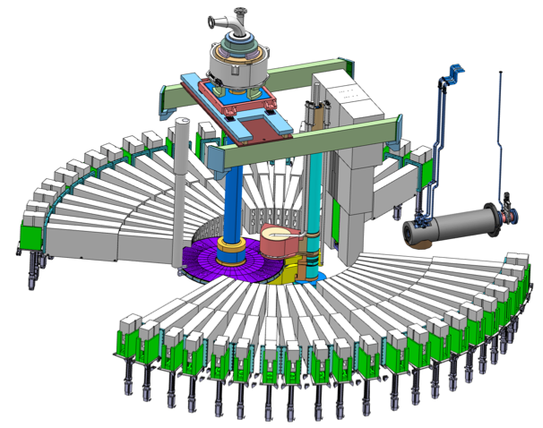
ESS High level design
Flat moderator delivering smaller and brighter neutron beams
High Power Accelerator means more neutrons
High brightness and tuneable resolution makes new measurements possible
An Innovative Target Station that can host >30 instruments

Slide 7
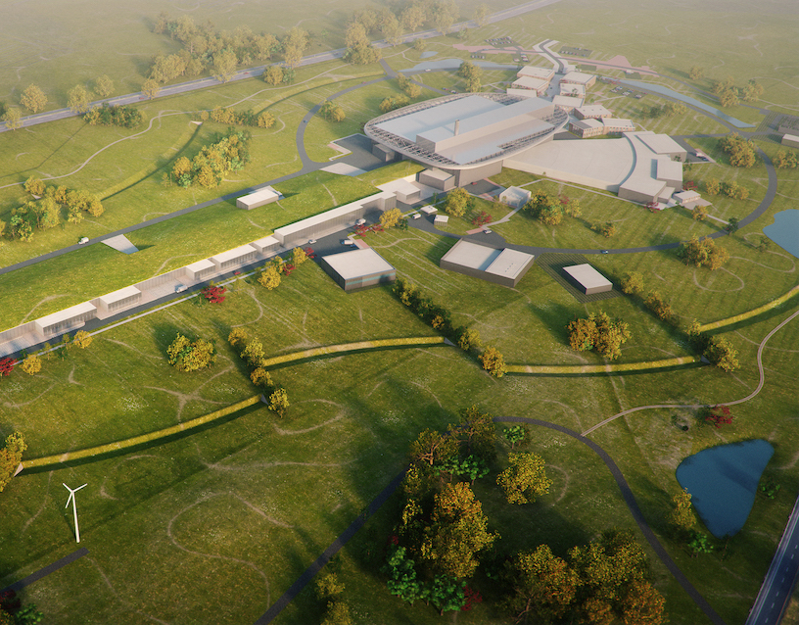
Journey to deliver the world’s leading facility for research using neutrons
2025
ESS Construction Phase Complete
2014
Construction Starts on Green Field Site
2023
ESS Starts
User Program
2009
Decision to Site ESS in Lund
2019
Start of Initial Operations Phase
2012
ESS Design Update Phase Complete
2003
European Design of ESS Completed

Slide 8
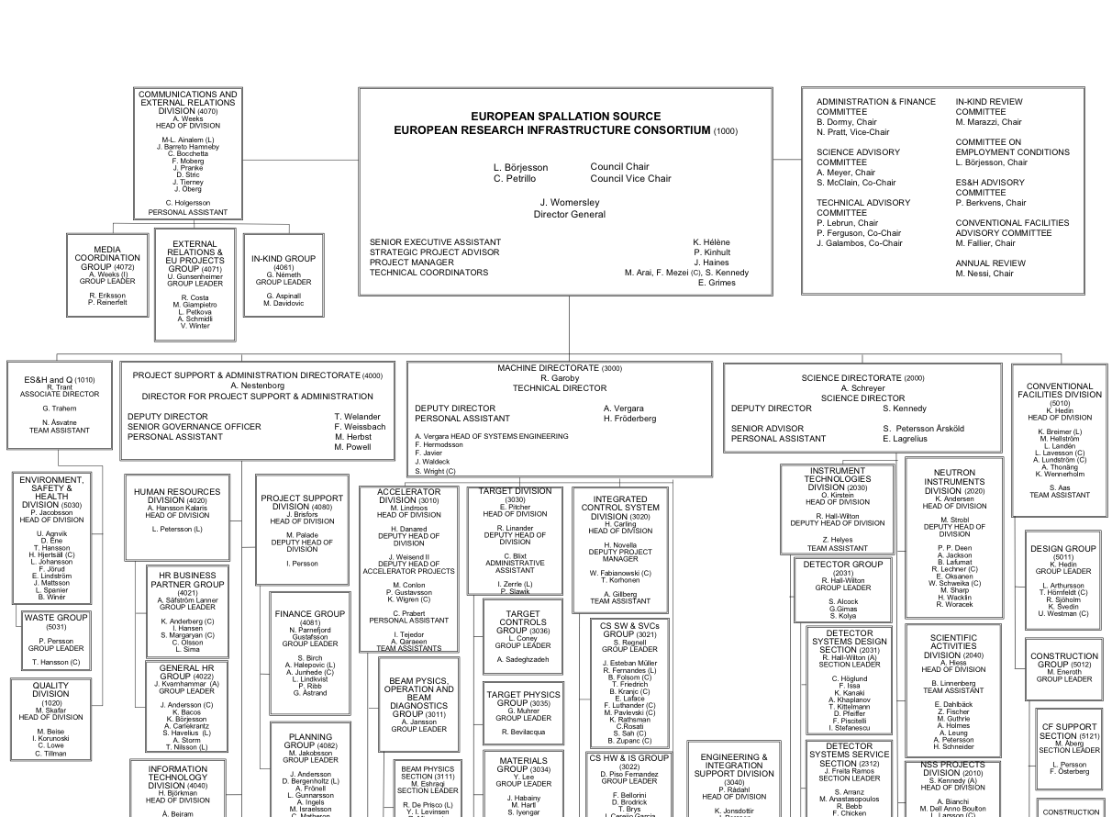


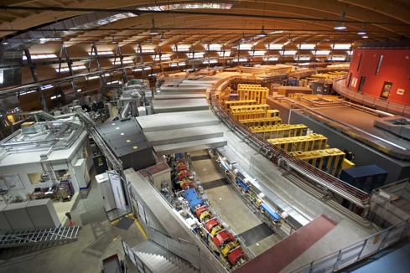
Organisation and People
409
Employees
48
Nationalities
~ 100
Collaborating Institutions
Notes:
As of 14 June 2017

Slide 9















Financing includes cash and deliverables
The European Spallation Source ERIC established in 2015
Host Countries Sweden and Denmark
Construction 47.5% Cash Investment ~ 97%
Operations 15%
Non Host Member Countries
Construction 52.5% In-kind Deliverables ~ 70%
Operations 85%
15 European Member and Observer Countries

Slide 10
ESS In-Kind Goals
Construction cost: € 1,84 Billion
In-Kind: € 747.5 Million
€ 510 M
40.5%
€ 350 M
75%
65%
€ 155 M
€ 73 M
65%
50%
Controls
Target
Instruments (NSS)
Accelerator

Slide 11
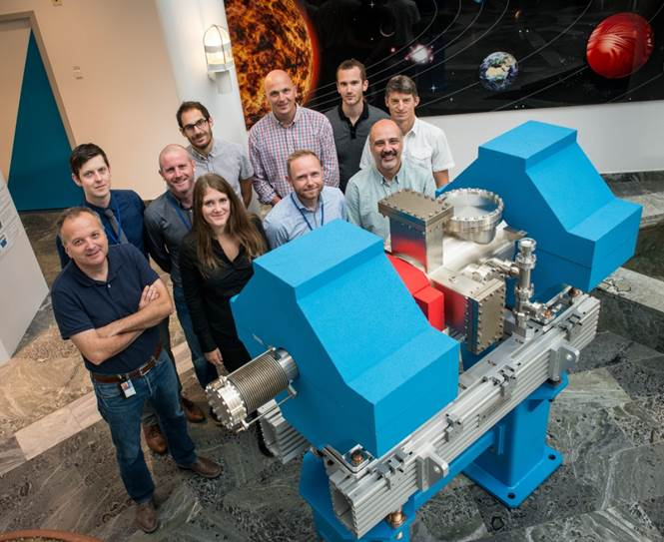
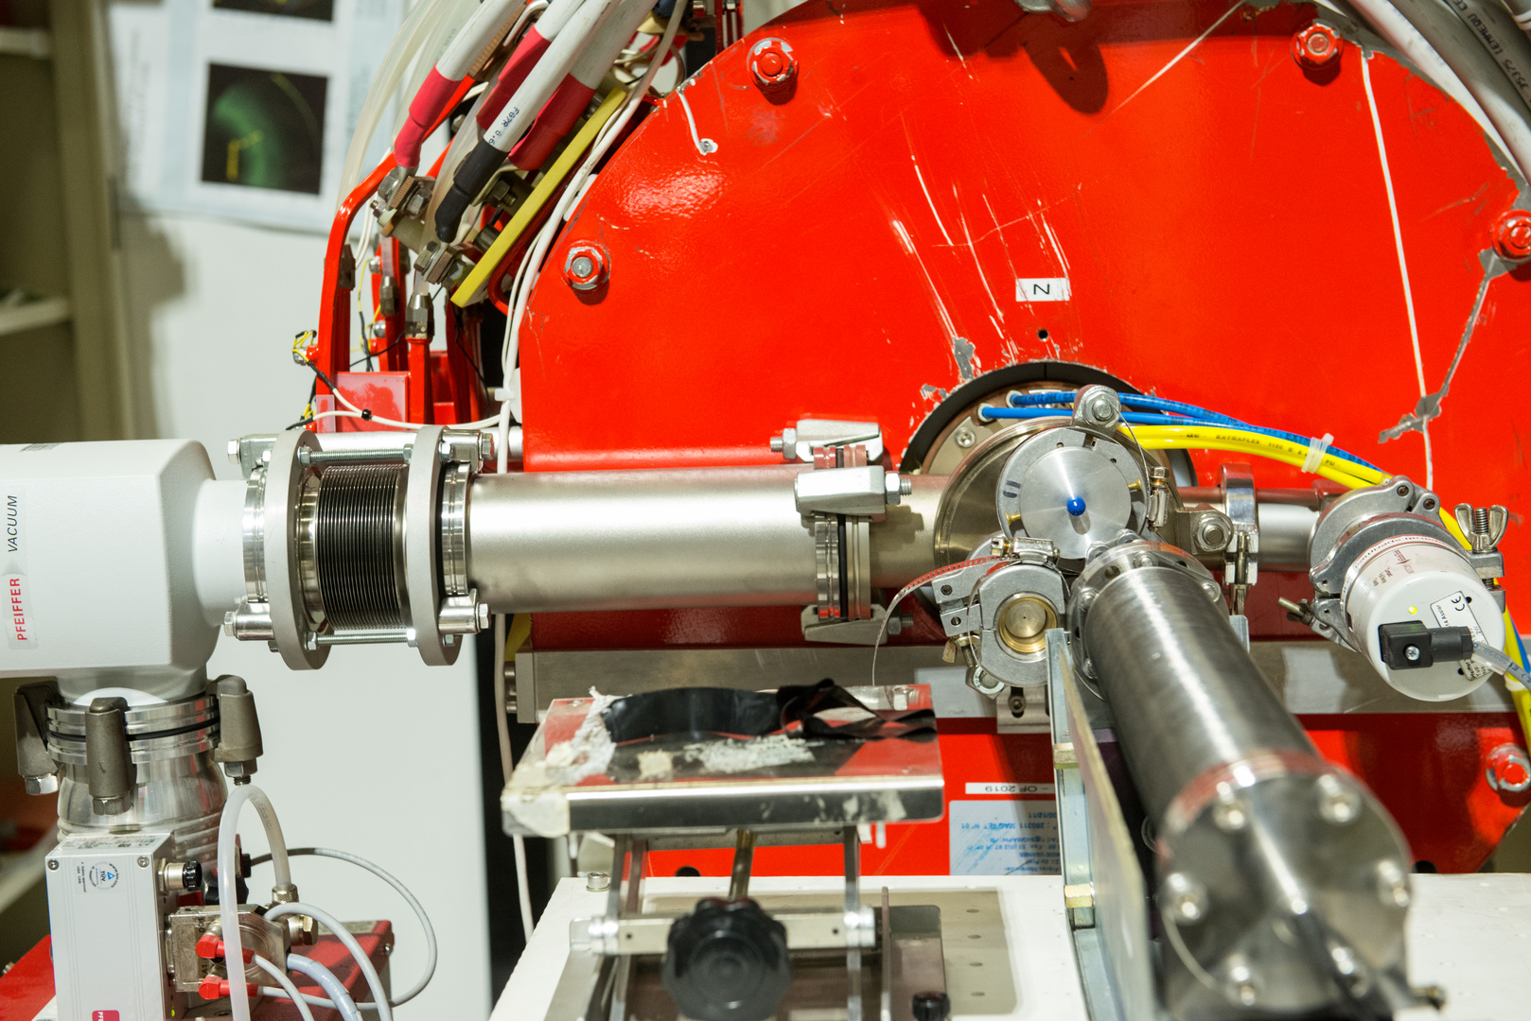
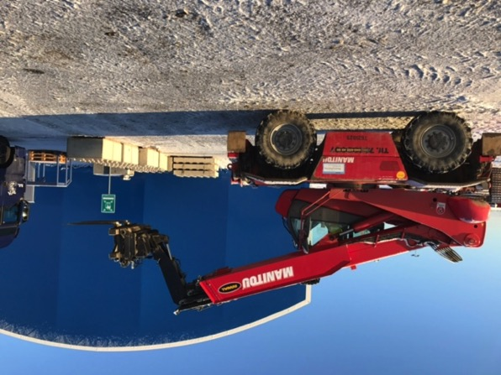
ESS In-kind Partners
Aarhus University
Atomki - Institute for Nuclear Research
Bergen University
CEA Saclay, Paris
Centre for Energy Research, Budapest
Centre for Nuclear Research, Poland, (NCBJ)
CNR, Rome
CNRS Orsay, Paris
Cockcroft Institute, Daresbury
Elettra – Sincrotrone Trieste
ESS Bilbao
Forschungszentrum Jülich
Helmholtz-Zentrum Geesthacht
Huddersfield University
IFJ PAN, Krakow
INFN, Catania
INFN, Legnaro
INFN, Milan
Institute for Energy
Research (IFE)
ISIS - Rutherford-Appleton Laboratory, Oxford
Laboratoire Léon Brilouin (LLB)
Lund University
Nuclear Physics Institute of the ASCR
Oslo University
Paul Scherrer Institute (PSI)
Polish Electronic Group (PEG)
Roskilde University
Tallinn Technical University
Technical University of Denmark (DTU)
Technical University Munich (TUM)
Science and Technology Facilities Council
University of Copenhagen (KU)
University of Tartu
Uppsala University
Wigner Research Centre for Physics
Wroclaw University of Technology
Warsaw University of Technology
Zurich University of Applied Sciences (ZHAW)

Slide 12

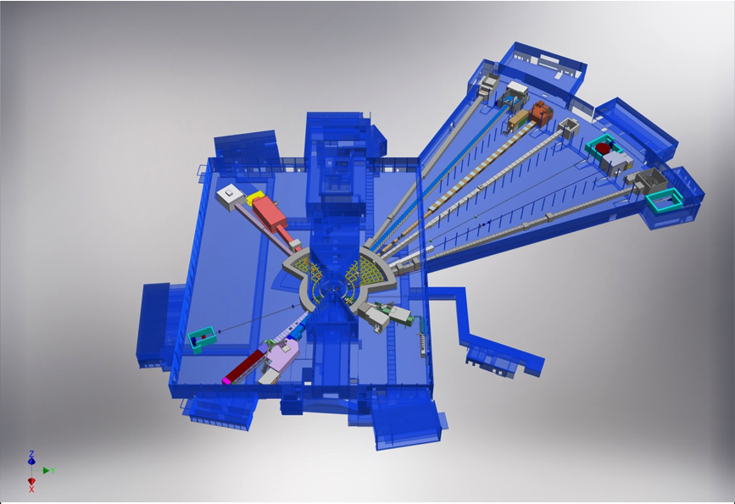











NSS Neutron Instrument positions
ESS Lead Partners for instrument construction
+
Nuclear Physics Institute
NMX
BEER
+
C-SPEC
BIFROST
MIRACLES
MAGIC
ODIN
T-REX
DREAM
HEIMDAL
LoKI
VESPA
FREIA
SKADI
ESTIA
+
ESS In-Kind Partners also collaborate on sample environment, data management systems etc.
ESS Instrument Layout (December 2016)

Slide 13
The 15 NSS Project Instruments
All are funded to be world leading in 2023
Instrument Class | Instrument | Costbook Value (M€) | Performance targets (@ 2MW)
Large Scale Structures | LOKI (Broad band SANS) | 12.19 | 5 x D22 & 20 x SANS2D
 | SKADI (General Purpose SANS) (+SONDE funds) | 11.50 | 4 x D22
 | ESTIA (Focusing Reflectometer) | 11.80 | Conventional mode: ~ 100 x D17 High intensity mode: 1cm² samples = seconds
 | FREIA (Liquids Reflectometer) | 13.2 | 30 x FIGARO, INTER
Diffraction | DREAM (Bispectral powder diffractometer) | 13.66 | > 10 x POWGEN or WISH
 | HEIMDAL (Hybrid diffractometer) | 13.55 | ~ 50 x GEM, ~ 8 x new POLARIS
 | MAGIC (magnetism single crystal diffractometer) | 13.10 | Cold: > 100 x worlds best, Thermal: 1mm³ crystals = 10 min
 | NMX (Macromolecular crystallography) | 11.67 | > 10 x LADI & Biodiff
Engineering & Industrial | BEER (Engineering diffractometer) | 14.99 | world leading in strain scanning, unique flexibility
 | ODIN (multi-purpose imaging) | 11.60 | world leading for high resolution, > 10 x best for TOF methods
Spectroscopy | BIFROST (extreme environment spectrometer) | 13.45 | > 10 x THALES & MACS
 | C-SPEC (cold chopper spectrometer) | 16.50 | 100 x IN5 (w RRM)
 | T-REX (bispectral chopper spectrometer) | 16.85 | 3 x 4-SEASONS, 3 x IN5
 | VESPA (vibrational spectroscopy) | 12.0 | 10 x VISION (ΔE = 130 meV)
 | MIRACLES (backscattering spectrometer) | 13.53 | 2 x BASIS and DNA
Total cost book value |  | 199.59

Slide 14
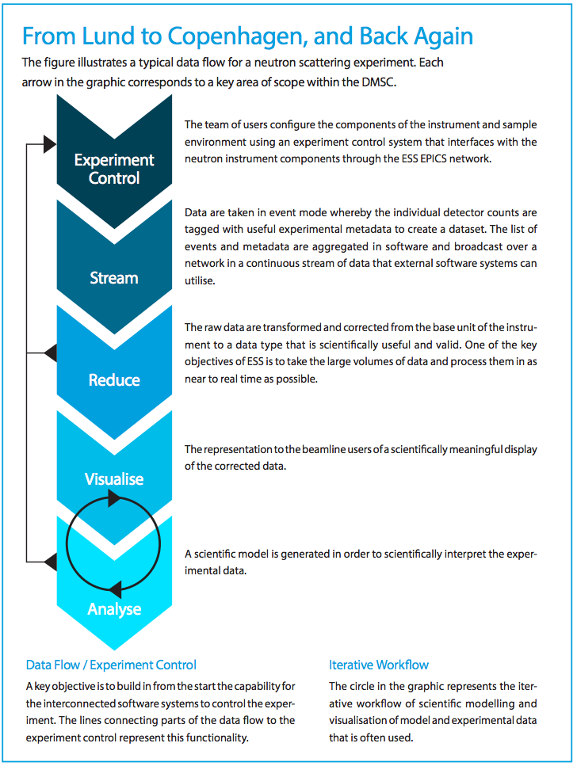
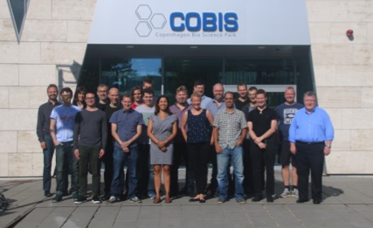
Data Management and Software Centre
COBIS, Copenhagen University North Campus
Provide world leading scientific software and scientific computing support for neutron scattering at ESS
Scientific Software
ESS experiment control system, Data acquisition, Data correction software, visualization, and software to model and analyze experimental data sets.
Data center operations
Store and catalogue ESS datasets, provide ESS users remote access to their data, computing for live data correction, and analysis software during and after experiments.
User support
Support ESS users with
data treatment and
analysis.
14

Slide 15
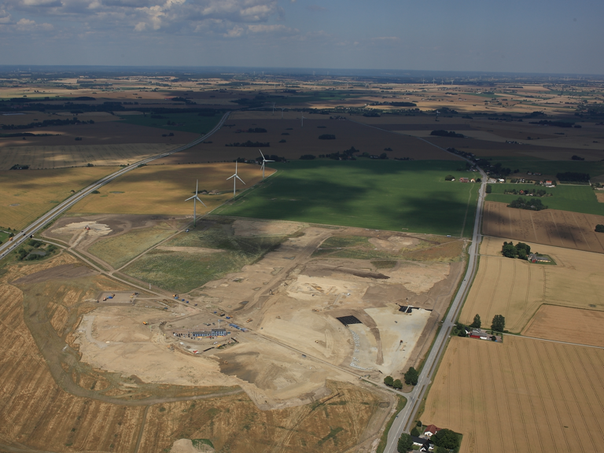
Civil Construction Groundbreaking
September 2014

Slide 16
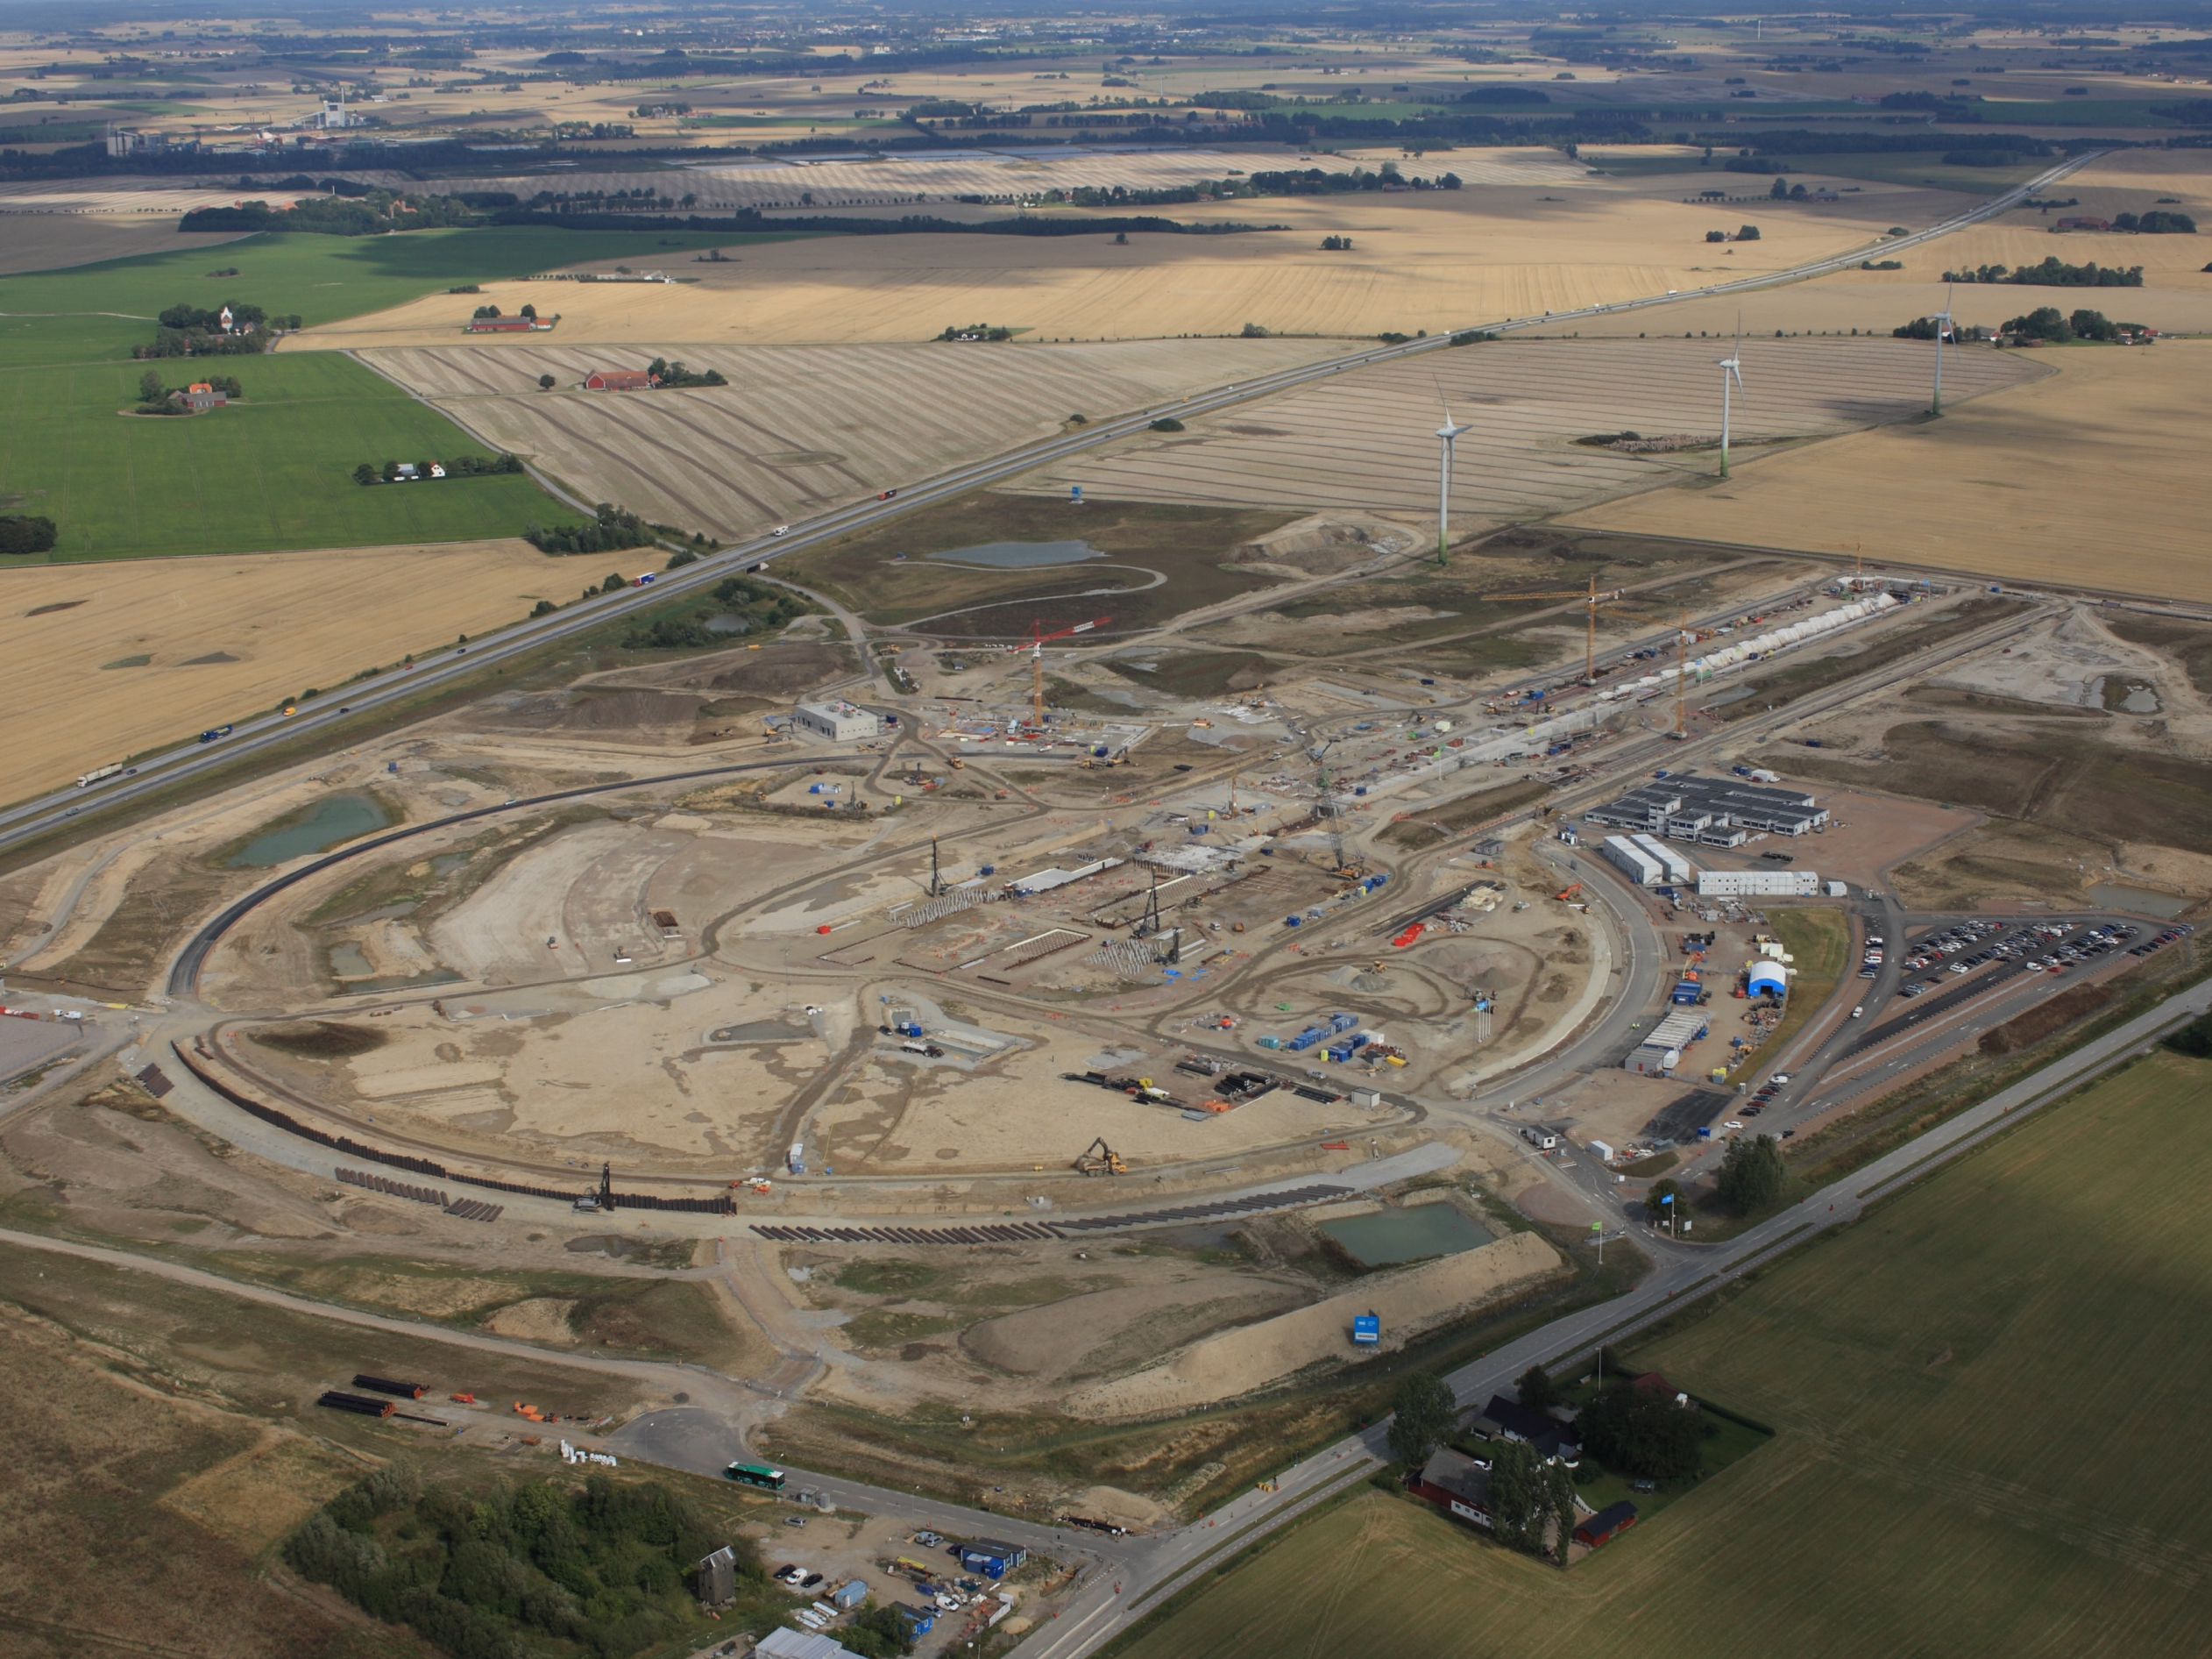
Civil Construction Groundbreaking
September 2015

Slide 17
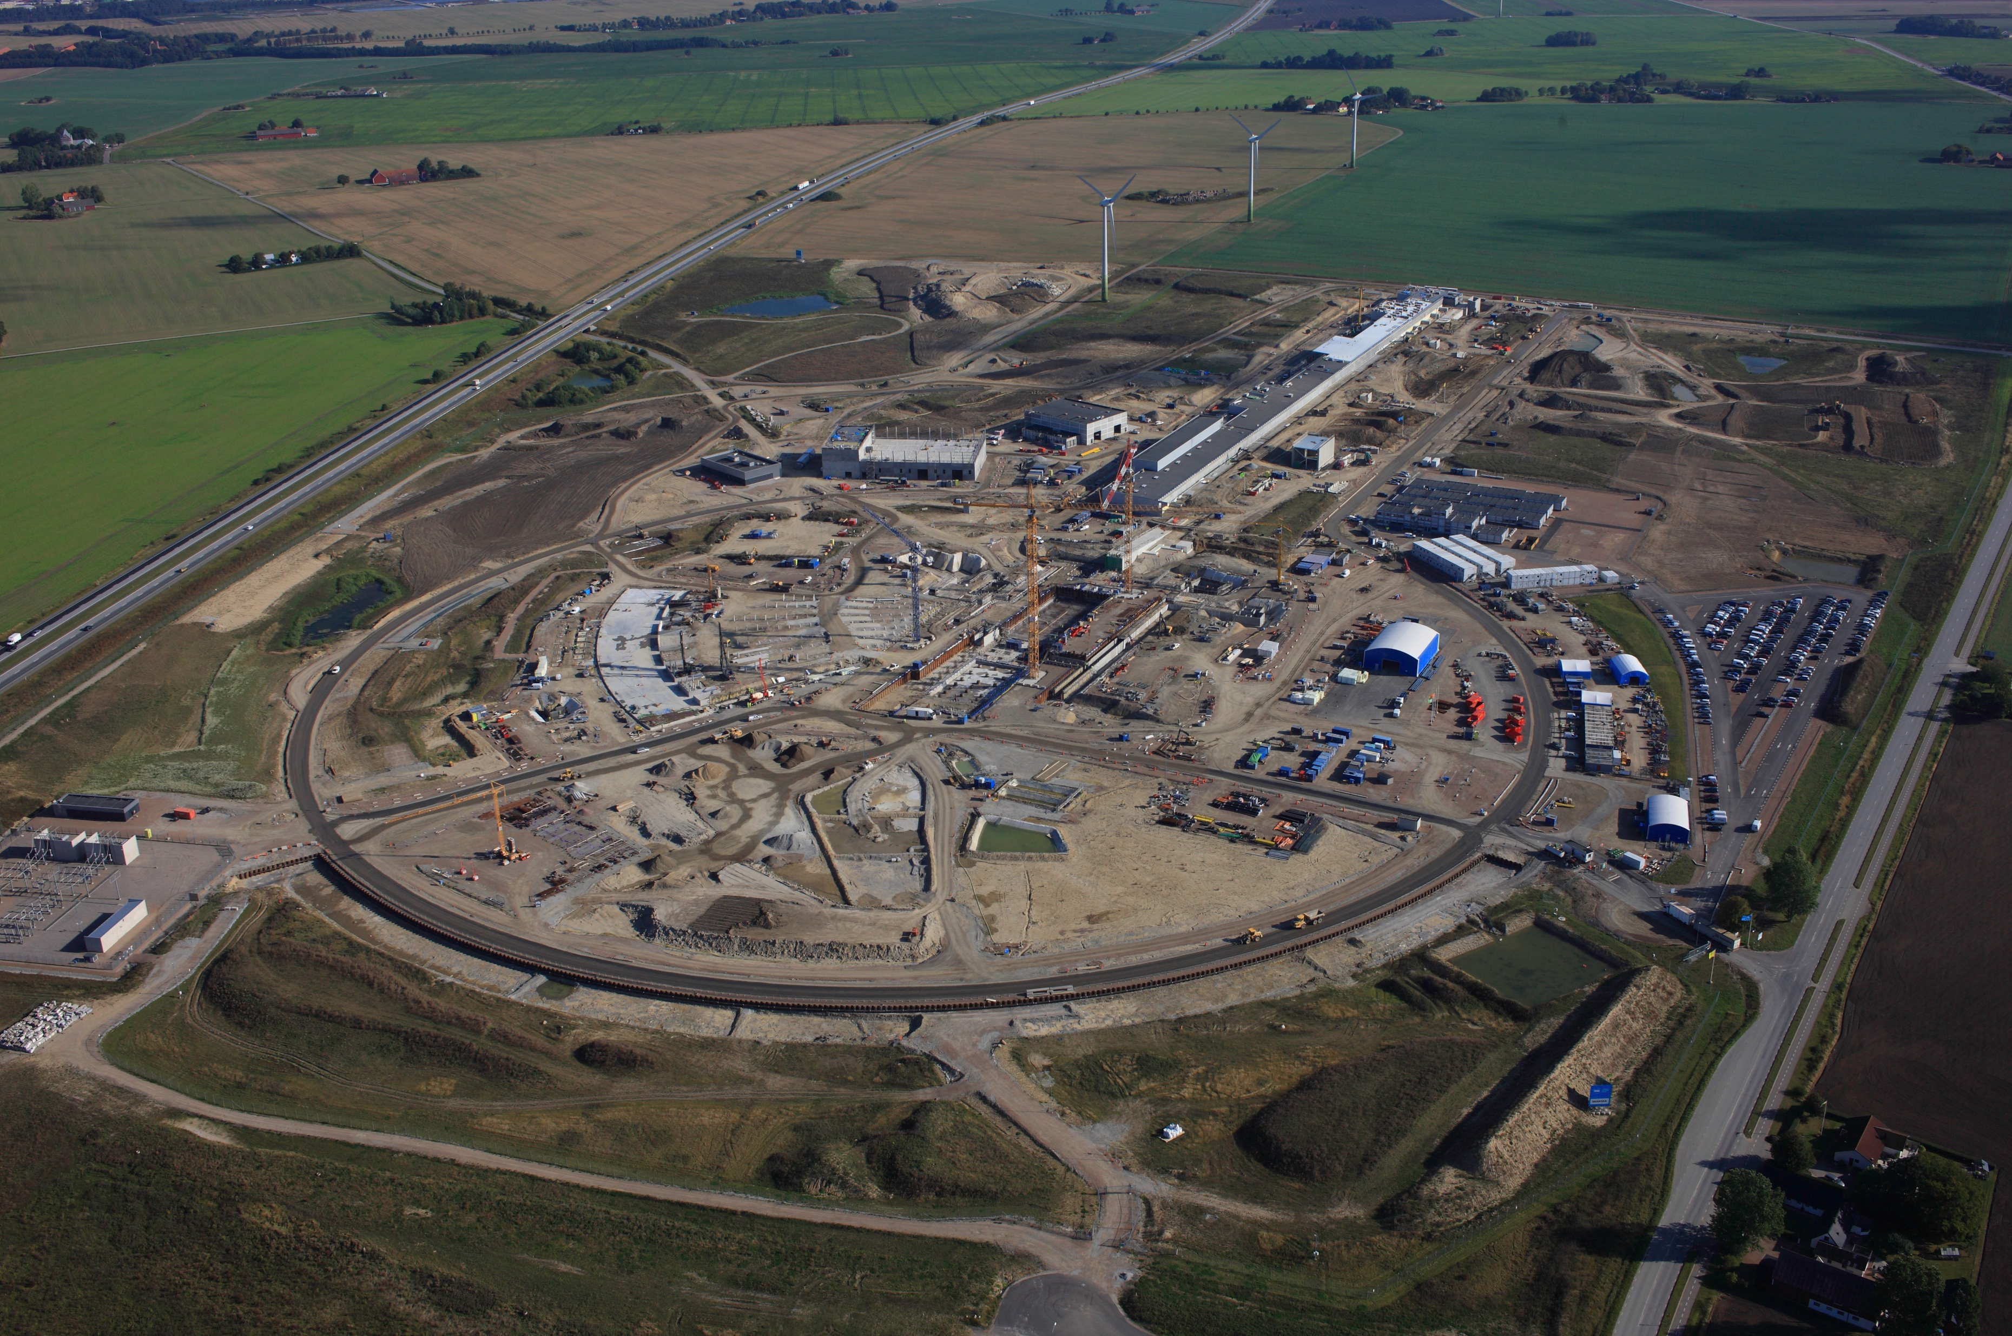
Civil Construction Groundbreaking
September 2016

Slide 18
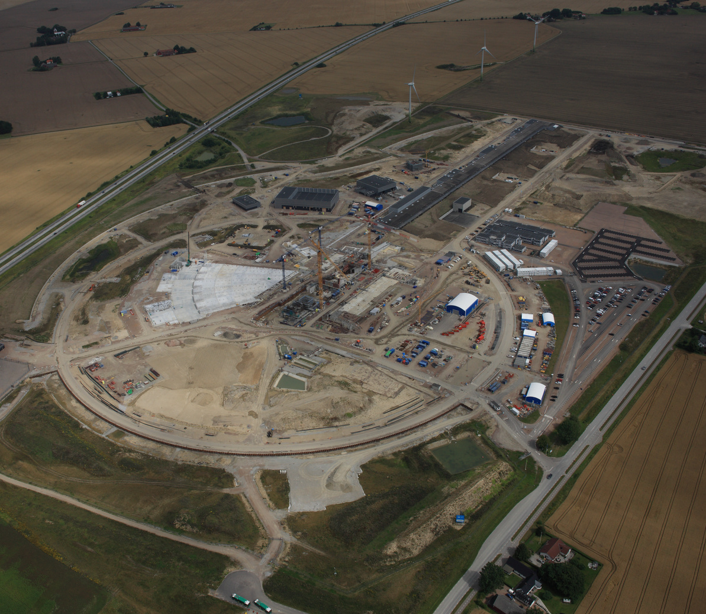
Civil Construction Groundbreaking
September 2017

Slide 19
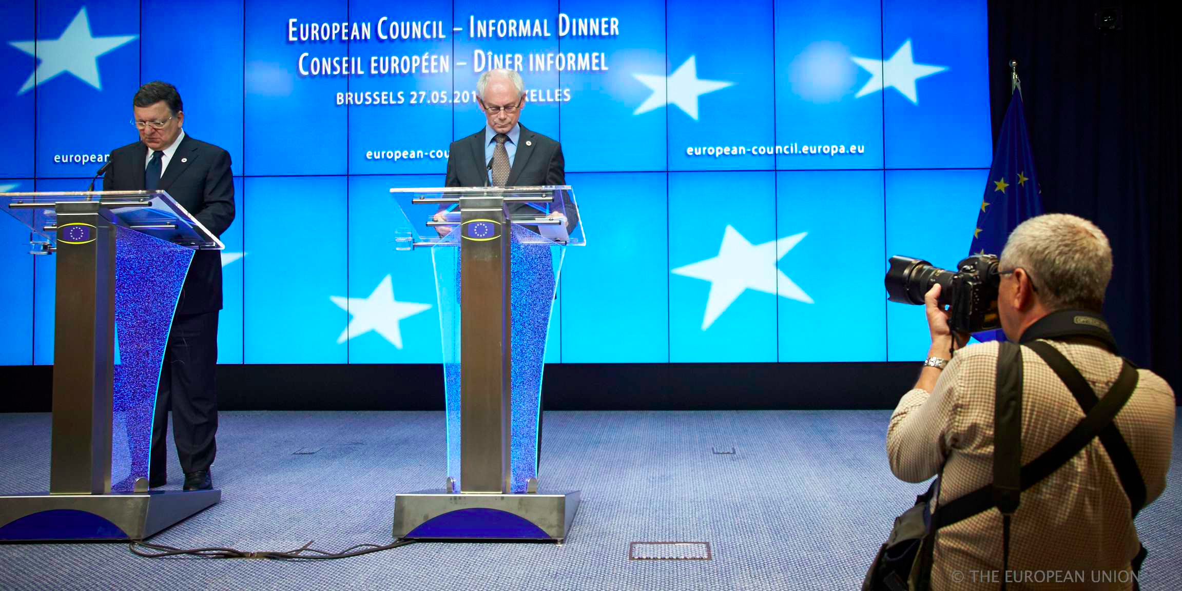
ESS selected as a prioritised RI project
ESS selected as one of three prioritised research infrastructure projects in Europe.
“The Council adopted conclusions in support of the implementation of the roadmap for the European Strategy Forum on Research Infrastructures (ESFRI) … ESFRI has identified three projects that are strategically relevant for Europe and are ready for development:
the European Plate Observing System (EPOS), the European Life-Science Infrastructure for Biological Information (ELIXIR), and the European Spallation Source.”
- Competitiveness Council, 27.05.2014

Slide 20
BrightnESS - Background
Prioritisation of Support to ESFRI Project for Implementation published 26 May 2014 identified three projects (EPOS, ELIXIR, ESS) from the ESFRI roadmap to be
pushing the boundaries of scientific excellence
strategically relevant for Europe
and ready for immediate action
H2020’s INFRADEV-3-2015: Developing New World-Class Research Infrastructures
Scope: Mitigate identified risks for implementation of prioritised ESFRI projects
Submission deadline: 14/01/2015
Budget: 97 MEUR (prioritized RI shall request 15-20MEUR)
Funding rate: 100% (+ 25% overhead)
BrightnESS
Evaluation: Positive
Approved budget: 19,941,964.00 EUR
Duration: 36 months
Grant & Consortium Agreements: Signed by all partners

Slide 21
In-Kind possible and agreed/planned
1,088 M€
Stretch Goal 747.5 M€
670 M€
636 M€
520 M€

Slide 22

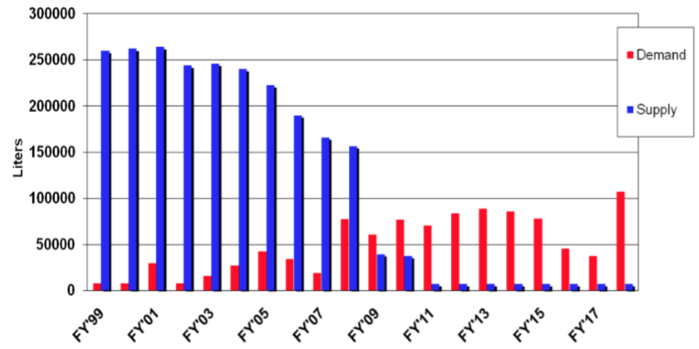
Detector: The Helium-3 Crisis
…An approppriate initial rection…
Since ca. 2009
Little or None Available (comment: seems to be some naivety at the moment as stocks are being emptied rapidly) Figure 1: Global supply and demand situation for 3He gas in bar-litres as reported in late 2011. The demand for the gas here excludes any ESS requirements or those of other future spallation sources.
Aside ... maybe He-3 detectors are anyway not what is needed for ESS? Eg. Rate, resolution reaching the limit…
Crisis or opportunity?

Slide 23
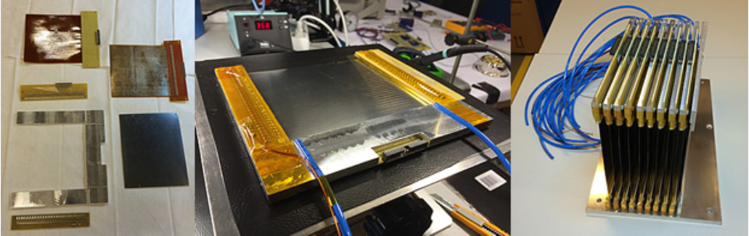
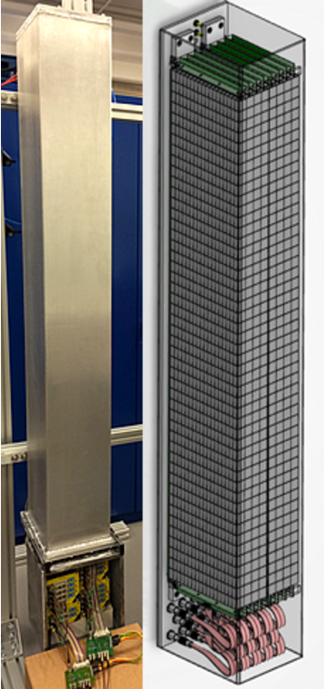
Detector Developments at ESS
The Multi-Blade detector components (left), a fully assembled cassette (center), and the nine-cassette technology demonstrator
Multi-Grid Detector demonstration for the SNS instrument CNCS (Cold Neutron Chopper Spectrometer)

Slide 24
Thank you

