Slide 1
WP3: Organizational Innovation
BrightnESS Mid-Term Review
Allen Weeks

Slide 2
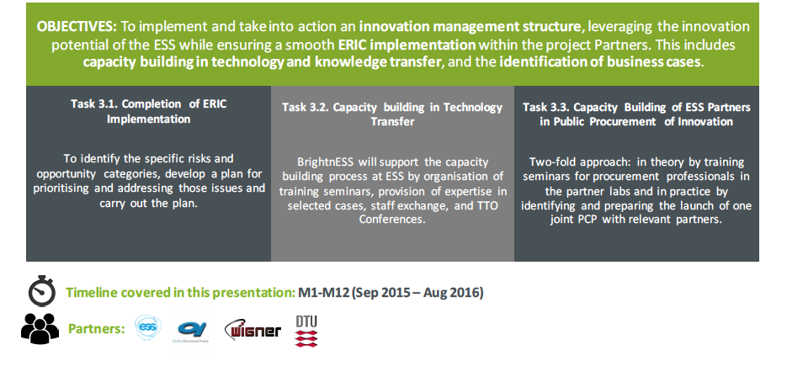
Overview
Completion of ERIC Implementation
To identify the specific risks and opportunity categories, develop a plan for prioritising and addressing those issues and carry out the plan
Task 3.1
Capacity building in Technology Transfer
BrightnESS will support the capacity building process at ESS by organisation of training seminars, provision of expertise in selected cases, staff exchange, and TTO Conferences
Task 3.2
Capacity Building of ESS Partners in Public Procurement of Innovation
Two-fold approach: in theory by training seminars for procurement professionals in the partner labs in practice by identifying and preparing the launch of one joint PCP with relevant partners
Task 3.3
BrightnESS is funded by the European Union’s Horizon 2020 research and innovation programme under grant agreement No. 676548

Slide 3
Activities in Task 3.1.
Completion of ERIC Implementation
Allen Weeks

Slide 4
Milestones and Deliverables
Year 1 |  |  |  |  |  |  |  |  |  |  |  | Year 2 |  |  |  |  |  |  |  |  |  |  |  | Year 3
1 | 2 | 3 | 4 | 5 | 6 | 7 | 8 | 9 | 10 | 11 | 12 | 13 | 14 | 15 | 16 | 17 | 18 | 19 | 20 | 21 | 22 | 23 | 24 | 25 | 26 | 27 | 28 | 29 | 30 | 31 | 32 | 33 | 34 | 35 | 36
 |  | M |  |  |  |  |  |  |  |  |  |  |  |  |  |  |  |  |  |  |  |  |  | D |  |  |  |  |  |  |  |  | D
Milestones
Accomplished ERIC transfer (M3)
Deliverables
“ERIC Risk and Opportunity Plan” (M25)
ERIC Operations Programme (M34)
BrightnESS is funded by the European Union’s Horizon 2020 research and innovation programme under grant agreement No. 676548

Slide 5
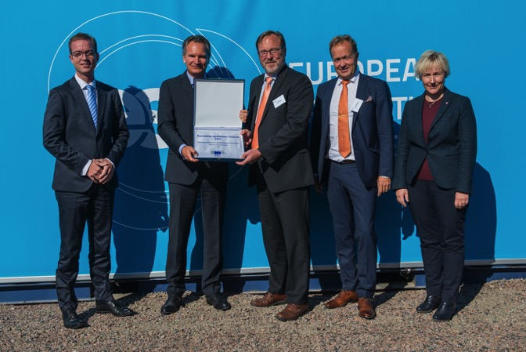

ESS AB transitioned into
European Research Infrastructure Consortium (ERIC)
ESS AB
Swedish limited liability corporation, owned by the Swedish and Danish governments
European Spallation Source ERIC
European Research Infrastructure Consortium, Sole governing body: the European Spallation Source ERIC Council, comprised of representatives from the Member and Observer Countries
Transfer of Assets,
Obligations and
Personnel
on Oct 1, 2015
ERIC Plate Ceremony
8 September, 60 guest on site
Ceremony marked the transition to the European Spallation Source ERIC.
Robert-Jan Smits, DG RTD, presented the ERIC
Guest speakers :
  SE Minister Hellmark Knutsson
  DK Minister Lunde Larsen
Photo opportunities and media interviews resulted in extensive media coverage

Slide 6

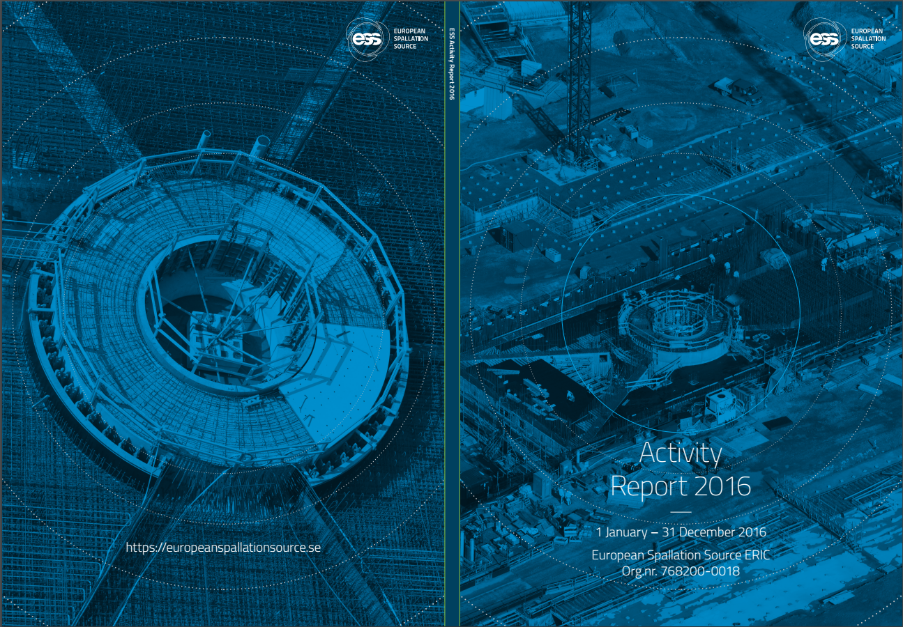

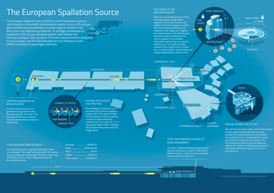
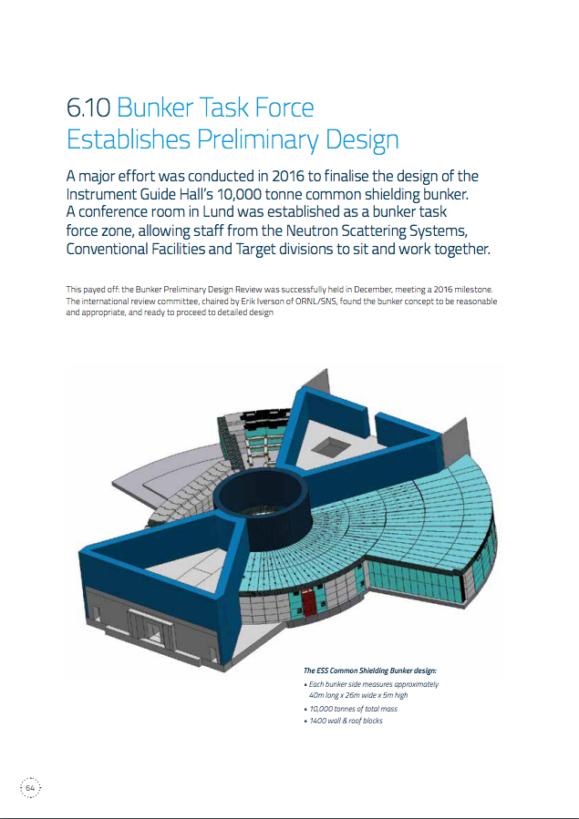
Activity Report 2015
Activity Report 2016
Revision of Working Version of Activity Report
Production of Activity Report
  1000 Soft Cover
  100 Hard Cover
Distribution of Activity Report to Key Stakeholders
Production of Activity Report
  5000 Soft Cover
  100 Hard Cover
Promotion of Activity Report on website and social media
Digital dissemination to ESS mailing list to 7000+ recipients
Direct distribution of hard copies to 200+ Key Stakeholders

Slide 7
Challenges Pertaining to the ERIC Regulation
Procurement
Value-Added Tax on IKC
International Staffing Profile
Accounting of IKC

Slide 8
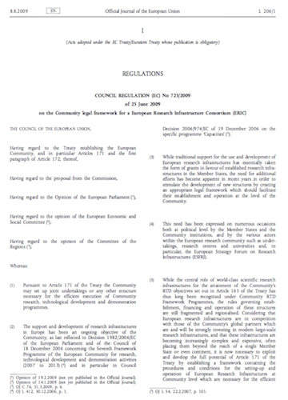
Challenges Pertaining to the ERIC Regulation
Procurement: Legal Framework
Article 7(3) of the Council Regulation (EC) No 723/2009 of 25 June 2009 on the Community legal framework for ERIC:
“An ERIC is an international organisation within the meaning of Article 15(c) of Directive 2004/18/EC.”
An ERIC is not required to follow the procurement procedures established by Directive 2004/18/EC and Directive 2014/24/EU, and has the freedom to decide on its own procurement rules, respecting basic principles of transparency, non-discrimination, and competition.

Slide 9
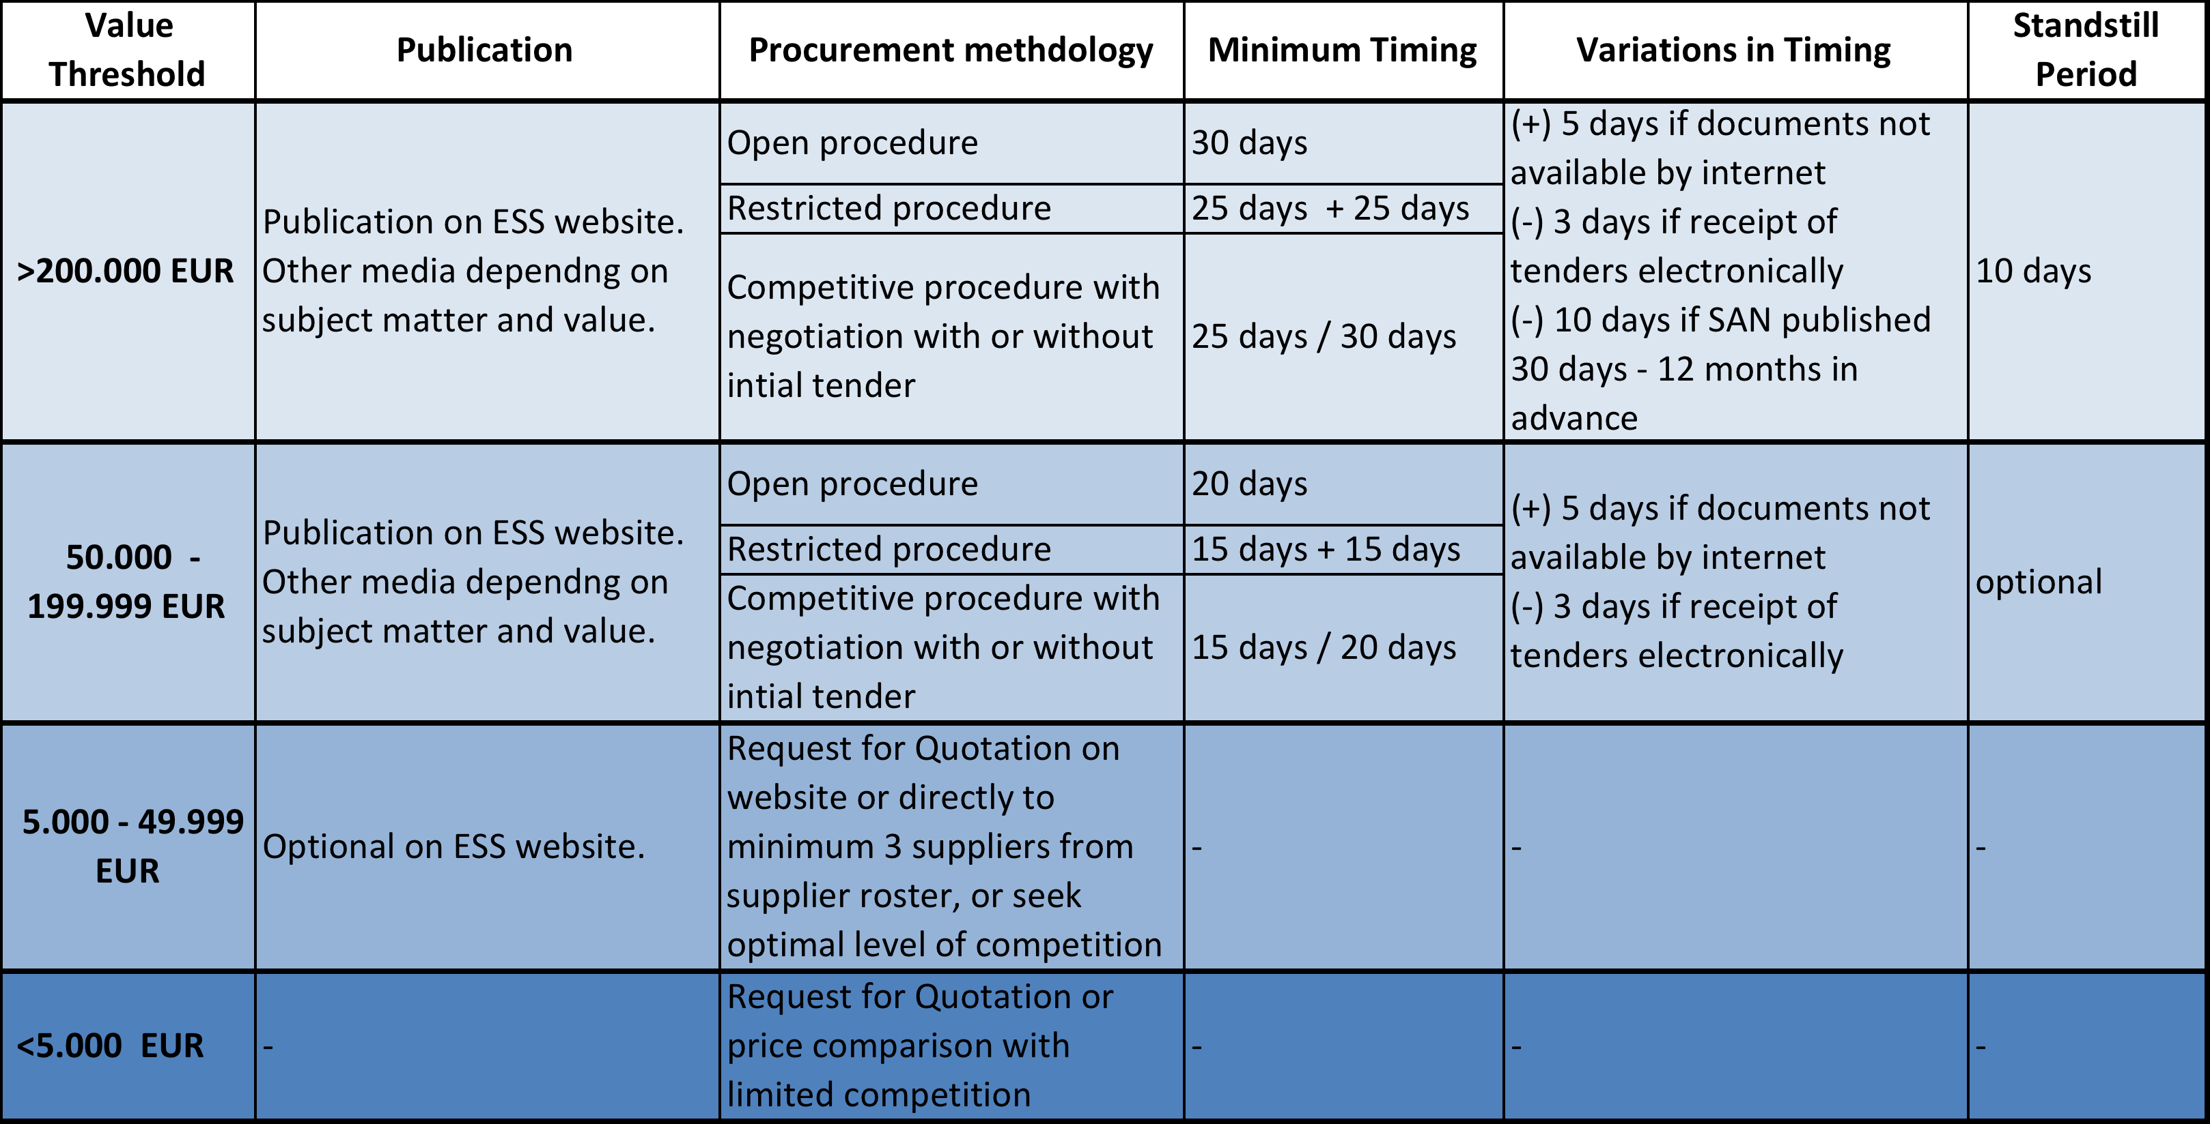
ESS Procurement Rules from 1 Oct 2015
https://europeanspallationsource.se/page/contract-award-notices

Slide 10
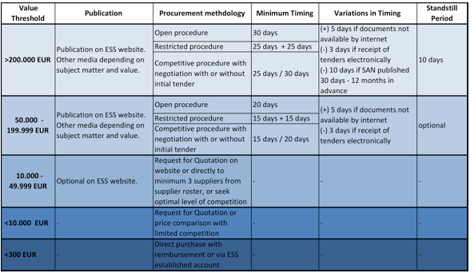
Updated ESS Procurement Rules
https://europeanspallationsource.se/page/contract-award-notices

Slide 11
Appeal Process
Articles 37-39 of the ESS Procurement Rules:
All appeals are handled by the Tenders Appeal Board composed of 3-5 members of ESS or external parties appointed by the ESS Director General
Appeals must be submitted in writing to the Board
If the Board decides that the Organization has infringed its procurement rules, it shall order that the tender procedure or parts of it be rectified
For the purpose of investigating an appeal, the Board may order an audit
The Board may make an order suspending the procurement procedure or the award of contract until it has issued its final decision. The Board shall notify the appellant in writing of its final decision within 30 working days following the date of receipt of the appeal.
4 appeals were brought by suppliers against ESS. 1 was accepted by Board, 2 were rejected and 1 went to court bypassing the Board. The Malmö Court confirmed that the supplier should have appealed to the ESS Tenders Appeal Board. Court also acknowledged the authority of the Tenders Appeal Board and the validity of the appeal procedure outlined in the ESS Procurement Rules. This was the first time that an ERIC has been challenged in terms of public procurement and the court decision from 2016 represents a great success.
Remedies Directive for the utilities sector (Directive 92/13/EEC)
Remedies Directive for the public sector (Directive 89/665/EEC)
Set minimum national review standards to ensure that rapid and effective means of redress are available in all EU countries. The directives have mandatory and optional provisions => do not intend to harmonize the remedies system in the EU.

Slide 12
Amendments following the Review of Procurement Rules
Increased transparency in the publication of specific advance notices
Facilitating the operation of supplier rosters
Higher thresholds for small value procurement (10 000 EUR)
Facilitate joint procurement activities with other international organisations (e.g. CERN)
Increased transparency in information provided to unsuccessful tenderers
Extending the time limits to bring appeals against procurement decisions
Other tweaking and fine-tuning of wording throughout the document

Slide 13

Challenges Pertaining to the ERIC Regulation
Value-Added Tax on IKC
Council Regulation (EC) No 723/2009 gives ERICs broad flexibility in treatment of taxation and VAT, but does not provide guidance for IKC partner institutions
Payment of VAT by national institutes to industrial suppliers was not included in the ESS Cost Book. This was due to the fact that the governing bodies foresaw the future ERIC as being exempt from paying VAT as an international organization
Several institutes have notified ESS that the fact that there is no certainty on VAT the result might either be:
Reduction of the IKC scope to compensate for the VAT costs
A request by the institutes, via the Council, that ESS pays the VAT

Slide 14
VAT on IKC

Slide 15
Value-Added Tax by Country
 | ESS Recognized as an International Organisation
 | Direct Exemption | Representing Entity | Representing Entity with supporting documents | Cash Contribution
Belgium
Czech Republic
Denmark
France
Germany
Hungary
Italy
Netherlands
Norway
Poland
Spain
Sweden
Switzerland
United Kingdom
 | Being Explored
 | Achievable
 | Not Possible

Slide 16
Lessons Learned
ERICs are non-economic actors
Direct exemption is preferable to reimbursement
The VAT treatment relative to IKC from ERIC Members must be approached strategically and globally
Representing Entities play an important role in the establishment and construction of ERICs

Slide 17
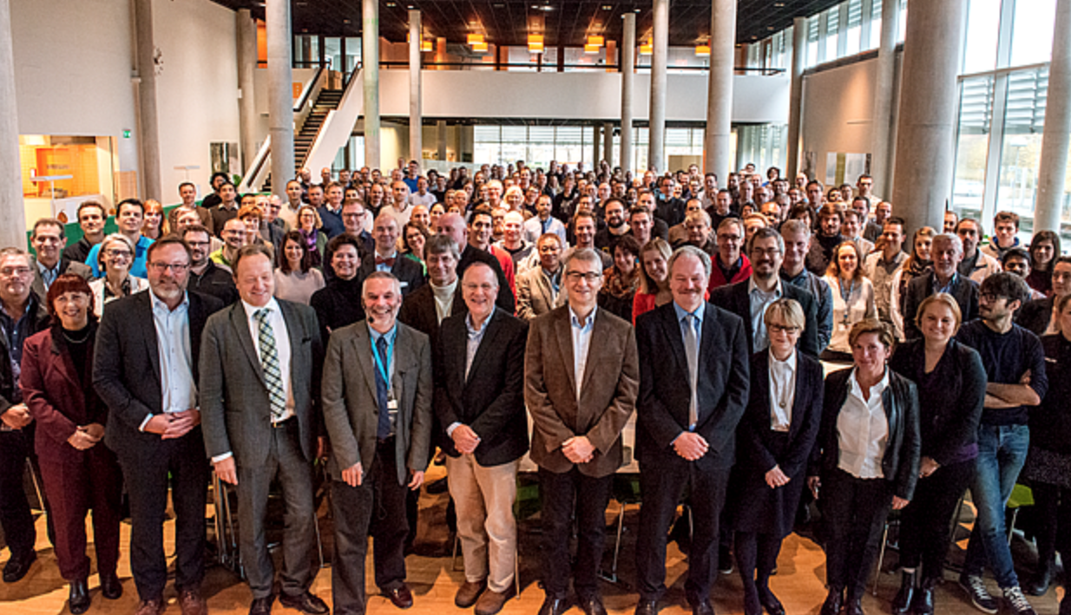
Challenges Pertaining to the ERIC Regulation
International Staffing Profile: Problem Background
ESS is a fast-growing organisation with staff coming from nearly 50 countries: 40 employees in 2010, approx. 400 in 2017.
It is crucial for ESS to attract, recruit, and retain highly skilled, international staff over the life span of the facility, while aiming at a healthy staff turnover.
Both Host Countries operate strongly regulated labour systems, which drove the set-up of the ERIC in 2015. Many of the challenges faced by ESS in recruiting personnel worldwide are related to income tax, a waiver of which has not been given priority by the Host Countries.

Slide 18

ERICs vs International Organisations
Council Regulation (EC) No 723/2009 does not give any special status to ERICs in terms of individual employment contracts. ERICs are governed by the same laws as other employers
It is the employment contract that specifies which national law is applicable. The choice of national law is guided by the rules outlined in the Rome I Regulation of the EU, which has replaced the Rome Convention
Article 6 of the Rome Convention:
  “A contract of employment shall (normally) be governed by the law of the country in which the employee habitually carries out his work, even if he/she is employed in another country”.

Slide 19

Time-Limited Contracts: Background
Time-limited contracts represent an important tool to maintain the anticipated staff flow
Following a common practice in Sweden, ESS signed Collective Agreement for Development and Services with Almega employers' confederations
ESS requires to establish temporary positions of up to 5 years in duration, particularly within the following job categories: senior scientist and engineer, scientist and engineer, technician, and post-doctoral researcher.
According to Swedish law, the maximum time for time-limited contracts is 2 years. The Collective Agreement of ESS limits it even further to 1 year. ESS has the possibility to make use of fixed-term contracts only for:
  Specific duty of a particular nature, e.g. staff financed through grants
  Agreed fixed-term employment as defined in the Collective Agreement (max. 5 employees)

Slide 20

Time-Limited Contracts: Action Taken
ESS HR Working Group negotiated with local union and reached an agreement which allows ESS to sign the following types of time-limited contracts:
Substitute: Max. 36 months during a 5-year period
“Avtalad visstid”: Max. 36 months during a 5-year period. Agreement of at least 7 days. There is no limitation in number of contracts, but the position should have been foreseen to be time-limited in the staff planning
Students: Without requirement of employment period
Contract for period after retirement
Season work: According to the Employment Protection Act
PhD students: When party or completely done at the company
Probation period: Maximum 6 months

Slide 21
Taxation and Social Security Related to Secondments and IKC Personnel: Background
Severe limitations exist on secondments and in-kind staff from many partner laboratories due to the current Swedish laws governing taxation and social security:
  Seconded and in-kind staff can only work in Sweden for up to 183 days per year or per 12 consecutive months before being subject to Swedish income taxation and social security charges, in addition to those paid in their home countries.
  Only in-kind staff from governmental institutions can be seconded to ESS while remaining taxable in their home countries and exempted from taxation in Sweden. Sweden has not signed the CERN Protocol on Privileges and Immunities

Slide 22
Expert Tax Relief
Restrictions faced by ESS
25% reduction of taxable income of a foreign key person
All salaries and employers’ contributions to housing and living costs
First 3 years of the temporary stay in Sweden
Expert/specialist, researcher, executive and other key personnel, or staff with salary price base of 44 900 SEK (2017)
Employees can only apply once they reside in Sweden
Outcome of application cannot be guaranteed
Limited to small number of experts due to high salary ceiling
Time-limited: 3 years vs. 5 years in DK

Slide 23
Expat Tax Relief, and Taxation and Social Security Related to Secondments and IKC Personnel: Action Taken
Council Committee on Employment Conditions recommended in October 2016 to initiate discussions with the Swedish government to find solutions to issues related to employment conditions at ESS. The recommendation was endorsed by the Council in December 2016
ESS Director General sent a letter to State Secretary Röding on 2 February 2017 and proposed a high-level meeting to explain issues related to employment conditions at ESS
On 21 February 2017 a meeting between State Secretary Röding, ESS Director General and ESS Director for Administration and Project Support took place
Senior Advisor at the Swedish Ministry of Education and Research and ESS Human Resources Officer work on a possible wording for a tax exemption for in-kind and seconded personnel. The suggestion is that in-kind and seconded personnel working at ESS under an IKC Agreement will remain liable to pay taxes in their home countries regardless of the length of their stay in Sweden. Expert Tax Relief has not been given priority in further discussion.

Slide 24
Challenges Pertaining to the ERIC Regulation
Accounting of IKC
While in-kind contributions are key to deliver the ESS project, it is not clear how to treat them in accounting terms. This leads to a number of questions that could pose a potential risk:
Are IKC an asset?
What is the value of an IKC?
  Due to the above described IKC principles, it is not obvious what their cost and their value for the organisation are
  For the time being we take the cost book value (or IKCA number?) as reference
When does an IKC have to be accounted?
  Day of delivery/hand-over?
  Approval by Council?

Slide 25

Results
Procurement: Robust and tailored framework that facilitates efficient procurement and purchasing activity, and validity of the procurement rules acknowledged by a Court decision
VAT taxation on IKC: Steady progress on country-by-country basis, but issues still remain
International staffing profile: Progress on some issues but further discussions are needed
Accounting of IKC: Ongoing discussion about potential risks

Slide 26
Activities in Task 3.2.
Capacity Building in Technology Transfer
Allen Weeks

Slide 27
Milestones and Deliverables
Year 1 |  |  |  |  |  |  |  |  |  |  |  | Year 2 |  |  |  |  |  |  |  |  |  |  |  | Year 3
1 | 2 | 3 | 4 | 5 | 6 | 7 | 8 | 9 | 10 | 11 | 12 | 13 | 14 | 15 | 16 | 17 | 18 | 19 | 20 | 21 | 22 | 23 | 24 | 25 | 26 | 27 | 28 | 29 | 30 | 31 | 32 | 33 | 34 | 35 | 36
 |  | M |  |  |  |  |  |  |  |  |  |  |  |  |  |  |  |  |  |  |  |  |  |  | M |  | D |  |  |  |  |  | M |  | D
Milestones
Setting-up of a Technology Transfer Office at ESS (M3)
First Organisation of 2 TTO conferences (M26)
Second Organisation of 2 TTO conferences (M34)
Deliverables
Determine TT strategy and policy (M28)
TTO industry agreement (M36)

Slide 28

Innovation Framework at ESS
Innovation Strategy
Innovation Culture
Policy
Process
Procedure(s)
Generating a framework for innovation activities at ESS
Creating a supportive environment for creative thinking, to generate new or improved products, services or processes
Establishing a level of ambition for innovation at ESS
Outlining the mechanism for capturing, processing and utilising innovation at ESS
Describing the means of the process

Slide 29

Innovation Strategy
Innovation Culture
Workshops with management to move the innovation strategy into practice
Regular company wide training on innovation issues
Fostering innovation by internal innovation competitions
Establishment of system of material and non-material incentives for innovation active personnel
Establishment of network of innovation ambassadors
Brainstorming workshop @ESS x2
15.03.2017 + 29.08.2017
Facilitator DTU
Participants: ESS management + Work Package leaders (Potential Future ESS Innovation Stakeholders)

Slide 30
Policy
Open access concept
Supporting utilisation of internally and externally applicable innovations
Academia Industry cooperation promotion
Protection and commercialization only when prepending significant added value to facilitate its transfer
Process
The main steps:
Innovation Inputs
Internal Assessment
Utilisation Planning
Plan Approval
Valorisation
Utilisation Monitoring
Procedure
The individual related procedures analyse the main steps from the process chain

Slide 31
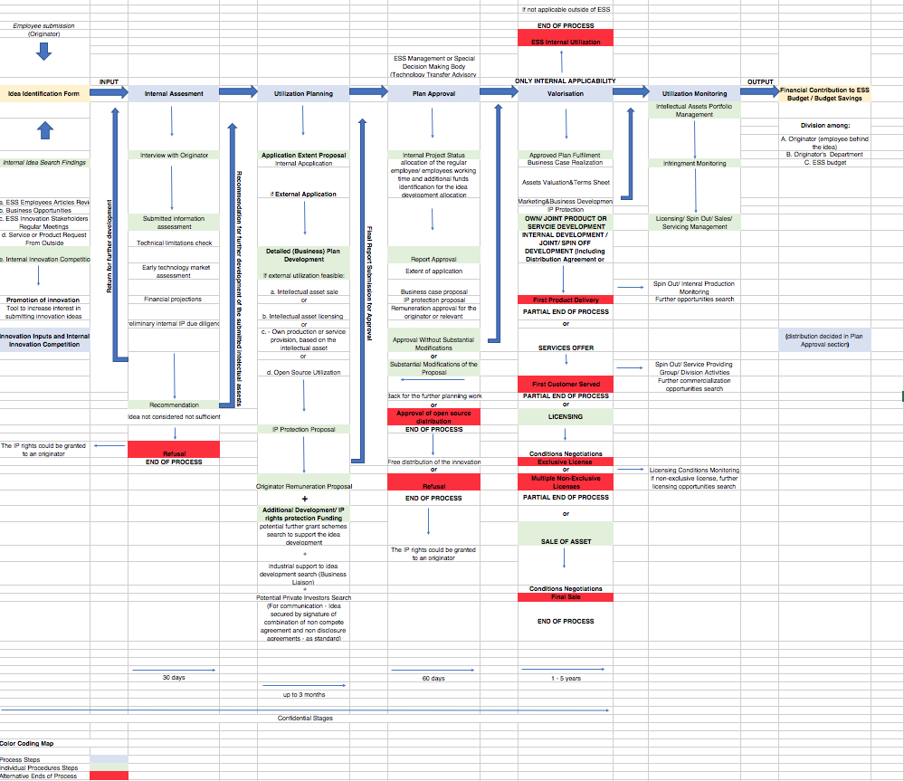
Overview of the Innovation Process Mechanism

Slide 32
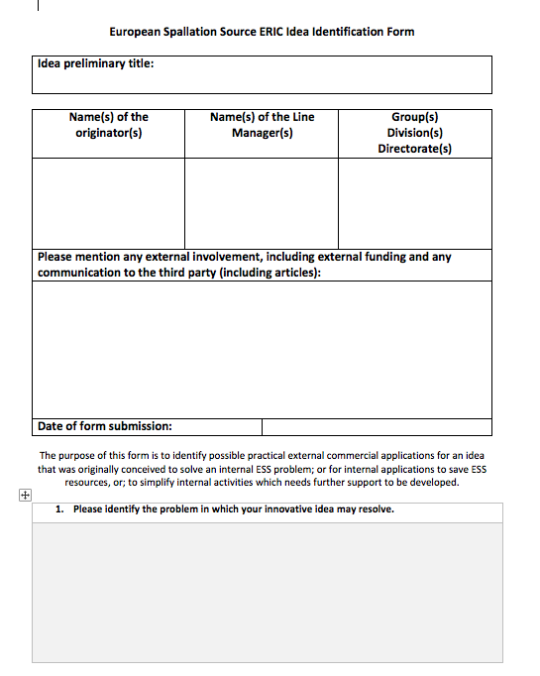
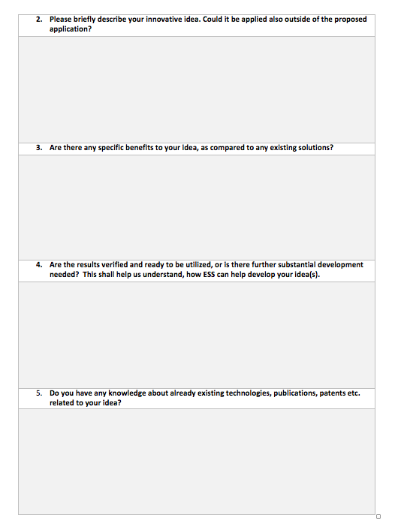
Idea Identification Form – First Step in the Internal Innovation Search
The purpose of this form is to identify possible practical external commercial applications for an idea that was originally conceived to
solve an internal ESS problem
save ESS resources via internal application
simplify internal activities which needs further support to be developed

Slide 33
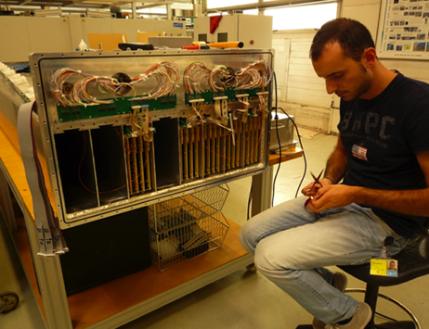
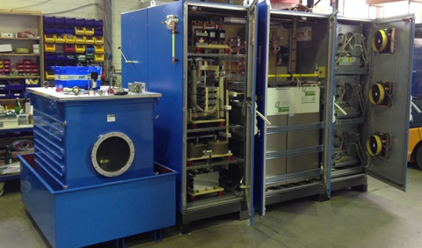
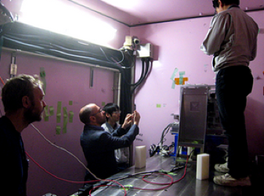
Innovation@ESS
High-power modulators
2-dimensional “pancake” moderators
Boron-based detector

Slide 34
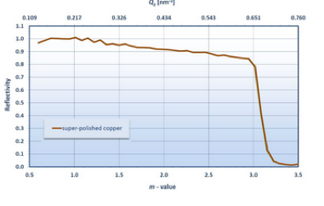
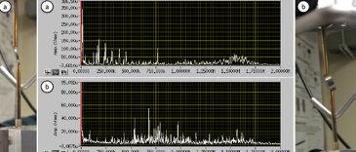
Innovation@ESS: Recent Innovation Inputs
Material Real Time Integrity Assessment and Quality Assurance - MARTIAN QA
Sample Environment Communication Protocol
Energy Tagged Neutrons
Copper Substrate Guides

Slide 35
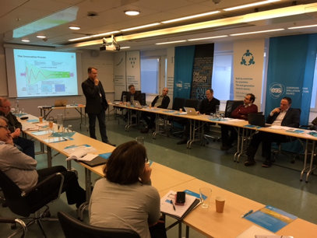
Capacity Building Activities
Dec 2017: DTU training workshop / DS
Participation in HEPTech meetings and strategic collaboration
Upcoming 1st TTO Conference
a. a broad exchange of best practice
b. addresses stakeholders of the innovation systems
2nd TTO Conference in the pipeline

Slide 36

“Establishing and Maintaining an Innovation Framework”
1st ESS TTO Conference, co-organized with DTU and HEPTech
11th October 2017, DTU Campus, Anker Engelundsvej 1, 2800 Lyngby, Denmark
Speakers from EU JRC, CEA, ESRF, ELETTRA, EPFL, STFC, PSI
The main aim is a broad exchange of best practices among all participants to improve their capacity in knowledge transfer.
Participants will have a chance to discuss and ask the speakers questions during two workshop sessions.
The presentations complement each other to avoid repetition, cover the most important steps of setting up innovation infrastructure and the most important processes to identify the values
Notes:
the most important steps (financing, culture creation, coordination of those activities with the scientific nature of ESS and similar entities)
the most important processes (searching for innovations within organization, evaluating them and their internal/ external application)

Slide 37

Results
Set-Up of Technology Transfer Office (TTO) at ESS
Internal Innovation Workshops (15.3.2017/ 29.8. 2017)
Mapping of Innovation Environments a. Scientific and academic users
b. Industrial Users
c. Actors in Innovation Ecosystems
DTU plays an active role in the organization of innovation workshops, mapping of actors in the local innovation ecosystem mapping
and organization of the upcoming ESS Technology Transfer Conference
For mapping of Innovation Environments were conducted interviews with innovation experts and technology transfer officers in the selected regions
First findings for the ESS Innovation Portfolio. The results to be analyzed by prepared innovation strategy

Slide 38

Next steps
”TT Strategy and Policy”
Finalization of the documents. Open discussion with ESS innovation stakeholders about the final versions. Testing on prepared documents the provided business cases
“TTO Industry Agreement”
Search for potential industrial cooperation partners
“1st Organization of 2 TTO Conferences”
  Final stage of the event preparation. Strategic tech transfer partnerships will be established and maintained (ESS Partners, HEPTech, CREMLIN, ESFRI facilities)
“2nd Organization of 2 TTO Conferences”
Organization of the event. Establishing and maintaining the TT relevant partnerships

Slide 39
Activities in Task 3.3.
Capacity Building of ESS Partner Organizations in Public Procurement of Innovation
Meredith Shirley

Slide 40
Milestones and Deliverables
Year 1 |  |  |  |  |  |  |  |  |  |  |  | Year 2 |  |  |  |  |  |  |  |  |  |  |  | Year 3
1 | 2 | 3 | 4 | 5 | 6 | 7 | 8 | 9 | 10 | 11 | 12 | 13 | 14 | 15 | 16 | 17 | 18 | 19 | 20 | 21 | 22 | 23 | 24 | 25 | 26 | 27 | 28 | 29 | 30 | 31 | 32 | 33 | 34 | 35 | 36
 |  |  |  |  |  |  |  |  |  |  |  |  |  |  |  |  |  |  |  |  | M |  | M |  |  | D |  |  |  |  |  | D
Milestones
Implementation of 6 Training seminars on Capacity Building on Public Procurement of Innovation in Regional Hubs (M24)
Identification of one suitable PCP (M22)
Deliverables
Invitation to Market Consultation (M27)
Tender documents for PCP (M33)
BrightnESS is funded by the European Union’s Horizon 2020 research and innovation programme under grant agreement No. 676548

Slide 41
Current Status – M24
Implementation of 6 Training seminars on Capacity Building on Public Procurement of Innovation in Regional Hubs (M24)
  ESS, STFC (June 2016)
  ESS, Lund University, MaxIV, DTI, DTU, BNC Wigner (Sept 2016)
  ESS, CERN (Sept 2016)
  ESS/NSS (Sept 2016)
  ESS/Procurement (Oct 2016)
  ESS, Juelich (Sept 2017)
Progressive approach focusing on cross-border collaboration, needs identification and experiences
Next step: consolidation and dissemination of findings from workshops

Slide 42
Current Status – M22
Identification of one suitable PCP (M22)
  Re-scoping from PCP to PPI (Dec 2016)
    Due to current status and level of R&D existing in the ESS Project
    Deliverables still include market consultation and development of procurement documents
  Identified a case requiring a coordinated effort from procurers in order to adapt current technology and standardize new products (microTCA systems)
    Requires high level of interest and commitment from technical responsible person
  Next step: Documentation of process for identification of an appropriate case (by end September 2017)

Slide 43
PPI – description of the challenge
ESS has chosen mTCA.4 as the standard technology for high-speed data acquisition applications. MicroTCA (Micro Telecommunications Computing Architecture) originated from telecommunications hardware and was formally introduced by PICMG (PCI Industrial Computer Manufacturers Group) in October 2011 as a standard describing a new class of modular computer systems. MicroTCA.4 has evolved to become a standard for demanding applications in large-scale research facilities e.g. particle accelerators, high-energy physics, plasma fusion sources, etc.
However, there is still room for development in terms of the stability, operation, interoperability and adaptation to new architectures. Potential areas of improvement in terms of innovation are:
Crate design. Improvement of mechanical design, air flow and heat dissipation, health monitoring and software infrastructure management
mTCA Carrier Hub and CPUs. Adaptation to new AMC architectures, PCI bus management, solving of interoperability issues, etc.

Slide 44
Current Status – M27 & M33
Invitation to Market Consultation – delayed, but
  In process of identifying consultants to facilitate market consultation (RFQ conducted, award pending)
  Next step: Market consultation expected in Q4 2017
Tender documents for PCP
  Will be adjusted to PPI
  Next step: to be completed after market consultation

Slide 45
Milestones and Deliverables
 | Year 1 |  |  |  |  |  |  |  |  |  |  |  | Year 2 |  |  |  |  |  |  |  |  |  |  |  | Year 3
 | 1 | 2 | 3 | 4 | 5 | 6 | 7 | 8 | 9 | 10 | 11 | 12 | 13 | 14 | 15 | 16 | 17 | 18 | 19 | 20 | 21 | 22 | 23 | 24 | 25 | 26 | 27 | 28 | 29 | 30 | 31 | 32 | 33 | 34 | 35 | 36
ERIC implementation |  |  |  |  |  |  |  |  |  |  |  |  |  |  |  |  |  |  |  |  |  |  |  |  | MD |  |  |  |  |  |  |  |  | D
TTO |  |  | M |  |  |  |  |  |  |  |  |  |  |  |  |  |  |  |  |  |  |  |  |  |  | M |  | D |  |  |  |  |  | M |  | D
Capacity Building PCP |  |  |  |  |  |  |  |  |  |  |  |  |  |  |  |  |  |  |  |  |  | M |  | M |  |  | D |  |  |  |  |  | D
Milestones
MS6. Accomplished ERIC transfer (M25)
MS7. Setting-up of a Technology Transfer Office at ESS (M3)
MS8. Implementation of 6 Training seminars on Capacity Building on Public Procurement of Innovation in Regional Hubs (M24)
MS9. First Organisation of 2 TTO conferences (M26)
MS 10. Identification of one suitable PCP (M22)
MS11. Second Organisation of 2 TTO conferences (M34)
Deliverables
D3.1 “ERIC Risk and Opportunity Plan” (M25)
D3.2 Determine TT strategy and policy (M28)
D3.3 Invitation to Market Consultation (M27)
D3.4 Tender documents for PCP (M33)
D3.5 ERIC Operations Programme (M34)
D3.6 TTO industry agreement (M36)
BrightnESS is funded by the European Union’s Horizon 2020 research and innovation programme under grant agreement No. 676548

Slide 46
Overall spending M1-M22
Overall overview per cost category
39%
503 533,13 EUR

