Slide 1
Mid-Term Review
WORK PACKAGE 2
Strengthening the In-kind Contribution coordination
Carlo J. Bocchetta

Slide 2









WP2 Mandate
Strengthening the coordination of In-kind Contributions - Maximise the possibility for ESS and In-Kind partner organisations to deliver value during the Construction Phase through ‘In-Kind Contributions’ (IKC) according to the ESS IKC Process and to minimise and mitigate the risks associated with those contributions.
Nine Partners: STFC (UK), TUD (NL), INFN & Elettra (IT), BNC Wigner (HU), ESS-Bilbao (ES), CEA (FR), FZJ (DE), ESS.
4.247 M€, 345 Person-Months (minimum)

Slide 3
IKC Context - Year by Year In-Kind planning

Slide 4
IKC Context - Partners and Main Agreements
Aarhus University
Atomki - Institute for Nuclear Research
Bergen University
CEA Saclay, Paris
Centre for Energy Research, Budapest
Centre for Nuclear Research, Poland, (NCBJ)
CNR, Rome
CNRS Orsay, Paris
Cockcroft Institute, Daresbury
Elettra – Sincrotrone Trieste
ESS Bilbao
Forschungszentrum Jülich
Helmholtz-Zentrum Geesthacht
Huddersfield University
IFJ PAN, Krakow
INFN, Catania
INFN, Legnaro
INFN, Milan
Institute for Energy
Research (IFE)
Rutherford-Appleton
Laboratory, Oxford(ISIS)
Kopenhagen University
Laboratoire Léon Brilouin (CEA – CNRS – LLB)
Lund University
Nuclear Physics Institute of the ASCR
Oslo University
Paul Scherrer Institute (PSI)
Polska Grupa Energetyczna - PGE
Roskilde University
Tallinn Technical University
Technical University of Denmark
Technical University Munich
Science and Technology Facilities Council
UKAEA Culham
University of Tartu
Uppsala University
WIGNER Research Centre for Physics
Wroclaw University of Technology
Warsaw University of Technology
Zurich University of Applied Sciences (ZHAW)
BOLD =signed

Slide 5











IKC Context - Country Status
Country | Intended (by member) | In the pipeline Planned + Agreed | Remaining funding
Czech Republic | 30,40 M€ | 25,97 M€ | 4,43 M€
Estonia | 3,23 M€ | 1,97 M€ | 1,26 M€
France | 132,70 M€ | 125,15 M€ | 7,55 M€
Germany | 123,27 M€ | 55,06 M€ | 68,21 M€
Hungary | 12,30 M€ | 4,19 M€ | 8,11 M€
Norway | 18,43 M€ | 16,76 M€ | 1,69 M€
Italy | 89,39 M€ | 77,59 M€ | 11,8 M€
Poland | 25,21 M€ | 26,14 M€ | 0 M€
Spain | 50,30 M€ (total value) | 47,14 M€ | 3,16 M€
Switzerland | 41,73 M€ | 32,70 M€ | 9,03 M€
United Kingdom | 129,00 M€ | 99,35 M€ | 29,65 M€

Slide 6
IKC Context - Status of In-Kind
Country | No. of Inst. | Value under IK Agreement | Value under TAs with Cover Page | Planned
Czech Republic | 1 | 18,51 M€ | None | 7,45 M€
Estonia | 2 | 1,97 M€ | None | None
France | 3 | 96,30 M€ | 0,90 M€ | 27,91 M€
Germany | 3 | Pending | Pending | 55,06 M€
Hungary | 3 | 3,33 M€ | None | 0,85 M€
Norway | 3 | 6,64 M€ | None | 10,12 M€
Italy | 3 | 39,23 M€ | 23,89 M€ | 14,45 M€
Poland | 6 | 25,54 M€ | None | 0,60 M€
Spain | 1 | Pending ERIC membership | 33,03 M€ | 14,10 M€
Switzerland | 2 | 7,35 M€ | 2,22 M€ | 22,81 M€
United Kingdom | 4 | Pending | 26,30 M€ | 73,05 M€
Sweden | 2 | Host Country Collaborations – 14,27 M€
Denmark | 4 | Host Country Collaborations – 7,92 M€

Slide 7
Overview of WP2 – Four Tasks
Preparation of project implementation and training of resources needed
(ESS, CEA, FZJ, INFN, ESSB, STFC, BNC Wigner)
Development and implementation of an In-kind information system for the coordination of IKC activities
(Elettra, ESS)
Development of an IKC 'Best Practice' system and standards (WEB) and organisation of collaboration meetings
(Elettra, ESS)
Creation of an IKC network of Regional Hubs
(ESS, STFC, TUD, FZJ, ESSB, INFN, CEA, BNC Wigner)
WP2.1
WP2.2
WP2.3
WP2.4

Slide 8
Overview of WP2 - Deliverables
 | Deliverable | Month | Status
D2.1 | Risk assessment and mitigation plan | M3 | Accepted
D2.2 | Launch of IKC Best practice online platform | M6 | Accepted
D2.3 | Deployment of Management Information System | M12 | Accepted
D2.4 | 1st Annual IKC Progress Assessment | M13 M18 | Accepted
D2.5 | 2nd Annual IKC Progress Assessment | M24 M29 | In Progress
D2.6 | Revision of IKC Best practice online platform | M30 | To do
D2.7 | IKC Work Package Assignment Plan | M36 | To do
In RED new dates from amendment

Slide 9
Overview of WP2 – Milestones
 | Milestone | Month | Means of Verification | Status
MS1 | Establishment of Regional Hubs | 4 | Staff in place | Done
MS2 | Definition of workflows | 6 | Management Chart | Done
MS3 | 1st Organisation of annual IKC conferences | 6 18 | Agenda and minutes of IKC conferences | Done
MS4 | 2nd Organisation of annual IKC conferences | 18 29 | Agenda and minutes of IKC conferences | Done
MS5 | 3rd Organisation of annual IKC conferences | 30 36 | Agenda and minutes of IKC conferences | In progress
In RED new dates from amendment
Allows the possibility of an additional workshop to further support partners in the installation phase.

Slide 10
Task WP2.1

Slide 11
WP2.1 - Preparation of project implementation and training of resources
Assessment of ESS project management software to analyse IKC’s (contracted, planned and potential), Implementation, Participation and ESS & partner risk analysis.
Deliverable 2.1 (26 page Report) accepted by EC.
Risk mitigation activities form the basis of work for Regional Hub Field Coordinators (WP2.4).
Notes:
Deliverable 2.1 based on analysis of risk analysis codes at the ESS, the results of analysis and input from Field Coordinators of their risk analysis.
The activities of FC at the hubs is focused on risk mitigation.

Slide 12
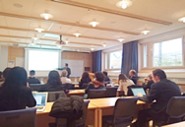
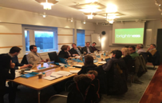
Highlights WP2.1 - Preparation of project implementation and training of resources
Field Coordinators (FC) will be identified and trained to strengthen IKC management.
Train to understand the ESS, the related political environment, the involvement of the home institute in ESS and familiarization with other related clusters.
FC’s Identified in all Hubs (WP2.4)
Training sessions held

Slide 13

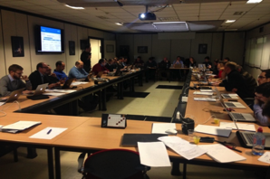

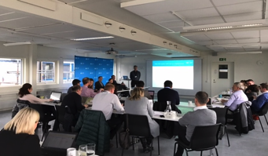
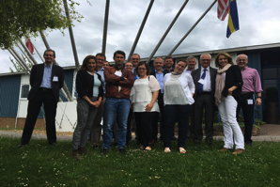
Highlights WP2.1 - Preparation of project implementation and training of resources
Training & Management events for 2016-2017 Field Coordinators
• Kick-off Meeting – 25/Sept/2015 (Lund).
• WP2 Meeting 11-12/Feb/2016 (Lund).
• ESS Training Event on Systems, Procedures – 27-28/Apr/2016 (Lund).
• CHESS Training Video Conf – 28/Sept/2016.
• Support for NSS - 13/Sept/2016 (Lund).
• Best Practice Workshop – 14-15/Nov/2016 (Bilbao).
• Preparing for IK installations - 18/Jan/2017 (Catania).
• Training in Quality for IKC (Norms, Procedures & Processes) – 7-8/Mar/2017 (Lund).
• General Management of WP2 – 2/Jun/2017 (Didcot).
• Best Practice Workshop – 13-14/Jun/2017 (Catania).
PLUS numerous one-to-one meetings with ESS and other hub FC’s & WP Leaders

Slide 14
Task WP2.2

Slide 15
WP2.2 - Development and implementation of an In-kind information system – XRM+
Establish a centralized platform that will provide support to the In-kind Management Coordination Office, management, and governance of the ESS Project. Provide an active database to establish matching the WBS in P6 and Work Package realization with IKC Partners.
IN-KIND CONTRIBUTIONS
EOI management
Tracking interactions between contacts
Contracts management
Milestone management
CONTACTS
Individual/Organisation
1. Activity reporting
2. Project management status reports
3. Documentary evidence for quality assurance and control
4. Process tracking
5. Relations management
EVENTS
Organization of events
Participant registration tool
Documentation of attendances
STAKEHOLDER RELATIONS
Management of external contacts
Tracking of activities
Documentation of communications with external contacts

Slide 16
WP2.2 - Development and implementation of an In-kind information system – XRM+
ESS & Elettra formulated code specification in March 2016
The staged writing of the code was assigned to Elettra (approved by EC officer – 25/Jul/2016) with deliverable end Aug 2016 & two updates. This permited an effective & user friendly development of the database.
D2.3 – Accepted (44 page report): Describes the system which includes the core and most important functionalities and is the official deliverable D2.3 in the grant agreement. Includes the design of the core database and the implementation of the general structure (users, contacts, institutes, in-kind contributions, etc.) on top of which all other components will be added.
Update 1 (28/2/2017): Improvements and a Dash Board and an on-line reporting system. Transfer the XRM+ code to ESS servers.
Update 2 (31/8/2017): Improvements and integration with external tools CiviCRM and Primavera P6.
Review (31/8/2018): Improvements and forms for integration with external tools: Indico and CHESS with the storage of acceptance reports.

Slide 17
WP2.2 - Development and implementation of an In-kind information system – XRM+
Status August 2017 – The program is being tested by Field Coordinators and IK interface people at the ESS.
Update 1 (28/2/2017): Improvements and a Dash Board and an on-line reporting system: The reporting function has expanded significantly compared to what was initially planned, including Council approval reports, Country Sheet Reports, Call Off reports and all the other reports listed in the requirements. Modification to Update 1: XRM+ code will continue to be on Elettra servers until end Jan 2018 following discussions at ESS with IT to enhance its development and debugging. Allows time for adjustments on server at ESS.
Update 2 (31/8/2017): Improvements and integration with external tools CiviCRM and Primavera P6: Integration of CiviCRM is close to completion. Integration to P6 has been put on hold pending a review of functionality.

Slide 18
WP2.2 - Development and implementation of an In-kind information system – XRM+
Milos shows live example of XRM+ use

Slide 19
Task WP2.3

Slide 20
WP2.3 - Development of IKC 'Best Practice' system and organisation of collaboration meetings
Maximize the common knowledge of how to best execute IKC activities.
Establish standard approaches to implementation of technical scope.
Knowledge is exchanged and shared across an open communication platform (WEB based). Consisting of:
ESS Project and IKC related documents that are relatively static.
News on the status of the project and IKC.
Forum for sharing questions and answers.
Documents from the Best Practice workshops.
Interface
done on the BrightnESS WEB page & described in deliverable D2.2 (accepted)

Slide 21
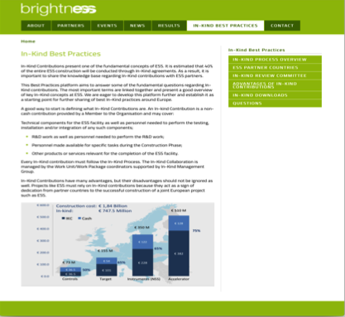
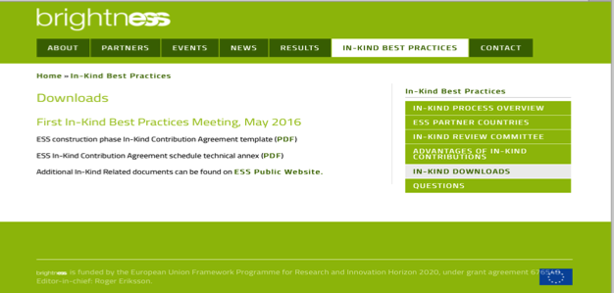
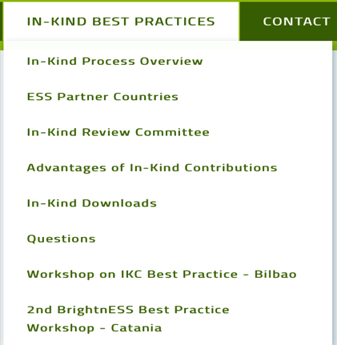
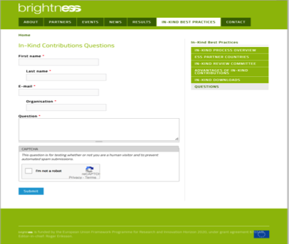
WP2.3 - Development of IKC 'Best Practice' system and organisation of collaboration meetings
WEB Page: https://brightness.esss.se/in-kind-best-practices/in-kind-process-overview

Slide 22


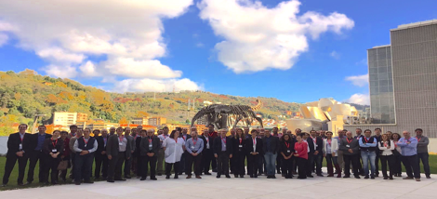
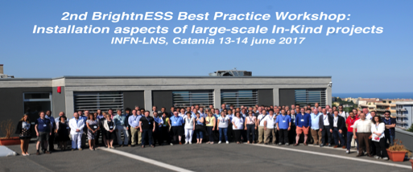
Highlights WP2.3 - Development of IKC 'Best Practice' system and organisation of collaboration meetings
The Best Practice workshops are organised by ESS in collaboration with the technical groups at the ESS and with input from the Field Coordinators (Partners).
Elettra provides support personnel and financial support for all speakers and chairpersons. Elettra covers the costs of travel, accomodation, venue and catering.
Host ESS partners provided local support.
Two events have been organised:
1st BrightnESS Best Practice Workshop: Engineering aspects of large-scale In-Kind projects
Engineering aspects of large-scale In-Kind projects
ESS-Bilbao, Bilbao, Spain
Installation aspects of large-scale In-Kind projects
INFN-LNS, Catania, Italy

Slide 23
Highlights WP2.3 - Development of IKC 'Best Practice' system and organisation of collaboration meetings
The Best Practice workshops are organised by ESS in collaboration with the technical groups at the ESS and with input from the Field Coordinators (Partners).
Elettra provides support personnel and financial support for all speakers and chairpersons. Elettra covers the costs of travel, accomodation, venue and catering.
Host ESS partners provided local support.
Two events have been organised:
Speakers and participants from:
CERN, ITER, European-XFEL, MAX IV Laboratory, SwissFEL, J-Parc, SNS, FAIR, SKA Organisation, Cherenkov Telescope Array Observatory
ESS Partners
ESS

Slide 24
Highlights WP2.3 - Development of IKC 'Best Practice' system and organisation of collaboration meetings
1st BrightnESS Best Practice workshop was held on 14-15 November 2016 in Bilbao, Spain. 80+ attendees. Organised and supported by ESS-Bilbao, Elettra & ESS.
“Engineering aspects of large-scale In-Kind projects”
Four Sessions (22 speakers):
Plenary
Standardization
Integration
Project Information Management
ESS-Bilbao provided local support and laboratory visits.
Presentations are public on the BrightnESS web page.
The workshop was dedicated to the engineering requirements and constraints of in-kind contributions (IKC) to large-scale research infrastructure projects, such as the ESS.
Experience was shared from other large-scale projects, from partners and the ESS itself and proposed improvements to the engineering practices when working on IKC.
Projects based on IKC have unique aspects associated with the management and sharing of project information, the adoption of standards and the consequent approaches to interfaces and integration. Partner contributions are often the result of work from national teams that have long standing knowledge of specialized design, manufacturing and operation. Partners have their own extensive expertise with in-house engineering protocols and standards which may differ from other collaborating partners and the host project. Whenever protocols, conventions and engineering practices differ between partners, the project and/or the contribution may have integration overheads that will impact both schedule and costs.
https://brightness.esss.se/in-kind-best-practices/workshop-ikc-best-practice-bilbao

Slide 25
Highlights WP2.3 - Development of IKC 'Best Practice' system and organisation of collaboration meetings
2nd BrightnESS Best Practice workshop was held on 13-14 June 2017 in Catania, Italy. 100+ attendees. Organized and supported by INFN-LNS, Elettra & ESS.
“Installation aspects of large-scale In-Kind projects”
Four Sessions (22+ speakers):
Plenary
Design, Integration & preparation for installation
Installation
Systems Commissioning
INFN-LNS provided local support and laboratory visits.
Presentations are public on the BrightnESS web page.
The workshop was dedicated to the processes, requirements and preparation for the installation of in-kind contributions (IKC) to large-scale research infrastructure projects with focus on the European Spallation Source ERIC (ESS).
The plenary session reviewed international projects and their experience with preparation, installation and system commissioning. The talks highlighted best practices adopted and provide a forum for recommendations.
The Design, Integration and Preparation session focussed on safety and Swedish regulations, survey and alignment, logistics and storage, cable coordination and preparations for installation, including document and procedures, planning and sequences. The session on Installation covered its organisation and the required services, the coordination and planning of In-Kind contributions including concurrent activities with the installation of conventional facility and cryogenic plants and ESS partner considerations for an In-Kind installation. Systems Commissioning covered ESS commissioning strategies, the switch on and system commissioning of the controls systems, initial beam commissioning and asset and maintenance management.
https://brightness.esss.se/in-kind-best-practices/2nd-best-practice-workshop-catania

Slide 26
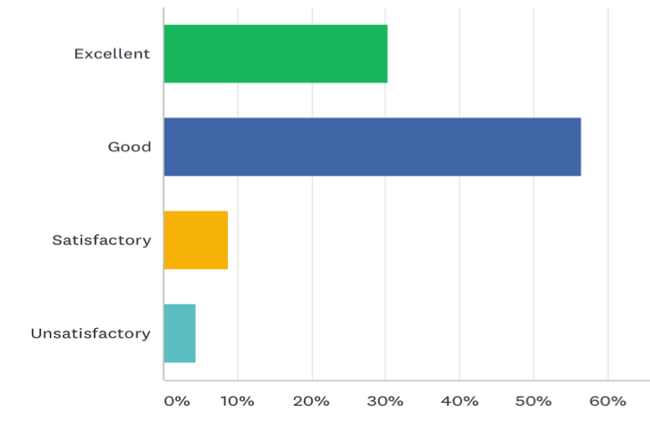
Highlights WP2.3 – Catania Survey (47% of attendees)
Rating of Workshop Content
Rating of structure and format of the sessions

Slide 27
Task WP2.4

Slide 28
WP2.4 - Creation of an IKC network of Regional Hubs
The regional hubs are established and have Field Coordinators that:
Assist the timely and qualitative delivery of IKC in their region.
Are involved and support all three phases of the IKC process.
Have regular meetings between the ESS HQ and other Regional Hubs.
Participate in the organization and facilitation of Task 2.3 (best practice workshops)
Task 2.4 is directly linked to global ESS Project milestones and key performance indicators.
Field Coordinators are additional resources for the IK processes.
Will enhance the communication channels.
Assist in addressing risks and risk mitigation of IK processes.
Strengthen interfaces, reinforce quality, standards and best practices by facilitating the flow of critical information between partners.

Slide 29
WP2.4 - Creation of an IKC network of Regional Hubs
Up to 27 people active for
WP2.4 – with six leaders.
Regional Hub | Owner | Field Coordinator | Countries
North-West | STFC TU Delft | Louise Dixon, Deena Fernandes, Justin Greenhalgh, Philippa Kingston, John Webber for the UK Toon Verhoeven for the NL | UK NL
Central | FZJ | Ulrike Nägele Stefano Pasini, Tania Claudio Weber | DE, CZ, CH
Iberia | ESS Bilbao | Estefania Abad Garcia, Fiamma Garcia-Toriello | ES
Gallia | CEA | Antoine Dael, Florence Ragon, | FR
South-East | INFN BNC Wigner | Santo Gammino, Ornella Leonardi Paolo Mereu, Andrea Miraglia for IT Dániel Csanády for HU | IT HU
Nordic-Baltic | ESS | Marie-Louise Ainalem, Gareth Aspinall, Jazmin Barreto Hamneby, Carlo J. Bocchetta, Miloš Davidović, Michela Dell'Anno Boulton (NSS), Wojtek Fabianowski (ICS), Peo Gustavsson (ACC), Jazmin Barreto Hamneby, | DK, SE, NO,IS, LT, LV, EE, PL
WP2 Regional Hubs
Field Coordinator Leaders in bold

Slide 30
For reference from Grant Proposal: The first and foremost responsibility IKC Field Coordinators is coordination between ESS and its respective Partners.
• Support ESS in identification and evaluation of potential IKC Partners in Partner Countries.
• Assist in evaluating Partners based on technical merits and capabilities.
• Facilitate timely and qualitative achievement of IKC Agreements.
• Will act as representatives of ESS at the Partner institutes and organizations, providing support and service in key components of In-kind collaboration.
• Monitor and maintain technical progress relative to schedule on IKCs during the periods of peak project activity.
• ESS IKC Coordinators will maintain daily communication with In-kind Partners.
• They must establish knowledge of In-kind processes and procedures, ESS and Partner needs, local industrial and institutional capacities.
• Will report their activities in centrally, and maintain a strong connection with the Work Package Leaders coordinators.
• Harmonise efforts with national ILOs, help to bridge the gap between industry and institutes, and multiple IKC Partners.
• Will be the first line quality control agents.
• Must identify potential problems and opportunities and be empowered to act to avoid or resolve issues (or communicate issues to both ESS and partners and recommend actions where possible).
• Will observe and facilitate establishment of quality criteria, acceptance, transfer and transportation of In-kind component between IKC Partners and ultimately to the ESS site in Lund.
• IKC Field Coordinators will be expected to spend a majority of their time on the road, constantly interacting with potential and current partners.
Notes:
At the hubs: Track/Assist partner activities (the progress in assigning a work-package, in setting up a "Technical Annex" (TA) and the implementation of the TA). Track/Assist activities shared between different partners - both within the regional hub and between regional hub partners. Report to ESS & Partner Leaders issues that arise or risks in program execution. Where possible propose solutions.

Slide 31
For reference from Grant Proposal: The first and foremost responsibility IKC Field Coordinators is coordination between ESS and its respective Partners.
• Support ESS in identification and evaluation of potential IKC Partners in Partner Countries.
• Assist in evaluating Partners based on technical merits and capabilities.
• Facilitate timely and qualitative achievement of IKC Agreements.
• Will act as representatives of ESS at the Partner institutes and organizations, providing support and service in key components of In-kind collaboration.
• Monitor and maintain technical progress relative to schedule on IKCs during the periods of peak project activity.
• ESS IKC Coordinators will maintain daily communication with In-kind Partners.
• They must establish knowledge of In-kind processes and procedures, ESS and Partner needs, local industrial and institutional capacities.
• Will report their activities in centrally, and maintain a strong connection with the Work Package Leaders coordinators.
• Harmonise efforts with national ILOs, help to bridge the gap between industry and institutes, and multiple IKC Partners.
• Will be the first line quality control agents.
• Must identify potential problems and opportunities and be empowered to act to avoid or resolve issues (or communicate issues to both ESS and partners and recommend actions where possible).
• Will observe and facilitate establishment of quality criteria, acceptance, transfer and transportation of In-kind component between IKC Partners and ultimately to the ESS site in Lund.
• IKC Field Coordinators will be expected to spend a majority of their time on the road, constantly interacting with potential and current partners.
Field Coordinators have a generous and broad list
of tasks and activities.
Notes:
At the hubs: Track/Assist partner activities (the progress in assigning a work-package, in setting up a "Technical Annex" (TA) and the implementation of the TA). Track/Assist activities shared between different partners - both within the regional hub and between regional hub partners. Report to ESS & Partner Leaders issues that arise or risks in program execution. Where possible propose solutions.

Slide 32
Highlights WP2.4 – Field Coordinator Activities
At the ESS
Be knowledgeable of the IK processes, ESS master plan, standards, quality control, systems engineering management plans, logistics and related documents, be up to date with ESS IK "cost-book" work-packages both “still to be assigned” and “assigned”.
Actions that requires training and follow-ups at the ESS.
Share lessons learnt
Bi-Weekly
Meetings,
Visits,
Calls, Training events, Workshops
At the Hubs
Track/Assist partner activities.
Track/Assist activities shared between different partners - both within the regional hub and between regional hub partners.
Report to ESS & Partner Leaders issues that arise or risks in program execution.
Where possible propose solutions.
Notes:
At the hubs: Track/Assist partner activities (the progress in assigning a work-package, in setting up a "Technical Annex" (TA) and the implementation of the TA). Track/Assist activities shared between different partners - both within the regional hub and between regional hub partners. Report to ESS & Partner Leaders issues that arise or risks in program execution. Where possible propose solutions.

Slide 33
Highlights WP2.4 – Field Coordinator Activities
The heterogeneous nature of Hub IK status has led to a diversity of actions by the Field Coordinators.
e.g. country membership, national law and regulations and level of maturity of the work for the ESS In-Kind contributions.
Hub Field Coordinators act within the mandate of WP2 as appropriate for the level of maturity of the IK activities.
These actions are in line with the objectives and goals of Work Package 2, as exemplified in Deliverable D2.4.
Notes:
At the hubs: Track/Assist partner activities (the progress in assigning a work-package, in setting up a "Technical Annex" (TA) and the implementation of the TA). Track/Assist activities shared between different partners - both within the regional hub and between regional hub partners. Report to ESS & Partner Leaders issues that arise or risks in program execution. Where possible propose solutions.

Slide 34
Highlights WP2.4 – North West Hub
UK
Attended WP2 training events and Best Practice Workshops and disseminated to UK IK Project Managers.
Monitoring and keeping up to date with progress on UK IK contributions and from these monitoring activities identify potential problems/opportunities that need field coordinator assistance or communication to ESS/UK Board to mitigate the risk.
Understanding ESS IK processes and assisting IKC project managers navigate these
Facilitating work to get IKA and TAs to point of agreement with ESS.
Establishing and running Project Office (specific STFC role in grant agreement)
  The Project Office is now established and fully staffed.
  Functions as the coordination point for all the UKs IK contributions to ESS
  Provides advice and support to PMs (STFC procurement, financial processes and PM best practice along with ESS processes and information.
  Coordinates the IKC updates to the UK-ESS Board allowing the Board to better understand and therefore deal with the risks to the UK’s contributions to ESS.
Developed a dashboard to help communicate progress, issues and risks to the UK-ESS Board
Introduced a UK-ESS Risk Management Plan and updated risk register.
Put in place a change management plan that aligns with the ESS change control procedure.
Contributed to risk mitigation by communicating identified risks and issues at the appropriate level.
Facilitated progress on: STFC agreements required with IK partners University of Huddersfield & UKAEA, VAT (using exemption certificates), IKA – progress made though still not resolved.
NL
All major activities are related to trying to have the Netherlands becoming a solid founding member of ESS.
Attending WP2 Training Events and Best Practice Workshops.
Assisting the Netherlands to become a member of the ESS through attendance and presentations to meetings (Dutch ILO, Dutch ministries, Business forums, International EU conferences).
The major step in the funding process was the detailed roadmap application that was send in on June 1, 2017.
The Dutch scientists are ready to participate.
The Dutch industry is ready to work on the packages available at the moment of becoming an ESS member
Supporting Swedish and Dutch Science Council visits.
Assisting ESS delegations.
WP2 Regional Hubs

Slide 35
Highlights WP2.4 – South East Hub
IT
Creation of intra-partner network devoted to IKC management (INFN groups, Elettra, CNR).
Regular meetings with HU partners and the creation of a Field Coordinator for Hungary.
Dissemination of best practices, harmonisation of tenders, QA/QC, documentation.
Mitigate risks through the creation and monitoring of Industrial Partner Network (surveys, network of able industries,..)
Distribution of information (i.e., characterisation of technical industrial expertise) to increase available participants in calls for tender.
QA during manufacturing, periodic visits to companies, scheduled meetings, handling of non-conformities.
Monitoring and checking progress wrt ESS schedule, supporting compilation of monthly reports.
Check and share information for interfaces and installations.
Creation of a Database for Orders & Supplies and document management.
Meetings with other Hub partners and EU laboaratories (i.e., DESY, GSI)
Participating in WP2 meetings and training events.
Organisation of Catania Workshop
HU
The South-East hub has evolved with a Field Coordinator (Dániel Csanády) for Hungary in addition to that of Italy (Paolo Mereu).
Disseminating information and minimising risks to HU partners.
Participating in training events at ESS and workshops.
Participating in Hub meetings (IT & HU)
Tracking activities at Hub partners.
WP2 Regional Hubs

Slide 36
Highlights WP2.4 – Gallia Hub
Attend training at ESS and sharing information in its home institutes e.g. Quality (Mar. 2017) and accompanied by L. Napoly (Quality Engineer at CEA/Irfu).
Regular contact with all the stakeholders:
• CEA/Irfu: Monthly ESS-Irfu Meeting &Weekly Meeting on Cryomodule Assembly
• CNRS/IPNO: Regular Meetings on Industrial Progress (e.g. Meeting with Sébastien Bousson on the 20/03/2017)
• CEA-CNRS/LLB: Regular interactions with LLB scientists (e.g. Meeting on the 06/06/2017 with Christiane Alba-Simionesco & LLB scientists for an update on the French contribution to ESS Instruments)
• The Gallia Hub has also regular contacts with the French representatives in ESS governing bodies (council, AFC, Collaboration Board,…).
Promoted Best Practice workshops in the hub, selecting speakers and participants
Collaborating with the national ILO and communicating (processes, schedules) with industry on IKC from France, assisting with meetings.
Assisting partners on VAT issues and certificates.
Improving awareness of information sources to French partners (i.e., CHESS at ESS).
WP2 Regional Hubs

Slide 37
Highlights WP2.4 – Central Hub
Established processes to facilitate the management of documentation (technical annexes, contribution agreements, collaboration agreements, etc) using Jira.
Worked on several solutions around the delay of financing due to VAT issues between the member country and ESS.
Introduced a financial controlling plan for risk mitigation on internal overspending with any ESS related work.
Started work on the quality management plan and assigned a quality manager to the ESS project.
Worked in close contact with ESS and partners to establish priorities and project integration.
Contributed to risk mitigation by communicating identified risks and issues at the appropriate level and bringing together the right people to resolve or identify solutions.
Constantly visited in-kind partners in DE, CZ , CH and FR to discuss urgent issues related to technical annexes, early procurement and contributions agreements
Organised German Contributions workshop (10/11/16, DE), Shielding Meeting (03-05/05/17, DE), visit to FZJ by DMSc (19/02/17, DE).
Meeting with LLB (22/06/17) enhancing consortium instruments.
Connection to other H2020 projects (SoNDe 02/06/17)
Visits to IK partners and suppliers sharing lessons learnt.
Attendance to Best Practice workshops (13-15/11/16 ES, 13-14/06/17 IT), Trianing Events (13-16/02/17 SE), General Meeting (02/06/17, UK).
WP2 Regional Hubs

Slide 38
Highlights WP2.4 – Nordic-Baltic Hub
  Attended Quality Training at ESS March 6th-7th 2017. Strengthened emphasis on future communication between Quality Group at ESS and Field Coordinators.
  Extensive effort put into conceptualizing, managing, and deploying the XRM+ platform to different level internal and external stakeholders. Weekly meetings with partners from Elettra ensure continued development. With support from other Lund based BrightnESS personnel, contacts database has been implemented as an additional feature of the software.
  Monitoring In-Kind contributions between Nordic partner countries and ESS.
  Mitigating current and potential risks.
  Strong emphasis on collaboration with internal ESS stakeholders vis-à-vis the VAT issues surfacing for some of ESS Nordic Partners.
  Identifying gaps in dedicated In-Kind Value with the partners. Assessing future opportunities for collaboration with ESS sub-projects.
  Establishing and maintaining a relationship with key stakeholders in all Nordic Partner Institutes. Liaising between internal ESS staff and partners.
  Supporting the Call-Off procedure (particular to Norway); facilitating administrative requirements for payments to be made – strong cooperation with ICS and Accelerator Sub-Projects.
WP2 Regional Hubs

Slide 39
Highlights WP2.4 – Iberia Hub
  Supporting work to get TA and IKC ready to sign with ESS
  Supervision and monitoring IK work
      Milestones tracking (progress, achievements, delays, action points)
      Regular meetings with WP leaders
      Monitoring of WP planning and monthly report
  Supporting work in Call for Tenders preparation and procurements tracking
  Understanding ESS IK processes and assisting WP leaders follow them
  Risks Management of the WPs
  Coordination with ESS and other partners – biweekly videoconferences- to share information
  Supporting works and coordination with ESS in Logistics
  Coordination with ESS Installation Managers to plan future installation works
  Understanding QA/QC ESS requirements and supporting Quality Control work for Spanish IK contribution
  Coordination with WP6 outreach and dissemination
  Coordination with Spanish ILO
  Follow up Technical Board and Collaboration Board meetings for Accelerator, Target and Instruments
Presentation by
José Luis Martinez
ESS-Bilbao
WP2 Regional Hubs

Slide 40
Results
All Major objectives accomplished (last 24 months).
WP2 provides additional resources to both ESS and partners for many IK actions.
The IK Information System is streamlining data and keeping ESS participants up to date on actions, provides support for partner-partner interactions. Broader use of the program is envisaged following beta-testing by FC’s and selected ESS support personnel.
The IK Best Practice Workshops are leading to shared knowledge and recommendations on the extremely important areas of engineering, testing, component assembly and installation.
Field Coordinators track activities highlighting risks and provide support to a wide range of topics. They strengthen inter-regional partner communication which mitigates risks and open new opportunities for IK work and support. A network of skilled multi-tasking people has been established that extends international cooperation and will catalyse new opportunities.

Slide 41
Issues resolved
Strengthened inter-regional interactions in the south-east hub. Meetings held between SE hub members and amendment made allowing Hungary to have an FC and activities in WP2.
All hubs fully staffed and working. ESS interface personnel (Accelerator, NSS and ICS) operational.
Strengthened WP2 awareness in Estonia and Norway.
Issues to resolved
Strengthen interaction with partners in Poland. Initial contact has been made with Nuclear Physics Institute in Krakow (Dec-2016). Follow-up meetings in Sept/Oct Krakow, Wroclaw, Warsaw.

Slide 42
WP2 Expenditure months 1-22 (as % of 36 months)
Overall expenditure
Expenditure per cost categories
> 50%
Forecast for linear spending ~61%

Slide 43
Next steps
WP2.1: Focus of training and transfer of information for IK Component installation. Review current and forecasted risks for IKC at partners and interact with ESS and hubs to assist in mitigation. Update FC’s on ESS developments for installation processes: personnel, Swedish protocols, logistics, health and safety, etc..
WP2.2: Extend use of XRM+ to partners and additional ESS personnel. Continue development and debugging. Review incorporation of P6 data. Transfer code to ESS servers by Feb 2018 and cover support and transfer costs at ESS
WP2.3: Follow up with conclusions of Catania workshop and survey and update WEB page. Initiate 3rd Workshop organisation. Examine possibility of an additional topical workshop at ESS for specific aspects of facility installation of IK components and services.
WP2.4: Continue the strengthening of FC activities and their network. Enhance focus at partner laboratories on preparations for installations and processes, continue work on QC, deliveries and tests at partners, etc… Continue to strengthen relations between partner institutes within a hub with focused meetings and actions.

Slide 44
Carlo J. Bocchetta
Horizon 2020 BrightnESS project (grant no. 676548) - WP2 Leader
Mobile: +46 72-179 24 08
E-mail: carlo.bocchetta@esss.se

