Slide 1
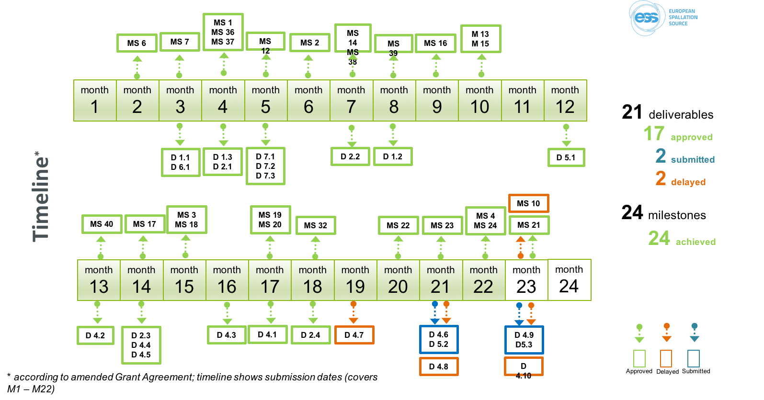
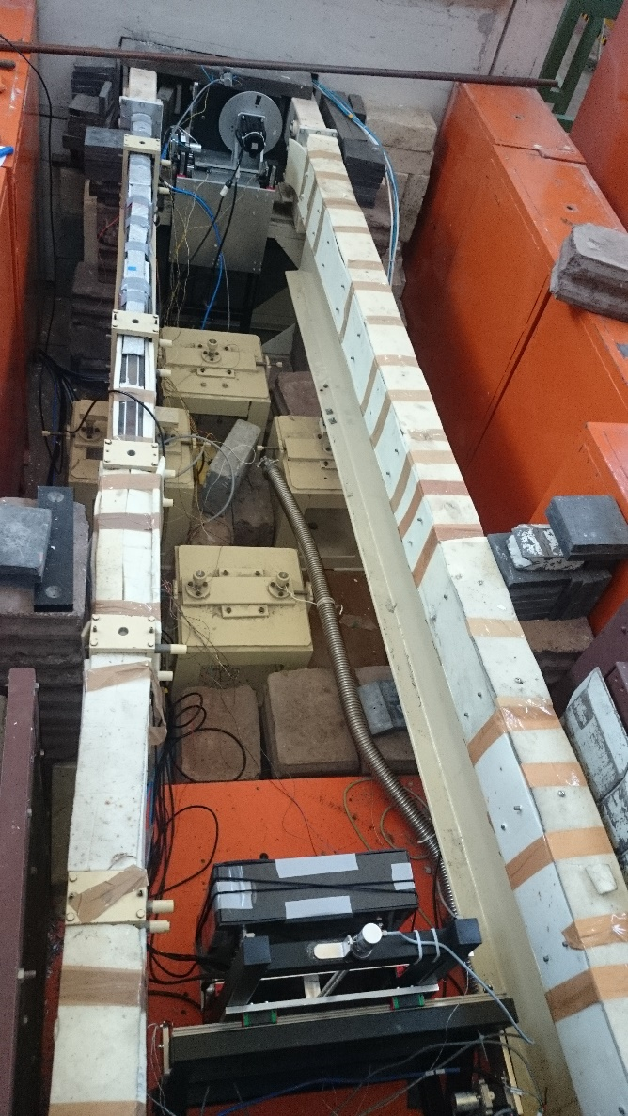
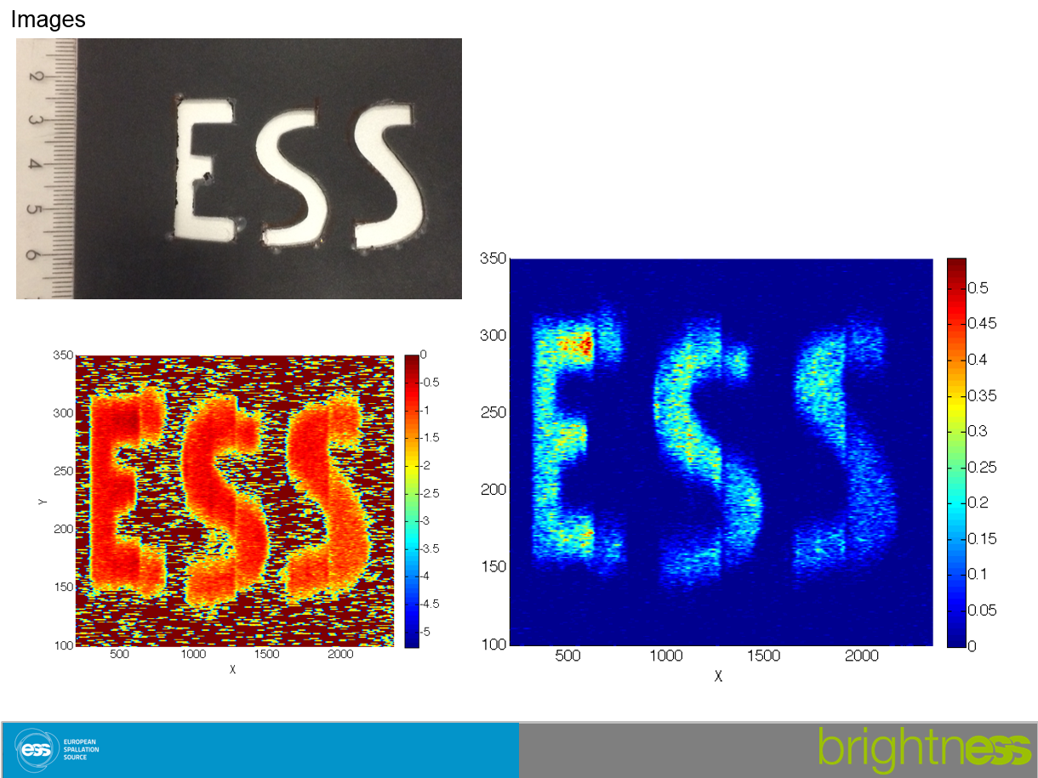
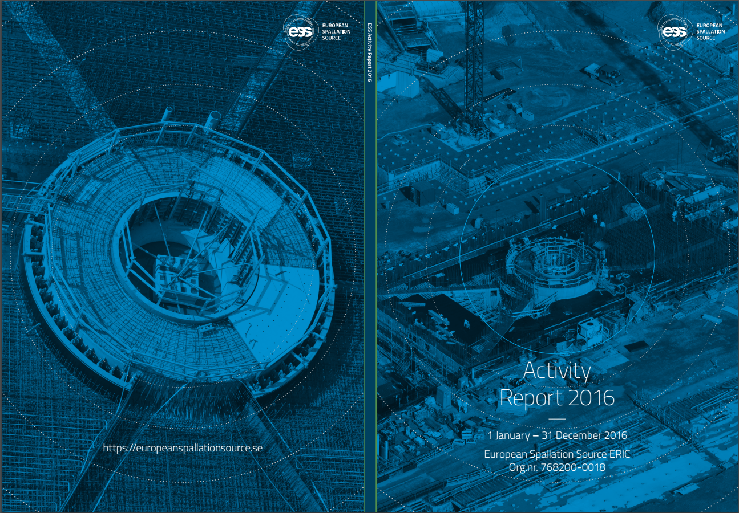
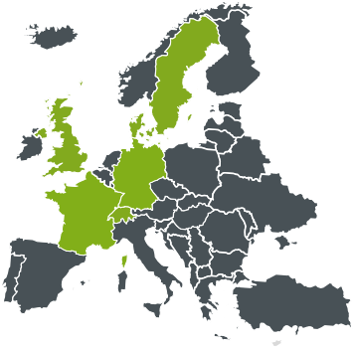
September 2015 – September 2017
Contractual obligations fulfilled & project on schedule and budget
GA approval for both years
1st periodic report ‘approved’
Amendment approved
Boron-based detector concept tested
Low Dimensional Moderator engineering design complete
Multigrid detector concept validated
15 scientific publications
€307M of agreed IK Agreements, Technical Annexes with a Cover Page and Collaboration agreements, incl. SE and DK
XRM⁺ operational
Network of field coordinators in place and collaborating
Definition and configuration of Data Capture Storage and Streaming confirmed
ERIC transfer completed
Innovation policy approved
TTO office in place
PPI identified
Trainings and conferences on innovation in progress
Target group survey completed (‘approval-stage’)
1 new ESS Member country
6484 individuals visited the construction site
BrightnESS is funded by the European Union Framework Programme for Research and Innovation Horizon 2020, under grant agreement 676548

