Slide 1
General Assembly meeting
Work Package 1: Project Management
Roy Pennings, Project Coordinator
Raquel Costa / Anne-Charlotte Joubert, Project Managers

Slide 2

Status of
Deliverables
BrightnESS is funded by the European Union Framework Programme for Research and Innovation Horizon 2020, under grant agreement 676548

Slide 3
Status of
Milestones
BrightnESS is funded by the European Union Framework Programme for Research and Innovation Horizon 2020, under grant agreement 676548

Slide 4
Timeline*
MS 1
MS 36
MS 37
MS 12
MS 14
MS 38
M 13
M 15
MS 6
MS 7
MS 2
MS 39
MS 16
month
1
month
2
month
3
month
4
month
5
month
6
month
7
month
8
month
9
month
10
month
11
month
12
21 deliverables
17 approved
2 submitted
D 1.1
D 6.1
D 2.1
D 7.1
D 7.2
D 7.3
D 2.2
D 1.2
D 5.1
1 delayed
BrightnESS is funded by the European Union Framework Programme for Research and Innovation Horizon 2020, under grant agreement 676548
MS 10
24 milestones
MS 3
MS 18
MS 19
MS 20
MS 4
MS 24
MS 40
MS 17
MS 32
MS 22
MS 23
MS 21
24 achieved
month
13
month
14
month
15
month
16
month
17
month
18
month
19
month
20
month
21
month
22
month
23
month
24
D 4.2
D 2.3
D 4.4
D 4.5
D 4.3
D 1.3
D 4.1
D 2.4
D 4.6
D 5.2
D 4.9
D 4.7
D 4.10
D 5.3
* timeline shows actual submission dates between M1 – M22
D 4.8
Approved
Delayed
Submitted

Slide 5
planned:
2000 contacts
20 best practices
9 small meetings
30 staff trained
98 IKC contracts
6 IKC phase 2 reports
BrightnESS KPIs (1)
Organisational innovation
- 12 ERIC members
- 4 innovation inputs
- PPIs identified
Innovation in neutronic technologies
- 15 scientific publications
- 3 open software packages
- 9 successful simulations (Gd GEM, MultiBlade, MultiGrid)
- 32 neutrons conference participations
Strengthening IKC
- over 20.000 contact addresses
- 25 best practice presentations
- 23 trainings & workshops
- 226 collaboration meetings
- 27 Agreements; 127 TAs
- 60 IKC phase 2 reports
planned:
12 members
4 innovation inputs
6 PCPs identified
planned:
7 publications
6 open source packages
6 simulations
23 conferences
BrightnESS is funded by the European Union Framework Programme for Research and Innovation Horizon 2020, under grant agreement 676548

Slide 6
BrightnESS KPIs (2)
Collaboration building & dissemination
- 40 outreach activities (per hub)
- 1 new Member Country
- 6 events in New Member States
- 251 Business profiles registered
- 7 new supplier contracts (above €200K)
- 1169 participants in ILO industry events
- 87 press releases (web)
- 7 non-scientific publications
- 50K+ page views per month (8K – 10K unique visits p/m)
Managing ESS data
- 39 software repositories
planned:
30 software releases
planned:
5 outreach per cluster
3 new Member Countries
10 events in new Member Countries
500 new business profiles
40 new supplier contracts
500 participants in ILO industry events
6 press releases
8 publications
25.000 average website visitors p/m
Project management
- 9 key risks reduced by more than 5 units
planned:
6 key risks reduced by 5 impact points (according to ESS risk register)
BrightnESS is funded by the European Union Framework Programme for Research and Innovation Horizon 2020, under grant agreement 676548

Slide 7
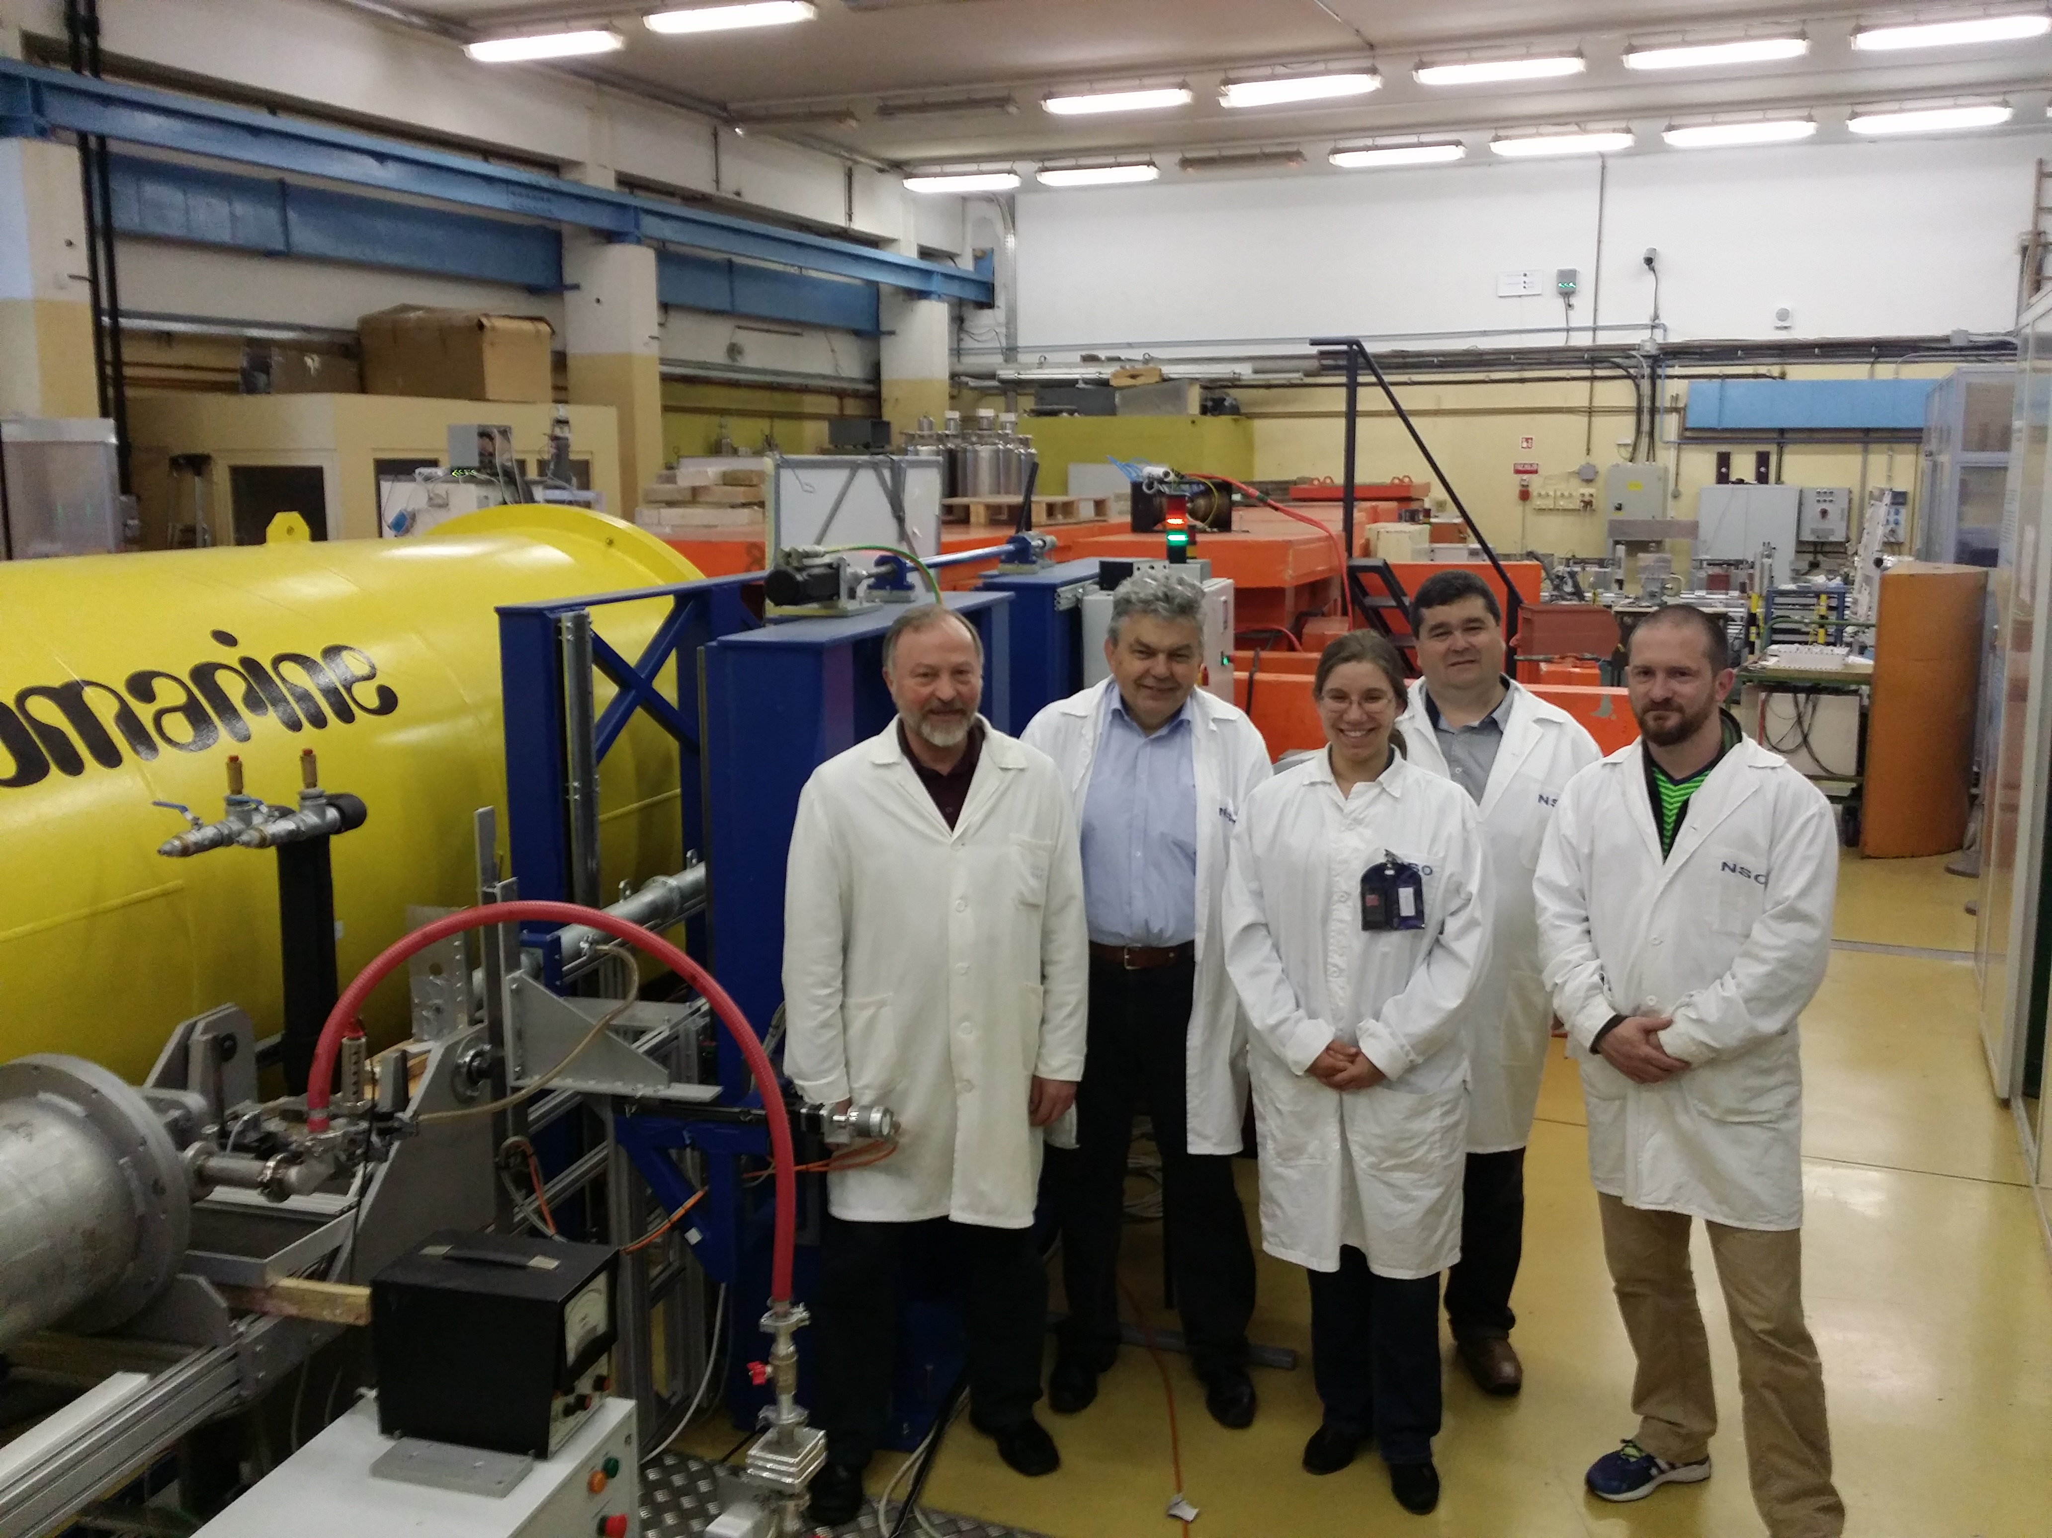
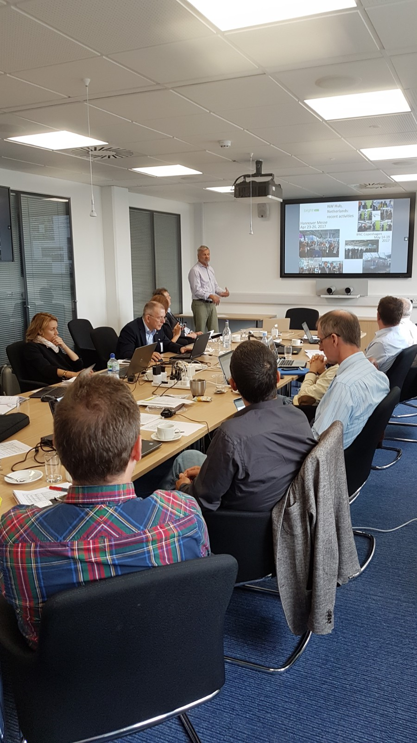
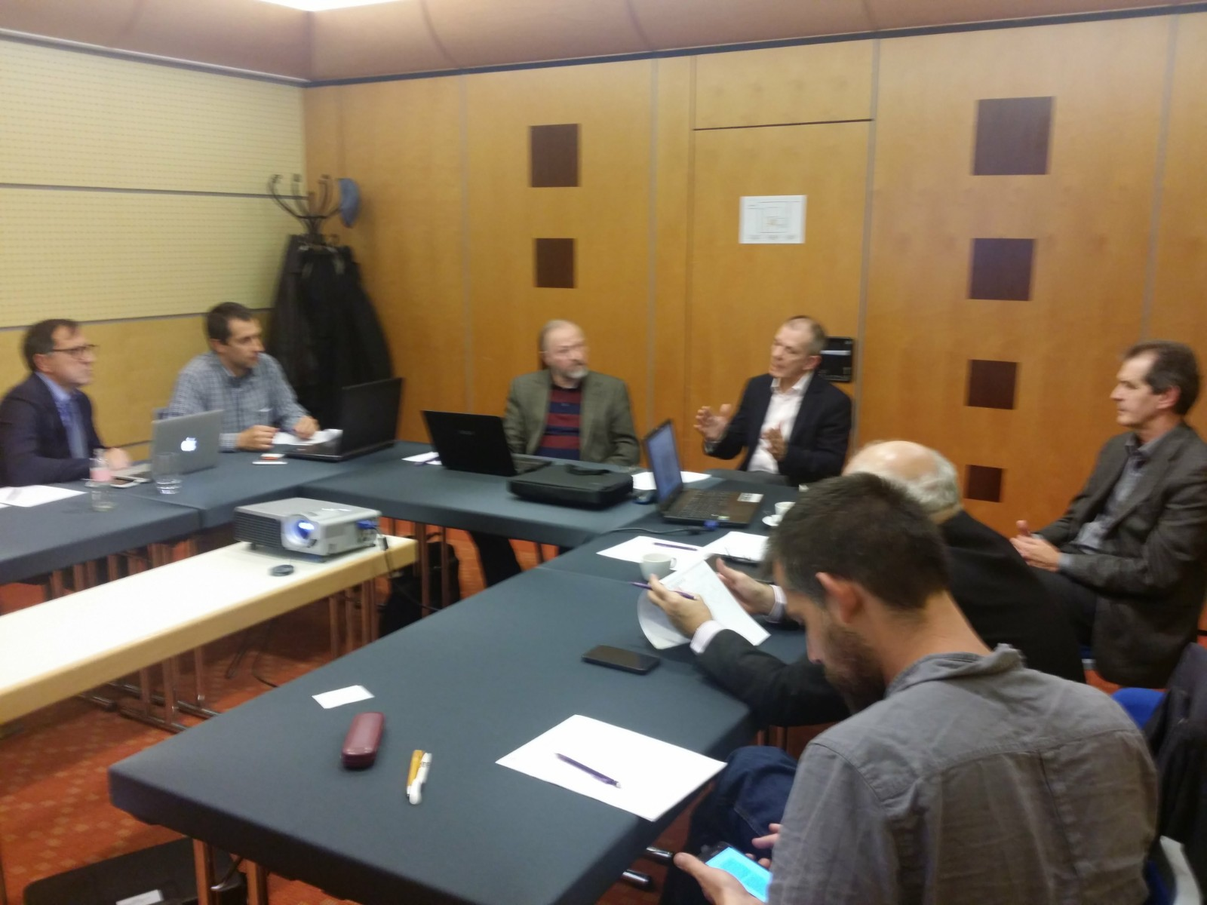
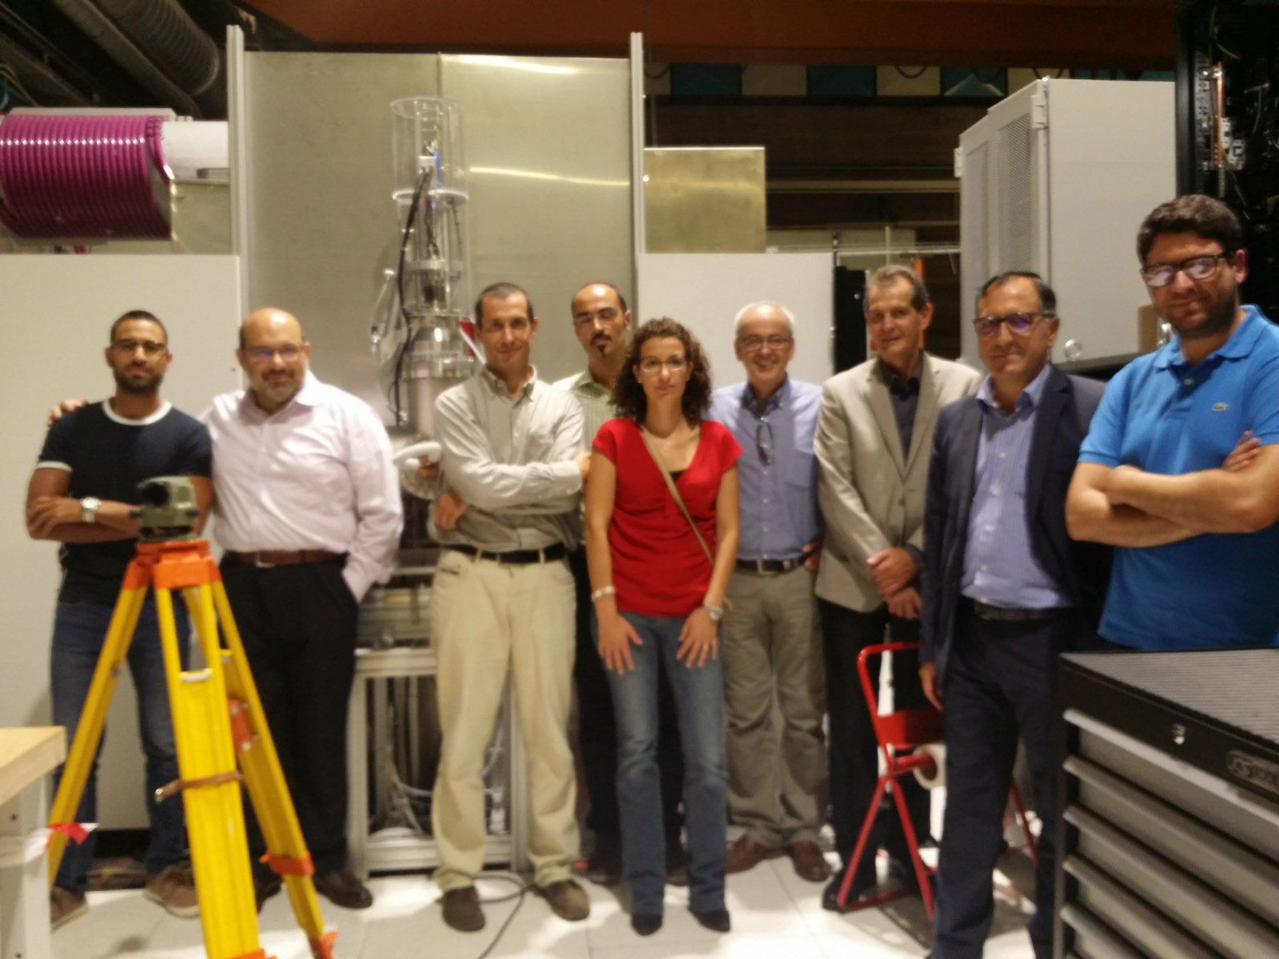
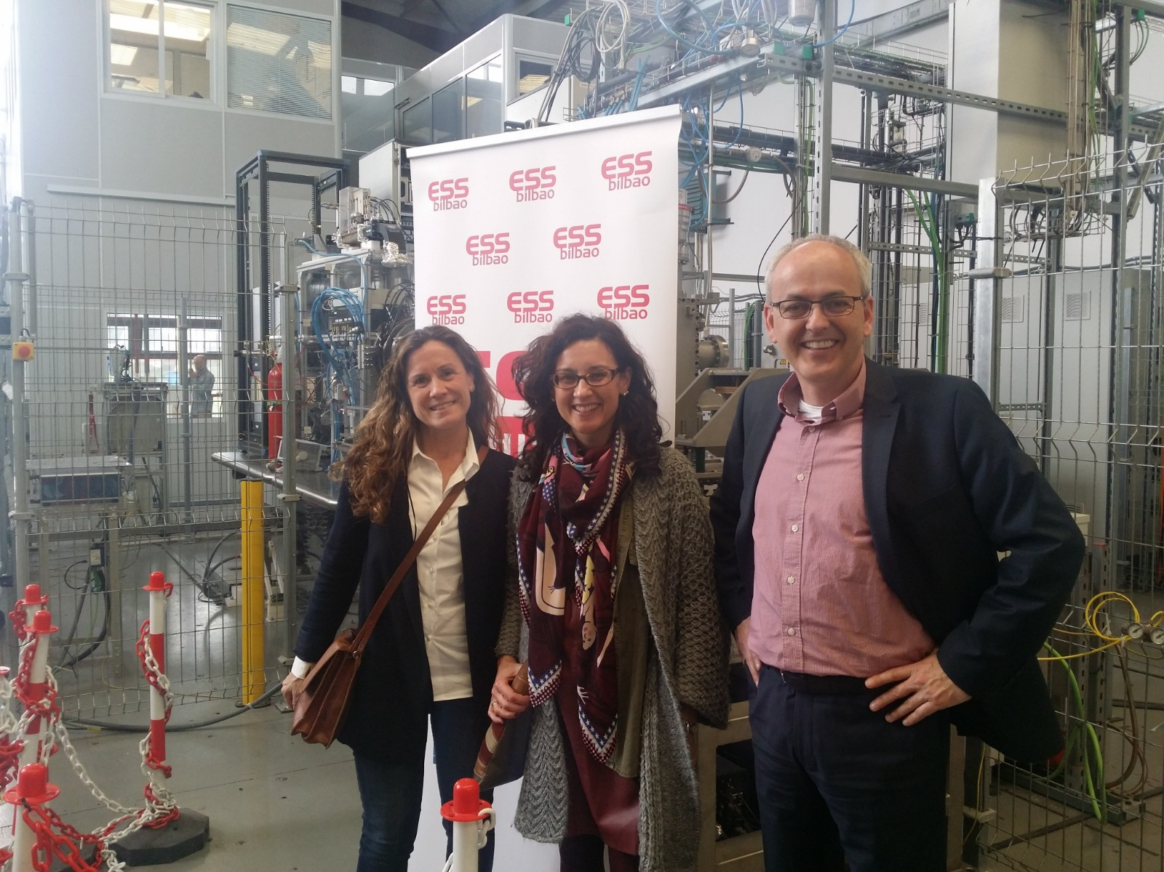
Partner meetings
@ consortium partner | Location | Date
(PSI) – part of WP5 meeting | Villigen, CH | 31 March 2016
ESS Bilbao | Bilbao, SP | 19 April 2016
BNC Wigner | Budapest, HU | 12 May 2016
ESS Bilbao | Bilbao, SP | 19 May 2016
(ILL) – included in non-BrightnESS meeting | Grenoble, FR | 02 June 2016
IEAP CTU | Prague, CZ | 19 July 2016
TUD | Delft, NL | 18 August 2016
FZJ | Jülich, D | 08 September 2016
KU | Copenhagen, DK | 09 February 2017
DTI + DTU | Taastrup, DK | 21 February 2017
LU | Lund, SE | 07 March 2017
KU | Copenhagen, DK | 03 May 2017
STFC | Harwell, UK | 02 June 2017
ESS Bilbao | Bilbao, SP | 06 & 07 June 2017
MiUN | Sundsvall, SE | 16 June 2017
LU | Lund, SE | 22 August 2017
Additional meetings to ensure
coherence and alignment
Typical points for discussion:
project aims (for admin/finance)
financial/admin record keeping
time sheets (incl. ‘difficult cases’)
general cost eligibility issues
cost transfer issues
technical progress
additional activities
status of cost expenditure
collaboration & support
2017 ‘to-do’: CEA, Elettra, CERN
BrightnESS is funded by the European Union Framework Programme for Research and Innovation Horizon 2020, under grant agreement 676548

Slide 8
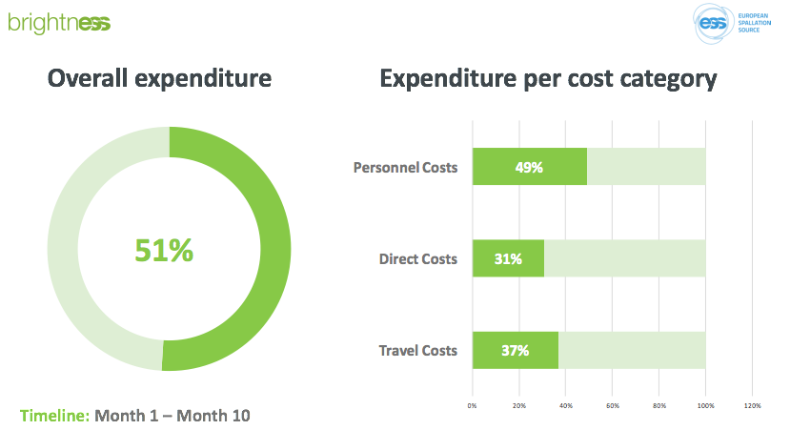
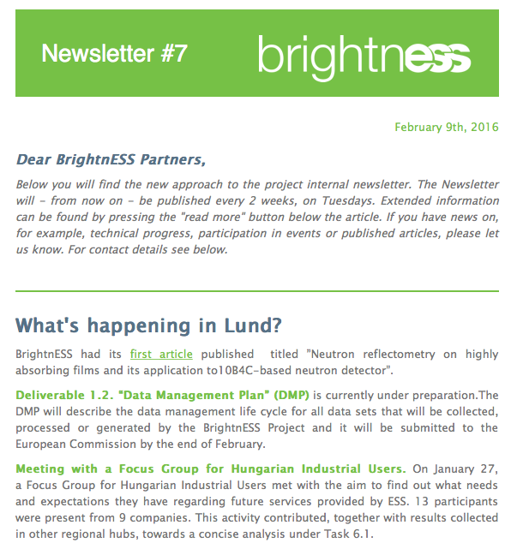
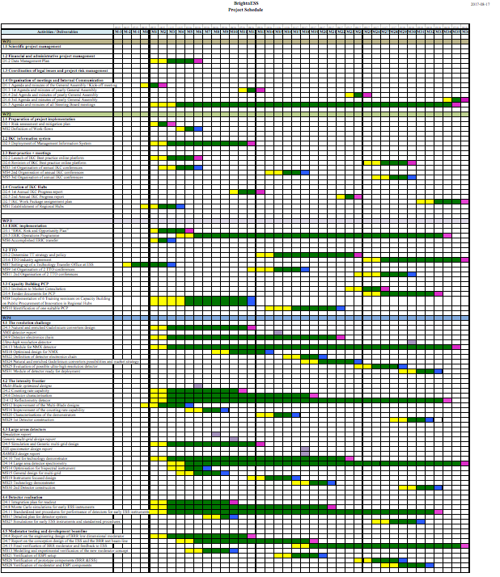
Monitoring tools: approaches and methods
Continuous, clear, honest and targeted communication
Monitoring technical progress and resources
Resource and expenditure monitoring
- Meetings,
- TelCons,
- Newsletter,
- Emails to GA
- STB minutes,
- Monitoring tools,
- Quality check,
- Partner visits
- Quarterly, with analysis per WP and partner
Expect the unexpected
Handle issues at individual level (partner visits)
Consistent collaboration management
Flexibility
- Re-design planning,
- Costs and timeframe; check consequences
- Patience,
- Acceptance of individual unforeseen problems
- Availability,
- Response-time within 24 hrs,
- Knowledge sharing
- Adjusting activities to needs
BrightnESS is funded by the European Union Framework Programme for Research and Innovation Horizon 2020, under grant agreement 676548

Slide 9
(Approved) Amendment to the Grant Agreement
Change of ESS legal status of ESS to ERIC inside EC Participant Portal
Change in subcontracting
(ESS subcontracting to Elettra direct costs for XRM+)
Changed delivery dates of some deliverables
Change from PCP identification to PPI identification
New deliverable (impact assessment) with subcontracting
Addition of partners to WPs (BNC to WP2, ESS-B to WP4) and attribution of PM
Addition of activities (summer courses, visits to/from ESS from outside Europe)
Addition of cost eligibility (ESS visitor centre maintenance, specific risk assessment meetings)
Transfer of activity and potential budget transfer from ESS to LU in WP4
Reduction in new Member countries and ILO nodes (from 5 to 3)
BrightnESS is funded by the European Union Framework Programme for Research and Innovation Horizon 2020, under grant agreement 676548

Slide 10
Monitoring cost performance
Quarterly monitoring
Budget control
  Project budget and updates
  Record of quarterly reports
  Project performance measurement (global/partner/WP/cost category)
  Partner report via online google form
COST MONITORING TOOL
Preventive function
Work performance indication
Project cost risk management
Performance measurement analysis
  Taking corrective action
  Project cost management plan
  Status assessment
  Comparing actual performance with budget
  Investigating the variance
  Forecasting
  Recommend corrective action
  Risk monitoring
Optimise project full value
BrightnESS is funded by the European Union Framework Programme for Research and Innovation Horizon 2020, under grant agreement 676548

Slide 11
Financials M1 – M22

Slide 12
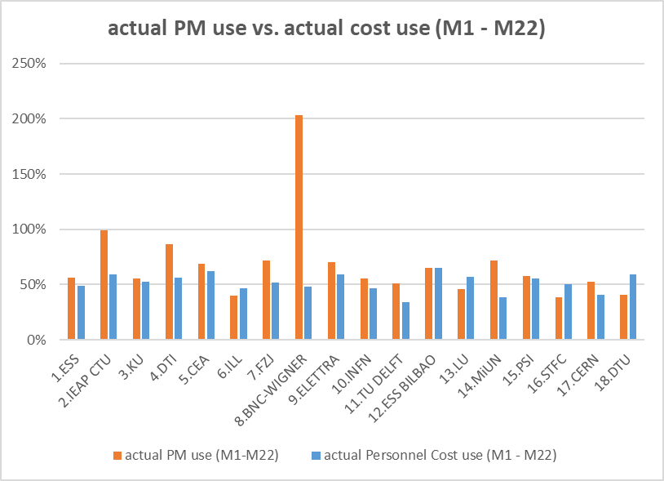
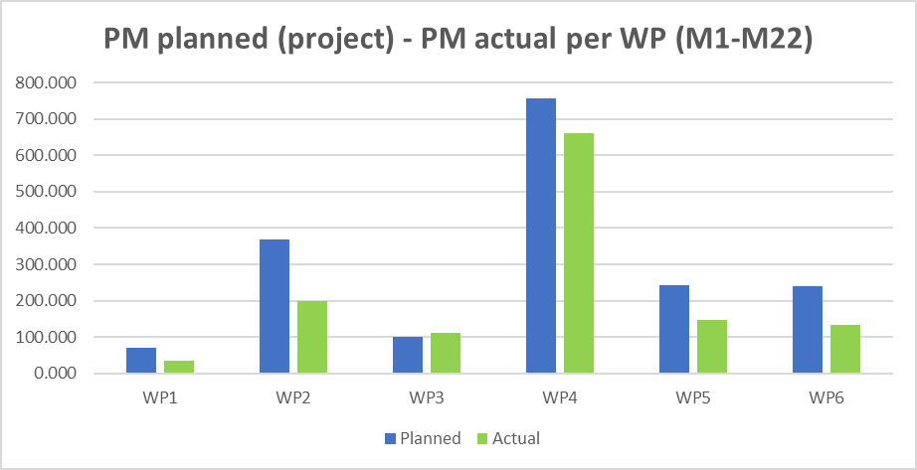
Use of effort & available efforts (PM) - 1
BrightnESS is funded by the European Union Framework Programme for Research and Innovation Horizon 2020, under grant agreement 676548

Slide 13
Personnel effort - 2
BrightnESS is funded by the European Union Framework Programme for Research and Innovation Horizon 2020, under grant agreement 676548

Slide 14
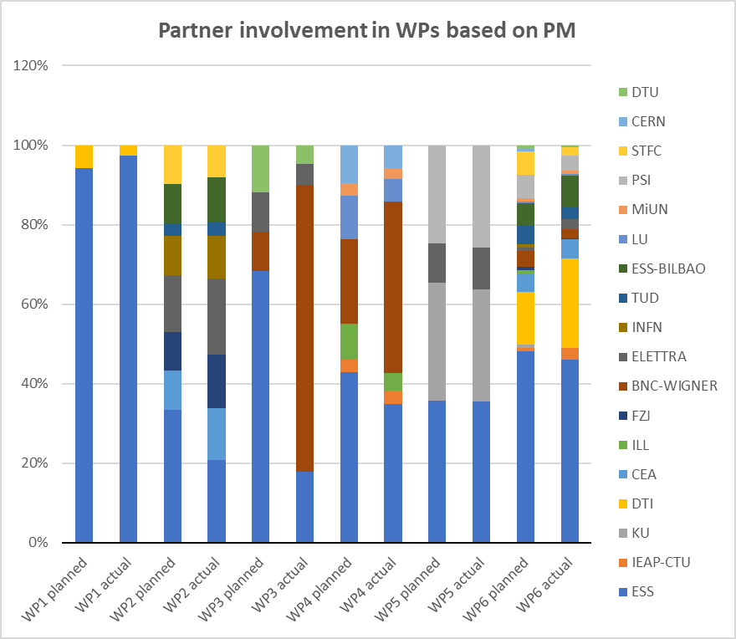
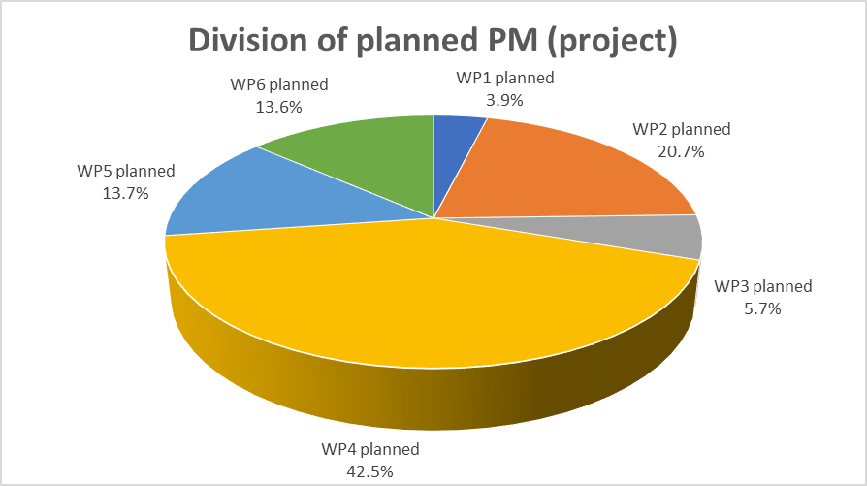
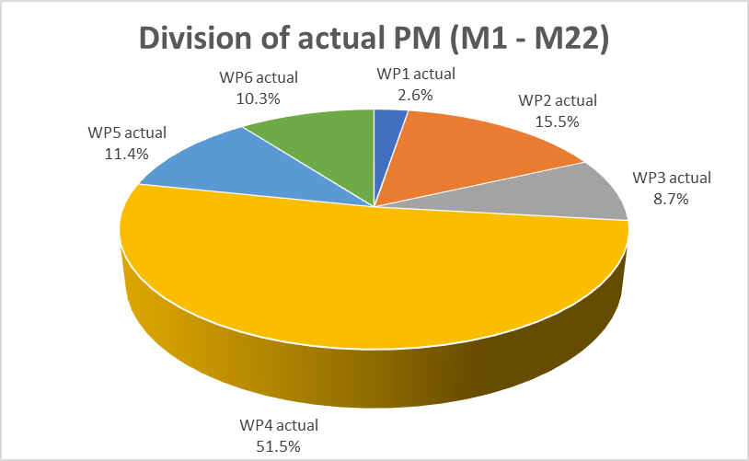
Role of WPs & partners’ role in WPs (based on PMs)
BrightnESS is funded by the European Union Framework Programme for Research and Innovation Horizon 2020, under grant agreement 676548

Slide 15
Use of effort & available efforts (PM) - 2
BrightnESS is funded by the European Union Framework Programme for Research and Innovation Horizon 2020, under grant agreement 676548

Slide 16
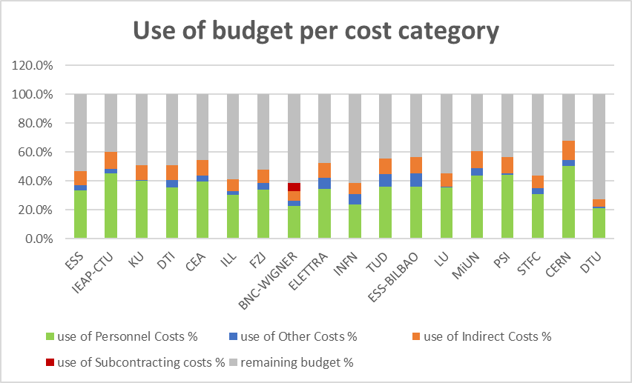
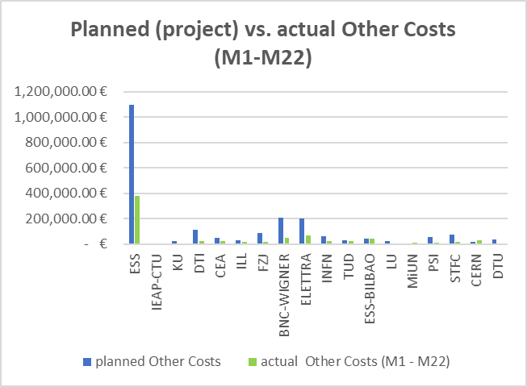
Use of budget - 1
BrightnESS is funded by the European Union Framework Programme for Research and Innovation Horizon 2020, under grant agreement 676548

Slide 17
Use of budget - 2
BrightnESS is funded by the European Union Framework Programme for Research and Innovation Horizon 2020, under grant agreement 676548

Slide 18
Use of budget – 3
(scenario based on extrapolation of M19-M22 expenditure)
Scenario based on ‘staged expenditure’:
Yr1: €4 million
Yr2: €7 million
Yr3: €9 million
Status :
Current Schedule Performance Index: 0.94
Current Schedule Variance: €479K
Estimate to Completion: €10.4 million
Estimate at Completion: €18.8 million
BrightnESS is funded by the European Union Framework Programme for Research and Innovation Horizon 2020, under grant agreement 676548

Slide 19
Cost flexibility and planning
Current situation:
‘underspend’ of 12% compared to linear cost progression (not realistic!)
forward extrapolation scenario indicates overall spent of 94%
WP-leaders to check forward planning for M23-M36 with all partners. Aim is: full cost expenditure based on correct cost reporting + additional activities (where relevant)
Contingency:
WP1 to prepare a re-designed plan by November 2017 (submission by March 2018).
Options:
        additional activities by partner
        additional activities within WP
        new task/deliverables elsewhere in project
Examples of spending M22-M36:
WP1/WP5: implementation DMP
WP2: addition of workshop on rules/regulations on ESS-IKC installation in Sweden
WP3: innovation trainings and TTO conferences
WP4: ESS-B added to develop viability study on low background thermal neutron beam monitor
WP6: DTI to produce several BrightnESS partner videos
BrightnESS is funded by the European Union Framework Programme for Research and Innovation Horizon 2020, under grant agreement 676548

Slide 20
Summary status
Technical
Financial
Risks
  17 out of 21 deliverables successfully submitted
  (M1 – M22)
  almost all milestones for the period achieved
  planning is on target and monitoring is running
  amendment approved
  Periodic Report ‘approved’
  collaboration running
  smoothly
  ACTIONS:
  start work on Impact
  Assessment
  update KPI list
  Cost Monitoring Tool in place and checked with partners
  Financial Statements checked
  spend monitoring
  ACTIONS:
  solve ‘Portal linking’
  transfer Interim Payment
  improve monitoring tool
  track partner costs
  verify partner entries in
  periodic reporting
  staffing (WP contingency)
  under-reporting by partners
  ACTIONS:
  WP-leaders to revise
  activities/budgets;
  WP1 to monitor availability
  and follow-through of
  forward planning by partners
BrightnESS is funded by the European Union Framework Programme for Research and Innovation Horizon 2020, under grant agreement 676548

Slide 21
Thank you!
Questions or comments, please

