Slide 1
WP6: Collaboration,
Communication and Dissemination
BrightnESS General Assembly
Ute Gunsenheimer, ESS | WP Co-leader for Tasks 6.1, 6.2, 6.3
Juliette Forneris, DTI | WP Co-leader for Task 6.4

Slide 2

6.1. Collaboration Building & Outreach
6.4. Communication & Dissemination of Results
6.2. Enlargement of Membership
6.3. Strengthening the ILO Network
WP6 Overview

Slide 3
Deliverables and Milestones
D6.1
MS36
MS37
MS38
MS39
BrightESS Section on www.europeanspallationsource.se M2
Issuing of Corporate Identity Guide M3
Establishment of Regional Hubs for Collaboration Building & Outreach M4
BrightnESS Information Materials M7
1st Outreach Activity Plans for Each Cluster M8
D6.2
D6.3
Results of Target Group Online Survey M25
Three new ILO nodes M35
D6.4
Three new ESS Member Countries (Member, Observer, Associate) M36
MS40
2nd Outreach Activity Plans for Each Cluster M13
MS41
3rd Outreach Activity Plans for Each Cluster M25
✓
Achieved

Slide 4
Overall spending M1-M22
Overall overview per cost category
Partner | Use of budget %
1.ESS | 51%
2.IEAP CTU | 141%
3.KU | 0%
4.DTI | 54%
5.CEA | 57%
6.ILL | 0%
7.FZJ | 13%
8.BNC-WIGNER | 14%
9.ELETTRA | 102%
10.INFN | 0%
11.TU DELFT | 43%
12.ESS BILBAO | 58%
13.LU | 34%
14.MiUN | 69%
15.PSI | 36%
16.STFC | 50%
17.CERN | 36%
18.DTU | 16%
TOTAL | 49%

Slide 5
Task 6.1: Collaboration Building and Outreach
Target Group Analysis
Academia and science
Industry
Regional Hubs
Networking and outreach
Regional context and expertise
Visits
Stakeholder, business and informational visits
Innovation ecosystem

Slide 6

Pan-European Survey of Neutron Sources*
WHY? To support ESS in drafting policies for innovation and access, and in developing outreach strategies
WHO? 15 neutron sources in Europe
WHEN? Spring 2016 – Summer 2017
HOW? Through an electronic questionnaire, developed in collaboration with BrightnESS partners and participating RIs, and distributed to Heads of RIs and/or the Heads of Users Offices
RESULTS IN NUMBERS
15 facilities
5 777 users
198 instruments
2 699 operational days
24 398 beam days
4 788 experiments
*Data presented herein are only preliminary as the approval process of the survey report is still ongoing.

Slide 7
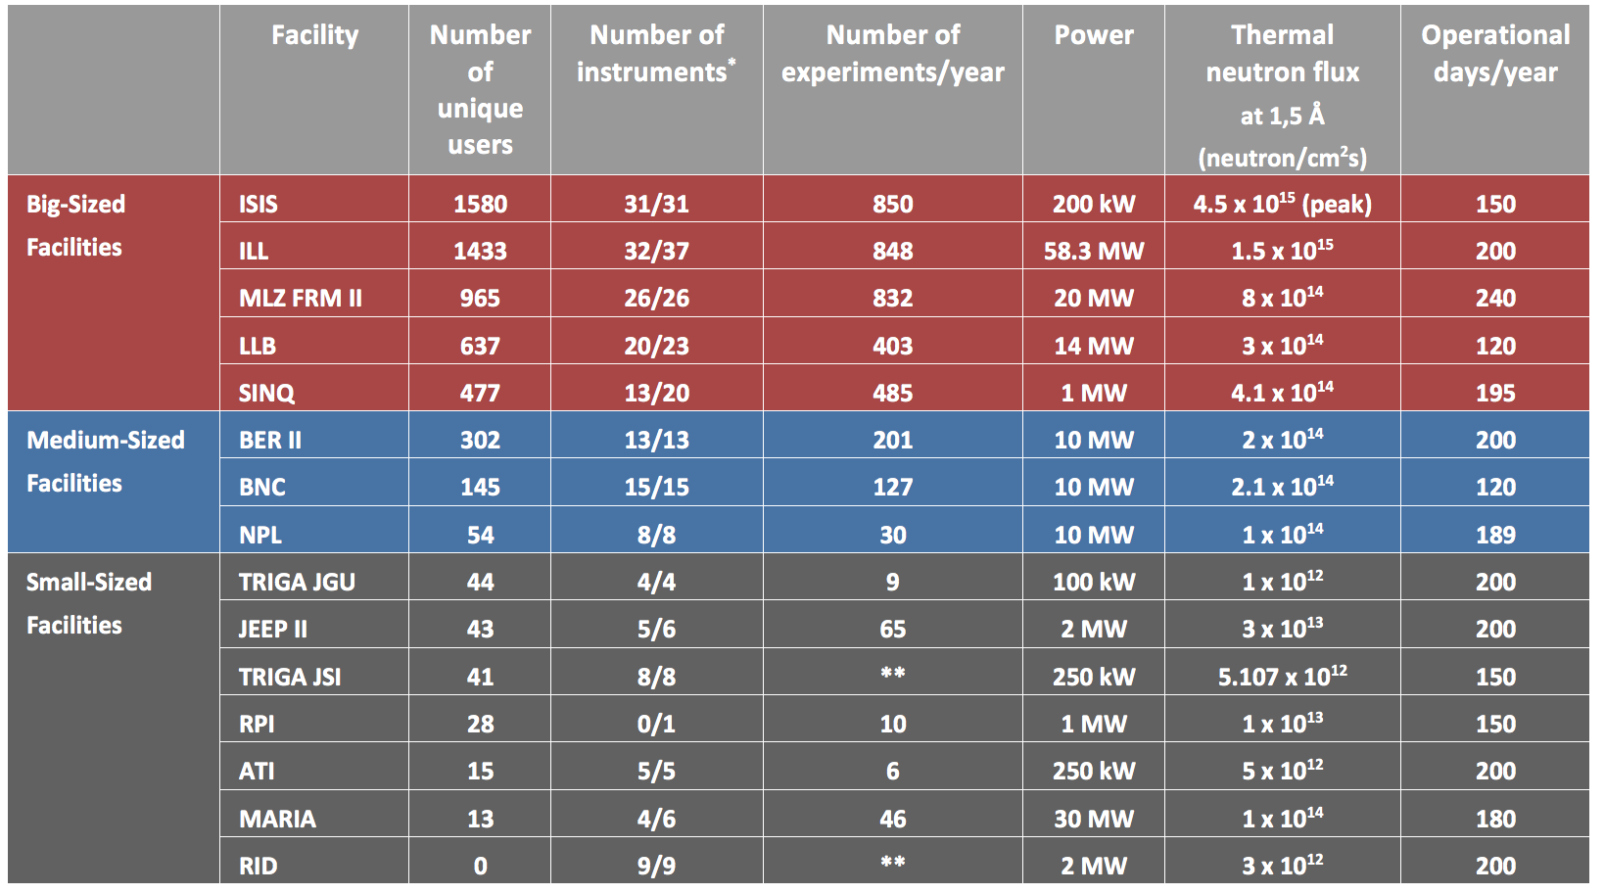
Categories of Neutron Sources
5 092 users
501 users
184 users

Slide 8
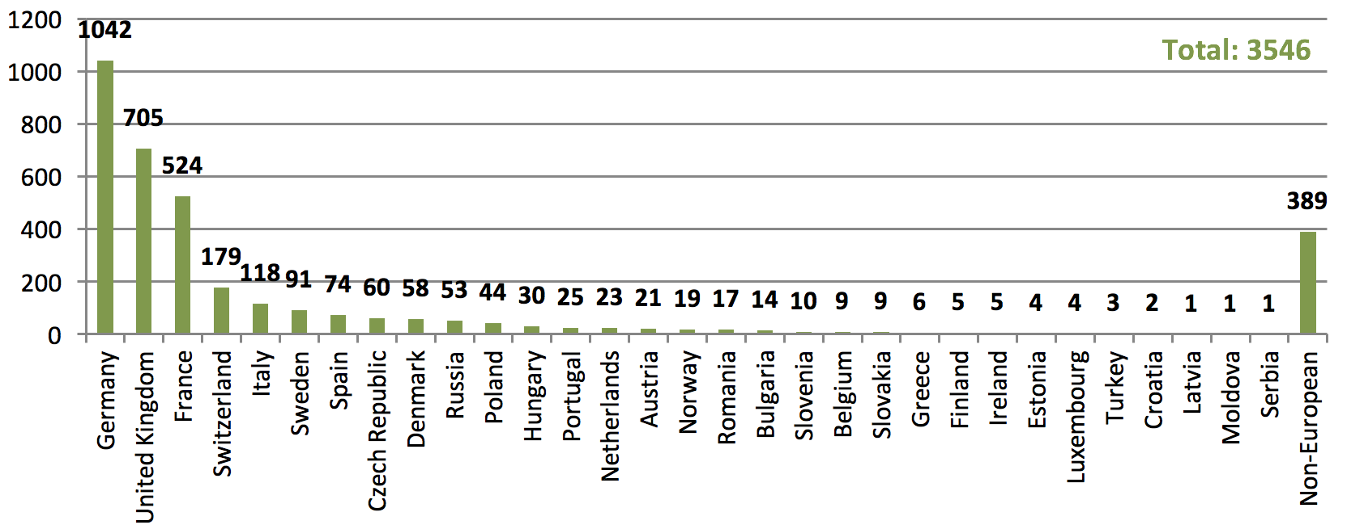
Total Number of Principal Investigators per Country

Slide 9
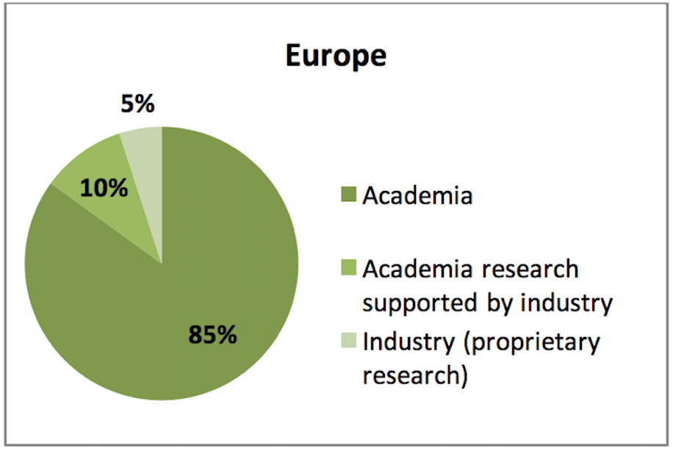
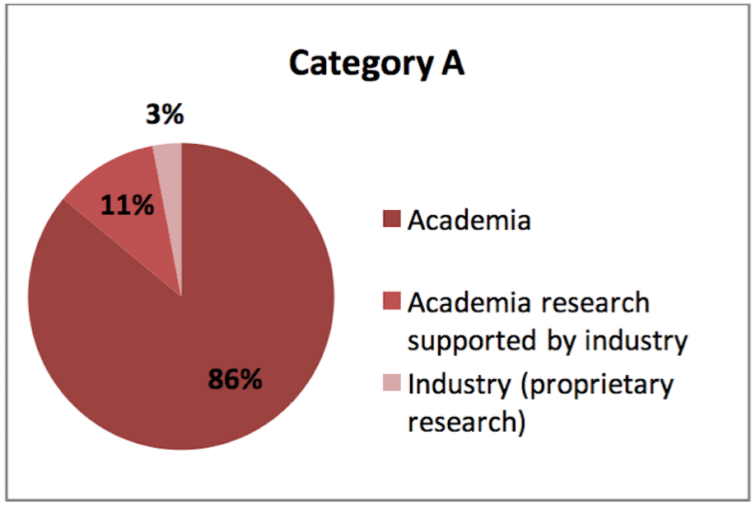
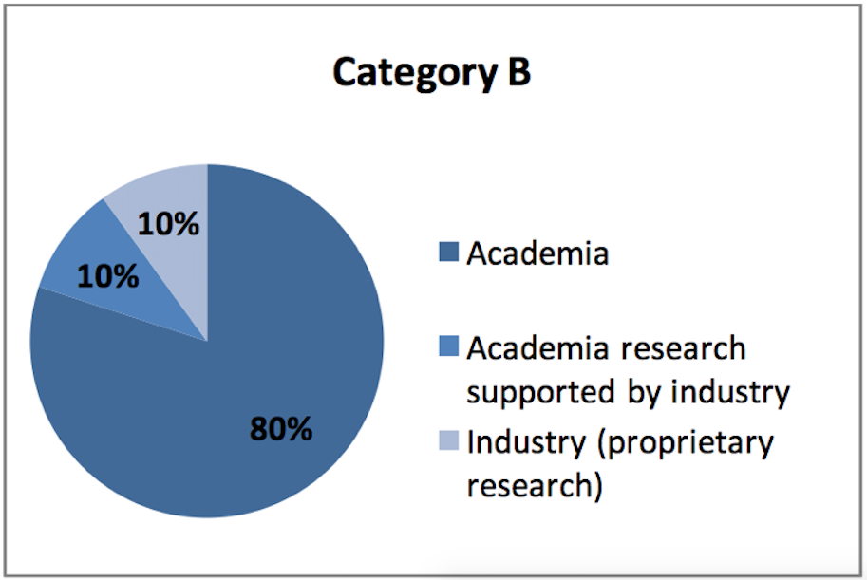
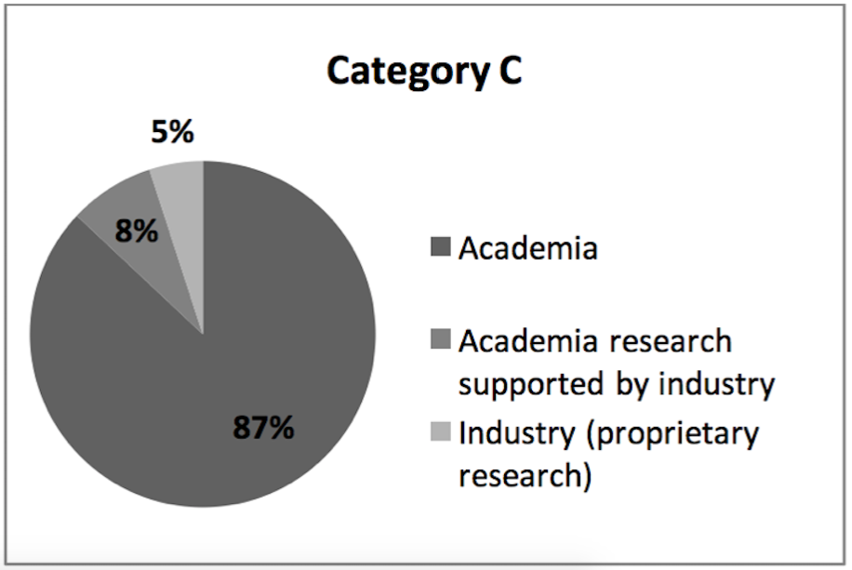
Distribution of Users According to Affiliation Expressed as Percentage of Beam Time

Slide 10
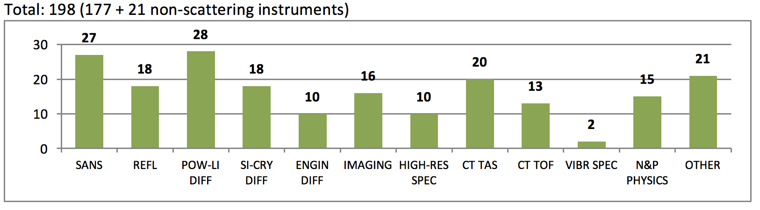
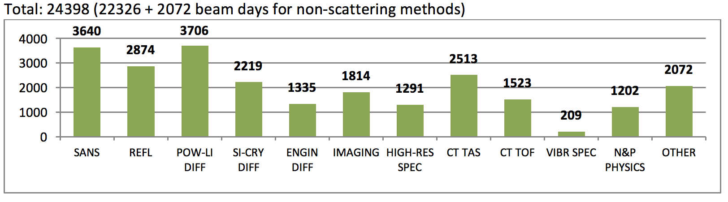
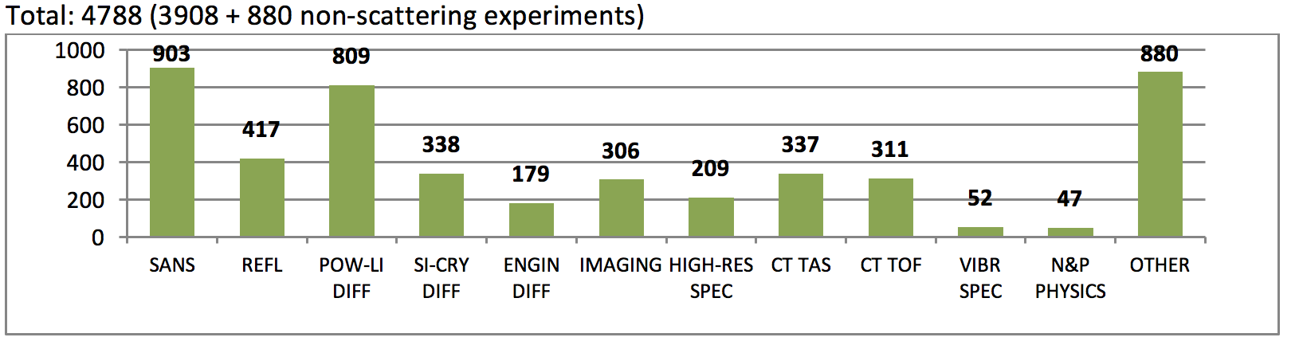
Number of instruments in Europe
Number of beam days in Europe
Number of experiments in Europe

Slide 11
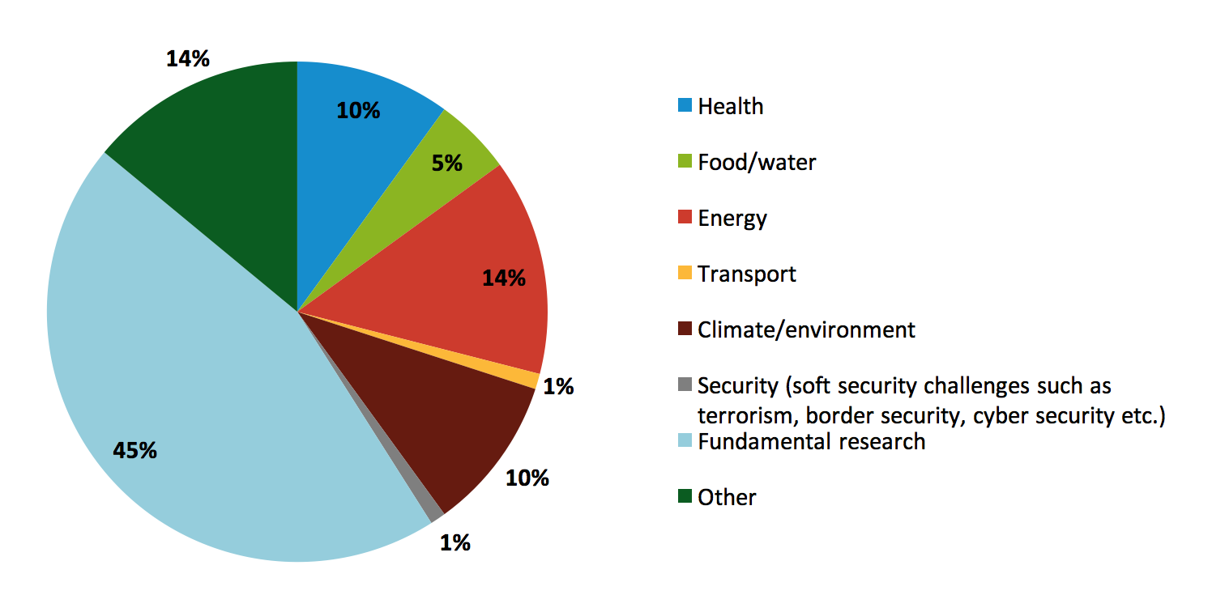
Horizon 2020 Topics and Challenges
Expressed as Percentage of Research

Slide 12
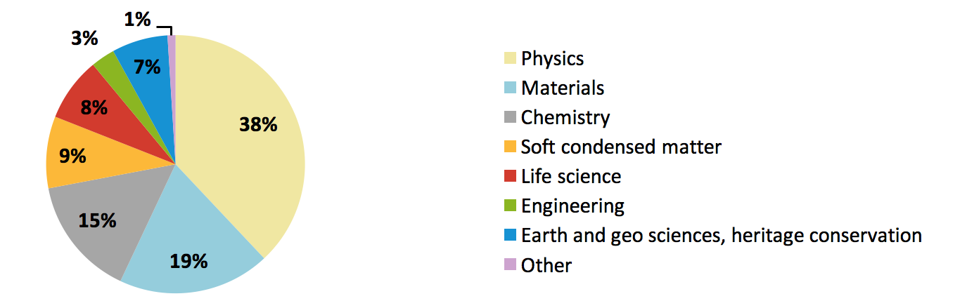
Science Fields Expressed as
Percentage of Experiments

Slide 13
Engaging Industrial Users
Industry group | Experienced users of RIs (incl. neutron sources) | Potential users with R&D capacity | Companies with no R&D capacity
Needs and expectations | Well-defined access modes for industrial users | Better understanding of neutron techniques, collaborative R&D through academia and other intermediaries | Awareness of neutron research and its societal impact
Recommendations for ESS Engagement Approach | Commission a study to analyze best practices in Access Policies at RIs worldwide | Engage companies indirectly, establish synergies with European projects, and set-up incentive schemes in collaboration with academia | Awareness-raising actions at regional level

Slide 14
Engaging Industrial Users
Industry group | Experienced users of RIs (incl. neutron sources) | Potential users with R&D capacity | Companies with no R&D capacity
Needs and expectations | Well-defined access modes for industrial users | Better understanding of neutron techniques, collaborative R&D through academia and other intermediaries | Awareness of neutron research and its societal impact
Recommendations for ESS Engagement Approach | Commission a study to analyze best practices in Access Policies at RIs worldwide | Engage companies indirectly, establish synergies with European projects, and set-up incentive schemes in collaboration with academia | Awareness-raising actions at regional level

Slide 15
Engaging Industrial Users
Industry group | Experienced users of RIs (incl. neutron sources) | Potential users with R&D capacity | Companies with no R&D capacity
Needs and expectations | Well-defined access modes for industrial users | Better understanding of neutron techniques, collaborative R&D through academia and other intermediaries | Awareness of neutron research and its societal impact
Recommendations for ESS Engagement Approach | Commission a study to analyze best practices in Access Policies at RIs worldwide | Engage companies indirectly, establish synergies with European projects, and set-up incentive schemes in collaboration with academia | Awareness-raising actions at regional level

Slide 16





Mapping of Innovation Ecosystem of ESS
WHY?
Provide guidelines for ESS to effectively engage with the identified players, replicate good practices observed and proved in other European regions, and establish strategic partnerships to push the boundaries of innovation.
LOCATION | COUNTRY | POPULATION | FACILITIES
Greater CPH | DK / SE | 3,877,887 | ESS / MAX IV
Rhône Alpes | FR | 6,510,561 | ESRF / ILL
Thames Valley | UK | 2,361,105 | ISIS / Diamond
Aargau | CH / DE | 4,089,991 | SINQ / SLS
✓
Greater CPH has the largest research and development activity as percentage of GDP.
Incubators
Private & public
funding
Private companies
Support networks

Slide 17
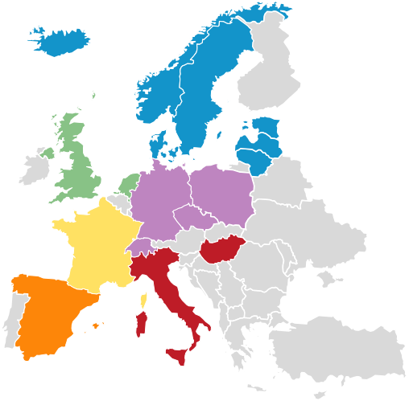
Regional Hubs
Regional Hub | Owner | Coordinator | Countries
North-West | STFC TU Delft | Laura Sewell Toon Verhoeven | UK NL
Central | PSI | Knud Thomsen | DE, PL, CZ, CH
Iberia | ESS Bilbao | Sira Cordon | ES
Gallia | CEA | Antoine Dael & Florence Ragon | FR
South-East | BNC | Margit Fabian | IT, HU
Nordic-Baltic | ESS | Lenka Petkova & Rikke Nielsen | DK, SE, NO, IS, LT, LV, EE

Slide 18
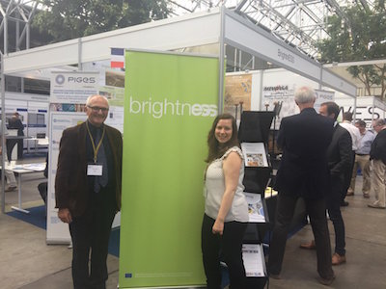
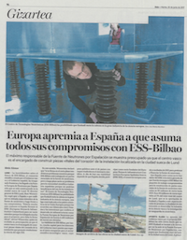
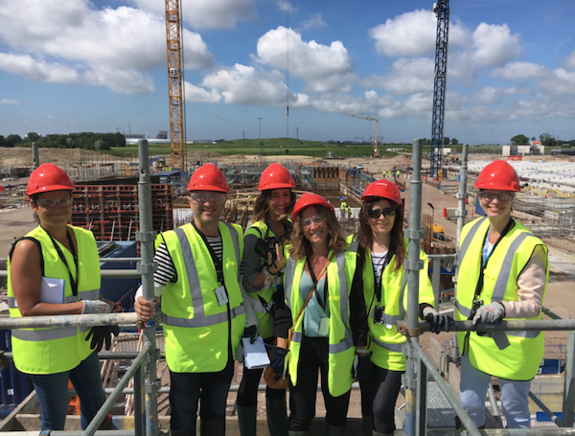
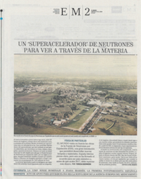
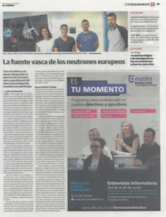
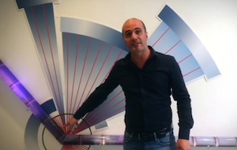
Highlights from Regional Hubs
Gallia Hub: Reaching Out to Industry
Industry exhibitor at IPAC’17 for 3 days in May 2017 with approx. 1300 participants at conference.
Iberia Hub: Engaging Media
Visit of a group of Spanish journalists to ESS in June 2017 resulted in three articles including web videos and radio report.

Slide 19
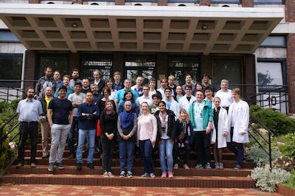
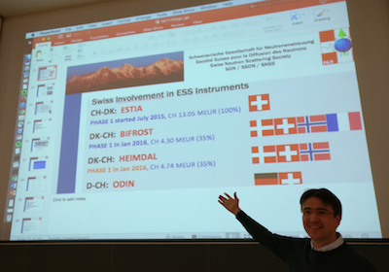
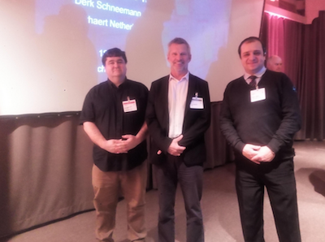
Highlights from Regional Hubs
South-East Hub: Training for Future Generation of ESS Users
The 10th edition of the CETS School hosted at BNC in May 2016 attracted 31 participants from 18 countries and introduced them to neutron techniques.
Central Hub: Collaboration with National User Society
Swiss Neutron Scattering Society met at PSI in November 2016 for yearly assembly meeting and discussed involvement in the ESS instrument suite.
North-West Hub/NL: Connecting National Industry with ESS
ESS participated in the 16th Precision Fair in Veldhoven in November 2016. The fair has gained international reputation as a meeting point for precision technology.

Slide 20
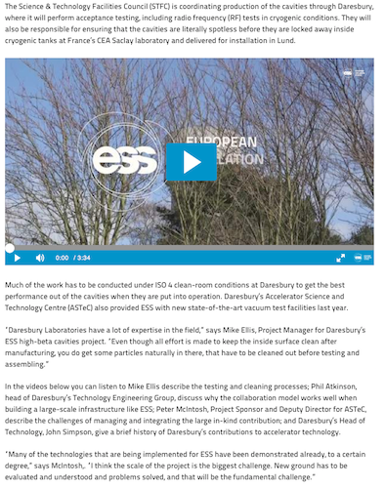
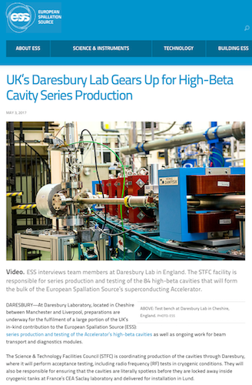
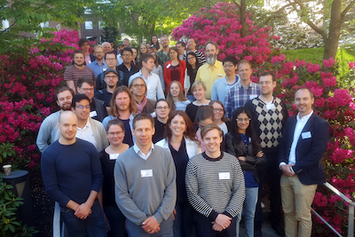
Highlights from Regional Hubs
Nordic-Baltic Hub: Collaboration with Other Strategic Initiatives in the Region
BrightnESS has joined forces with the Nordic Neutron Science Program to carry out activities targeting future users of ESS.
North-West Hub/UK: Collaboration of STFC and ESS Communications Teams to Produce Webcontent

Slide 21
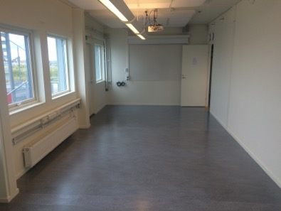
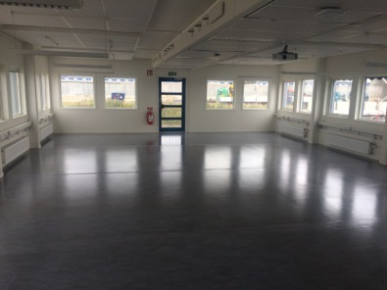
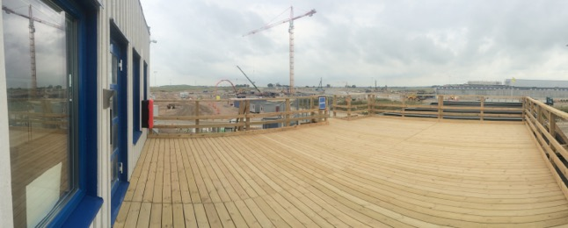
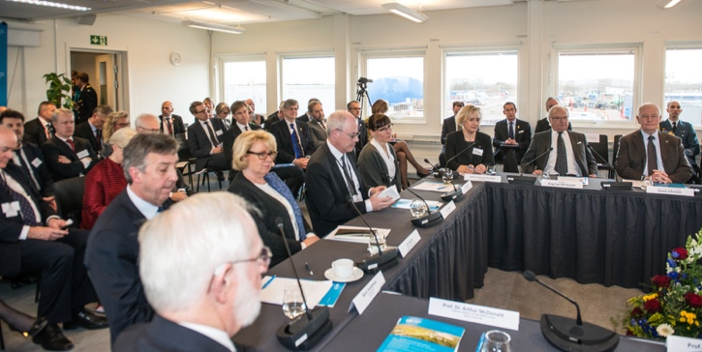
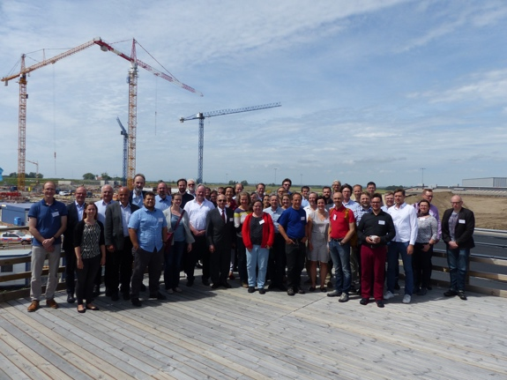
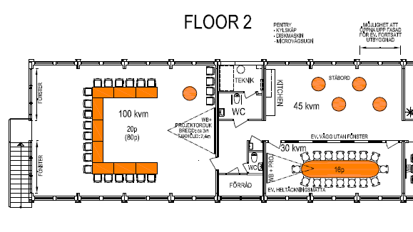
New Site Office Space for Visits and Meetings
Aim
Maintain an area where internal and external visitors can experience the ESS construction site.
BrightnESS
pax. 60
Brilliance
pax. 20
Horizon platform
pax. 50

Slide 22
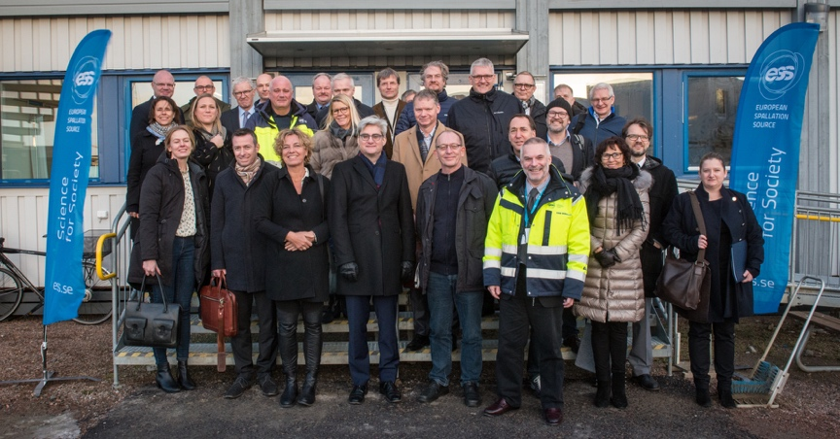
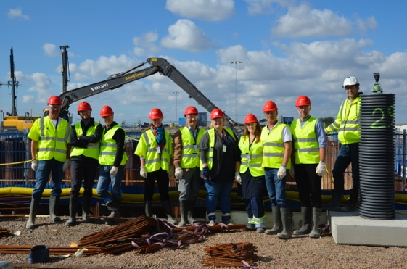
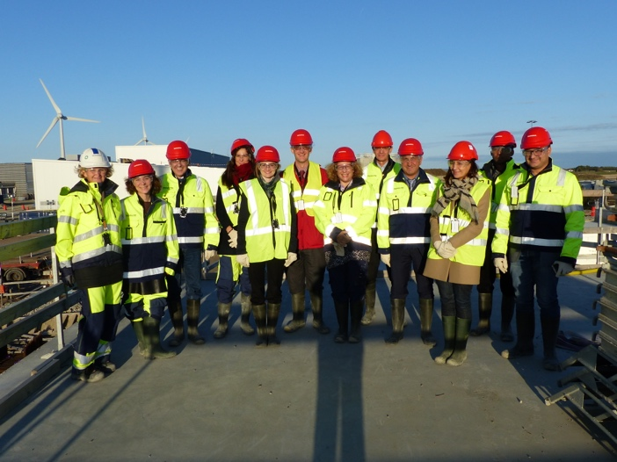
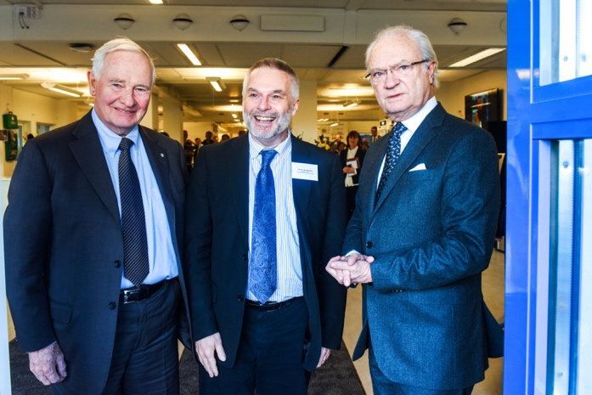
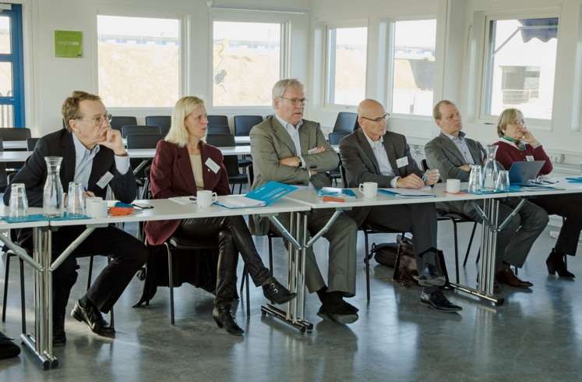
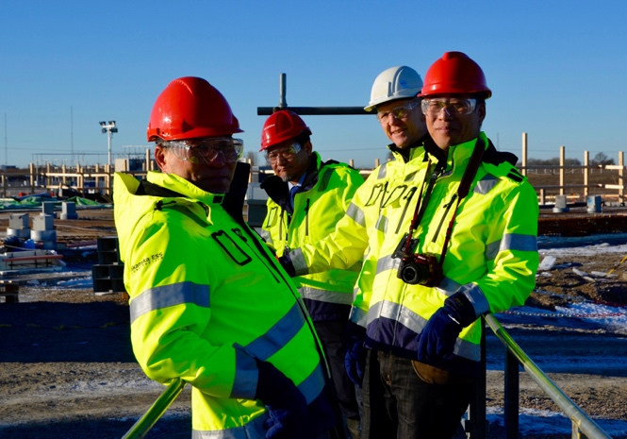
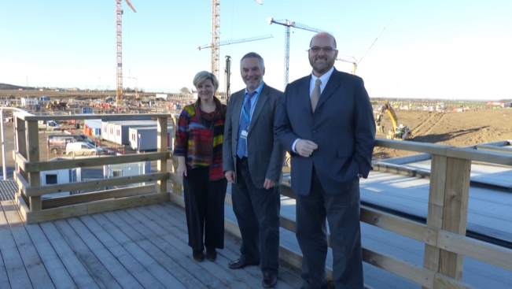
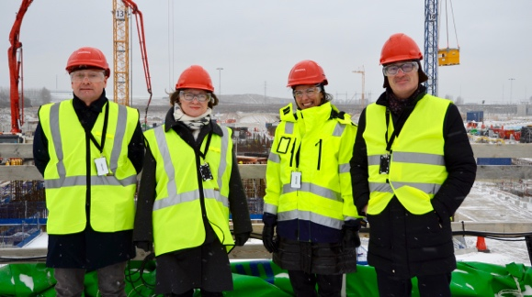



Visits to ESS - Highlights (Sep 2015 – Jun 2017)
6487
Individuals
504
Groups
Walk
1836
Individuals
Bus
2274 Individuals
Office
2377
Individuals

Slide 23
Results
Better understanding of future users’ needs
Informed policy making based on collected data and survey results
Outreach across Europe
Stronger collaboration with partner institutes

Slide 24
Task 6.2: Enlargement of Membership
Observers
Turn Founding Observers into Members
ERA Countries
Geographical proximity and shared interest
Global
Contacts within and outside the GSO Framework
At the beginning of BrightnESS: Belgium, Netherlands, Spain, United Kingdom
As the world’s most powerful spallation neutron source, ESS will be positioned globally
Systematic process for engaging all relevant stakeholders

Slide 25







Activities in Observer and ERA Countries
UK joins ESS as Full Member
(Jun 2016)
NWO Visit (Nov 2016)
Visit of Dutch Ambassadors to DK & SE (May 2016)
Science Workshop in Riga (May 2017)
Visit of Latvian delegation (Nov 2016)
ESS Science Seminar in Brussels (Sep 2017)
SCK-CEN visit (Mar 2016)
Press Trip for Spanish Media (Jun 2017)
Partner & Industry Day (Oct 2015)
Partner & Industry Day (Nov 2015)
OesteCIM visit (May 2016)

Slide 26
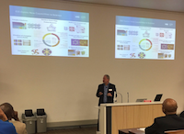
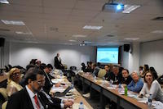
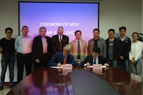
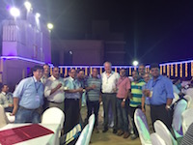
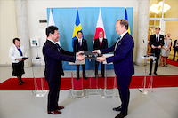
Cooperation Beyond Europe
South Africa
Brazil
China
ESS will host a scientific delegation from South Africa in late 2017 or early 2018 to discuss collaboration opportunities
José Roque da Silva, Director of the Brazilian Synchrotron Light Laboratory (LNLS), visited ESS, Jun 2016
ESS and high-level delegation from SE participated in the “Brazil-Sweden Excellence Seminar” in Brasilia, May 2016
ESS hosted professors from the Chinese Academy of Sciences in Dec 2015
India
ESS Director for Science participated in the 6th Conference on Neutron Scattering (CNS2016) at the Bhabha Atomic Research Centre (BARC) in Mumbai in November 2016
ESS signed MoUs with two institutes at the Chinese Academy of Sciences, i.e. the Institute of High Energy Physics (IHEP), and the Institute of Modern Physics (IMP)
ESS hosted representative of the China Spallation Neutron Source (CSNS)
Japan
Director of J-PARC, Prof. Saito visited ESS in Jan 2017 to plan a joint MIRAI workshop together with Lund University and ESS
ESS Director for Science participated in the Annual Conference of the South African Institute of Physics (SAIP) in Jul 2017
ESS and J-PARC signed a new Memorandum of Collaboration in Jul 2017
MIRAI workshop will take place in Lund in Oct 2017
ESS will host a joint workshop with J-PARC in Lund in Jan 2018
Presentation about ESS at Brazilian universities by ESS Partner, Julich

Slide 27

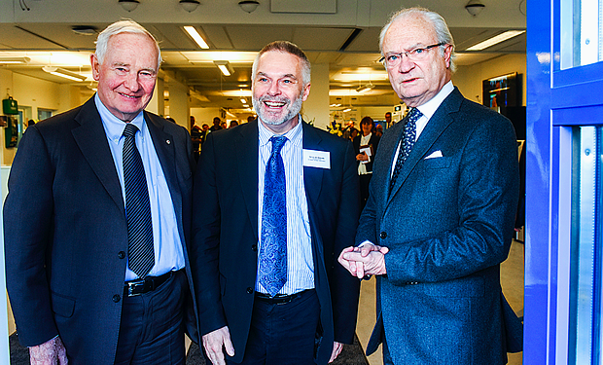
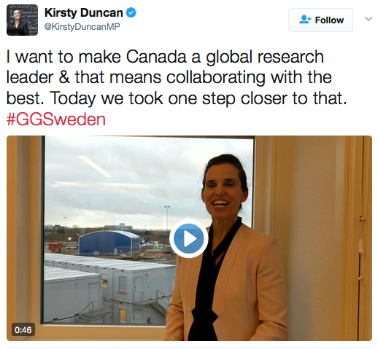
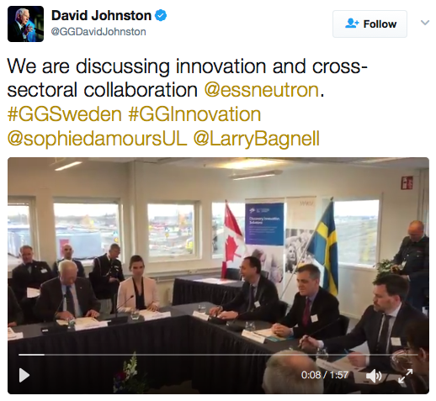
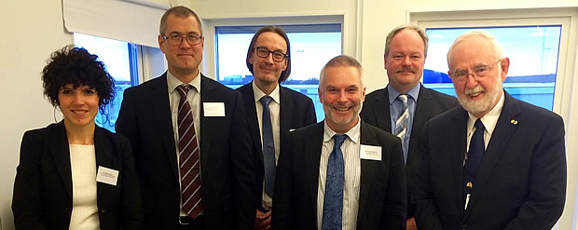
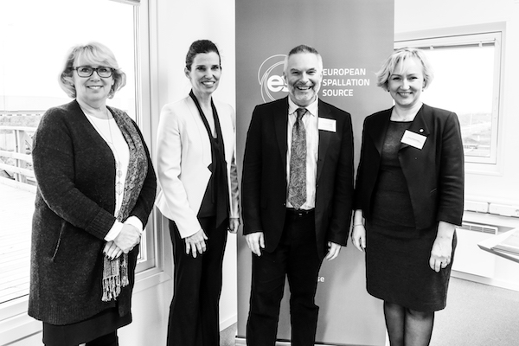
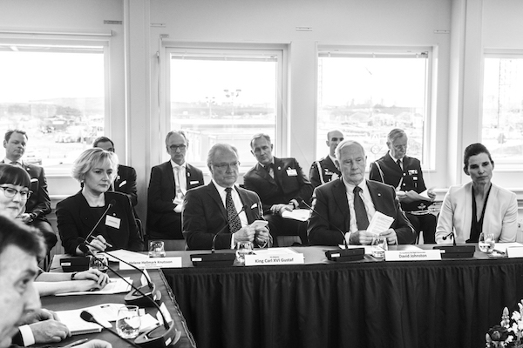
Cooperation Beyond Europe: Canada
Roundtable discussion on cross-sectoral collaboration featuring King Carl XVI Gustaf of Sweden, and the Governor General of Canada, David Johnston; science seminar; and ministerial meeting during the Canadian State Visit to Sweden on 22 February 2017
Discussion about collaboration opportunities between Canada and ESS during the 2016 Annual General Meeting of the Canadian neutron beam community hosted by McMaster University on 14-15 October 2016
Informational meetings with Canada Foundation for Innovation (President Gilles Patry and Vice President Guy Levesque) and Innovation, Science and Economic Development Canada (Jessica Norup and Ryan Hampel) on 17 October 2016

Slide 28
Results
Open dialogue with Partner Countries
Stronger relationships with stakeholders
Moving from European to global membership base

Slide 29
Task 6.3: Strengthening the ILO Network
ILO Network
Enabling industrial partners to participate in the construction of ESS
Industry Events
Sharing best practice
Increasing industrial involvement

Slide 30
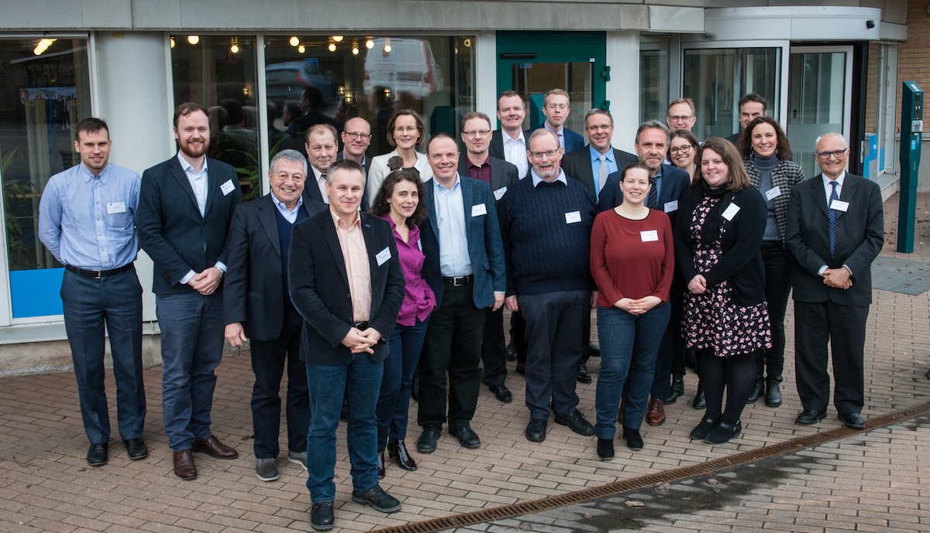
Regular Meetings of the ILO Network
Network of Industrial Liaison Officers:
Supports two-way communication with key stakeholders
Enables companies to maximize the benefit from ESS procurement opportunities and R&D partnerships
Allows ESS to integrate the companies’ know-how into the construction of the facility

Slide 31




Industry-Related Activities
Tailored Informational Events: United Kingdom
Over 100 delegates from approx. 75 UK organizations met at an event hosted by STFC in November 2016 to learn about opportunities for UK industry to get involved in the ESS project.
Promotion at Industrial Conferences: Netherlands
Dutch Companies participated in IPAC conference in 2016 and 2017 existing and future accelerator projects and to present products, services, and publications of interest to the international accelerator community.
Outreach in Collaboration
with ESS: France
The second ESS French Partner & Industry Day brought together 180 participants in visits to laboratories, interactive presentations, poster sessions, and business to business discussions.
Engagement Supported by Framework: Denmark
BigScience.dk works to promote Danish skills and know-how on the Big Science market. The secretariat coordinates a network of highly qualified companies able to deliver products and services matching the needs of large scale RIs.

Slide 32



Slide 33
Results
Support to ILO Officers in their national roles
Timely communication about up-coming procurements
Participation of European industry in the building of ESS

Slide 34
Task 6.4: Communication & Dissemination of Results (DTI)
Internal communication
Sharing information through the BrightnESS newsletter
External communication
Communicating progress through intensive Twitter effort
Developing a network of the WP6 Hub Coordinators
Disseminating results via the BrightnESS website
Promoting partner collaboration through video content

Slide 35



BrightnESS Newsletter
Is sent every two weeks to more than 200 subscribers
Currently, 45 newsletters are sent
Contains updates from the entire BrightnESS project and related news and projects
The average rate of opened newsletters is approx. 45%

Slide 36

BrightnESS Newsletter content
Section with news from ESS
Section with an update from a Partner Institute
A profile on one of the people in BrightnESS
Event calendar

Slide 37


Regular Meetings with the WP6 Hub Coordinators
Updates from the Hubs and presentations of past and upcoming activity
Sharing best practice cases and examples for inspiration
Informal meeting time and brainstorming new initiatives

Slide 38



Twitter - @brightnesseu
Enables BrightnESS to reach out to diverse audiences and share real-time project progress
Tool for engaging project partners and sharing their work and collaboration
Most BrightnESS content is re-tweeted by the ESS account, enabling a broader reach for the content
Twitter status as of 4 September 2017:

Slide 39





Twitter highlights:

Slide 40

Scientific articles
BrightnESS publications during the first reporting period:
Eight articles have been published on the BrightnESS website and on the European Commission’s publication website, OpenAire

Slide 41



Website content
In-Kind Best Practice section with extensive information
Long-read articles on project progress

Slide 42

Video series: Partner in focus
Features the ESS partners and their contribution to the ESS, primarily through their participation in the BrightnESS work packages and their (In-Kind) contribution to building the ESS
First video from Budapest Neutron Center elaborates on moderators, detectors and In-Kind contributions from BNC

Slide 43
Results
Sharing project information with internal and external audiences
Communications support to Hub Coordinators
Awareness-raising about breakthrough developments within detectors and moderators
Creating ties to relevant projects and networks

Slide 44
Planning ahead
Creation of more partner videos
Creating a graphic layout for the Neutron Users in Europe Survey Report
Social media training session with Hub Coordinators at next Hub Meeting
Continued Twitter and website content creation

Slide 45
Next Steps: Third Year
Disseminating survey results
Organizing enlargement activities (BE: Sep 2017, CA: Nov 2017, SA: Spring 2018)
Drafting New Members Policy
Supporting outreach activities in regional hubs
Strengthening the ILO Network
Communicating project results
Networking and collaborating with other projects

Slide 46


Accessing the Socio-Economic Impact of ESS
The effects of research carried out at large-scale facilities such as ESS clearly go beyond the arena of science and influence developments in private and public sectors alike. Technological innovation triggered at research infrastructures benefits industrial R&D, supports economic growth, helps to address societal challenges and improves the quality of life.
Within the framework of BrightnESS, ESS established collaboration with the Grenoble School of Management to identify set of fitted indicators to measure socio-economic impact of ESS.
Scientific impact
Economic impact
Societal impact

Slide 47
Timeline for the Socio-Economic Assessment
Aug 2017:
Validation by EMT
Sep 2017:
Data collection in Lund
Oct 2017:
First indicators and metrics are ready
Oct 2017:
Validation by Council Chair, Vice-Chair, SAC, Host Countries, and key IKC partners
Nov 2017:
Case studies and templates are ready
Dec 2017:
Presentation of indicators and metrics to Council
Jan 2018:
Validation by external experts
Feb 2018:
Presentation of early report to Council
Aug 2018:
Final report is ready

