Slide 1
General Assembly
WORK PACKAGE 5 – Real time management of ESS data
Tobias Richter, Work Package Leader

Slide 2
WP5 – Real time Management of ESS Data
Captures technical scope that was not in the ESS TDR
Offers new options for capturing data not available anywhere else
Reduces risk in the ESS construction phase through collaboration with existing facilities, offering expertise
and the ability to test under real conditions
Fits into the Data Management Group of the
Data Management and Software Centre (Copenhagen)
BrightnESS is funded by the European Union’s Horizon 2020 research and innovation programme under grant agreement No. 676548

Slide 3

Overview of WP5
Task 5.1 | Creating a standard neutron event data stream for different detector types | ESS, KU
Task 5.2 | Creating a standard method for streaming meta-data for fast applied fields | ESS, PSI
Task 5.3 | Software to aggregate and make available neutron event data and sample meta-data | ESS, PSI, Elettra
BrightnESS is funded by the European Union’s Horizon 2020 research and innovation programme under grant agreement No. 676548

Slide 4
Instrument Readout Architecture
Instrument Hardware
DMSC Hardware
Detector Backend
Event Formation Unit
MRF
100 GB/s fibre
Detector Backend
Event Formation Unit
NeXus File Writing
Data Aggregation (Kafka)
Chopper
Live Feedback
EPICS
EPICS Bridge
MRF
Motion
BrightnESS is funded by the European Union’s Horizon 2020 research and innovation programme under grant agreement No. 676548

Slide 5
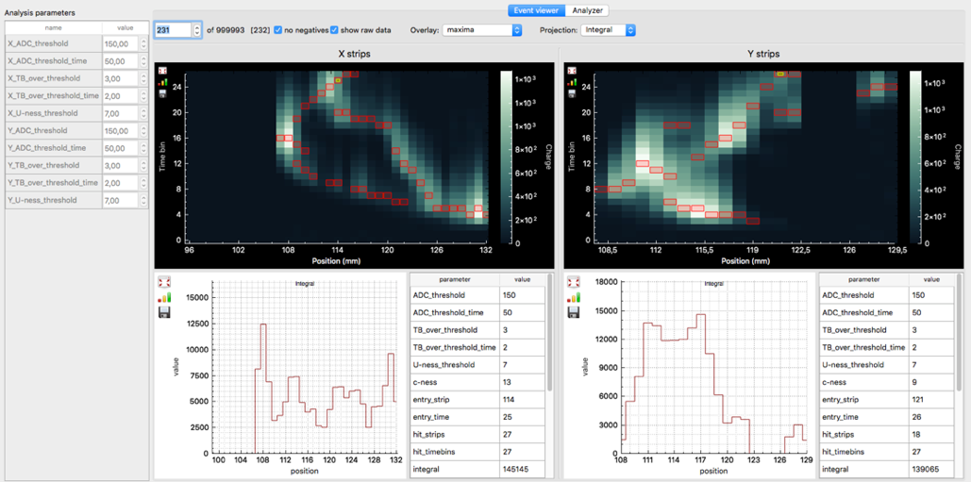
5.1 - Event Formation
What does it do?
Convert digitized raw
detector signals to
pixel ID & timestamp per event
in a detector type specific way
Think of it as detector electronics
in software running on
commercial of the shelf hardware
Reduces technical risks associated
with developing and maintaining custom hardware
Provides flexibility and extensibility of a software package
Shared responsibility of DMSC and Detector Group (WP4)
Challenging task to get right in terms of performance and correctness
Enables the neutron count rates and detector capabilities ESS aims for
NMX

Slide 6
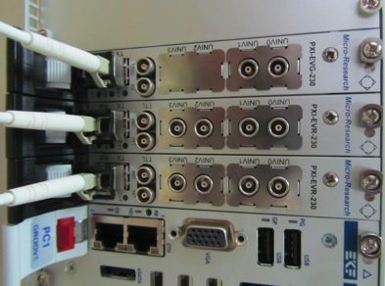
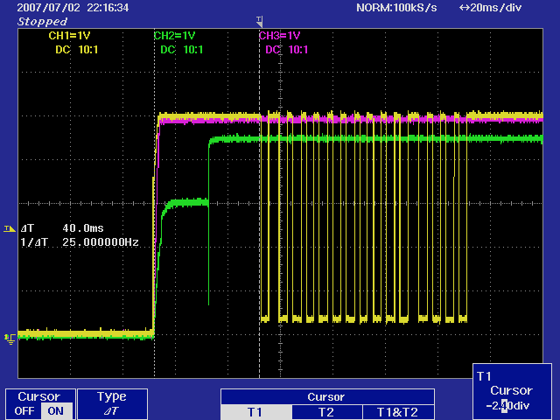
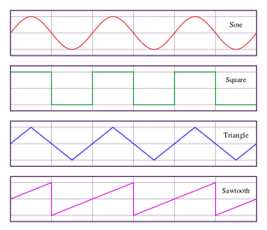
5.2 – Fast Field Data
Collecting Metadata from “fast” Sample Environments Equipment
High Speed – up to MHz
Challenges:
  Absolute Timestamping
  Continuous Operation
No turn key solution available
Evaluating partial technical
solutions that can be combined
Integration into ESS timing system
and data stream (aggregator)
Enables experiments not currently feasible
BrightnESS is funded by the European Union’s Horizon 2020 research and innovation programme under grant agreement No. 676548

Slide 7
5.3 – Data Aggregation
Task with PSI, Elettra, and our ISIS/STFC in kind collaborators
Target goal: Software Framework to support unified neutron and metadata data stream
Problem includes the “Big Data” 3 Vs:
  Volume
  Velocity
  Variety
Startup objective:
Agree on technology platform
based on common criteria
Current phase: Prototyping
Until the end of the project:
Testing and Ramping up for operations
Establishes a modern, open source framework for
neutron data acquisition and subsequent processing
MS21 Meeting
BrightnESS is funded by the European Union’s Horizon 2020 research and innovation programme under grant agreement No. 676548

Slide 8
Milestones and Deliverables
BrightnESS is funded by the European Union’s Horizon 2020 research and innovation programme under grant agreement No. 676548

Slide 9
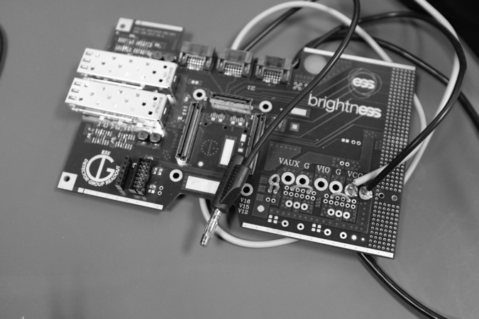
Detector Event Formation
Deliverable D5.2 submitted as promised, detailing work on processing infrastructure and individual algorithms.
Interfacing to hardware started after successful readout meeting with Detector Group and their in kind partners.
Successful presentation of software processing concept at detector session of ICANS 2017 in Oxford.
Session planned at upcoming IKON meeting to get in kind instrument and detector teams on board.
ICANS
D5.2

Slide 10
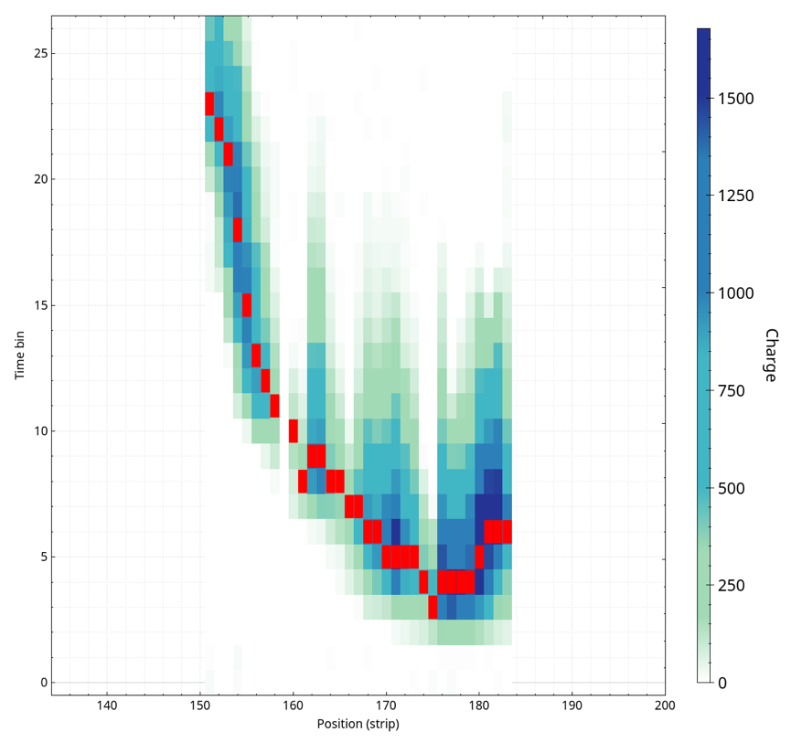
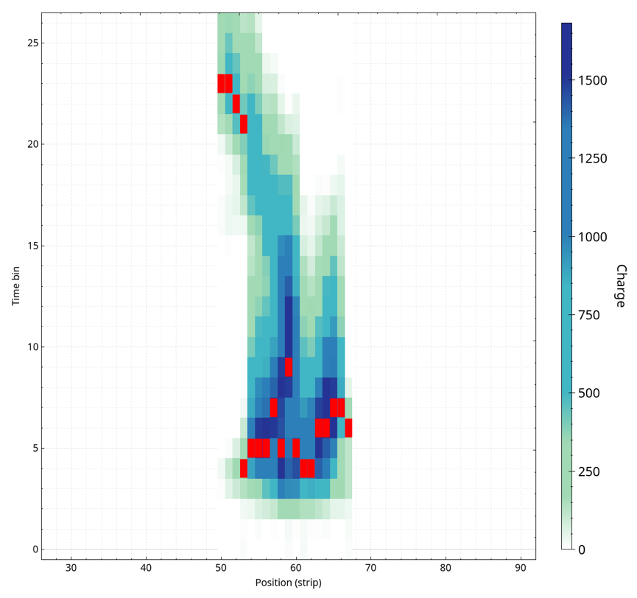
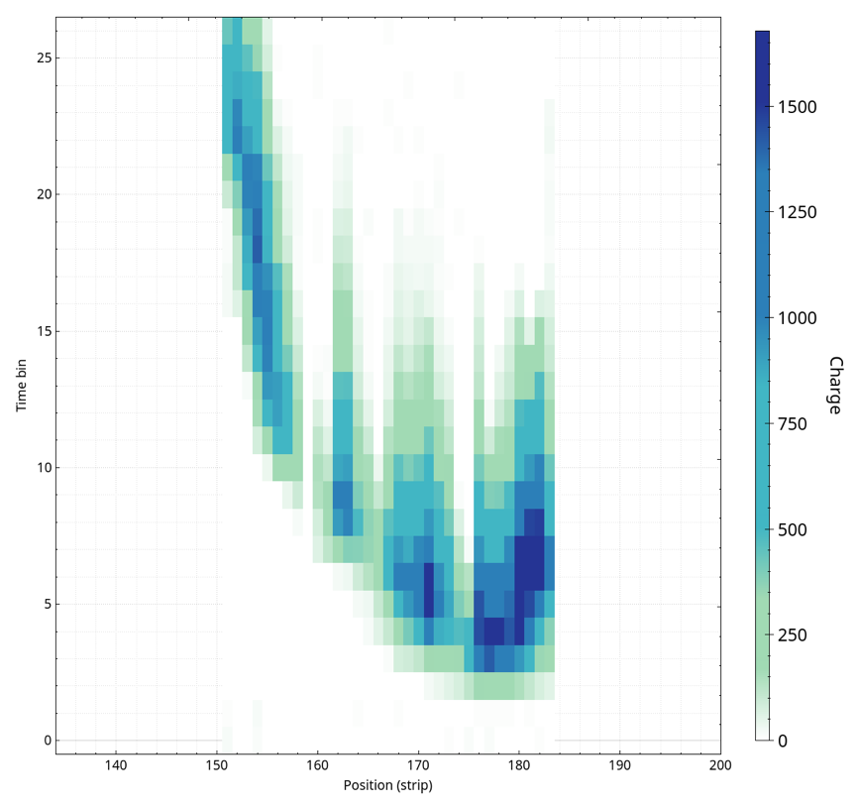
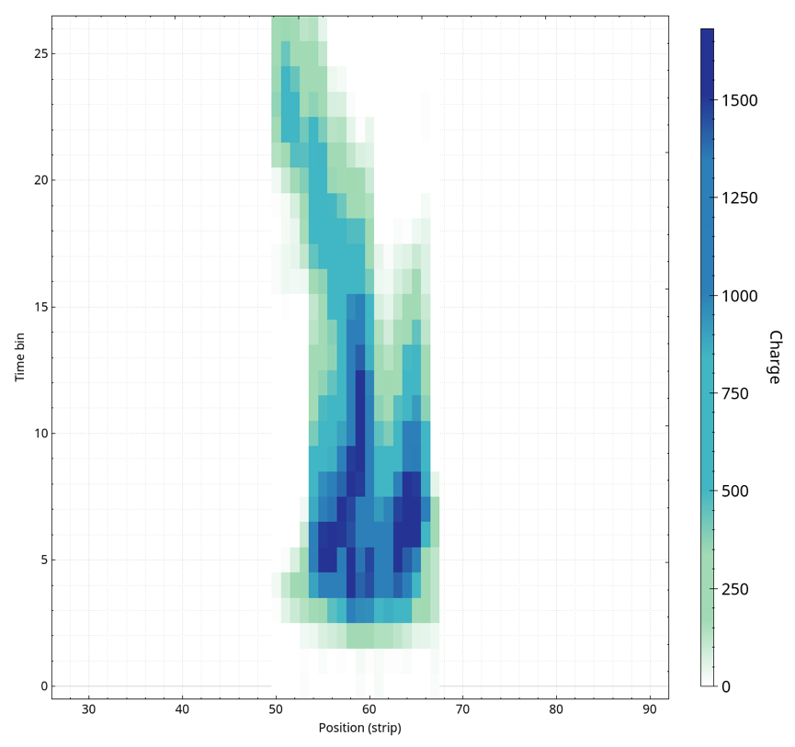
Gd-GEM Example Traces
Data for X and Y with time and spatial dimension
To be reduced to two numbers
Converter layer (neutron entry point) at the top
APV test data with 25ns time resolution
Final timing will be on a high precision absolute clock
Reduced VMM data (red) simulated

Slide 11
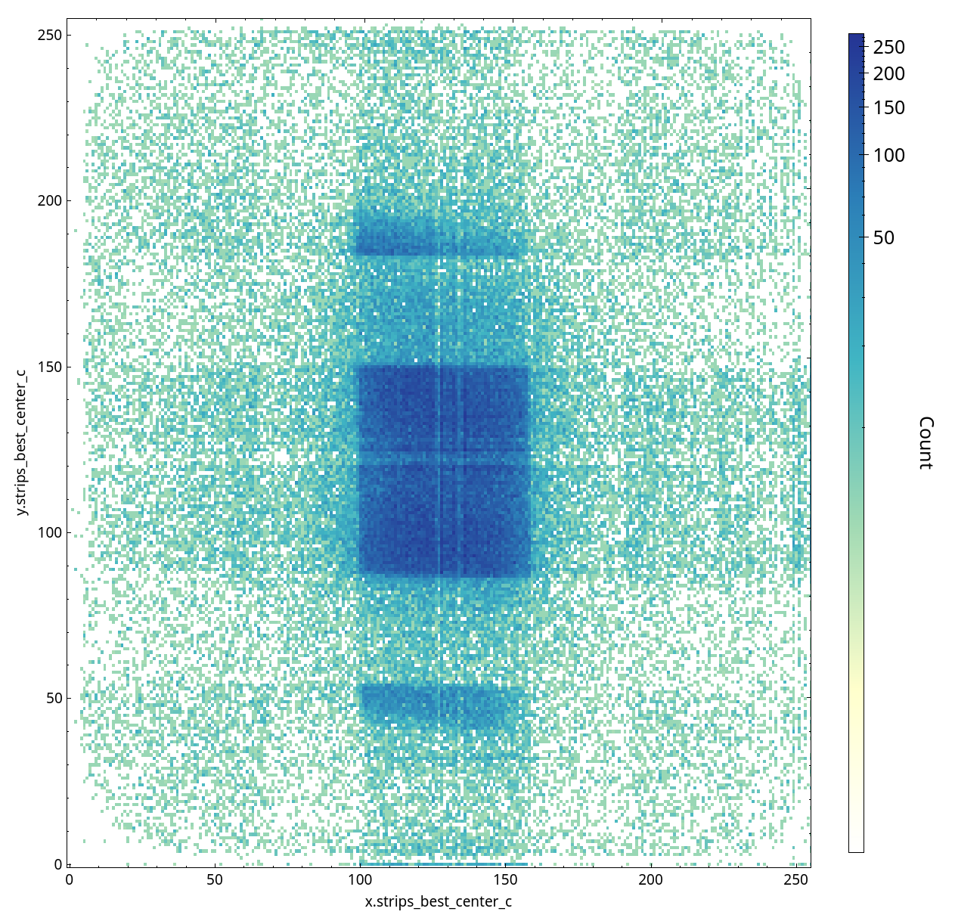
2D Detector Image
Log scale
Detector covered with Pb strips
Image constructed by locating event in time and space

Slide 12
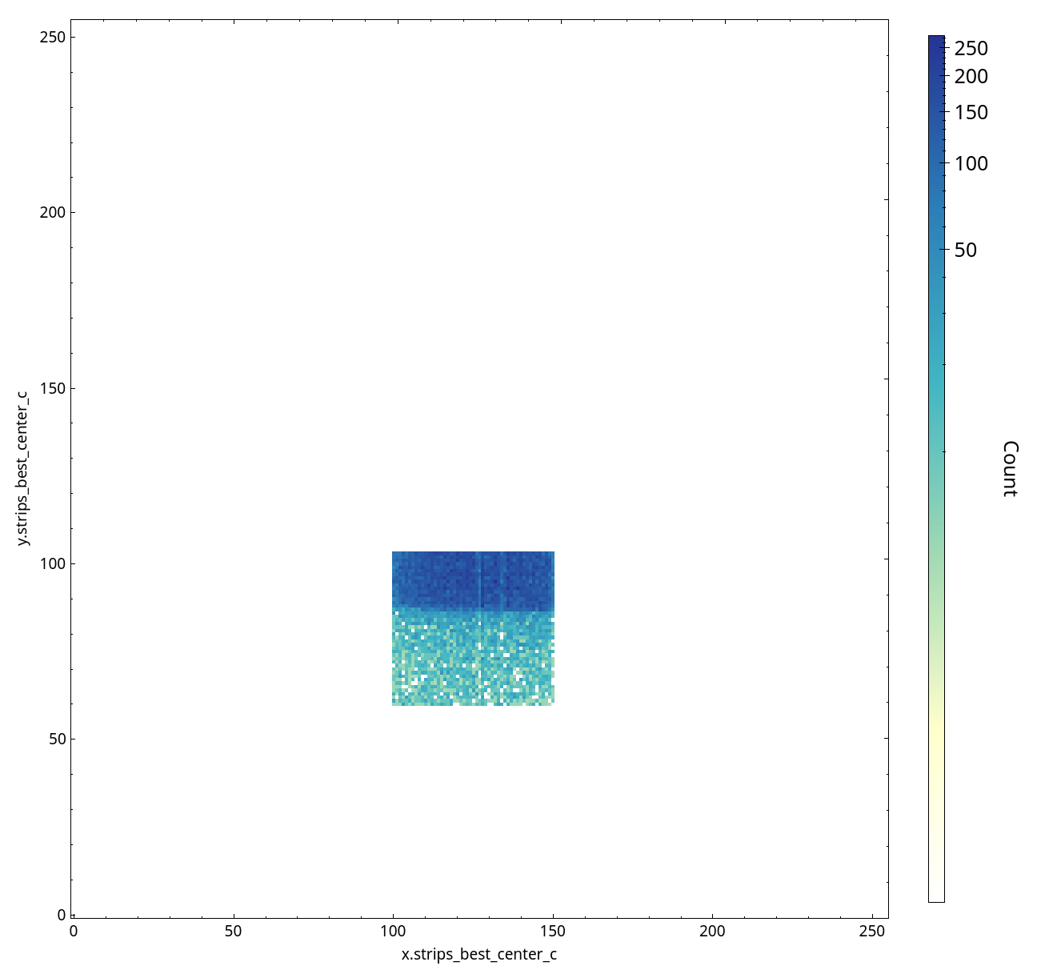
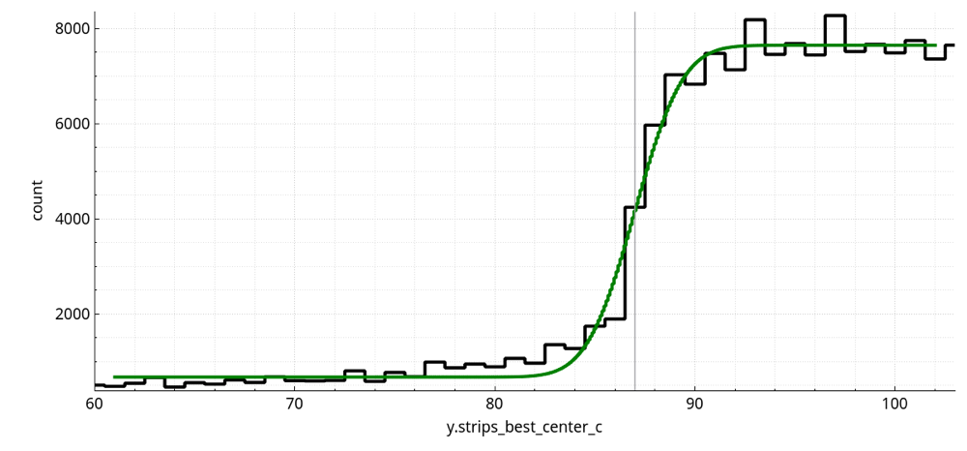
2D Detector Image
How do we pick the right locating algorithm and rejection filters?
Which event to keep, refine, or reject?
Proof is in the pudding.
We fit an edge to quantify our processing quality.

Slide 13
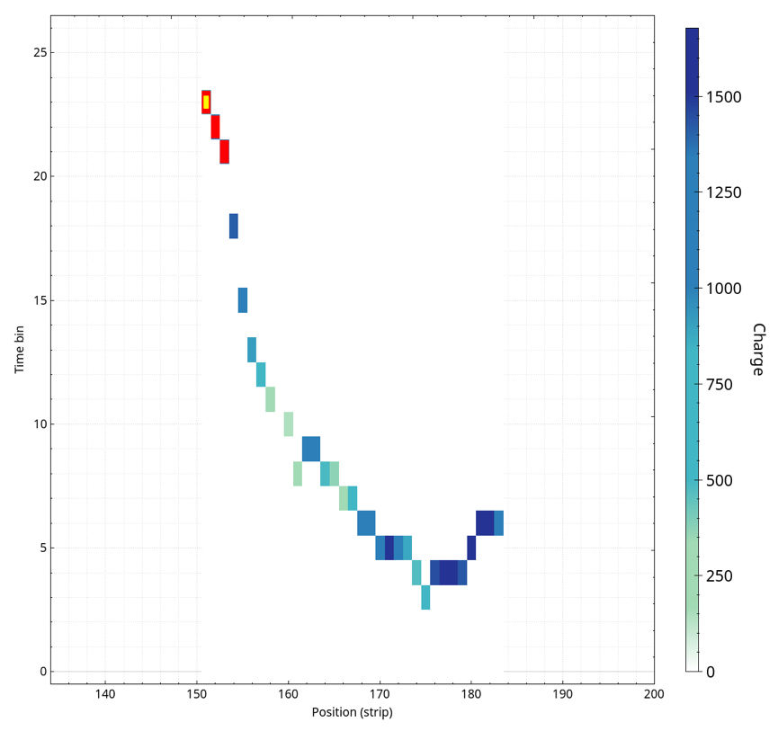
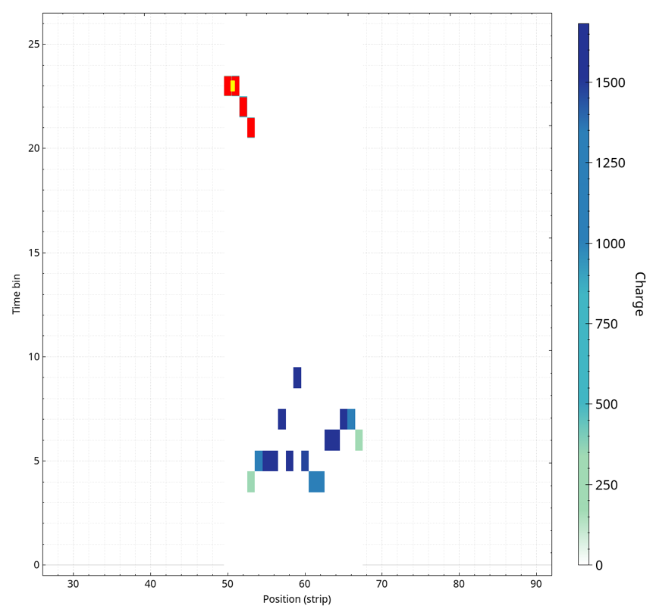
Gd-GEM Example Traces
Easy to locate
with baseline algorithm

Slide 14
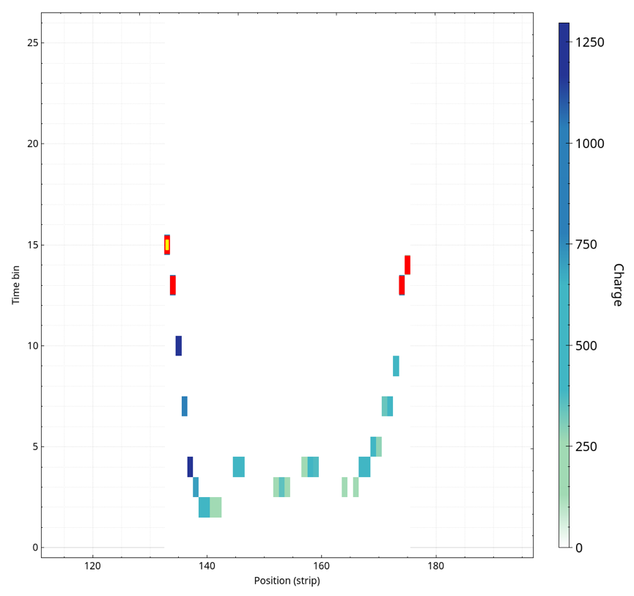
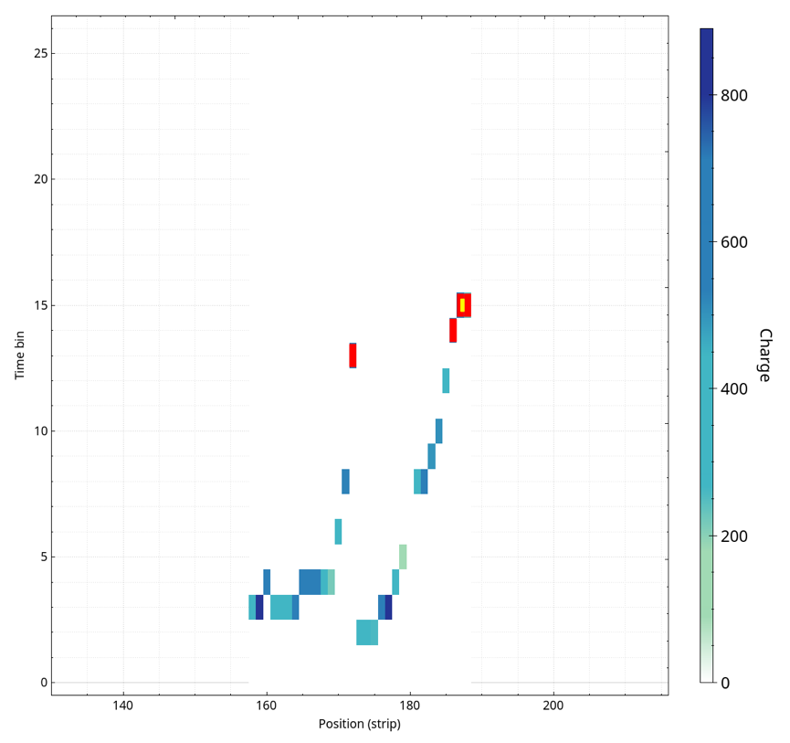
Gd-GEM Example Traces
Two potential entry points.
Refinement uncertain.
Reject/Filter

Slide 15
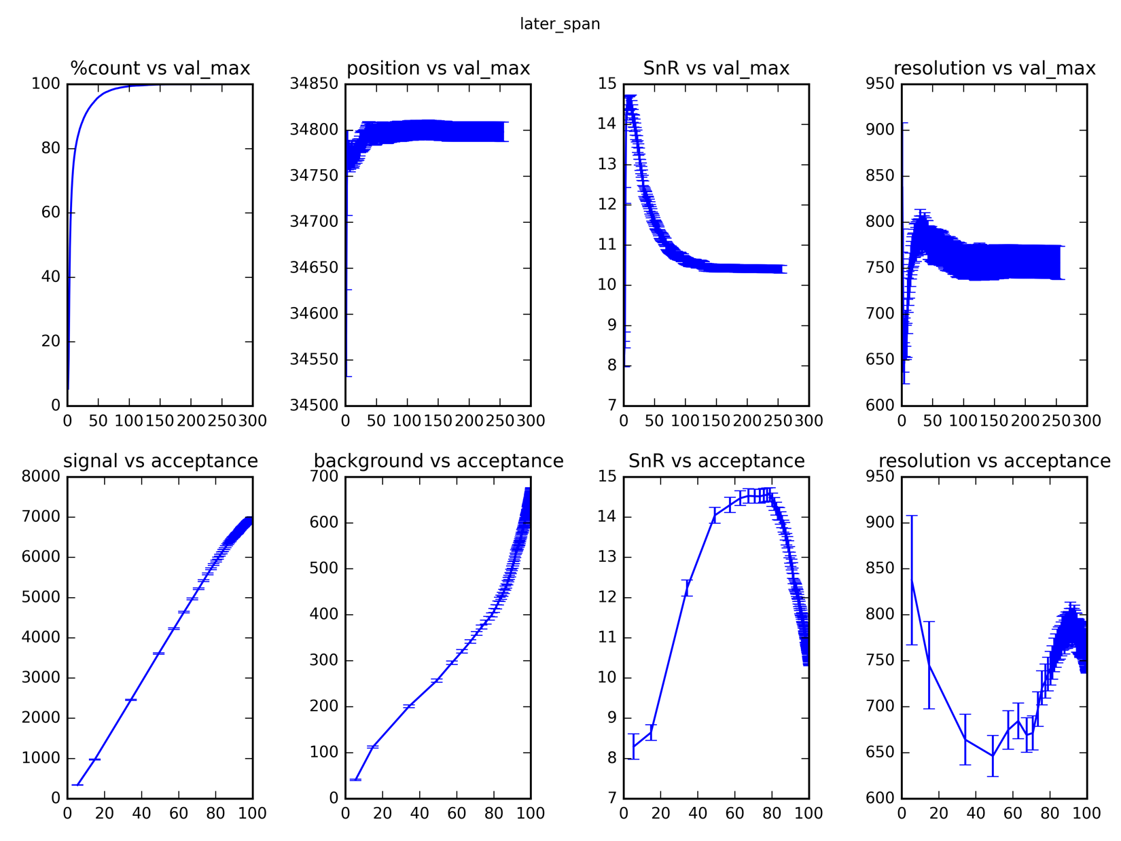
Example Filter Performance

Slide 16
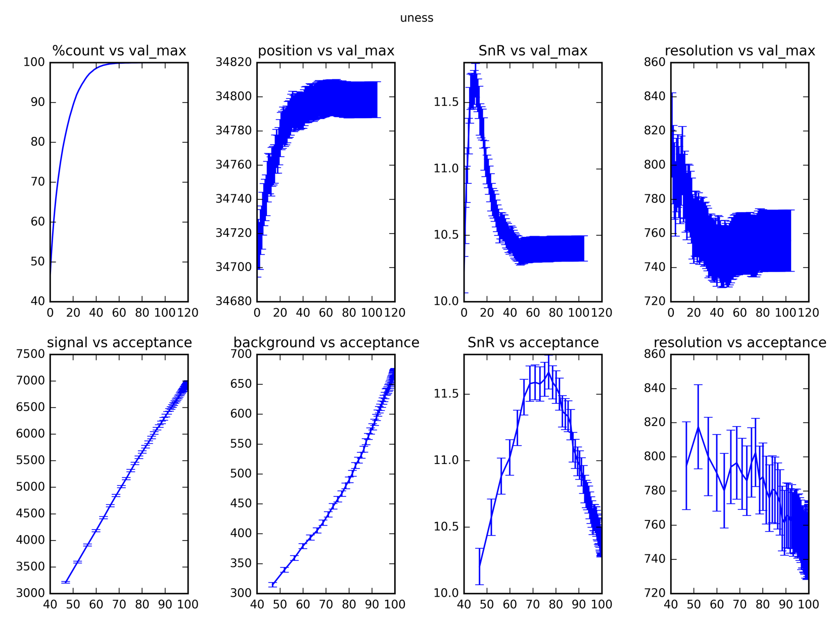
Example Filter Performance

Slide 17
“Live” Multi Grid Processing
Multi-Grid prototype live at CNCS (SNS)
Relatively straight forward in processing needs
Was first working demonstrator of processing framework and algorithms
Internal wire data format agreed
Started thinking about
diagnostics tools

Slide 18
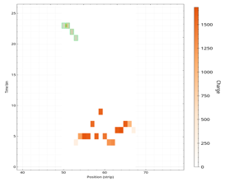
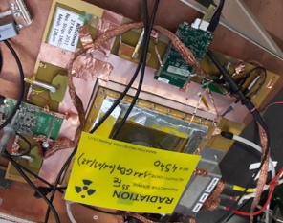


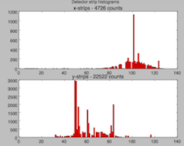
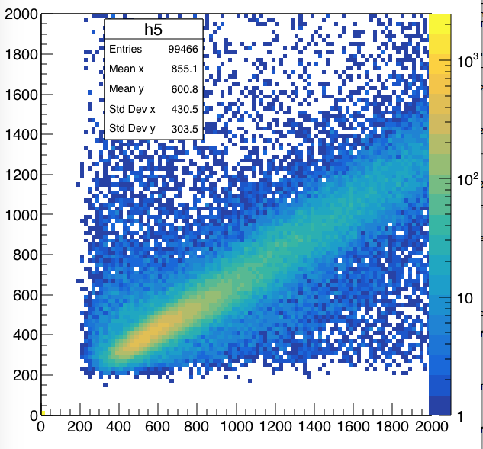
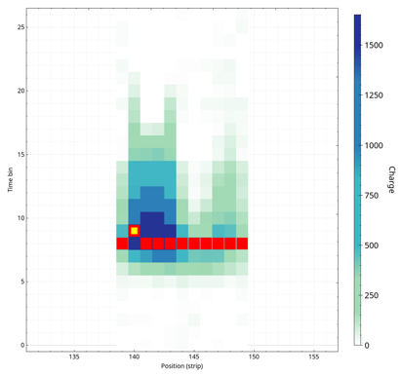
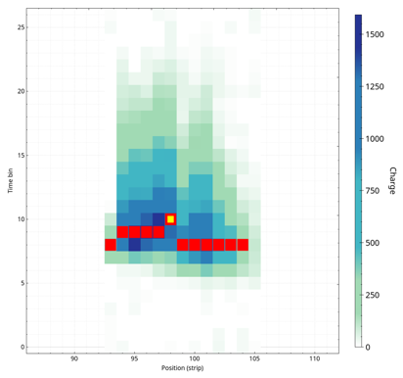
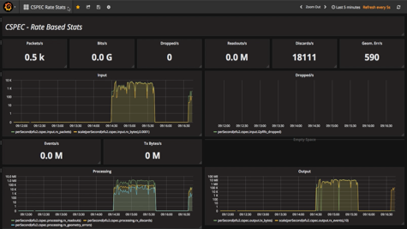
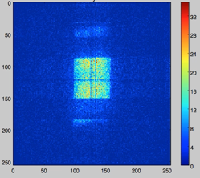
NMX DAQ & Monitoring
Event formation
Installation live in the CERN detector lab
Gives faster feedback than existing DAQ system
Win-win collaboration
Detector and readout
Aggregation
Live View
RD-51 SRS
Gd-GEM
Application Monitoring
Added Bonus Outcome!

Slide 19
5.1 Summary
Deliverables and general progress well on track.
Event formation in standard computing hardware is not state of the art for neutron detectors.
Event formation solved for a number of detector prototypes.
New quantitative measures of raw event data developed, leading the way to a process to adapt to new detector types or final products within a fixed, reasonable timescale.
Knowledge is being shared with the detector community, which has identified hardware processing as a potential long term maintenance problem.
Live acquisition available as added bonus.

Slide 20
5.2 Current Results
First deliverable with results of fact finding in internal review
Gathered requirements
Three different hardware platforms identified
Three different schemes of running the fast data acquisition and time stamping
Three different ways to integrate that into the data steam

Slide 21
Event Generators
5.3 Results
ESS does not yet generate neutron event data
Need to simulate neutron events for testing software
  From histogrammed NeXus files
  From McStas output
Integrated with PSI style counting and EPICS scalerRecord
DAQ2 electronics at PSI
  now successful in production at RITA-2
  sends 0MQ neutron event stream, adapted to Kafka
  Extended old SinqHM to read and histogram the stream
  This old SW can do simple histogramming at ~800MB/sec!

Slide 22
SINQ-AMORSIM
5.3 Results
Deep simulation of the AMOR instrument for integration testing
  Simulate instrument hardware with Python servers
  EPICS drivers and IOC on top
  Event generator
Adding
  BrightnESS software: DONE
  Experiment Control Interface: In progress
  Online data reduction: In planning
Aim: testing against the real instrument

Slide 23
Forward-EPICS-To-Kafka
5.3 Results
For recording time stamped EPICS data
Metadata to correlate with the event stream
Forward-EPICS-To-Kafka does this
  Uses EPICS-4 API
  Supports all standard EPICS types and waveforms
  Can be extended to support advanced EPICS4 data types
Can already stream 220MB/sec of EPICS data to Kafka with ease
  Limit: File system

Slide 24
NeXus File Writer
5.3 Results
Collects Neutron event streams and EPICS streams from Kafka topics
Saves streams to HDF5 files in NeXus format
Header data and streaming configuration determined through JSON command messages on a Kafka topic
Extendable to more stream types
We have a well working prototype:
  event generator-Kafka-FileWriter: 220MB/sec
  raw file writer speed on GPFS: 1.3GB/sec with > 2MB event messages

Slide 25
5.3 Future Plans
Experiment Control Programme (ECP) Integration
  Close collaboration with PSI in kind ECP project
  This will put our current implementations to a thorough test
Make NeXus File Writing go fast
  Gained limited access to a parallel filesystem at SLS
  Working on testing and tuning

Slide 26
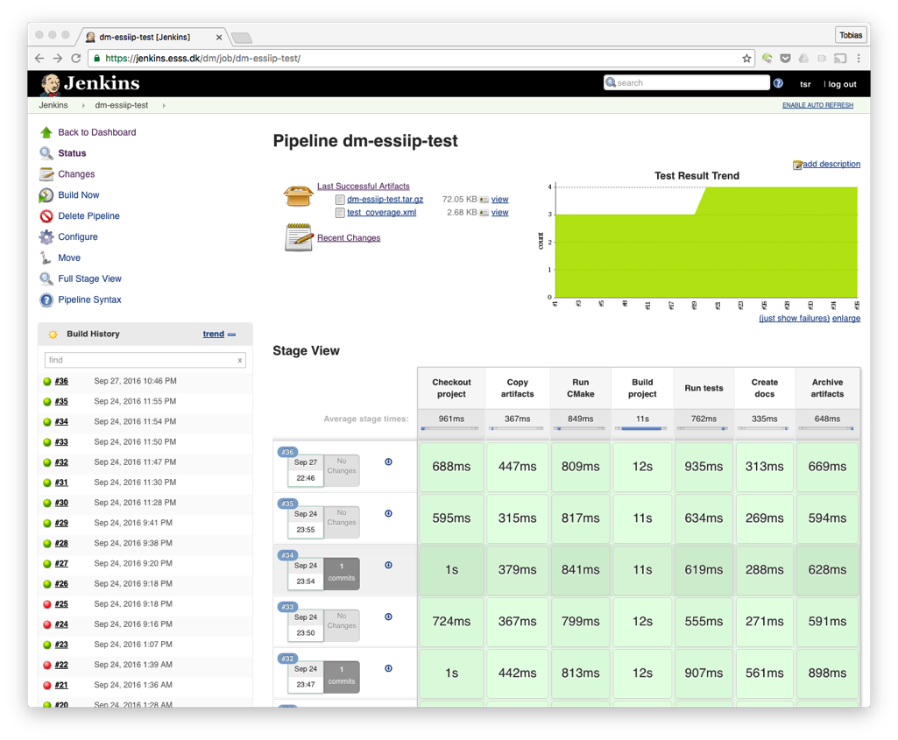
Software Testing
Our data stream will be the one
and only scientific record of ESS
experiments
Software needs to function
correctly, reliable, and in real time
Going forward software testing
will be as important as implementing
new features
Integration and testing facility is
set up in the ESSIIP lab (Lund)
Test will be run by partners in
their facilities
Automated test are implemented on
virtual hardware for now
BrightnESS is funded by the European Union’s Horizon 2020 research and innovation programme under grant agreement No. 676548

Slide 27






Continuous Deployment
dmg-build-scripts
h5cc
streaming-data-types
graylog-logger
event-formation-unit
kafka-to-nexus
jenkins
192.168.12.102
Includes and integrates all prototypes.
Near production experience
for staff and code
Lessons learned and actions logged
(Wiki & Jira)
Integration into experiment control is in the works
1 Jenkins master instructs dmbuild01
to start building
2 build script clones
repositories from Github
release.tar
output/
├── bin
├── data
├── inc
├── lib
└── util
4 Ansible deploys the release and starts all relevant executables
dmbuild01
192.168.12.100
executables are built and run
on the target OS
3 result of build is a tar file
SINQ AMORSIM
192.168.12.21
EPICS Forwarder
192.168.12.23
Kafka Broker 1
192.168.12.22
FileWriter
192.168.12.?
5 Data is streamed through the pipeline
Detector Data 192.168.12.21
EFU
192.168.12.22
Kafka Broker 2
192.168.12.23
EEE is made available to nodes using NFS
6 Logs and Metrics are sent
as evidence of success
Graylog
192.168.12.11
Graphite / Grafana
192.168.12.11
eeenfs
192.168.12.24
Notes:
wiki

Slide 28
Main Risks
Late availability of hardware for testing
Performance not sufficient for ESS real time
Staff retention
Upcoming events
WP4 WP5 Jamboree, next week
IKON13 Detector Session, end of the month
MS34 January/February 2018
Milestone Meeting -- 2nd integrated software test
MS35 May 2018
Final software delivery
End of Project
Corresponding final deliverables in the individual tasks

Slide 29

Acknowledgements
Tobias Richter | DMSC | Group Leader
Martin Shetty | DMSC | BrightnESS 5.1
Afonso Mukai | DMSC | BrightnESS 5.3
Morten Jagd Christensen | DMSC | BrightnESS 5.1
Jonas Nilsson | DMSC | BrightnESS 5.2
Stig Skelboe | NBI | BrightnESS 5.1
Carsten Søgaard | NBI | BrightnESS 5.1
Troels Blum | NBI | BrightnESS 5.1
Matt Clarke | STFC/ISIS | Streaming In Kind
Freddie Akeroyd | STFC/ISIS | Streaming In Kind
Matthew Jones | STFC/ISIS | Streaming In Kind
Mark Koennecke | PSI | BrightnESS 5.2/5.3
Michele Brambilla | PSI | BrightnESS 5.3
Dominik Werder | PSI | BrightnESS 5.3
Roberto Pugliese | Elettra | BrightnESS 5.3
Carlos Reis | Elettra | BrightnESS 5.3
George Kourousias | Elettra | BrightnESS 5.3
Special Thanks:
Dorothea Pfeiffer
Michael Lupberger
Patrik Thunier
Anton Khaplanov
Francesco Piscitelli
Scott Kolya
Steven Alcock
Richard Hall-Wilton
ESS DG (WP4)

Slide 30
T

