Slide 1
ODH Phase 1 Hazard Analysis, Monitor Placement, Installation Progress.
Stuart Birch
www.europeanspallationsource.se
19th September 2017

Slide 2
Introduction
Hazard Analysis
ODH monitor positions
Installation Update
Critical path items

Slide 3
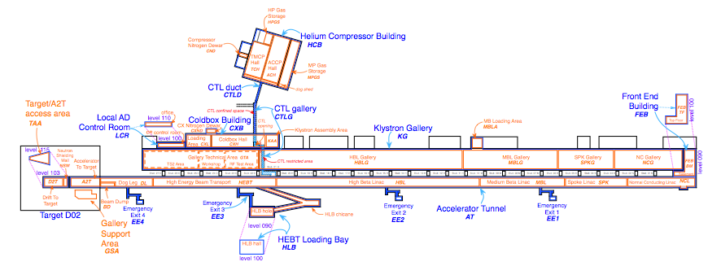
ODH Phase 1.
HPGS
ACCP
TMCP
Dog shed
Cold Box Hall
CTL
G02

Slide 4
Hazard Analysis
Hazards
Hazard ID | Hazard | Hazard Description
PSS_ODH Hazard_001 | Oxygen deficiency hazard from Helium | Catastrophic failures of devices (valves, flanges pipe etc.) leading to a large inventory of helium entering areas were personnel will be carrying out checks and maintenance or personnel enter an area which has a larger inventory of Helium in that area
PSS_ODH Hazard_002 | Oxygen deficiency hazard from Nitrogen | Catastrophic failures of devices (valves, flanges pipe etc.) leading to a large inventory of Nitrogen entering areas were personnel will be carrying out checks and maintenance or personnel enter an area which has a large inventory of Nitrogen in that area

Slide 5
Hazard Analysis
Initiating Events
ODH Hazard ID | Hazard | Area | Initiating Event
PSS_ODH Hazard_001 | Oxygen Depletion Hazard Helium | ACCP Hall or TCCP hall, HPGS Room, Cold Box Hall or CTL | A person is in an area and a full rupture of either a pipe flange, Relief device, Valve or Pipe causes a large inventory of helium to leak into the area.
PSS_ODH Hazard_001 | Oxygen Depletion Hazard Helium | ACCP Hall or TCCP hall, HPGS Room, Cold Box Hall or CTL | A person enters into an area with Helium hazard within that area.
PSS_ODH Hazard_002 | Oxygen Depletion Hazard Nitrogen | ACCP Hall or TCCP hall, or Cold Box Hall | A person is in an area and a full rupture of either a pipe flange, Relief device, Valve or Pipe causes a large inventory of nitrogen to leak into the area.
PSS_ODH Hazard_002 | Oxygen Depletion Hazard Nitrogen | ACCP Hall or TCCP hall, or Cold Box Hall | A person enters into an area with Nitrogen hazard within that area.
See ODH hazard register V2

Slide 6
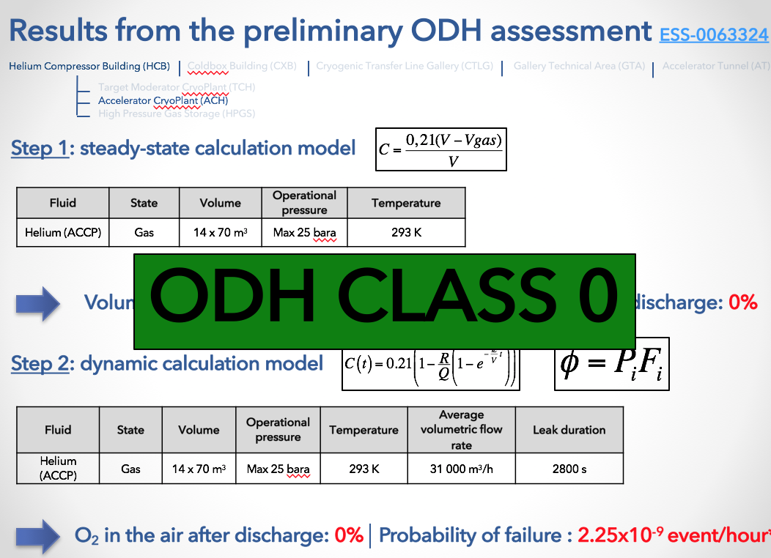
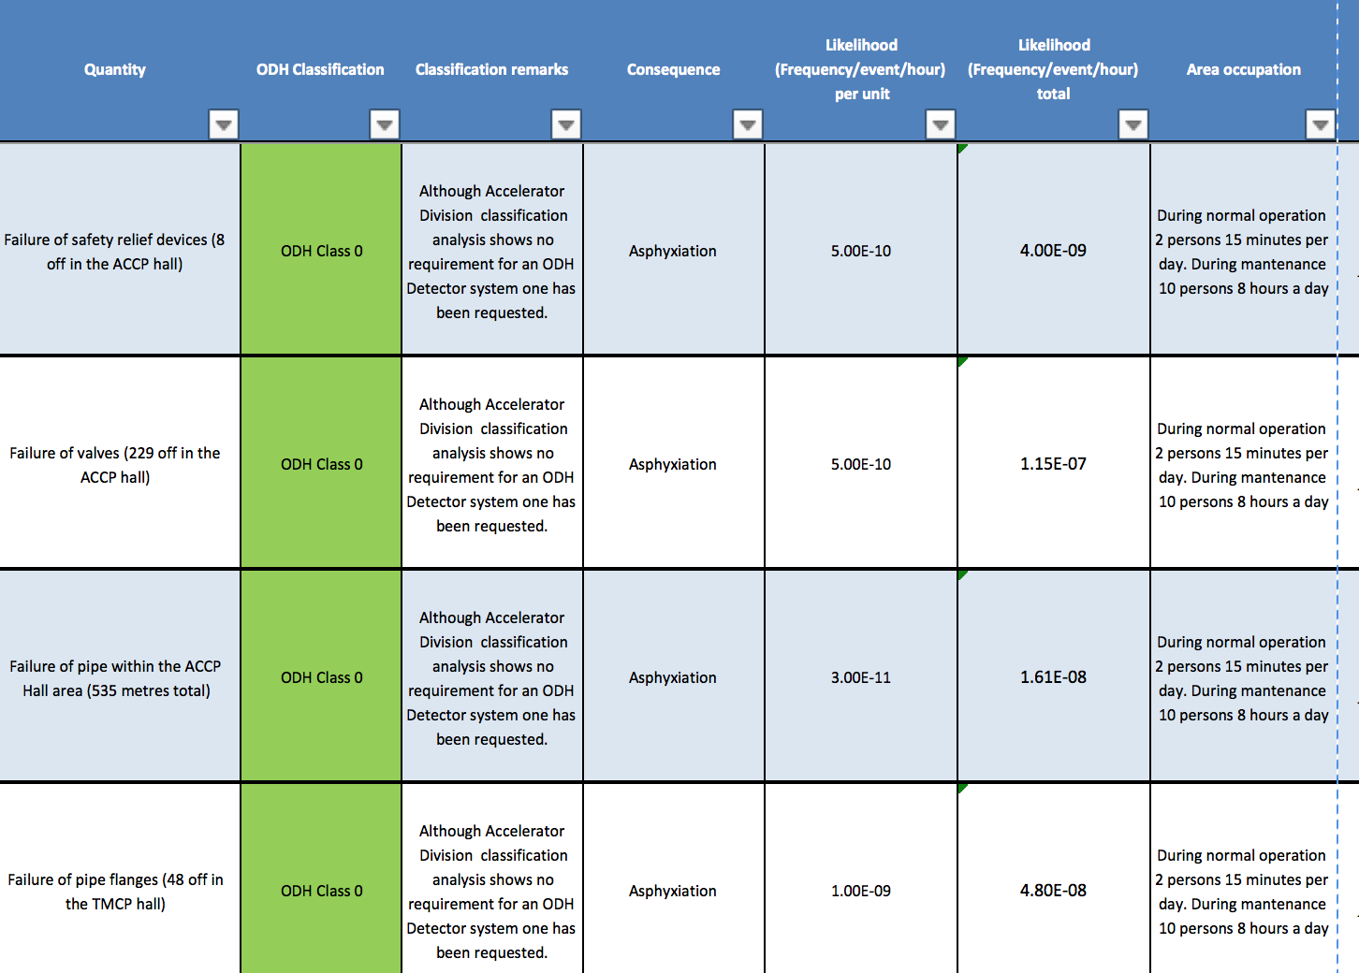
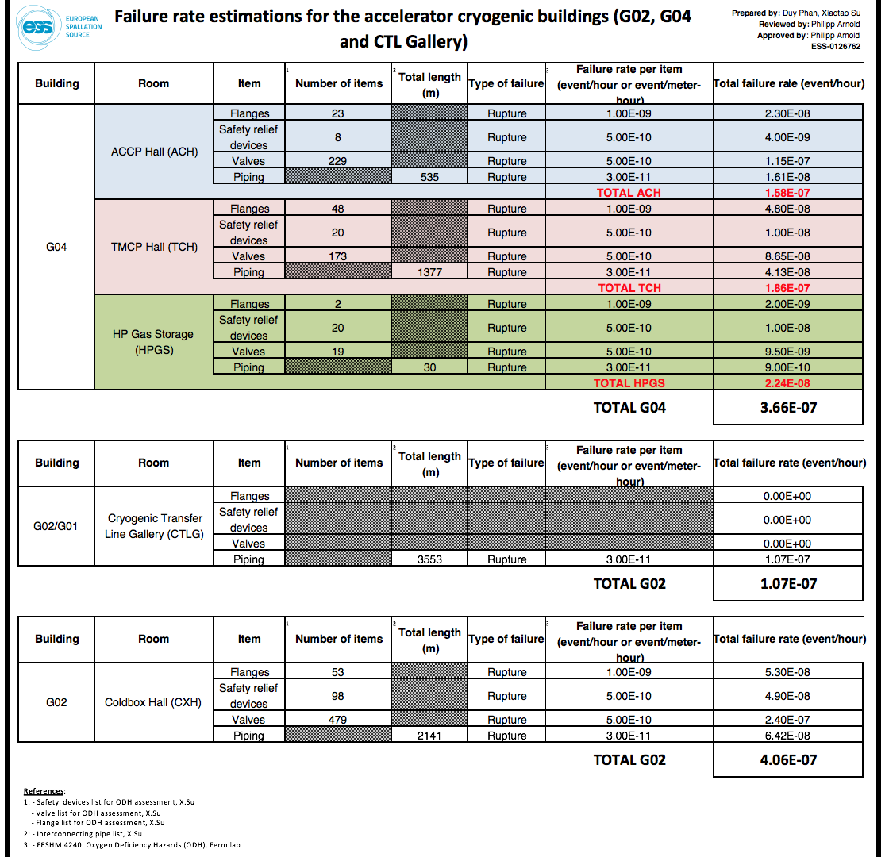
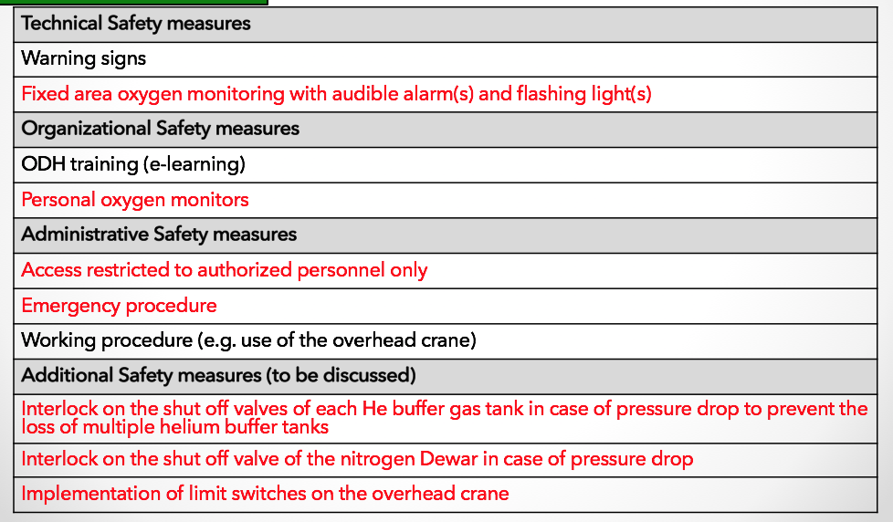
Hazard Analysis

Slide 7
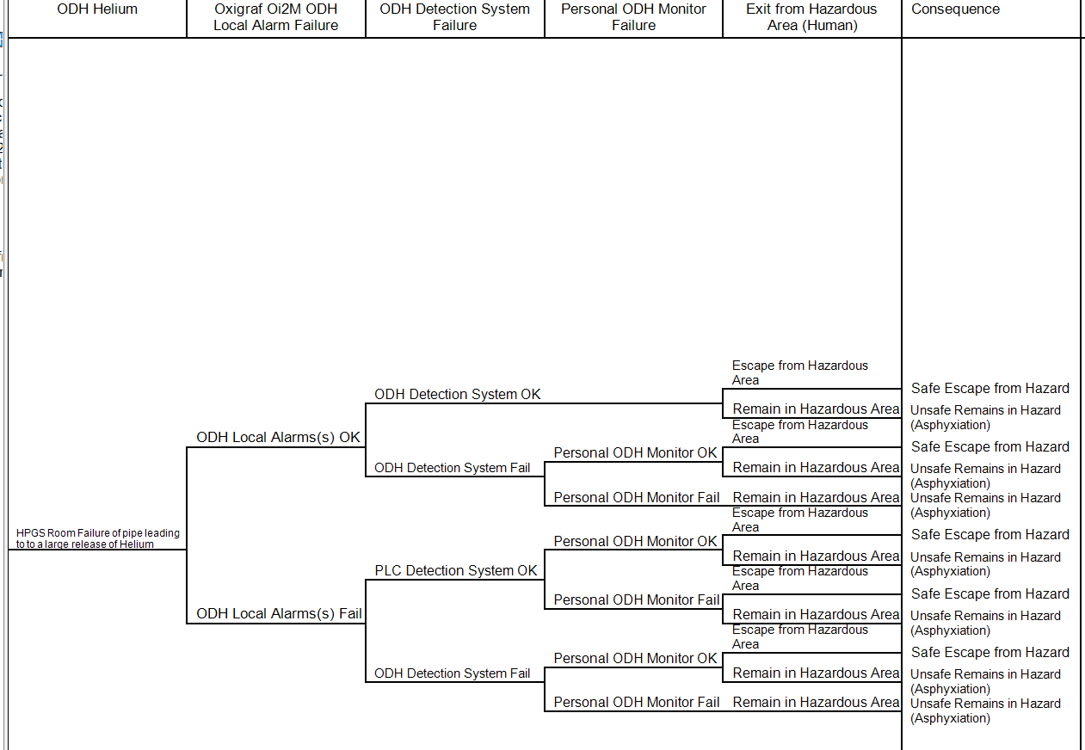
Hazard Analysis HPGS ODH ETA

Slide 8
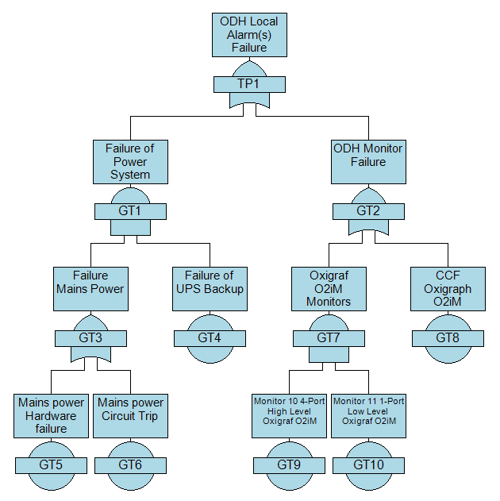
Hazard Analysis FTA Local Alarm(s)

Slide 9
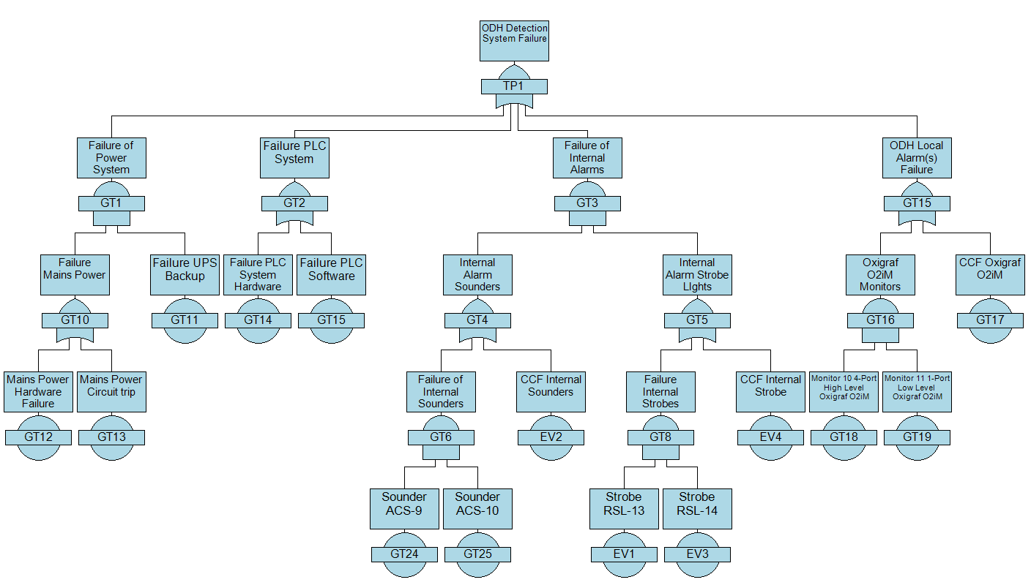
Hazard Analysis FTA ODH Detection System (Internal)

Slide 10
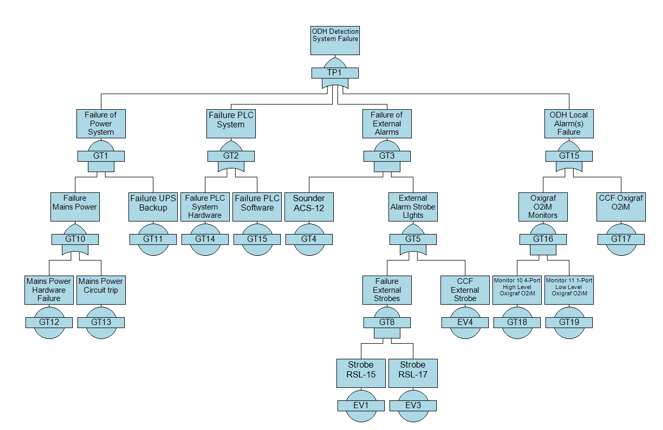
Hazard Analysis FTA ODH Detection System (External)

Slide 11
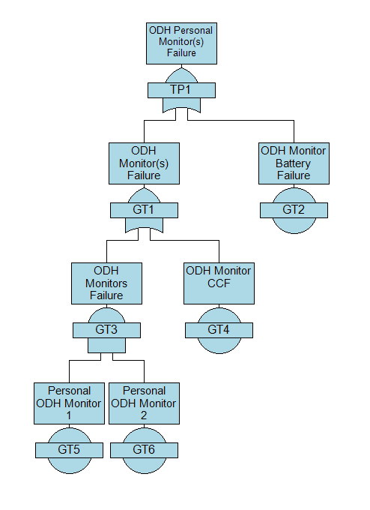
Hazard Analysis FTA Personal ODH Monitors

Slide 12
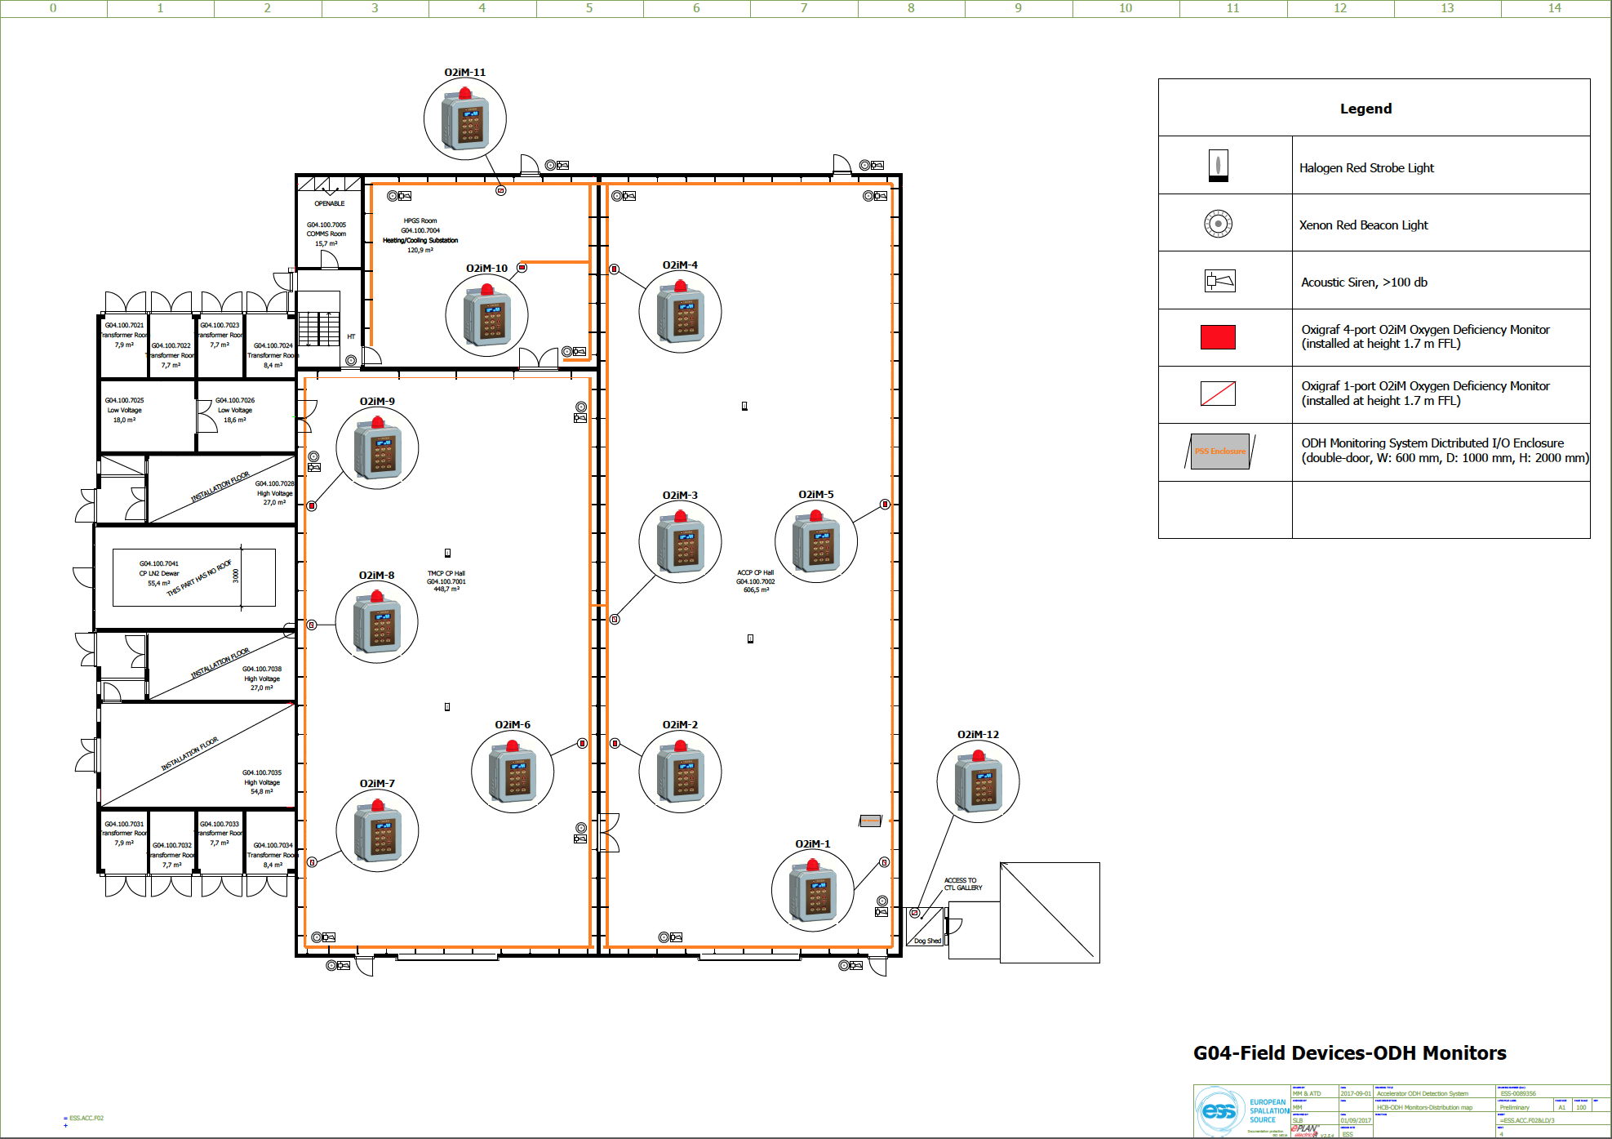
G04 ODH Detector Positions

Slide 13
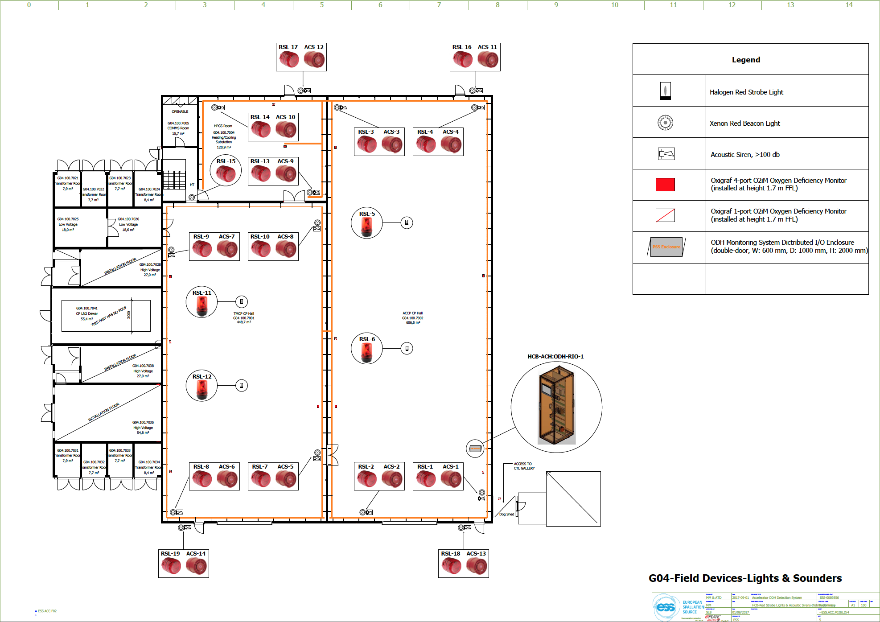
G04 ODH Alarm Sounder and Light Positions

Slide 14
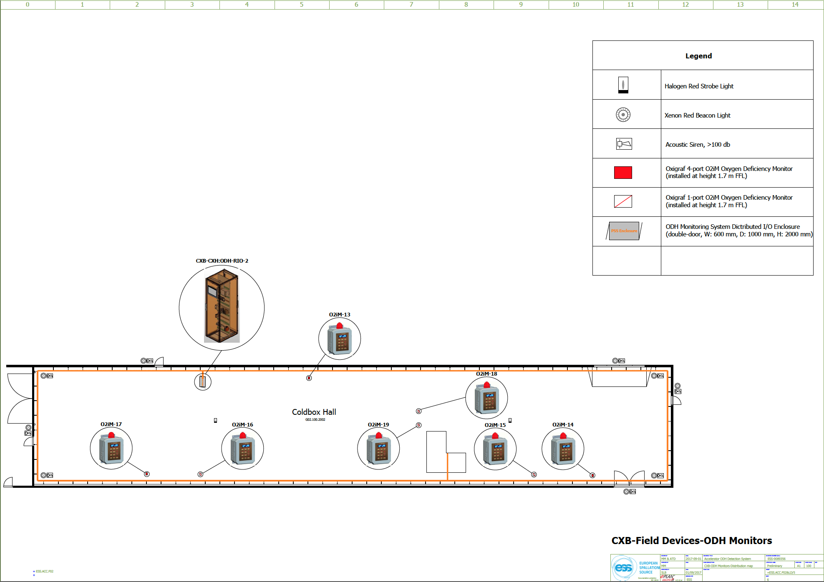
Cold Box Hall ODH Detector Positions

Slide 15
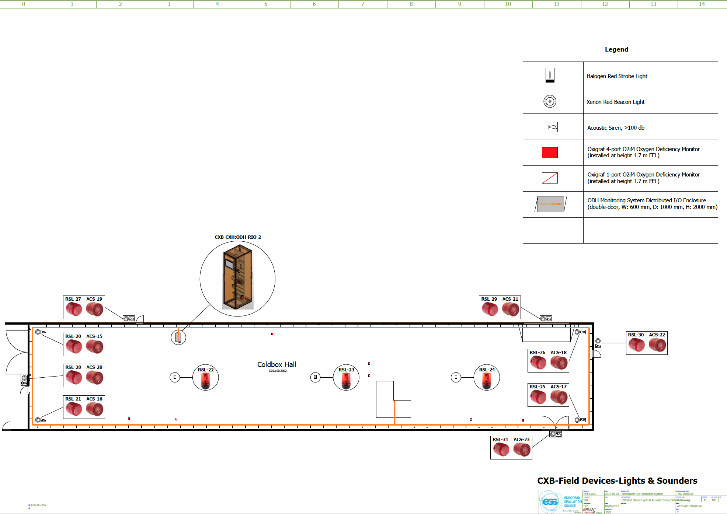
Cold box hall ODH Alarm Sounder and Light positions

Slide 16
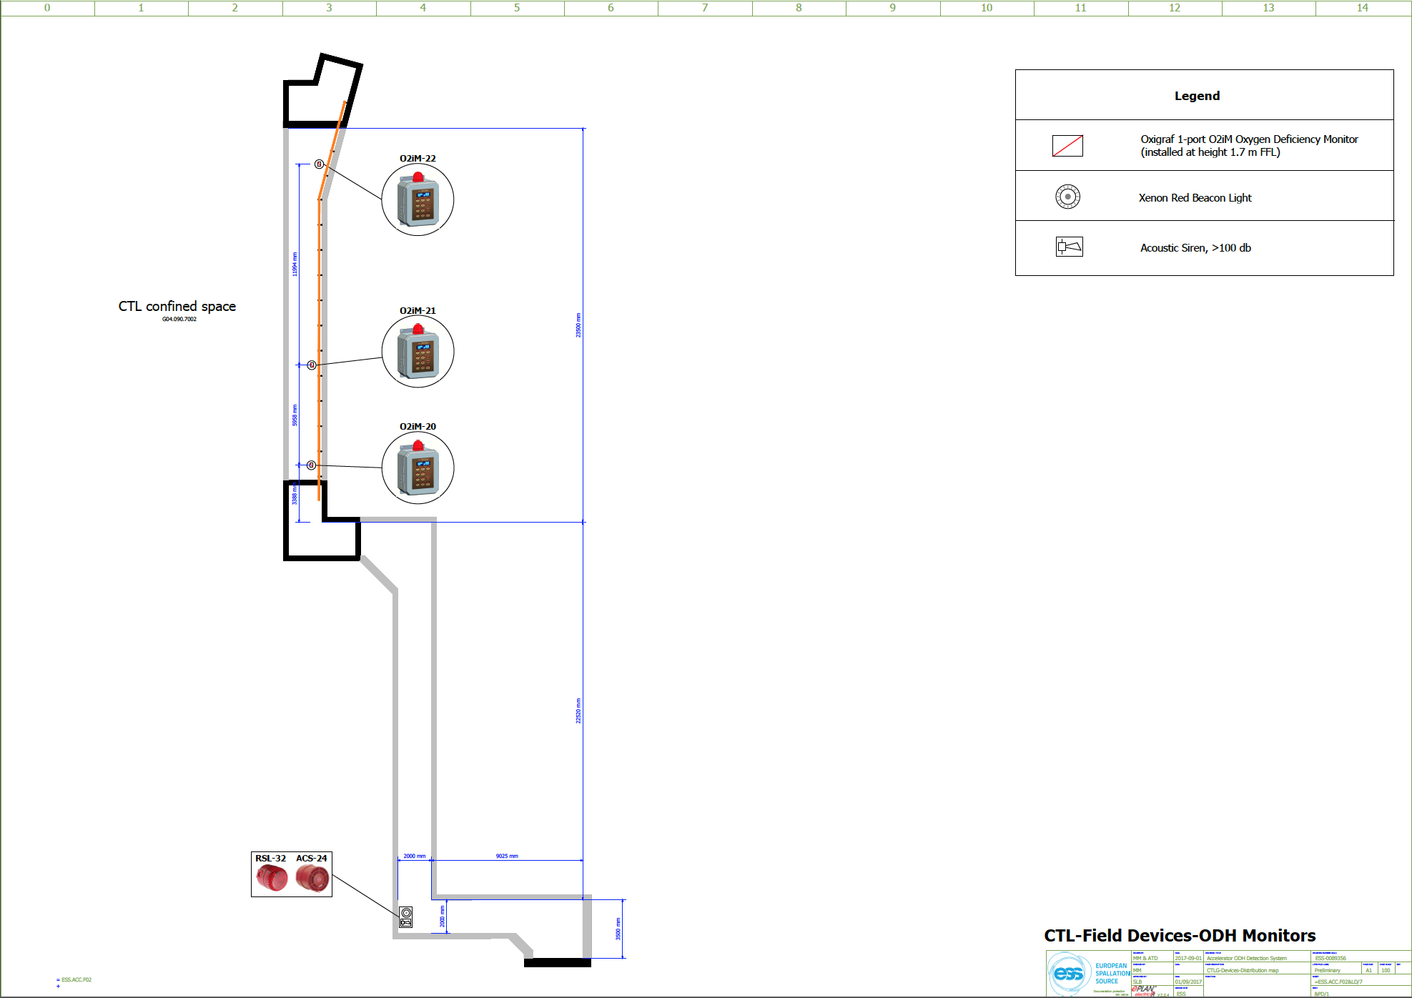
CTL Detector, Alarm light and Sounder Positions

Slide 17
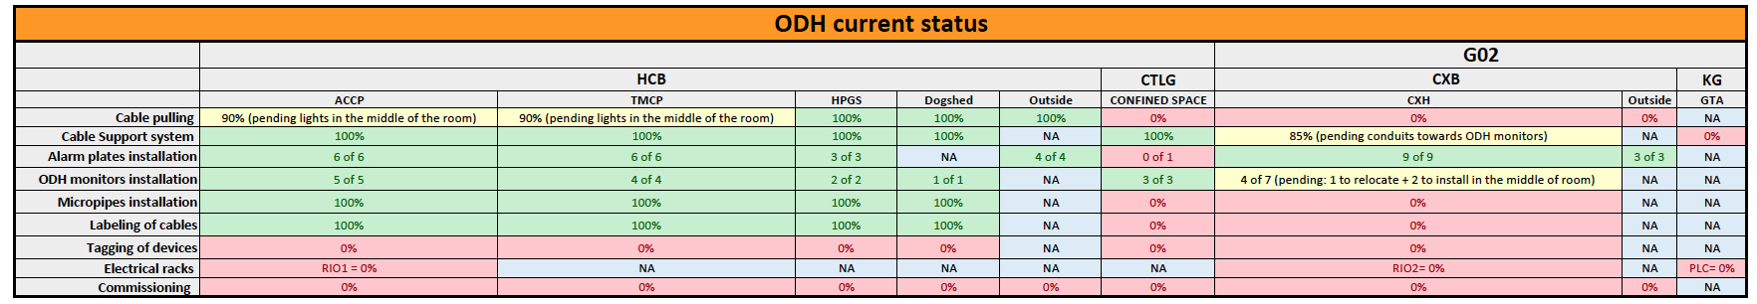
Installation update
G04
All monitors Installed
All Micro pipework installed
All cables Pulled
All Containment Installed
All alarm plates installed
To Do:
Tag Devices
Electrical Racks (Critical Path)
Terminate Racks (Critical Path)
Fibre Installation (Critical Path)
Commissioning (Critical Path
Cold Box Hall
Monitors Installed (4 from 9 some relocation)
Micro pipework installed (4 from 9)
All Alarm plates installed
Cables to be pulled
All Containment Installed
To Do:
Electrical Racks (Critical Path)
Terminate Racks (Critical Path)
Fibre Installation (Critical Path)
Commissioning (Critical Path)
Cold Box Hall And CTL Installation to be
completed by 30th September

Slide 18
Critical Path items
PLC racks 3 off delivery to Processkontroll October
FAT Expected Week 44.
Installation and commissioning will start Week 45

Slide 19
Thank You

