Slide 1
ESHAC#7 General Q-progress CE marking
Mattias Skafar
Head of Quality Division
www.europeanspallationsource.se
8 October, 2017

Slide 2
Quality Division
Third-party
Tuv-Nord AIB
Dekra (AFS)
Q Division
Mattias Skafar (HoD)
QAM
Ivan Korunoski
Carl Tillman
QCM
Cecilia Lowe, QC-mech.
Conny Wendt, QI
Kenth Ödbratt © Q Div
Kent Wigren © Acc.
Mikael Beise © Target
Stefan Arvidsson © QC-elec.
QMDI
Diana Bading
T
Acc.
CF
NSS
ICS

Slide 3
Quality Division – Functional Descriptions
Quality Division ESS-0126528
Quality Assurance Mgmt. ESS-0126529
Lean Management system
Continuous improvements
Quality Control Mgmt. ESS-0126530
Reviewed and inspected project /facility documentation and deliverables in compliance with agreed requirements
Certificate of compliance
Quality Mgmt. Documented Info. ESS-0126531
Facility documentation and records documented and archived in accordance with internal and external stakeholders requirements.

Slide 4
Certifiable Management System*
ISO
Quality
9001
OH & Safety
45001
Environmental
14001
Info. Security
27001
*In alignment with internal and external stakeholders expectations SSMFS 2008:27 and ESS Special Conditions 15-36

Slide 5
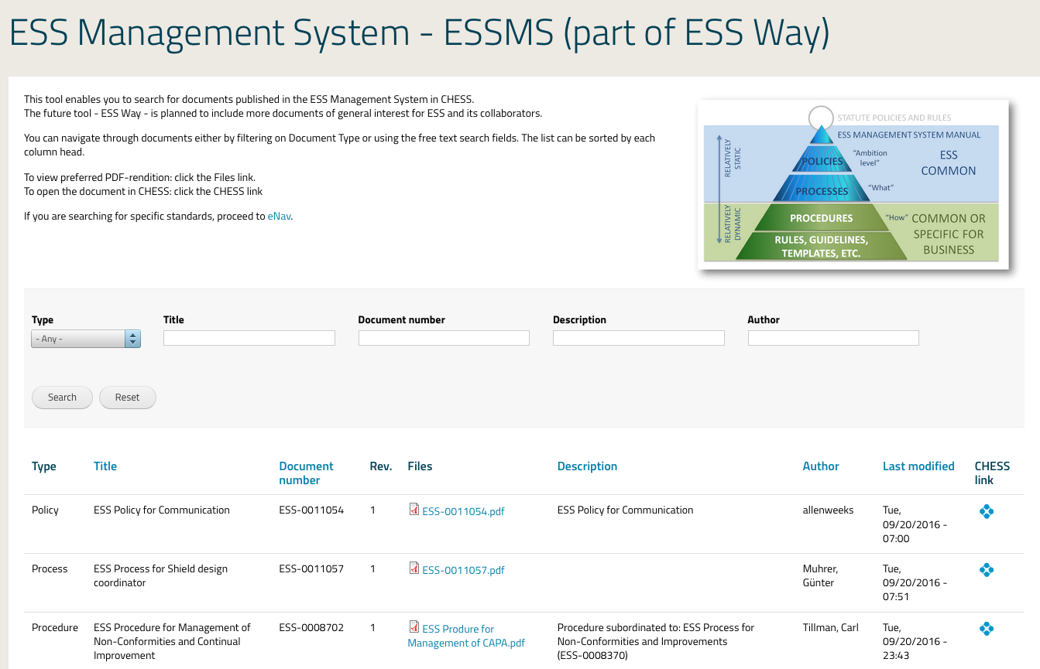
ESSMS on Intranet

Slide 6
Greenfield – maturity process
2019
2017
2016
2015
ESS
ESS
ESS
ESS
Greenfield

Slide 7
Quality Management - Foundation
ESS
IKC Contract
Technical Annex
Project Quality Plan
Applicable standards
Non-conformity reports
Quality visits
Supplier audits
High
(Right)
Quality
Delivery
External provider
In-Kind Collaborator
Commercial contract
Technical specification
Notes:
ESS-0055446 ESS procedure for Graded approach.
ESS-0016468 ESS rule for identification and classification of safety important components

Slide 8
ESSMS – Document development
Handbooks
Template drafted
Update of Governing documents and ESSMS Manual accordingly
Project Management Handbook
issued by John Haines
Engineering Handbook
Detailed engineering support
PDR, CDR, IRR continues
SRR planning and preparation ongoing
Operations Handbook
Radiation protection Handbook

Slide 9
Quality Division – Progress
Validation by EFQM for Committed to Excellence
3 improvement projects
Decision making, John Womersley DG
Internal communication, Allen Weeks Head of Communication
Learning Management system, Ralf Trant Ass. Dir. Of ESH&Q
Management Review Meeting
2 meetings performed, next planned 27th of November
Quality Coordination meetings, cont
Classification Documents
QAM and QCM parts
Internal Audit
Test stand
Catania INFN-LNS, Ion Source and LEBT
Success!

Slide 10
Quality Division – Progress
Document Management and archival
Resource hired
Steering document developed
High-level plan for archival
physical & electronic
Discussions with Landsarkivet in Lund
Define stakeholder requirements for documentation structures
Document Management Coordination/support
Documentation aspects of SSM application
Supporting the forthcoming SSM applications

Slide 11
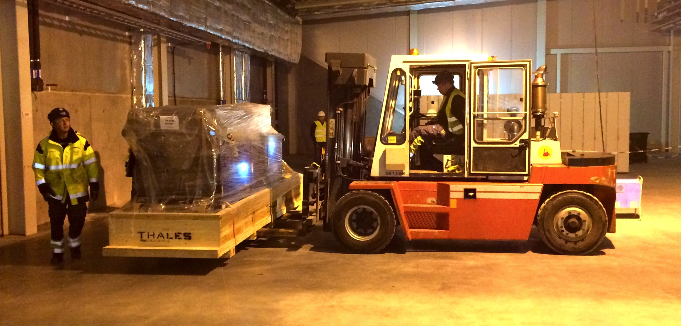
Quality Division – Progress
Receiving Inspection
Resource hired
Procedure + Templates
Office in RATS and at Site
Derogation, procedure + template
Handover working group
ESS – CF – Skanska
Thales 704 MHz Klystron delivery
RATS – Receiving, Accept, Test and Storage

Slide 12
Why document management?
ISO 9001:2015 Documentation Requirements
ISO 9001:2015 clause 4.4 “maintain documented information to the extent necessary to support the operation of processes and retain documented information to the extent necessary to have confident that the processes are being carried out as planned.”
Use CHESS from the beginning.
Document numbering
Revision handling
Traceability
Archiving
Review process:
Author
Reviewer
Approver
Use of CHESS Templates
Independent reviewer is mandatory

Slide 13
Why document management? (cont.)
ESS has several internal and external stakeholders requiring us to have our Management system and facility documentation structured and retrievable.
ESS organization itself
Swedish Radiation Authority - SSM
Swedish work environmental authority
Insurance company
This to be able to show:
how the facility is built
how safety analysis and measures have been applied
how requirements have been met
how we intend to archive and plan for long term preservation of facility documentation
This will give us the means to:
Install,
Operate,
Maintain,
Repair and update
the facility in a safe and cost effective way.

Slide 14
Facility documentation
ESS definition on high-level (extract from ESS-0068713):
System Requirement Specification
Concept of Operation Description
System Architecture Description
System Detailed Design Descriptions
Non-Conformity Reports
Verification Report
Validation Report
Minimum requirement from SSM (req. 6-21 as identified in ESS-0121507):
The term technical facility documentation refers to relevant drawings of the facility, its building structures, systems, components, and devices, as well as documentation showing how these have been manufactured, installed, and checked.
Where applicable, information on any changes made to the facility should also be included in the documentation.
The technical facility documentation should also include relevant process and flow charts, as well as the investigations and analyses that form the basis of safety analysis reports.

Slide 15
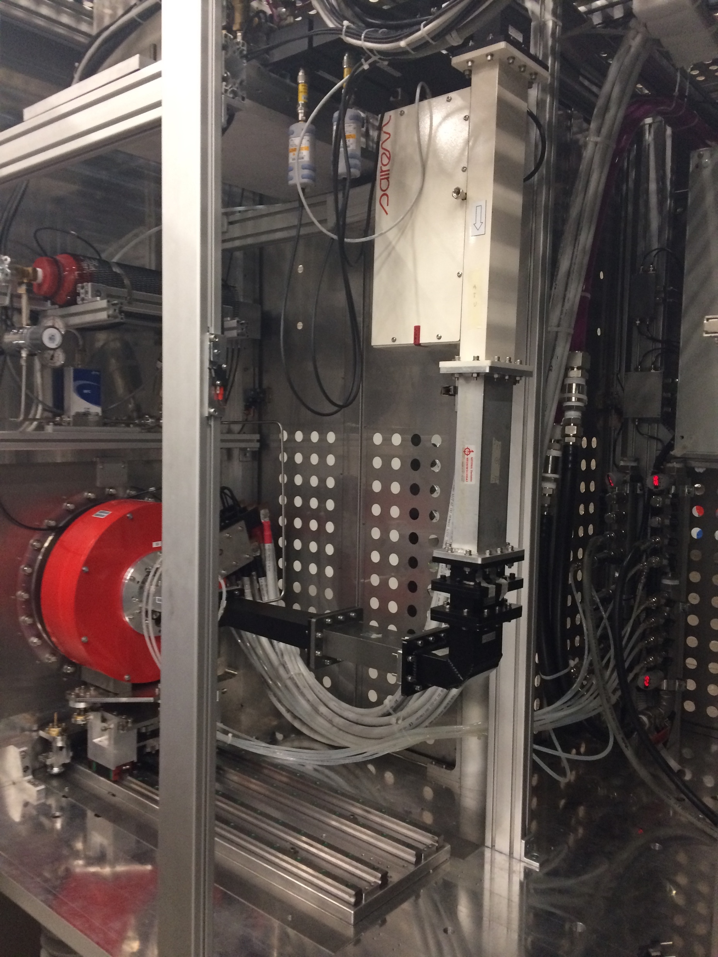
ESS Strategy for CE Marking
Approved by DG and ESS Management Team
The Strategy (ESS-0103087) applies to:
Internal deliverables
Commercial contracts
In-Kind Contributions
CE marking is mandatory.
when there is an applicable European Directive.
The delivery shall include:
Risk assessment (ISO 12100)
Technical File, drawings, wiring diagram, P&ID, etc.
Operational Manual, in English
Declaration of Conformity (ISO 17050)
Ion Source INFN - LNS
CE marking Rule + 4 templates

Slide 16
Definition – USE
With regard to mechanical devices, the term „use” covers all of the activities shown in the diagram below, arising in connection with the use of the mechanical device.
USE
Assembly
Testing
Putting into service
Defined intended purpose
Transport
Conversion Dismantling
Incidents
Inspections
Maintenance
Repair
Its clearly defined intended use is specialised in the operating instructions or manual.

Slide 17
Workflow
Product
Identify Relevant EC Directives e.g.
2006/42/EC
2014/35/EU
2014/30/EU
Identify and apply applicable provisions
Compile Technical file
Description, Technical reports, Test reports, Construction plans, Circuit diagrams, Part lists etc.
Issue
User manual
in English
Create a EC - Declaration of conformity
(Machine or part of a machine)
Award of the EC-Conformity mark (CE)
(If applicable)
Notes:
42 Machine
35 Low voltage
30 Electromagnetic compatibility

Slide 18
Declaration of Conformity – DoC
Contributions needs to be delivered with a DoC*
Verifying that applicable directives and requirements have been applied by the supplier/IKC.
This will ease the integration process and secure that the Manufacturer of a deliverable have taken their responsibility for the delivery in terms of:
Safety requirements
Quality requirements
Technical requirements
Compliance to European and Swedish legislation
Applies for commercial and In-Kind deliveries
* According to ISO 17050

Slide 19
Example
Declaration of Conformity*
IKC
Declaration of Conformity*
Declaration of Conformity*
Partner institute
Supplier
Type of delivery:
In house design
In-kind Contribution
External provider
Of the shelf, CE marked
* Declaration of Conformity for part of machine (to be incorporated) or a complete machine

Slide 20
Divide in Logical packages
ESS level
* Declaration of Conformity for part of machine (to be incorporated) or a complete machine
Declaration of Conformity
IKC A
IKC B
IKC C
IKC D
IKC E
Declaration of Conformity*
Declaration of Conformity
Declaration of Conformity
Declaration of Conformity
Declaration of Conformity

Slide 21
ESS – Steering documents
ESS has issued a steering document describing the approach:
ESS Rules for CE Marking
ESS-0127031
Supported by four templates:
EU Declaration of Conformity (machine)
ESS-0145024
EU Declaration of Incorporation (part of a machine)
ESS-0145023
Signature card for EU Declaration of Conformity
ESS-0145020
Checklist for formal assessment of the EU conformity procedure
ESS-0145018

Slide 22
Thank you for your attention!
and now…
QUALITY
IS EVERYONE´S
RESPONSIBILIY
- MATTIAS SKAFAR -

