Slide 1
ESS Overview and Status
ESHAC
John Womersley
Director-General
www.europeanspallationsource.se
October, 2017

Slide 2
ESS Status
Construction continues to make excellent progress – 40% complete
High tech equipment arriving and installation beginning
Granted conditional permit to install equipment capable of producing ionising radiation
Plan to move all ESS staff out to the construction site in 2018

Slide 3
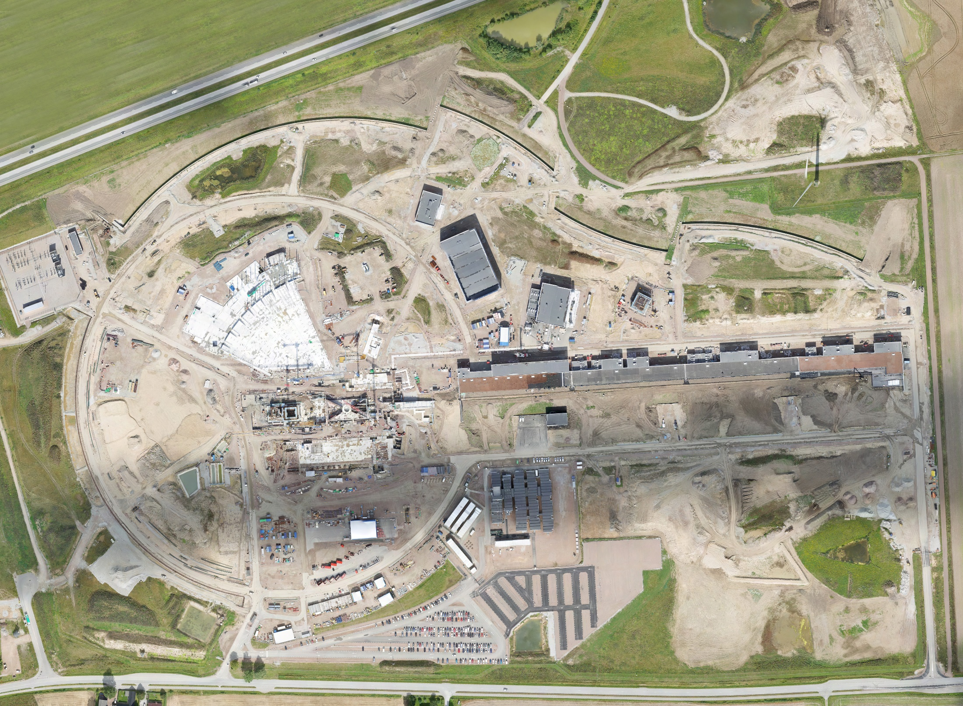
August 2017

Slide 4
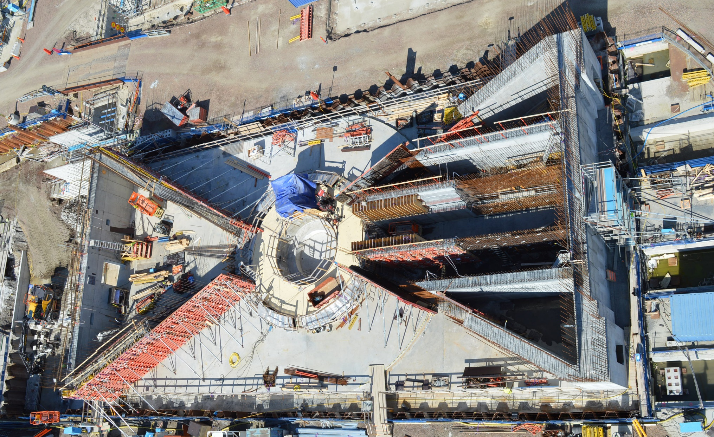
Monolith, August 2017

Slide 5
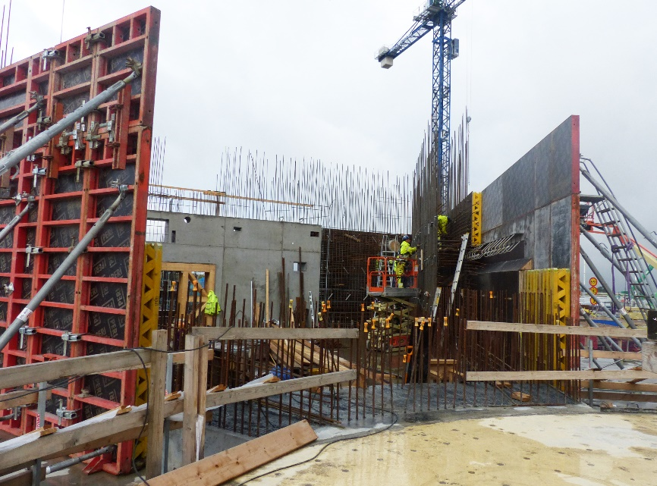
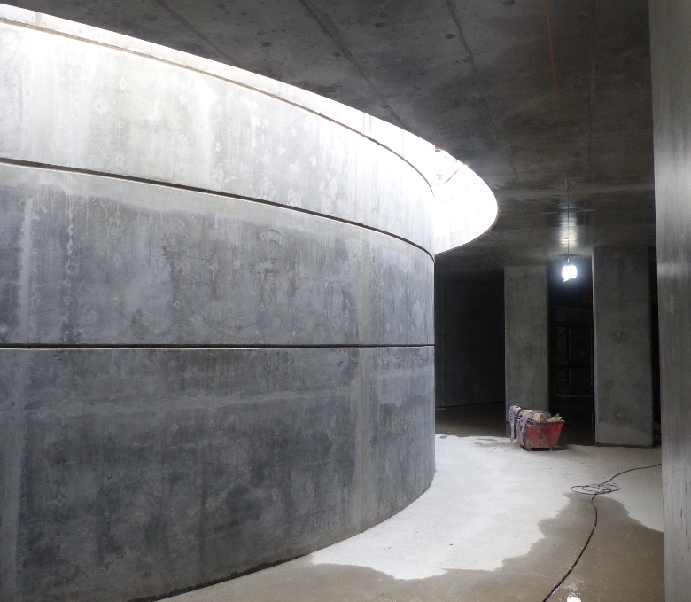
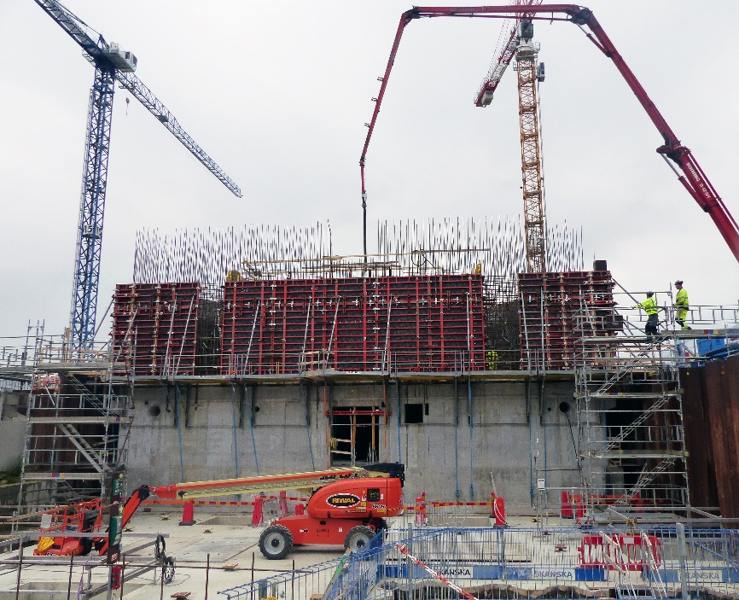
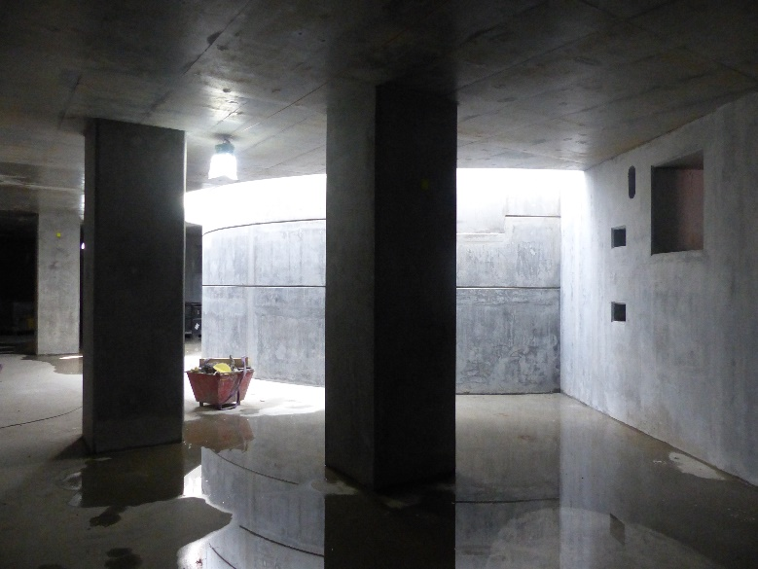
Monolith

Slide 6
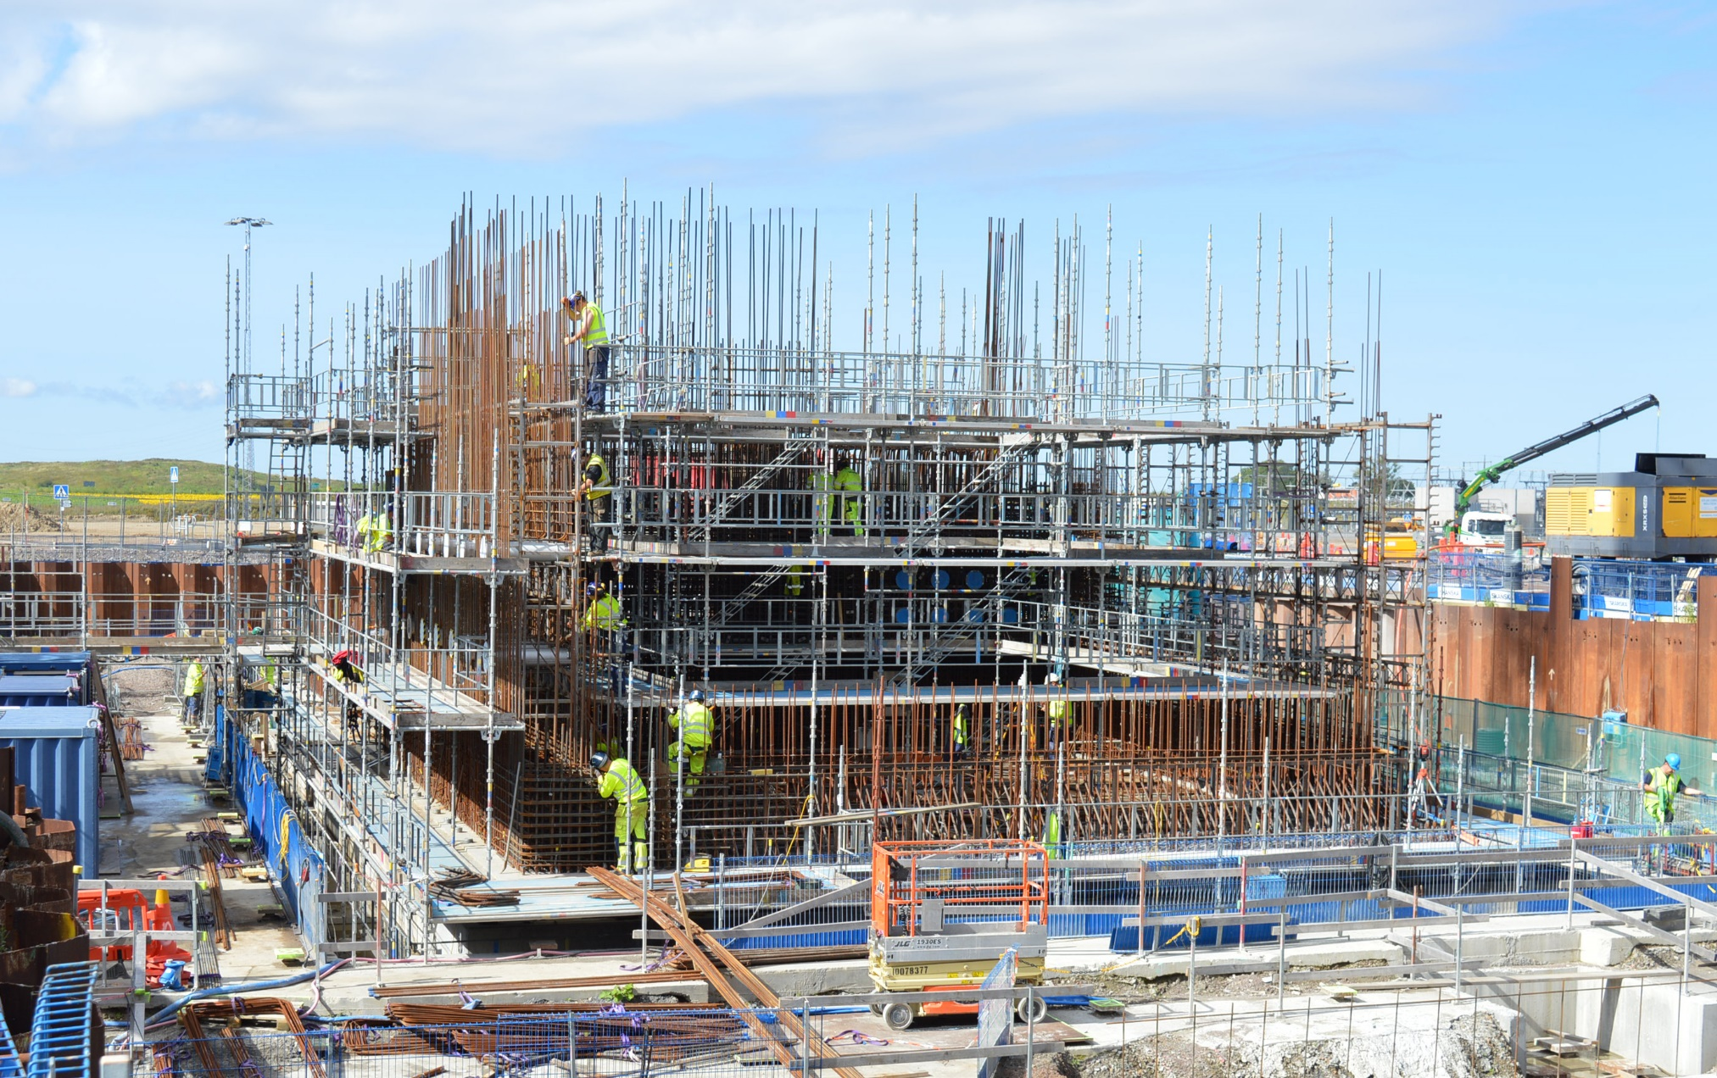
Active Cells

Slide 7
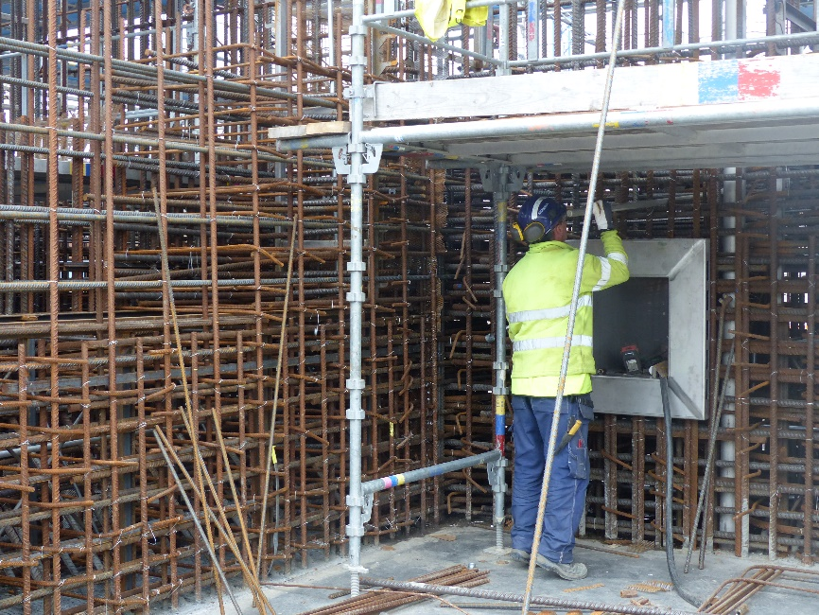
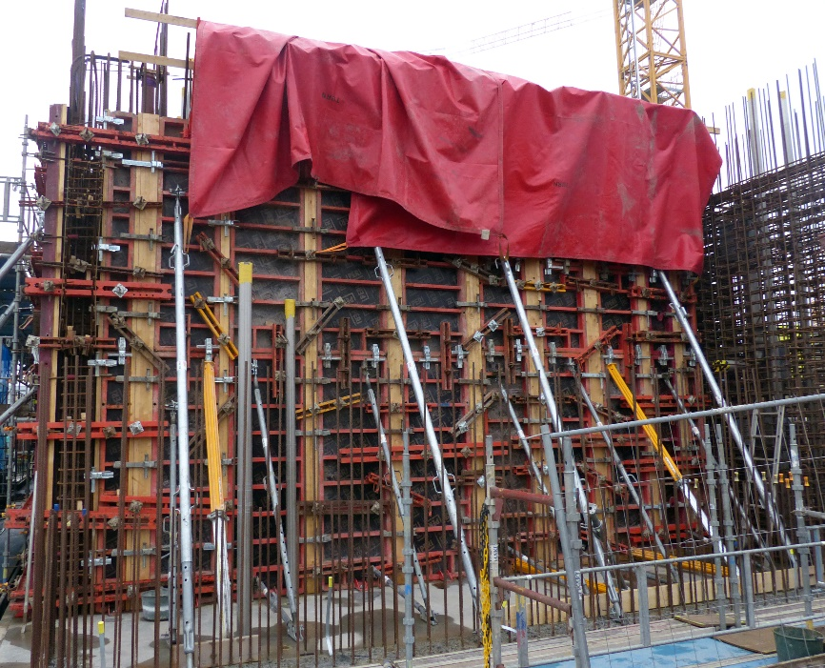
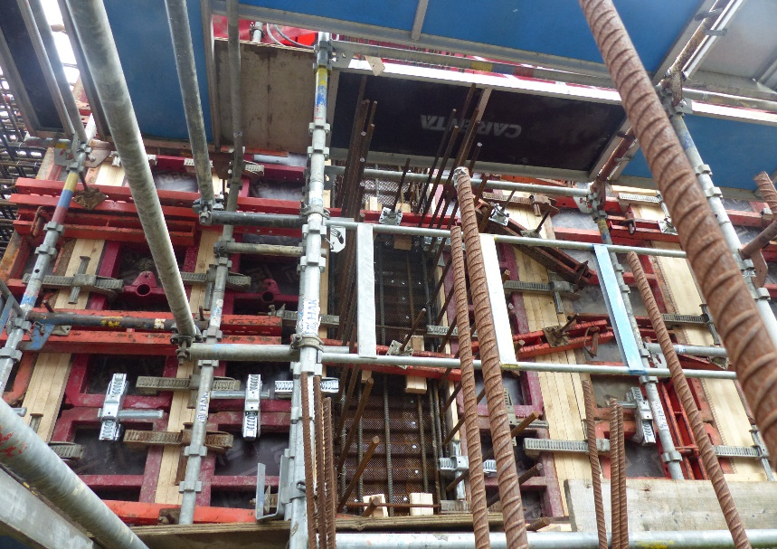
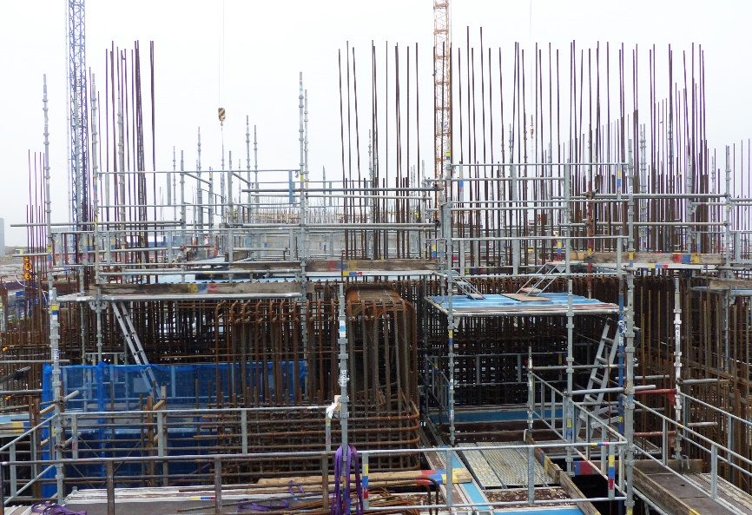
Active Cells

Slide 8
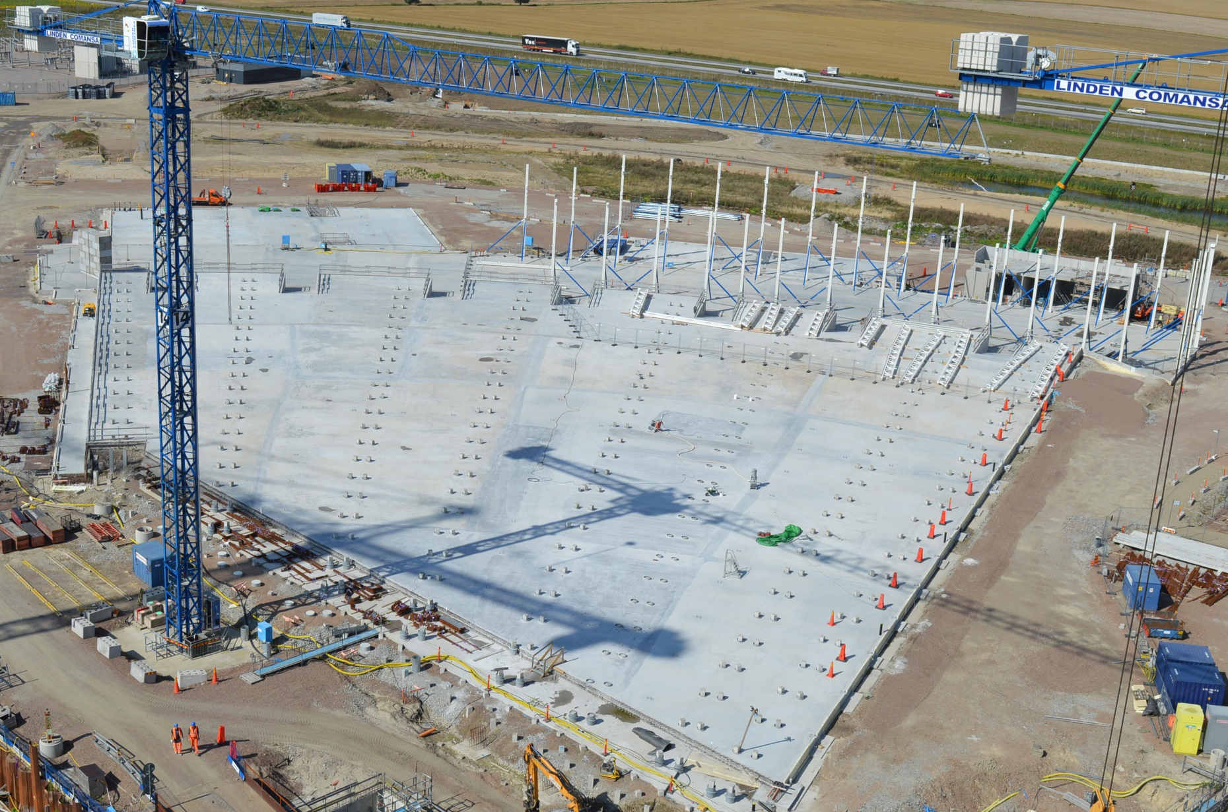
E-buildings, August 2017

Slide 9
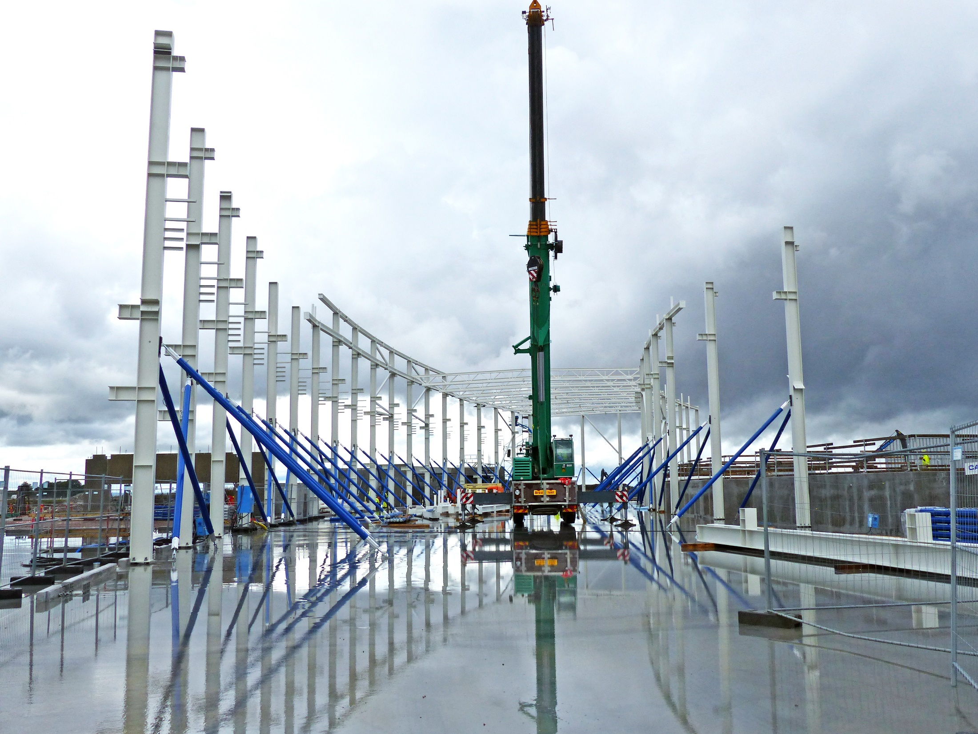
E01 Superstructure 14 September 2017

Slide 10
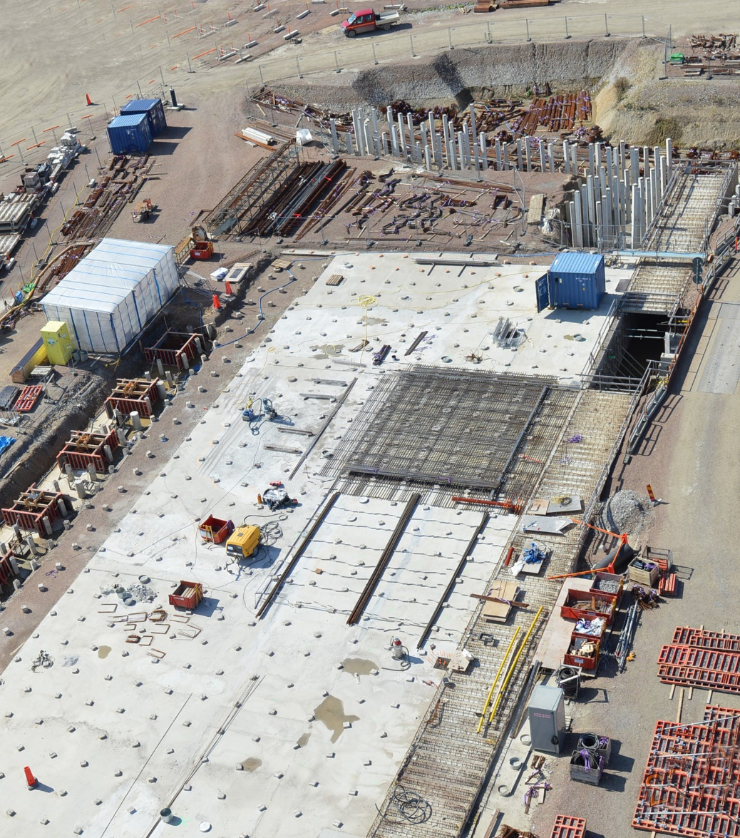
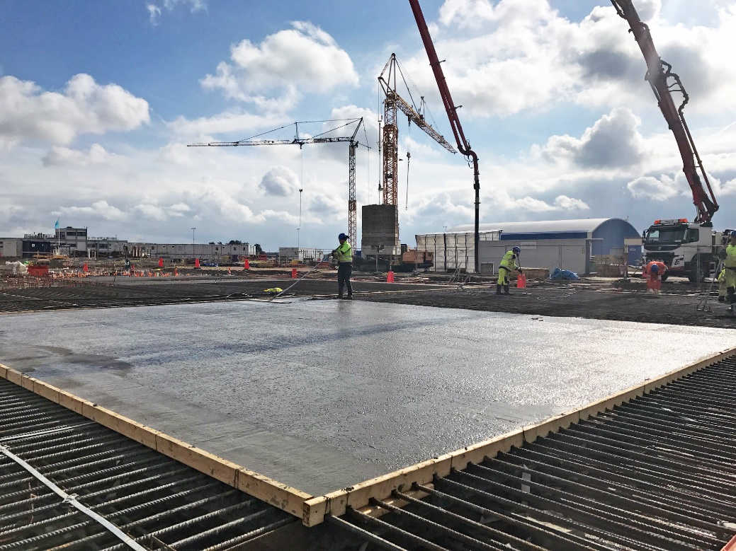
D01, base slab for Experimental Hall 1
D01 First bottom slab casting
12 September 2017

Slide 11
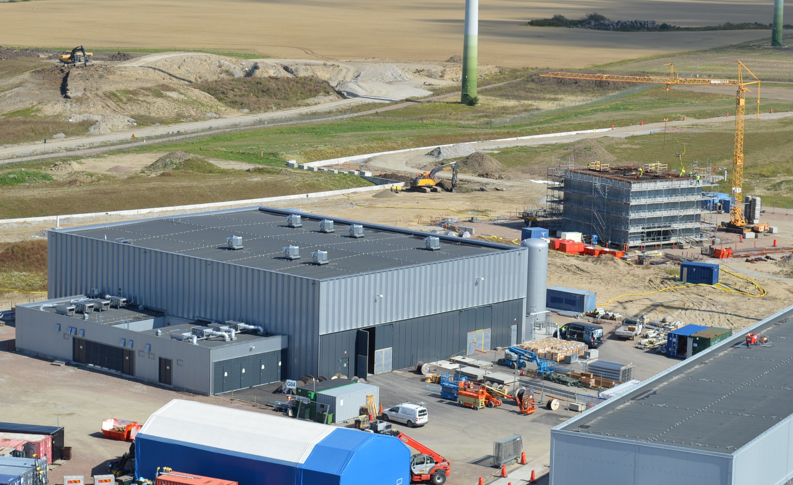
Cryo and Sprinkler Buildings
H10
G04
H01
G02

Slide 12
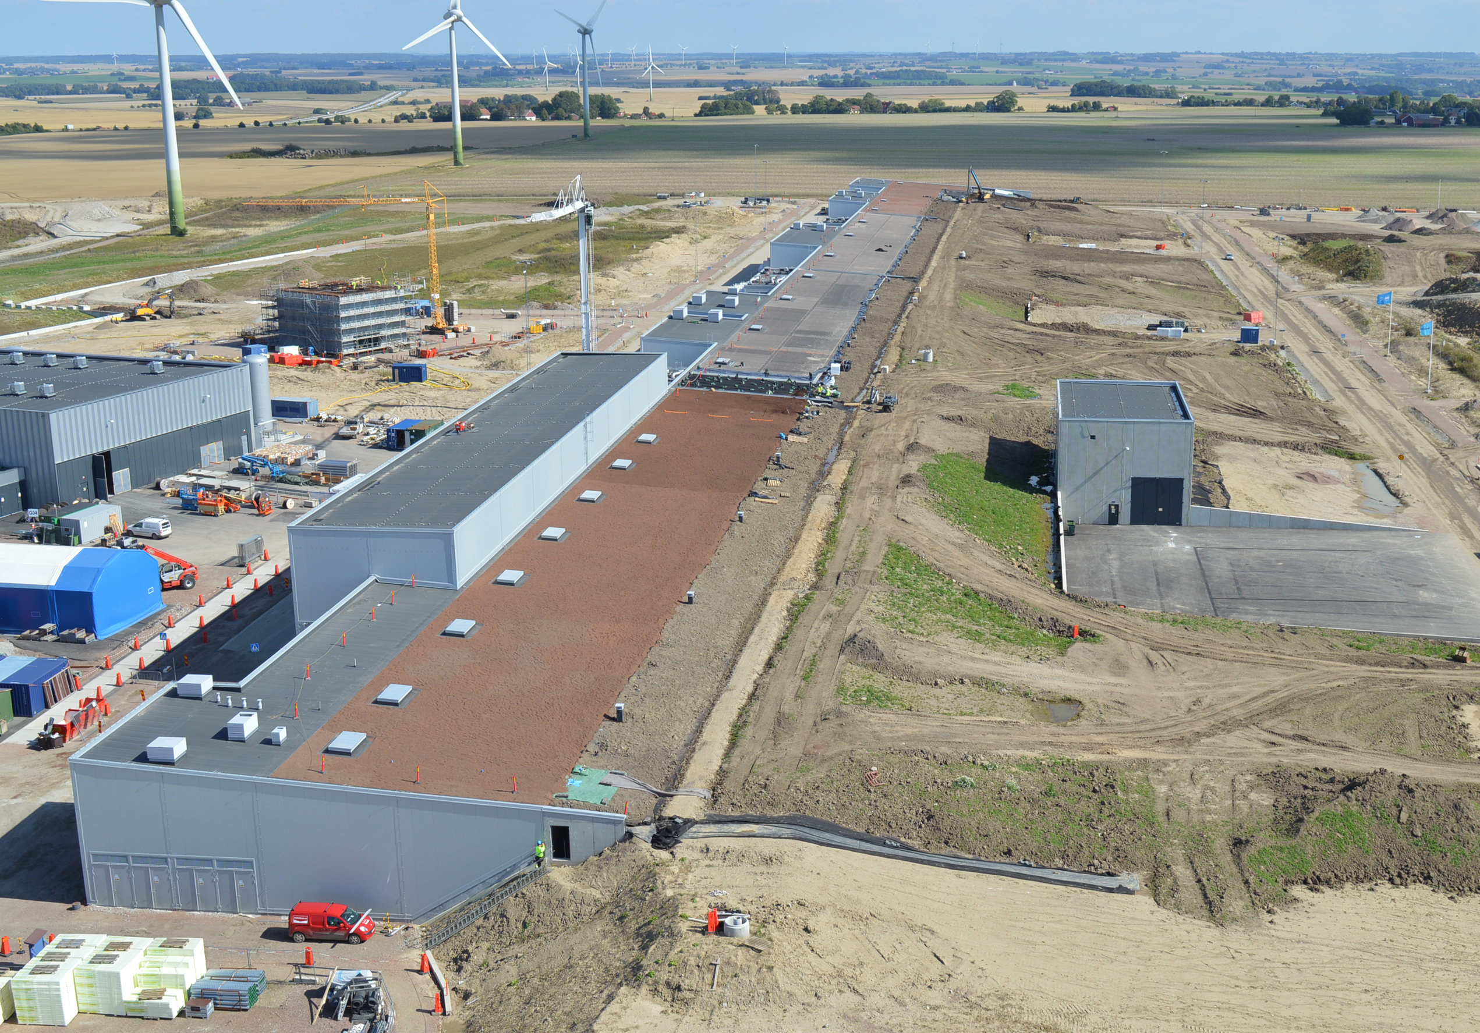
Accelerator & Klystron Gallery

Slide 13
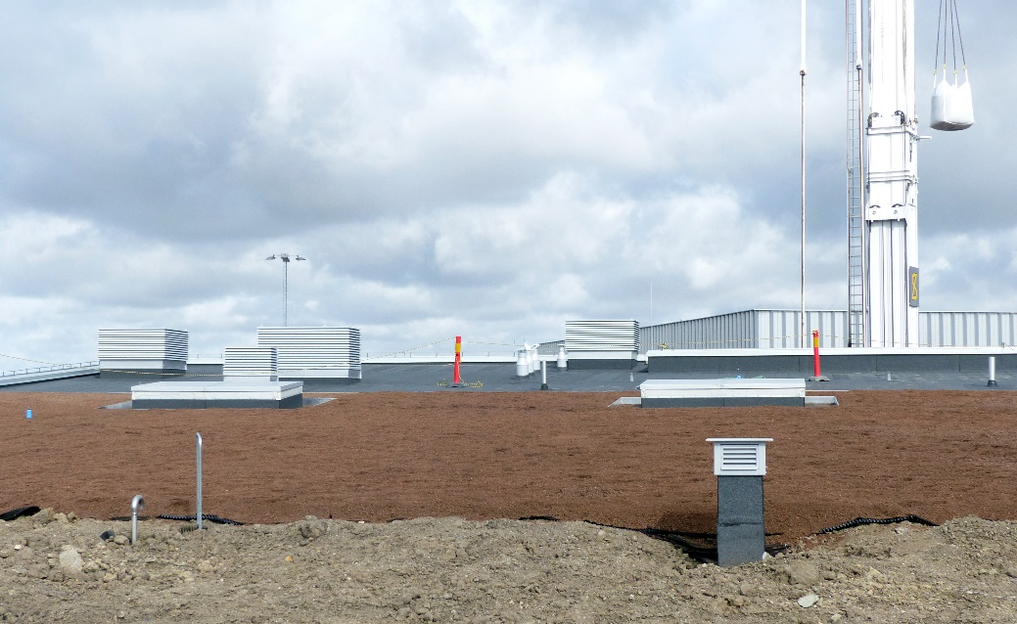
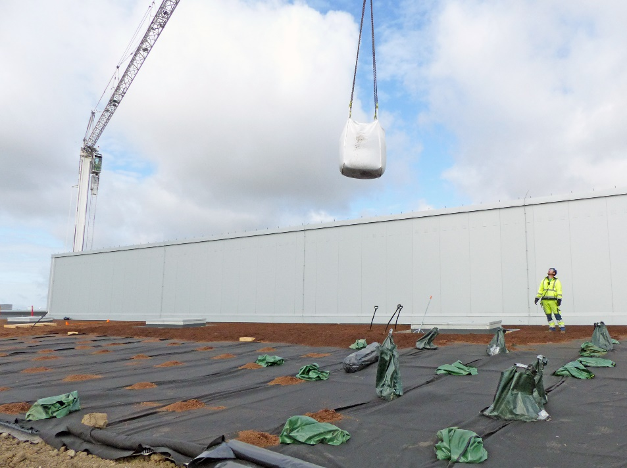
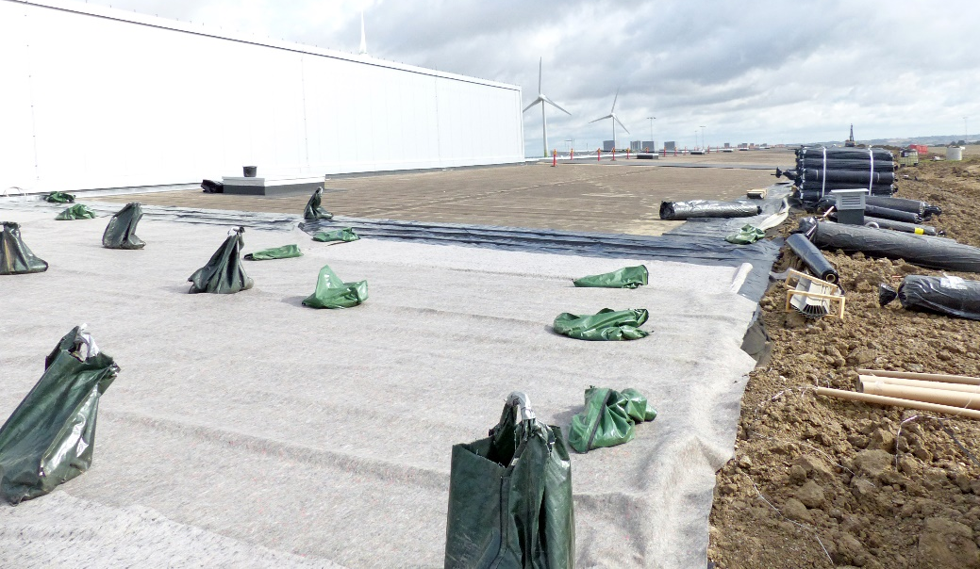
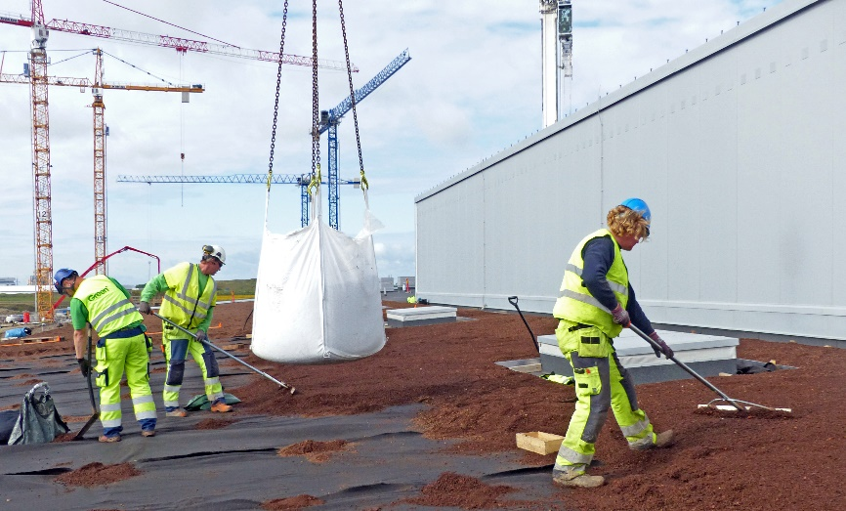
Green Roof, G02

Slide 14
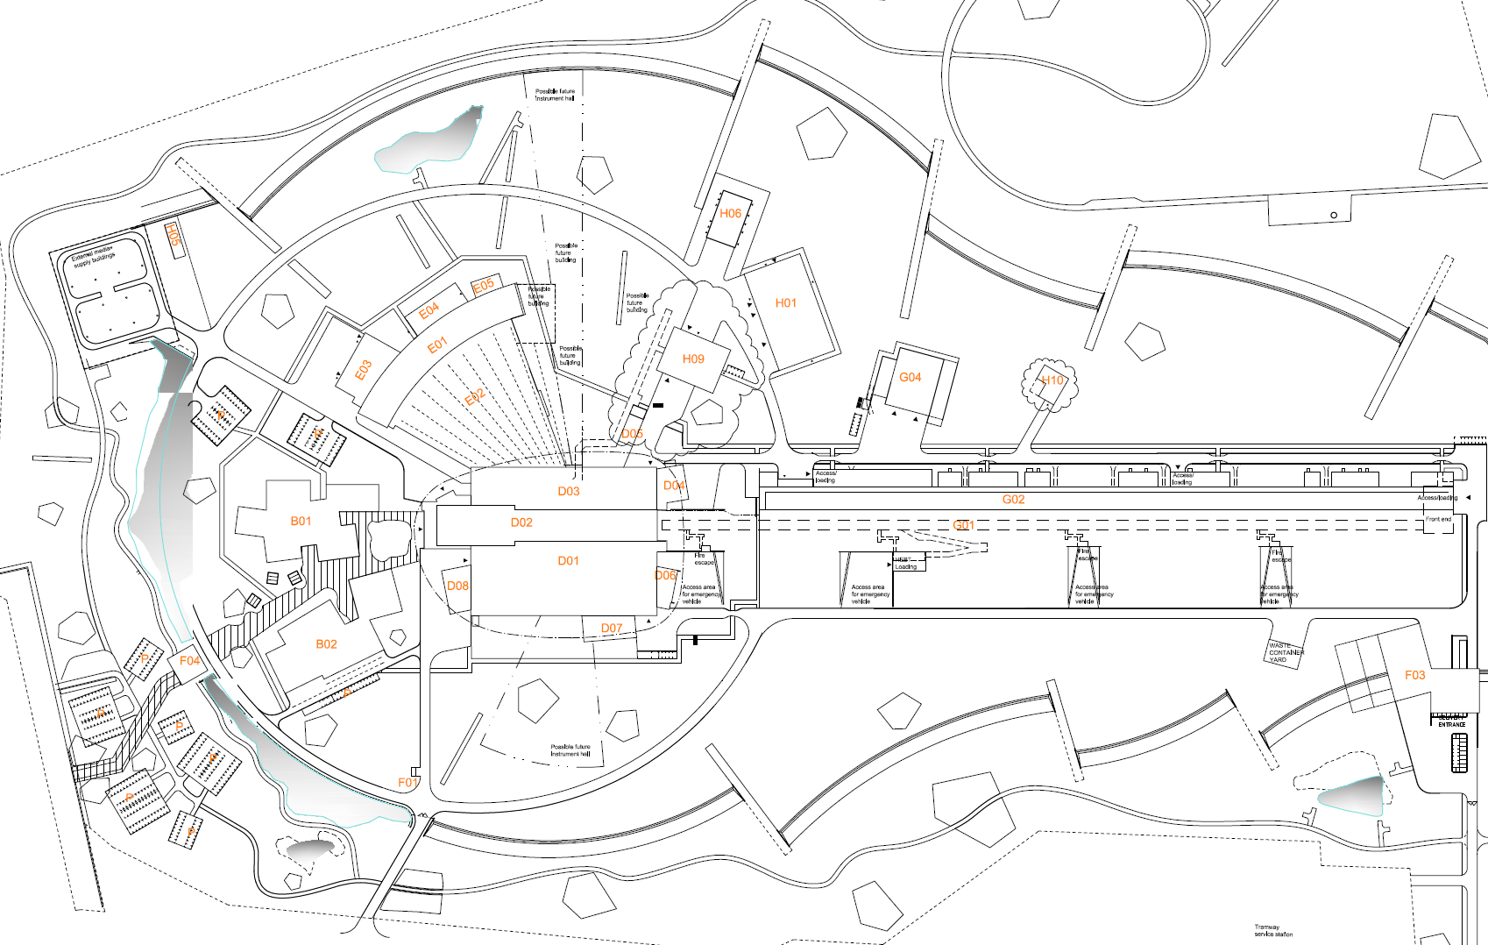
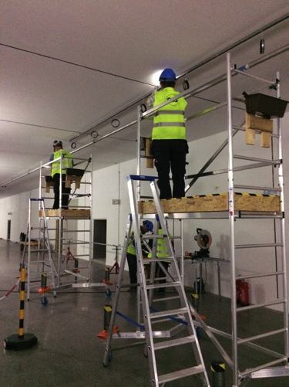
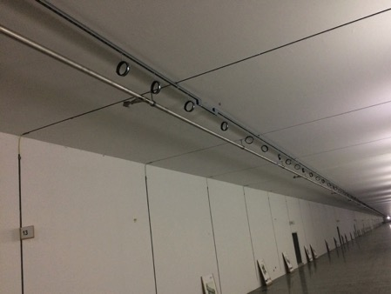
Reference line installation in G01
Reference line

Slide 15
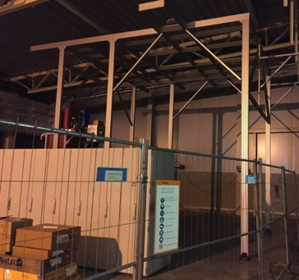
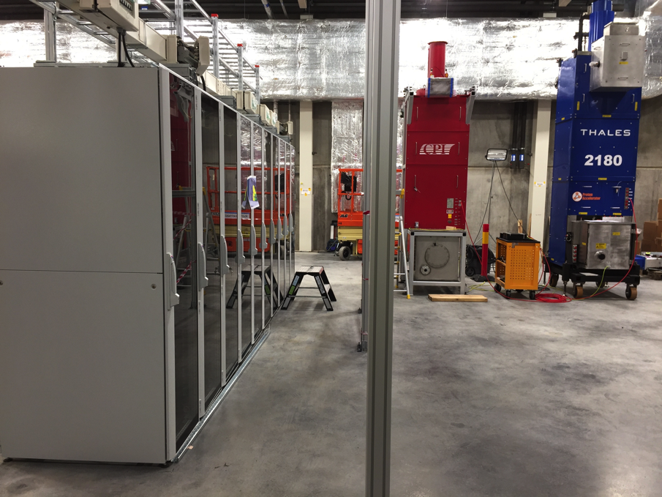
Progress on RF Test Stand 2 in G02
Installation of Racks, Cable Trays and Power Distribution
RF test stand 2
Support structure for RF Distribution System and Water Piping

Slide 16
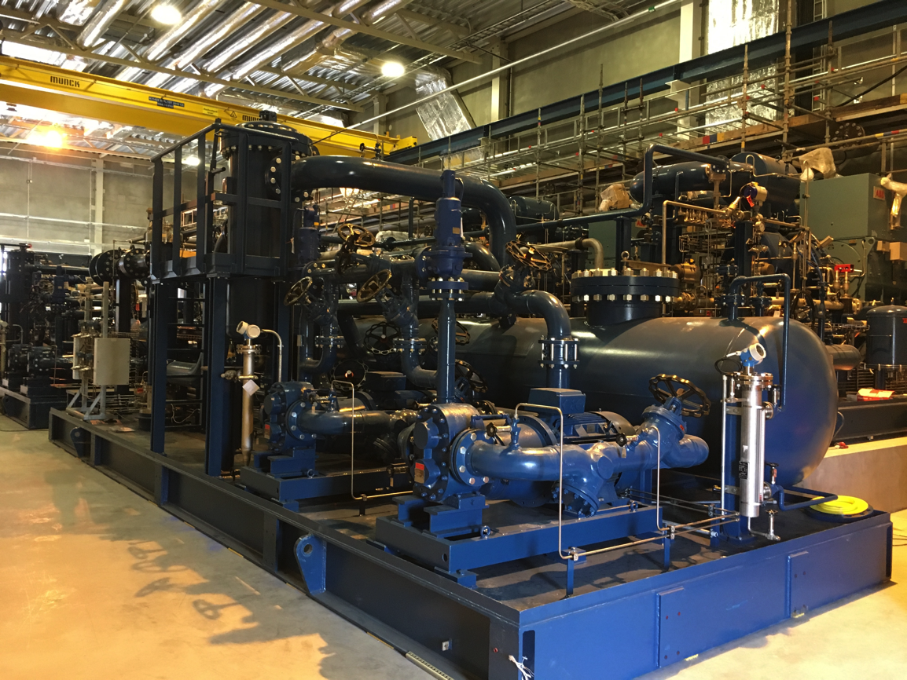
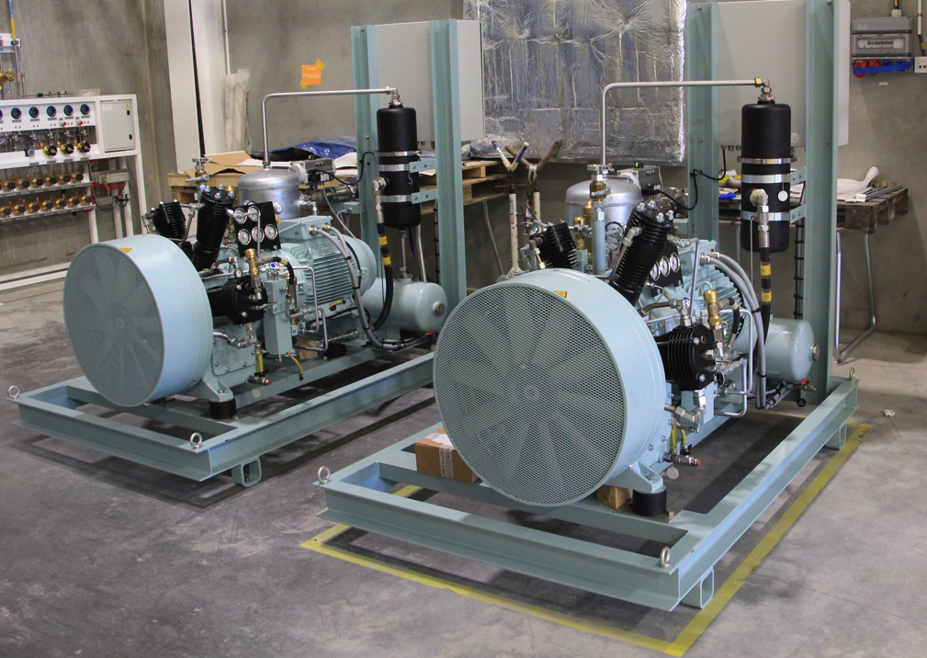
Helium Systems in G04
Helium Recovery System Compressors
Helium compressors
and recovery system
ACCP compressors and oil removal system

Slide 17
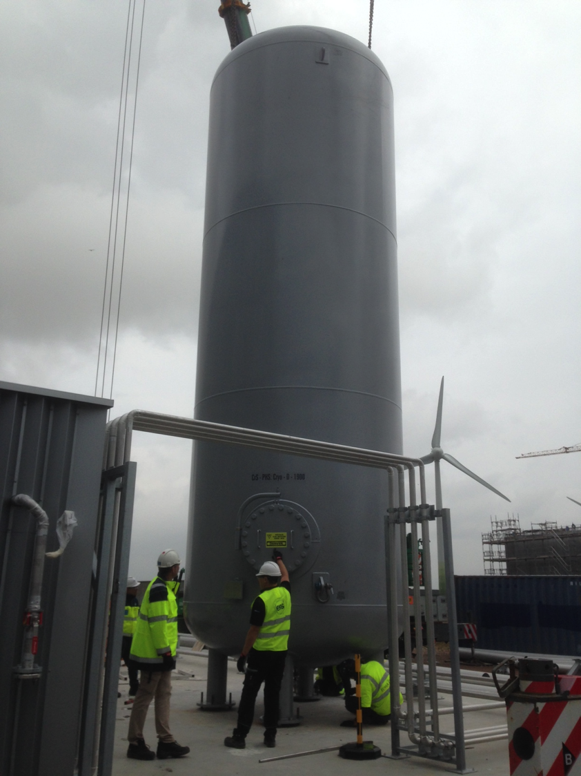
First Medium Pressure (20 Bar) Helium Gas Storage Tank Installed
Helium storage tanks

Slide 18
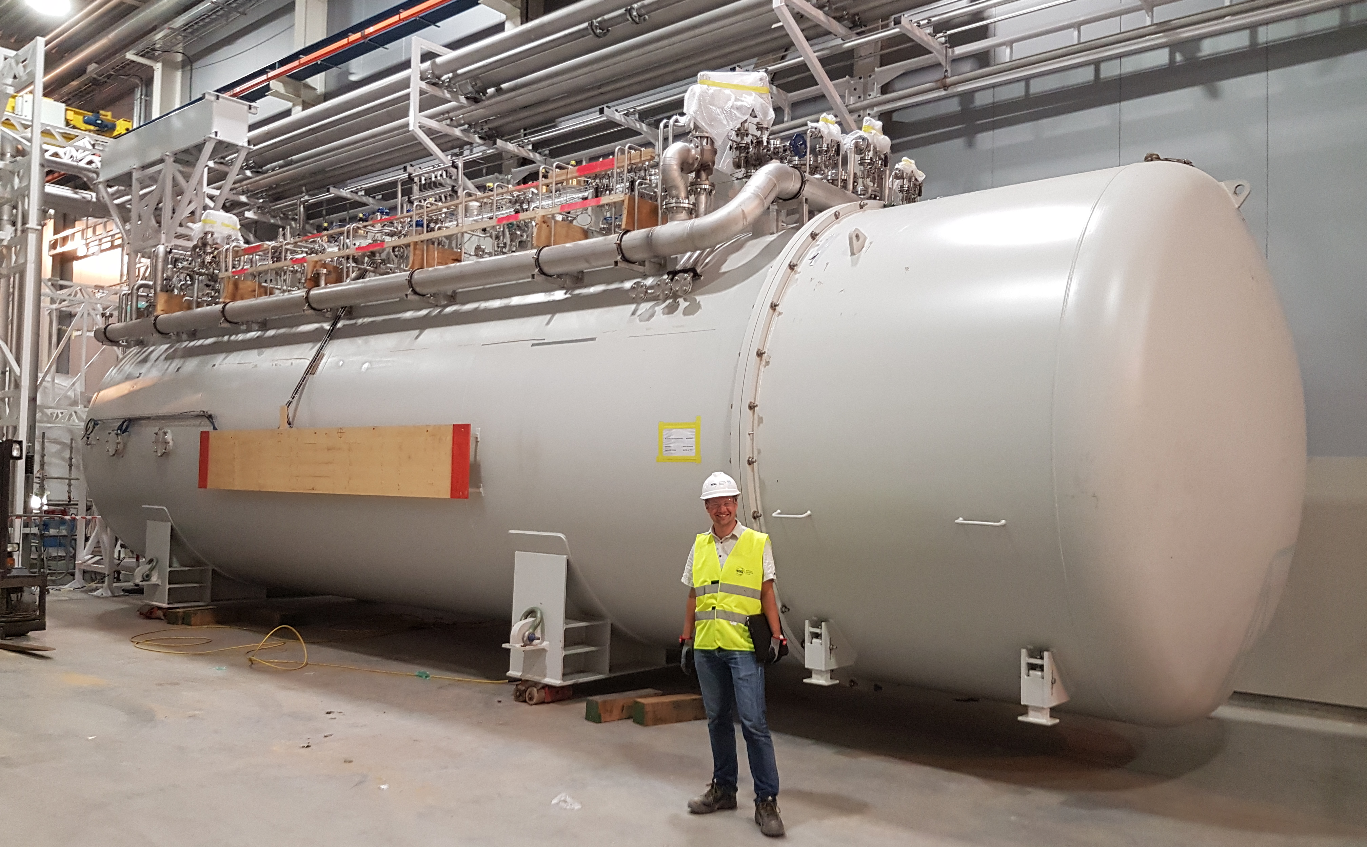
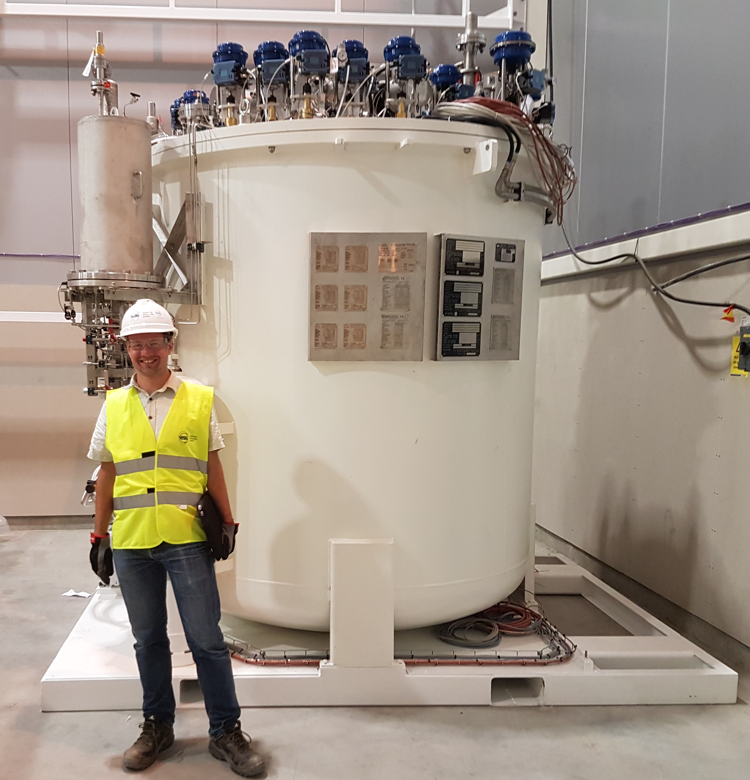
Cold Boxes in G02
TICP cold box
Cold boxes
ACCP cold box

Slide 19
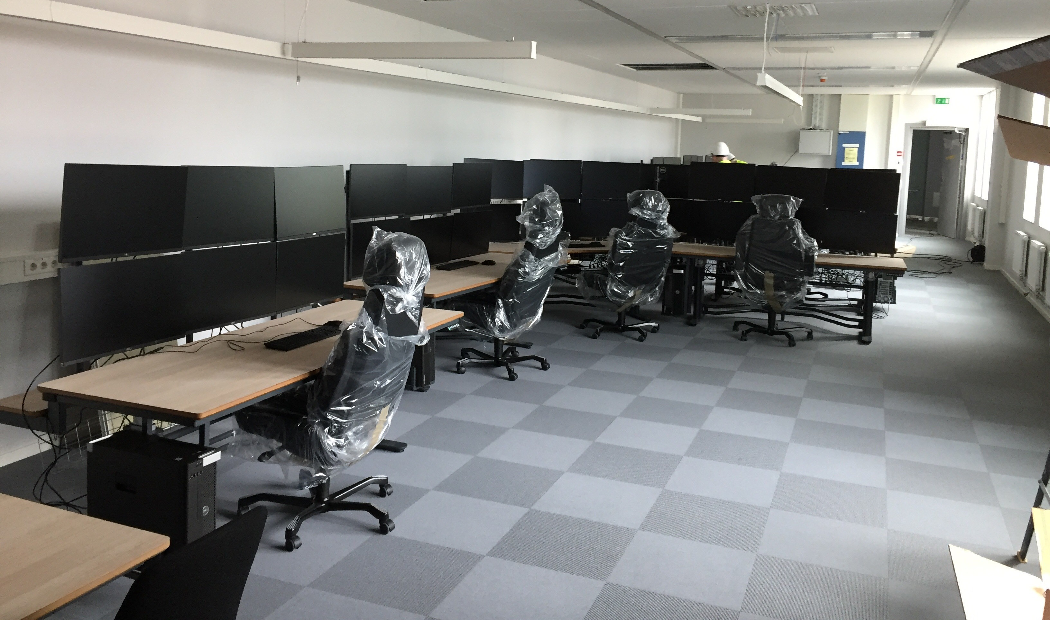
Temporary Control Room
Temporary Control Room

Slide 20
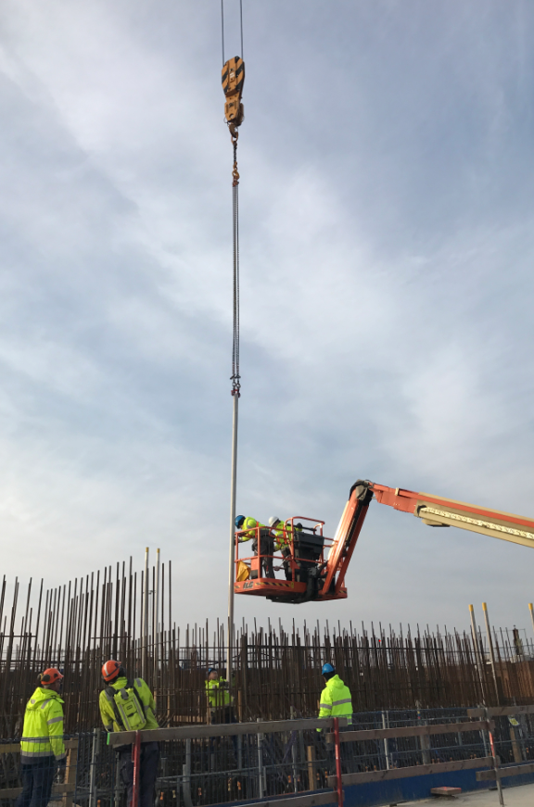
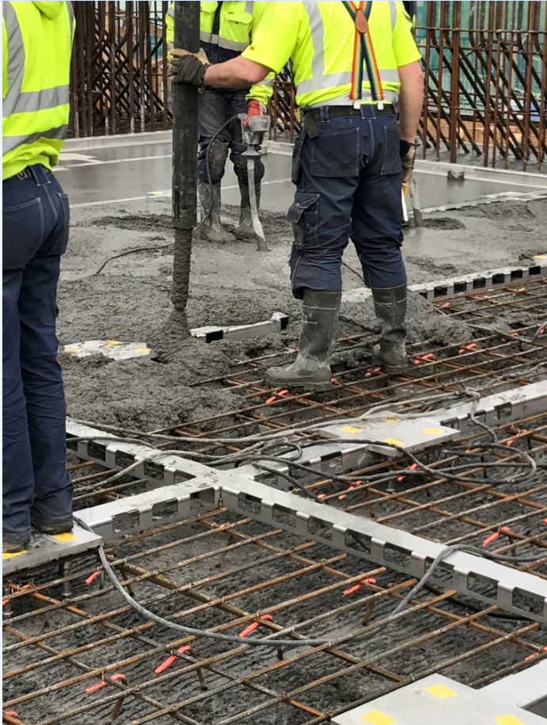
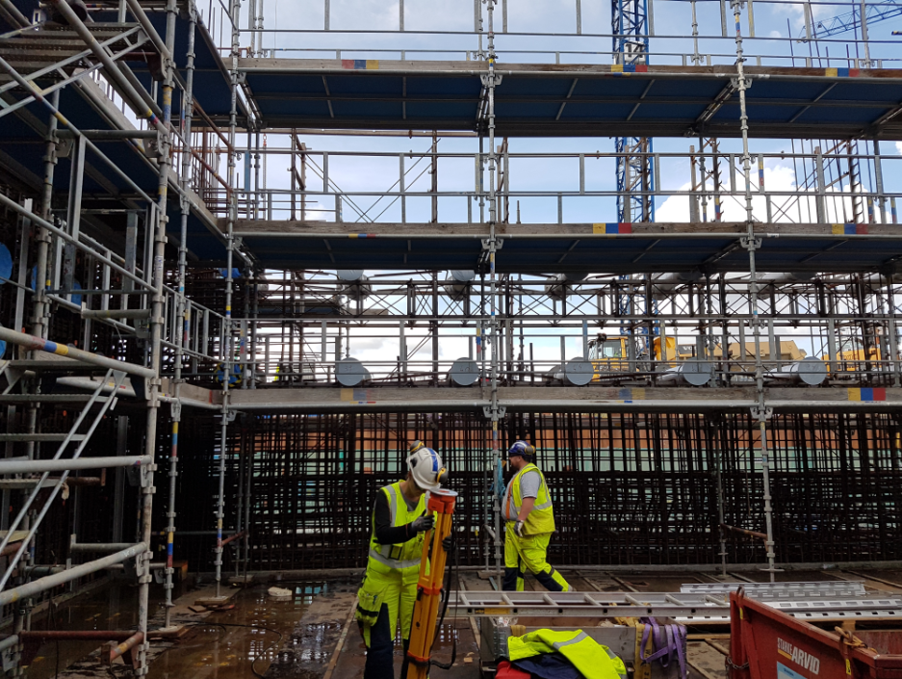
Embedments in Active Cell
Liner beams
(May 17)
Embedments in walls
(on-going)
Active cell
Electrical conduits
(April 17)

Slide 21
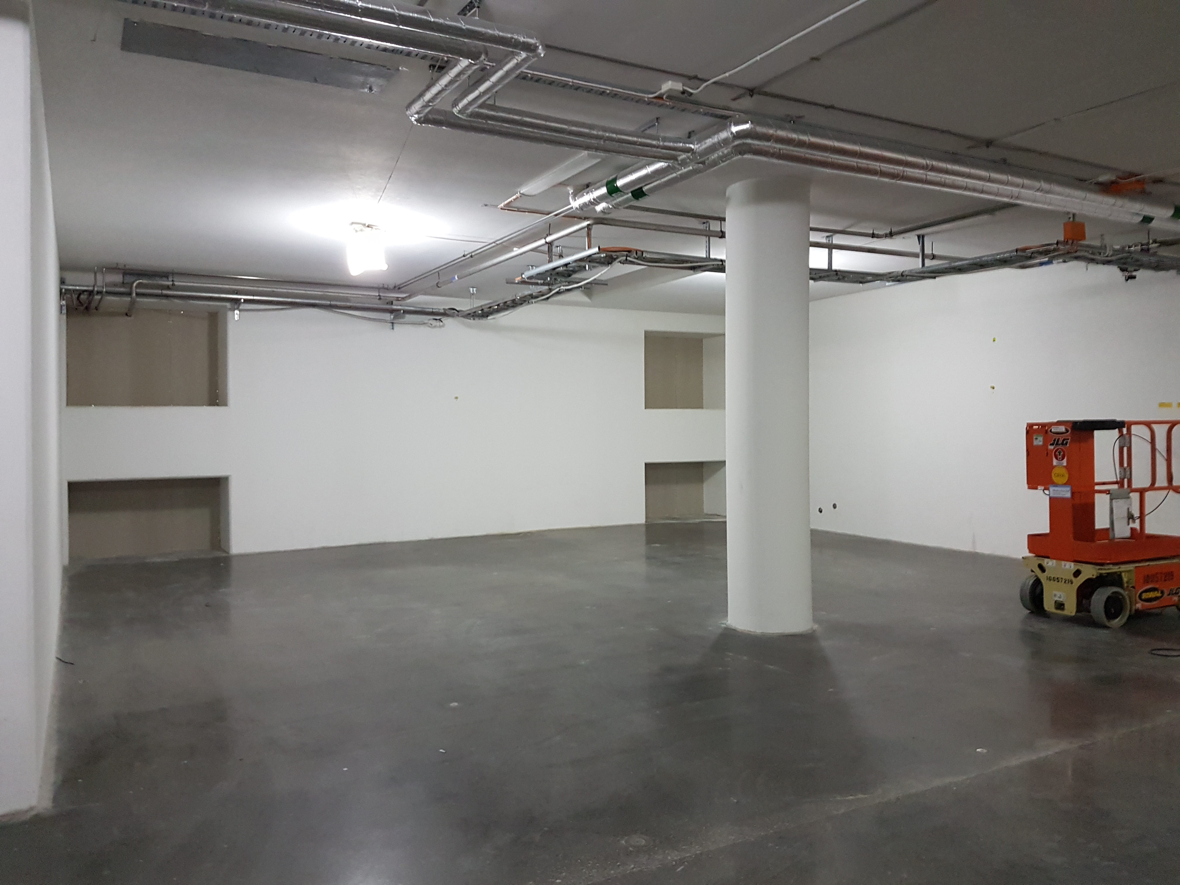
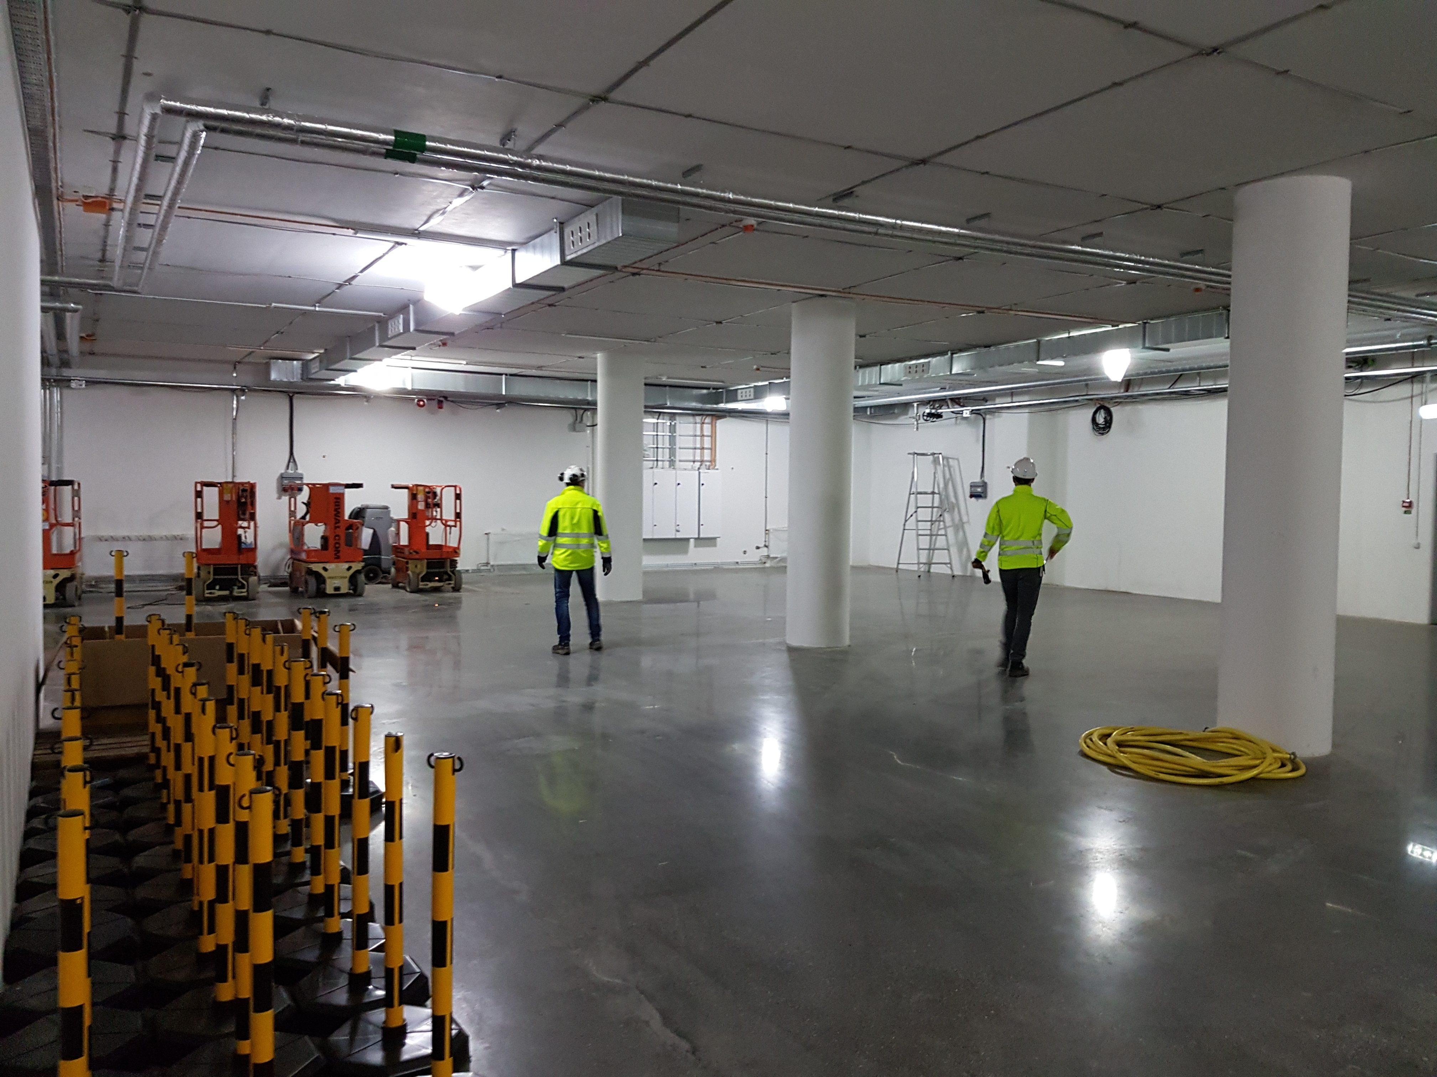
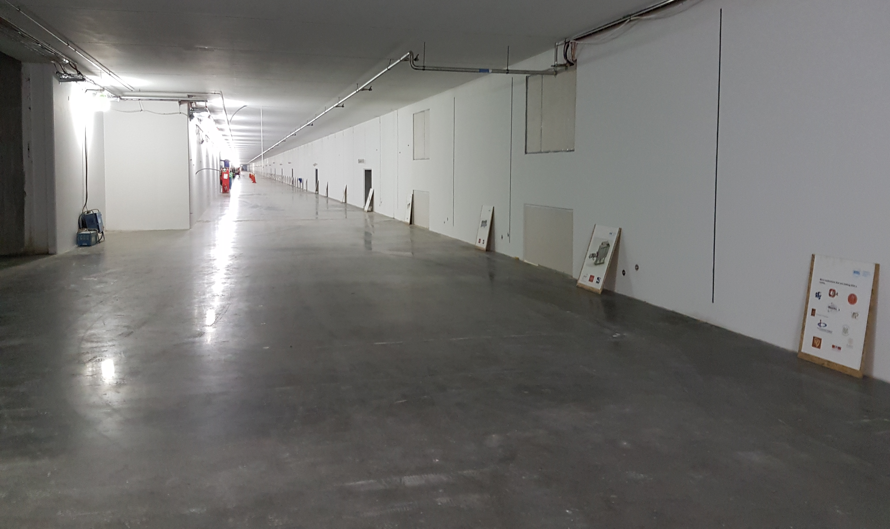
Important next step: Ion Source and LEBT
Accelerator Front End
(Ion Source and LEBT)

Slide 22
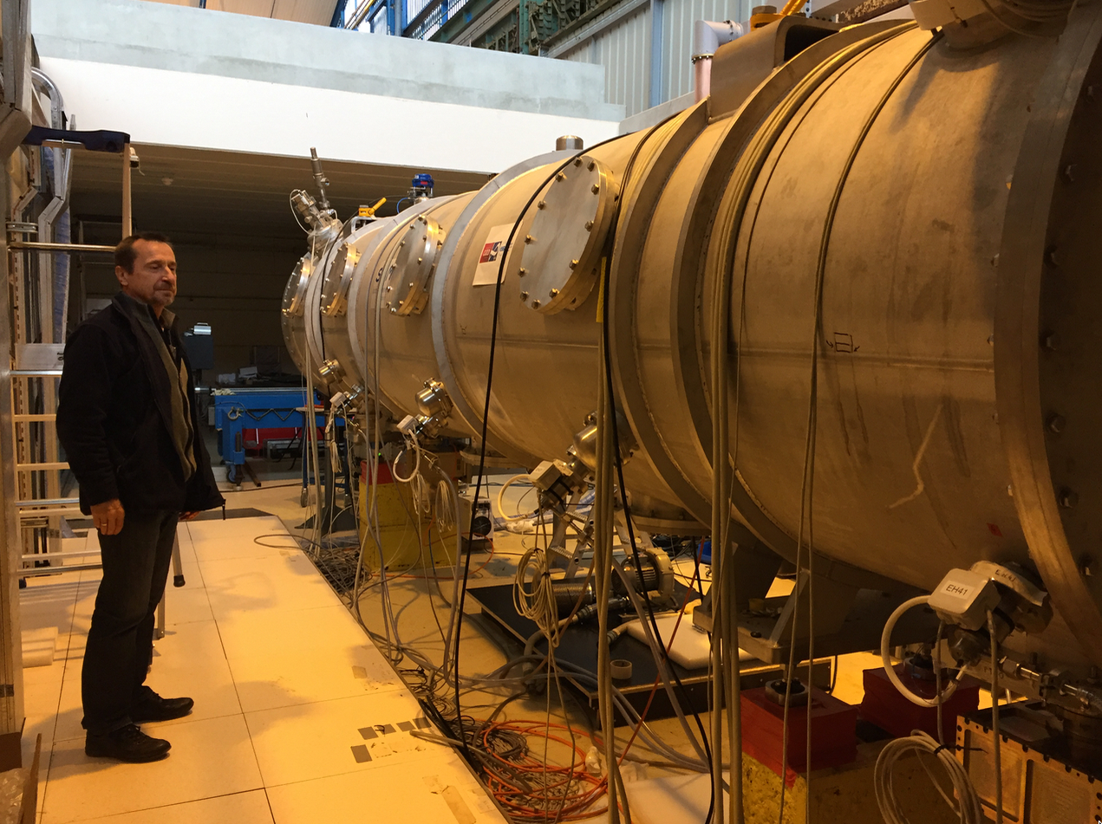
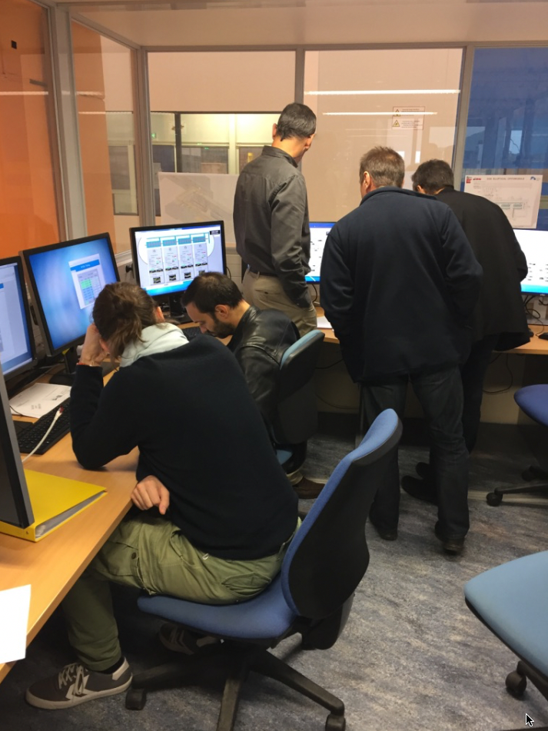
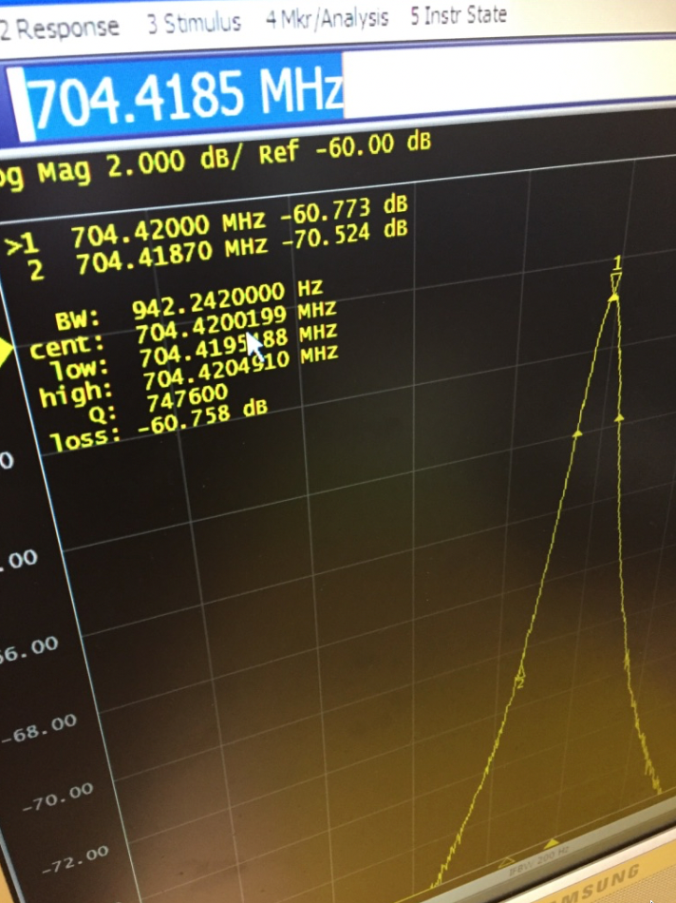
CEA test of medium beta elliptical cavity cryomodule
Medium beta cavity cryomodule at 2K with 4 cavities
Control room for CEA cryomodule test stand with a lot of activity
Tuning system of all cavities operational at 2K
Here one cavity is tuned to the ESS frequency of 704.42 MHz

Slide 23
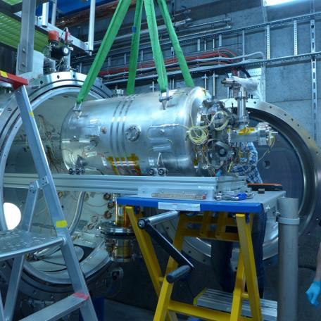
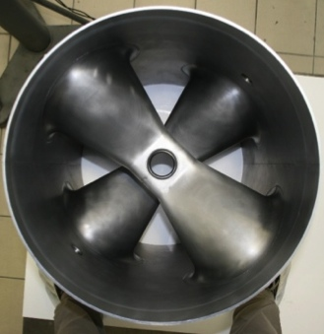
Spoke CM being tested
Series production of double spoke cavities started at ZANON in Italy for CNRS
Testing of spoke cavity with coupler with high power RF in Uppsala at FREIA

Slide 24
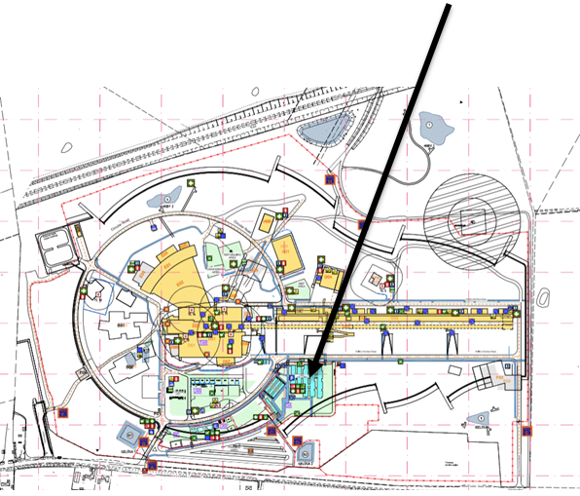
Move to the construction site
Accelerator moved 11 people in May, another 20 (Target, ICS & Accelerator) moved September 4. Next wave end October – all workstations occupied
Increasing demand for support and services on site and we are addressing additional requests (bikes, lockers, micro-waves, manuals, shuttle service, bike shed, etc.)
Scenarios for moving all ESS staff to temporary buildings on site were presented to EMT in August.
Preferred option is integrated with Skanska’s present office modules.
EMT’s ambition is to have moved all to site when MV lease expires June 2018, at the latest.
A pre-study is on the way (cost estimates and time-plans, etc.) and project manager for move will be engaged.

Slide 25
Major risks for our planning baseline are being addressed
 | Risk Event
1 | Failure to secure initial operations funds in 2019
2 | Failure to secure full member commitments (currently 5.7%/111 M€ missing) to fully fund project
3 | Failure to properly prepare for technical equipment installation and commissioning
4 | In-Kind VAT costs cannot be avoided
5 | Delivered In-Kind equipment does not fulfil requirements
6 | Inadequate preparation of the Organisation for ES&H responsibilities during installation, commissioning and operations
7 | Difficulty in transitioning to installation, commissioning and operations phase with regard to staffing, logistics, contracts etc.
8 | Index costs might be underfinanced.
9 | Delay in securing licenses and permits from Swedish nuclear regulator
Working with Council to resolve Risks 1 and 2
Remaining risks have an expected value of 138 M€ - highlighting importance of identifying and following through on mitigation measures
  Mitigation measures outlined in report to Council
  Workshops and new monthly reporting process emphasizes mitigation actions

Slide 26
Current Concerns
Continuing cost pressures
  Earthquake and radiation safety requirements
Developing a realistic schedule
Managing the transition to initial operations
Finalising in-kind funding (ES, NL…) and agreements (UK, DE…)

Slide 27
Overall
Construction continues to make excellent progress
High tech equipment arriving and installation beginning
On track for:
  Start of initial operations in 2019
  Instrument commissioning in 2021
  User access for science beginning in 2023

