Slide 1
Licensing update ESHAC #7, October 2017
Johan Waldeck
Licensing project manager
www.europeanspallationsource.se
6 October, 2017

Slide 2
Presentation Outline
Installation permit overview
Licensing program outlook

Slide 3
Installation permit overview
Detailed design
Procurement and Installation
Commissioning
Operation
Preliminary Design
ESS project phases
Permissibility
Permit
Installation
Permit
Trial operation
Permit
Routine operation
Permit
SSM stepwise licensing process

Slide 4
Overview of ‘Installation permit’ process
Application sent to SSM in May 2016 covering installation and trial operation of Warm LINAC
Significant number of requests for additional information
Delivery of additional documentation completed 3rd March 2017
Trial operation review on hold pending installation review
New plan for trial operation agreed with SSM May 2017

Slide 5
Conditional Permit received 30 June 2017
To install devices intended to generate ionizing radiation
Cover Accelerator, Klystron, and Target buildings
Waste building and NSS not covered in permit, re-submission needed
Re-submission for incremental trial operation needed as agreed with SSM
Installation conditioned that SSM received and reviewed
Comprehensive framework for safety classification of SSC
IT security procedures for development of software (PSS, TSS)
Conditioned that ESS follows commitments presented in submission
ESS to submit specific action plan before 29 Sept 2017
in the area of waste, decommissioning and decommissioning cost up until application for intentional neutron production
quarterly reporting on progress to SSM

Slide 6
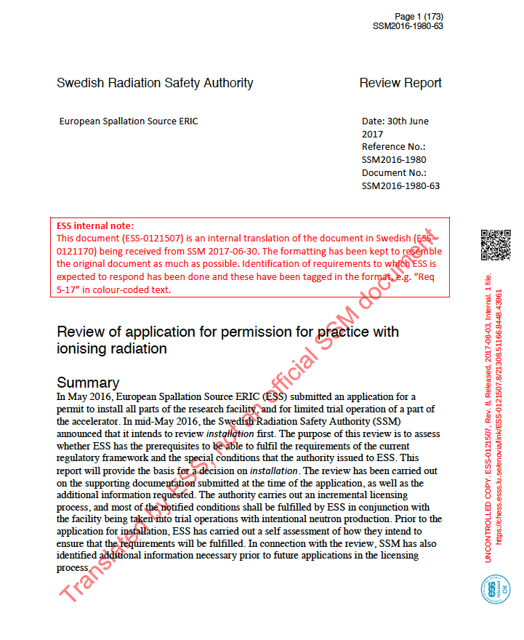
Comprehensive Review report
170 page report divided in 11 review areas
Details what ESS need to do and when
332 requests tied to trial operation applications
Warm LINAC, 160 requests
SC LINAC, 24 requests
Intentional neutron production, 148 requests
Most of the requested information was expected by SSM to be present in the installation application

Slide 7
Not a clean installation permit
A roadblock to remove
Classification of SSC
Information security
Submission sent 29 Sept. to fulfil conditions for installation
500 pages
20 documents
SSM review
Sampling
Expect answer mid Oct.

Slide 8
Discipline specific classification rules
Discipline | Document
Mechanical | ESS rules for radiation safety classification of mechanical equipment [ESS-0033258]
 | ESS rules for technical requirements for mechanical equipment [ESS-0039311]
 | ESS rules for quality requirements for mechanical equipment [ESS-0047989]
 | Required submittals for mechanical safety systems [ESS-0091757]
Electrical and I&C | ESS rules for radiation safety classification of Electrical and I&C equipment including technical and quality requirements [ESS-0054158]
 | ESS rules for design of electrical power systems [ESS-0135373]
 | ESS rules for electrical design [ESS-0015433]
 | ESS rules for qualification of electrical and I&C equipment [ESS-0118082]
Civil | ESS rules for radiation safety classification of civil structure including technical and quality requirements [ESS-0134987]
HVAC | ESS rules for radiation safety classification of HVAC systems and components [ESS-0036956]
 | ESS-0037914 ESS rules for technical requirements applicable to HVAC systems and components [ESS-0037914]
 | ESS rules for quality requirements applicable to HVAC systems and components [ESS-0083831]
Lifting | ESS rules for radiation safety classification of lifting equipment including technical and quality requirements [ESS-0135186]

Slide 9
Information security
Current activities, processes and procedures as well as planned work
Assessment of current software assurance maturity level and maturity targets

Slide 10
Licensing outlook
The Plan
The Challenges
The Team

Slide 11
Licensing timeline for trial operation as of 2017-08-30
Prepare and submit for warm LINAC trial operation
Prepare and submit for
SC LINAC trial operation
Prepare and submit for
Intentional neutron-
production trial operation
ESS
Prepare documentation for review
Prepare documentation for review
Prepare documentation
for review
Submission
Submission
Submission
Readiness review
Readiness review
Readiness review
IoS
Subm.
IoS
Beam
BoFC
BoD
BoT
75keV
3.7MeV
23MeV
75MeV
570MeV
570MeV
First instr. ready
1.3GeV
2017
2018
2019
2020
2021
IoS test stand permit
Inspection
Inspection
Inspection
Installation
permit
Conditional permit
Conditional permit
Conditional permit
Installation review
Warm LINAC trial operation review
SC LINAC trial operation review
Intentional neutron production trial operation review
SSM
Updated conditions & regulations

Slide 12
Activities leading up submission of Warm LINAC trial operation as of 2017-08-30
Projects develop required documentation
Update PSAR to reflect trial operation and SSM review comments
Update Self Ass.
Internal review of quality and consistency
Documentation
Released
PSAR
released
Self assessment released
Submission
ESS
Jan 2018
Feb 2018
March 2018
Apr 2018
SSM
SSM
review

Slide 13
Safety review (säkerhetsgranskning) -an underestimated SSM condition
Document review in the context of SSM-Conditions and SSM-review report
Self assessment
PSAR
Referenced documents
Need to improve for next submission
More time
More resources
Better quality
SSM
Conditions
SSM
Review report
Self Ass.
demonstrating fulfillment of conditions
PSAR
Requests met in revised document
Applied in design
1 order ref.
1 order ref.
1 order ref.
2 order ref.
2 order ref.
2 order ref.
13

Slide 14
Licensing managed as a project
Core Team composed of central resources and project representatives
Team meets every week
Coordinate work to be performed across ESS projects
Licensing not a separate thread
integrated part of “normal“ project activities
Per N
Target Sub-project
Michael
CF Sub-project
Carl
Q Sub-project
Licensing project core team
One member from each Project/division
Johan
Project manager
Peter S
NSS Sub-project
Francois
Systems eng.
Peter J
ESH Sub-project
Henrik C
ICS Sub-project
Lali
Acc Sub-project
Mikael J
Admin & Proj. Man. Sub-project
Notes:
Lot of work to be done
Safety Not a separate activity - integrated part of everyday work
Core team of project representatives - they form there own sub teams as needed
Cover the whole organisation - ensure consistency, and coherence
The main product of the core team is the Safety Analysis Report and the Self Assessment
These references work performed and documented in the main projects.
Lets take a closer look at the past and future project phases

Slide 15
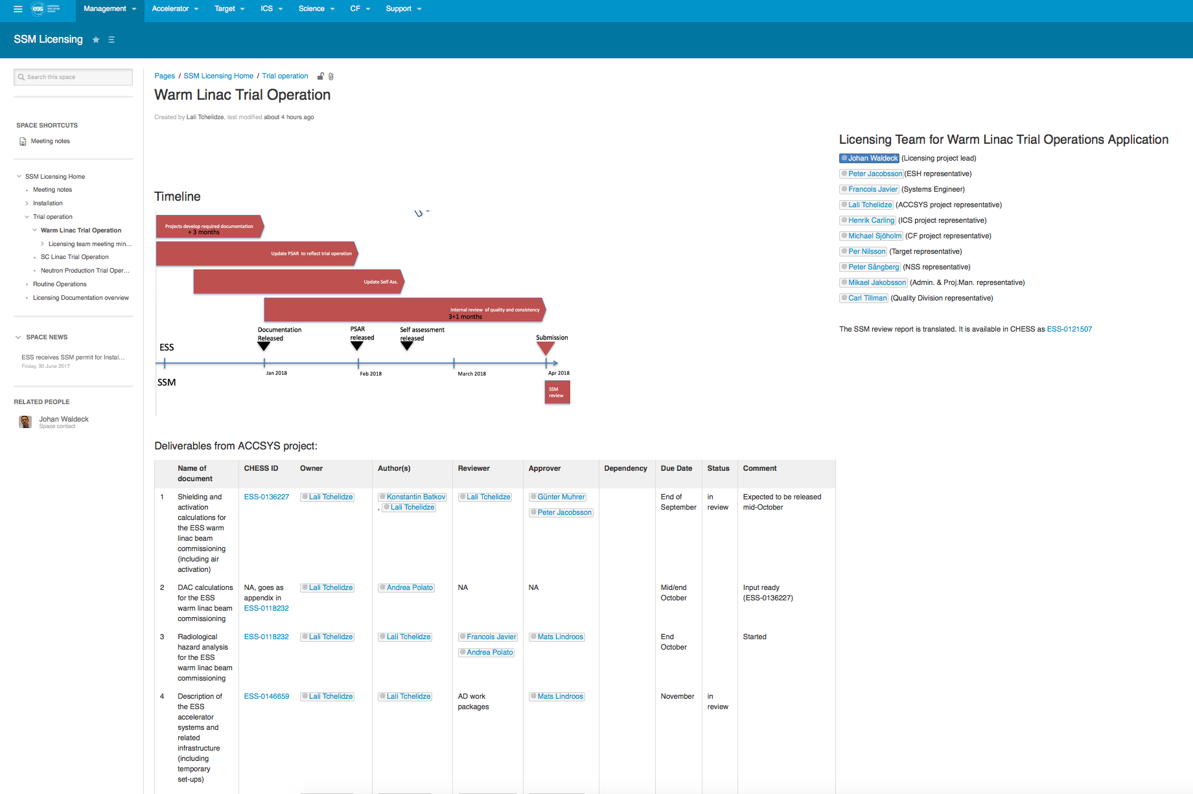
Confluence web space to share and track information and activities

Slide 16
Work ahead …...
Apply the classification rules
Result of applying will form part of next submission
Continue to develop procedures for Information security and increase maturity level
Be prepared to answer questions from SSM
Changing WP schedules continue to be a challenge -better planning, more short term milestones
Licensing (safety) is now more integrated to project work but still “too many undiscovered islands”– increase awareness of PM and WPs
Increase “review” effort to meet SSM expectations –they will not continue to act as our QA

