Slide 1
Radiation Protection Updates
L. Johansson
ESHAC, 9-10 October 2017
www.europeanspallationsource.se

Slide 2
Updates on
Management system
RP resources
Dosimetry
Archiving
Access database
RP Roles (Warm Linac Commissioning)
Posting of Radiation Zones
Others – Orphan scope etc.
Monitors (Ali)
RP training (Lars)

Slide 3
Radiation Protection Handbook Objectives
To collect all information regarding Radiation Protection in one place for simplified management of activities with ionising radiation.
Clear description and identification of how authority’s conditions are fulfilled and handled by ESS. Dead lines identified for SSM conditions (on Licensing Confluence page).
The Handbook handles the top level of the Operation Limits and Conditions procedures with regards to RP.
Will, in some cases, point towards more detailed procedures and relevant forms.

Slide 4
Handbook Content
ESS radiation protection – Policy, Responsibilities and QA
General Safety Objectives
ALARA
Work with Ionising Radiation
Radioactive Materials
Dosimetry
Radiation Monitoring
Environmental Radiation Monitoring
Shielding
Radiation safety interlock systems
Training and Qualifications
Emergency Preparedness
The handbook is based loosely on Fermilab’s Handbook for Radiological Control

Slide 5
Handbook Progress
The handbook is built on the already released relevant ESS documents
and documents that are about to be released (deadlines on OLC page).
ESS Handbook for Radiation Protection | ESS-0129743
ESS radiation protection – Policy, Responsibilities and QA
General Safety Objectives | ESS-0000004
ALARA | ESS-0037524
Work with Ionising Radiation | ESS-0001786
Radioactive Materials | ESS-0052862 Transport plan for the radioactive waste from ESS
Dosimetry | ESS-0052868 ESS Rules for Medical Examinations Mostly in the handbook
Radiation Monitoring
Environmental Radiation Monitoring | ESS-0051197 Environmental Monitoring Plan
Radiation safety interlock systems | ESS-0058389
Training and Qualifications | ESS-0111690 Safety Training Matrix for Installation Activities
Shielding | ESS-0120786 ESS Shielding Configuration Control Manual ESS-0019931 ESS Procedure for Designing Shielding for Safety
Emergency preparedness | ESS-0092951 Emergency Preparedness Plan ESS-0087172 Training activities for Emergency Preparedness Plan

Slide 6
Radiation Protection Resources
The RP group is continuously expanding,
the current resources dedicated to the RP Management System are (new staff in green):
ESS Handbook for Radiation Protection | ESS-0129743
ESS radiation protection – Policy, Responsibilities and QA | Lena Johansson (RPE)
General Safety Objectives | ESS + RP Group
ALARA | Francois Javier
Work with Ionising Radiation | Ida Bergström (RPO), RPT (mid Oct 2017)
Radioactive Materials | Per Persson
Dosimetry | Lena Johansson
Radiation Monitoring | Alasdair Day (1 Oct 2017)
Environmental Radiation Monitoring | Daniela Ene
Radiation safety interlock systems | Integrated Control Systems Division
Training and Qualifications | Lars Aprin (4 Sept 2017)
Shielding (verification) | Accelerator Safety Group
Emergency preparedness | Fredrik Jörud
RP Group will also have a Group Leader shortly

Slide 7
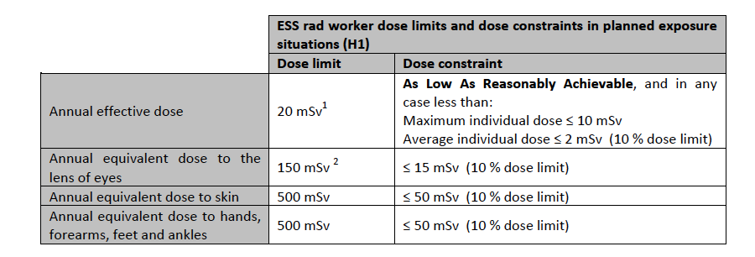
Dose constraints established at ESS
Updates of ESS guiding documents to comply with EU Directives from 2013
(implemented 6 February 2018) – affecting ESS GSO and Zoning document

Slide 8
Procedures for radiological safety
Supervised Area
General local rules
Local rules
AHA and JHA
ALARA
Environmental monitoring
NEW! Passive dosimetry
ESS will monitor the effective personal dose of staff, users and visitors also in supervised areas as required for reporting to other facilities and for keeping track of personal accumulated dose from ionising radiation.
RFID will be included in the passive dosimeter also for Supervised Areas, graded implementation.

Slide 9
Procedures for radiological safety
Controlled Area
General local rules
Local rules
AHA and JHA
Environmental monitoring
Work permit and ALARA
Personal dosimetry
Passive
Active

Slide 10
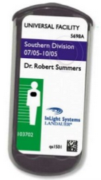
Passive personal dosimetry – Warm Linac Commissioning
Passive monitoring of personal doses for radiation workers will be by Landauer Nordic using OSL dosimeters.
Long-term this could be replaced by e.g. DIS or equivalent dosimetry capability for when users are on site.
Rules for Medical Examination (ESS-0052868) in place.
Personal Doses are archived in Chess at the moment.
Archiving requirements for RP have been identified and added to the orphan scope of database/archiving.
Extracts are collected from dose registers
also for ESS staff.

Slide 11
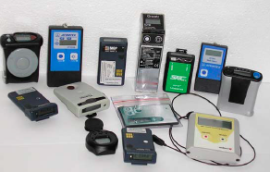
Active personal dosimetry
For work in controlled areas
Quote for DMC has been received for procurement in three phases of operation (Warm Linac commissioning is the first)

Slide 12
Archiving
Type of documentation | Archiving time
Applications for permits and all supporting documentation plus issued permits. | Long-term storage
Design criteria, facility description | Long-term storage
Operating Instructions and Disruption Instructions related to radiation protection | 50 years
Event registration or reporting and report-worthy events with respect to radiation protection | 50 years
Radiation Protection Instruction | 50 year
Data on personal doses in accordance with SSMFS 2008:51 | until the affected individual turns 75, but for at least 30 years after work with ionising radiation
Accident instructions/emergency preparedness plan | 25 years
Annual reports in accordance with Chapter 6 (SSM special conditions) | 25 years
Results of measurements of ambient and emission samples | Long-term storage
Documentation on the properties, treatment and final disposal of generated waste | Long-term storage
Documentation on generated waste at the facility shall be saved there for as long as the waste is found there. When the waste is transferred to other facilities for treatment prior to final storage or for final storage, the responsibility for documentation also transfers to these facilities. | Long-term storage
Metrological data* | 5 years
Type of data identified and communicated to Quality.
Documents will be stored in Chess.

Slide 13
Access
Identified operational data
Document type | Required for access control
Medical records for individuals (ESS and visitors) | X
Training records for individuals | X
Annual effective dose and equivalent dose to extremities (current status) | X
Re-classification of zones
Access authorization by area manager | X
Work permits | X
Area Hazard analysis and Job hazard analysis
Safety Manuals and Local Rules
Radioactive Materials Inventory
Radiation Instruments Database with calibration dates

Slide 14
Access Interface Safety & Security
On-line registering
Internet
Access Directory
Visitor management Information / admin
LMS safety training HR/ ESH
Security Physical protection ESH
Safety Radiological control ESH
Safety PSS system ICS
IT account IT
E-learning
Supervised area
RFI technology – common
Identity verification
Security Access control Databace CF
PSS system Databace ICS
Information can maybe transferred via QR code ??
Interface physically separated

Slide 15
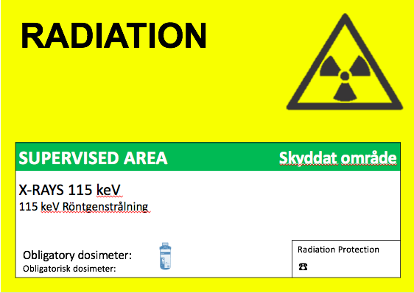
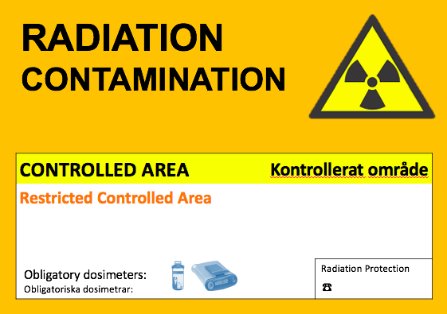
Posting of Rad Zones

Slide 16
Proposed RP Roles
Operational Radiation Protection
RPS Radiation Protection Supervisor (Additional Role)
Member of staff trained in Radiation Protection (does not have to be from ES&H) that is closely involved in the work being done. Will have a supervisory role in ensuring that the local rules and radiation zoning requirements are fulfilled. Prepares documentation on changes and occurrences with regards to radiation protection in the work area (review and approval by ES&H).
RPT Radiation Protection Technicians. (Core role)
Sits under ES&H in the organisation and is assigned to specific work or areas within ESS. Could also be longer term assignment. Full-time role.
RPE Radiation Protection Expert. (Core role)
Legally required RP expert that will have advisory input to most aspects related to Radiation Protection at ESS. Not a “in-the-field” role. Full time.
Line manager
Ensure that employee is working in a safe environment and has relevant training and medical examination (etc.). Has legal responsibility for employee’s safety.

Slide 17
Radiation Protection – other
“Orphan scope” to be addressed:
Radioanalytical Laboratory
Radiation Protection Studies (shielding and activation calculations) competencies available at ESS, but no role within ES&H yet. To
Database for RP data and access
Practicalities:
RP space at facility
Review of Handbook by Experts ?

Slide 18
Thank you!

Slide 19
Radiation Zones within ESS
Public area External whole body dose rate in none permanently occupied areas: EWBDR < 0.5 μSv/h External whole body dose rate in permanently occupied areas: EWBDR < 0. 025 μSv/h Airborne contamination No Surface contamination Νο Temporary hotspots No | Supervised area External whole body dose rate: EWBDR < 3 μSv/h Airborne contamination No Combination: (EWBDR/3 μSv/h) < 1 Surface contamination β, γ < 4 Bq/cm² α < 0.4 Bq/cm² Temporary hotspots 3 μSv integrated dose over any one-hour period H2 dose to worker < 2 mSv/event Worker will not be allowed to enter if annual dose of the worker has reached 3.5 mSv. | Unrestricted Controlled area External whole body dose rate (without airborne contamination): EWBDR < 25 μSv/h Airborne contamination (without external radiation) Ac < 2.5 DAC Combination: (EWBDR/25 μSv/h) + (Ac/2.5 DAC) < 1 Surface contamination β,γ < 40 Bq/cm² α < 4 Bq/cm² Temporary hotspots: 25 μSv integrated dose over any one-hour period H2 dose to worker < 20 mSv/event Worker will not be allowed to enter if annual dose of the worker has reached 10 mSv. | Restricted controlled area External whole body dose rate (without airborne contamination): EWBDR < 2.5 mSv/h Airborne contamination (without external radiation) Ac < 250 DAC Combination (EWBDR/2.5 mSv/h) + (Ac/250 DAC) < 1 Surface contamination β,γ < 100 Bq/cm² α < 10 Bq/cm² H2 dose to worker < 20 mSv/event Worker will not be allowed to enter if annual dose of the worker has reached 10 mSv. | Highly restricted controlled area External whole body dose rate (without airborne contamination): EWBDR > 2.5 mSv/h Airborne contamination (without external radiation) Ac > 250 DAC Combination (EWBDR/2.5 mSv/h) + (Ac/250 DAC) > 1 Surface contamination β,γ > 100 Bq/cm² Α > 10 Bq/cm² H2 dose to worker < 20 mSv/event Worker will not be allowed to enter if annual dose of the worker has reached 10 mSv.

